Slide 1
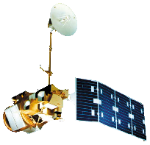
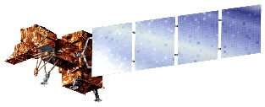
Tyler Rhodes (Project Lead)
Amy Phillips
Romina Gotzmann
Rebekke Muench
Jared Ryks
Dr. Kenton Ross
NASA DEVELOP National Program Science Advisor
Landsat 4 & 5
TM
Landsat 7 ETM+
Landsat 8 OLI/TIRS

Slide 2
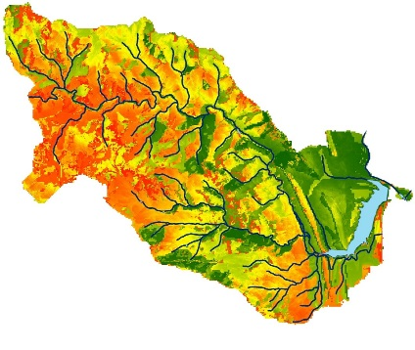
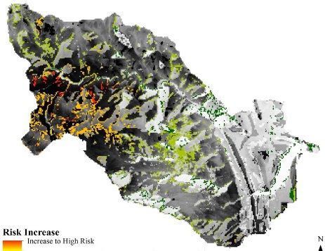
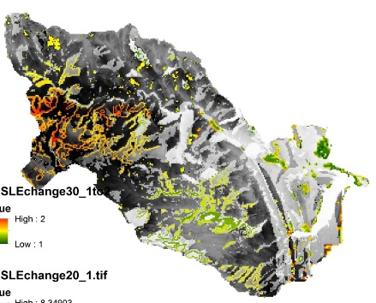
Utilizing NASA Earth Observations to identify locations for sedimentation mitigation in the Ralston Creek Watershed following the 2013 Colorado floods
2 – High
1 – Low
Increase to high
Increase to low
Increase to high
Increase to low
Figure 1 Map depicting the 2014 RUSLE output where red indicated high risk of erosion and green indicates low risk
Figure 2 Map showing change in risk between 2002 and 2014. Red areas indicate an increase to high risk and areas in black and white have persisted in risk
Figure 3 Map showing predictive RUSLE risk map where red indicates areas projected to become high risk by 2030 and areas in black and white will persist in risk
Denver Water provides 1.3 million people in Denver with clean water.
The Ralston Creek Watershed is located 30 minutes northwest of Denver, Colorado. Floods in September 2013 and unpredictable and heavy rains in 2015 prompted concern regarding sedimentation in waterbodies. The NASA DEVELOP team partnered with Denver Water to create soil erosion risk assessment maps for pre- and post- flood periods that can help guide the placement of suggested mitigation sites in the Ralston Creek Watershed.
Denver Water is concerned about excess sediment in waterways. Heavy rainfall and flooding events have increased erosion in the Ralston Creek Watershed. Increased erosion leads to increased sedimentation, nutrients and heavy metals in the waterways which decreases water quality and ecosystem health. Denver Water would like to improve water quality through erosion mitigation, because it is more cost effective to prevent sedimentation than it is to filter polluted waterbodies.
The Colorado Water Resources team delivered a geodatabase to Denver Water for the Ralston Watershed, which included a LiDAR DEM, RUSLE risk maps, land cover maps, and RUSLE factor maps. Denver Water will be able to interact with these data in order to make decisions regarding mitigation in the watershed. The team has also provided a detailed tutorial that will allow Denver Water to repeat the RUSLE process in any watershed in order improve
general preparedness.

