Slide 1
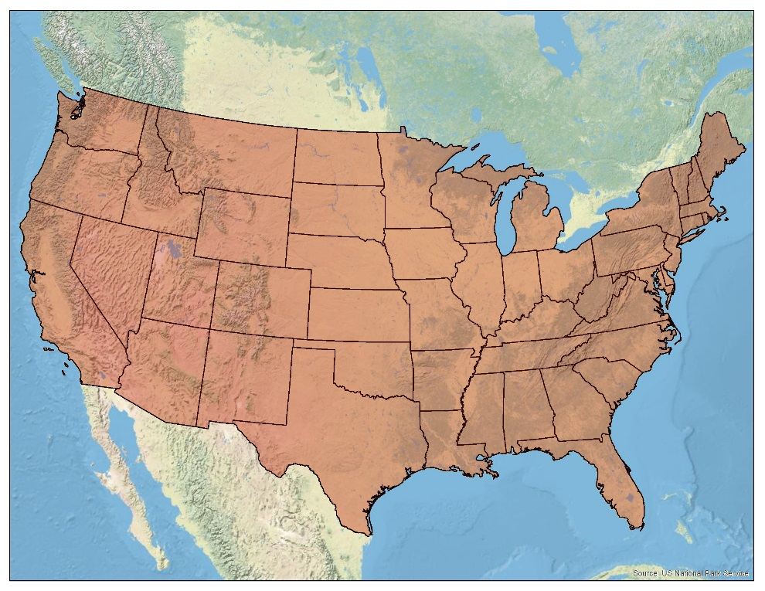
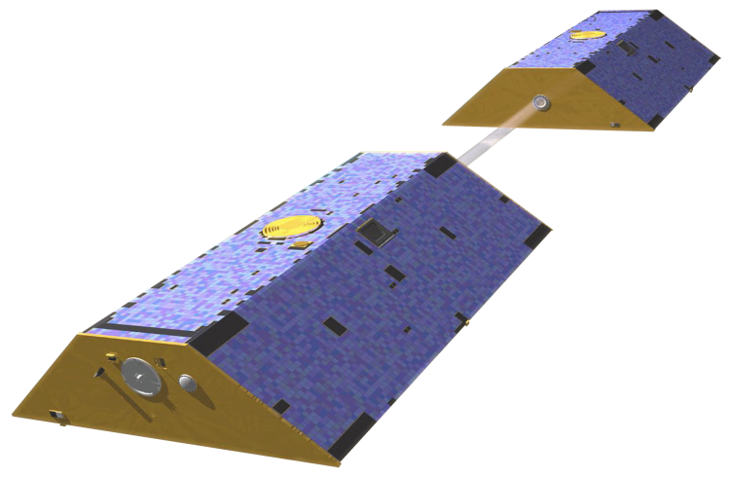
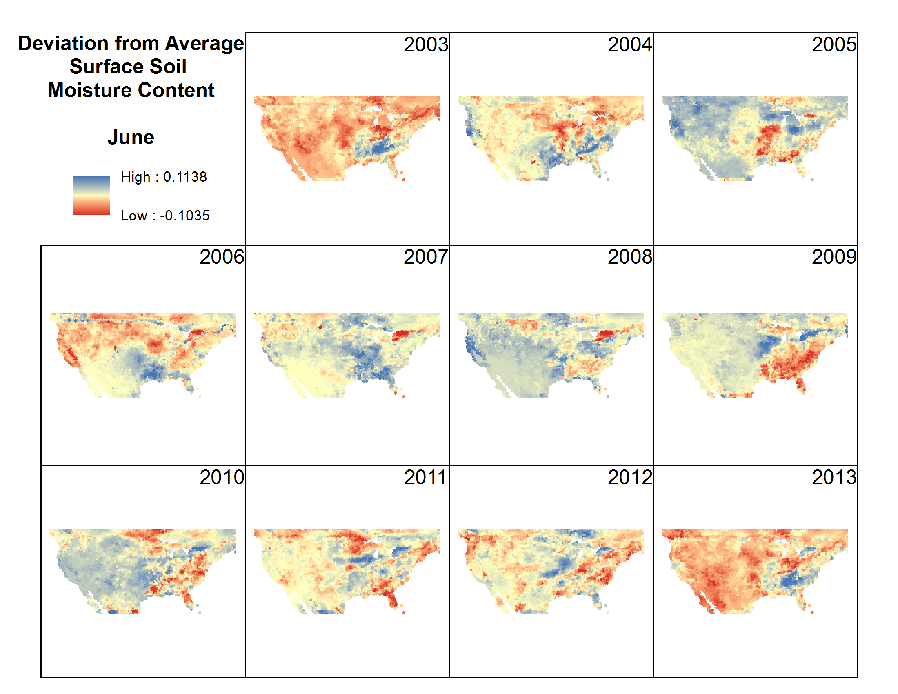
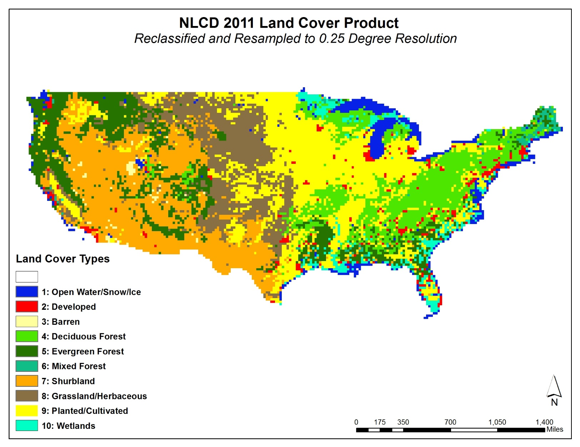
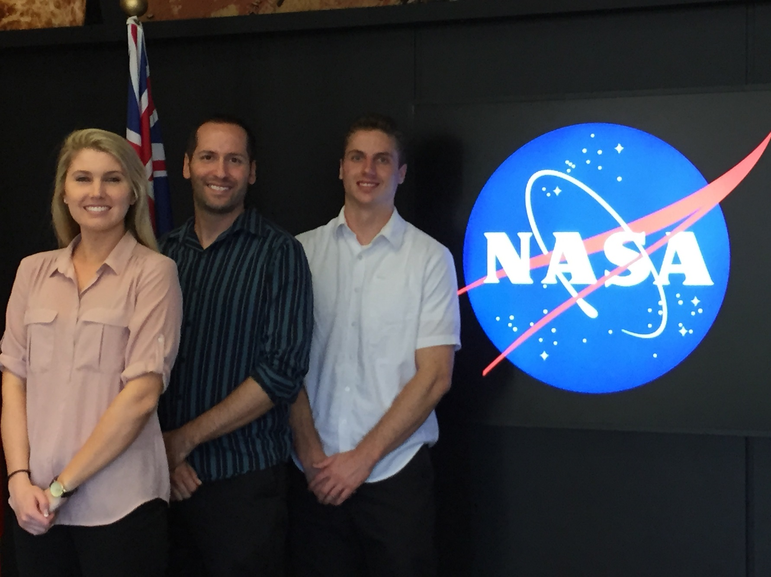
U.S. DISASTERS II
Using GRACE-derived water and moisture products as a predictive tool for wildfire response in the contiguous United States
Brittany Zajic (Project Lead), Daniel Jensen, Nick Rousseau
NASA DEVELOP National Program
Abstract
Objectives
Keep this blank for now.
Body text point size should be at least 24.
Caption text point size should be at least 16.
Feel free to rename, move, and resize sections as needed.
Develop a methodology and toolset for forecasting wildfire activity based on GRACE assimilated data using Python
Correlate GRACE assimilated soil moisture data with wildfire data in the contiguous United States
Create a predictive algorithm that forecasts areas of potential high fire activity risk
Methodology
Study Area
GRACE Assimilated Data
(Surface Soil Moisture)
Correlation
(Python - NumPy)
Contiguous United States
Fire Program Analysis Fire-Occurrence Database
(Wildfire data)
Multivariate Regression
(Python - SciPy)
Predictive Algorithm
Earth Observations
NLCD Land Cover Types
Gravity Recovery and Climate Experiment (GRACE)
Land Cover Analysis
FPA FOD Wildfire data
Results
Conclusions
TBD
(Placeholder)
(Placeholder)
Team Members
Acknowledgements
Project Partners
We would like to thank our Science Advisor, Dr. John T. Reager (NASA JPL), for his guidance on this project.
We would like to thank Mark Finney, Chuck McHugh, and Everett Hinkley from the USDA Forest Service for their involvement in providing direction and information regarding wildfires in the United States.
We would like to thank Dr. Matt Rodell of the NASA Terrestrial Hydrology Program at Goddard Space Flight Center for his help in attaining and utilizing the assimilated GRACE data.
We would also like to thank Max Baldridge, a contributor on the first phase of this project.
USDA Forest Service Remote Sensing Applications Center (RSAC)
Terrestrial Hydrology Program at NASA Goddard Space Flight Center
Brittany Zajic, Nick Rousseau, Daniel Jensen
NASA JET PROPULSION LABORATORY

