Slide 1
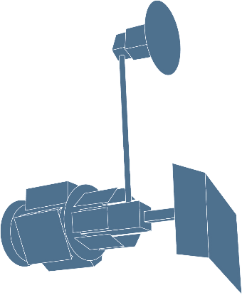
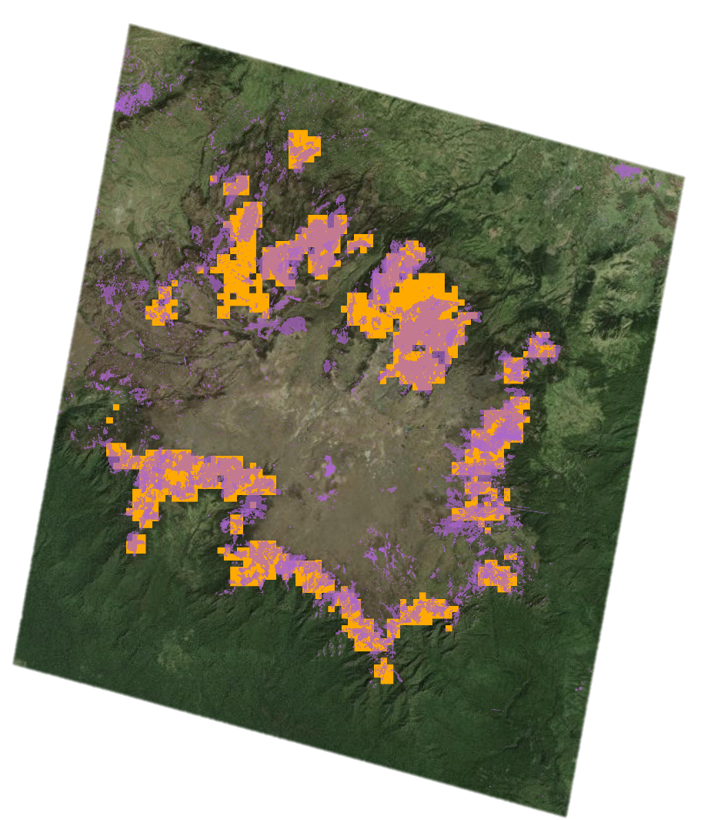
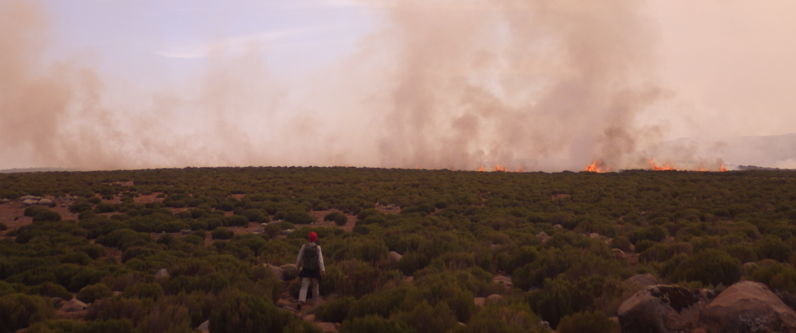
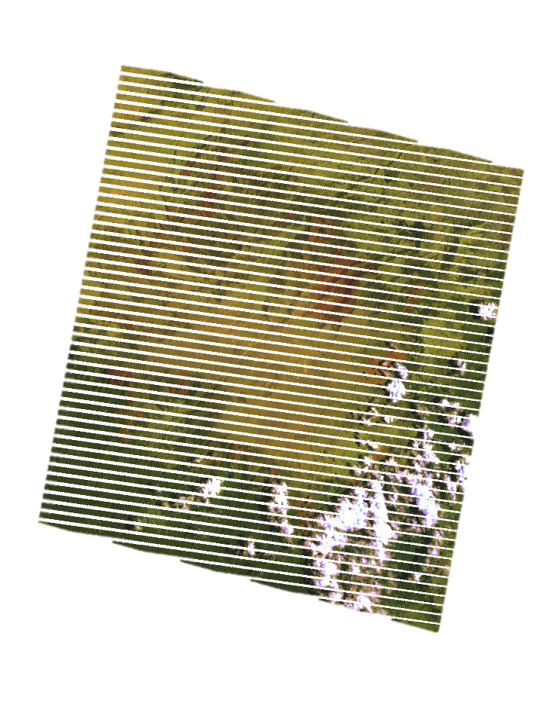
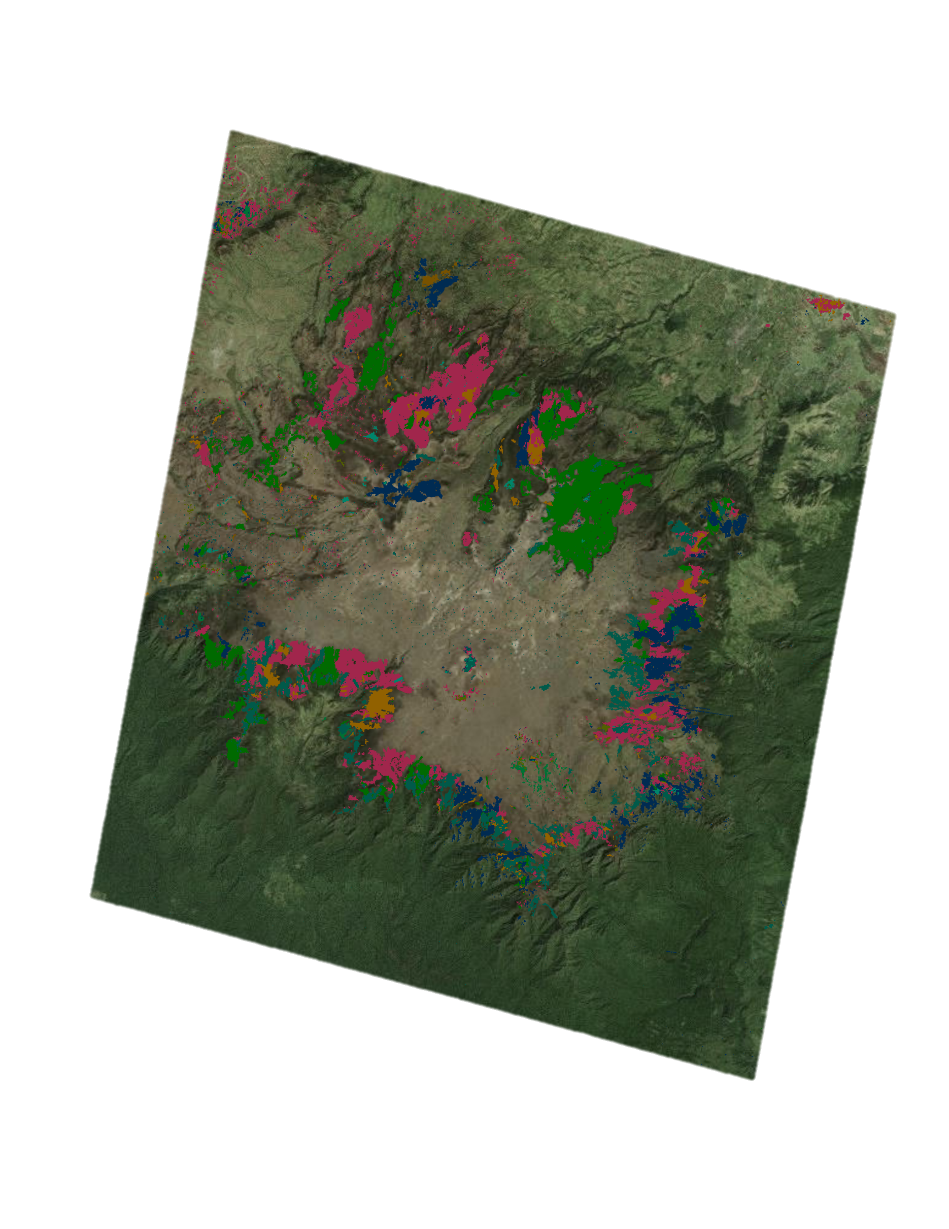
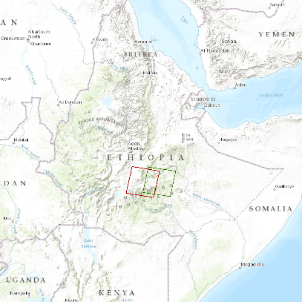
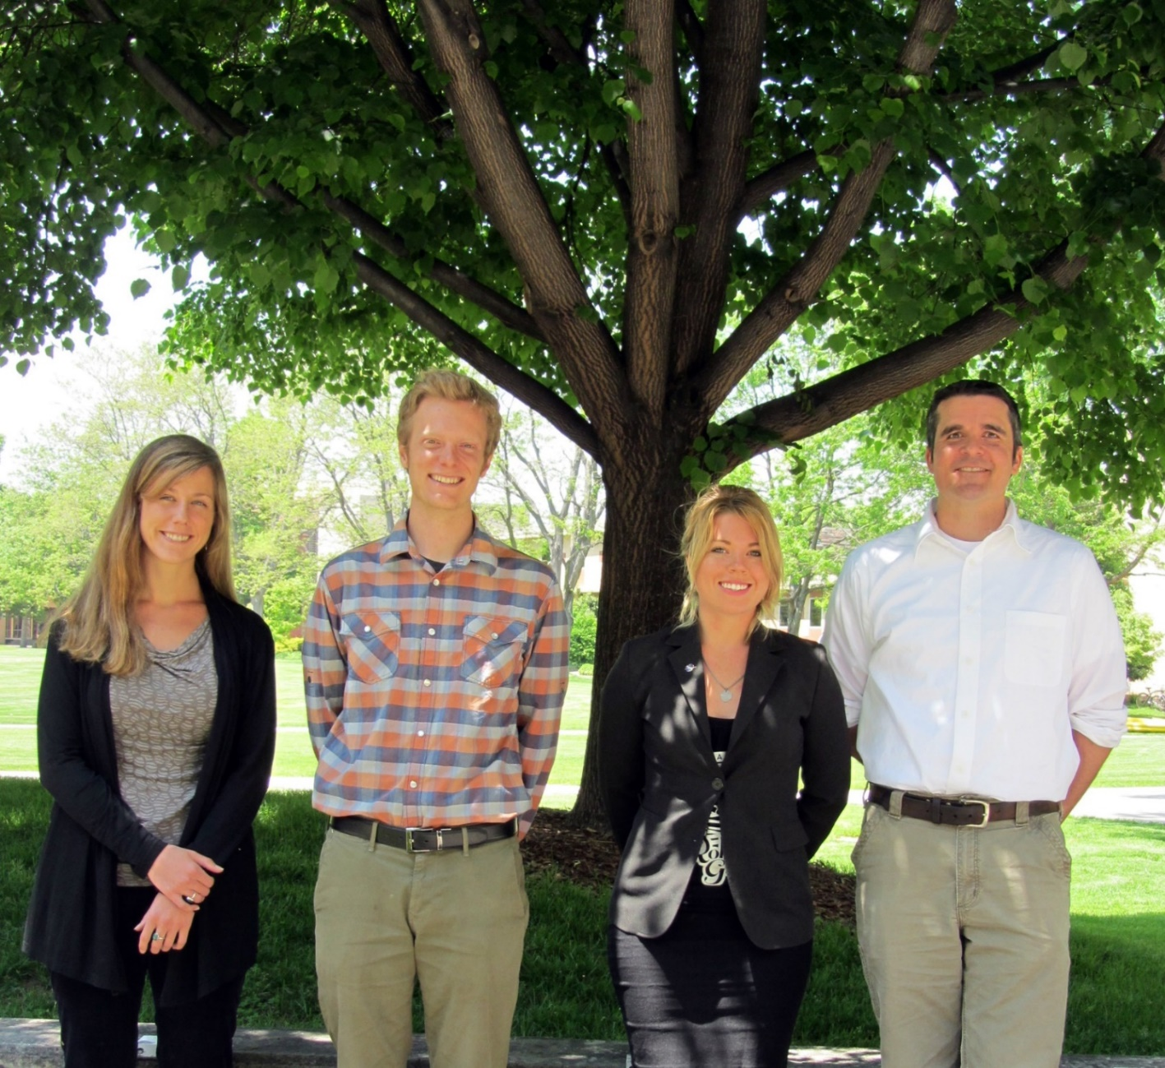
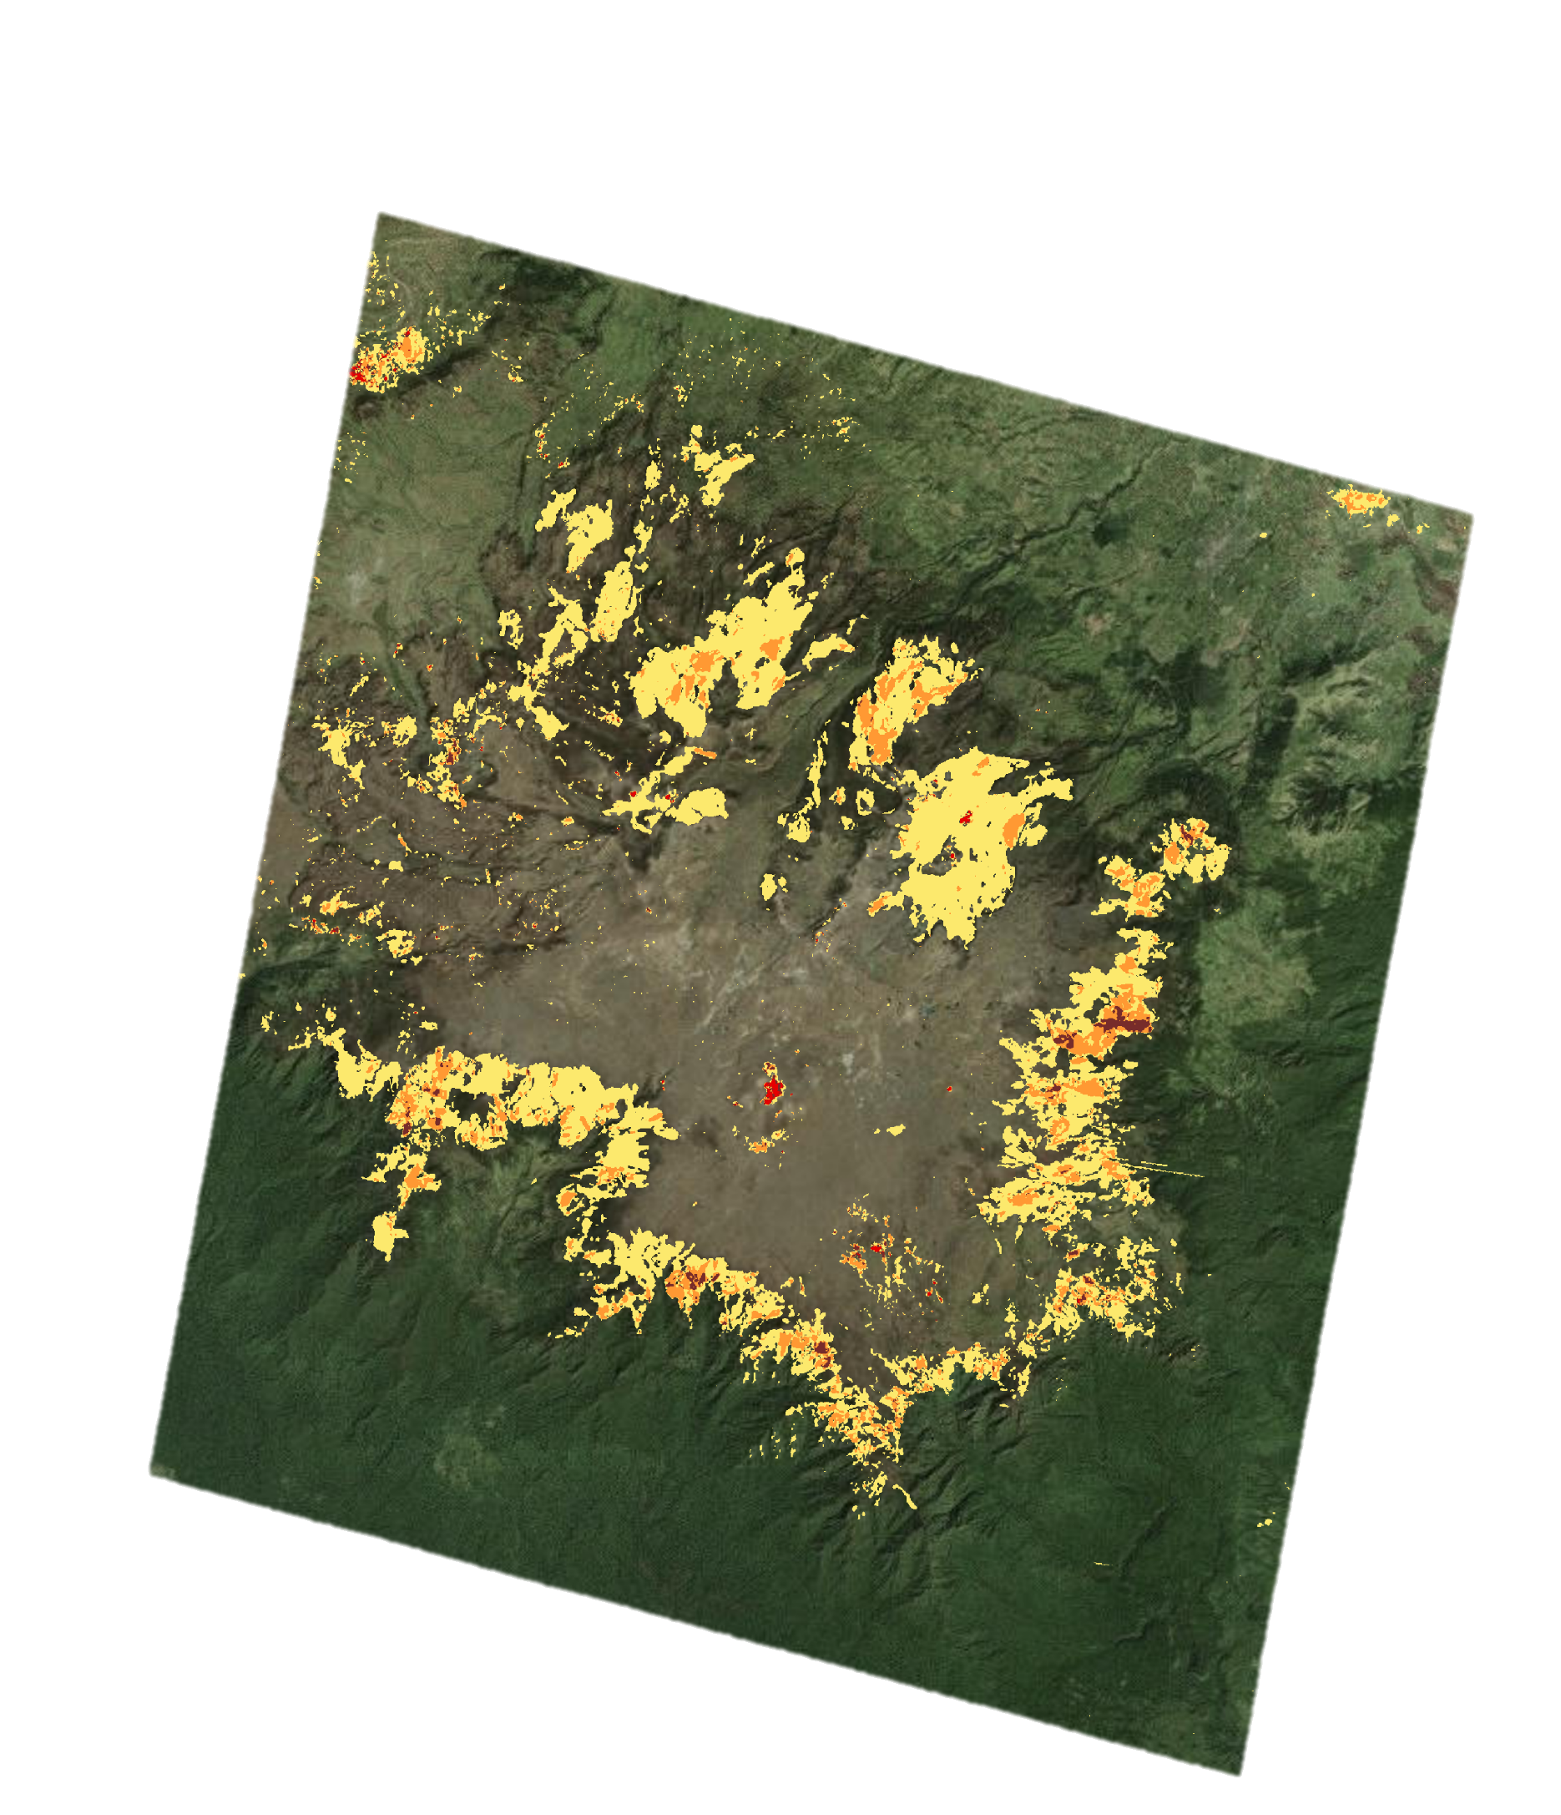
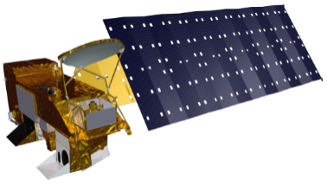
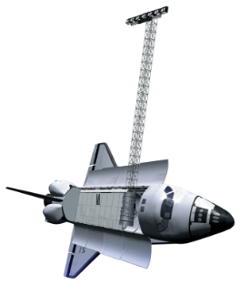
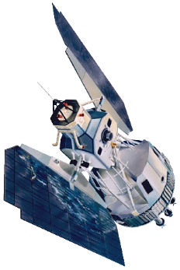
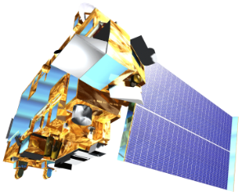

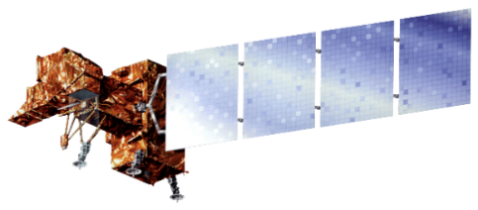

Ethiopia Ecological Forecasting
Mapping four decades of fire history for targeted conservation in the south-central highlands of Ethiopia
Stephen Chignell (Project Lead), Chandra Fowler, Kelly Hopping, Darin Schulte
NASA DEVELOP National Program at USGS Colorado State University
Abstract
The Bale Mountains of south-central Ethiopia comprise one of the largest and least studied mountain systems in Africa. An internationally recognized biodiversity hotspot, the region is home to Bale Mountains National Park and the Sanetti Plateau, which provide critical alpine habitat for numerous endemic and endangered species, such as the mountain nyala. Ethiopian agro-pastoralists in the region practice intentional burning to clear land for grazing and planting; however, pressures related to climate change and increasing populations have made understanding the frequency and extent of burning a top priority for conservationists and land managers seeking to balance conservation goals with the needs of local communities. To address this need, we mapped historical fire extent and frequency in the unique, high-altitude Ericaceous shrublands of Bale, using all available dry-season scenes from 42 years (1973-2015) of the Landsat record. We spatially and spectrally linked imagery within the LandsatLinkr R package to visualize landscape disturbances with a tasseled cap time series. A quantitative assessment of burned areas derived from the normalized burn ratio found that nearly all Ericaceous vegetation in the study area has burned since 1995, but with few repeated fires in the same location. Our results were not only in agreement with the MODIS Burned Area product and fire records compiled from the literature, but also improved upon their spatial resolution and augmented their temporal record. Maps and spatial data of fire date, extent, and frequency were disseminated to partners working in Ethiopia. These will support detailed studies of fire ecology in Bale and inform management approaches that ensure the preservation of the region's natural resources and the social-ecological systems they support.
Objectives
Methodology
Results (continued)
Quantify fire extent and distribution in the Bale Mountains over a 42-year time period
Identify spatial, temporal, and ecological patterns of burning
Provide land managers in the region with the most detailed and complete record of fires to date
Demonstrate a reproducible methodology applicable in Ethiopia and around the globe
Data Acquisition
Data Processing
Analysis
Results
MSS, SRTM
LandsatLinkr
Tasseled Cap
Compositing
Time Series Visualization
TM, ETM+
Fire Extent
Figure 5. Proportion of burned areas within land cover classes.
Gap-filling &
Normalized Burn Ratio
Thresholding
Burn Frequency
MODIS
OLI
N
Landsat
MODIS
Burned Area
Aggregation
Landsat
Validation
Land Cover
Assessment
0
5
10
20
km
Figure 1. Generalized workflow for the study methods. This can be broken into four main stages: data acquisition, processing, analysis, and generation of results.
Figure 4. Cumulative burned areas detected by MODIS (260 km²) and Landsat (271 km²) sensors.
Project Partners
Figure 6. Shrubland burning.
The Murulle Foundation
Natural Resource Ecology Laboratory at Colorado State University
Conclusions
Nearly all ericaceous vegetation of the Bale escarpment burned between 1995-2015, but few areas experienced repeated fires.
LandsatLinkr expedites pre-processing, but data gaps and cloud cover remain serious challenges for time series analysis in remote, tropical alpine regions.
Final products for partners:
Maps and spatial data of fire extent and frequency (1995-2015).
Spectrally comparable and composited tasseled cap time series (1973-2015).
Study Area
N
0
5
10
20
km
Scan line error interpolation
Cloud masks and NBR
Figure 2. For Landsat imagery, we interpolated scan line errors, masked clouds, and calculated and thresholded the normalized burn ratio (NBR) for each scene.
Results
Year
1995
1999
2000
2007
2008
2010
2012
2013
2015
Bale Mountains National Park
Figure 3a. Years in which burned areas were detected, using all available dry-season TM, ETM+, and OLI Landsat scenes (1995-2015). Major burn events occurred at 7- to 8-year intervals (2000, 2008, 2015).
Team Members
WRS1 Path180 Row 55
Map projection:
WGS84 UTM Zone 37N
Elevation data source:
SRTM 1-arc second global
Locater data source:
Esri base maps
WRS2 Path 167 Row 55
Elevation
High
Lakes
Low
Earth Observations
Burn frequency
1
2
Team members (left to right): Kelly Hopping, Stephen Chignell, Chandra Fowler, Darin Schulte
3
>3
Terra/Aqua – MODIS
Shuttle Radar Topography Mission (SRTM)
Landsat 1, 3 –
Multispectral Scanner (MSS)
Figure 3b. Burn frequency (number of times each pixel burned). The “jigsaw” pattern of fires across years (Fig. 3a) indicates that, within the study period, the same locations tended not to burn more than 1-3 times.
Acknowledgements
We would like to thank Dr. Paul Evangelista and Nicholas Young (Natural Resource Ecology Laboratory, Colorado State University), for their guidance and support throughout this project. Special thanks to Justin Braaten (Oregon State University) and Brian Woodward (NASA DEVELOP) for their considerable help with LandsatLinkr and LandTrendr.
Landsat 5 –
Thematic Mapper (TM)
Landsat 7 – Enhanced Thematic Mapper (ETM+)
Landsat 8 – Operational Land Imager (OLI)
N
0
5
10
20
km
USGS at Colorado State University

