Slide 1
Delaware
Ecological Forecasting
Assessing Land Cover and Soil to Identify Suitable Sites for Tidal Marsh Mitigation in Delaware
McKenna Brahler, Amanda Bosserman, Eian Davis, Jacob Frankel, & Rebecca Ohman
Alabama – Marshall

Slide 2
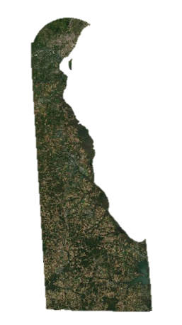
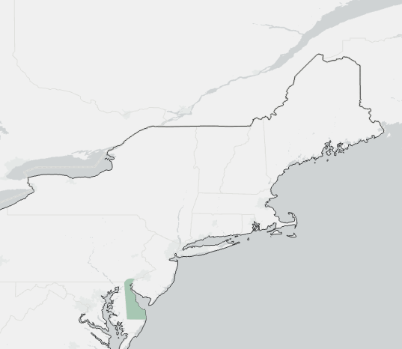
STUDY AREA AND STUDY PERIOD
Study Area
Delaware
Focus on coastal areas
Study Period
January 2000 – June 2021
Forecasting to 2050
State of Delaware
United States Border
Northeastern United States
Delaware
N
0
10
20
40 miles
Notes:
McKenna
This project’s study area was the coast of the state of Delaware. The study period was from January 2000 to June 2021. The forecasting element of the project was forecasted out to 2050 in 5-year intervals.
Base Map: Esri, Maxar, GeoEye, Earthstart Geographics, CNES/Airbus DS, USDA, USGS, AeroGRID, IGN, and the GIS User Community.

Slide 3
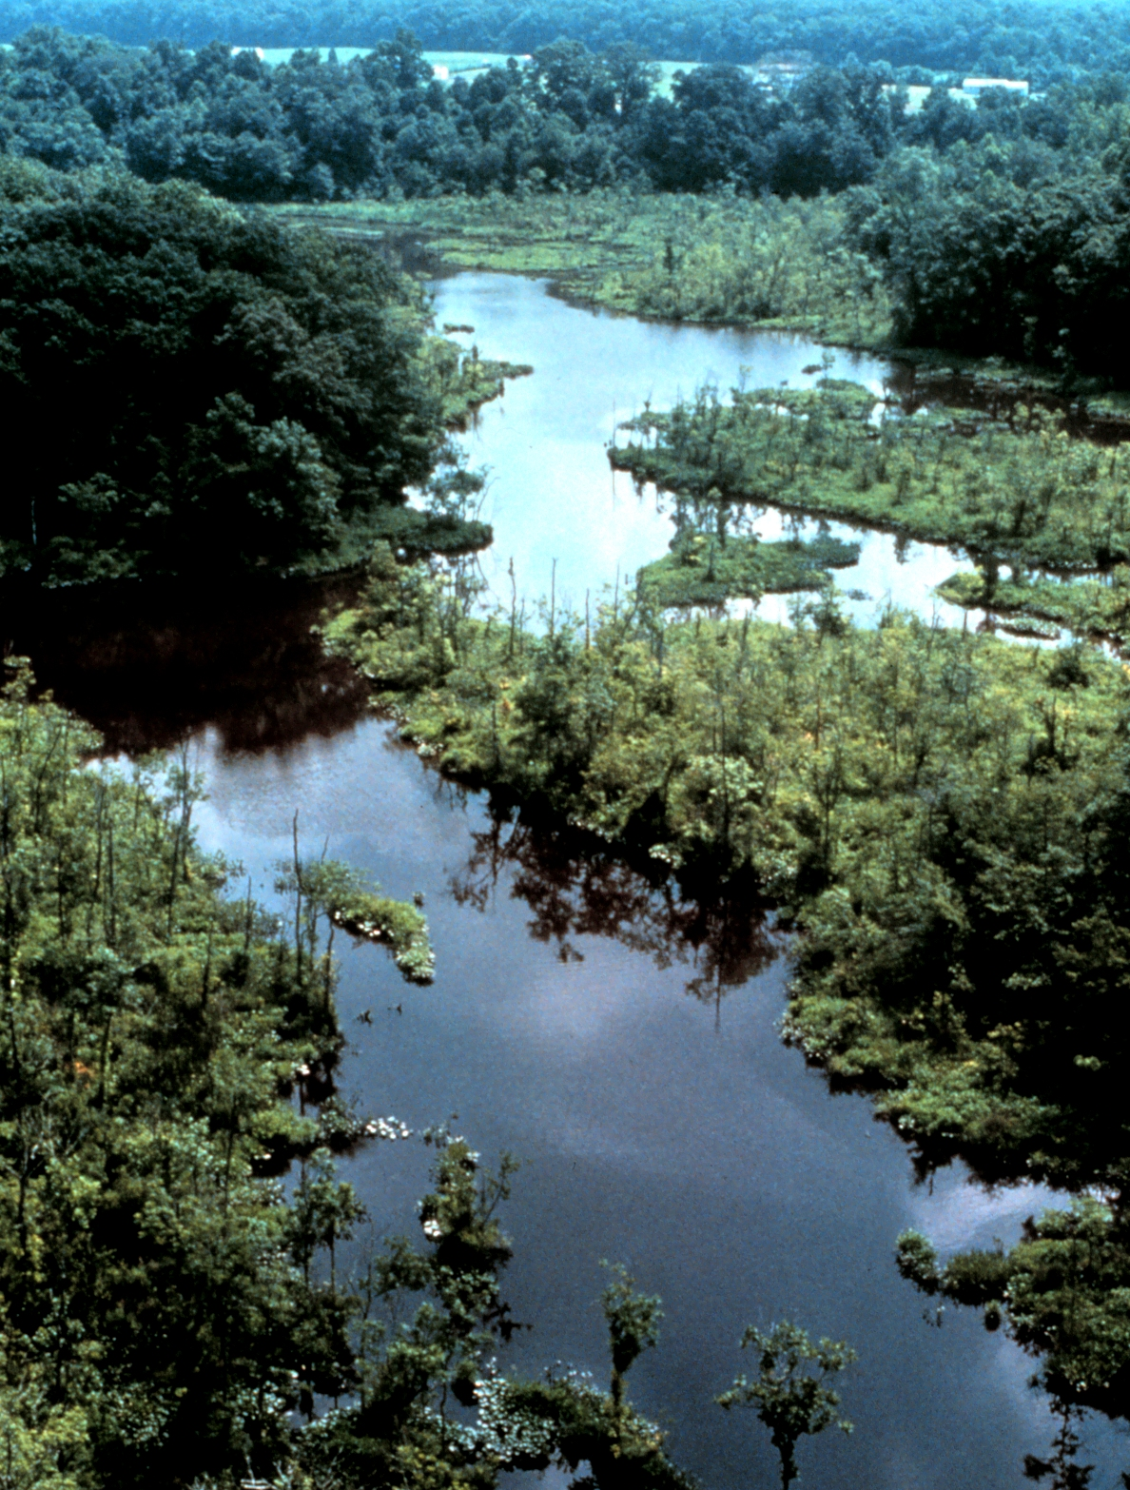
COMMUNITY CONCERNS
Preservation of sufficient tidal marsh area
Tidal wetland ecosystem services
5,000 acres of wetland loss since 1980
Lowest mean elevation in the US
Locations for suitable landward marsh migration
Delaware National Estuarine Research Reserve
Image credit: NOAA Photo Library
Notes:
Rebecca
Healthy tidal wetlands are vitally important for the state of Delaware. By preserving a sufficient area of tidal wetlands through land reclamation or conservation, some of the valuable services provided by these ecosystems can be protected, such as protection against storm surges, water purification, carbon sequestration, habitat for native species, and recreation opportunities. Approximately 5,000 acres of Delaware’s wetlands have already been lost over the last 30 years, due to human activities such as development and agriculture, and natural factors like severe weather events, sea-level rise, and erosion. Delaware has the lowest mean elevation in the US, making it particularly susceptible to sea-level rise and erosion during extreme weather events. Furthermore, landward tidal marsh migration is likely to occur as a result of shifts in climate and sea-level rise, and suitable locations for marsh migration can be limited by impervious landcover, like roads and buildings, as well as natural landscape features.
------------------------------Image Information Below ------------------------------
•Image Credit: NOAA Photo Library
•Image Source: https://photolib.noaa.gov/Collections/National-Estuarine-Research-Reserve-System/Other/emodule/854/eitem/37422
•Image License: Public domain

Slide 4
PROJECT PARTNERS
Delaware Department of Natural Resources and Environmental Control (DNREC)
Division of Climate, Coastal and Energy
Division of Watershed Stewardship
Delaware Tidal Wetland
Image credit: Dr. Kari St. Laurent
Notes:
*Amanda*
We have partnered with the Delaware Department of Natural Resources and Environmental Control, specifically the Division of Climate, Coastal and Energy. We are also collaborating with the Division of Watershed Stewardship within DNREC.
------------------------------Image Information Below ------------------------------
•Image Credit: Dr. St. Laurent
•Image Source: Provided by Dr. Kari St. Laurent, DNREC
Image license: Written permission

Slide 5
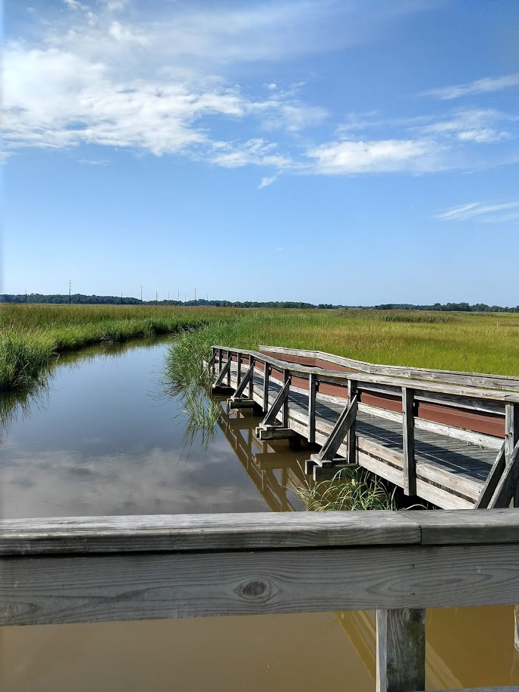
PROJECT OBJECTIVES
Identify current and future wetland habitats, marsh locations, and changing climate variables
Analyze Land Use Land Cover Change(LULC), marsh migration, and climate variation
Generate maps of wetland habitat and marsh locations
Predict areas of likely landward marsh migration in different wetland gain/loss scenarios
Delaware Tidal Wetland
Image credit: Dr. Kari St. Laurent
Notes:
McKenna
This project had four main objectives. The first was to identify current and future wetland habitats, marsh locations, and changing climate variables. Then, using these observations, analyze LULC change, marsh migration, and climate variation over the study period. The analyses were used to generate maps of wetland habitat and marsh locations. Finally, the maps were used to predict areas of likely landward marsh migration in different climate scenarios.
------------------------------Image Information Below ------------------------------
•Image Credit: Dr. St. Laurent
•Image Source: Provided by Dr. Kari St. Laurent, DNREC
Image License: Written Permission to Use

Slide 6
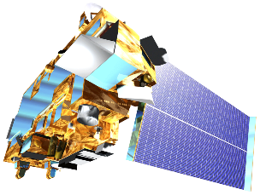
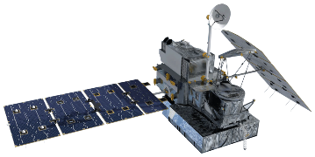
NASA SATELLITES USED
Landsat 5
Thematic Mapper (TM)
Landsat 8 Operational Land Imager (OLI)
Terra
Moderate Resolution Imaging Spectroradiometer (MODIS)
Global Precipitation Measurement (GPM)
Image Credits: NASA
Notes:
McKenna
To achieve out project’s objectives, the team utilized several satellites and sensors.
For the Land Use Land Cover Change and Tidal Marsh Maps, the team used Landsat 5 Thematic Mapper and Landsat 8 Operational Land Imager.
We also used the Terra Moderate Resolution Imaging Spectroradiometer or MODIS and Global Precipitation Measurement or GPM to collect Land Surface Temperature and Monthly Precipitation Amounts for the climate analysis.
------------------------------Image Information Below ------------------------------
•Image Credit: NASA
•Image Source https://www.devpedia.developexchange.com/dp/index.php?title=List_of_Satellite_Pictures

Slide 7
ANCILLIARY DATA
LULC Change | Tidal Marsh Maps | Climate Analysis
NDVI NDBI NDWI SAVI PCA Components 1 & 2 | Delaware Soils Data Digital Elevation Model National Hydrology Dataset Flowlines National Land Cover Database National Agricultural Statistics Service Cropland Data Layer | GPM IMERG Merged Satellite-Gauge Precipitation Estimate – Final Run (0.1 degrees spatial resolution) Terra MODIS Average Monthly Daytime Land Surface Temperature (0.05 degrees spatial resolution)
Notes:
McKenna
The team used several ancillary datasets for this project. Specifically, for the land use land cover change maps, Normalized Difference Indices for Vegetation, Built-Up, and Water were used along with the Soil-Adjusted Vegetation Index to create the spectral portion of the maps.
The tidal marsh maps utilized datasets from Delaware’s FirstMap, Unites States Geological Survey, and United States Department of Agriculture. These datasets include Delaware Soil Data, DEM, National Hydrology Flowlines, National Land Cover, and National Agricultural Statistics Service’s Cropland Data Layer.
For the climate analysis, the team used GPM Integrated Multi-SatellitE Retrievals to collect Final Precipitation Monthly. For temperature, Terra MODIS was used to collect Land Surface Temperature Monthly. These datasets were used to create graphs and maps as displays of seasonal analyses.

Slide 8
METHODOLOGY – LAND USE LAND COVER CHANGE
Using Landsat
Download satellite imagery from 2010 and 2020
Create ancillary datasets
Composite all ancillary datasets into one larger .tif
Load results into Land Change Modeler
Random forest classification
Create training data
Calculate land cover changes
Calculate transition potentials
Predict future land cover changes
Notes:
Jacob
The first step to the LULC portion of the project is to download the satellite data. For this part, the team used a Landsat 5 image from 2010 and a Landsat 8 image from 2020. Using those two images, a series of ancillary data were calculated using the Raster Function suite of tools in ArcGIS Pro. The ancillary data consisted of indices (NDVI, SAVI, MDNWI, and NDBI) and components 1 and 2 from a Principal Component Analysis of the images. All of the files for each year were then merged into a single .tif file using the Composite Band function in ArcGIS Pro. To complete the Random Forest classification, the team used the Image Classification Wizard in ArcGIS Pro. The team opted to use the Object Based Image Analysis option within the tool, and for both images the classes chosen were: Non-Wetland Vegetation/Open Space, Wetlands, Water, and Developed space. Segments that represent those classes well for both years were selected as training data. The model ran and created classified images for both years. The results were then plugged into the Land Change Modeler (LCM) in TerrSet. The first step was to calculate land cover change between the two years, which resulted in images showing loss, gain, and persistence of each of the four classes over the time period. The next step was to calculate transition potentials, meaning the likelihood for a class to transition to a different class in the future. This step is a key building block of the next step, the prediction of future land cover change. Using the changes that occurred between 2010-2020, as well as the recorded transition potentials of each class, the team was able to predict wetland extent at 5-year intervals from 2025 to 2050.

Slide 9
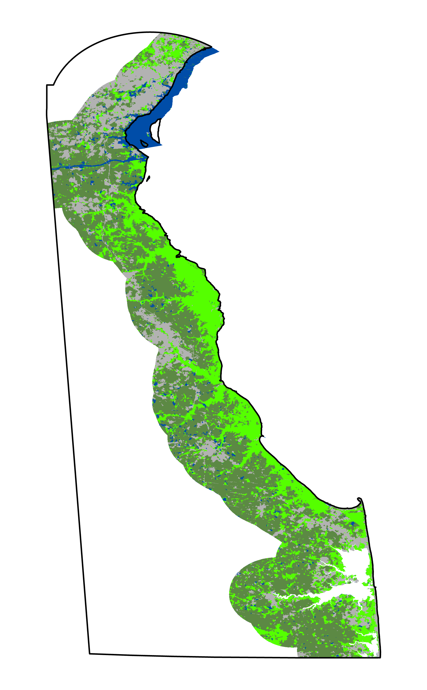
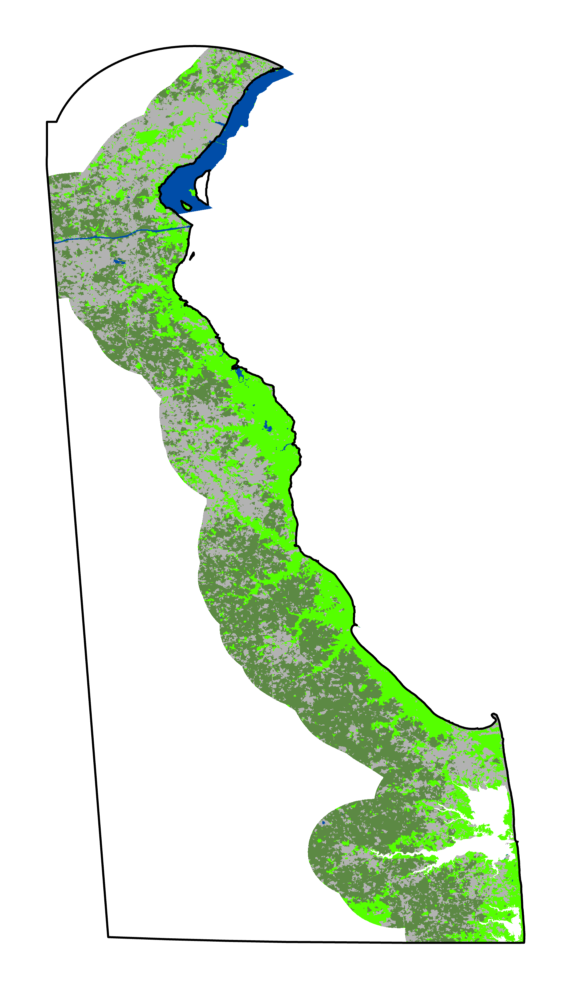
RESULTS – LAND USE LAND COVER CHANGE
2010 (Landsat 5 TM)
2020 (Landsat 8 OLI)
​ Delaware State Boundary​
Land Cover Types​
Water​
Developed​
Non-wetland Vegetation​
Wetlands
N
10
Miles
Wetland Change | Area (Hectares)
Loss | 23,402.59
Gain | 21,608.22
Persistence | 47,051.65
Notes:
Rebecca
The Land Use Land Cover change series, classified from 2010 and 2020 imagery using the Image Classification Wizard in ArcGIS Pro, indicates shifting wetland area across Delaware's coastal region. While there was an overall net loss of roughly 1,794 hectares of wetland during the 10-year transition, this land cover model did indicate some areas of wetland gain and persistence.
------------------------------Image Information Below ------------------------------
•Image Credit: MSFC DEVELOP Summer 2021
•Image Source: Produced in ArcGIS Pro

Slide 10
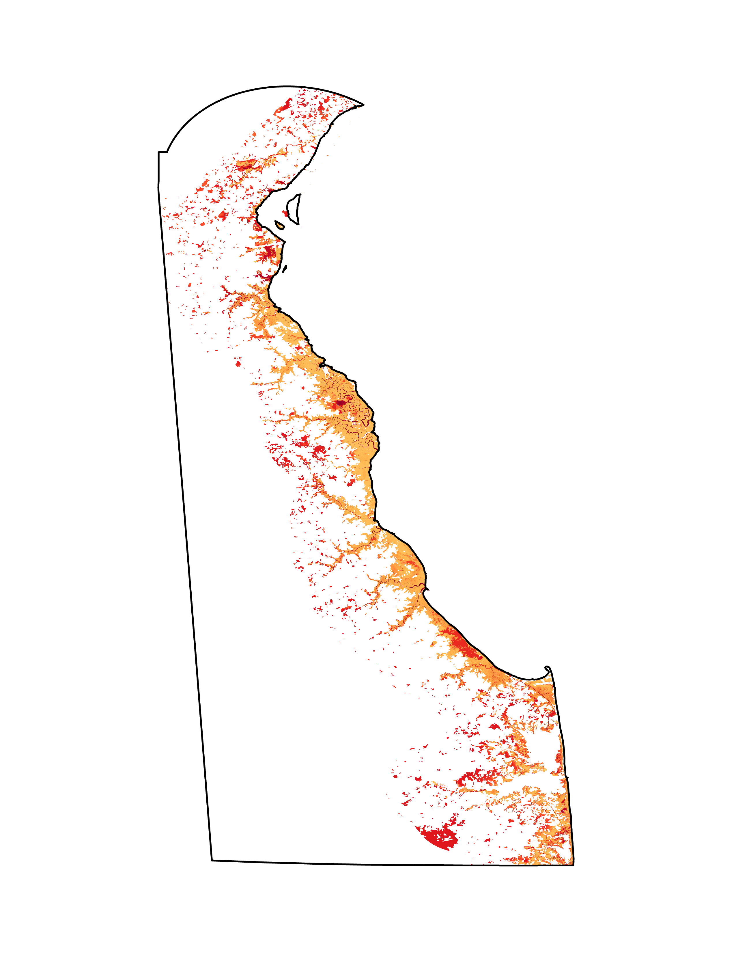
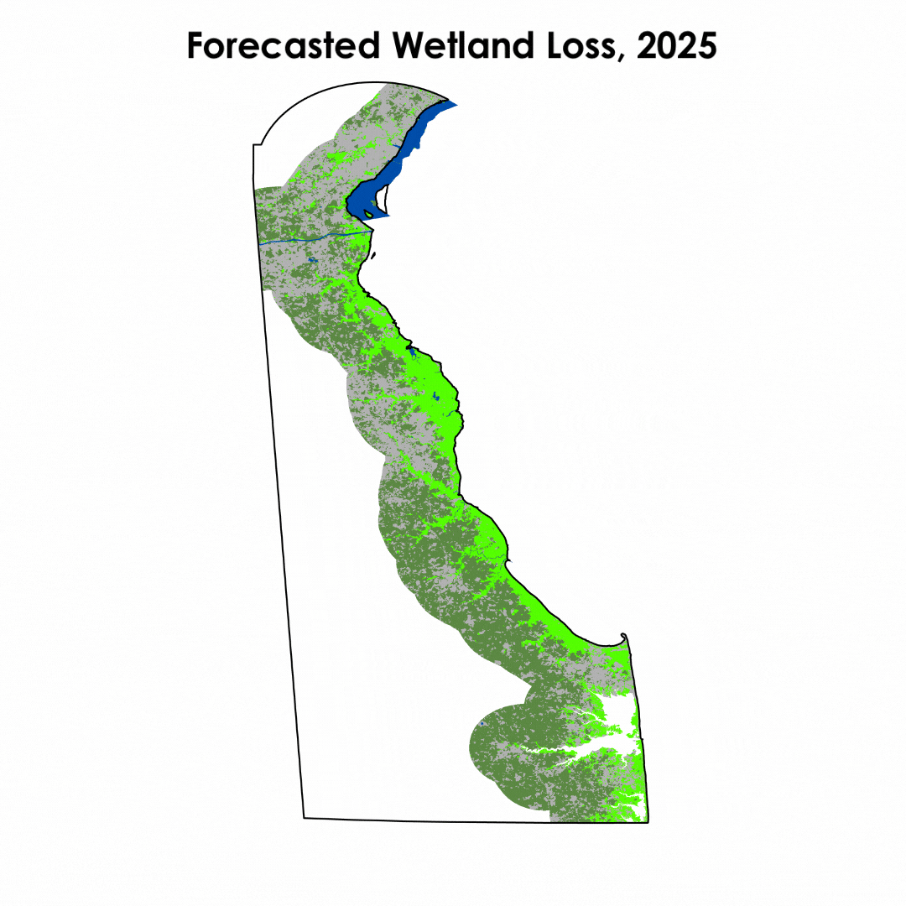
RESULTS – FORECASTED WETLAND LOSS MAPS
Wetland Loss Soft Projection
Follows current patterns of wetland transition to water, developed land, and non-wetland vegetation
Does not account for current patterns of wetland gain
Preserves current protected lands
Likelihood of Wetland Transition to Other Classes by 2050
100%
0%
​ Delaware State Boundary​
Land Cover Types​
Water​
Developed​
Non-wetland Vegetation​
Wetlands
N
10
Miles
Notes:
Forecasted maps were created for 5-year intervals, using transition potentials that follow current patterns of wetland gain as indicated by 2010 to 2020 land cover change. This model follows current patterns of transition from wetland to water, developed land, and non-wetland vegetation, not accounting for current rates of wetland gain. Public protected lands, as updated in 2019, were modeled as protected throughout the forecasted years.
------------------------------Image Information Below ------------------------------
•Image Credit: MSFC DEVELOP Summer 2021
•Image Source: Produced in ArcGIS Pro

Slide 11
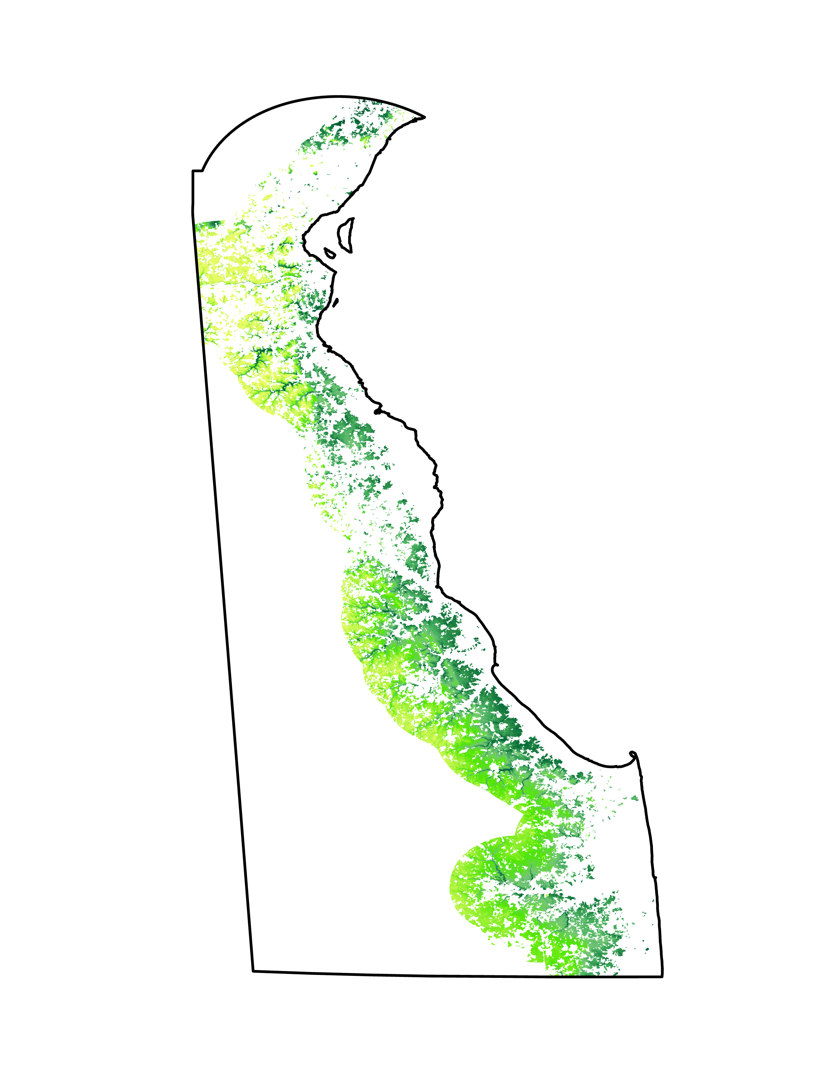
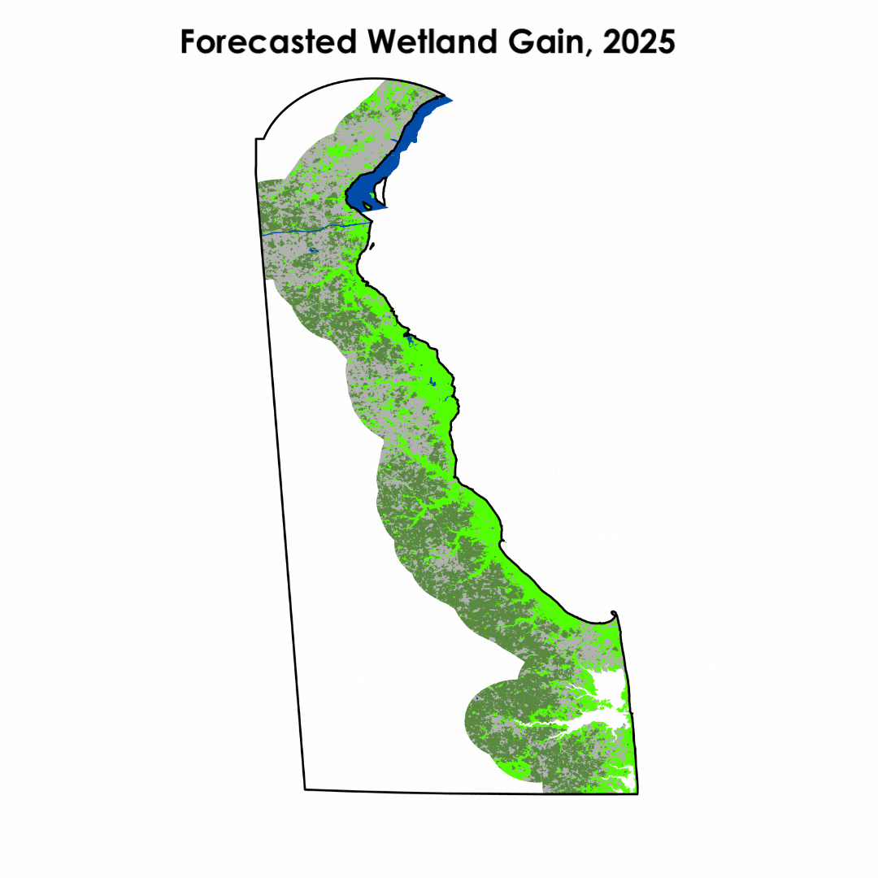
RESULTS – FORECASTED WETLAND GAIN MAPS
Wetland Gain Soft Projection
Forecasted Wetland Gain, 2025
Follows current patterns of vegetation transition to wetland
Potential link to rates of sea level rise
Model does not account for patterns of wetland loss
Likelihood of Vegetation Transition to Wetland by 2050
93%
0%
​ Delaware State Boundary​
Land Cover Types​
Water​
Developed​
Non-wetland Vegetation​
Wetlands
N
10
Miles
Notes:
A second model was created using transition potentials that follow current patterns of wetland gain as indicated by 2010 to 2020 land cover change. This model follows current patterns of transition from non-wetland vegetation to wetland, not accounting for current rates of wetland loss. There is a possible connection to current rates of sea level rise, though this is not confirmed.
------------------------------Image Information Below ------------------------------
•Image Credit: MSFC DEVELOP Summer 2021
•Image Source: Produced in ArcGIS Pro

Slide 12
METHODOLOGY – LAND USE LAND COVER CHANGE
Using NAIP
Download 2018 NASS image
Create training data
Random Forest classification in GEE
Export images to ArcGIS Pro for processing
Notes:
Jacob
The team also created land cover maps using NAIP imagery, which is a much finer resolution than Landsat. The most recent available NAIP imagery at the time this research was being conducted was from 2018, which is earlier than the Landsat imagery. The team downloaded a 2018 image from NASS (National Agricultural Statistical Service), which has a detailed land cover classifications scheme. After finding sections within the NASS image that represented the data well, the team used the Random Points tool in ArcGIS Pro to create 1000-3000 points for each class we were looking at. The team found a Random Forest classification script in the Supervised Classification folder in the DEVELOP GEE set of folder. It was then adapted to use NAIP imagery and to fit the study area. Using the training data, the team was able to classify the entire coastal region and compute a confusion matrix that showed the accuracy of the classification. The images were then exported from GEE by county, as exporting the entire image exceeded the GEE pixel limit for exporting. Because the files were so large, they were exported at 5-meter resolution, instead of the typical 1-meter resolution. Once in ArcGIS Pro, the images were processed by being once more clipped to the study area and having all 0 values set to null, as well as having the same symbology applied to all three county images.

Slide 13
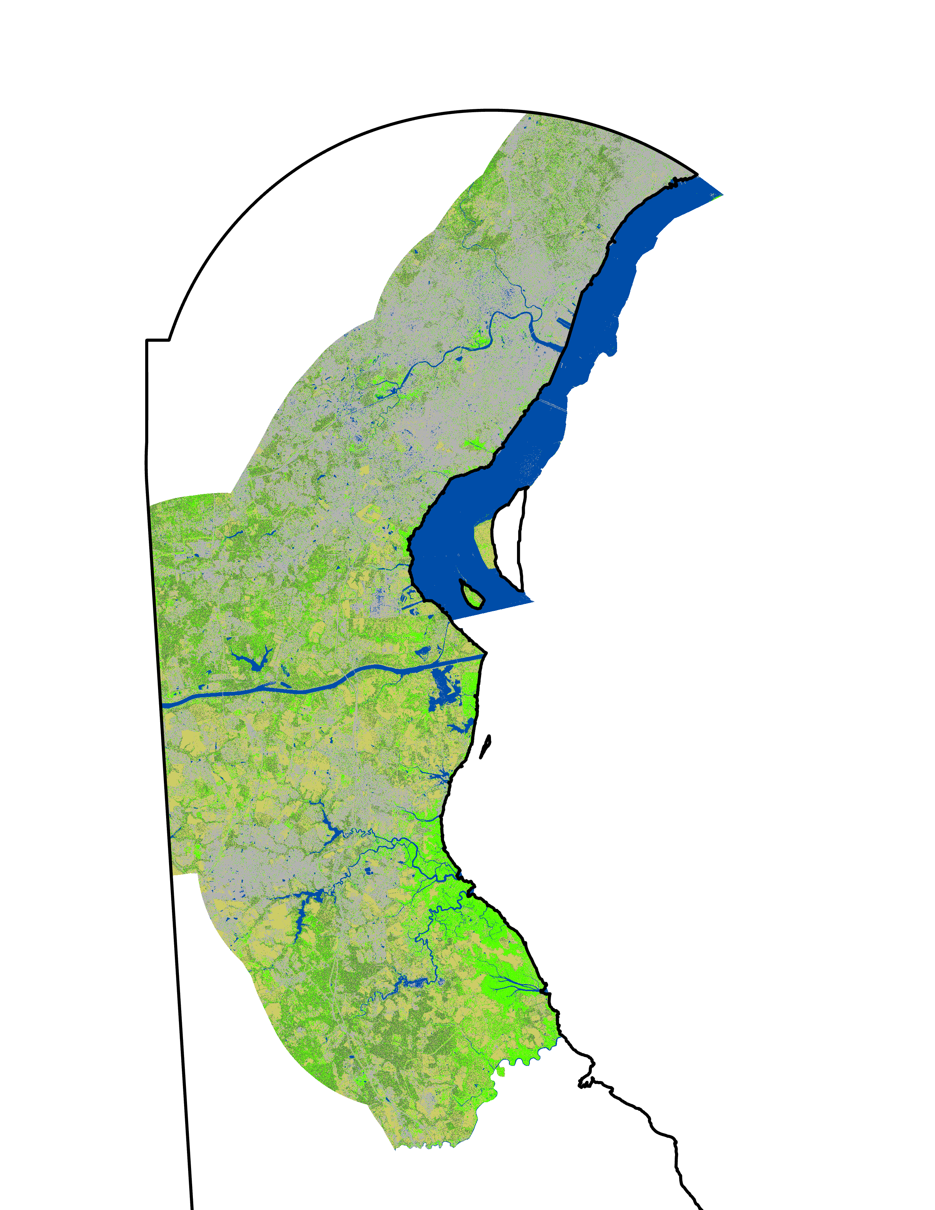
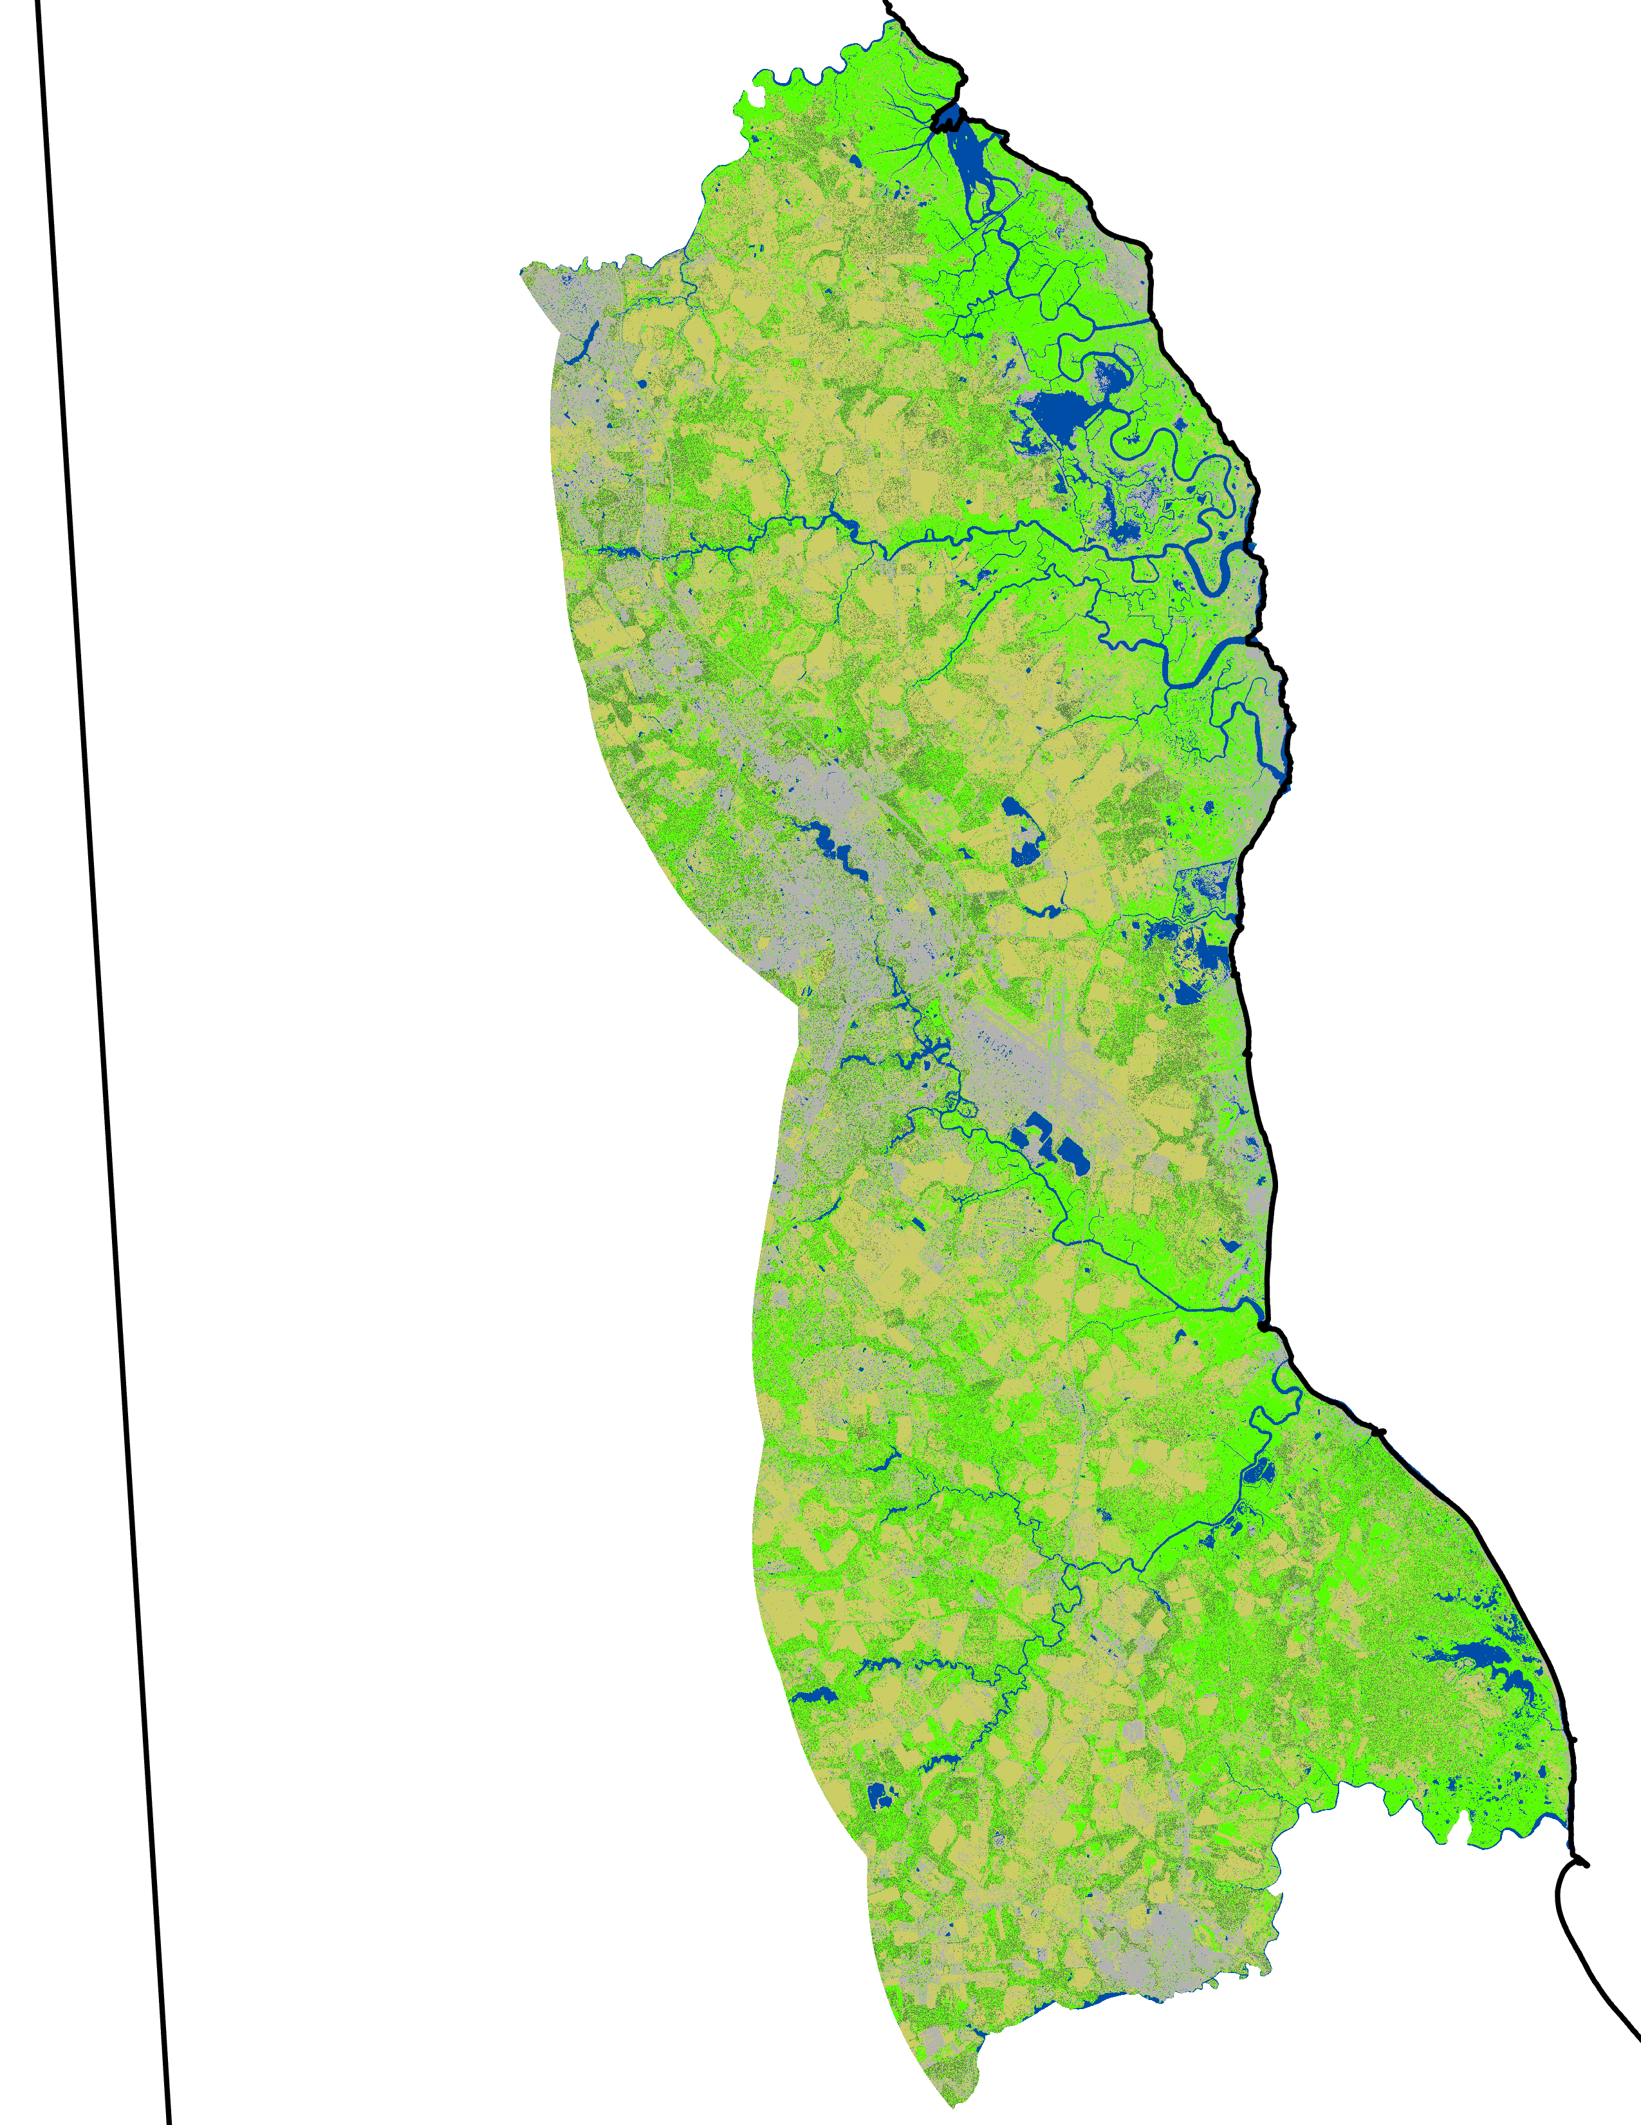
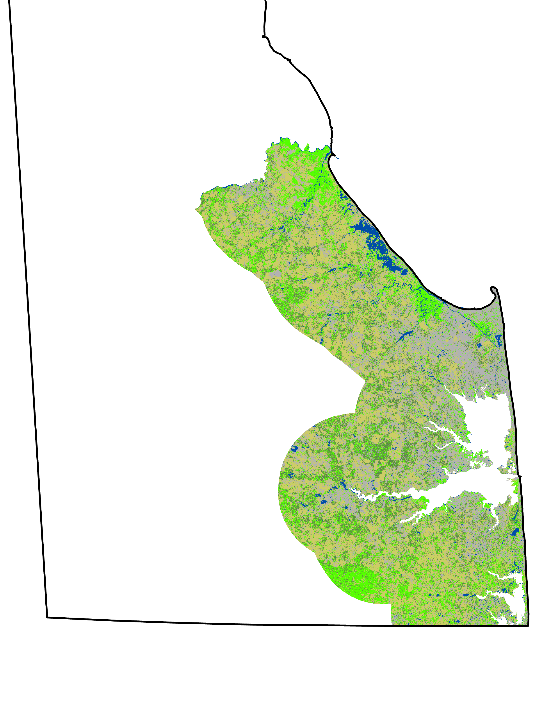
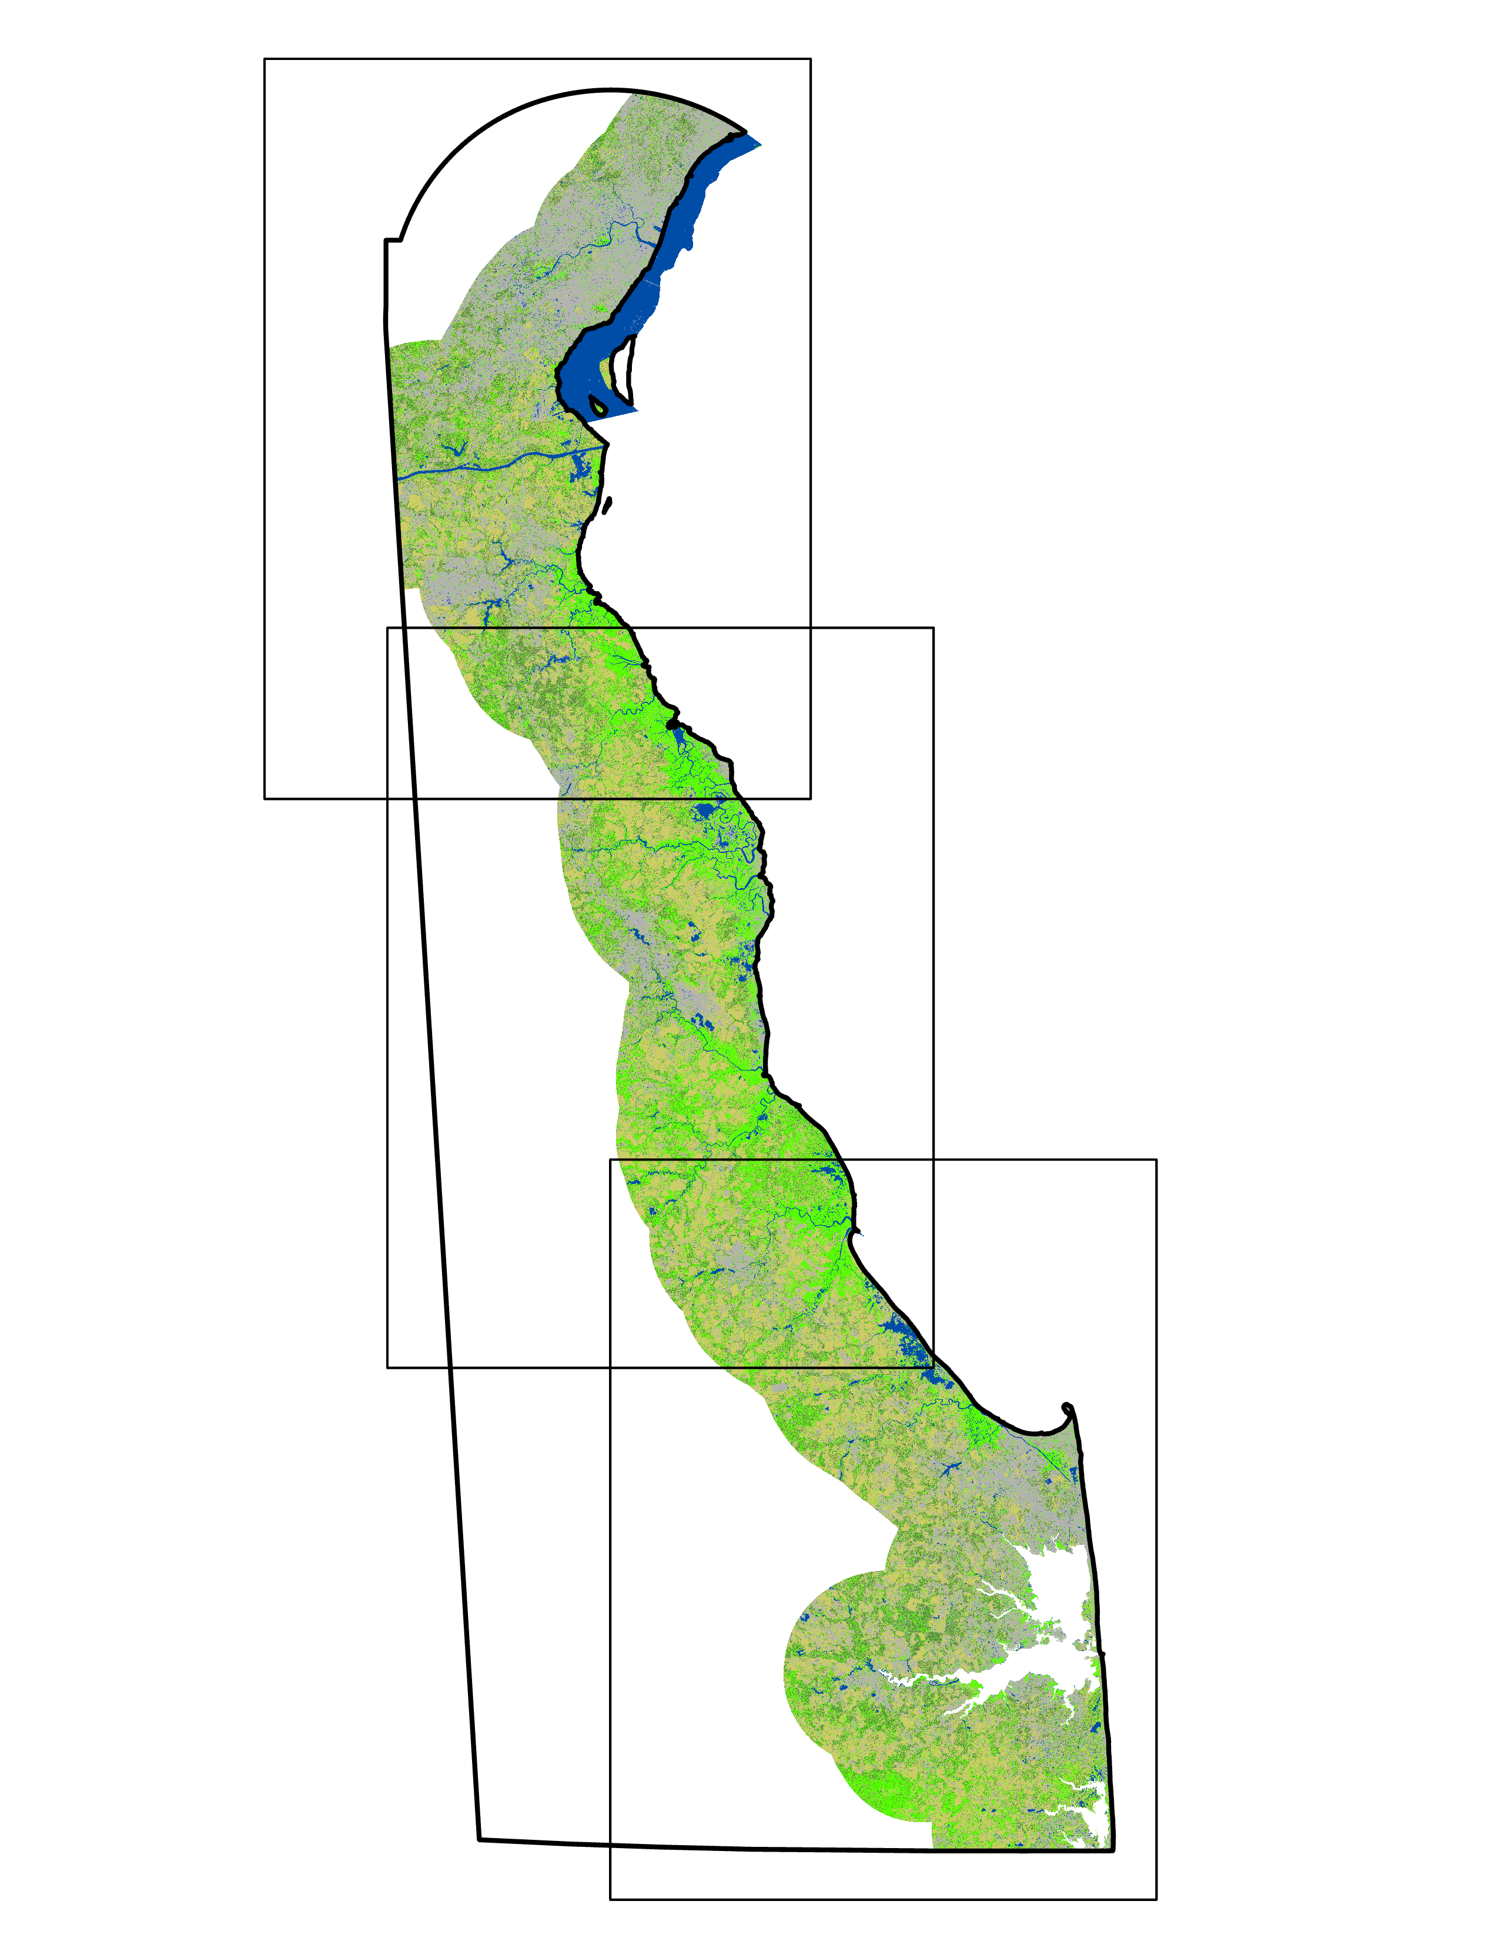
RESULTS – 2018 NAIP Classification
Non-Wetland Vegetation/
Cropland/Open Space
Forest/Shrubland
Developed
Water
Wetlands
1. New Castle County
2. Kent County
3. Sussex County
1.
2.
3.
N
1 mile
10 miles
Notes:
Jacob
The above images show the Random Forest classifications for each of Delaware's three counties in 2018. The legend in the top right corner shows the different land cover classes that were classified. For reference, New Castle county is located at the northern end of the state and is bordered by Kent County to the south, which is bordered by Sussex County to the south.

Slide 14
METHODOLOGY – TIDAL MARSH MAPS
Cropland
(USDA NASS)
Reclassify Data
Impervious Surface (USGS NLCD)
Reclassify Data
Suitability Modeler
Transform to common scale
Identify Suitable Land
Elevation
(USGS DEM)
Slope
Delaware Soils (NCSS)
Merge counties, poly to raster
Flowlines (USGS NHD)
Euclidean Distance
Notes:
Amanda
Suitable locations for marsh migration based on impervious surfaces, hydric soils, slope, water availability, and agricultural land were analyzed in ArcGIS Pro using the Suitability Modeler tool. Each criterion was put through a series of pre-processing steps before being loaded into the Suitability Modeler. Each criterion was then transformed to a common suitability scale of 1 to 5 (one being the least suitable and five being the most suitable). We then weighted criteria relative to one another and combine them to create a suitability map.
Cropland = 20%
Slope = 20%
Flowlines = 10%
Impervious surfaces = 30%
Cropland = 20%
Suitable land areas were identified using the Locate Regions tool and was then compared to LULC change maps to determine the best locations for conservation efforts.

Slide 15
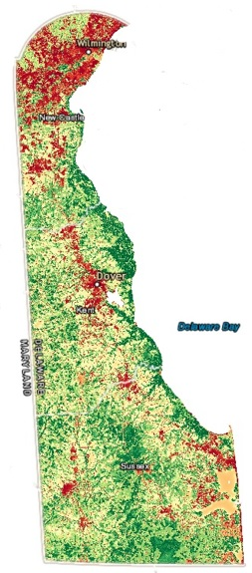
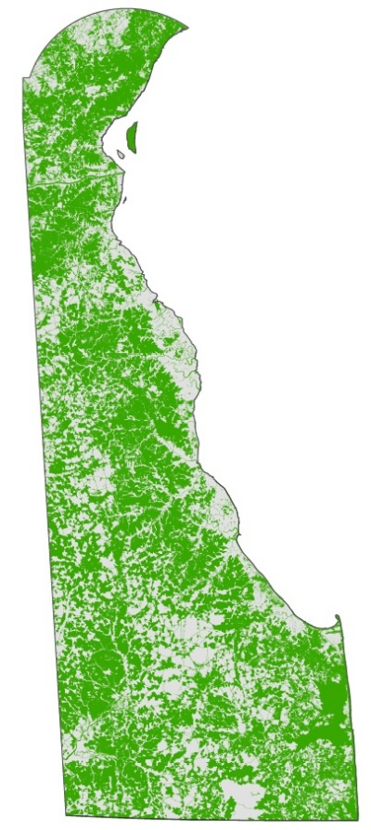
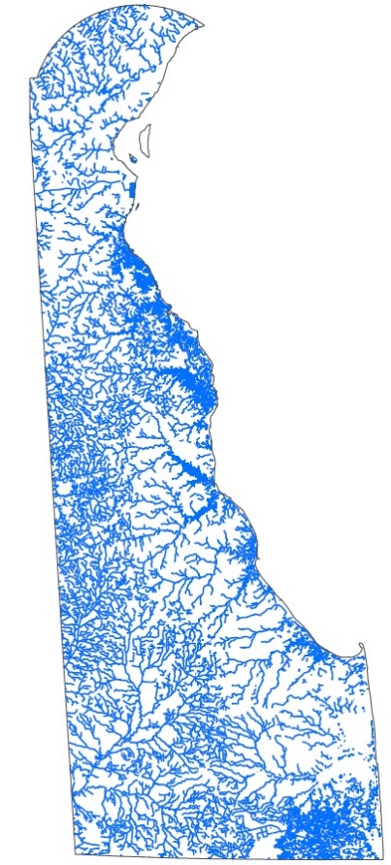
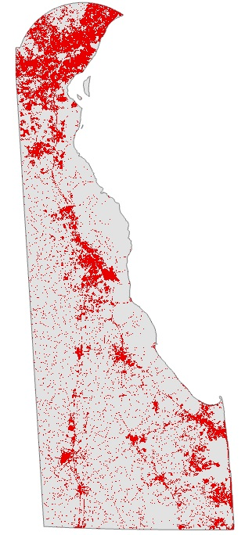
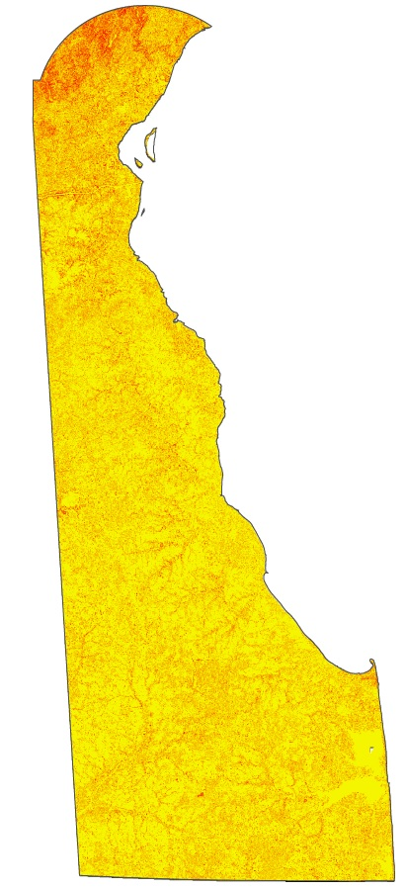
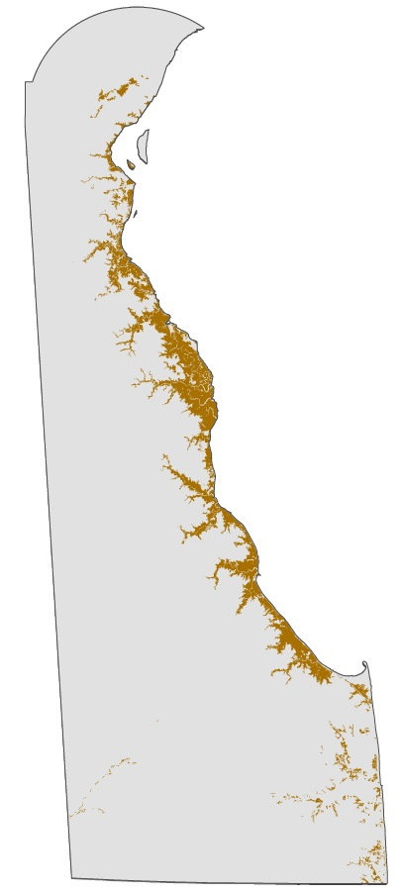
RESULTS – TIDAL MARSH MAPS
Suitability Score
High
Low
N
Cropland
Flowlines
Impervious Surfaces
Slope
Hydric Soils
0
5
10 miles
Notes:
Amanda
The resulting map created in the Suitability Modeler in Arc Pro on the right shows the suitability of land for marsh migration and conservation efforts based on the 5 criteria shown on the left. The unsuitable areas show up as red, the moderately suitable areas are shades of yellow, and the most suitable areas are shown in green.

Slide 16
METHODOLOGY – CLIMATE ANALYSIS
Download data (Terra MODIS and GPM)
Import and Transform in QGIS
Import into GEE
Average Map Creation
Average LST and precipitation 2000-2020
Finalized Difference Maps
Identify and Conclude Variability
Applied Power Regression Trend
Notes:
Eian
Satellite data was obtained from the Terra MODIS and GPM satellites from 2000 to 2020.
Seasonal 5-year averaged data files were transformed in QGIS from a HDF file format to a TIFF format and clipped to the state of Delaware. Then average maps of temperature and precipitation were created from 2000 to 2015 for each season. These were used to create difference maps for each season to compare the average temperature and precipitation from 2000 to 2015 to that of the last 5 years (2015 to 2020). From these maps, was possible for the team to identify changes in climate variables.
Terra MODIS 8-day data was imported into Google Earth Engine to produce average temperature analysis across the entire state of Delaware; charts were produced for 2000 and 2020 as well as an overall 2000 to 2020 graph of temperature variation.

Slide 17
RESULTS – CLIMATE ANALYSIS
GPM Seasonal Average Precipitation Difference (inches/day)
Winter
Spring
Summer
Fall
0.03
-0.04
N
0
10
20 miles
Notes:
McKenna
These are the GPM Seasonal Average Precipitation Difference maps. They show the difference in the average seasonal precipitation between the average for 2000 to 2015 and the average for 2015 to 2020 in units of inches per day. From the results in the maps, we can see that fall has become slightly drier in the northern portion of the state and slightly wetter in the southern portion of the state. Winter and Spring do not see much notable change in precipitation within state boundaries. Summer has the most increase in precipitation, with the largest increase occurring in the northern portion of Delaware.

Slide 18
RESULTS – CLIMATE ANALYSIS
Terra MODIS Seasonal Average Daytime Temperature (Fahrenheit)
Winter
Spring
Summer
Fall
3.15°
-3.15°
N
0
10
20 miles
Notes:
McKenna
These are the Terra MODIS Seasonal Average Daytime Temperature Difference maps. They show the difference in the average seasonal temperature between the average for 2000 to 2015 and the average for 2015 to 2020 in units of degrees Fahrenheit. From the results in the maps, we can see that winter and fall have been warmer in the last 5 years compared to the previous 15 years. Spring and summer are trending slightly cooler than the previous average. It is important to note that climate variability is more accurate and definitive when a longer time period is used. Due to the constraints of this project timeline, only a 20-year time period was able to be analyzed.

Slide 19
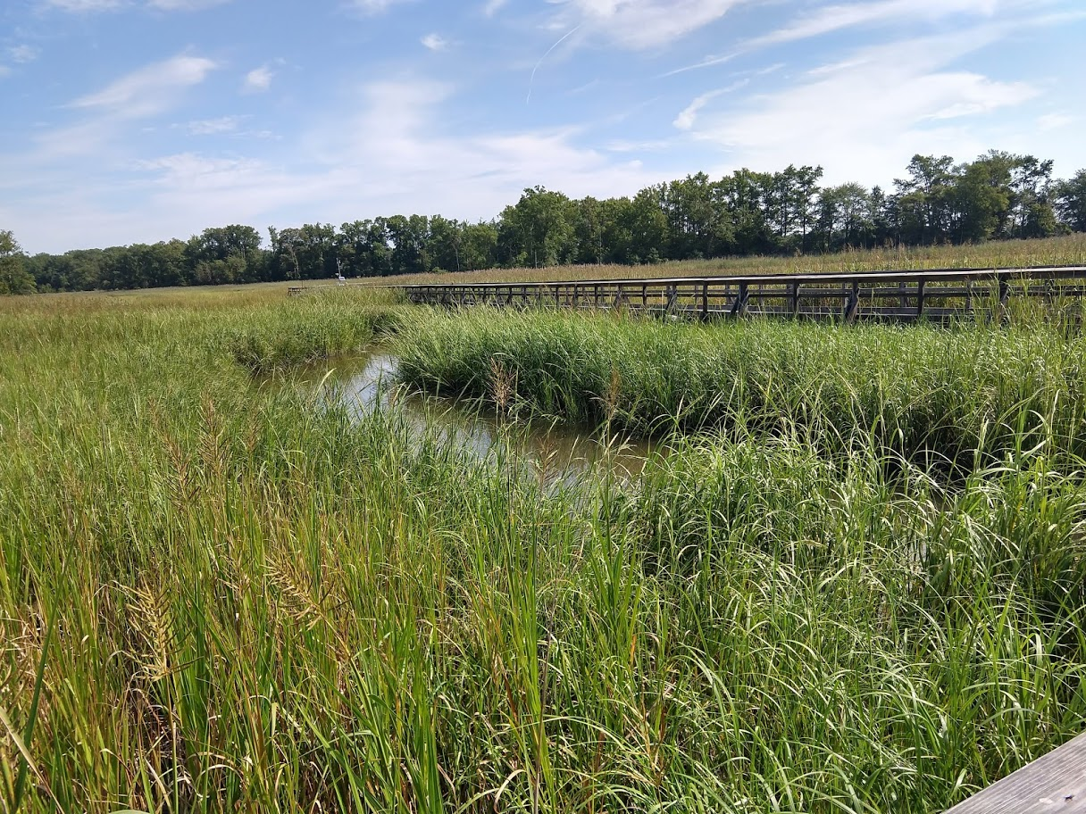
CONCLUSIONS
Winter has the largest temperature difference with an increase of 1.6°F
Summer has the largest precipitation difference with an increase of 0.012 inches per day
2010–2020: Net loss of roughly 1,794 hectares of wetland in Delaware's coastal zone
Potential for major wetland loss over the next 30 years if current trends are not interrupted
Most suitable sites for tidal marsh migration are located near the middle of the Delaware coastline
Delaware Tidal Wetland
Image credit: Dr. Kari St. Laurent
Notes:
Overall, winter has the largest temperature difference with an increase of 1.6 degrees Fahrenheit, and summer has the largest precipitation difference with an increase of 0.012 inches per day. Between 2010 and 2020, there was a net loss of approximately 1,800 hectares of wetland in Delaware’s coastal zone. If current trends are not interrupted, there is potential for major wetland loss over the next 30 years. Most of the suitable sites for tidal marsh migrations are located near the middle of the Delaware coastline.
------------------------------Image Information Below ------------------------------
•Image Credit: Dr. St. Laurent
•Image Source: Provided by Dr. Kari St. Laurent, DNREC
Image License: Written Permission to Use

Slide 20
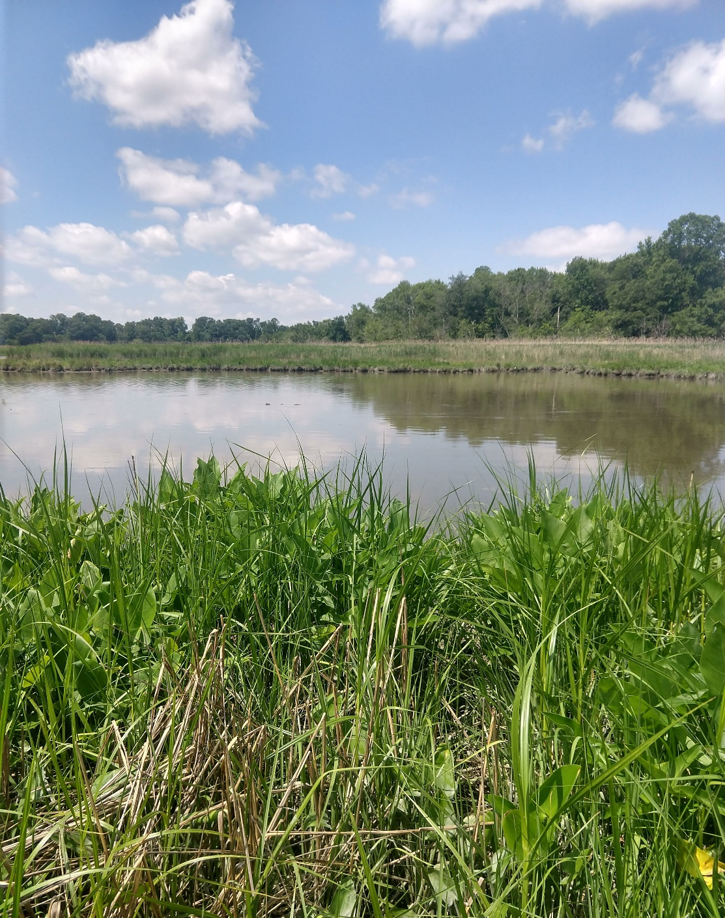
FUTURE WORK
Use of additional variables
Land subsidence, marsh drowning, wind fetch, edge erosion
Analyzing regression relationships
Include endangered species studies along the coast
Salinity studies
Smaller study area
Case studies
Delaware Tidal Wetland
Image credit: Dr. Kari St. Laurent
Notes:
McKenna
Due to the complexities of tidal marsh systems and the factors that impact them, there are several variables affecting marsh migration potential that were not able to be analyzed in this short-term study. These variables include the effects of land subsidence, marsh drowning, wind fetch, and edge erosion on the formation of tidal marsh habitat. In addition, future work on this topic could include analyzing regression relationships between different variables and tidal marsh suitability to aid in the creation of a repeatable model that would predict tidal marsh suitability in specific areas of interest. Future areas of research could also focus on endangered species affected by coastal marsh habitat loss and ways to implement conservation methods, as well as detailed salinity studies to identify and analyze different types of tidal marsh systems. Going forward, our team would suggest choosing a smaller area of interest due to time constraints, processing obstacles, and the possibility of a more detailed analysis of tidal marsh processes.
------------------------------Image Information Below ------------------------------
•Image Credit: Dr. St. Laurent
•Image Source: Provided by Dr. Kari St. Laurent, DNREC
Image License: Written Permission to Use

Slide 21
Advisors:
Dr. Jeffrey Luvall, NASA Marshall Space Flight Center
Dr. Robert Griffin, University of Alabama in Huntsville
A. R. Williams, NASA DEVELOP
Partners:
Dr. Kari St. Laurent, DNREC Division of Climate, Coastal, and Energy
Justin Shawler, DNREC Shoreline and Waterway Program
Alison Rogerson, DNREC Wetland Monitoring and Assessment Program
Notes:
McKenna
The team would like to thank our science advisors, Dr. Jeffrey Luvall and Dr. Robert Griffin, as well as our node fellow, A.R. Williams. The team would also like to thank our partners in this project, Dr. Kari St. Laurent, Justin Shawler, and Alison Rogerson of DNREC for inspiring us to create the best possible end products for them. Thank you.

Slide 22
Supplemental Slides

Slide 23
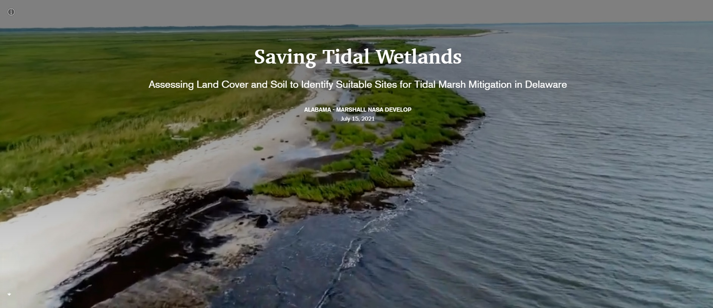
Notes:
AGOL StoryMap

Slide 24
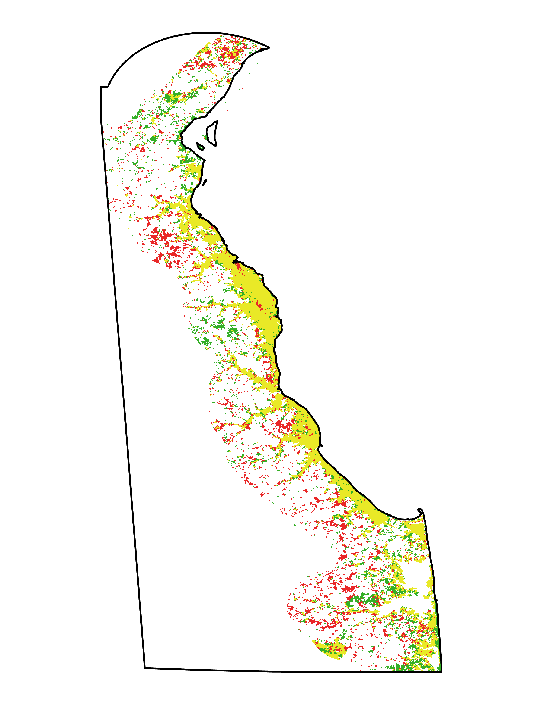
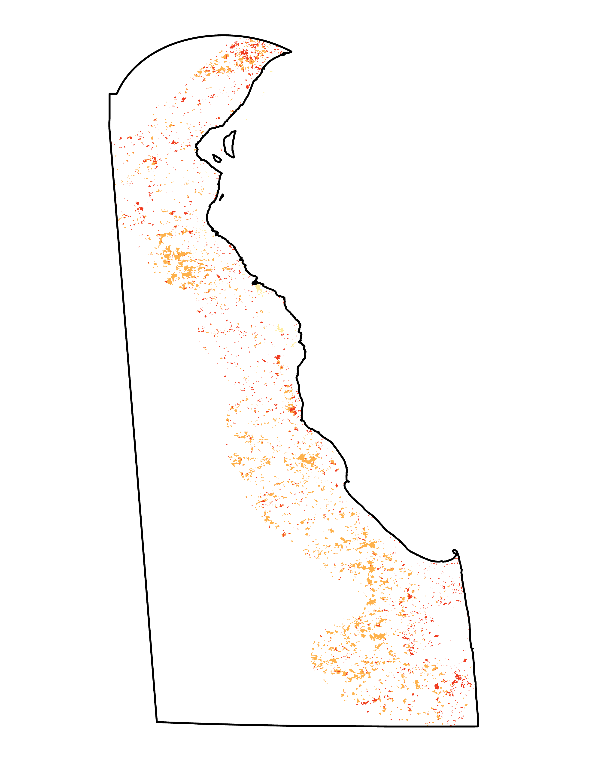
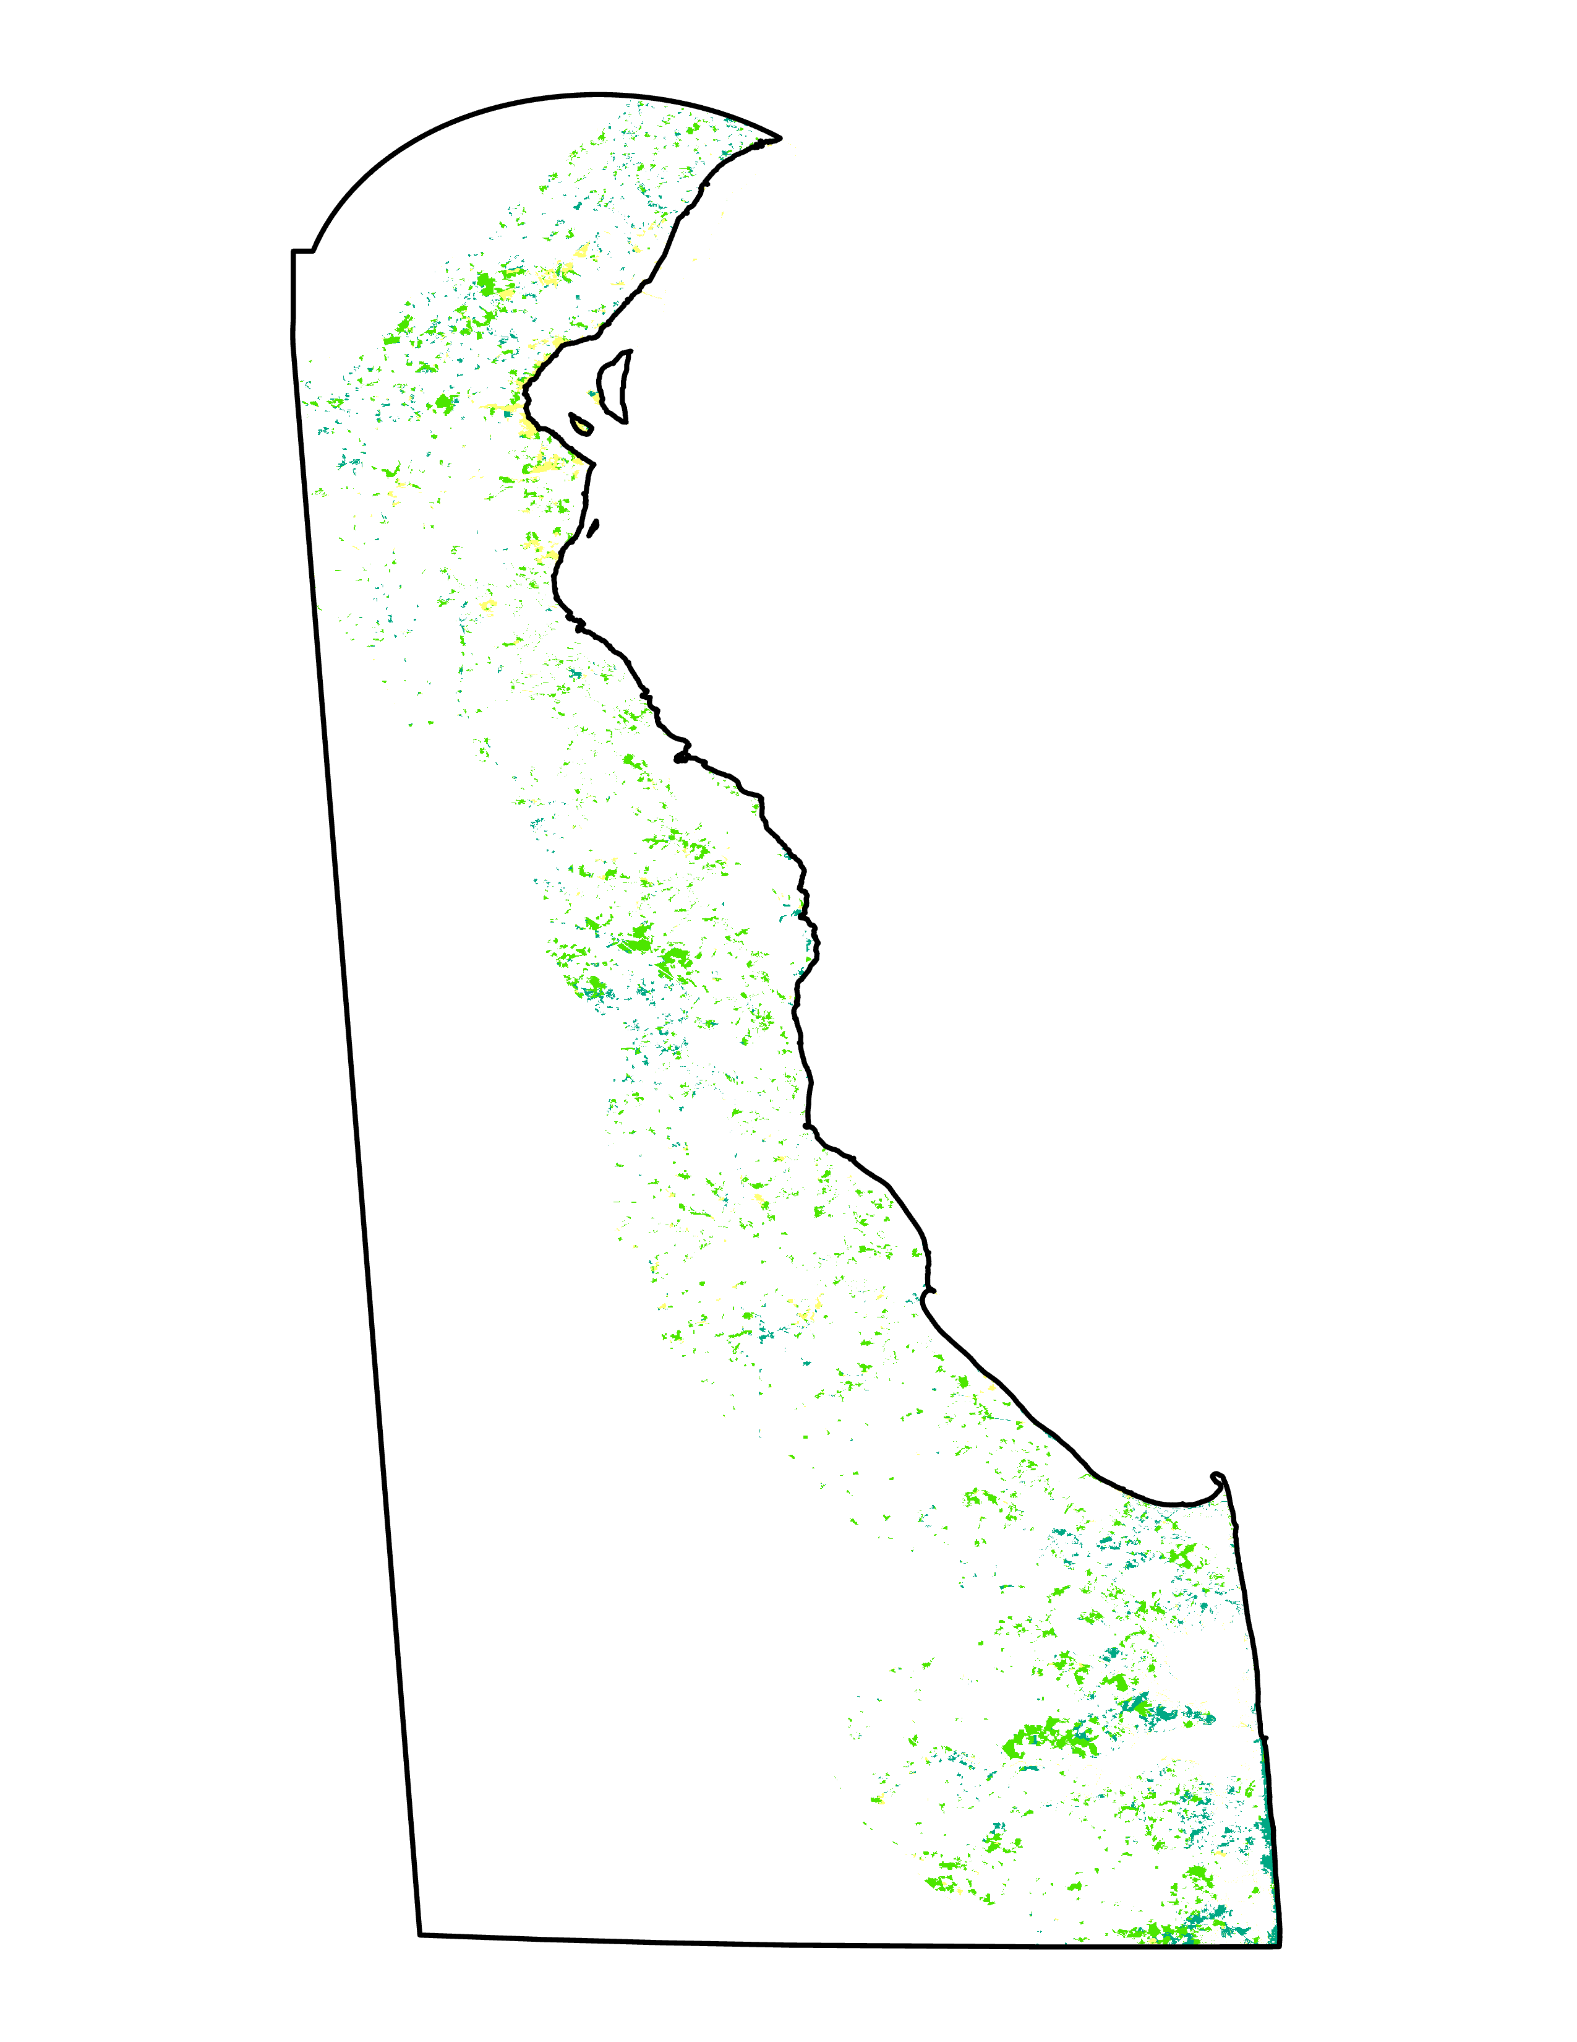
RESULTS – LAND USE LAND COVER CHANGE
Wetland Change 2010-2020
Wetland Loss 2010-2020
Wetland Gain 2010-2020
​Loss
Persistence
Gain
​Wetland to Water
Wetland to Vegetation
Wetland to Developed
​Water to Wetland
Vegetation to Wetland
Developed to Wetland
N
10
Miles
Notes:
Rebecca
The Land Use Land Cover change series, classified from 2010 and 2020 imagery using the Image Classification Wizard in ArcGIS Pro, indicates shifting wetland area across Delaware's coastal region. While there was an overall pattern of wetland loss, this land cover model did indicate some areas of wetland gain and persistence. Between the two study years for this region, a total loss of 1,794.37 hectares of wetland was indicated.
------------------------------Image Information Below ------------------------------
•Image Credit: MSFC DEVELOP Summer 2021
•Image Source: Produced in ArcGIS Pro

Slide 25
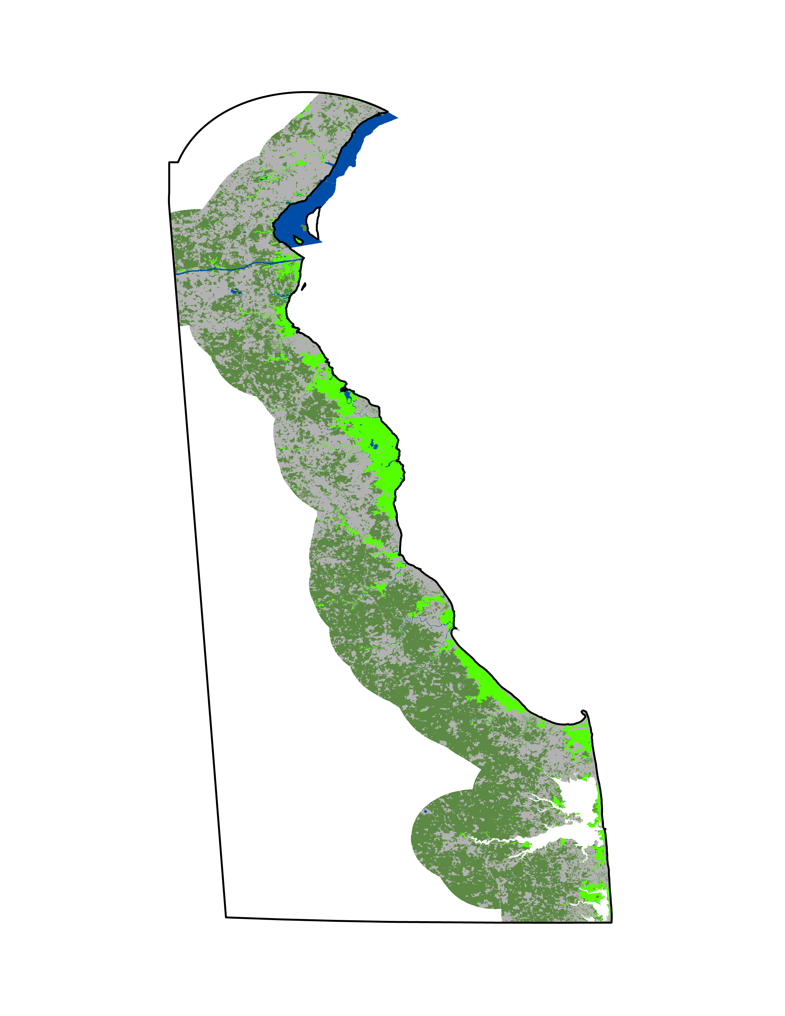
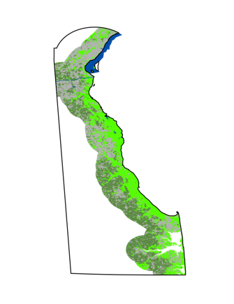
​ Delaware State Boundary​
Land Cover Types​
Water​
Developed​
Non-wetland Vegetation​
Wetlands
RESULTS – FORECASTED MAPS
Land Cover 2020
"Worst Case" 2050
"Best Case" 2050
N
10
Miles
Notes:
Rebecca
Forecasted maps were created for 5 year intervals, using transition potentials that follow current patterns of wetland change as indicated by 2010 to 2020 land cover change. The "worst case" scenario maps are modeled after current drivers of wetland loss, including transformations from wetland to water, developed land, and non-wetland vegetation. These maps show a dramatic loss of wetland area [insert amount] over the next thirty years, if patterns of wetland loss are not interrupted. The "best case" scenario maps follow patterns of wetland gain during the study period, specifically following vegetation to wetland transitions. Developed to wetland and water to wetland were excluded because these transitions were deemed extremely unlikely.
------------------------------Image Information Below ------------------------------
•Image Credit: MSFC DEVELOP Summer 2021
•Image Source: Produced in ArcGIS Pro

Slide 26
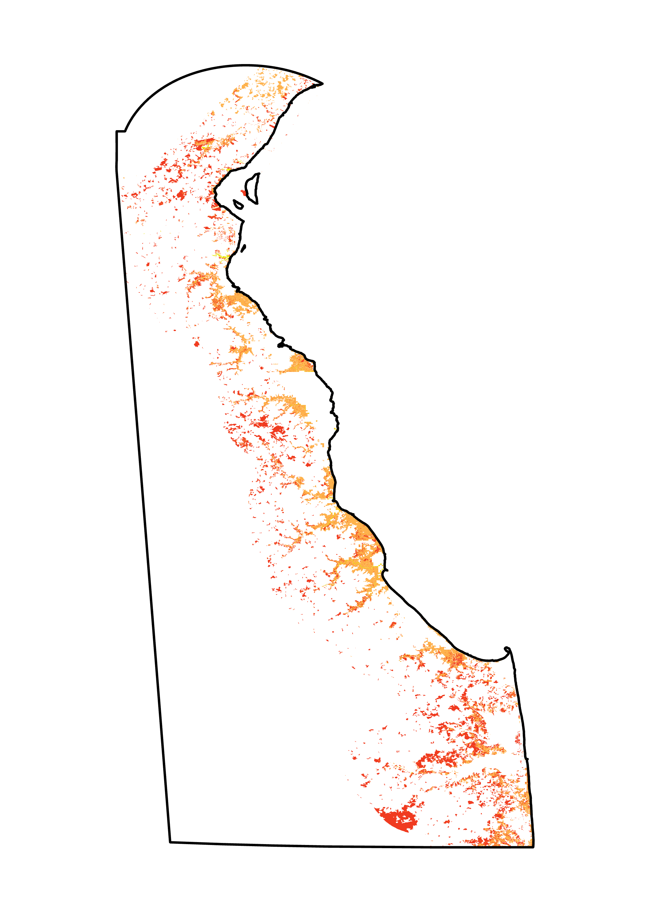
RESULTS – FORECASTED MAPS
Land Cover 2020
"Worst Case" 2050
​ Delaware State Boundary​
Land Cover Types​
Water​
Developed​
Non-wetland Vegetation​
Wetlands
2020-2050 Transitions
Wetland to Water
Wetland to Developed
Wetland to Vegetation
Gains and Losses 2020-2050
N
Wetland
Vegetation
Developed
Water
10
-60 -50 -40 -30 -20 -10 0 10 20
Miles
% change
Wetland Loss... | Area (Hectares)
To Water | 623.67
To Developed | 20,961.79
To Vegetation | 21,285.96
Total | 42,871.42
Notes:
Rebecca
Forecasted maps were created for 5 year intervals, using transition potentials that follow current patterns of wetland change as indicated by 2010 to 2020 land cover change. The "worst case" scenario maps are modeled after current drivers of wetland loss, including transformations from wetland to water, developed land, and non-wetland vegetation. These maps show a dramatic loss of wetland area [insert amount] over the next thirty years, if patterns of wetland loss are not interrupted. The "best case" scenario maps follow patterns of wetland gain during the study period, specifically following vegetation to wetland transitions. Developed to wetland and water to wetland were excluded because these transitions were deemed extremely unlikely.
------------------------------Image Information Below ------------------------------
•Image Credit: MSFC DEVELOP Summer 2021
•Image Source: Produced in ArcGIS Pro

Slide 27
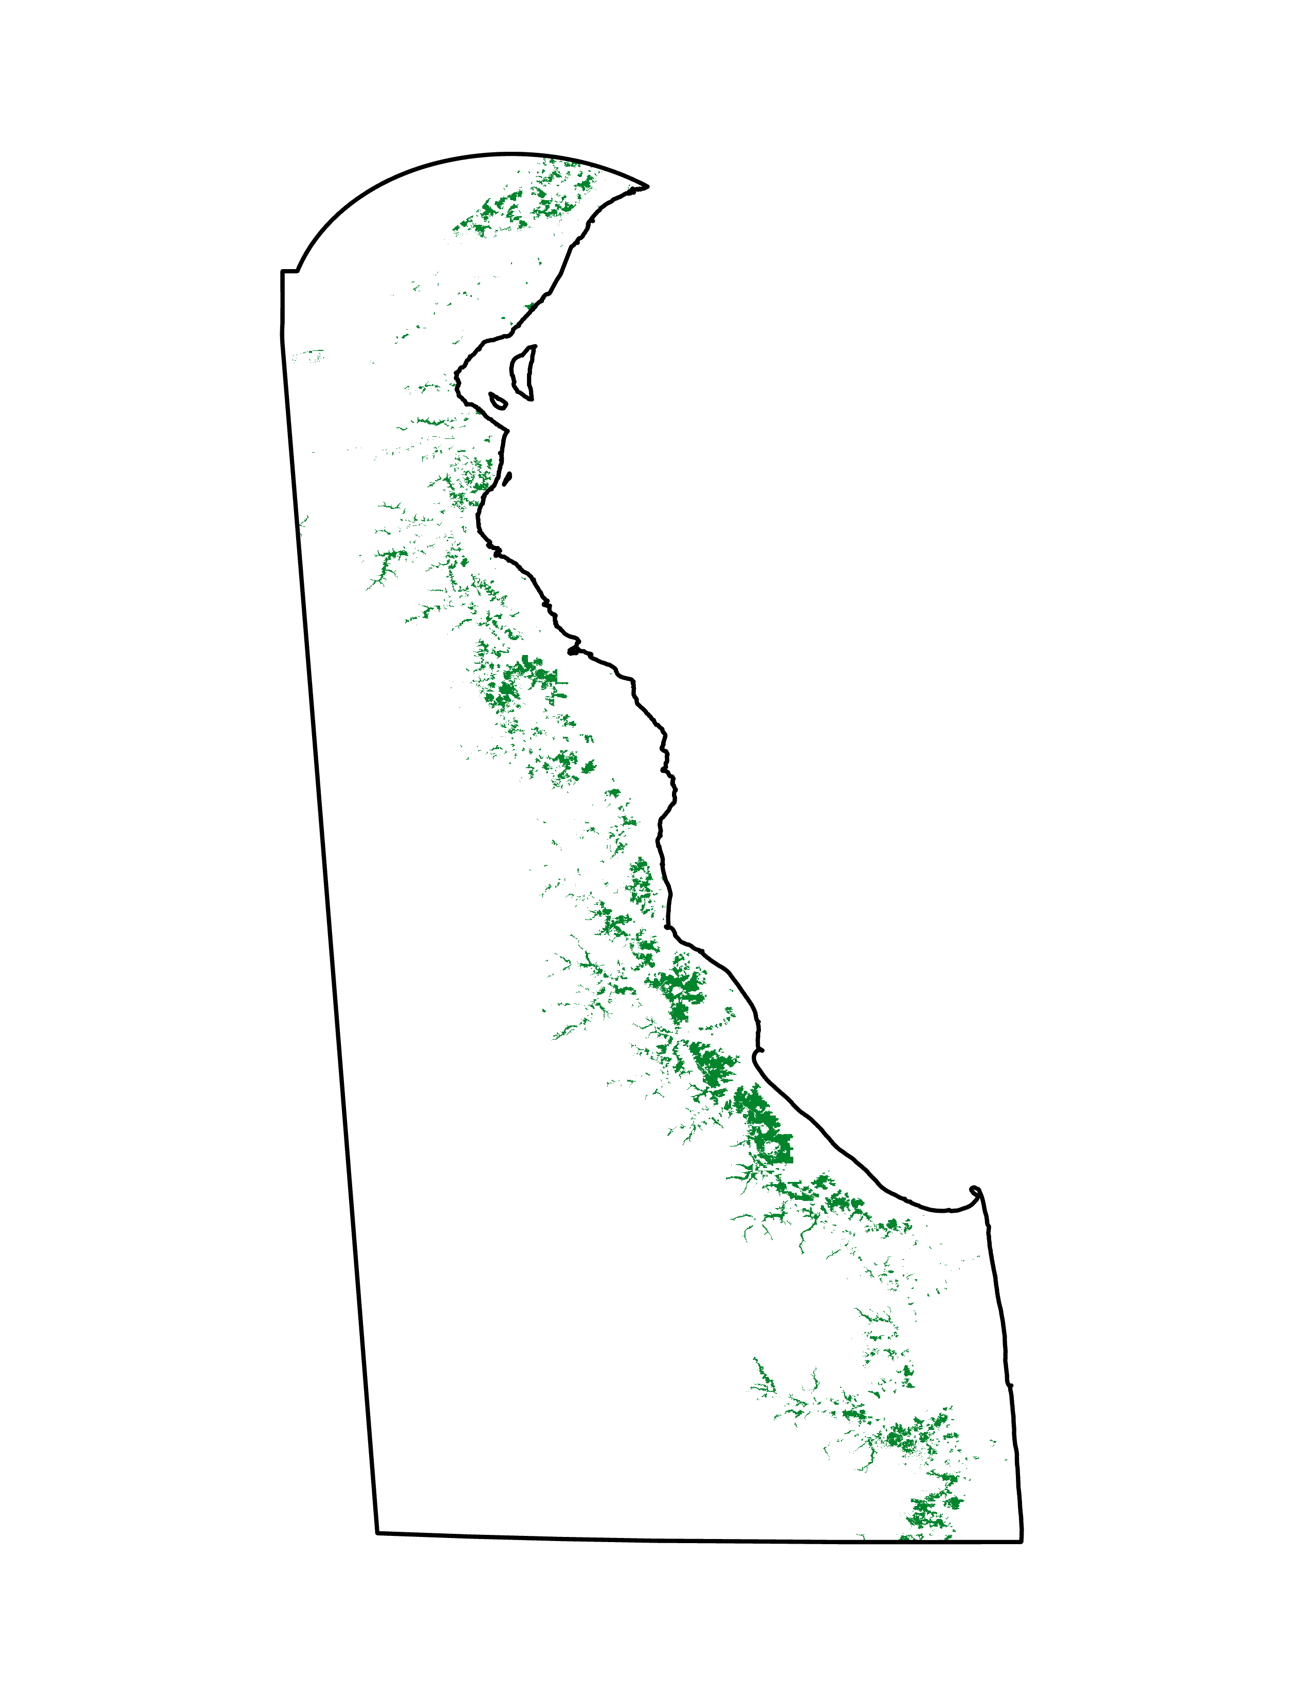
RESULTS – FORECASTED MAPS
Land Cover 2020
"Best Case" 2050
​ Delaware State Boundary​
Land Cover Types​
Water​
Developed​
Non-wetland Vegetation​
Wetlands
2020-2050 Transitions
Vegetation to Wetland
N
Gains and Losses 2020-2050
Wetland
Vegetation
-18 -12 -6 0 6 12 18 24
10
% change
Miles
Wetland Gain... | Area (Hectares)
To Vegetation | 19,933.06
Notes:
Rebecca
Forecasted maps were created for 5 year intervals, using transition potentials that follow current patterns of wetland change as indicated by 2010 to 2020 land cover change. The "worst case" scenario maps are modeled after current drivers of wetland loss, including transformations from wetland to water, developed land, and non-wetland vegetation. These maps show a dramatic loss of wetland area [insert amount] over the next thirty years, if patterns of wetland loss are not interrupted. The "best case" scenario maps follow patterns of wetland gain during the study period, specifically following vegetation to wetland transitions. Developed to wetland and water to wetland were excluded because these transitions were deemed extremely unlikely.
------------------------------Image Information Below ------------------------------
•Image Credit: MSFC DEVELOP Summer 2021
•Image Source: Produced in ArcGIS Pro

Slide 28
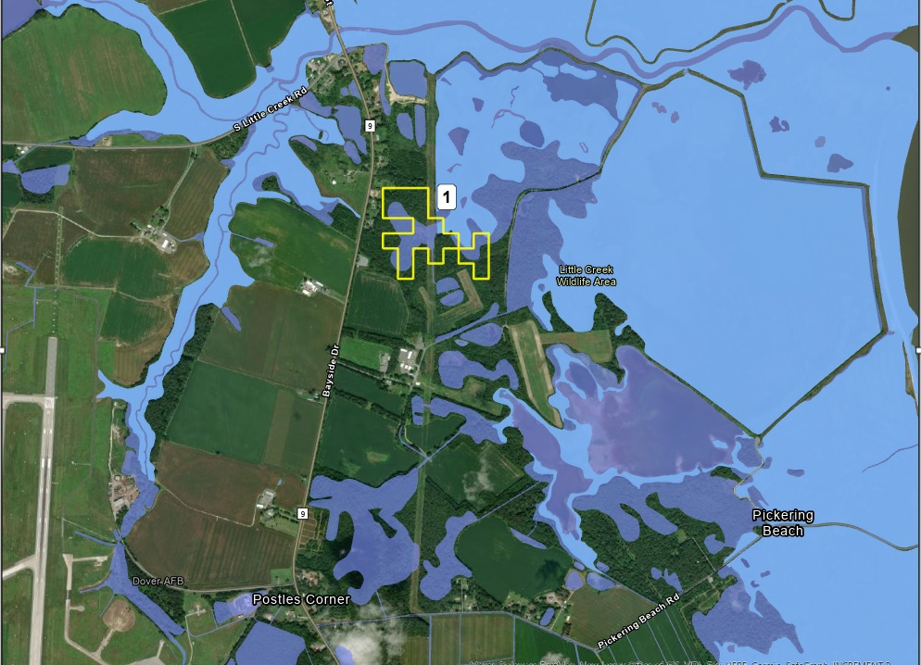
RESULTS – TIDAL MARSH MAPS
Ranking | Avg. Suitability | Acreage
1 | 4.99 | 49
Suitable Locations
N
Estuarine Wetlands
Freshwater Wetlands
Notes:
Amanda
Here I have added the top 5 most suitable locations that both border tidal wetlands and have existing freshwater wetlands on the land. This is the plot of land with the highest suitability rating located near the Little Creek Wildlife Area and Pickering Beach. I ran into difficulty with the Locate Regions tool when asking it to identify land between 1 and 5 acres so the acreage of land is larger than desired. This is something that may be able to be fixed in the future with troubleshooting within the tool or writing code specifically for this issue.

Slide 29
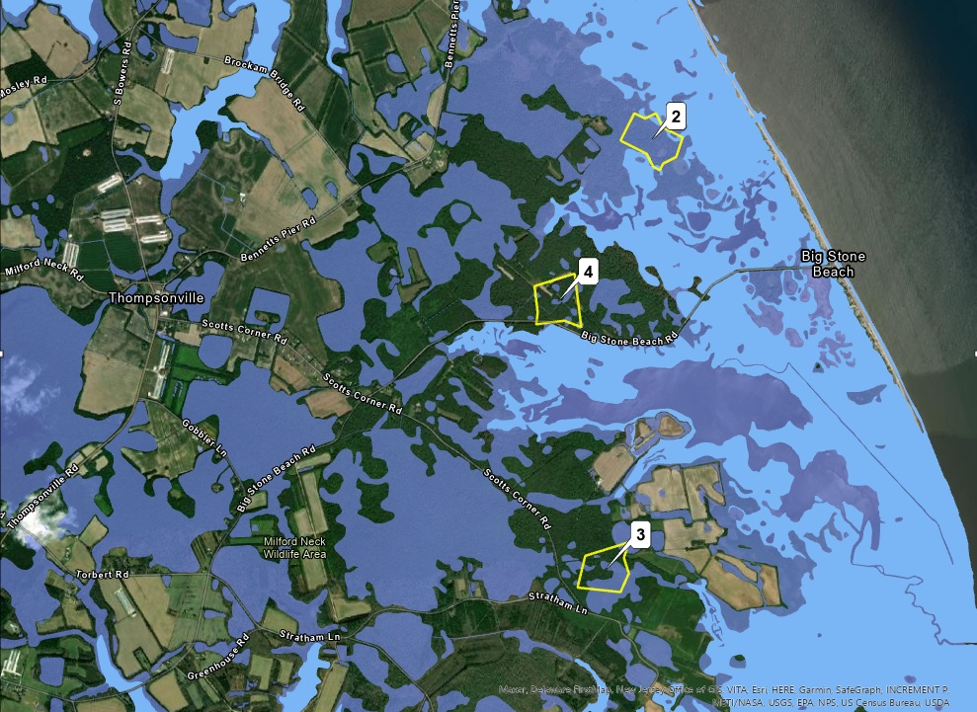
RESULTS – TIDAL MARSH MAPS
Ranking | Avg. Suitability | Acreage
2 | 4.93 | 48
3 | 4.90 | 45
4 | 4.89 | 46
Suitable Locations
N
Estuarine Wetlands
Freshwater Wetlands
Notes:
This map shows land ranked 2-4 located near Big Stone Beach and the city of Thompsonville. All land has existing freshwater wetlands present and is bordering tidal wetlands, allowing for the natural process of marsh migration.

Slide 30
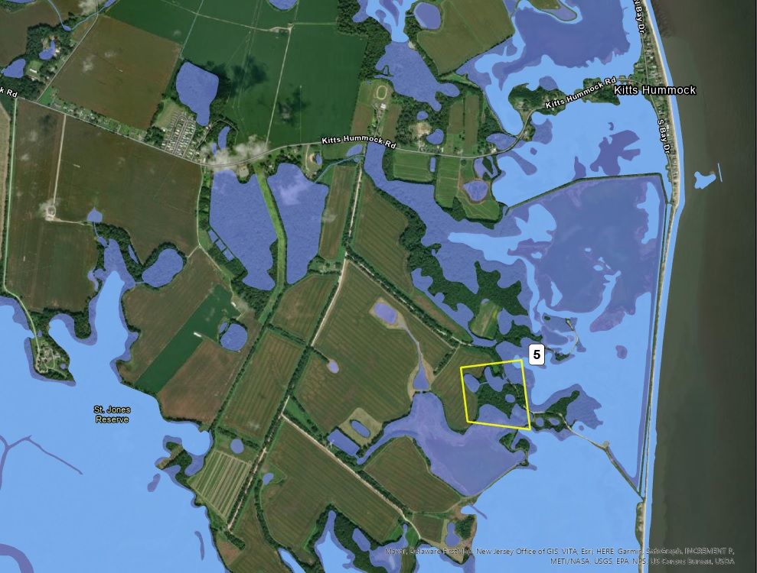
RESULTS – TIDAL MARSH MAPS
Ranking | Avg. Suitability | Acreage
5 | 4.88 | 44
Suitable Locations
Estuarine Wetlands
N
Freshwater Wetlands
Notes:
This map shows the 5th most suitable area of land located near St. Jones Reserve and the community of Kitts Hummock

Slide 31
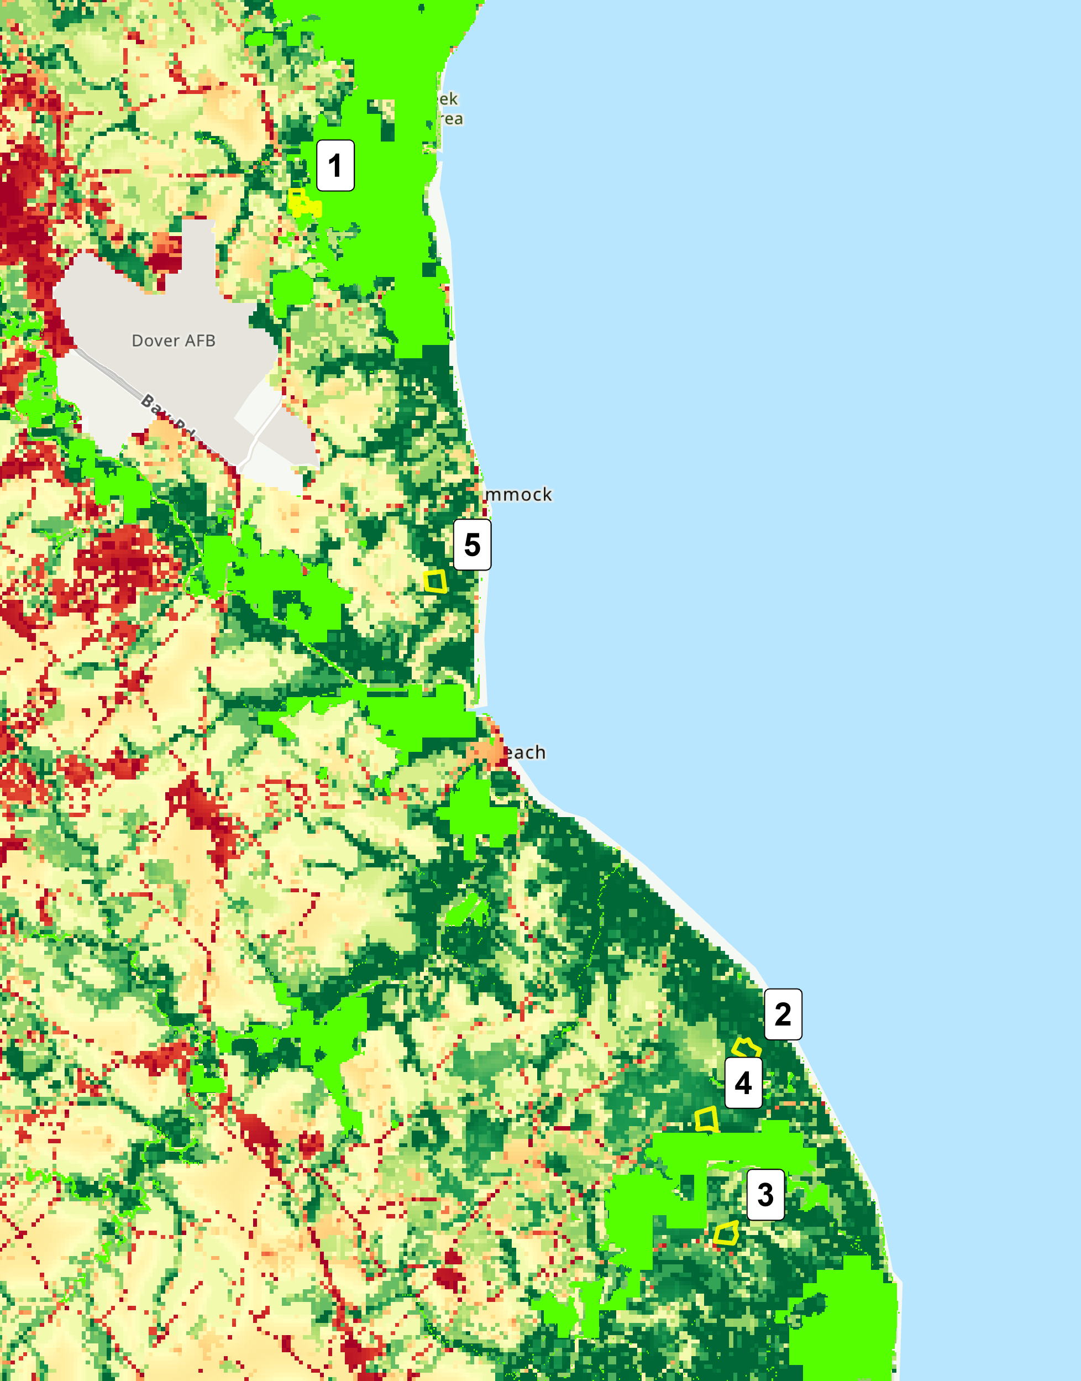
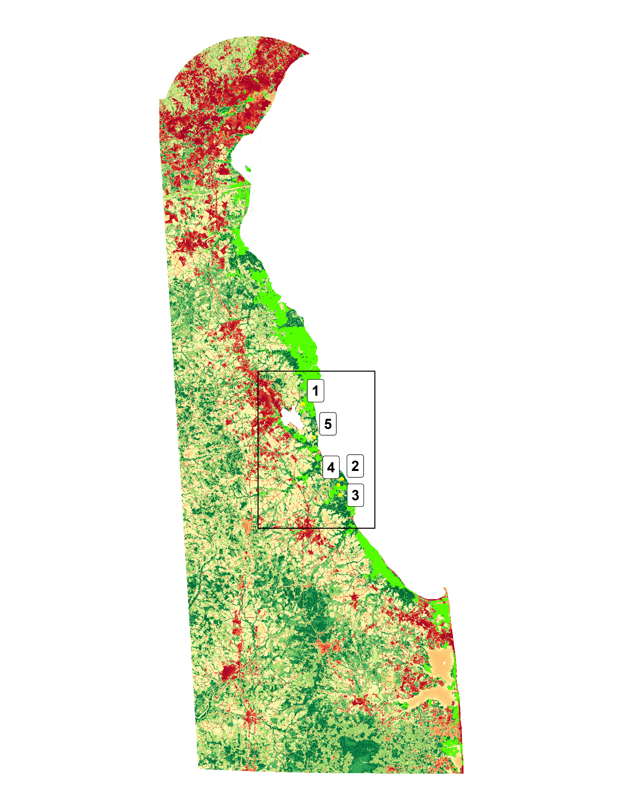
RESULTS – TIDAL MARSH MAPS
Tidal marsh suitability overlaid with projected 2050 wetland area, as forecasted by wetland loss model
Indicates areas of long-term restoration/preservation success
Projected Wetland, 2050
N
Suitable Locations
High Wetland Suitability
Low Wetland Suitability
5
Miles

Slide 32
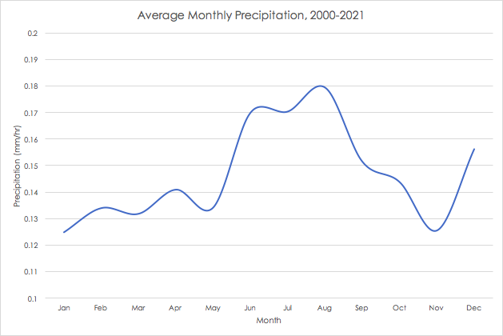
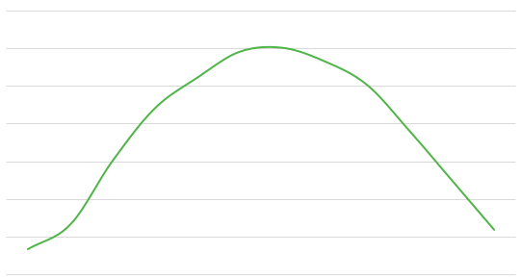
RESULTS – CLIMATE ANALYSIS
Average Monthly Precipitation, 2000-2020
Average Monthly LST, 2000-2020
0.2
0.19
0.18
0.17
0.16
0.15
0.14
0.13
0.12
0.11
0.1
35
30
25
20
15
10
5
0
Precipitation (mm/hr)
Temperature (Celsius)
Jan Feb Mar Apr May Jun Jul Aug Sep Oct Nov Dec
Jan Feb Mar Apr May Jun Jul Aug Sep Oct Nov Dec
Month
Month
Notes:
Monthly average: Average monthly temperature across the State of Delaware between 2000 and 2020 remained relatively stable, maintaining a specific pattern with little variation. These graphs represent the average precipitation and temperature for each month across the entire study period.

Slide 33
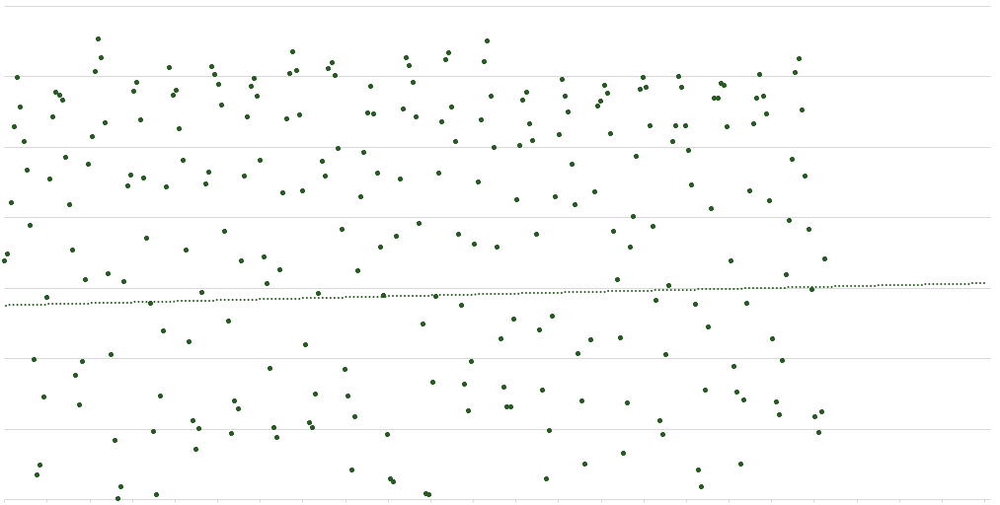
RESULTS – CLIMATE ANALYSIS
LST Monthly Average Temperature Trend, 2000-2025
35
30
25
20
15
10
5
0
Land Surface Temperature (Celsius)
y = 0.0901x^{0.4788} ^{R² = 0.00079}
2000 2001 2002 2003 2004 2005 2006 2007 2008 2009 2011 2012 2013 2014 2015 2016 2017 2018 2019 2020 2021 2023 2024 2025
Year
Notes:
*NOTE* Regression trends and forecasting do not provide high accuracy on non-linear data. These trends are to be used as an informative guide to general climate trends and are subject to change in the future.

Slide 34
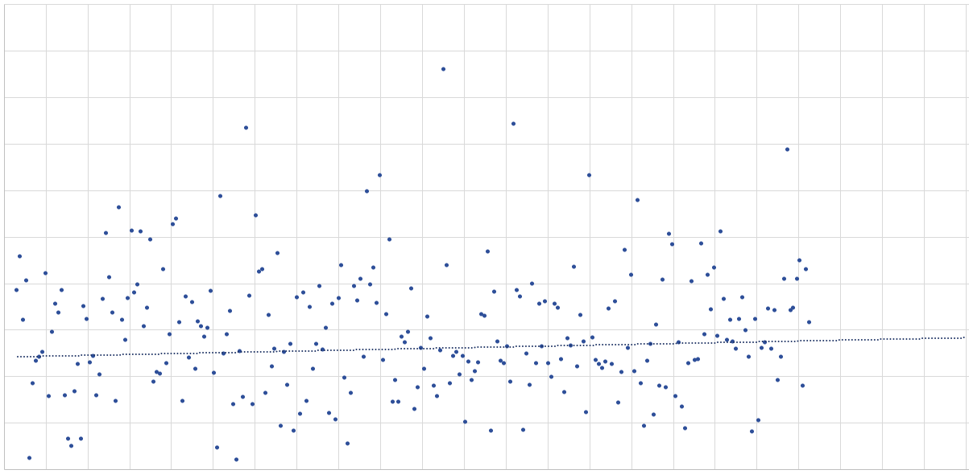
RESULTS – CLIMATE ANALYSIS
0.5
0.45
0.4
0.35
0.3
0.25
0.2
0.15
0.1
0.05
0
GPM Monthly Average Precipitation Trend, 2000-2025
Precipitation (mm/hr)
^{y = 7E-05x0.7062} ^{R² = 0.00498}
2000 2001 2002 2003 2004 2005 2006 2007 2008 2009 2011 2012 2013 2014 2015 2016 2017 2018 2019 2020 2021 2023 2024 2025
Year
Notes:
*NOTE* Regression trends and forecasting do not provide high accuracy on non-linear data. These trends are to be used as an informative guide to general climate trends and are subject to change in the future.

Slide 35
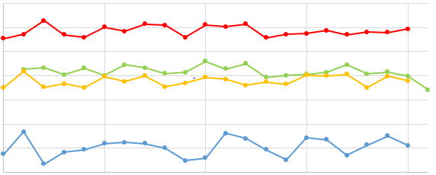
RESULTS – CLIMATE ANALYSIS
Seasonal Average LST, 2000-2020
35
30
25
20
Temperature (Celsius)
15
10
5
0
2000 2005 2010 2015 2020
Year
Spring
Summer
Fall
Winter
Notes:
Seasons:
Spring-March, April, May
Summer-June, July, August
Fall-September, October, November
Winter- December, January, February (all winter seasons were recorded as the year that the first month – December – fell under. Example: December 2000, January 2001, February 2001 season recorded as Winter 2000).
Average monthly temperature across the State of Delaware between 2000 and 2020 remained relatively stable, maintaining a specific pattern with little variation. Visualization of average seasonal temperature versus average monthly temperature revealed slight fluctuations throughout the time interval, with Winter showing the greatest variation.
*NOTE* Spring and Winter data for LST year 2000 were not included in the dataset, however, Spring 2021 was available. All seasonal graphs made in Microsoft Excel using exported climate data.

Slide 36
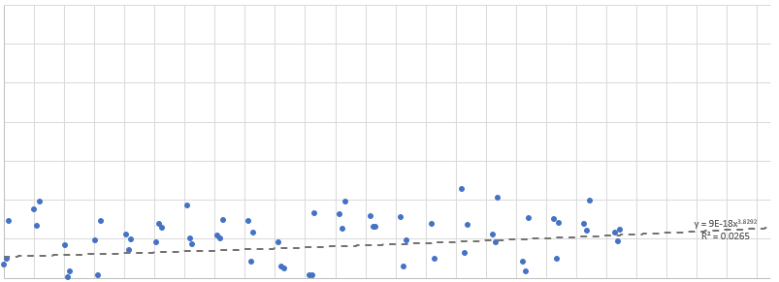
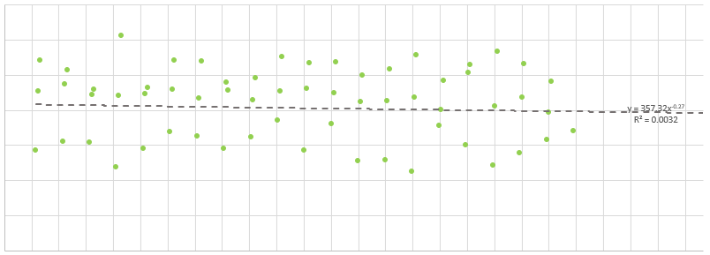
RESULTS – CLIMATE ANALYSIS
LST Seasonal Average Temperature Trend, 2000-2025
35
30
25
20
Temperature
(Celsius)
15
10
5
0
2000 2002 2004 2006 2008 2010 2012 2014 2016 2018 2020 2022 2024
35
30
25
20
Temperature
(Celsius)
15
10
5
0
2000 2002 2004 2006 2008 2010 2012 2014 2016 2018 2020 2022 2024
Year
Winter
Spring
Notes:
*NOTE* Regression trends and forecasting do not provide high accuracy on non-linear data. These trends are to be used as an informative guide to general climate trends and are subject to change in the future. Spring and Winter data for LST year 2000 were not included in the dataset, however, Spring 2021 was available. One outlier (-1.736 Celsius) was removed from the Winter dataset (date: February 1, 2015). Outlier was removed because the linear trend cannot compute negative integers.
Seasons:
Spring-March, April, May
Summer-June, July, August
Fall-September, October, November
Winter- December, January, February (all winter seasons were recorded as the year that the first month – December – fell under. Example: December 2000, January 2001, February 2001 season recorded as Winter 2000).
Temperature – Spring, Summer, and Fall all have a relatively consistent temperature range with Winter having the highest variation from year to year. This could be due to the spatial relation to the coast which aids in stabilizing temperature shifts year-round.
Spring and Fall have a similar variation pattern across the time interval.
Summer is the most consistent. All temperatures fall within a relatively small range of degrees with a flat trendline indicate no significant change detected.
Fall has the highest variation among the months per year.
Winter shows a more linear path than Spring and Fall but isn’t as consistent as Summer However, this season shows the greatest rate of change in trend with an increasing pattern noted by the trend line.

Slide 37
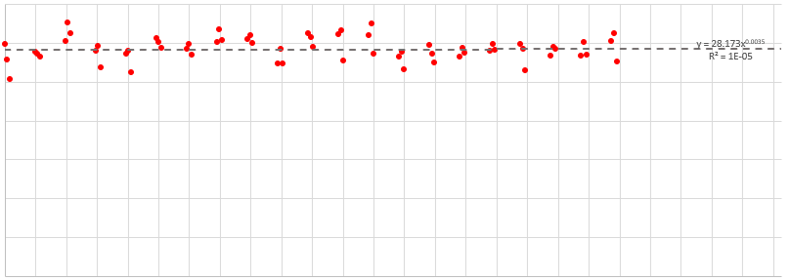
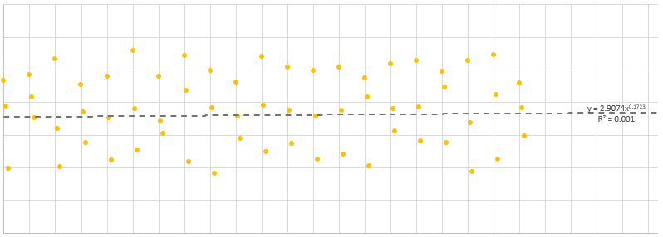
RESULTS – CLIMATE ANALYSIS
LST Seasonal Average Temperature Trend, 2000-2025
35
30
25
20
Temperature
(Celsius)
15
10
5
0
2000 2002 2004 2006 2008 2010 2012 2014 2016 2018 2020 2022 2024
35
30
25
20
Temperature
(Celsius)
15
10
5
0
2000 2002 2004 2006 2008 2010 2012 2014 2016 2018 2020 2022 2024
Year
Summer
Fall
Notes:
*NOTE* Regression trends and forecasting do not provide high accuracy on non-linear data. These trends are to be used as an informative guide to general climate trends and are subject to change in the future. Spring and Winter data for LST year 2000 were not included in the dataset, however, Spring 2021 was available.
Seasons:
Spring-March, April, May
Summer-June, July, August
Fall-September, October, November
Winter- December, January, February (all winter seasons were recorded as the year that the first month – December – fell under. Example: December 2000, January 2001, February 2001 season recorded as Winter 2000).
Temperature – Spring, Summer, and Fall all have a relatively consistent temperature range with Winter having the highest variation from year to year. This could be due to the spatial relation to the coast which aids in stabilizing temperature shifts year-round.
Spring and Fall have a similar variation pattern across the time interval.
Summer is the most consistent. All temperatures fall within a relatively small range of degrees with a flat trendline indicate no significant change detected.
Fall has the highest variation among the months per year.
Winter shows a more linear path than Spring and Fall but isn’t as consistent as Summer However, this season shows the greatest rate of change in trend with an increasing pattern noted by the trend line.

Slide 38
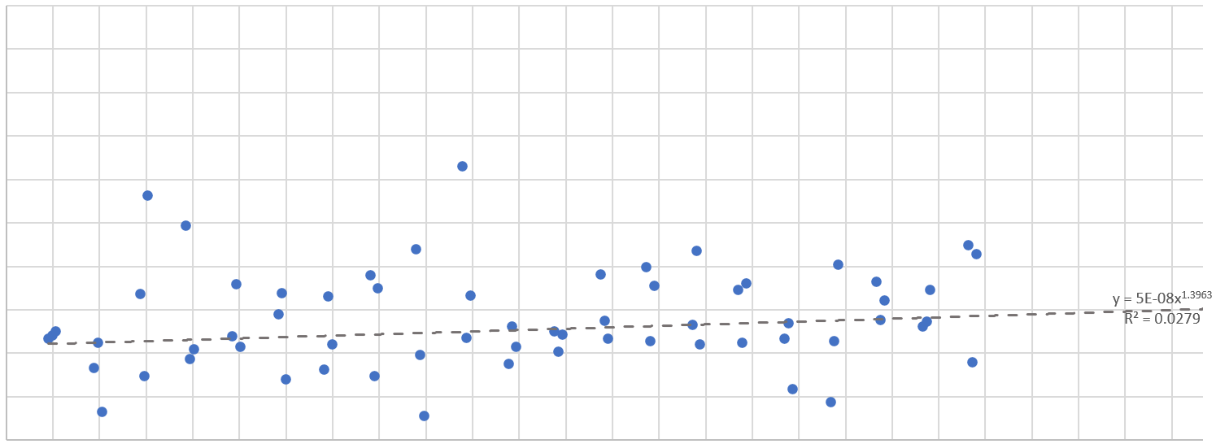
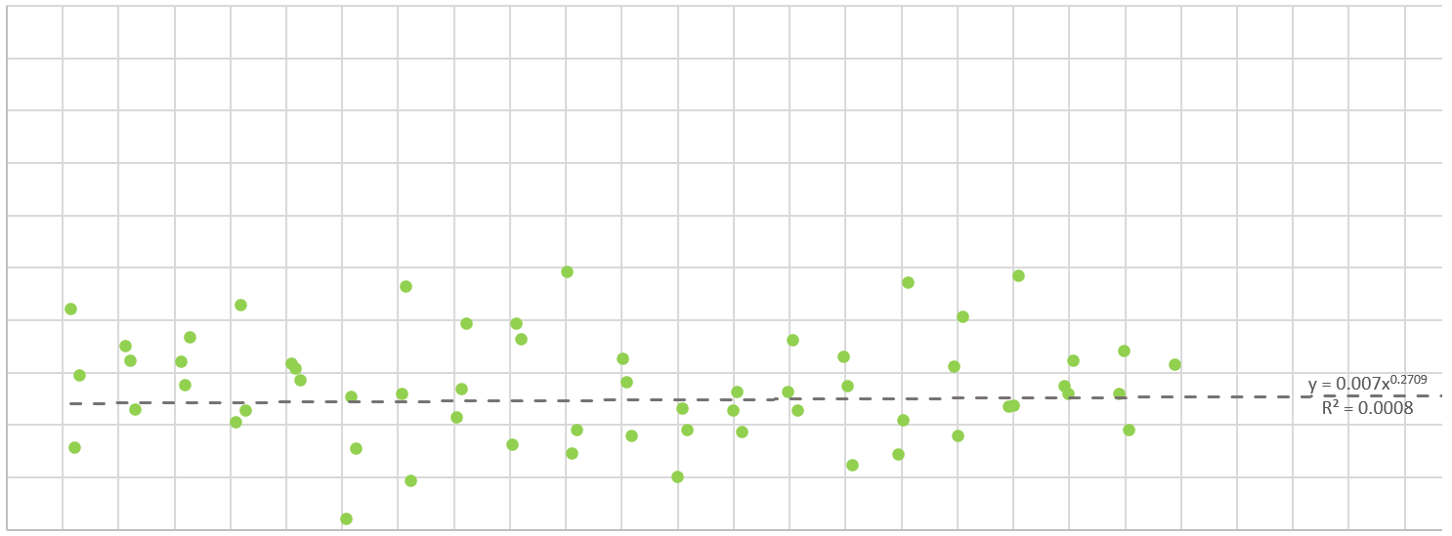
RESULTS – CLIMATE ANALYSIS
GPM Seasonal Average Precipitation Trend, 2000-2025
0.5
0.45
0.4
0.35
0.3
Precipitation (mm/hour)
0.25
0.2
0.15
0.1
0.05
0.0
2000 2002 2004 2006 2008 2010 2012 2014 2016 2018 2020 2022 2024
0.5
0.45
0.4
0.35
0.3
Precipitation (mm/hour)
0.25
0.2
0.15
0.1
0.05
0.0
2000 2002 2004 2006 2008 2010 2012 2014 2016 2018 2020 2022 2024
Year
Winter
Spring
Notes:
*NOTE* Regression trends and forecasting do not provide high accuracy on non-linear data. These trends are to be used as an informative guide to general climate trends and are subject to change in the future. Spring and Winter data for GPM year 2000 were not included in the dataset, however, Spring and Winter 2021 was available.
Seasons:
Spring-March, April, May
Summer-June, July, August
Fall-September, October, November
Winter- December, January, February (all winter seasons were recorded as the year that the first month – December – fell under. Example: December 2000, January 2001, February 2001 season recorded as Winter 2000).
Precipitation – All seasons show variation in data. Spring has a stable, flat trend with a very low increasing pattern. Summer displays a subtle decrease in rain patterns while Fall and Winter show an increasing trend.

Slide 39
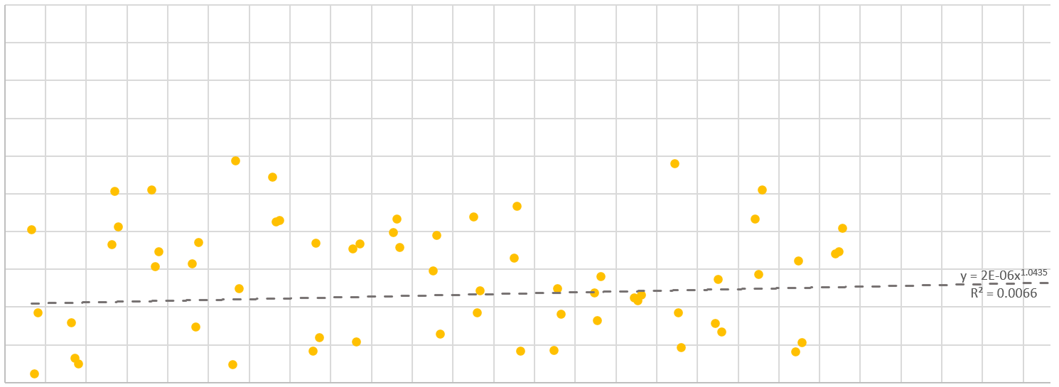
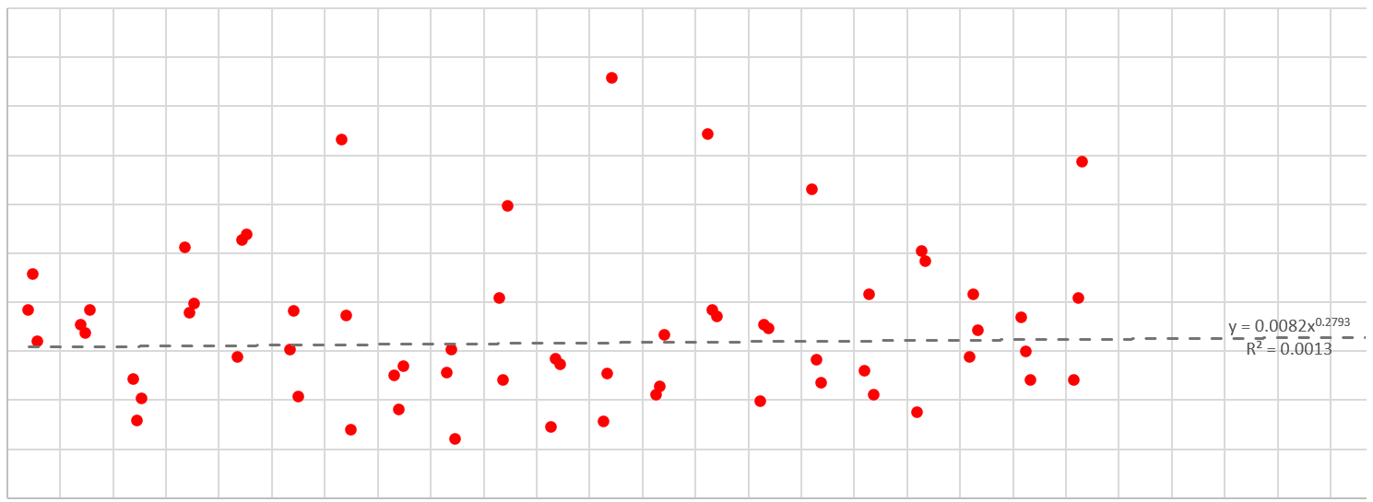
RESULTS – CLIMATE ANALYSIS
GPM Seasonal Average Precipitation Trend, 2000-2025
0.5
0.45
0.4
0.35
0.3
Precipitation (mm/hour)
0.25
0.2
0.15
0.1
0.05
0.0
2000 2002 2004 2006 2008 2010 2012 2014 2016 2018 2020 2022 2024
0.5
0.45
0.4
0.35
0.3
Precipitation (mm/hour)
0.25
0.2
0.15
0.1
0.05
0.0
2000 2002 2004 2006 2008 2010 2012 2014 2016 2018 2020 2022 2024
Year
Summer
Fall
Notes:
*NOTE* Regression trends and forecasting do not provide high accuracy on non-linear data. These trends are to be used as an informative guide to general climate trends and are subject to change in the future. Spring and Winter data for GPM year 2000 were not included in the dataset, however, Spring and Winter 2021 was available.
Seasons:
Spring-March, April, May
Summer-June, July, August
Fall-September, October, November
Winter- December, January, February (all winter seasons were recorded as the year that the first month – December – fell under. Example: December 2000, January 2001, February 2001 season recorded as Winter 2000).
Precipitation – All seasons show variation in data. Spring has a stable, flat trend with a very low increasing pattern. Summer displays a subtle decrease in rain patterns while Fall and Winter show an increasing trend.

