Slide 1
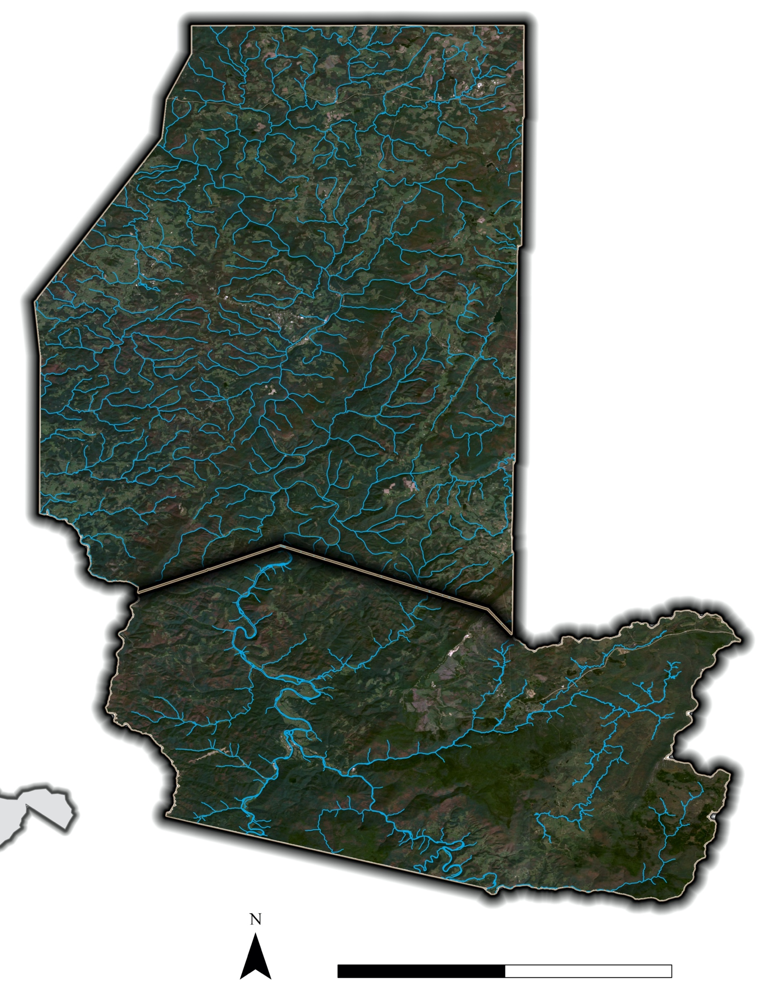
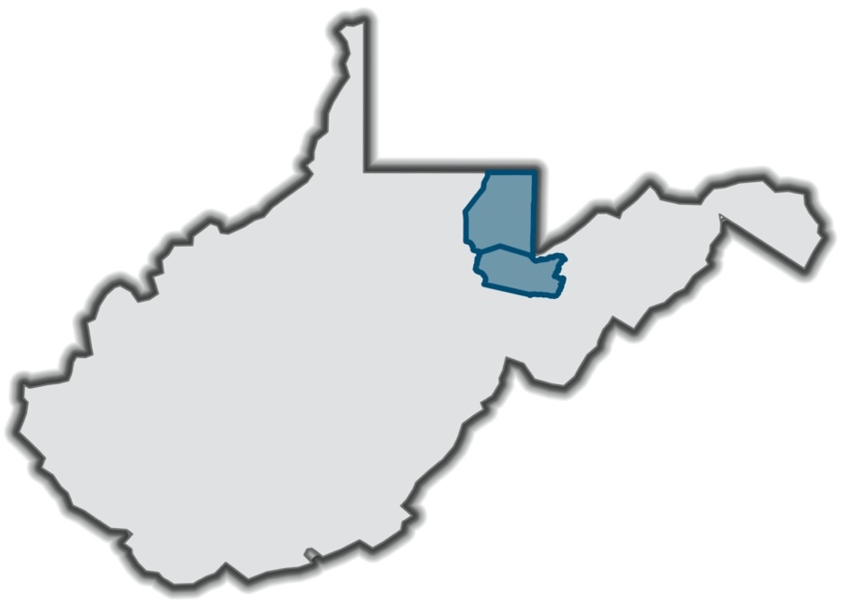
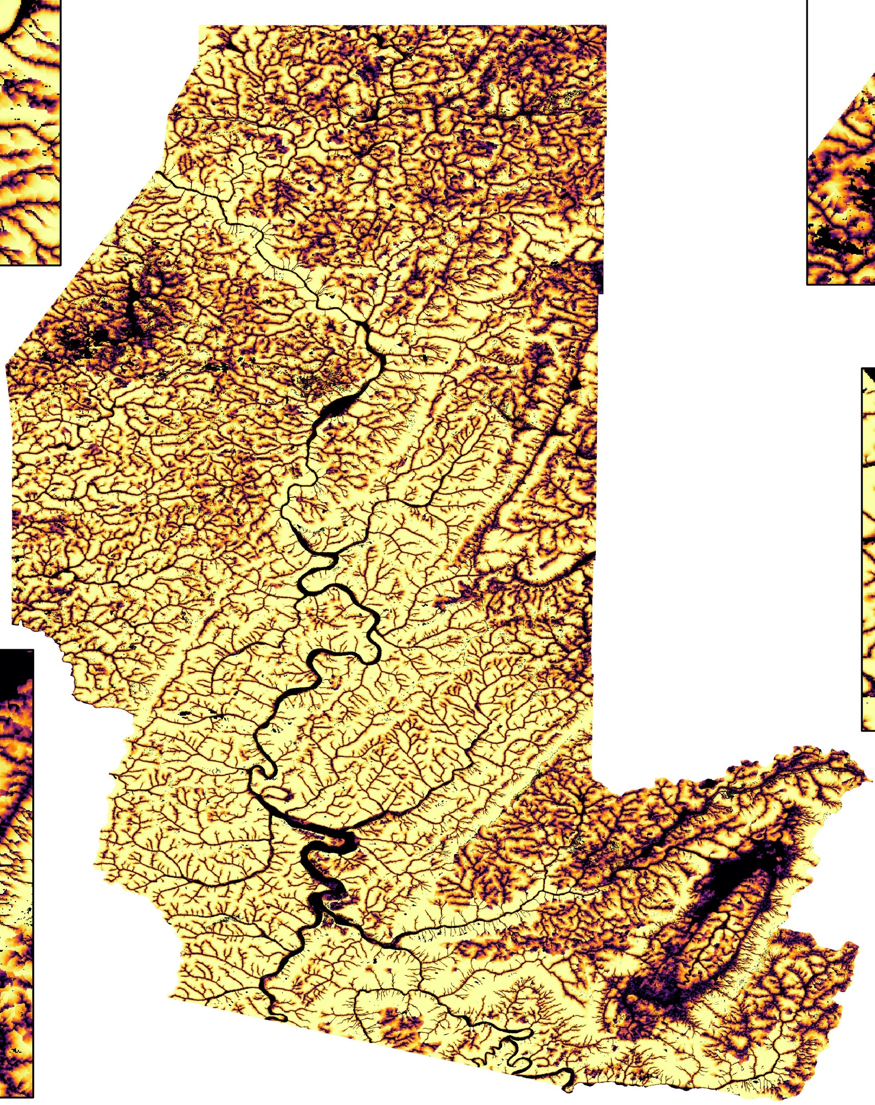
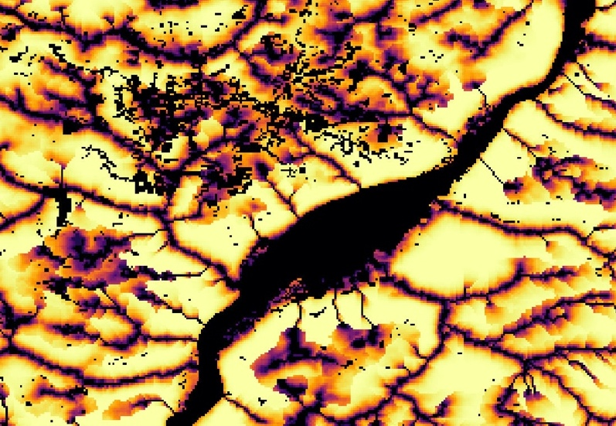
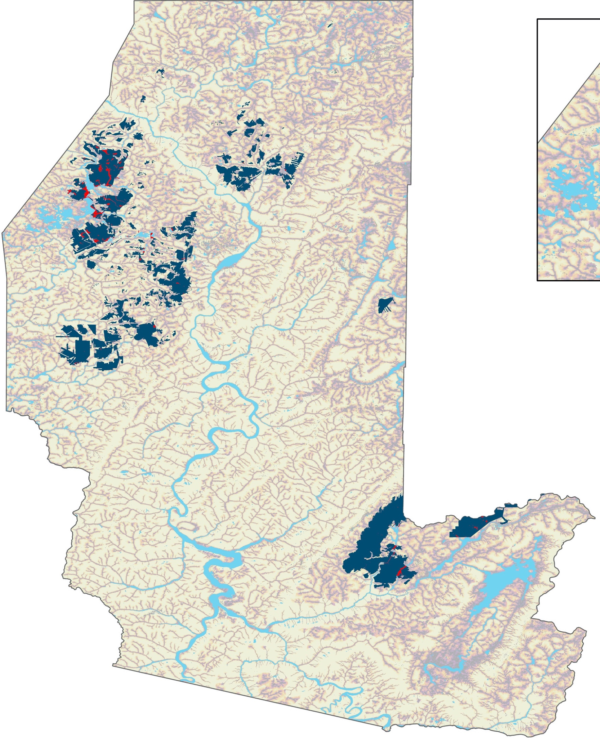
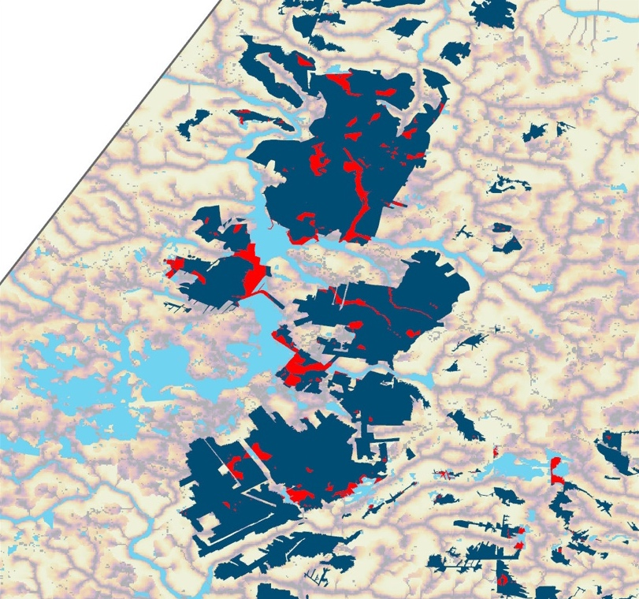
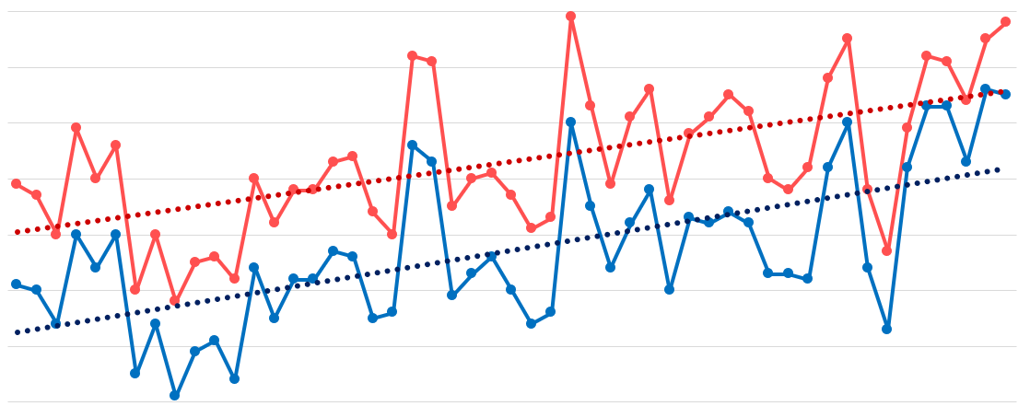
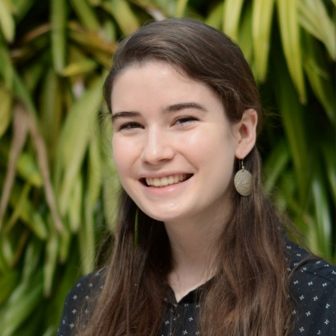
Assessing Climatology and Land Cover Trends and Evaluating Flood Risk of the Cheat River
Abstract
Project Partners
Study Area
Cheat Water Resources
The Cheat River, primarily located in northeast West Virginia, experiences major flooding events that negatively impact nearby communities. Poor water quality due to acid mine drainage and excess sediment loads during flood events threaten the health of communities and numerous animal species who depend on the Cheat as a primary water source. Communities in the Cheat River watershed are confronted with floods that can destroy housing, key infrastructure, and crops, and can further pollute the river. A warming climate is predicted to increase precipitation and storm severity in the region, which could increase flood frequency in the watershed. The team partnered with the Friends of the Cheat (FOC), an organization that has historically focused on mitigating acid mine drainage in the river and has recently begun to focus on proactive flood mitigation. Utilizing Landsat 5 Thematic Mapper (TM), Landsat 8 Operational Land Imager (OLI), and Shuttle Radar Topography Mission (SRTM), the team conducted a climatology time series analysis, monitored changes in land use and land cover change, and created flood risk and vulnerability maps to improve FOC’s flood mitigation efforts. To calculate the change in precipitation and temperature, the team used the equations of the linear trend lines based on annual averages of both counties and averaged the results. Results indicate that temperature has increased by about 1.5°C and precipitation has increased by 4.2 inches between 1970 and 2020, while monthly river discharge has become more variable. At the same time, there were no detectable trends in land cover at the county level. Communities near Parsons, Masontown, Reedsville and Eglon are among the most vulnerable to flood events based on the flood vulnerability analysis.
Friends of the Cheat (FOC)
Formed in 1994 in response to concerns about Acid Mine Drainage in the Cheat River Watershed
PRESTON COUNTY
Study Period
January 1950 – December 2020
TUCKER COUNTY
West Virginia
N
0 20 miles
Results
Objectives
Kingwood
Identify long-term trends in precipitation, temperature, and river discharge
Map flood vulnerability and identify areas in which to target mitigation efforts
Quantify recent changes in land cover to better assess flood risk
Flood Risk
High Flood Risk
Low Flood Risk
Earth Observations
N
0 20
miles
Flood Vulnerability: Mines
Landsat 5 Thematic Mapper (TM)
Landsat 8 Operational Land Imager (OLI)
Shuttle Rader Topography Mission (SRTM)
High Flood Risk
Low Flood Risk
Methodology
Flood extent
Areas with mining
USGS Stream Gauge
Mining areas within flood extent
N
0 20
miles
NOAA Climate Data
Excel
Climatology Time Series
52
Yearly Mean Temperature (1970 – 2020)
51
Land Cover Time Series
Flood Risk Map
50
SRTM Elevation
49
Temperature in °F
Landsat 5 TM, Landsat 8 OLI
Google Earth Engine
Flood Extent
48
ArcGIS Pro
Population
Road Network
Mines
47
Height Above Nearest Drainage
46
45
1970
1972
1974
1976
1978
1980
1982
1984
1986
1988
1990
1992
1994
1996
1998
2014
2016
2018
2000
2020
2002
2004
2006
2008
2010
Google Earth Engine
Mean Temperature – Preston County
Trend Line – Preston County
Year
2012
Normalized Difference Water Index
FEMA Floodplains
Flood Vulnerability Maps
Conclusions
Mean Temperature – Tucker County
Trend Line – Tucker County
Team Members
Since 1970, average annual precipitation has increased by 4.2 inches and average annual temperature has increased by about 2.75°F (1.5°C).
There were no substantial changes in land cover at the county level.
Based on our flood risk and vulnerability map, some of the areas most susceptible to flooding include Parsons, Masontown, Reedsville, and Eglon.
Acknowledgements
Partners: Madison Ball and Beth Warnick, Friends of the Cheat
DEVELOP Advisors: Dr. Robert Griffin, The University of Alabama Huntsville and Dr. Jeffrey Luvall, NASA Marshall Space Flight Center, and A.R. Williams, NASA DEVELOP National Program
Sabine Nix
Project Lead
Mary Everett Fuller
McKenna Brahler
Alex Rowland
Alabama – Marshall

