Slide 1
MIAMI BEACH
URBAN DEVELOPMENT
Utilizing NASA Earth Observations to Assess Sea Level Rise and Develop Optimal Green Infrastructure Plans to Restore Mangrove Habitat and Enhance Coastal Resiliency
Maria Luisa Escobar Pardo
David Rickless
Christopher Cameron
Navid Hashemi Tonekaboni
Abhishek Kumar
Sam Weber
Sonia Linton
Georgia – Athens
Fall 2017
Notes:
This project began in the fall of 2017 at the Georgia – Athens node. Throughout the term, this project evolved to incorporate elements as a response to Hurricane Irma, which devastated FL in September 2017.

Slide 2
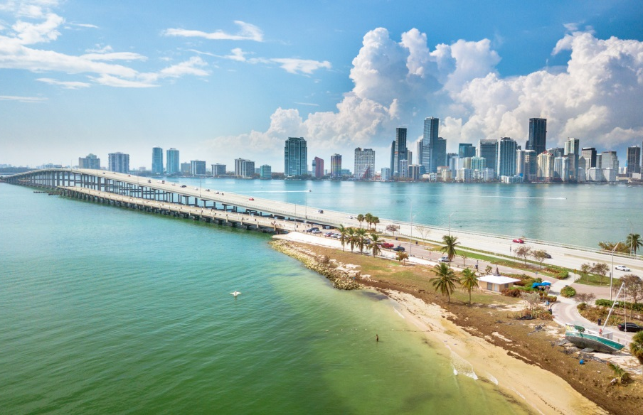
Community Concerns
Shoreline changes could significantly impact economies
Extreme weather is a major threat to coastal communities
Implementation of green infrastructure as a mitigation technique
Increase storm water drainage capacity and pump stations
Image Credit: Sevag Mehterian (GravelMonkey14)
Image Credit: EPA
Notes:
Due to extreme weather events, such as hurricanes, there are now major threats to coastal communities surrounding Biscayne Bay. Predicted changes in shoreline could significantly impact the economy, particularly the tourist industry of The Miami Beach and others in the Biscayne Bay. The cities surrounding Biscayne Bay have increased their storm water drainage capacity and pump stations as adaptive strategies to mitigate the effects associated with changing sea level conditions. As the world becomes more aware of the affect of the changing climate, the implementation of green infrastructure in cities and along their coasts can help to mitigate the damaging affects of storm surges.
Image Source: Images used with permission from Sevag Mehterian (GravelMonkey14) https://www.instagram.com/gravelmonkey14/

Slide 3
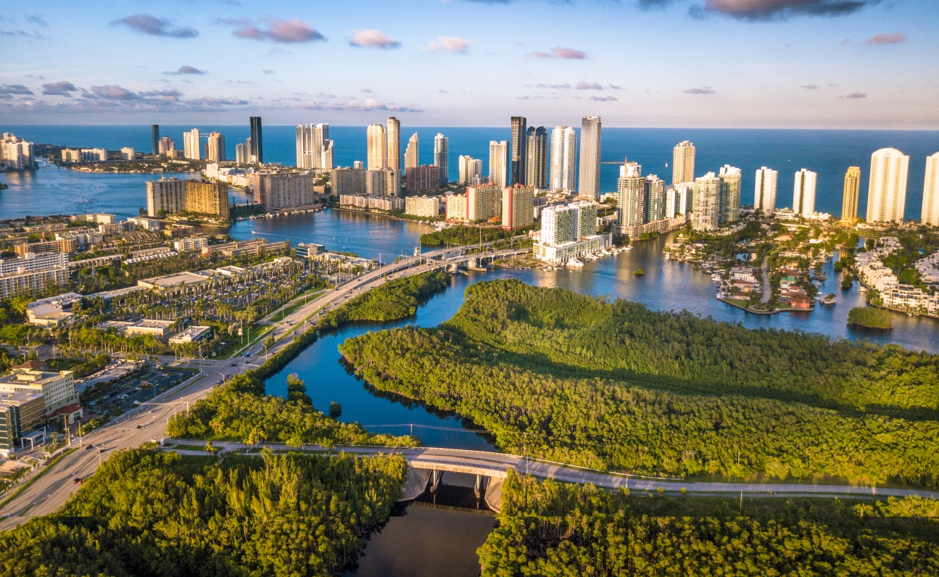
Project Partner
City of Miami Beach, Public Works Department
Image Credit: Sevag Mehterian (GravelMonkey14)
Image Credit: Mark Lowenstein
Notes:
The City of Miami Beach Public Works Department assess the areas surrounding Miami Beach to quantify and monitor runoff and storm water discharge from the canals and pumping stations in the region. As pumping requirements increase with expected sea level rise and subsidence, in addition to a growing population and urban development, there are concerns that water quality will no longer support aquatic biodiversity and ecosystems important for the ecosystem services they provide. We partnered with the City of Miami Beach Public Works Department to support their resiliency efforts with earth observation data.
Image Source: Sevag Mehterian (GravelMonkey14) https://www.instagram.com/gravelmonkey14/

Slide 4
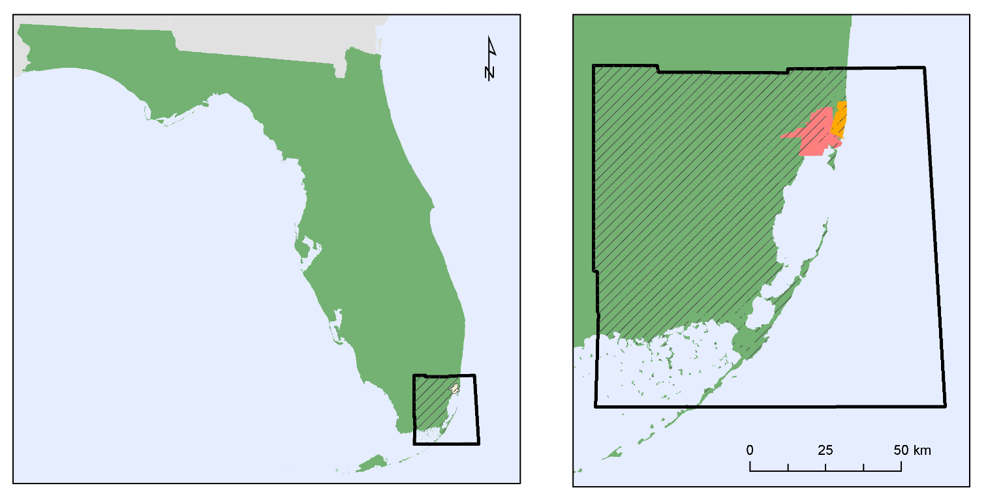
Study Area & Period
Florida
Gulf of Mexico
Biscayne Bay
Miami
Miami Beach
Study Area
Image Credit: Sevag Mehterian (GravelMonkey14)
Miami-Dade County
Biscayne Bay Area
City of Miami Beach
1984-2017
Notes:
Given our project partner’s location, we focused our study on the Biscayne Bay Area and Miami Beach in southern Florida. We analyzed the changes of the shoreline, urban vegetation and coastal wetlands. We defined our study period based on satellite imagery availability which began in 1984.
Image Source: Sevag Mehterian (GravelMonkey14) https://www.instagram.com/gravelmonkey14/

Slide 5
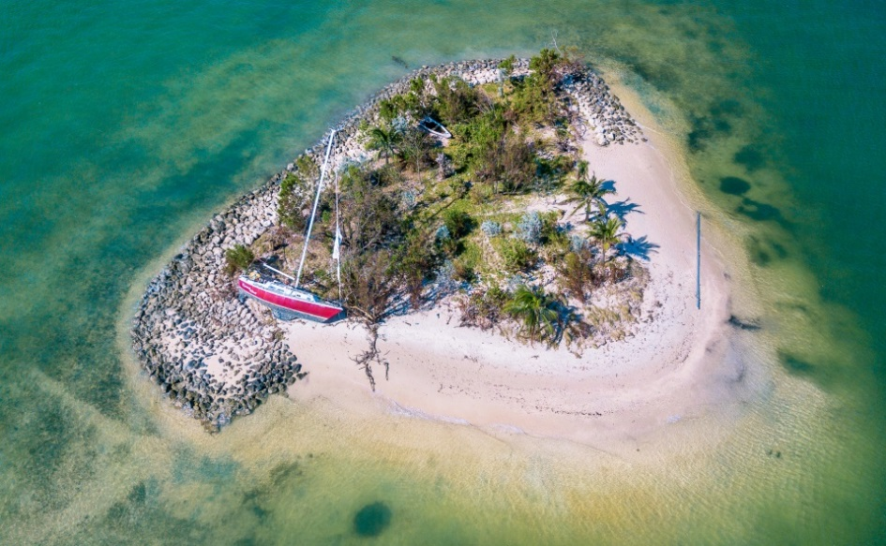
Objectives
Examine coastal damage in Miami Beach following Hurricane Irma
Map the distribution of historic urban vegetation in Miami Beach
Assess the range and health of coastal wetlands in southeast Florida using Landsat 5 TM, Landsat 8 OLI, and Terra MODIS data products
Image Credit: Sevag Mehterian (GravelMonkey14)
Image Credit: EPA
Notes:
To complete our project we decided on three main objectives based on the end products that we wanted to produce.
Image Source: Sevag Mehterian (GravelMonkey14) https://www.instagram.com/gravelmonkey14/

Slide 6
NASA Earth Observations
Image Credit: Monet
Landsat 8 OLI
Landsat 5 TM
Terra MODIS
Notes:
In order to maximize our temporal resolution, we used imagery from Landsat 5 Thematic Mapper for 1984-2013 data, Landsat 8 Operational Land Imager for 2013-2017. For comparison, we also used Terra MODIS (Moderate Resolution Imaging Spectroradiometer) for the 2002-2017 data. In addition to these earth observations, we also used aerial photography from the National Agriculture Imagery Program (otherwise known as NAIP), and Digital Orthophoto Quadrangles or DOQs for the study area. For the most recent analyses we used PlanetScope 4-band data.

Slide 7
Methods – Coastal Damage
PlanetScope 4-Band
Maximum Likelihood Classification
Land Use-Land Cover Change
Coastal Damage & Recovery Assessment
Image Credit: EPA
Notes:
The first end product we created is a post-Hurricane Irma coastal damage and recovery assessment. We used PlanetScope 4-band data from Planet Labs, mainly because it has 3 meters resolution and we were able to find cloud free images right before and after Hurricane Irma in their database. We used maximum likelihood classification, a broadly used classification technique in remote sensing in which a pixel with the maximum likelihood is classified into the corresponding class. In this study we only focused on the Miami Beach area to see how the vegetation along with the beach has been affected by the hurricane. Finally, we analyzed the images taken on October 30th, 40 days after the hurricane in order to assess the recovery of the vegetation lost or damaged.

Slide 8
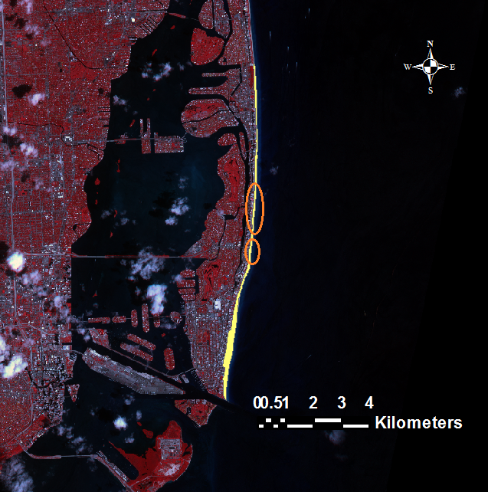
Results – Coastal Damage
Dates | Class | Area (${km}^{2}$)
09/07 (3 days before Irma) | Sand | 710.35
 | Vegetation | 480.54
09/12 (2 days after Irma) | Sand | 922.73
 | Vegetation | 263.52
10/30 (40 days after Irma) | Sand | 798.63
 | Vegetation | 392.49
3km
Sand
Vegetation
Water
Image Credit: EPA
Notes:
The highlighted section in the left image shows our area of interest. We can see how the training sample has been selected and then how our model classified the image. Each of the pixels in the image is equivalent to 9${ m}^{2}.$
The table shows approximately 217.02 ${ km}^{2}$ of the vegetation along the Miami Beach has been lost because of the hurricane and 128.97${ km}^{2}$ of them has been recovered after 40 days.

Slide 9
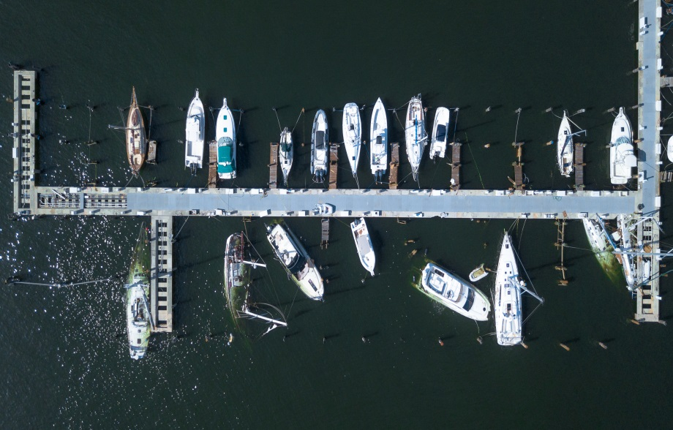
Conclusions – Coastal Damage
Approximately 45% of coastal vegetation along Miami Beach was lost or damaged
An estimated 26% of this vegetation recovered within 40 days of the storm’s passing
Image Credit: Sevag Mehterian (GravelMonkey14)
Image Credit: EPA
Notes:
As a result of Hurricane Irma, approximately 45% of coastal vegetation along Miami Beach was lost or damaged. An estimated 26% of this vegetation recovered within 40 days of the storm’s passing.
Image Source: Sevag Mehterian (GravelMonkey14) https://www.instagram.com/gravelmonkey14/

Slide 10
Methods – Urban Vegetation
Digital Orthophoto Quadrangles
Normalized Difference Vegetation Index
Zonal Statistics
Historic Green Space Distribution Assessment
National Agriculture Imagery Program
Image Credit: EPA
Notes:
To look for changes in vegetation coverage over time, we started with two data sources. We started with two mosaics, the first one was from digital orthophoto quadrangles (DOQs) from the 1994 dataset. The second mosaic was created from the National Agriculture Imagery Program from the 2015 dataset. To compare them, we produced a normalized difference vegetation index (NDVI) raster for each mosaic. This index uses visible and near infrared reflectivity to identify green vegetation in an image.
After masking out water areas, we reclassified the NDVI rasters into “green” and “nongreen” classes based on their histograms. Then we used Zonal Statistics to calculate the total area and green area of each neighborhood and divided these to find the percent green coverage. In the end we had percent green coverage for each neighborhood in Miami Beach, for 1994 and 2015.

Slide 11
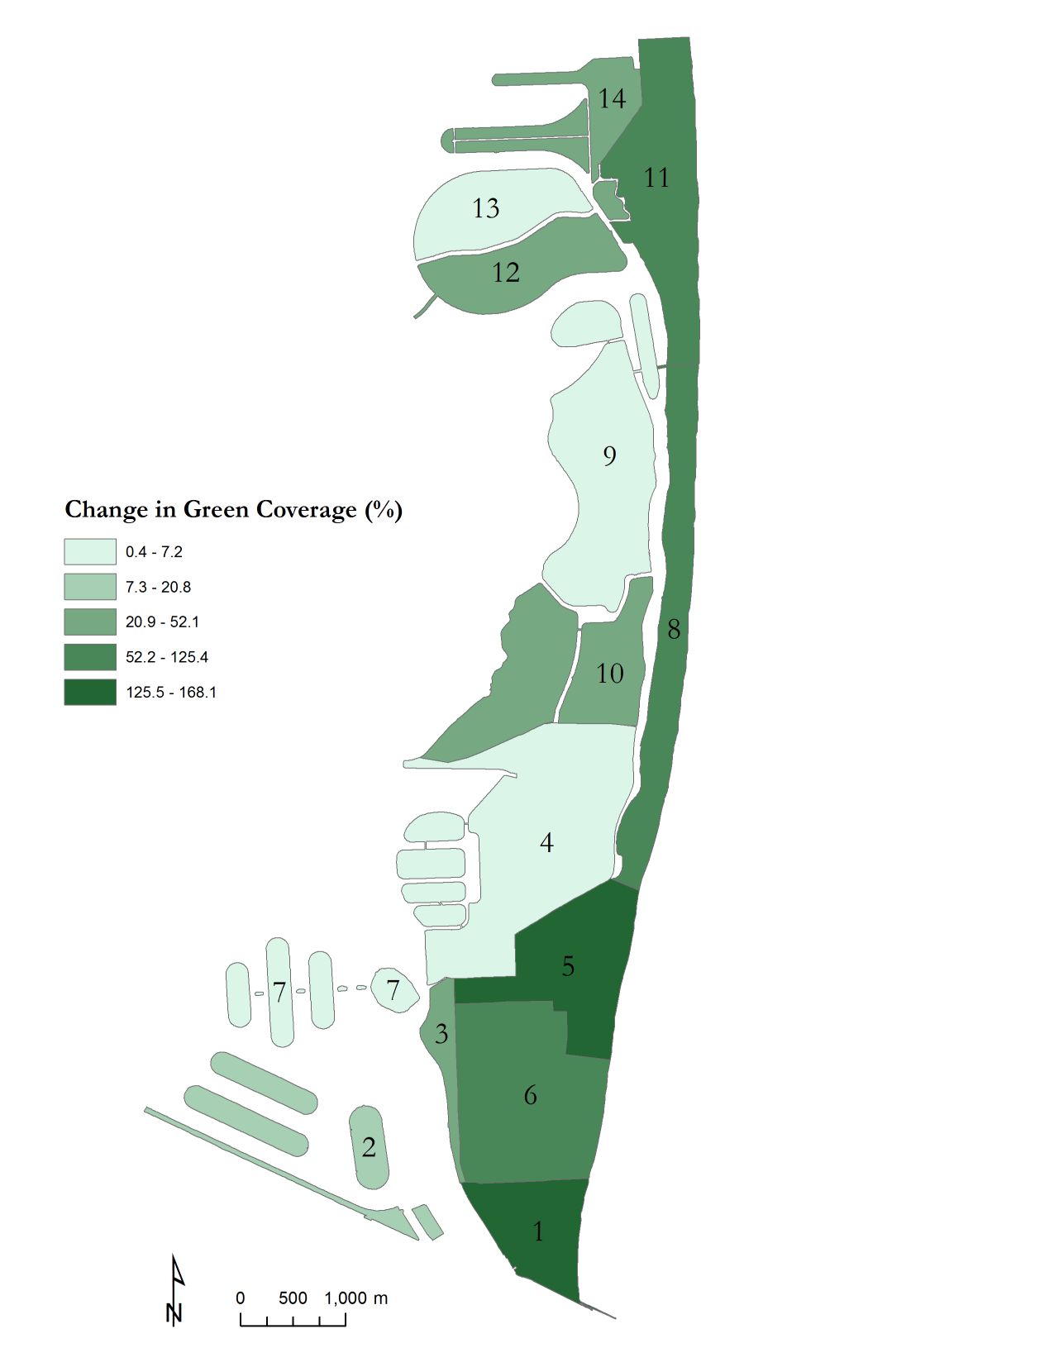
Results – Urban Vegetation
14
Neighborhoods
1. South Pointe
2. Star/Palm/Hibiscus
3. West Avenue & Bay Road
4. Bayshore
5. City Center
6. Flamingo/Lummus
7. South & Venetian Islands
8. Oceanfront
9. La Gorce
10. Nautilus
11. North Shore
12. Normandy Isles
13. Normandy Shores
14. Biscayne Point
13
11
Vegetation
Cover Change (%)
(1994-2015)
12
0.4 – 7.2
7.3 – 20.8
20.9 – 52.1
52.2 – 125.5
125.5 – 168.1
9
8
10
4
7
5
7
3
6
2
1
1
0
500
1000 m
Image Credit: EPA
Notes:
Based on this analysis, all neighborhoods in Miami Beach saw a increase in green coverage between 1994 and 2015. In this map of Miami Beach, darker colored neighborhoods had a greater increase in green coverage, as a percentage of the 1994 area. The number labels correspond with neighborhood names on the left.
For some neighborhoods, the change was negligible. For example, La Gorce saw an increase of less than 2 percent. However, the South Pointe, City Center, and Oceanfront areas saw an increase of over 100 percent. These neighborhoods ranked among the lowest in green coverage for both 1994 and 2015, so the large percent change could reflect a minor increase in green space that was dramatic relative to the total coverage.

Slide 12
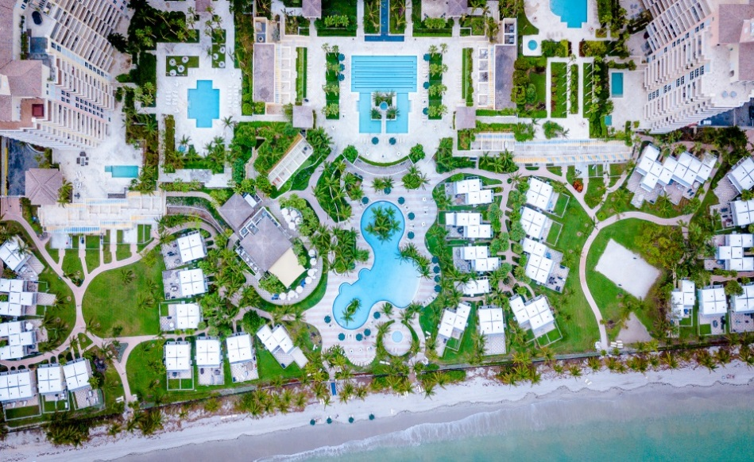
Conclusions – Urban Vegetation
The city of Miami Beach saw a 24% increase in vegetation coverage between 1994 and 2015
City plans to implement and maintain green infrastructure are having positive effects
Image Credit: Sevag Mehterian (GravelMonkey14)
Image Credit: EPA
Notes:
For the city of Miami Beach as a whole, green coverage increased by 24 percent, or just over 1,100,000 square meters. Based on this, we could say the city is doing a good job of maintaining its existing green space and adding more over time.
Image Source: Sevag Mehterian (GravelMonkey14) https://www.instagram.com/gravelmonkey14/

Slide 13
Methods – Mangrove Health
Landsat 5 TM
Landsat 5 TM
Gross Primary Productivity
Enhanced Vegetation Index
Gross Primary Productivity
Enhanced Vegetation Index
Historic Mangrove Health Assessment
Landsat 8 OLI
Landsat 8 OLI
Gross Primary Productivity
Gross Primary Productivity
Terra MODIS
Terra MODIS
Image Credit: EPA
Notes:
To complete our third end product, we assessed mangrove health in Biscayne National Park. We used Google Earth Engine to access data from Landsat 5 between 1984 to 2013, Landsat 8 from 2013 to 2017 and Terra MODIS data from 2002 to 2017. We then ran an Enhanced Vegetation Index and calculated Gross Primary Productivity (GPP), for the Landsat data, using GPP as the proxy for mangrove health. To complete our mangrove health assessment, we also analyzed GPP from the Terra MODIS data.

Slide 14
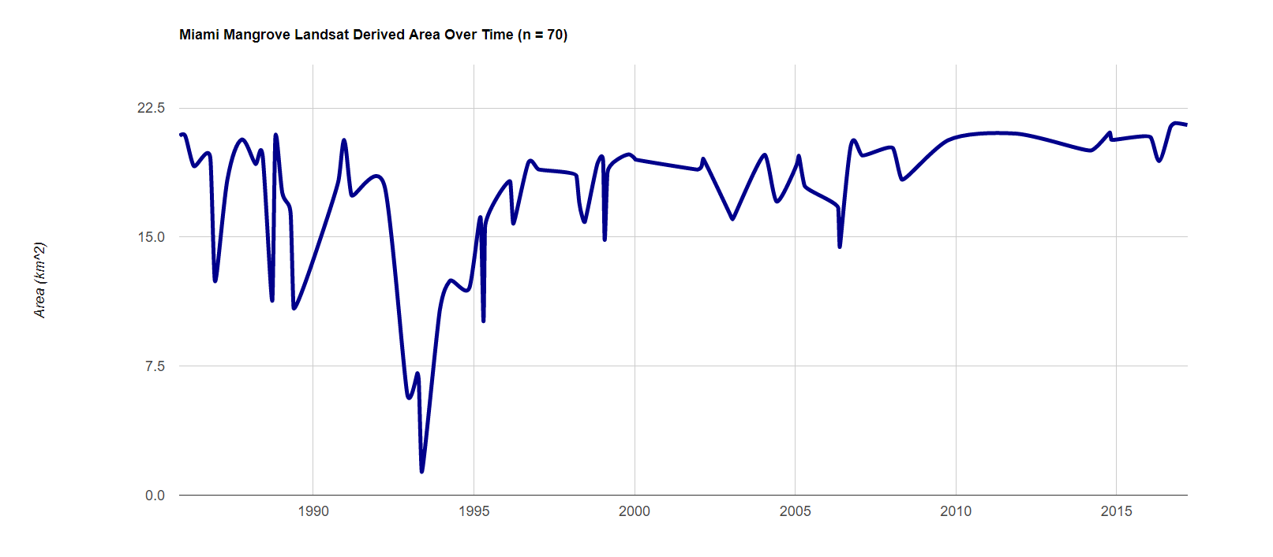
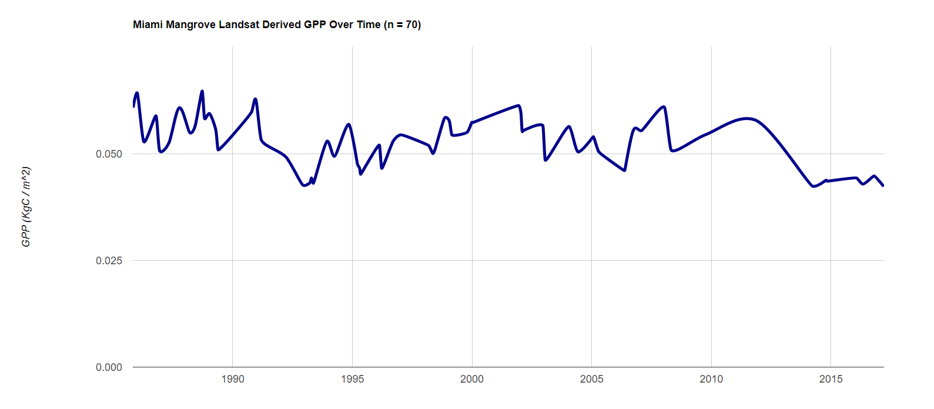
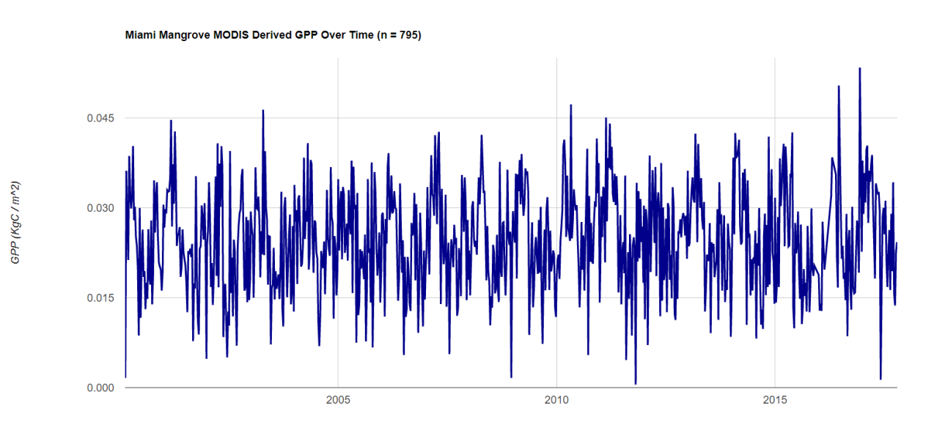
Results – Mangrove Health
Miami Mangrove Landsat Derived Area Over Time (n = 70)
Miami Mangrove Landsat Derived GPP Over Time (n = 70)
22.5
15.0
0.050
Area (km²)
GPP (KgC / m²)
Landsat 5 TM
Landsat 8 OLI
Landsat 5 TM
Landsat 8 OLI
7.5
0.025
0.0
‘84
‘90
‘95
‘05
‘10
‘15
‘17
0.000
‘00
‘84
‘90
‘95
‘00
‘05
‘10
‘15
‘17
Miami Mangrove MODIS Derived GPP Over Time (n = 795)
0.045
GPP=0.096926*EVI + 0.0003819
Where, EVI = 2.5 [(NIR -Red)/(1+NIR+2.4*Red)]
0.030
GPP (KgC / m²)
0.015
0.000
‘00
‘05
‘10
‘15
‘17
Notes:
The first graph on the top left of this slide shows change in mangrove area within Biscayne National Park between 1984 and 2017. The red dotted line alludes to the sensor change in 2013 from Landsat 5 TM to Landsat 8 OLI. It is also possible to notice a large dip in 1992 which represents the passage of Hurricane Andrew.
In the second graph to the right, we can observe that mangrove health has remained stable since 1984. The GPP in this graph was calculated using the above GPP equation. The decrease in mangrove health in recent years is attributed to the sensor calibration issues as a result of the sensor change in 2014.
Finally, the third graph represents GPP taken directly from Terra MODIS between 2002 and 2017.

Slide 15
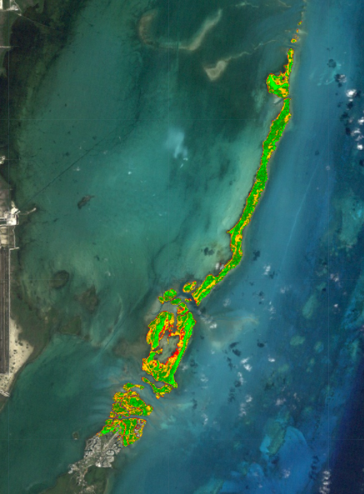
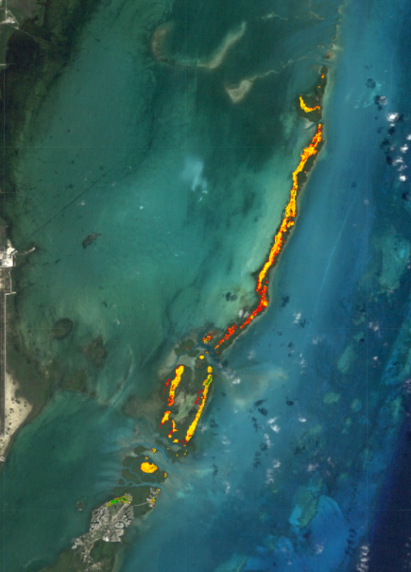
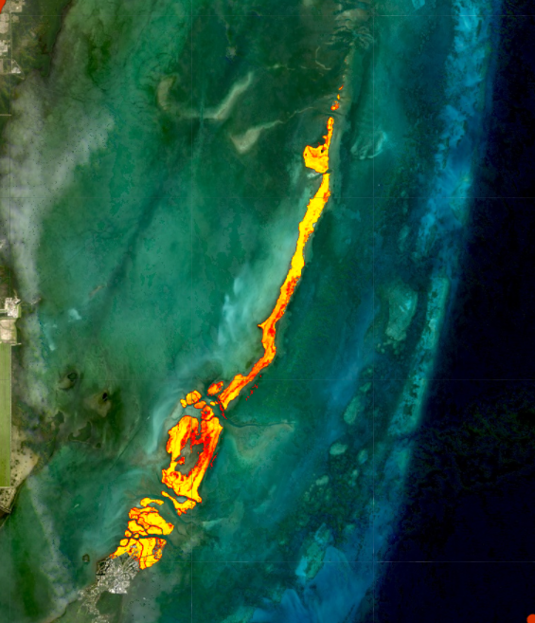
Results – Mangrove Health
Gross Primary Productivity
(KgC/m² )
N
0 – 0.035 0.035 – 0.045
0.045 – 0.055
0.055 – 0.065
0.065
12/18/1990
12/07/1992
12/18/1990
12/07/1992
03/15/2017
2km
2 km
Notes:
These maps depict mangrove health in Biscayne National Park before and after Hurricane Andrew. And most recently in March of 2017.

Slide 16
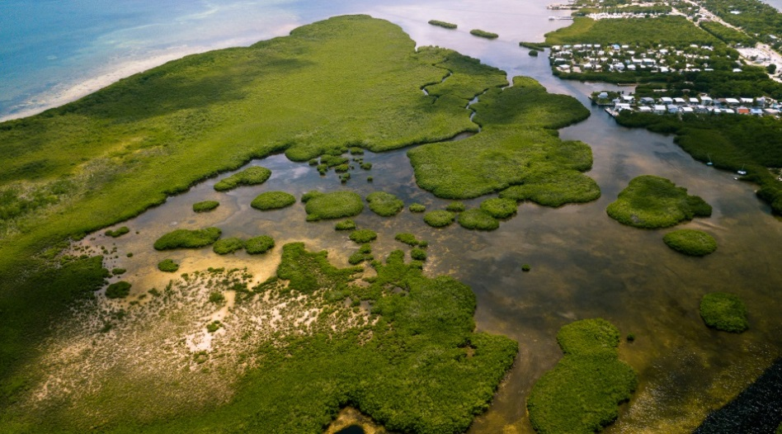
Conclusions – Mangrove Health
Mangrove forests in Biscayne National Park represent effective, self-sustaining green infrastructure
They exhibit resiliency in both hurricane and non-hurricane years
Image Credit: Sevag Mehterian (GravelMonkey14)
Image Credit: EPA
Notes:
Mangrove forests in Biscayne National Park represent effective, self-sustaining green infrastructure options because of their resiliency in both hurricane and non-hurricane years.
Image Source: Sevag Mehterian (GravelMonkey14) https://www.instagram.com/gravelmonkey14/

Slide 17
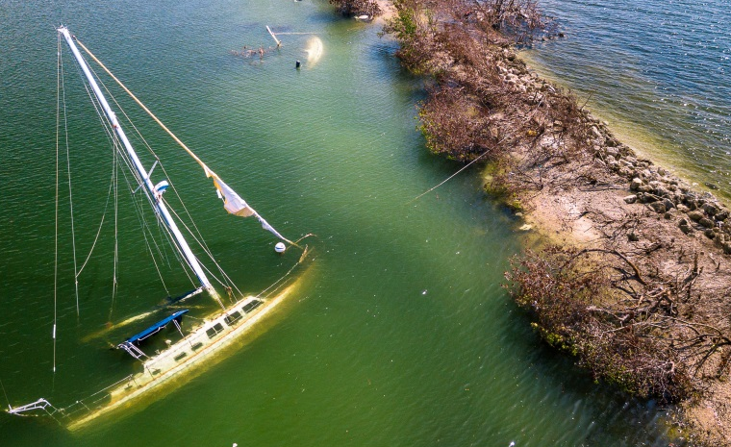
Future Work
How do the observed recovery rates compare with previous recovery rates?
How do storm impacts affect vegetation coverage?
What are the most suitable places for the implementation of green infrastructure in Miami Beach?
Image Credit: Sevag Mehterian (GravelMonkey14)
Image Credit: EPA
Notes:
These results demonstrate the importance of existing resiliency strategies in geographically vulnerable areas like Miami Beach. In terms of future work, we are interested in comparing our recovery rate results with previous hurricane recovery rates. We are also interested in having a better understanding of how storm impacts affect vegetation cover. Finally, our project partners are interested in defining areas that are suitable for the implementation of green infrastructure which is what the next term of this project will most likely focus on.
Image Source: Sevag Mehterian (GravelMonkey14) https://www.instagram.com/gravelmonkey14/

Slide 18
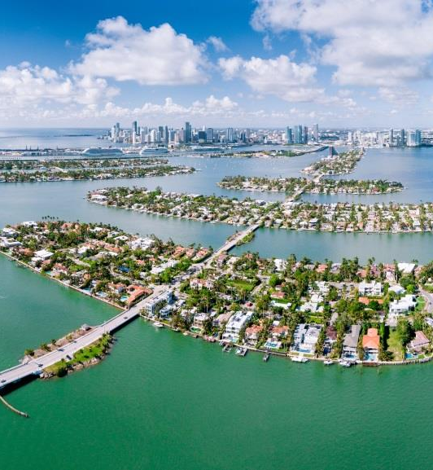
Acknowledgements
Science Advisors
Dr. Marguerite Madden
Department of Geography, University of Georgia
Dr. Rosanna Rivero
College of Environment and Design, University of Georgia
Project Partners
Francisco D’Elia
City of Miami Beach, Public Works Department
Bruce Mowry
City of Miami Beach, Public Works Department
Photographs Provided by
Sevag Mehterian (GravelMonkey14)
Image Credit: Sevag Mehterian
(GravelMonkey14)
Notes:
Image Source: Sevag Mehterian (GravelMonkey14) https://www.instagram.com/gravelmonkey14/

