Slide 1
DEVELOP National Program
Great Lakes climate ii
NASA Langley research center
Spring 2015
Final Imagery

Slide 2
Checklist for Each Image:
Image is derived from NASA sensor data
  Not from an outside source
  Not a photograph of the team/issue
Preferably, At least one image provided is derived from recent data (2014-2015)
  This is mandatory for inclusion in any highlight to NASA HQ
Some kind of processing has taken place
  Not a raw image or a photograph
The team actually created the image
  Not from some other source/world wide web/etc.
High-resolution (over 300 dpi)
Saved as a JPEG or TIFF
Also:
While there are three slides, you can have more imagery. Minimum of one, max of ten.
The “best” image should have a SVG version, saved as a separate file, that will be used on the DEVELOP website and brochures

Slide 3
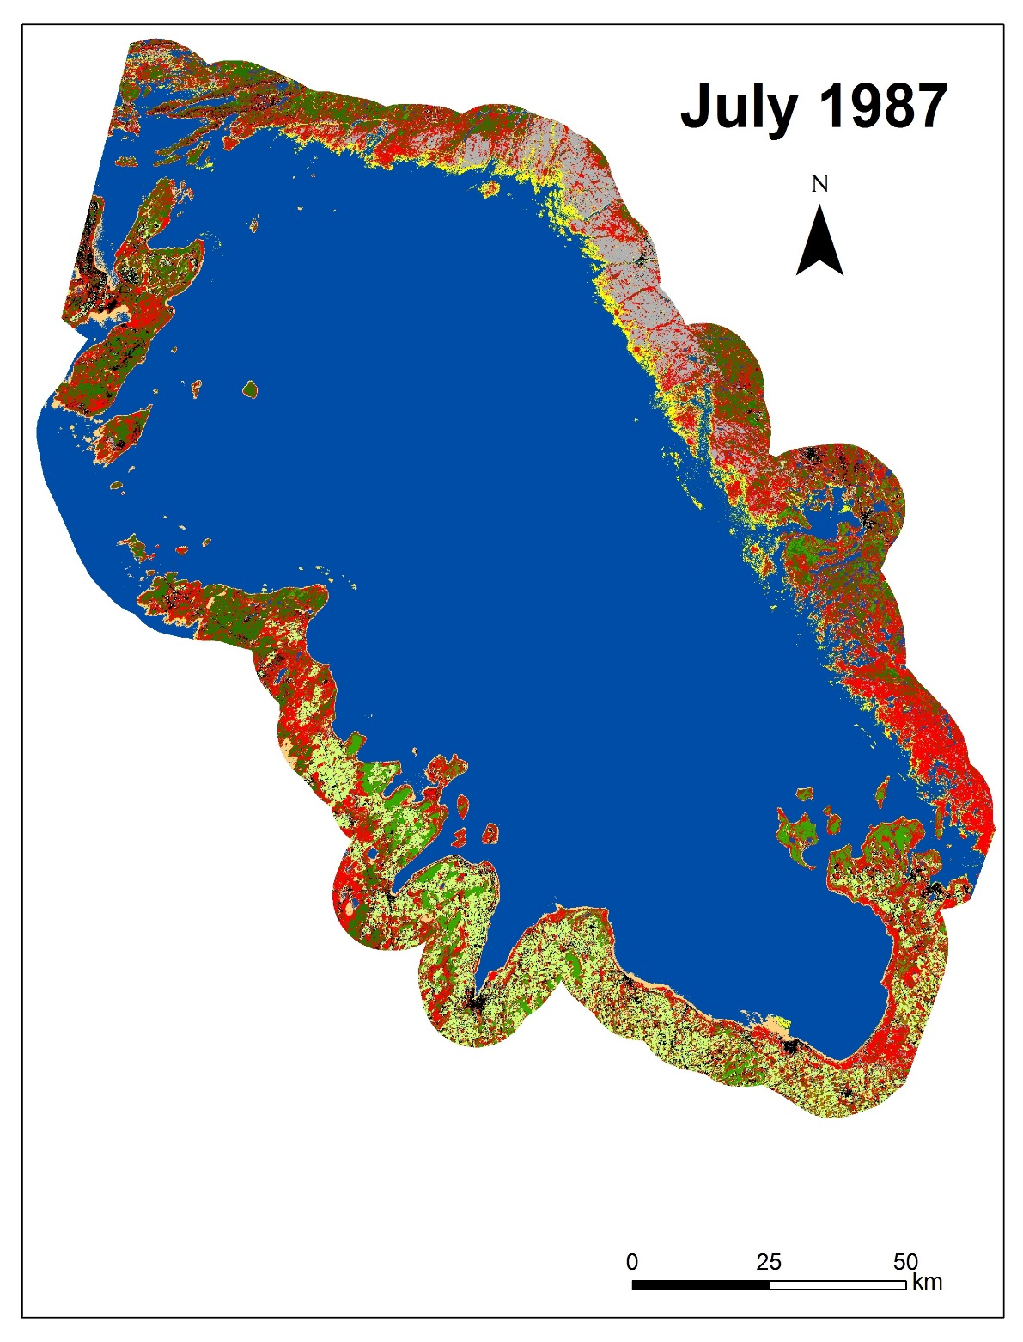
NASA Langley Research Center
Great Lakes Climate II
This land cover classified map of Georgian Bay, Ontario, Canada was created using Landsat 5 Thematic Mapper sensor data. The image was obtained in July 1987. The land cover map can be used to determine the historic extent of various land cover types and identify trends.

Slide 4
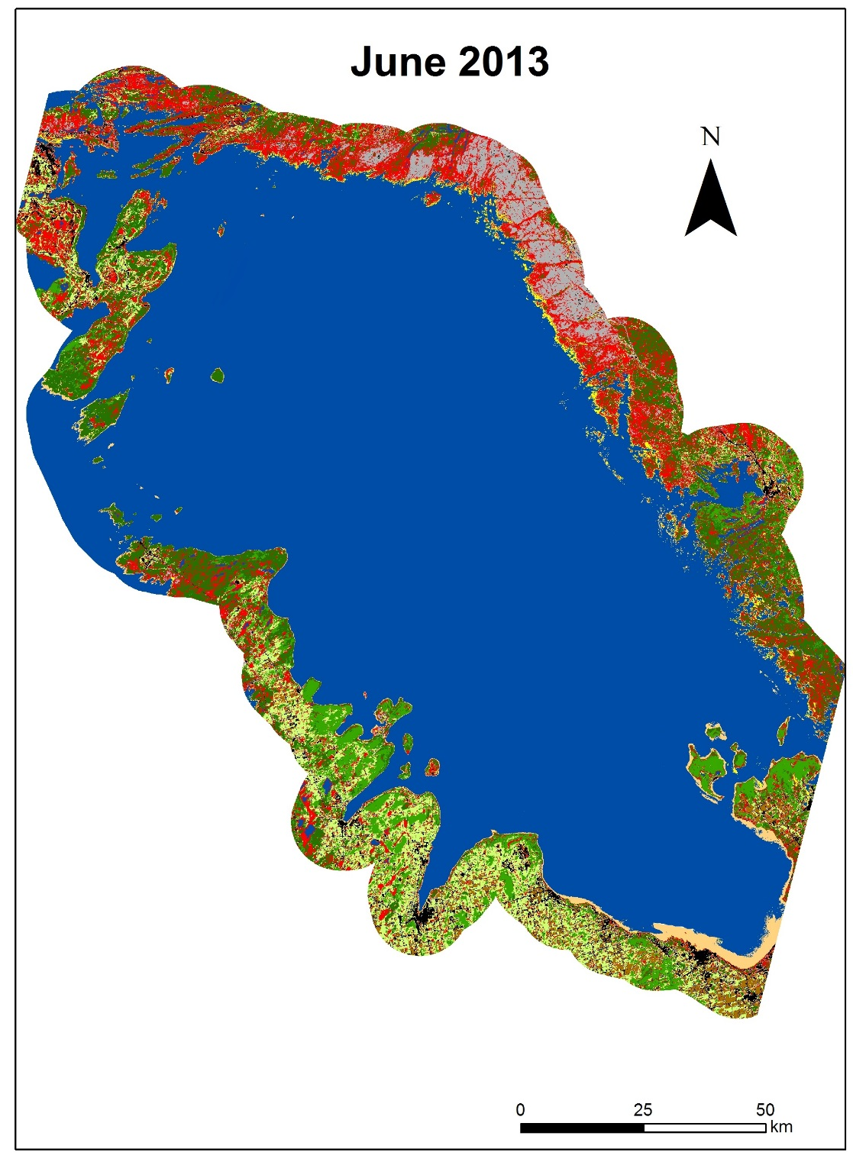
NASA Langley Research Center
Great Lakes Climate II
This land cover classified map of Georgian Bay, Ontario, Canada was created using Landsat Operational Land Imager sensor data. The image was obtained in June 2013. The land cover map can be used to determine the historic extent of various land cover types and identify trends.

Slide 5
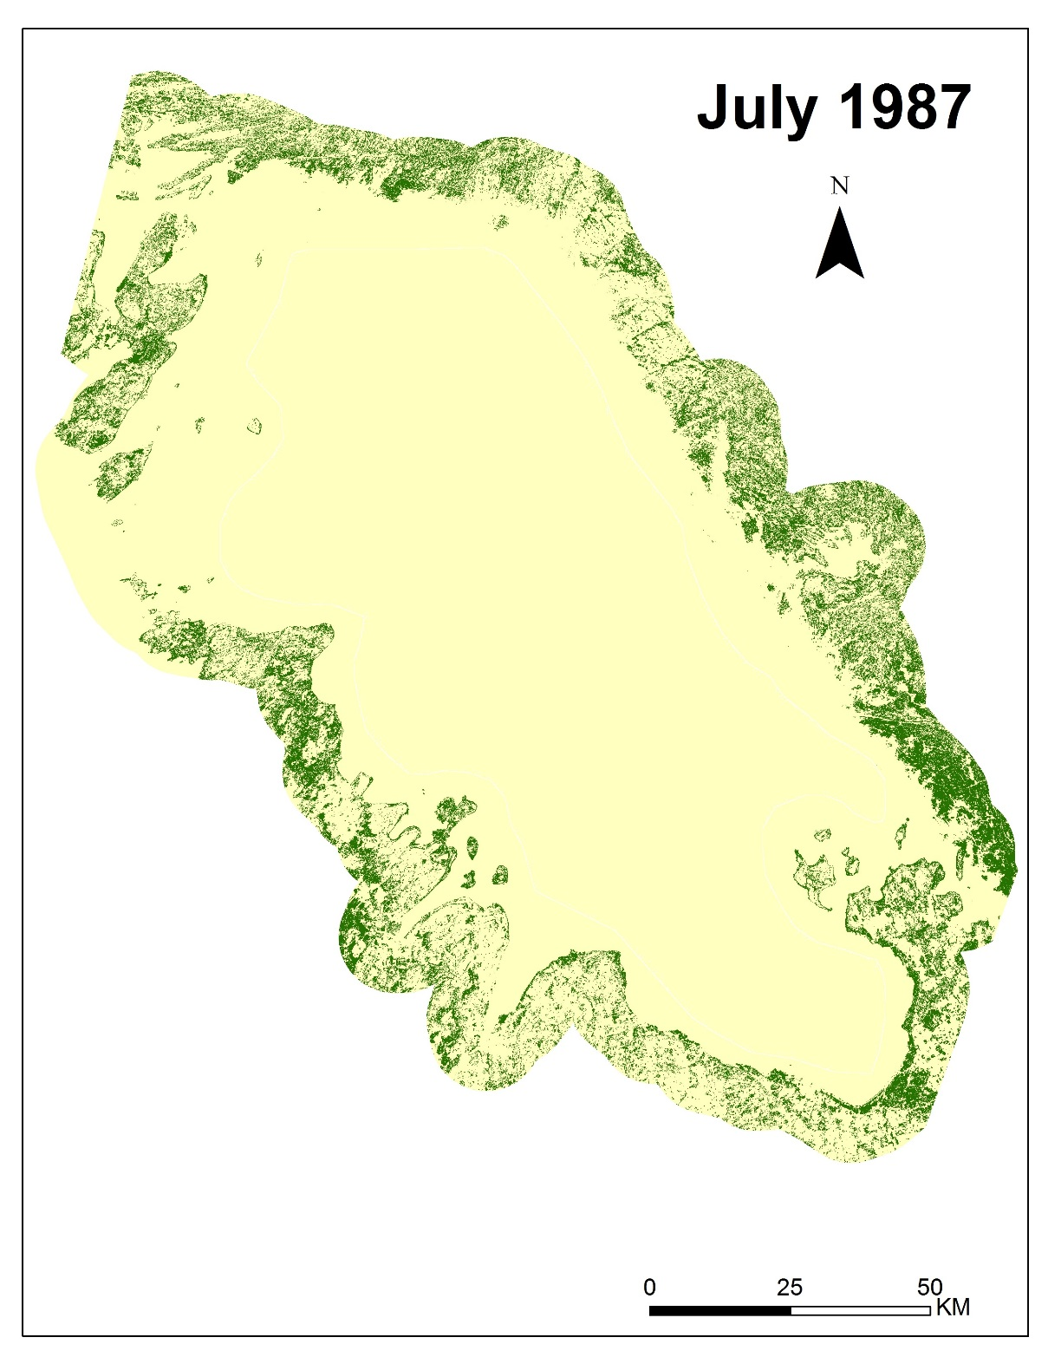
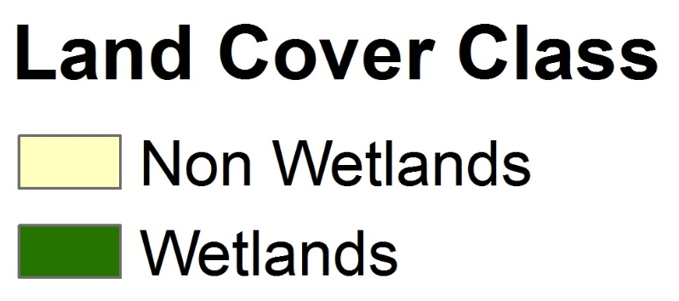
NASA Langley Research Center
Great Lakes Climate II
This wetlands versus non-wetlands map of Georgian Bay, Ontario, Canada was created by reclassifying the July 1987 land cover classification map and highlights wetlands classes. Landsat 5 Thematic Mapper sensor provided the data for classification. Historic land cover maps can be combined with recent wetland maps to determine changes in wetland extent over time.

Slide 6
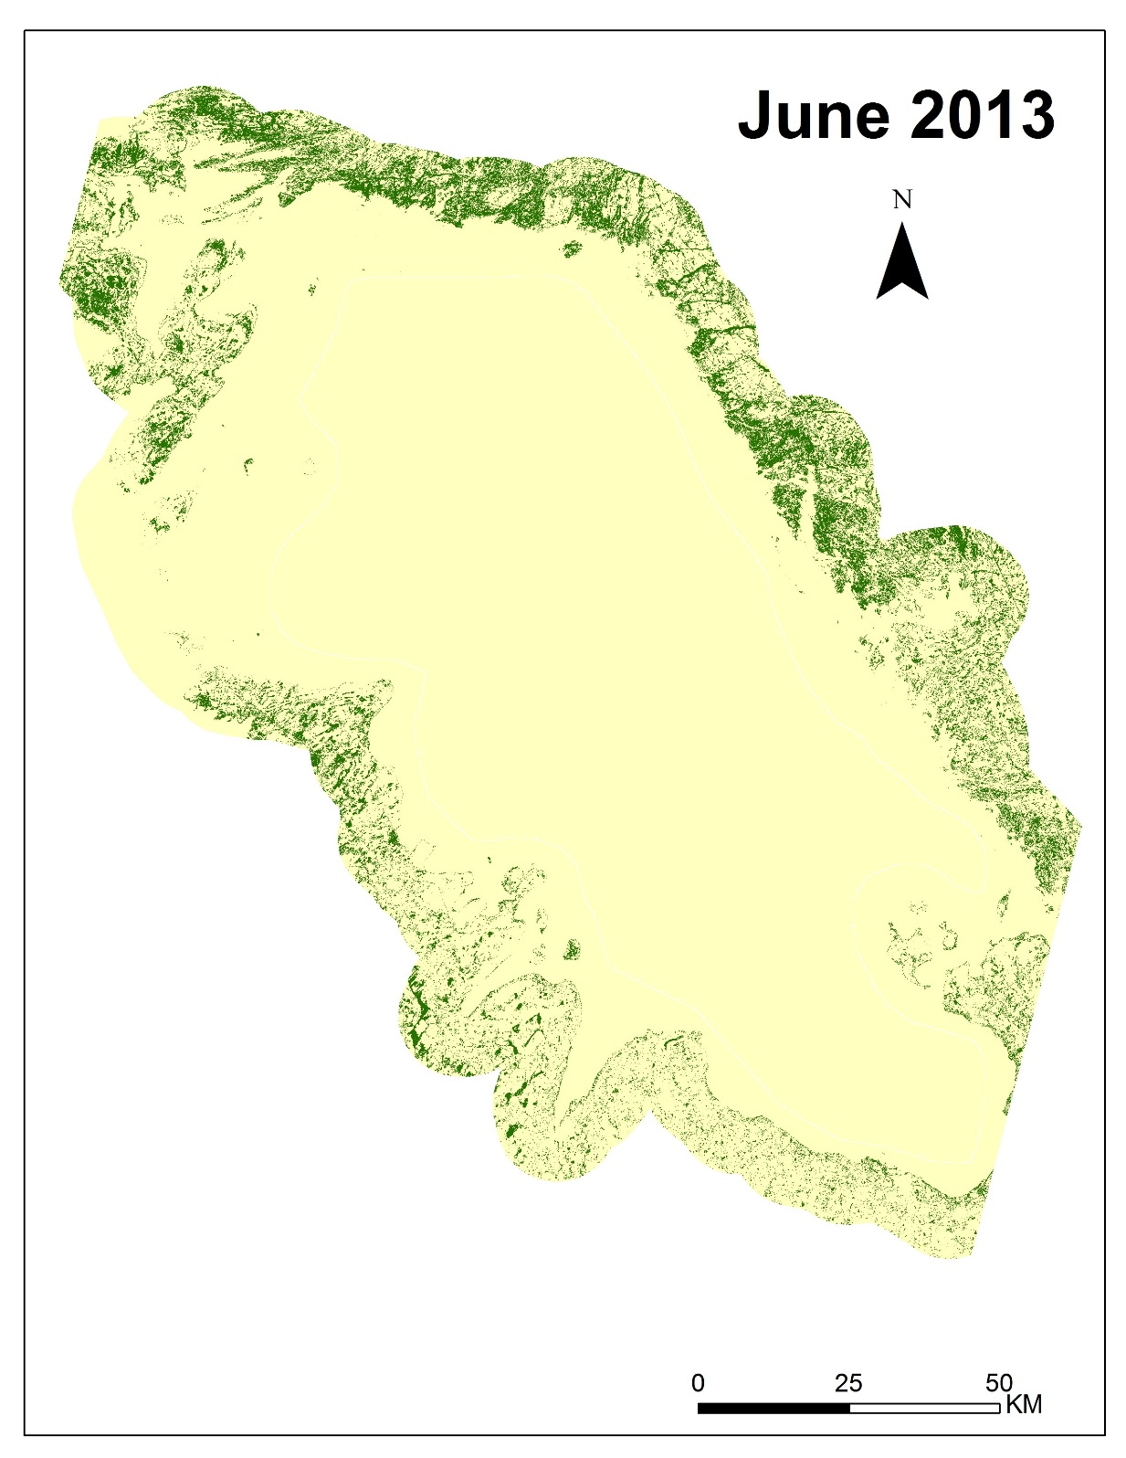
NASA Langley Research Center
Great Lakes Climate II
This wetlands versus non-wetlands map of Georgian Bay, Ontario, Canada was created by reclassifying the June 2013 land cover classification map and highlights wetlands classes. Landsat 8 Thematic Mapper sensor provided the data for classification. Historic land cover maps can be combined with recent wetland maps to determine changes in wetland extent over time.

Slide 7
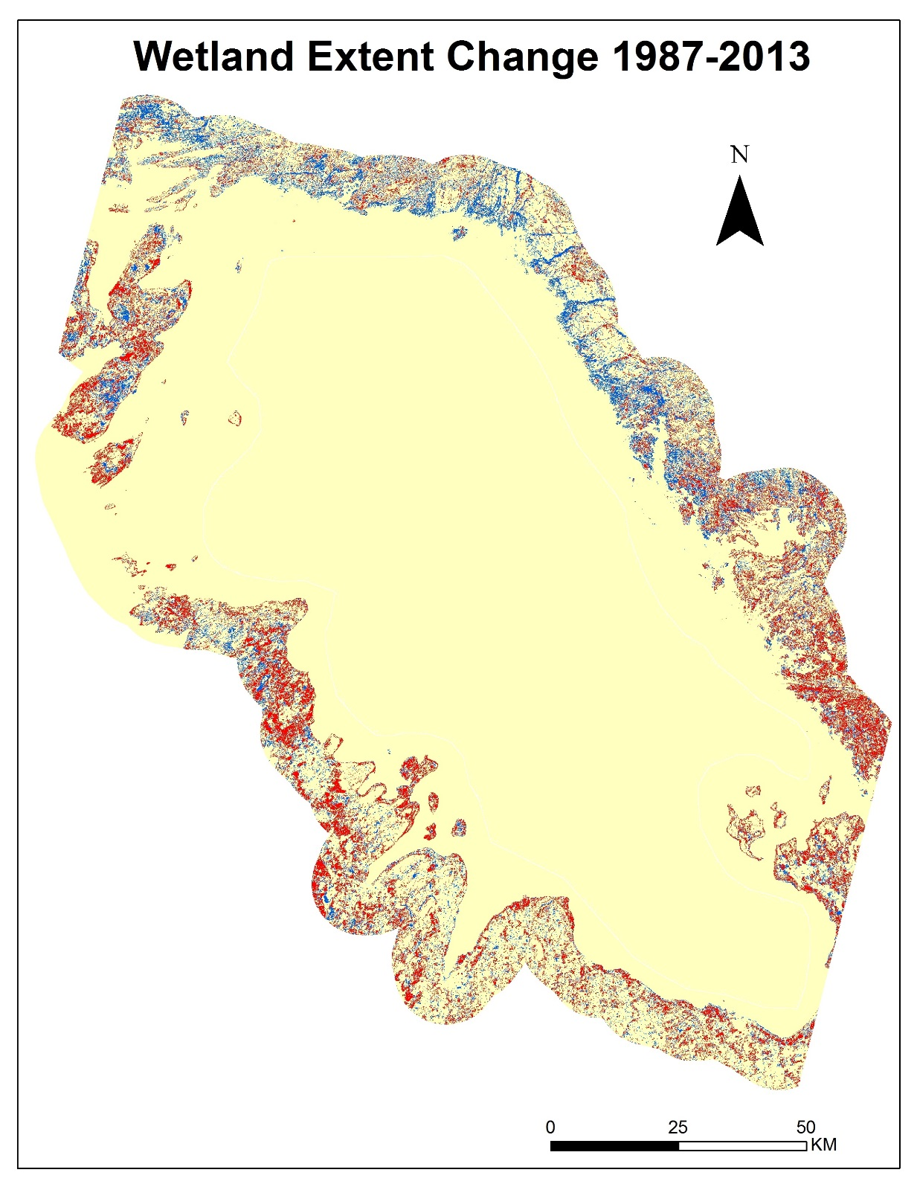
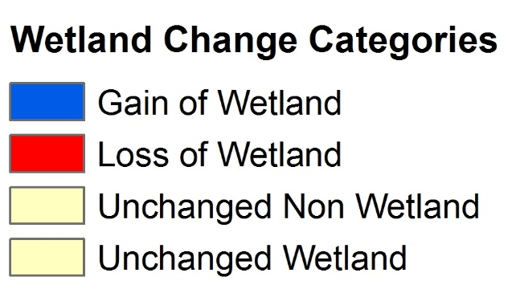
NASA Langley Research Center
Great Lakes Climate II
This wetland land cover change map of Georgian Bay, Ontario, Canada was created by combining the July 1987 imagery from the Landsat 5 Thematic Mapper sensor and June 2013 Landsat 8 Operational Land Imager. This map can be used to depict trends in the growth or loss of environmentally sensitive areas.

Slide 8
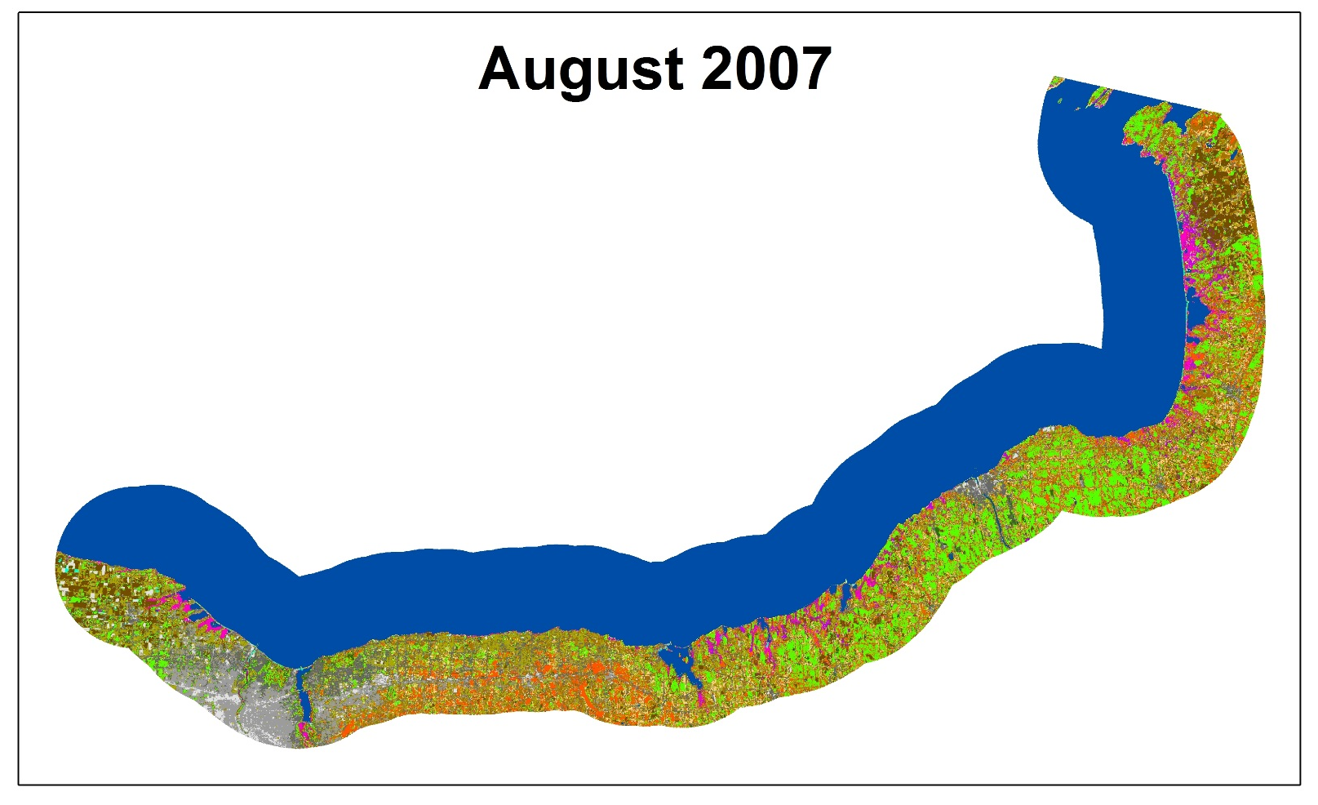
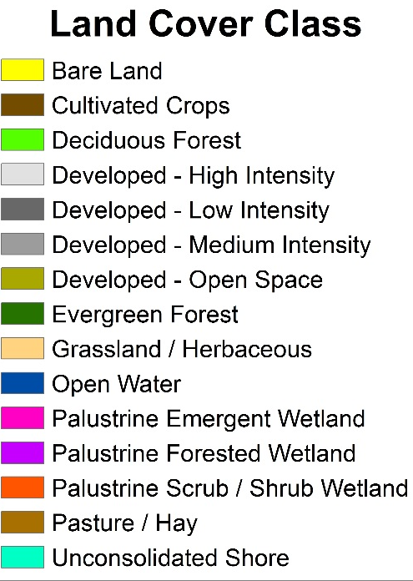
NASA Langley Research Center
Great Lakes Climate II
This land cover classified map of the southern shore of Lake Ontario in New York State was created using August 2007 Landsat 5 Thematic Mapper sensor data. This land cover map can be used to determine the historic extent of various land cover types and identify trends.

