Slide 1
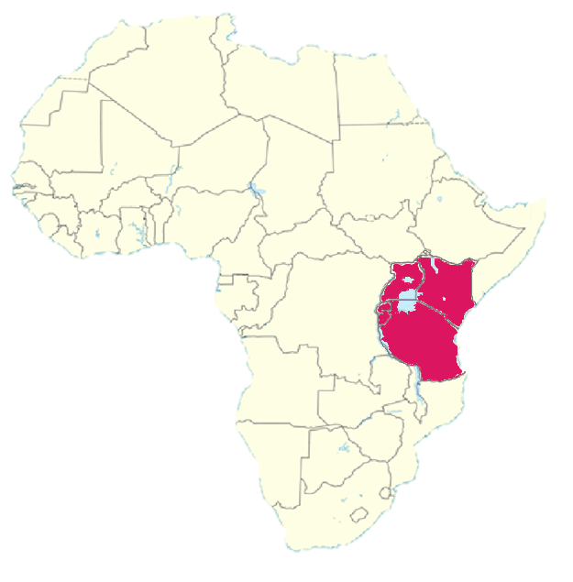
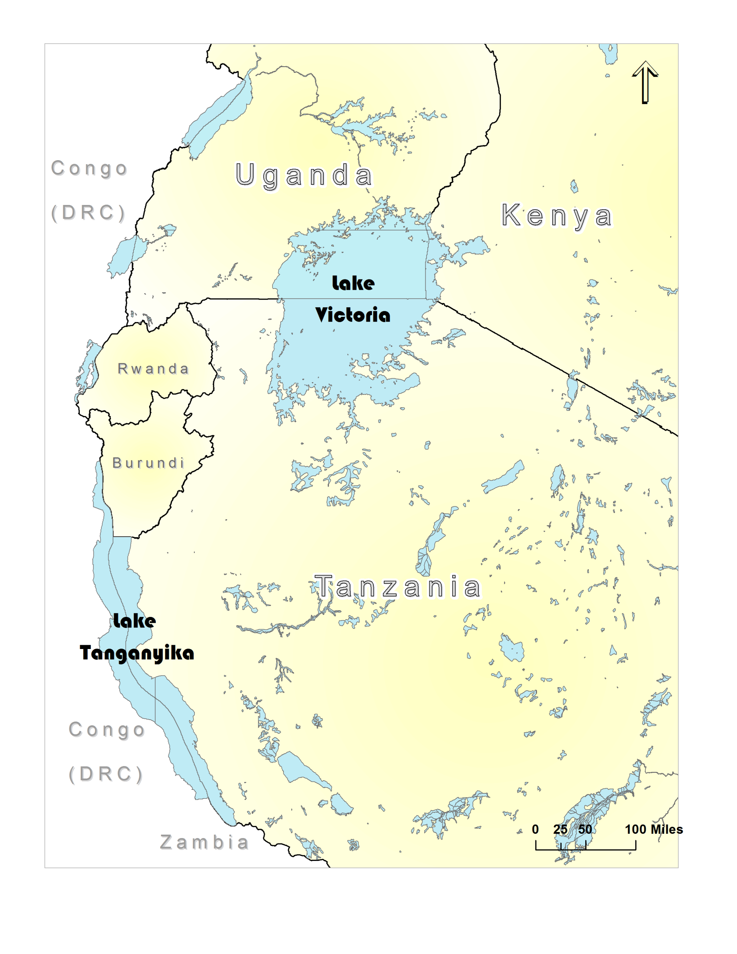
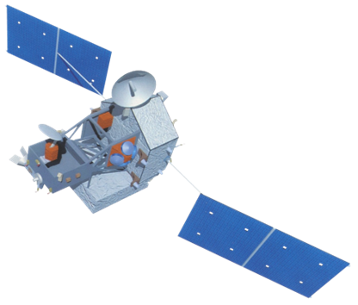
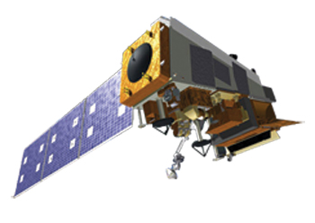
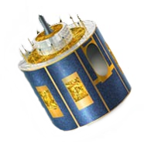
African Great Lakes Weather
Utilizing NASA Earth Observations to identify indicators to help predict deadly storms over the African Great Lakes
Will Wilson (Project Lead), Anabelle White, Grant Bloomer, Juan Antonio Chacon Castro
Abstract
Objectives
Keep this blank for now.
Body text point size should be at least 24.
Caption text point size should be at least 16.
Feel free to rename, move, and resize sections as needed.
Figure the temporal domain of further study by reducing the Hazardous Storm Events Database to summary sets of data. Extract sample dates at the 50th and 99th percentiles.
Determine what earth observations and other data products will be useful for analysis. .
Summary statistics and correlative statistics will be run through the data compiled at these respective dates. This will serve to highlight contributing environmental aspects present during days at the 99th percentile
Methodology
Study Area
Use imagery or a workflow here.
Keep text to a minimum.
The font should be easily readable.
Don’t paste images of flowcharts—all images should be editable.
Feel free to delete this text boxas appropriate to your workflow.
Earth Observations
TRMM
Aqua
Eumetsat - SEVIRI
Results
Conclusions
Use images.
Make sure that it has some sort of flow, that it makes sense. Show your results in a logical order.
No bullets.
Use bullets.
Use complete sentences with periods.
Team Members
Project Partners
Acknowledgements
Use a professional-looking photo.
Individual headshots are ok, if they aren’t pixelated and are all the same size.
Include a caption that states the team members’ names.
Dr. Kenton Ross, Science Advisor (NASA DEVELOP)
Dr. DeWayne Cecil, Science Advisor (Global Science and Technology Inc. )
Professor Robert Vangundy (UVA –Wise)
Ms. Melanie Salyer, NASA DEVELOP Wise Principal Investigator
Kenya Meteorological Department
Wise County & City of Norton Clerk of Court’s Office

