Slide 1
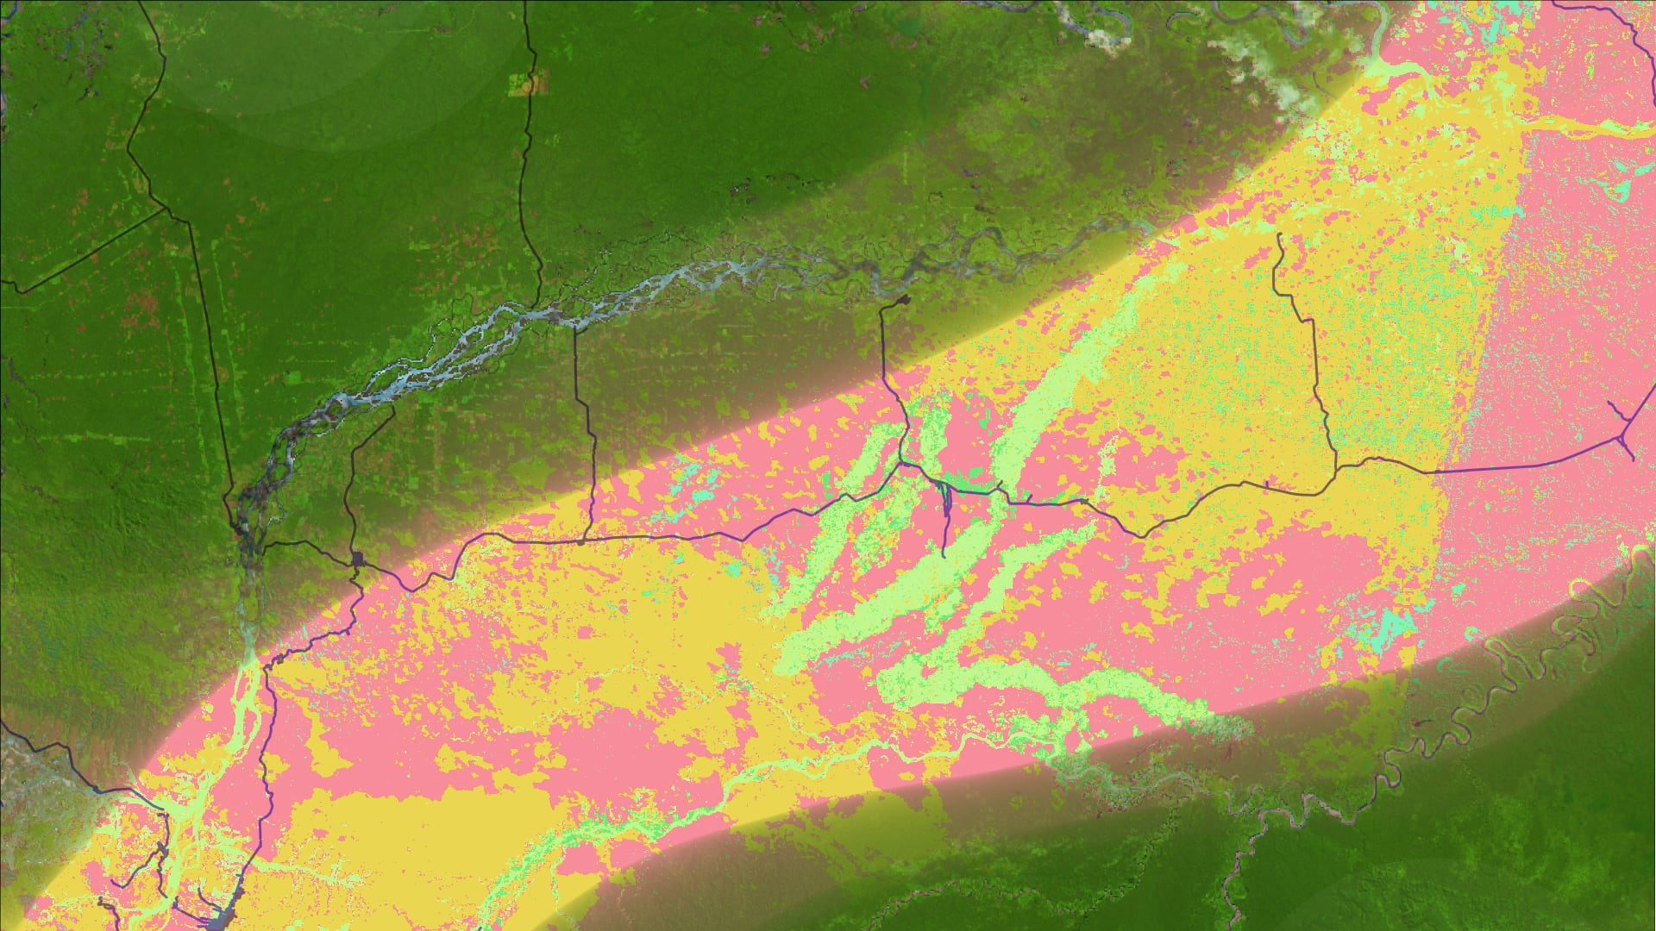
Your project Website Image will be added to the title slide by the PC Team.
Do not delete or move the DEVELOP logo or other page components, including name boxes.
Body text should default to “Black, Text 1, Lighter 25%”
The only font that should be in this presentation is Century Gothic
Delete all red text boxes like this one!
STUDY AREA
Climate
Long Title Goes Here (Title Case)
Adjust text box width if needed so title takes up a maximum of 3 lines of text
Team Member 1
Team Member 2
Team Member 3
Team Member 4
PLACEHOLDER IMAGE
Node Name (i.e. North Carolina – NCEI)

Slide 2

SLIDE TEMPLATE: COMPONENTS
Study Area
Study Period
Objectives
Partners
Community Concerns
NASA Satellites/Sensors Used
Methodology
Results
Conclusions
Errors & Uncertainties
Future Work
Acknowledgements
Feel free to expand upon these topics, alter the headings, and change the order of the slides to fit your needs. An outline slide is NOT required.
Image Credit: Monet
Notes:
These notes should be thorough enough for someone not familiar with the project to clearly present the material.
NOTE: For every image on the slide include an image source in the speaker notes (ex. URL; Name, Affiliation, etc.). ALL images need to be created by a DEVELOPer, in the public domain (federal agency), provided by the partner, or published under a creative commons license (if attributed correctly). See an example citation below:
------------------------------Image Information Below ------------------------------
•Image Credit: Claude Monet
•Image Source: http://commons.wikimedia.org/wiki/File:Claude_Monet_-_The_Magpie_-_Google_Art_Project.jpg (insert here whether this image is provided by a DEVELOPer/partner, public domain, or the type of creative commons license the image was published under – e.g. CC BY-SA)

Slide 3

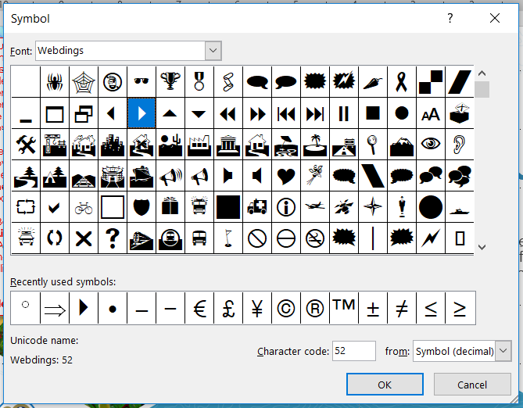
PRESENTATION GUIDELINES: FONTS
Font is always Century Gothic, including on figures and image captions
Font color is Black, Text 1, Lighter 25%, NOT Black
Font sizing:
  Header text point size should be between 32 and 44 on most slides.
  Body text point size should be at least 20.
  All other text (captions, legend items, image credits) should be no smaller than 14 point type.
Try to use a consistent font size between slides.
The standard DEVELOP bullet style is symbol #52 in the Webdings font
Not this
or this
or this

Slide 4
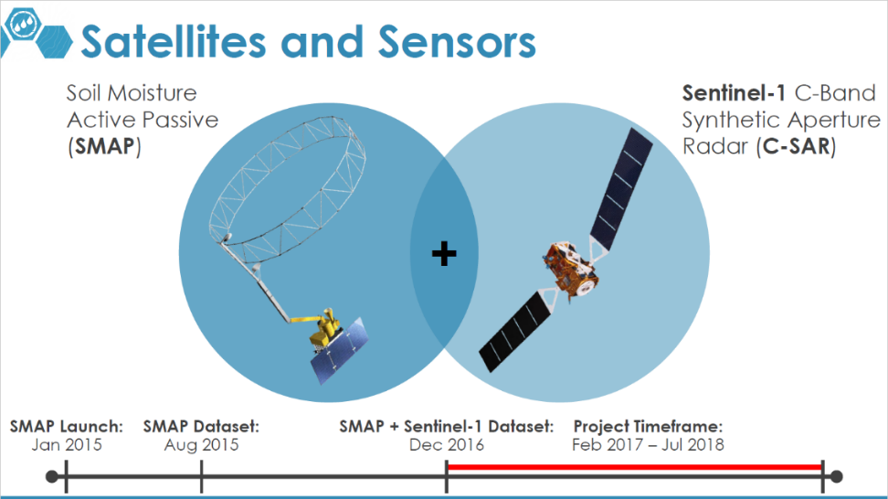
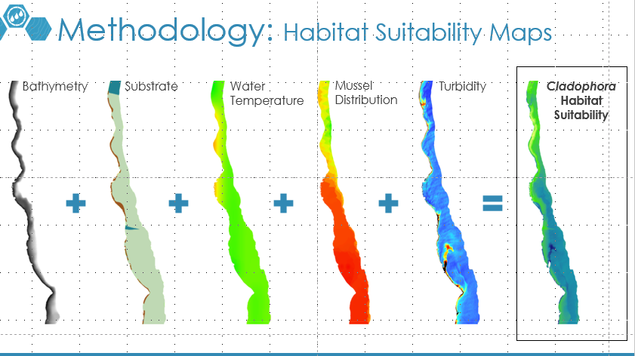
PRESENTATION GUIDELINES: TIPS
Overall, keep text to a minimum.
Include a visual on each slide, if possible.
  Maximize the size of any images, figures, and graphs to fill up the slide
  If you have image borders, which are usually a good idea, make sure they are consistent
Arrange content to minimize white space.
Include full speaker notes for each slide (see below).
  You need to include image information in your speakers notes as well.
Notes:
These notes should be thorough enough for someone not familiar with the project to clearly present the material.
NOTE: For every image on the slide include an image source in the speaker notes (ex. URL; Name, Affiliation, etc.). ALL images need to be created by a DEVELOPer, in the public domain (federal agency), or published under a creative commons license (if attributed correctly). See an example citation below:
------------------------------Image Information Below ------------------------------
•Image Credit: Claude Monet
•Image Source: http://commons.wikimedia.org/wiki/File:Claude_Monet_-_The_Magpie_-_Google_Art_Project.jpg (insert here whether this image is provided by a DEVELOPer/partner, public domain, or the type of creative commons license the image was published under – e.g. CC BY-SA)

Slide 5
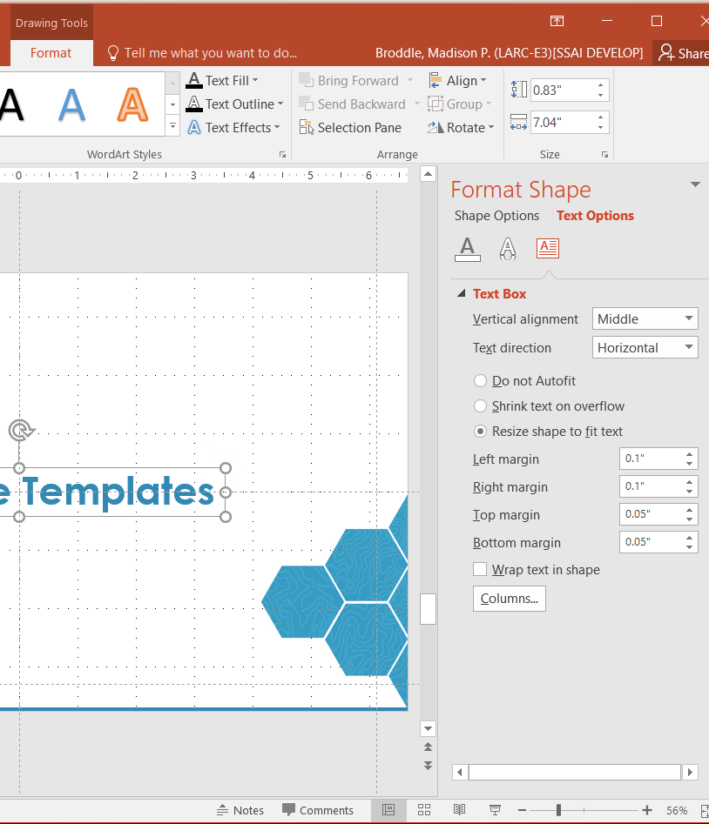
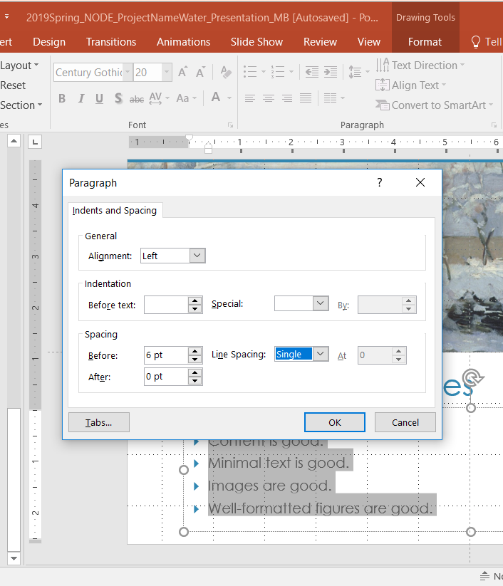
PRESENTATION GUIDELINES: TOOLS
The Align Tool
Don’t forget about the distribute spacing tool as well
Text Box Formatting (1)
Shrinking text boxes to fit your text can make it easy to align elements
Line Spacing Formatting (2)
Consistent line spacing can make your presentation look more professional
(1)
(2)
Notes:
Some useful tools, such as Gridlines, are not available on the online version of PowerPoint. If you need help with formatting for this reason, reach out to the PC team! Design and aesthetics are critical to science communication; these PowerPoint tools can help you ensure your presentation elements are neatly arranged.

Slide 6
IMAGES, PHOTOS, & LOGOS
Please do not include the image URL in the source text box but rather place it in the notes section below.
If you use a border for your images include it on all photographs to keep your presentation consistent.
Background images are not recommended. If you use one, make sure that your text remains clear and legible.
For images, use the Shadow (Outer) Shape Effect located in the Format Tab in the Drawing Section.
Obtain a media release form from all people in photos that your team has taken!
All image sources should be cited using a consistent format and should be visible on the slide.
On your partner slide, use US Federal logos only. No state, NGO, local and or international government logos, or software logos.
Only use images taken by your team, provided by your partners (as long as you have permission from them), from a Federal Agency or Creative Commons images.
Notes:
NOTE: For every image on the slide include an image source in the speaker notes (ex. URL; Name, Affiliation, etc.). ALL images need to be created by a DEVELOPer, in the public domain (federal agency), provided by the partner, or published under a creative commons license (if attributed correctly).
If the PC team notices frequent incorrect citations, or citations for images without Creative Commons licensing, you may be asked to resubmit the deliverable!
See an example citation below:
------------------------------Image Information Below ------------------------------
•Image Credit: Claude Monet
•Image Source: http://commons.wikimedia.org/wiki/File:Claude_Monet_-_The_Magpie_-_Google_Art_Project.jpg (insert here whether this image is provided by a DEVELOPer/partner, public domain, or the type of creative commons license the image was published under – e.g. CC BY-SA)

Slide 7

FIGURES & GRAPHS
Keep all images and text boxes editable, including individual elements of flowcharts.
Do not copy/paste graphs or flowcharts as images.
Remember, even graph labels need to be in Century Gothic, Black 25%.
Average Annual Mississippi Oyster Landings 2002 - 2015
4,500,000
4,000,000
3,500,000
3,000,000
2,500,000
Landings (Lbs)
2,000,000
1,500,000
1,000,000
500,000
Hurricane Katrina
DWH Spill
Bonnet Carré
0
2002 2003 2004 2005 2006 2007 2008 2009 2010 2011 2012 2013 2014 2015
Notes:
Note that each individual text box is separate and editable in this graph. We ask for figures and graphs to be separate and editable in case we reuse them and have to resize the image to fit a different template or presentation.

Slide 8
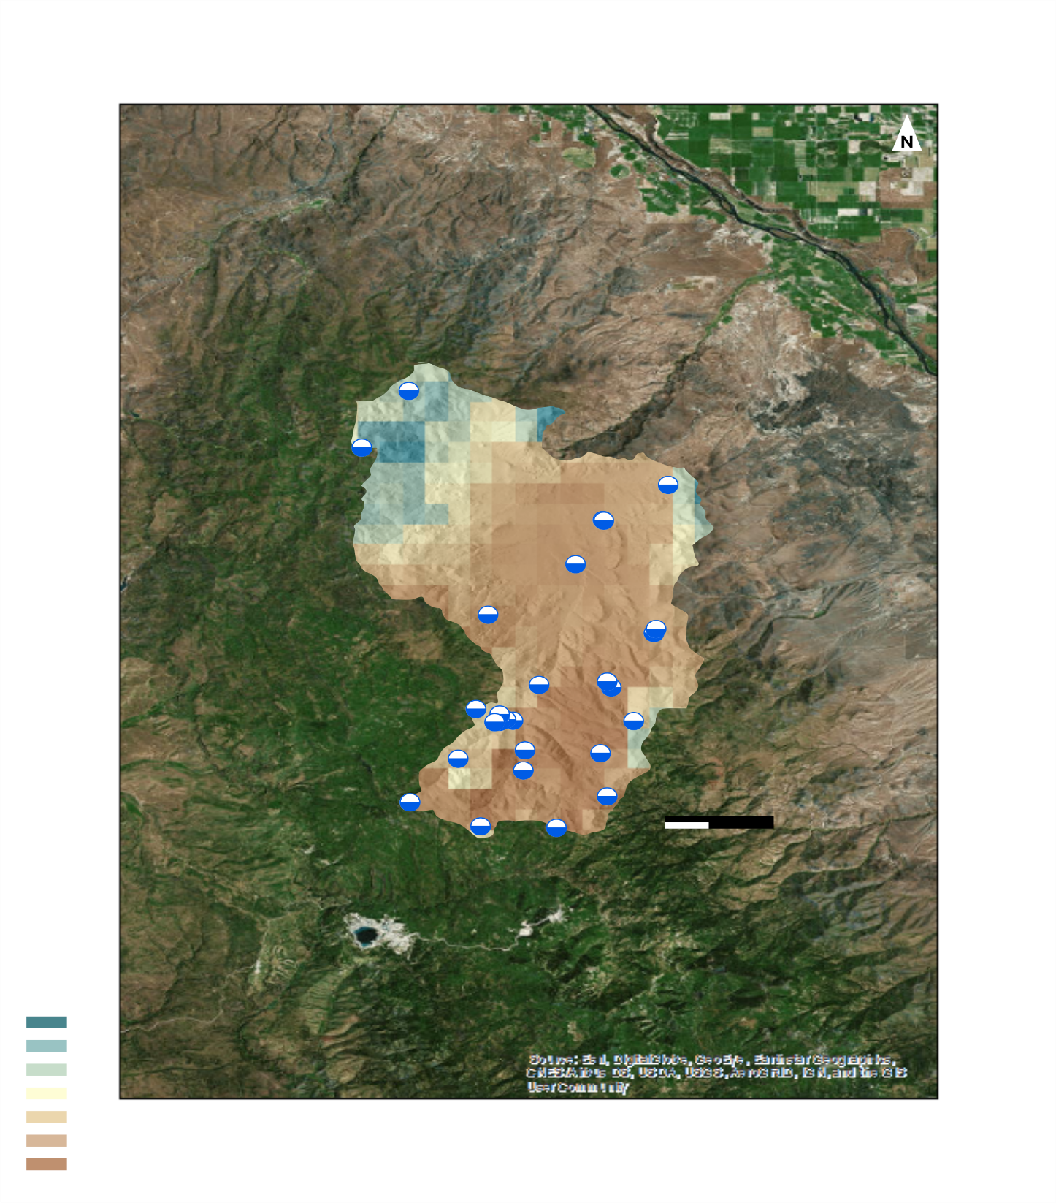



What element is missing from this map?
Soil Moisture Validation Sites
a reference map
MAPS
Soil Moisture Value:
0.6
Make sure all text is legible and in Century Gothic font.
Add legends separately so they can be moved or resized.
A scale bar is required for reference on all maps and should not be separate but the scale bar text should be.
A North arrow is required.
Inset maps are suggested to give context to your map’s location.
Cite base layer source in speaker notes.
0
km
2
5

Slide 9



SEPARATE & EDITABLE: THE BAD
Bad Example:
Legend is not separate or editable
  Barely legible
North arrow is hard to see
Scale bar is the only thing that is separate
If you can’t read a legend at 100% on your computer screen, your audience won’t be able to read it during a presentation.

Slide 10

SEPARATE & EDITABLE: THE BAD
Bad Example:
Legend is not separate or editable
  Barely legible
  Never label your legend “Legend”
North arrow is hard to see
No locational context for where this state is located

Slide 11
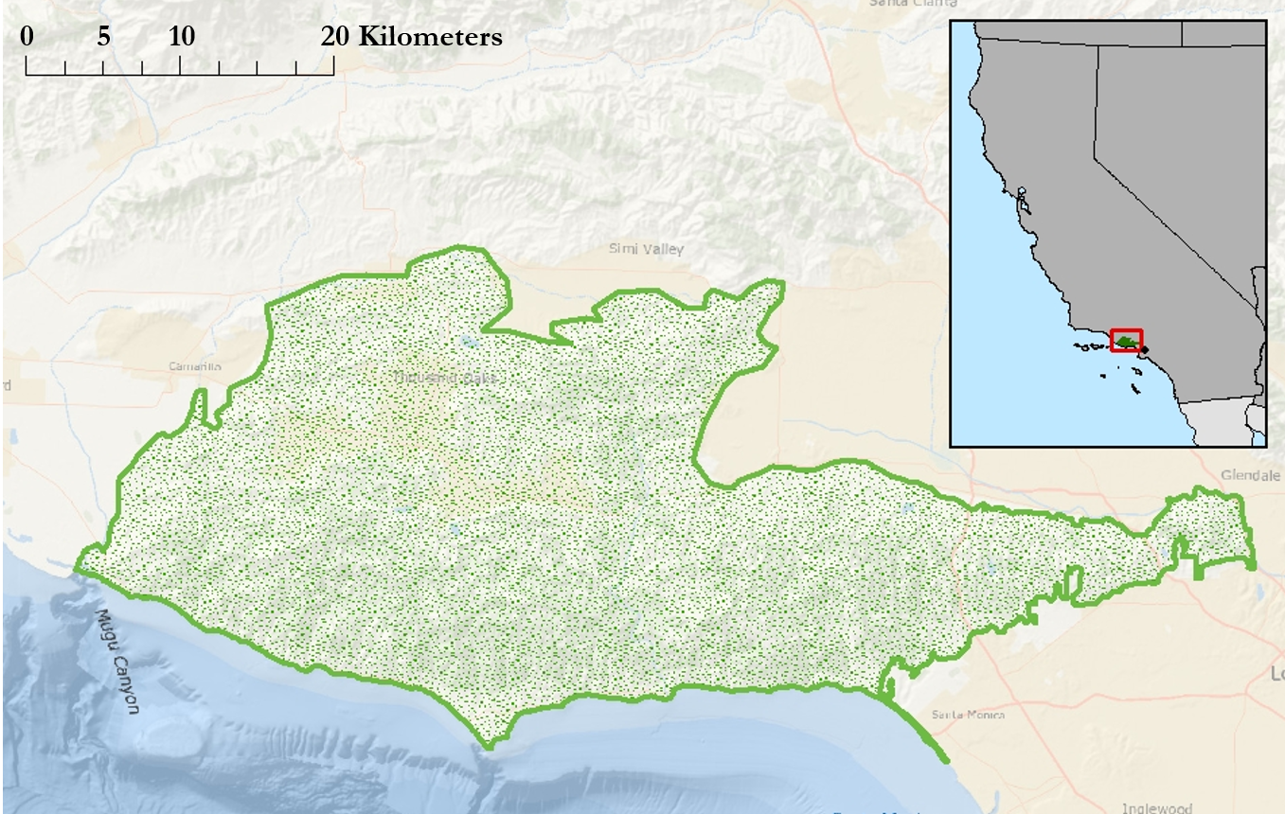
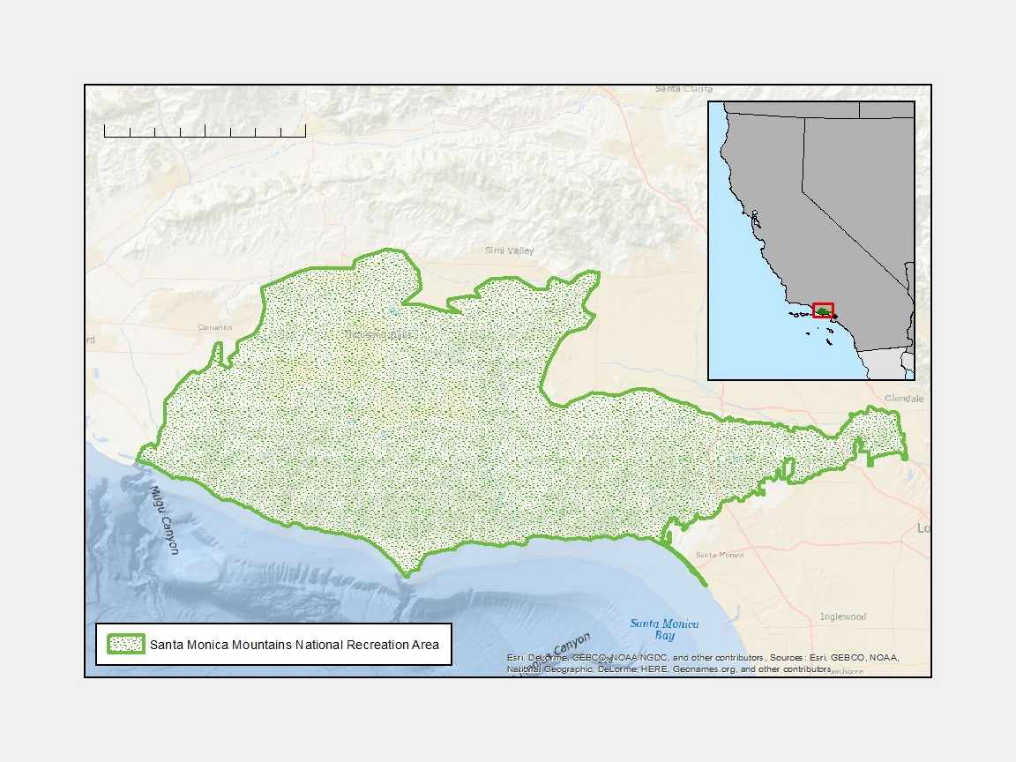
SEPARATE & EDITABLE: THE GOOD
0 5 10 15 20 Kilometers
Good Example:
All text is separate and editable
North arrow is included
Inset map is included to give locational context
Legend is easy to understand and is not titled “Legend”
NV
CA
Los Angeles
MEXICO
Santa Monica Mountains National Recreation Area

Slide 12
List advisors, partners, and others who have contributed in any way to the project.
If your project is a multi-term one, acknowledge past contributors.
If you used ESA data, you need to include the following disclaimer:
This material contains modified Copernicus Sentinel data (insert year), processed by ESA.
If you used Esri Software, include the following at the bottom (10 pt. font):
Maps throughout this work were created using ArcGIS® software by Esri. ArcGIS® and ArcMap™ are the intellectual property of Esri and are used herein under license. All rights reserved.
You must use this slide template for your acknowledgement section!

