Slide 1
Tonlé Sap
Agriculture III
Evaluating Changes in Ecosystem Vitality and Freshwater Health in the Tonlé Sap Basin using Remotely Sensed Data
Joey Lindsay, Keida Gaba, Lindsay Harmon, Susan Jarvis
Virginia – Langley

Slide 2
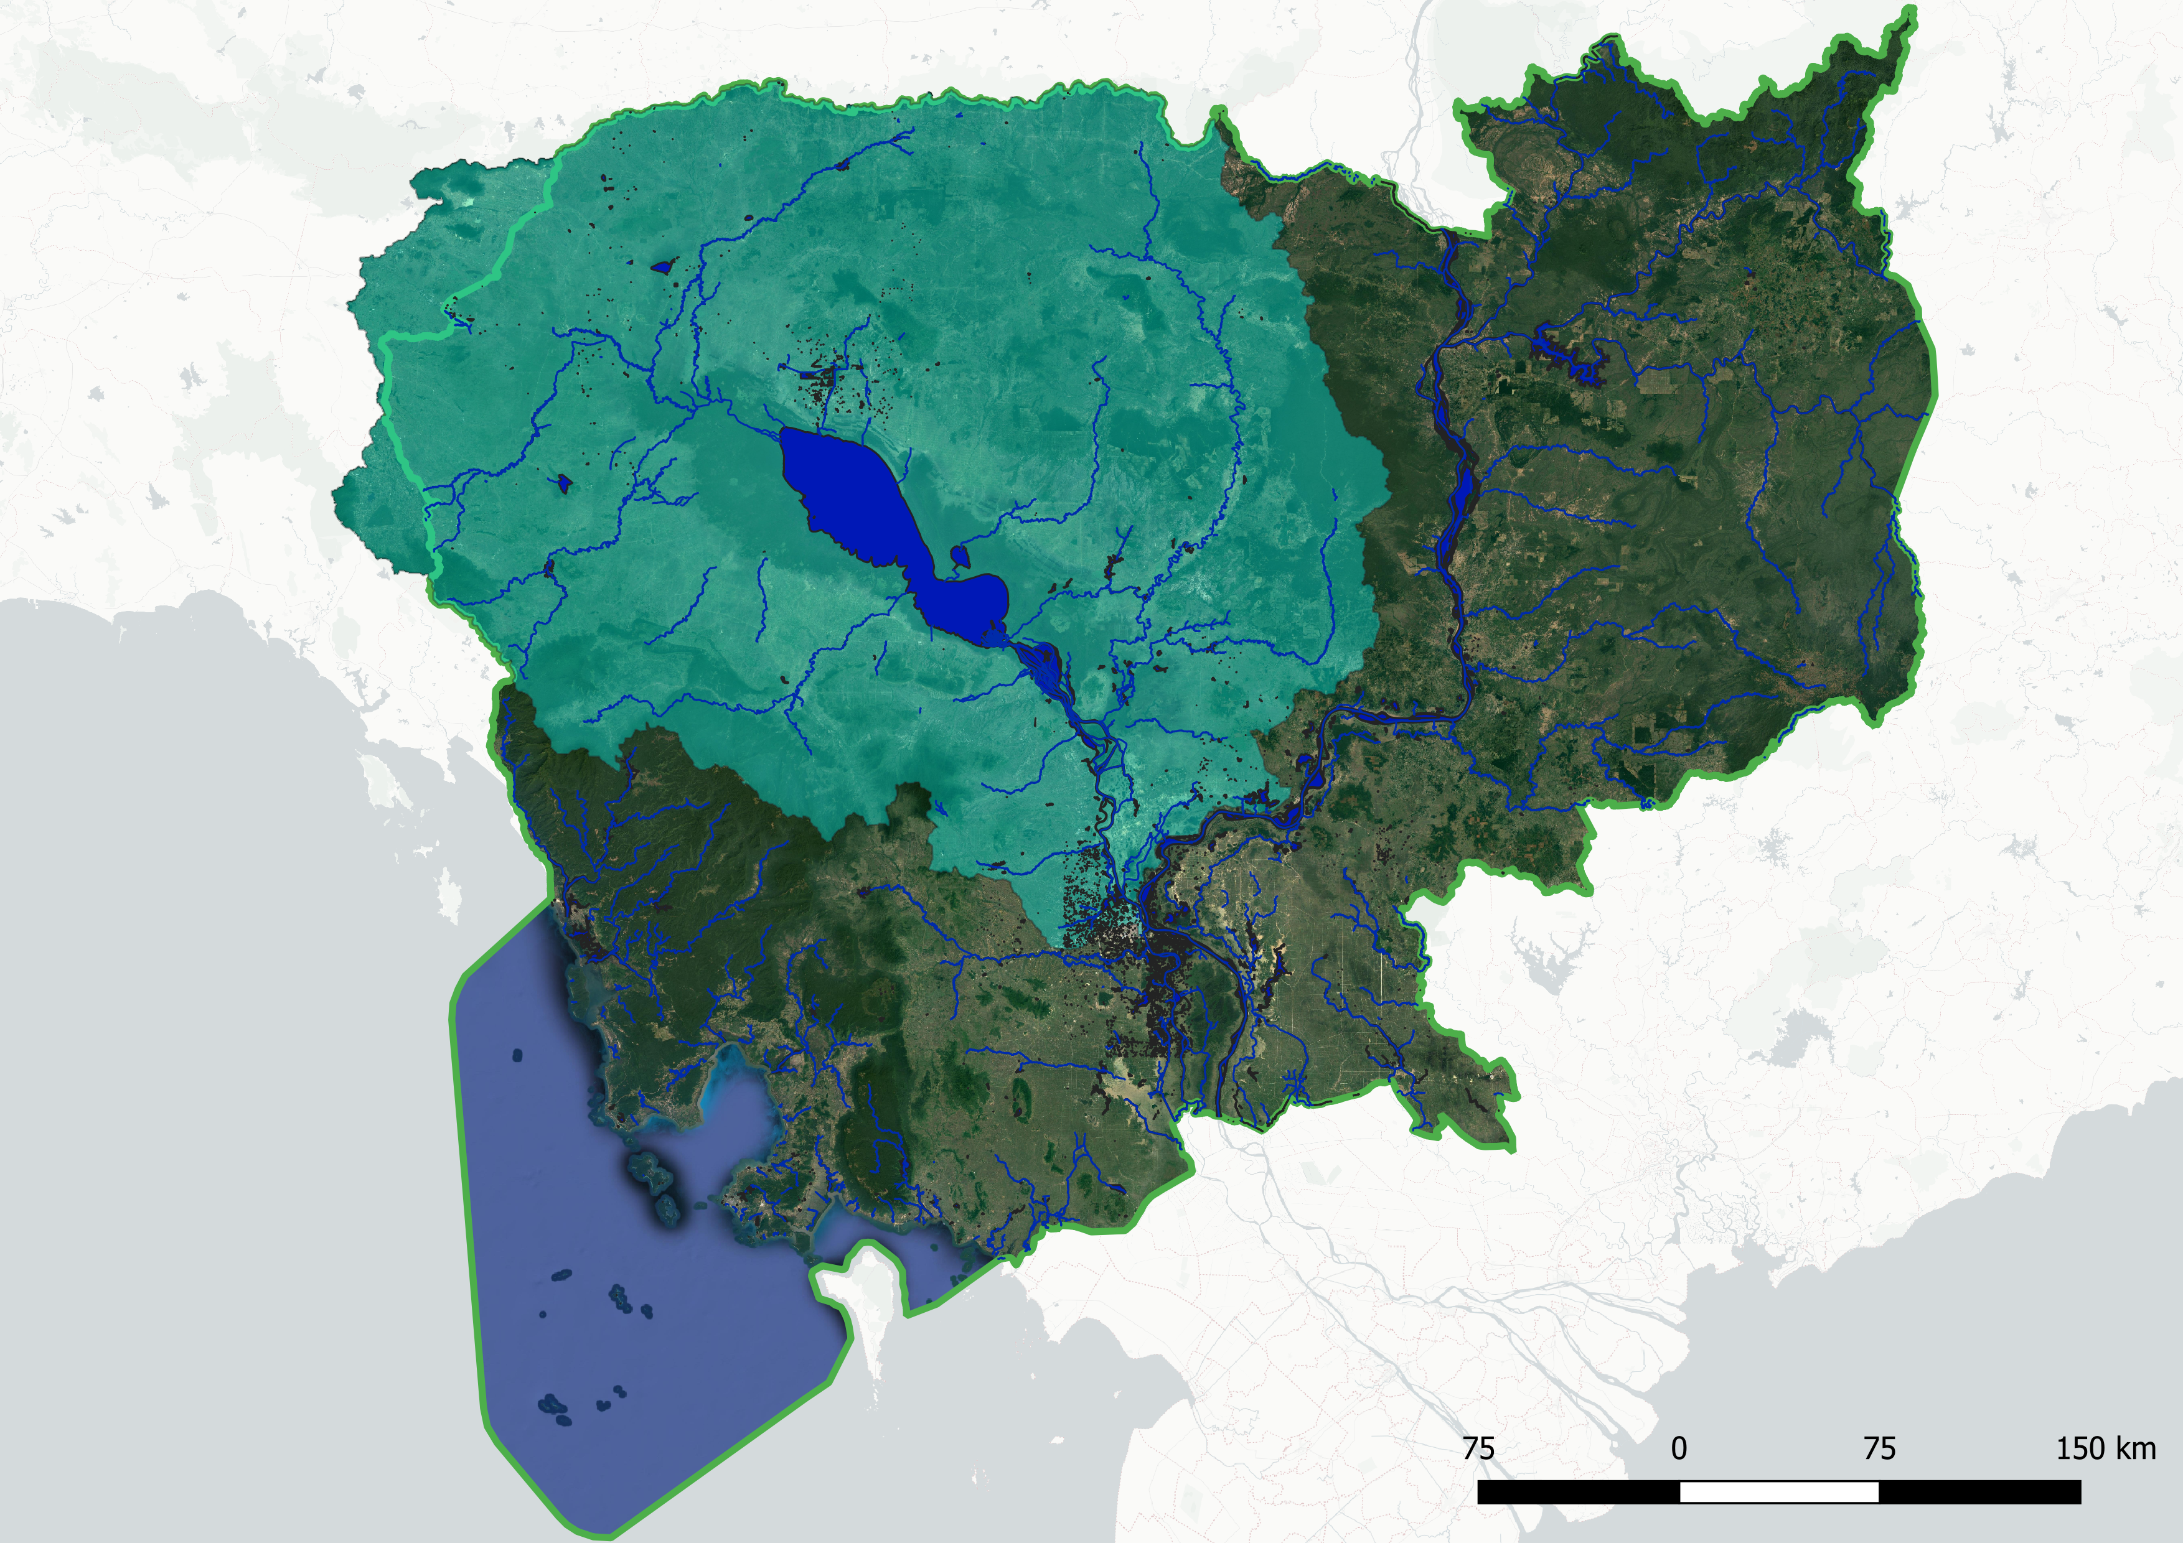
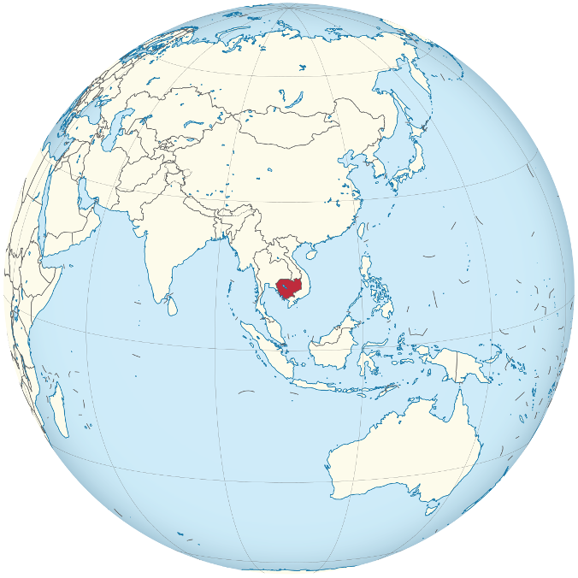
Tonlé Sap Lake
N
0 75 150 225
Source: Wikimedia Commons
Notes:
Our study site sits in the center of Cambodia, and we’ll be looking specifically at the Tonlé Sap Lake and river basin. The green line shows the country boundary of Cambodia, and the blue shape at the center is Tonlé Sap Lake — the largest lake in Southeast Asia!
Image Credits-----------------
Globe image: By Addicted04, source: https://commons.wikimedia.org/w/index.php?curid=30824720, license (CC BY-SA 3.0): Creative Commons — Attribution-ShareAlike 3.0 Unported — CC BY-SA 3.0, no changes were made
Map made by Tonle Sap I team

Slide 3
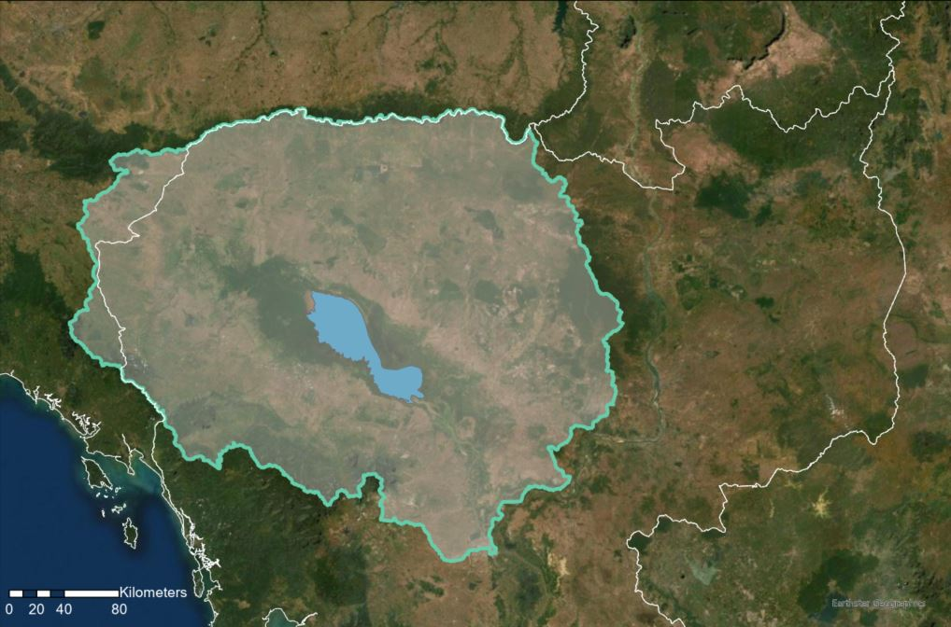
Study Area:
The Tonlé Sap Basin
Thailand
Laos
Cambodia
N
Vietnam
0 20 40 80
Notes:
SUSAN
The Tonlé Sap basin is a densely populated biodiversity hotspot, and “is of international significance culturally, hydrologically, and ecologically.” The basin has a unique hydrological cycle, where the annual rainy season reverses the flow of the Mekong river, leading to massive amounts of flooding and an increase in the lake's surface size and expanding to areas outside of the dry season lake area as shown in light blue.
The annual flood delivers nutrients that nourish nearby rice plantations and creates flooded forests that create ideal fish nurseries. These natural resources and ecosystem services directly support over 1 million people nutritionally and economically.
---------------------------
Map image and graphics produced by Tonle Sap III team

Slide 4
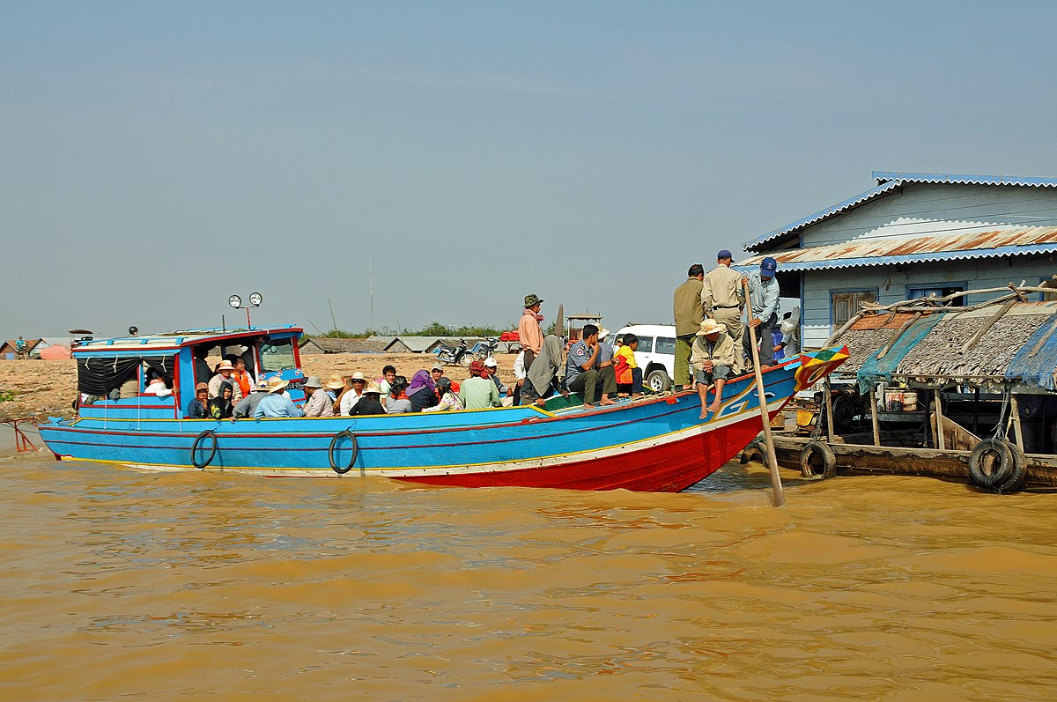
Community Concerns
Reductions in Fish Catches
Deforestation
Less Carbon Absorption
Agricultural production
Hotter Dry Seasons/ Drought
Building of Dams
Source: Wikimedia Commons by Dennis Jarvis
Notes:
Keida Speaker Notes:
Reductions in fish catches – Fishing as means of supporting local livelihoods and providing protein and sustenance is threatened, due to shrinking water levels and increasing pollution.
Deforestation- deforestation due to commercial farming, land development and logging for firewood are all matters of concern as Cambodians look to support themselves and their livelihoods.
Less Carbon Absorption – the burning of forests has contributed to the drop in lake water level, and loss in trees that act as water catchment areas. the flooded forests on the lake's edge are a massive carbon sink, and deforestation in the area threatens the fisheries in the lake
Agricultural production– The lake drains a massive amount of sediments from the surrounding region and filters freshwater. Its water is additionally important for the rice fields that surround the watershed. Supporting the population by increasing agricultural productions is stressing water levels.
Hotter dry seasons – combined with rising global temperatures, the reduction in forest cover and lake surface area threatens to make the Cambodian dry season increasingly hot and increase frequencies of droughts.
Dams – Proposed dam construction have detrimental impacts on lake levels and lake flood cycles. Energy concerns, however dams are not without negative consequences and may cause soil erosion, land slides, and reduced water quality
-------------------------------
Men on riverboat in Tonle Sap: https://commons.wikimedia.org/wiki/File:Cambodia-2965_(3635417492).jpg license CC

Slide 5
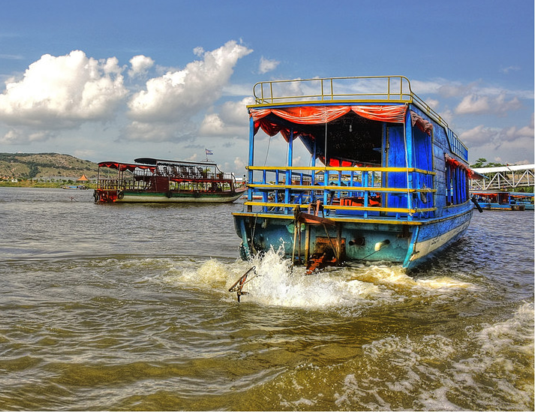
Partners
Cambodian Ministry of Water Resources and Meteorology
Governing body for the basin
Houses the Tonle Sap Authority
Conservation International
Non-profit organization
Created the Freshwater Health Index (FHI)
Source: Creative Commons by Daniel Mennerich
Notes:
Speaker Notes:
Our partners for the project are Conservation International and the Tonle Sap Authority. Conservation International is seeking to create a tool that will allow the FHI to be replicable across the globe. Their hope is to assess water ecosystem vitality for communities to restore stability in key areas and streamline decision making processes. Our other partner is the Cambodian Ministry of Water Resources and Meteorology. They house the Tonlé Sap Authority, who is the main governing body in the area and who relies on the health assessment of the Lake and basin to address and balance development concerns, ecosystem health, and a growing population.
------------------------------
Floating houses: "Tonle Sap Lake K - Chong Kneas the floating village 11" by Daniel Mennerich is licensed under CC BY-NC-ND 2.0

Slide 6
Freshwater Health Index Overview
Ecosystem Vitality: The ecological functioning of the freshwater body and its watershed
Governance & Stakeholders: decision-making structures and processes
Basin Condition
Biodiversity
Flow connectivity
Land cover naturalness
Bank modification
Species of concern
Invasive species
Water Quality
Water Quantity
Ecosystem Services: benefits to populations and livelihoods
Water quality (total suspended solids, nitrogen, phosphorous)
Deviation from natural flow
Groundwater storage depletion
Notes:
Keida
Conservation International developed the Freshwater Health Index, a tool to monitor baseline water systems. Such a tool is crucial for understanding complex social and ecological relationships and will serves as a monitoring system to mitigate threats to the basin by producing scores for each indicator. The freshwater health indicators are ecosystem vitality, ecosystem services, and governance & stakeholders. The DEVELOP Tonlé Sap projects focused on aspects within Ecosystem Vitality, which is further broken down into four areas of assessment: Basin condition, biodiversity, water quality and basin condition.
Graphic by Tonlé Sap I team, altered by Tonlé Sap II Team,

Slide 7
Freshwater Health Index Objectives
Ecosystem Vitality: The ecological functioning of the freshwater body and its watershed
Term I
Results
Basin Condition
Biodiversity
Flow connectivity
Land cover naturalness
Bank modification
Species of concern
Invasive species
Term II Results
Water Quality
Water Quantity
Term III Objectives
Water quality (total suspended solids, nitrogen, phosphorous)
Deviation from natural flow
Groundwater storage depletion
Notes:
Keida
We continued to build on the work of the previous Tonlé Sap DEVELOP teams. Terms I assessed land cover naturalness, deviation from natural flow, while Term II tackled water quality aspects. Our objectives for the project was to continue water quality assessment and gather applicable data to receive a final score to provide partners. For flow connectivity we inputted river and dam information. The rest will come as we finish up the FHI
Graphic by Tonlé Sap I team, altered by Tonlé Sap II team, updated by Tonlé Sap III Team

Slide 8
Summary of Previous Term's work
Spring 2021
Summer 2021
Fall 2021
Tonlé Sap Food Security & Agriculture
Water-level time series
Land use and land cover change maps
Tonlé Sap Food Security & Agriculture II
Ecosystem vitality
SWAT Model
GRACE
Tonlé Sap Food Security & Agriculture III
Compile work done by previous terms
Synthesize results into FHI
Calibrate previous term's model: SWATCUP
Notes:
SUMMARY OF PREVIOUS TERMS – SUSAN
As mentioned previously, our team compiled the work from the previous terms' teams with the objective of synthesizing results, calibrating models, and continual data processing of inputs for Conservation International's Freshwater Health Index. In this section I am going to break down how the project was broken up between the three teams over the three terms:
The Tonle Sap Food Security and Agriculture project started in Spring 2021. The first term of this project created a water level time series of Tonlé Sap lake, and used it to calculate deviation from natural flow within the FHI. The team also compiled land use and land cover change maps to calculate land cover naturalness.
In summer 2021, the project continued under the title, "The Tonle Sap Food Security and Agriculture project 2. This team built on prior work by continuing to integrate and refine inputs into the FHI to calculate ecosystem vitality as a major indicator. The summer team worked with the Soil & Water Assessment Tool, (SWAT model) to calculate water quality parameters for Tonle Sap. They also worked towards developing methodology for groundwater storage using GRACE satellite data.
Which brings us to Fall 2021.
We are the Tonlé Sap Food Security & Agriculture III team. Our group objective is to compile the work done by previous teams, synthesize results, calibrate the water quality model utilizing SWATCUP, and forecast future resource distribution of the basin by loading in all available inputs into the FHI.

Slide 9
Project Objectives
1
2
3
Calculate water quality with SWAT model and remotely sensed data & calibrate model using SWAT-CUP
Develop
methodology for calculating
groundwater
storage using
GRACE satellite data
Develop set of tools and software package to integrate remotely sensed data into future FHI analyses
Notes:
LINDSAY
Our specific project objectives will be, 1, to use remotely sensed data to run a Soil and Water Assessment Tool or SWAT model on the Tonlé Sap basin and assess nutrient flows and water quality.
2, to calculate and map changes in groundwater storage over the course of the 20 year study period.
And 3, to develop GEE code that will allow partners and end-users to leverage the same remotely sensed datasets in other FHI assessments.

Slide 10
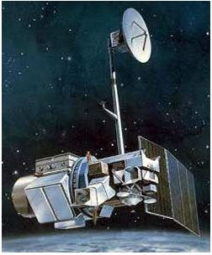
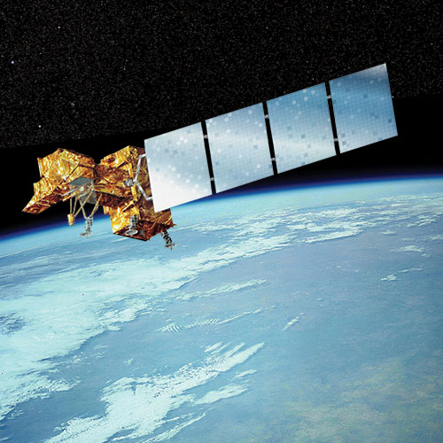
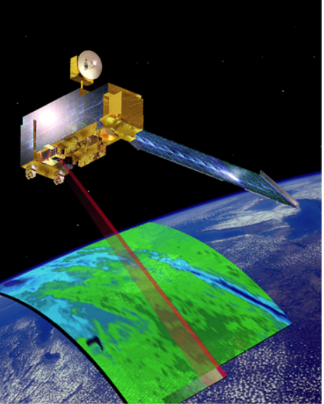
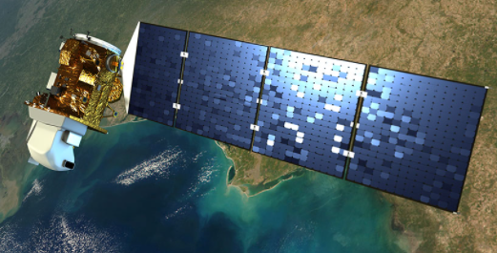
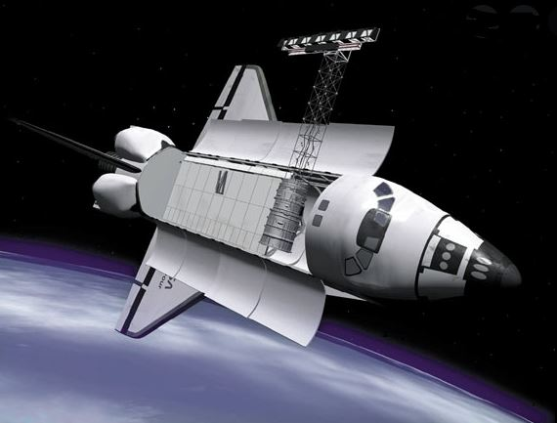
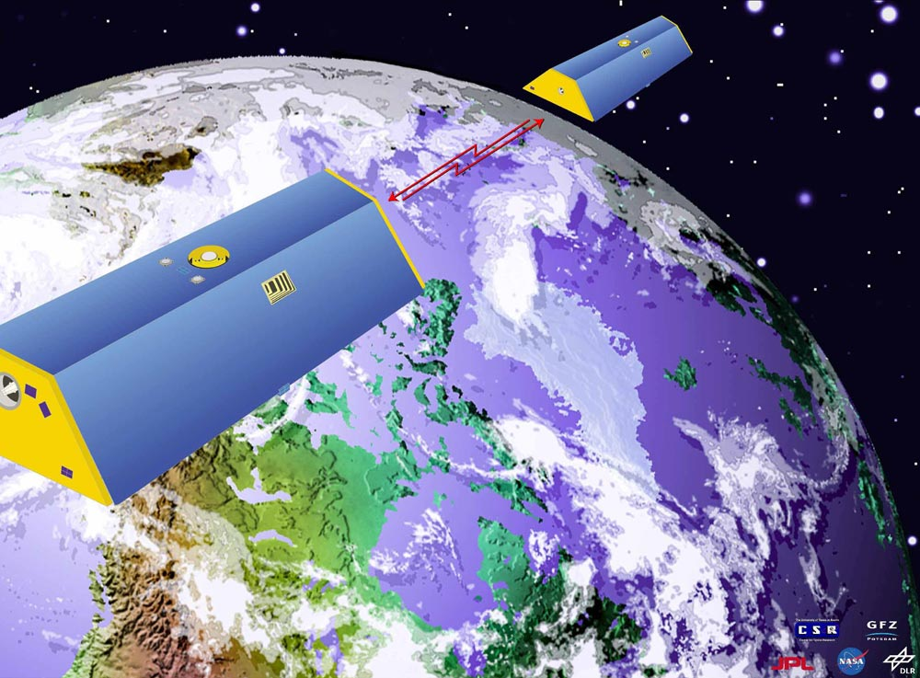
Satellites Used
Landsat 5 TM, Landsat 7 ETM+, Landsat 8 OLI
Terra MODIS
Source: NASA Historical ​
Missions Gallery
Source: NASA Landsat
Observing System
Source: NASA Terra
Source: NASA Landsat Overview
Source: NASA JPL
Shuttle Radar Topography Mission (STRM), Radar
Source: NASA JPL
Gravity Recovery and Climate Experiment (GRACE)
Source: Wikimedia Commons
Notes:
*Susan
Speaker Notes:
An FHI assessment requires mostly in situ data, and one of our goals was to test the feasibility of using remotely sensed datasets to provide the basin characteristics required to make an FHI assessment.
SRTM was used to provide the digital elevation model as a SWAT input, GRACE was used to provide groundwater storage information for the Freshwater Health Index (FHI), and Landsat 5TM, Landsat 7ETM+, and Landsat 8 OLI was used derive NDVI, measure surface reflectance in the Tonle Sap Basin and track vegetation changes from 2000 to 2020. NASA'S Terra MODIS, specifically the the MOD13A2 V6 product, provided an additional Normalized Difference Vegetation Index to create an animation for the NDVI changes of Tonle Sap for the years 2000-2020.
Image credits------------------------------------
GRACE: https://www.jpl.nasa.gov/missions/gravity-recovery-and-climate-experiment-grace, provided by NASA JPL
Shuttle Radar: https://www.jpl.nasa.gov/missions/shuttle-radar-topography-mission-srtm, provided by NASA JPL
Landsat8: https://www.nasa.gov/mission_pages/landsat/overview/index.html, provided by NASA Landsat Overview
Landsat7: https://eospso.nasa.gov/missions/landsat-7, provided by NASA's Earth Observing System Project Science Office
Landsat5: https://www.nasa.gov/directorates/heo/scan/services/missions/earth/Landsat5.html, provided by NASA Landsat-5

Slide 11
Study Period: 2000-2020
ERA5 – SRTM
Landsat 5 TM, Landsat 7 ETM+, Landsat 8 OLI & Terra MODIS
GRACE
Study Period, FHI Outputs Yearly
Notes:
Our study period is from 2000 to 2020, with FHI assessments calculated annually. The remotely sensed datasets we used have variable ranges of availability. Air temperature and precipitation had data for our entire study period, but GRACE data is only available from 2002 to 2017.

Slide 12
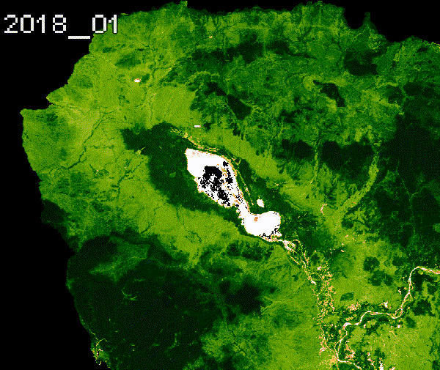
MODIS NDVI
for Tonlé Sap Lake
Visualized 2000-2020 imagery of calculated NDVI values; on the right is an example of a 3-year time series animation.
Imagery processed through Google Earth Engine (JavaScript coding language)
MOD13Q1.006 Terra Vegetation Indices 16-Day Global 250m
Time series data used as a proxy for calculating basin conditions for Tonle Sap.
Color gradient from tan to dark green = low to high photosynthetic capacity
MOD13Q1.006 Terra Vegetation Indices 16-Day Global 250m
(Tonlé Sap Basin, January 1st, 2018 - December 31st, 2020)
Notes:
SUSAN
One of the proposed methods of calculating bank modification for the Tonle Sap was utilizing the MOD13Q1.006 Terra Vegetation Indices 16-Day Global 250m to create a time series of MODIS derived Normalized Difference Vegetation Index (NDVI) values.
By calculating changes in green-ness reflectance values over time for Tonle Sap, potential bank modifications can be detected through remotely-sensed data to better understand basin condition, (/agricultural changes/physical land alterations).
MODIS is a moderate resolution satellite imaging system and NDVI is a common reflectance-based vegetation index. In the above animation, NDVI is mapped from the years 2018 to 2020, spanning January 1st to December 31st, as a color gradient from tan to dark green, representing low to high photosynthetic capacity. (low to high vegetation cover/density/productivity). The tide-like latitudinal shift in vegetation is associated with the sun’s declination moving between 23.5° north and 23.5° south, relative to the equator, throughout the year.
The general workflow involves:
1. We collected and imported the MODIS vegetation indices dataset, subset the NDVI band, and filter by date from Jan 1 2000, to Dec 31, 2020.
2. We defined region of interest and clip imagery to specified boundaries.
3. Next, we grouped the images into a 16-day composite window using the Join command in Google Earth Engine
4. Then we computed the median of the study area
5. We used this median to reduce the composite groups to single images
5. Finally, we defined the visualization parameters and exported the data as a time series

Slide 13
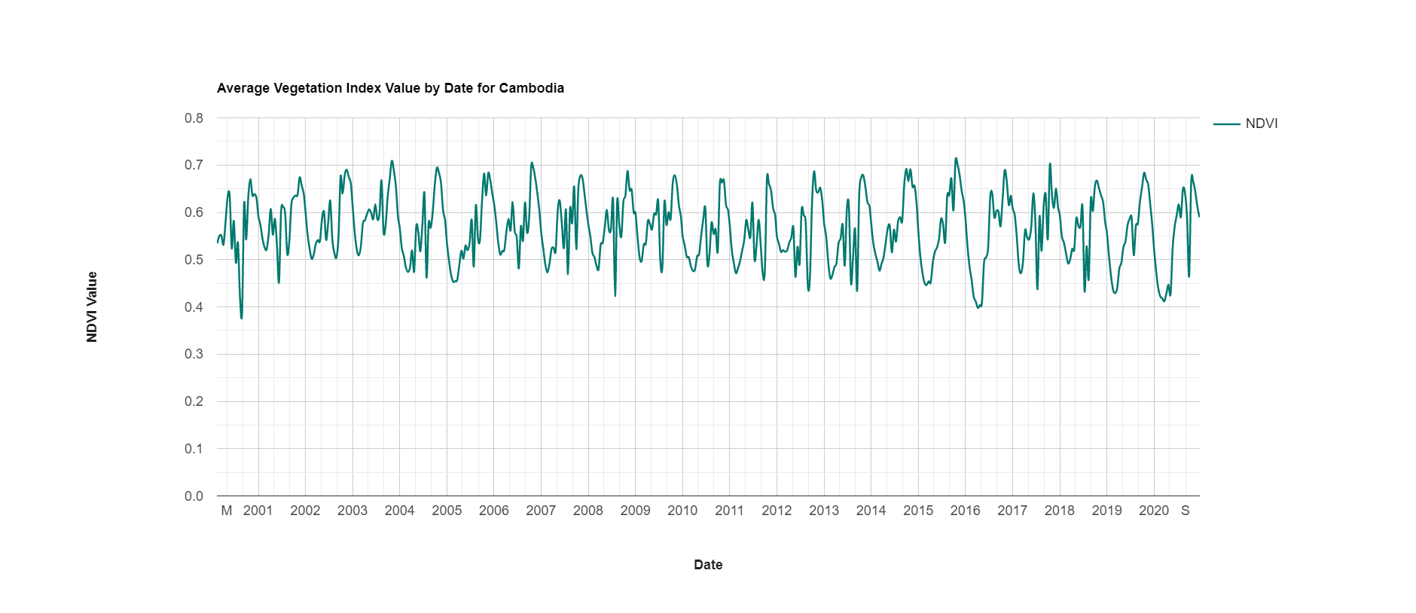
MODIS NDVI for Tonlé Sap Lake
R² = 0.005
y = -2E-06x + 0.6561
Notes:
SUSAN
The chart above was created through Google Earth Engine to calculate average NDVI values by date for the specified study area of Tonle Sap, within Cambodia SE Asia.
The MODIS-produced dataset exhibited:
Range of 0.391 to 0.711. The lowest value, (0.391) was observed in August 28, 2000. The highest value was observed October 12, 2015.
Highest values observed between Oct-Nov (>0.7)
Lowest values observed in April-Aug (<0.5).
As of 2020, maximum NDVI totaled to be 0.67 on October 12, 2020. The results indicate a small decline of NDVI over time, with seasonal variation between the wet and dry seasons.

Slide 14
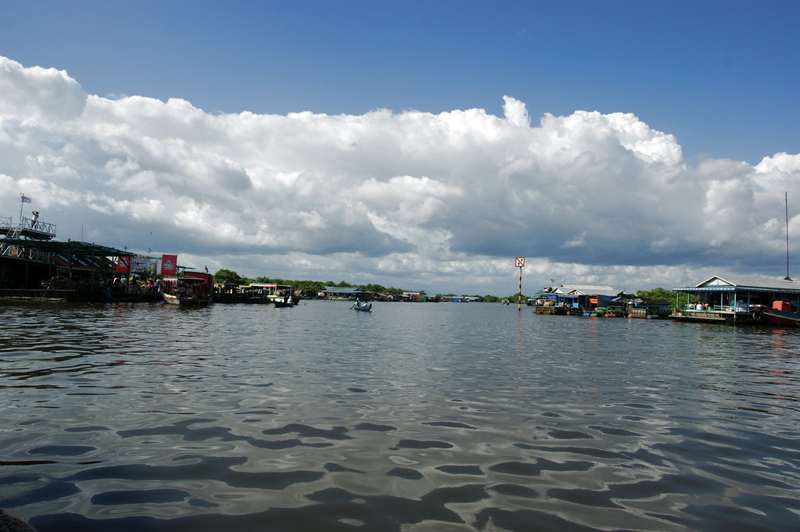
Methodology — Water Quality & SWAT
New Inputs:
Solar Radiation
Stream Locations
Source: Allie Caulfield
Notes:
This slide describes two new inputs that we added to our SWAT model in term three: A time series of solar radiation data, and a shapefile of stream location data. We will further describe these in the next two slides.
Image Credit: "2009-09-03 09-07 Siem Reap 451 Tonlé Sap Lake" by Allie_Caulfield is licensed under CC BY 2.0 (https://search.creativecommons.org/photos/4feb108d-4f99-4fc9-90ef-5d452773a136)

Slide 15
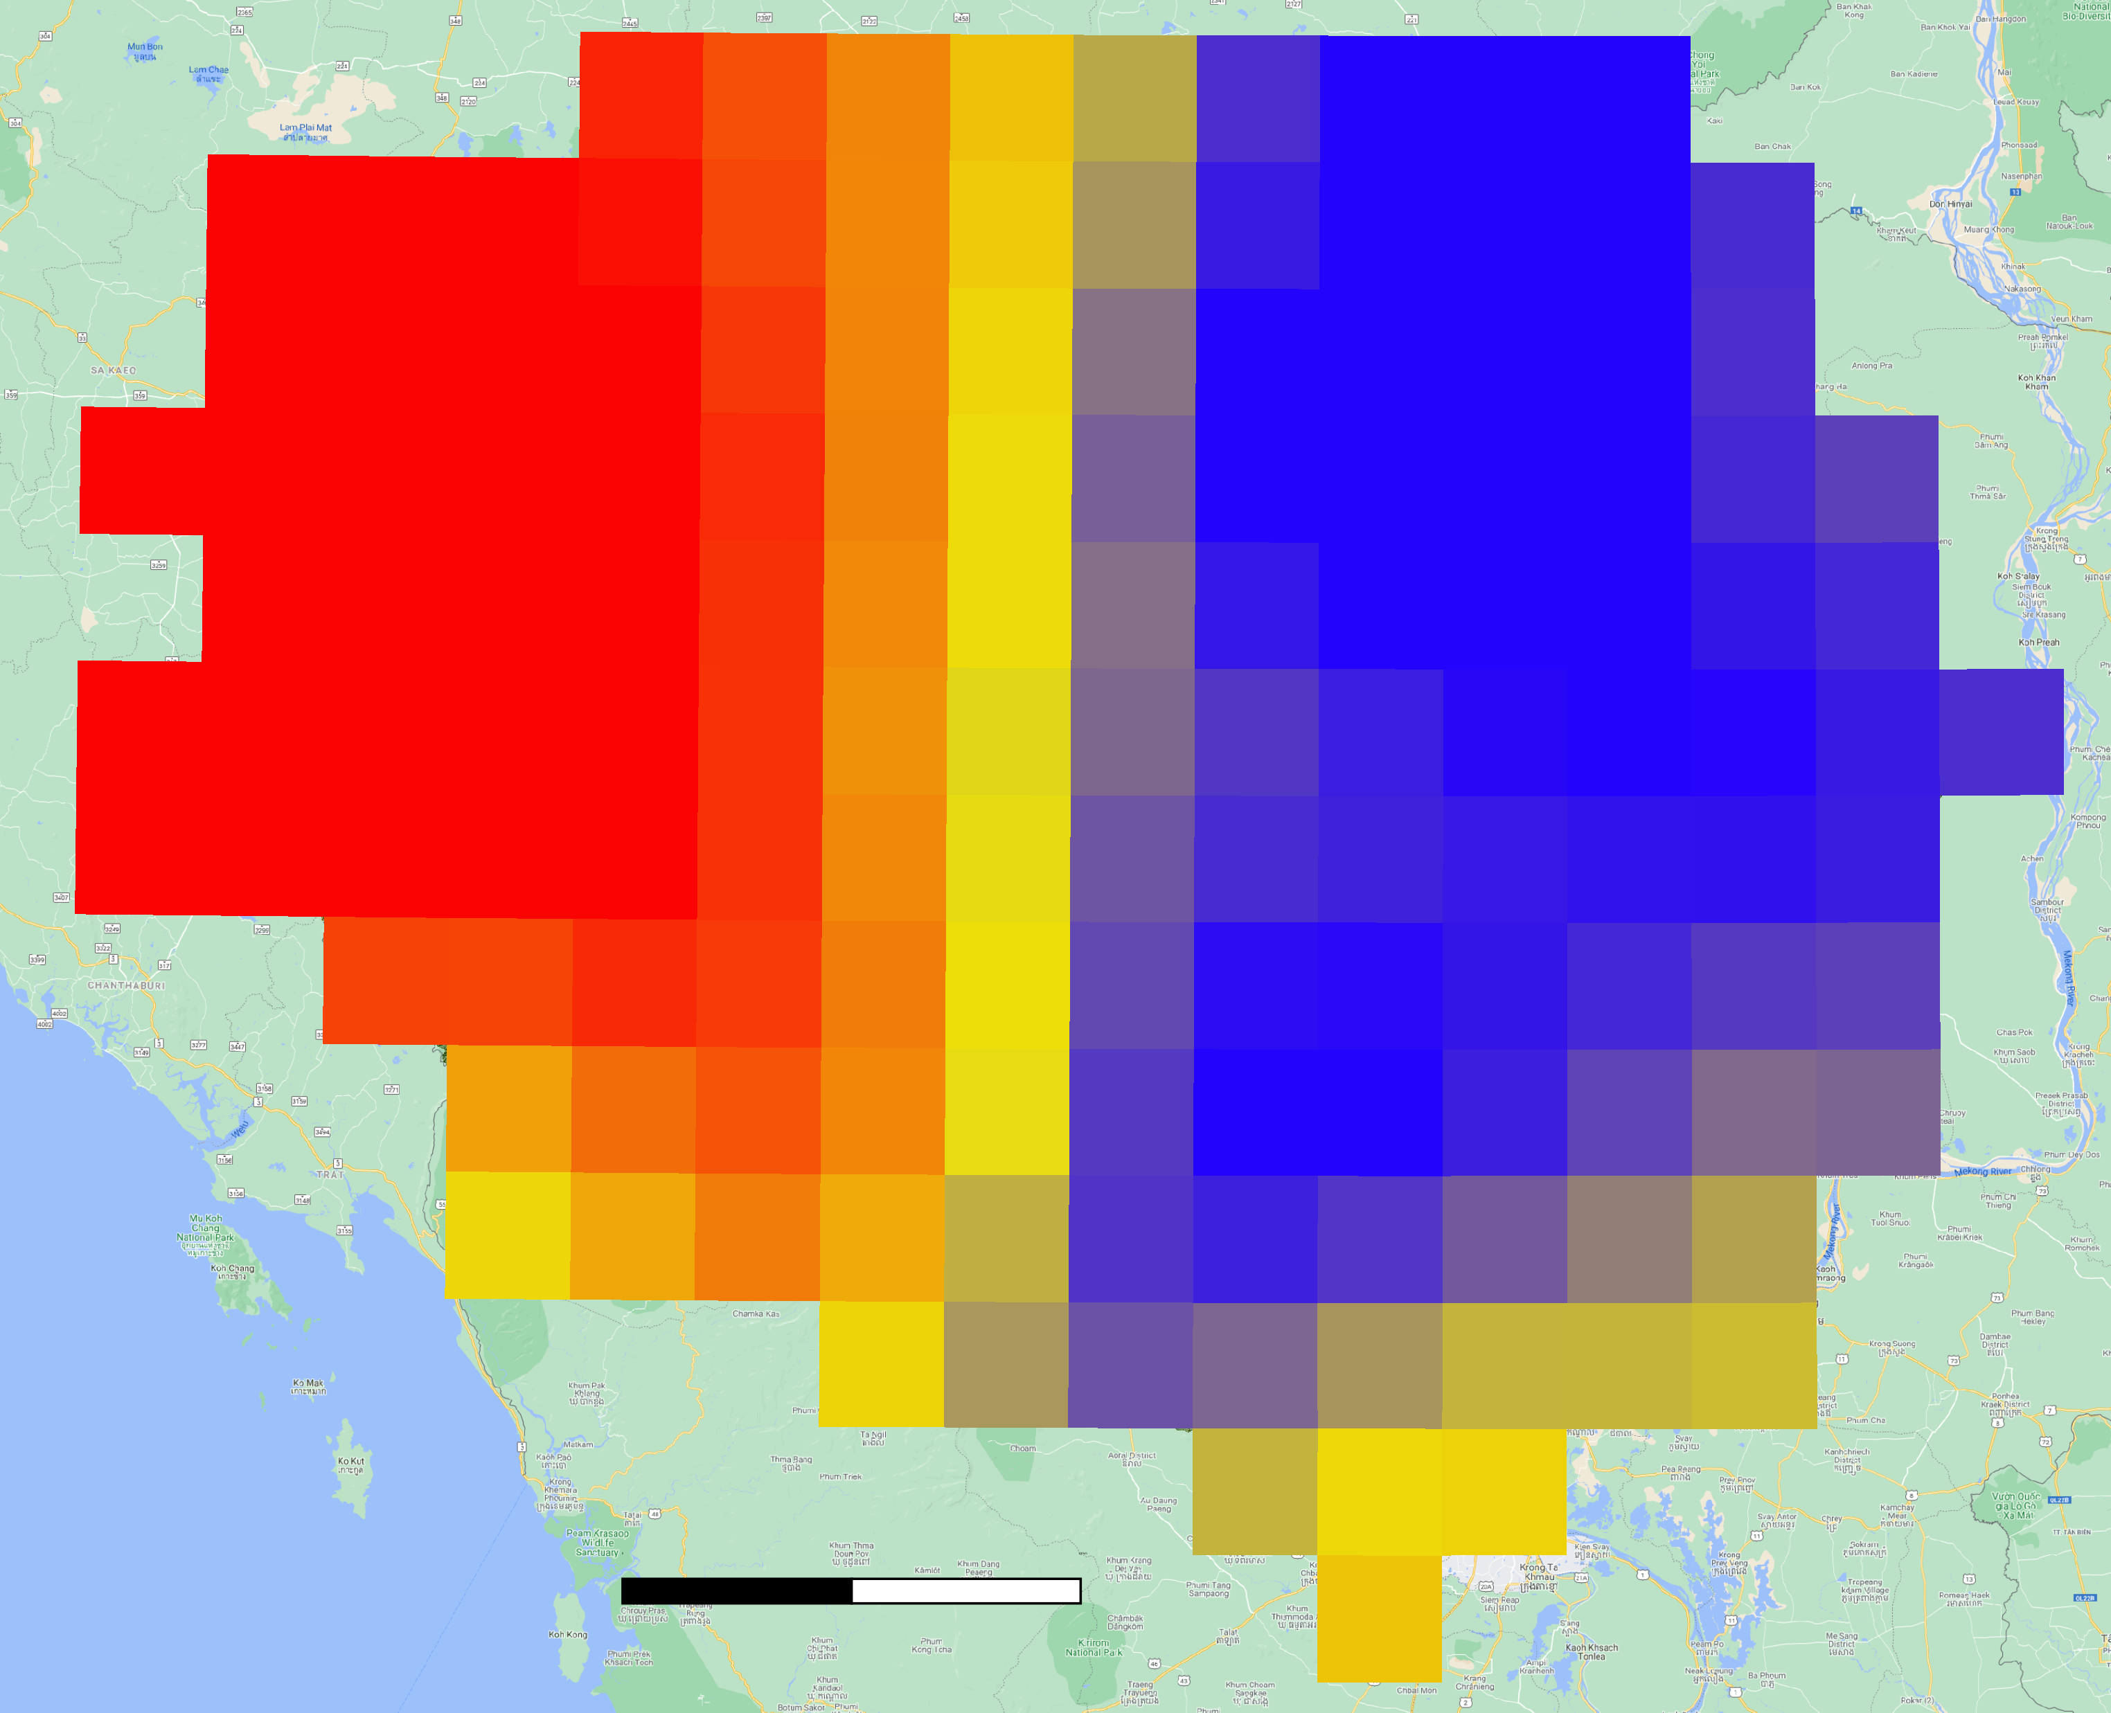
1. Solar Radiation
Solar Radiation data from an ERA5 reanalysis
Help SWAT to describe the temperature of the soil
Helps SWAT calculate evaporation parameters
Surface Solar Radiation (kJ)
6000
8000
11000
12000
N
0 50 100 km
Notes:
This image shows a day's worth of surface solar radiation into our study area Tonlé Sap Basin. It is utilized by SWAT to model soil temperature overtime. This data was added to last term's weather data product catalogue to increase the accuracy of the SWAT model. In the code, it had to be reduced from a temporal resolution of 3 hour to one day, and the spatial resolution had to be halved to match the rest of the ERA5 data.
---------------------------------------------
Image: Own Work

Slide 16
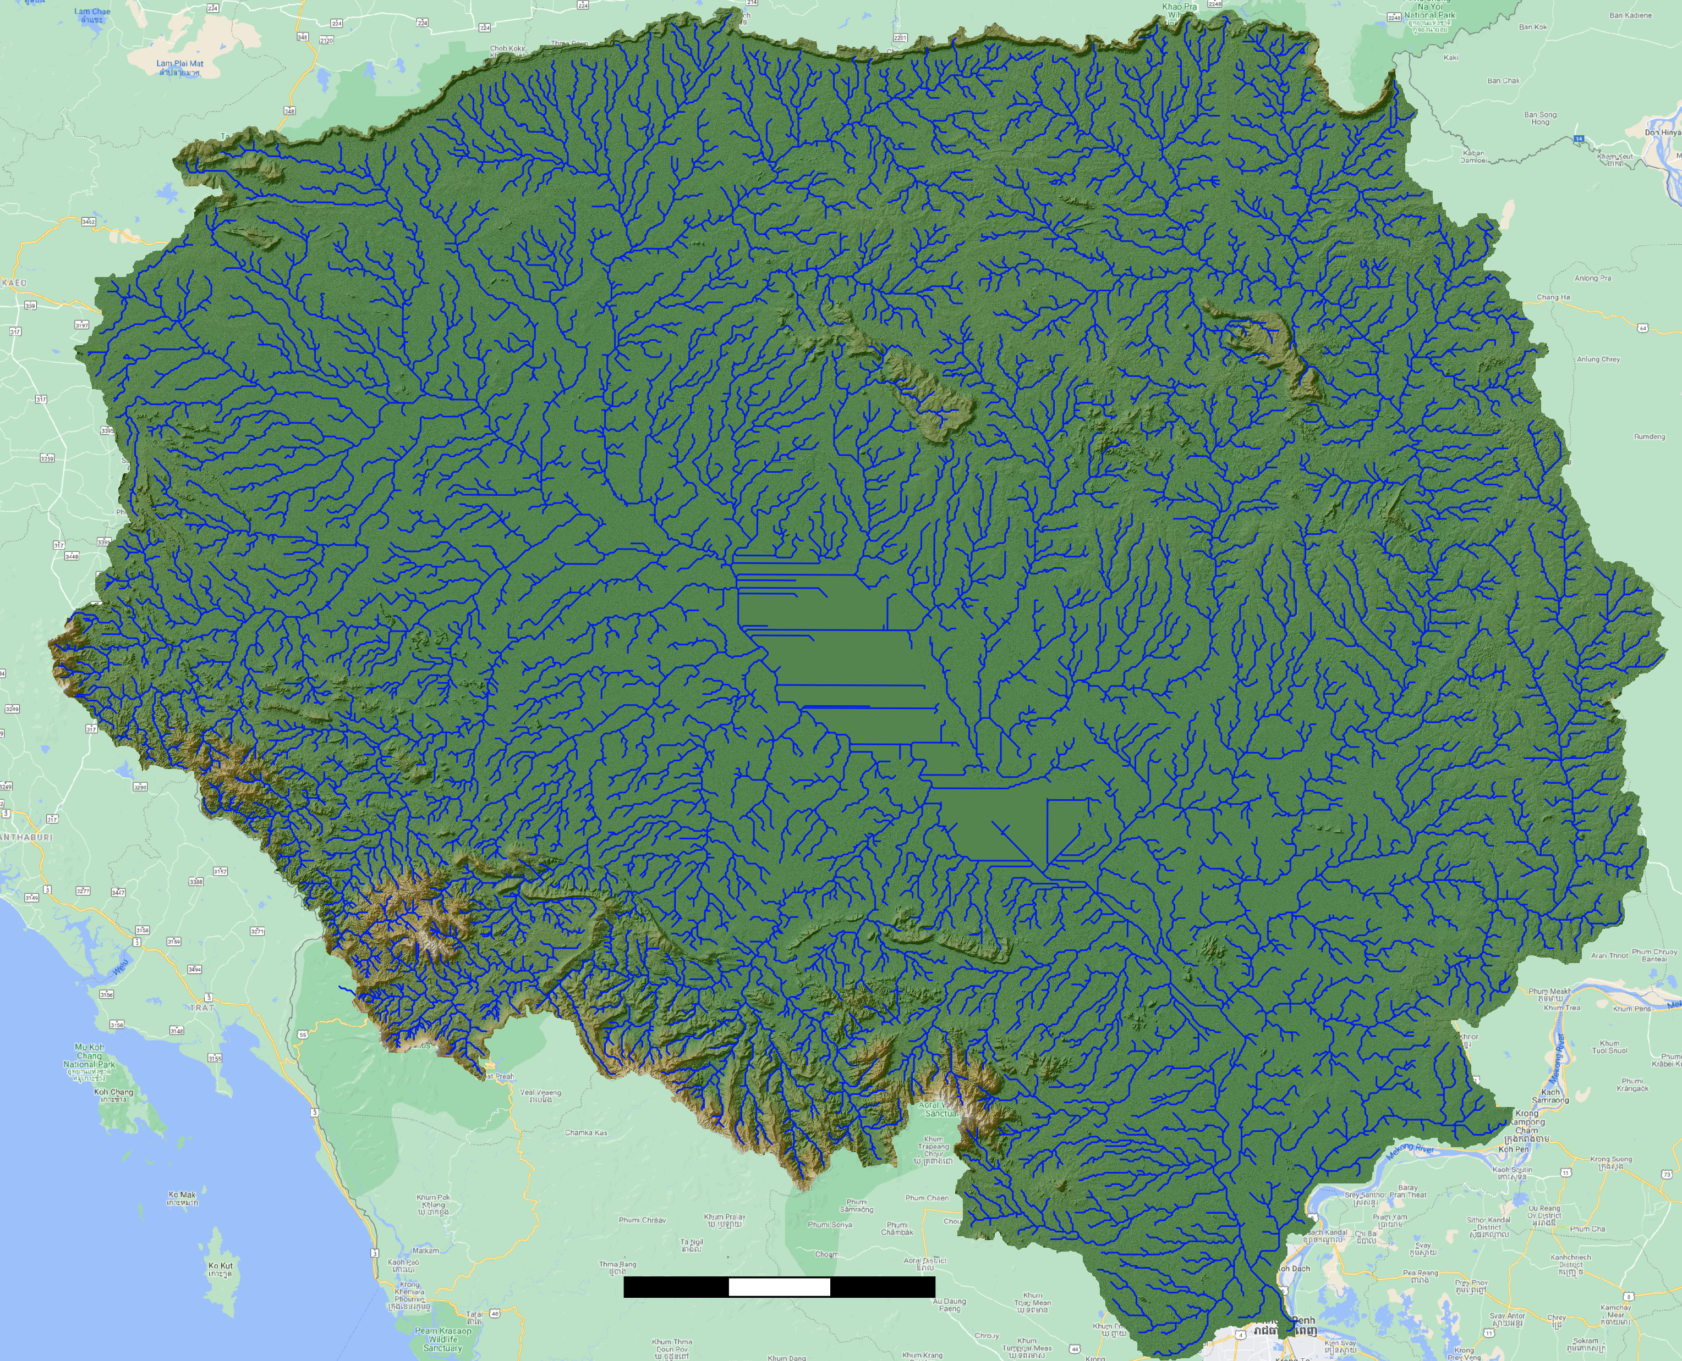
2. Stream Locations
Stream Location data
from the WWF
Helps SWAT differentiate between channels and streams
Helps SWAT place the streams in the correct locations
N
0 25 50 75 km
Notes:
We additionally used free flowing rivers data from the Wold Wildlife Fund to help SWAT determine the locations of streams and cannels within the basin area. These streams were "burned" into the digital elevation model, creating gullies in elevation at their locations. This helped the SWAT model correctly record and classify the streams in the basin.
Image: Own Work

Slide 17
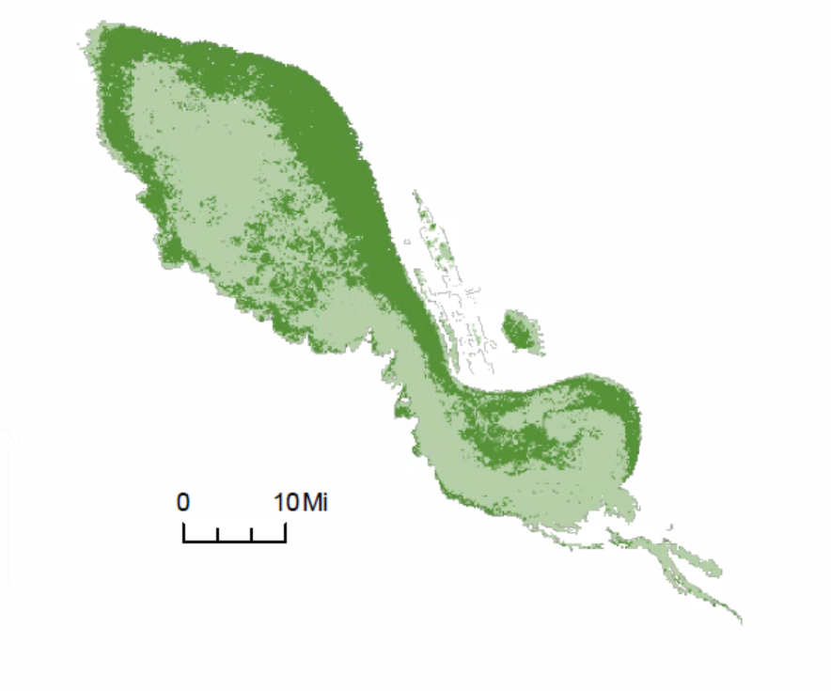
Chlorophyll-a Presence in the Lake
Trophic State Index
90
Median aggregate of monthly Trophic State Index values
Converted into chlorophyll-a concentration
Helps delineate water quality parameters
20
N
0 10 Mi
Notes:
Keida:
The FHI requires water quality indicator values. It is important to assess chlorophyll-a presence and to how it relates to phytoplankton content in the lake. High amounts of chlorophyll is an indicator of high level of phytoplankton presence in the water. Phytoplankton are responsible for the dissolved oxygen content found in surface waters. Because oxygen is required for aquatic organisms, a decrease in photosynthesis productivity may be detrimental to aquatic populations. Our analysis was made using data from the Copernicus Global Land Service mission, the median aggregate trophic state index values were extracted and converted into chlorphyll-a concentrations and inputted into the FHI tool.

Slide 18
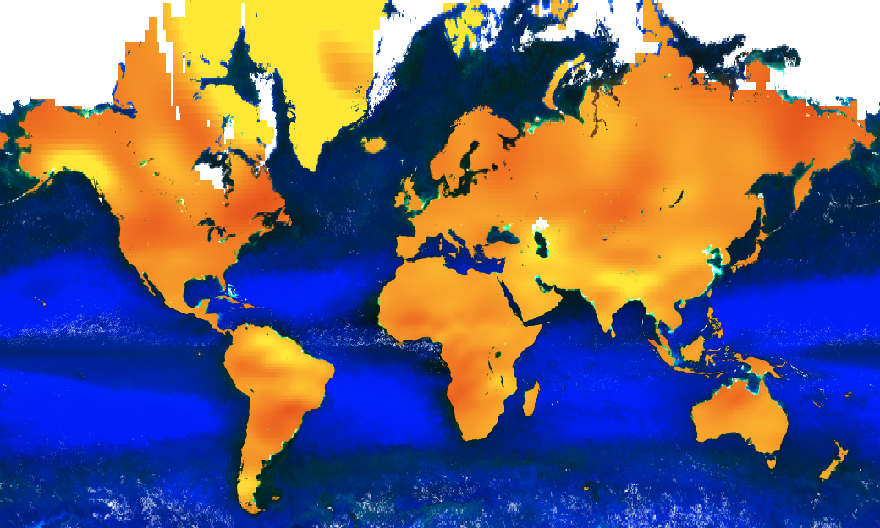
Groundwater Storage Calculation – Changes to Methodology
Calculation derived using GRACE
Using dry season metrics
Analyzed the lowest 5th percentile values of data
Liquid Water
Thickness (cm)
-1
0
+1
200km
ΔGW = ΔTWS - ΔSW - ΔSM - ΔPCI
Notes:
Keida - Our next FHI sub-indicator is Water Quantity, and specifically groundwater storage depletion. This indicator was calculated using The Gravity Recovery and Climate Experiment or GRACE data and the methodology of the previous term was altered and updated to match FHI indicator properties.
The GRACE satellite measures changes in Earth's gravity to provide Total Water Anomaly values, or the difference in water level compared to the baseline from 2004-2010. This metric includes all Terrestrial Water, so to look at groundwater specifically, the previous team isolated soil moisture, plant canopy intercept, and surface water from TWS (the Tonlé Sap Lake in our case). The equation at the bottom right of this slide outlines this transformation.
The Freshwater Health Index asks users to input the total area affected in the basin with groundwater depletion in the study period. Because of this, the Tonle Sap II team focused on dry season measurements only, because this is most likely to be when wells are running dry and water resources are scarce or insecure. Our team took the lowest 5th percentile values from the grace data export, and created a ratio of the affected areas in the grace data export and related it to the overall basin area to see the extent of affected area. This was validated against historical trends of lake water levels which similarly showed a decrease in water levels.
------------------------
Image created by Tonlé Sap II team— Shows Monthly mass land grids from GEE GRACE dataset

Slide 19
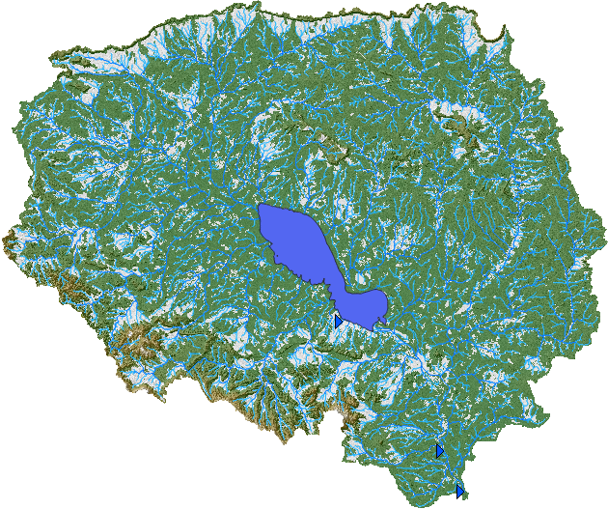
SWAT+
Advantages over SWAT 2012:
Supports lake boundaries
Computes Landscape values from slopes
Differentiates between channels and streams
Easy to use GUI
Notes:
This term, we transitioned from using a SWAT 2012 model to a SWAT+ model. SWAT+ is a more recent version of the software that carries several advantages over its older brother. Foremost for our purposes is its support of lake boundaries, which is critical in a basin that includes a large central lake feature. It additionally computes landscape units to accompany its hydrologic units, leading to more advanced flow and runoff calculations. Its differentiation between channels and streams allows for the model to more accurately determine a reach's contribution to a watershed. Finally, many usability improvements were made between SWAT 2012 and SWAT+, particularly in the design of its graphical user interface. On the right, you see the initial step of the swat model, with the lake boundaries in blue, and the new landscape units in white, indicating extreme slopes next to streams and channels

Slide 20
SWAT CUP
Input preparation Calibration Inputs Post-Calibration Analysis
SWAT Output
Parameters
Calibration Outputs
Calibration uncertainty program for SWAT
Used to perform calibration, validation, sensitivity analysis (one-at-a-time, and global) and uncertainty analysis
Uses txtinout file from SWAT
We used SWAT+ for generating watershed to include more accurate weather data
95ppu_plot
TxtInOut
Par_inf.txt
SUFI2_swEdit.df
File.cio
Observed streamflow
Best_Par
Observation
Monthly
Observed_rch.txt
Best_Sim
Parameters
Extraction
Similar case study
Summary_stat
Var_file_rch.txt
SUFI2_extract_rch.def
Sensitivity Analysis
Objective Function
Global Sensitivity
Observed.txt
Var_file_name.txt
One-at-a-time
Mahn-Hung Le, University of Virginia
Notes:
While we attempted to use SWAT+ to generate our water quality data, we found that in the later steps of the model, important weather data was not able to be inputted, so we switched to SWAT 2012 for all but the first step (watershed delineation) of the model.
Because the SWATplus cup software was not open source we used SWAT 2012 for all but the first step of the swat model so that we could properly calibrate the model to our study region as accurately as possible. This workflow shows the breakdown of the inputs and outputs of the calibration.

Slide 21
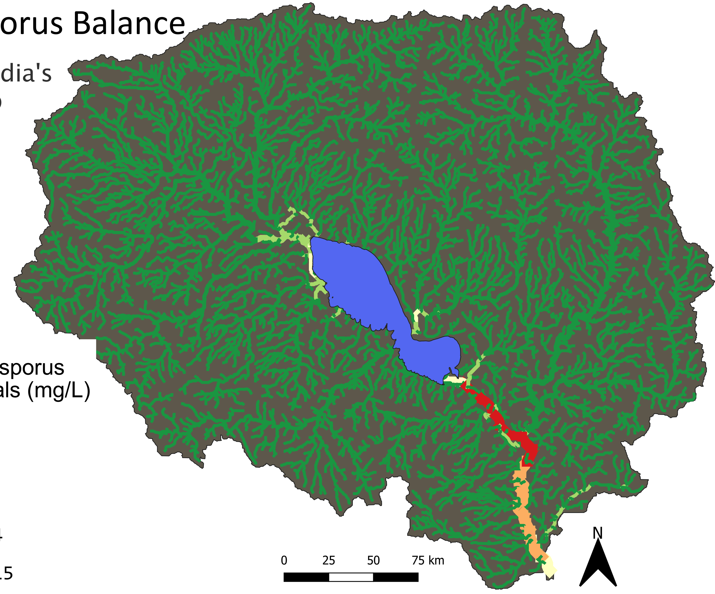
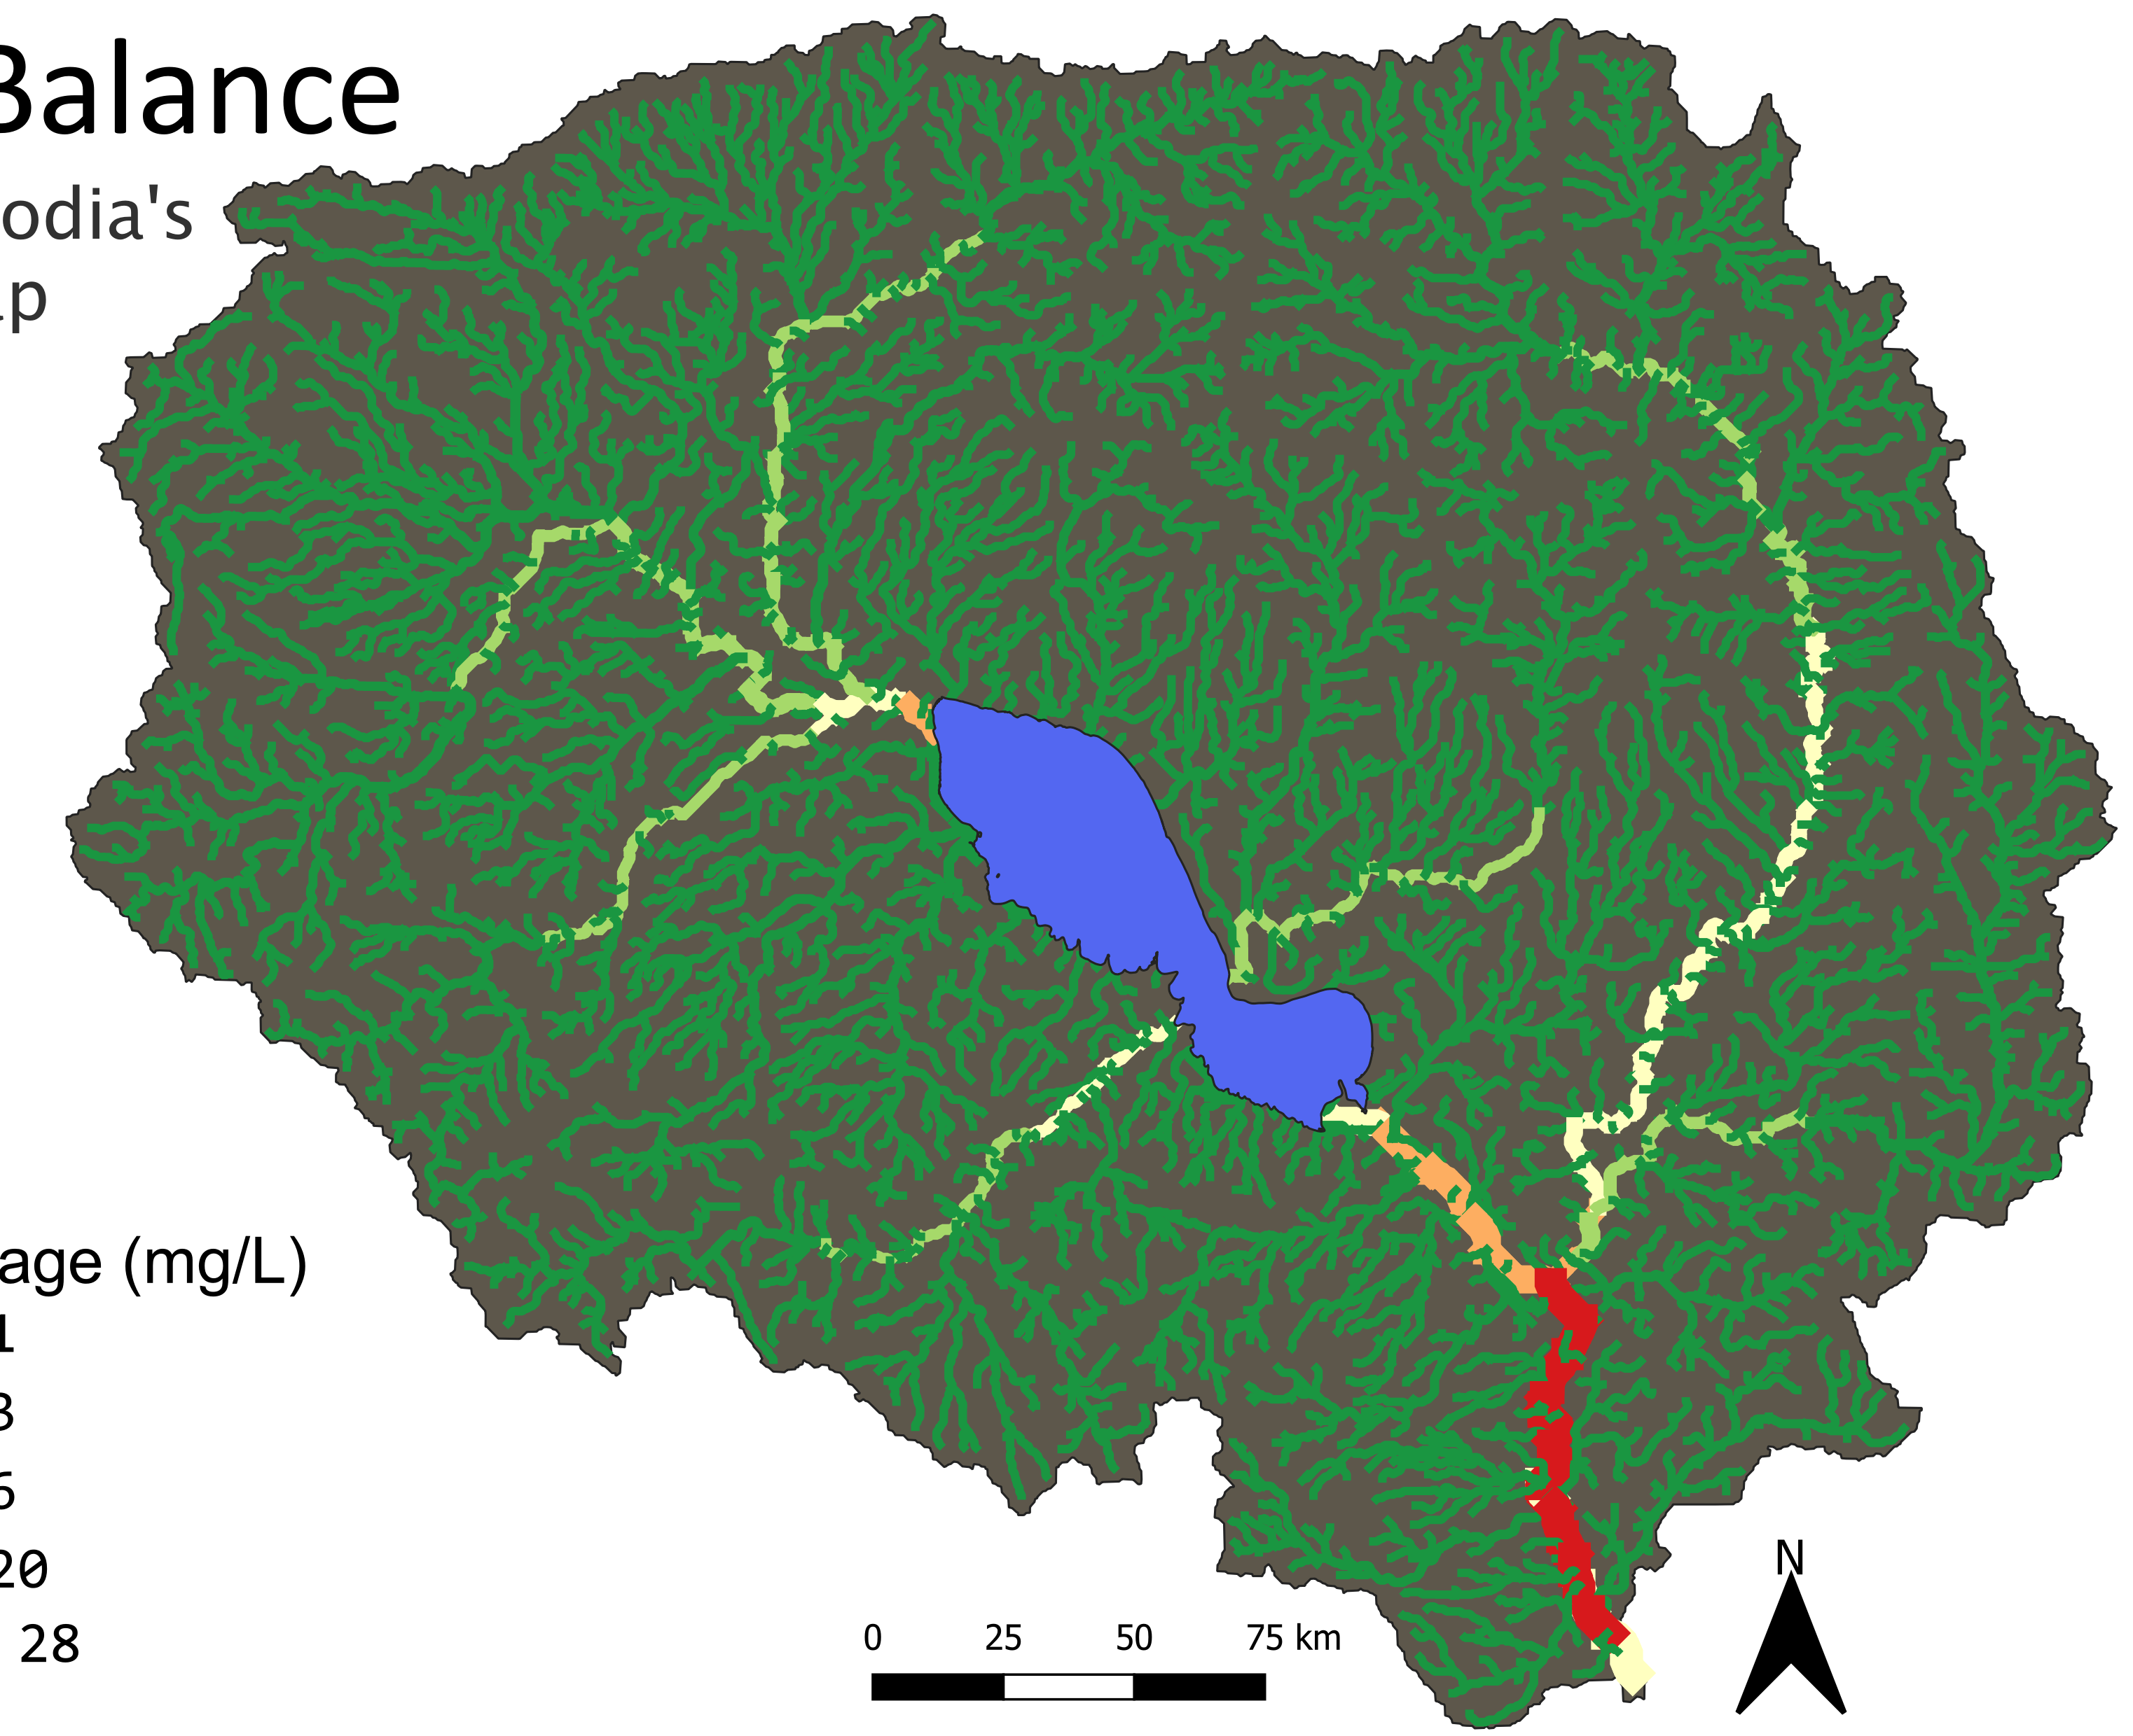
Results – SWAT
NO₂ Balance
Phosphorus Balance
NO₂ Balance
(mg/L)
Phosphorus Balance
(mg/mL)
0-1
1-3
3-6
6-20
20-28
N
0-1
1-7
7-66
66-284
284-315
0 25 50 75 km
N
0 25 50 75 km
N
0 25 50 75 km
Notes:
As demonstrated in these maps, SWAT indicated that nutrient balances increase and accumulate into the Tonlé Sap lake, and then remain high in concentration south of the lake outflow. Represented in these maps we see Nitrogen and Phosphorus balances, with low concentrations at headwaters that rise as these headwaters join into the lake and the major rivers

Slide 22
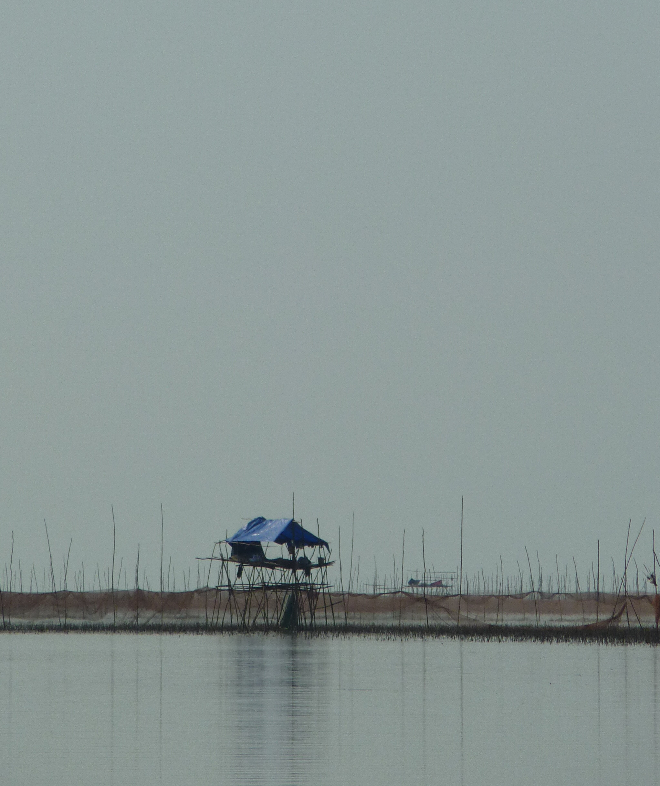
Conclusions
Remotely-sensed data are very useful for filling in data gaps for SWAT, but cannot fully replace its in-situ counterpart
Chlorophyll-a is difficult to include in the FHI for Tonlé Sap because eutrophication metrics do not apply to the basin
NDVI can be an informative metric for helping to determine bank modification in the Tonlé Sap watershed
Water storage in the basin is on a slowly declining trend
Source: Wikimedia Commons
Notes:
Joey - In conclusion, this project resulted in a number of deliverables. First, we have contributed an updated and revised version of the Python code from last term, that includes additional variables and new formatting for SWAT+. We have finalized the SWAT model feasibility study from last term by applying a fully computer SWAT+ model to the Tonlé Sap Basin. We calibrated that SWAT+ model utilizing in situ data, resulting in a more accurate model overall. We diverged from the GRACE methodology of last term and utilized whole GRACE numbers to develop affected area statistics for the Tonlé Sap region. Using NDVI, we computed bank modification in the basin, both on the lake and around river boundaries. Finally, we combined all of this data into the Freshwater Health index and generated a score for the region.
----------------------------------
https://commons.wikimedia.org/wiki/File:Cambodia_-_Tonle_Sap_-_014_Nets_and_Boat_(8583596195).jpg

Slide 23
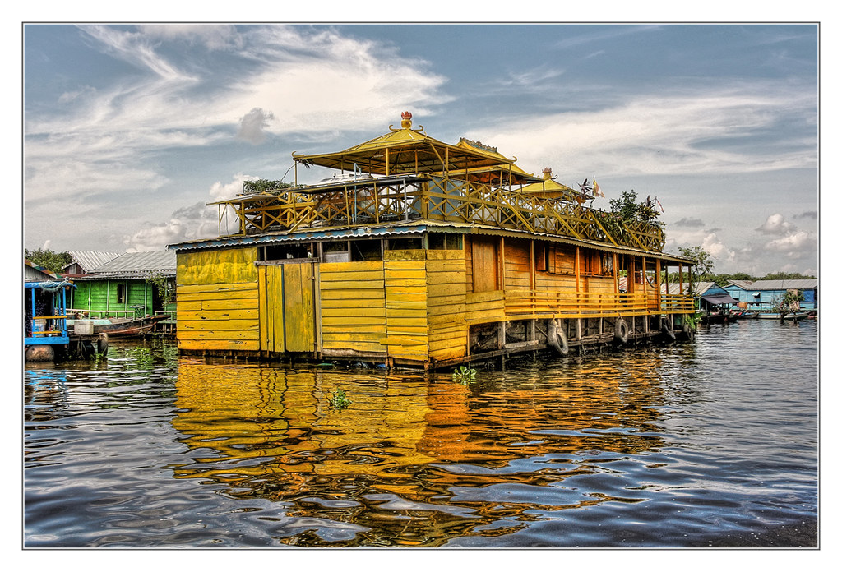
Errors and Limitations
Time limitation for retrieving and processing level 2 MODIS data for collection of Chlorophyll-a in study area
Data are not available for entire the study period
Remotely sensed data has errors and estimations
Source: Creative Commons by Daniel Mennerich
Notes:
Because this project term was only 10 weeks long, we were not able to acquire and process level 2 MODIS data in order to collect the Chlorophyll-a in the entire study area. Some data, such as GRACE, was only available for a portion of our study period.
Lastly, the use of remotely sensed data brings in its own errors and limitations as all metrics are derived from satellite products and subject to unique processing steps.
----------------------------
https://search.creativecommons.org/photos/d1bf3408-6e5a-41dc-b192-edec294ee118

Slide 24
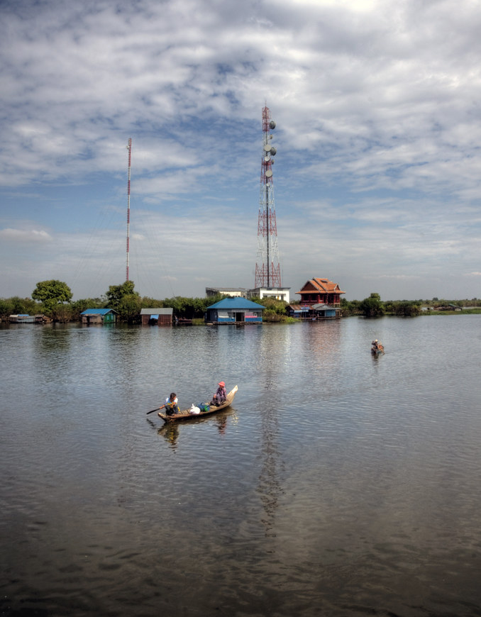
Future Work
1. Calibrate SWAT model with complete time frame of in-situ data
2. Figure out how to extract just groundwater component from GRACE methodology
3. Incorporate NDVI as part of comprehensive bank modification model
Source: Creative Commons by Mariusz Kluzniak
Notes:
Lindsay - For future work, a team could calibrate the SWAT model with in-situ data for the full study period, extract the groundwater component from the GRACE methodology, and incorporate NDVI as part of a comprehensive bank modification model.
Image credits---------------------
https://search.creativecommons.org/photos/992f2524-8a9c-474a-9c81-f416c0c191b2
"tonle sap lake" by mariusz kluzniak is licensed with CC BY-NC-ND 2.0. To view a copy of this license, visit https://creativecommons.org/licenses/by-nc-nd/2.0/

Slide 25
Adriana Le Compte, NASA DEVELOP LaRC
Dr. Kenton Ross, NASA Langley Research Center
Dr. Venkataraman Lakshmi, University of Virginia
Manh-Hung Le, University of Virginia
Dr. Derek Vollmer, Conservation International
Dr. Nick Souter, Conservation International
Notes:
Thank you so much to those who helped us with this fall's project!

Slide 26
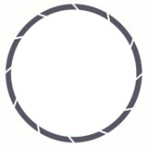
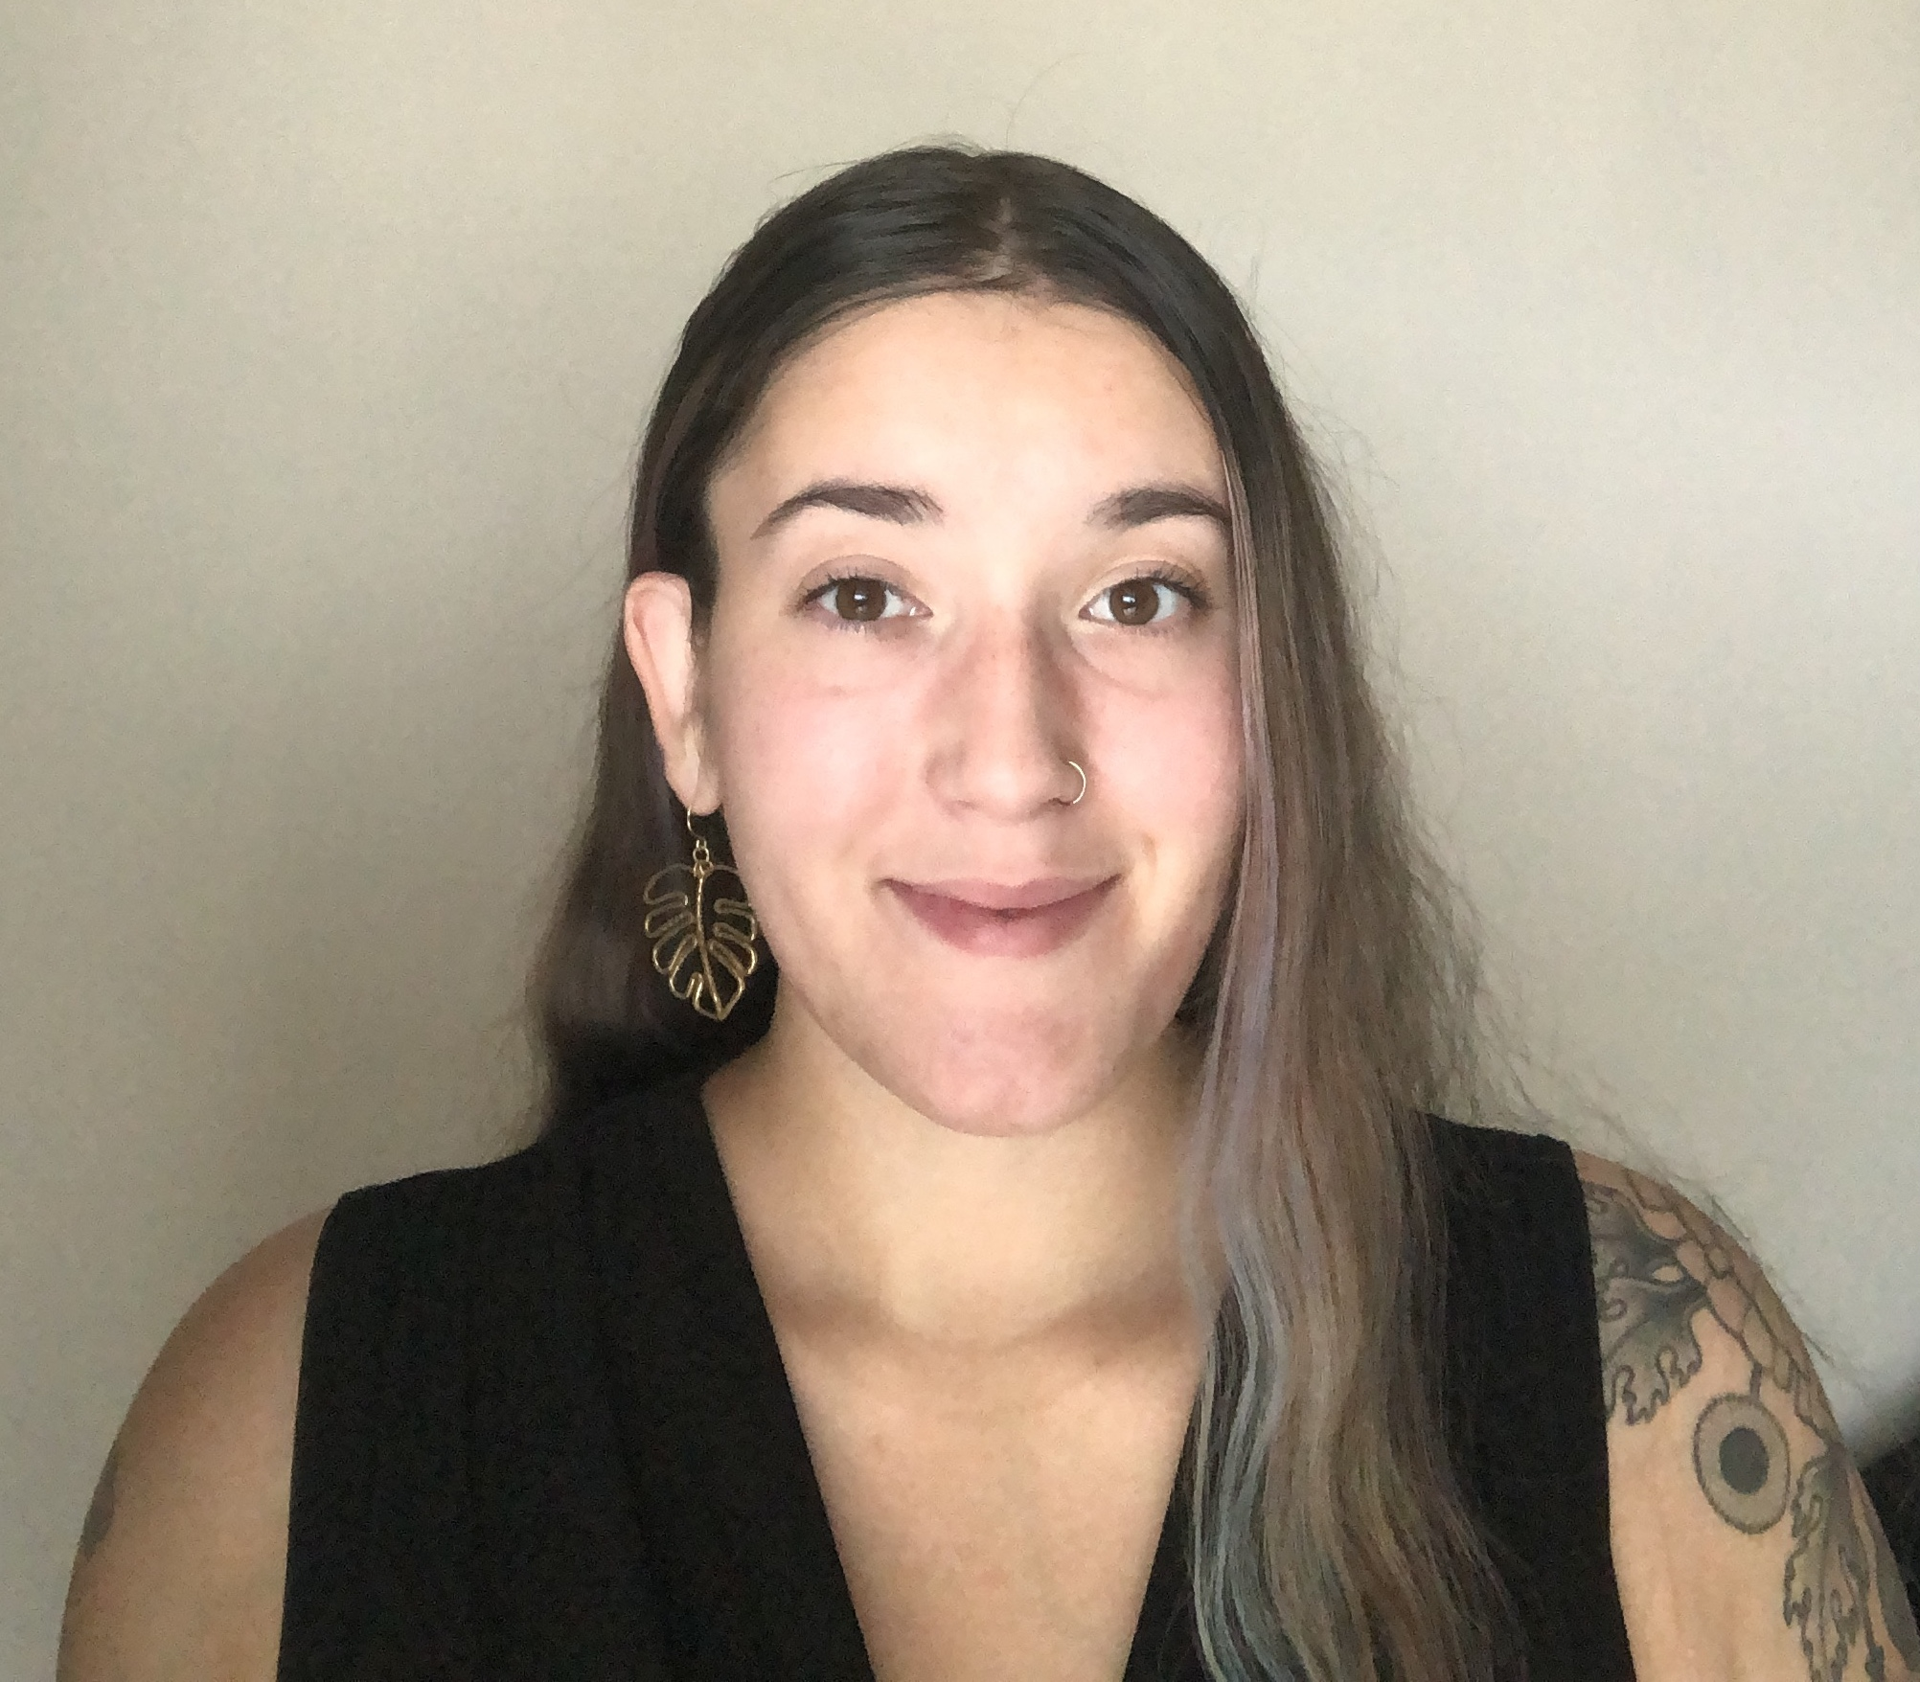
Meet the Team
Joey Lindsay
Lindsay Harmon
Keida Gaba
Susan Jarvis
Notes:
From top left to bottom right, Joey Lindsay (Team Lead), Lindsay Harmon, Keida Gaba, Susan Jarvis

