Slide 1
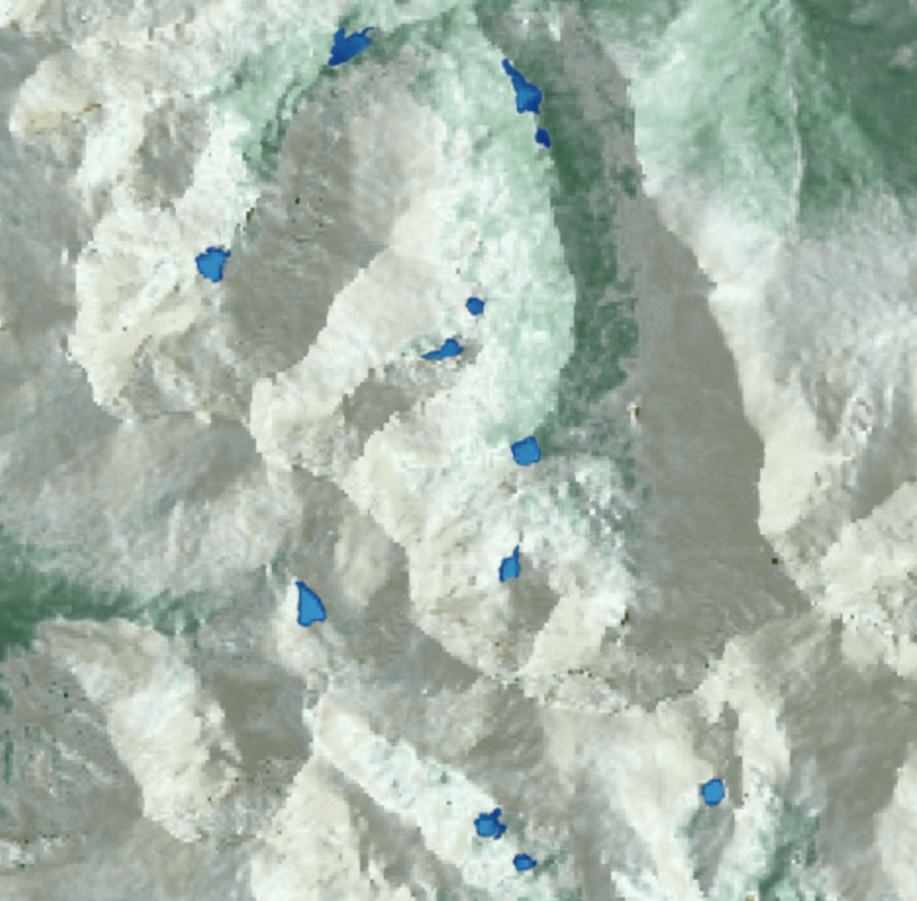
ROCKY MOUNTAIN WATER RESOURCES II
Employing NASA and ESA Earth Observations to Monitor Alpine Lake Algal Productivity in Rocky Mountain National Park
Anastasia Kunz
Genevieve Clow
Natalie Schmer
Sarah Wingard
Colorado – Fort Collins | Summer 2019

Slide 2
Project Partners
Dr. Jill Baron
Research Ecologist Senior Scientist
United States Geological Survey (USGS) Fort Collins Science Center
Dr. John Mack
Chief of Resource Management
National Park Service (NPS), Rocky Mountain National Park (RMNP)
Notes:
Sarah
For our project this term, our partners include Dr. Jill Baron, the Research Ecologist Senior Scientist at the United States Geological Survey and Dr. John Mack, Chief of Resource Management with the National Park Service in Rocky Mountain National Park with whom we collaborated to enhance long-term ecological research using remotely sensed data to monitor algal productivity in alpine lake systems in Rocky Mountain National Park

Slide 3
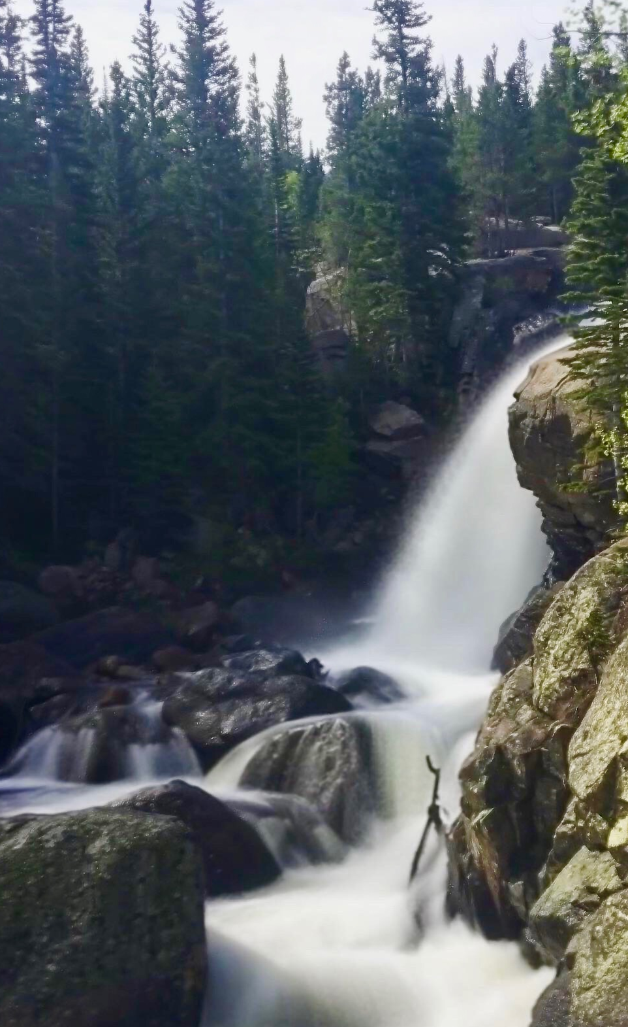
Background Information
147 alpine and subalpine lakes
Headwaters of the Colorado River
Low nutrient levels and algal production
Images: Rocky Mountain Water Resources II Team
Notes:
Sarah
Within Rocky Mountain National Park, there are 147 alpine and subalpine lakes. These systems provide vital freshwater resources to native species as well critical habitat for wildlife in the park. Not only are the park’s water sources important for the native ecosystems and its functioning, but headwater streams in the Rocky Mountains feed into rivers such as the Colorado River, which provides much of our water in the west. So monitoring the monitoring of any changes in these systems is a priority for both human and ecosystem health. Currently, we are witnessing a significant ecosystem shift. Historically, these alpine lake systems have had low nutrient levels and algal productivity, but ongoing research conducted by our project partners suggests these federally protected and once considered pristine ecosystems may be shifting toward a eutrophic state with increasing nutrient abundance and algal productivity
Photos: RM Water Resources II Team

Slide 4
Background Information
Transportation
Atmospheric
Nitrogen
Nutrient
Deposition
Agriculture
Industry
Images: Rocky Mountain Water Resources II Team, Dr. Bella Oleksy
Notes:
Sarah
The cause of this shift can be traced back to how nutrients move through a system. Human activity including transportation, power generation, and agriculture emit nitrogen, such as ammonia and nitrous oxides, into the atmosphere. This atmospheric nitrogen then makes its way to mountain watersheds through wet and dry deposition in the form of snow precipitation and dust and increasies the amount of available nitrogen in the ecosystem for algae to take up, resulting in the potential for a bloom
Diagram: RM Water Resources II Team, PowerPoint
Photo: Bella Oleksy

Slide 5
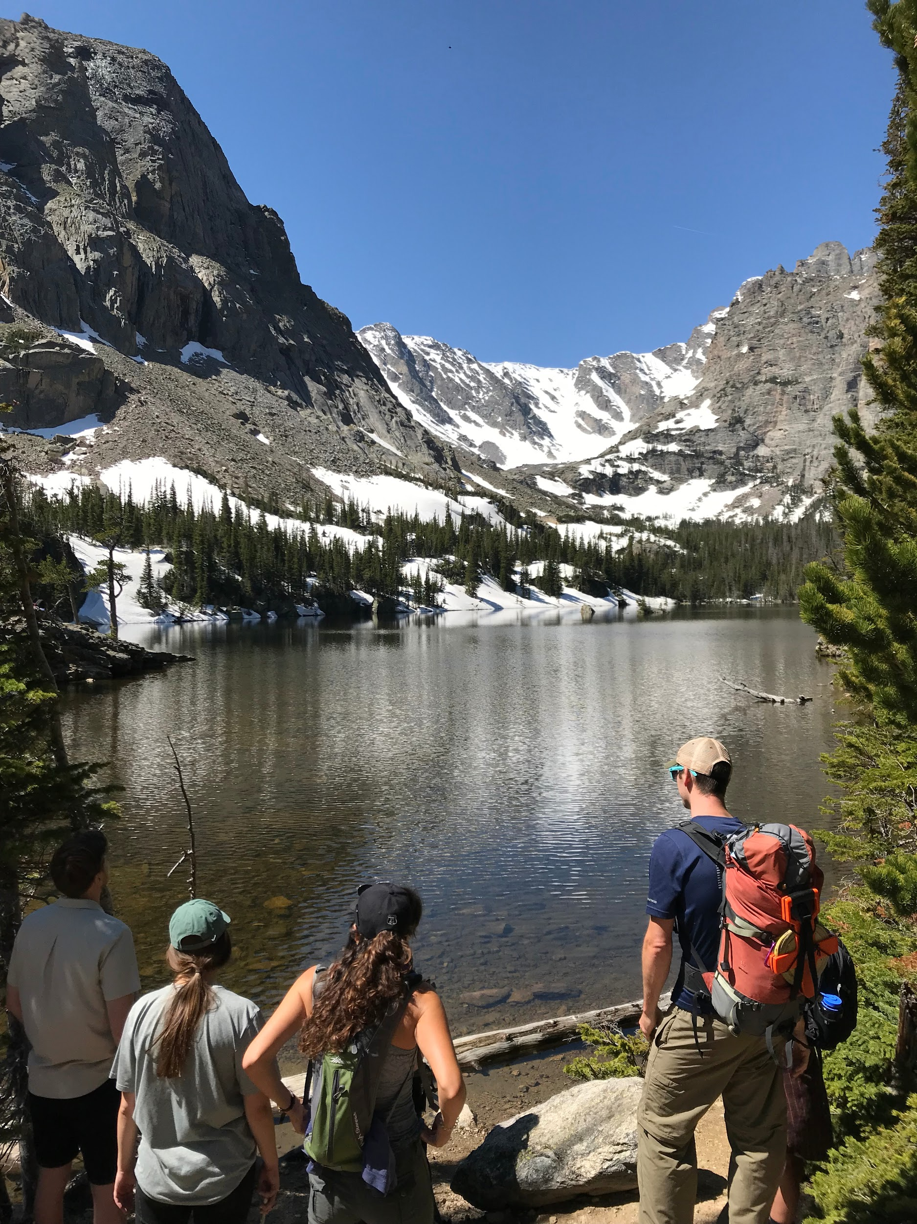
Community Concerns
Elevated nutrient inputs
Warming air and water temperatures
Increased algal biomass
Reduced water quality
Cascading effects to aquatic life
Diminished aesthetics
Image: Rocky Mountain Water Resources II Team
Notes:
Sarah
Specifically in Colorado, elevated nutrient inputs from industry and agriculture in the Front Range in addition to incoming nutrients from glacial melt as a result of warming air and water temperatures work synergistically to create ideal environments for increasing algal biomass in Rocky Mountain National Park’s alpine lakes. The cascading effects of algal blooms can negatively impact both human and ecological communities by reducing water quality, and creating anoxic environments that deplete oxygen necessary for a system to sustain many forms of aquatic life. Additionally, increased algal biomass can diminish the aesthetic quality of the pristine lakes in Rocky Mountain National Park that draw in millions of visitors a year and provide essential funding for the National Park Service.
Photo: RM Water Resources II Team, PowerPoint

Slide 6
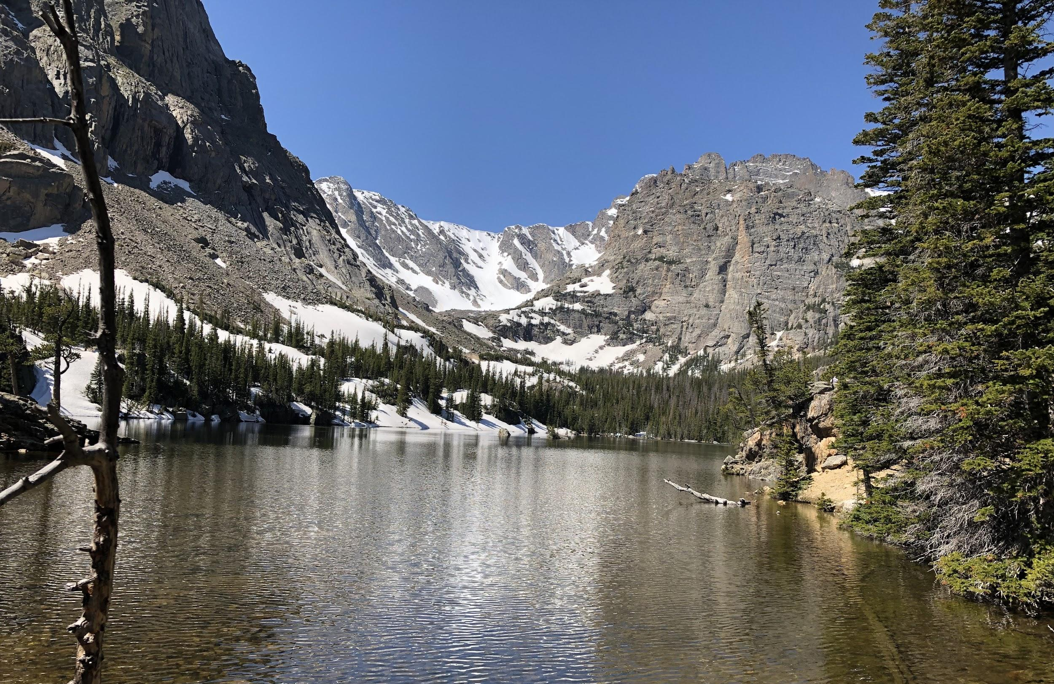
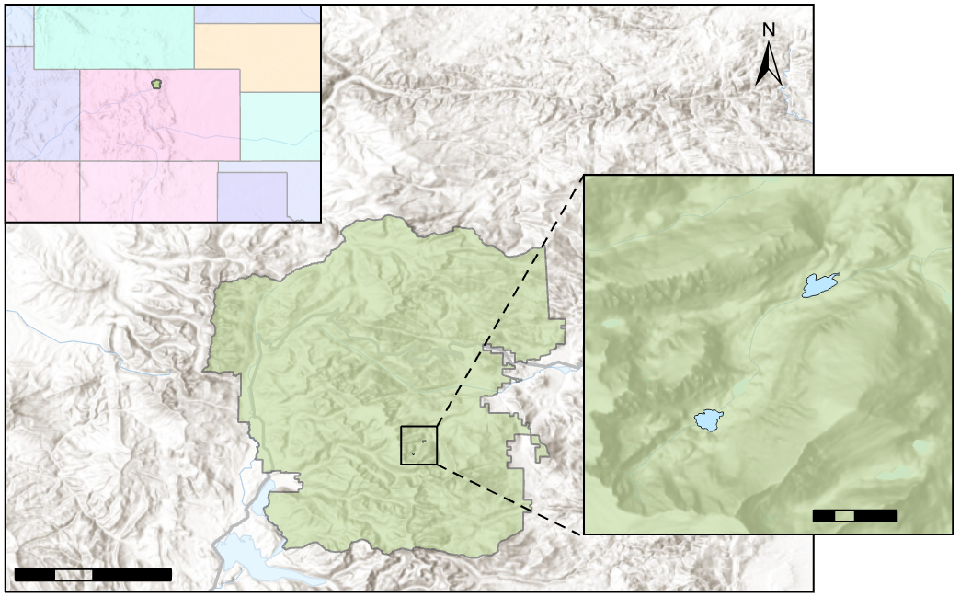
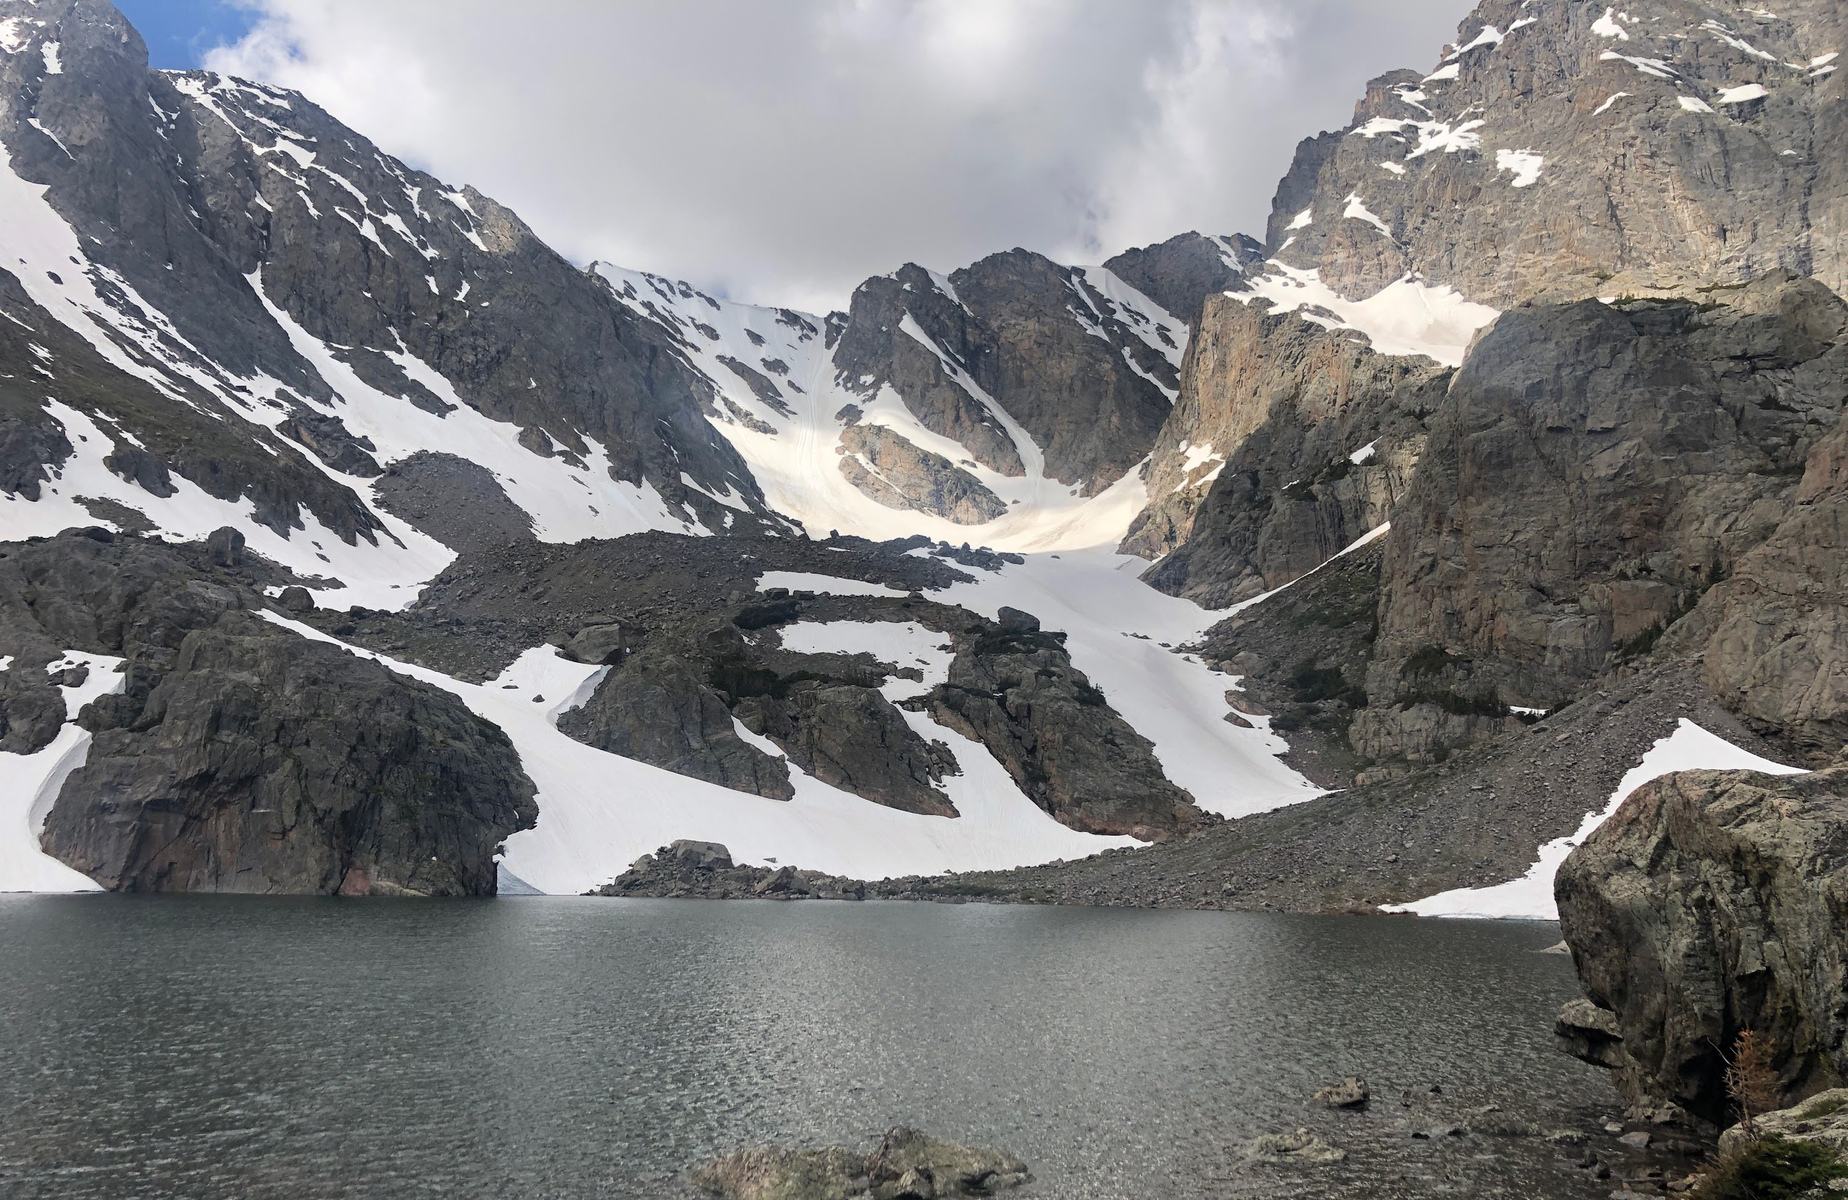
The Loch
Study Area
Colorado
The Loch
Rocky Mountain National Park
Sky Pond
Sky Pond
0.5
1
Km
5
10
20
Km
Images: Rocky Mountain Water Resources II Team
Notes:
Genevieve
For this project, we focused on two lakes within the Loch Vale watershed, the Loch and Sky Pond. These lakes have been part of a long term collaborative study by the USGS and NPS, which looked at human impacts and ecosystems changes since the 1980’s.
Map: Esri, ArcGIS
Photos: RM Water Resources II Team

Slide 7
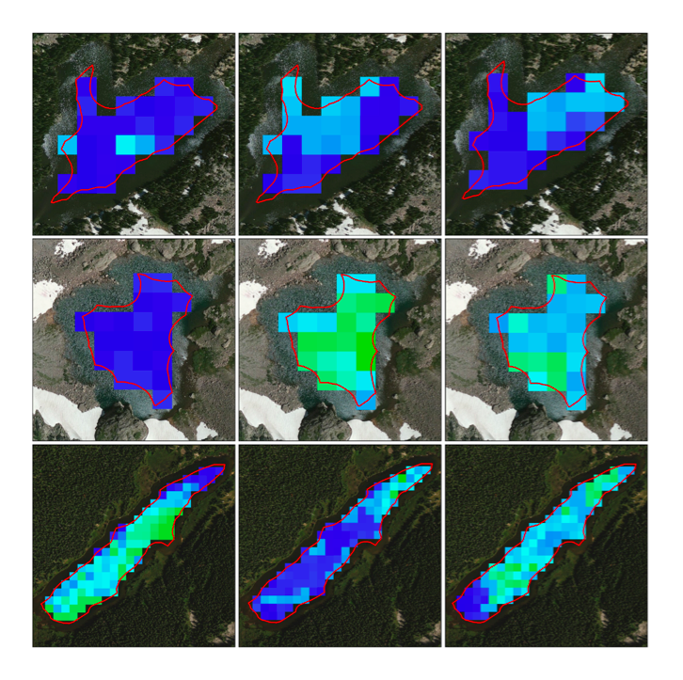
Previous DEVELOP Work
Rocky Mountain National Park Climate
Methods
Applied band ratios to Landsat 8 OLI imagery
Correlated remotely sensed data with field measurements
The Loch
Conclusions
NIR/Red band ratio showed moderate success (R²=0.22) in detecting chlorophyll-a
Sky Pond
Limitations
Spatial resolution of 30 m
Limited data
Long Lake
2.30
10.25
Estimated Chlorophyll-a Values µg/mL
Image: Rocky Mountain National Park Climate Team
Notes:
Genevieve
In 2016, the Rocky Mountain Climate team used Landsat 8 to map algal productivity in The Loch, Sky Pond, and Long Lake. Using Landsat 8 imagery, they applied band ratios and correlated their results with measurements taken in field. Although they had moderate success with one index, (NIR/Red) they were limited by a spatial resolution of 30 meters and temporal resolution of 16 days, resulting in low correlations. To avoid these shortcomings, Sentinel-2 was recommended as an alternative option to obtain finer approximations of chlorophyll-a in future studies.
Maps: Rocky Mountain National Park Climate team, Esri ArcGIS

Slide 8
Objectives
N
Assess feasibility of incorporating Landsat 8 & Sentinel-2 into alpine lake monitoring
Determine best spectral index for detecting chlorophyll-a
Create chlorophyll-a concentration maps for Sky Pond and the Loch
Design an automated tool for future monitoring efforts
Images: Rocky Mountain Water Resources II Team
Notes:
Genevieve
Our objectives were to assess the feasibility of incorporating Sentinel-2 MSI and Landsat 8 OLI to remotely monitor the algal productivity in these lakes, determine the most effective index for detecting chlorophyll-a, a proxy for algae, create chlorophyll-a concentration maps of the Loch and Sky Pond, and design an ArcGIS tool for future monitoring of algal productivity.
Image citations
Satellite : http://clipart-library.com/satellite-cliparts.html
Leaf: https://www.freepik.com/free-icon/leaf_739742.htm
Map: RM Water Resources II Team, PowerPoint
Tool: RM Water Resources II Team, PowerPoint
Photo: RM Water Resources II Team

Slide 9
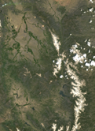
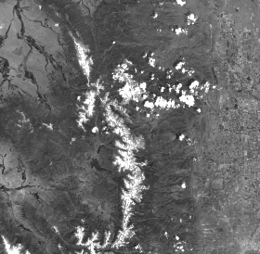
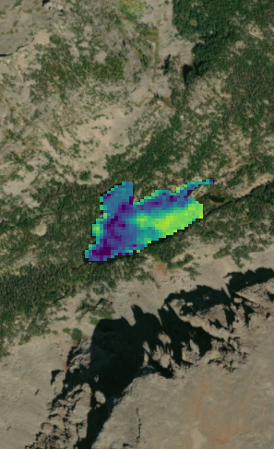
Methodology: Overview
Prepare
Calculate
Correlate
Sentinel-2 MSI and Landsat 8 imagery were downloaded from USGS Earth Explorer and atmospherically corrected if needed.
11 band indices were calculated for Sentinel-2 and 7 were calculated for Landsat 8 using ArcGIS.
The outputs of these indices were then correlated with field data using Spearman’s correlation coefficient in R.
Images: Rocky Mountain Water Resources II Team
Notes:
Nat
For this term, our methodology had three main steps.
First, we downloaded from the USGS Earth Explorer data during summer months from 2015 to 2018 for Landsat 8 OLI and 2017 to 2018 for Sentinel 2 MSI. We downloaded data from fly-over dates that corresponded as closely as possible to field collection dates. For Sentinel 2 imagery, we wanted to compare the effects of atmospheric correction so we left imagery as is, but also performed atmospheric correction using a software called ACOLITE. For Landsat 8, images were already atmospherically corrected, so we did not need to do any pre-processing.
Next, we calculated chlorophyll-a indices using raster calculator in ArcGIS. We calculated 11 indices for Sentinel 2 and 7 indices for Landsat 8.
After calculating the indices, we used a Spearman correlation to relate field observations with each index, and we report the correlation value rho.
Images: RM Water Resources II team, ESA Sentinel-2, Esri ArcGIS

Slide 10
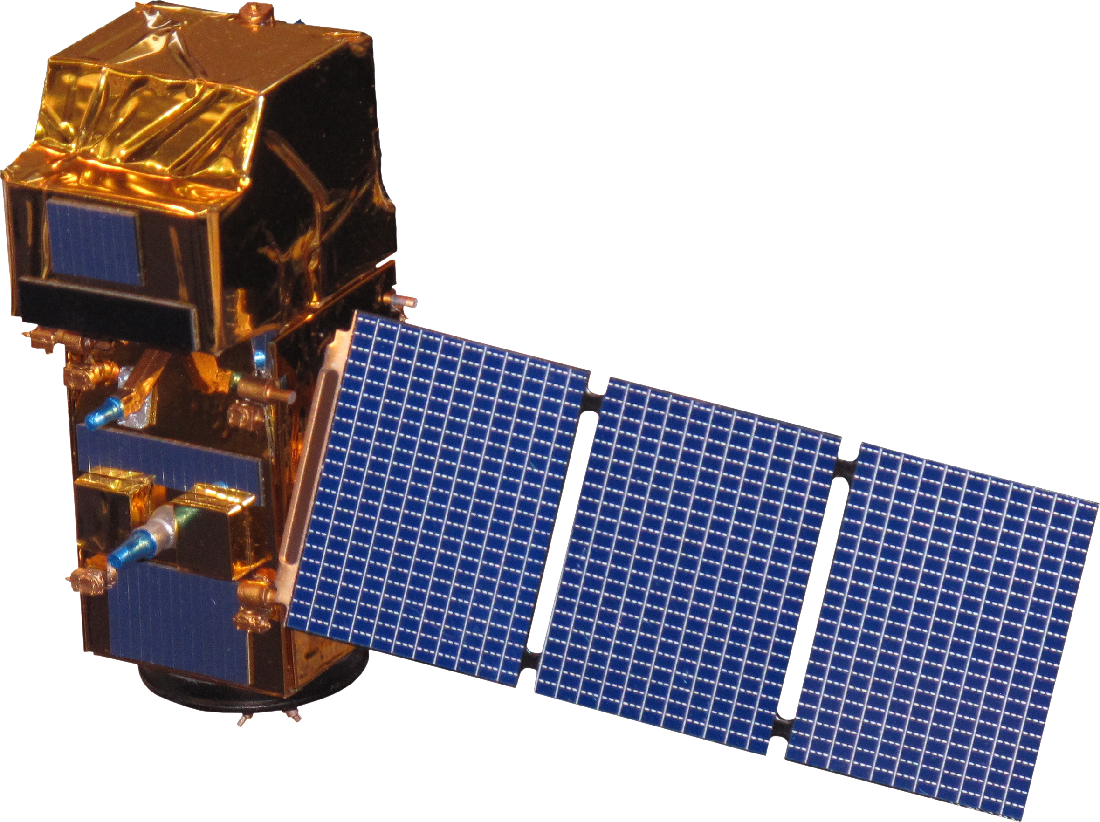
Earth Observations
Landsat 8 Operational Land Imager (OLI)
Spatial Resolution: 30 m
Temporal Resolution: 16 days
ESA’s Sentinel-2 MultiSpectral Instrument (MSI)
Spatial Resolution: 10 - 20 m
Temporal Resolution: 5 days
Image source: Pixabay
Notes:
Nat
For this project, we utilized Landsat 8 Operational Land Imager that has a spatial resolution of 30 meters and a temporal resolution of 16 days as well as ESA’s Sentinel 2 Multispectral Instrument that has a spatial resolution of 10-20 meters and a temporal resolution of 5 days.
Earth Image: Pixabay - https://pixabay.com/illustrations/earth-planet-world-globe-sun-1990298/
Satellites: DEVLEOPedia

Slide 11
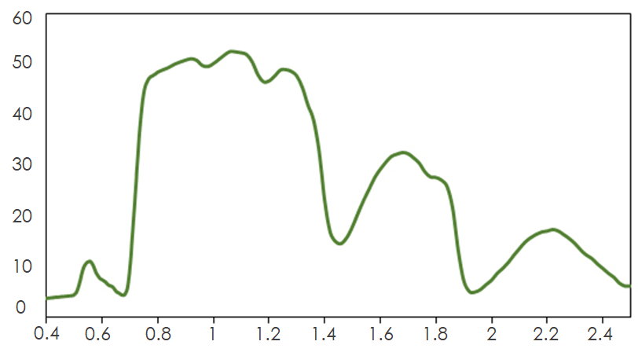
Remote Sensing of Chlorophyll-a
Spectral Reflectance of Vegetation
B2
B3
B4
B8
Sentinel-2 bands
Reflection (%)
Chlorophyll-a Absorption
Wavelength (μm)
Spectral Reflectance Data: Humboldt State University
Notes:
Nat
Chlorophyll-a is the main pigment present in green algae, and as such is commonly used as a proxy for green algae, and it can be detected by satellites due to its unique spectral reflectance.
Specifically, sentinel-2 has multiple bands that are capable of detecting chlorophyll content in water with the red and red-edge region, corresponding with bands 4 through 7. These bands have been used in similar studies regarding algal productivity and algal monitoring.
Spectral reflectance curve: http://gsp.humboldt.edu/olm_2015/Courses/GSP_216_Online/lesson2-1/reflectance.html

Slide 12
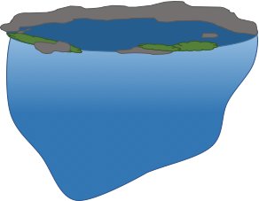
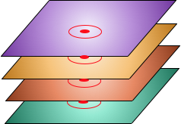
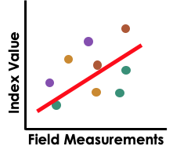
Methodology: Correlations
Averaged field data points over water column
Buffered field data GPS points (20 m)
Index 1
Index 2
Extracted raster values
Index 3
Index 4
Calculated Spearman’s correlation coefficient, ρ (rho)
Notes:
Nat
First, with the field data we got from our partners, we averaged the surface and hypolimnion chlorophyll concentrations for an aggregated water column concentration.
We did this because having an average value has been shown to give stronger correlations in other studies as well as in the previous term.
Next, we buffered the gps data points by 20 m and
extracted the calculated raster values for each index at the field collection data point.
Finally, we calculated the correlation coefficient for the Spearman correlation test in R, and used that relationship to determine which index was most accurate in representing the field collected chl-a concentration.
Diagrams: RM Water Resources II Team, PowerPoint

Slide 13
Results: Sentinel & Landsat Comparison
Sentinel-2 MSI
Landsat 8 OLI
0.5 km
0.5 km
0.5 km
0.5 km
Red Edge 1/Red
ρ = -0.548
6.92274 - 5.7581 * (ln(Blue))/(ln(Red))
ρ = -0.585
e^{(Green/Red)}
ρ = -0.366
(NIR - Red)/(NIR+Red)
ρ = 0.544
(Red Edge 3 - Red)/(Red Edge 3 + Red)
ρ = -0.358
(Blue - Red)/Green
ρ = 0.142
High Chlorophyll-a
Low Chlorophyll-a
Notes:
Staz
Out of all of our indices we tested, our top three predictors from both landsat and sentinel are shown here highlighting the difference in resolution.
These maps were generated using data from August 30th 2018, when both Landsat and Sentinel passed by our study location.
Our highest correlated indices are shown at the top, one from LS one from S2. Landsat performed slightly better, but marginally so. Two of our best performing indices from Sentinel 2 shown on the left incorporate the Red Edge Bands.
We found that correlations for both Landsat and sentinel were improved when including the average pixel value within a 20 meter buffer from the field point
Basemaps: Esri ArcGIS

Slide 14
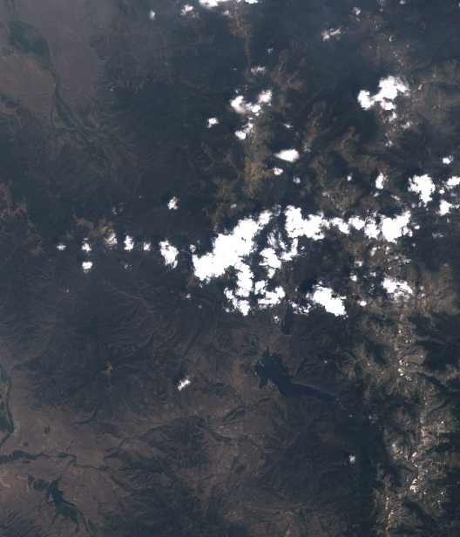
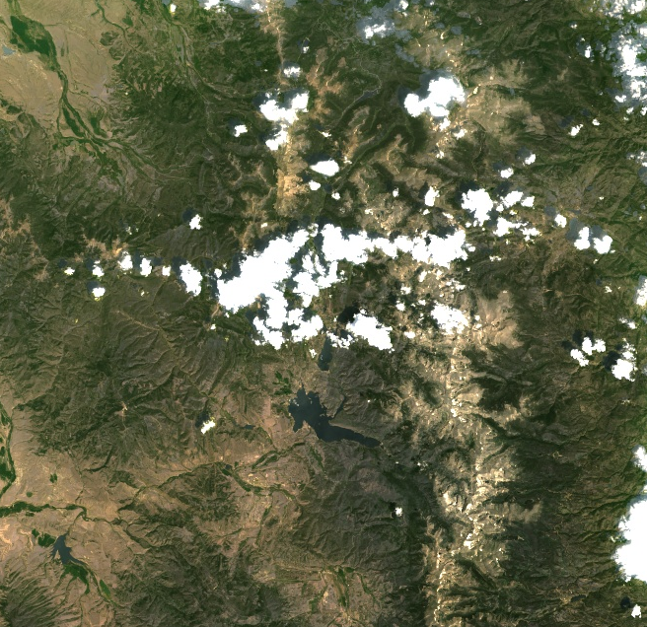
Results: Atmospheric Correction
Sentinel-2: Top of Atmosphere
Sentinel-2: Atmospherically Corrected with ACOLITE
e^{(Green/Red)}
ρ = -0.515
(1/Red) - (1/Red Edge 1) * Red Edge 4
ρ = -0.473
(Red Edge 1 - Red) - 0.389(Red Edge 2 - Red)
ρ = -0.233
Red Edge 1/Red
ρ = -0.548
e^{(Green/Red)}
ρ = -0.366
(Red Edge 3 - Red)/(Red Edge 3 + Red)
ρ = -0.358
Images: Google Earth Engine
Notes:
Staz
Atmospherically corrected Sentinel 2 was not avaliable over our study area during the study period for this project. There has also been some discrepancy in the literature about whether or not atmospheric correction interferes with detecting chlorophyll-a. We investigated the differences between using top of atmosphere reflectance vs. surface reflectance, which was corrected using ACOLITE software.
Our results showed that overall, many of our correlations improved with atmospheric correction. Interestingly, our top three indices were not consistent across different image processing levels. Only the Exp(Green/Red) remained a top performer when using atmospherically corrected imagery.
This is important to note for future use, because as the 2A level processing becomes more readily available, from this study we know that this will improve our ability to remotely monitor chlorophyll-a
Basemaps: Landsat 8, Google Earth Engine

Slide 15
Conclusions
vs
Landsat 8 and Sentinel-2 indices had comparable results using mean values within buffer
Frequent data collection is necessary due to rapid algal change
Atmospheric correction did not significantly improve correlations
Low chlorophyll-a concentrations made for difficult detection
Images: Rocky Mountain Water Resources II Team
Notes:
Staz
To highlight a few key conclusions; Sentinel 2 may enhance detection of chlorophyll-a in alpine lakes due to the red edge bands and higher spatial and temporal resolution.
We found that elapsed time between field collection and flyover dates is really important to this study because algae can produce rapidly. This encourages the use of products like Sentinel-2 with a revisit time of 5 days, or aligning field collection and flyover dates like our partners are currently doing.
Finally, we found that atmospheric correction did not significantly affects correlations. Our project found that atmospheric correction with ACOLITE reduced correlations, although different pre processing systems may have different results.
Most studies focus on large highly eutrophic lakes, whereas we are focusing on very small lakes with extremely low levels of chlorophyll a. This presents significant challenges to remote sensing applications.
Satellite : http://clipart-library.com/satellite-cliparts.html
Leaf: https://www.freepik.com/free-icon/leaf_739742.htm
Lakes diagram: RM Water Resources II Team, PowerPoint
Atmospheric correction diagram: RM Water Resources II Team, PowerPoint
Photo: RM Water Resources II Team

Slide 16
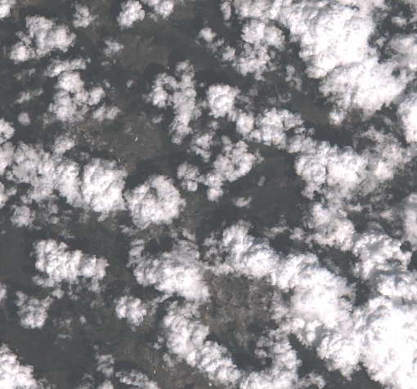
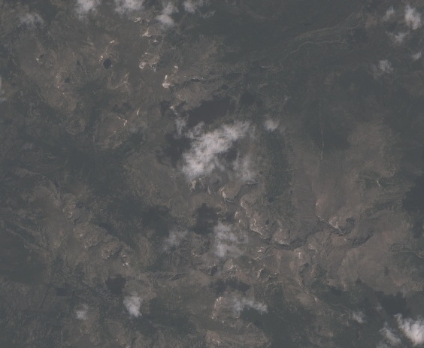
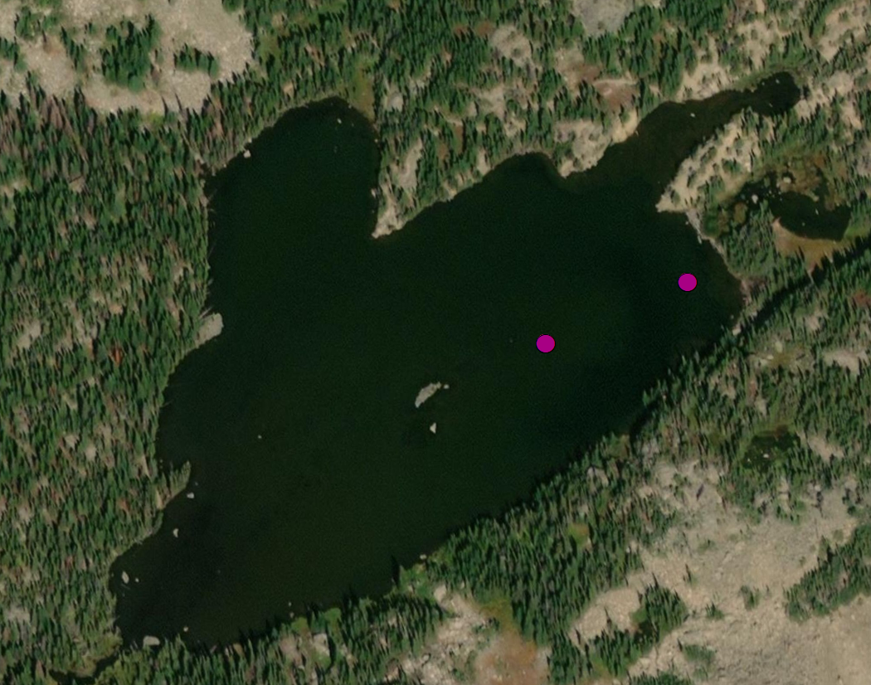
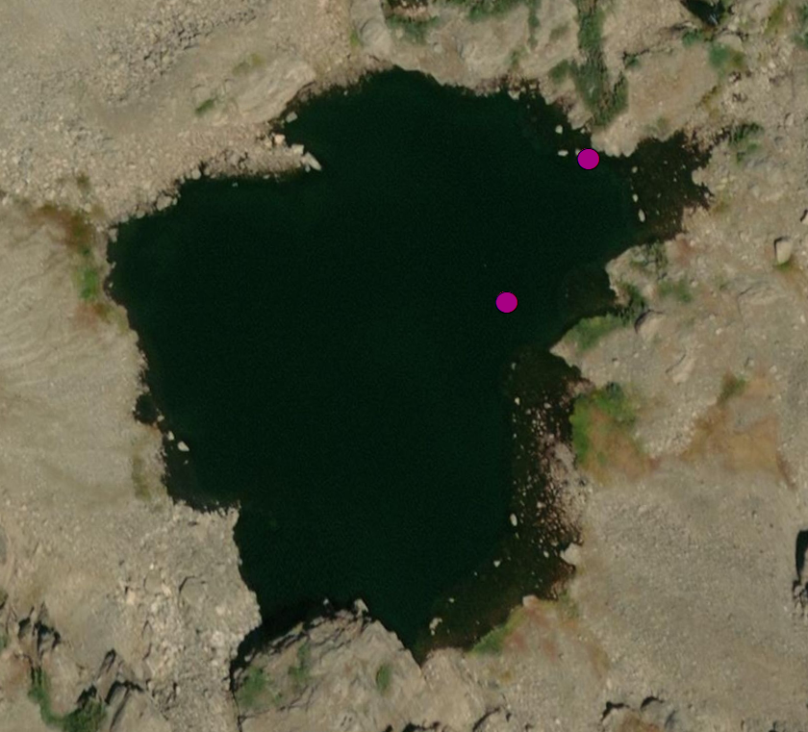
Limitations & Future Work
Cloud cover
Mixed pixels along lake edge
Study Area
July 26 2018
July 31 2018
Benthic vs. Pelagic algae
Limited field data
Field Data
Bottom left: Bella Oleksy, Others: Rocky Mountain Water Resources II Team, Esri
Notes:
Staz
Field collection dates through the summer months in Colorado had very high cloud cover. While the high revisit time of Sentinel 2 was helpful in choosing images that were clear and close to collection dates, there were some months, like July 2017 where there was only one clear image.
Another possible issue is mixed pixels: there may be a combination of water and rock or water and vegetation and if not unmixed, or accounted for, indices could be inaccurate because of terrestrial vegetation being included or algae on shoreline rocks being excluded, depending on buffers.
Another limitation could come from the differences in benthic and pelagic algae. With clear(er), shallow, lakes, sensors may be picking up chlorophyll-a on the lake bottom in the form of benthic algae, but if not accounted for in the field measurements could impact the strength of the correlation.
Additionally, abundance of field data is always beneficial, on both the temporal and spatial scale, and especially within 3-5 days of a sensor flyover for a more robust correlation. Future work could expand sampling to incorporate samples from more locations within the lake.
While we used ACOLITE preprocessing for all of our Sentinel 2 imagery, this step will not be necessary in the future as pre-processed imagery becomes available. When this data does become available, future work could include comparison to raw, uncorrected images.
Ultimately, this project is part of a wider effort to make this a feasible assessment on a global scale. Other work necessary to expand this methodology and these tools to a wider study area. We have developed an ArcGIS tool for future research, which will automatically incorporate Sentinel-2 imagery and field data as new data become available, and it will calculate Spearman’s correlation coefficient to continue our work of determining the most effective method of remotely studying alpine lakes.
For remote sensing purposes it is important to have a wide geographic span of sampling locations across our focal lakes, so future studies should look to incorporate additional field data to create more robust relationships
Top left: RM Water Resources II Team, Esri ArcGIS
Top right: RM Water Resources II Team, Esri ArcGIS
Bottom left: Bella Oleksy
Bottom right: RM Water Resources II Team, Esri ArcGIS

Slide 17
A special thanks to Kristen Dennis, Dr. Jill Baron, Peder Engelstad, Nicholas Young, Tony Vorster, Dr. Catherine Jarnevich, and Dr. Paul Evangelista
We would like to acknowledge the work of the previous NASA DEVELOP team by Amy Stuyvesant, Emily Campbell, Benjamin Ignac, Muthukumaran Sampath
This material contains modified Copernicus Sentinel data (2017-2018), processed by ESA.

