Slide 1
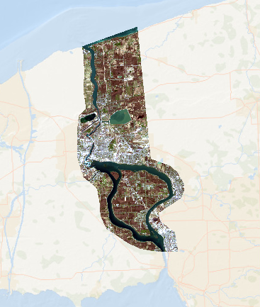
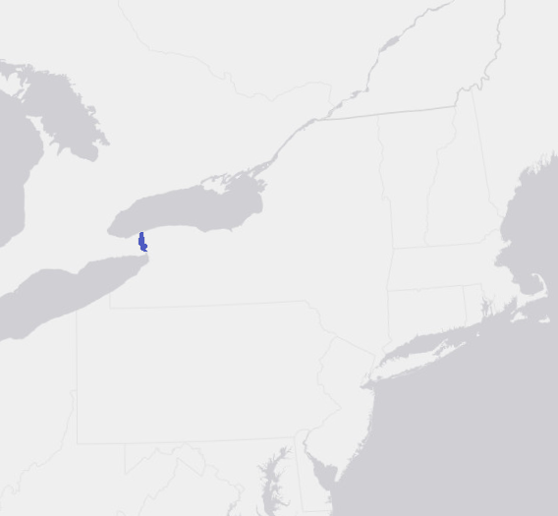
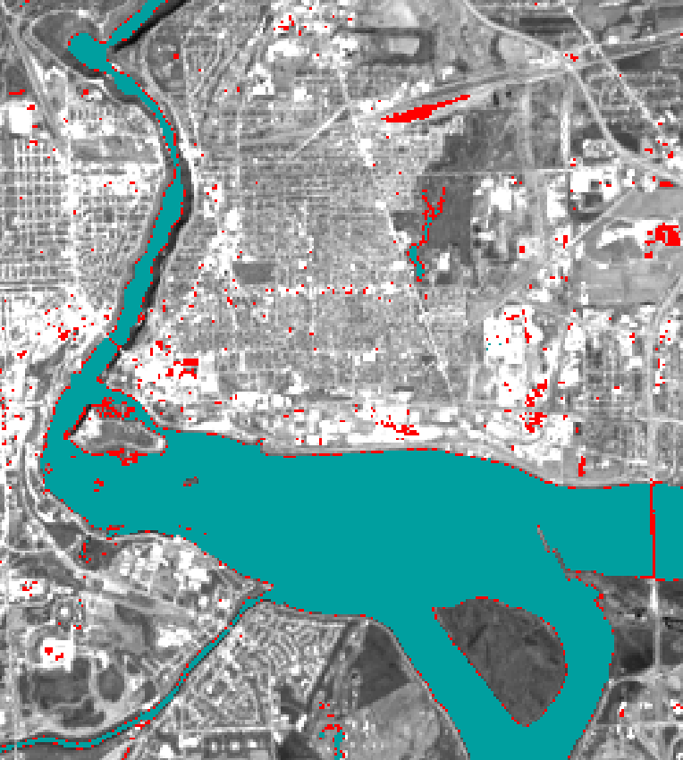
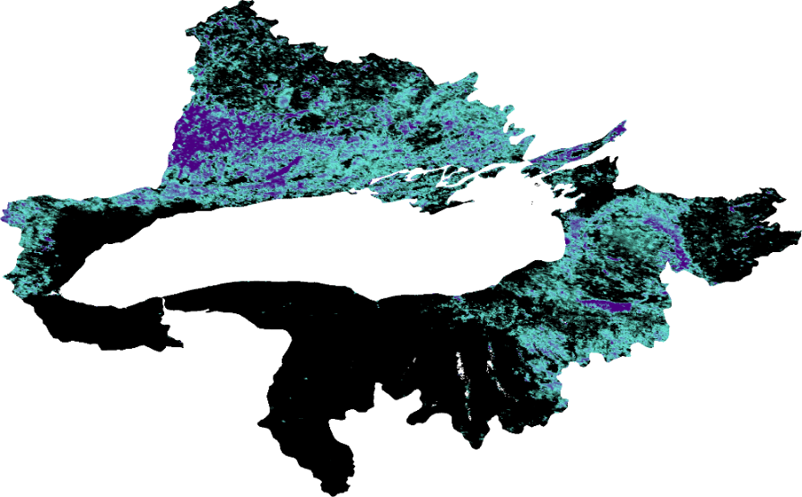






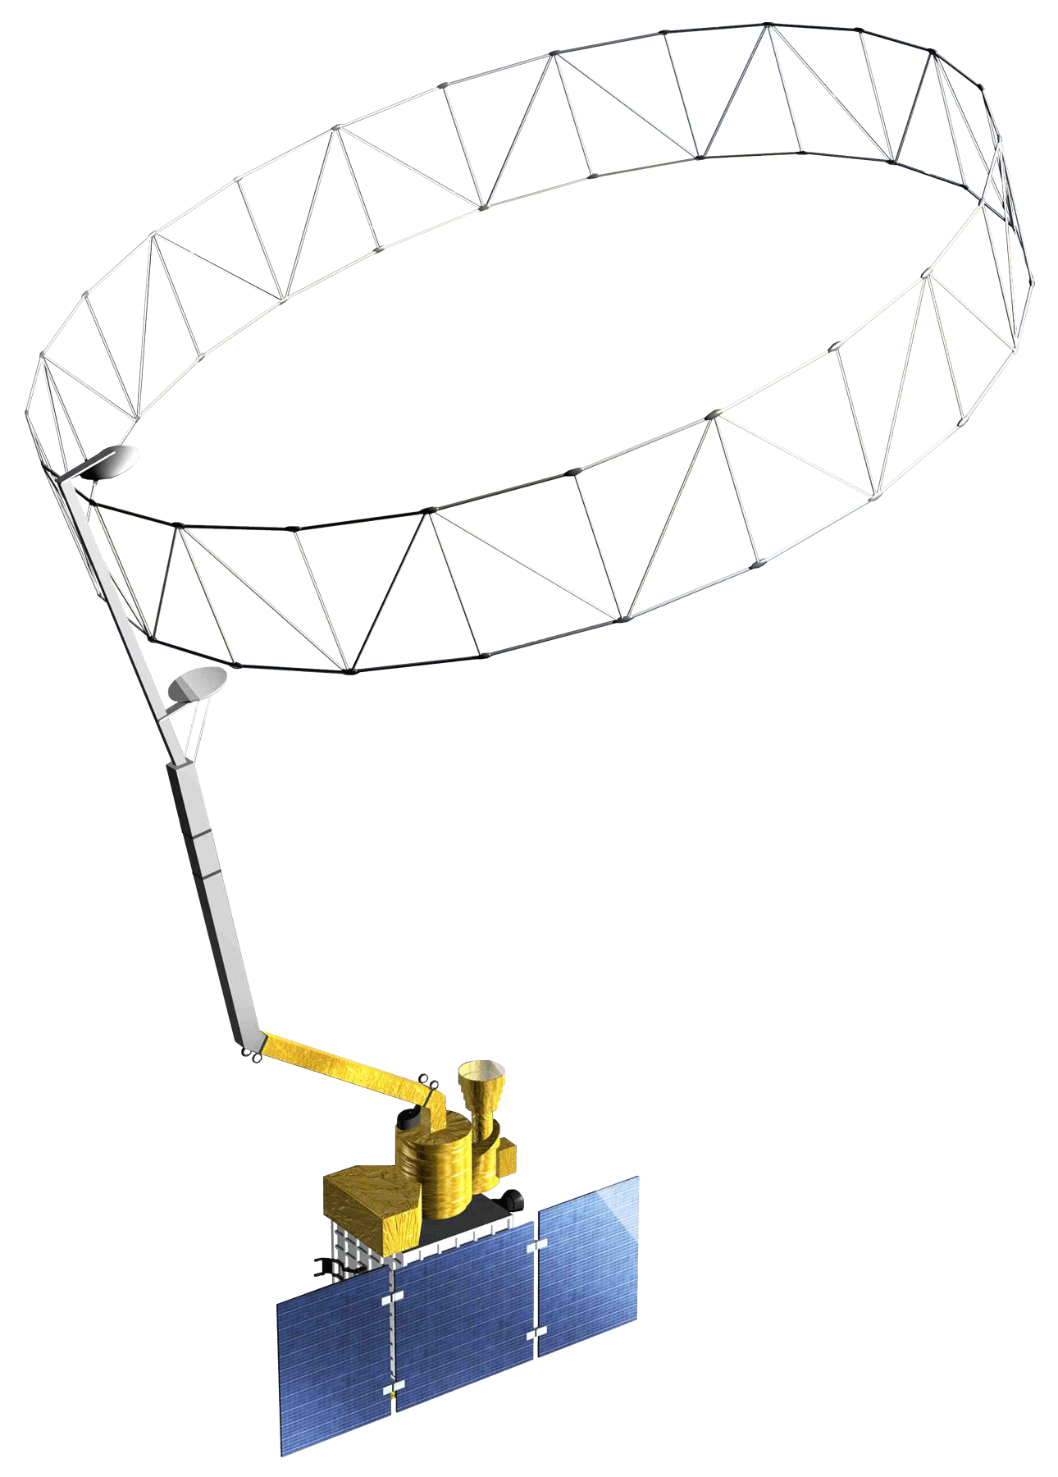
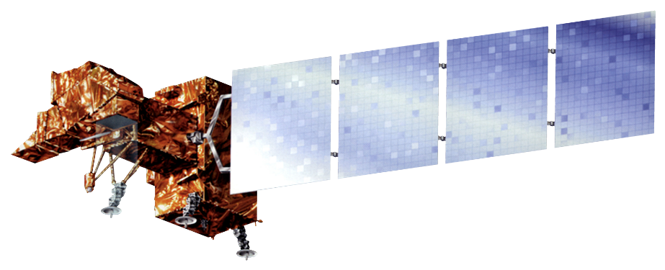


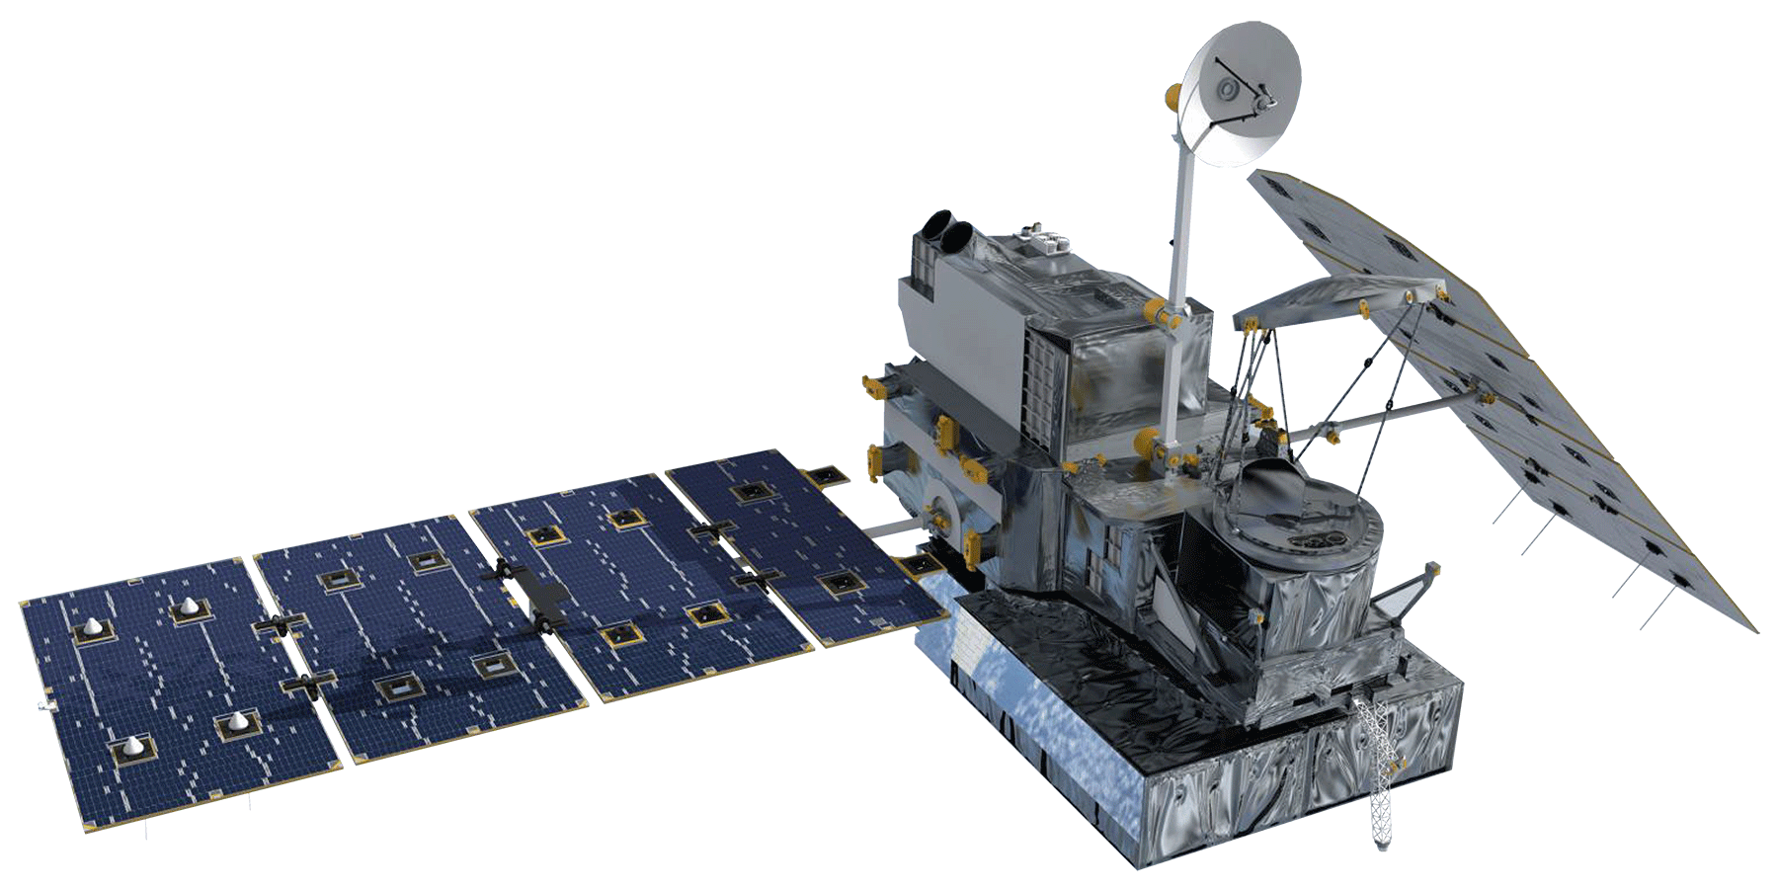
Employing Remote Sensing Techniques to Evaluate Flood Extent and Environmental Parameters that Contribute to High Water Levels in Lake Ontario’s Coastal New York Communities
Abstract
Objectives
Niagara Falls Disasters
Approximately 11 million people reside in the Lake Ontario watershed. Extreme high water levels in the spring of 2017 caused severe flood damage to communities off the coast of Lake Ontario. Niagara Falls drainage infrastructure did not accommodate floodwater inundation, which led to the destruction of property and unsafe conditions for residents. City management required further assessment of maximum flood extent and regional impacts in order to determine high flood risk areas. The Niagara Falls Disasters team partnered with the City of Niagara Falls, the Great Lakes and St. Lawrence Cities Initiative, Cornell University, and University of Michigan to map flood extent and create tools to assess relevant environmental parameters used in flood risk evaluation. The team used Google Earth Engine to identify river and coastline changes in the Niagara Falls, NY region. Additionally, the team evaluated various environmental parameters derived from NASA Earth observations, including snow and ice cover, precipitation, and soil moisture, and generated time series analyses for the months prior to and during the 2017 flood event. These products will allow the partners to better prepare at-risk communities for future extreme weather events.
Determine the feasibility of using satellite remote sensing techniques for urban flood extent mapping
Create flood extent maps that display the extent of high waters levels prior to and during the 2017 flood
Demonstrate how specific environmental parameters that contribute to flooding can be measured using satellite remote sensing
Methodology
Coastal Annual
Land
Cover Change
Acquired Landsat 7 & 8 data from Google Earth Engine
Applied NDWI & MNDWI calculations, binary classification, & calculated annual averages
Quantified river and coastline changes from 1999 to 2019
Flood
Extent
Maps
Acquired Landsat 8 data from USGS Earth Explorer
Applied water indices (Tasseled Cap, Red – SWIR1, NDWI/ MNDWI) using TerrSet software
Evaluated differences in water indices for 2017 flooding compared to the 2016 average of water indices
Study Area
CANADA
Hydrologic
Input
Tool
Acquired SMAP, MODIS, GPM, & SRTM data from Google Earth Engine
Calculated monthly median, mean, & sum for available data
Created monthly/yearly time series and visualization of soil moisture, snow/ice cover, precipitation, and elevation data for 2015 to 2019
Lake
Huron
Lake
Erie
Lake
Ontario
Results
February 2017 Monthly Median
UNITED STATES
Lake Ontario
Figure 1. The region of interest for this project, pictured here, encompasses a portion of the southern coast of Lake Ontario, the City of Niagara Falls, NY, and extends to Grand Island. The study period is April 2015 to February 2019.
➢
Project Partners
75 km
225 km
Snow and Ice Cover
High
Low
City of Niagara Falls, Department of Planning and Economic Development
Cornell University
Great Lakes and St. Lawrence Cities Initiative
University of Michigan
April 2017 Wetness
Figure 3. Median snow and ice cover values were calculated for February 2017, with black representing low percentages and purple representing high percentages.
2016 Average Wetness
Figure 2. Tasseled Cap wet areas for April 2017 shown in red overlaid with 2016 Base Average in turquoise.
June 2017
Monthly Sum
Conclusions
Given the relatively course spatial resolution of Landsat 7 & 8, NASA optical satellites provide limited functionality for mapping floods in urban environments.
Our team found that using NASA Earth observations to assess environmental parameters that contribute to high water can effectively contribute to model validation and forecasting efforts.
During April and May of 2017, precipitation was approximately 166 mm more than April and May 2016 and soil moisture was the highest of all months in 2017 and 2018.
Soil Moisture Time Series of Grandview Island, New York
Lake Ontario
Soil Moisture (mm)
➢
75 km
225 km
SMAP soil moisture
Low
Precipitation
High
6 period moving average
Figure 4. Cumulative precipitation values were calculated for June 2017, with light blue representing low values and darker blue representing high values.
Team Members
Figure 5. Soil moisture increases in the months surrounding the Spring 2017 flooding (April to May).
Acknowledgements
Tom DeSantis and Alan Nusbaum, City of Niagara Falls
Melissa Soline, Great Lakes and St. Lawrence Cities Initiative
Dr. Scott Steinschneider, Cornell University
Dr. Drew Gronewold, University of Michigan
Dr. Cédric Fichot, Boston University
Zachary Bengtsson, DEVELOP Massachusetts – Boston Node
Lake Ontario Disasters Team, DEVELOP Arizona – Tempe Node
Christine Fleming
Project Lead
Celeste Gambino
Eric Deutsch
Oyut Amarjargal
Earth Observations
Landsat 7 ETM+
Landsat 8 OLI
Terra MODIS
GPM IMERG
SRTM
SMAP L-band Radiometer
Massachusetts – Boston | Spring 2019

