Slide 1
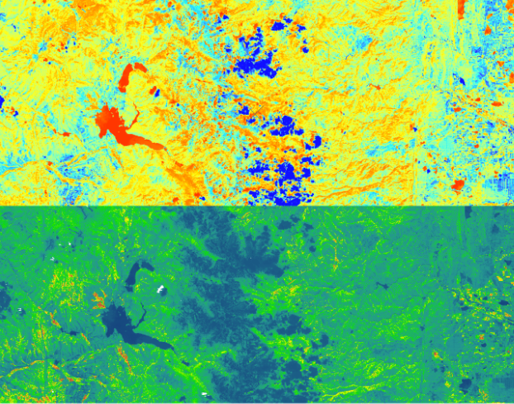
Amy Stuyvesant (Project Lead)
ROCKY MOUNTAIN NATIONAL PARK CLIMATE
Monitoring Algal Productivity to Inform Spatiotemporal Alpine Lake Dynamics
Emily Campbell
Benjamin Ignac
Muthukumaran Sampath
Notes:
Good afternoon and thank you for taking the time to hear about what our team worked on over the past 10 weeks. Our project is titled Monitoring Algal Productivity to Inform Spatiotemporal Alpine Lake Dynamics and we partnered with the National Park Service as well as USGS. I’m joined here today with the entire team, Amy, Emily, Ben, and Muthu.
Image source: Landsat 8 true color image, downloaded from USGS’s Earth Explorer website

Slide 2
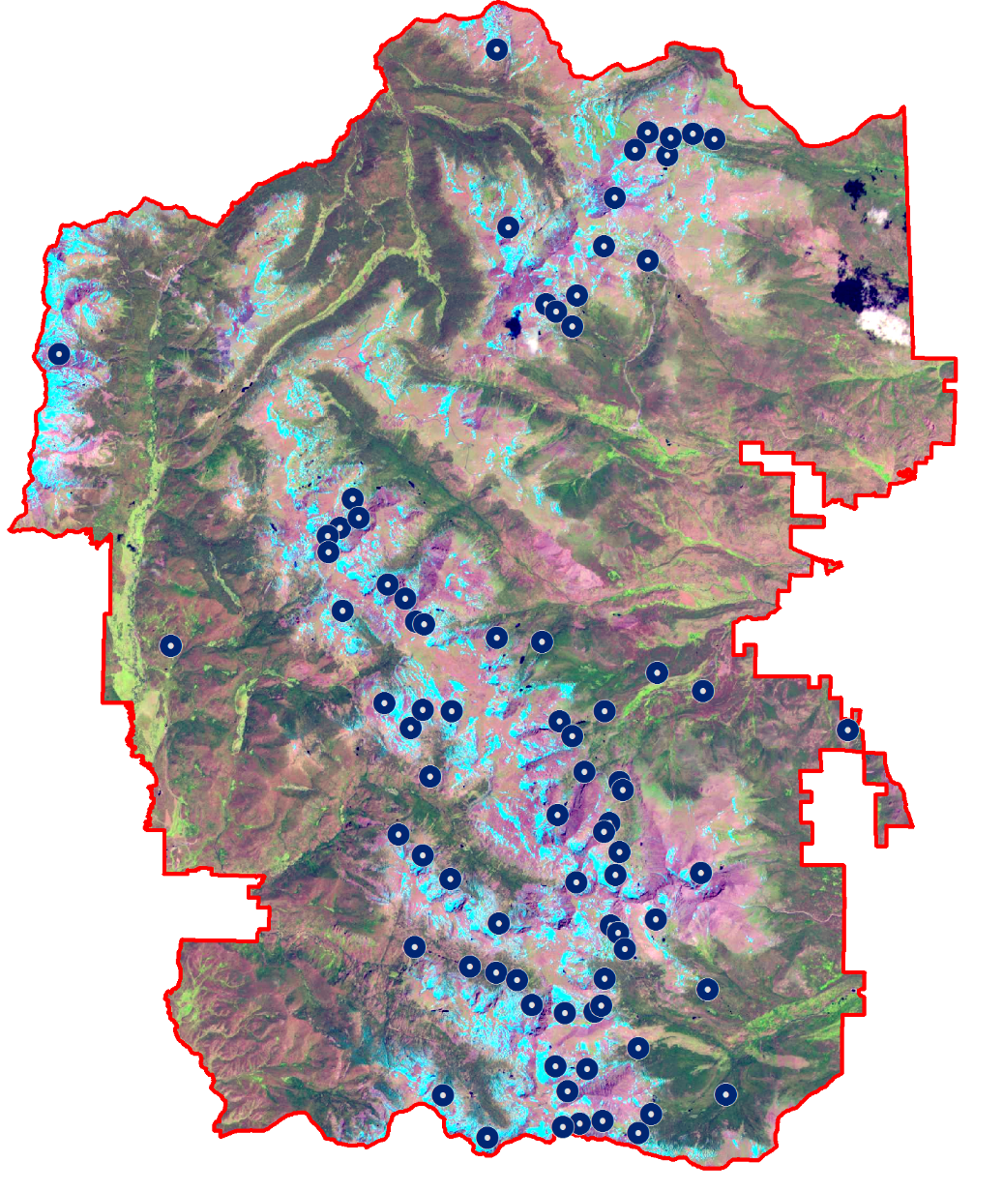
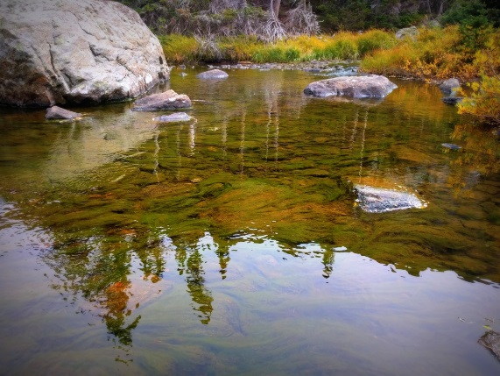
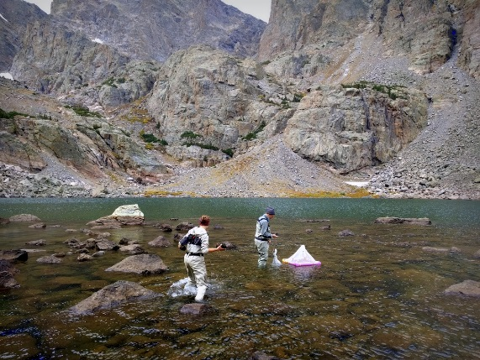
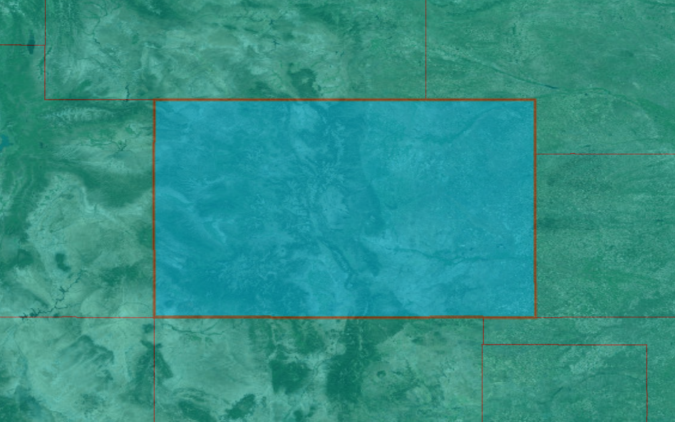
STUDY AREA & PERIOD
Loch Vale
Sky Pond
COLORADO
Area: RMNP Lakes Period: Summer months (June, July, August) 2014-2016
Image Credit: Benjamin Ignac
Notes:
Our study area for this project includes over 140 alpine lakes in the RMNP and the surrounding region. We paid special attention to Loch Vale and Sky Pond. These two lakes have in situ measurements that we used to validate our Earth observation data. The study period includes summer months (June, July, and August) from 2014 to 2016.
Image Credit: Benjamin Ignac

Slide 3
COMMUNITY CONCERNS
EUTROPHICATION
Dead Zones
Economic Loss
Drinking Water
Image Credit: Melissa (left), Antonio Calero (middle), and Nara Souza (right)
Notes:
Massive algal blooms cause oxygen depletion and eutrophication. These conditions can lead to the formation of dead zones in the lakes, which disrupts the ecosystems. Eutrophication has accelerated in many reservoirs and lakes, affecting their water quality and making them unfit for human consumption. Toxic algal blooms can also disrupt tourism due to foul odors/unsightly views, and poisoned fish. With stringent EPA guidelines for water quality, millions of dollars need to be spent per year on the treatment of fresh water polluted by nitrogen and phosphorus.
Photo Credits-
Left: https://commons.wikimedia.org/wiki/File%3AEutrophied_lake_-_Maack_-_200908_02
Middle: https://www.flickr.com/photos/114666927@N08/15726596829/in/photolist-pXGVkc-prNhdC-r67GCy-dCWHC9-GA4NSx-aroNp4-FArWV-atDSNU-pjY2FK-akoWta-cKj9Hd-5rxhtK-J8ZWGV-GPh6EY-5tX9d7-gBqJKL-ckv2Lb-pNGfbs-bATAMi-dCq95x-8SjoYA-k9ESKK-9jeSDA-8Yti5W-Gd8cw5-7KXw2d-75EC2o-omepFk-7gbdT2-bymNRM-Fr9McG-4cd9TF-newAf4-nXsgk2-9d3Aiu-5Ua3vM-6EMeqL-7YkKkU-HGLwwA-8bfuQK-9d3zhU-9BKucS-5tYbih-5AFco8-dJs66e-f5rjFS-2x3La1-bwrcYN-fJ5G25-oemUK8
Right: https://www.flickr.com/photos/48722974@N07/5120227735

Slide 4
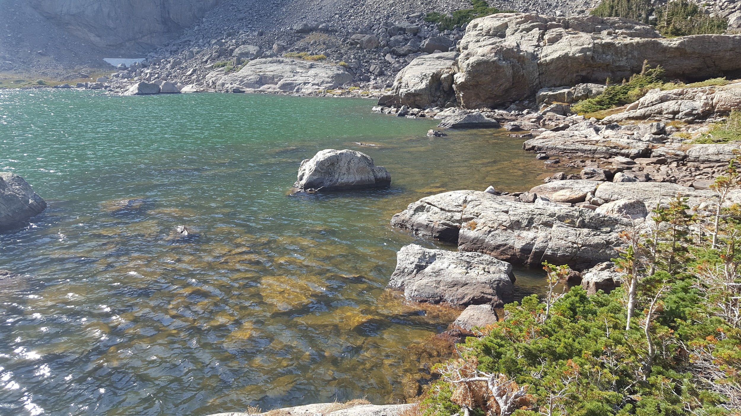
OBJECTIVES
Assess
Feasibility
Predict
Algae
Examine
Heterogeneity
Image Credit: Amy Stuyvesant & flaticon
Notes:
Our main objectives for this project included conducting a feasibility assessment [CLICK] of using NASA Earth observation data to monitor algal productivity for alpine lakes in Rocky Mountain National Park. This included making decisions on how to allocate our in situ measurements and satellite data to our study area and what spectral information was most important in predicting algae in lakes in and around the park. Using these parameters, we aimed to produce the best model to predict algae [CLICK] concentrations in all the lakes based on correlating in situ measurements with corresponding satellite imagery. Finally, we examined the heterogeneity [CLICK] of predicted algae concentrations over time and space.
Image Source: Amy Stuyvesant
Icons from Flat Icon: http://www.flaticon.com/

Slide 5
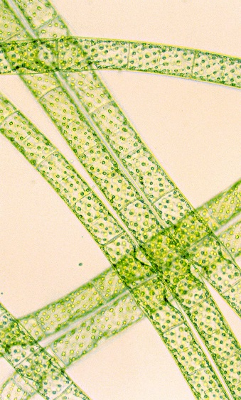
METHODS OVERVIEW
Spectral signature for vegetation
b2
60
b3
b4
b5
45
Reflection (%)
b6
Near Infrared (NIR)
Shortwave Infrared (SWIR)
Visible
b7
30
Chlorophyll-a absorption
Landsat 8 bands
15
0.4
0.5
0.6
0.7
0.8
0.9
1.0
1.1
1.2
1.3
1.4
1.5
1.6
1.7
1.8
1.9
2.0
2.1
2.2
2.3
2.4
2.5
Wavelength (μm)
Images credit: Josef Reischig (algae), NASA (Landsat 8)
Notes:
[CLICK CLICK] In order to produce a model that could accurately predict algae in the lakes, we first examined the spectral reflectance of chlorophyll-a as it falls on the electromagnetic spectrum to find the best predictor band ratios for our model. Chlorophyll-a, a pigment found in all vegetation, reflects highest in the near-infrared portion of the spectrum and in the green portion of the visible spectrum. [CLICK CLICK] Chlorophyll-a strongly absorbs in the red and blue wavelengths of the visible spectrum. Due to this spectral behavior of chlorophyll-a [CLICK] we chose these Landsat 8 bands to add into our model as predictor variables.
Photo Credits: Algae: https://commons.wikimedia.org/wiki/File:Spirogyra_(248_00)_Native_preparation.jpg
Landsat 8 Satellite: DEVELOPEDIA

Slide 6
METHODS OVERVIEW
Landsat 8 OLI
Surface Reflectance Product
Surface Reflectance Product
Surface Reflectance Product
Surface Reflectance Product
Surface Reflectance Product
Gathered cloud-free images near in situ collection
Surface Reflectance Product
Surface Reflectance Product
Normalized & clipped images to study area
Calculate relationship between remotely sensed and in situ chlorophyll–a levels
Applied several band ratios as predictor variables
NIR/
RED
NIR/RED + SWIR-1
NIR/
COASTAL
BLUE/RED
Images credit: NASA (Landsat 8) and Flaticon (Clip art)
Notes:
We acquired satellite images (click) of our study area gathered by the Landsat 8 Operational Land Imager freely available on USGS Earth Explorer(click click). Then we removed all images with substantial cloud cover or shadow near the studied lakes. We narrowed down the remaining images to the ones that were taken within one week of in situ collection. After normalizing all useable dates, we clipped the images to our study area and applied various band ratios based on ratios we found in our literature review. These indices were averaged for each lake and the statistical relationship between remotely sensed chlorophyll and the in situ measurements was calculated.
Icons from Flat Icon: http://www.flaticon.com/

Slide 7
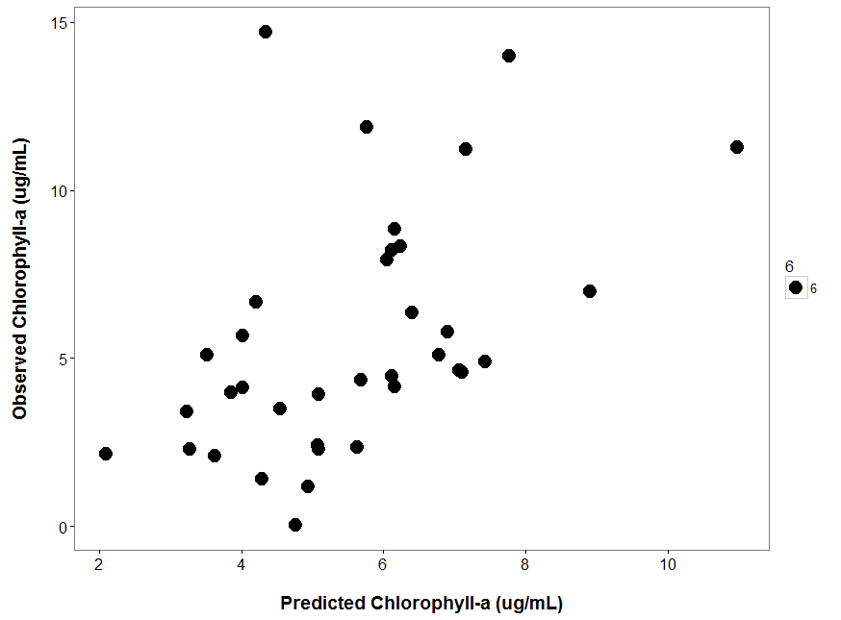
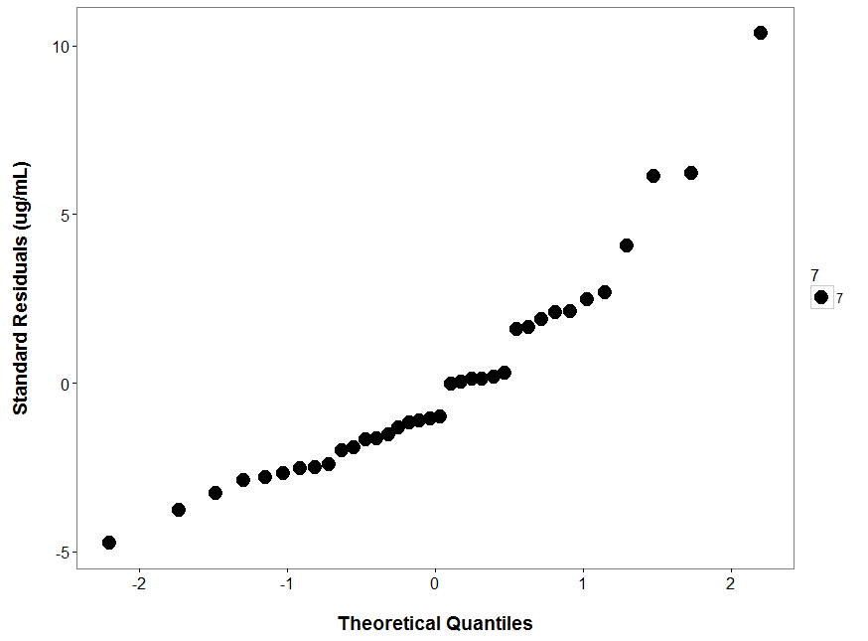
METHODS OVERVIEW
Generalized Linear Model
Random Forests Model
Our data set does not meet assumptions for GLM
Multiple Regression Analysis
Identifying key feature
Random sample
Data is not normally distributed
Finding set of variables that produce the strongest prediction model
Notes:
In order to determine how accurately remotely sensed data can predict actual chlorophyll-a values in the lakes, we utilized and compared two statistical models(click click) – GLM and RF. Multiple regression analysis had difficulties predicting high chlorophyll-a observations (7xclick). GLM is used for data that is normally distributed and our data does not meet that criteria as we can see from the QQ plot. Departures from a linear pattern indicate a lack of normality in the data. (click) The Random Forests Model was used instead, since it can process data that is not normally distributed. What this model does is, (click)it creates multiple random samples from the dataset. (click click click) Each sample is a decision tree that builds the “random forest” and identifies key features or variables to grow the decision tree.(click click click) Finally, the model finds a set of variables (click click) that produce the strongest prediction for chlorophyll –a.

Slide 8
RESULTS
Landsat 8
SWIR-2
Feasibility Assessment
Predictor variables: Band 7 (SWIR2)
Band 5/Band4 (NIR/Red)
In Situ Collection: Average depth >
Surface
Landsat 8
NIR/RED
Collection
Point
Pixel Aggregation: Collection Point >
Whole Lake
Images credit: Flat Icon
Notes:
After assessing several band ratios in the Random Forests model, we found that the (click) shortwave infrared Landsat band and a ratio of near-infrared band over the red band were the most important variables in predicting chlorophyll’s presence. The near-infrared over red ratio is very commonly used in literature to isolate vegetation, which contains chlorophyll-a. The SWIR-2 band is also used often used in studies to detect moisture content in plants, and as algae is submerged in water we concluded that this property of SWIR-2 aids model performance. We also looked at how to draw boundaries for our data, for example do we only use the surface measurement of in situ algae or do we include the whole column (click). When we conducted this sensitivity analysis, we determined that using the chlorophyll-a averaged by depth in the water column increased model performance. Similarly, when we looked at how to allocate the pixels in each lake (click), our analysis showed averaged the pixels within a 30 m buffer of the collection point yielded higher model results compared to averaged all of the pixels in a lake.
Icons from Flat Icon: http://www.flaticon.com/

Slide 9
RESULTS
Feasibility Assessment
Predictor variables: Band 7 (SWIR)
Band 5/Band4 (NIR/Red)
Model statistics (n = 38):
$r^{2}$ = 0.226
RMSE = 3.128
RMSE Scaled = 56.22%
In Situ Collection: Average depth >
Surface
Pixel Aggregation: Collection Point >
Whole Lake
Notes:
With this conclusions (click), we proceeded with a Random Forests Classification model (click)c using SWIR-2 and NIR/RED as predictor variables, choosing the in situ data averaged by depth, and averaging pixels near the collection point.

Slide 10
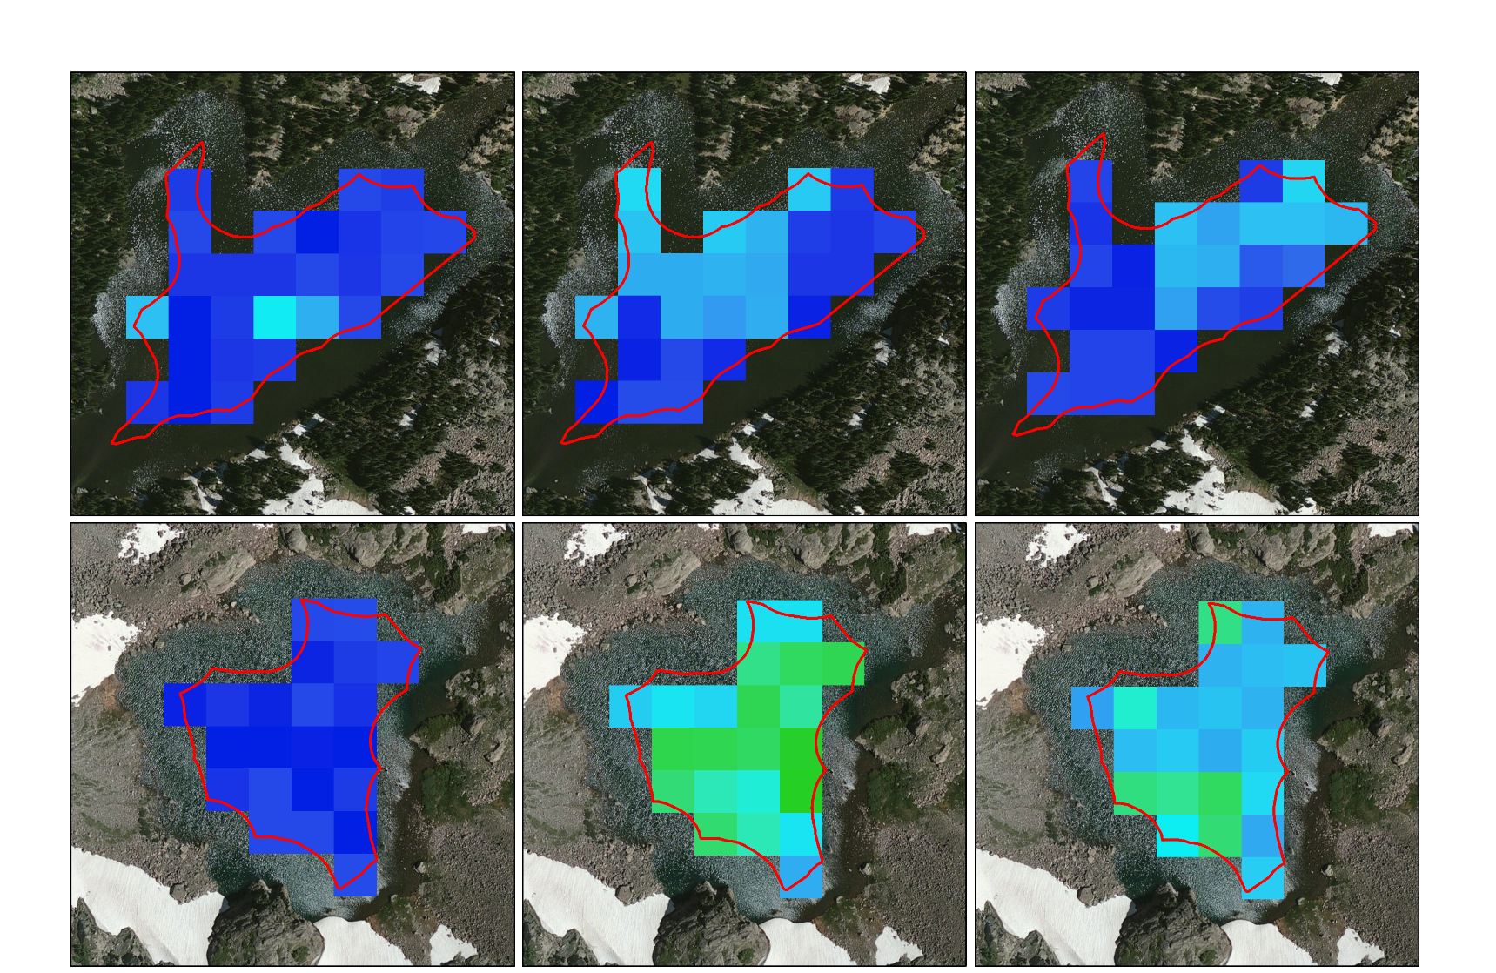
RESULTS
July 2014
August 2015
July 2016
3$.14 ±0.9$
3$.92 ±1.2$
3$.71 ±1.2$
Heterogeneity
Loch Vale
Average Values Over All Lakes
 | July 2014 (n = 84) | Aug. 2015 (n = 85) | July 2016 (n = 93)
Range | 4.28 | 3.356 | 4.391
Std. | 1.257 | 1.024 | 1.277
Mean | 5.423 | 7.009 | 5.493
Predicted Average
$$±$$
Standard Deviation
2$.75 ±0.3$
7$.54 ±1.5$
6$.14 ±1.3$
Sky Pond
No Significant Association
2.3 μg/l
Chlorophyll-a estimation
10.25 μg/l
Notes:
We used this model to predict chlorophyll-a values across the study area and assessed heterogeneity both spatially and temporally. We isolated two lakes, Loch Vale and Sky Pond for further analysis. Based on the average of each lake and an analysis of variance, the predicted values do not significant differ over time. (click) Taking a step back and looking all of the lakes in the park over time, we see a similar pattern. For each lake we calculated the range, standard deviation, and average for each chlorophyll-a predicted values. These values were then averaged for each lake in each year, seen in these table. We also found that there was no significant association (click) between these summary statistics and year. In all, we found that our predicted values did not show spatial or temporal heterogeneity. It should be be noted though that our model did under and over predict in situ values so the lower and upper ends of the distribution are cut off in this model. This may be why we are not seeing variation here.

Slide 11
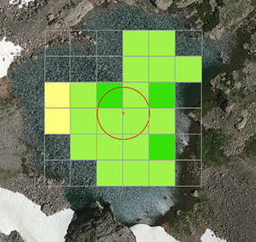
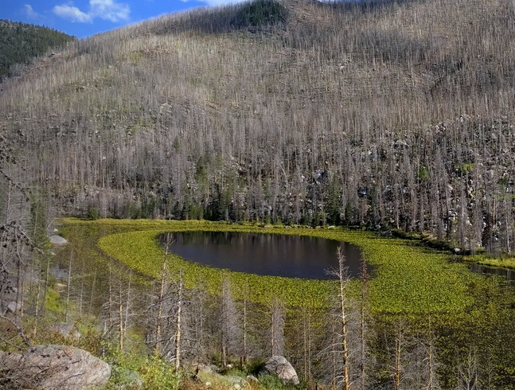
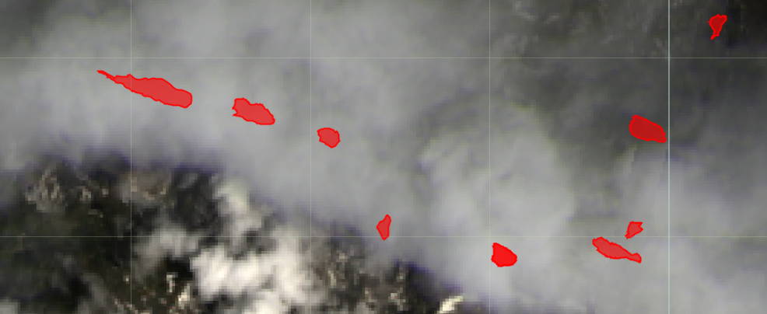
LIMITATIONS
Landsat 8 spatial resolution: 30 m per pixel
Landsat 8 OLI spectral, spatial and temporal limitations
Water Surface and shoreline vegetation
Cloud/snow/ice cover
Limited in situ data
Scan lines Landsat 7: Aug 29 2003
Shoreline vegetation Cub Lake: Sep 16 2016
Cloud Cover Landsat 8: July 5th 2015
Image Credit: Benjamin Ignac (Top right)
Notes:
As with all studies of this nature, we faced limitations. We found Landsat 8’s spatial resolution of 30m per pixel to be a challenge with these small study area lakes, especially with such optically complex lakes (i.e. shoreline and bottom-of-lake interference). Additionally, Landsat 8 does not have a band that captures wavelengths in the ‘red-edge’, or that area between the visible red and NIR. These wavelengths are very important in chloprpohyll detection and we believe proceeding with a satellite, such as Sentinel-2, that includes this band would be worthwhile. While Sentinel-2 does have both lower spatial and temporal resolution, this satellite is new and there were only two usable images available for this study. When cross-referenced with available in situ measurements, the sample size dropped to 11 and was deemed too small for modeling.
Additionally, observing a mountainous area proved to have many challenges. Due to the climatological features of mountain ranges, many images in the summer months included substantial cloud cover. Additionally, the high elevation of many lakes resulted in snow and ice cover in early June images, making some of these unusable. This issue is compounded by
Lastly, we used three separate in situ datasets. While all data was collected using the same methodology, human error and differences in instrument calibration could have caused error in the model.
Photo Credits: Benjamin Ignac

Slide 12
Dr. Paul Evangelista (Science Advisor), Colorado State University, Natural Resource Ecology Laboratory
Tony Vorster (Science Mentor), Colorado State University, Natural Resource Ecology Laboratory
Brian Woodward (Center Lead), NASA DEVELOP – Fort Collins
Dr. Amanda West (Science Mentor), Colorado State University, Natural Resource Ecology Laboratory
Bella Oleksy, Colorado State University
Dr. Jill Baron (Partner), United States Geological Survey
Dr. Pieter Johnson (Data Provider), University of Colorado at Boulder
Dr. Hope Humphries (Data Provider), Niwot Ridge Long-Term Ecological Research project and the University of Colorado Mountain Research Station
Notes:
We would like to thank Dr. Paul Evangelista, Dr. Amanda West, Brian Woodward, Tony Vorster, Bella Oleksy, Dr. Pieter Johnson, and Dr. Hope Humphries and her team for helping us with our project.

Slide 13
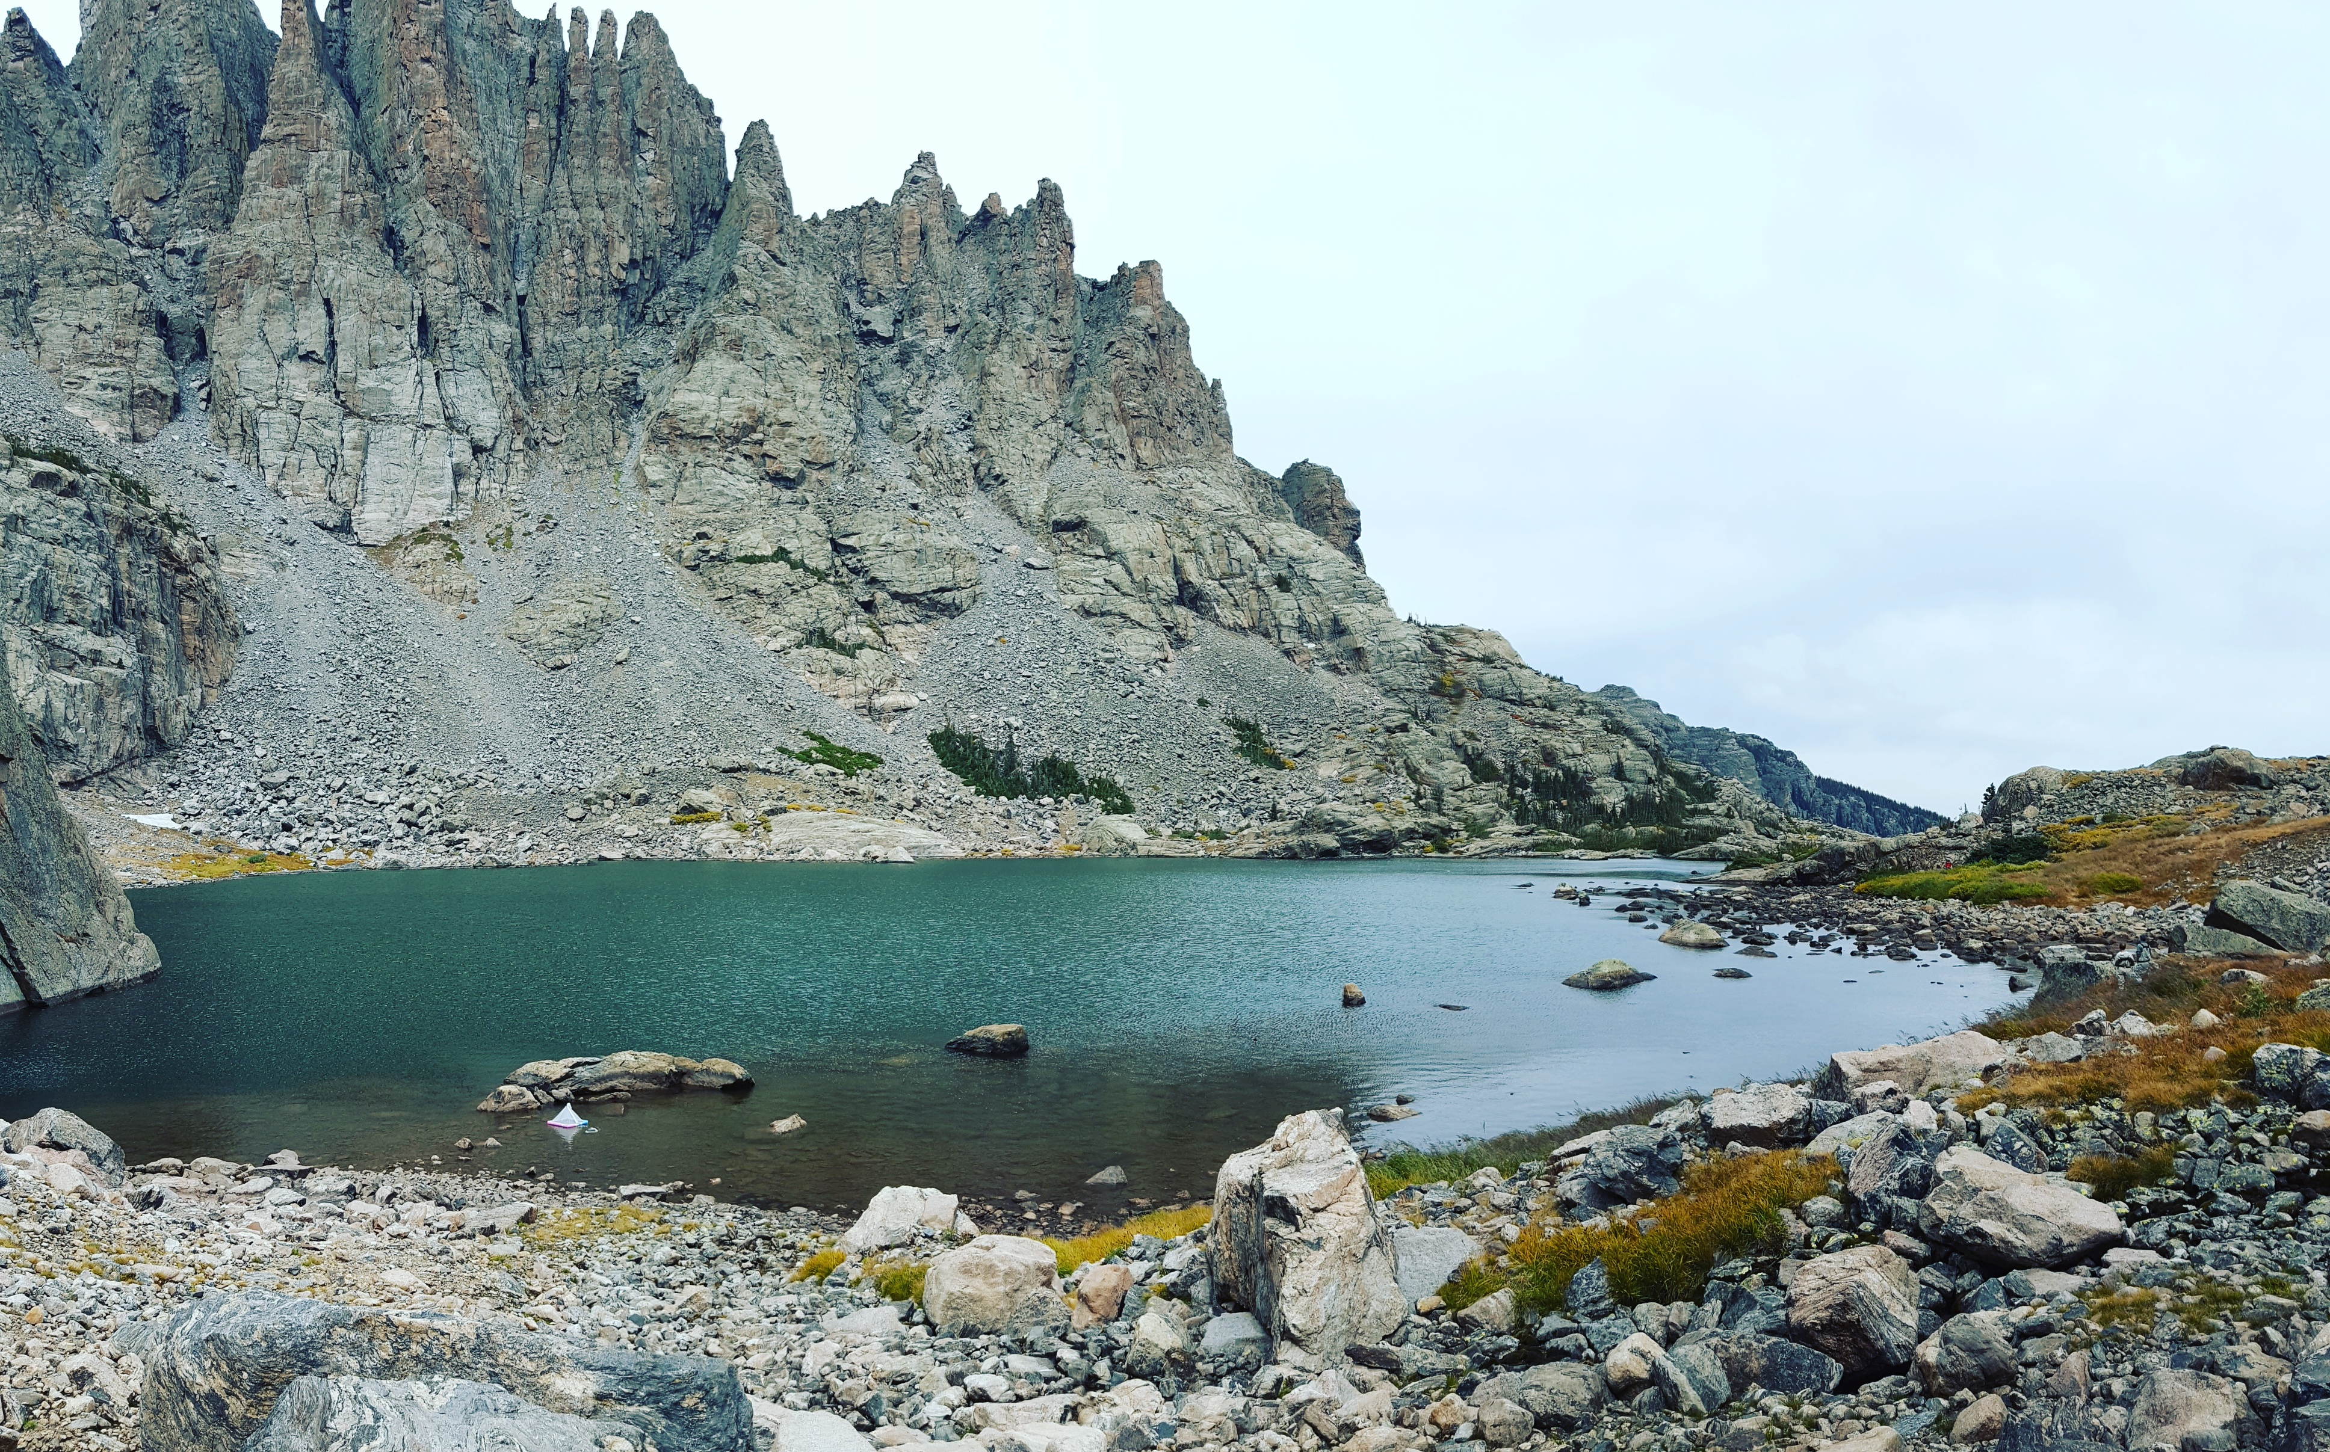
Questions?
Image Credit: Amy Stuyvesant

