Slide 1
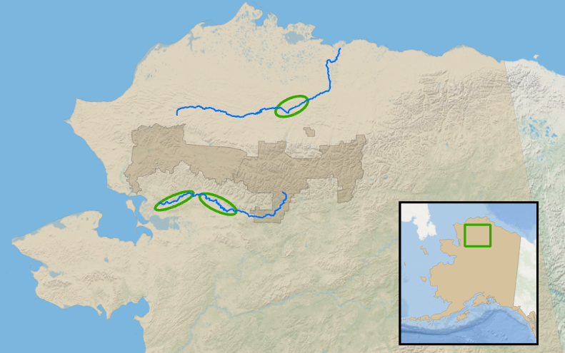
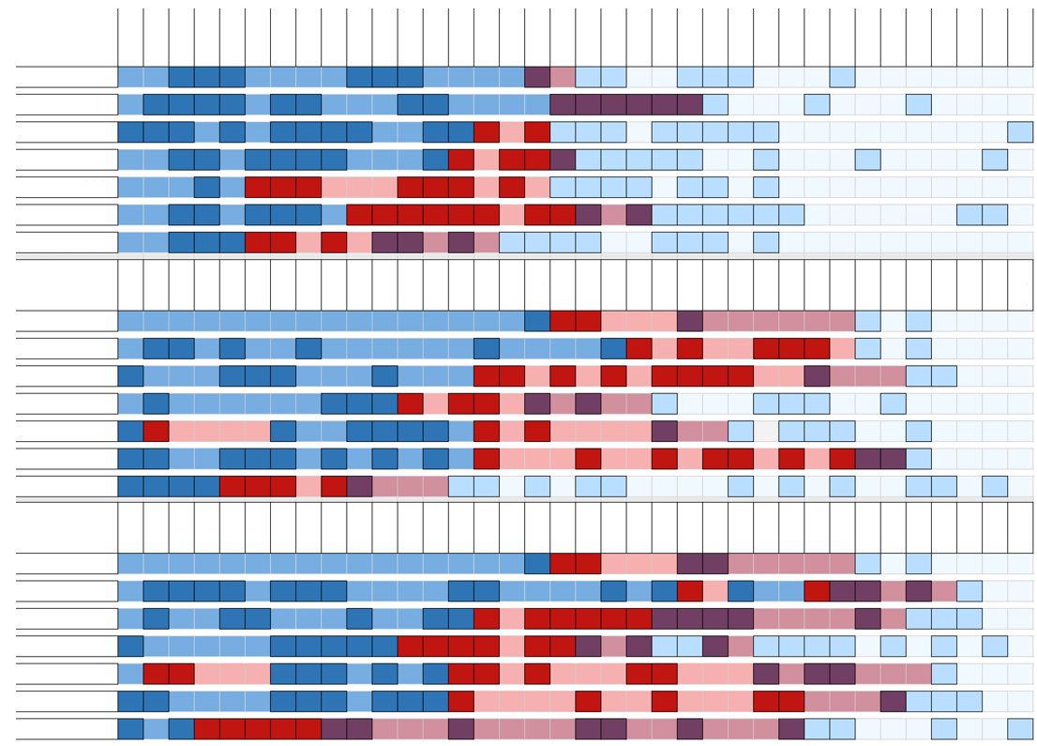
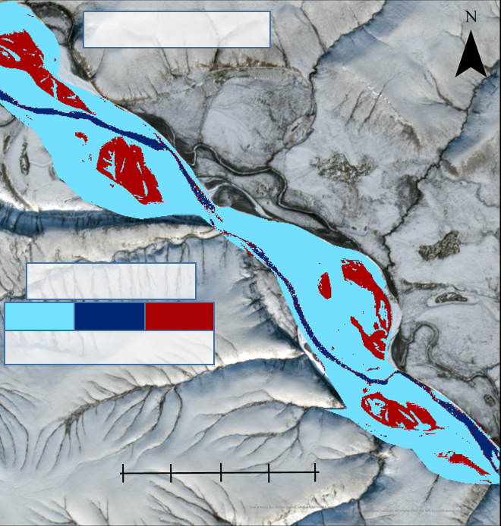
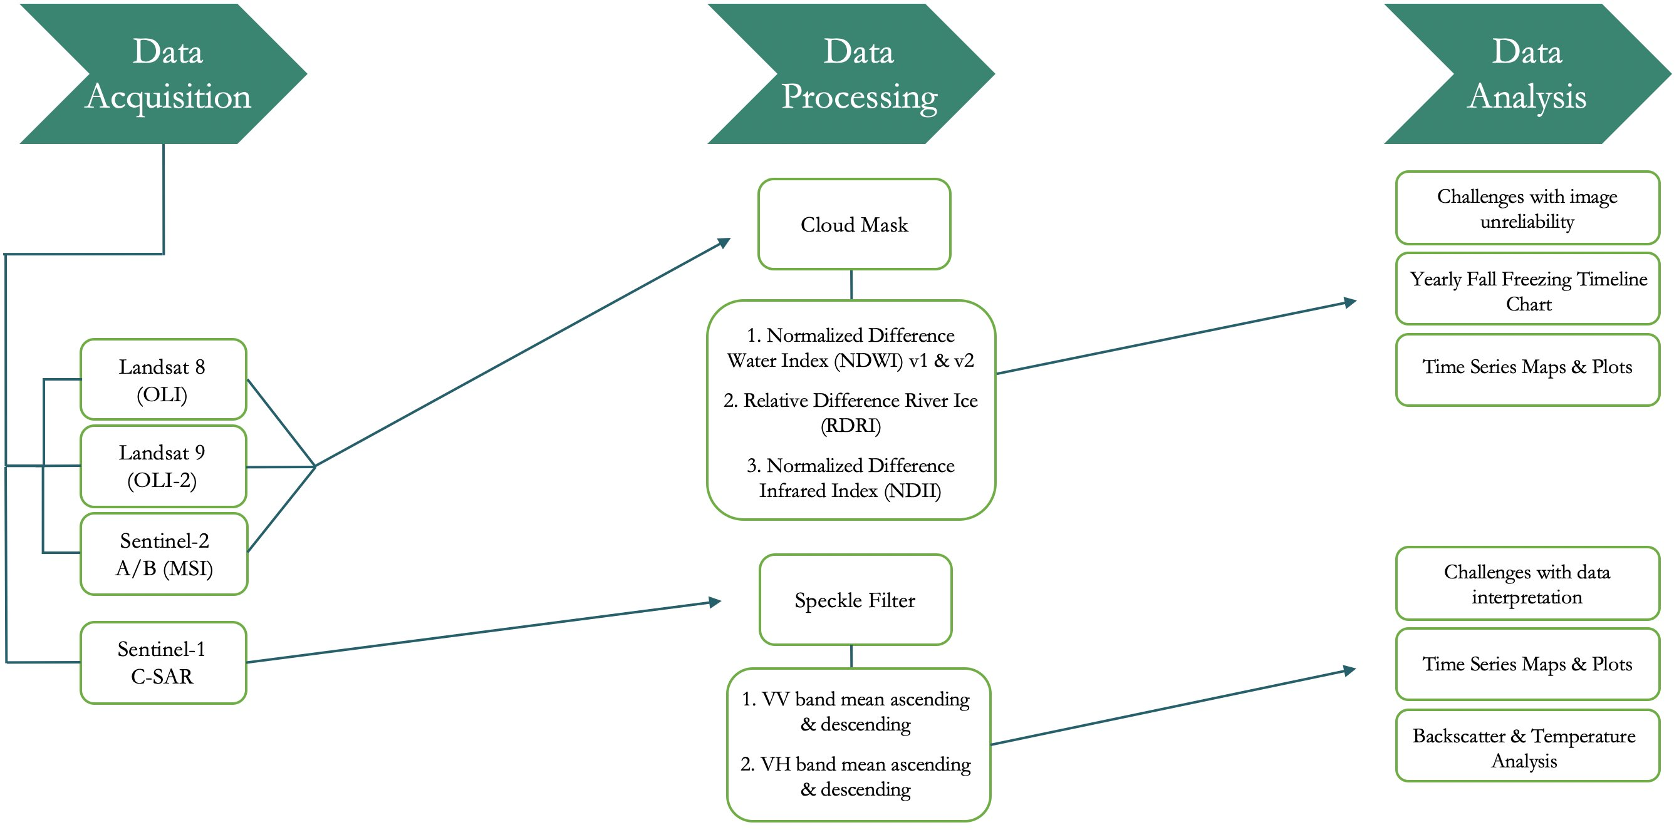
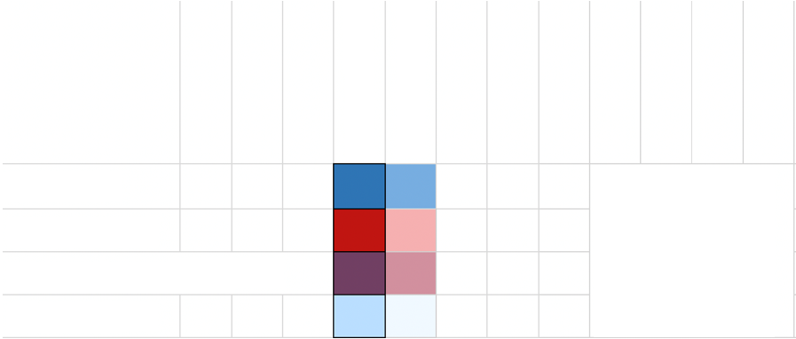
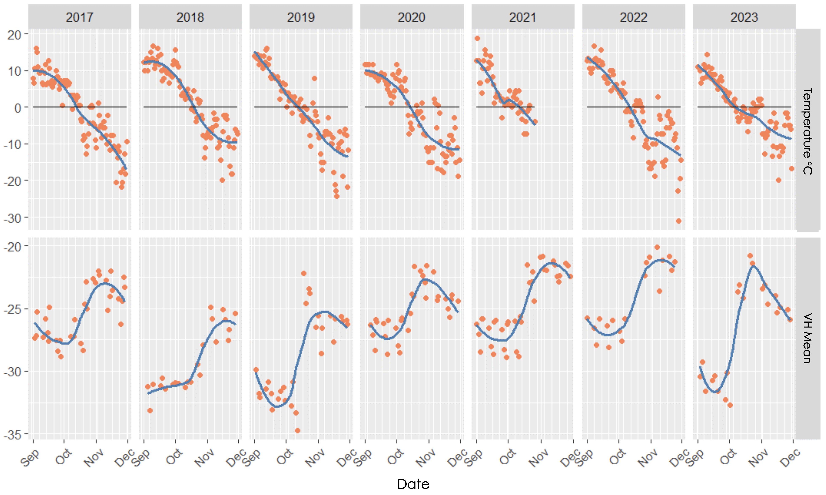
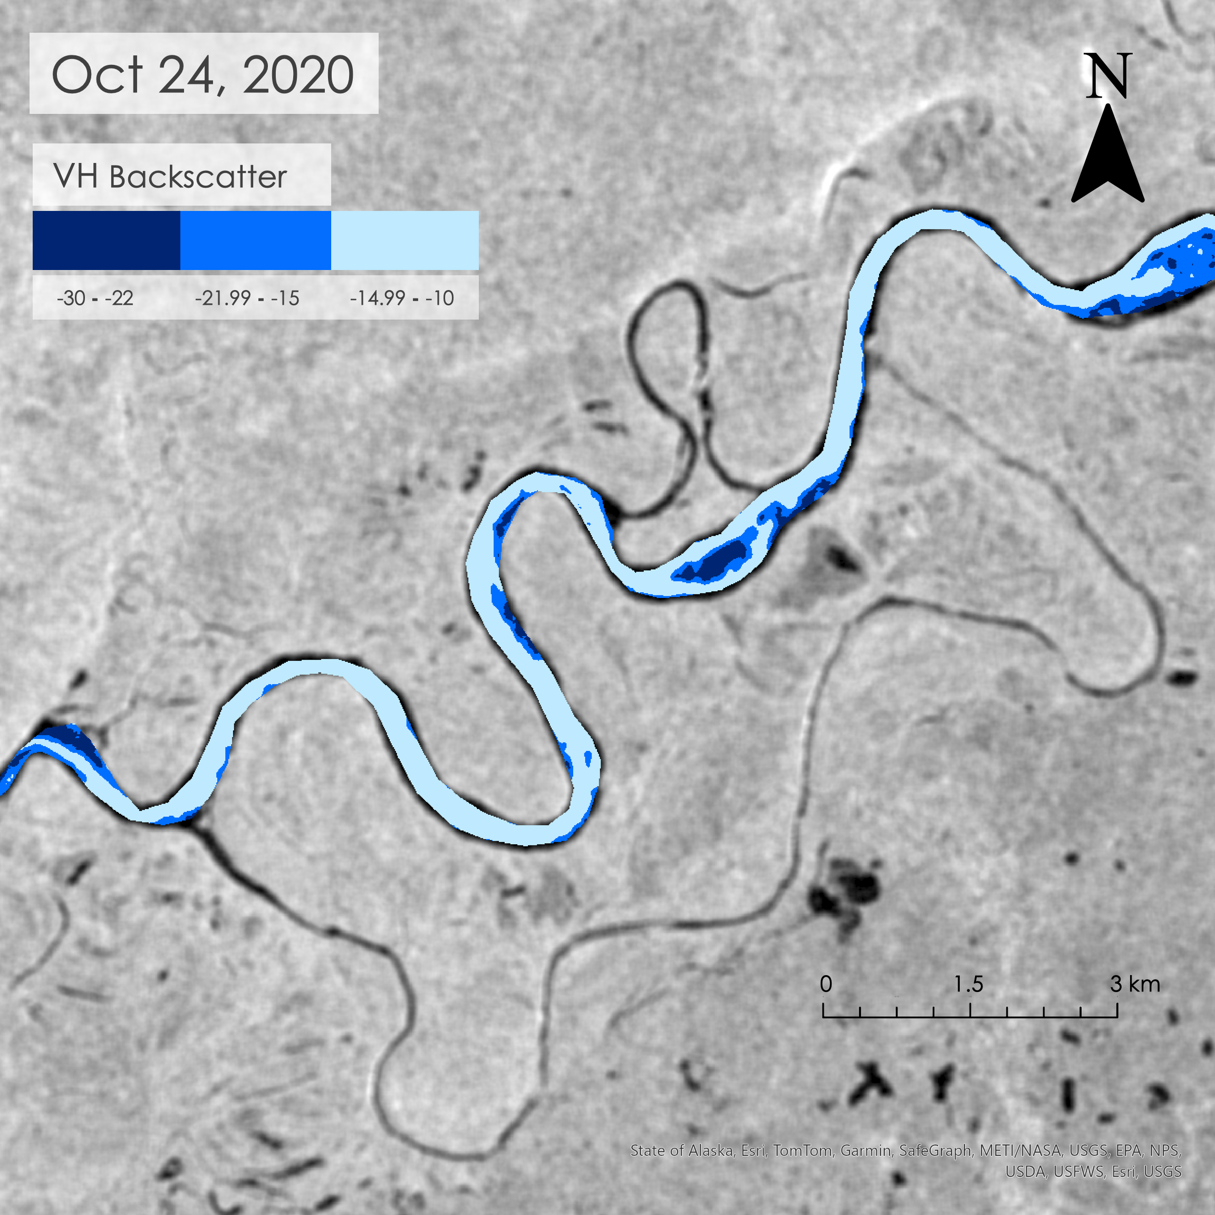
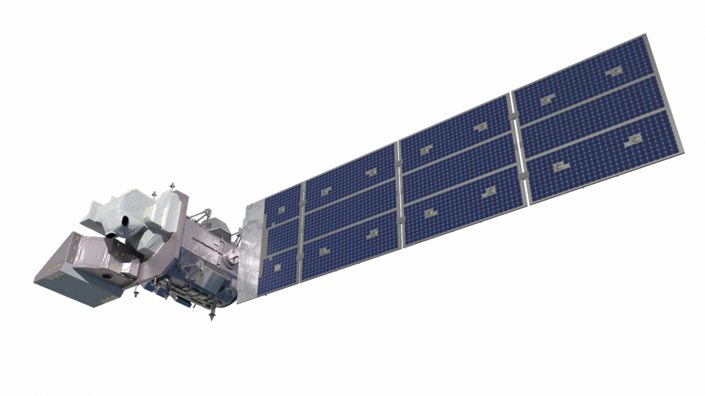
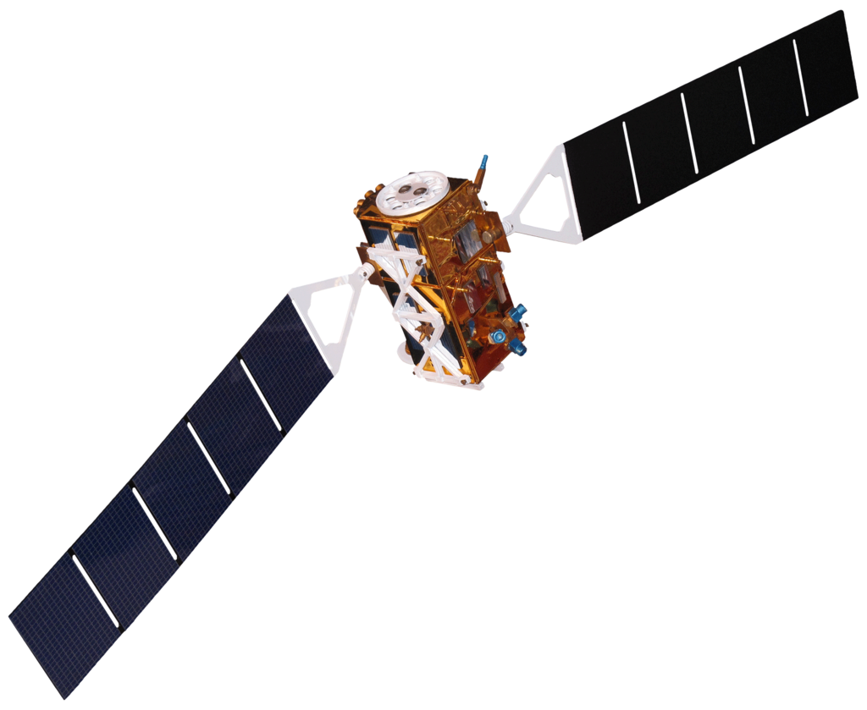
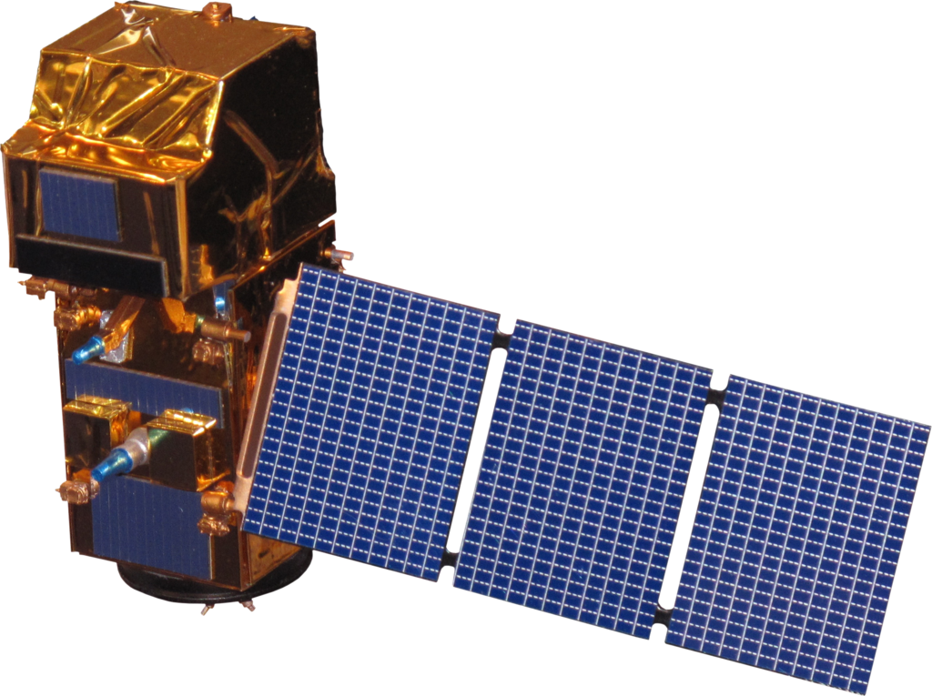
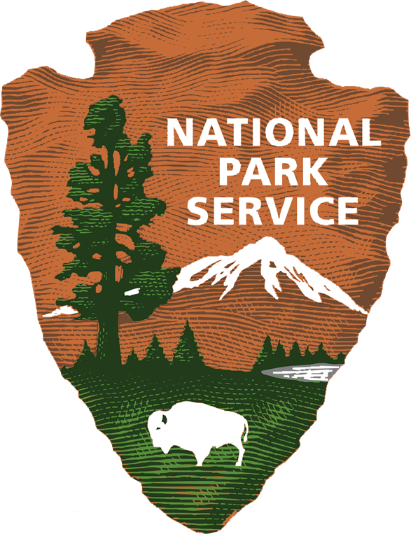
Alaska Ecological Conservation
Using NASA Earth Observations to Identify Recent Changes in River Ice Phenology and Its Impacts on Caribou Migration
Project Synopsis
Study Area
In northwestern Alaska, pronounced seasonal differences prompt caribou (Rangifer tarandus) herds to migrate to and from their wintering grounds to calving areas each year. Warming temperatures and resulting shifts in river ice phenology have the potential to restrict the caribou’s ability to cross large rivers along their migration routes. Partners at the National Park Service (NPS) were interested in assessing whether observed changes in the timing of river ice formation have contributed to changes in observed caribou migration patterns since 2017. Using imagery from Landsat 8 Operational Land Imager (OLI) and 9 OLI-2, Sentinel-1 C-band Synthetic Aperture Radar (C-SAR), and Sentinel-2 MultiSpectral Instrument (MSI), this project assessed the timing of fall river ice formation from optical reflectance and radar satellite image data. By implementing a relative difference river ice method, the Normalized Difference Water Index (NDWI) visualizing both near-infrared and short-wave infrared bands, C-SAR VH images, and the Normalized Difference Infrared Index (NDII), this project assessed the availability of satellite imagery, tested the aptitude of different ice detection indices, and created time series plots and maps of fall ice phenology to inform impacts on caribou migration in a changing climate. When compared alongside caribou migration data, these results can be used by the NPS to better understand shifts in migration to mitigate the decline of caribou populations in northwestern Alaska, in addition to informing hunting regulations in areas of cross-river migration.
N
Colville River
Kobuk River
Rivers
0
50
100
Alaska
Crossing Zones
Miles
Park Boundaries
Basemap: ESRI, GEBCO, Garmin, NaturalVue
Objectives
Results
Capture trends in river ice phenology on the Kobuk and Colville Rivers for the fall caribou migration between early October to late November for the years 2017 to 2023
Produce time series maps and plots to display timing and progression of river ice using satellite imagery and imagery analysis
Determine capabilities and limitations of NASA remotely sensed data to inform caribou management
Annual Ice Formation phases
1-Nov
3-Nov
5-Nov
Colville Ice Coverage (NDII)
27-Oct
31-Oct
2-Nov
4-Nov
24-Oct
26-Oct
28-Oct
30-Oct
21-Oct
23-Oct
25-Oct
29-Oct
7-Oct
20-Oct
22-Oct
6-Oct
8-Oct
2-Oct
5-Oct
9-Oct
1-Oct
4-Oct
3-Oct
13-Oct
16-Oct
18-Oct
12-Oct
14-Oct
11-Oct
15-Oct
17-Oct
19-Oct
Colville
10-Oct
October 14, 2019
2017
2018
2019
2020
2021
2022
2023
1-Nov
3-Nov
5-Nov
27-Oct
31-Oct
2-Nov
4-Nov
24-Oct
26-Oct
28-Oct
30-Oct
21-Oct
23-Oct
25-Oct
29-Oct
7-Oct
20-Oct
22-Oct
6-Oct
8-Oct
2-Oct
5-Oct
9-Oct
1-Oct
4-Oct
3-Oct
13-Oct
16-Oct
18-Oct
12-Oct
14-Oct
11-Oct
15-Oct
17-Oct
19-Oct
W. Kobuk
10-Oct
2017
2018
2019
NDII Classification
2020
2021
2022
2023
1-Nov
3-Nov
5-Nov
Snow/Ice Open Water Sediment
27-Oct
31-Oct
2-Nov
4-Nov
24-Oct
26-Oct
28-Oct
30-Oct
21-Oct
23-Oct
25-Oct
29-Oct
7-Oct
20-Oct
22-Oct
6-Oct
8-Oct
2-Oct
5-Oct
9-Oct
1-Oct
4-Oct
3-Oct
13-Oct
16-Oct
18-Oct
12-Oct
14-Oct
11-Oct
15-Oct
17-Oct
19-Oct
E. Kobuk
10-Oct
2017
Methodology
2018
2019
0
3
6 km
2020
2021
2022
2023
Estimated
Basemap: State of Alaska, Esri, TomTom, Garmin, StateGraph, METI/NASA, USGS, EPA, NPS, USDA, USFS, Esri, USGS
Water
Observed
Made with:
Sentinel 2A/B MSI
Landsat 8 OLI
Landsat 9 OLI-2
Flowing Ice
Flowing Ice + Ice Jams
Frozen River
West Kobuk VH Backscatter
West Kobuk Temperature & VH Backscatter
2017
2018
2019
2020
2021
2022
2023
Temperature °C
VH Mean
Sept
Nov
Sept
Nov
Sept
Nov
Sept
Nov
Sept
Nov
Sept
Nov
Sept
Nov
Date
Conclusions
Earth Observations
Using remote sensing to analyze Alaskan Rivers poses many challenges which must be further addressed for future studies.
As a result of its temporal resolution and ability to penetrate clouds, SAR data appeared to be more successful than spectral reflectance in analyzing river ice presence.
The timeline of river ice freeze up in the fall varied over 2017 to 2023 at the three study sites.
Landsat 9 OLI-2
Landsat 8 OLI
Sentinel-1 C-SAR
Sentinel-2 A/B MSI
Acknowledgements
Team Members
Dr. Kyle Joly - Project Partner, National Park Service
Madison Arndt - DEVELOP Lead, Massachusetts – Boston
Dr. Cédric Fichot - Science Advisor, Boston University
Project Partners
Christian Sarro
Project Lead
Levi Mitchell
Mahnoor Naeem
Ben Silver
Dr. Kyle Joly, Wildlife Biologist
National Park Service – Region 11: Alaska
Massachusetts – Boston | Spring 2024

