Slide 1
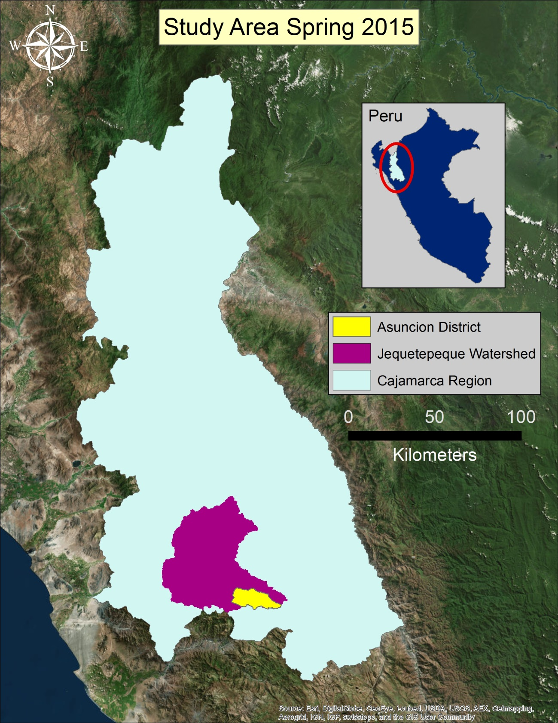
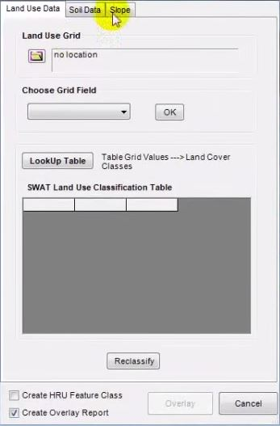
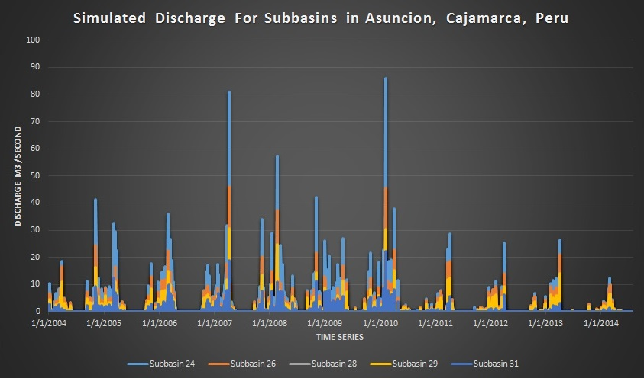
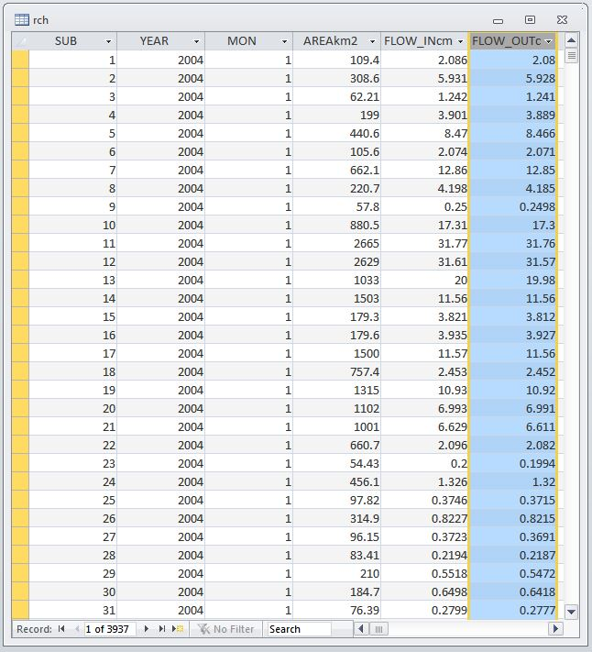
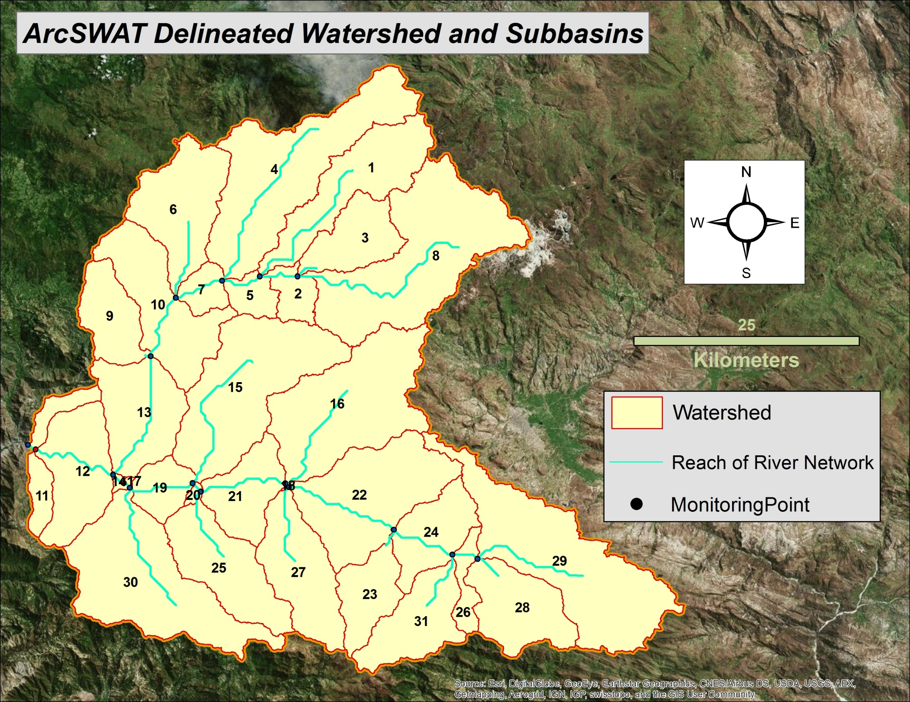
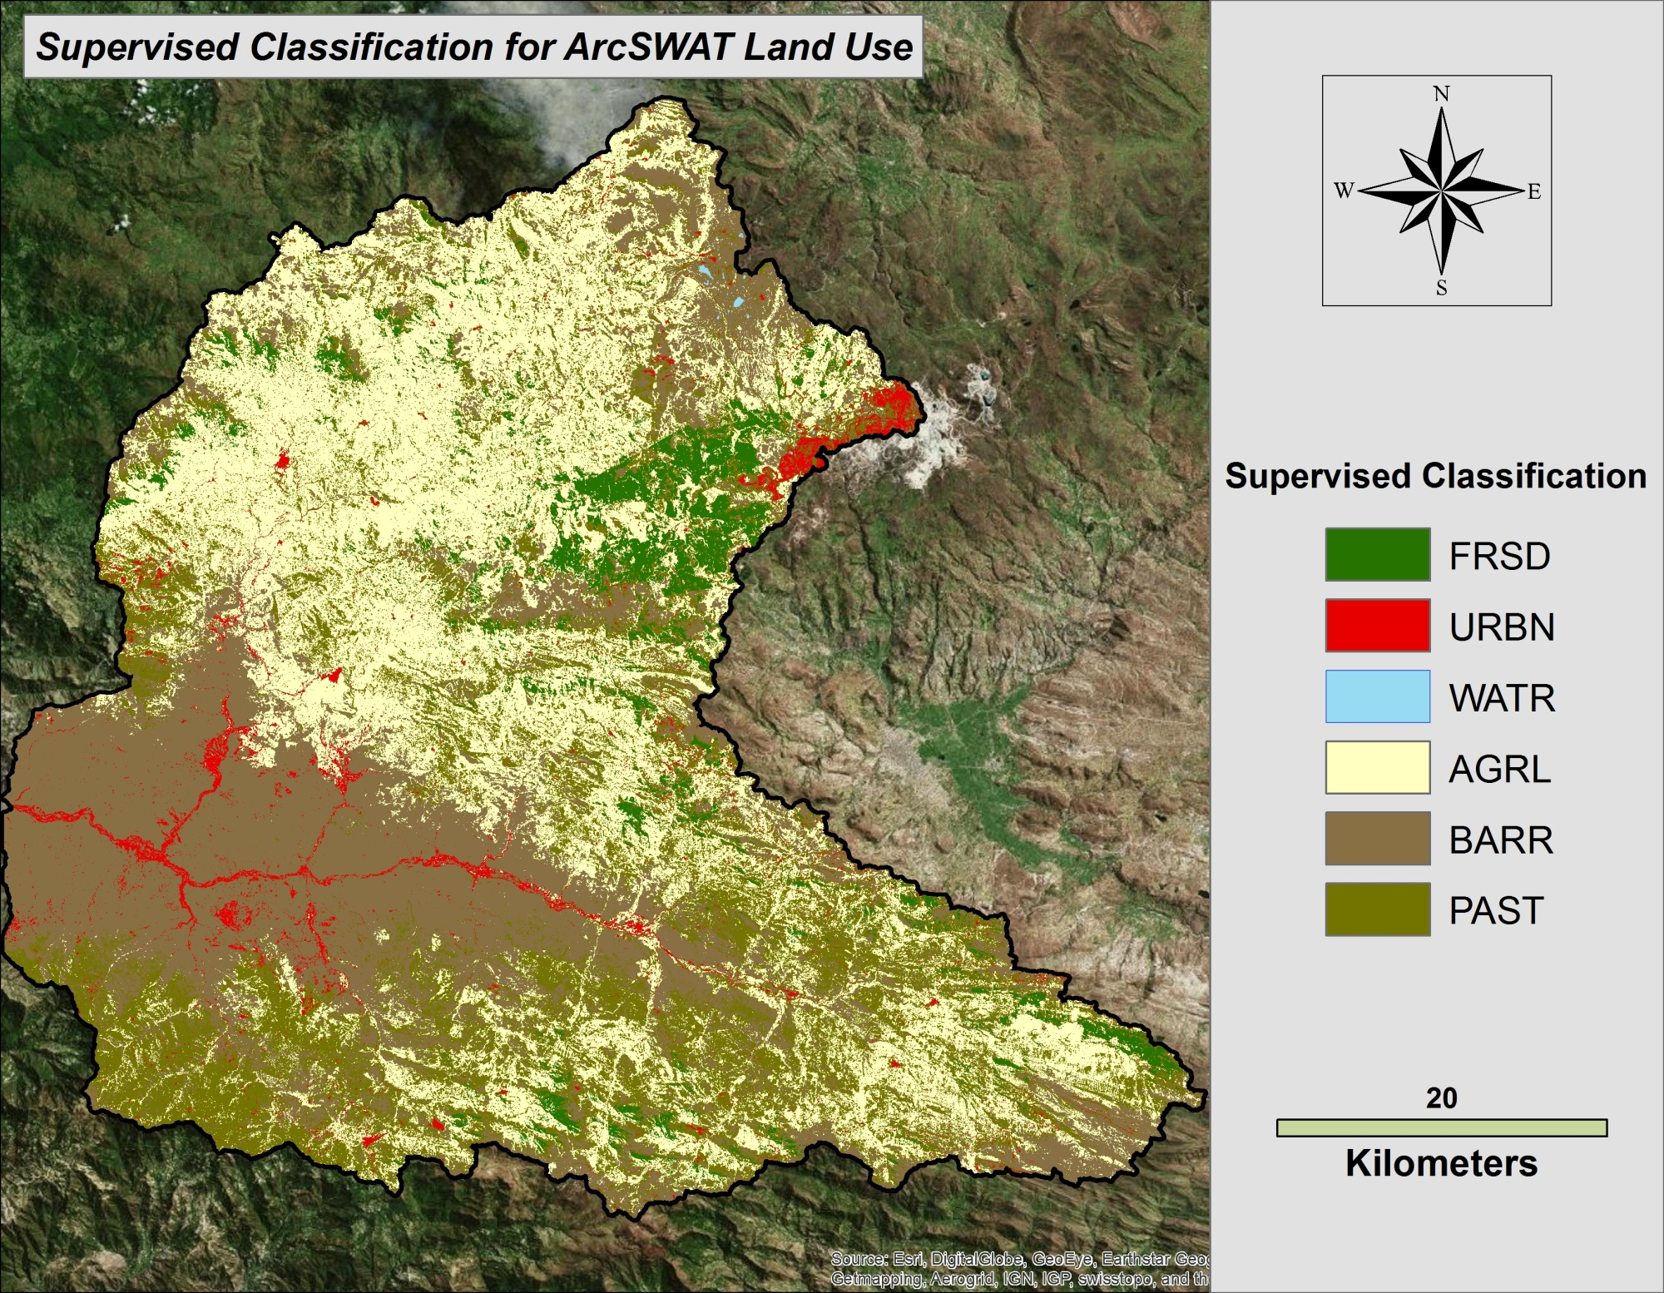
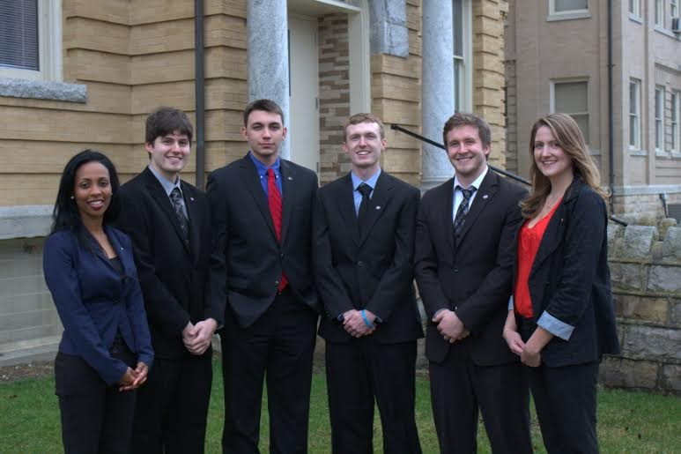
Peru Disasters
Utilizing NASA Earth Observations to Develop a Comprehensive Water Budget for the Asuncion district in Peru
Sarah Medley (Project Lead), Kieran Blakemore, Jordan Bates, Scott Arnette, Grant Bloomer, Azeb Shewago, Michael Mullins
Wise County Clerk of Court’s Office
In rural regions of Peru, access to adequate water and sanitation systems is limited, and large percentages of the population remain below the poverty line. In addition, major flooding in 2008, 2013, and 2014 devastated the region. In a partnership with Water For People, a non-profit organization, this project aimed to create datasets and tools necessary for water resource management projects in the Gran Chimú province and Asunción district of Peru. An additional partnership with the Instituto Nacional de Defensa Civil del Peru (INDECI) will aim to support flood mitigation. NASA Earth observations were used in this project to provide alternative datasets for Water For People’s projects in Peru. Earth observations systems such as Landsat 8’s Operational Land Imager (OLI) data, Digital Elevation Model (DEM) data from the Advanced Spaceborne Thermal Emission and Reflection Radiometer (ASTER), and land use data from the Moderate-resolution Imaging Spectroradiometer (MODIS) were used in this project. The Soil and Water Assessment Tool (SWAT) was used to build a model that will enable the end-user to study the hydrological processes and to develop a water resources inventory for the study area. Necessary models and data to estimate the flood risk assessment were also identified. The final maps, models, datasets and tutorials developed in this project will enable Water For People and the Peruvian government to improve water management programs.
Build a SWAT model for the Jequetepeque river watershed to study the hydrological processes in the study area
Locate areas prone to floods and research best flood prediction models
Help develop a comprehensive water resources inventory and datasets for the Asunción district
Transfer the knowledge to build and collaborate SWAT models to Water For People
Digital Elevation Model
- ASTER
Land Use
- OLI, MODIS
Soil Map
- Food and Agriculture Organization (FAO)
Slope Classification
- SWAT Tool HRU Analysis
River Map
- Water For People
Weather Data
- Globalweather.tamu.edu
Study Area’s Shape File
- Water For People
ArcGIS
ArcSWAT
Project Setup
Water Delineation
HRU Analysis
Write Input Tables
Edit SWAT Input
SWAT Simulation
The final results can be used to serve as decision support tools in Water for People’s projects in Peru.
Tutorials developed for Water For People can be used to assist other regions facing similar challenges.
In the future, flood models will be developed for the located flood risk areas.
Water For People
Instituto Nacional de Defensa Civil de Peru (INDECI)
Dr. Kenton Ross NASA DEVELOP National Science Advisor
Dr. DeWayne Cecil Global Science Technology Inc.
Hon. J. Jack Kennedy Clerk of Court
Melanie Salyer Mentor
From left to right: Azeb Schwego, Scott Arnette, Grant Bloomer, Kieran Blakemore, Jordan Bates, Sarah Medley

