Slide 1
Impact Analysis
Georgina Crepps – December 2014

Slide 2
What is it?
New YP position geared toward assessing impacts of the DEVELOP program

Slide 3
What impacts?
Partners
Uniting NASA Earth observations with society to foster future innovation and cultivate the professionals of tomorrow by addressing diverse environmental issues today.
Participants
Projects
Notes:
I put up the DEVELOP’s mission statement here because I think it highlights the three broad areas where we’re trying to assess the impacts of the program. The first being the partners/end-users, the second is participants, and the third projects. These are hopefully useful categories to think about as I go through the rest of my presentation. I would like to note that these aren’t exclusive categories—for example, a lot of how we evaluate projects is the utility they provide for partners.

Slide 4
Partners
Participants
Projects
Pre-Project Partner Surveys
End User Exit Surveys
Alumni Survey
Equal Futures Reporting
Beginning & End of Term Surveys
Socioeconomic Impact Analyses
PSI
Impact Mapping
Results & Indicators
Tracking Metrics
Notes:
Currently there are several tools being used to measure the impacts in each of these categories. Several of these help track multiple categories at once, most notably the Results & Indicators, and the Tracking Metrics. I’m going to go over some highlights for each of these, except those in purple. There is a lot of overlap and collaboration between impact analysis and project coordination, and those three fall under project coordination. The pre-project partner survey is something that, as she mentioned, Christine and I worked on together and as she already discussed it, I will only briefly mention it.

Slide 5
Pre-Project Partner Survey

Slide 6
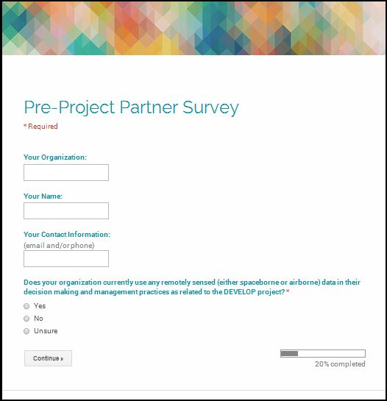
Pre-Project Partner Survey
Baseline data of current RS usage
Background on how partnership started
Expectations for project communication and end products
Expectations for how end products will be used
Notes:
The pre-project partner survey was designed to fulfill a couple of different needs. First, to provide data for socioeconomic impact analyses and tracking. And second, to give teams some information about their partners’ expectations. Broadly speaking, this survey aims to gather the following, baseline data of the organization’s current remote sensing usage, how the DEVELOP partnership started, and expectations for project communication and what end products they would like to see (in general terms). Lastly, their expectations for how they will use the end products they receive, which, ideally, will be used to compare with how they actually use the end products.

Slide 7
Alumni Survey

Slide 8
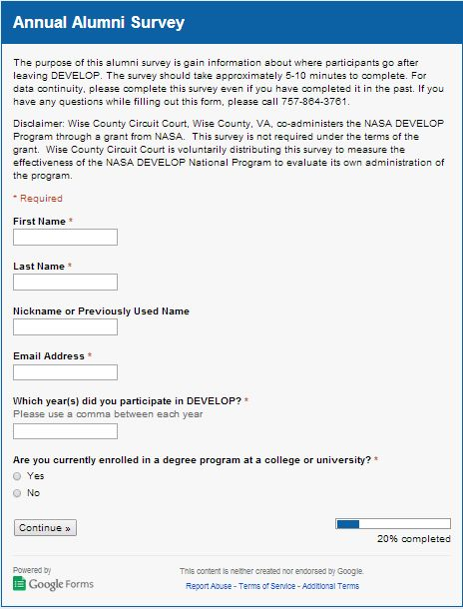
Survey sent to 1,381 email addresses
381 immediate bounce-backs
Spam issues
245 responses as of Nov 3
136 Graduated
  123 currently employed

Slide 9
Careers:
Analytic Methodologist
City Councilmember
Research Associate
Software Engineer
GIS Engineer
Virginia Marine Resources Commission
DEVELOP
Sea Ice Program Leader (NOAA/NWS)
GIS Analyst

Slide 10
Do you currently work with, or have exposure to remote sensing?/ Do you currently work with NASA's Earth observations? (not enrolled, employed (123 respondents)
Notes:
Two people said they used NASA EO, but not remote sensing, which since EO is a type of RS, I changed those to a yes.

Slide 11
How did DEVELOP assist with your job search? (123: not enrolled, employed)

Slide 12
Professional Skills Gained (245 respondents)
Notes:
I excluded two “did not contribute” responses where the person had marked other responses as well, so I am assuming that was a mistake.

Slide 13
Personal stories

Slide 14
Equal Futures Reporting

Slide 15
Number of Participants by Location and Gender, FY 2014

Slide 16
Number of Total DEVELOP Applicants and Participants by Gender, FY 2011 – 2014
Percent Applicants Accepted from Total Applicants by Gender,
FY 2011 – 2014

Slide 17
Major Milestones FY 2015
Milestone Title Target Date
1. Engage with professional women in science/GIS organizations Fall 2015
1a. Engage with two science professional women’s organizations.
1b. Request at least one speaker / guest lecture.
2. Seek involvement with involved with NASA / Women@NASA’s
activities for Women’s History Month in March. Spring 2015
3. Increase outreach to female science student groups at universities (Sum 2015)
3a. Reach out to student groups at three universities.
4. Begin tracking women in leadership roles at DEVELOP, not just
participants. Spring 2015
4a. Track NPO, CL/ACL, YP positions by gender.
5. Maintain target of 50% female participation Spring 2015
Notes:
So these are the goals that we have set out for DEVELOP for the upcoming year. I wanted to go over them so you can keep an eye out for some of these events we’re hoping to have, or if you would like to be involved in doing any of these things, and lastly, if you do any of these things, please let us know because we would like to keep track of it.

Slide 18
Beginning & End of Term Surveys
Notes:
So one of the things you’ve heard me say a couple of times and I’m going to say a few more, is the need for baseline data. So these surveys are one way to try to do that. You might be able to guess, but the idea is to give one at the beginning and one at the end of the term. However, I think I need to change the name because there is an end of the term survey that Karen also sends out and people got confused and four people took my survey twice. I mean it’s a pretty cool survey but I’m not sure it’s that cool. So over the fall, we tested this out by having participants at MCHD, Langley, and JPL do it. There were about 25/26 respondents in total (we managed to gain one in the end of term survey). The main idea is to see people’s expectations for the term and then if they were met.

Slide 19
Technical skills hoped to gain from DEVELOP:
Notes:
So this is done in a few parts. It’s a pretty short survey.
For many of these skills, what participants hoped to gain lines up fairly well with what they reported as having gained– GIS, technical writing, programming skills. A few that they were hoping to gain more were quantitative scientific and spatial data analysis, statistics, and impact analysis.

Slide 20
Professional skills hoped to gain from DEVELOP:
Notes:
For professional skills, a lot of the expected skills were reported to be gained at fairly the same rates, plus or minus a couple of people, like professional etiquette, communication, presentation. More people said they received writing and self-awareness skills than they hoped to gain. The most dramatic difference is networking, where 22 stated they hoped to gain networking and only 10 stated they did.

Slide 21
Upcoming
Revise some questions
Send it to all nodes (Spring 2015?)

Slide 22
Tracking metrics
Notes:
You guys are probably most familiar with the tracking metrics so I’m just going to point out a few highlights here and a few more are included in the results & indicators. Many of you received several emails from me at the beginning of the term in regards to filling out these spreadsheets. This led to the realization that the tracking metrics needed to be updated and made more user-friendly. So these next few slides are going to focus on our new and exciting tracking metrics, which you all got in your read-ahead materials, and I’m sure just dying to complete.

Slide 23
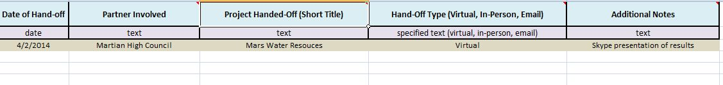
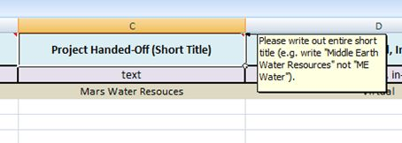

Slide 24
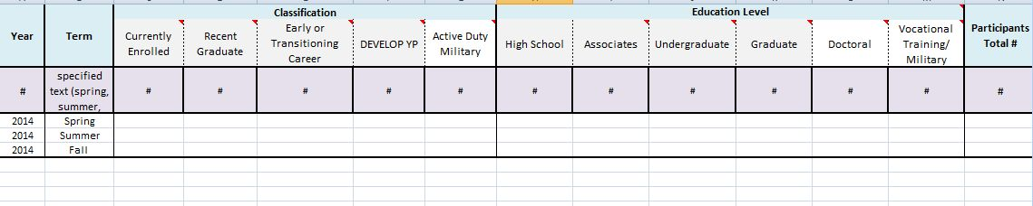
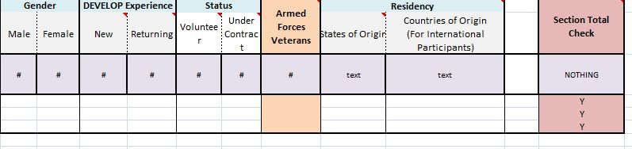

Slide 25
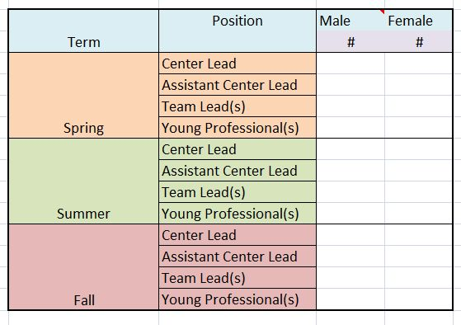
Leadership & Gender
Notes:
This is the new and last tab of the tracking metrics. It’s pretty straightforward. You just list how many males and females are in each category each term and if someone has two positions, put them for both. The reason I am pointing this tab out in particular is just to highlight that if you can remember several slides ago, this is one of the goals we set for the Equal Futures reporting.

Slide 26
Results & Indicators
Notes:
Results & indicators are something that Lauren mentioned earlier. These are the preliminary results, as some have not been tallied up yet and some don’t include the fall data yet.

Slide 27
DEVELOP National Program
Strategic Objective: Foster enhanced workforce and end-user capabilities to use Earth observations assets in decision making
Intermediate Result 1:
Built Awareness
Intermediate Result 2:
Engaged Participants & Decision Makers
Intermediate Result 3:
Increased Use of Earth Observations in Decision-Making Process
Intermediate Result 4:
Regional Networks and Nodes Established & Functioning
Intermediate Result 5:
Synergy & Communication with Earth Science Community
1.1: Awareness Increased through Outreach
2.1: Participants Engaged, Professional Skills & Networks Enhanced
3.1: Delivery of Project Results and Methodologies
4.1: Existing Nodes Strengthened & Additional Nodes Established
5.1: Communication to/from DEVELOP Alumni Network
1.2: Applicants Introduced to DEVELOP & Recruited
3.2: EO Adept Workforce
5.2: Synergy & Communication with NASA Entities
2.2: Feasibility Projects Conducted Demonstrating Use of EO
4.2: Networks Established & Functioning
1.3 Potential Collaborators Engaged through Outreach
3.3: Organizations Using EO in their Decision-Making Process
5.3: Synergy & Communication with non-NASA Entities
Indicators
1.1.1: # of hits on online content
1.1.2: # of conference presentations
1.2.1: # of recruiting events
1.2.2: # of applications received
1.3.1: # of project request forms received
Indicators
2.1.1: # of participants
2.1.2: # of internship hours completed
2.1.3: # of professional & personal development activities
2.1.4: # of states impacted through participant engagement
2.2.1: # of projects
2.2.2: # of partner organizations
2.2.3: # of states impacted by a project
Indicators
3.1.1: # of hand-off events
3.1.2: # of end-user needs assessments completed 3.1.3: # of end-users participating in exit survey 3.2.1: % of alumni using EO in career
3.2.2: % of alumni in STEM/ES fields
3.3.1: # of decisions incorporating NASA EO
Indicators
4.1.1: # of nodes
4.1.2: $ leveraged through in-kind contributions
4.1.3: $ provided by non-NASA Applied Sciences entities
4.2.1: # of boundary organizations engaged 4.2.2: # of parallel organizations engaged
Indicators
5.1.1: # of DEVELOP alumni receiving DEVELOP newsletter
5.1.2: % responses to alumni survey
5.2.1: # of participants engaged with other CBP elements
5.2.2: # of NASA activities supported/participated in 5.2.3: # of projects transferred to NASA ESD counterparts
5.3.1: # of non-NASA activities supported/participated in

Slide 28
Built Awareness
Indicator | 2013 | 2014
Indicator 1.1.1: # of hits on online content | 82598 | Waiting for results
Indicator 1.1.2: # of conference presentations | 28 | 40
Indicator 1.2.1: # of recruiting events |  | 71
Indicator 1.2.2: # of applications received | 1036 | 611
Indicator 1.3.1: # of project request forms received | N/A | In the Works

Slide 29
DEVELOP National Program
Strategic Objective: Foster enhanced workforce and end-user capabilities to use Earth observations assets in decision making
Intermediate Result 1:
Built Awareness
Intermediate Result 2:
Engaged Participants & Decision Makers
Intermediate Result 3:
Increased Use of Earth Observations in Decision-Making Process
Intermediate Result 4:
Regional Networks and Nodes Established & Functioning
Intermediate Result 5:
Synergy & Communication with Earth Science Community
1.1: Awareness Increased through Outreach
2.1: Participants Engaged, Professional Skills & Networks Enhanced
3.1: Delivery of Project Results and Methodologies
4.1: Existing Nodes Strengthened & Additional Nodes Established
5.1: Communication to/from DEVELOP Alumni Network
1.2: Applicants Introduced to DEVELOP & Recruited
3.2: EO Adept Workforce
5.2: Synergy & Communication with NASA Entities
2.2: Feasibility Projects Conducted Demonstrating Use of EO
4.2: Networks Established & Functioning
1.3 Potential Collaborators Engaged through Outreach
3.3: Organizations Using EO in their Decision-Making Process
5.3: Synergy & Communication with non-NASA Entities
Indicators
1.1.1: # of hits on online content
1.1.2: # of conference presentations
1.2.1: # of recruiting events
1.2.2: # of applications received
1.3.1: # of project request forms received
Indicators
2.1.1: # of participants
2.1.2: # of internship hours completed
2.1.3: # of professional & personal development activities
2.1.4: # of states impacted through participant engagement
2.2.1: # of projects
2.2.2: # of partner organizations
2.2.3: # of states impacted by a project
Indicators
3.1.1: # of hand-off events
3.1.2: # of end-user needs assessments completed 3.1.3: # of end-users participating in exit survey 3.2.1: % of alumni using EO in career
3.2.2: % of alumni in STEM/ES fields
3.3.1: # of decisions incorporating NASA EO
Indicators
4.1.1: # of nodes
4.1.2: $ leveraged through in-kind contributions
4.1.3: $ provided by non-NASA Applied Sciences entities
4.2.1: # of boundary organizations engaged 4.2.2: # of parallel organizations engaged
Indicators
5.1.1: # of DEVELOP alumni receiving DEVELOP newsletter
5.1.2: % responses to alumni survey
5.2.1: # of participants engaged with other CBP elements
5.2.2: # of NASA activities supported/participated in 5.2.3: # of projects transferred to NASA ESD counterparts
5.3.1: # of non-NASA activities supported/participated in

Slide 30
Engaged Participants
& Decision Makers
Indicator | 2013 | 2014
Indicator 2.1.1: # of participants | 348 | 252
Indicator 2.1.2: # of internship hours completed |  | In the Works
Indicator 2.1.3: # of professional & personal development activities |  | 86
Indicator 2.1.4: # of states impacted through participant engagment | 32 + DC | 27 + DC
Indicator 2.2.1: # of projects | 78 | 56
Indicator 2.2.2: # of partner organizations | 153 | 81
Indicator 2.2.3: # of states impacted by a project | 50 | 45
Notes:
One thing to note for participants, is that the fall participants are not included yet.

Slide 31
DEVELOP National Program
Strategic Objective: Foster enhanced workforce and end-user capabilities to use Earth observations assets in decision making
Intermediate Result 1:
Built Awareness
Intermediate Result 2:
Engaged Participants & Decision Makers
Intermediate Result 3:
Increased Use of Earth Observations in Decision-Making Process
Intermediate Result 4:
Regional Networks and Nodes Established & Functioning
Intermediate Result 5:
Synergy & Communication with Earth Science Community
1.1: Awareness Increased through Outreach
2.1: Participants Engaged, Professional Skills & Networks Enhanced
3.1: Delivery of Project Results and Methodologies
4.1: Existing Nodes Strengthened & Additional Nodes Established
5.1: Communication to/from DEVELOP Alumni Network
1.2: Applicants Introduced to DEVELOP & Recruited
3.2: EO Adept Workforce
5.2: Synergy & Communication with NASA Entities
2.2: Feasibility Projects Conducted Demonstrating Use of EO
4.2: Networks Established & Functioning
1.3 Potential Collaborators Engaged through Outreach
3.3: Organizations Using EO in their Decision-Making Process
5.3: Synergy & Communication with non-NASA Entities
Indicators
1.1.1: # of hits on online content
1.1.2: # of conference presentations
1.2.1: # of recruiting events
1.2.2: # of applications received
1.3.1: # of project request forms received
Indicators
2.1.1: # of participants
2.1.2: # of internship hours completed
2.1.3: # of professional & personal development activities
2.1.4: # of states impacted through participant engagement
2.2.1: # of projects
2.2.2: # of partner organizations
2.2.3: # of states impacted by a project
Indicators
3.1.1: # of hand-off events
3.1.2: # of end-user needs assessments completed 3.1.3: # of end-users participating in exit survey 3.2.1: % of alumni using EO in career
3.2.2: % of alumni in STEM/ES fields
3.3.1: # of decisions incorporating NASA EO
Indicators
4.1.1: # of nodes
4.1.2: $ leveraged through in-kind contributions
4.1.3: $ provided by non-NASA Applied Sciences entities
4.2.1: # of boundary organizations engaged 4.2.2: # of parallel organizations engaged
Indicators
5.1.1: # of DEVELOP alumni receiving DEVELOP newsletter
5.1.2: % responses to alumni survey
5.2.1: # of participants engaged with other CBP elements
5.2.2: # of NASA activities supported/participated in 5.2.3: # of projects transferred to NASA ESD counterparts
5.3.1: # of non-NASA activities supported/participated in

Slide 32
Increased Use of Earth Observations in Decision-Making Process
Indicator | 2013 | 2014
Indicator 3.1.1: # of hand-off events | 17 | 50
Indicator 3.1.2: # of end-user needs assessments completed | N/A | 20
Indicator 3.1.3: # of end-users participating in exit survey | N/A | 5
Indicator 3.2.1: % of alumni using Earth observations in career | 42% | 32%
Indicator 3.2.2: % of alumni in STEM/ES fields | 84% | 78%
Indicator 3.3.1: # of decisions incorporating NASA EO | N/A | 3

Slide 33
DEVELOP National Program
Strategic Objective: Foster enhanced workforce and end-user capabilities to use Earth observations assets in decision making
Intermediate Result 1:
Built Awareness
Intermediate Result 2:
Engaged Participants & Decision Makers
Intermediate Result 3:
Increased Use of Earth Observations in Decision-Making Process
Intermediate Result 4:
Regional Networks and Nodes Established & Functioning
Intermediate Result 5:
Synergy & Communication with Earth Science Community
1.1: Awareness Increased through Outreach
2.1: Participants Engaged, Professional Skills & Networks Enhanced
3.1: Delivery of Project Results and Methodologies
4.1: Existing Nodes Strengthened & Additional Nodes Established
5.1: Communication to/from DEVELOP Alumni Network
1.2: Applicants Introduced to DEVELOP & Recruited
3.2: EO Adept Workforce
5.2: Synergy & Communication with NASA Entities
2.2: Feasibility Projects Conducted Demonstrating Use of EO
4.2: Networks Established & Functioning
1.3 Potential Collaborators Engaged through Outreach
3.3: Organizations Using EO in their Decision-Making Process
5.3: Synergy & Communication with non-NASA Entities
Indicators
1.1.1: # of hits on online content
1.1.2: # of conference presentations
1.2.1: # of recruiting events
1.2.2: # of applications received
1.3.1: # of project request forms received
Indicators
2.1.1: # of participants
2.1.2: # of internship hours completed
2.1.3: # of professional & personal development activities
2.1.4: # of states impacted through participant engagement
2.2.1: # of projects
2.2.2: # of partner organizations
2.2.3: # of states impacted by a project
Indicators
3.1.1: # of hand-off events
3.1.2: # of end-user needs assessments completed 3.1.3: # of end-users participating in exit survey 3.2.1: % of alumni using EO in career
3.2.2: % of alumni in STEM/ES fields
3.3.1: # of decisions incorporating NASA EO
Indicators
4.1.1: # of nodes
4.1.2: $ leveraged through in-kind contributions
4.1.3: $ provided by non-NASA Applied Sciences entities
4.2.1: # of boundary organizations engaged 4.2.2: # of parallel organizations engaged
Indicators
5.1.1: # of DEVELOP alumni receiving DEVELOP newsletter
5.1.2: % responses to alumni survey
5.2.1: # of participants engaged with other CBP elements
5.2.2: # of NASA activities supported/participated in 5.2.3: # of projects transferred to NASA ESD counterparts
5.3.1: # of non-NASA activities supported/participated in

Slide 34
Regional Networks and Nodes
Established & Functioning
Indicator | 2013 | 2014
Indicator 4.1.1: # of nodes | 16 | 14
Indicator 4.1.2: $ leveraged through in-kind contributions | N/A | $388,061
Indicator 4.1.3: $ provided by non-NASA Applied Sciences entities | 0 | $50,000
Indicator 4.2.1: # of boundary organizations engaged | N/A | 34
Indicator 4.2.2: # of parallel organizations engaged | 3

Slide 35
DEVELOP National Program
Strategic Objective: Foster enhanced workforce and end-user capabilities to use Earth observations assets in decision making
Intermediate Result 1:
Built Awareness
Intermediate Result 2:
Engaged Participants & Decision Makers
Intermediate Result 3:
Increased Use of Earth Observations in Decision-Making Process
Intermediate Result 4:
Regional Networks and Nodes Established & Functioning
Intermediate Result 5:
Synergy & Communication with Earth Science Community
1.1: Awareness Increased through Outreach
2.1: Participants Engaged, Professional Skills & Networks Enhanced
3.1: Delivery of Project Results and Methodologies
4.1: Existing Nodes Strengthened & Additional Nodes Established
5.1: Communication to/from DEVELOP Alumni Network
1.2: Applicants Introduced to DEVELOP & Recruited
3.2: EO Adept Workforce
5.2: Synergy & Communication with NASA Entities
2.2: Feasibility Projects Conducted Demonstrating Use of EO
4.2: Networks Established & Functioning
1.3 Potential Collaborators Engaged through Outreach
3.3: Organizations Using EO in their Decision-Making Process
5.3: Synergy & Communication with non-NASA Entities
Indicators
1.1.1: # of hits on online content
1.1.2: # of conference presentations
1.2.1: # of recruiting events
1.2.2: # of applications received
1.3.1: # of project request forms received
Indicators
2.1.1: # of participants
2.1.2: # of internship hours completed
2.1.3: # of professional & personal development activities
2.1.4: # of states impacted through participant engagement
2.2.1: # of projects
2.2.2: # of partner organizations
2.2.3: # of states impacted by a project
Indicators
3.1.1: # of hand-off events
3.1.2: # of end-user needs assessments completed 3.1.3: # of end-users participating in exit survey 3.2.1: % of alumni using EO in career
3.2.2: % of alumni in STEM/ES fields
3.3.1: # of decisions incorporating NASA EO
Indicators
4.1.1: # of nodes
4.1.2: $ leveraged through in-kind contributions
4.1.3: $ provided by non-NASA Applied Sciences entities
4.2.1: # of boundary organizations engaged 4.2.2: # of parallel organizations engaged
Indicators
5.1.1: # of DEVELOP alumni receiving DEVELOP newsletter
5.1.2: % responses to alumni survey
5.2.1: # of participants engaged with other CBP elements
5.2.2: # of NASA activities supported/participated in 5.2.3: # of projects transferred to NASA ESD counterparts
5.3.1: # of non-NASA activities supported/participated in

Slide 36
Synergy & Communication with
Earth Science Community
Indicator | 2013 | 2014
Indicator 5.1.1: # of DEVELOP alumni receiving DEVELOP newsletter | 185 | 671
Indicator 5.1.2: % responses to alumni survey | 36% | 18%
Indicator 5.2.1: # of participants engaged with other CBP elements | 45
Indicator 5.2.2: # of NASA activities supported/participated in | 10 | 11
Indicator 5.2.3: # of projects transferred to NASA ESD counterparts | N/A
Indicator 5.3.1: # of non-NASA activities supported/participated in | 17 | 11
Notes:
Total responses - 245

Slide 37
Socioeconomic Impact Analyses

Slide 38
Workflow
Contact Team
& Partner
PSI scores
Select Project
End User Exit Surveys
How partner is using end products
Pre-Project Partner Surveys
Quantify impacts from decisions using end products

Slide 39
Challenges
Reliance on surveys
  Inconsistencies
  Accuracy
  Response Rates

