Slide 1
Grand Valley
Ecological Forecasting
Forecasting Trends in Pinyon-Juniper and Sagebrush Habitat Relative to Wildfire, Drought, Beetle Disturbance, and Treatment Impact for Management Planning
William Curtiss (Project Lead)
Sambadi Majumder
Rhea Martinez
Aliza White
Idaho - Pocatello
Notes:
Bill: Good ________, we are the Grand Valley Ecological Forecasting Team with NASA DEVELOP National Program, based out of the Pocatello, Idaho node. We'll be talking today about forecasting land cover change in pinyon-juniper woodlands and savannahs as well as sagebrush habitats, regarding disturbances such as drought driven beetle kill, wildfire and vegetation treatments, for purposes of advising future management planning and practices.
I'm William and joining me today we have Sam, Rhea, and Aliza.
Grand Valley Ecological Forecasting Term II Web Image
Image Credit: Grand Valley Ecological Forecasting Term II (DEVELOPer)
Image Source: Grand Valley Ecological Forecasting Term II (DEVELOPer)

Slide 2
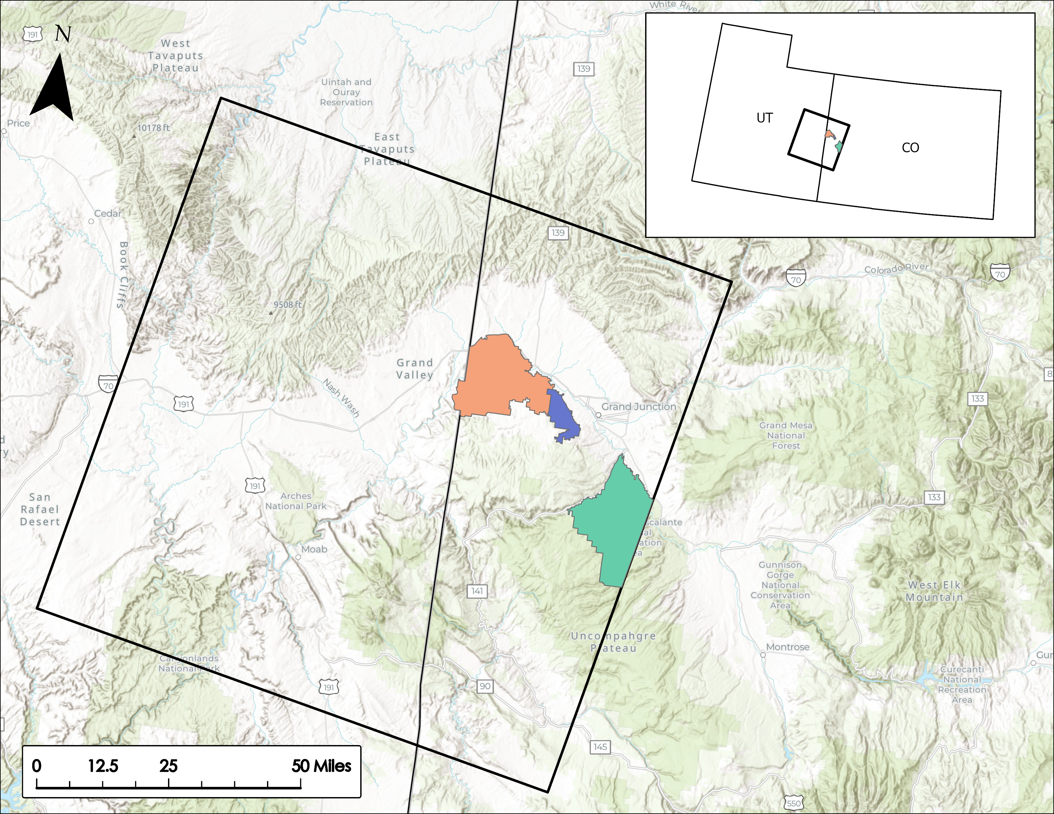
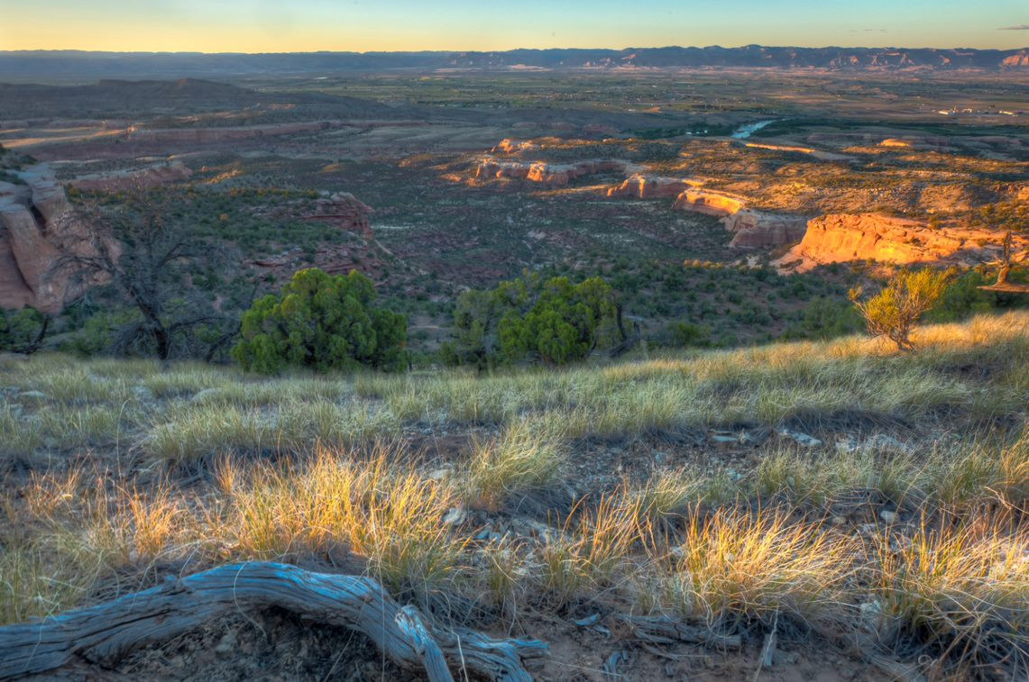
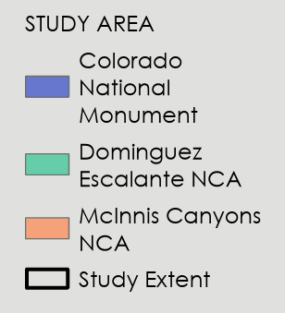
STUDY AREA AND PERIOD
Grand Valley, Colorado
Colorado National Monument (CNM)
McInnis Canyons National Conservation Area (MCNCA)
Dominguez-Escalante National Conservation Area (DENCA)
Historical: 1985–2020
Forecasted: 2025, 2030, 2040
Study Area
Colorado National Monument
Dominguez-Escalante NCA
McInnis Canyons NCA
0
12.5
25
50 mi
Study Extent
Image Credits: BLM, McInnis Canyons National Conservation Area (2022)
Notes:
Aliza:
Our study area was comprised of a scene located at path 36, row 33 of the Worldwide Reference System-2. This gave us ample availability of usable Landsat data and allowed for streamlined processing.
Within the larger extent, our project focused on the Grand Valley which overlays the border between Mesa County, in western Colorado and Grand County, Utah. For the benefit of our project partners, we are most interested in the ecosystems within Colorado National Monument (CNM), McInnis Canyons National Conservation Area (MCNCA), and Dominguez-Escalante National Conservation Area (DENCA), which are outlined here on the map.
The Spring 2022 Term conducted a historical study exploring data from 1985-2020 and our Summer term has focused on forecasting change for the years 2025, 2030 and 2040.
------------------------------Image Information Below ------------------------------
Study Area Map
Image Credit: Created by the team
McInnis Canyons National Conservation Area
Image credit: Nikki Grant-Hoffman, BLM
Image Source: Provided by partners, used with permission

Slide 3
OBJECTIVES
Field Validate
vegetation decline
Forecast
future landcover changes
Assess
recovery from wildland fire & vegetation treatments
Notes:
This project addressed several objectives including:
-Conducting a field validation of areas of consecutive decline in vegetation productivity, based on historical data that the first term calculated. The expected driver for these areas is IPS beetle infestation in which ground verification was required and performed by our project partners.
-Second was to forecast landcover changes in pinyon-juniper and sagebrush habitat using models that incorporate projections of climatic and geographical variables.
-And finally we would create clear directions on how to interpret the projections for use in future management practices.
------------------------------Image Information Below ------------------------------
Image credit: Icons provided by Microsoft PowerPoint
Image source: Icons provided by Microsoft PowerPoint

Slide 4
PARTNERS
National Park Service
Bureau of Land Management
Colorado National Monument
~20,000 acres
Management Philosophy
Recreation
Preservation
McInnis Canyon and Dominguez Escalante National Conservation Areas
~342,000 acres
Management Philosophy
Multiple Use
Sustainable Yield
Image Credits: NPS, BLM
Notes:
Our partners for this project were the National Park Service (NPS) at Colorado National Monument (CNM) and the Bureau of Land Management at McInnis Canyons National Conservation Area (MCNCA) and Dominguez-Escalante National Conservation Area (DENCA).
------------------------------Image Information Below ------------------------------
Image credit: NPS, BLM
Image source: https://nps.gov/ ; https:/www.blm.gov/ (public domain)

Slide 5
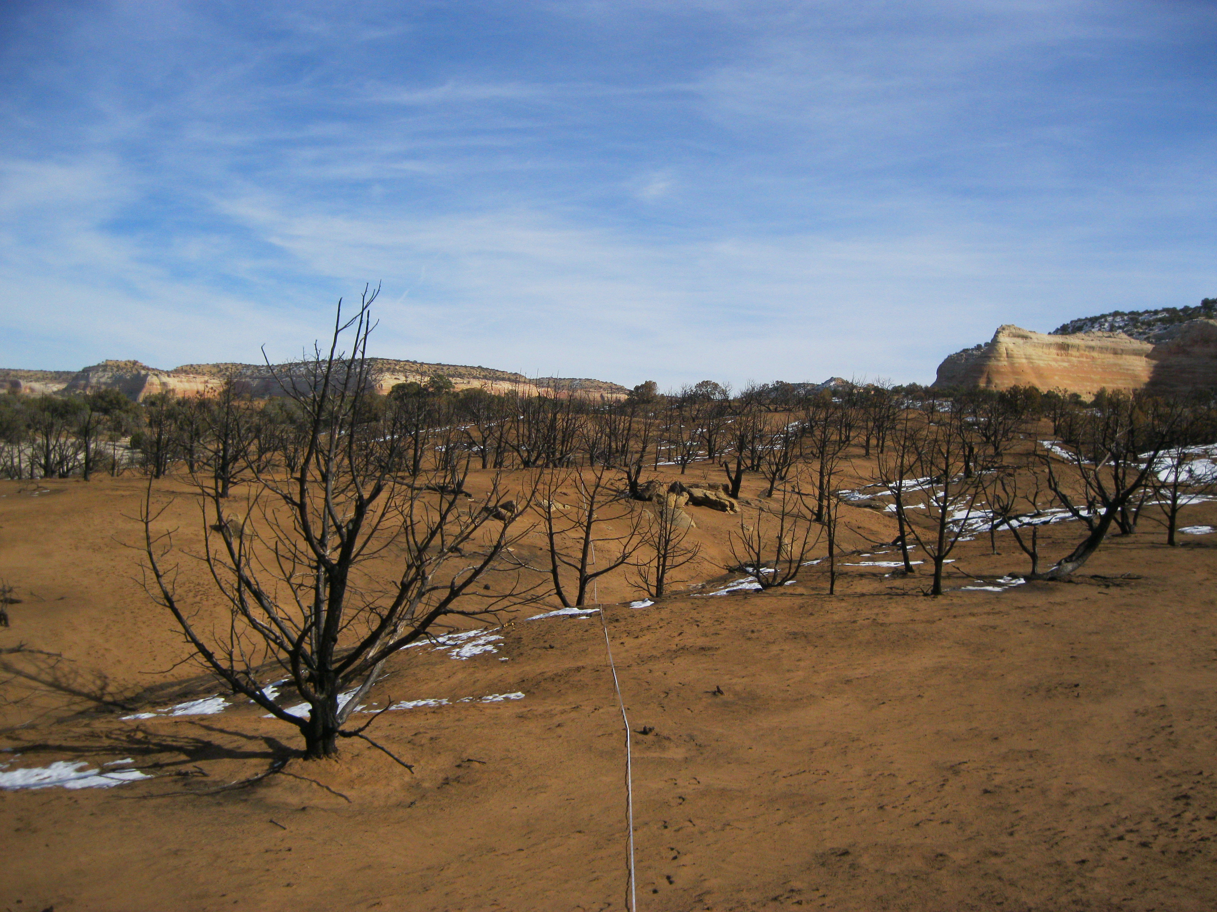
COMMUNITY CONCERNS
Loss of native flora & fauna
Encroachment of invasive plant species
Damage of infrastructure & homes in rural communities
Rely on pinyon-juniper woodlands (PJW) for protection from erosion, stabilization of water content, and heat abatement
More frequent & severe fires
Image Credit: BLM
Notes:
Pinyon-juniper and sagebrush habitats present in Grand Valley stabilize soil, reduce heat, and regulate soil water content, providing habitat for the various fauna of the region and facilitate living conditions for perennials and forbs.
Continued loss of this habitat will lead to loss of native fauna, which are critical for the function of the ecosystem as a whole, and could lead to the encroachment of invasive plant species.
PJW and sagebrush provide rural communities with protection from erosion, stabilization of water content, and heat abatement, which assist in maintaining their ways of life. The loss of this habitat due to beetle infestation or fire would impact community infrastructure and damage homes.
The PJW habitat is widespread throughout the Southwest. Therefore, due to climate change, increased threat of wildfires and wild bark beetle infestation are expected across the American west, which threatens the regions native wildlife and community infrastructure.
------------------------------Image Information Below ------------------------------
Image Credit: Nikki Grant-Hoffman, BLM
Image Source: Partner provided, used with permission

Slide 6
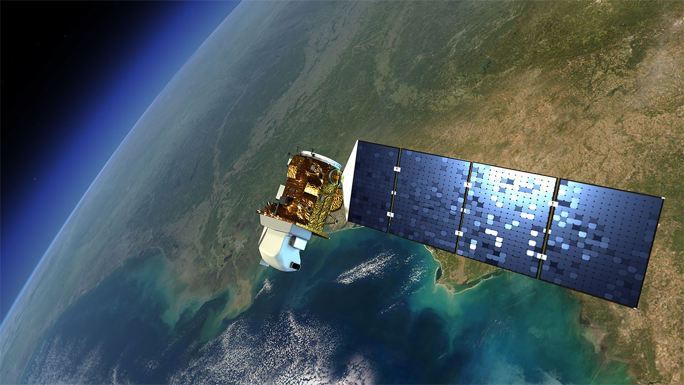
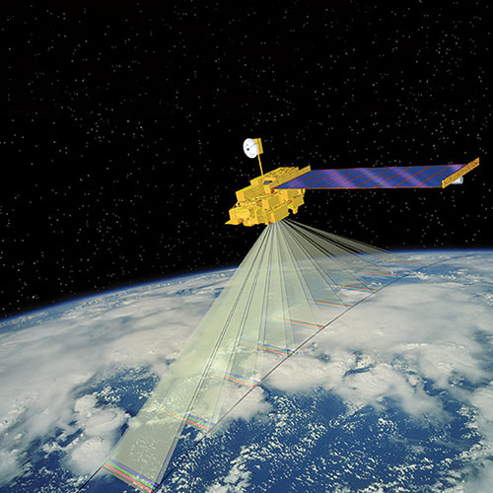
EARTH OBSERVING SATELLITES
Vegetation Productivity
NDVI
Landcover Type
LCMS
Landsat 5 TM
Landsat 7 ETM+
Landsat 8 OLI
Vegetation Productivity
NDVI
Aqua MODIS
Terra MODIS
Image Credit: NASA
Notes:
The team used satellite data that was gathered by the previous term in our analysis
Most of this data was collected from Landsat 5,7, and 8 as well as MODIS onboard Terra and Aqua satellites
Normalized Difference Vegetation Index (NDVI) to evaluate vegetation productivity by measuring surface reflectance
Land cover types were also classified by the previous term using Landscape Change Modeling System (LCMS)
------------------------------Image Information Below ------------------------------
Landsat 4/5,7,8 Mission Credit: NASA
Image source: https://www.nasa.gov/mission_pages/landsat/overview/index.html
MODIS Mission Credit: NASA
Image source: https://www.devpedia.developexchange.com/dp/index.php?title=Terra_Moderate_Resolution_Imaging_Spectroradiometer_(MODIS)

Slide 7
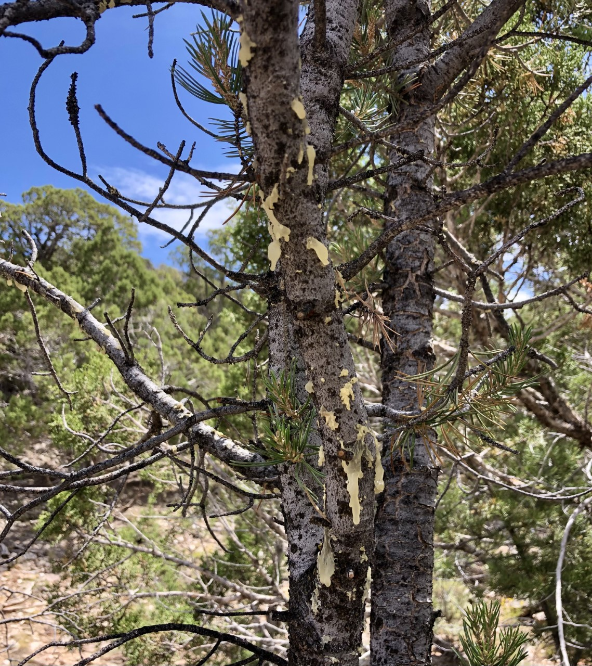
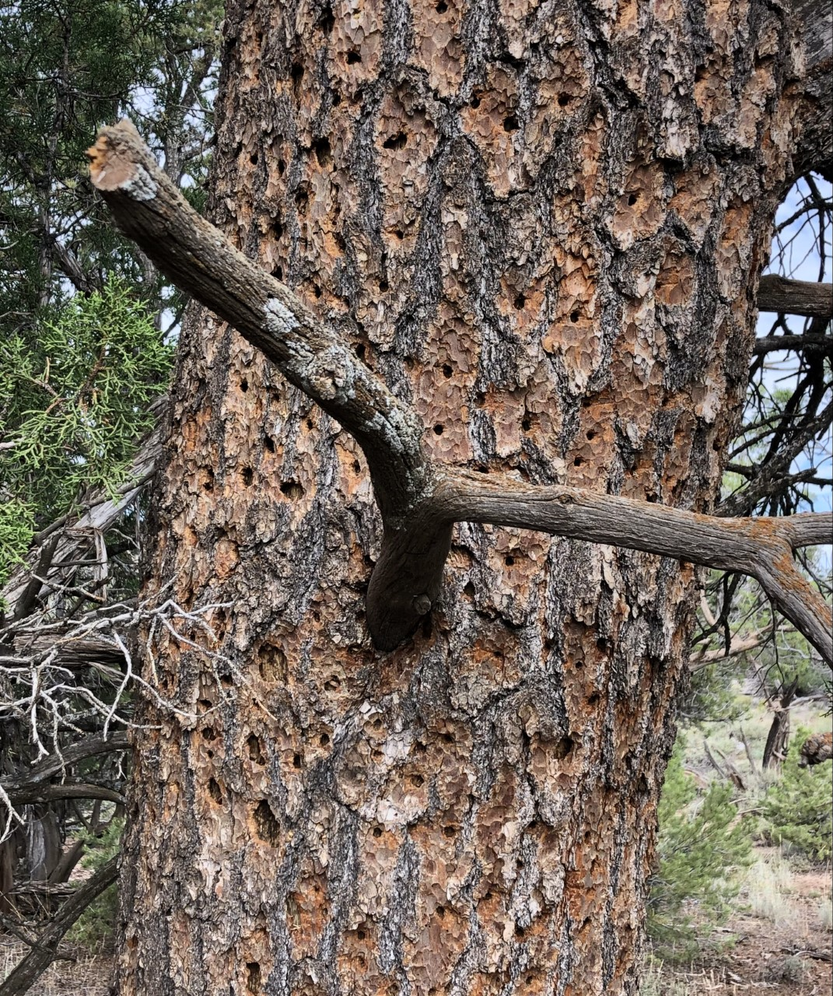
METHODOLOGY- Field Validation
Shapefile + Survey123
Ground validation of possible beetle infestation points
Control points of healthy vegetation
Image Credit: NPS
Notes:
To validate the previous term’s conclusion that areas of consecutive vegetation decline that could not be attributed to wildfire suffered from beetle infestation, we created shapefiles of points of interest and a Survey123 to send to partners so they could collect data from the field.
The survey inquired partners to assess the health of the ecosystem and verify whether or not selected points were sites of tree mortality attributed to bark beetle infestation
Ground validation points were selected in areas of consecutive vegetation decline of 3 or more years.
We also selected points of no consecutive vegetation decline to collect reference points of healthy pinyon-juniper vegetation.
For additional validation, satellite imagery was used to identify areas of green healthy vegetation as well as brown colored beetle infested trees
------------------------------Image Information Below ------------------------------
Image Credit: Molly Murphy, NPS
Image Source: Partner provided, used with permission

Slide 8
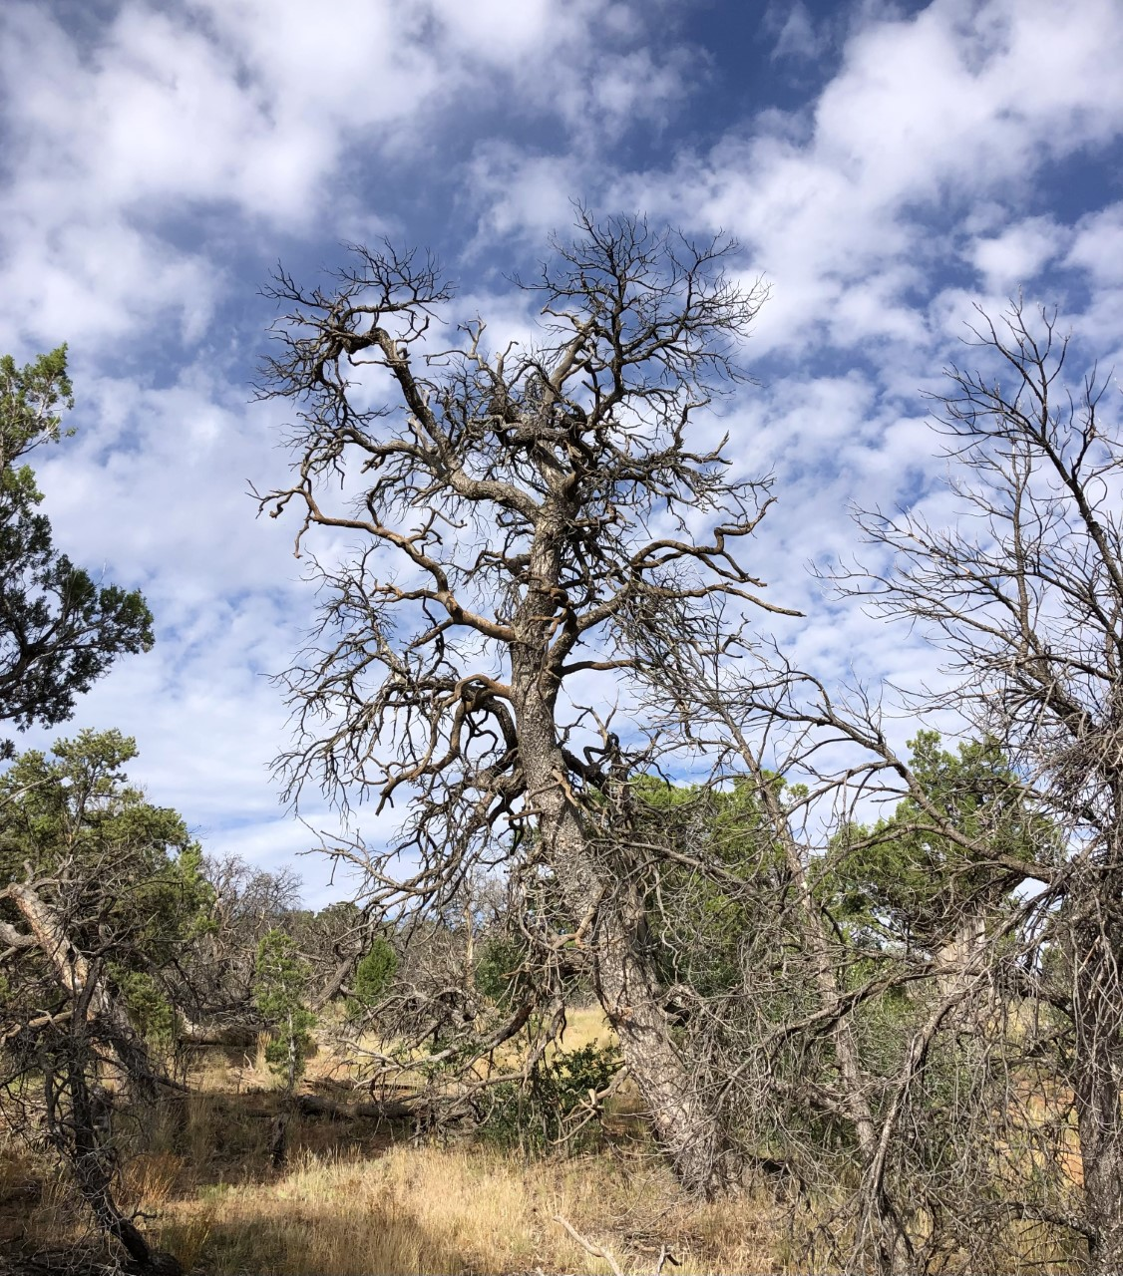
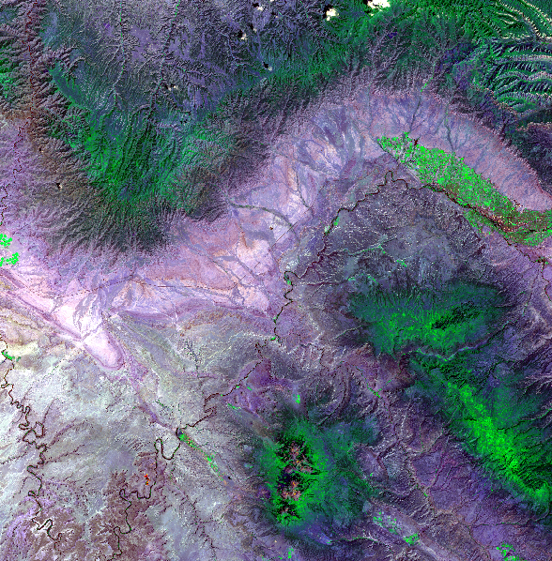
RESULTS- Field Validation
68.9% match – beetle kill satellite estimates & ground validation points
Image Credit: NPS
Notes:
Ground validation points matched satellite estimations of beetle kill areas 68.9% of the time. Ground validations were performed by our partners in the National Park Service and a team of citizen science volunteers on 10m predetermined plots.
NDVI from Landsat 8 was used to predict areas of beetle kill, and compared to the ground validation
------------------------------Image Information Below ------------------------------
Image Credit: Team
Image Source: Landsat image from Earth Explorer, processed by team in TerrSet
Image Credit: Molly Murphy, NPS
Image Source: Partner provided, used with permission

Slide 9
METHODOLOGY – Datasets and Processing
Monthly average max & min temperature
(National Centers for Environmental Information)
Monthly average precipitation
(National Centers for Environmental Information)
Re-project raster datasets
Clip raster to study area using Extract by Mask
Export raster files as NetCDF or tiff
Use R scripting to reshape data into a tabular dataset
Elevation & aspect
(GIS Training and Research Center at Idaho State University, United States Geological Survey)
Notes:
1) Monthly average precipitation, maximum and minimum temperature data were multidimensional raster datasets in netCDF format. The temporal range of the original dataset was from January 1st 1895 up to May 1st 2022
2) No elevation change was assumed throughout the temporal range of the study unlike temperature and precipitation data
Processing:
1) To subset the multidimensional raster datasets in accordance to the temporal range of the study (1987 to 2020), the Subset Multidimensional Raster tool was applied to the NetCDF files. This step wasn't needed for the Elevation and the NDVI dataset because it wasn't a multidimensional raster.
2) Then the raster datasets were reprojected to the USA contiguous Albers Equal Area Conic coordinate system.
3) The raster datasets were then clipped to the study area using the Extract by Mask tool
4) The data from these raster datasets were extracted and a tabular dataset was created using R scripting. To do this R packages such as "ncdf4", "tidyverse" and "raster" was used.
5) The tabular dataset contained the average yearly values for precipitation, maximum and minimum temperature as well as Elevation and NDVI
Image credit: Icons provided by Microsoft PowerPoint
Image source: Icons provided by Microsoft PowerPoint

Slide 10
METHODOLOGY – Driver Variable Identification
Training Data Informs:
Predictor Variables
Random Forest Regressor Algorithm
Target Oriented Cross-Validation
Training Data
1987–2013
Elevation
Annual Temperature
Evaluation 2
Aspect
Precipitation
Run the model on environmental characteristics from 2014–2020 and compare to the test data evaluate the forecasting ability of the model
Evaluation 1
Run R-squared analysis on the training data and predictor variables to explain variation in land cover
Response Variable
Test Data 2014–2020
Normalized Difference Vegetation Index (NDVI)
Notes:
1) The tabular dataset contained 4 predictor variables and the response variable.
2) The dataset was divided into a training and a test dataset. Data from 1987 up to 2013 was the training data while the remaining was the test data.
3) A random forest regressor algorithm was trained on the training data. Random Forest is a tree based algorithm which is robust to autocorrelation, multicollinearity and overfitting. The algorithm learns from the pattern within the data rather than starting from an assumption about the data distribution. That is why it is a reliable option to model non-linear multidimensional data as ours. Target oriented cross validation was used to preserve the spatio-temporal structure of the data. By preserving this structure of the data we avoided model overfitting that can arise when working with spatial time-series data. The R package "CAST" was used in the modeling process.
4) Important driver variables were identified by computing the variable importance of each predictor. The metric used in this case was the mean decrease of root mean square error.
5) R-squared metric was used to ascertain how much variation in NDVI do the predictors in the dataset explain. The capability of the model to predict on new data was evaluated root mean square error on the test dataset.

Slide 11
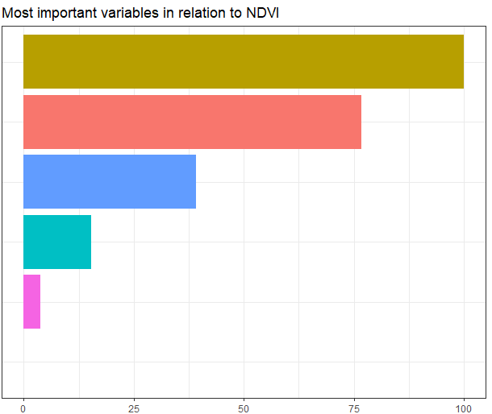
RESULTS: Important Factors of NDVI Variation
Most Important Variables in Relation to NDVI
Elevation
Important drivers used as input variables for LCM
Variables with negligible influence were discarded
Aspect
Annual avg.
minimum
temperature
Annual
avg. maximum temperature
Annual avg.
cumulative
precipitation
Annual avg.
solar irradiance
0
25
50
75
100
Variable Importance
Notes:
1) Elevation, Aspect, average annual minimum temperature, maximum temperature and cumulative precipitation explained 87 % of the variation in NDVI (R-squared: 0.87)
2) Elevation, Aspect average annual minimum temperature, maximum temperature, cumulative precipitation seem to be the most important drivers of NDVI variation
3) The RMSE on the test dataset was 0.37. This shows that the model has reasonably good predictive capability on data that it has not been trained on. This means it can effectively learn from the pattern in the data.

Slide 12
METHODOLOGY – Forecasting
Idrisi TerrSet Land Change Modeler (LCM)
Data
Processing
Preparation
Change Analysis
Sub-Models
Validation
Forecasting
Driver Variables
Notes:
Forecast maps were created using Idrisi TerrSet Land Change Modeler (LCM).
Historic LCMS maps were input into the software to first create change analysis maps.
Then, land cover transitions were grouped into a single sub-model and were trained using the driver variables identified during preprocessing.
Temperature and precipitation variables were ultimately disregarded because of their poor resolution and the negative effect of their inclusion on the accuracy of our LCM forecasts
Aspect and Elevation were included in our models because they are static variables and had a higher resolution, both of which increased the accuracy of our predictions
A forecast map was generated for 2015 and then validated using the existing LCMS map for 2015.
Forecast maps were then created for 2025, 2030, and 2040 years in the future.

Slide 13
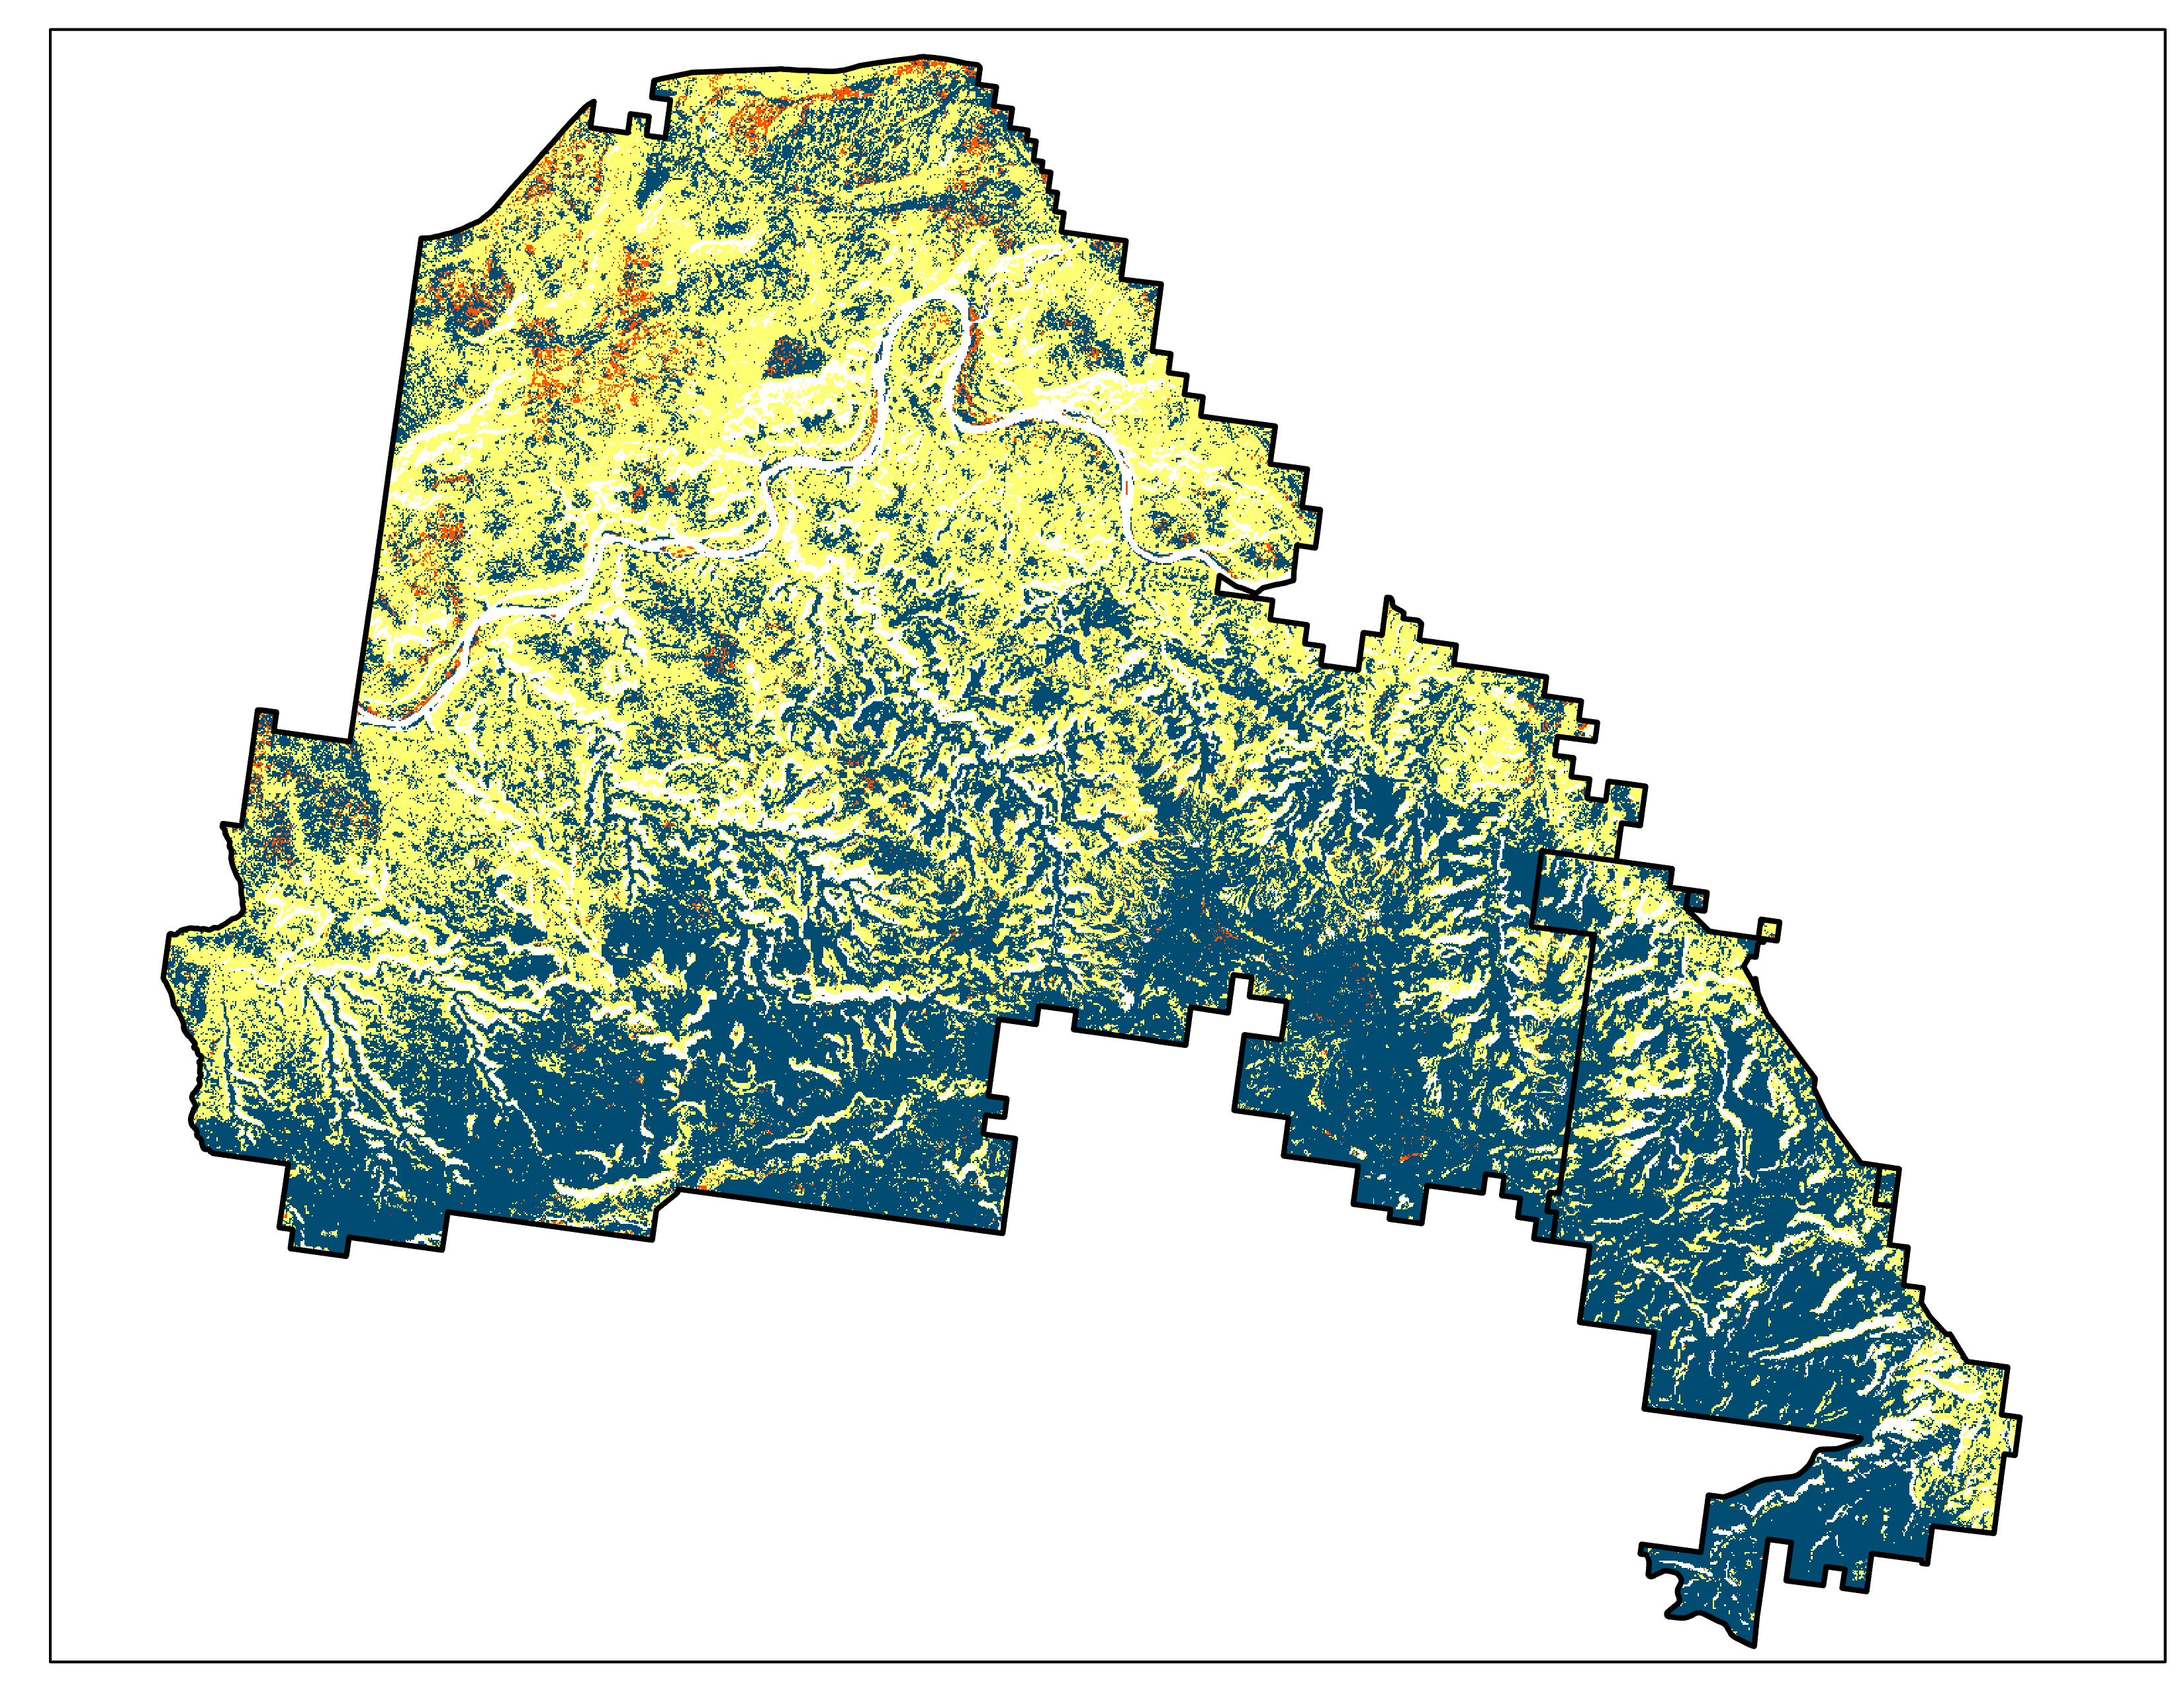
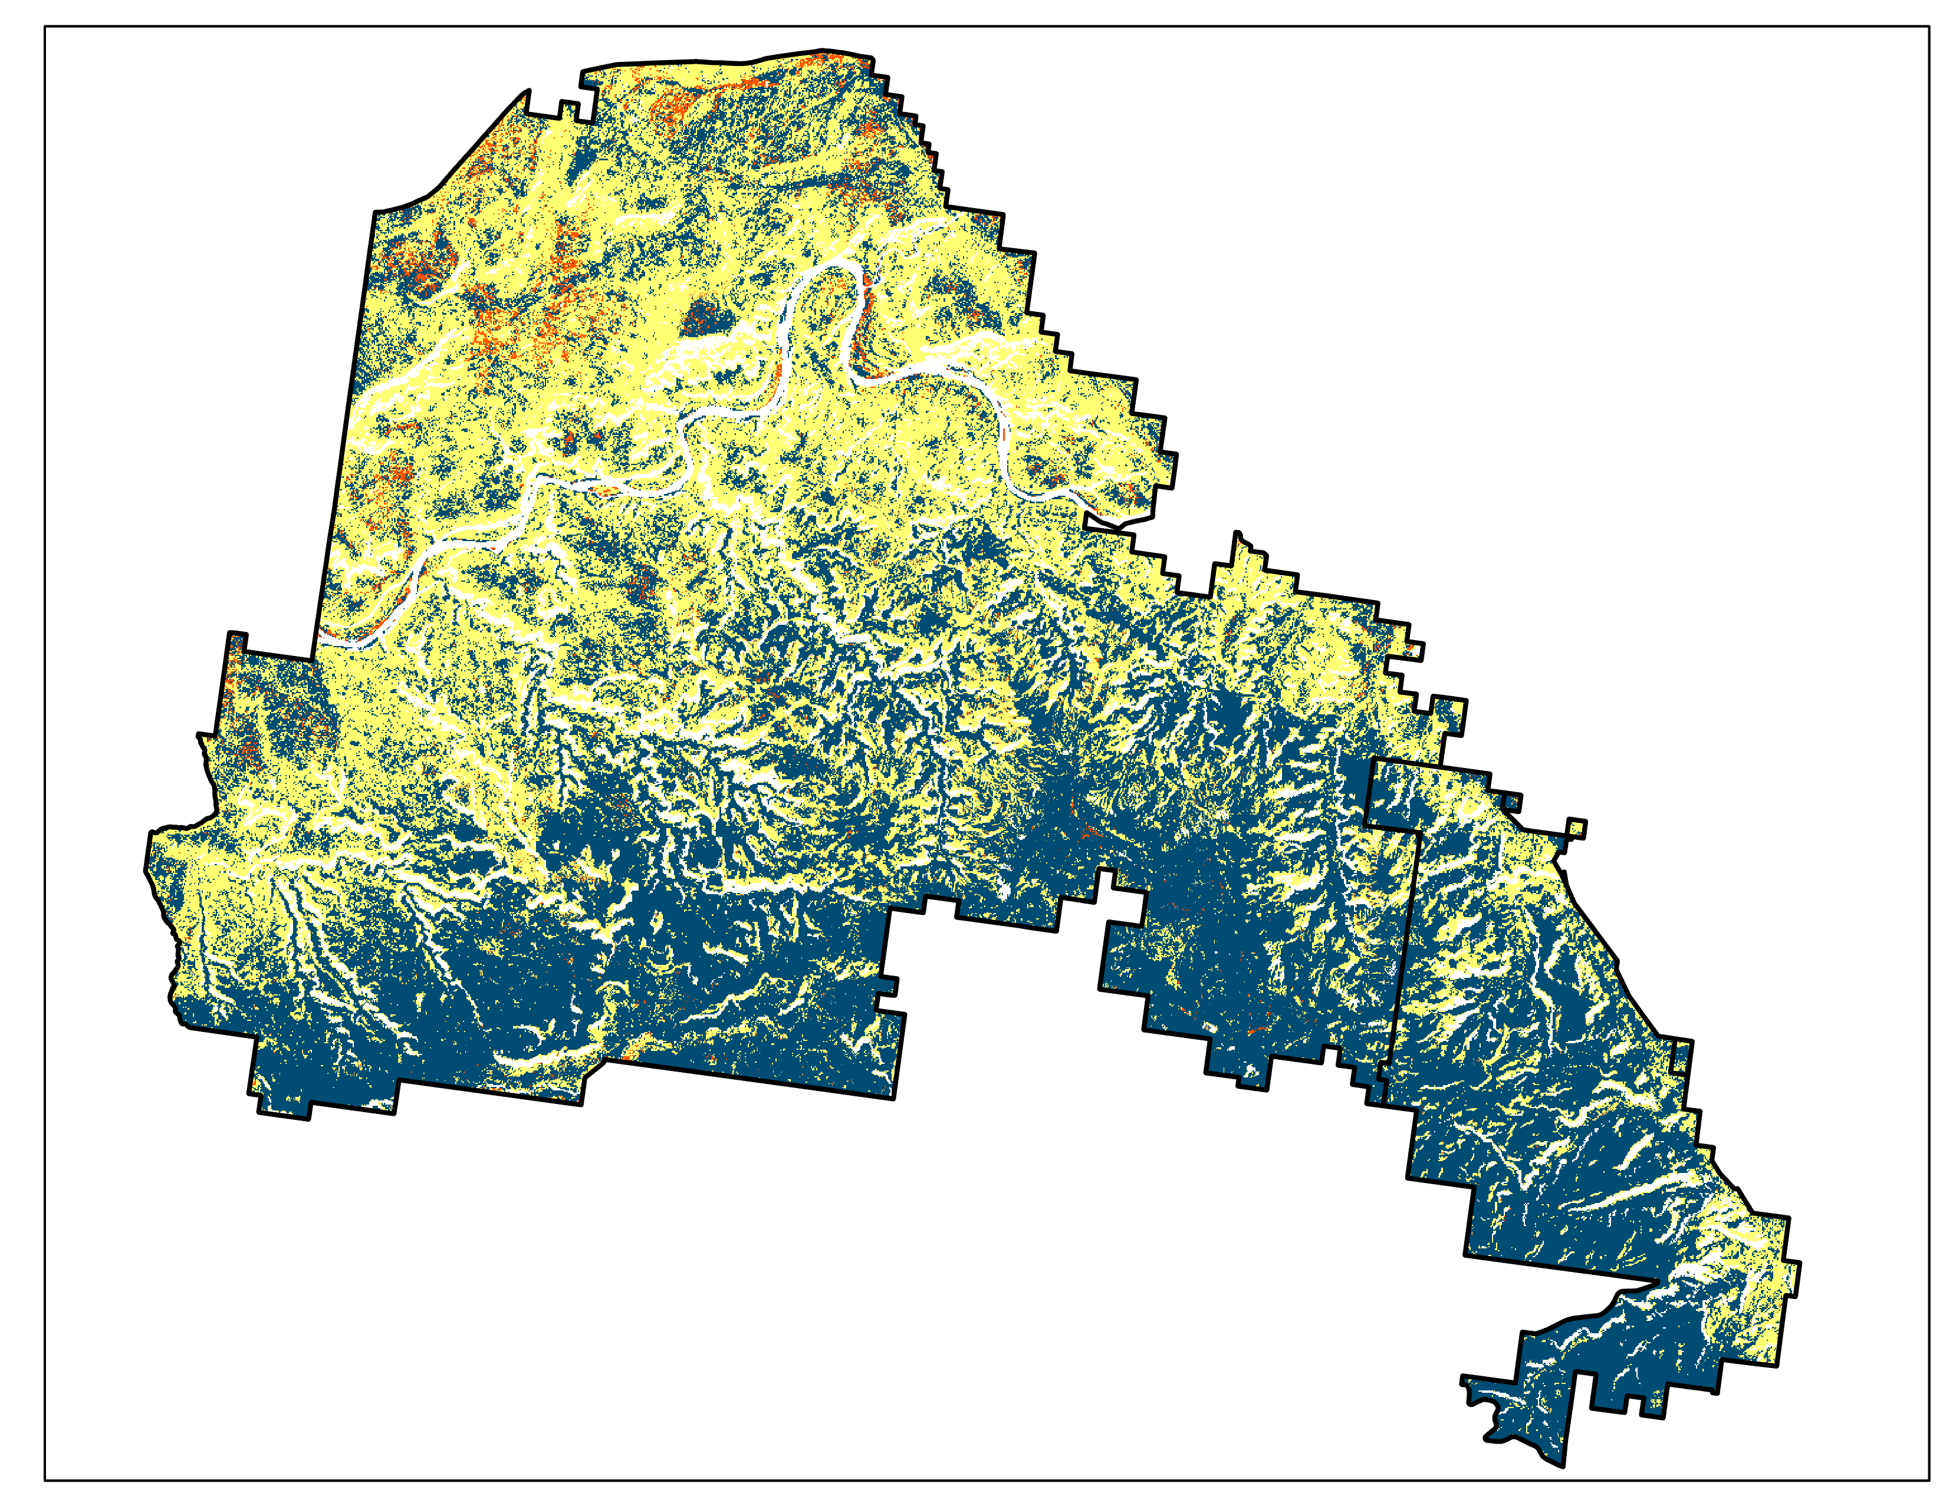
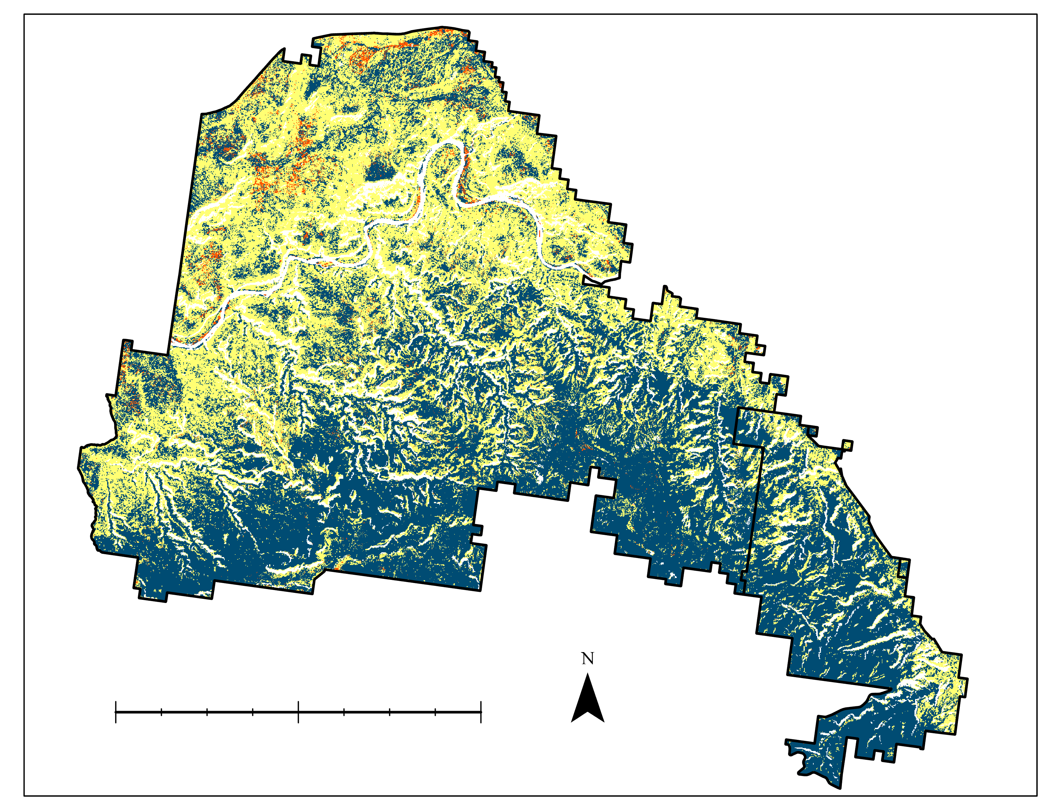
RESULTS- Forecasted Landcover Change
2025
2030
2040
0
5
10mi
Tree
Shrub
Grass & Forb
Notes:
Forecast maps were generated for the years of 2025, 2030, and 2040
These maps show how land cover might change within MCNCS and CNM under certain conditions show a shift toward trees in the south especially
Landcover was expected to shift toward shrubs and other short-canopy foliage, with a general move away from tree-based ecosystems. As stated above, temperature and precipitation were not included of their poor resolution and its negative effect on our LCM forecasts, as the accuracy of our forecasts decreased substantially when they were included. Using elevation and aspect, our models predict an encroachment of trees on shrubland.
------------------------------Image Information Below ------------------------------
Image credit: Team

Slide 14
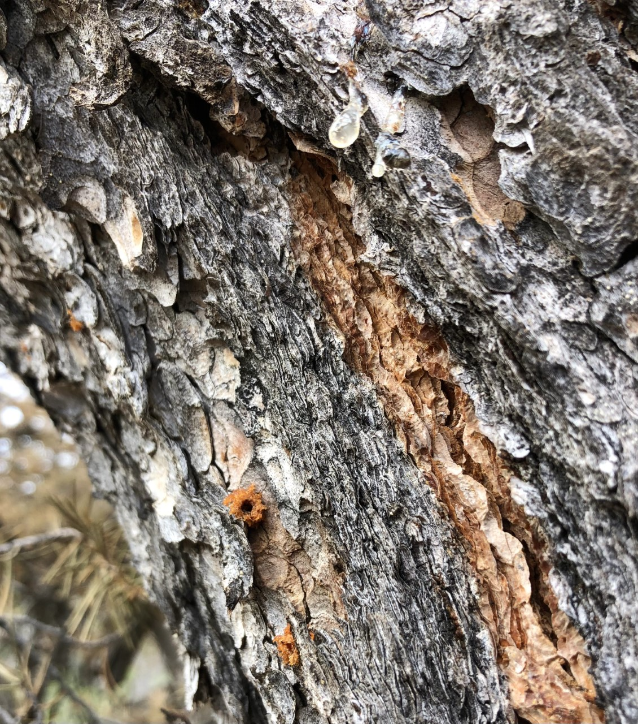
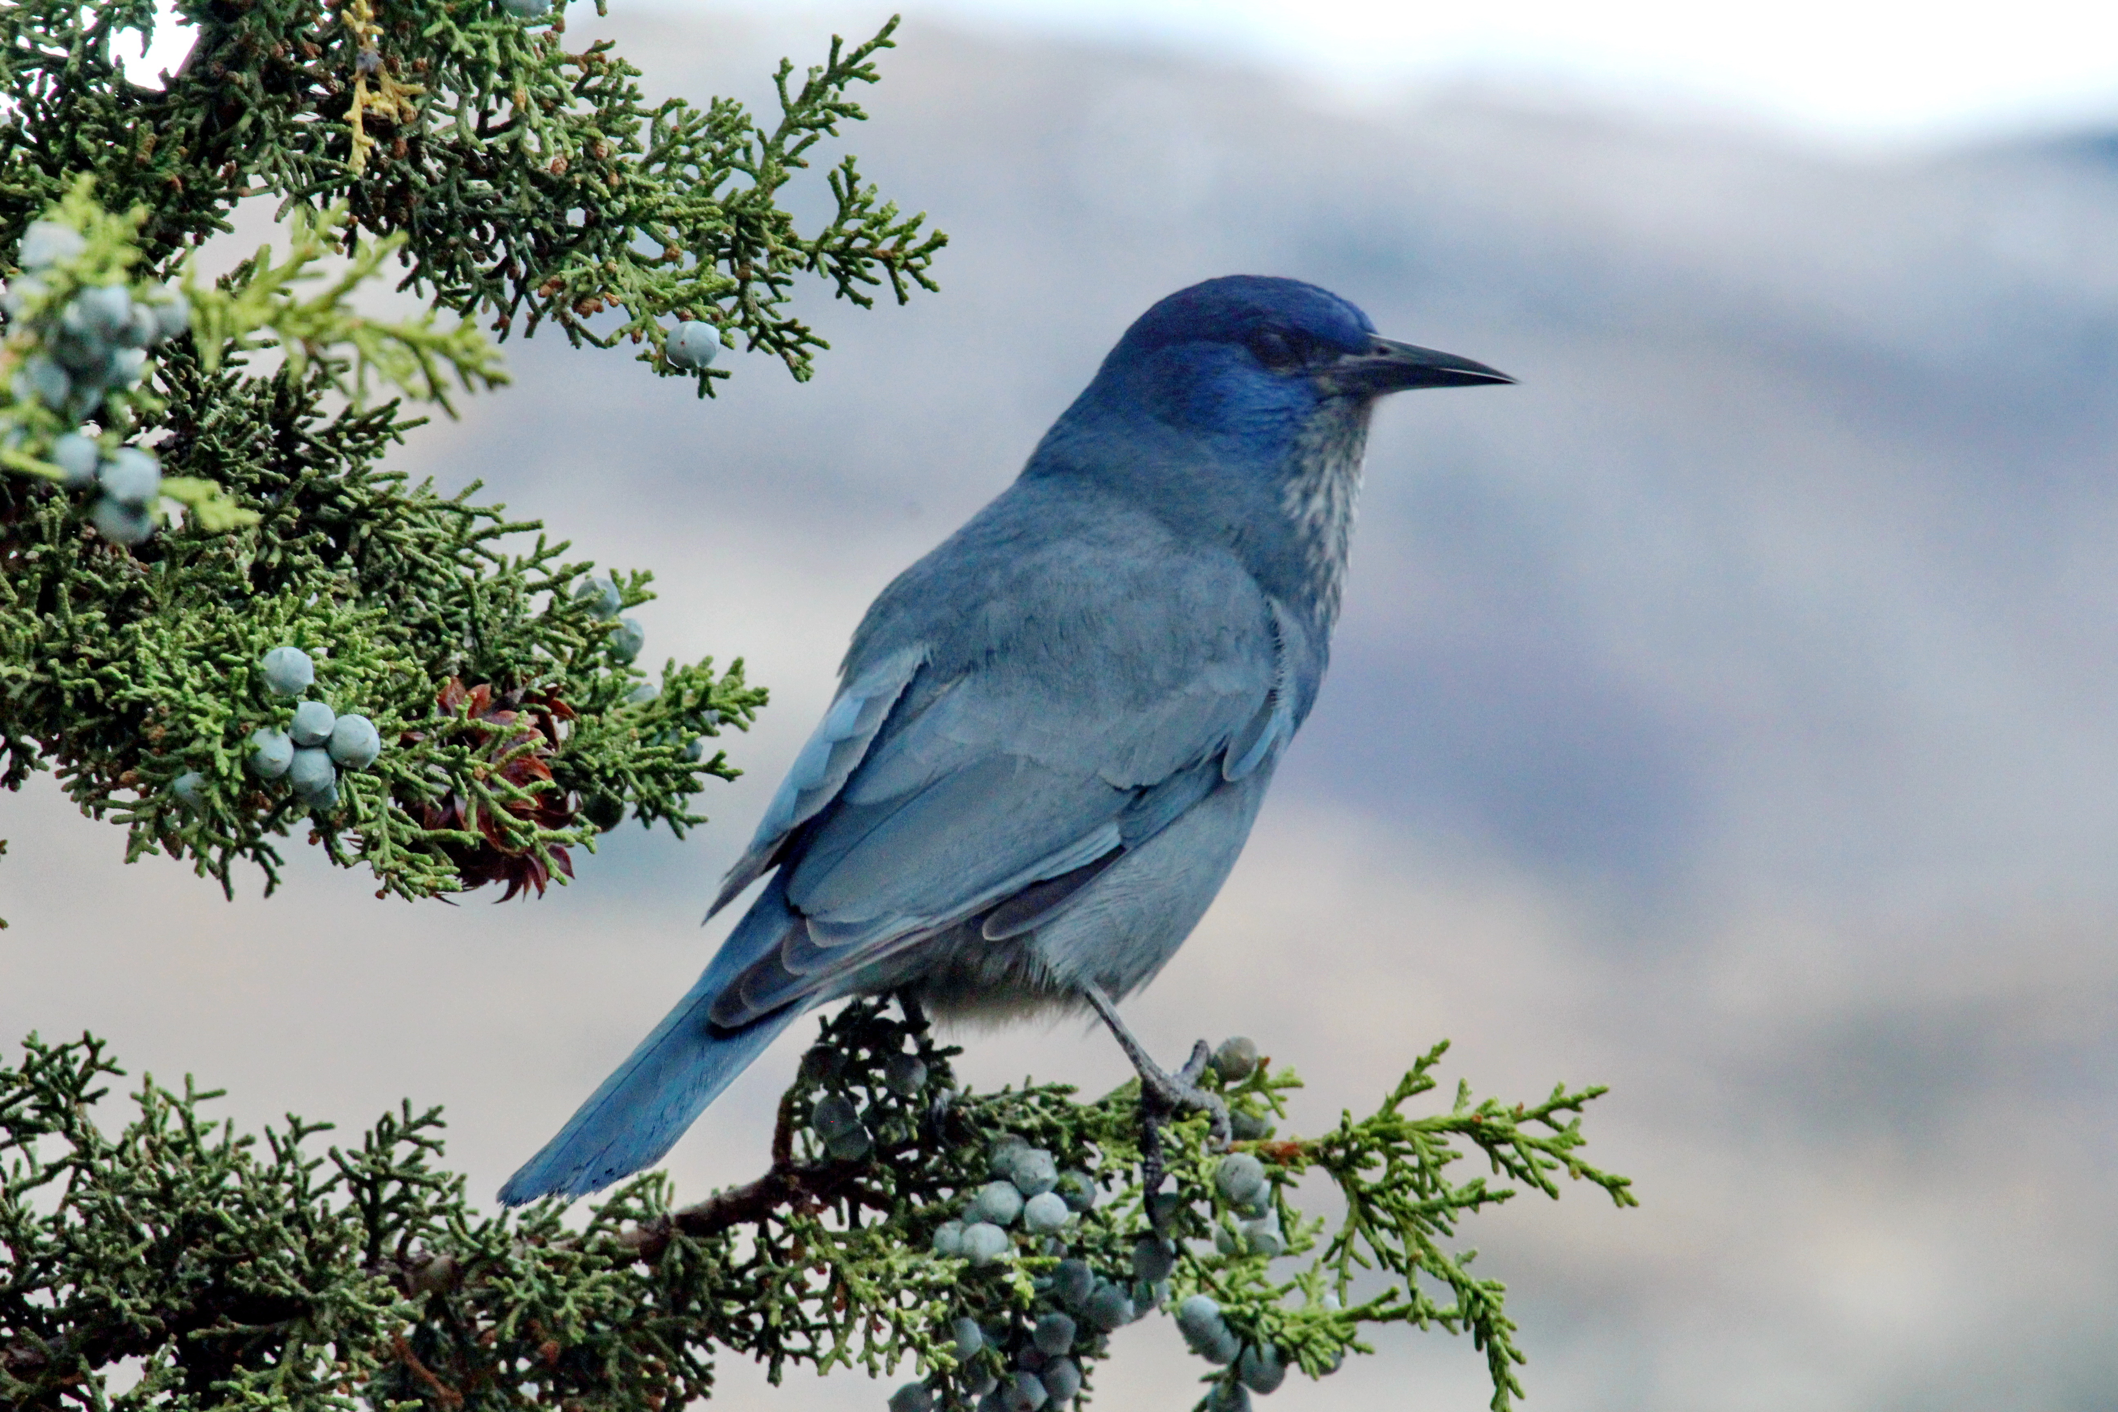
CONCLUSIONS- Field Validation
Sites identified as potential beetle kill in Term I were relatively accurate
As identified by: Landsat satellite imagery, ground validation
Satellites may be useful in identifying the causes of tree mortality
Image Credits: NPS
Notes:
Based on the metric of 68.9% similarity to ground validation, it is possible to identify areas of beetle kill from NDVI measurements
Preliminary results and analysis suggest that satellites may be useful in identifying the causes of tree mortality
Can use this to search for vulnerable areas without needing to travel overland, which can aid management by reducing the need for time expenditure on ground-based surveys
------------------------------Image Information Below ------------------------------
Image credit: NPS
Image source: https://npgallery.nps.gov/SearchResults/e5ee95e45098497c90db20b0e60e17a1?view=grid NPS photo archive (public domain)
Image credit: Molly Murphy, NPS
Image source: Partner provided, used with permission

Slide 15
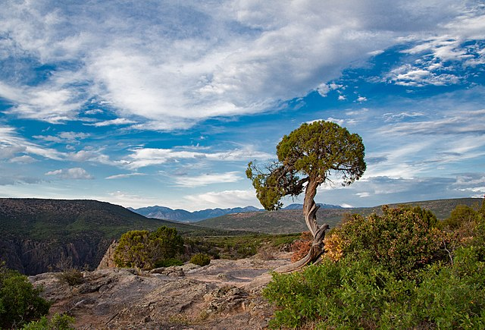
CONCLUSIONS- Forecasted Landcover Change
Shrubs had the greatest losses in CNM & MCNCA
Trees had the greatest gains in CNM & MCNCA
Nearing complete conversion of shrubs → trees within CNM perimeter by 2040
Image Credits: Victoria Stauffenberg, NPS
Notes:
Based on our forecast maps, we can conclude that the tree land cover type had the greatest gains over all forecasted years
On the other hand, the shrub land cover type had the greatest losses across all forecasted years
Within the perimeter of CNM, shrubs were nearing complete conversion to trees by 2040
We can thus conclude that PJW has the potential to decline significantly by the year 2040 in certain areas under certain conditions
Managers can anticipate this change a change like this and plan their management strategy to address it accordingly
------------------------------Image Information Below ------------------------------
Image Credit: Victoria Stauffenberg, NPS
Image Source: https://npgallery.nps.gov/GetAsset/c577f4b3-ec35-454e-b09d-ffbcee1c39ef/popupimage (Public domain)
Image Credit: Icons provided by Microsoft PowerPoint
Image Source: Microsoft PowerPoint

Slide 16
ERRORS AND UNCERTAINTIES
Down-sampling spatial resolution of data
Extrapolation into the future needs to be
interpreted with caution
Model run under static conditions
A fire can change these predictions
Notes:
There are several limitations to our analysis that need to be considered when interpreting our results
For example, in order to run the models we used, down sampling the spatial resolution of our data was required, which may impact the accuracy of our results
Of course, our forecast maps are not exact predictions of future conditions and the land cover changes observed should be interpreted with caution
Additionally, our model was ultimately run and forecasted land cover maps created under static conditions (aspect and elevation; excluding temperature and precipitation variations) so any unexpected event, such as a fire, could change the results we observed drastically
------------------------------Image Information Below ------------------------------
Image credit: Icons provided by Microsoft PowerPoint
Image source: Icons provided by Microsoft PowerPoint

Slide 17
FUTURE WORK
Consider disease outbreaks in relation to climate, wildfires, and beetle infestation
Forecast encroachment of invasive species
Investigate effects of wildlife grazing and changes in wildlife distribution
Reevaluate possible beetle infestation sites
Include additional climate variables in forecast modeling
Notes:
Although there will not be a third term of this project, there are several additional analyses that could be investigated by partners to add to the complexity and informative capability of this project in the future.
Our team was unable to incorporate temperature and precipitation data into our modeling, but in the future, those variables could be added to forecasts for a more robust forecasted land cover change map
Future research could factor in the effect of disease outbreaks on pinyon-juniper and sagebrush habitats in addition to the climate variables investigated in this study, as climate change can increase the occurrence of fatal diseases that can cause large-scale die-off (Shaw et al., 2005).
Focus explicitly on forecasting what expected invasion of non-native species would look like if trends in land cover change continue as forecasted.
Partners could also use the forecasting methods utilized in this project to also investigate the effects of wildlife grazing on pinyon-juniper and sagebrush habitats as well as map changes in wildlife distribution based on forecasted land cover change.
Sites identified by the first term to potentially be beetle infestation that were found to not be infested by beetles in field validation could be reevaluated in the future for increased accuracy
------------------------------Image Information Below ------------------------------
Image credit: Microsoft Powerpoint
Image source: Microsoft Powerpoint

Slide 18
Science Advisors
Keith Weber (Idaho State University, GIS Training and Research Center)
Joseph Spruce (Science Systems and Applications, Inc., Consultant)
Fellow
Brandy Nisbet-Wilcox (Science Systems and Applications, Inc., NASA DEVELOP National Program)
Partners
Molly Murphy (NPS, CNM)
Nikki Grant-Hoffman (BLM, MCNCA & DENCA)
Maps throughout this work were created using ArcGIS® software by Esri. ArcGIS® and ArcMap™ are the intellectual property of Esri and are used herein under license. All rights reserved.

Slide 19
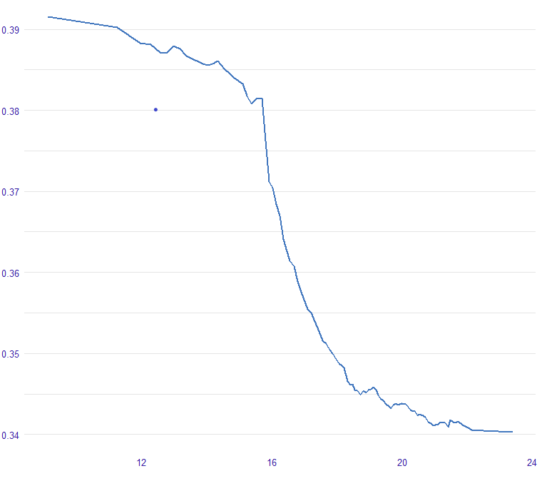
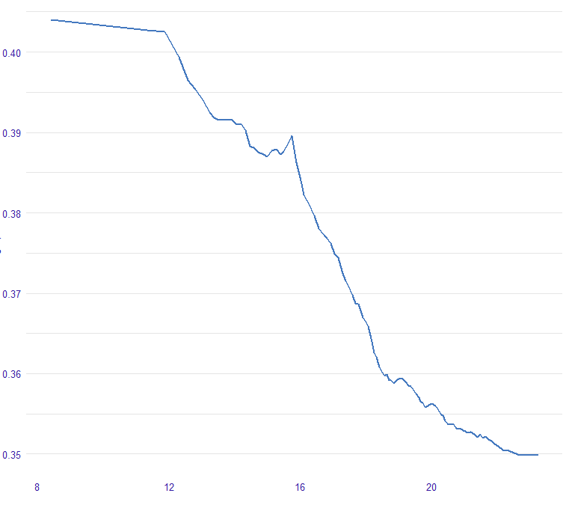
FUTURE WORK
NDVI from trees and shrubs taller than 1-meter declines with increase of annual maximum temperature
NDVI from shrubs shorter than 1-meter declines with the increase of annual maximum temperature
0.39
0.40
0.38
0.39
0.37
0.38
Yearly Maximum NDVI
Yearly Maximum NDVI
0.37
0.36
0.36
0.35
0.35
0.34
8
12
16
20
12
16
20
24
Average annual maximum temperature in Celsius
Average annual maximum temperature in Celsius
Notes:
Some additional avenues may be explored in relation to how different climate variables affect the growth and proliferation of trees versus shrubs. For example, how does the increase of average annual maximum temperature influence the growth/proliferation of shrubs? Does it influence trees the same way ? Or do the growth and proliferation of trees tend to follow a different pattern in relation to average annual maximum temperature.
It is possible to explore similar patterns in relation to precipitation and tree/shrub/grass growth as well as between average annual minimum temperature and growth
Exploring these patterns will help us ascertain how future climate change can influence landcover change in the area.

