Slide 1
DEVELOP National Program
[Project Title]
[Node]
spring 2017
Technical Imagery

Slide 2
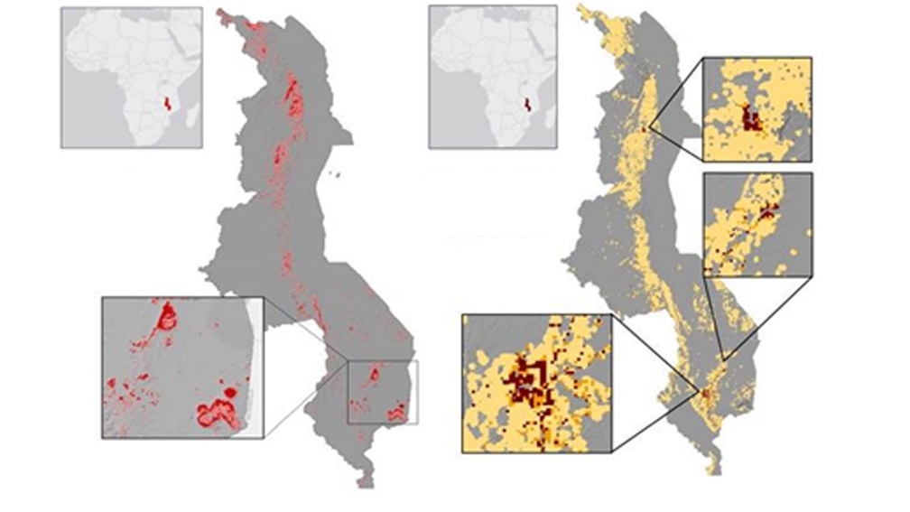
Purposes and Examples
Technical Image
Susceptibility
People per Square Mile
Moderate
1 - 500
High
500 – 1,000
1,000 – 37,000
Display and explain project results.
Used on website Project Page, term booklet, or any future purpose that visual results are needed.
Text is separate from image and typed in PowerPoint (no exported text images)
Delete this slide upon submission.

Slide 3
Image Checklist:
Map resources available on DEVELOPedia
Image is derived from NASA sensor data
  Not from an outside source
  Not a photograph of the team or landscape
  Exception: NCEI projects using CDRs
At least one image provided is derived from recent data (2016-2017)
Some kind of processing has taken place
  Not just a raw satellite image or simple re-order of spectral bands
The team actually created the image
  There can be NO outside content included (what we mean by this is something some non-DEVELOP person processed/created/picture they took) – including non-NASA data along with NASA data in the creation of your image is fine, but you can’t take a map or diagram someone else made and include it
High-resolution 1920 x 1080 (over 300 dpi) – landscape orientation
White background
Saved as a JPEG or PNG
Delete this slide upon submission.

Slide 4
Technical Image Guidelines:
  Don’t:
    Title your legend “Legend”
    Be sloppy with labels overlapping or misspellings
    Include metadata (datasets, who made the map, what the projection is, etc.)
    Import text as a photo
  Do:
    Make sure if you decide to include text that it is legible and you type it into the slide.
    Consider the scale/shape of the image – feel free to zoom in to a particularly interesting part of the study area that fits the dimensions listed above
    Pick your symbology wisely
    Be thoughtful with color schemes (remember color blind people and be kind to viewers eyes as some colors should not be next to each other!)
    Coloration: Sequential and qualitative are great, diverging should be used carefully
    Have multiple people look at the imagery with a critical eye
    Be careful about scale bars. You can put the bar part in the image, however the numbers and units text must be typed in PPT separately. Don’t submit an entirely separate scale bar because it will immediately not be to scale if it gets resized to fit on/near an image.
  Can:
    Include text and legends as long as they are legible or include no text if you prefer
    Exclude the North arrow if North is directly up
    Include insets to give a greater context of where in the US or world you are zoomed in
    If your study area shape is inherently portrait-style, get creative how to make your image in landscape – duplicate the image to make a time series, zoom in on one specific area, etc.
Delete this slide upon submission.

Slide 5
Project Short Title Here
Technical Image
Caption: Make sure to include what NASA satellite and sensor the image is derived from and the date the data were collected by the satellite. Also include what the image is (ex. NDVI, etc.), and how it can be used for decision making. 25 word limit.
Submit legends as separate images so they can be re-sized for future use if needed.

