Slide 1

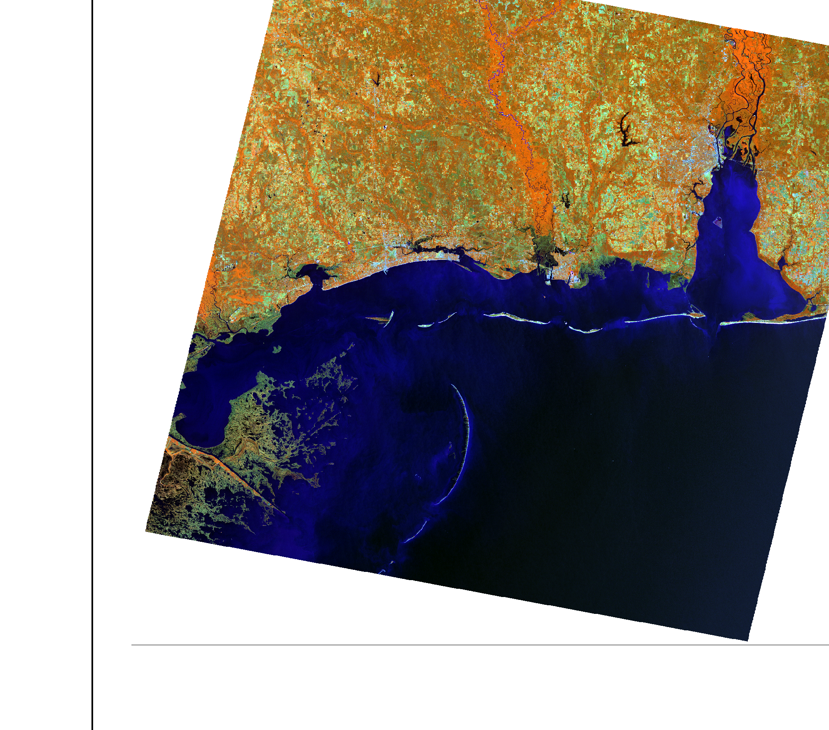
MOBILE BAY ECOLOGICAL FORECASTING II
MOBILE BAY ECOLOGICAL FORECASTING II
Monitoring Marsh Conditions in Coastal Alabama Using NASA Earth Observations to Support the Alabama Coastal Foundation’s Restoration and Conservation Initiatives
Darius Hixon (Project Lead)
Austin Clark
Tyler Lynn
Manoela Rosa
Monitoring Marsh Conditions in Coastal Alabama Using NASA Earth Observations to Support the Alabama Coastal Foundation’s Restoration and Conservation Initiatives
Notes:
Hello we are the Mobile Bay Eco Forecasting II team.

Slide 2
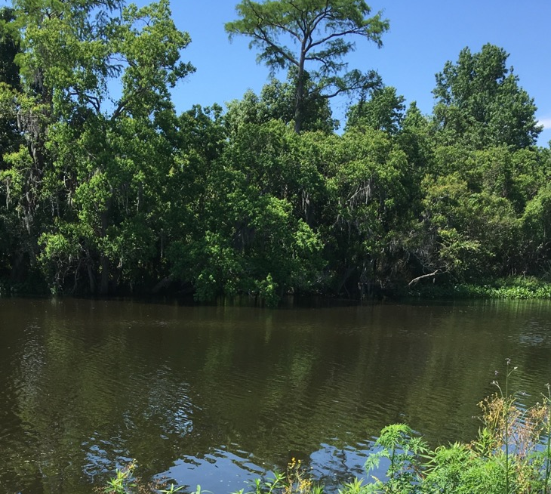
Objectives
Apply NASA Earth observations in Mobile and Baldwin Counties to investigate:
Marsh health trends
Marsh extent
Urban development
Image Credit :Mobile Bay Eco Forecasting II Team
Notes:
The overarching goals of this project were to use NASA Earth Observations to explore marsh health trends, marsh extent, and urban growth. This data will be used to aid the Alabama Coastal Foundation and other coastal Alabama environmental organizations in their decision making process as they implement restoration efforts.

Slide 3
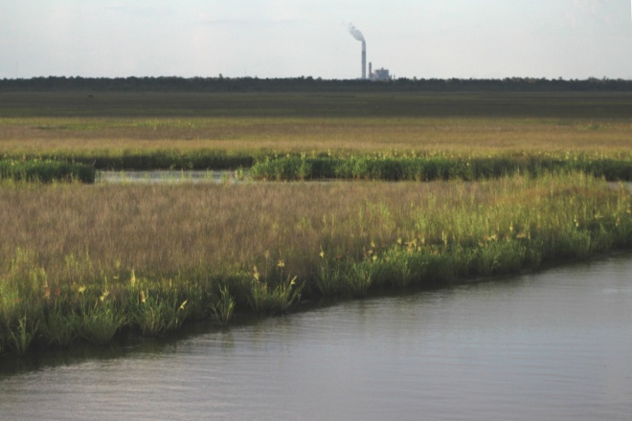
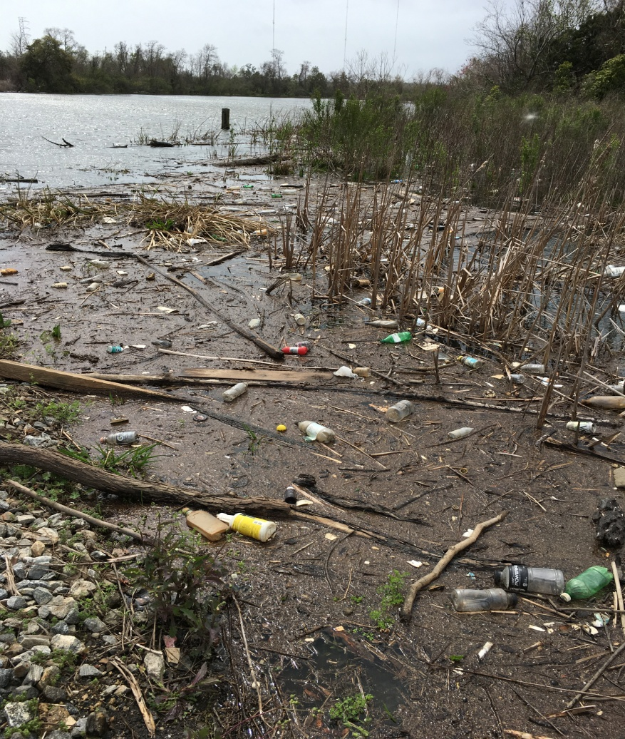
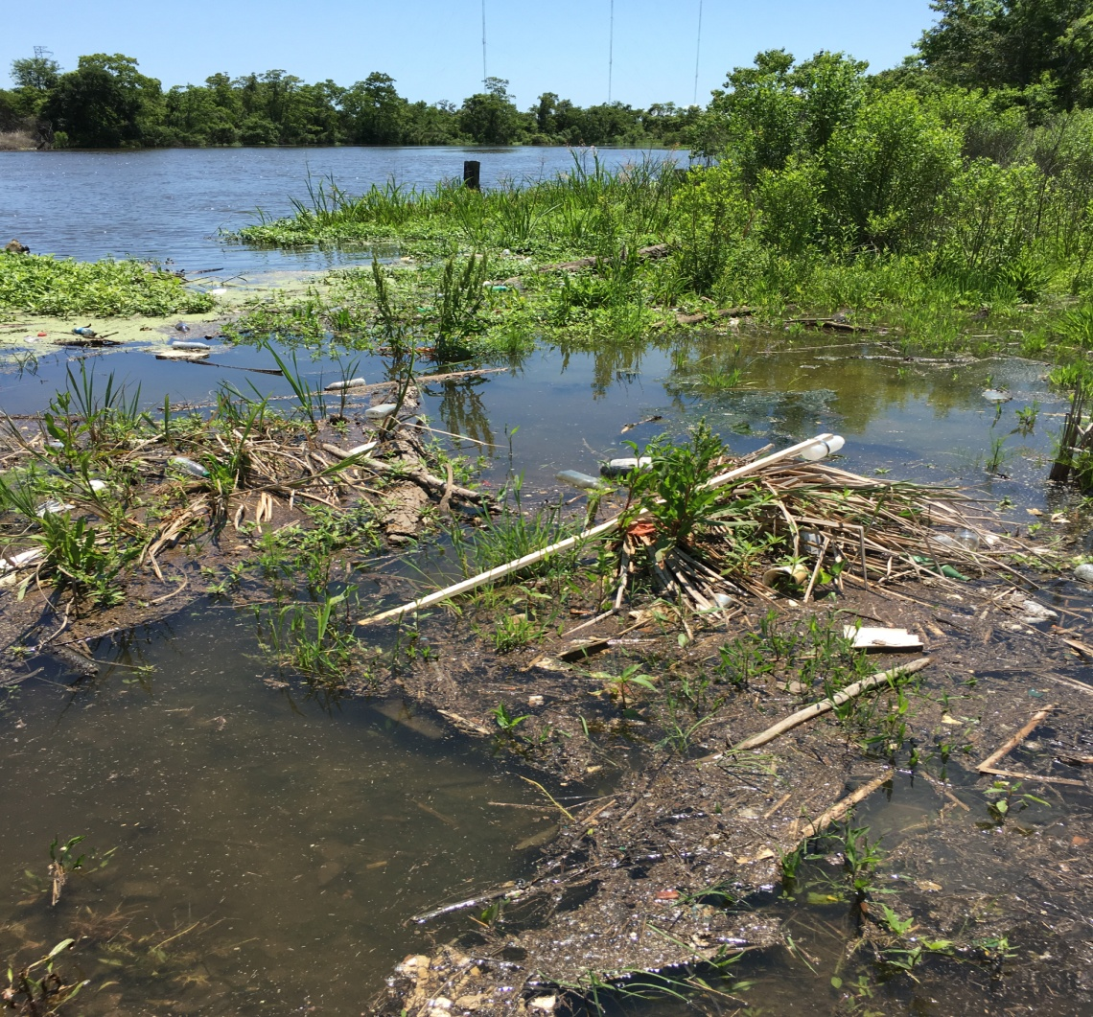
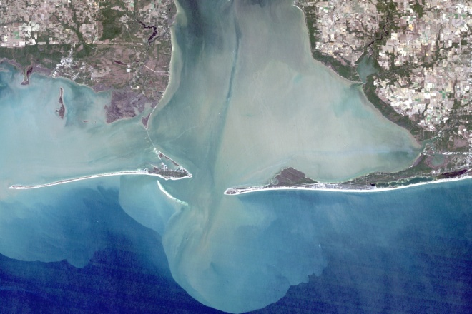
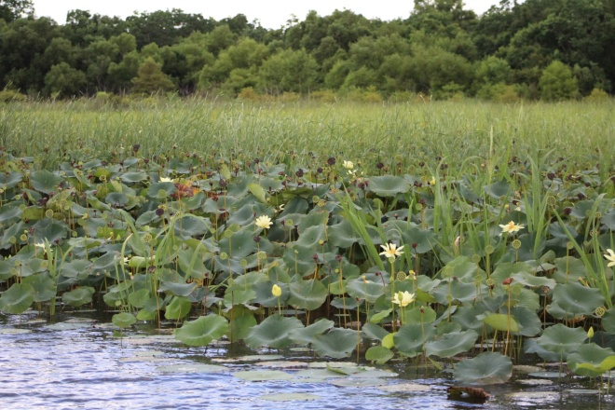
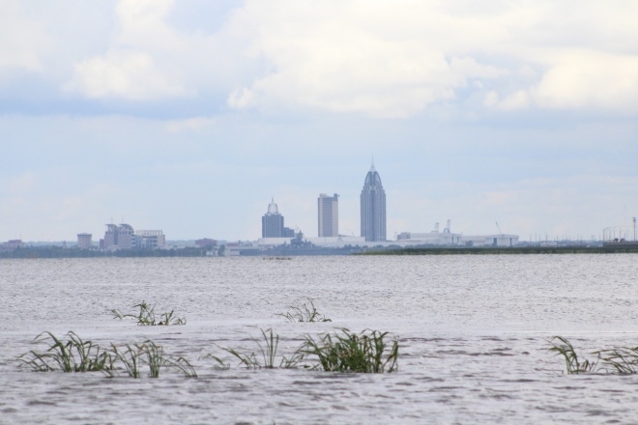
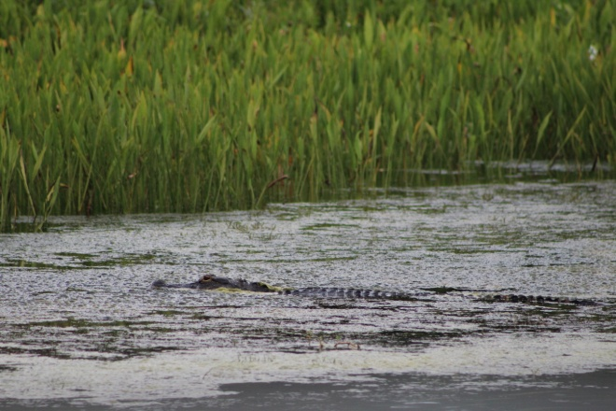
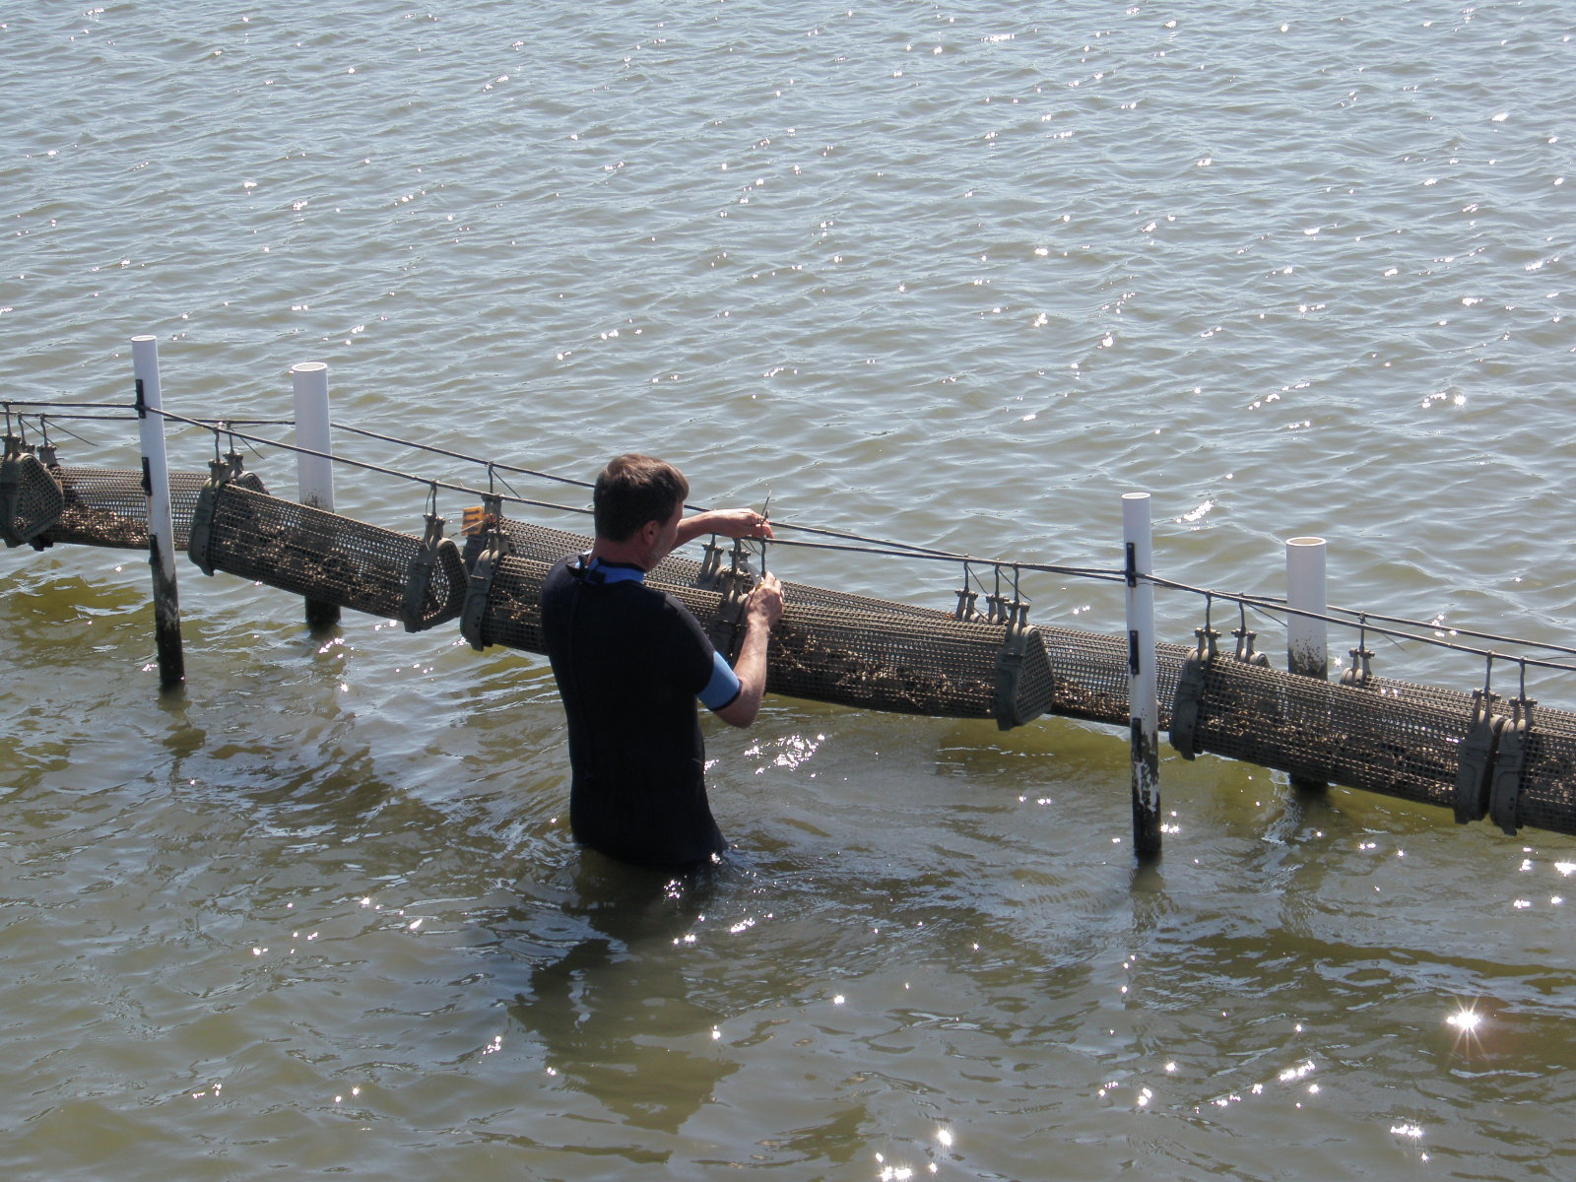
Community Concerns
Image Credit: Mobile Bay Eco Forecasting II Team
Image Credit: Mobile Bay Eco Forecasting II Team
Image Credit: Mobile Bay Eco Forecasting II Team
Image Credit: Mobile Bay Eco Forecasting II Team
Pollution
Trash Dumping
Water Quality
Turbidity
Image Credit: Mobile Bay Eco Forecasting II Team
Image Credit: Mobile Bay Eco Forecasting II Team
Image Credit: Mobile Bay Eco Forecasting II Team
Image Credit: National Oceanic and Atmospheric Administration
Marsh Extent
Urbanization
Ecological Diversity
Economic Cost
Notes:
Mobile Bay and the marsh areas within it are faced with a number of pressing environmental issues such as increasing pollution and trash dumping, water quality, impervious surface growth, and declining ecological diversity.

Slide 4
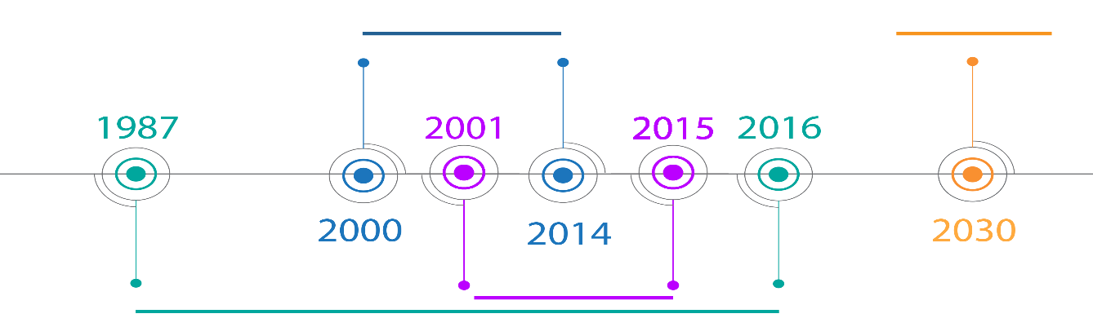
Study Area and Period
The study area included Mobile and Baldwin Counties, located in Coastal Alabama
Study Period: Jan 1987-May 2016
Forecast models and maps through 2030
MARSH HEALTH
FORECAST
URBANIZATION
MARSH EXTENT
Image Source: Mobile Bay Eco Forecasting II Team
Notes:
The overall study period ranged from January of 1987-May 2016 with forecast models and maps through 2030. Marsh health was analyzed from 2000-2014, marsh extent was investigated from 1987-2016, and urbanization was measured from 2000-2015.

Slide 5


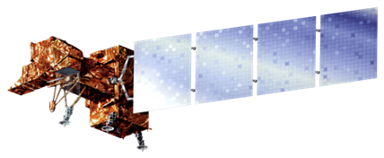
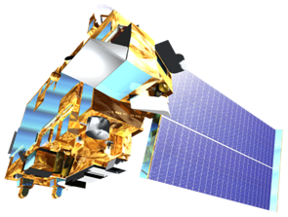
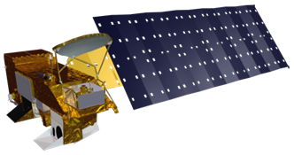
NASA Satellites and Sensors Used
Landsat 7 – ETM+
Landsat 8 - OLI
Landsat 5 - TM
AQUA - MODIS
TERRA - MODIS
Image Credit: NASA
Notes:
For this project we used Landsat 5-Thematic Mapper, Landsat 7 Enhanced Thematic Mapper Plus, Landsat 8 Operational Land Imager and Thermal Infrared Sensor, and the MODIS Sensor on AQUA and TERRA.

Slide 6
Datasets
Software and Manipulation
Analysis
Methodology: Marsh Health Trends
8-Day MODIS Composite NDVI Images from the USDA Forest Service ForWarn Dataset from 2000 to 2014
ArcGIS and model builder
Microsoft Excel
Maps and excel time series plots displaying the diversity of health trends in the study area
Notes:
To address the marsh health concerns as mentioned above, MODIS 8-day composite Normalized Difference Vegetation Index or NDVI images were downloaded from the USDA Forest Service ForWarn Dataset for 2000-2014. The NDVI is calibrated to observe the chlorophyll in plants and is used here as a proxy for plant health. These images were pre-processed for atmospheric corrections and cloud removal and were at 250m resolution. These images were then uploaded into ArcGIS model builder, where they were run through the following 9-step model to reduce data size, calculate statistics, and generate images of the statistics for each 8 day period. These statistics were then placed into Excel to create a time series of NDVI as a proxy for wetland health. These maps and patterns were able to differentiate different health patterns based on vegetative type, geographic location, and stressing events on a watershed level and for the entire study area.

Slide 7
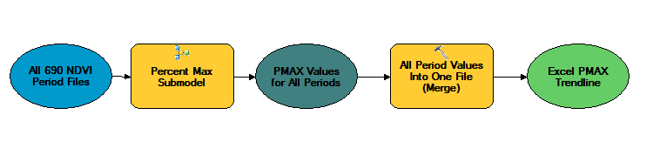
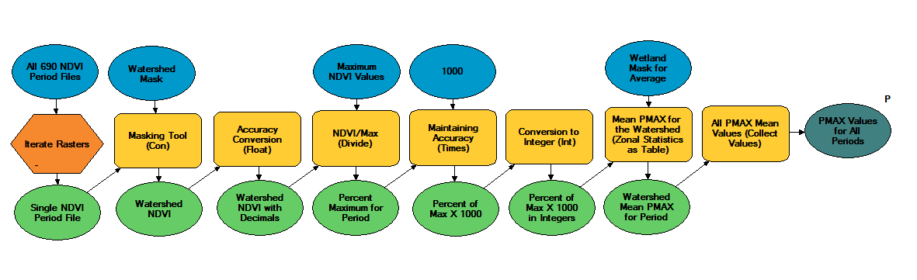
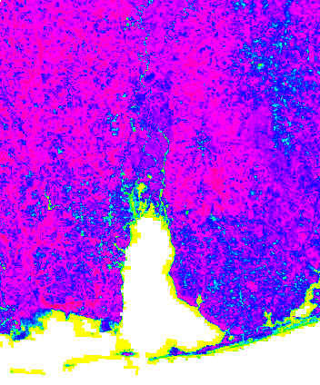
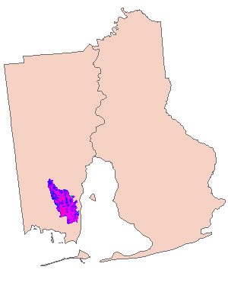
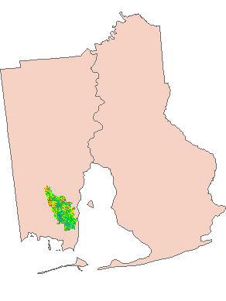
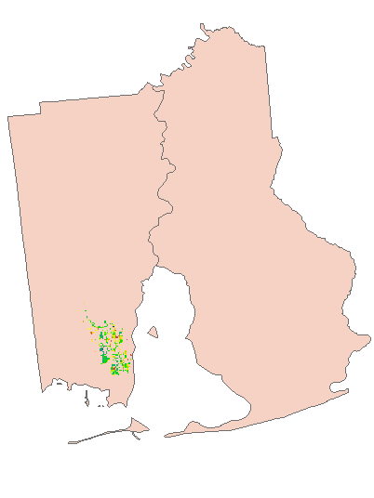
Methodology: Marsh Health Trends
Marsh health trends were generated using the model pictured at left
This model created graphs in Microsoft Excel and maps to spatially analyze relative trends
Percent maximum was used to account for different plant species
9
1
2
3
4
5
6
7
8
1
3
4
7
Mask
PMAX
Wetlands
Image Credit: Mobile Bay Eco Forecasting II Team
Notes:
As mentioned earlier, this 9 step model effectively reduced the amount of data down to each individual watershed and then the wetland pixels within them, while also calculating the necessary statistics on each pixel. The process is shown graphically at the bottom with the corollary step in the model on each image. It begins at the raw NDVI image, and then masks it to the desired watershed, in this case the Fowl River in southern Mobile County. Next, a percent maximum is calculated on the watershed for each pixel. Lastly, these pixels are masked to only wetland pixels using a mask from the Coastal Change and Analysis Program (CCAP). The criteria to be considered a wetland was for a pixel to be identified as a wetland in the 2001, 2006, and 2011 CCAP analyses. The statistic of choice was the percent maximum because it is better able to accommodate different vegetation types and reduce bias for NDVI to greener plants. It is calculated using the NDVI value for each pixel in each period divided by the maximum value observed in each pixel over the entire study period. Finding this value required the use of cell statistics in a separate model. Once the percent maximum values are masked to the wetlands, they are then averaged together and that average is the health “value” for that period in that watershed. This is done for all 690 periods in our study period and then the 15 year time series is generated in step 9 of the model and looks similar (advance to next slide) to this.

Slide 8
Results: Marsh Health
These differences in vegetation can be seen in the health patterns
Trend lines were also drawn, indicating a downward trend in both palustrine and estuarine wetlands, with the palustrine health declining faster than the estuarine
Image Credit: Mobile Bay Eco Forecasting II Team
Notes:
These two particular trend lines are for all estuarine and all palustrine wetlands in the study area. Estuarine wetlands are typically coastal bogs, swamps, and marshes that are in brackish or salt water and tend to have a grassier flora, whereas palustrine wetlands are inland freshwater bogs, swamps, and floodplains with a more woody composition. These differences in dominant vegetation are evident in the patterns, especially on a yearly scale. The amplitude of each individual year is much higher with palustrine wetlands when compared to the estuarine, likely attributable to trees. When the trees are all extremely green and healthy the PMAX is very high, but when the deciduous trees lose their leaves the PMAX plummets. While the same pattern is observed in the estuarine marshes, there are fewer trees and warmer ocean water that helps to mitigate the seasonal differences within a year. Estuarine marshes also are typically lower in PMAX, presumably due to a more diverse ecosystem and possibly more water influences in mixed pixels. Another interesting note on this graph are the impacts of Hurricane Ivan in 2004 and Katrina in 2005, which were subsequently followed by a severe drought in 2006 and 2007. While both types of wetland took a significant hit, the estuarine wetlands with the grassier vegetation were able to recover while the palustrine environments never did.

Slide 9
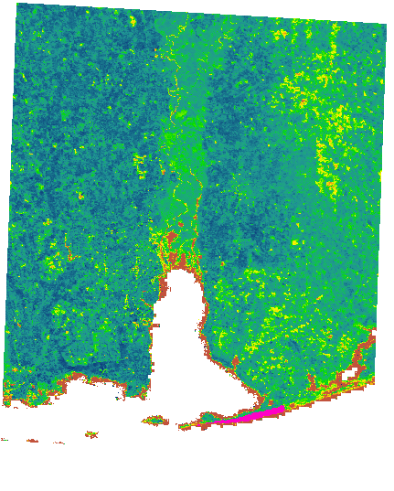

Results: Marsh Health
Other interesting features can be determined from the trends, such as hurricanes, droughts, and harsh winters
Little Lagoon was hit directly by Hurricane Ivan in 2004 and then a drought two years later in 2006, significantly affecting the health
PMAX
Little Lagoon
Hurricane Ivan
Image Credit: Mobile Bay Eco Forecasting II Team
Notes:
Natural stressors like hurricanes, droughts, and cold winters were observed to be the biggest influences on wetland health, for instance Hurricane Ivan. It made landfall in mid September of 2004 right in the heart of Little Lagoon, the small pink sliver just west of Gulf Shores. Little Lagoon got the worst of the eastern eye wall of Ivan and took a massive hit. Little Lagoon was not the only area impacted by Ivan however, as can be seen along the track. Most of Baldwin County has much lower values along the track of Ivan as compared to Mobile County on the western side of the bay.

Slide 10
Results: Marsh Health
These trends can help to pinpoint areas in need of restoration following significant stressing events
Ivan
Image Credit: Mobile Bay Eco Forecasting II Team
Notes:
The impacts Ivan had on Little Lagoon can really be seen at the watershed level, where the NDVI PMAX really takes a dive following the hurricane. As mentioned earlier, the drought in 2006 and 2007 worked to reduce most regeneration that Little Lagoon attempted. Following the drought it does begin to make a recovery, though it never does reach the initial maxima that it had prior to Ivan. This type of data can help to identify regions where natural regeneration may not be enough to fully restore a watershed and where anthropogenic intervention or protection may be necessary.

Slide 11
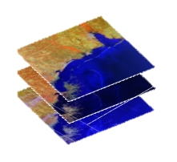
Methodology: Marsh Extent Analysis
  Calculated reflectance at the top of the atmosphere
  Used segments to create training samples
  Landsat's 5, 7 and 8 images from 1987-2016, once every 5 years
  Stack of 4 images each year (12 band composite)
  Segmented Images
Data
Image Credit: Mobile Bay Eco Forecasting II Team
Notes:
For marsh extent, the study period ranged from 1987 to 2016. In order to do the analysis, Landsat’s 5, 7 and 8 images were used to create one map for every 5 years. So, in total, 7 maps were created.
Four different images from four different dates and four different seasons were downloaded for each of the seven years. The illumination of the Landsat images was then corrected by calculating the reflectance at the top of the atmosphere. Finally, the images were stacked, creating a 12 band composite image for each year. The Segment Mean Shift tool on ArcMap was used to run a segmentation on those images, and the segments were used to create the training samples.

Slide 12
Methodology: Marsh Extent Analysis
  Produced Land Cover Map
  Masked out everything but the marshes
  Calculated area of marshes for each year
Analysis
Image Credit: Mobile Bay Eco Forecasting II Team
Notes:
The training samples were used to create a signature file for each one of the seven years. Those signatures file were utilized when running the supervised segmentation. Land cover maps were then produced. Each map has seven different classes, such as water, urban and non-woody wetlands. That last was the class of land cover we were interested in, because non-woody wetlands are basically composed of marshes. Everything but the marshes was masked, and that final image was used to calculate the area of the marshes for each year by assuming that each Landsat pixel is a 30 meter square.

Slide 13
Results: Marsh Extent
Marsh extent increasingly changed from 1987 to 2001
Between 2001 and 2006, extent has dropped significantly
Hurricanes Ivan (2004) and Katrina (2005)
Drought (2006 & 2007), Winter (2010)
Conservation efforts &/or natural regeneration
Image Credit: Mobile Bay Eco Forecasting II Team
Notes:
As a result, although the extent of the marshes was stable from 1987 to 2001, it has dropped significantly between 2001 and 2006. Alabama suffered the effects of two hurricanes between those years: Ivan, in 2004; and Katrina, in 2005. This data may imply that the marshes were directly affected by those natural events. The extent continued to decrease between 2006 and 2011. As referenced earlier, the reason for that could be that the marshes suffered with the severe to extreme droughts that happened in 2006 and 2007, or with the record cold winter in Mobile, in 2010. After that, in 2016, we can see some signs of recovery in the marshes, as the extent increases again by about 500 acres. This could mean that the marshes are being positively affected by the conservation efforts, and/or are naturally regenerating.

Slide 14
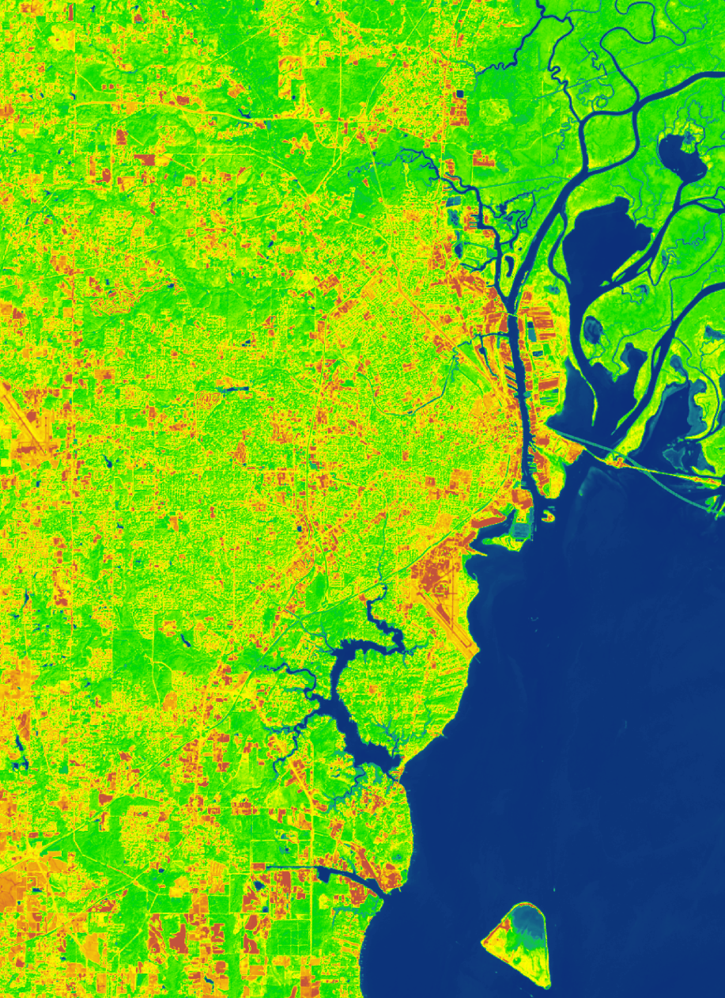
Methodology: Urban Development
Methods and Software
Data
Analysis
NDISI Formula: TIR-(VIS+NIR+SWIR)/3 TIR+(VIS+NIR-SWIR)/3
ISAT: C-CAP, NLCD, and HUC-12 watershed shapefiles to estimate risk, percent imperviousness, and impervious surface area
2015 Landsat 8 Images
NOAA Coastal Change Analysis Program (C-CAP) (2001-2011)
National Land Cover Databases (2001-2011)
Normalized Difference Impervious Surface Index (NDISI)
NOAA Impervious Surface Analysis Tool (ISAT)
Top of atmosphere reflectance
Analysis
Impervious Surfaces 2015
Value
High : 1.00
Low: 0.16
Image Credit: Mobile Bay Eco Forecasting II Team
Notes:
Urban development was mapped out by calculating the growth of impervious surfaces in Mobile and Baldwin Counties. This was done by utilizing the Normalized Difference Impervious Surface Index (NDISI) and the Impervious Surface Analysis Tool (ISAT) developed by NOAA. The NDISI uses the Landsat 8 Thermal Infrared Sensor to enhance the heat that impervious surfaces naturally absorb and reflect while “suppressing” the reflectance of vegetation, water, and sand. However the NDISI is prone to detecting large areas of unused land or agriculture, however this may have application in estimating the environmental impacts of agriculture. The ISAT tool is used in Arc GIS and relies upon land cover data from the Coastal Change Analysis Program (C-CAP) and National Land Cover Database (NLCD). The ISAT tool is then able to use this data to estimate risk presented by impervious surface, area of impervious surface, and the percent imperviousness in defined areas. These metrics can be displayed a number of ways but for this project we chose to use HUC-12 watershed shapefiles.

Slide 15
Results: Urban Development
Impervious surfaces increased by over 24% in priority watersheds from 2001-2011
Addition of 2000+ acres of impervious surfaces 2001-2011
Average growth of +2.4 percent each year
Seven watersheds exceed 10% surface imperviousness including four priority watersheds
Additional eight watersheds fall into 5-10% warning category
Many of these watersheds contain marshes
Image Credit: Mobile Bay Eco Forecasting II Team
Notes:
Upon completion of analysis, the ISAT tool estimated that from 2001-2011 impervious surfaces increased by over 24% in ACF priority watersheds which is equivalent to the addition of over 2000 acres of new impervious surfaces. The overall increase across the study equated to a increase of over 9000 acres that relates closely to the decrease in marsh extent observed in the same period. Ten percent is the cutoff point where more serious disruptions to water quality and hydrological cycles are more frequently observed. Seven watersheds in the study area exceed the 10% recommended impervious surface percentage, with an additional eight watersheds in the 5-10 percent warning range. Many of these watersheds contain marsh areas highlighting a need for more research on the growth and impacts of increasing urbanization in these sensitive regions.

Slide 16
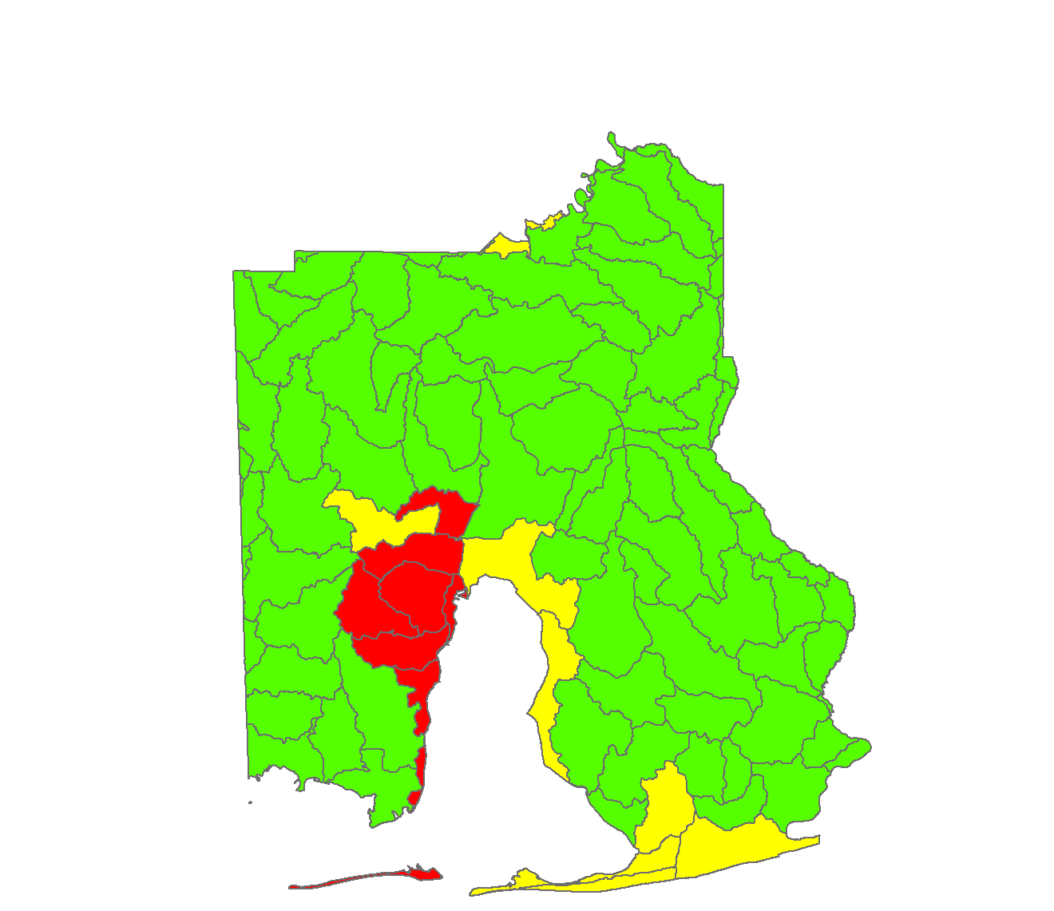
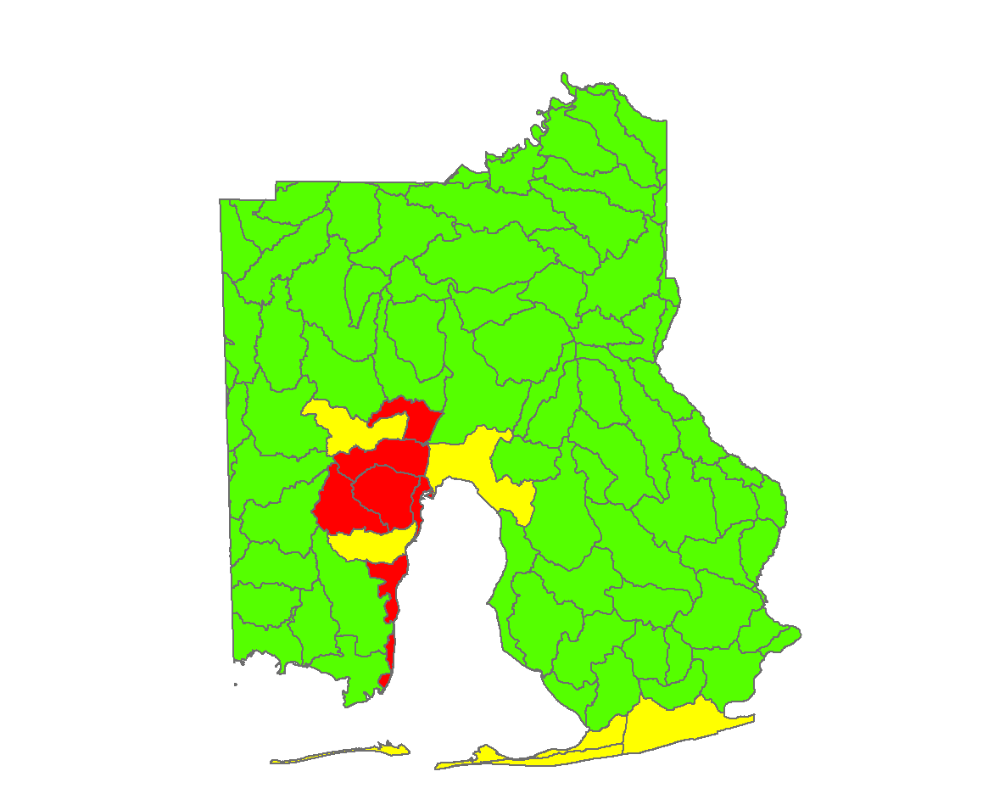
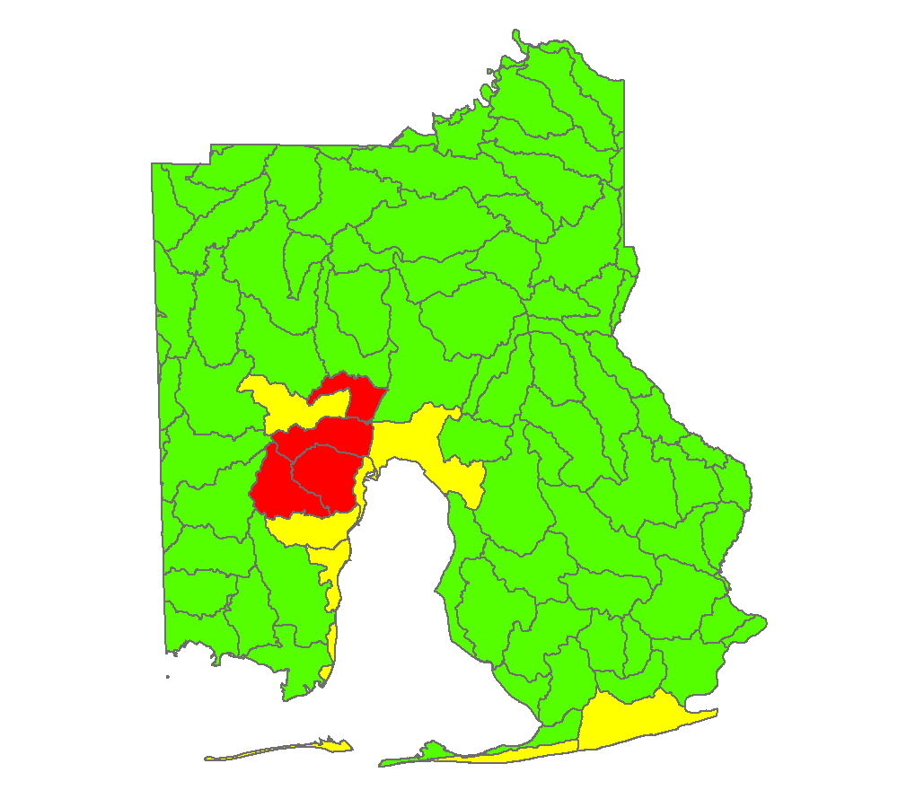
Results: Urban Development
Percent Imperviousness
Average
0.00 - 5.00
5.01 - 10.00
10.01 – 25.00
2001
2006
2011
Image Credit: Mobile Bay Eco Forecasting II Team
Notes:
These images display outputs produced by the ISAT tool. Areas that appear yellow or red on the maps are at the highest risk for negative impacts from impervious surfaces and are centers of increasing urbanization. Although many watersheds do not fall into these yellow or red categories , it is important to keep in mind that total impervious surface area is still increasing in all watersheds, and this is most evident when observing the progression of impervious surface growth in Baldwin in the above images. Based upon analysis, watersheds that line the coasts of Mobile and Baldwin are at the greatest risk for impacts from urbanization.

Slide 17
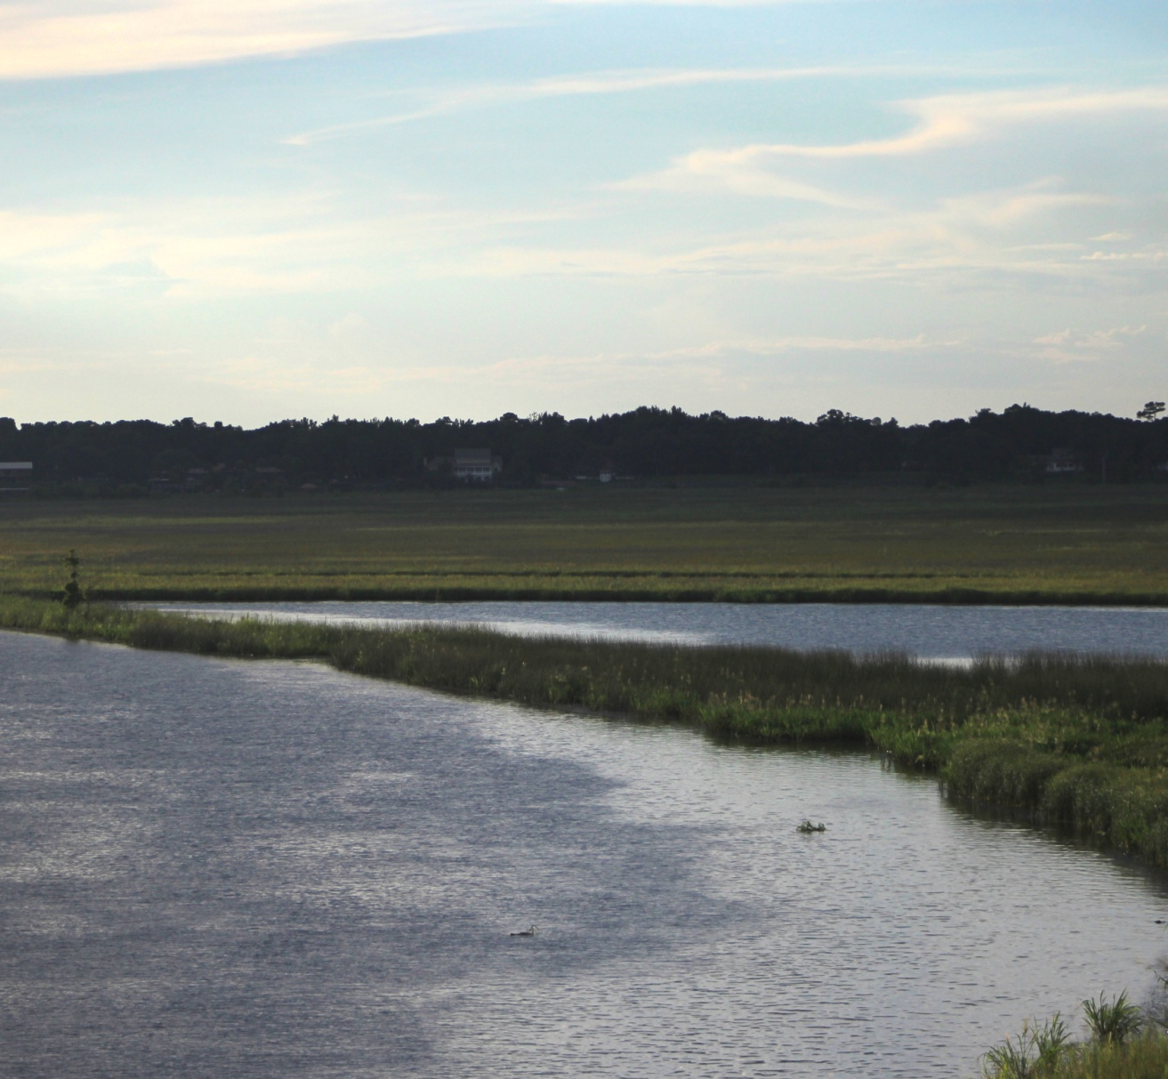
Conclusions
Impervious surface areas are increasing in priority watersheds
Marsh extent declined during study period but there is evidence of recovery
Overall wetland health trends are downward
Health trends seem to be most impacted by weather conditions and urbanization
Image Credit: Mobile Bay Eco Forecasting II Team
Notes:
In summation, the MCHD Eco Forecasting II team was able to conclude that during the study period impervious surfaces increased, while marsh health and extent declined dramatically in many areas during this same period. Based upon statistical analysis, it appears that the most extensive changes to land cover and marsh health occurred during the first decade of the 2000’s. During this period it seems that marshes were most impacted by extreme weather events that occurred 2004 and 2010. During the present decade urban growth has continued to increase, but it is difficult to separate the impact of impervious surface growth on marshes from the impact weather events. However is important to note that certain marshes in the study area have recovered in extent and health.

Slide 18
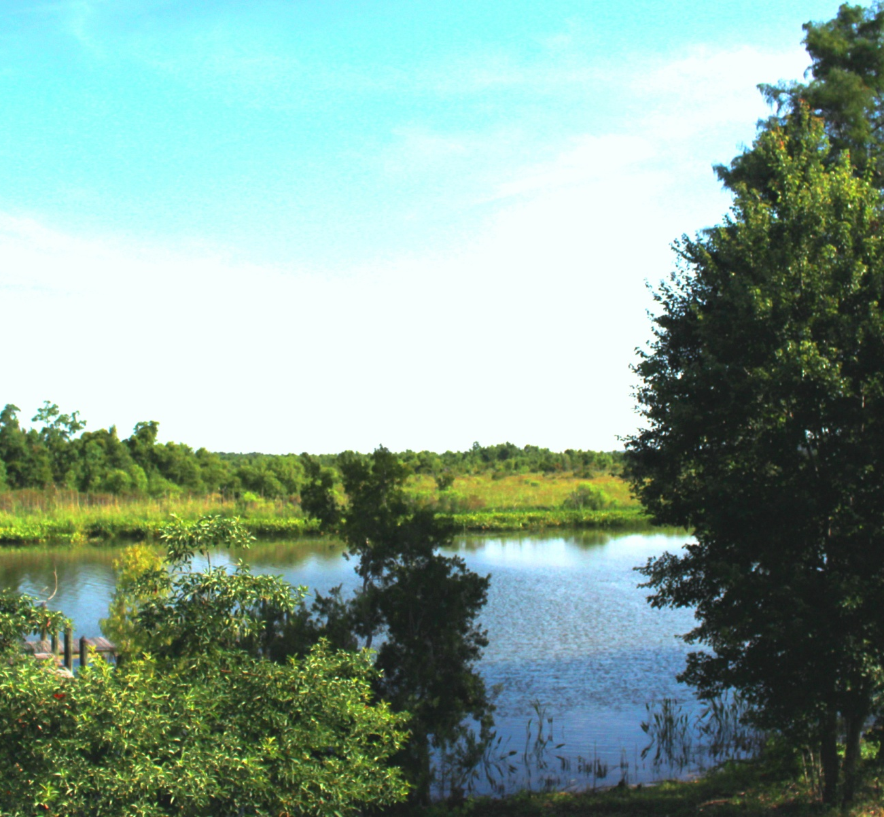
Errors and Uncertainties
Spatial and temporal resolution
In situ monitoring
Ground truth validation
Atmospheric correction
Cloud Removal
Processing time
Image Credit: Mobile Bay Eco Forecasting II Team
Notes:
The study was limited by a number of data specific and environmental limitations. Although the ForWarn datasets were collected with higher temporal resolution, the 250m resolution lowers the ability to spatially separate pixels and may mask certain portions of data leading to more mixed pixels. Landsat has a higher spatial resolution of 30m but at the expense of only being available once every 16 days which limits image availability. ForWarn images were corrected for atmospheric interferences and top of atmosphere reflectance, and also had clouds removed, but Landsat images were only corrected for top of atmosphere reflectance. This further limited image selection to images that were relatively cloud free. Tidal influence also played a role mostly in the boundary pixels which could be mixed with more or less water than that could skew NDVI values and classifications. Another limitation was the rather limited study period available from the dataset. Longer trend lines with a more moderated climatology could help to delve deeper into the roles of urbanization regarding its relationship with marsh health and extent, whereas our 15 year dataset was more heavily influenced by extreme weather phenomena. Our dataset was also void of any in-situ observations or ground truth validation. These types of data are very time consuming and expensive and we simply did not have the time or resources to do our own validation. What data were available was in years we did not study, but to remediate this problem we accompanied our data with high resolution National Agriculture Imagery Project (NAIP) 1m data from 2006 and 2015. Lastly, due to the complex nature of the models and processes performed in this study, computer operations were rather long or had to be run multiple times, which limited the amount of individual analyses that could be performed.

Slide 19
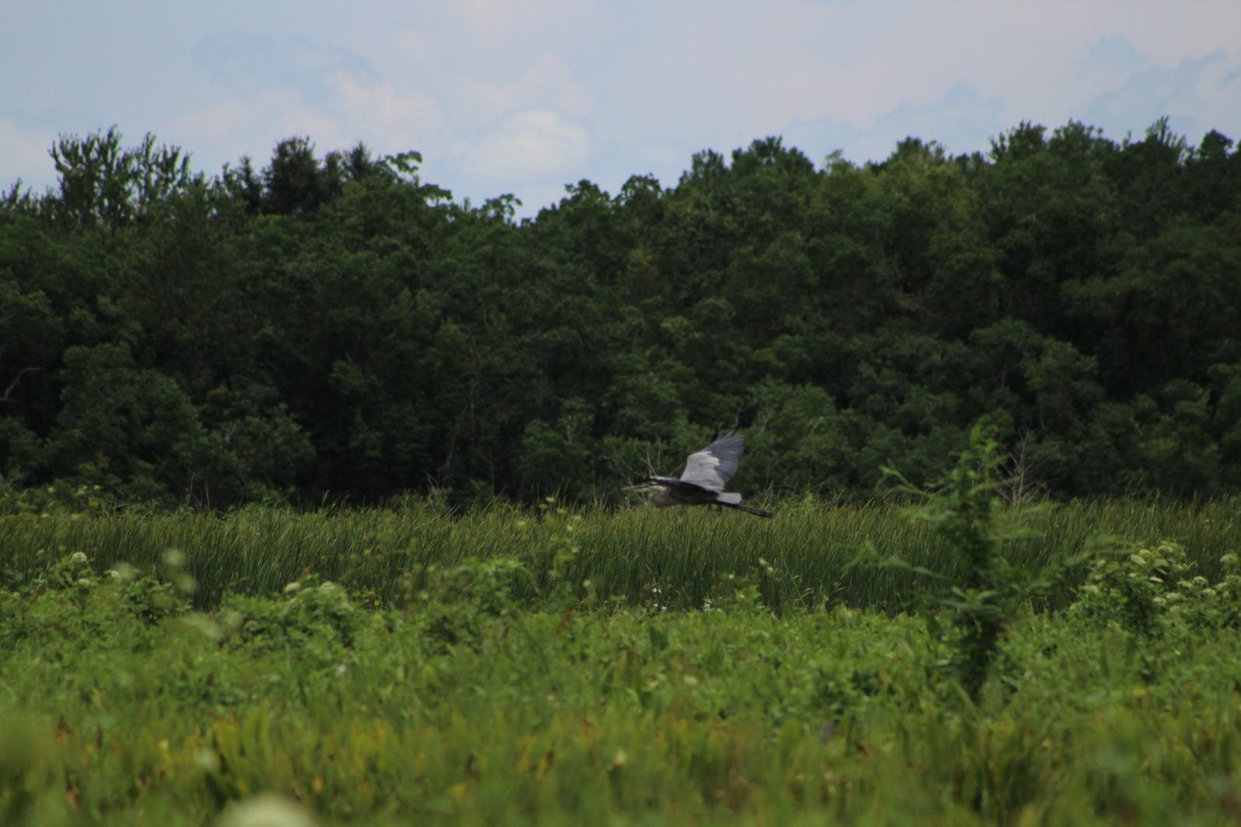
Bernard Eichold, M.D., Dr. PH, Mobile County Health Department
Kenton Ross, Ph. D., NASA Langley Research Center
Saranee Dutta, Previous contributor
Vishal Arya, Previous contributor
Jeanett Bosarge, Previous contributor
Courtney Kirkham, Previous contributor
Mark Berte, Alabama Coastal Foundation
Just Cebrian, Ph. D., Dauphin Island Sea Lab
Mobile Bay National Estuary Program
Eastern Forest Environmental Threat Assessment Center of the USDA Forest Service
Image Credit: Mobile Bay Eco Forecasting II Team
Notes:
The Mobile Bay Eco Forecasting II team would like to thank our mentor Dr. Eichold. Our science advisor Dr. Ross and the previous contributors. We would also like to thank our project partners at the Alabama Coastal Foundation, Dauphin Island Sea Lab, and the Mobile BaY National Estuary Program. Additional thanks go to the Eastern Forest Environmental Threat Assessment Center of the USDA Forest Service.

