Slide 1
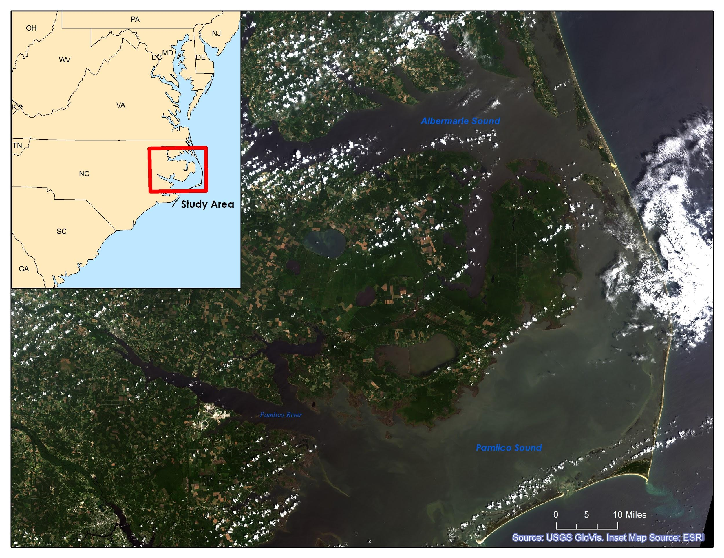
North Carolina Water Resources
Utilizing NASA Earth Observations to Explore Extent of Harmful Algal Blooms
in the Albemarle-Pamlico National Estuary
Chad Smith (Team Lead), Jelly Riedel, Keith Benjamin, Daniel Wozniak, Matthew Carter
Langley Research Center
[PENDING]
Provide a ten year time series representation of harmful algal blooms (HABs) in the Albemarle-Pamlico National Estuary in order to capture a more complete historical observation of the spatial and temporal characteristics of HAB activity on a large scale.
Data Acquisition:
Aqua MODIS ocean color products will be used to estimate an overview of chlorophyll-a extent throughout the Albemarle-Pamlico Estuary. Landsat 5, 7, and 8 will be used to provide higher resolution informational maps during known periods of intense HAB activity. In situ water quality data provided by USGS North Carolina Water Science Center and additional data downloaded from the National Water Quality Monitoring Council will provide a standard to compare with our satellite-based HAB extent.
Data Processing:
Aqua MODIS Level 2 Data was downloaded from NASA Goddard Space Flight Center’s Ocean Color SeaDAS Website using a Linux operating system. The data was cropped to only include the immediate area surrounding the Albemarle and Pamlico Sounds. The data layers were then reprojected from their original sinusoidal form to the NAD83 projected coordinate system.
Data from Landsat 5, 7, and 8 were included to provide reference basemaps and higher resolution floating algae maps for informational purposes during periods of known HAB activity.
Data Analysis:
[PENDING]
Aqua, MODIS
Landsat 8, OLI
Landsat 7, ETM+
Landsat 5 TM
[PENDING]
[PENDING]
Chad Smith (Team Lead)
Jelly Riedel
Keith Benjamin
Daniel Wozniak
Matthew Carter
[insert picture]
U.S. Geologic Survey North Carolina Water Science Center, Dr. Michelle Moorman, Biologist (Science Advisor)
Albemarle-Pamlico
National Estuary Partnership
Dr. Bill Crowell, Dean Carpenter & Jim Hawhee (Science Advisors)
Dr. Kenton Ross-National Program Science Advisor
Jeffry Ely- Geoinformatics Scientist
Nathan Owen-Center Lead

