Slide 1
Louisiana Ecological Forecasting
Using UAVSAR, AVIRIS and AirSWOT to Examine Historic Trends and Model Sediment Transport within the Wax Lake Delta, Louisiana to Inform Coastal Restoration Efforts
Emily Beck(Project Lead)
Brittany Zajic
Raul Garcia

Slide 2
Study Area
Wax Lake Delta, LA
Study Period
May 2009-May 2015

Slide 3
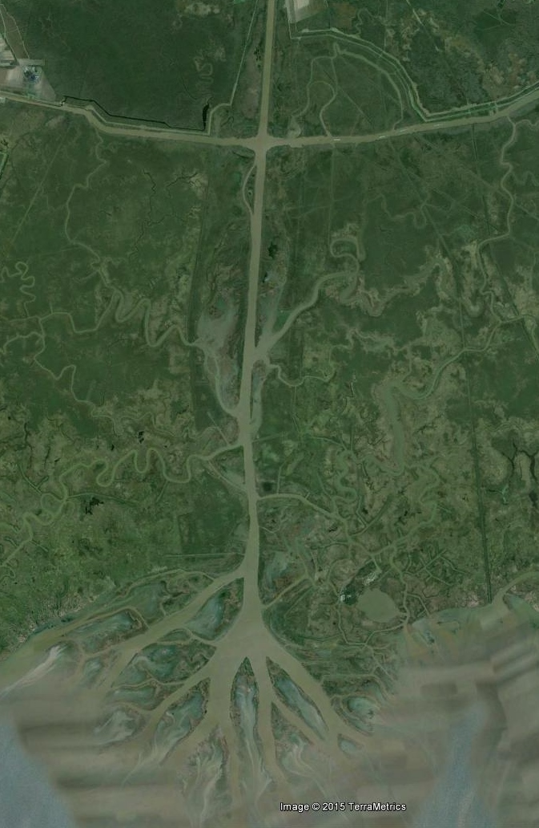
Objectives
Model water flow and sediment transport
Gain a better understanding of why
Wax Lake Delta is aggregating
Forecast the future extent of
delta formation
Improve coastline change
prediction accuracy
Image Credit: Google Earth

Slide 4
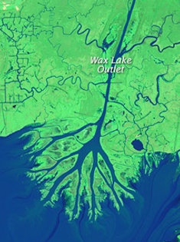
Community Concern
Land loss
Port systems being threatened
Potential land loss
Image Credit: NASA
Notes:
Land loss due to erosion, land subsidence and sea level rise along the Louisiana coast has amounted to a staggering 4900 km² since the 1930’s, threatening one of the most economically important port systems in the United States. The State of Louisiana’s Comprehensive Master Plan for a Sustainable Coast (2012) confirmed that Louisiana has the potential to lose up to an additional 4500 km² over the next 50 years unless immediate efforts are taken to combat this trend.

Slide 5
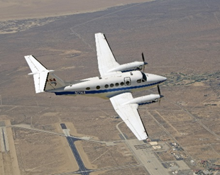
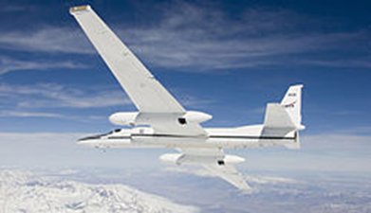
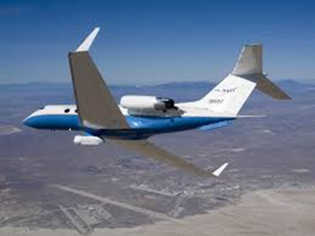
NASA Earth Observations
AirSWOT
AVIRIS
UAVSAR
Image Credit: NASA
Notes:
AirSWOT: designed for centimeter-level detection of water surfaces and flood plains. Water-surface gradients measured by this instrument will be used to constrain deposition rates on deltas, yielding new insight into how delta tops keep pace with sea-level rise.
AVIRIS: provides high-spectral resolution ( 224 bands) to identify vegetation type
UAVSAR: provides high-resolution (<10 m) radar data to detect shallow bathymetry

Slide 6
Methodology
ArcGIS Inputs
Modeled sediment transport
Vegetation Info from AVIRIS
Delft3D Hydrological Model
Model Calibration Using AirSWOT Data
In Situ Data
Modeled water flow
Wave Info from UAVSAR

Slide 7
Results
Output showing modeled water level
(Real results TBD)

Slide 8
Conclusions
TBD

Slide 9
Errors & Uncertainties
TBD

Slide 10
Future Work
TBD

Slide 11
Advisors
Dr. Cathleen Jones, Jet Propulsion Laboratory
Dr. Marc Simard, Jet Propulsion Laboratory
Partners
Richard Crout, Naval Research Laboratory
Alexander Kolker, Louisiana Universities Marine Consortium
Others
Gwen Miller, DEVELOP
Doug Edmonds, Delft 3D

Slide 12
General Guidelines I
Things that are typically included in a presentation:
The slides provided in the template are just a starting point for teams. Feel free to expand upon these topics, alter the headings, and change the order of the slides to fit your needs.
Study area
Study period
Objectives
Community concerns
NASA satellites/sensors used
Methodology
Results
Conclusions
Errors & uncertainties
Future work
Acknowledgements
Backup slides
Required Statement

Slide 13
General Guidelines II
Header text point size should be between 40 and 60 on most slides.
Body text point size should be at least 20.
Use Century Gothic.
Keep text to a minimum.
Try to use a consistent font size between slides.
Image Credit: Monet
Notes:
Image Source: http://commons.wikimedia.org/wiki/File:Claude_Monet_-_The_Magpie_-_Google_Art_Project.jpg

Slide 14
Image Credit: Monet
General Guidelines III
Include speaker notes for each slide (see below).
Include a visual on each slide, if possible.
Arrange content to minimize white space.
Notes:
These notes should be thorough enough for someone not familiar with the project to clearly present the material.
Image Source: http://commons.wikimedia.org/wiki/File:Claude_Monet_-_The_Magpie_-_Google_Art_Project.jpg

Slide 15
Maps & Logos
Maps
Import the legend separately.
Make sure all text is legible and editable.
Cite base layer source in speaker notes.
Logos
US Federal logos only.
No state, NGO, local and or international government logos, or software logos.

Slide 16
Photos & Figures I
You may only use images taken by your team, provided by your partners (as long as you have permission from them), from a Federal Agency, from the new DEVELOP stock imagery collection on DEVELOP’s Flickr page, or Creative Commons images.
Obtain a media release form from all people in photos that your team has taken — no children!
All image sources should be cited using a consistent format and should be visible on the slide.

Slide 17
Photos & Figures II
Please do not include the image URL in the source text box but rather place it in the notes section below.
If you use a border for your images include it on all photographs to keep your presentation consistent.
Keep all images and text boxes editable, including individual elements of flowcharts.
Background images are discouraged. If you use one, make sure that your text remains clear and legible.

Slide 18
Acknowledgements
List advisors, partners, and others who have contributed in any way to the project.
If your project is a multi-term one, acknowledge past contributors.
Choose one of the two following slides as an acknowledgements page. Feel free to modify them as needed to fit your content.
Image Credit: Monet
Notes:
Image Source: http://commons.wikimedia.org/wiki/File:Claude_Monet_-_The_Magpie_-_Google_Art_Project.jpg

