Slide 1
PC team will add our website image here.
Southeast Coast Ecological Conservation
Investigating the Development of Ghost Forests Due to Saltwater Intrusion along the Savannah River, Georgia Coastline of the United States
Emma Cheriegate • Eleri Griffiths
• Quintin Munoz • Vivienne von Welczeck
California – JPL | Summer 2023
Notes:
Short title font size: 32pt Long title font size: 22pt Team names font size: 20pt

Slide 2
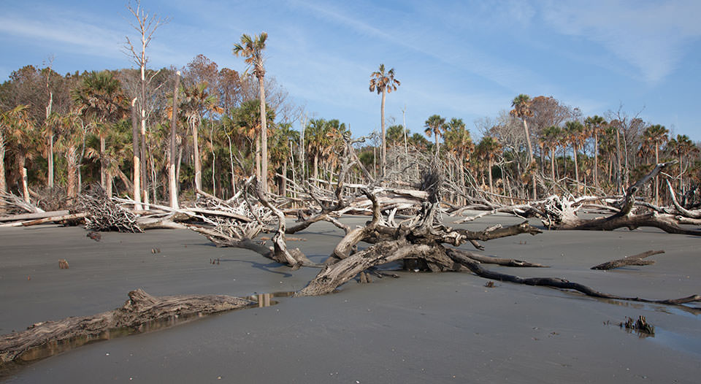
Background
↑ Saltwater intrusion (SWI) into freshwater systems
Ghost forest formation
Natural and anthropogenic drivers intensifying SWI
Image Credit: NOAA
Image Credit: Bernardo62
Notes:
------------------------------Speaker Notes ------------------------------
There is growing concern about SWI, especially with its visible effect of ghost forests, where once vibrant woodlands have been converted to marshland due to high influxes of saltwater.
Drivers of SWI include both natural and anthropogenic factors that include but are not limited to: sea level rise, land subsidence, hurricanes/storm surges and subsequent flooding, and drainage systems (e.g., canals/ditches).
Low lying areas are particularly vulnerable and experience higher rates of SWI, where saline water can intrude into a greater portion of the soil and water tables.
This can severely impact ecosystem services: trees dying off results in reductions of habitat and therefore species richness/diversity, less carbon sequestered, and lower rates of primary productivity.
------------------------------Image Information Below ------------------------------
•Image Credit: NOAA
•Image Source: https://oceanservice.noaa.gov/facts/ghost-forest.html (CC - NOAA - Public Domain).

Slide 3
Community Concerns
Loss of biodiversity
Inhibited carbon sequestration
Declining drinking water quality and supply
Dangerous storm surges
Climate change adaptation strategies
Image Credit: Dr. William Conner, USGS
Notes:
------------------------------Speaker Notes ------------------------------
Saltwater intrusion affects coastal ecosystems and the communities that live in these areas and rely on the ecosystem services that these areas provide, including diverse habitats for plants and animals, carbon sequestration and protection from storm surges, and the shallow aquifers in this area that provide drinking water and are important sources for agricultural production. Communities are having to create climate adaptation strategies to adapt to these changing environments.
By using NASA EO we hope to provide insight and tools for understanding how these ecosystems are changing and where there are areas most at risk of collapse.
Community Concerns Sources: EPA, 2022; Richardson, 2022
------------------------------Image Information Below------------------------------
Image Credit: Dr. William Conner, Clemson University
Image Source: USGS 2015

Slide 4
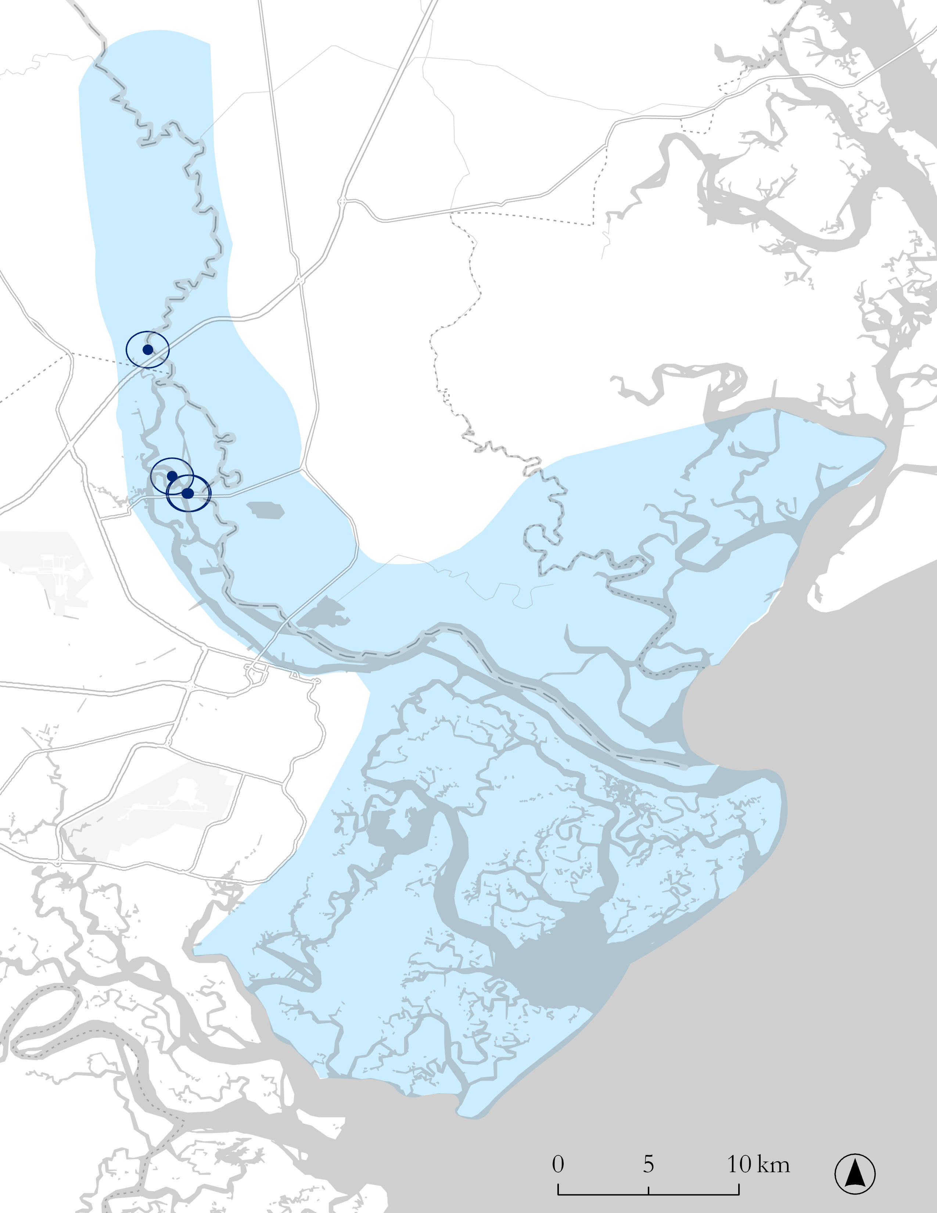
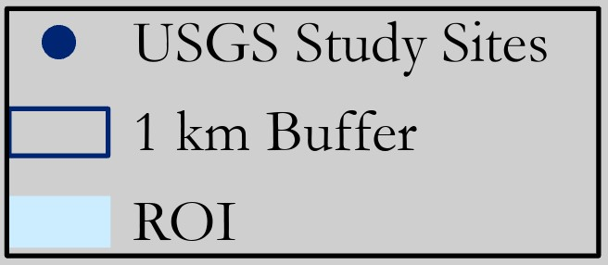
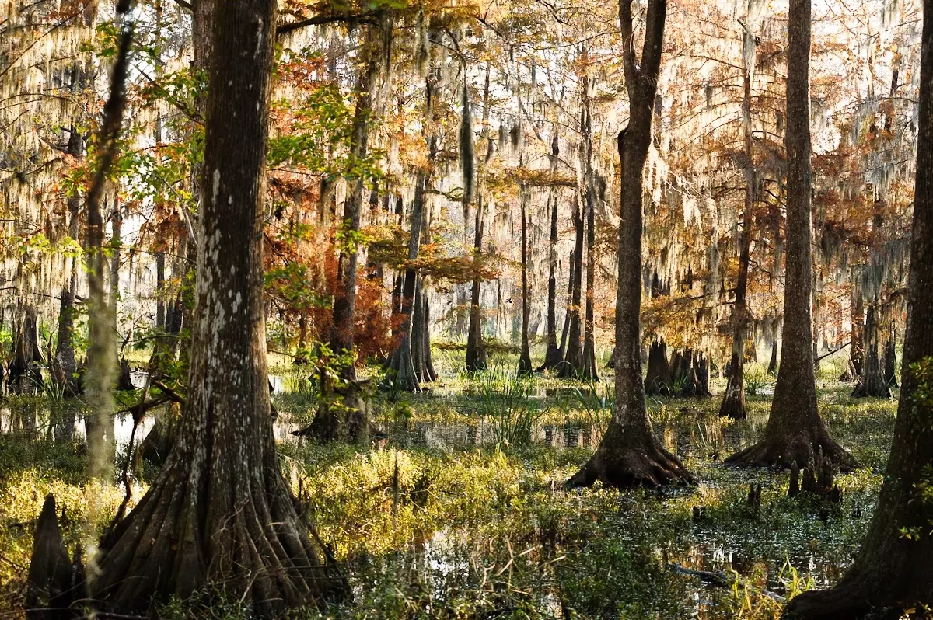
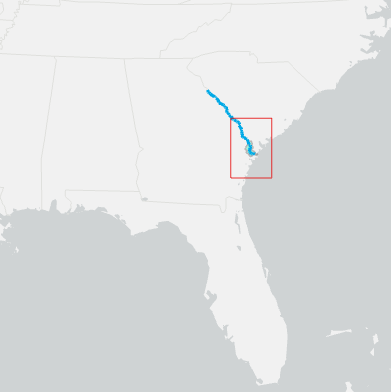
Study Area & Period
Lower Savannah River Basin
Lower Savannah River, Georgia
HUC10 Watershed
Savannah National Wildlife Refuge
Time Frame: Growing Season of 2013 – 2023 (March-Sept)
1
2
4
3
GA, USA
Image Credit: U.S. Fish & Wildlife Service. Bald cypress in bottomland hardwood forest at Savannah National Wildlife Refuge.
Image Credit: Bernardo62
Notes:
------------------------------Speaker Notes ------------------------------
The study area for this project encompasses the lower savannah river delta that borders Georgia and South Carolina.
This region is high in biodiversity with a unique mosaic of coastal wetland ecosystems. Deciduous forest within this ecosystem are at high risk due to Salt Water Intrusion.
Our project defined the study area boundary marked in light blue on the map that extends from the coast through the upper regions of the savannah river.
Selecting an area at this scale allowed us to investigate and integrate in situ data collected by our project partners at the study plots marked by the red on the map – as well as integrating NASA Earth observation data.
------------------------------Image Information Below -----------------
•Image Credit: Sharon Lindsay
•Image Source: Bottomland hardwood forest at Savannah NWR | FWS.gov (CC US Fish & Wildlife Service – Public Domain)
Image Credit: Title: ArcGIS Basemap "Light Gray Canvas". Provider: Esri (Environmental Systems Research Institute).
Source: ArcGIS Online Access Date: [07/26/2023]

Slide 5
Objectives
Investigate Changes
in sea level rise (SLR) and vegetative health
Synthesize & Analyze
trends in saltwater intrusion (SWI)
Validate and Correlate
NASA Earth Observations (EO) with in-situ (field-derived) data
Notes:
------------------------------Speaker Notes ------------------------------
Objective #1: Investigated changes in sea level rise (SLR) and vegetative health in the eastern Savannah River ecosystem using NDVI calculations, ECOSTRESS data, and tide gauge records.
Objective #2: Analyzed these data for trends in SWI by creating timeseries visuals of changes in NDVI, Evaporative Stress Index, and tidal gauge records on a monthly time step from 2013-2023.
Objective #3: Validated and compared NASA EOs with in situ data provided for the eastern Savannah River to ground-truth where EO identifies significant changes in SWI and vegetative health that may indicate areas of ghost forests. To perform this comparison, linear regression analysis was applied to understand correlations between the datasets.
------------------------------Image Information Below------------------------------
Image Credits: Microsoft PowerPoint
Image Source: PowerPoint stock photos

Slide 6
Project Partners
Action Plan for Climate Adaptation and Resilience (2021)
Southeast Regional Climate Hub
Wetland and Aquatic Research Center (WARC)
Florence Bascom Geoscience Center (FBGC)
Department of Biology, Georgia Southern University
Notes:
------------------------------Speaker Notes ------------------------------
The researchers involved span a range of ecological, biogeochemical, and hydrological backgrounds. The WARC is a leader in aquatic ecosystem conservation, research and management
The project partners include the Wetland and Aquatic Research Center (WARC) and the Florence Bascom Geoscience Center (FBGC) of the USGS, the Southeast Regional Climate Hub of the USDA, and Georgia Southern University. The USDA is also heavily invested in mitigating the future impacts of climate change, launching their Action Plan for Climate Adaptation and Resilience in 2021, a guide for Americans in the agriculture sector to aid in land management practices within a changing climate.
The partners and collaborators of this project’s work aid land managers with research within ecological forecasting and disaster prevention and assessments. Their collective aspiration is to gain a deeper comprehension of the underlying factors and consequential ramifications associated with saltwater intrusions on flora within the locality. This study provided substantiative insights derived from NASA EO on the temporal ecological trends of SWI around the coastal south of the United States.
------------------------------Image Information Below ------------------------------
•Image Credit: USDA, USGS, Georgia Southern University
•Image Sources: https://www.usda.gov/style-guide/logo, https://cals.arizona.edu/research/climategem/file/123, https://cosm.georgiasouthern.edu/biology/georgianne-moore/ https://www.linkedin.com/in/charlesjpell (CC USDA, USGS, Georgia Southern University and Linkedin – Public Domain)

Slide 7
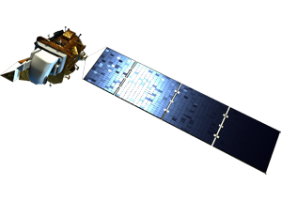
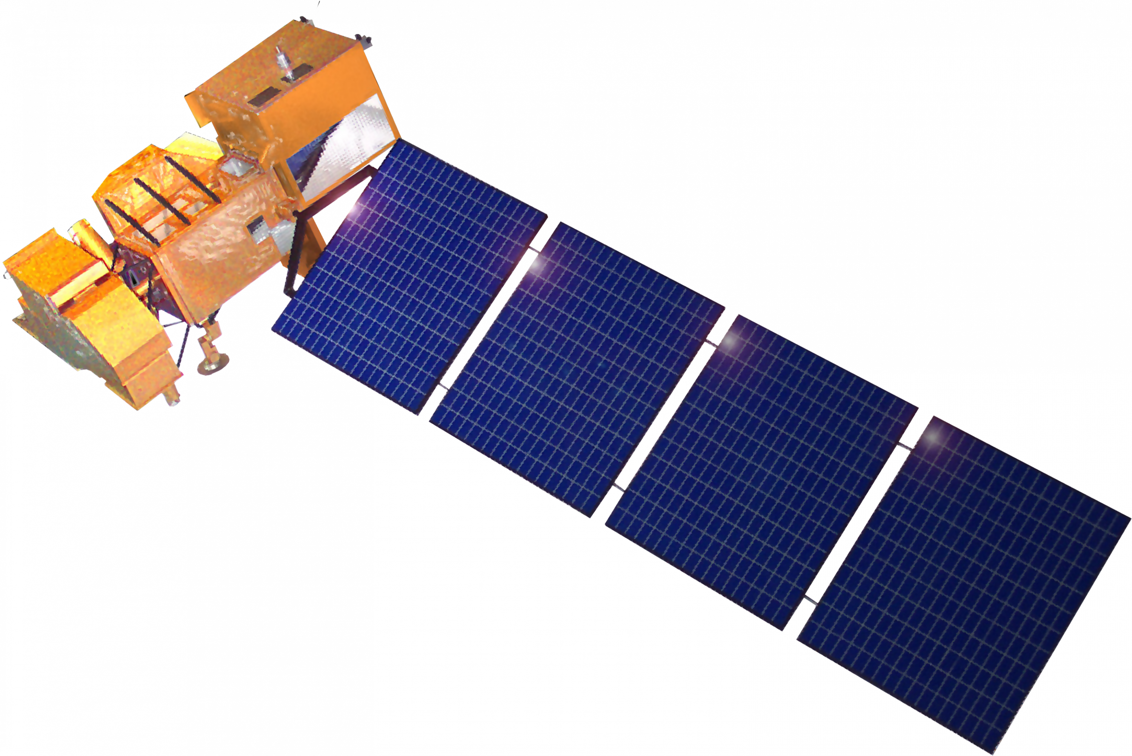
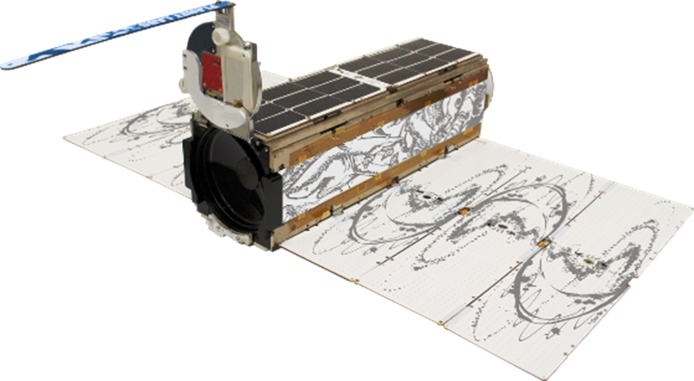
Earth Observations (EOs)
Landsat 7 ETM+
Landsat 8 OLI
Planet Scope Rapid Eye and Dove
Land Classification
NDVI Parallel Processing
Image Credit: NASA, Planet Labs PBC
Notes:
------------------------------Speaker Notes ------------------------------
We primarily used Landsat 8 throughout this study, though several months within our study period were obscured by clouds, so we used Landsat 7 imagery to replace those images.
Landsat 8 was used to calculate NDVI values and to build, train, and run the Random Forest land classification model.
Planet imagery was used to also calculate NDVI values for key dates within the study period as a form of parallel processing to help us understand how different resolution images might affect our results.
------------------------------Image Information Below ------------------------------
• Landsat 7 Image Credit: NASA.gov
• Image Source: Spacecraft Icons | Science Mission Directorate (nasa.gov)
Landsat 8 Imag Credit: NASA.gov
Image Source: Spacecraft Icons | Science Mission Directorate (nasa.gov)
Planet Image Credit: Planet Labs PBC
Image Source: Satellite Imagery Analytics | Planet

Slide 8
Methodology – NDVI Parallel Processing
Inputs
Processing
Analysis
Output
Landsat 8 OLI
Filter by date and ROI
12 Month Mean NDVI
Water Mask
Cloud Mask
ee.ReducerMean
PlanetScope Dove
Filter by date and ROI
Mean NDVI per month
Water Mask
ee.ReducerMean
Notes:
------------------------------Speaker Notes ------------------------------
Here is the flow of our processing and analysis methodology for both Planet and Landsat NDVI calculations. Most steps in this process were similar, but there were a few key differences.
We used Google Earth Engine (GEE) to process both sets of imagery. However, while we were able to code both a cloud and water mask for Landsat images, Planet's restricted access API did not allow us to use a pre-coded water mask, so NDVI values indicative of water (-1-0) were removed manually once the NDVI was calculated. Additionally, Planet images were deliberately chosen with minimal cloud cover in mind, while Landsat images had a cloud mask applied in GEE.
The end result was monthly mean values of NDVI for the entirety of our study period (2013-2023) from Landsat 8 imagery, and mean monthly NDVI values for select months at both the beginning and end of the study period for Planet data due to time and cost restraints. These monthly values were compared both spatially within the ROI and graphically by USGS study site to identify differences on a site-by-site basis as well.

Slide 9
Methodology – Random Forest Land Classification
Inputs
Processing
Analysis
Output
Landsat 8 OLI
Urban Mask
Delineate training points
Random Forest Land Cover
Classification​
10 land cover images (1 per year)
Seasonal composite (May-Sept)
Cloud Mask
Water Mask
Notes:
------------------------------Speaker Notes ------------------------------
Landsat 8 was also used for the random forest land classification aspect of our project.
Here, seasonal composites of the growing season (May-Sept) were created for each year within the study period. Then, cloud, water, and urban masks were applied to these images to only train and run the model on areas of relatively undisturbed vegetation. In these areas I manually delinated training points for four different land classes (healthy vegetation, unhealthy vegetation, evergreen, and marsh).
This model was then run in GEE on the ROI to determine how and where coastal land is changing over time.

Slide 10
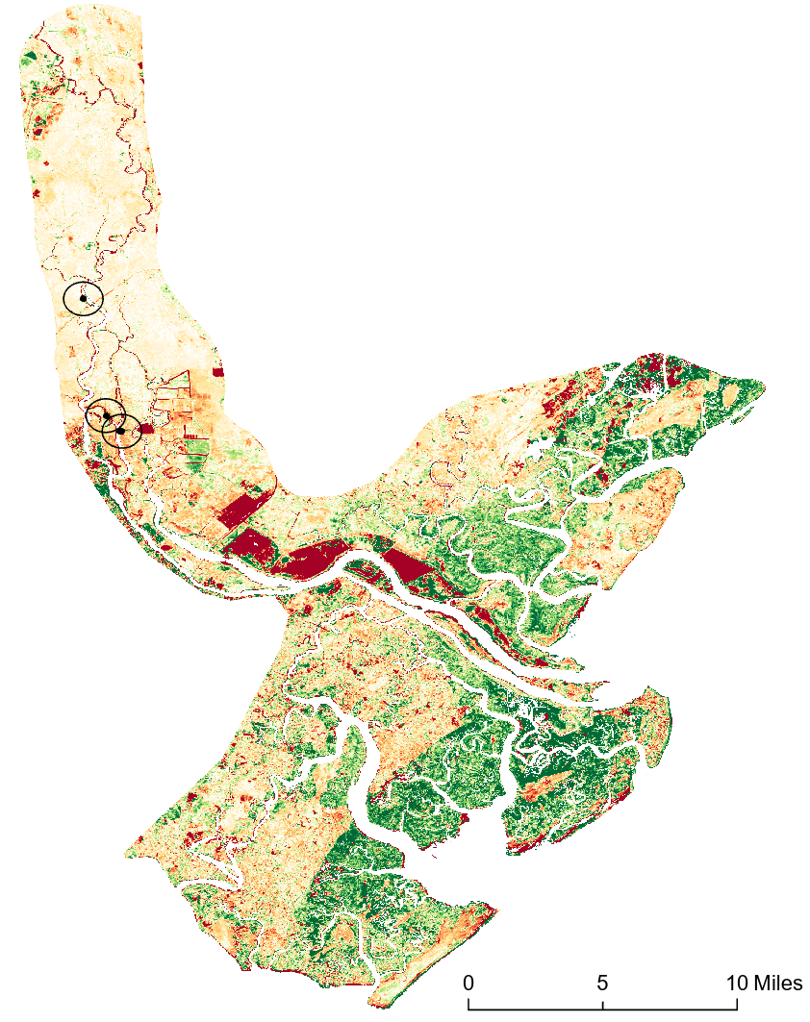
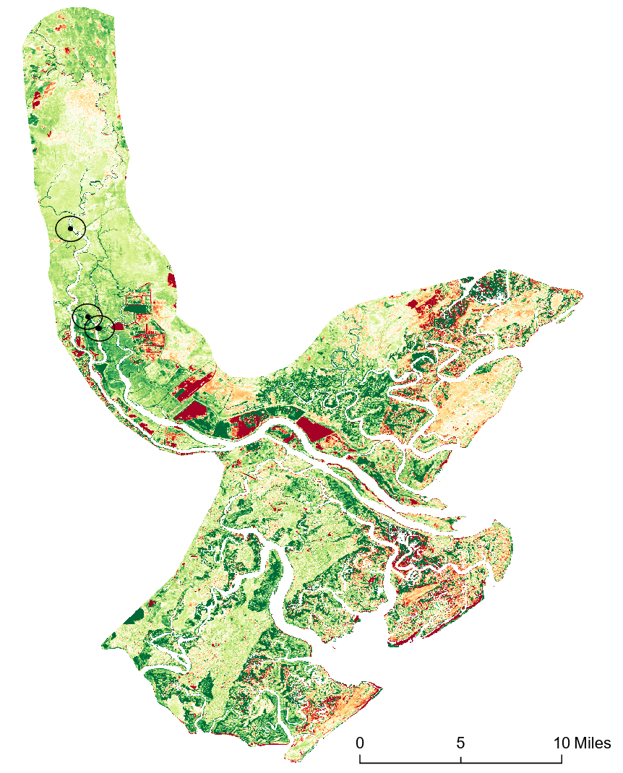
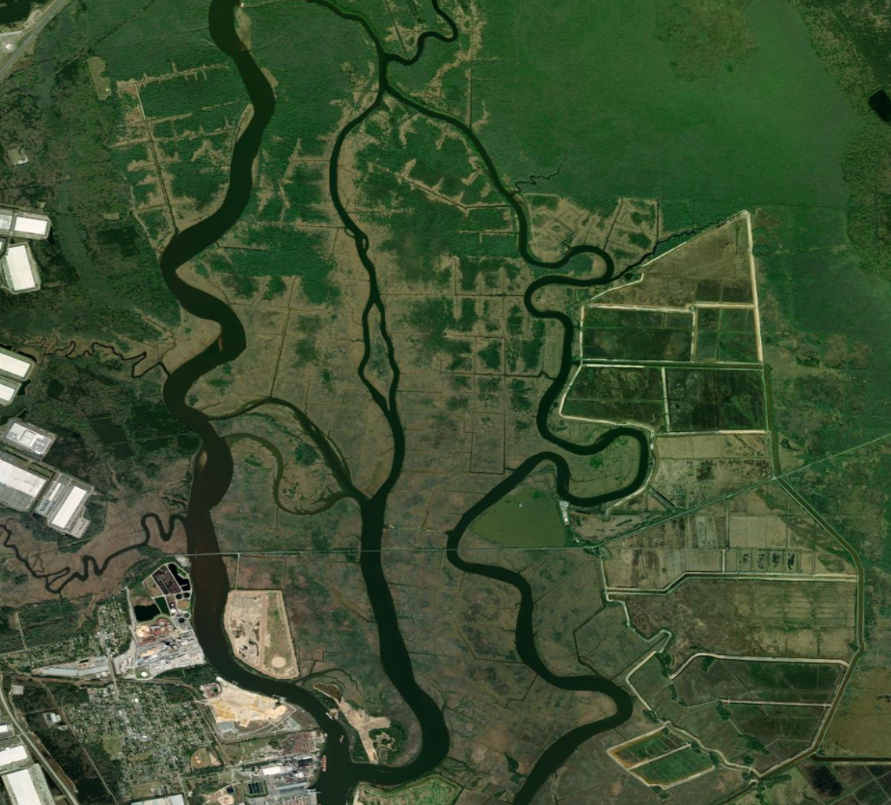
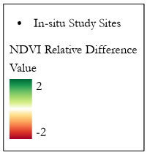
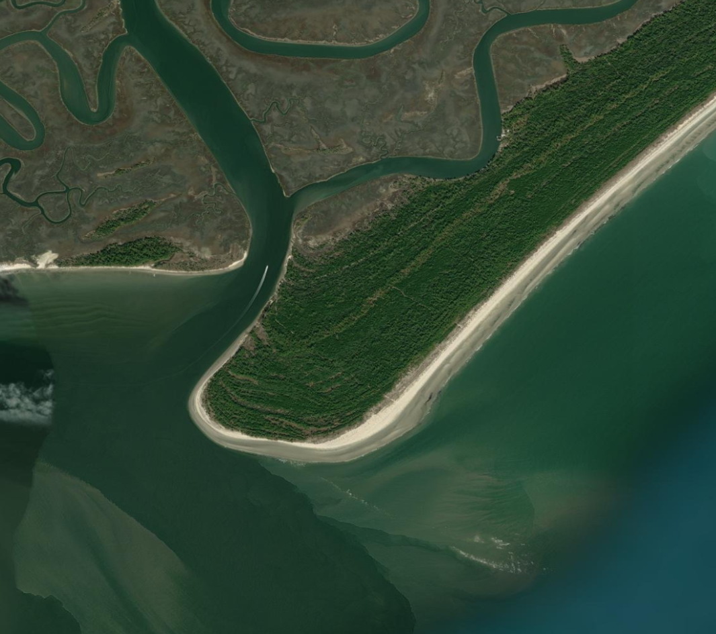
Results – NDVI Parallel Processing (Landsat 8)
Δ NDVI = June 2022 – June 2014
Δ NDVI = March 2023 – March 2013
NDVI Map
NDVI Map
In-situ Study Sites
In-situ Study Sites
NDVI Relative Difference
NDVI Relative Difference
Value
Value
2
2
-2
-2
0
5
10
Images Credit: Maxar, ESRI
0
5
10
Notes:
------------------------------Speaker Notes ------------------------------
Both of these Images reflect an NDVI change detection for their respective months. NDVI Difference of June 2022 and June 2014 on the left, and March 2023 and March 2013 on the right. Areas in red highlight significant change in NDVI overtime while green areas signal vegetative growth.
Notice the region just below the study sites in June clearly have negative values shown in red and yellow, indicating a transitional zone with declining vegetative health, potentially due to SWI. We expected more positive green values in March prior to the main budding event in April where NDVI exponentially increases but levels out by June. As you can see, the marsh area remains green after the budding season but certain regions, primarily with tree coverage have declined over the 10-year period.
------------------------------Image Information Below ------------------------------
NDVI data generated in GEE (Gorelick et al., 2017), maps created in ArcGIS Pro (powered by ESRI), and close-up tiles created in GEE using NASA Landsat 8 (Gorelick et al., 2017).
Image Credit and Source: Title: ArcGIS Basemap "Imagery". Provider: Esri (Environmental Systems Research Institute), Maxar. Source: ArcGIS Online Access Date: [07/26/2023]

Slide 11
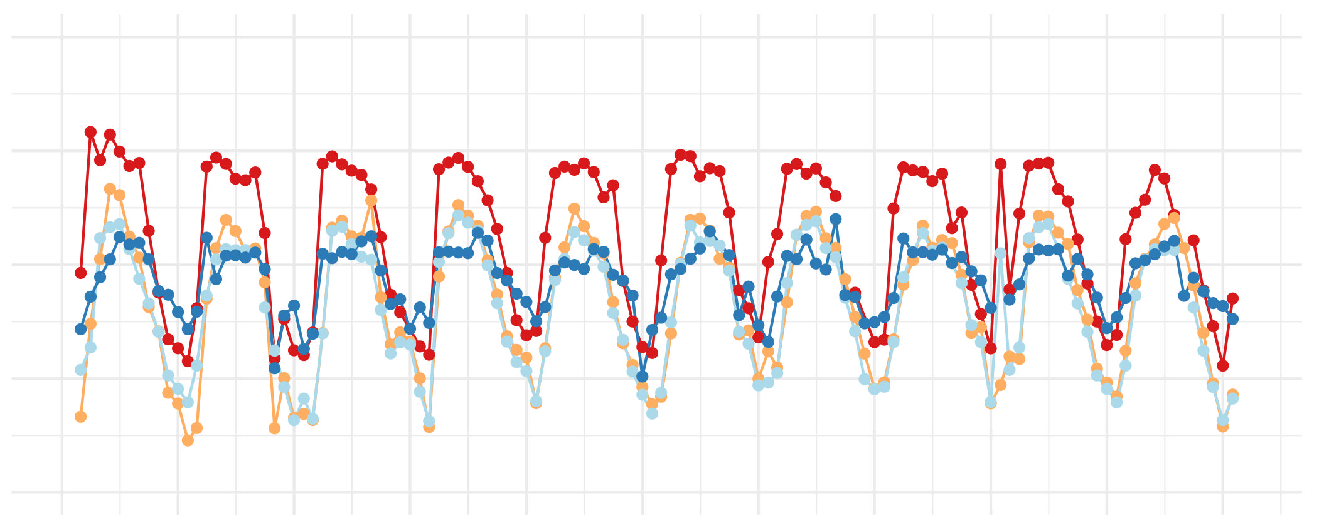
Results – NDVI Time Series (Landsat 8)
Monthly Mean NDVI 2013 - 2023
1.00
0.75
Site
0.50
1
Monthly Mean NDVI
2
3
4
0.25
0.00
2013
2014
2015
2016
2017
2018
2019
2020
2021
2022
2023
Notes:
------------------------------ Speaker Notes ------------------------------
Now we'll zoom into the four USGS study sites to get a better idea of how the NDVI values vary between site and over time.
Sites 1 and 2 have higher seasonal NDVI fluctuations while Sites 3 and 4 have more muted NDVI signals. Interestingly, Site 1 furthest upstream maintains the highest NDVI values overtime compared to sites downriver – signaling a potential salinity gradient as you move downstream.
------------------------------Image Information Below ------------------------------
NDVI data generated from Landsat 7 and 8 in GEE (Gorelick et al., 2017). Plots created in RStudio (RStudio Team, 2020).

Slide 12
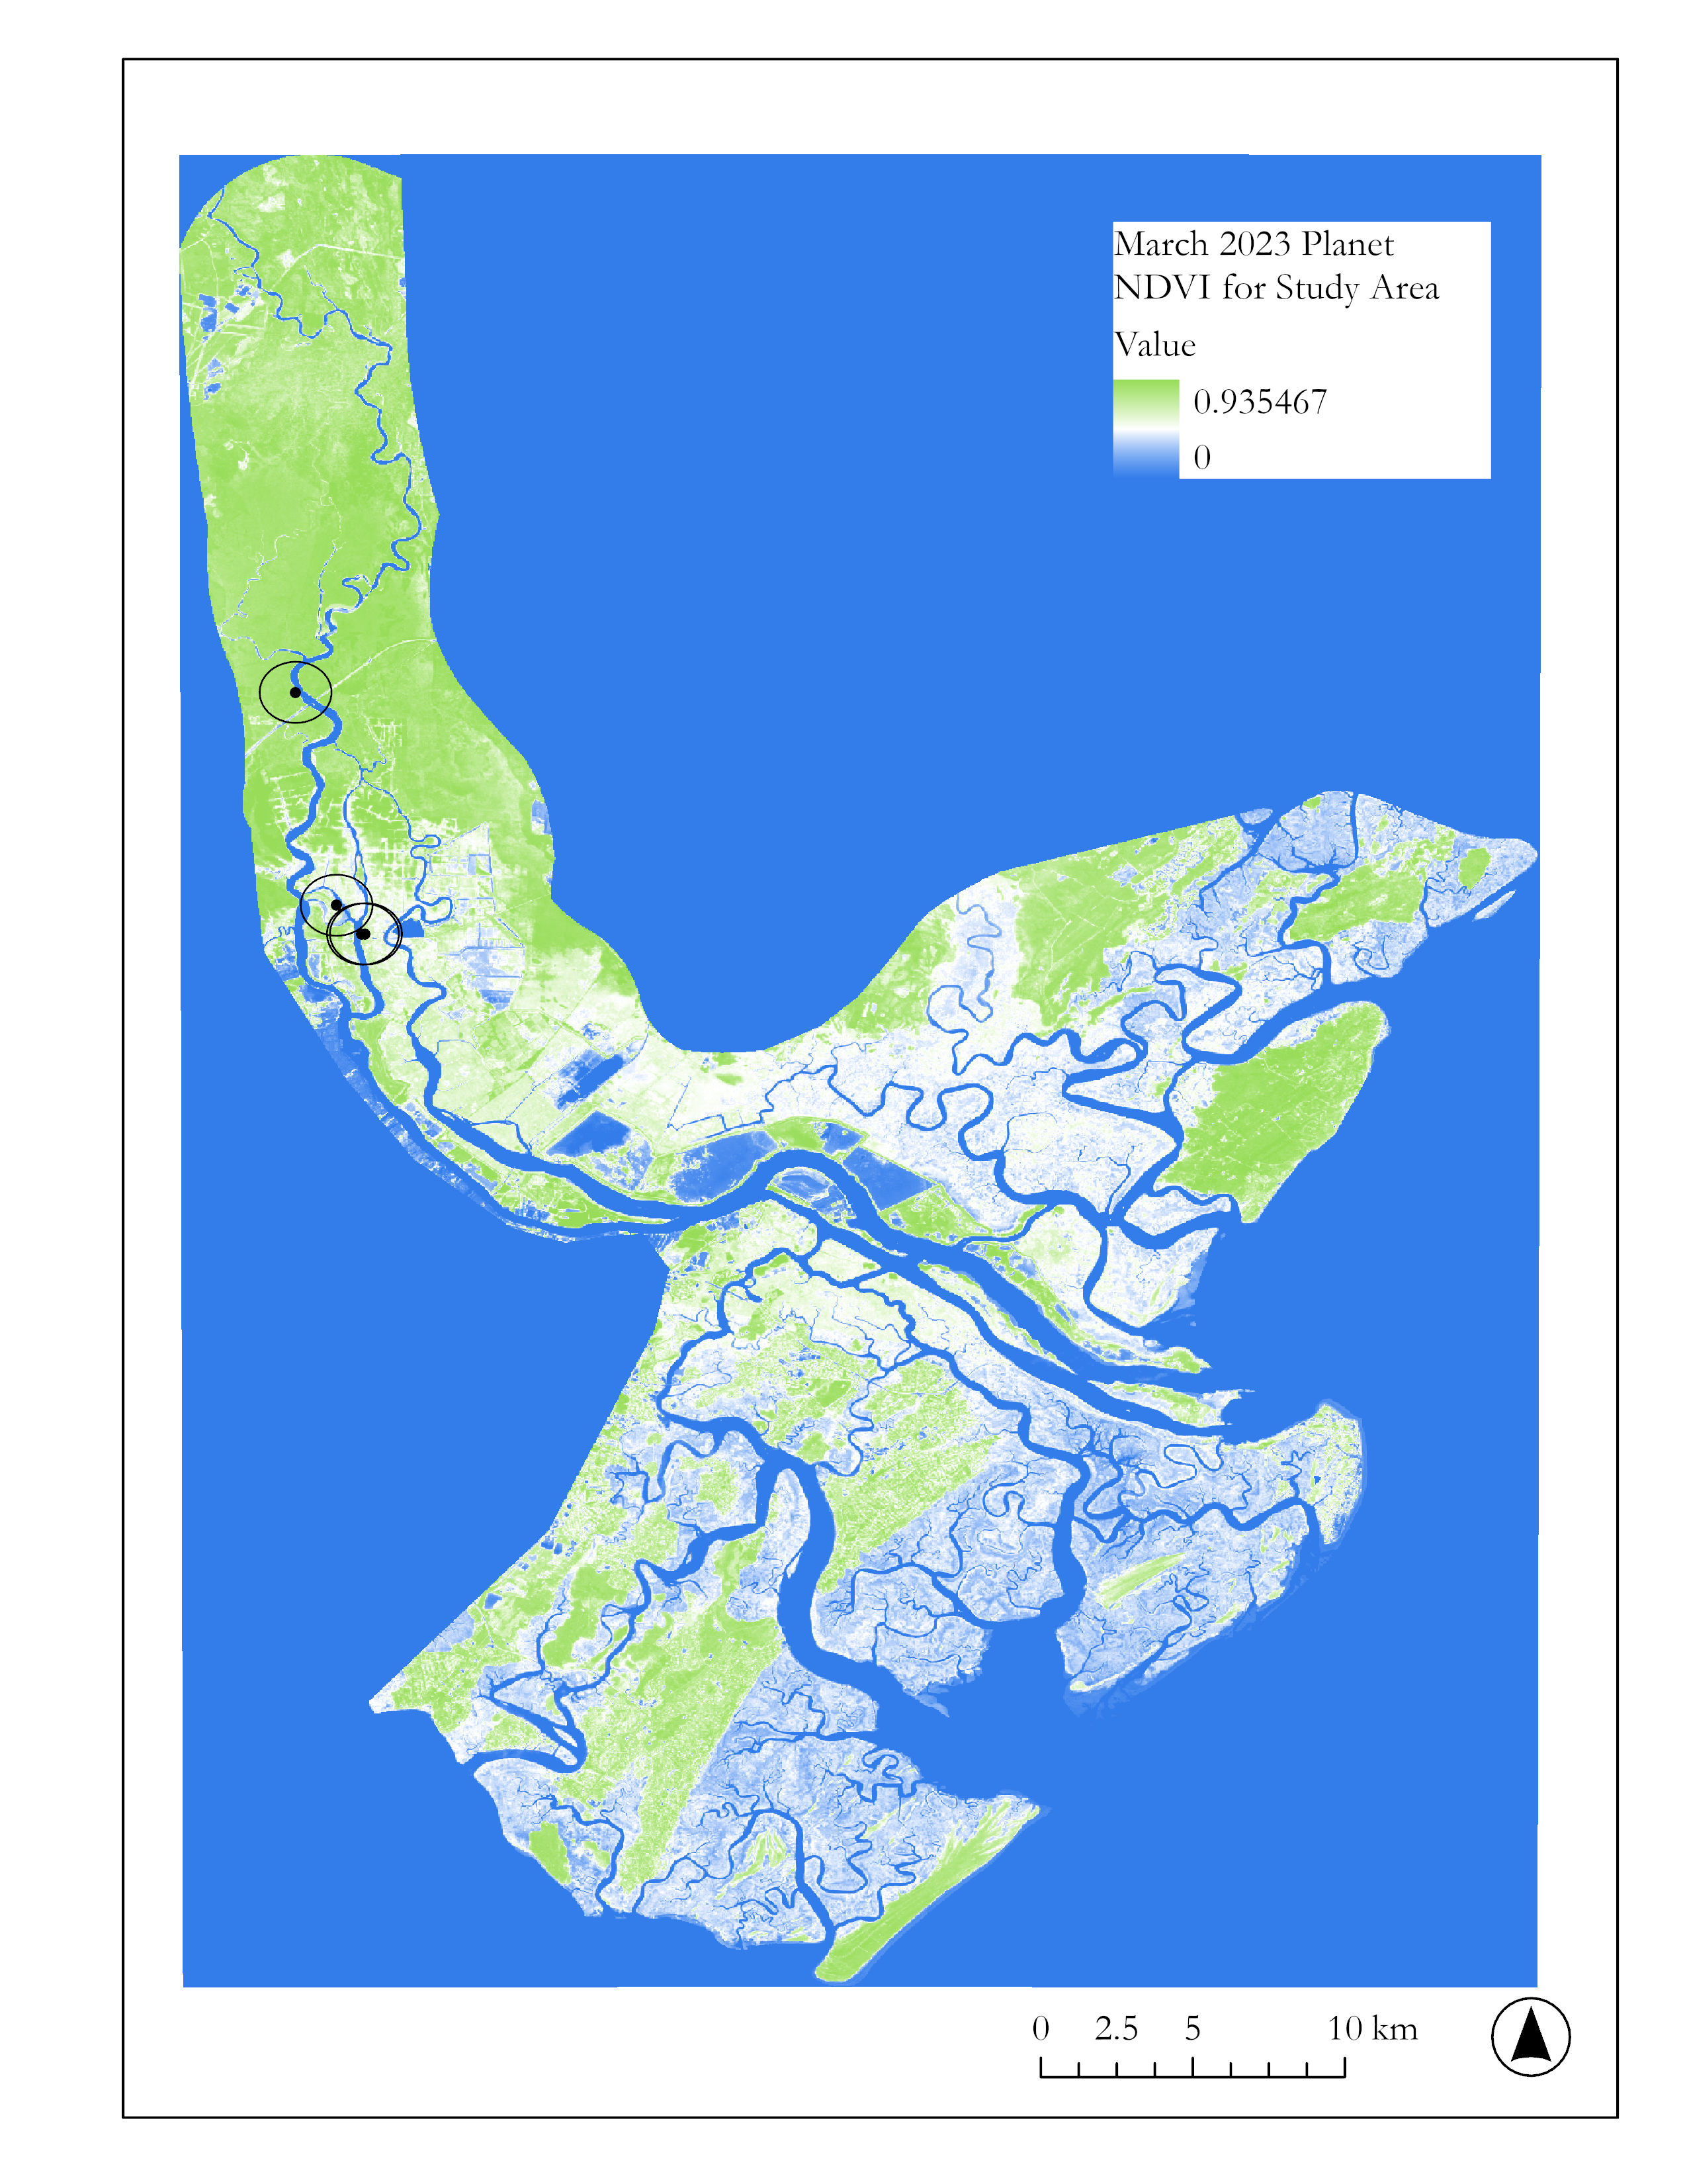
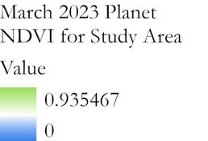
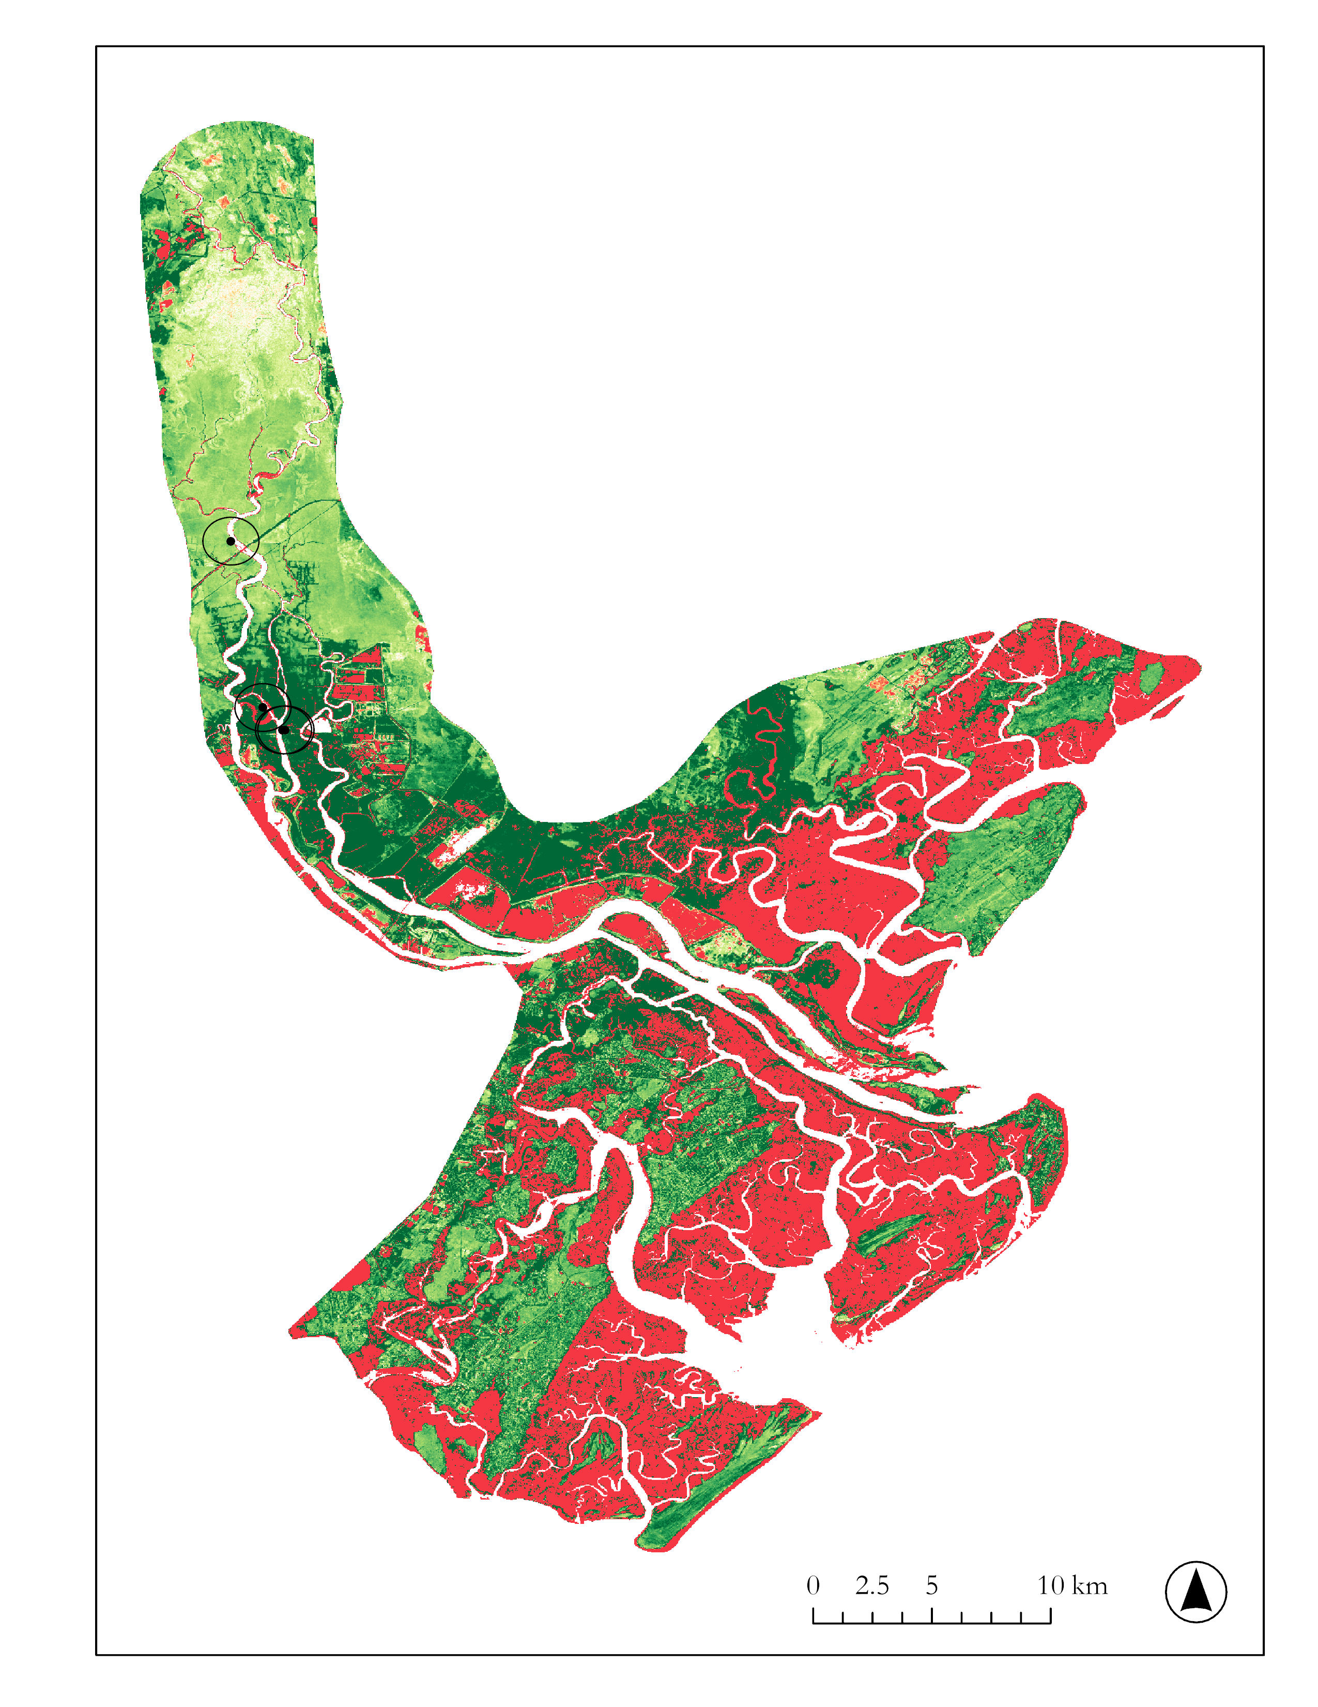
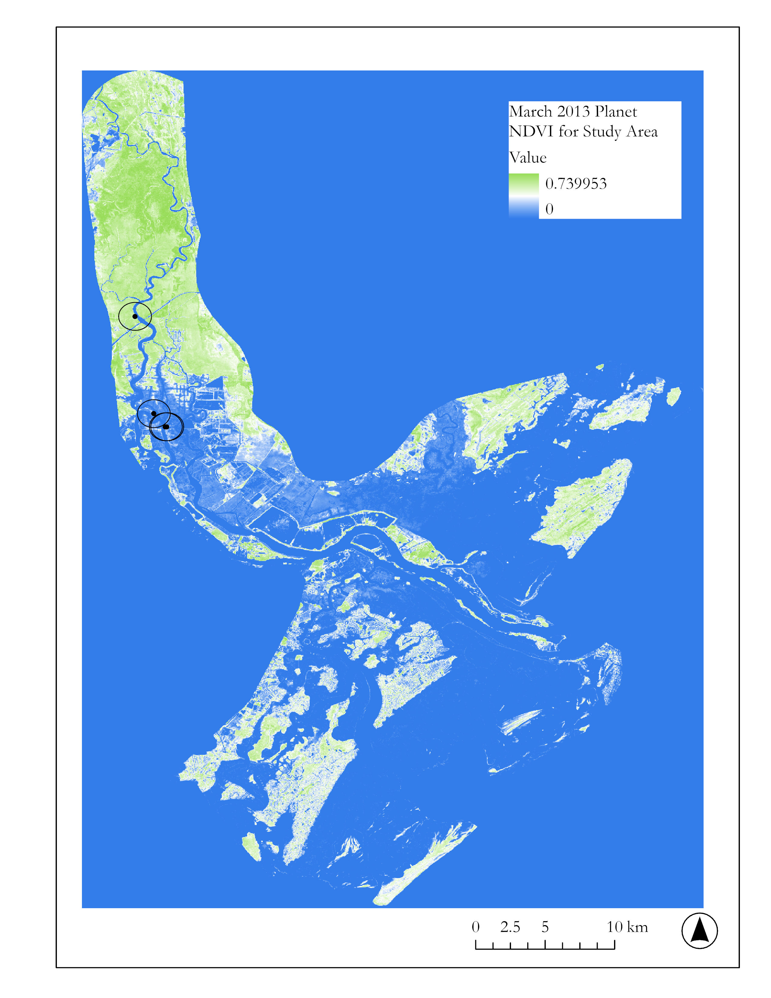
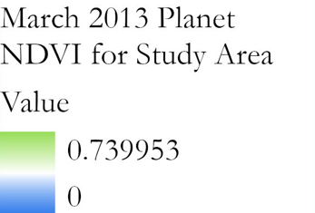
Results – NDVI Parallel Processing (Planet)
NDVI
Δ NDVI = April 2023 – April 2013
0.94
0
In-situ Study Sites
NDVI Relative Difference
March 2023
Planet NDVI
for Overall
Study Site​
Value
2
-2
0
10 km
5
NDVI
0.94
0
March 2013 Planet NDVI for Overall Study Site
0
5
10 km
0
5
10 km
Includes copyrighted material of Planet Labs PBC. All rights reserved.
Notes:
------------------------------Speaker Notes ------------------------------
We ran a parallel analysis between Landsat and Planet data. The images on the left show how we calculated NDVI for March 2013 and March 2023 Planet derived imagery. We then ran a relative difference computation between the two images to find out where there were observable increases and decreases in NDVI between the two images. The resultant map on the right shows increases in NDVI in green and decreases in NDVI in red. The overall trend shows an increase in NDVI between 2013 and 2023 based on Planet images used to run the computations.
------------------------------Image Information Below ------------------------------
NDVI data generated in GEE (Gorelick et al., 2017) using Planet imagery (Planet Team, 2017), maps created in ArcGIS Pro (powered by ESRI), and close-up tiles of coastal areas created in GEE using NASA Landsat 8 (Gorelick et al., 2017).

Slide 13
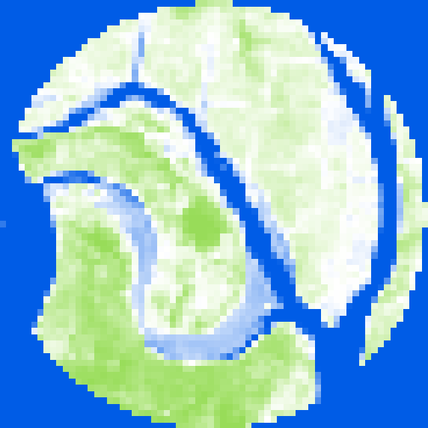
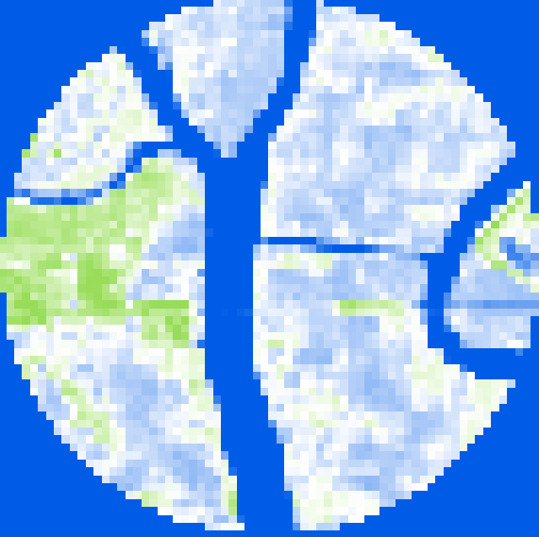
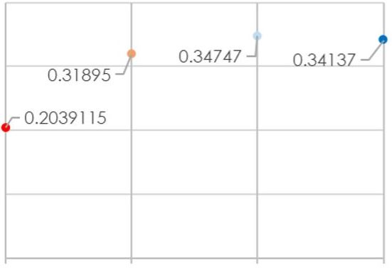
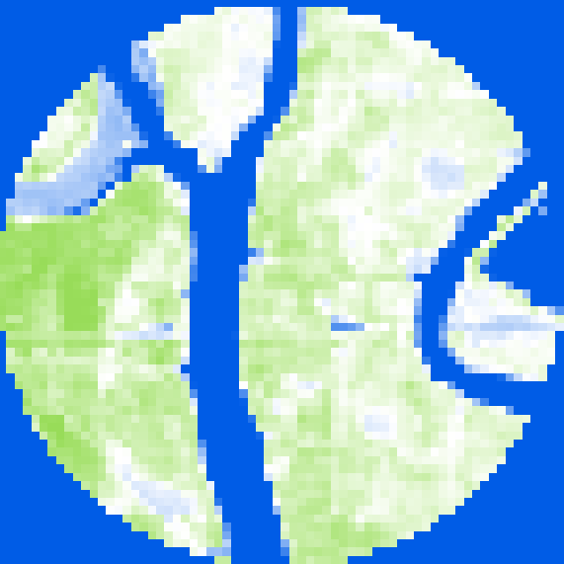
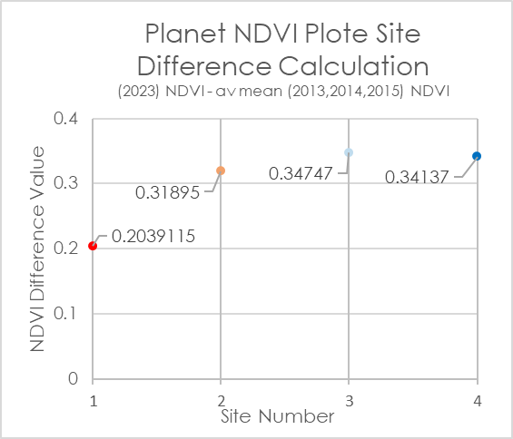
Results – NDVI Parallel Processing (Planet)
(2013 - 2015 & 2023) Planet NDVI Values for USGS Plot Sites
1.00
0.75
Site 1
0.50
0.25
Planet NDVI Plot Maps for USGS Sites
(April 2023)
0.00
Site 2
2013
2014
2015
2016
2017
2018
2019
2020
2021
2022
2023
Planet NDVI Plot Site Difference Calculation
(2023) NDVI – av mean (2013,2014,2015) NDVI
Site 3
0.4
0.3
NDVI Difference Values
0.2
Site 4
0.1
0.00
1
2
3
4
Includes copyrighted material of Planet Labs PBC. All rights reserved.
Site Number
Notes:
------------------------------Speaker Notes ------------------------------
On the left you can see examples of the NDVI map calculations for the 4 USGS plot sites. These smaller NDVI rois show higher levels on NDVI in green and lower levels of NDVI in blue. This visual change is also observable as indicated in the data charts on the right. The top graph shows the NDVI for all 4 USGS plot sites from March and April 2013, 2014, 2015 and 2023. The data computed via Planet imagery indicates an overall increase in NDVI at all 4 plot USGS sites. The graph below that shows the NDVI difference between the 2023 NDVI data and the average mean NDVI of the first three years (2013,2014, 2015). We chose to compute the average mean NDVI values exclusively for the initial first three years of our study period (2013-2015) rather than the whole ten year mean to better highlight the observable fluctuations in NDVI over the span of ten years, which would have been less evident had the mean of the entire decade been used to calculate the difference. The graph shows that there was an overall positive NDVI difference (increase in NDVI values) at all four USGS plot sites based on the data computed via Planet imagery.
------------------------------Image Information Below ------------------------------
NDVI data generated in GEE (Gorelick et al., 2017) using Planet imagery (Planet Team, 2017), and graphs of NDVI data created in Microsoft Excel (Microsoft Corporation, 2018).

Slide 14
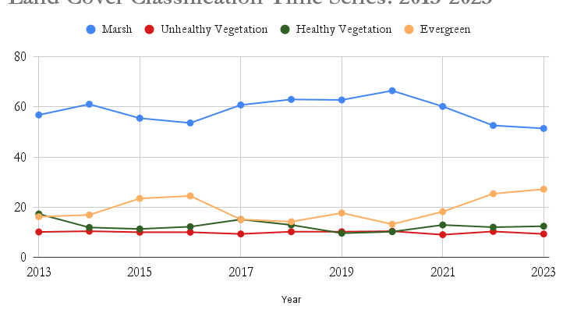
Results – Land Cover Classification
Land Cover Classification Time Series 2013-2023
Marsh
Unhealthy Vegetation
Healthy Vegetation
Evergreen
80
60
Percentage of Land Cover by area (m²)
40
20
0
2013
2014
2015
2016
2017
2018
2019
2020
2021
2022
2023
Year
Notes:
------------------------------Speaker Notes ------------------------------
This plot shows the percentage of land within the ROI covered by each of these types of vegetation.
Most of the ROI includes marshland, which may increase as sea level continues to rise.
Evergreen forests had the highest variability in area covered.
------------------------------Image Information Below ------------------------------
Land cover data generated in GEE (Gorelick et al., 2017), and graph created in Microsoft Excel (Microsoft Corporation, 2018).

Slide 15
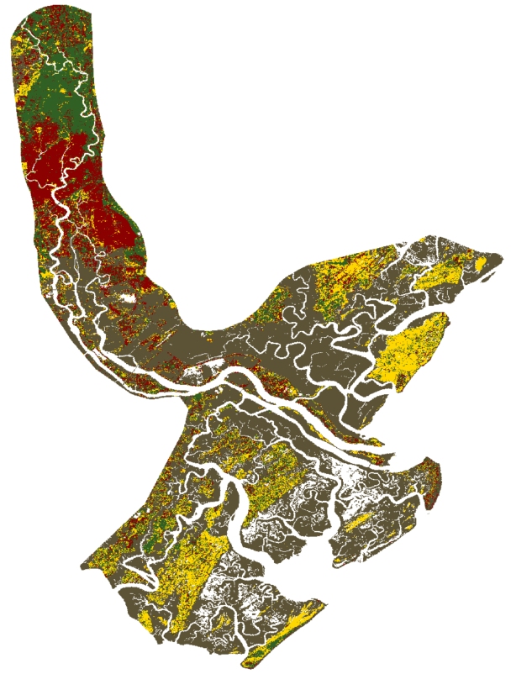
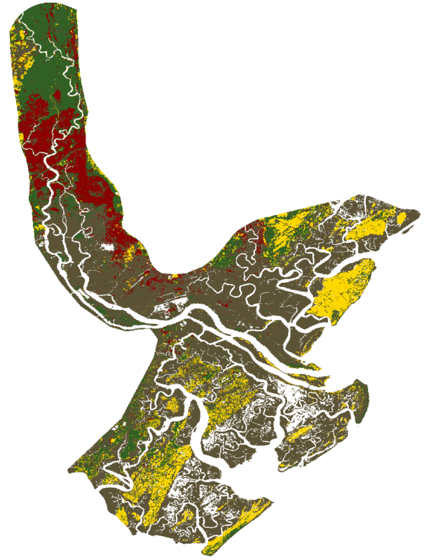
Results – Land Cover Classification (Landsat 8)
Growing Season Composite = May to Sept 2013
Growing Season Composite = May to Sept 2023
2013 Land Cover Type
2023 Land Cover Type
Marsh
Marsh
Unhealthy Vegetation
Unhealthy Vegetation
Healthy Vegetation
Healthy Vegetation
Evergreen
Evergreen
0
5
10 km
0
5
10 km
Notes:
------------------------------Speaker Notes ------------------------------
Here you can see the results of the land classification model, with the growing season of 2013 on the left and the growing season of 2023 on the right.
------------------------------Image Information Below ------------------------------
Land cover data generated in GEE (Gorelick et al., 2017), and maps created in ArcGIS Pro (powered by ESRI).

Slide 16
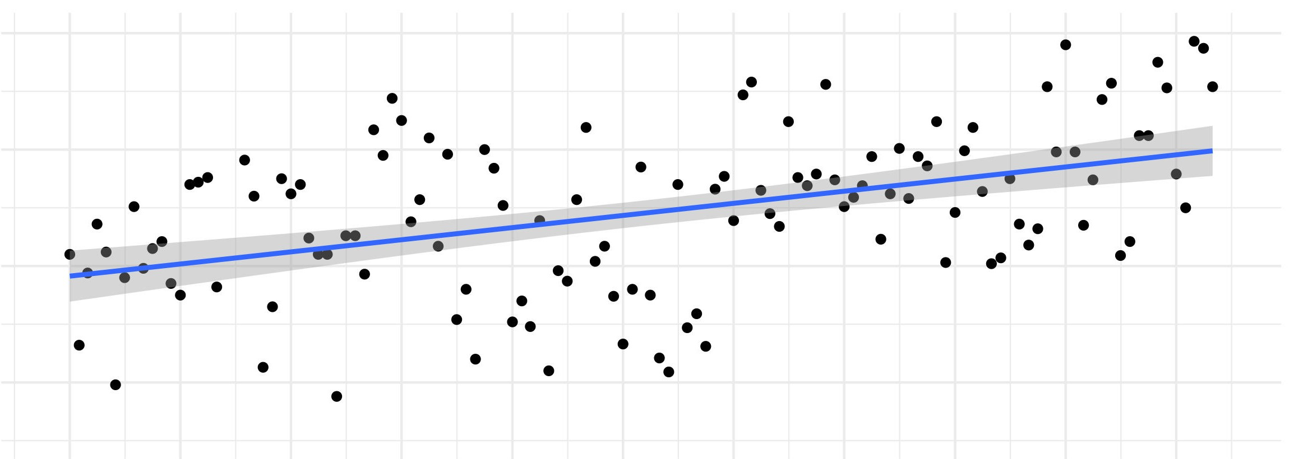
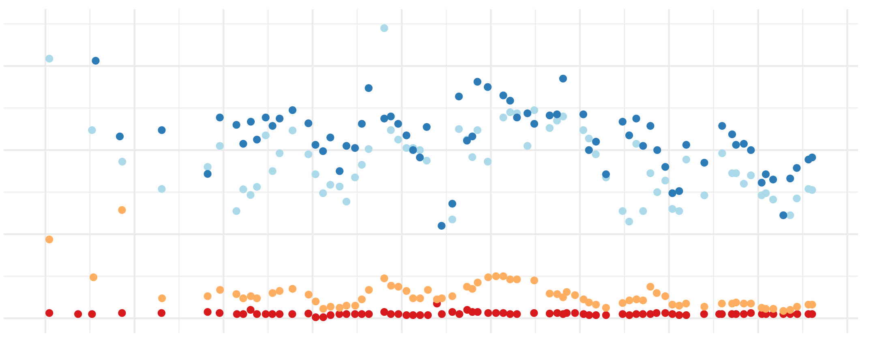
Results – In Situ Data
Sea Level Rise Trend 2013-2023
0.3
0.2
Monthly Mean Sea Level (m)
0.1
0.0
2013
2014
2015
2016
2017
2018
2019
2020
2021
2022
2023
USGS Porewater Salinity Measurements 2023-2021
6
Monthly Mean Salinity (ppt)
4
Site
4
1
2
2
3
0
4
2013
2014
2015
2016
2017
2018
2019
2020
2021
2022
2023
Notes:
------------------------------Speaker Notes ------------------------------
Our in situ data comes primarily from the USGS. In particular, they have been monitoring four sites along the lower Savannah River for several decades now that appear to be in a transition zone between salt and freshwater ecosystems.
In the top graph, you can see tide gauge data from NOAA's Fort Pulaski site at the mouth of the Savannah River on the coast. The points represent the mean monthly sea level, with the red line showing the trend in sea level change over time, with a 95% upper and lower confidence interval. It is clear that sea level in this area is rising, even within the short decadal timeframe of our project.
Salinity levels correspond to this increase, with Sites 3 and 4 being closer to the coast and the impacts of sea level rise having higher salinity levels, while Sites 1 and 2 are less saline.
------------------------------Image Information Below ------------------------------
Tide gauge data adapted from NOAA Tides and Currents (2023). Salinity data adapted from USGS. Plots created in RStudio (RStudio Team, 2020).

Slide 17
Results – Long Term Trends
Monthly Mean NDVI 2013-2023
1.00
0.75
Site
Monthly Mean Sea Level (m)
1
0.50
2
0.25
3
4
2013
2014
2015
2016
2017
2018
2019
2020
2021
2022
2023
USGS Porewater Salinity Measurements 2023-2021
6
Monthly Mean Salinity (ppt)
Site
4
1
2
2
3
4
0
2013
2014
2015
2016
2017
2018
2019
2020
2021
2022
2023
Notes:
------------------------------Speaker Notes ------------------------------
When you compare salinity to NDVI, visually you can see that the sites further from the coast have higher NDVI fluctuations throughout the seasons, while the sites closer to the coast have a smaller and more muted NDVI signal.
Additionally, running the Pearsons correlation test in RStudio found that the correlation between NDVI and salinity is significantly negative, which means that as salinity increases, NDVI decreases. This pattern is indicative of declining vegetation health and vegetation susceptibility to sea level rise.
------------------------------Image Information Below ------------------------------
NDVI data calculated from Landsat 7 and 8 in GEE (Gorelick et al., 2017). Salinity data adapted from USGS. Plots created in RStudio (RStudio Team, 2020).

Slide 18
Limitations and Uncertainties
Landsat 8 NDVI: Cloud coverage
Planet Imagery: API accessibility
Land cover classification:
# of training points
Temporal variation
Mixed pixels/resolution limitations
Edge effects
Salinity: Data availability
Image Credit: Maxar, ESRI
Notes:
------------------------------Speaker Notes ------------------------------
Planet imagery: Limitations and uncertainties include imagery budget and API accessibility to perform data processing techniques such as cloud and urban masks.
Landsat 8 NDVI: Limitations and uncertainties include increased cloud coverage during the 10-year monthly period which caused (< 5 months) to return outlier values inconsistent with the overall mean NDVI data. These outlier values were replaced with Landsat 7 ETM+ input scenes to generate values consistent with the overall trend in the data. The same methodology was applied during this process to reduce outliers.
Land Cover: Limitations include:
Number of training points, with only 10 polygons (20x20 30m pixels) being selected due to the limited processing capacity of GEE.
Temporal variations: Our model only looked at growing season (May-Sept), rseults might change depending on time frame.
Mixed pixels/resolution limitations: 30m resolution of Landsat 8, might be issue where land cover is not homogenous in a pixel.
Edge Effects: the random forest algorithm may have trouble accurately classifying pixels near the edges of land cover classes, might contain mixed characteristics.
Salinity data: we had limited porewater salinity data at beginning of study period compared to end. In addition, Porewater salinity patterns may be influenced by sub-surface hydrological processes that are hard to detect by remote sensing.
------------------------------Image Information Below------------------------------
Image Credit and Source: Title: ArcGIS Basemap "Imagery". Provider: Esri (Environmental Systems Research Institute), Maxar.
Source: ArcGIS Online Access Date: [07/26/2023]

Slide 19
Conclusions
Landsat 8 NDVI values decreased over time while Planet NDVI values increased, potentially due to varying spatial resolutions
Marshes were stable and dominant over time, possibly due to ecological saline adaptation
Evergreen areas experienced the highest fluctuations and increased over time, leading to potential ecological effects
Salinity levels were highest at the southernmost study sites closest to the coast
As salinity increased, NDVI decreased
Notes:
------------------------------Speaker Notes ------------------------------
Landsat 8-derived NDVI calculations showed a general decline in mean values across the entire region of interest (ROI), except for an increase observed at the northernmost USGS study site. Conversely, NDVI computed from Planet imagery showed an overall increase in mean values, including all four USGS sites.
Over time, the in situ data revealed a rise in salinity measurements, with the highest porewater salinity observed at the southernmost study sites. Additionally, a robust negative correlation was observed between NDVI and salinity, indicating that as salinity increased, NDVI showed a decrease.
Marshes showed the highest and most consistent land cover area among the classes, indicating stability over time. Salt marshes thrive in saline conditions due to salt-tolerant plant species and other factors like sediment deposition, root structure, and regional hydrology.
The evergreen class had the highest fluctuations and a significant increase, which could alter biodiversity habitat structure/composition, carbon sequestration, and affect water/nutrient cycling levels. This increase, especially from 2020-2023, might be attributed to their salt-tolerant tree species and higher elevation. Investigating underlying factors, including human-driven land use changes and saltwater intrusion, can shed light on Evergreen area dynamics.

Slide 20
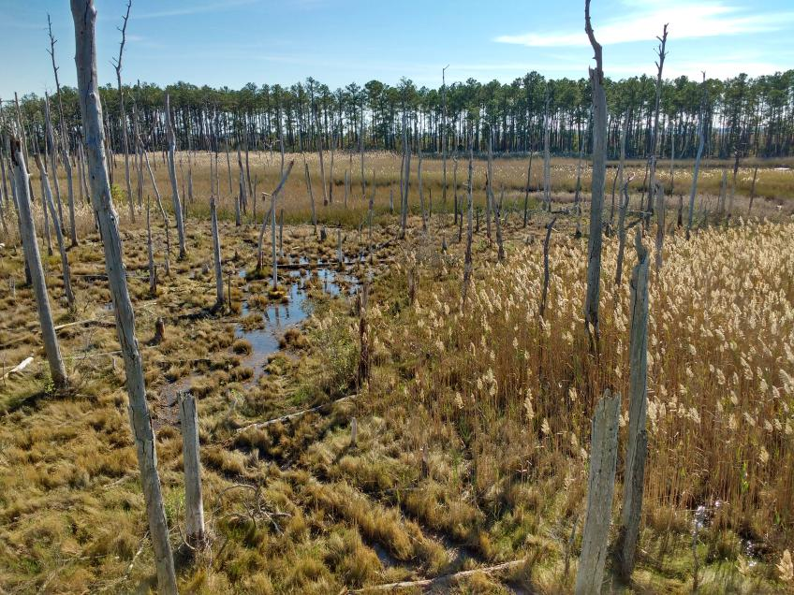
Future Work
↑ temporal/spatial resolution
↑ Scale & # of variables
Investigate other drivers of SWI
Attempt different classification algorithms, ↑ # of training points
↑ porewater salinity data & sites
Image Credit: USDA Forest Service
Notes:
------------------------------Speaker Notes ------------------------------
To further investigate the impacts of SWI in this area, we recommend looking at stream salinity (in addition to porewater salinity, which this project looked at) and inundation levels using USGS sites along the lower Savannah River and between the four project sites used for this study and Fort Pulaski (NOAA and USGS monitoring station) on the coast, and compare these findings to long term NDVI trends and land cover changes.
For vegetative patterns, future research could increase the temporal resolution (>10 years) and incorporate additional variables of interest such as land surface temperature.
Future work could also investigate additional drivers of SWI, such as hurricanes, land subsidence, groundwater pumping, sea level rise, and drainage canals/ditches.
------------------------------Image Information Below------------------------------
Image Credit: Forest Service, United States Department of Agriculture
Image Source: USDAFS 2022

Slide 21
Partners
United States Department of Agriculture
Dr. Steve McNulty, Southeast Regional Climate Hub
United States Geological Survey
Dr. Ken Krauss Names, Wetland and Aquatic Research Center (WARC)
Dr. Gregory Noe, Florence Bascom Geoscience Center (FBGC)
Georgia Southern University
Dr. Georgianne Moore, Chair Biology
CJ Pell, postdoc
Science Advisors
Dr. Kyra Adams
NASA Jet Propulsion Laboratory, California Institute of Technology
Dr. Elliott White Jr.
Stanford Woods Institute for the Environment
Benjamin Holt
NASA Jet Propulsion Laboratory, California Institute of Technology
Fellow
Michael Pazmino
Science Systems and Applications, Inc., NASA DEVELOP National Program
Notes:
------------------------------Speaker Notes ------------------------------
We would like to thank our partners at the United States Department of Agriculture, United States Geological Survey, and Georgia Southern University, our outstanding science advisors, Dr. Kyra Adams, Dr. Elliott White Jr., and Benjamin Holt, and our phenomenal fellow, Michael Pazmino, for all their help, support, and guidance throughout the term!

