Slide 1
Delaware Basin
Health & Air Quality
Analysis of Air Pollutants Collected from Ground and Space Instruments Around the Guadalupe Mountains and Carlsbad Caverns National Parks
Sean Cusick (Team Lead)
Amber Schlessiger
Billy Henshaw
Perrin Krisko
Virginia – Langley
Notes:
Perrin (30 seconds):
Greetings to all who have joined us today. My name is Perrin Krisko, and I am accompanied by my team members, Sean Cusick, Amber Schlessiger, and Billy Henshaw. We will be presenting our work as part of the 10-week DEVELOP program with NASA analyzing NO2 concentrations around the Delaware Basin.
In this area, our partners at the National Park Service have reported concerns about health and deteriorating air quality, so we used satellite data to take a closer look at what could be happening here.

Slide 2
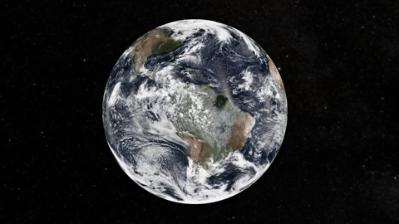
COMPONENTS
Study Area
Study Period
Objectives
Partners
Community Concerns
NASA Satellites / Sensors Used
Methodology
Results
Errors & Uncertainties
Conclusions
Future Work
Acknowledgements
Image Credit: NASA Giphy
Notes:
Perrin (15 seconds):
We will be walking through 12 slides, including our project's background, significance, partnerships, methodologies, limitations, future work, and more. So with that, Amber, take it away.
------------------------------Image Information Below ------------------------------
•Image Credit: National Aeronautics and Space Administration Giphy
•Image Source: https://giphy.com/gifs/nasa-space-earth-1zlU57Bawc50fi3AwJ

Slide 3
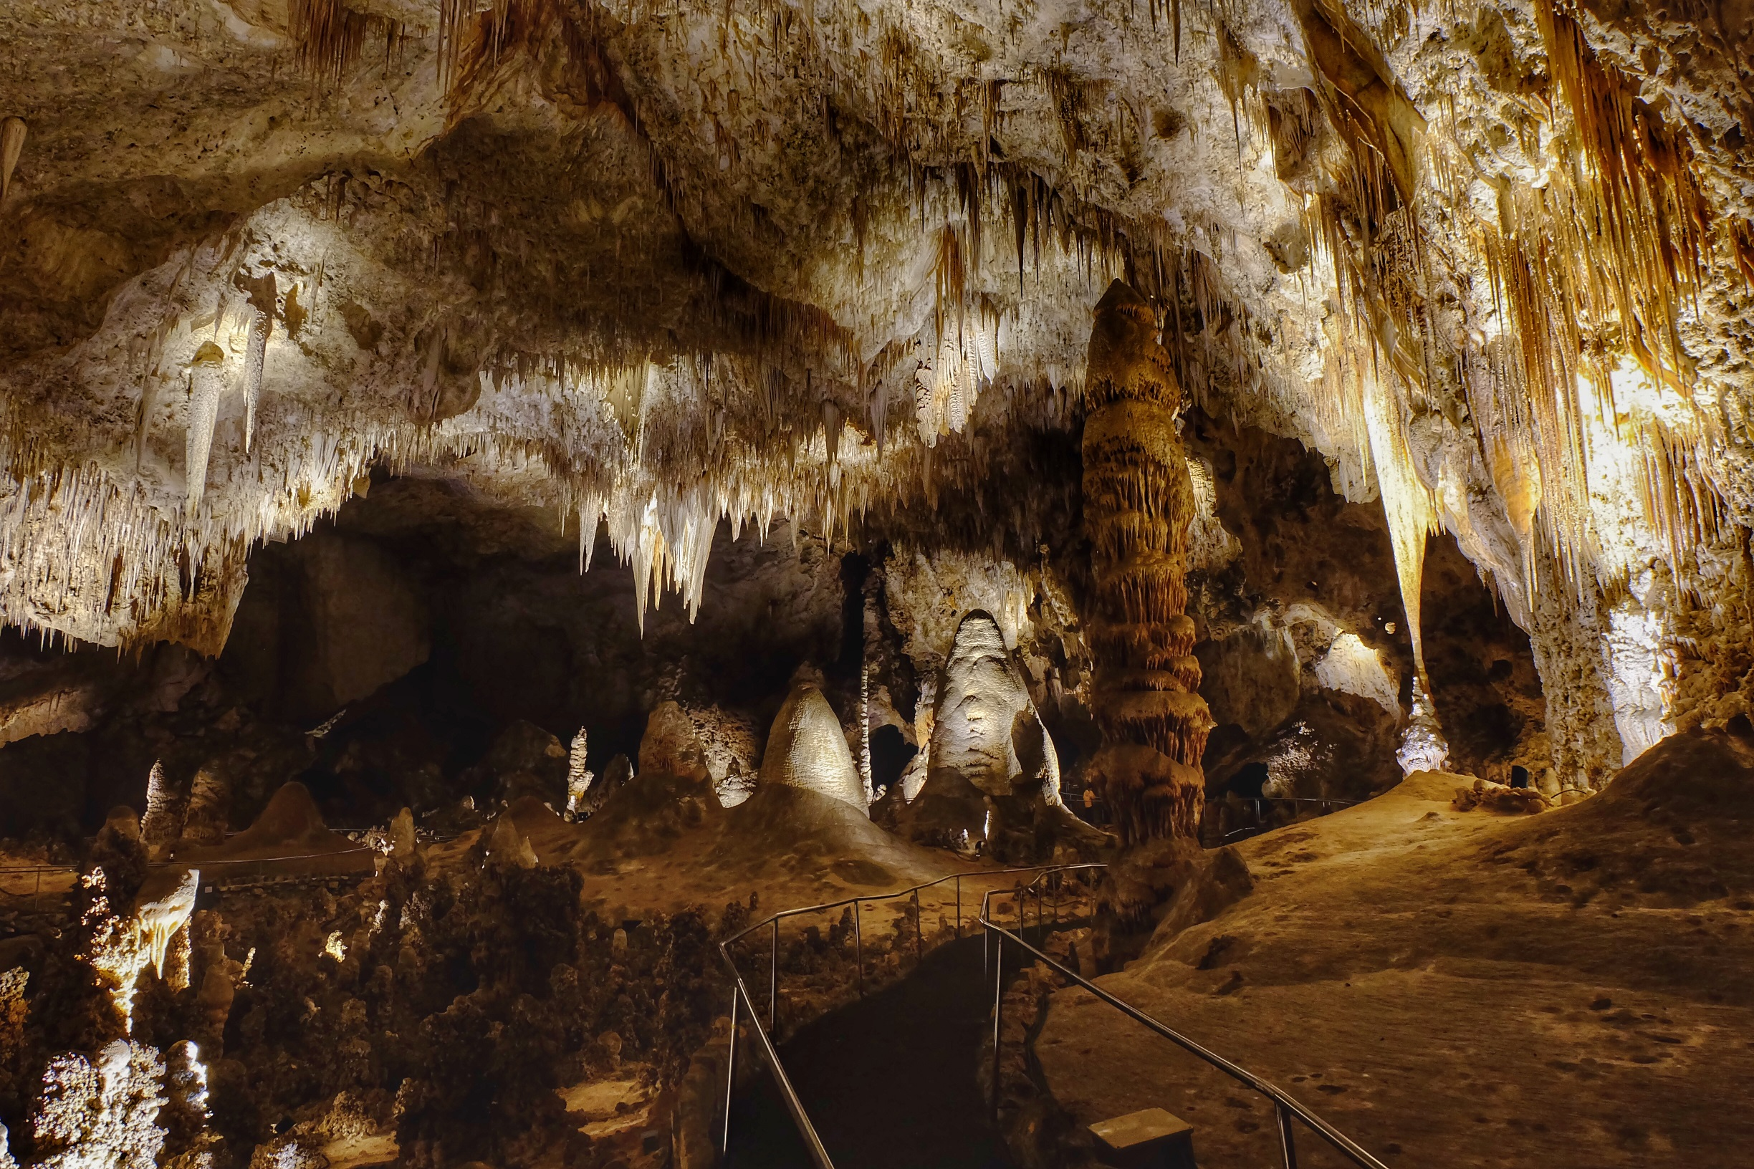
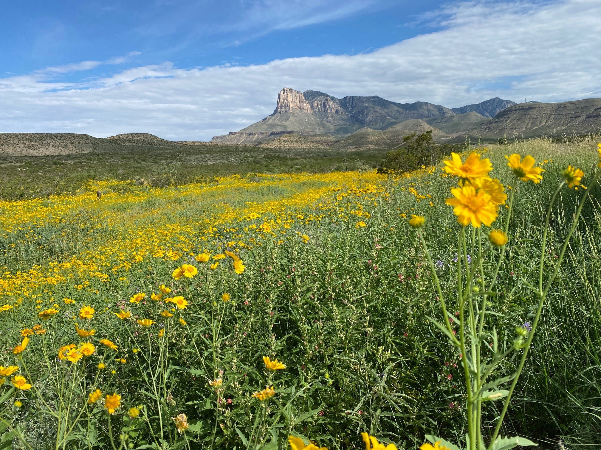
PROJECT PARTNERS
"Big Room" in CAVE
Lisa Devore
Air Quality Specialist
Intermountain Region
Erin Lynch
Physical Scientist
Carlsbad Caverns
Image Credit: NPS/Michael Larson
El Capitan in GUMO
Mike Medrano
Resource Stewardship and Science Manager
Guadalupe Mountains
Image Credit: NPS/Karen Poteet
Image Credits: Michael Larson, Karen Poteet
Notes:
Amber (1 minute)
To accomplish our project objectives, we partnered with the National Park Service. Our partners were Lisa Devore, who is the Air Quality Specialist for the Intermountain Region, Erin Lynch, who is a Physical Science Technician at CAVE, and Mike Medrano who is a Resource Stewardship and Science Manager at GUMO.
Our partners expressed that they have seen changes in the parks regarding air quality and haze, and helped steer us towards data that would be relevant to our project and its objectives. In addition, they provided images of the parks from different days and years, which we later used for further analysis in our project.
Now that all of that is covered, I will hand it off to Billy!
------------------------------Image Information Below ------------------------------
•Image Credit: NPS/Michael Larson
•Image Source: https://flickr.com/photos/193079646@N03/51234085016/
•Image Credit: NPS/Karen Poteet
•Image Source: https://www.nps.gov/media/photo/gallery-item.htm?pg=2169359&id=4a0f5d52-6f77-4724-888f-a5af821e1bad&gid=FE206BC4-155D-451F-67FE294D025BA1DC

Slide 4
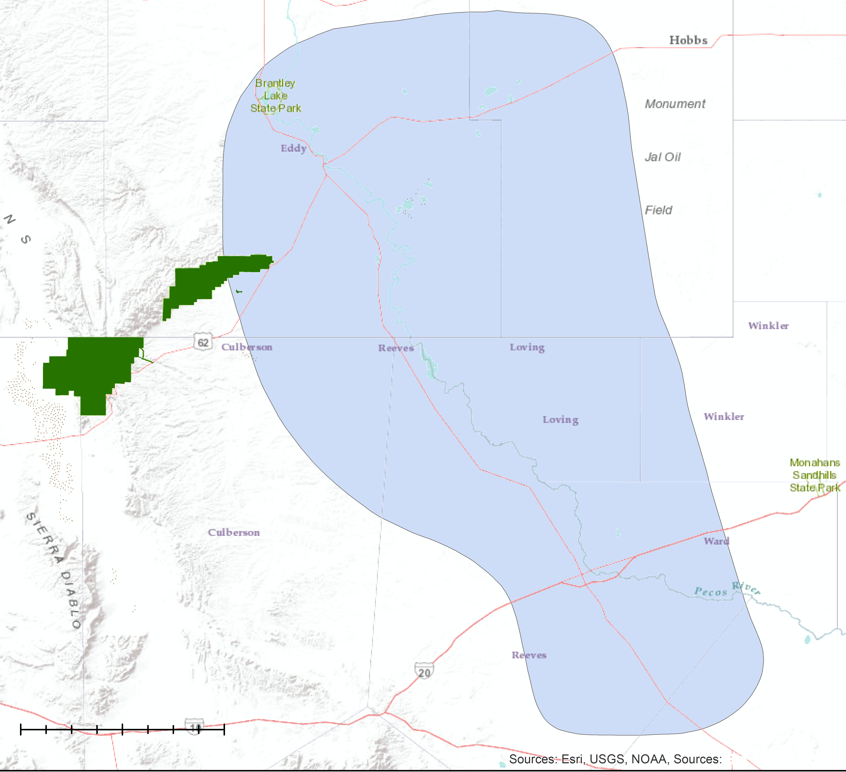
STUDY AREA AND STUDY PERIOD
Guadalupe Mountains National Park (GUMO)
Carlsbad Caverns National Park (CAVE)
May 2010 – May 2021
CAVE
0
2
6
8 Miles
4
Delaware Basin
GUMO
0
10
20
30
40 Miles
0
2
4
6
8 Miles
Notes:
Amber (1.5 minutes):
Don’t let the name "Delaware" fool you! This project actually is not located in the state most of us know of!
Instead, our project focuses on an area located on the western Texas/southern New Mexico border. This region is called the Delaware Basin and is home to several different unique features. One of these features includes being a part of the larger Permian Basin, which is known as one of the richest oil and gas deposits in the world. In addition, several unique plants and animals call this area home, making it a diverse ecosystem. Within the Delaware Basin lies 2 national parks: Carlsbad Caverns National Park, which is also known as "CAVE" and Guadalupe Mountains National Park, also known as "GUMO". These areas are outlined on the map with the purple outline denoting CAVE boundaries and the orange outline denoting GUMO boundaries. Because this area is so diverse, our project wanted to address how these parks may be changing over time, so we decided to study this area from May 2010 – May 2021.
Basemap: Esri – USGS, NOAA

Slide 5
OBJECTIVES
Produce monthly NO₂ maps for May 2018 – May 2021.
Produce annual NO₂ outlooks for May 2010 – May 2018.
Cross-reference results with oil & gas data to pinpoint sources of NO₂.
Image Credit: Erin Lynch
Nighttime flaring near CAVE
Notes:
Amber (1.5 minutes)
For our objectives, it was important we plan how to best represent changes in the park so we decided to look at NO2 over the years. NO2 is a precursor to ozone. You may ask, "What is a precursor?". Well, it simply means that NO2 is an ingredient needed to produce ozone! If an area is exhibiting high amounts of NO2, high amounts of ozone are likely present as well. Our region has seen an increase in oil and gas leases over the years. Because of this, we wondered if the increased human activity might cause higher NO2 values over the years.
To answer this question, we decided we needed to create 2 different types of maps. The first would be annually averaged NO2 maps from May 2010 to May 2018, and the second would be monthly averaged NO2 maps from May 2018 to May 2021. In addition, we also wanted to look at the oil and gas industry by cross-referencing our results with oil and gas data. This would hopefully allow us to pinpoint sources of increased NO2.
------------------------------Image Information Below ------------------------------
• Image Credit: Erin Lynch, used with permission from partner

Slide 6
COMMUNITY CONCERNS
Reduced visibility from haze
Environmental degradation from pollution
Adverse effect on human health
Notes:
Our project partners were concerned with the impacts pollution can have on the environment and public health. The first being reduced visibility from the presence of haze. Haze can impede driving but also hurt NPS visitor experience. Pollution also has negative effects of ecosystem health with pollutants entering the ground and streams in the area, altering its chemistry. Lastly, pollution harms human respiratory health. Concentrated exposure in the short term can cause adverse reaction to people who have preexisting conditions such as asthma and long term exposure can lead to chronic health problems such as reoccurring infections.
------------------------------Image Information Below ------------------------------
•Image Credit: Powerpoint Template Icon
•Image Source: PowerPoint (Office 2020) [Computer Software]. Redmond, WA: Microsoft

Slide 7
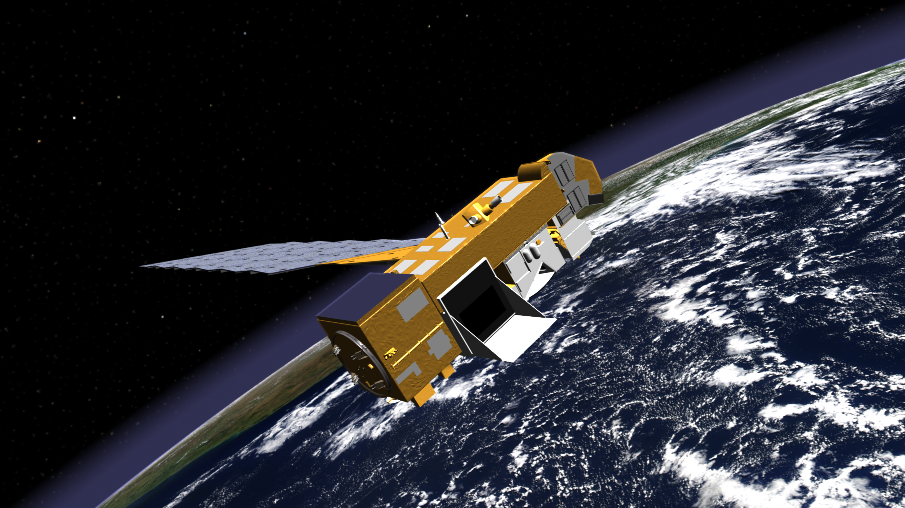
NASA SATELLITES & SENSORS
Aura OMI
Sentinel-5P TROPOMI
Image Credit: NASA and ESA
Notes:
The team used data from NASA's Ozone Monitoring Instrument, or OMI, on the Aura satellite for a historic view of pollution within our study area. In addition, the team used the European space agency's tropospheric monitoring instrument, or TROPOMI, aboard the sentinel 5p satellite. TROPOMI offers a much higher resolution and a larger range of products such as wind direction while OMI was used for historical data. For this project, tropospheric NO2 column satellite measurements are being used as a proxy for surface NO2.
------------------------------Image Information Below ------------------------------
•Image Credit: National Aeronautics and Space Administration
•Image Source: https://www.nasa.gov/directorates/heo/scan/services/missions/earth/Aura.html
•Image Credit: European Space Agency
•Image Source: https://www.esa.int/Enabling_Support/Operations/Sentinel-5P_operations

Slide 8
METHODOLOGY: SATELLITE DATA
Download and geo-filter
Regrid and extract features
Overlay with study area for analysis
OMI
TROPOMI
Image Credit: NASA and ESA
Notes:
OMI data from 2010-2021 and TROPOMI from 2018-2021 was downloaded and clipped to only show our area of interest. It was run through IDL script to regrid and oversample the data to improve its quality. Lastly the team averaged the data over certain time frames and inserted into ArcGIS along with out park boundaries for analysis.
------------------------------Image Information Below ------------------------------
•Image Credit: National Aeronautics and Space Administration
•Image Source: https://www.nasa.gov/directorates/heo/scan/services/missions/earth/Aura.html
•Image Credit: European Space Agency
•Image Source: https://www.esa.int/Enabling_Support/Operations/Sentinel-5P_operations

Slide 9
METHODOLOGY: GROUND DATA
Compare accuracy validation
Compute pollutants from emissions
Integrate monthly flare data
Well Flaring
Validate satellite data
EPA Monitors
Notes:
Ground data was used as a comparison but more importantly validation of the team's satellite's findings. First the district flaring monthly data was converted into yearly data as a comparison to the individual well flaring data. Once the data was verified it was combined to produce a monthly set of pollutant data of the wells surrounding the study area. Lastly, this was checked by EPA ground monitors close to the study area for accuracy.
------------------------------Image Information Below ------------------------------
•Image Credit: Powerpoint Template Icon
•Image Source: PowerPoint (Office 2020) [Computer Software]. Redmond, WA: Microsoft

Slide 10
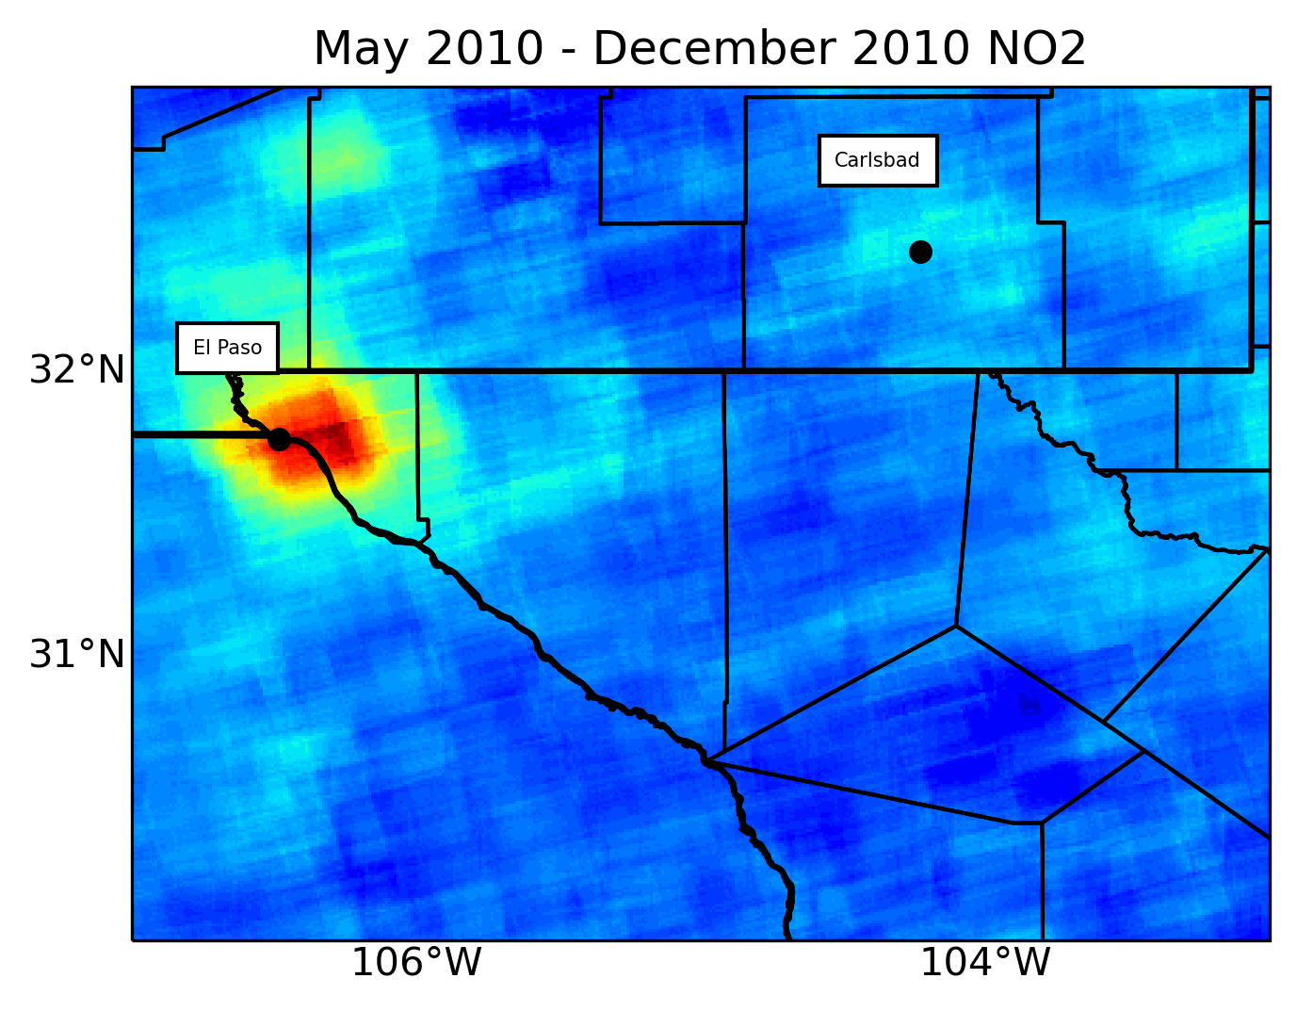
RESULTS
Annual Average NO₂ - OMI
1e15 molecules/cm²
1e15 molecules/cm²
Highest NO₂ concentrations over
Delaware Basin in 2017 and 2018.
1
3.5
Observations of oil, gas flaring
increased by 8% from 2013 – 2021.
3.0
2
2.5
3
2.0
2.5% increase in annual average NO₂
levels across parks (2018 – 2021).
Annual Average NO₂ - TROPOMI
1.5
1.0
Around the parks, highest levels of
NO₂ found around eastern edge.
4
0.5
0.0
Highly similar NO₂ patterns between
CAVE and within 10 mi of CAVE.
5
Notes:
After performing some of the pre-processing techniques mentioned in the previous slide, the outputs we obtained are the two GIFs you will see on this slide and the next. The GIF on this slide shows the average yearly NO2 measurements retrieved from NASA’s OMI sensor from 2010 - 2018, while the GIF on the next slide shows the average monthly measurements retrieved from ESA’s TROPOMI sensor from May 2018 – April 2021. You can see the Delaware Basin shown as the red polygon. As you can see in this OMI gif, NO2 levels gradually increase over the Delaware Basin from 2010, with 2017 and 2018 showing the largest levels of NO2. This corresponds nicely with our discovery that the number of oil and gas flaring observations has steadily increased since 2013. I’ll pause briefly to give everyone time to process and understand the spatial patterns found with the OMI sensor before moving on to the TROPOMI sensor.
Moving on to TROPOMI,

Slide 11
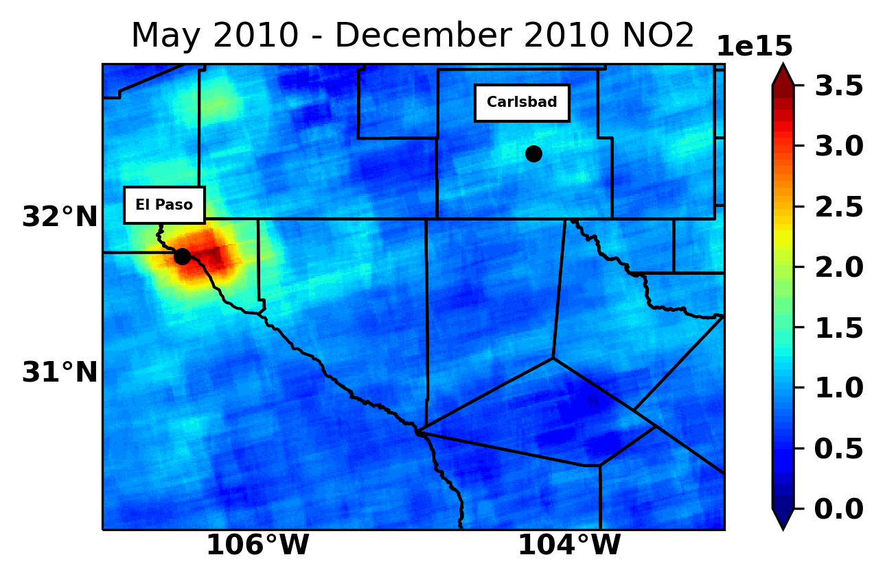
RESULTS – TEST SLIDE
Annual Average NO₂ - OMI
1e15 molecules/cm²
1e15 molecules/cm²
Highest NO₂ concentrations over
Delaware Basin in 2017 and 2018.
1
3.5
Observations of oil, gas flaring
increased by 8% from 2013 – 2021.
3.0
2
2.5
3
2.0
2.5% increase in annual average NO₂
levels across parks (2018 – 2021).
1.5
1.0
Around the parks, highest levels of
NO₂ found around eastern edge.
4
0.5
0.0
Highly similar NO₂ patterns between
CAVE and within 10 mi of CAVE.
5
Notes:
After performing some of the pre-processing techniques mentioned in the previous slide, the outputs we obtained are the two GIFs you will see on this slide and the next. The GIF on this slide shows the average yearly NO2 measurements retrieved from NASA’s OMI sensor from 2010 - 2018, while the GIF on the next slide shows the average monthly measurements retrieved from ESA’s TROPOMI sensor from May 2018 – April 2021. You can see the Delaware Basin shown as the red polygon. As you can see in this OMI gif, NO2 levels gradually increase over the Delaware Basin from 2010, with 2017 and 2018 showing the largest levels of NO2. This corresponds nicely with our discovery that the number of oil and gas flaring observations has steadily increased since 2013. I’ll pause briefly to give everyone time to process and understand the spatial patterns found with the OMI sensor before moving on to the TROPOMI sensor.
Moving on to TROPOMI,

Slide 12
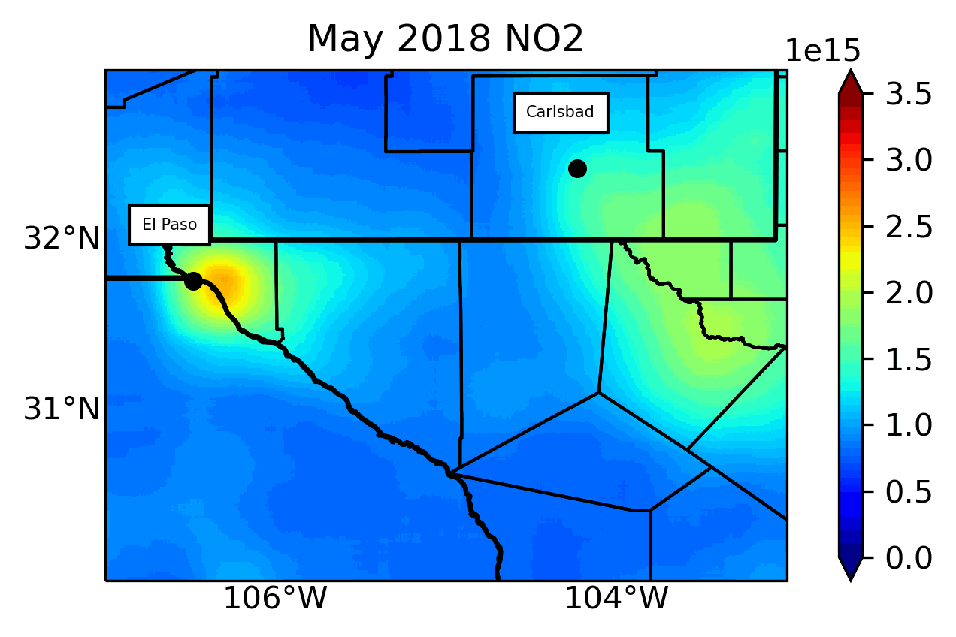
RESULTS
Monthly Average NO₂ - TROPOMI
1e15 molecules/cm²
1e15 molecules/cm²
Highest NO₂ concentrations over
Delaware Basin in 2017 and 2018.
1
3.5
3.5
3.0
Observations of oil, gas flaring
increased by 8% from 2013 – 2021.
3.0
2
2.5
2.5
2.0
3
2.0
2.5% increase in annual average NO₂
levels across parks (2018 – 2021).
1.5
1.5
1.0
1.0
Around the parks, highest levels of
NO₂ found around eastern edge.
4
0.5
0.5
0.0
0.0
Highly similar NO₂ patterns between
CAVE and within 10 mi of CAVE.
5
Notes:
Once again, the GIF on this slide shows the average monthly measurements retrieved from ESA’s TROPOMI sensor from May 2018 – April 2021.
We discovered that the increase in NO2 concentration leveled off after 2018, averaging to roughly 2.5% from 2018 – 2021. Using the very high spatial resolution offered by TROPOMI, we zoomed in around the parks themselves to identify any local NO2 trends. What we found was that the highest levels of NO2 were found within 10mi of the eastern edges of these islands. The final step to round out our results was to compare the NO2 time series of areas in the Delaware Basin within 10 mi of the eastern edge of CAVE with the measurements inside CAVE and the measurements in the Delaware Basin beyond the 10 mi zone. What we discovered was that the NO2 patterns within CAVE are nearly identical to the temporal patterns found in the area just outside the eastern portion of CAVE. The pattern of the rest of the Delaware Basin was similar, but not nearly as similar. This corroborates our knowledge of NO2 being a short-lived pollutant in the air and being unable to travel far before dissipating.

Slide 13
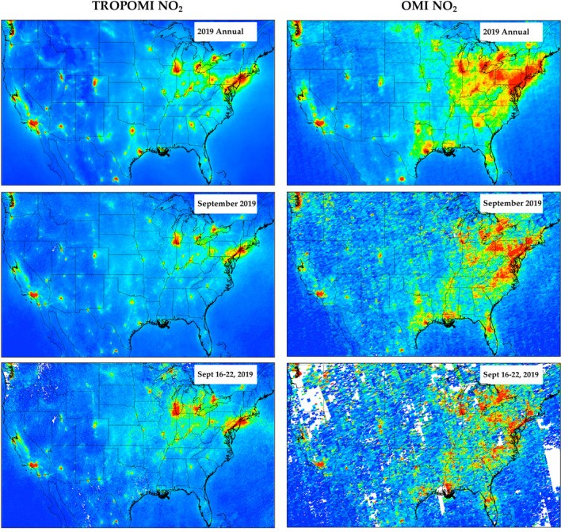
10⁻¹⁵ cm⁻²
ERRORS & UNCERTAINTIES
0.0
1.0
2.0
3.0
4.0
Cloud cover presents a degree of uncertainty.
Maps using OMI satellite data prior to 2017 lack some spatial granularity.
Estimates of monthly flaring were used to describe NO₂ emissions.
Example of OMI vs. TROPOMI satellite imagery (national scale)
Image Credit: with permission from Dr. Daniel Goldberg
Notes:
Perrin (2 mins)
Now, I'll be talking a bit about the errors and uncertainties that were associated with our analysis.
Due to uncertainty deriving from cloud cover on particular days, we applied a 75% air quality factor. Clouds can distort satellite imagery, but it is possible to filter clouds out of the satellite image to see ground. We wouldn't want to apply a much higher aq percentage filter or else it might start to filter out aspects, like haze that we still want to detect by satellite.
Second, for years before 2018, we used OMI satellite data to compose our maps. OMI generates a much coarser granularity than does TROPOMI, which was launched in 2017. TROPOMI can provide details up to 0.01° × 0.01° grid cell resolution, while OMI provides 0.25° × 0.25° resolution.
In real world application, this can mean that a lot of spatial detail is lost through the usage of OMI. This image from a publication by Dr. Daniel Goldberg et al. demonstrates the differences between OMI mapping on the right versus TROPOMI on the left.
First of all, we can see how TROPOMI does a much better job at pinpointing exact NO2 hotspots, whereas OMI is more generalized, and perhaps a bit misleading in that respect. It's not that OMI is a "bad" satellite, because it can give us a lot of good information about the historical backdrop, it's just that spatial granularity is not its strength as more specified satellite sensors have been developed over time.
A third uncertainty we faced was in our estimation of oil and gas flaring in Texas. Because there was not publicly-available Oil Conservation Division data for Texas like there was in New Mexico, we assumed that oil and gas production seasonal values were proportional in Texas to New Mexico, due to their close proximity. There is no standard practice for quantifying natural gas flaring in a universal way besides the World Bank's current methodology, so we used that to validate our estimates.
------------------------------Image Information Below ------------------------------
•Image Credit: (with permissions from) Daniel Goldberg
•Image Source: (2021) TROPOMI NO2 in the United States: A Detailed Look at the Annual Averages, Weekly Cycles, Effects of Temperature, and Correlation With Surface NO2 Concentrations, https://www.ncbi.nlm.nih.gov/pmc/articles/PMC8047911/

Slide 14
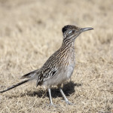
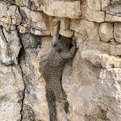
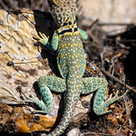
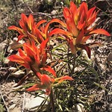
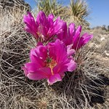
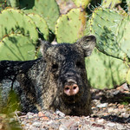
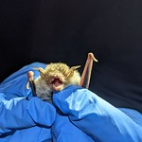
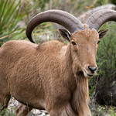
CONCLUSION
NO₂ concentrations have increased in the Guadalupe Mountains and Carlsbad Caverns National Parks during the past 10 years. These findings correspond with oil & gas activity in the area.
Images show native wildlife in GUMO and CAVE.
Image Credit: NPS/Daniel Leifheit, Dan Pawlak, Erin Lynch, Anthony Mazzucco, Kailey Day
Notes:
Perrin (1.5 mins)
In conclusion, we found that NO2 concentrations have increased in the Guadalupe Mountains and Carlsbad Caverns National Parks during the past 10 years and that these findings correspond with oil and gas activity in the area.
To summarize, our analysis capitalized on 2 satellite sensing instruments: 1. OMI and 2. TROPOMI; 2 ground-based sources: 1. a single EPA NO2 monitor and 2. gas/oil flare data from New Mexico's Oil Conservation Division. We also exploited wind data from the area to inform air transport.
For data processing we oversampled column densities using IDL code and to create monthly and seasonal maps we used ArcGIS. As for data analysis, we plotted trends and regression in Python – although did not include these figures as part of this presentation.
These methods are useful in areas such as GUMO and CAVE national parks when ground monitor data is not available.
The outputs from this project may be used to inform the placement of future air monitoring stations in the Guadalupe Mountains and Carlsbad Caverns National Parks, which could better inform visitors, NPS staff, or other stakeholders for improved park experience, health, and stewardship.
------------------------------Image Information Below ------------------------------
•Image Credit: Greater RoadRunner, NPS/Daniel Leifheit
•Image Source: Carlsbad Caverns National Park, https://flickr.com/photos/193079646@N03/51201856757/
•Image Credit: Eastern Collared Lizard, NPS/Dan Pawlak
•Image Source: Carlsbad Caverns National Park, https://flickr.com/photos/193079646@N03/51232199964/
•Image Credit: Strawberry Cactus, NPS/Dan Pawlak
•Image Source: Carlsbad Caverns National Park, https://flickr.com/photos/193079646@N03/51230752197/
•Image Credit: White Nose Syndrome Surveillance at Rattlesnake Springs, NPS/Erin Lynch
•Image Source: Carlsbad Caverns National Park, Flickr https://flickr.com/photos/193079646@N03/51337755670/
•Image Credit: Rock Squirrel, NPS / Anthony Mazzucco
•Image Source: Carlsbad Caverns National Park, https://flickr.com/photos/193079646@N03/51203395974/
•Image Credit: Desert Paintbrush, NPS / Kailey Day
•Image Source: Carlsbad Caverns National Park, https://flickr.com/photos/193079646@N03/51203606845/
•Image Credit: Javelina; Collared Pecary, NPS / Dan Pawlak
•Image Source: Carlsbad Caverns National Park, https://flickr.com/photos/193079646@N03/51232216024/
•Image Credit: Barbary Sheep, NPS / Dan Pawlak
•Image Source: Carlsbad Caverns National Park, https://flickr.com/photos/193079646@N03/51202624011/

Slide 15
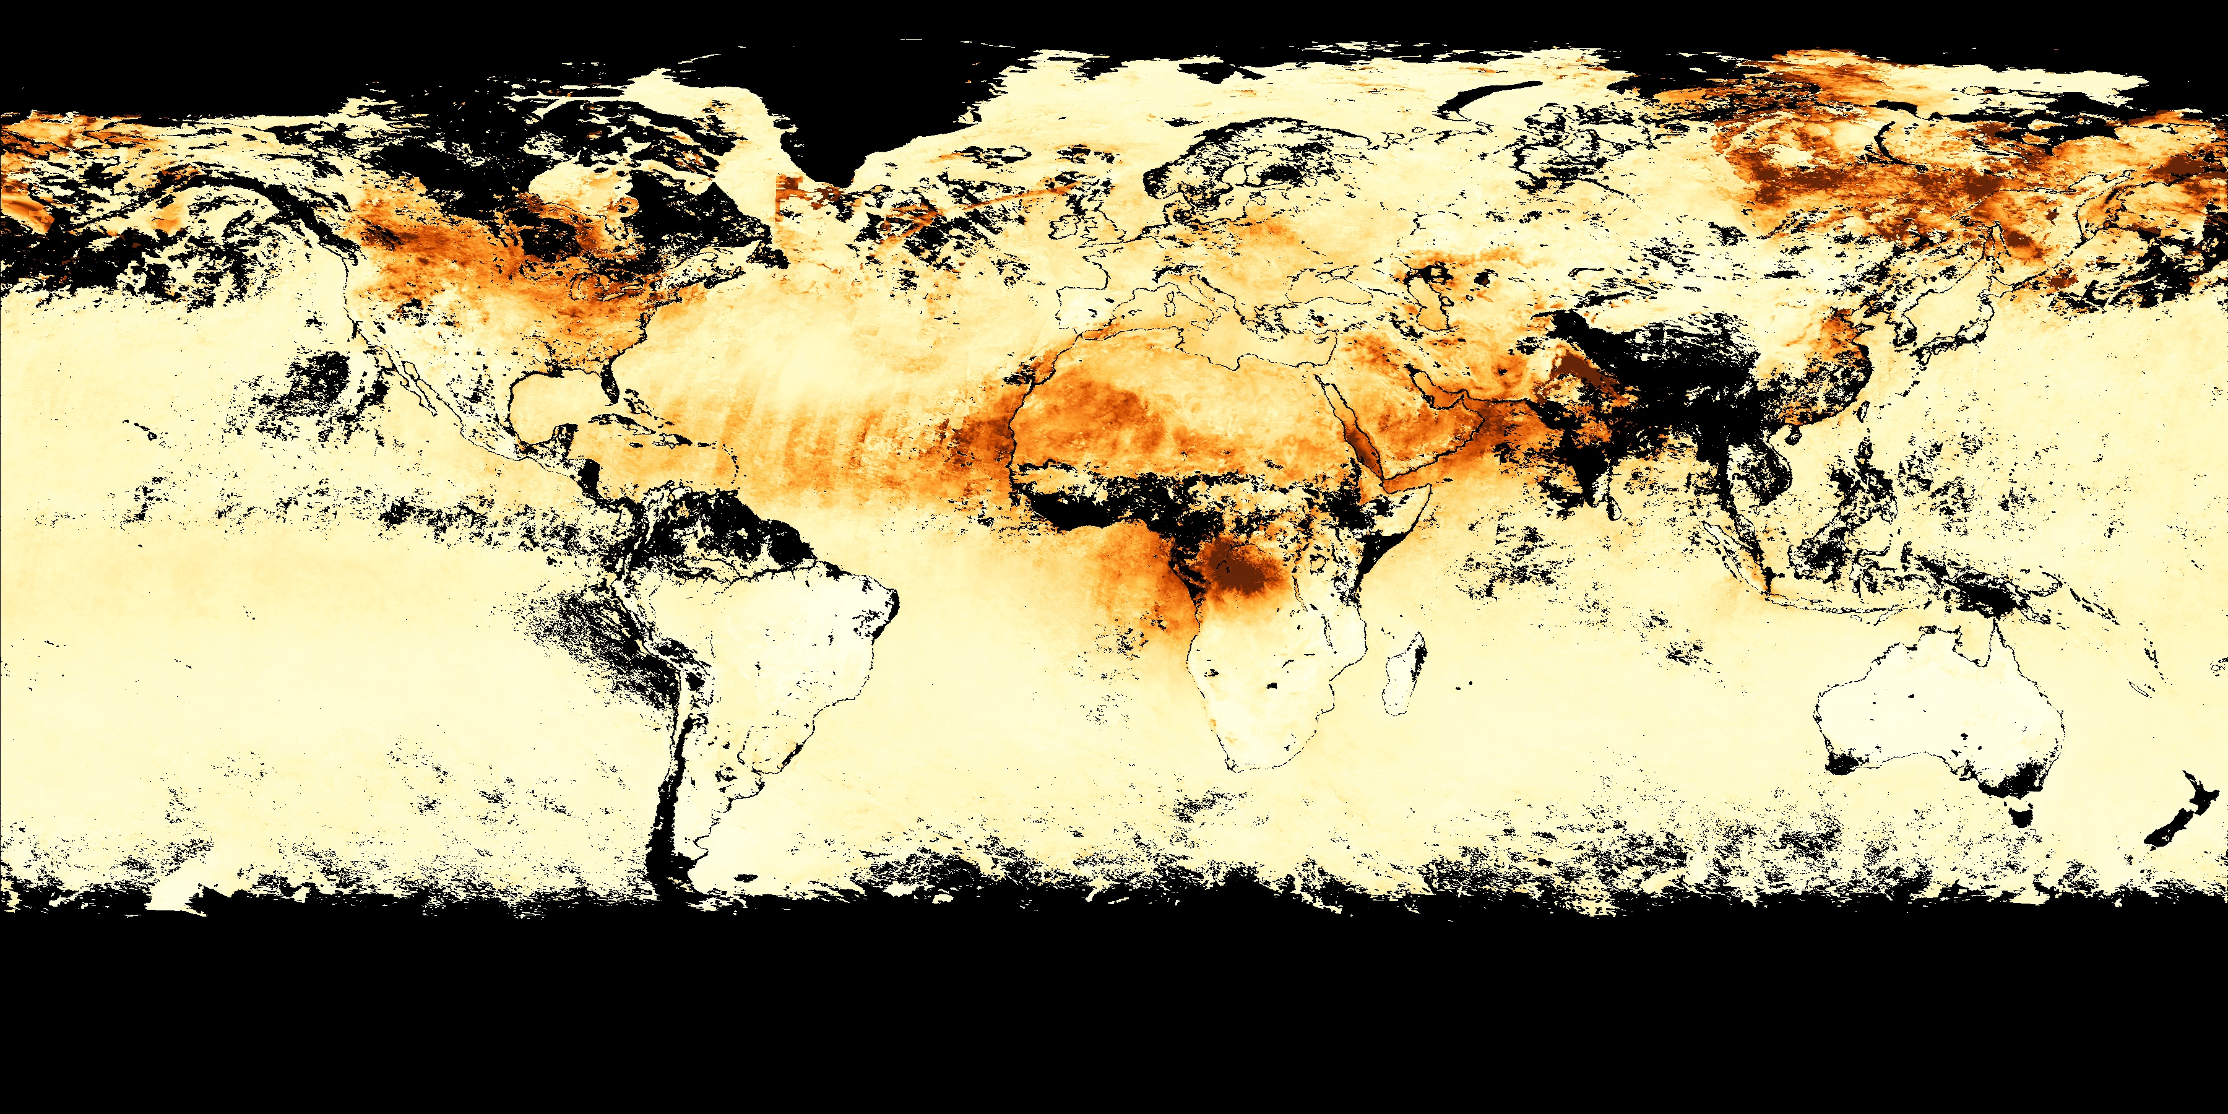
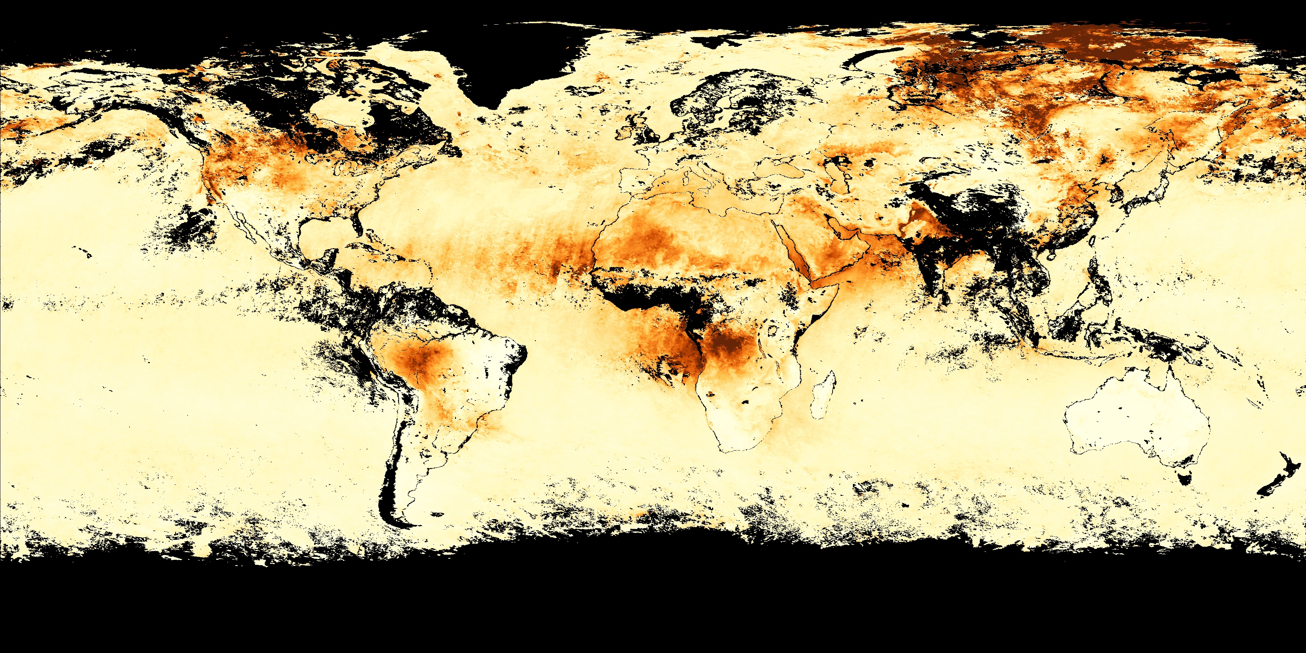
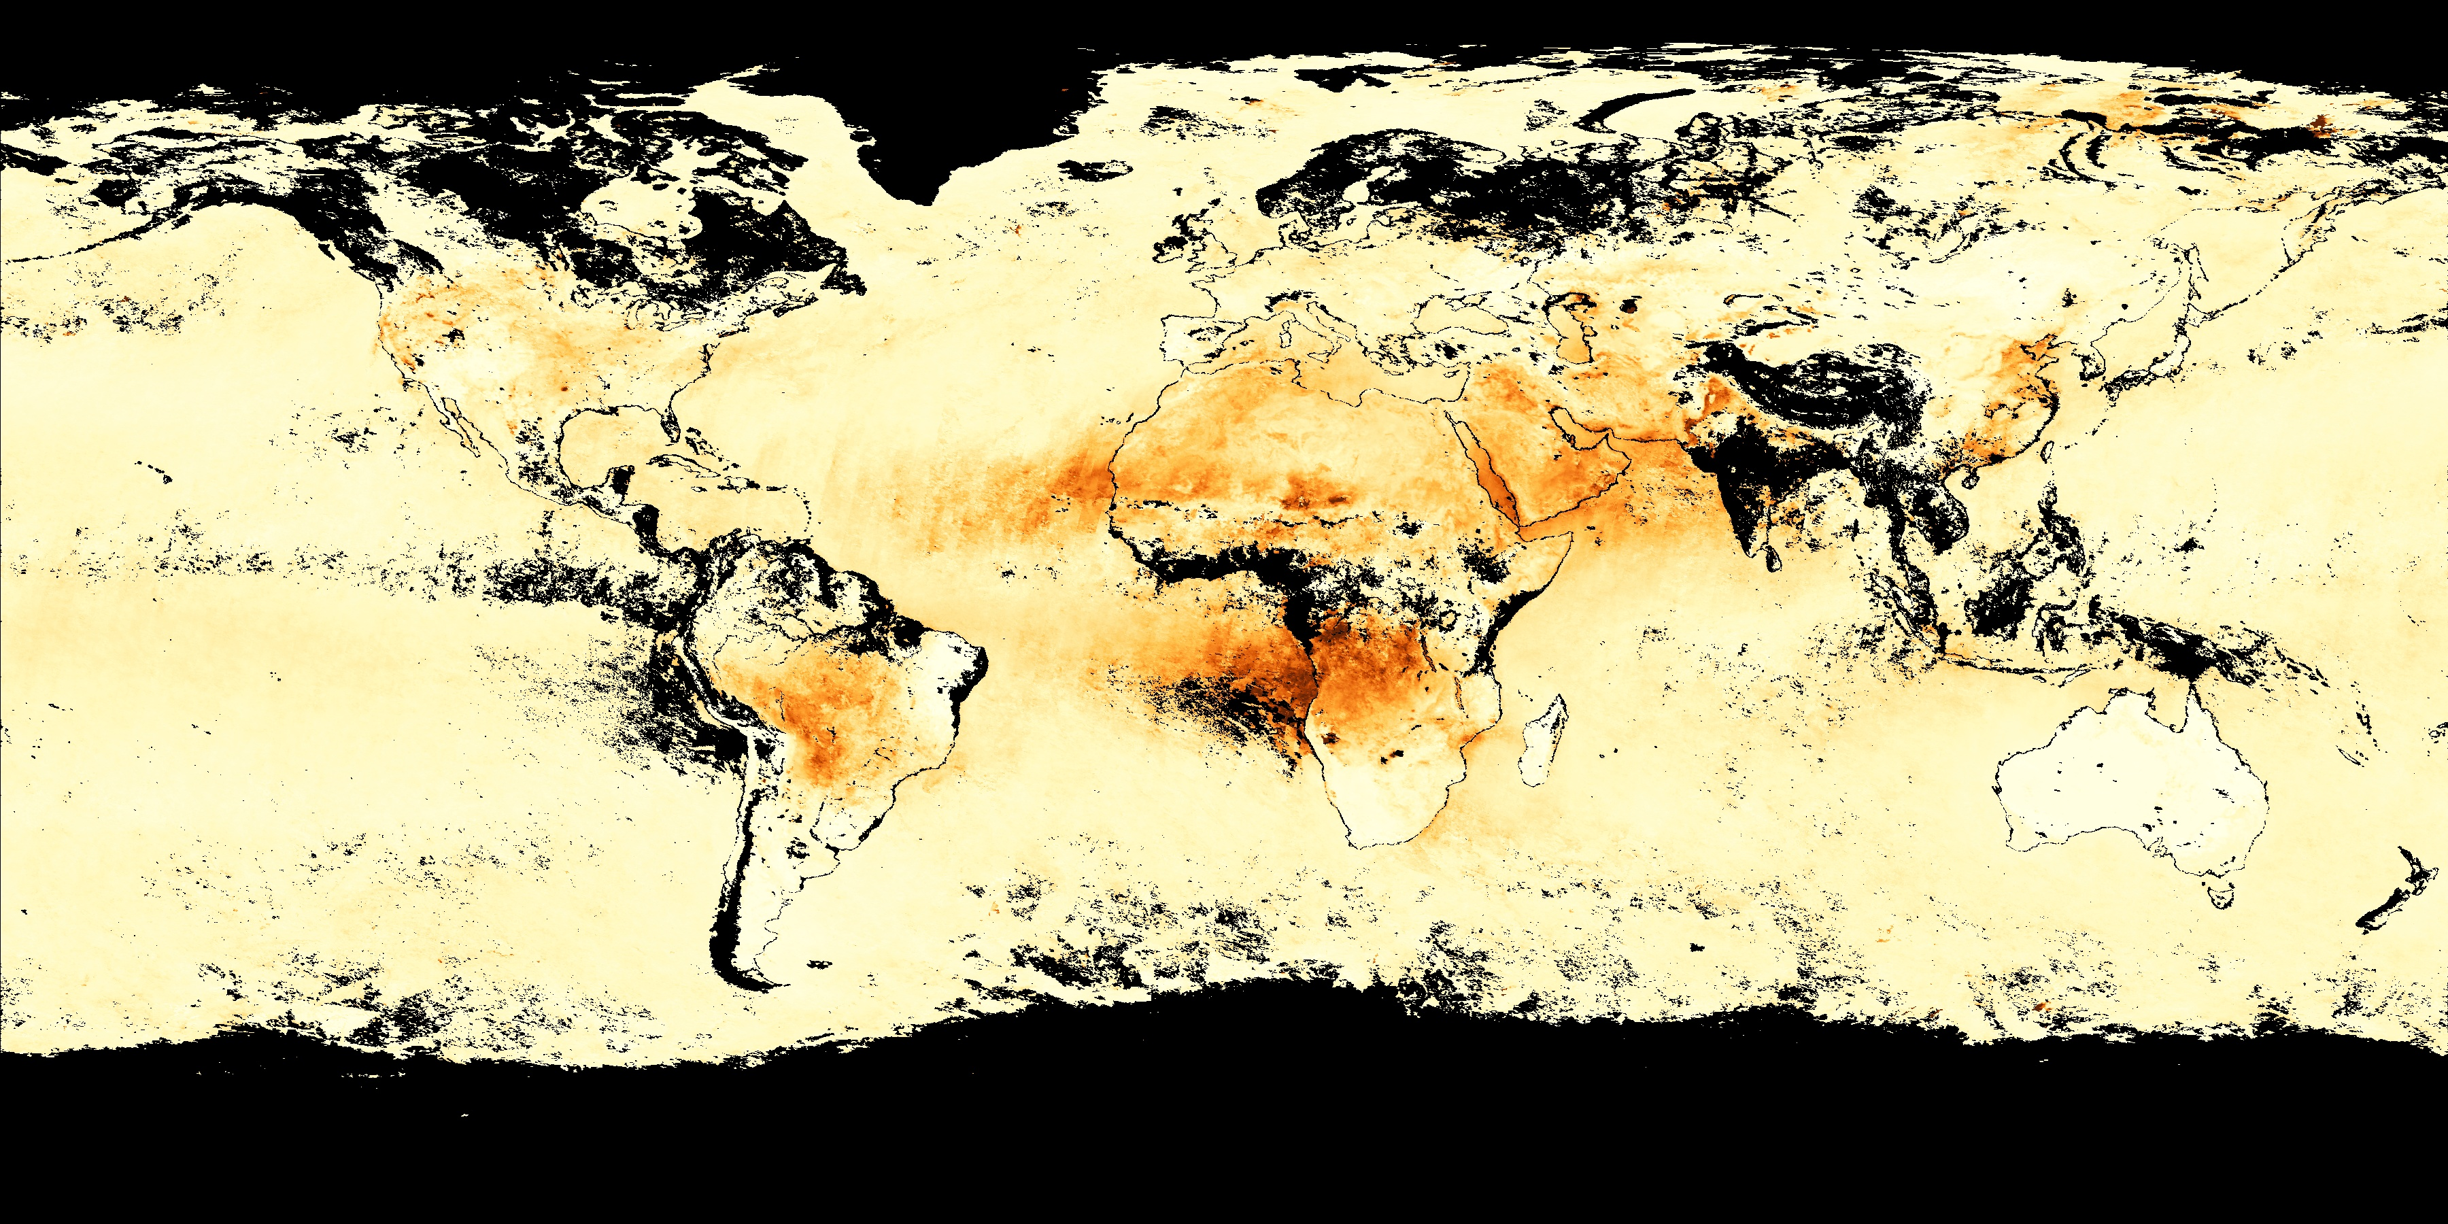
FUTURE WORK
Integrate additional atmospheric algorithms for air quality, like AOD (Aerosol Optical Depth).
Quantify effects from air pollution on vegetation, water quality, and health.
Consider demographic proxy data, including traffic density and population information.
Compare satellite data with more precise ground monitoring measures.
Global average Aerosol Optical Depth Jul. – Sep. 2021
Image Credit: NASA Earth Observatory
Notes:
Perrin (1.5 mins):
Now let's talk about future work! With this being the first term to conceptualize this project in the Delaware Basin, we believe this work can be expanded in a number of ways.
First, aerosol optical depth would be a logical next measure to investigate, given its contribution to deteriorating visibility. AOD is closely related to PM and can change the distance that light may be seen through the air.
Second, we quantified NO2 temporally and spatially; however, we did not go further to investigate the effects of these pollutants on local resources like vegetation or water quality. We also did not explore the health impacts. It would be really interesting to look more specifically at these effects that directly impact the parks.
We also refined the scope of this project to oil and gas contributions to NO2 concentrations, but it would help to determine other variables, such as traffic density, population growth, or other demographic factors that have changed over the past decade.
Our analysis was not able to utilize a wide network of air monitors; actually there was only one EPA NO2 monitor that was available in the area to verify satellite measures from the ground. But it is possible after this project to pinpoint ideal locations for NO2 monitors to create a larger scale network of ground-based monitors that could be used to compare satellite data more accurately.
------------------------------Image Information Below ------------------------------
•Image Credit: Aerosol Optical Depth
•Image Source: NASA Earth Observations, https://earthobservatory.nasa.gov/global-maps/MODAL2_M_AER_OD#:~:text=An%20optical%20thickness%20of%20less,places%20and%20times%20of%20year.

Slide 16
Partners
Science Advisors
Lisa Devore, National Park Service Intermountain Region
Erin Lynch, Carlsbad Caverns National Park
Mike Medrano, Guadalupe Mountains National Park
Dr. Laura Judd, NASA Langley Research Center
Dr. Elizabeth Wiggins, NASA Langley Research Center
Dr. Kenton Ross, NASA Langley Research Center
NASA DEVELOP
Special Thanks
Adriana Le Compte, Langley Research Center
Dr. Daniel Goldberg, George Washington University
This material contains modified Copernicus Sentinel data 2018 – 2021, processed by ESA
Notes:
Perrin (1 min):
Before we close, our team wants to thank everyone for attending our presentation today. We would also like to give a huge thanks to our partners with the National Park Service at Carlsbad Caverns and the Guadalupe Mountains National Parks.
Thank you Lisa Devore, Erin Lynch, and Mike Medrano for offering your experience on the ground, which ultimately led to the successful completion of this DEVELOP project.
We'd also like to thank our science advisors, Dr. Laura Judd and Elizabeth Wiggins, whose technical and scientific expertise were instrumental to the team and our methodologies.
We also want to give a special thanks to Dr. Daniel Goldberg at the George Washington University for his continuous support and guidance, whose contributions made this project possible and sustainable.
And lasty, we want to thank our node fellow, Adriana Le Compte, for her day-to-day leadership throughout the DEVELOP process. Thank you all.
Maps throughout this work were created using ArcGIS® software by Esri. ArcGIS® and ArcMap™ are the intellectual property of Esri and are used herein under license.

