Slide 1
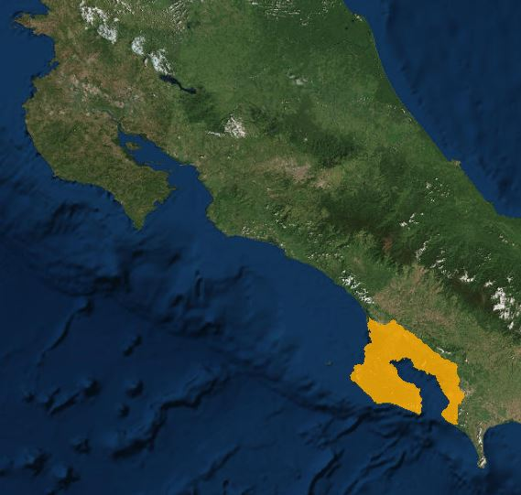
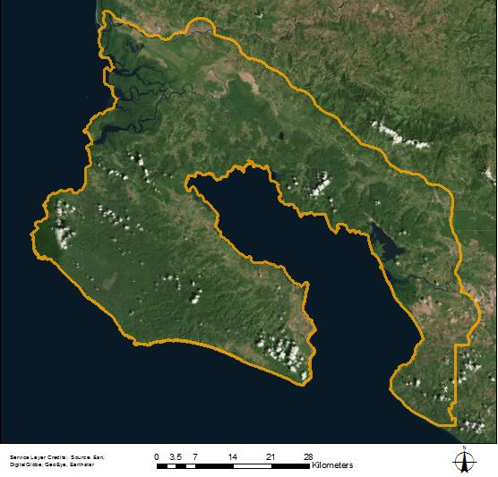
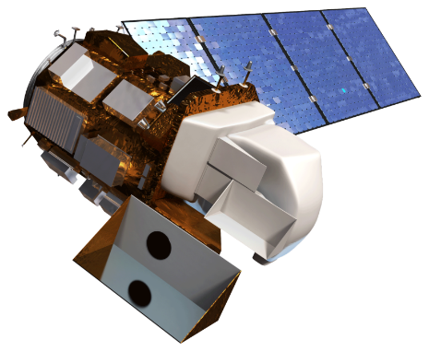
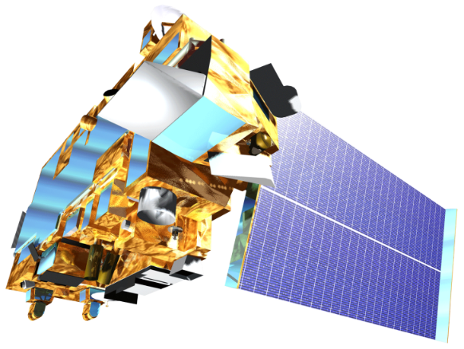
Assessing Threats to River Water Quality and Mangrove Health Based on Watershed Land Use on the Osa Peninsula, Costa Rica
Abstract
Study Area
The Osa Peninsula, located in the southern region of Costa Rica’s Pacific Coast, is one of the most biologically-diverse places on Earth and is a popular ecotourism destination. However, the area faces watershed degradation and loss of biodiversity due to deforestation, pollution from agriculture, and human settlement. NASA DEVELOP worked with Osa Conservation to analyze land use and land cover change in the Osa Peninsula to better understand threats to river water quality and mangrove health. This project used Landsat 5 Thematic Mapper (TM), Landsat 8 Operational Land Imager (OLI), Terra Advanced Spaceborne Thermal Emission and Reflection Radiometer (ASTER), to create a land cover time series map from 1987 to 2017. These time series data were used to compare land use over time, as well as patterns in water quality, mangrove health, erosion, and deforestation. The time series also helped to identify the impact of the creation of protected areas and the 1996 Forest Law 7575, which aimed to support reforestation and riparian health. Osa Conservation will use and distribute results to the National System of Conservation Areas (SINAC), Ministry of Environment and Energy (MINAE), and local communities to inform land management decisions, policy enforcement, education and outreach initiatives, and watershed restoration and monitoring.
Costa Rica
Project Partner
Earth Observations
Objectives
Osa Conservation
Produce high resolution time series maps of land use and land cover change in the Osa Peninsula for the years 1987, 1999 and 2017.
Determine the rates of land use change in riparian zones.
Quantify the effectiveness of the 1996 Forest Law 7575 in curbing deforestation and erosion in riparian zones.
Create accessible public outreach materials to inform the local community on how to implement sustainable practices.
Landsat 8 OLI
Landsat 5 TM
Terra ASTER
Methodology
Data Collection
Results
Terra ASTER
Landsat 5 TM
PlanetScope
Land Cover Classification
Include a map that has easily readable text and a legend. Including the study period is optional.
For ALL images – make sure all text is legible and add legends separately (so they can be moved or resized). If text is not editable, a team member must be available to make changes with a very short turn-around time (hours, not days) after submission.
DEM:
Elevation Data
Landsat 8 OLI
2016
2017
1987
1999
2017
Forest
ArcMap:
Unsupervised Classification
Water
Palm
Bare/Urban
Grassland
Negra forra
ArcMap:
NDVI Analysis
1987
1999
2017
Wetland
Land Cover Time Series
High Resolution Land Cover Map – Case Study Area
(2016-2017)
Change in Normalized Difference Vegetation Index (NDVI) between 1987 and 2017
Area of Major Land Cover Types for 1987, 1999 and 2017 (%)
Increase in NDVI
No Change
Decrease in NDVI
Conclusions
A comparison between the classifications for 1987 and 2017 indicate that palm plantation, urban/bare area, and grassland decreased while negra forra, water, forest, and wetlands increased.
The Osa Peninsula saw a 10.7% increase in vegetation cover between 1987 and 2017 as indicated by our land cover classification and NDVI analysis.
These results demonstrate historical land cover change trends and provide insights for evaluating policies and conservation strategies.
Acknowledgements
Dr. Marguerite Madden, University of Georgia
Hilary Brumberg, Osa Conservation
Dr. Andy Whitworth, Osa Conservation
Team Members
Suravi Shrestha
Project Lead
Marie Bouffard
John Langstaff
Candice Lee
Emily Pauline
Sam Tingle
Osa Peninsula Water Resources
Georgia – Athens | Spring 2018

