Slide 1
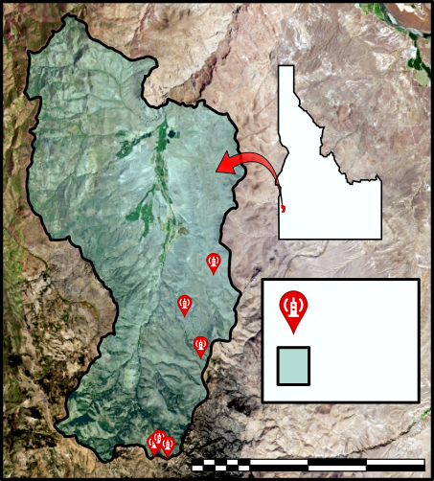
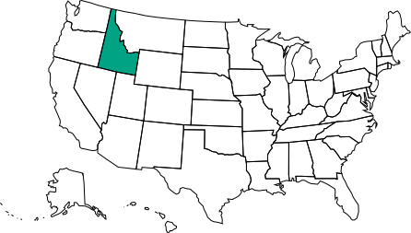
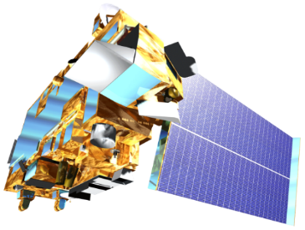
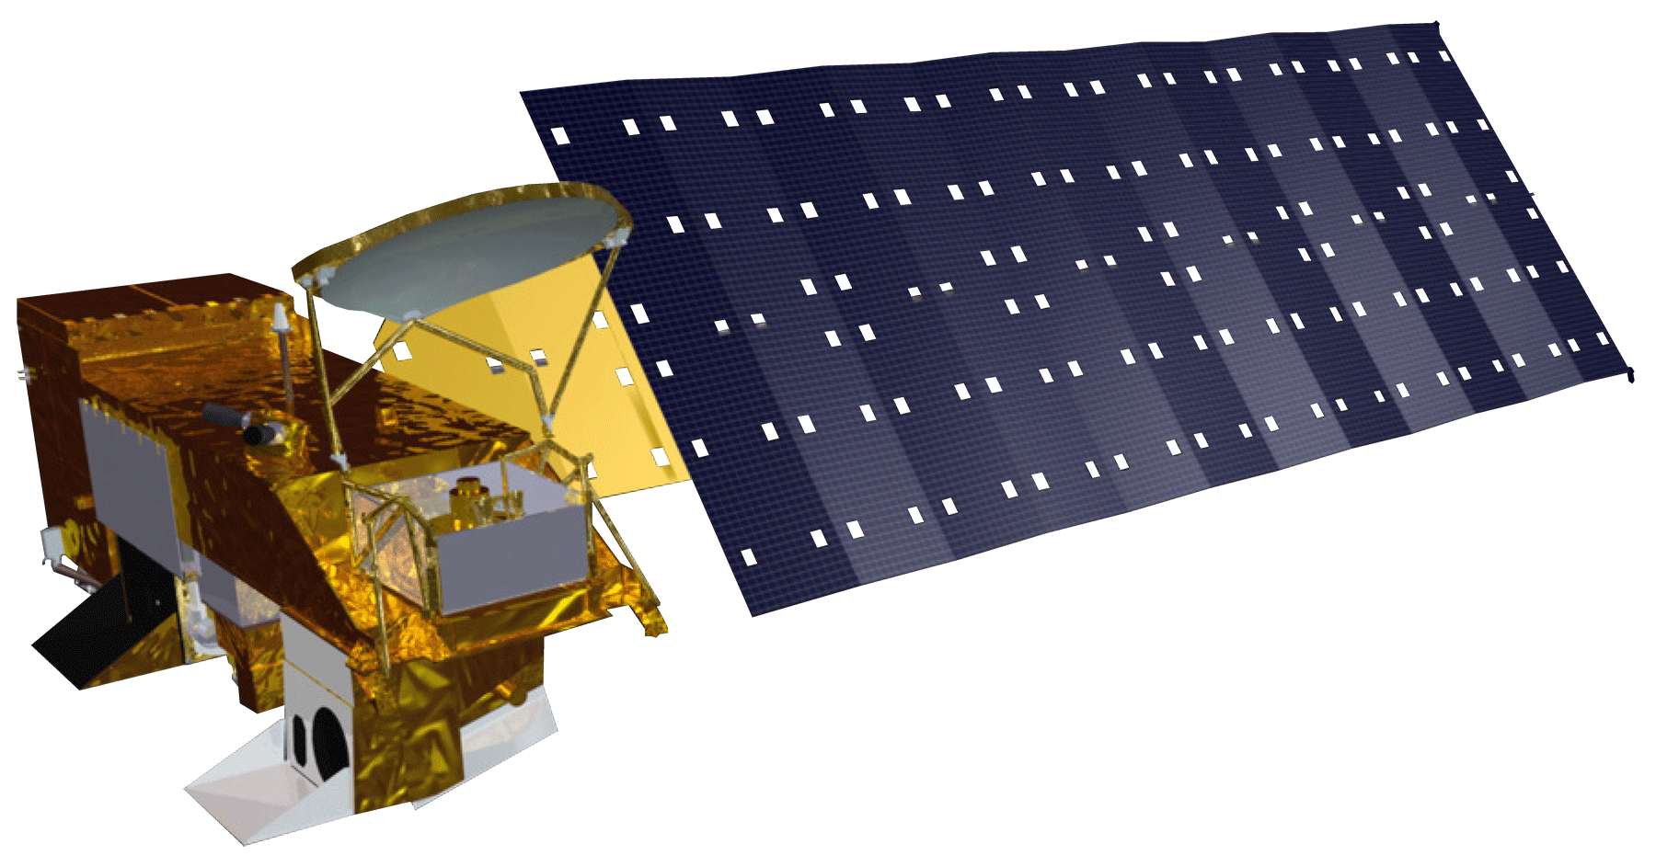
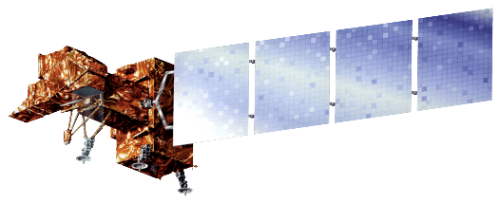
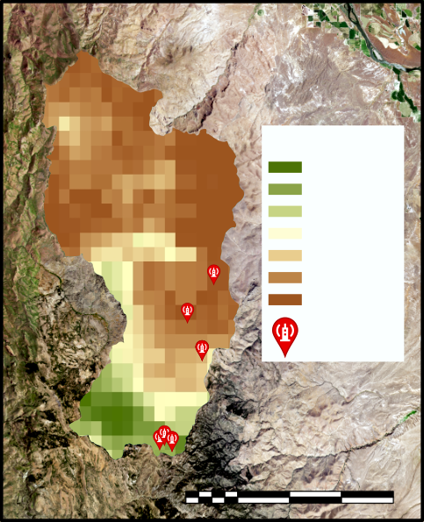
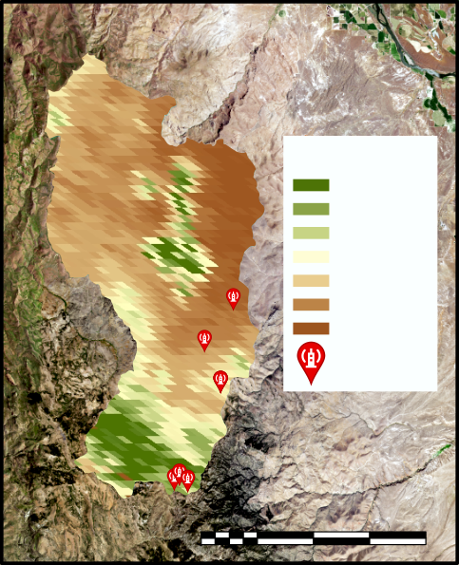
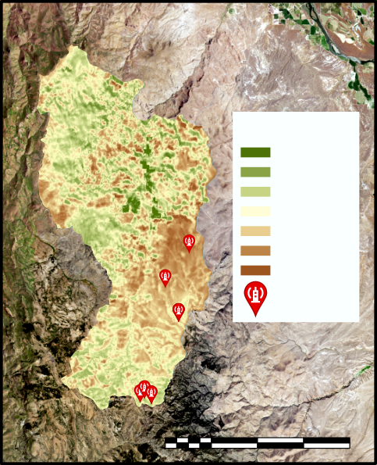
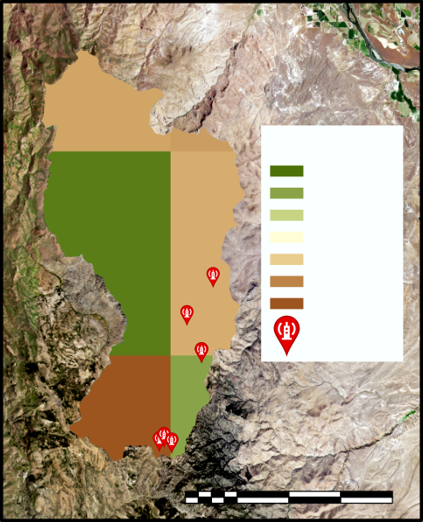
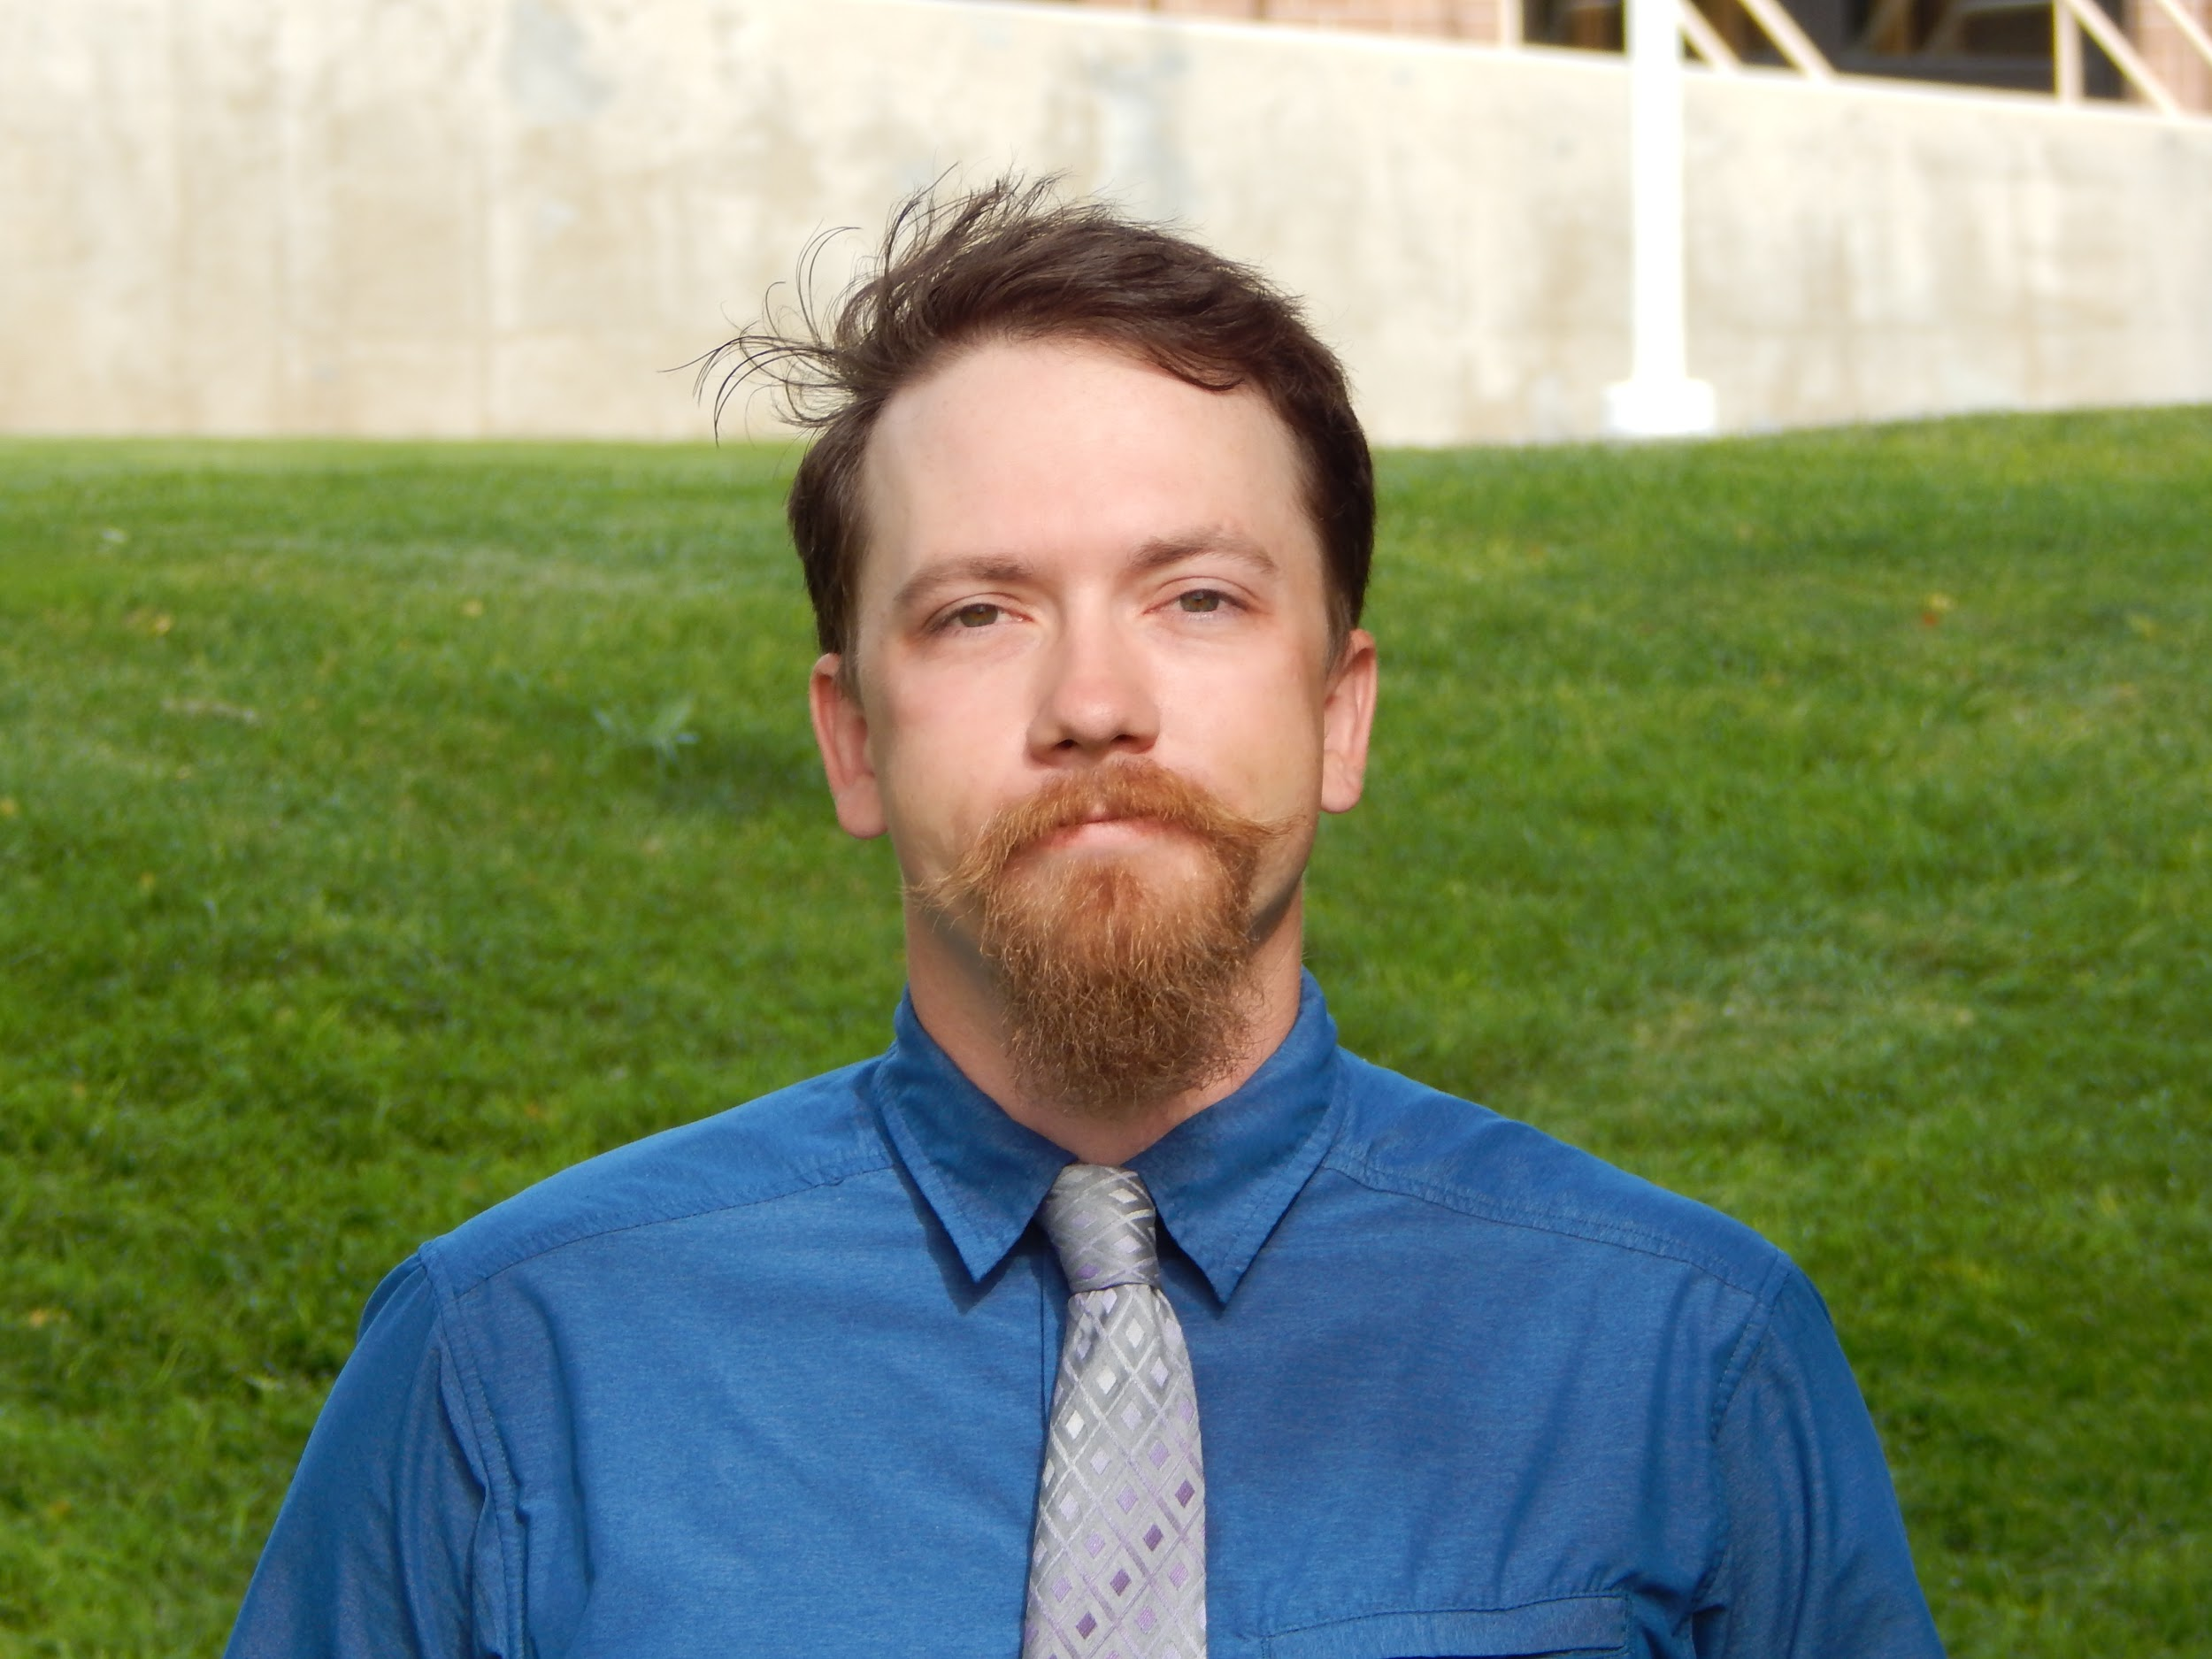
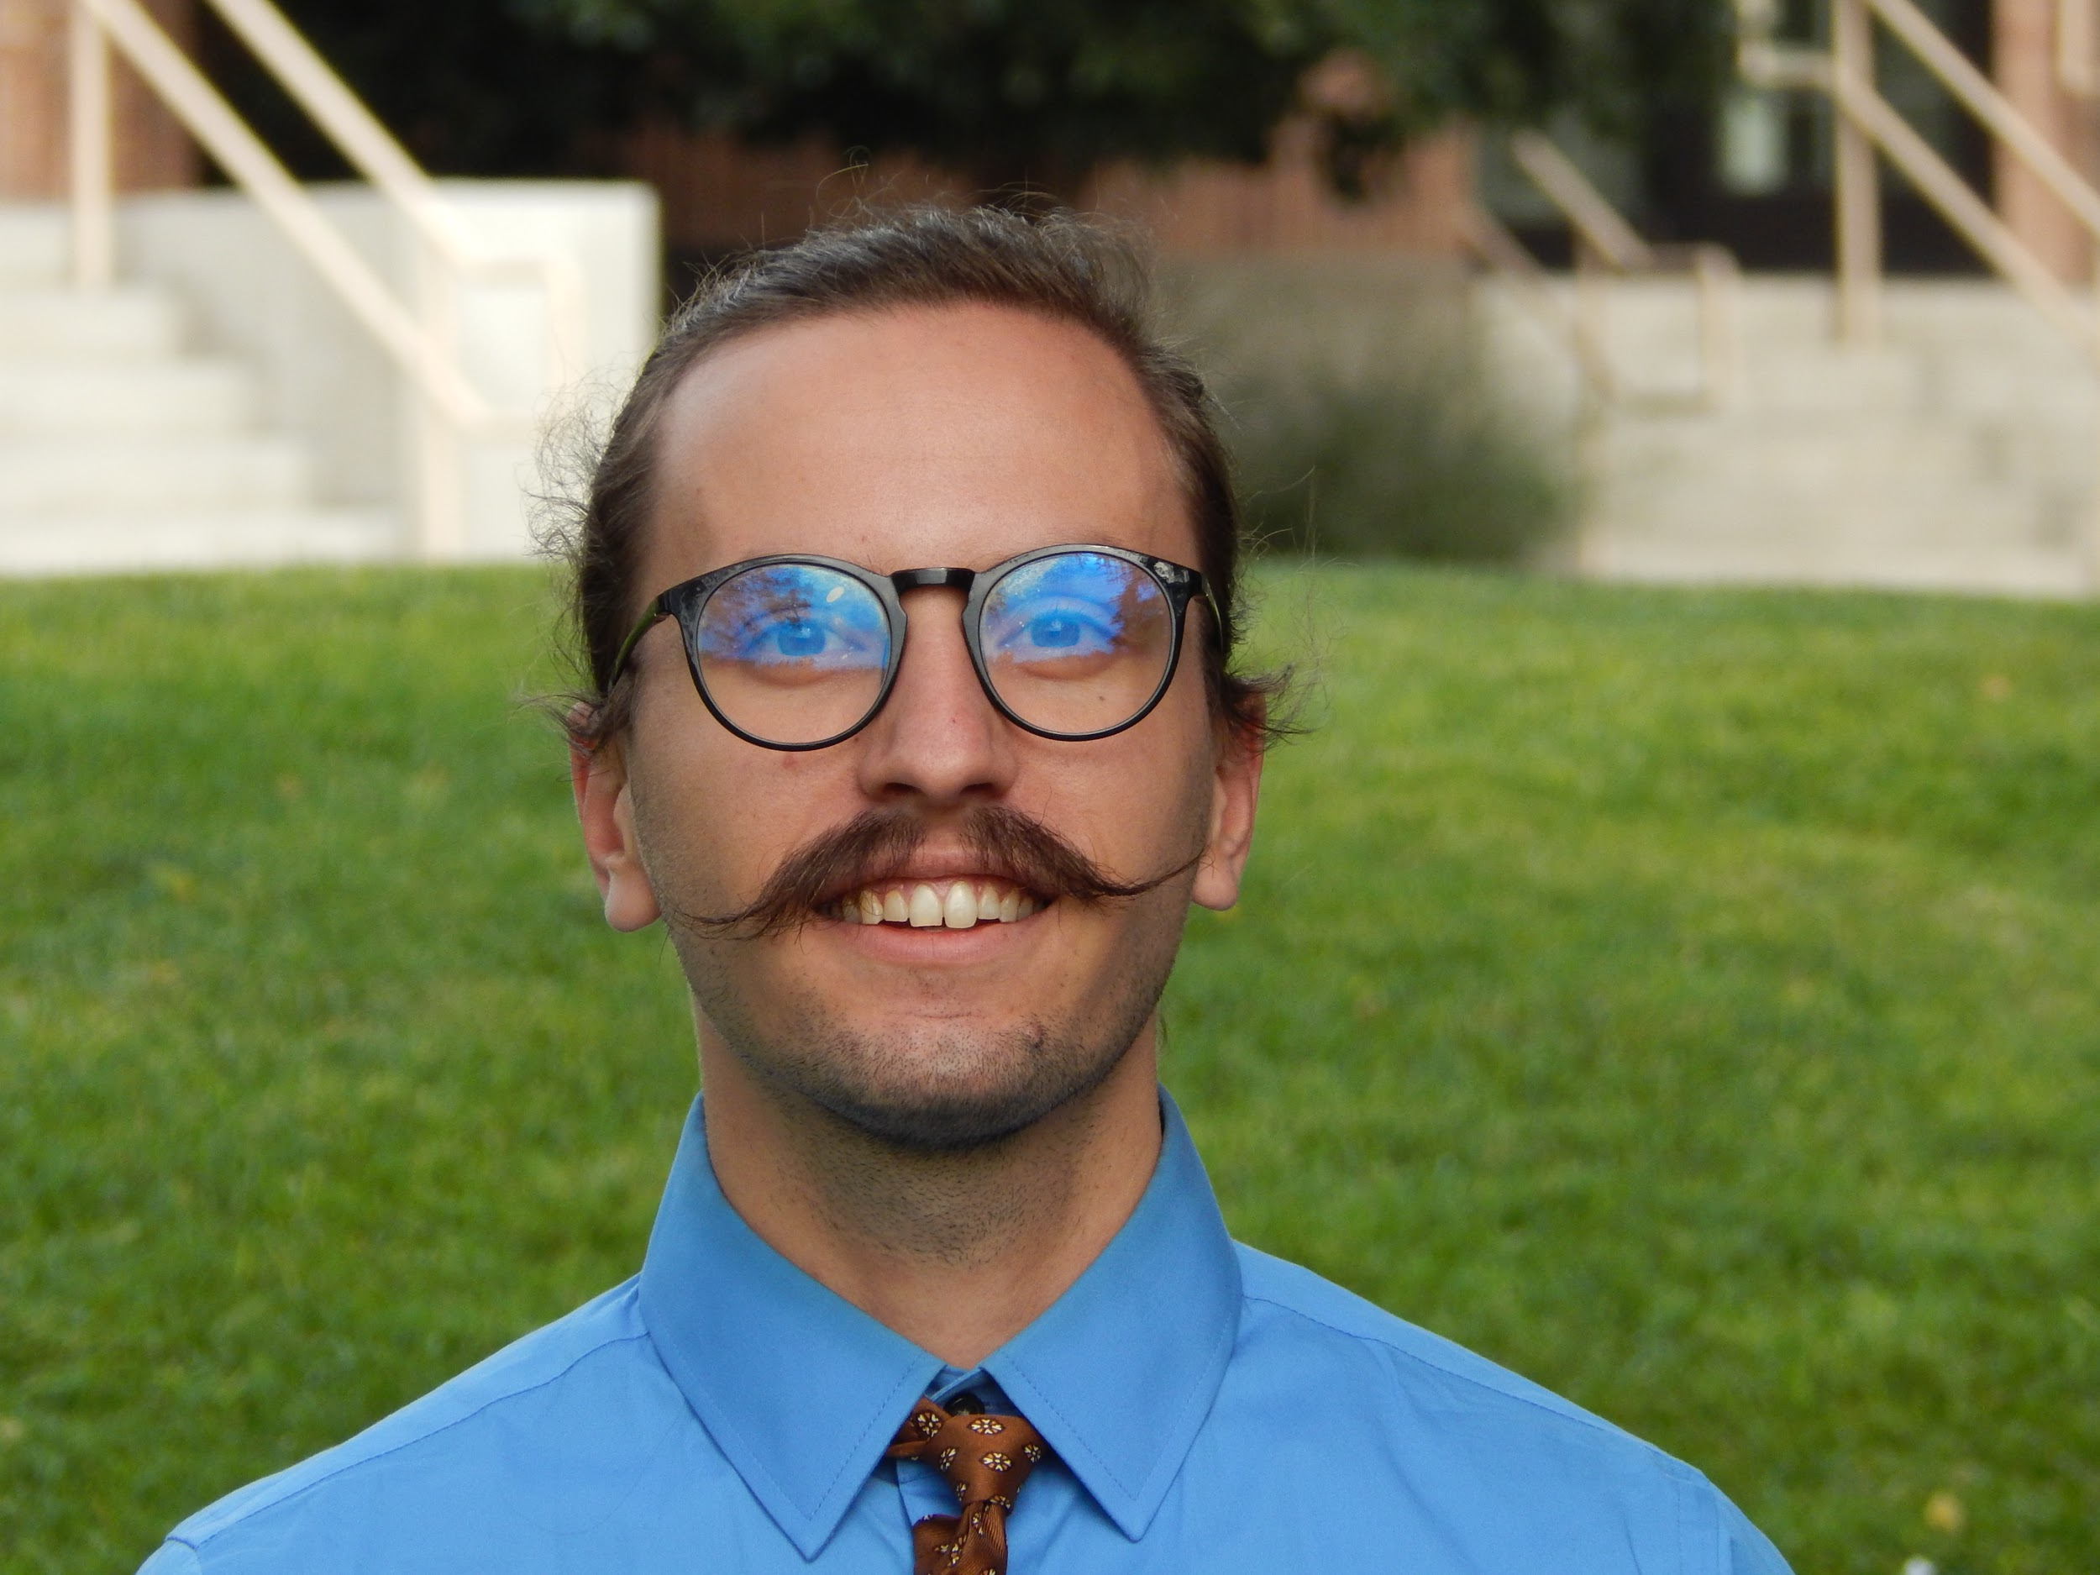
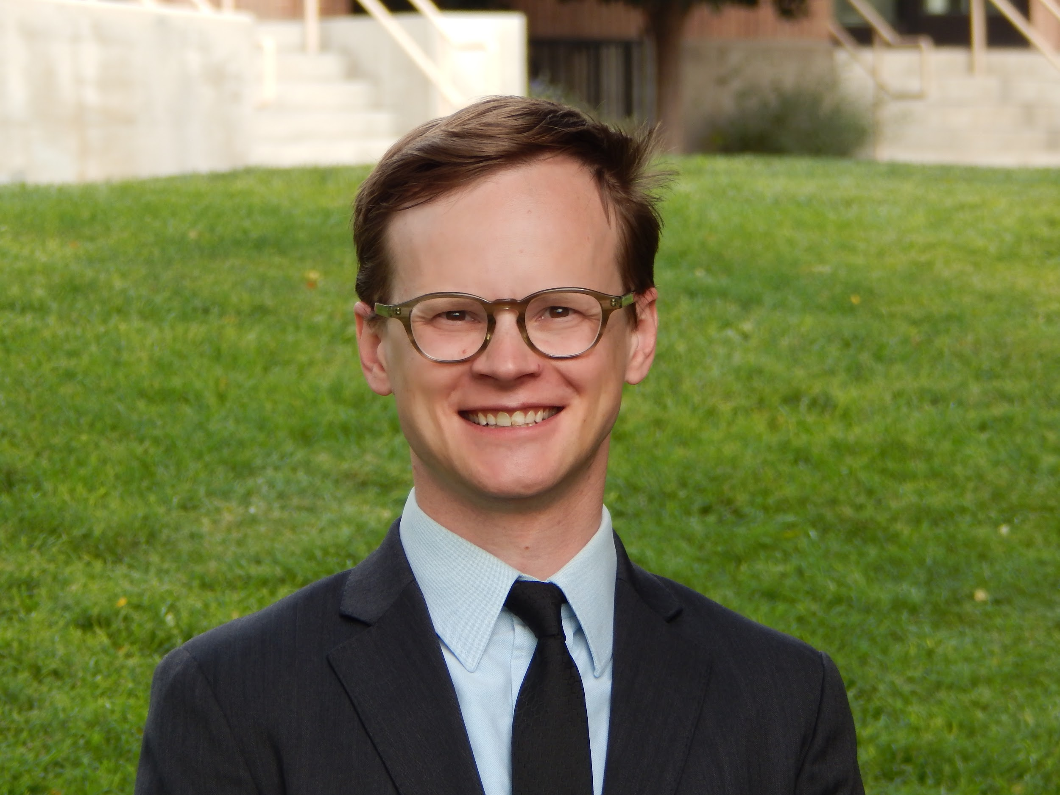
Evaluating Evapotranspiration and Water Budget Components in Semi-Arid Sagebrush Steppe
Abstract
Objectives
Evapotranspiration (ET) is a vital component of the hydrologic cycle, especially in semi-arid environments; water availability can have a substantial impact on ecosystem services, such as grazing patterns of native and domesticated animal populations, vegetation health, and fire susceptibility. Current practices to measure ET rely on costly field sampling approaches or models that are typically calibrated for agricultural land cover. Validating remotely-sensed ET models with paired in situ eddy covariance flux tower data from Reynolds Creek Experimental Watershed (RCEW) will increase the confidence of measuring ET using remotely sensed data in the sagebrush steppe environment. ET estimates were derived from NASA Terra Moderate Resolution Imaging Spectroradiometer (MODIS) and Advanced Spaceborne Thermal Emission and Reflection Radiometer (ASTER), Landsat 8 Operational Land Imager (OLI) and Thermal Infrared Sensor (TIRS). Additionally, the project utilized modeled data from Google Earth Engine Evapotranspiration Flux (EEFlux), Simplified Surface Energy Balance (SSEBop), MODIS Global ET Project (MOD16), and North American Land Data Assimilation System (NLDAS-2 Noah). The NLDAS-2 Noah model produced the best correlation to the RCEW in situ measurements, with an average coefficient of determination of r2 = 0.87. The other three models resulted in coefficients ranging from r2 = 0.086 (MOD16) to r2 = 0.86 (EEFlux). Although NLDAS-2 Noah has the lowest spatial resolution of the tested models (~12 km), it has the highest temporal resolution (hourly), which is promising for developing hybrid models paired with higher spatial resolution datasets such as SSEBop.
Assess the potential of multiple models to map ET across semi-arid environments
Validate models by comparing them to in situ measurements
Compare ET data to soil moisture, vegetation health, and precipitation data to produce a holistic view of water availability in Reynold’s Creek Experimental Watershed
Produce a model or methodology that can be used by project partners in their respective disciplines
Study Area
Methodology
DATA INPUTS
ANALYZE
COMPARE
OUTPUT
GEE ET Models: EEFlux
MOD16
IDAHO
Google Earth Engine:
Combine GEE and in situ data; extract values at RCEW sites
Earth
Observations
In situ ET, soil moisture, NDVI
Compare ET maps to elevation, soil moisture, etc.
ET Maps & Correlation
Plots
E.C. Flux
Towers
ArcGIS Pro:
Clip to study area; extract values at RCEW Points
Study Area Outline
Terra MODIS
& ASTER
Landsat 8
OLI & TIRS
Other Models: SSEBop,
NLDAS-2-Noah
Results
0 5 10 20 km
Aqua MODIS
Landsat 7
ETM+
SSEBop
MOD16
EEFlux
NLDAS-2-Noah
Evapotranspiration
Evapotranspiration
Evapotranspiration
Evapotranspiration
110
45
15
60
(mm/
month)
(mm/
8 days)
(mm/
8 days)
(mm/
month)
0
0
0
0
E.C. Flux Towers
E.C. Flux Towers
E.C. Flux Towers
E.C. Flux Towers
0 5 10 20 km
0 5 10 20 km
0 5 10 20 km
0 5 10 20 km
SSEBop
MOD16
EEFlux
NLDAS-2-Noah
E.C. Flux
Tower Sites
Mtn. Sage 1
Low Sage
Mtn. Sage 2
WY Sage
Conclusions
Month
Team Members
NLDAS-2 Noah was the best estimator of in situ ET measurements and had the best temporal resolution at 1 hr, but had the lowest spatial resolution.
Choose ET model based on the question you want to answer – different spatial and temporal scales mean they would apply to different problems.
Sharpening high temporal resolution (NLDAS) data with high spatial resolution models (SSEBop, MOD16, or EEFlux) has the potential to be an ideal model.
Ian Lauer
Project Lead
Carl Jurkowski
Carolyn Macek
Frank Zurek
Project Partners
Acknowledgements
Idaho National Laboratory
Idaho Department of Fish and Game
The Idaho Water Resources II team would like to thank our partners, advisors, collaborators, and contributors for their help: Ian Lauer, Dane Coats, Leah Kucera, Zach Sforzo, and Madison Broddle (Idaho Water Resources I Team); Keith Weber (GIS Training and Research Center at ISU); Evan Ohr, Lisa Dlugolecki, and Matt Bringhurst (US Fish and Wildlife Service); Dr. Scott Bergen (Idaho Department of Fish and Game); Nate Matlack and Trudy Pink (USDA Natural Resource Conservation Service); Dr. Patrick Clark and Mark Seyfried (USDA Agricultural Research Service); and Tammie Borders and Trent Armstrong (Idaho National Laboratory).
Idaho Water Resources II
Idaho – Pocatello | Fall 2018

