Slide 1
Southern Rockies Ecological Forecasting
Using NASA Earth Observations to Identify and Predict Suitable Mule Deer Habitats
Ross Reahard (Project Lead)
Teresa Fenn
Jeri Wisman

Slide 2
Study area
SRLCC States
SRLCC Boundary
Mule Deer Winter Range
Idaho
Idaho
Wyoming
Wyoming
Idaho
Utah
Wyoming
Colorado
Utah
Colorado
Utah
Colorado
Arizona
New Mexico
New Mexico
Arizona
Arizona
New Mexico
Study period 2010-2014

Slide 3

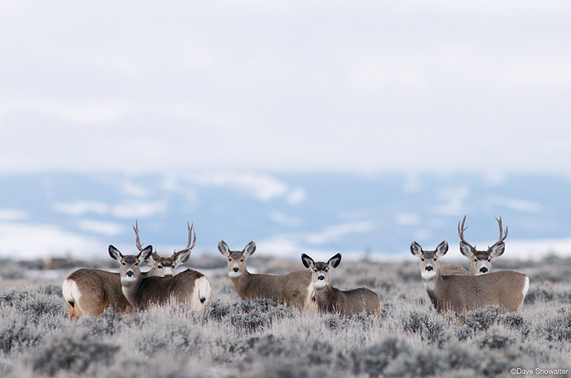


Community concerns
Economically important species
Ecologically important species
Facing land loss due to human development
Image credits: Dave Showalter Photography, Arabia Oil and Gas, Freshhome.com, Kansas AG Network
Notes:
House: http://cdn.freshome.com/wp-content/uploads/2013/08/selling-your-home-cedar-shingle-home.jpg
Farm: http://kansasagnetwork.com/wp-content/uploads/2015/01/agriculture-3.jpg
Gas: http://www.arabianoilandgas.com/pictures/gallery/Onshore/Kingdom3.jpg
Deer: http://www.daveshowalter.com/photo/winter-mule-deer/

Slide 4
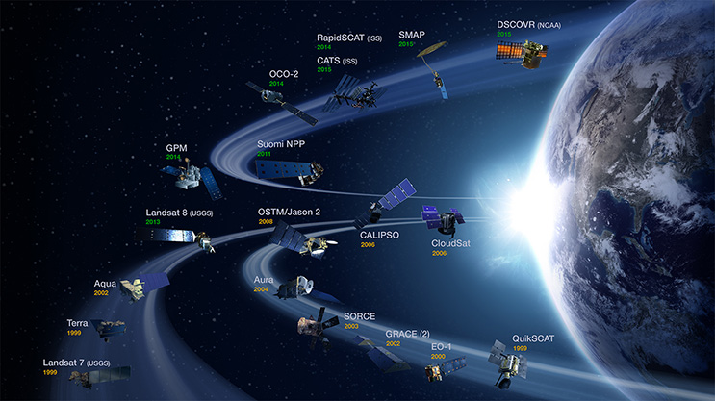


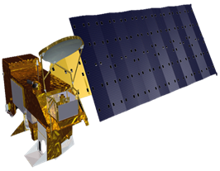

NASA satellites/ sensors used
The Southern Rockies LCC (SRLCC) expressed a need for an evaluation of habitat quality at a landscape scale, but how?
Landsat 8
Landsat 5
Terra
Aqua
Image Credit: NASA.gov
Notes:
NASA: http://eospso.nasa.gov/

Slide 5
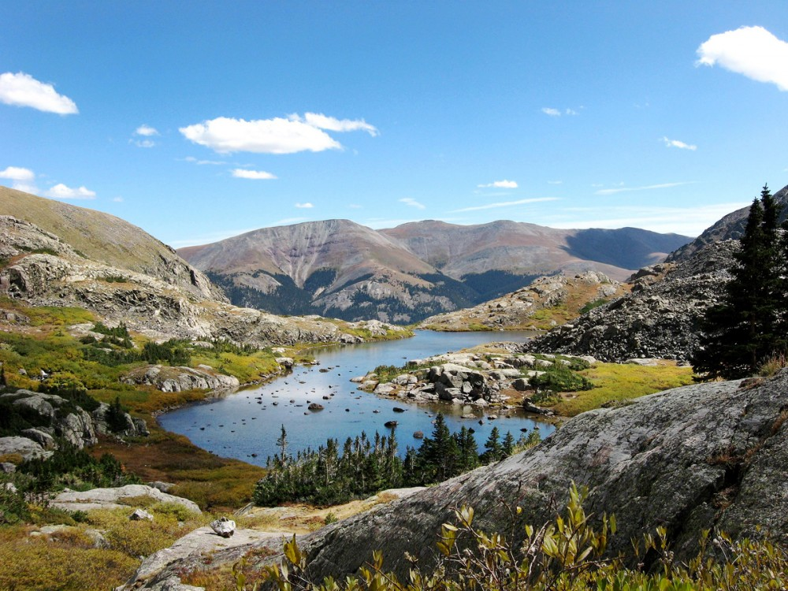



Partners
End-users
Southern Rockies LCC
John Rice, Science Coordinator
WAFWA Mule Deer Working Group
Jim Heffelfinger, Chair
Image Credit: Summit County Citizens Voice
Notes:
Background: http://summitcountyvoice.com/tag/hidden-gems-wilderness/

Slide 6
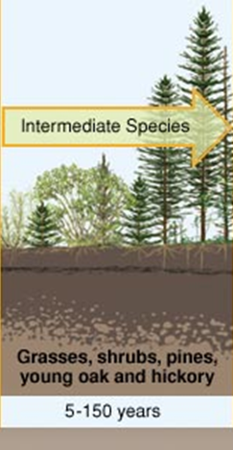

Fires’ impact
Areas recently disturbed by fires may serve as good habitat
Encourages browse plant growth
Potential increase in amount of available forage and thermal cover post-fire
Image Credit: Britannica
Notes:
Photo: http://www.britannica.com/science/ecological-succession

Slide 7
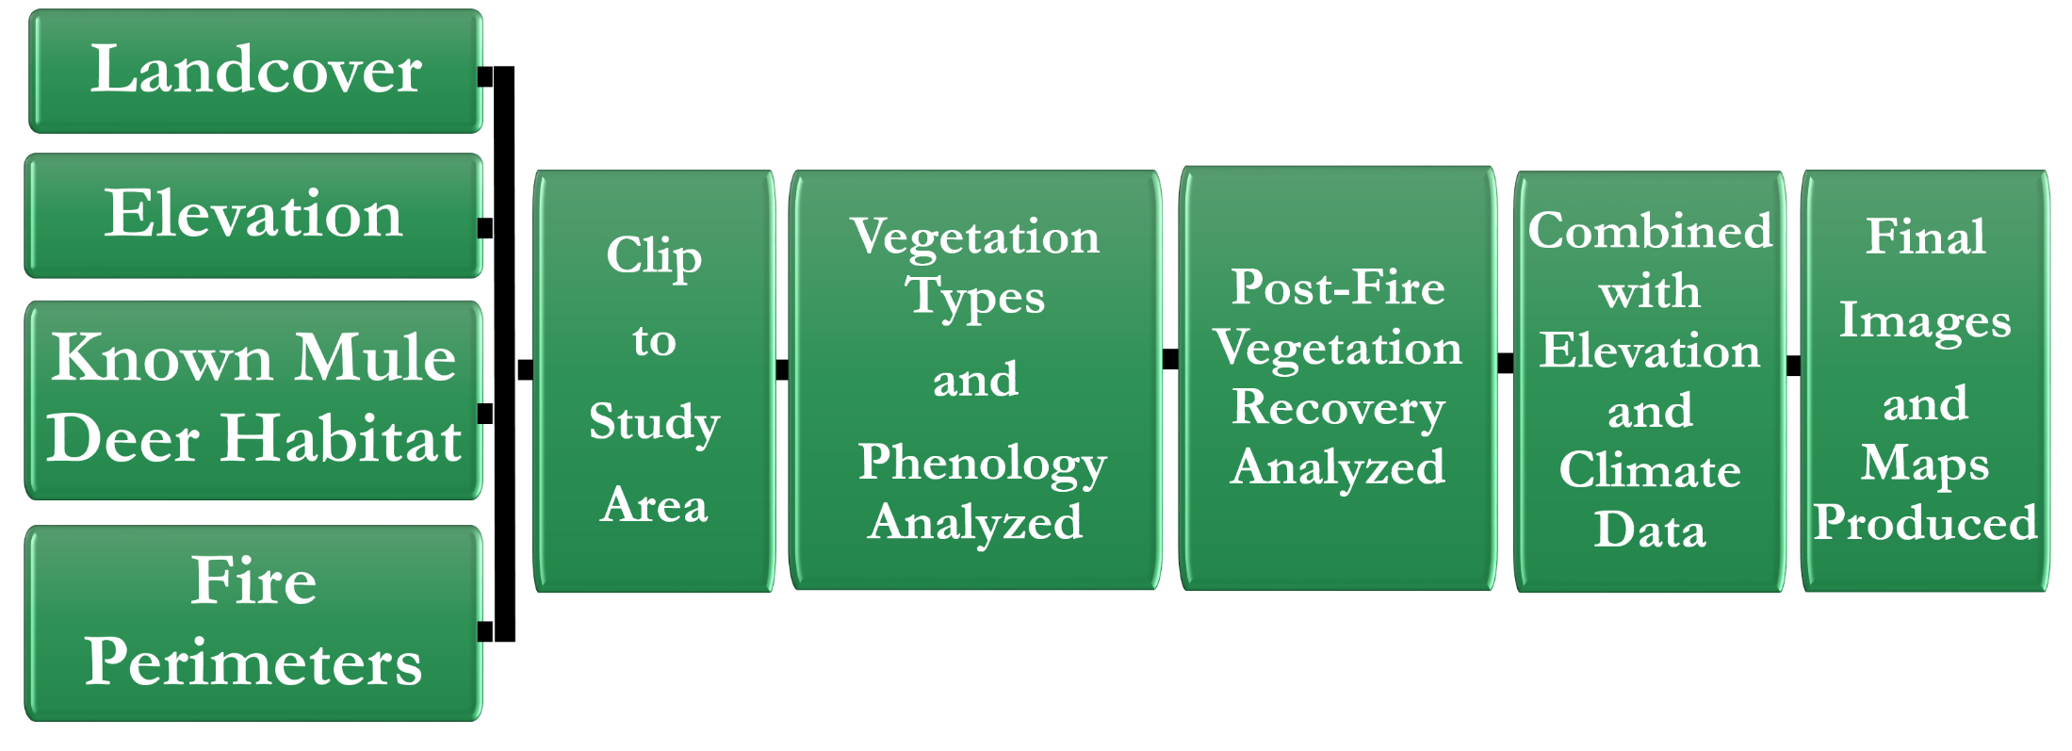
Methodology

Slide 8
Results (preliminary) – Cumulative NDVI
2011
2012
High
Low
2011
2013
2014

Slide 9
Conclusions

Slide 10
Errors & uncertainties

Slide 11
Future work

Slide 12
Joseph Spruce, John C. Stennis NASA Center
James “Doc” Smoot, John C. Stennis NASA Center
Advisors
John Rice, Southern Rockies LCC
Jim Heffelfinger, WAFWA Mule Deer Working Group
Partners
Others
DEVELOP National Program Office

Slide 13

Questions?

Slide 14
Backup slides

