Slide 1
Tonlé Sap
Agriculture & Food Security II
Evaluating Changes in Ecosystem Vitality and Freshwater Health in the Tonlé Sap Basin using Remotely Sensed Data
Justine Spore, Molly Farrell, Joey Lindsay, Brian Place, and Nick Pelaccio
Virginia – Langley
Notes:
Hello, we are Justine Spore, Molly Farrell, Joey Lindsay, Brian Place and Nick Pelaccio, and today we'll be sharing our work this summer as the DEVELOP Tonlé Sap Agriculture and Food Security III team.

Slide 2
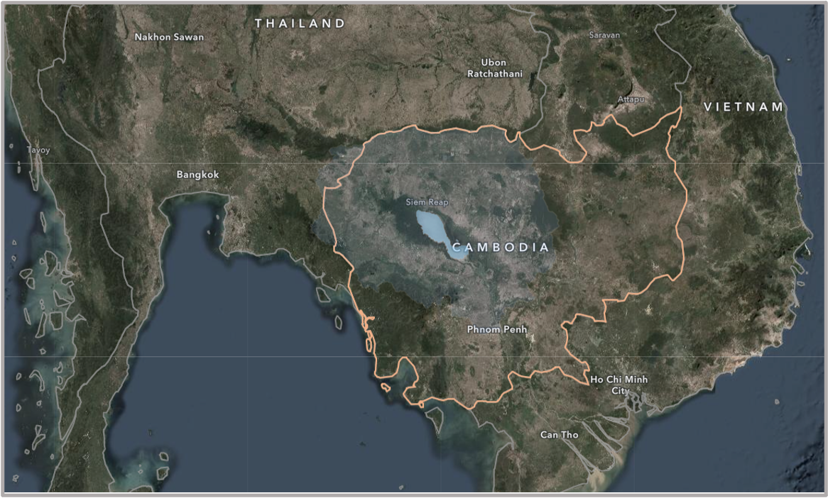
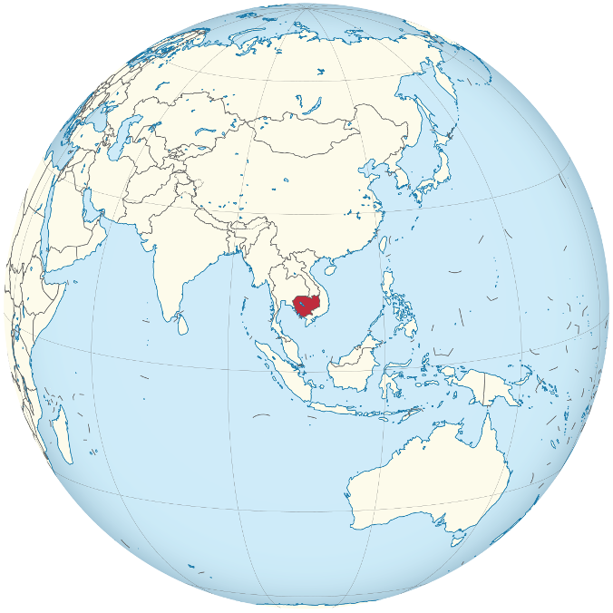
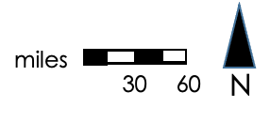
Tonlé Sap Lake
Source: Wikimedia Commons
Notes:
Our study site sits in the center of Cambodia, and we’ll be looking specifically at the Tonlé Sap Lake and river basin. The orange line shows the county boundary of Cambodia, and the blue shape at the center is Tonlé Sap Lake — the largest lake in Southeast Asia!
Image Credits-----------------
Globe image: By Addicted04, source: https://commons.wikimedia.org/w/index.php?curid=30824720, license (CC BY-SA 3.0): Creative Commons — Attribution-ShareAlike 3.0 Unported — CC BY-SA 3.0, no changes were made
Map made by Tonle Sap I team

Slide 3
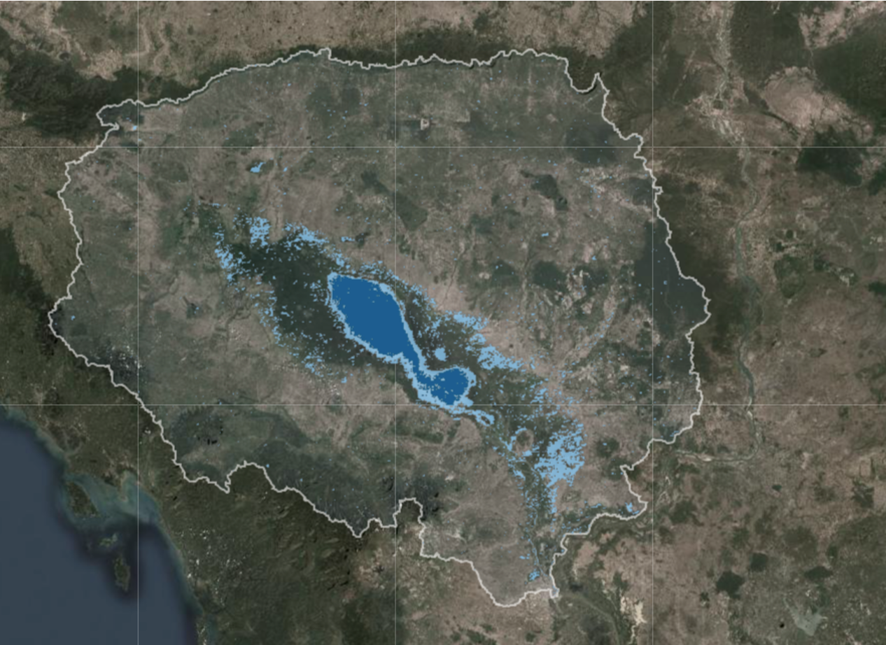
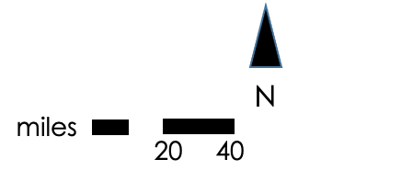
Study Area:
The Tonlé Sap Basin
Dry season lake area
Rainy season lake area
Notes:
The Tonlé Sap basin is a densely populated biodiversity hotspot, and “is of international significance culturally, hydrologically, and ecologically.” The basin has a unique hydrological cycle, where the annual rainy season reverses the flow of the Mekong river, leading to massive amounts of flooding and an increase in the lake's surface size and expanding to areas outside of the dry season lake area as shown in light blue.
The annual flood delivers nutrients that nourish nearby rice plantations and creates flooded forests that create ideal fish nurseries. These natural resources and ecosysten services directly support over 1 million people nutritionally and economically.
---------------------------
Map image and graphics produced by Tonle Sap I team

Slide 4
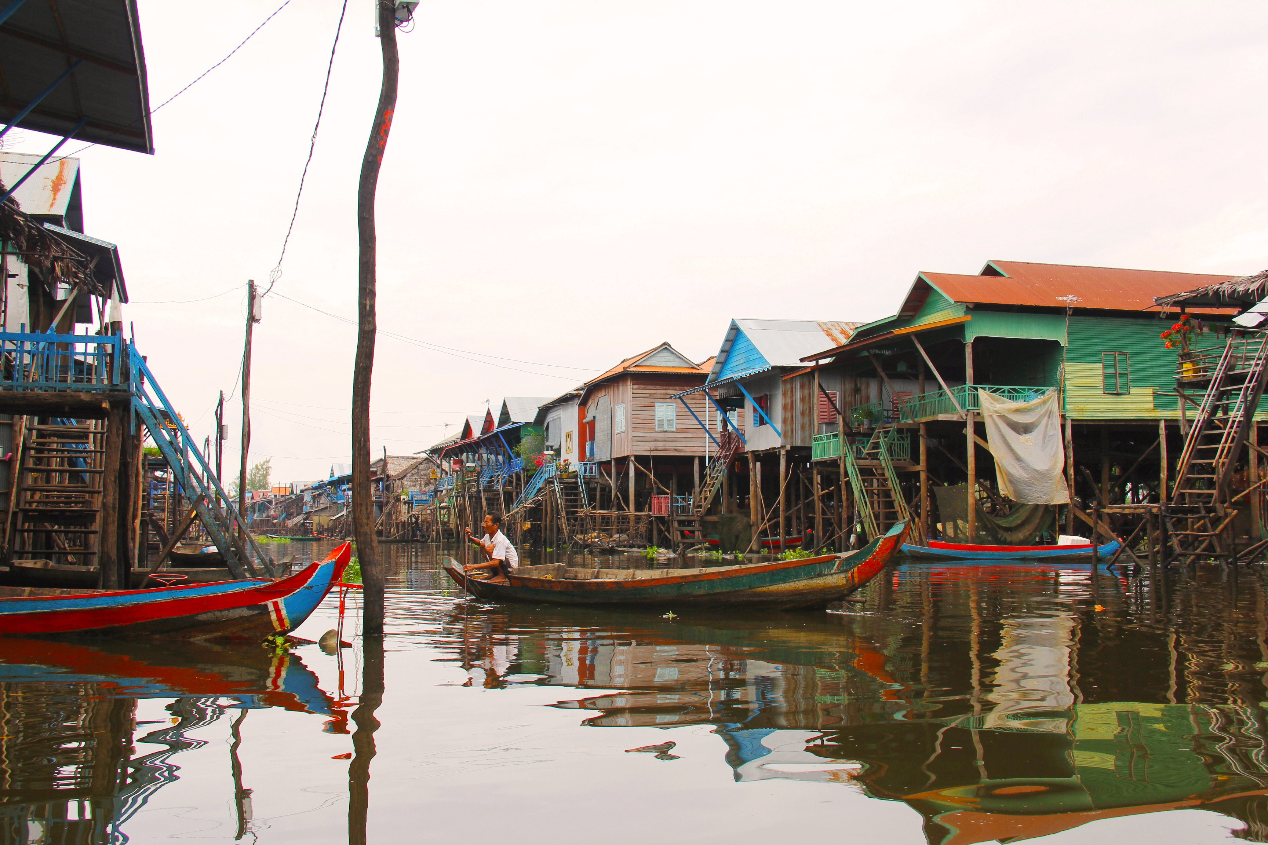
Community Concerns
Reductions in Fish Catches
Receding Waterline
Agricultural Health
Hotter Dry Seasons
Less Carbon Absorption
Unpredictable Flooding
Source: Pixabay by sharonang
Notes:
Speaker Notes:
Reductions in fish catches – Shrinking water levels combined with increasing pollution have dramatically reduced fish catches in the lake, which provides protein for millions of Cambodians
Receding waterline – As a major source of water for Cambodia, a receding waterline threatens to leave a smaller, poorer lake region with less water supply for its residents
Agricultural Health – The lake drains a massive amount of sediments from the surrounding region and filters freshwater. Its water is additionally important for the rice fields that surround the watershed
Less Carbon Absorption – the flooded forests on the lake's edge are a massive carbon sink, and deforestation in the area threatens to aggravate climate change
Unpredictable flooding – dam construction and changing lake flows have resulted in the normally predictable flooding cycles becoming increasingly irregular
Hotter dry seasons – combined with rising global temperatures, the reduction in forest cover and lake surface area threatens to make the Cambodian dry season increasingly hot
-------------------------------
Man on riverboat in Tonle Sap: https://pixabay.com/photos/kompong-phluk-kompong-tour-village-953319/, license CC

Slide 5
Partners
Conservation International
Tonlé Sap Authority
Boundary organization
Created the Freshwater Health Index
International non-profit
Governing body for the basin
Established in 2009
Housed within Cambodia's Ministry of Water Resources and Meteorology
Source: Creative Commons by Pondspider
Notes:
Speaker Notes:
Conservation International – Seeking to create a generalizable tool to integrate with their freshwater health index in order to make quickly assessing water quality a reality worldwide. They do have specific interest in the Tonlé Sap region for its importance in southeast Asian climate and stability
Tonlé Sap Authority – Balancing development concerns, ecosystem health, and a growing population makes a rapid and accurate assessment of the heath of the basin a priority for its governing authority, the Tonlé Sap Authority
------------------------------
Floating houses: https://search.creativecommons.org/photos/bfaaa5da-9f06-46cf-b204-cf2a553f7723

Slide 6
Freshwater Health Index (FHI) Overview
Ecosystem Vitality: The ecological functioning of the freshwater body and its watershed
Governance & Stakeholders: decision-making structures and processes
Basin Condition
Biodiversity
Flow connectivity
Land cover naturalness
Bank modification
Species of concern
Invasive species
Water Quality
Water Quantity
Ecosystem Services: benefits to populations and livelihoods
Water quality (total suspended solids, nitrogen, phosphorous)
Deviation from natural flow
Groundwater storage depletion
Notes:
Our partners at Conservation International have developed a tool called the Freshwater Health Index for baseline water system health monitoring. This is crucial for understanding complex social and ecological relationships and will help mitigate threats to the basin. A Freshwater Health assessment divides freshwater health into three indicators: ecosystem vitality, ecosystem services, and governance & stakeholders. The DEVELOP Tonlé Sap projects focused on Ecosystem Vitality, which is further broken down into four areas of assessment: Basin condition, biodiversity, water quality and basin condition.
Graphic by Tonlé Sap I team, altered by Tonlé Sap II Team

Slide 7
Freshwater Health Index Objectives
Ecosystem Vitality: The ecological functioning of the freshwater body and its watershed
Term I
Results
Basin Condition
Biodiversity
Flow connectivity
Land cover naturalness
Bank modification
Species of concern
Invasive species
Water Quality
Water Quantity
Term II Objectives
Water quality (total suspended solids, nitrogen, phosphorous)
Deviation from natural flow
Groundwater storage depletion
Notes:
Here we've broken down what the previous Tonlé Sap DEVELOP team completed, and our objectives for the project. Term I assessed land cover naturalness, bank modification and deviation from natural flow. We continued building on their work and tackled two additional sections of the FHI: water quality and groundwater storage depletion, shown in yellow.
Graphic by Tonlé Sap I team, altered and updated by Tonlé Sap II team

Slide 8
Project Objectives
1
2
3
Calculate water quality with SWAT model and remotely sensed data
Develop
methodology for calculating
groundwater
storage using
GRACE satellite data
Develop set of tools and software package to integrate remotely sensed data into future FHI analyses
Notes:
Our specific project objectives will be, 1, to use remotely sensed data to run a Soil and Water Assessment Tool or SWAT model on the Tonlé Sap basin and assess nutrient flows and water quality.
2, to calculate and map changes in groundwater storage over the course of the 20 year study period.
And 3, to develop GEE code that will allow partners and end-users to leverage the same remotely sensed datasets in other FHI assessments.

Slide 9
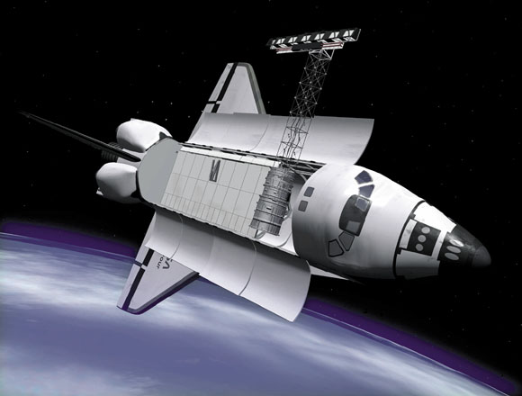
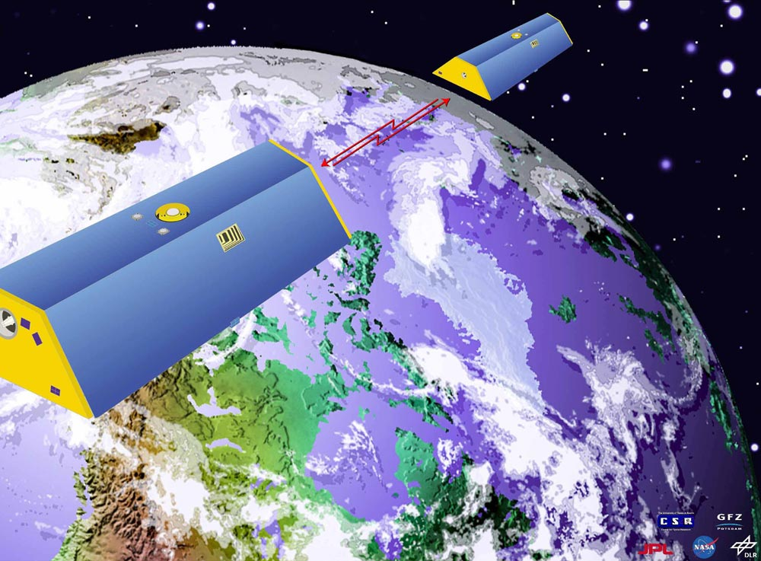
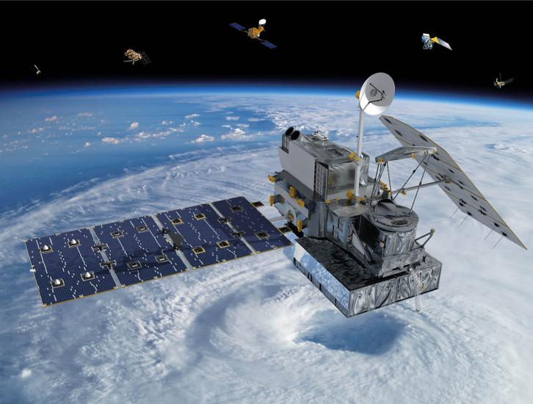
Satellites Used
Shuttle Radar Topography Mission (SRTM)
Source: NASA JPL
Gravity Recovery and Climate Experiment (GRACE)
Source: NASA JPL
Global Precipitation Mission – Integrated Multi-satellite Retrievals (GPM – IMERG)
Source: NASA GPM
Notes:
Speaker Notes:
An FHI assessment requires mostly in situ data, and one of our goals was to test the feasibility of using remotely sensed datasets to provide the basin characteristics required to make an FHI assessment.
SRTM was used to provide the digital elevation model as a SWAT input, GPM IMERG was used to provide the precipitation data for the SWAT input, and GRACE was used to provide groundwater storage information for the Freshwater Health Index (FHI).
Image credits------------------------------------
GRACE: https://www.jpl.nasa.gov/missions/gravity-recovery-and-climate-experiment-grace, provided by NASA JPL
Shuttle Radar: https://www.jpl.nasa.gov/missions/shuttle-radar-topography-mission-srtm, provided by NASA JPL
GPM: https://gpm.nasa.gov/missions/GPM, provided by NASA GPM

Slide 10
Study Period: 2000-2020
ERA5 – SRTM
GPM - IMERG
GRACE
Study Period, FHI Outputs Yearly
Notes:
Our study period is from 2000 to 2020, with FHI assessments calculated annually. The remotely sensed datasets we used have variable ranges of availability. Air temperature and precipitation had data for our entire study period, but GRACE data is only available from 2002 to 2017.

Slide 11
Water Quality
Ecosystem Vitality
Basin Condition
Biodiversity
Flow connectivity
Land cover naturalness
Bank modification
Species of concern
Invasive species
Water Quality
Water Quantity
Water quality (total suspended solids, nitrogen, phosphorous)
Deviation from natural flow
Groundwater storage depletion
Notes:
First we will discuss our calculation of the Tonlé Sap's water quality, which within the FHI assessment is its own category with only one section — nutrient flows.

Slide 12
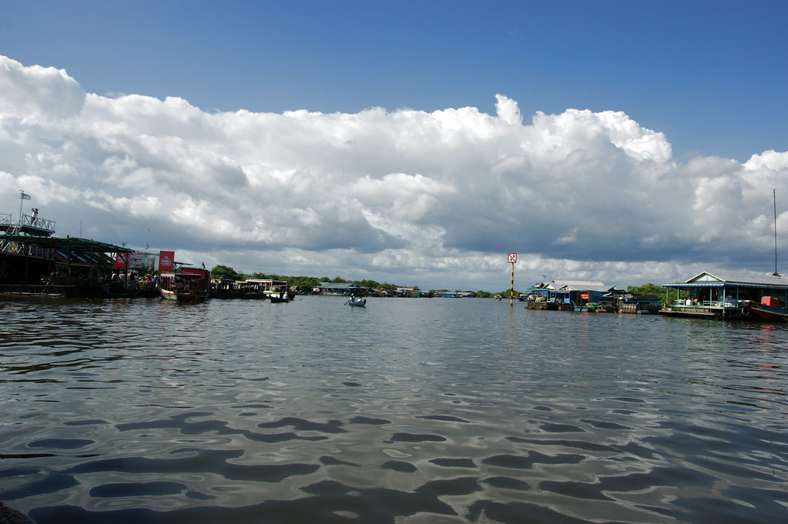
Methodology — Water Quality & SWAT
Required Inputs:
DEM
Land Cover Classification
Precipitation
Air Temperature
Soil Classification
Source: Allie Caulfield
Notes:
We used a Soil and Water Assessment Tool, or SWAT, to monitor changes in nutrient flows over the course of our study period. The SWAT tool required five inputs: a Digital Elevation Model (DEM), a land cover classification, a soil classification, daily air temperature and daily precipitation. Our goal was to collect each of these inputs from remotely sensed datasets when possible.
This land cover classification map of Tonle Sap is one of SWAT's outputs during the initialization of the model in QGIS using the QSWAT plugin.
Image Credit: "2009-09-03 09-07 Siem Reap 451 Tonlé Sap Lake" by Allie_Caulfield is licensed under CC BY 2.0 (https://search.creativecommons.org/photos/4feb108d-4f99-4fc9-90ef-5d452773a136)

Slide 13
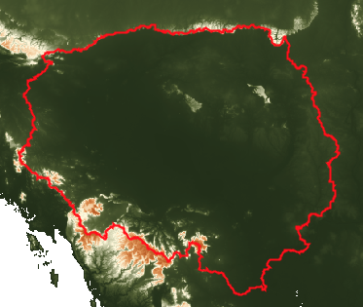
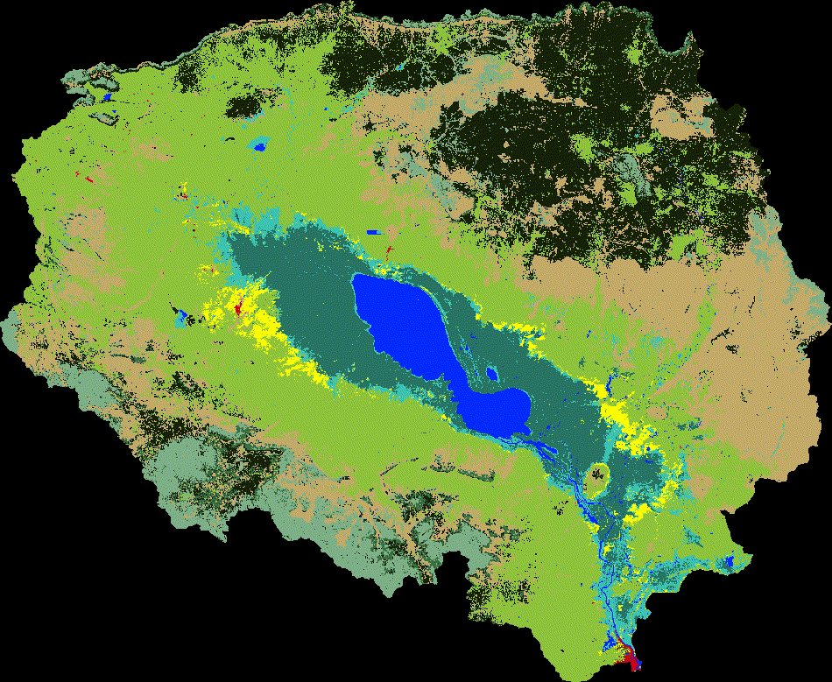
1. DEM &
2. Land Cover
N
0
20
50
75
100
Miles
Land Cover Class
Surface Water
Flooded Forest
Cropland
Forest
Rice
Orchard/Plantation
Barren
Evergreen Broadleaf
Wetland
Mixed Forest
Grassland
Urban
Shrubland
Notes:
The first SWAT input was a Digital Elevation Model, or DEM, shown in the upper left corner. The red outline shows the Tonlé Sap basin boundary. This input was the least challenging to process for SWAT. We acquired it through Google Earth Engine as a readily available dataset, cropped it to our study area, and exported out of GEE and into SWAT.
The second input was a land cover classification for our study time period. For this input, we used the map and classification created by the DEVELOP Tonlé Sap Term I team. Shown at right is a gif of land cover change from 2000-2018. Areas and landscapes evolve as societies grow and develop, leading to noticeable land cover change to address an increase in population and need for food. The dark blue color shows Tonlé Sap lake, and the surrounding area is the rest of the basin.
---------------------------------------------
DEM from GEE, map generated by Tonlé Sap Ag II team
Land cover map created by Tonlé Sap Term I

Slide 14
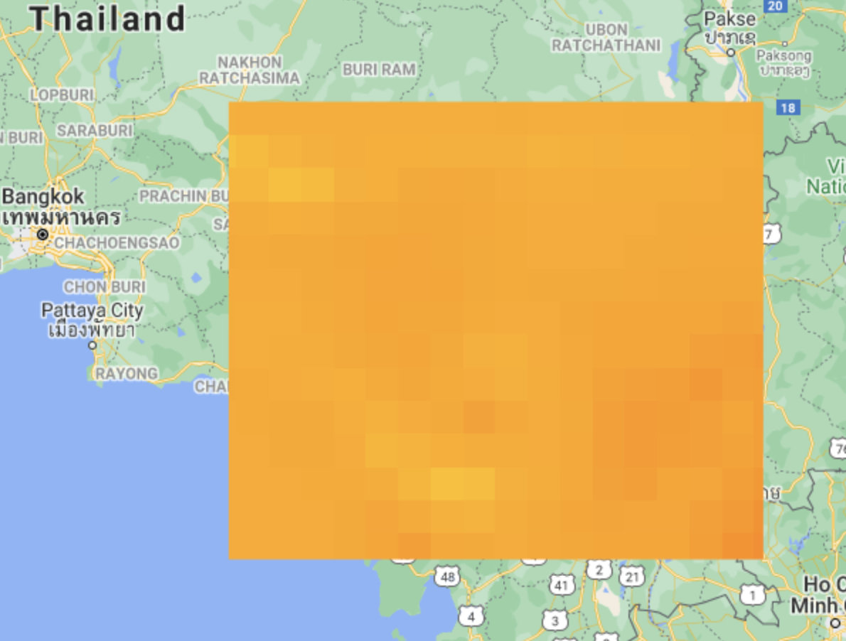
3. Precipitation & 4. Air Temperature
Collect Precipitation & Air Temperature from GEE
Use GEE Python API to turn rasters into tables
Export tables into Google Drive
Turn tables into separate .txt files using GEE Python API
Air Temperature raster from GEE
Notes:
The next two SWAT inputs were daily precipitation and air temperature data. These variables were available through Google Earth Engine — precipitation from the Global Precipitation Model – and air temperature from ERA5 daily temperature. The two variables were imported from GEE into a GEE Python API. The GEE Python API contains code that turned the rasters into tables. The newly created tables were then exported into Google drive in order to complete the last step. Finally, in the GEE Python API, the exported tables were turned into separate text files. The data for air temperature and precipitation is now ready for SWAT analysis.
-------------------------
Maps and graphic created by Tonlé Sap II team

Slide 15
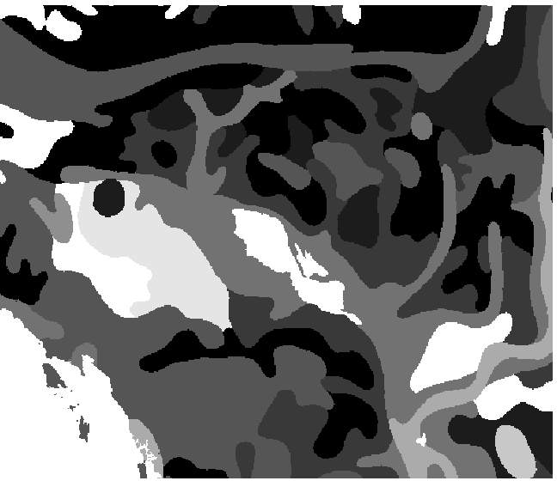
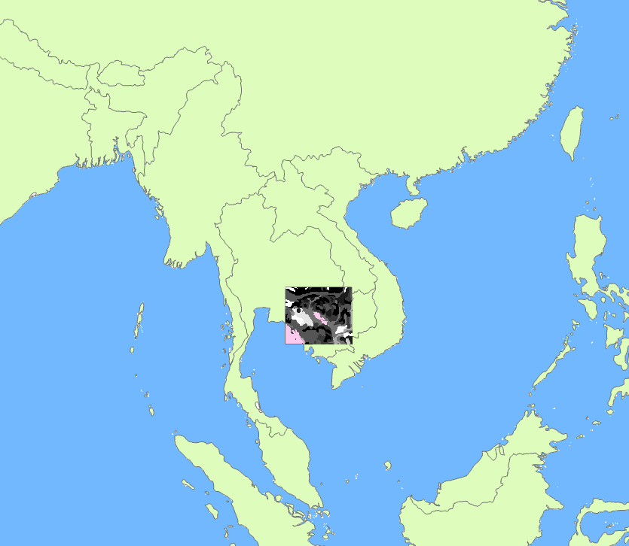
5. Soil Classification
Download the Harmonized World Soil Database from the United Nations FAO website
Extract soil attributes into a CSV file
Rename soil classes to match soil ID number
Save & visualize raster
N
0
125
250
375
500
Miles
Notes:
For the soil data, we used data from the Food and Agriculture Organization of the United Nations. The dataset is known as the Harmonized World Soil Database (HWSD). In order to make the soil data compatible with the SWAT model, we had to follow four major steps that included downloading the data, extracting soil attributes into a CSV file, naming the soil classes, and saving the final raster product as well as visualizing the final product as a check to see if the process was executed properly.
---------------
Maps and graphic created by Tonlé Sap II team

Slide 16
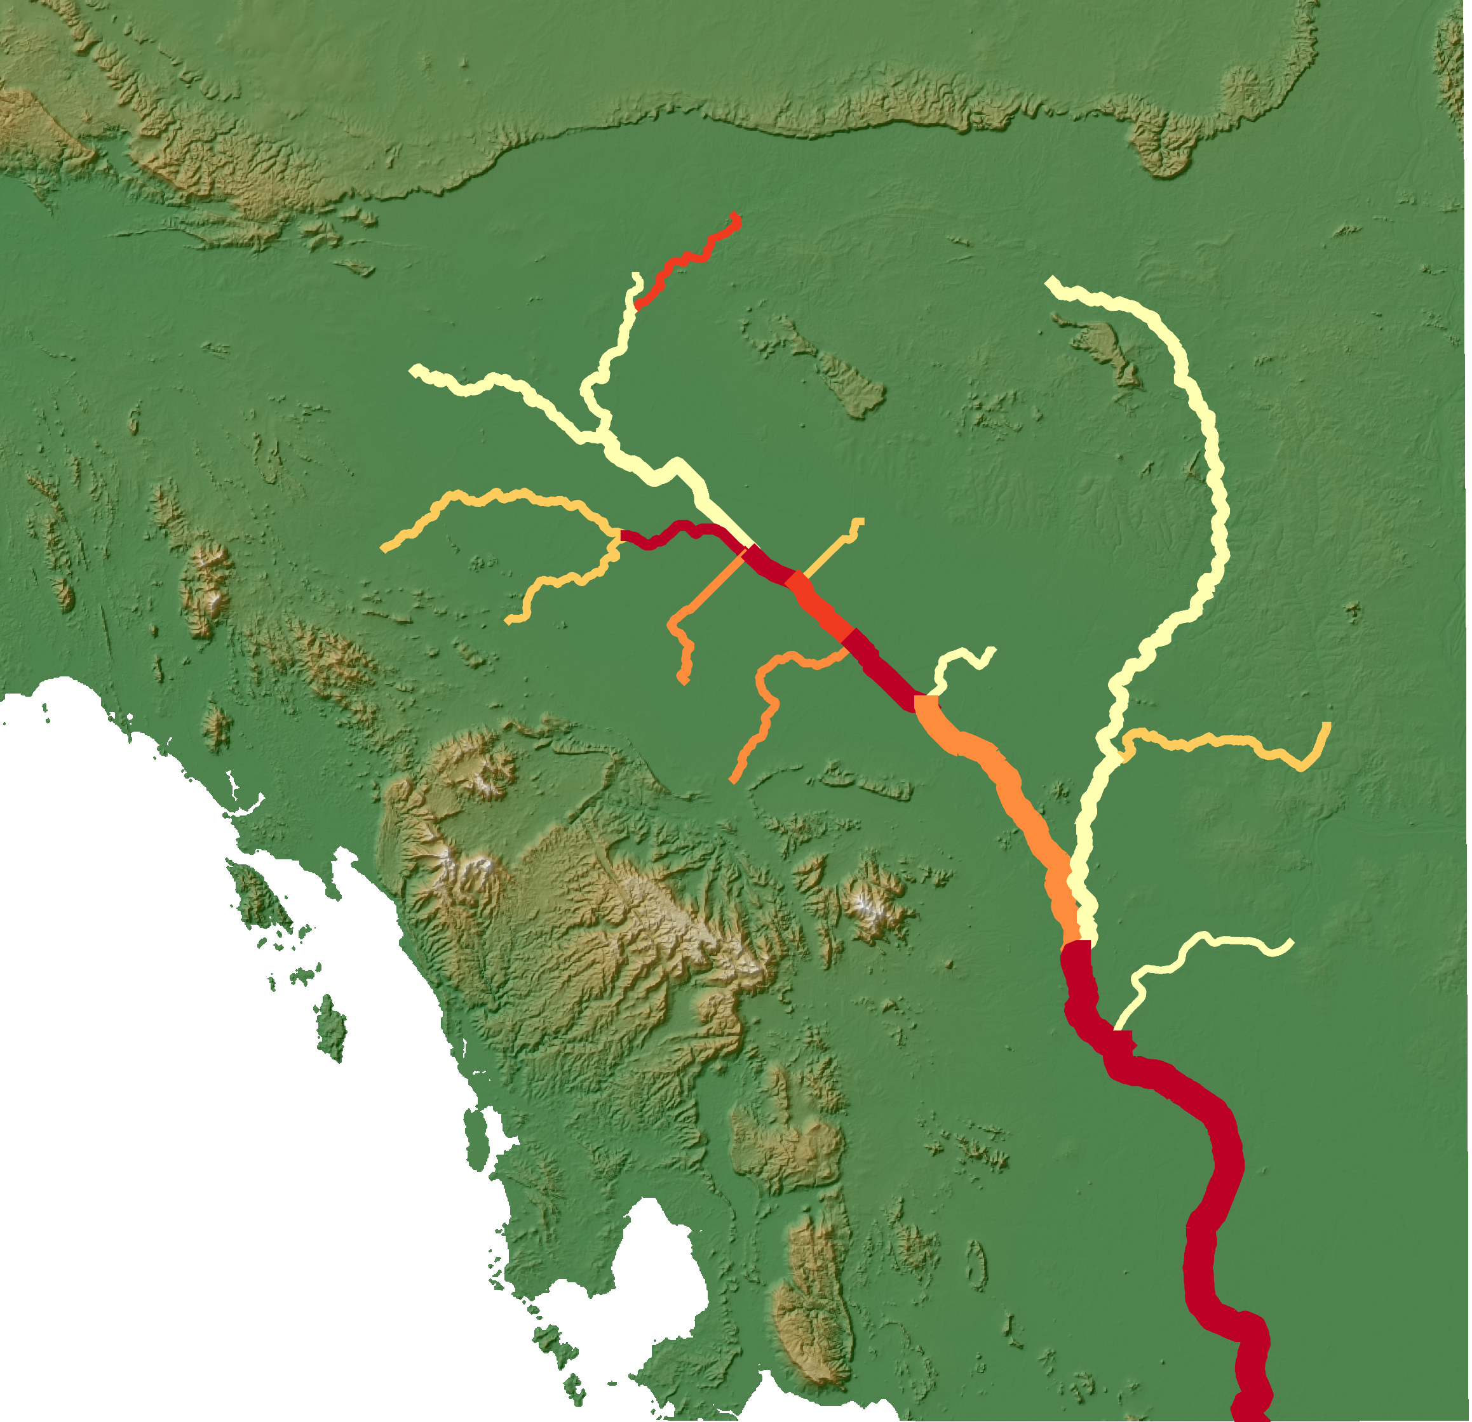
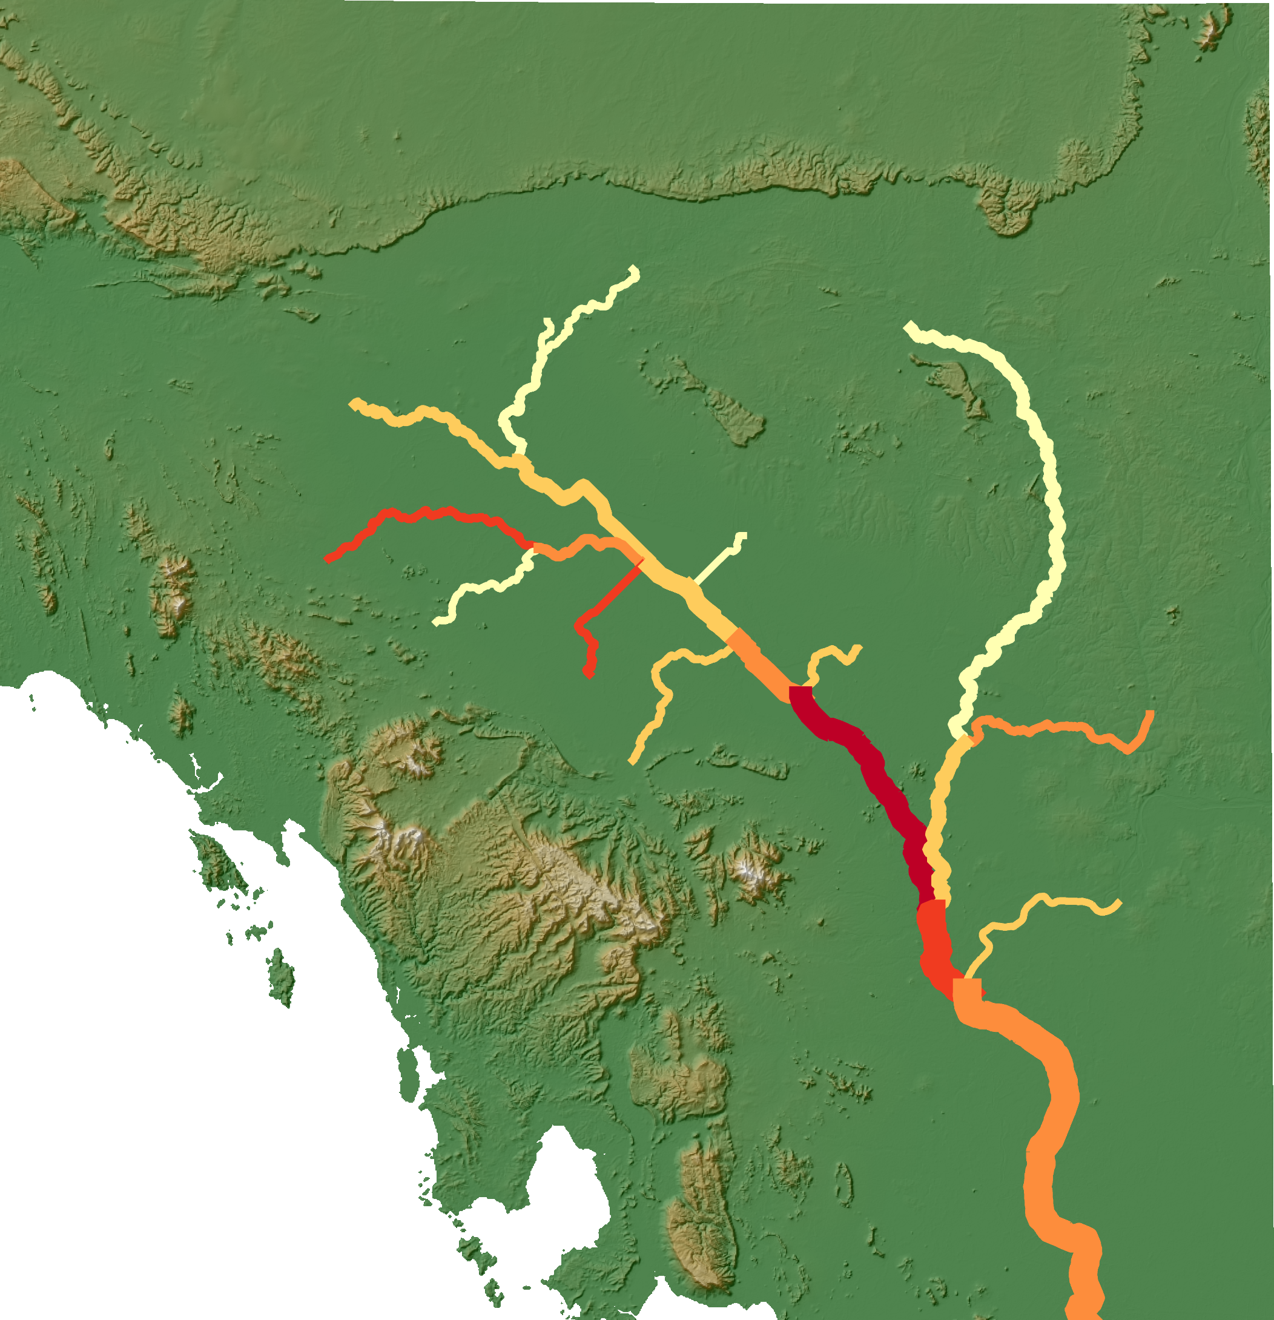
Results — Water Quality & SWAT
N
N
N
0
20
50
75
100
0
20
50
75
100
Miles
Miles
0
20
50
75
100
Miles
Nitrate (NO3) Daily Mean mg/L
Phosphorus (P) Daily Mean mg/L
Sediment in-flow Daily Mean in Tons
0.04 - 0.138
0 -162
0.01 - 0.12
162 - 550
0.12 - 0.38
0.138 - 0.256
0.38 - 0.56
0.256 - 0.431
550 - 1015
0.56 - 0.76
0.431 - 0.697
1015 - 1701
0.76 - 1.26
0.697 - 1.187
1701 - 6193
Notes:
This map shows examples of SWAT model outputs for daily nitrogen, phosphorous, and sediment over five months in the Tonlé Sap basin. SWAT takes in all of the previously discussed inputs and calculates nutrient flows within each hydrological response unit (HRUs) which are shown by each of the different widths of waterways.
These outputs prove the feasibility of using remotely sensed data as inputs for the SWAT model. In this map the water is flowing southbound and we can see that as you move downstream, the water has increasing amounts of nitrogen, while phosphorous and sediment are noticeably more loaded in the center of the basin.
For our analysis, we created annual SWAT outputs for the Tonlé Sap basin from 2000-2020, and we were specifically interested in nitrogen, phosphorous and suspended solids.
-----------------------
Maps and graphics produced by Tonlé Sap II team in SWAT model

Slide 17
Groundwater Storage Depletion
Ecosystem Vitality
Basin Condition
Biodiversity
Flow connectivity
Land cover naturalness
Bank modification
Species of concern
Invasive species
Water Quality
Water Quantity
Water quality (total suspended solids, nitrogen, phosphorous)
Deviation from natural flow
Groundwater storage depletion
Notes:
Next we will talk about the second FHI sub-indicator we tackled, Water Quantity, and specifically groundwater storage depletion.

Slide 18
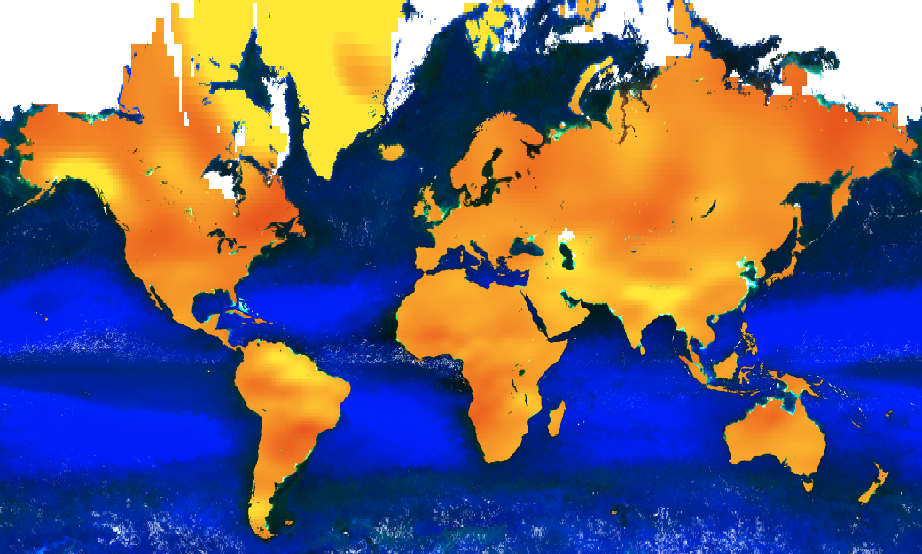
Groundwater Calculation with GRACE
Measures changes in Earth's gravitational pull
Groundwater (GW) must be isolated from Total Terrestrial Water (TWS)
Interested only in dry season metrics
200km
ΔGW = ΔTWS - ΔSW - ΔSM - ΔPCI
Notes:
The GRACE satellite measured changes in Earth's gravity to provide Total Water Anomaly values — how much more or less water there is based on a baseline from 2004-2010. This metric includes all Terrestrial Water, so to look at groundwater, we need to isolate it from all the other sources of water on Earth. This includes soil moisture, plant canopy intercept, and surface water (the Tonlé Sap Lake in our case). The equation at the bottom right of this slide outlines this transformation.
The Freshwater Health Index asks users to input the number of areas affected with groundwater depletion in the study period. Because of this, we decided to focus on dry season measurements only, because this is most likely to be when wells are running dry and water resources are scarce or insecure.
------------------------
Image created by Tonlé Sap II team— Shows Monthly mass land grids from GEE GRACE dataset

Slide 19
Results — GRACE Methodology
Plant Canopy Intercept
Water and land percentage (derived from water mask)
Baseline values from
2004-2010
Percent within Tonlé Sap Basin
Soil Moisture
Annual dry season minimums
Surface water anomaly
Tonlé Sap I lake level data
Surface Water
Monthly water mask
Total Terrestrial Water anomaly from GRACE
Groundwater anomaly
Notes:
To isolate groundwater from GRACE, we had to find all sources of surface water within the Tonlé Sap basin, which was the three previously mentioned sources: plant canopy intercept (the water that's on plants), soil moisture, and surface water (the Tonlé Sap lake in our case). Plant canopy water and soil moisture are available as global daily datasets through the Global Land Data Assimilation System (GLDAS).
The surface water of the lake required its own calculation, and we relied on altimetry data from the first Tonlé Sap DEVELOP team and a monthly water mask derived from Landsat 5, 6 and 7. By multiplying the lake level with the square area of the lake, we could extract a volumetric measurement of the lake.
Because the GRACE data provides monthly water anomaly, our surface water values also had to be in the form of monthly anomaly. So, for each of the three surface water sources, we created 1) a baseline of values from 2004-2010, and 2) the dry season minimums (the variable of interest). Subtracting the baseline from each minimum resulted in surface water anomaly for each variable.
Next, we had to account for the percentage of pixels that were land and water, and also within the Tonlé Sap basin — this was required due to the extremely coarse resolution of the GRACE pixels. Our study area only contained about ~10 GRACE pixels, so we had to use a multiplier to spread each surface water source throughout the whole pixel and use only the area of what was included in the basin.
The anomaly multiplied by each of these percentages results in our final Surface Water anomaly, which when subtracted from GRACE resulted in groundwater anomaly. By monitoring this groundwater metric overtime, future work will be able to detect trends in groundwater storage within the Tonlé Sap basin.

Slide 20
Conclusions
Python API tool for processing remotely sensed data into SWAT model
Feasibility of SWAT outputs for Tonlé Sap basin using remotely sensed data
GRACE Methodology for analyzing Tonlé Sap basin groundwater storage in FHI Framework
Additional analysis of feasibility of using remotely sensed data to calculate FHI scores
Source: Creative Commons by Pretre
Notes:
In conclusion, this project resulted in a Python API for processing each of the five remotely-sensed SWAT inputs, a feasibility analysis of using remotely sensed data to run the SWAT model for the Tonlé Sap basin, a methodology for extracting groundwater storage metrics from the GRACE satellite for the Tonlé Sap basin, and additional analysis of using remotely sensed data for other Freshwater Health Index analysis.
----------------------------------
https://search.creativecommons.org/photos/1ccf8ab7-b0dc-4ca0-94e2-da0f23be1420

Slide 21
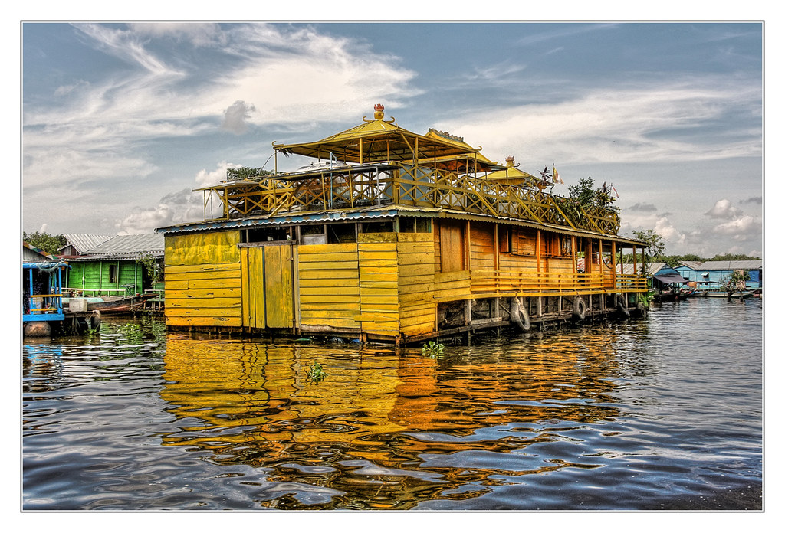
Errors and Limitations
GRACE analysis only shows quantity of groundwater, not quality
SWAT model requires additional calibration with SWAT Cup and in situ data
Data is not available for entire the study period
Remotely sensed data has its own errors and estimations
Source: Creative Commons by Daniel Mennerich
Notes:
There were several limitations associated with our analyses, and areas for improvement in future work. Firstly, the GRACE methodology for monitoring groundwater storage depletion only considers the quantity of groundwater, not the quality. This could result in inaccurate representations of the health of groundwater in the basin.
Second, the SWAT model is uncalibrated, and our results for this presentation are simply feasibility analyses. Calibration and validation requires in situ data, which means that in some ways the use of remotely sensed data for the SWAT model is limited.
Third, some data, such as GRACE, was only available for a portion of our study period.
Lastly, the use of remotely sensed data brings in its own errors and limitations as all metrics are derived from satellite products and subject to unique processing steps.
----------------------------
https://search.creativecommons.org/photos/d1bf3408-6e5a-41dc-b192-edec294ee118

Slide 22
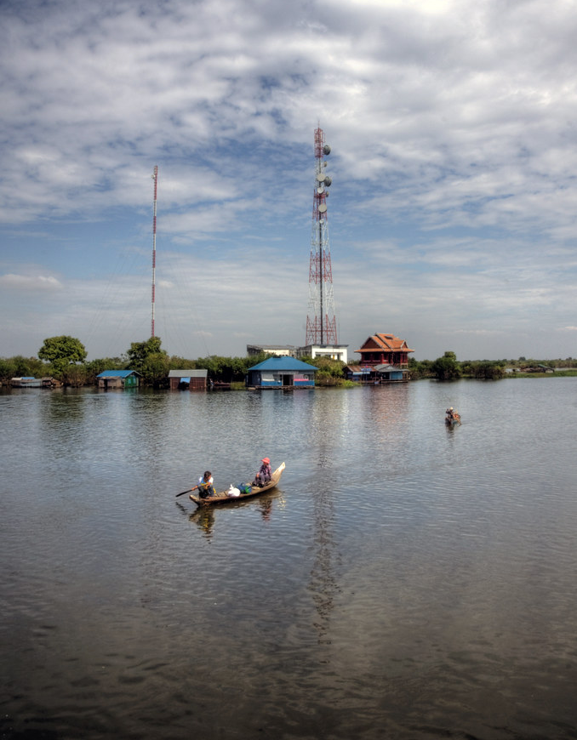
Future Work
The third Tonlé Sap Food & Ag DEVELOP term will:
1. Compile work from Terms I and II to create robust software package
2. Complete groundwater analysis with Term II methodology
3. Continue to assess feasibility of using remotely sensed data in Freshwater Health Index
Source: Creative Commons by Mariusz Kluzniak
Notes:
For future work, a third DEVELOP Tonlé Sap team will tackle the groundwater analysis with GRACE with the methodology developed this term, and compile work from all three terms to create a robust software package for leveraging remotely sensed data in Conservation International's Freshwater Health Index.
Lastly, they will continue to assess the feasibility of using remotely sensed data in the Freshwater Health Index.
Image credits---------------------
https://search.creativecommons.org/photos/992f2524-8a9c-474a-9c81-f416c0c191b2
"tonle sap lake" by mariusz kluzniak is licensed with CC BY-NC-ND 2.0. To view a copy of this license, visit https://creativecommons.org/licenses/by-nc-nd/2.0/

Slide 23
Adriana Le Compte, NASA DEVELOP LaRC
Dr. Kenton Ross, NASA Langley Research Center
Dr. Venkataraman Lakshmi, University of Virginia
Manh-Hung Le, University of Virginia
Dr. Derek Vollmer, Conservation International
Notes:
Thank you so much to those who helped us with this summer's project!

Slide 24
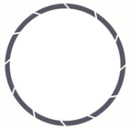
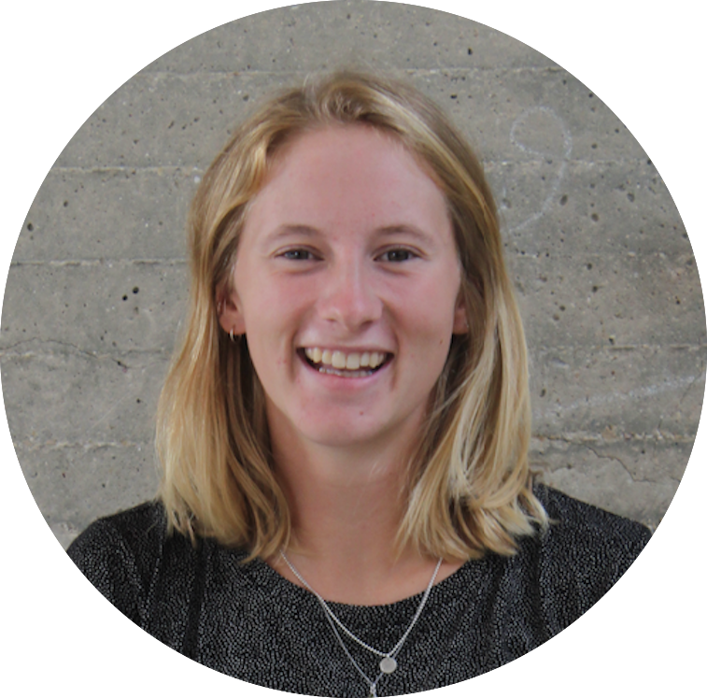
Meet the Team
Justine Spore
Brian Place
Nick Pelaccio
Joey Lindsay
Molly Farrell
Notes:
From top left to bottom right, Justine Spore (Team Lead), Brian Place, Nick Pelaccio, Joey Lindsay and Moly Farrell

