Slide 1
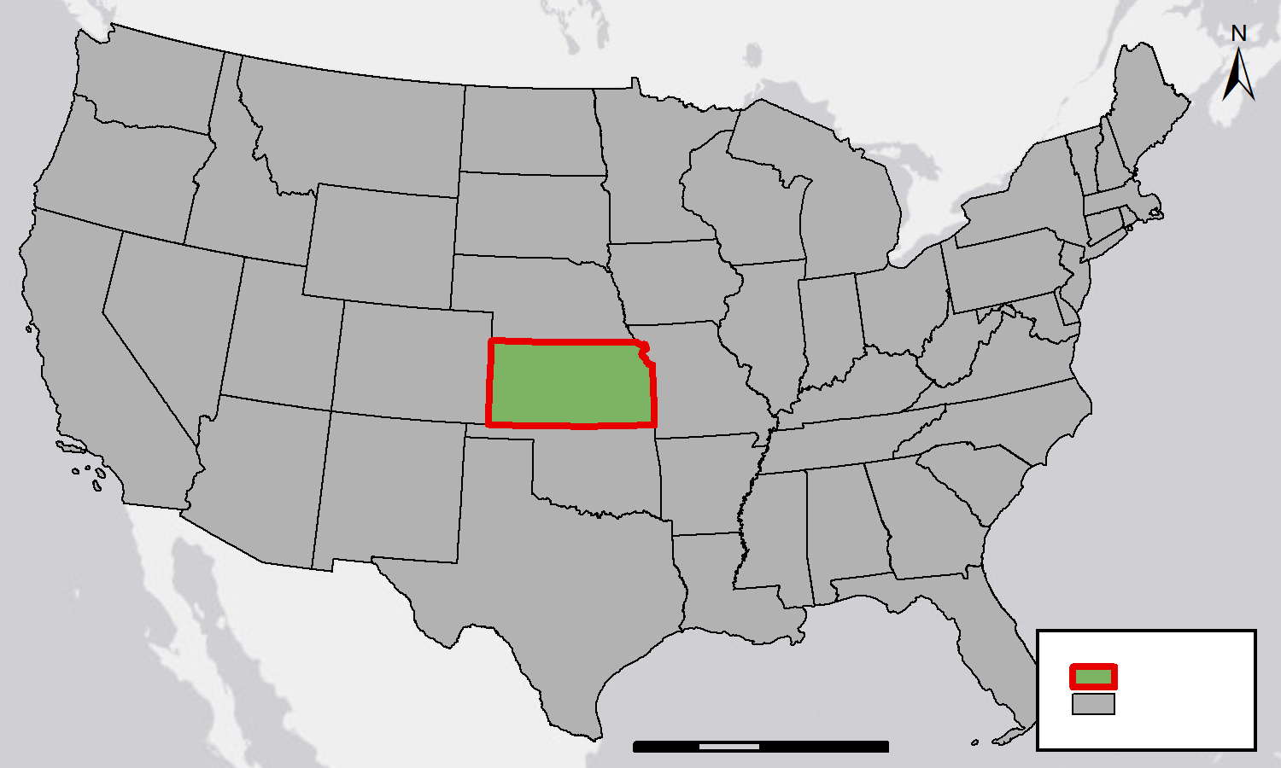
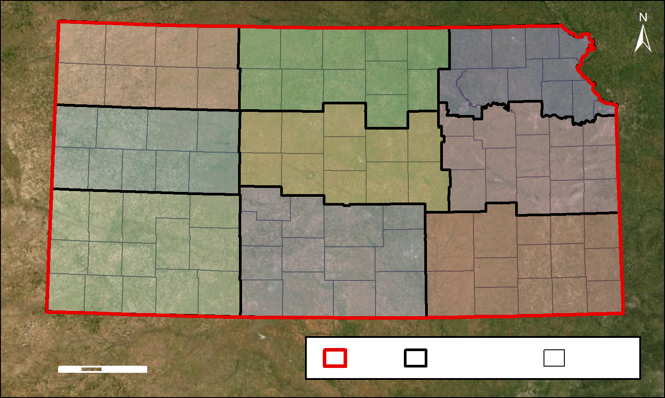
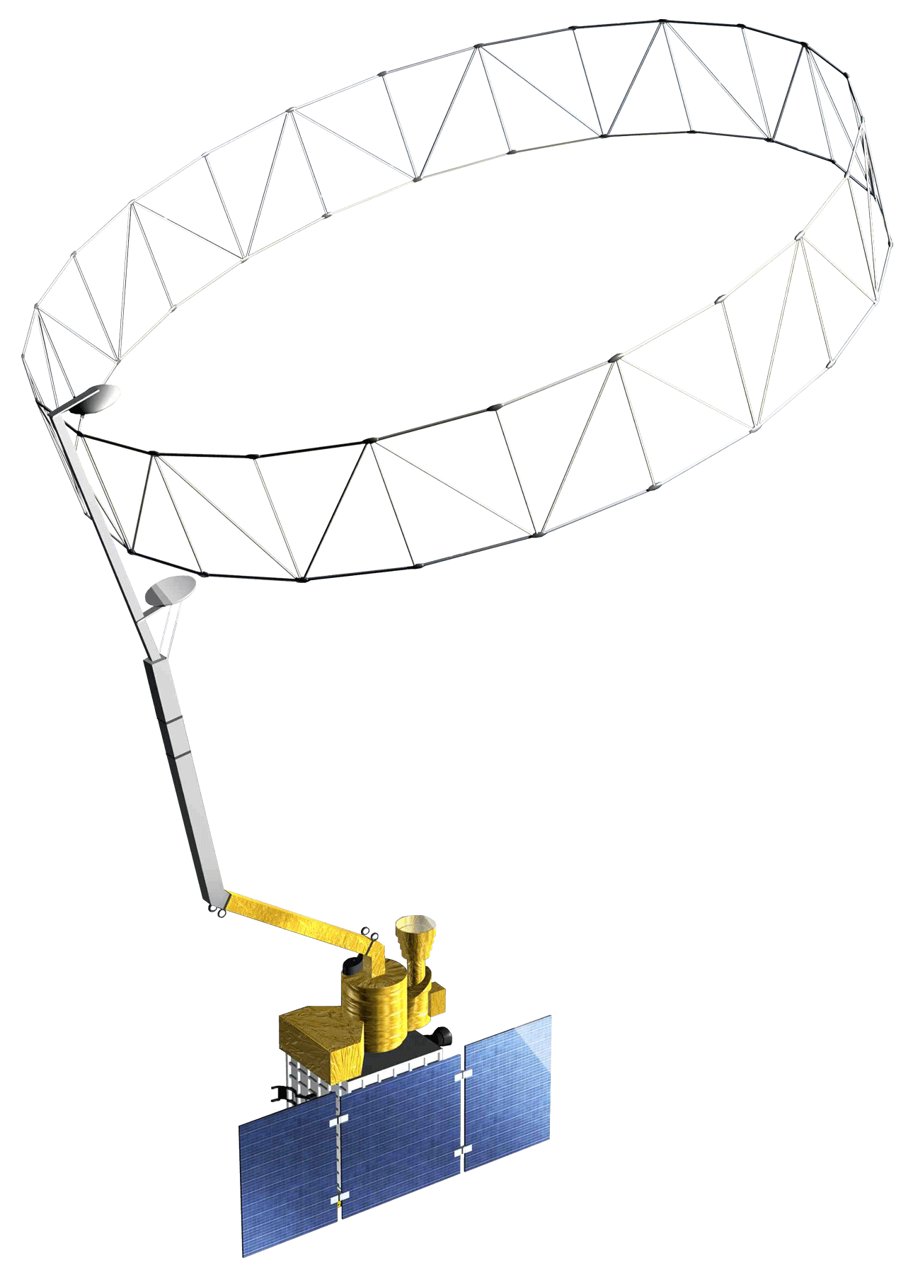
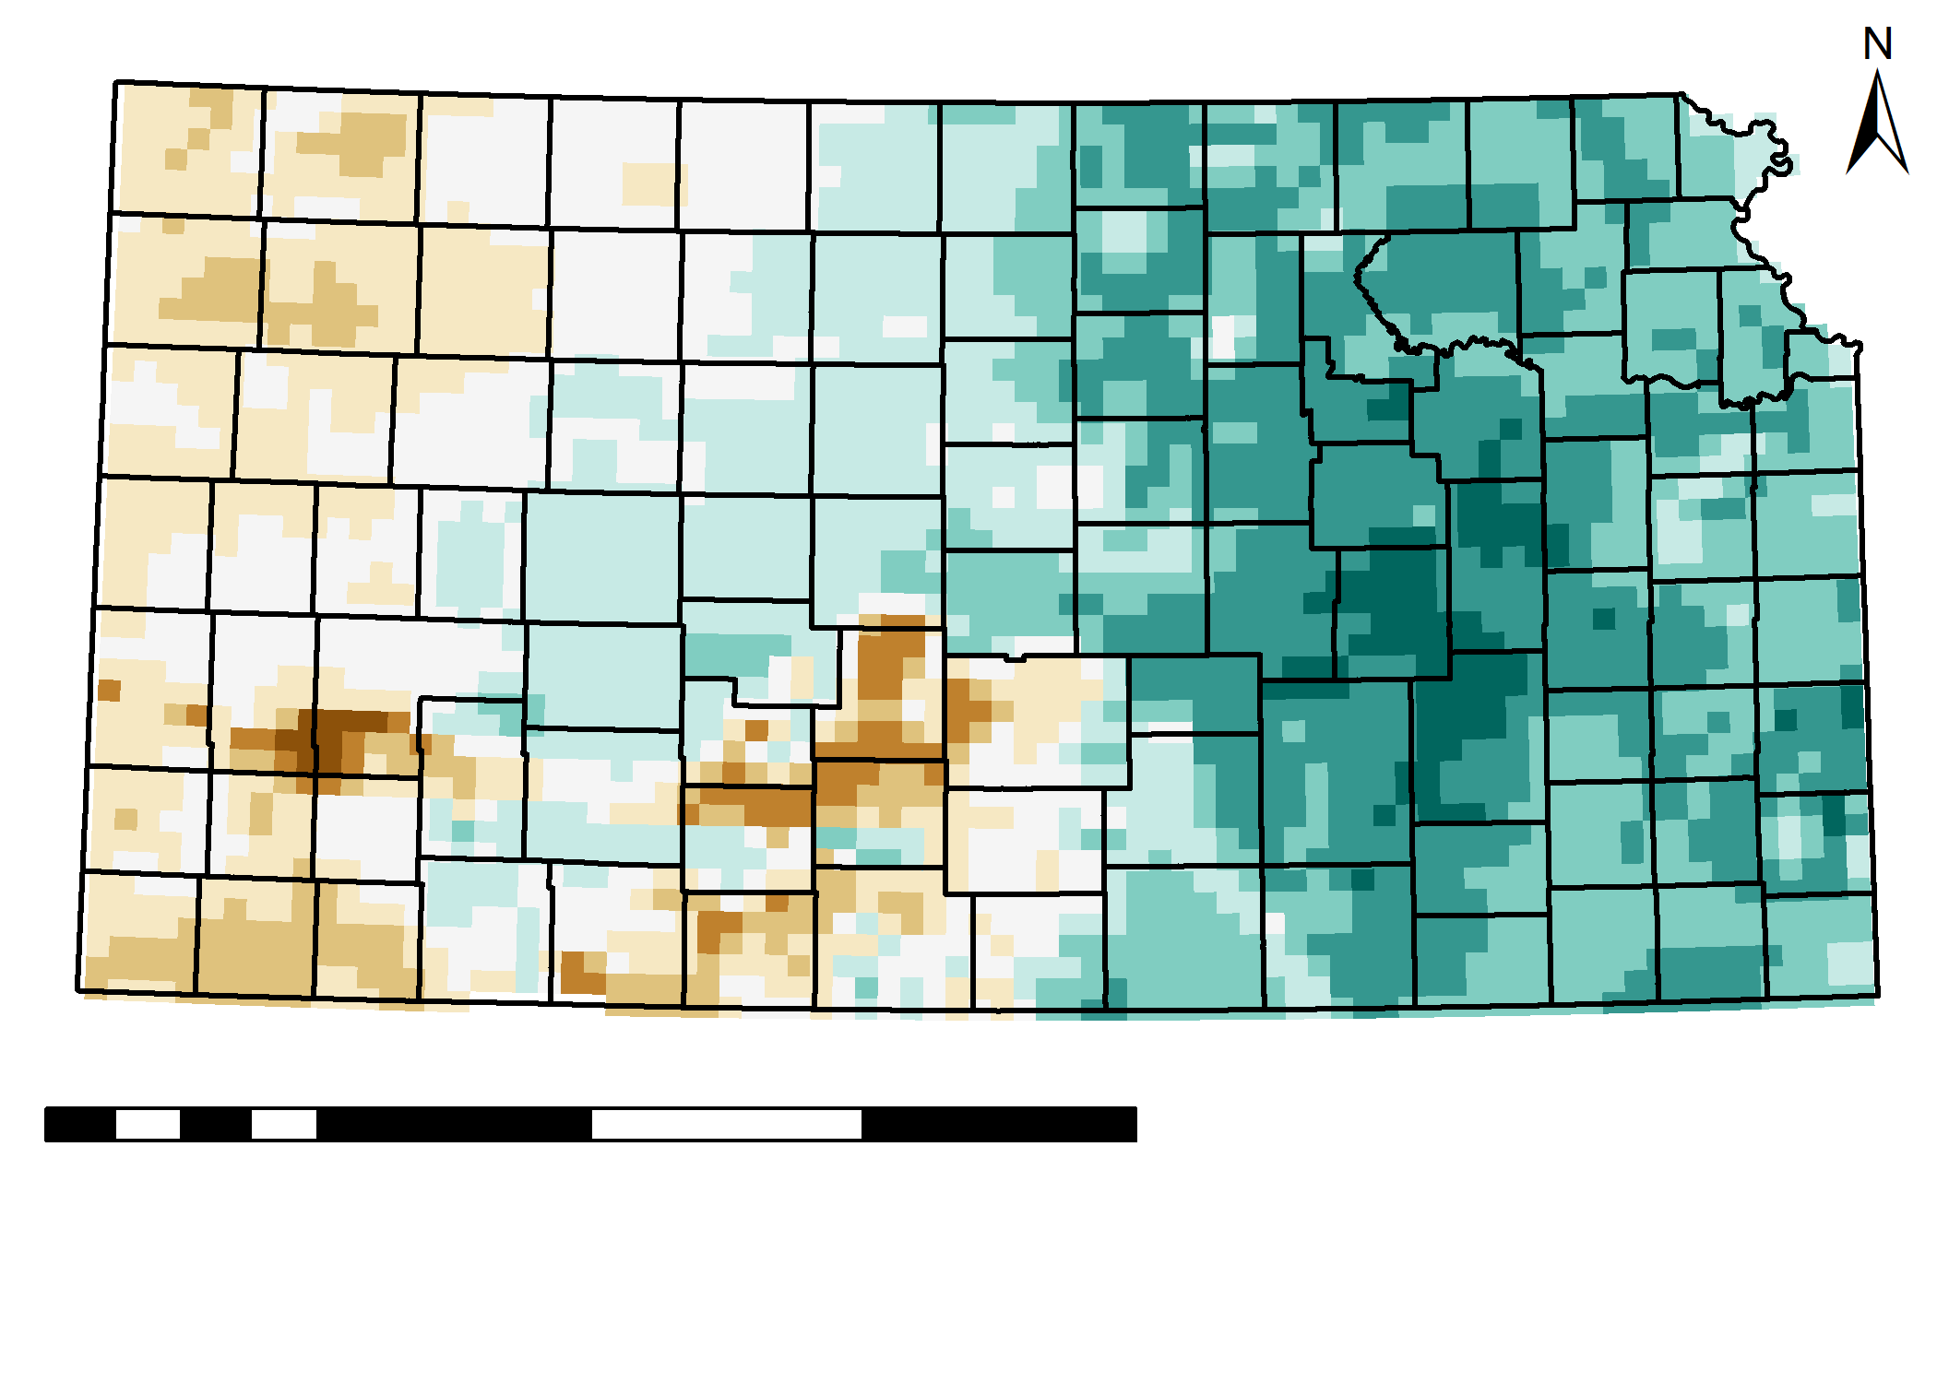
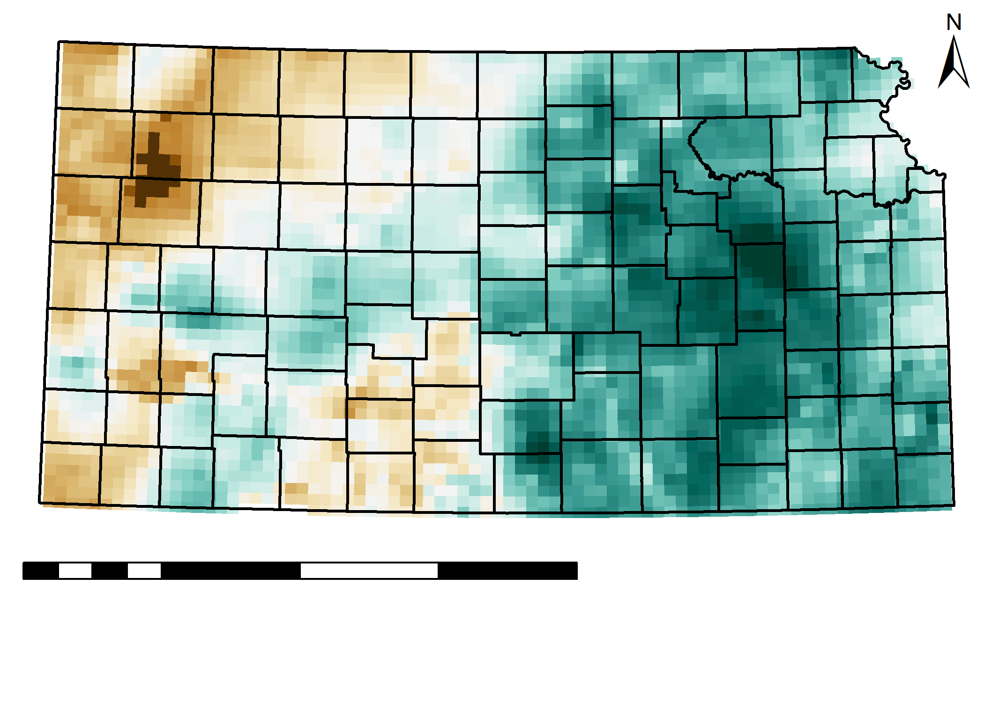
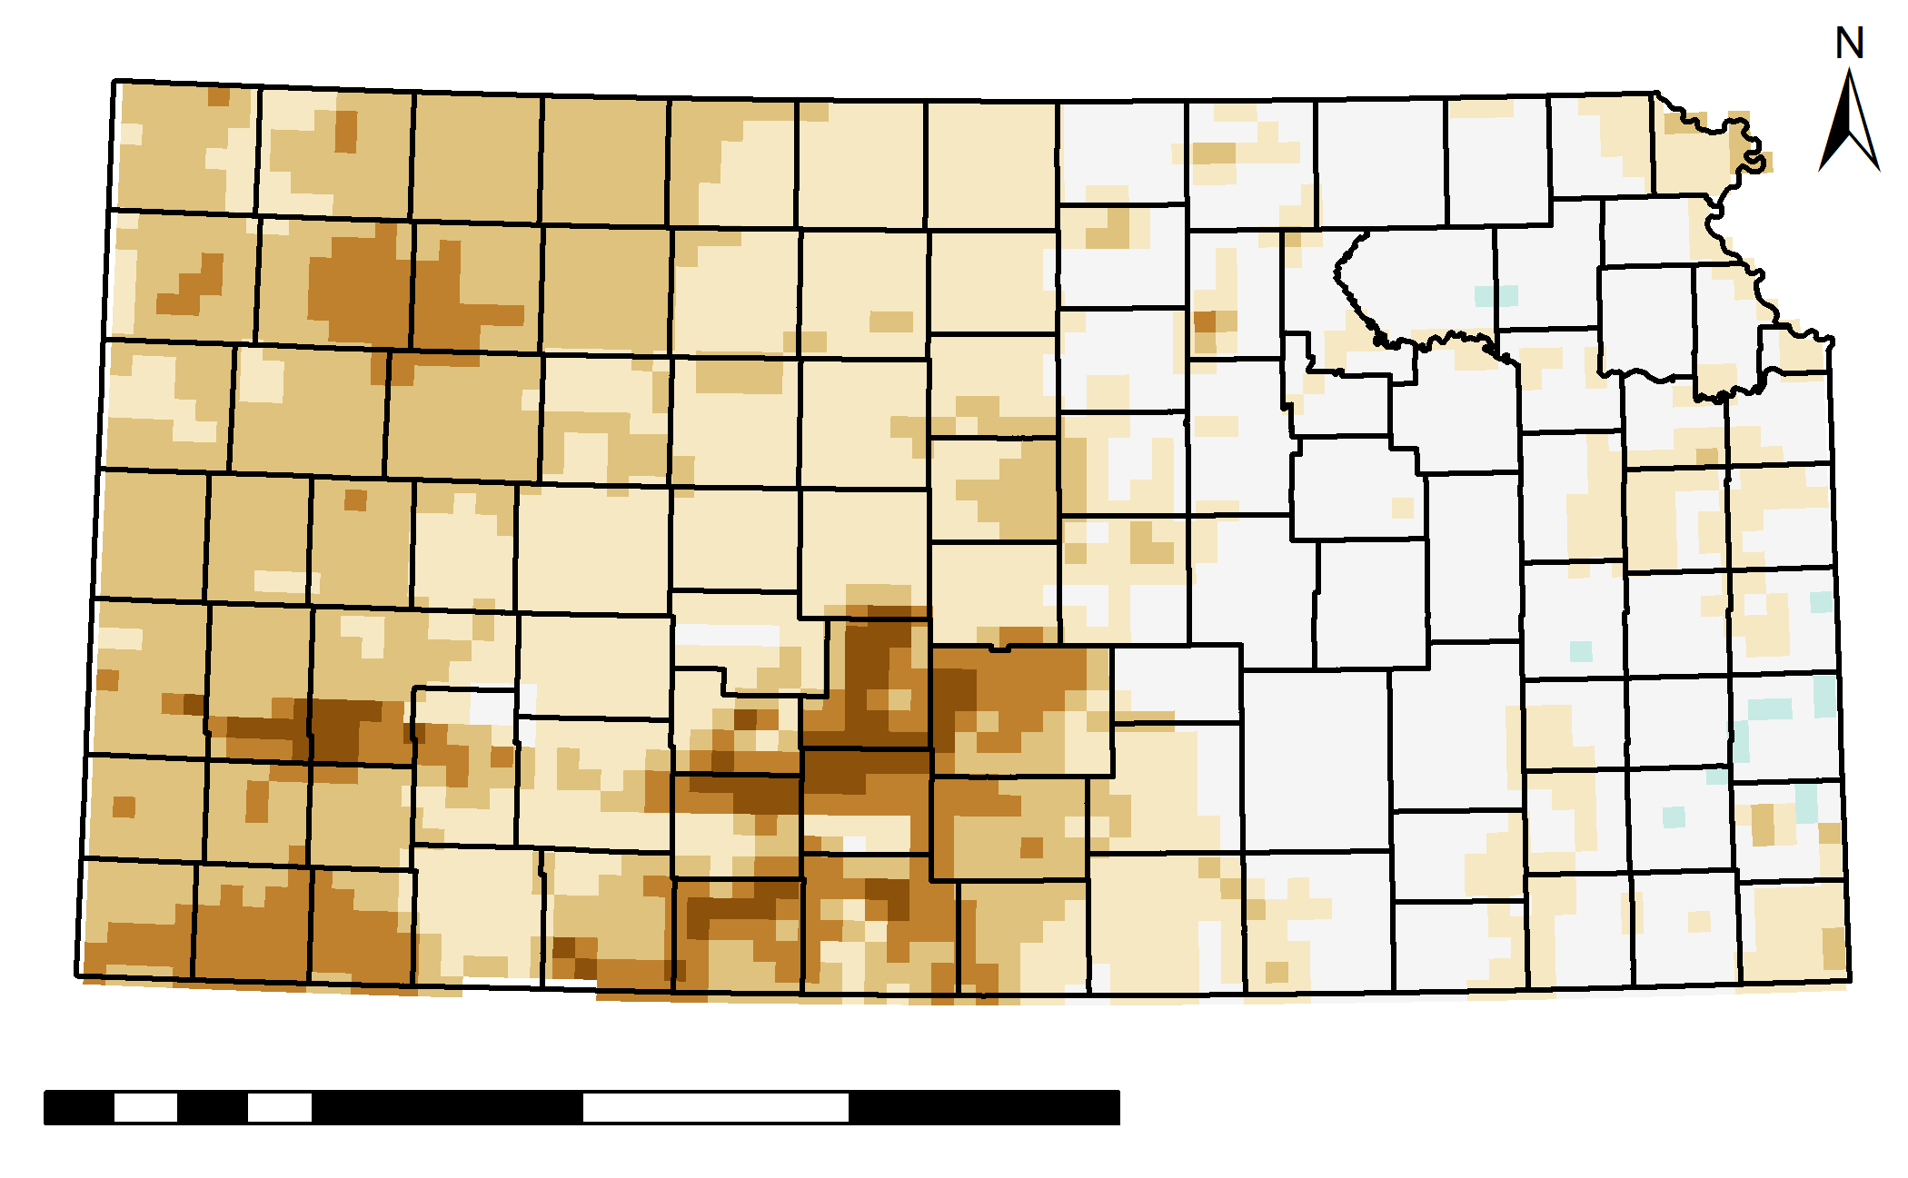
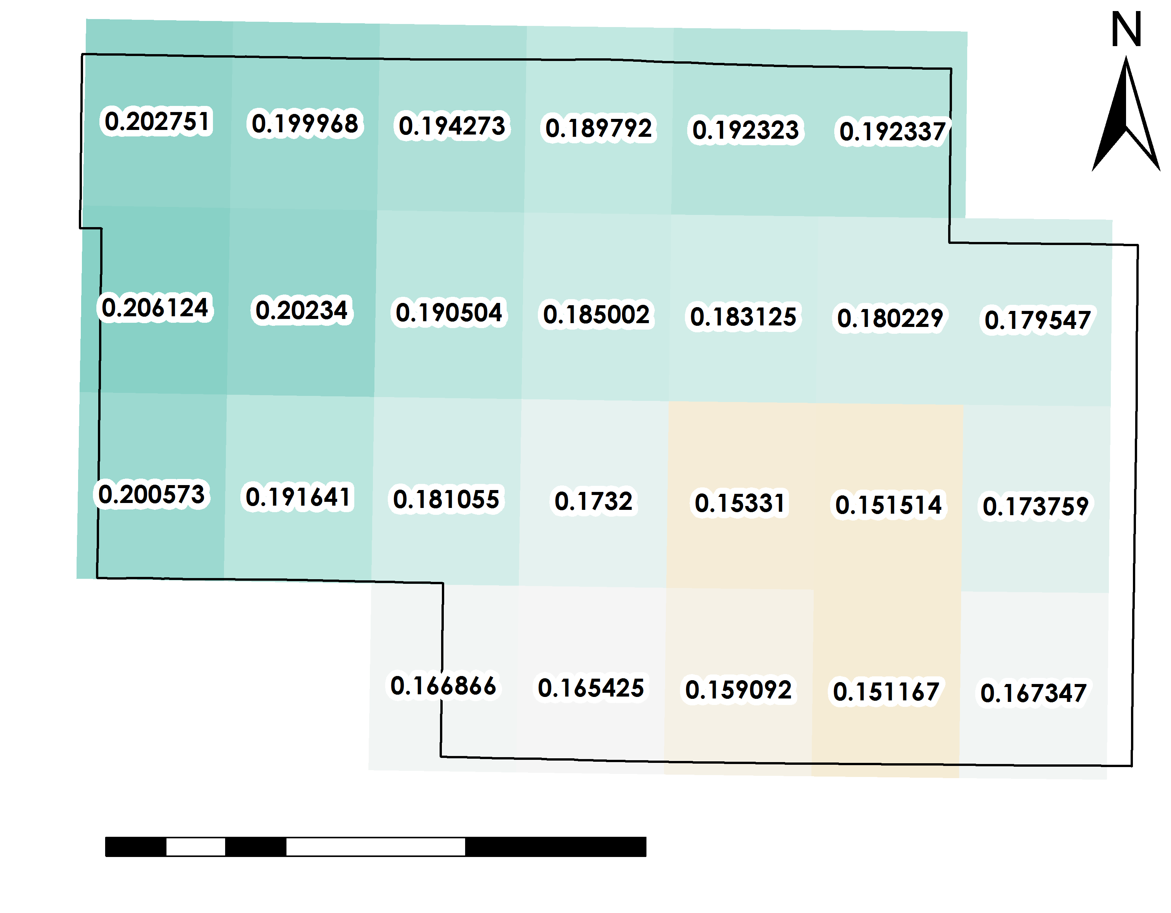
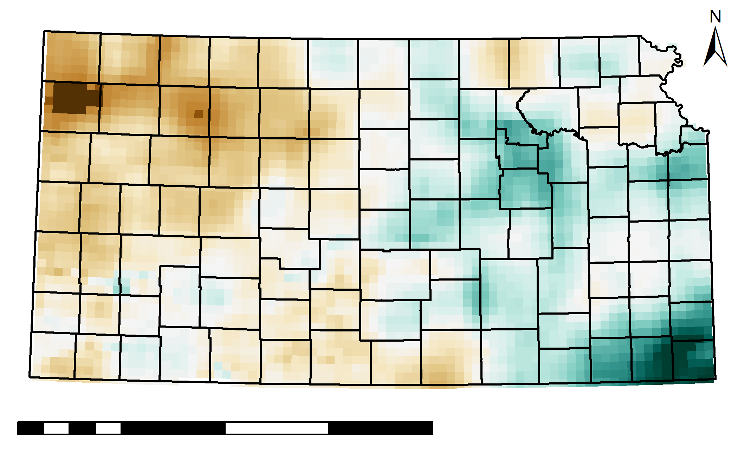
Modeling Soil Drydown Parameters for Drought Mitigation in Cropland and Rangeland of Kansas Using NASA Earth Observations
Abstract
Study Area
Objectives
Kansas Agriculture & Food Security
Kansas is a leading state in agricultural production, however, during recent droughts, farmers experienced decreased yields that negatively impacted the state and national economies. The exponential decay of soil moisture content is a major consequence of drought, stymieing plant growth. This study examined the rate of soil moisture drydown to understand and mitigate the damage caused by soil water shortage. Soil Moisture Active Passive (SMAP) L-band Radiometer rootzone soil moisture imagery from March 2015 to the present was used to understand the minimum and maximum soil moisture capacity. The variables selected from SMAP and parameters derived from in situ data were input into an exponential model. The model forecasted, for a given length of time, the rootzone soil moisture assuming no precipitation. Another model was used to identify areas in Kansas currently below a given percentage of their relative soil moisture saturation, measured as a function of minimum, maximum, and current soil moisture, and forecasted the number of days until the other pixels would reach that level. The data were observed at a spatial resolution of 9 km × 9 km. These outputs were compared to Evaporative Drought Demand Index (EDDI) data to understand the relationship between agricultural and meteorological drought for our partners at Kansas State University and the Desert Research Institute. Additionally, the project assisted the Kansas Water Office and Kansas Office of the State Climatologist at Kansas State University in creating statewide drought mitigation plans and disseminating comprehensive information to farmers.
Develop an exponential model to estimate the decay of root zone soil moisture (soil drydown)
Utilize remote sensing and in situ data to calculate model parameters Analyze the relationship between soil moisture and drought indices
Produce a statewide map atlas of soil moisture characteristics
Enhance understanding of soil drydown for drought mitigation planning
Study Area
0 250 500 1,000
United
1
km
States
2
3
Earth Observations
4
5
Kansas
6
Soil Moisture Active Passive (SMAP)
L-band Radiometer Rootzone Soil Moisture, Level 4 Analysis Update
7
8
9
Methodology
0 25 50 100
km
Study Area
Climate Zones
Counties
Data Acquisition
Characterize
Forecast
Model
Acquire daily SMAP data for Kansas from March 31, 2015 to present for 12pm observation
Calculate water storage capacity for each pixel by subtracting minimum soil moisture from maximum soil moisture over the study period
Using current RZSM, minimum RZSM, and decay constant in an exponential model assuming no precipitation
Days until or since each pixel reaches a selected percent of relative saturation
End
Products
Soil Moisture for July 1st, 2019
Water Storage Capacity
Forecasted Soil Moisture
Soil Moisture Characteristics Map Atlas by County
Days Since/Until Relative Soil Saturation
A represents the most soil moisture can decline from its current level
Calculate days from current relative saturation to selected relative saturation, determined by x, based on 𝜏, current RZSM, minimum RZSM, and maximum RZSM
0 50 200 400
km
0 50 200 400
km
Calculate soil water content, in cm³/cm³ based on A, exponential decay constant 𝜏, & selected number of days t
0 0.5
0.1 0.27
Results
cm³/cm³
cm³/cm³
Forecasted Soil Moisture to July 30, 2019
Water Storage Capacity for Pawnee County
25% Relative Soil Saturation Model from July 1, 2019
Using July 1, 2019 assuming no precipitation
Days Since (Brown), Days Until (Blue) assuming no precipitation
0 50 200 400
km
0 10 30
km
0 50 200 400
km
0 0.5
-30 30
Conclusions
cm³/cm³
Project Partners
Days
Modeled outputs showed sub-county variations in forecasted soil moisture and estimated days to a selected relative soil saturation under the same no precipitation scenario.
Remote sensing is useful for spatially comprehensive forecasts of soil moisture when used in combination with empirically measured decay parameters.
Initial tests of forecasted versus actual soil moisture show agreement for areas experiencing extreme to exceptional drought.
Evaporative Demand Drought Index is inversely related to RZSM percentiles.
Remote sensing fills gaps in in situ data, enhancing information available for drought planning.
Kansas Water Office
Desert Research Institute, Western Regional Climate Center
Kansas State University
Kansas Office of the State Climatologist
Department of Agronomy
Team Members
Acknowledgements
We thank our advisor Jessica Blunden for her mentorship and Center Lead Andrew Shannon for his guidance. We also thank our partners Andres Patrignani, Diane Knowles, Chip Redmond, Mary Knapp, and Daniel McEvoy for their expertise and insightful suggestions and comments.
We extend our thanks to the National Integrated Drought Information System (NIDIS), NOAA National Centers for Environmental Information, and the DEVELOP National Program Office who have supported this project.
Danika Mosher
Project Lead
Max Dunsker
Krishna Tiwari
North Carolina – NCEI | Summer 2019

