Slide 1
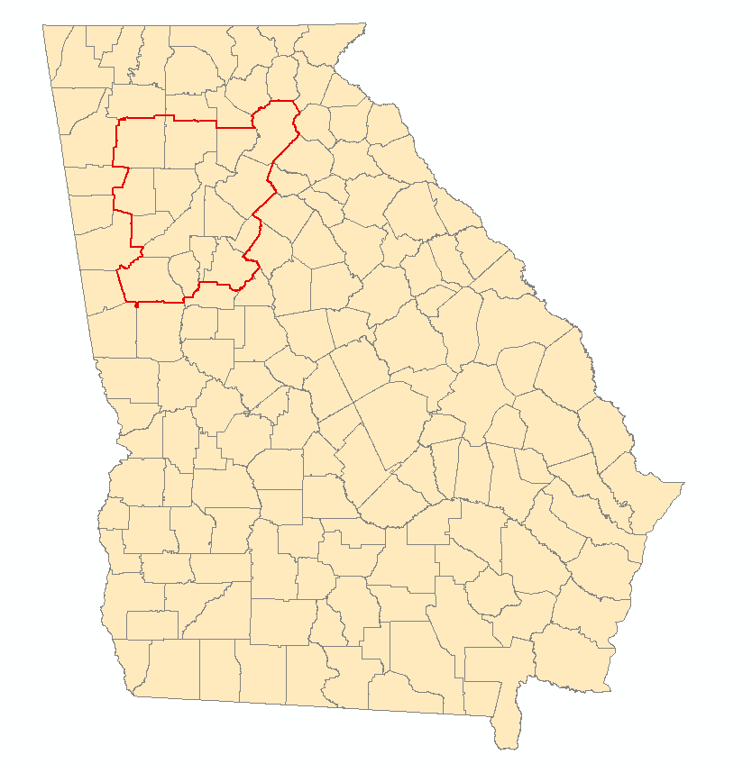
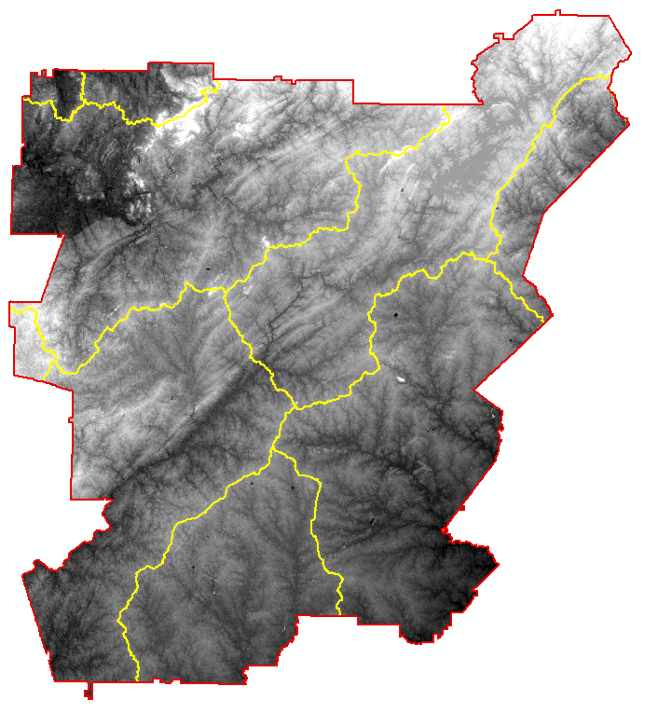
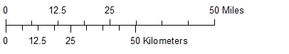
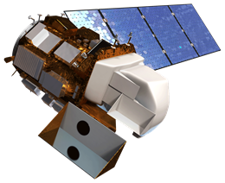
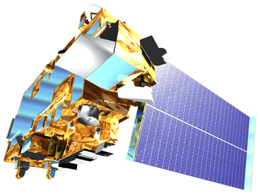
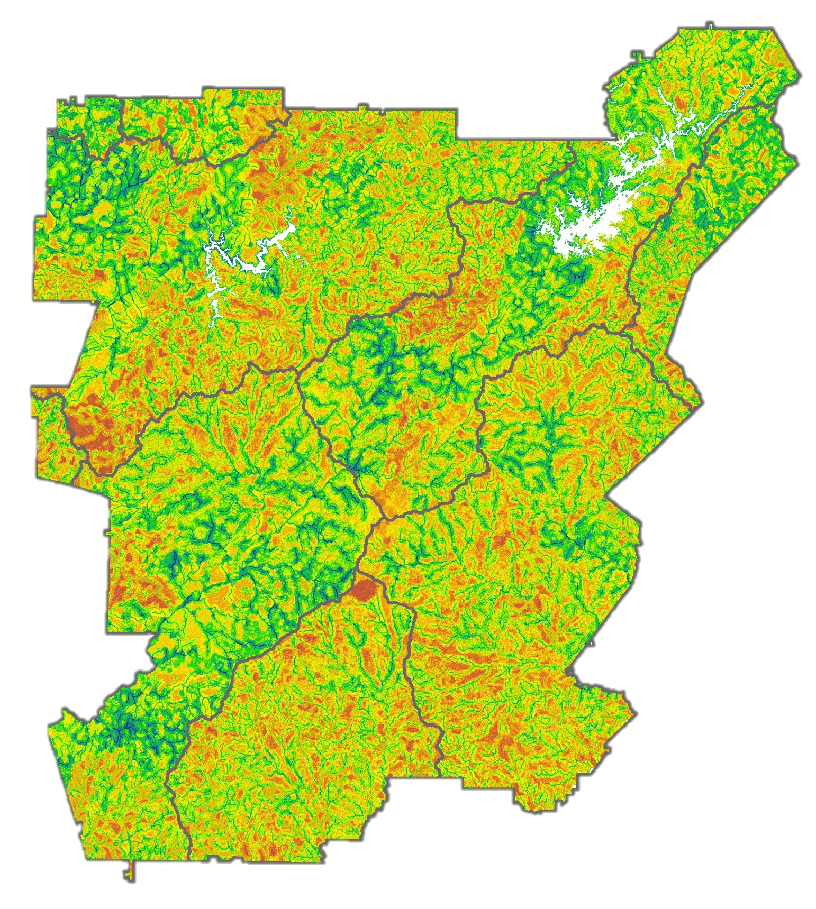
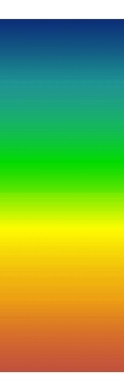

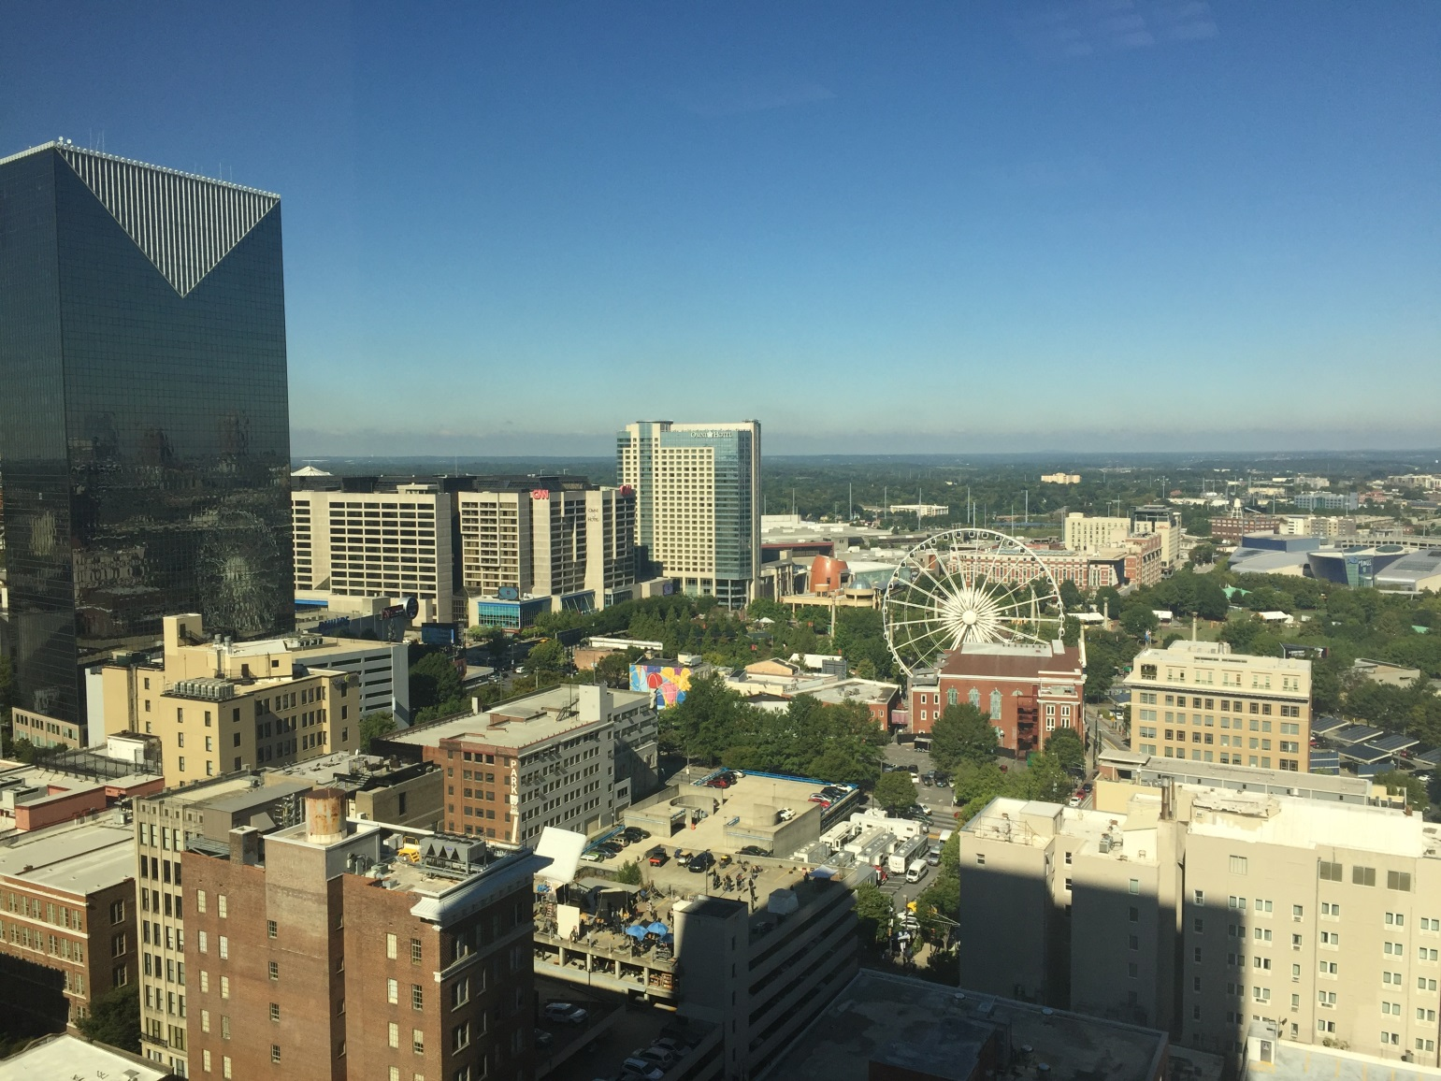
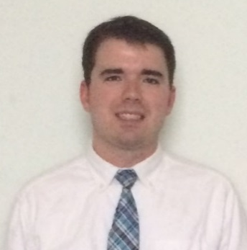
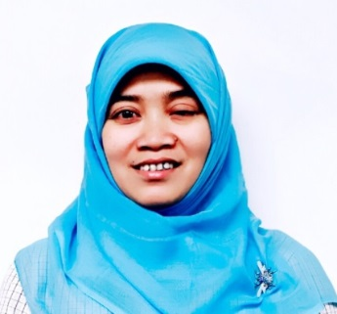
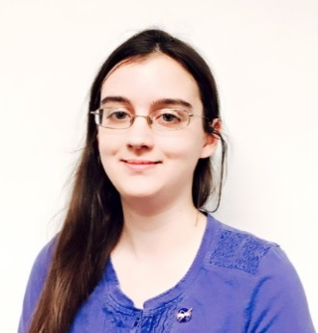
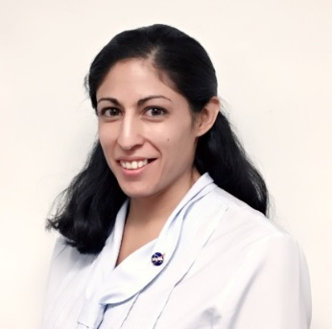
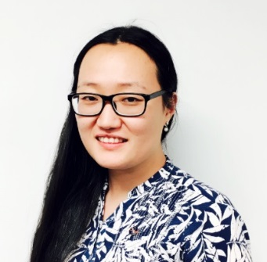

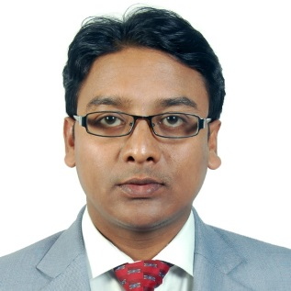
Identifying Key Urban Areas to Reduce Stormwater Runoff and Maximize Conservation Efforts in Metropolitan Atlanta
Abstract
Objectives
Residents of metropolitan Atlanta pay among the highest rates in the nation for municipal water and sewer services due to massive, recent investments in infrastructure to manage stormwater runoff. As development continues at a rapid pace in Atlanta and its suburbs, expanding areas of impervious surface will continue to exacerbate this problem. Forested land is known to slow runoff during storms, allowing water to infiltrate, and the soil to absorb particles and contaminants before entering the surface water. Protecting existing green infrastructure and strategically planting more trees to intercept stormwater runoff will help reduce sediment and nutrient-laden stormwater runoff in local watersheds and, ultimately, limit the need for future city infrastructure. The DEVELOP team at the University of Georgia partnered with The Nature Conservancy to identify conservation targets in the Atlanta region to improve existing green infrastructure and locate additional areas suitable for expansion of reforestation efforts using NASA data from the Landsat 8 and Terra satellites. This was accomplished through a combined, watershed-scale assessment of metropolitan Atlanta using the Land-Use Conflict Identification Strategy (LUCIS) and Soil and Water Assessment Tool (SWAT) models. The LUCIS model was employed in this project to identify areas of land use prioritization as it relates to existing and future conservation areas in Atlanta. The SWAT model produced an analysis of streamflow and runoff within the study area. Together, these model results provided project partners with an integrated understanding of water resource issues in metropolitan Atlanta that emphasized land use scenarios.
Locate areas within the Atlanta region for conservation and forested land protection efforts using the LUCIS model
Analyze watershed processes using the SWAT model
Identify reforestation targets to help reduce harmful stormwater runoff in the Atlanta region
Study Area
Atlanta
Methodology
Etowah
Upper Chattahoochee
Landsat 8 Imagery
U.S. Census
ASTER DEM
Soil & Watershed Assessment Tool (SWAT)
Soils & Geology
Topography
National Hydrography Dataset
Global Weather Data
Middle
Chattahoochee
Ocmulgee
Input Data
USGS Streamflow & Water Quality
gSSURGO
Land Cover
Climate
National Land Cover Dataset
Flint
Stormwater Infrastructure
Proximity to Waterways
Green Spaces
Community Impact
Soil Permeability
Proximity to Forests
Flint
Canopy Cover
Associated Land Cover
Proximity to Waterways
Surface Flow
Pollution Sources
Open Spaces
Proximity to Waterways
Slope
Earth Observations
Minimize Untreated Stormwater Flow from Impervious Surfaces
Protect Existing Green Infrastructure and Identify Opportunities for Conservation
Identify Lands with a High Potential to Impact Water Quality
Atlanta Water Resources III
Suitability Analysis
Land Use Conflict Identification Strategy (LUCIS)
Land Use Prioritization
Landsat 8, OLI
Terra, ASTER
Results
Conclusions
MNGWPD Land Use Prioritization
Upper Chattahoochee, SWAT Calibrated Flow 2013
NASA satellite data was successfully integrated into three water resource management goals in the MNGWPD.
The LUCIS suitability maps identified areas with high potential to affect local water resources in the MNGWPD by incorporating a variety of input datasets.
The SWAT model provided information about water quality parameters to be used in the LUCIS methodology.
This project has identified a smaller subset of places within the Atlanta region where The Nature Conservancy and their local partners can target reforestation and urban conservation projects.
These results provided project partners with data to help create and promote strategies emphasizing stormwater management alternatives and greenspace protection.
Flow (m³/sec)
0 - 10
10 - 20
20 - 50
50 - 100
100 - 150
Priority
 | SWAT Calibration |  | SWAT Validation
 | R² | NS | R² | NS
Upper Chattahoocheel | 0.65 | 0.65 | 0.42 | 0.36
Middle Chattahoocheel | 0.63 | 0.55 | 0.67 | 0.66
Upper Ocmulgeel | 0.77 | 0.77 | 0.61 | 0.61
Flintl | 0.72 | 0.72 | 0.60 | 0.57
Etowahl | 0.68 | 0.67 | 0.84 | 0.83
High
Low
Team Members
Acknowledgements
Project Partners
We would like to thank our science advisors, Dr. Rosanna Rivero, Dr. Adam Milewski, and Dr. Marguerite Madden, for their advice and guidance on this project.
We also would like to thank our partners at The Nature Conservancy, Sara Gottlieb, Myriam Dormer, and Whitney Palanci, for their support and involvement throughout the project.
Previous team members Beatriz Avila, Wenjing Xu, Veronica Fay, Jason Reynolds, Jacob Spaulding, Mark Beatty, Manasi Parkhi, and Alex Smith.
Any opinions, findings, and conclusions or recommendations expressed in this material are those of the author(s) and do not necessarily reflect the views of the National Aeronautics and Space Administration. This material is based upon work supported by NASA through contract NNL11AA00B and cooperative agreement NNX14AB60A.
The Nature Conservancy
Christopher Cameron
Team Lead
Ike Sari Astuti
Alys Hannum
Amanda Aragon
Natalia Bhattacharjee
Doori Oh
Kamalakanta Sahoo
The University of Georgia – Fall 2016

