Slide 1
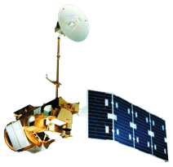
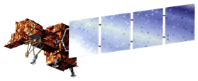
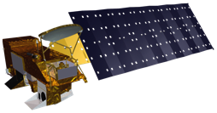
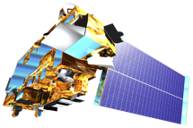
Indonesia Disasters
Creating an enhanced methodology for mapping burn scars in Indonesia by transforming red green blue false color composites to hue saturation value images using Landsat
Jerrod Lessel (Project Lead), Alex Sweeney
International Research Institute for Climate and Society (IRI)
Abstract
Objectives
Keep this blank for now.
Body text point size should be at least 24.
Caption text point size should be at least 16.
Feel free to rename, move, and resize sections as needed.
Present a new methodology for effectively mapping and identifying burn scars using scenes from Landsat TM and ETM+.
Landsat TM and ETM+ scenes were used to test a technique of transforming Red Green Blue (RGB) false color composites to Hue Saturation Value (HSV) in order to determine whether it was an effective procedure for identifying burn scars.
Isolate hue range that differentiates burn scars from surroundings.
Study Area
Methodology
Landsat TM & ETM+ Download
Color Transformation
RGB composite created using Landsat TM bands 5 (SWIR), 4 (NIR), and 3 (Red)
RGB Composite
Transformed to HSV images
More content will be added in for Final Draft.
Earth Observations
Landsat 5 and 7
Results
Aqua and Terra
Forthcoming in Final Draft
Use images.
Make sure that it has some sort of flow, that it makes sense. Show your results in a logical order.
No bullets.
Project Partners
Bogor Agricultural University
Center for International Forestry Research
Team Members
Jerrod Lessel
&
Alex Sweeney
Picture forthcoming in Final Draft
Conclusions
Forthcoming in Final Draft
Use bullets.
Use complete sentences with periods.
Acknowledgements
Dr. Pietro Ceccato, Science Advisor, IRI
IRI

