Slide 1
Colorado Water Resources II
Utilizing NASA Earth Observations to Identify Locations for Sedimentation Mitigation in the Ralston Creek Watershed Following the September 2013 Colorado Floods
Tyler Rhodes(Team Lead)
Romina Gotzmann
Amy Phillips
Jared Ryks
Rebekke Muench

Slide 2
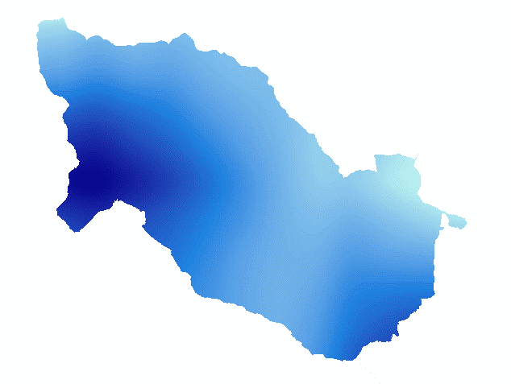
The Revised Universal Soil Loss Equation (RUSLE)
Predicted soil loss: R * K * LS * C * P
R = Rainfall and runoff factor
High
Low
Source: PRISM Precipitation

Slide 3
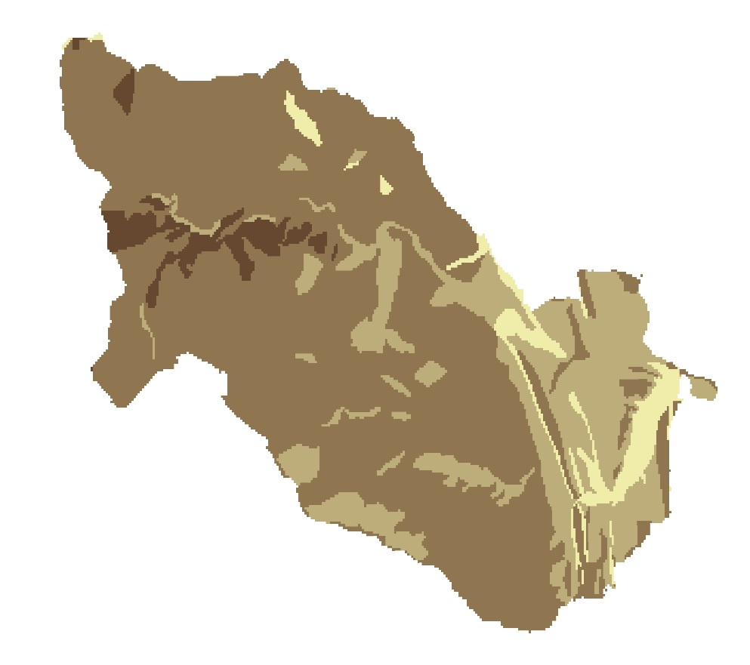
The Revised Universal Soil Loss Equation (RUSLE)
Predicted soil loss: R * K * LS * C * P
K = Soil erodibility factor
Soil Type | K Factor
Water | 1.0
Urban/Bedrock | 1.0
Clay Loam | 1.3
Loam | 1.3
Sandy Loam | 1.7
Loamy Sand | 2.0
Water/ Rock
Loam
Sandy loam
Loamy sand
Source: USDA Web Soil Survey

Slide 4
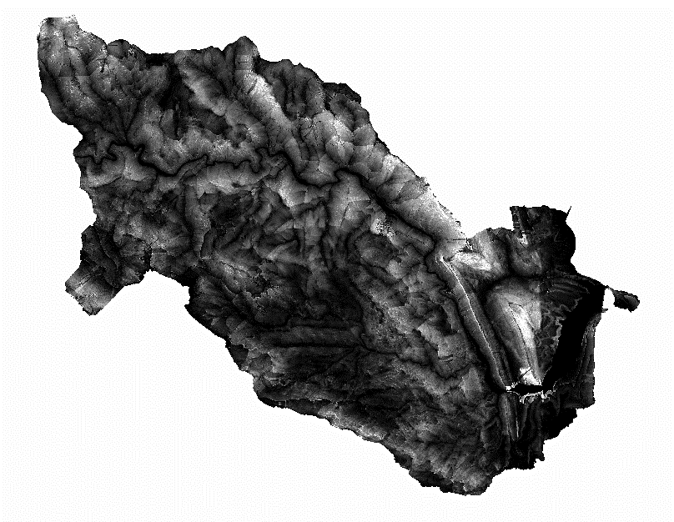
The Revised Universal Soil Loss Equation (RUSLE)
Predicted soil loss: R * K * LS * C * P
LS = Length slope factor
As = catchment length
β = slope measure in degrees
High
Low
Source: FEMA LiDAR

Slide 5
The Revised Universal Soil Loss Equation (RUSLE)
Predicted soil loss: R * K * LS * C * P
C = Crop and land cover management factor
Land Cover Classification | C Factor
Water | 1.0
Forest | 1.1
Developed-Low Intensity | 1.2
Shrub/ Grass | 1.4
Bare Soil | 2.0
Bare Ground
Low vegetation
Low intensity development
Source:
NASA EOS
Landsat 4-5 TM
Landsat 7
Landsat 8
Forest
Water

Slide 6
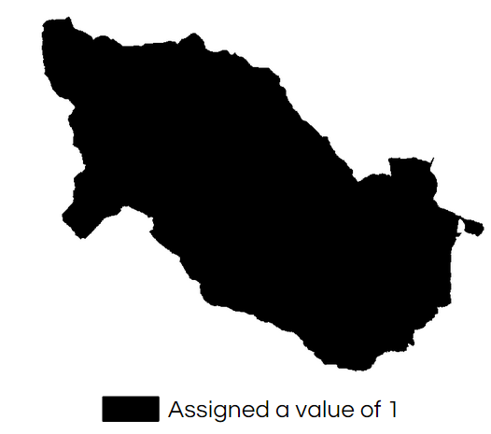
The Revised Universal Soil Loss Equation (RUSLE)
Predicted soil loss: R * K * LS * C * P
P = Conservation practice factor
Credit: NASA

Slide 7
RUSLE 2002
2 - High
Waterways
Ralston Reservoir
1 - Low

Slide 8
RUSLE 2010
2 - High
Waterways
Ralston Reservoir
1 - Low

Slide 9
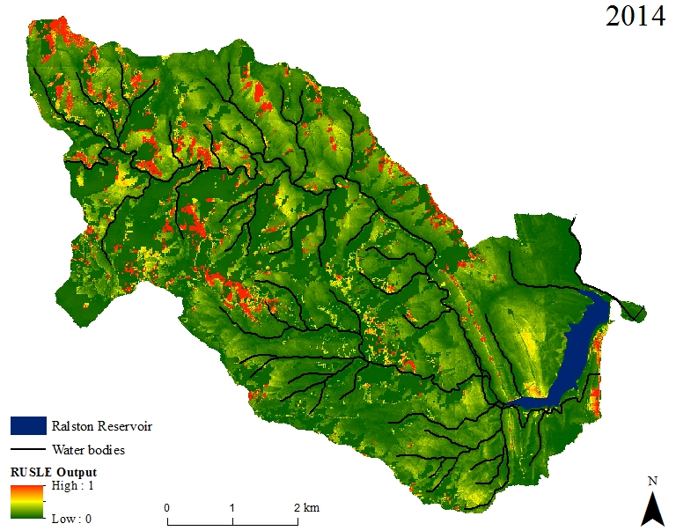
RUSLE 0-1 Scale
Ralston Reservoir
Waterways
1 - High
0 - Low

Slide 10
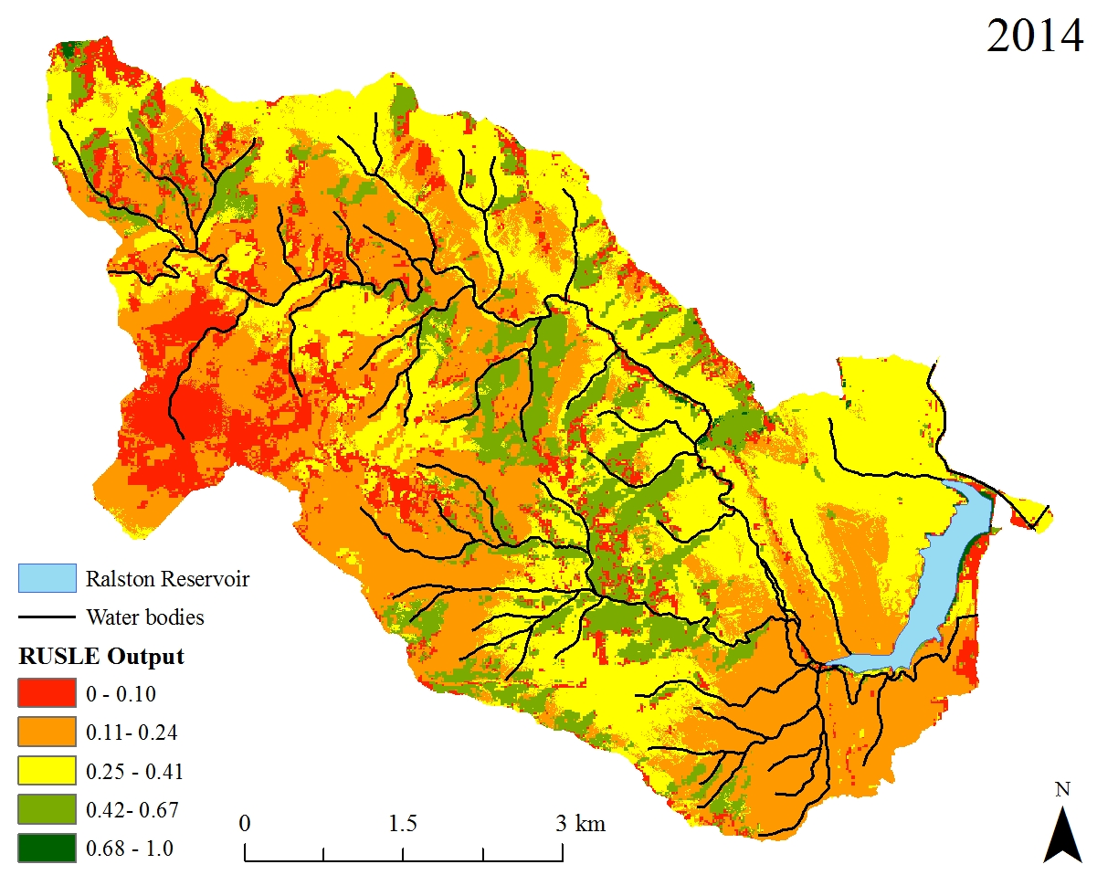
RUSLE 2014 Inverted 0-1 Scale
Ralston Reservoir
Waterways
0-0.10
0.11-0.24
0.25-0.41
0.42-0.67
0.68-1.0

Slide 11
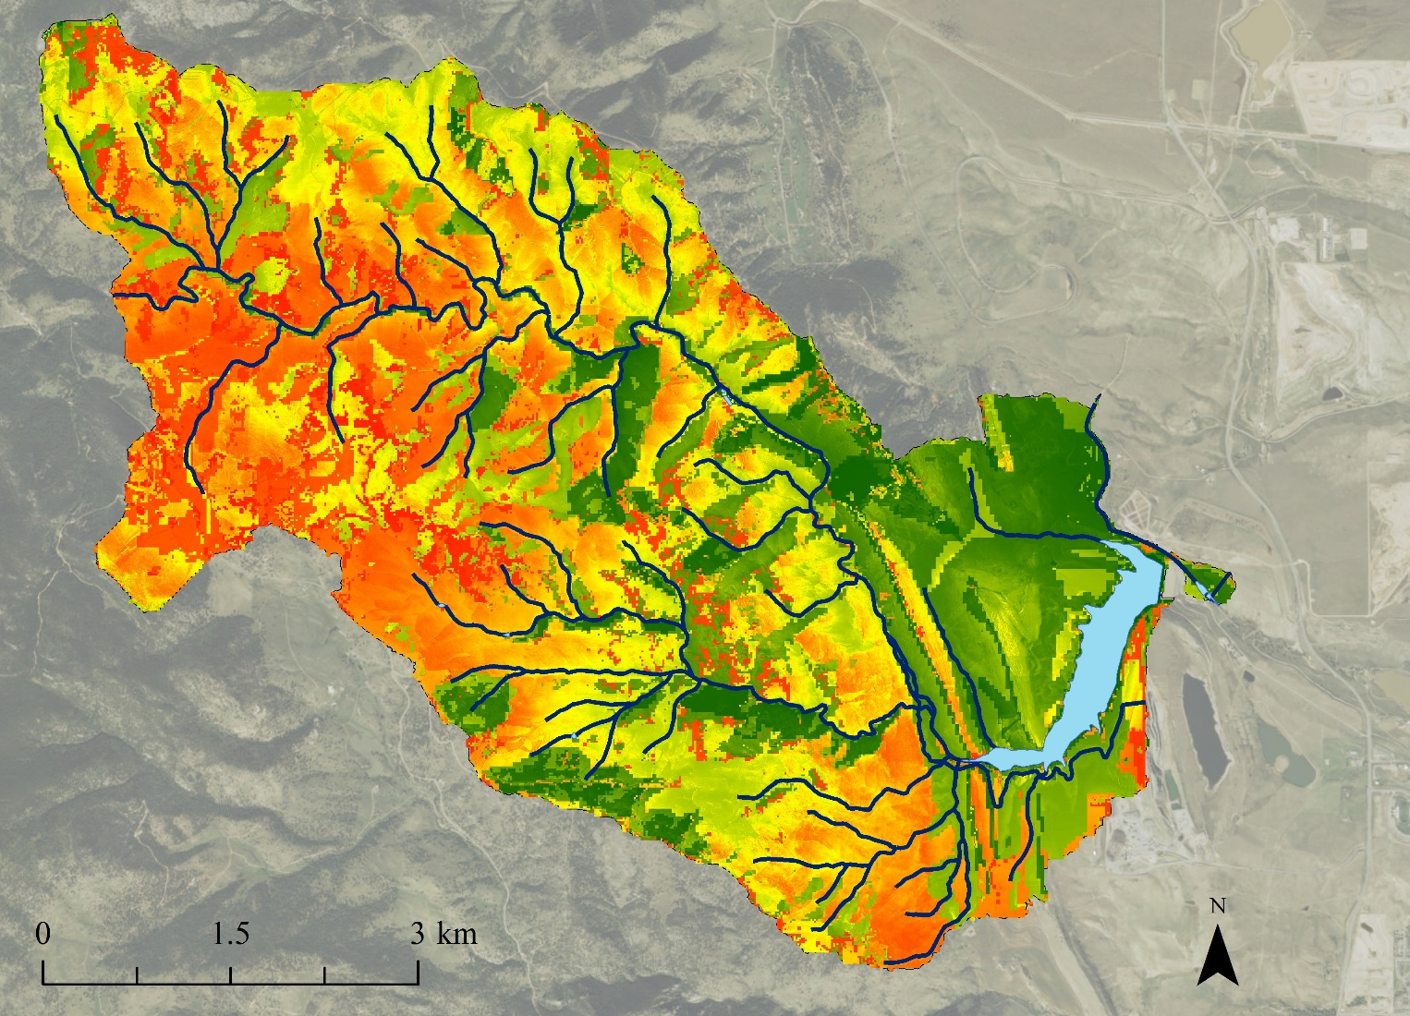
RUSLE 2014 1-2 Scale
2 - High
Waterways
Ralston Reservoir
1 - Low

Slide 12
2002-2014 Change Risk
Increase to High Risk
Increase to Low Risk

Slide 13
Prediction to 2020
2 - High
1 - Low

Slide 14
Prediction to 2030
2 - High
1 - Low

