Slide 1
WASHINGTON DC & MARYLAND
Energy
Estimating Solar Potential Using NASA POWER Data to Inform Renewable Energy Policy for Washington DC
Edward Cronin, Ashley Fernando, Jarrett James, and Rupa Kurinchi-Vendhan
Virginia – Langley
Notes:
Hello everyone. We are Edward, Ashley, Jarrett, and Rupa and we're the Washington DC and Maryland Energy team for the Fall 2021 NASA DEVELOP term. We partnered with the Washington DC Department of Energy and Environment (DOEE) to create solar potential maps of surrounding county areas to inform decision makers in their pursuit to reach 100% renewable energy by 2050.

Slide 2
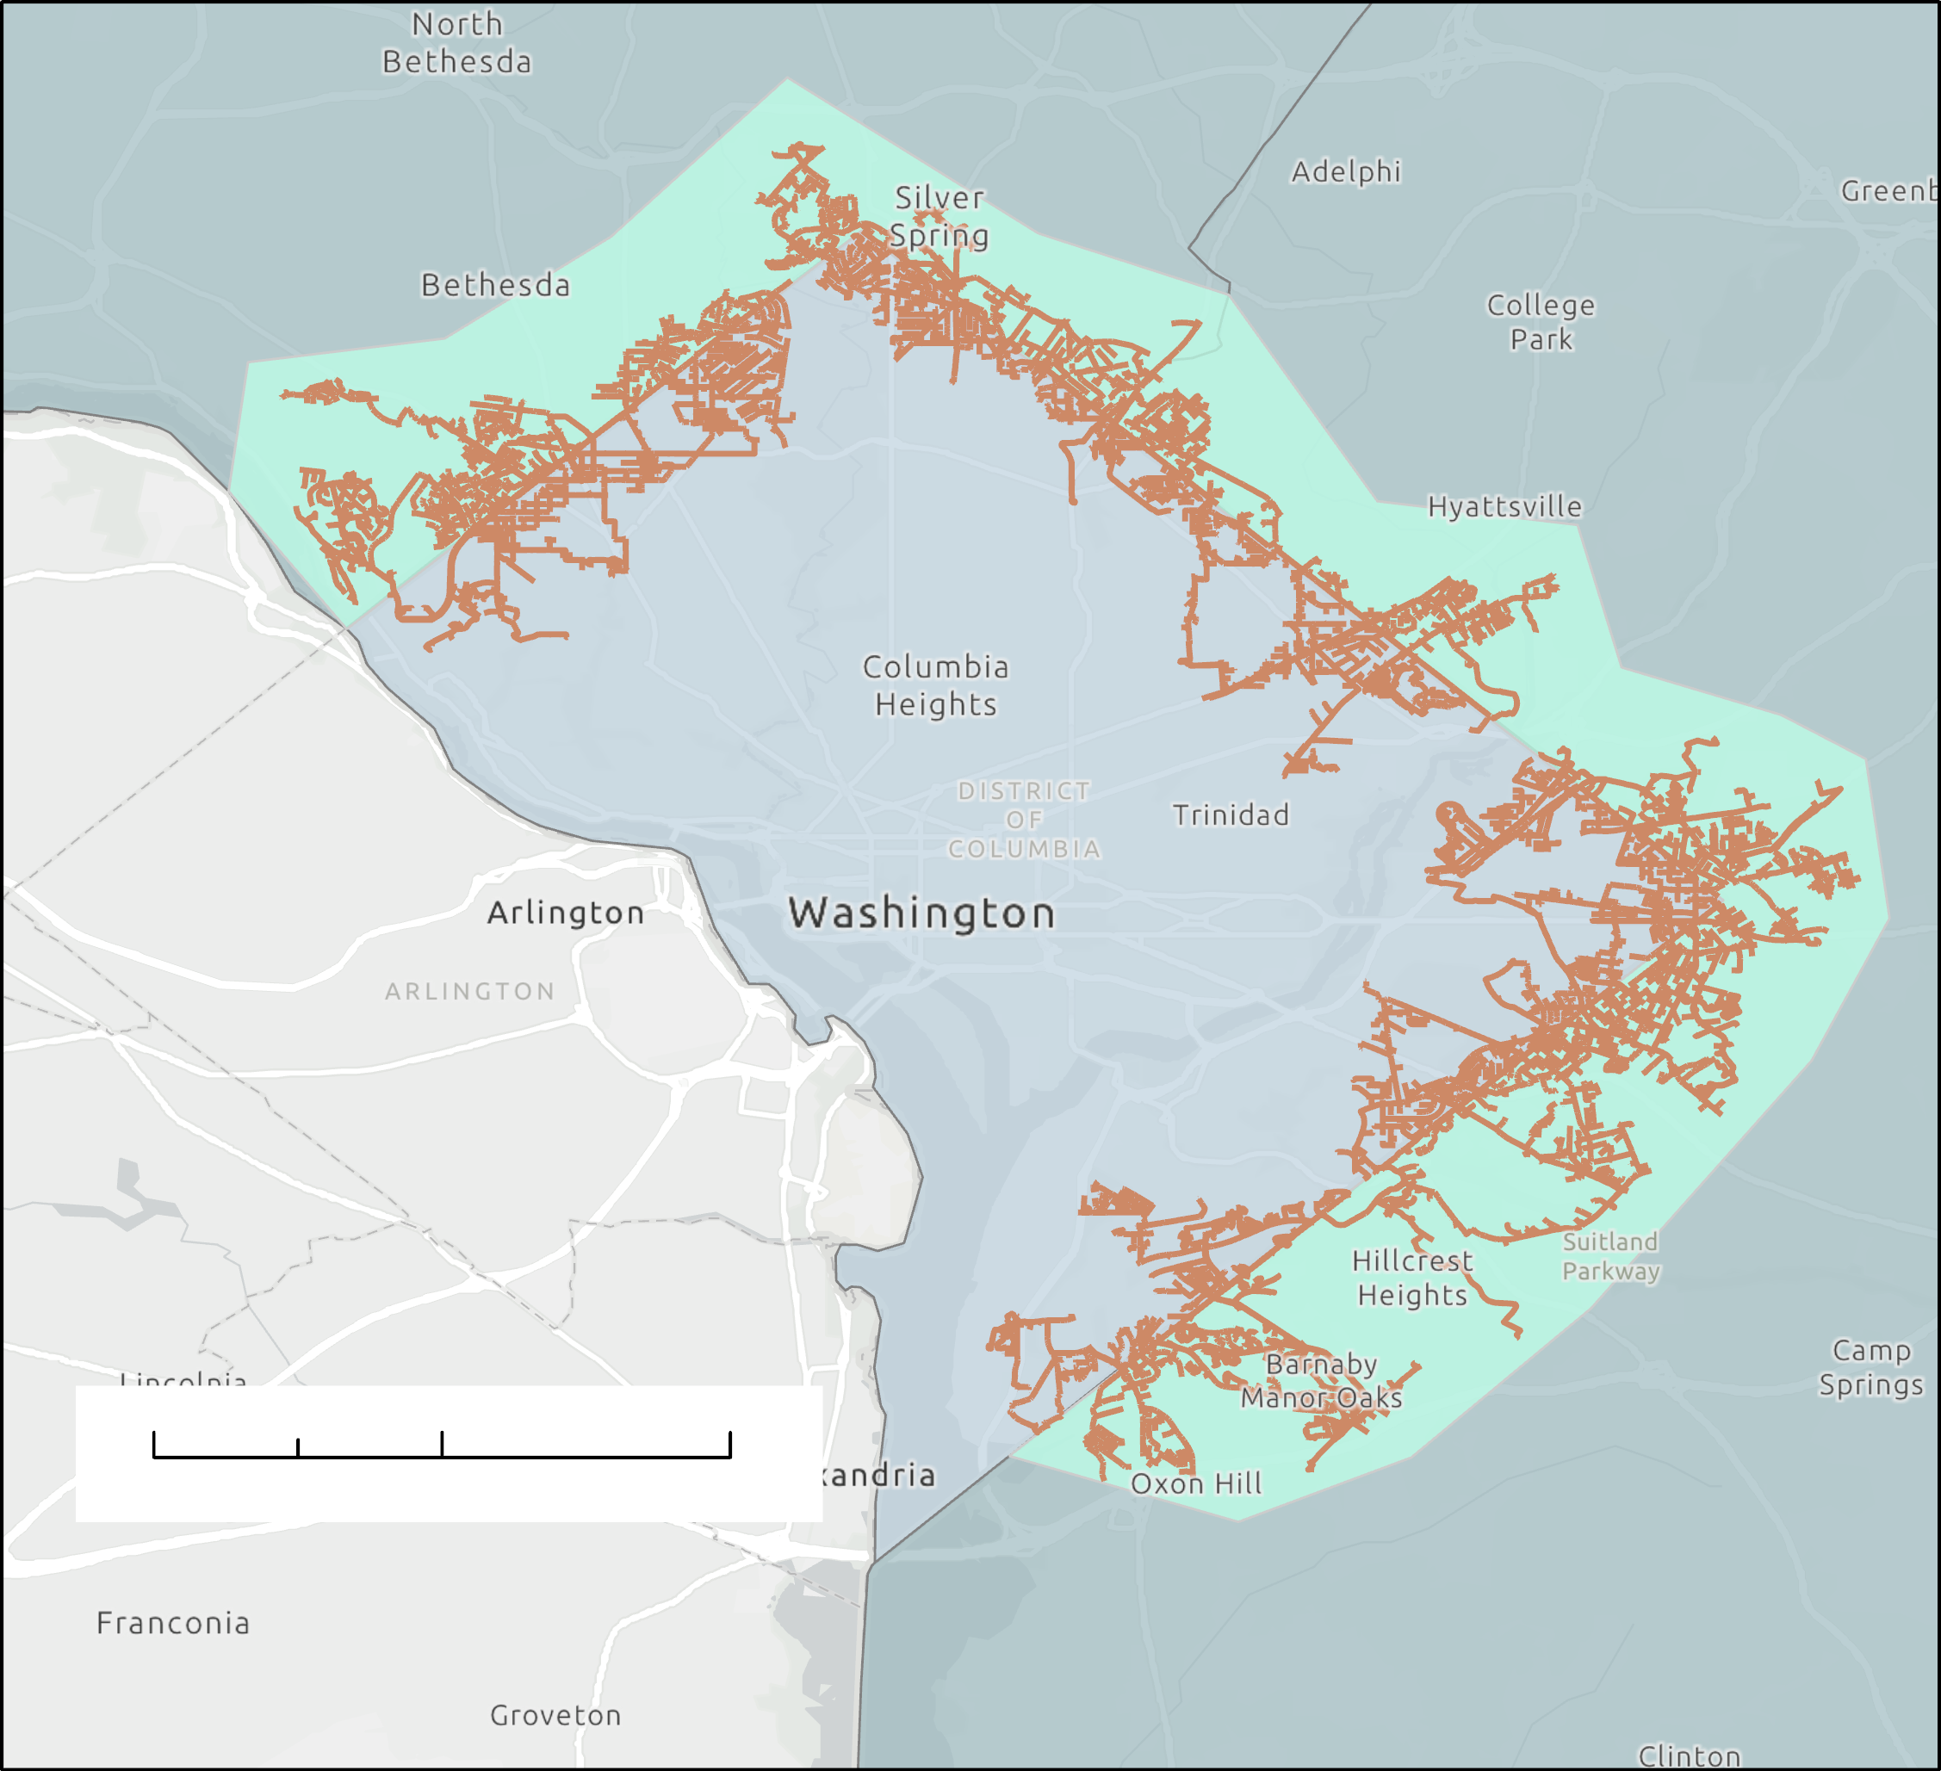
STUDY AREA & PERIOD
Study Area:
Prince George's and Montgomery Counties, Maryland
Focus on select cities on the Maryland and Washington DC border
Study Period:
LiDAR (2018)
NASA POWER (2015-2021)
Building Footprints (2018)
Cross-Border Electricity Feeders
Study Area
Washington D.C.
Maryland
0 2.45 4.9 9.8 km
Credits: Pepco Holdings and Pepco, U.S. Census Bureau 2018
Notes:
The area of focus for this project takes place in Prince George's and Montgomery County, Maryland. These two counties directly border Washington DC and in a handful of select cities, they are connected to the same power feeders as the District. The map above displays the straight boundaries that divide DC and Maryland with Montgomery County towards the top and Prince George's County more towards the bottom. The orange lines highlight the power feeder lines themselves as they spread into DC and the Maryland towns while the green section displays the area in which we mapped out the total solar potential for rooftops. Existing solar potential maps for the area, namely from Mapdwell, do not have data that extends to these areas. Thus, we want to create solar potential maps for the highlighted blue region.
As for the study period of this project. Our data covers information from 2015-2021 with our LiDAR data from 2018, NASA POWER Data from 2015-2021, and building footprints in 2018.

Slide 3
PARTNERS
Washington DC Department of Energy and Environment (DOEE)
Image Credit: DC DOEE
Notes:
For this project, we partnered with the Washington DC Department of Energy and Environment (DOEE) to generate a solar potential map for the surrounding Maryland counties and further their goals set by the Sustainable DC 2.0 Plan. In the District, the DOEE is responsible for policy decisions that concern renewable energy and environmental issues. To incentivize the use of renewable energy—more specifically, solar power — for residents in DC, they implemented solar energy credits.
------------------------------Image Information Below ------------------------------
•Image Credit: Andra C. Taylor Jr.
•Image Source: photo-1623473775552-61222e3c22ba

Slide 4
COMMUNITY CONCERNS
ECONOMIC
SOCIAL
POLITICAL
Solar is cost-efficient and contributes to a growing job market
Community solar programs make solar accessible to all
The 2018 CEDC Omnibus Act is moving D.C. to 100% renewable energy by 2032
Notes:
Residents in Maryland and Washington D.C. have been transitioning to solar primarily for the cost savings as solar energy is cheaper than its nonrenewable counterparts and the cost of solar panels has decreased over the past ten years. Switching to solar also contributes to a growing solar job market in the Maryland-D.C. area, with solar panel installation and development jobs taking up the biggest share in the solar industry. Maryland and Washington D.C. experienced their highest numbers of residents employed by the solar industry in 2016 and 2017, respectively. Since then, the number of solar jobs has slowly trended downward in both regions, but they are expected to increase overall due to bolstered renewable energy policy.
In both Washington D.C. and Maryland, community solar programs make solar energy more widely accessible by allowing residents to subscribe to the energy produced by an offsite solar array. Through community solar programs, residents living in neighborhoods with little sunlight, homes with dilapidated roofs, or rental units can transition to solar energy as their main electricity source.
The main policy currently in play in the District is the CEDC Omnibus Act of 2018, a codification of the Sustainable D.C. 2.0 Plan’s energy initiatives. The CEDC Act outlines the District's renewable energy portfolio standard (RPS) which states that 100% of electricity generated or consumed in-state must come from renewable resources by 2032, and 10% of that electricity must come from solar energy by 2041. Although D.C. residents generate their own solar energy, some of their electric grid is fed by renewable energy generators in the Maryland communities surrounding D.C.
------------------------------ Citations Below ------------------------------
Icon Credits: PowerPoint

Slide 5
OBJECTIVES
EVALUATE
Solar Potential for the Study Area
ESTIMATE
Annual
Rooftop Solar Potential for Study Area
PROVIDE
Documented Methodology for the DOEE
Notes:
To outline our objectives for the project, we aimed to
Evaluate solar energy potential for Prince George’s and Montgomery counties in Maryland which overlap the PEPCO feeder lines using LiDAR and NASA POWER data.
Estimate total rooftop solar potential.
And provide a documentation of our methodology to our partners to extend this to other parts of our study area or to other regions entirely.
Icon Credit: Powerpoint

Slide 6
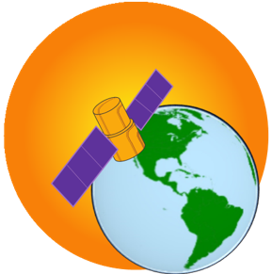
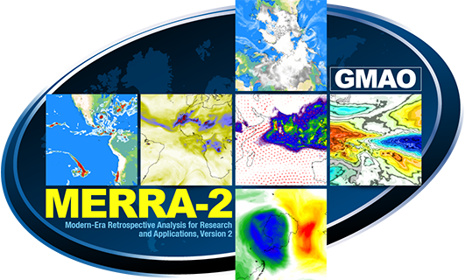
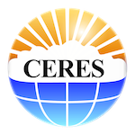
NASA EARTH OBSERVATIONS
NASA Prediction of Worldwide Energy Resources (POWER)
Image Credits: NASA
Notes:
The Earth Observation data used by our team was obtained from advisors at NASA Prediction of Worldwide Energy Resources AKA (NASA POWER), their services provided meteorological and climatological data over a 30 year period. We focused our attention on the information this resource provided for solar irradiation for tilted surfaces, albedo, and solar geometry which allowed us to create solar potential maps that factored in cloud scattering and atmospheric factors in to our final solar potential map. NASA POWER draws from a multitude of datasets, satellites and sensors these earth observations resources include: MERRA-2, GEOS, GEWEX SRB, and CERES FLASHFlux.
Image Credits:
NASA POWER Logo:
Image Credit: NASA
Image Source: https://power.larc.nasa.gov/docs/
MERRA-2 Logo:
Image Credit: NASA
Image Source: https://gmao.gsfc.nasa.gov/reanalysis/MERRA-2/
CERES Logo:
Image Credit: NASA
Image Source: https://ceres.larc.nasa.gov/data/

Slide 7
DATA ACQUISITION
LiDAR 2018 – Maryland GIS Data Catalog
30-year Meteorological and Solar Monthly & Annual Climatologies – NASA POWER
Solar irradiance data to determine the solar potential for tilted surfaces
Building Footprints – Maryland GIS Data Catalog
Creating roof segmentation shapefiles
LiDAR 2018 – Maryland GIS Data Catalog
30-year Meteorological and Solar Monthly & Annual Climatologies – NASA POWER
Solar irradiance data to determine the solar potential for tilted surfaces
Notes:
We collected LiDAR and building footprint data from Maryland’s Mapping and GIS Data Portal, which enabled us to generate Digital Surface Models, or DSMs, and calculate the aspect and slope of the building footprint. We also obtained solar irradiance data from LaRC's POWER Project for 1990 to 2019 from the 30-year Meteorological and Solar Monthly & Annual Climatologies dataset.

Slide 8
DATA PROCESSING
Generated DSMs
Solar Irradiation by Building Footprint
Mapped Solar Potential
Notes:
Using the LiDAR point cloud data, we created DSMs from LAS files using the LAS Dataset to Raster Tool. We then clipped our DSMs to the building footprint dataset, and used slope and aspect calculation tools to demonstrate the directions at which each building roof points. Using these aspect and slope rasters as inputs, we created polygons of each roof footprint in the study area and assigned the values to the pixels based on the angle of the roof and the azimuth (position) of the sun throughout the year. Joining the slope and aspect together in one vector layer before dissolving the pixels based on the angle allowed us to assign the average daily energy per pixel in our building footprint layer using NASA POWER data. We then took this output and applied our NASA POWER data to generate solar potential maps by roof segment.

Slide 9
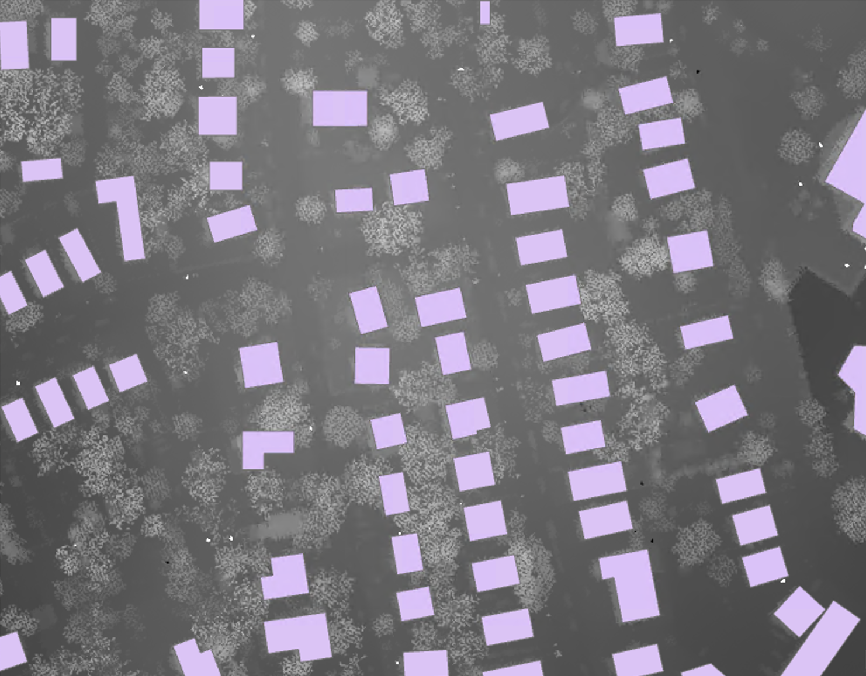
DATA PROCESSING
DSMs
Slope &
Aspect
Dissolve
Potential
Notes:
From left to right, this image shows the data processing steps taken that resulted in the solar irradiance per building footprint. With building footprints being used to clip aspect and slope of the DSM to the structures that were the focus of our project. The raster layer was converted to polygons which were dissolved allowed the team to focus on specific slope angles. Each pixel in our building footprint layer was then assigned a solar irradiance value based on the slope and aspect it contained. This allowed the team to calculate the average daily energy potential per pixel through averaging the incoming solar irradiance for a 24 hour window for each month of a year.

Slide 10
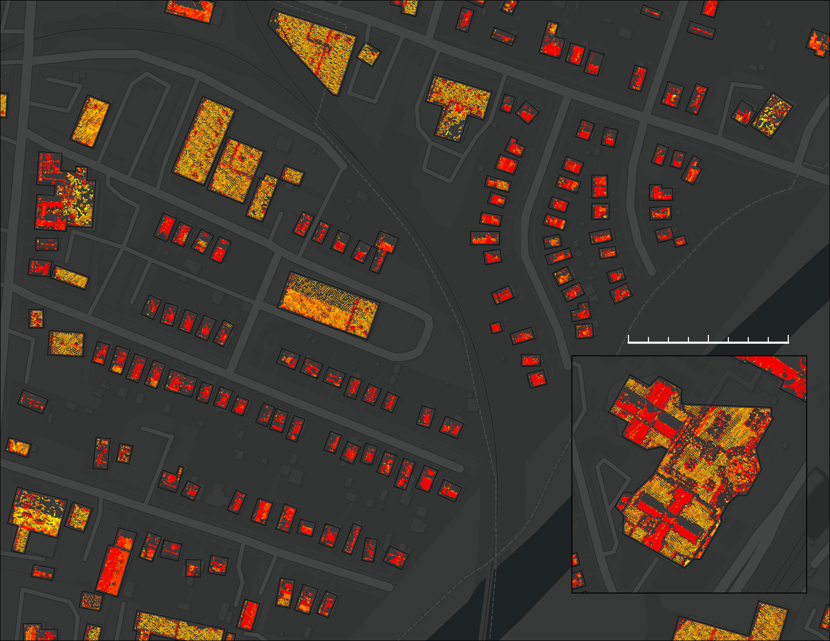
RESULTS
3987 – 4834 kW
4834 – 7160 kW
7160 – 13286 kW
0.01 0.03 0.05 0.1 km
13286 – 22113 kW
22113 – 53168 kW
Data: NASA POWER, Maryland iMap Data Catalog, Maryland Statewide LiDAR Download Tool
Notes:
The figure on the left shows a portion of our final solar potential map of the study area. The rooftop segments displayed in bright colors have the highest solar potential, and those displayed with dark colors have the lowest potential. We observe from the building in the inset that flat roofs are assigned a potential of 0, and that we exclude north facing roofs (because Maryland lives in the northern hemisphere, south facing roofs yield higher potentials on average). Additionally, there are spikes in potential around the boundaries oof some houses due to the 90 degree angles at the edges.

Slide 11
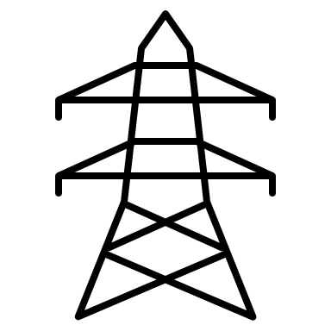
CONCLUSION
Roughly
242 GW
would supply nearly
1,703 buildings
with power each year.
Notes:
If we do a sample calculation of one region within our study area as a preliminary result, the average annual rooftop potential reveals that these towns and cities in Prince George's and Montgomery Counties, Maryland could provide roughly 1,703 buildings with 242 GWs of power. These results provide our partners with an understanding of how much solar potential is available in this area which can be used to determine the feasibility of expanding rooftop solar in Maryland to help meet the Sustainable DC 2.0 Plan.
Icon credits: PowerPoint

Slide 12
LIMITATIONS
Lack of Spatial Precision and Inaccuracies in LiDAR Data
30-year Meteorological and Solar Monthly & Annual Climatologies – NASA POWER
Lack of Spatial Precision of Building Footprint Data
Physical Uncertainties in NASA POWER DATA
Computational Limits
Notes:
The error that propagate through our potential calculations result from the uncertainties in the data that we use. For instance, the LiDAR data and building footprint data has a lack of spatial precision which make it difficult to confirm whether or not the data is located in the correct place geographically. The LiDAR data may also have inaccuracies in the elevation data on the order of centimeters. Additionally, the NASA POWER data may have had uncertainties that originated from physical calculations, such as those for cloud statistics. The team was also limited in terms of computational resources. To account for long runtimes and restricted functionality, the team decided to narrow the scope of our study area.

Slide 13
FUTURE WORK
Apply our methodology to the entire study area
Comprehensive analysis of grayspace
Assign potential to each roof segment
Model the socioeconomic distribution
Notes:
In the future, we hope to extend this work to our entire study area, where the PEPCO feeder lines overlap Prince George's and Montgomery counties in Maryland. Including grayspaces, or places with unused land, in additional to rooftops in our study will offer additional optimal places for solar panel installation. Additionally, assigning potential to each roof segment by running zonal statistics and obtaining a sum of the potential that can be generated for a given area may better inform the DOEE of where it is best to install solar panels. Combining our solar potential maps with socioeconomic distribution data may also highlight income variability and ensure equitable solar panel distributions across our study area.
Icon Credits: PowerPoint

Slide 14
We gratefully acknowledge Dr. Kenton Ross (NASA Langley Research Center) and Dr. Paul Stackhouse (NASA Langley Research Center) for their contributions to this work as science advisors, Thomas Bartholomew (Branch Chief of the Washington DC DOEE) for his role as a partner, and Adriana LeCompte (DEVELOP LaRC Fellow) for her coordination between the team and the DEVELOP program.
Notes:
We gratefully acknowledge Dr. Kenton Ross (NASA Langley Research Center) and Dr. Paul Stackhouse (NASA Langley Research Center) for their contributions to this work as science advisors, Thomas Bartholomew (Branch Chief of the Washington DC DOEE) for his role as a partner, and Adriana LeCompte (DEVELOP LaRC Fellow) for her coordination between the team and the DEVELOP program.

