Slide 1

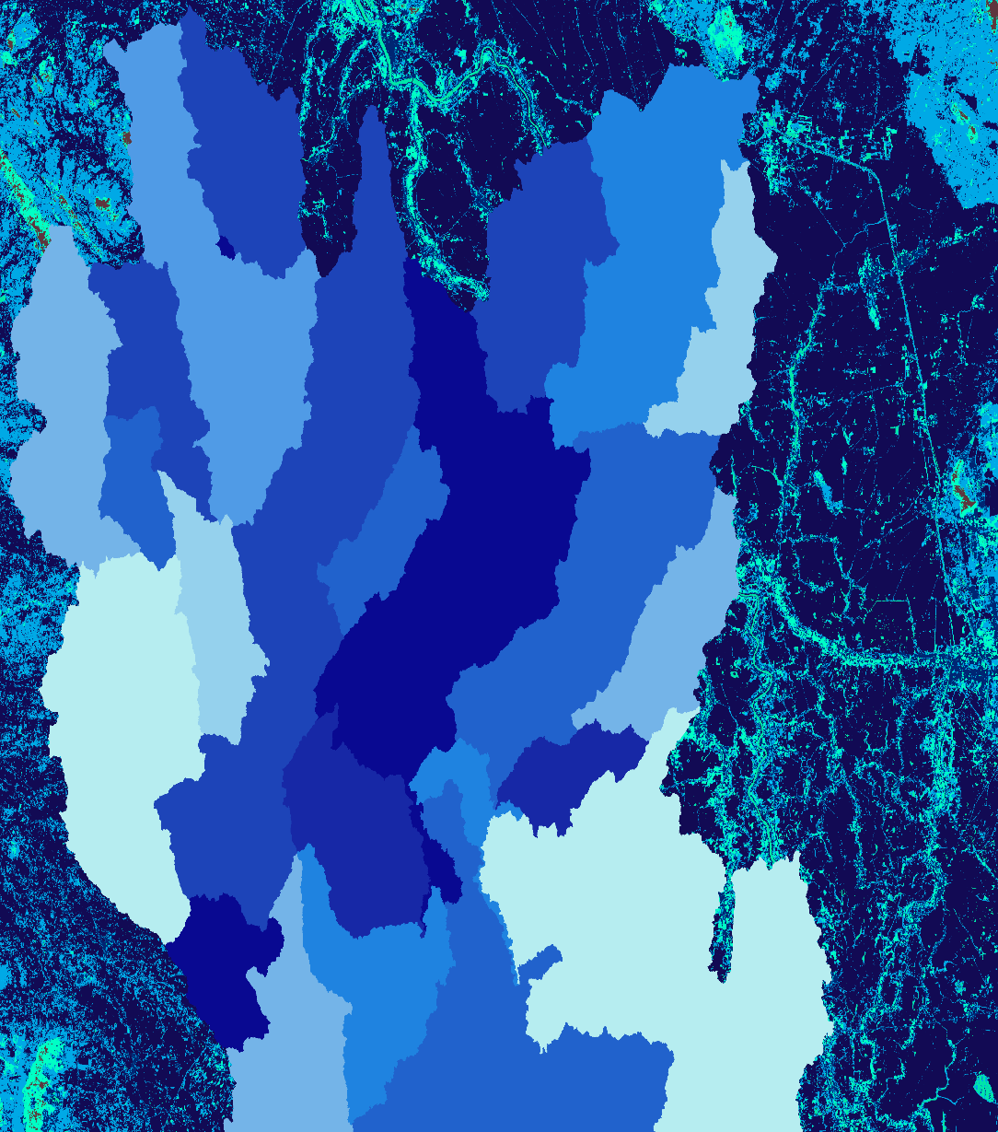

2018 Summer | Alabama – Marshall
Chao Phraya Water Resources
Assessing Water Quality in Thailand’s Chao Phraya Watershed through Modeling Sediment Concentration and Urban Footprint
Kathrene Garcia
Claire Nauman
Matthew Preisser
Notes:
Chao Phraya Water Resources, Alabama – Marshall node located in Huntsville. Center Lead: Helen Baldwin, Assistant Center Lead and Fellow: Mercedes Bartkovich, Project Lead: Kathrene Garcia, Team Members: Claire Nauman and Matthew Preisser

Slide 2
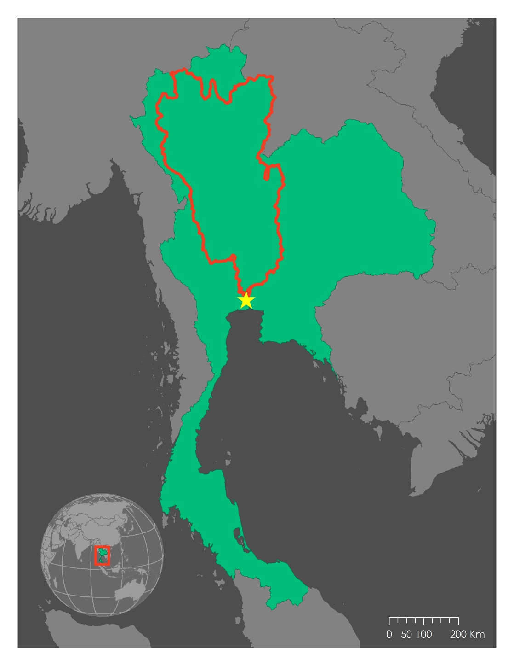
Study Area & Period
Myanmar
Laos
Chao Phraya Watershed, Thailand
Area:160,000 km²
2003 - 2017
Four time periods
  2003 - 2006
  2007 - 2010
  2011 - 2014
  2015 - 2017
Cambodia
^
Bangkok
Chao Phraya
Watershed
Thailand
Notes:
Just to orient you to our study area and the time period we’re focusing on, we looked at the Chao Phraya Watershed in Thailand (point out Thailand highlighted in green, Chao Phraya watershed outline in red, and Bangkok at the outlet of the watershed). The Chao Phraya is about 160,000 square kilometers and covers about one third of Thailand. Our study period stretches from 2003 to 2017, and we broke that down into 4 smaller time chunks so that we can look at, not only how things have changed from start to finish, but also see what has happened at some of those intermediate steps in between.
Image created using ArcMap.

Slide 3
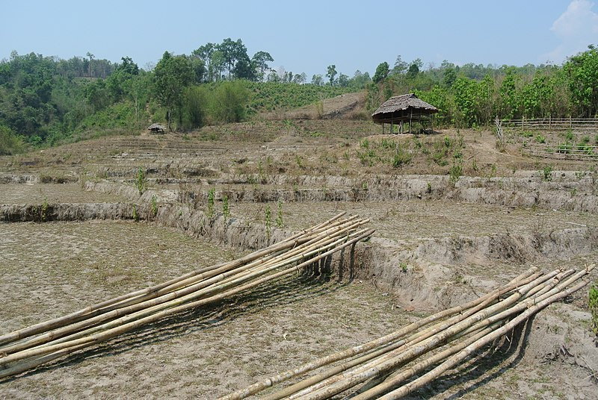
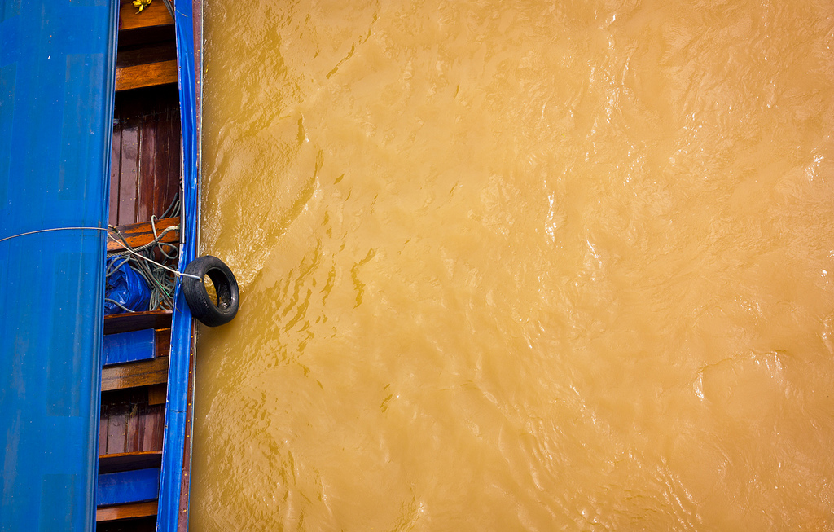
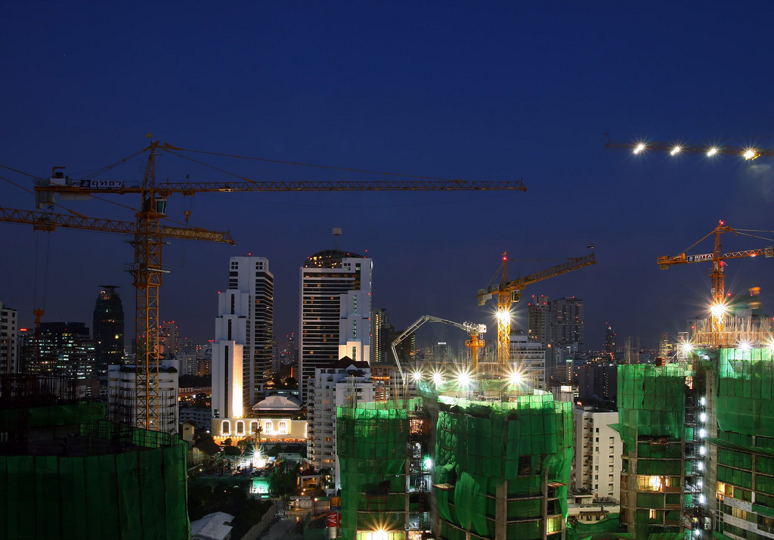
Community Concerns
Water availability during the dry season
Intense development during the 20th century
Water quality degradation
Photo by Adbar
Photo by Waldemer Merger
Photo by Pandiyan V
Notes:
Our project is formed around 3 main community concerns.
During the dry season, available water meets just over half of the demonstrated demand. With this shortage of water, water quality becomes incredibly important. Water samples taken throughout the watershed show an overall trend of water quality degradation. These 2 issues have coincided with a period of intense development during the 20th century. Our project looks to see how we might be able to find connections between these 3 issues in order to find solutions.
Dry landscape: https://commons.wikimedia.org/wiki/File:Rice_fields_dry_season_Karen.JPG
Dirty Water: Waldemar Merger : https://www.flickr.com/photos/paxx/6146890300/in/photolist-anbqkf-ftvVU4-doRLxB-94RWsA-7hhc5b-89uPWu-qV3i6j-SU7ZuX-Er1G5E-RLtWVo-JgjXJc-hV4aYj-dkJmhL-q3mbKb-6Bhfi6-ryELKU-dkAKm7-dvwq5k-jYaRG1-bKfQtX-DLxtzw-57TrKd-4ucP1e-VhXai3-Vz1AVz-Ukr9N4-Vvsxe9-6HXkge-Vvsyef-6HXrY4-6HXcPr-q3EyVX-cHBd-4YDi5x-d3894Q-cLz4x-77V5d4-VjpW6Q-Ukr1Gz-m7QEmR-qV2dpA-d38bZL-dWrhzJ-VnrGBc-bvY2ra-bvY4PR-TfkFXk-83iVr6-qfAoEQ-eeB5Jr
Development: Pandiyan V : https://www.flickr.com/photos/pandiyan/2244592052/in/photolist-6fsG3v-acrU7a-bKfzUZ-6ZNmRW-7pFKNA-ZD54JT-dW48FD-dW9JYL-9NKVq9-6ZJkYc-8nZLWh-7f8fWj-5857Y2-x4cKf-5QZb4s-6954y7-zUoDF-bKfHJc-4iQZgi-C2ToE-8rnujt-HncQS-5uQEH1-dVDCdw-8LCXQv-5qwssp-E6U1x-d7Keqs-xawWLr-9rPZyL-bBQKZJ-4qm81Y-e9JXNn-5858xt-Fv3bR-4KayVQ-59KQAs-ACRkw-5857BM-wGFZ3-9AdrPx-hLTqTu-6u8K6Y-7aS3Pg-v6e1u-nmzzqU-5858Tv-zHQZV-9cEX46-6u8K71

Slide 4
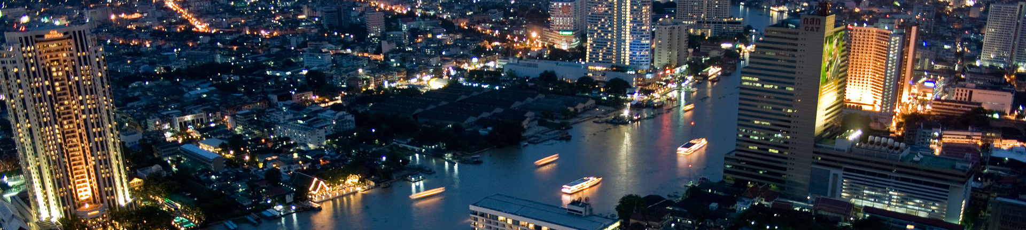
Project Partners
End Users
Asian Institute of Technology (AIT)
Bangkok Metropolitan Administration (BMA)
Royal Thai Embassy, Office of Science and Tech.
Asian Disaster Preparedness Center (ADPC)
NASA SERVIR Science Coordination Office
Collaborators
Photo by Swaminathan Gurgaon
Notes:
Each of these community concerns has been voiced by our project partners. We have 2 end users…
The Asian Institute of Technology and Bangkok Metropolitan Administration
and 3 collaborators…
The Royal Thai Embassy, the Asian Disaster Preparedness Center, and the NASA SERVIR Science Coordination Office
Image source: https://commons.wikimedia.org/w/index.php?search=bangkok+skyline+and+river&title=Special:Search&profile=default&fulltext=1&searchToken=6bjmxuwkohfntf062u0l24sdh#/media/File:Statetower.jpg

Slide 5
Objectives
Locate areas contributing to high sediment concentrations
Understand the historical changes in water quality throughout the watershed
Analyze the relationship between urbanization and sediment concentration
Notes:
After discussing the community concerns with our partners exploring the literature, we came up with three objectives for this project. And they are too…
Locate areas contributing to high sediment concentrations
Understand historical changes in WQ throughout the entire watershed
And to analyze the relationship between urbanization and sediment concentration

Slide 6
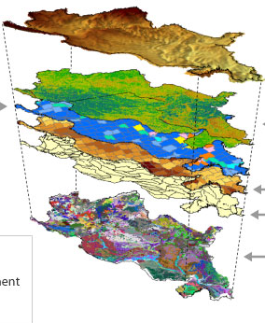
SWAT Model
Ground Surface Topography
SWAT – Soil and Water Assessment Tool
  Used to model flow and sediment concentrations
  ArcGIS extension
Precipitation
Land Cover
Sub-Basins
Other
Weather Data
Soil Type
Image from University of Chicago, Swift Case Studies on Hydrology
Notes:
To accomplish these objectives ,we used the SWAT model, which is an ArcGIS extension and stand for the Soil and Water Assessment Tool. This tool allows us to model streamflow and sediment concentrations by taking multiple layers into consideration including…
Land use
Elevation
Soil
And numerous weather variables
Image source: http://web.ci.uchicago.edu/~wozniak/swift-www/case_studies/Hydrology.php

Slide 7
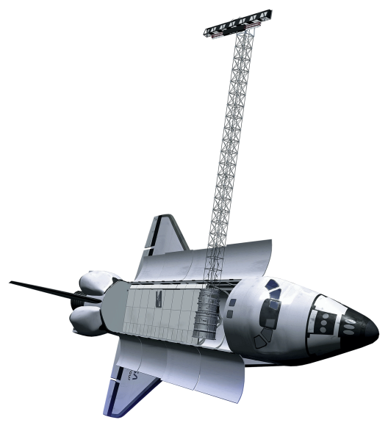
Datasets
TRMM (TMPA)
NASA Earth Observations
  Precipitation: TRMM (TMPA)
  Elevation: SRTM
Ancillary Datasets
  Land Cover: SERVIR-Mekong Regional Land Cover Monitoring System (RLCMS)
  Soil Type: FAO Harmonized World Soil Database v 1.2
  Relative Humidity, Wind Speed, Solar Radiation, Air Temperature: National Center for Environmental Prediction Climate Forecast System Reanalysis
SRTM
Images from NASA
Notes:
We utilized two specific NASA Earth observations. The first being the TRMM TMPA constellation for daily precipitation data, and elevation data derived from the SRTM.
To supplement these data sets, we also acquired….
land cover files from the SERVIR Mekong Regional Land Cover Monitory system,
a soil file from the Food and Agricultural Organizations Harmonized Soil Database,
and other weather variables from the National Center for Environmental Prediction
TRMM (TMPA): http://www.devpedia.developexchange.com/dp/images/1/1a/04_TRMM.png
SRTM: http://www.devpedia.developexchange.com/dp/images/a/ab/12_SRTM.png

Slide 8
Methodology
DATA
MODEL
SERVIR-Mekong RLCMS
Land Cover
Hydrologic Response Units
FAO Harmonized World Soil
Soil Type
ANALYSIS
Recent Average Water Quality Map
SRTM
Digital Elevation Model (DEM)
Delineate the Watershed
Asian Institute of Technology
River Shapefile
Water Quality Time Series
TRMM TMPA
Precipitation
Water Quality & Urban Footprint Percent Change Map
Streamflow & Discharge
NCEP CFSR
Humidity, Wind, Solar, Air Temperature
Seasonal Variation Graphs
Royal Irrigation Department
In Situ Data
Calibration & Validation
Notes:
We used all these datasets as inputs to our SWAT model
Land cover and soil along with the slope acquired from the DEM were considered in Hydrologic response units (HRUs) -- smallest level of analysis the SWAT model will analyze
A river shapefile constructed by AIT was used alongside the DEM to determine sub basins within the SWAT model
Precip and weather data were added to all of this to create streamflow and nutrient outputs
Ideally detailed In situ data would be used to calibrate the model in SWAT CUP (calibration and uncertainty program) -- important to note here that we have not received this data and are still in the process of acquiring it- We did however find a small sample of insitu data published
All in all the SWAT model processes all of these components to create finalized output files with data associated with the sub basins created.

Slide 9
Validation: Modeled vs Observed
Notes:
As I mentioned, ideally we would have had detailed in situ data from the Royal Irrigation Department for our river system to help calibrate and validate our model. Unfortunately we have yet to receive enough data that would help with this. We did however find a small handful of data in a paper by Butsawan Bidorn. So here we have our model in green, the real time data in blue, and the values of our model that correspond with the observed in yellow. Since this is not enough data to make any significant changes to our model we have yet to adjust the model or come to any conclusions regarding its accuracy. If we had enough values there is a statistical equation we could use to quantify the models accuracy, but for now all we have are these graphs which show how varied the model is right now. Occasionally it exceeds real time data, other times it underestimates. Understanding how we go about calibrating and validating our model is important for when we acquire detailed in situ data, but in the meantime we warn you to take our model with a grain of salt.
we would calibrate and validate if we had more data points (use SWAT-CUP), point out that we need more baseflow and less runoff
Plots created using Excel.

Slide 10
End Products
Recent Average Water Quality Map
Percent Change Relationship Map
Water Quality Time Series
Seasonal Variation Graphs
Notes:
Even though we weren’t able to validate our model, we did still produce our end products with the hope that they can be easily updated if/when in situ data can be obtained. We’ll walk through each of these over the next couple of slides.

Slide 11
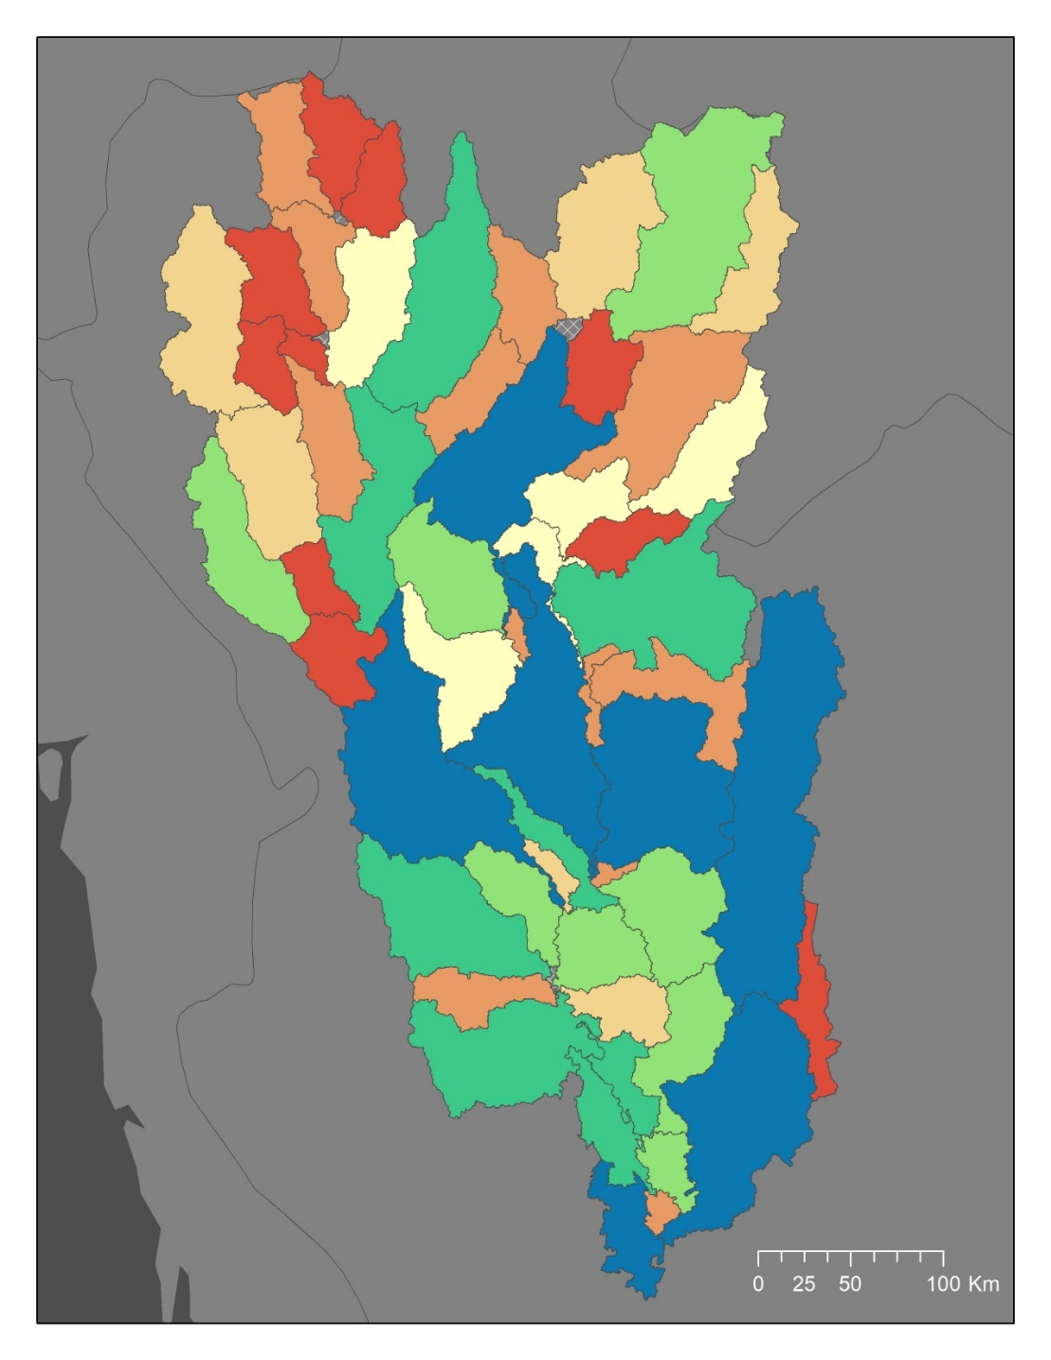
Recent Average Water Quality
Contribution to Sediment Concentration
by Sub-basin (g/m³/km²)
0.02 - 0.26
0.27 - 0.47
0.48 - 0.71
0.72 - 1.00
1.01 - 1.30
1.31 - 1.88
1.89 - 7.63
No Data
Notes:
Our first end product is a recent average water quality map. If you can remember our 4 time chunks, this is our most recent one, from January 2015 to December 2017. This is our watershed. It’s broken into 56 sub-basins. We removed some of the smallest ones. Each sub-basin is colored according to its contribution to sediment concentration per unit area of the sub-basin. The warmer colors show a higher contribution to poor water quality. The cooler colors show a lower contribution to poor water quality. You can see that there is a high concentration of red in the upper northwest section of the watershed. Even though Bangkok is where some of the worst water quality issues are occurring, most of the sub-basins in the lower parts of the watershed fall into the blue and green categories, so lower contributions to poor water quality.
Image created using ArcMap.

Slide 12
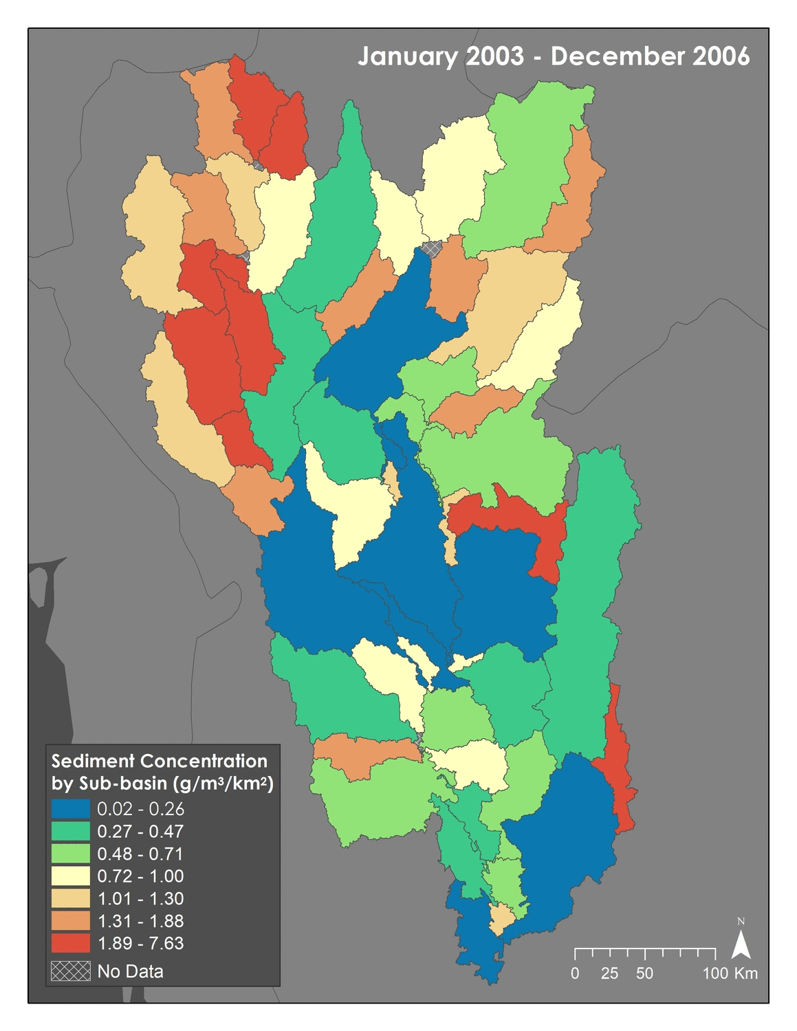
Water Quality Time Series
Notes:
GIF
2003-2006
2007-2010
2011-2014
Our second end product is a water quality time series. We made the same kind of map you just saw for each of our time chunks and lined them up in an animation. It can be kind of hard to take it in when everything is moving though so we also printed out the maps.
Map images in GIF created using ArcMap.

Slide 13
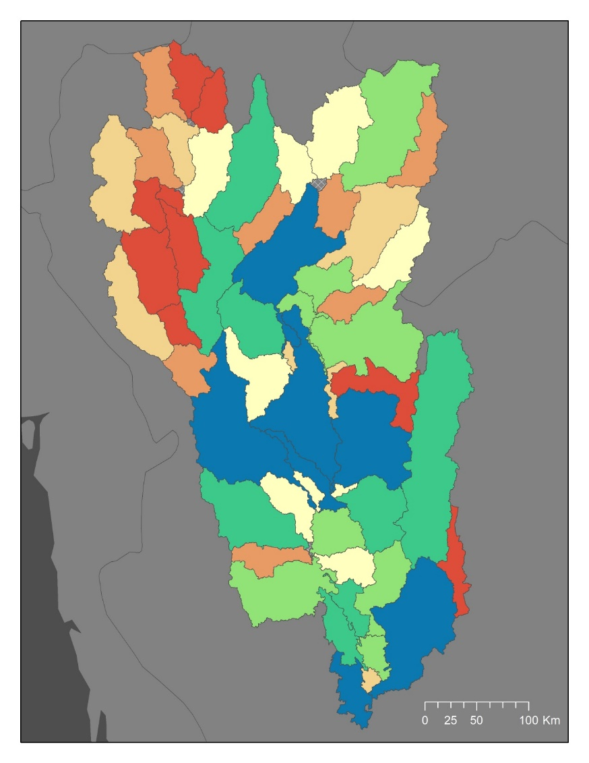
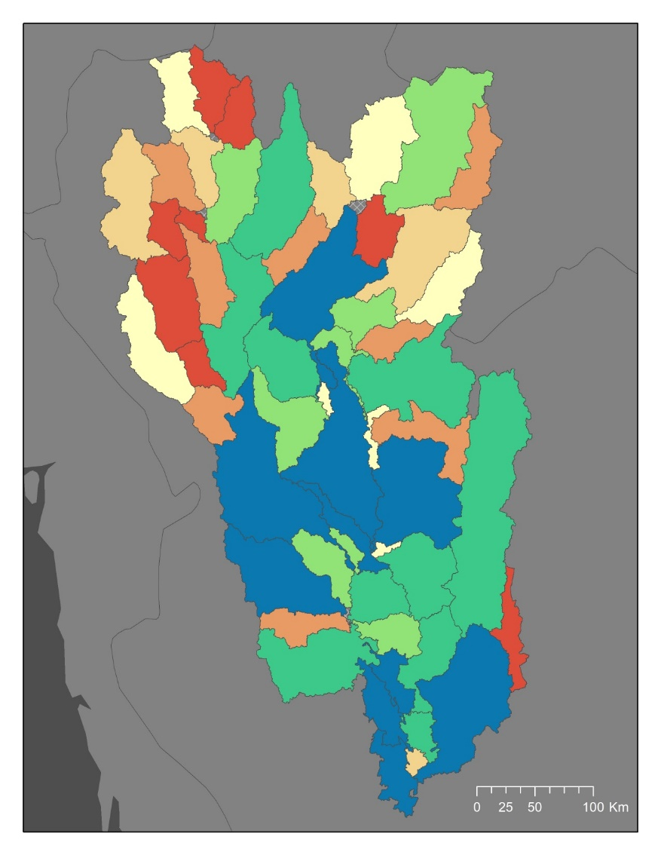
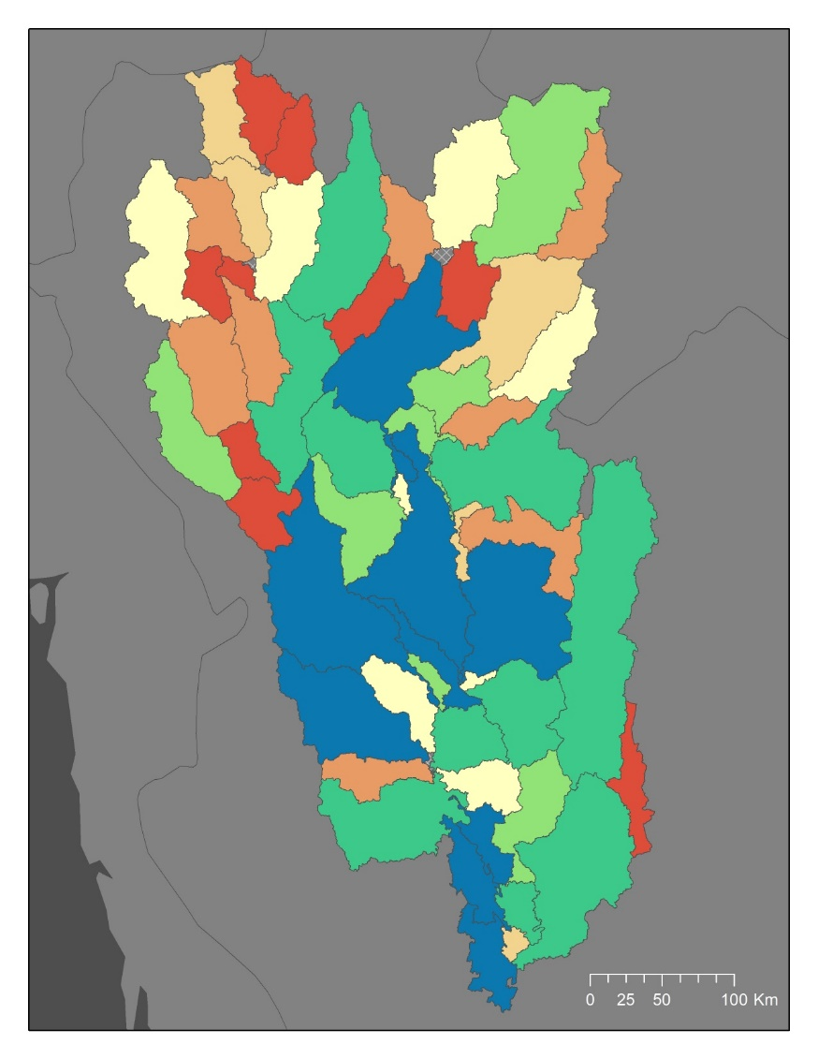
Water Quality Time Series
2003-2006
2007-2010
2011-2014
Contribution to Sediment Concentration by Sub-basin (g/m³/km²)
Low
High
No Data
Notes:
The main thing we noticed here is that most of the sub-basins stay in the same water quality category across the entire time period. So that high concentration of red in the upper northwest and the blues and greens in the lower parts of the watershed occurs consistently. These aren’t just recent developments. So, it would be a good idea to investigate why those upper basins are red and those may be good candidates for watershed remediation efforts.
Images created using ArcMap.

Slide 14
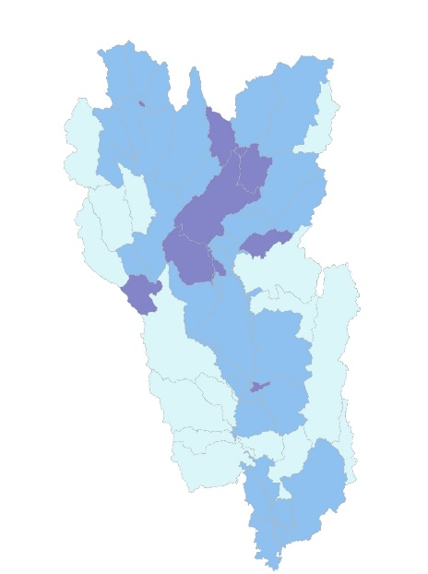
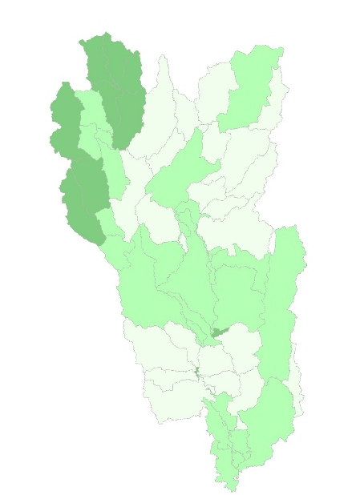
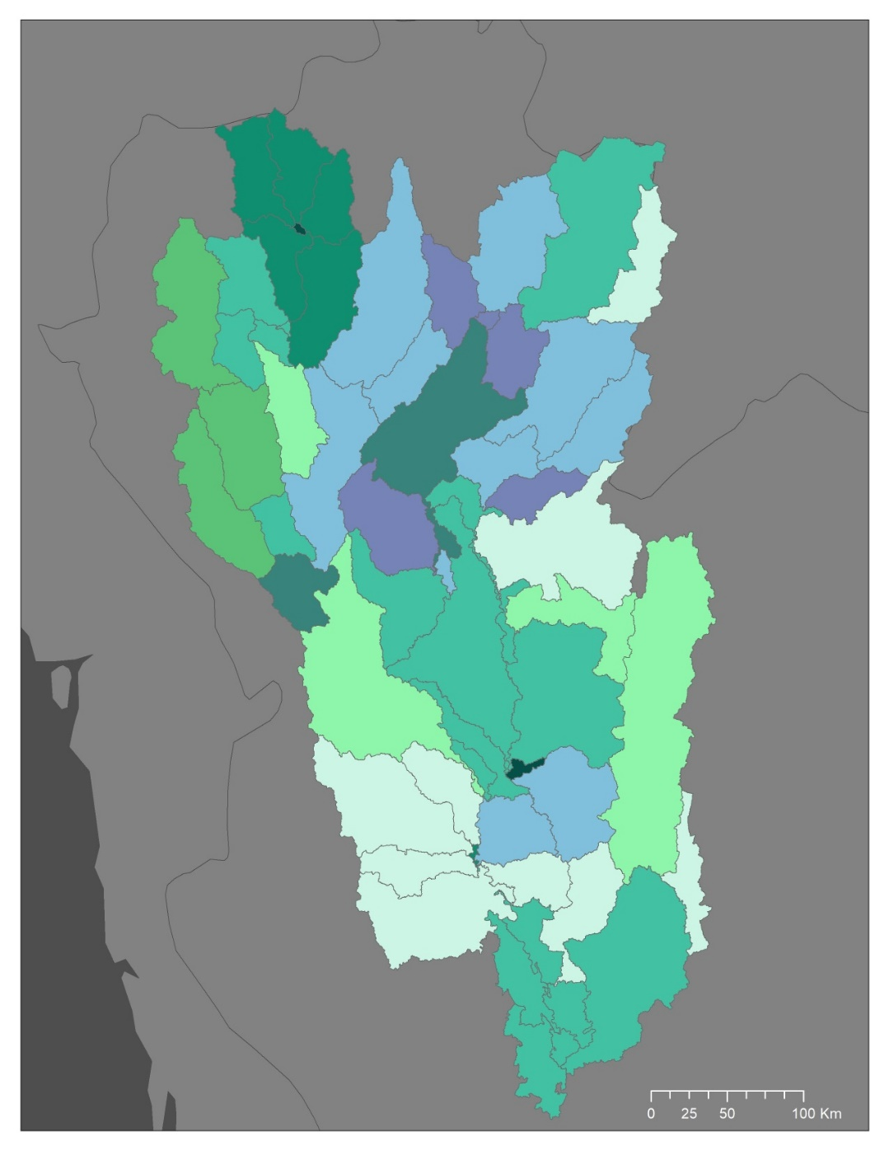
Urban Expansion and Water Quality Comparison
Water Quality Percent Change
Urban Expansion
Percent Change
High
Urban Area
Low
Low
High
Water Quality
Notes:
Highest Change in Water Quality in the northern Central parts of the basin
Largest increases in Urban area in the northwest
Dark green means high percent change in urban land cover and low change in water quality
Purple means a high percent change in sediment contributions by sub-basin and a little change in urban land cover
Dark Teal indicates locations where both variables experienced an increase
Images created using ArcMap.

Slide 15
Statistical Regression
Notes:
No correlation was found between percent change in urban land cover and percent change in water quality, we have explored other relationships, but results remain inconclusive and we have yet to find an explanation for the changes in water quality seen.
Plot created using Excel.

Slide 16
Seasonal Variation
Streamflow
Sediment Load
Avg. Flow Out of Watershed
(Thousand Cubic Meters per Second)
Avg. Sediment Out of Watershed
(Million Metric Tons per Month)
Month of the Year
Month of the Year
2003-2006 2007-2010 2011-2014 2015-2017
Notes:
Since Thailand has a pronounced wet and dry season, seasonal variation in water quality and availability is of major concern. These two graphs show seasonal variation in stream flow and sediment during our four time periods. This is showing these variables at the exit of the entire watershed, which as we have mentioned is just north of the City of Bangkok. As we can see from these graphs there is a peak in flow and in sediment during September and October which is the middle of the wet season.
Graphs created using Excel

Slide 17
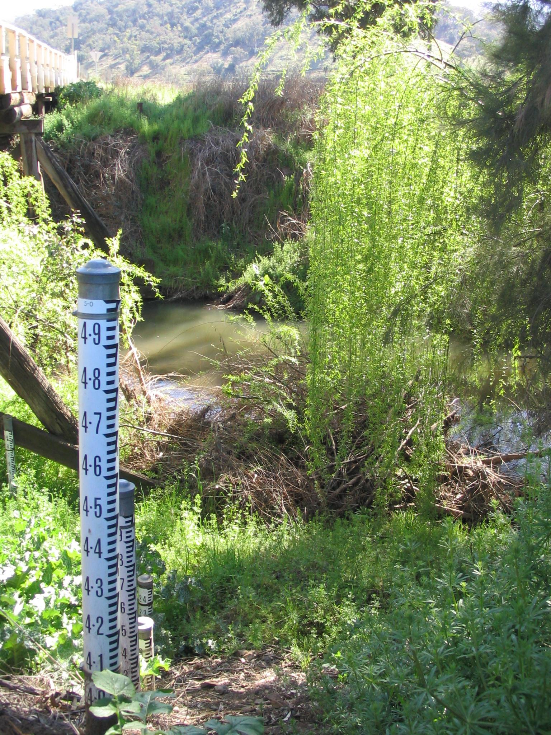
Limitations
No point source data
SWAT model primarily an agricultural tool
SWAT unable to model dams
Difficulty delineating watershed in the Bangkok Metropolitan Area using DEM
Lack of access to in situ data
Other water quality parameters not investigated
Photo by Felix Andrews
Notes:
There are a couple of limitations that we recognized over the course of this project.
The first one being that we did not include point source data. SWAT has the capability to include these discharges, such as from a wastewater treatment plant or factory which would certainly effect downstream water quality, but we did not have access to such data and that was out of the scope of our project.
The second limitation is that SWAT is primarily used as an agricultural tool to study runoff and pollutants in agricultural settings, making this a difficult tool to analyze pollutants through an urban setting.
To go along with that, SWAT does not take into consideration dams and other man-made structures that might influence stream flow. So a river with a lot of anthropogenic stressors will act differently than how SWAT models it.
Delineating the watershed around the city of Bangkok was also difficult. Since this is a low lying area with vertical elevation changes only being a couple of feet, the model is not able to clearly define where water is flowing the closer to the coast we get.
As we have mentioned, in situ data takes time to get and we were unable to calibrate the model with this information but we are hopeful that our end users will be receiving that data in the next couple of weeks so that they can use it.
Finally we only examined one water quality parameter, and SWAT is capable of modeling more including nitrogen concentrations, organics, phosphorus, all important variables when it comes to water quality. And again, with more access to in situ data to be able to calibrate the model for these variables, this could be an easy addition that our end users use in the future.
Image source: https://commons.wikimedia.org/wiki/File:Peel-River-Gauge.jpg

Slide 18

Conclusion &Discussion
Upper sub-basins consistently contribute more to sediment concentrations than lower sub-basins
No correlation was found between percent change in urban area and percent change in water quality
Our project begins a basin-wide assessment of the watershed, which lays a foundation for our partners to replicate our findings.
Photo by Andrew Ly
Notes:
Despite these limitations we’re able to make some conclusions regarding our work
The first is that the upper sub-basins consistently contribute more to sediment concentrations than lower sub-basins, suggesting that these sub-basins could be a good place to further research and remediation efforts.
No Correlations was found between percent change in urban area and percent change in water quality – this could be for a number of reasons, perhaps urban pressure on other land cover change has a greater impact than urban expansion itself, or maybe we were looking at the wrong parameter for water quality. Whatever the reason we believe this relationship demands further research.
And while we were unable to calibrate and validate our model, our project lays a replicable foundation for our partners to continue a basin-wide assessment of the watershed.
Image source: https://unsplash.com/photos/4fkJZ4Txrbw

Slide 19
Acknowledgements
Dr. Jeffrey Luvall, NASA Marshall Space Flight Center
Dr. Robert Griffin, University of Alabama in Huntsville
Helen Baldwin, NASA DEVELOP
Mercedes Bartkovich, NASA DEVELOP
Thailynn Munroe, World Resources Institute
Dr. Sarawut Ninsawat, Asian Institute of Technology
Rattanawadee Charoensook, Bangkok Metropolitan Administration
Gam Bunyakiat Petri, Royal Thai Embassy, Office of Science and Technology
Dr. Peeranan Towashirapom, Asian Disaster Preparedness Center
Eric Anderson, NASA SERVIR Science Coordination Office
Leigh Sinclair, University of Alabama in Huntsville/Information Technology and Systems Center)
Maggi Klug, University of Alabama in Huntsville
Notes:
We would like to thank all of the people who made this project possible. Our science Advisors Dr. Luvall and Dr. Griffin, our supervisors Helen and Mercedes and all of our project partners and mentors.

Slide 20
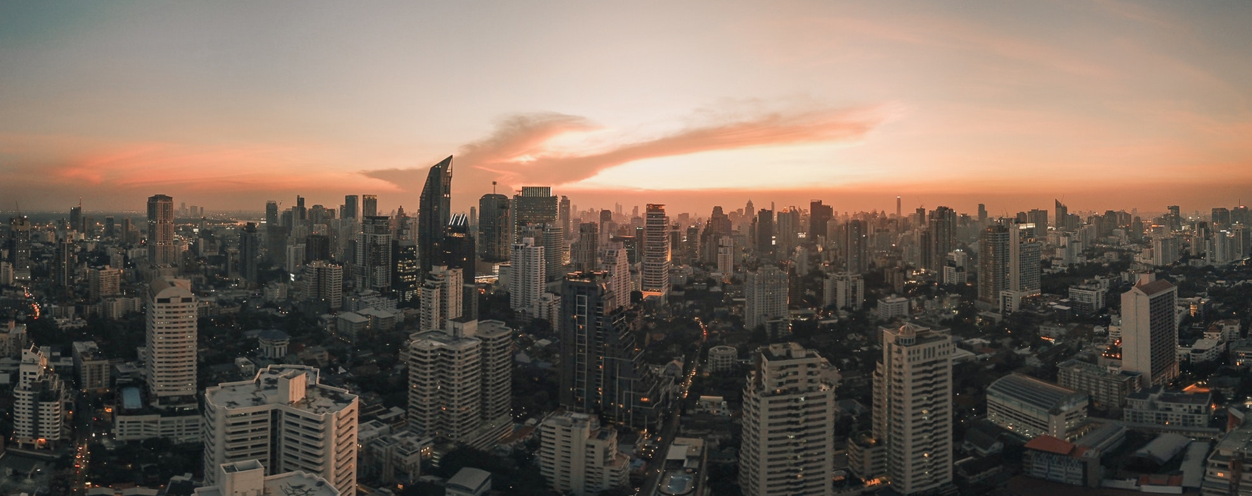
Questions?
Photo by Joshua Rawson-Harris
Notes:
At this time we’ll take questions
Image source: https://unsplash.com/photos/k3fmuSvQi2A

