Slide 1
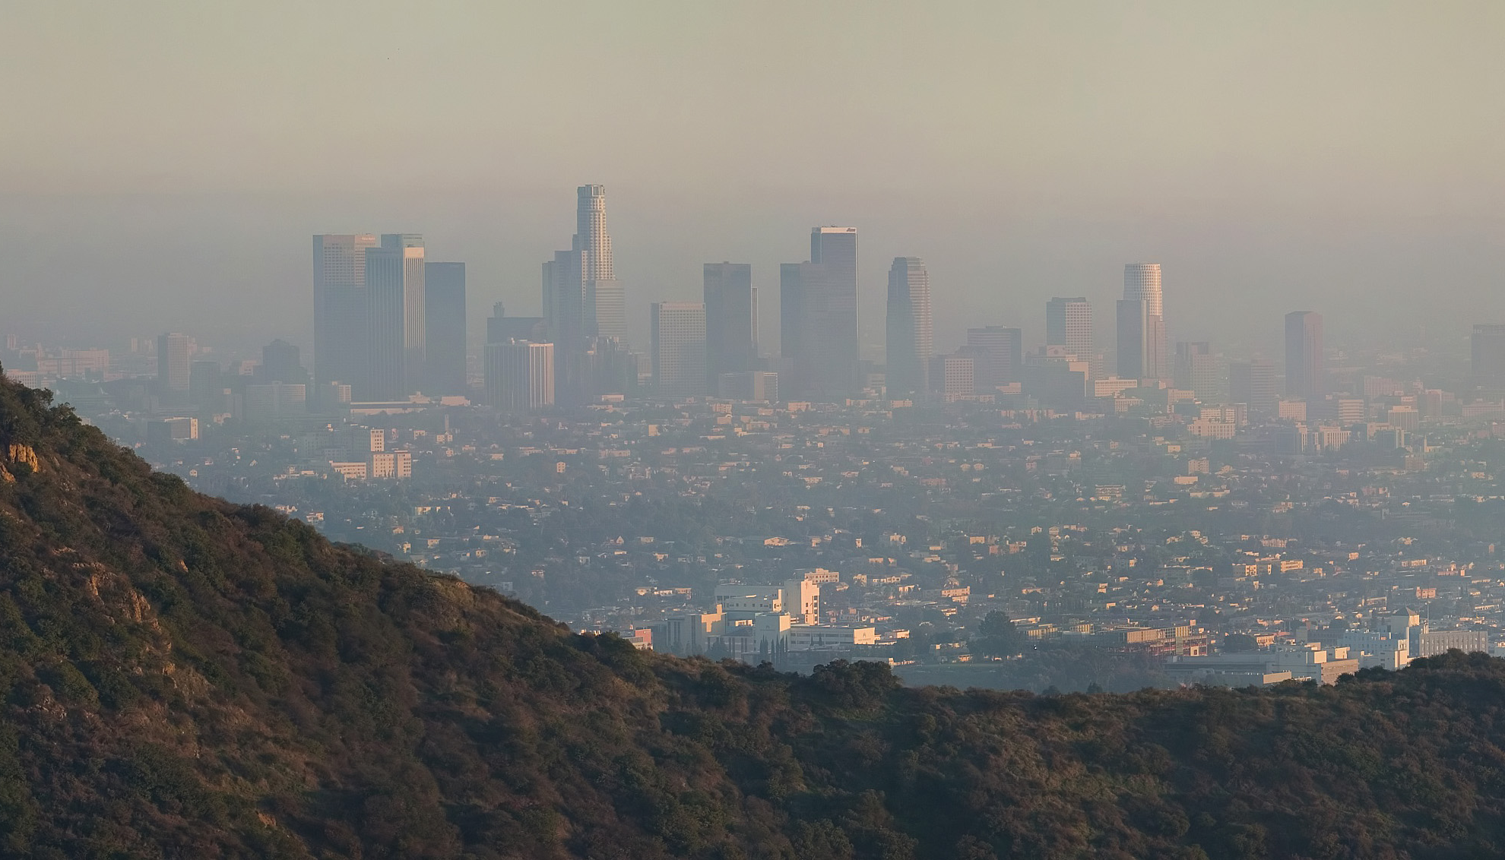
Los Angeles Health & Air Quality
Identifying Urban Emission Patterns in the Los Angeles Megacity
NASA DEVELOP Showcase
Washington, D.C.
July, 30th 2015
Talha Rafiq (Project Lead)
Isis Frausto-Vicencio
Valerie Carranza
Photo by DAVID ILIFF. License: CC-BY-SA 3.0

Slide 2

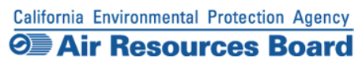
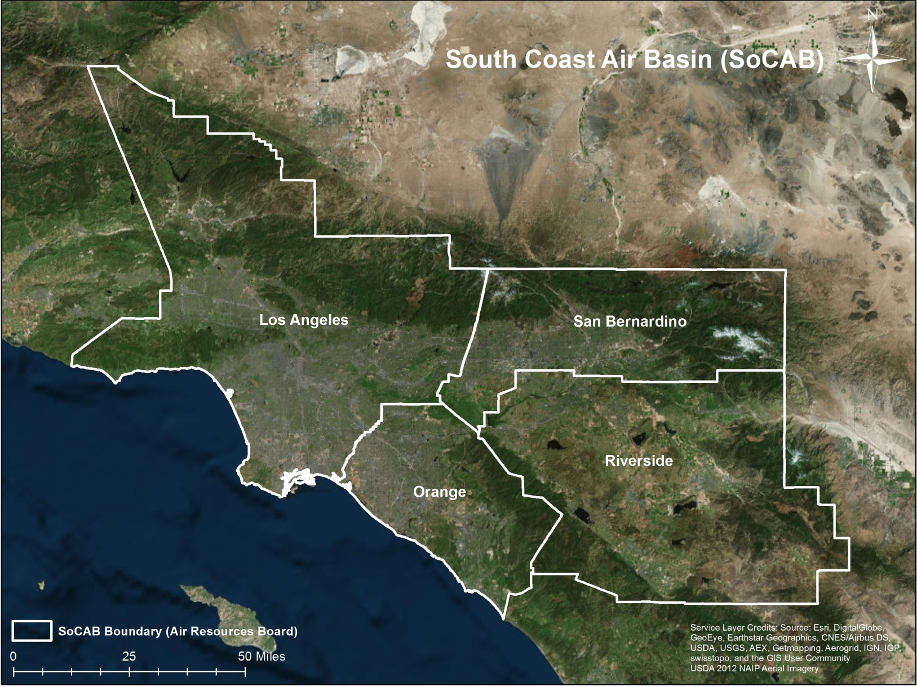
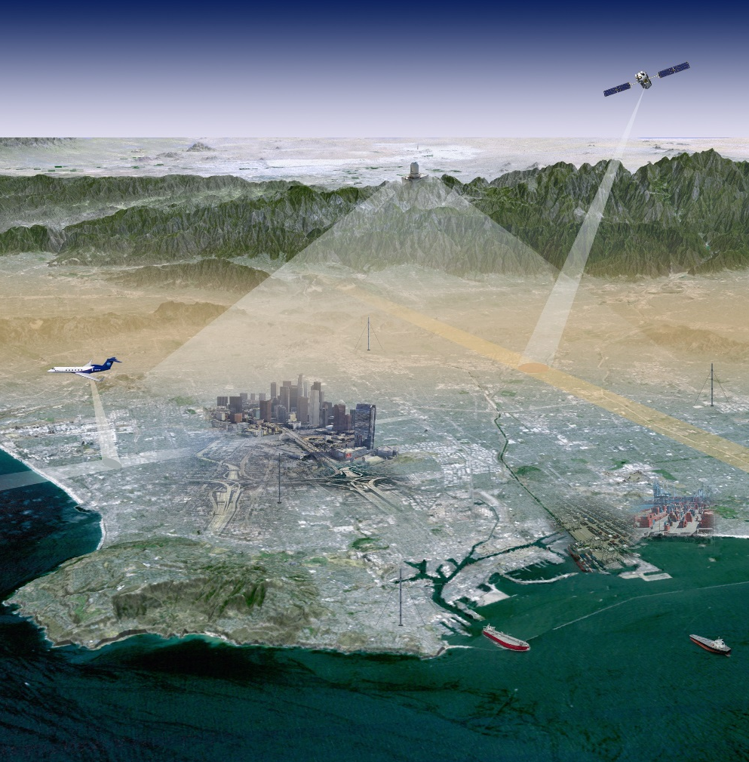
Megacities Carbon Project
Photo by JPL Megacities Carbon Project
Notes:
40% of CA population resides in LA
Methane is 21 times more global warming potential than CO2
A better understanding of methane is needed

Slide 3
Objectives
Research
Obtain and formulate emission factors for the top CH₄ producing sectors
Develop
Develop a raster-based spatial representation of CH₄ emissions in the SoCAB region
Compare
Compare our bottom-up method with top-down NASA Earth observations: HyTES and CLARS
Notes:
Our research presents a bottom-up approach to mapping methane distribution for the LA megacity
HyTES = hyperspectral thermal emissions spectrometer (on a plane)
CLARS= California Laboratory for Atmospheric Remote Sensing

Slide 4
Methodology
CARB 2012 | SoCAB (projected)
Data Collection of Methane Sectors
Process & Validate
Research & Rank of CH₄ Emission Sectors using studies from California AIR Resources Board (CARB)
Convert all data into 3km by 3km grid cell raster visualization
Rank | Source | SoCAB Total (Gg CH₄/year)
1 | Landfills | 171.3
2 | Oil & Natural Gas | 87.4
3 | Livestock-Dairy | 77.3
4 | Wastewater Treatment Plants | 56.3

Slide 5
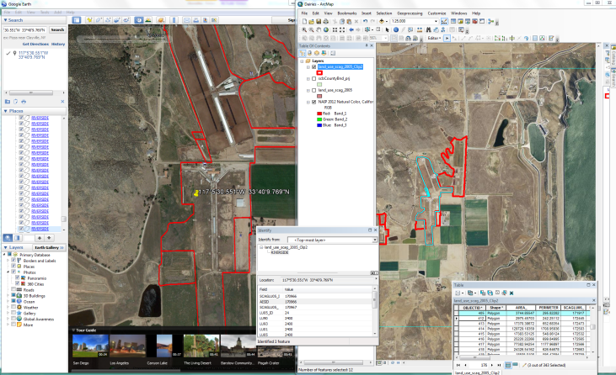
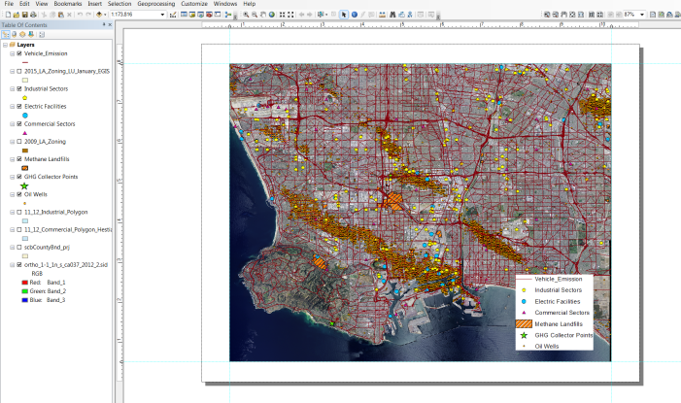
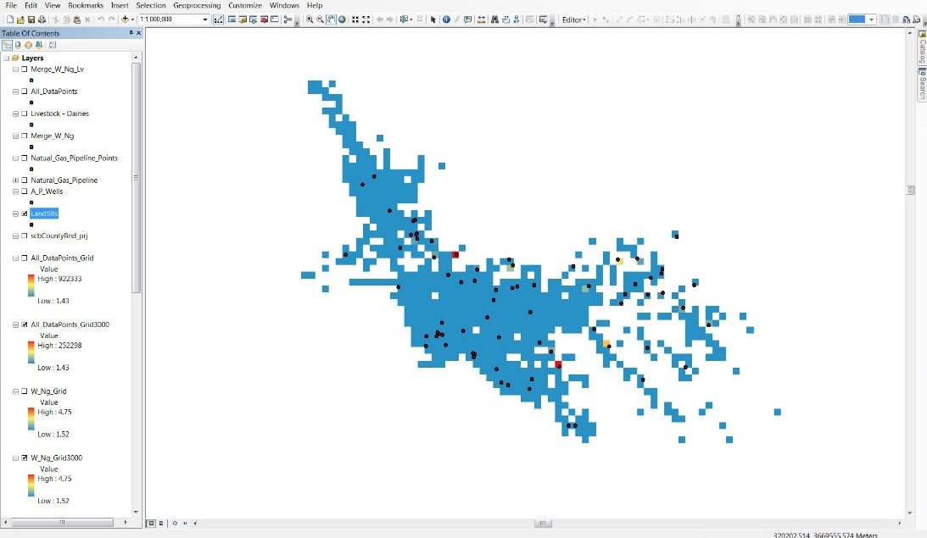
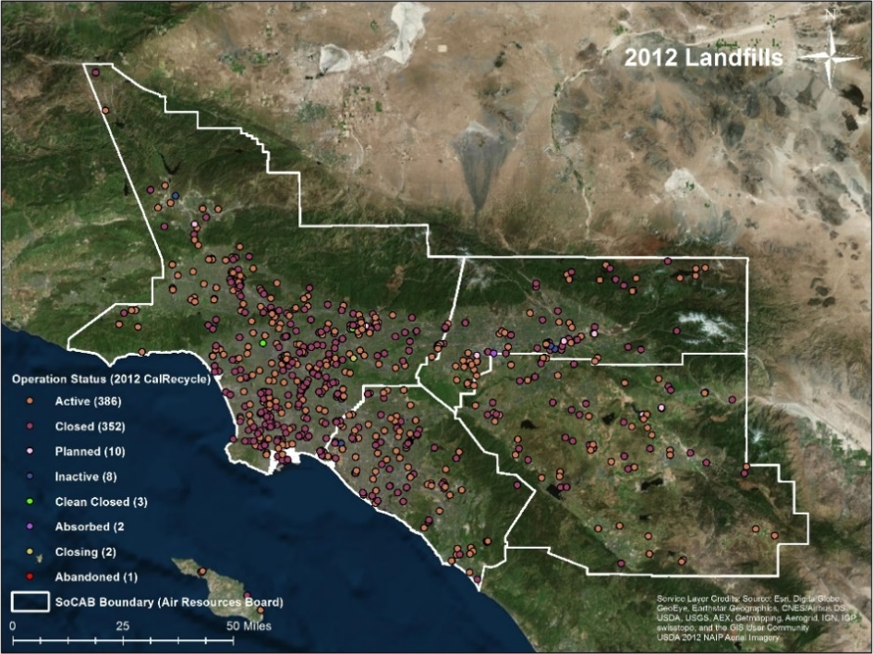
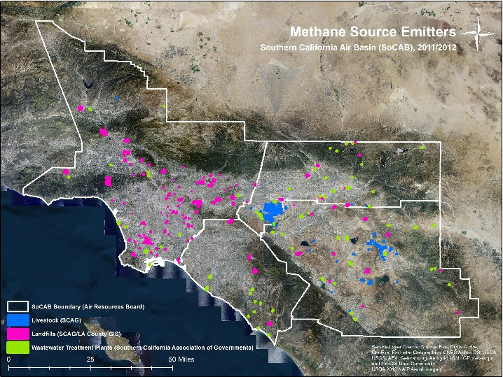
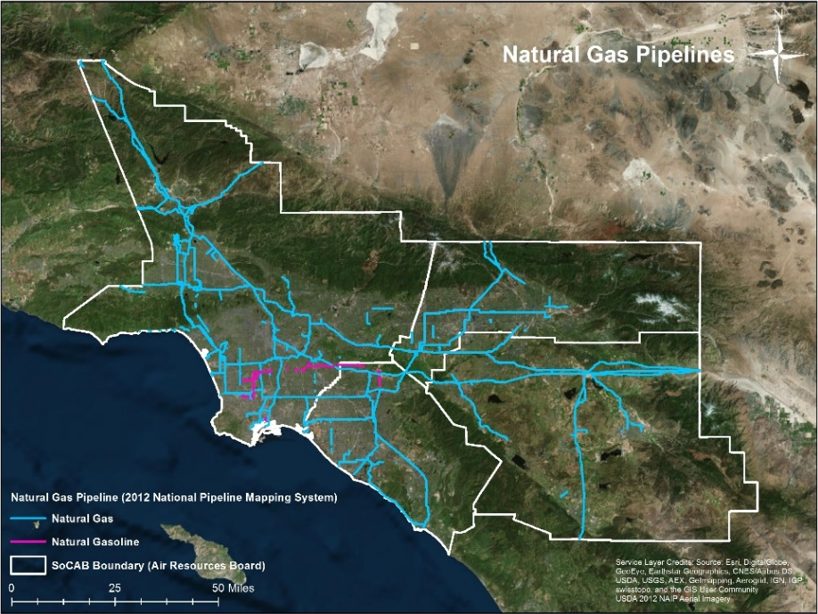
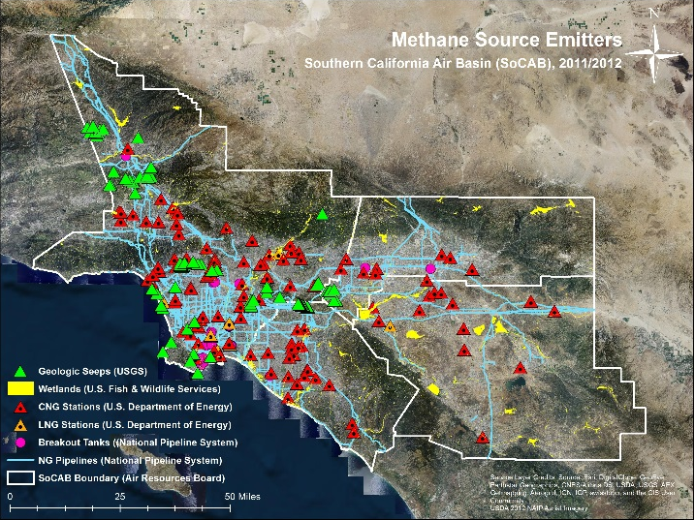
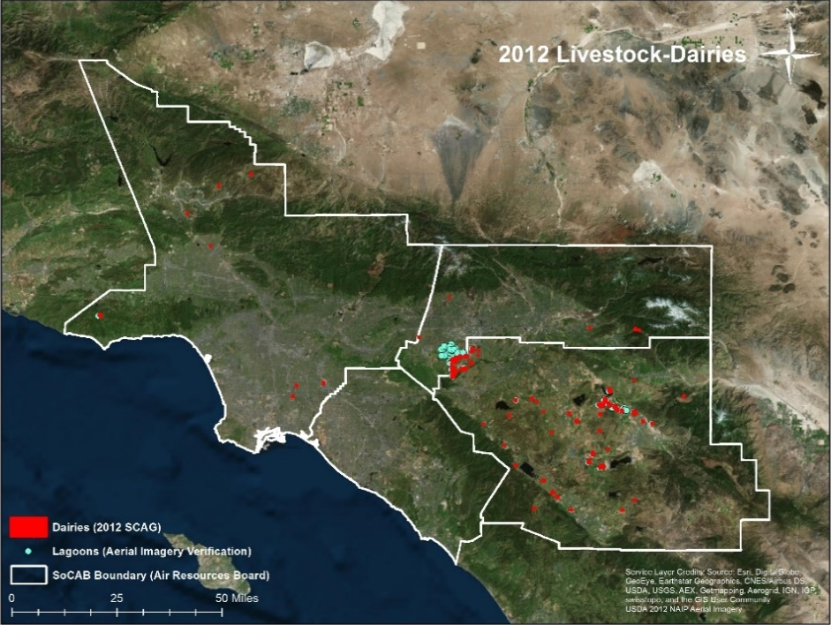
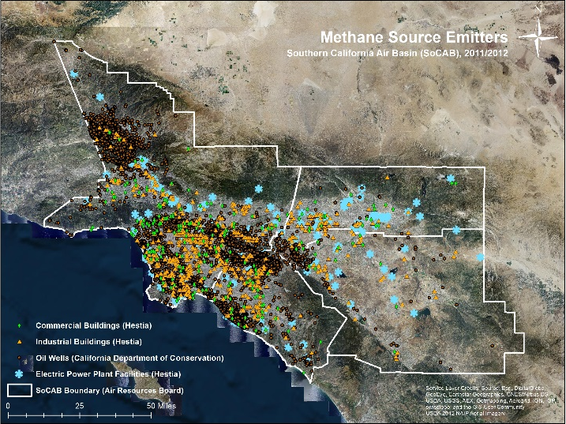
Methodology

Slide 6
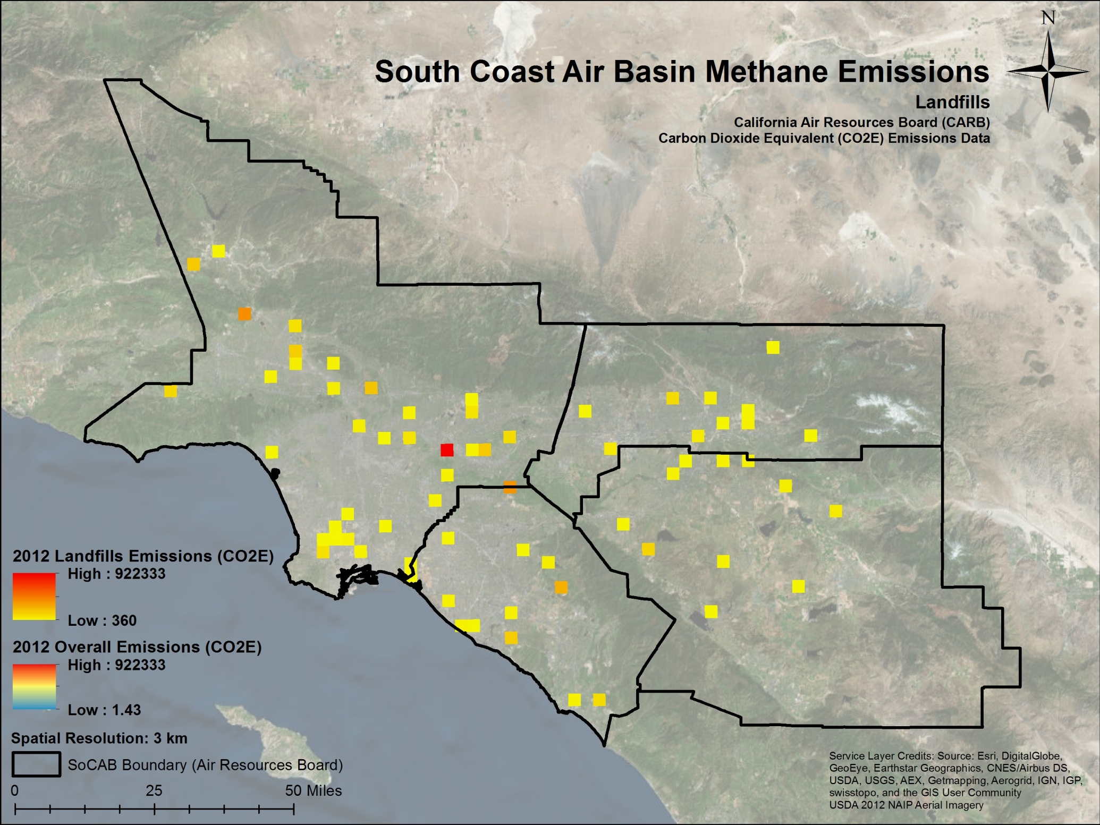
1
Notes:
Landfill data gathered from the California Department of Resources, Recycle, and Recovery, 84 landfills in SoCAB, 21 active, 59 closed, 1 closing, 3 inactive, landfill emissions data is calculated using
Landfill with the highest output was the Puente Hills Landfill in Los Angeles County at 922,333 CO2 Equivalent emissions in 2012

Slide 7
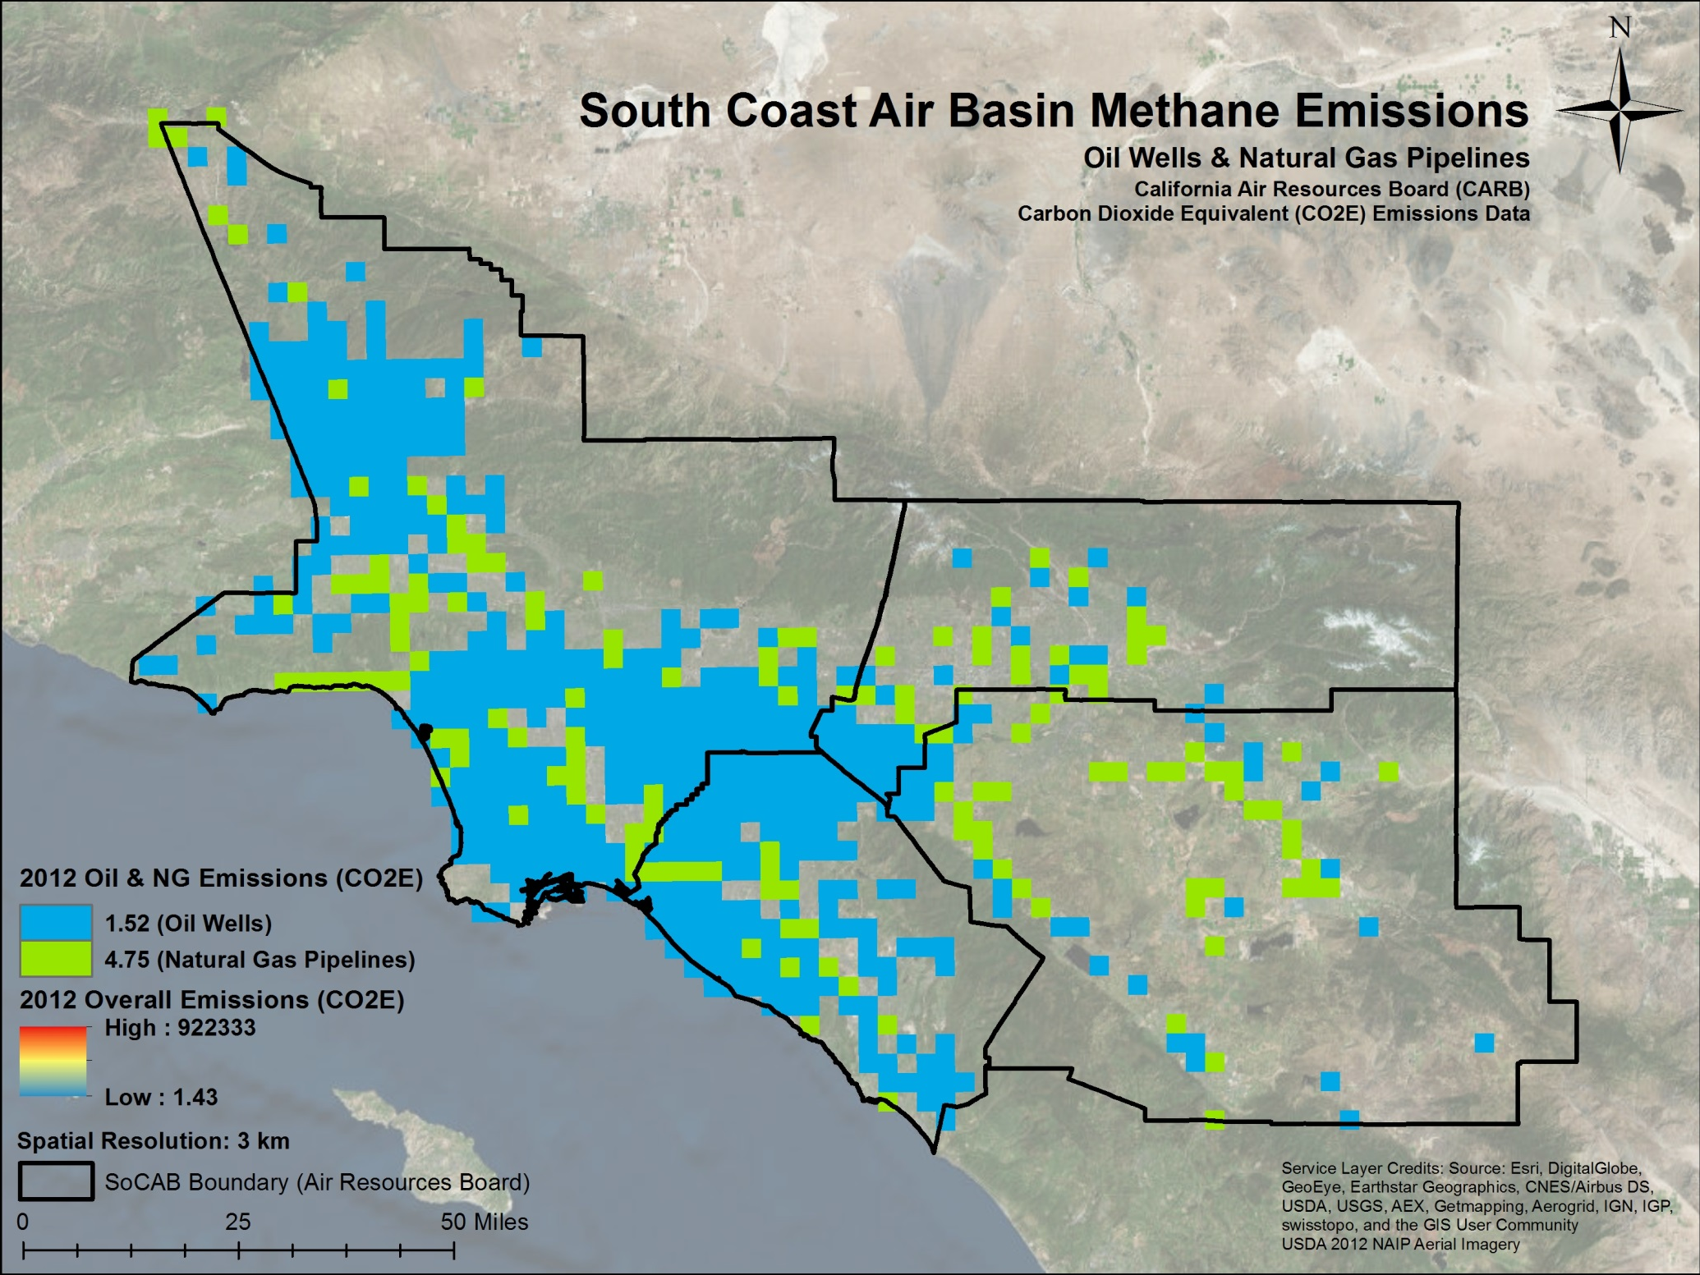
2
Notes:
Oil Wells: 28915; 5585 active, 23330 plugged and abandoned; California Department of Conservation
Division of Oil, Gas, and Geothermal Resources
NG Pipelines: 1067; storage distribution, and transmission; National Pipeline Mapping System

Slide 8
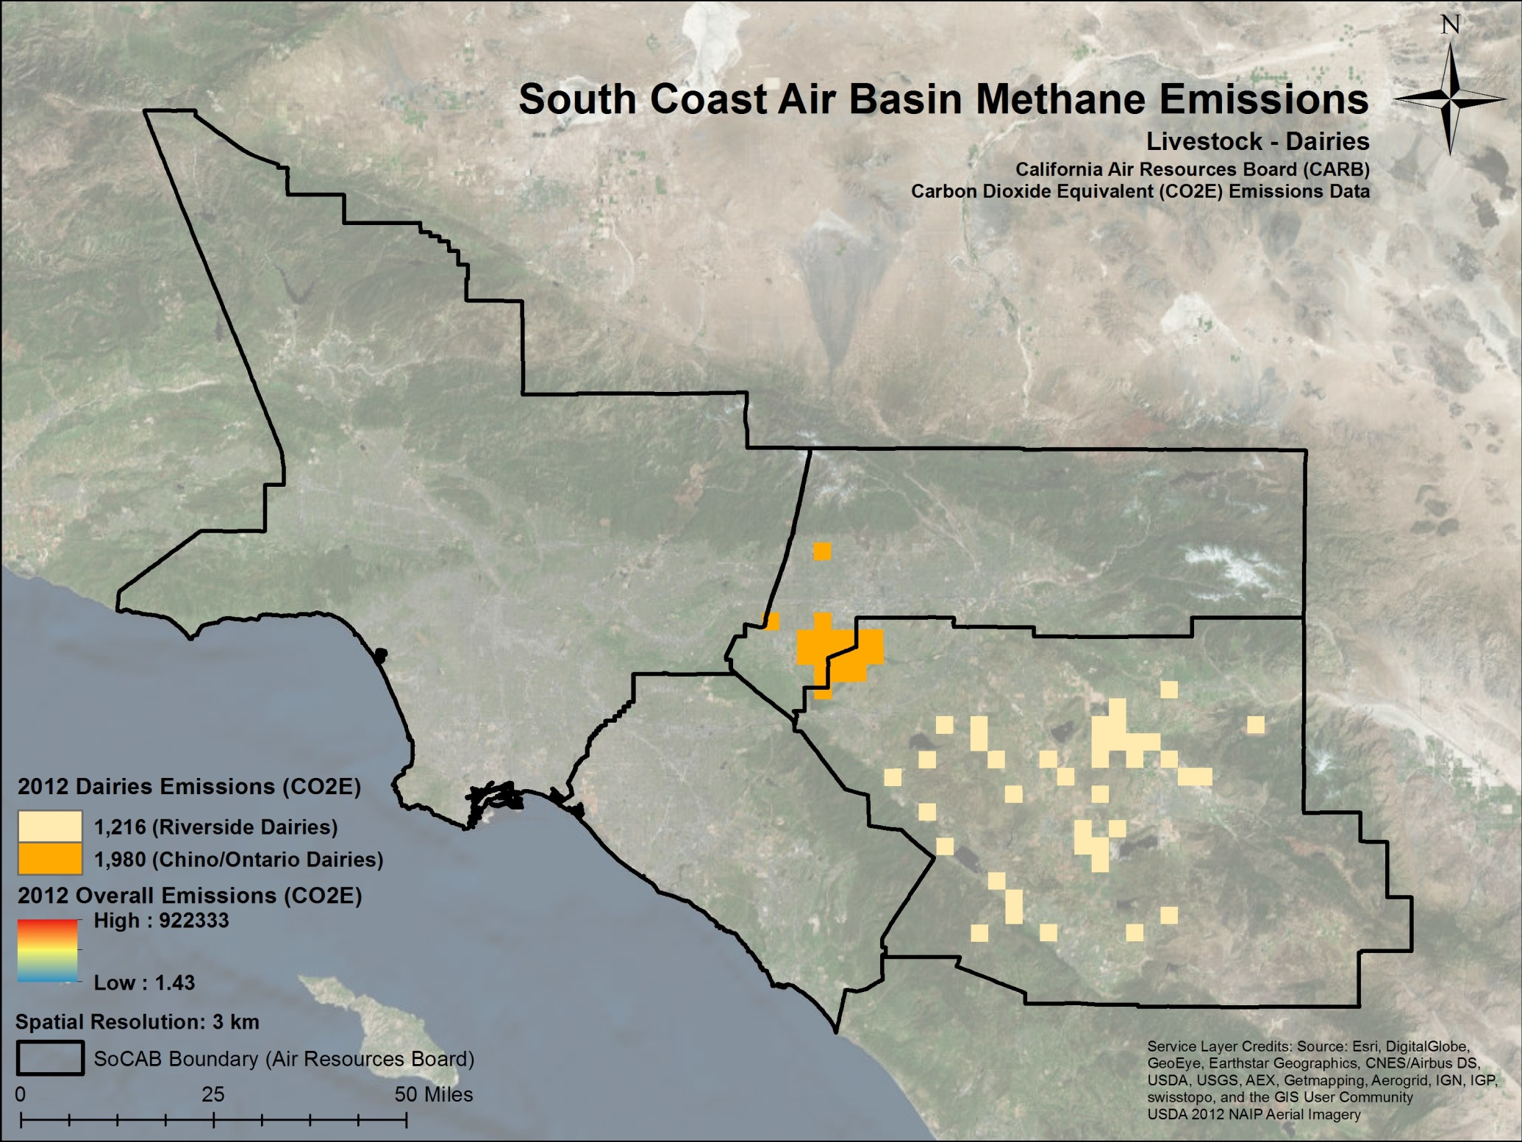
3
Notes:
158 dairies in Chino/Ontario Area
122 Riverside Dairies

Slide 9
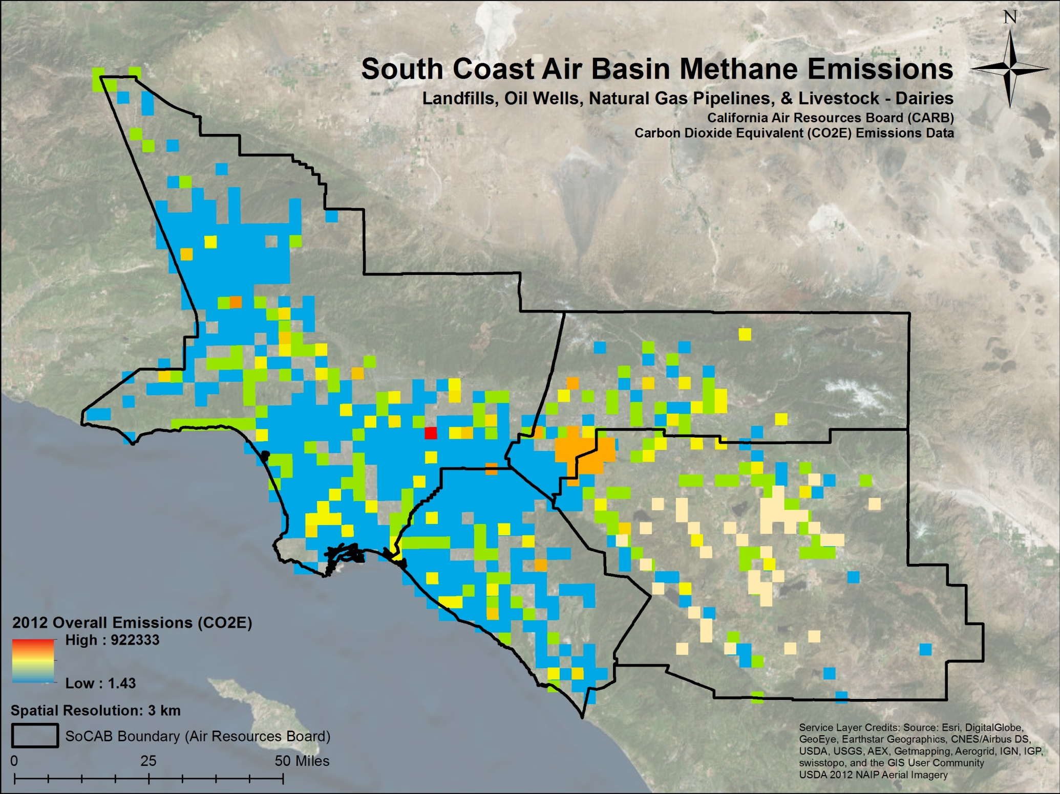
Notes:
And when you overlay all three types of sectors together, here’s what it looks like! The range from most emissive which is red to least emissive which is blue

Slide 10

Future Research
Comparison of this bottom-up method to top-down NASA Earth Observations
In-situ network
OCO-2
TCCON
JAXA GOSAT

