Slide 1
INTERMOUNTAIN WEST WILDLAND FIRES
Mapping Tree Mortality and Burn Patches using NASA Earth Observations to Determine Fire Risk and Inform Fire Management Practices
Teo Rautu
Mark Cervantes
Britt Hays
Alec Wallen
Pop-Up Project | Spring 2024
Notes:
[Speaker]:
Good morning/afternoon everyone! We are the Intermountain West Wildland Fires team that is based out of the PUP University of Wyoming location.
[Introductions]
We appreciate you taking the time to listen to our project today as we are very excited to present about what we've been working on!

Slide 2
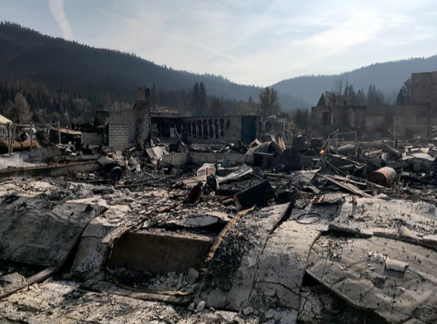
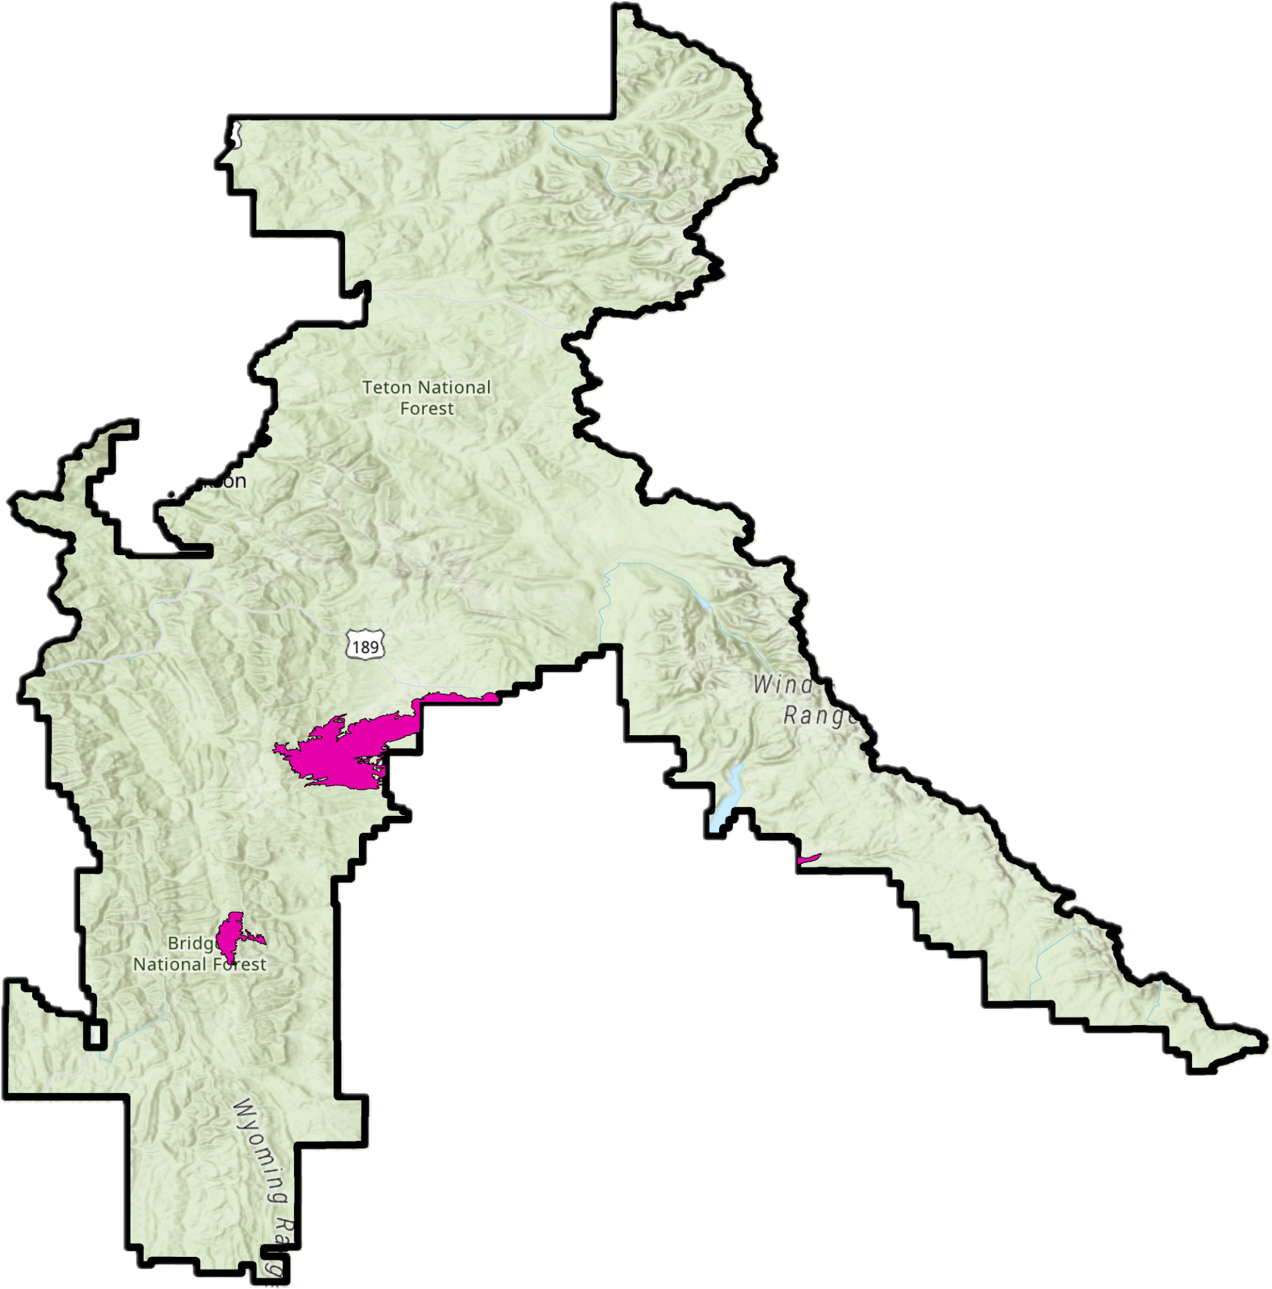
COMMUNITY CONCERNS
Image Credit: Angela Coleman, US Forest Service
Image Credit: US Forest Service:
Scott et al. 2020
Image Credit: Bernardo62
Notes:
[Speaker]:
Communities near wildfire urban interfaces otherwise called WUIs (WUI pronounced "woo-ees") are threatened by rapidly spreading wildfire. As more homes are built in these WUIs there is greater risk to people, their property, and urban infrastructure such as telephone lines. According to Radeloff et. al. 2022 from statistics collected in 2020, several residences across the United States are within WUI areas, including over 60% of Wyomingites. Above is a "Wildfire Risk to Communities" Map from April 2020, indicating the percentile of homes at risk in a WUI area. Communities around the Bridger-Teton National Forest (overlayed with the study area and circled) have a moderate to very high risk of wildfire (40-95th percentile).
------------------------------Image Information Below ------------------------------
•Image Credits: USDA, USFS, Wildfire Risk to Communities
Source: https://doi.org/10.2737/RDS-2020-0016 (Public Domain), Image Source: https://wildfirerisk.org/wp-content/uploads/2020/04/WRC-US-Risk-to-Homes-202004.pdf
Image was cropped and resized and title, doi moved to fit the slide for readability, the original image is in the .pdf above A circle was added to increase focus on the area of the study site: Bridger-Teton National Forest.
Image Credit Top Right: Caldor fire aftermath in Greenville, California. USDA Forest Service photo by Angela Coleman (Public Domain)
Image Source Top Right: https://www.flickr.com/photos/usforestservice/51602328756

Slide 3
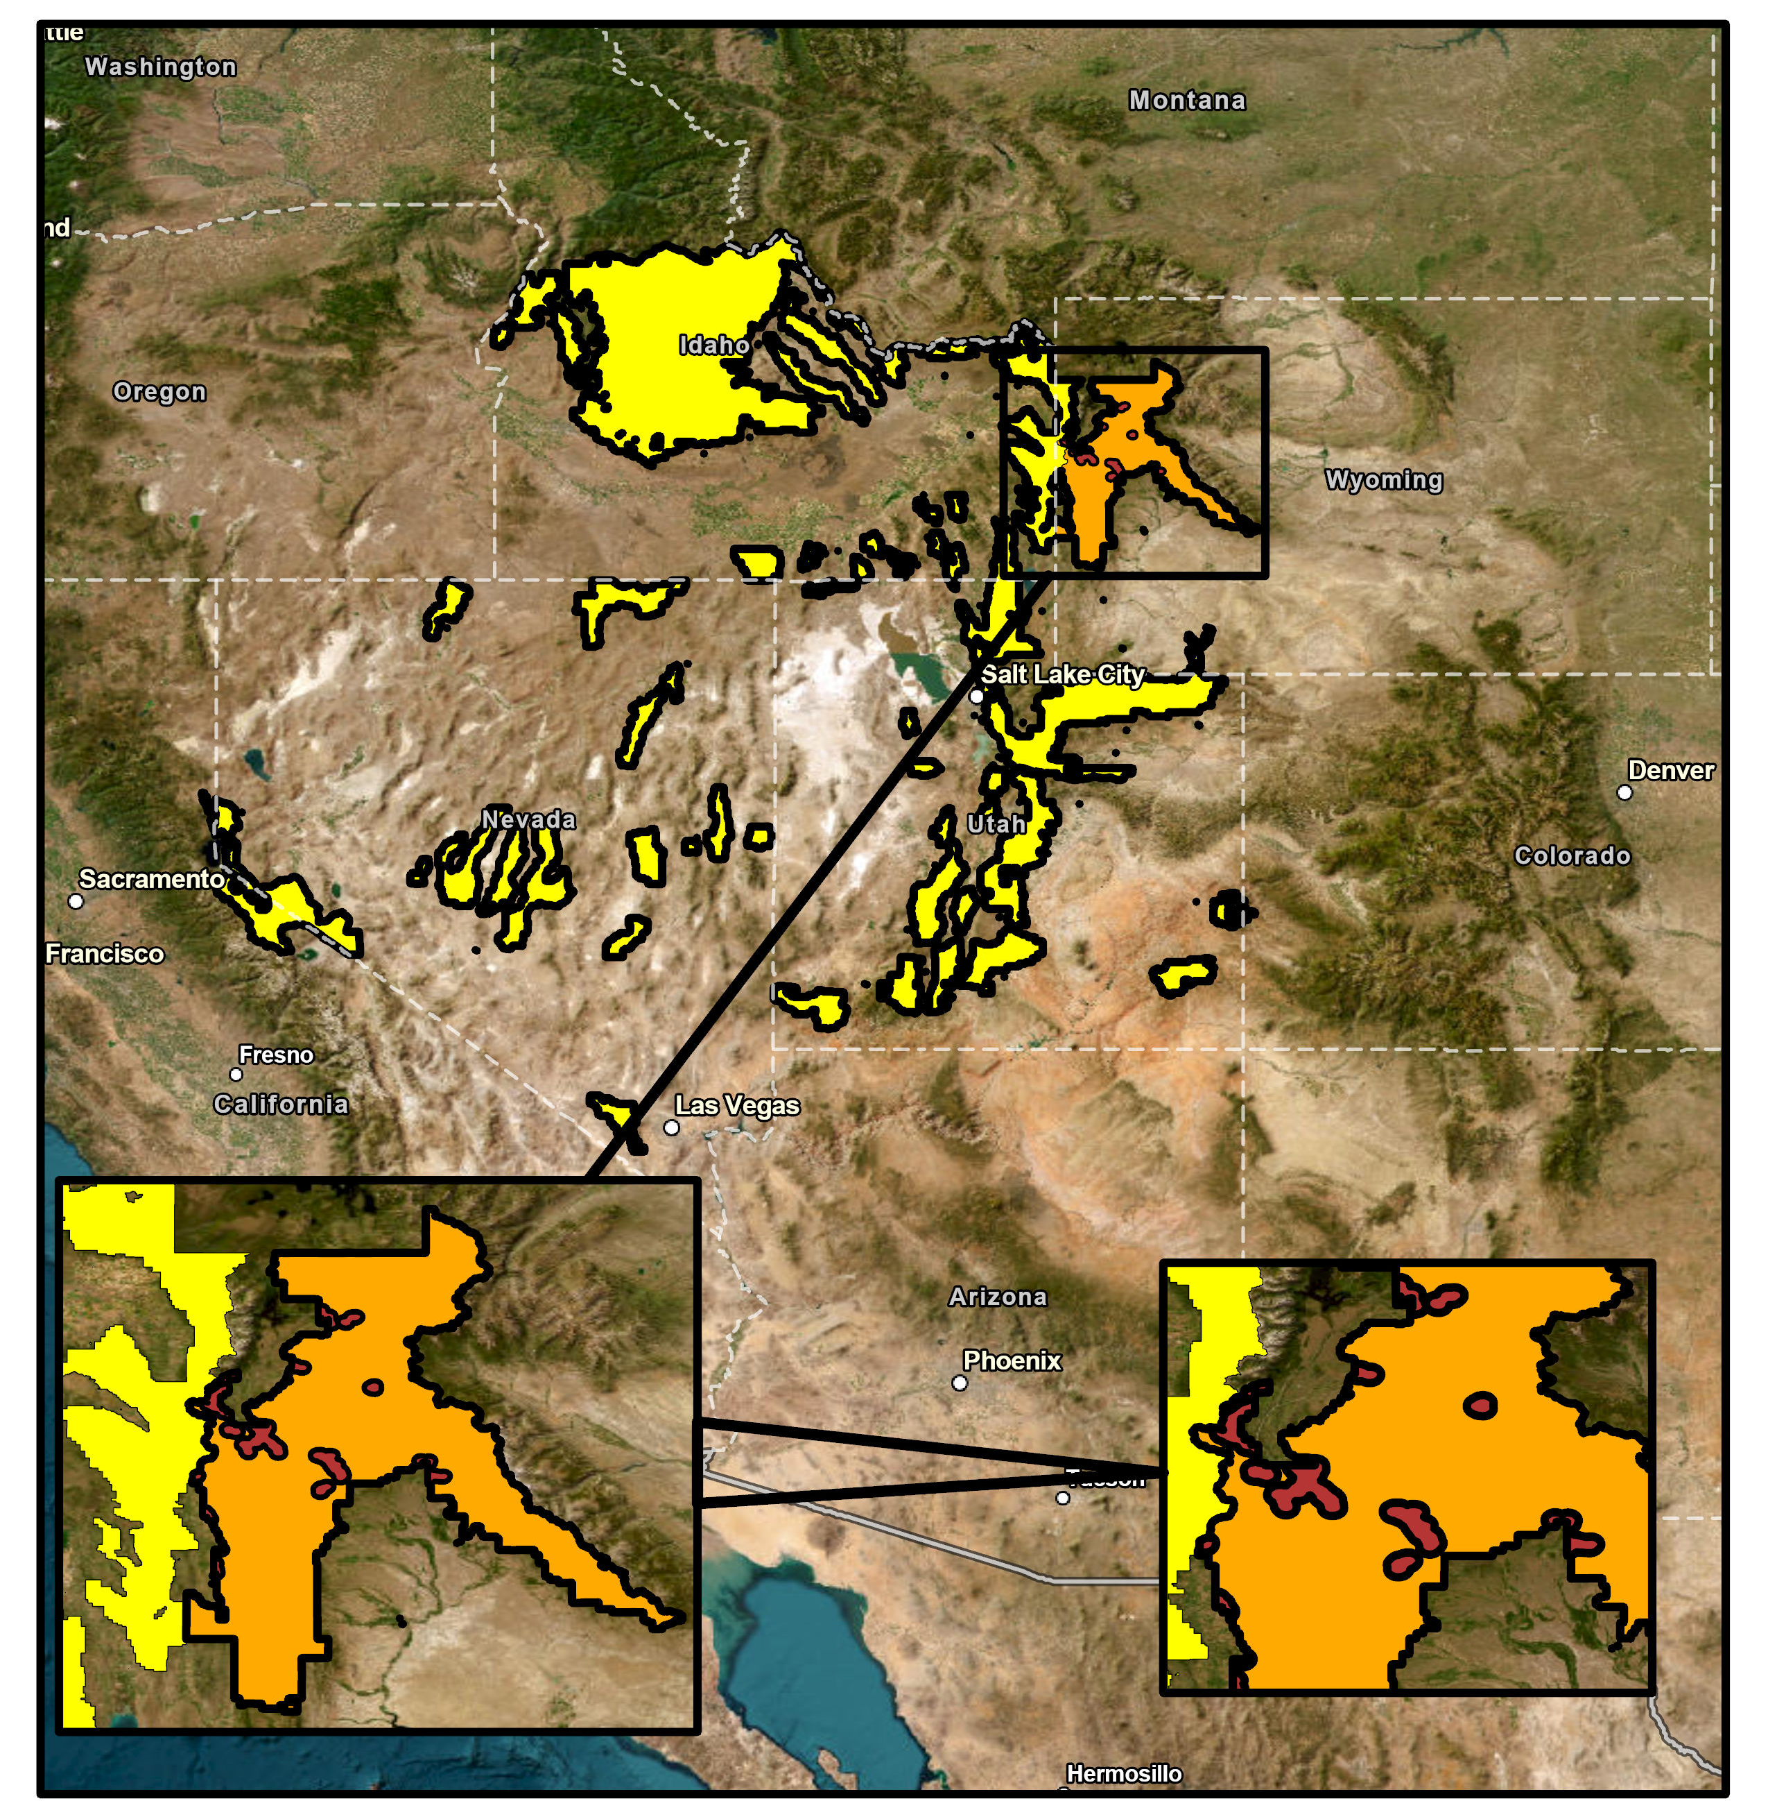
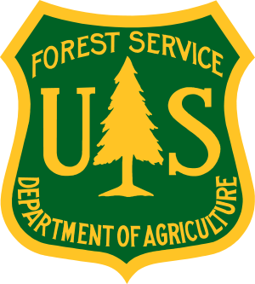
PARTNERS
N
Study Area
0 25 50 75 100 miles
USFS Region 4
Bridger-Teton National Forest
Wildland Urban Interface
Image Credit: Bernardo62
Notes:
[Speaker]:
For this project, our partner is the US Forest Service. Our contact within the forest service is Jed Gregory who serves as the remote sensing program manager for Region 4. Region 4 Intermountain West (area in yellow) covers 5 states including CA, UT, ID, NV, and WY. There are tens of millions of acres of land encompassing thousands of communities in the western United States threatened by wildland fire.
------------------------------Image Information Below Left to Right ------------------------------
•Image Credit: US Forest Service
•Image Source: https://www.climatehubs.usda.gov/image/us-forest-service-logo (Public domain)
•Image Credit: US Forest Service
Image Source: https://www.fs.usda.gov/detail/r4/landmanagement/projects/?cid=fseprd597283 (Public Domain)
Image Credit: PUP-WY (Britt Hays)-Map

Slide 4
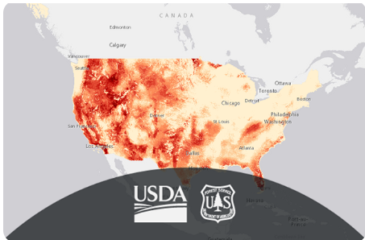
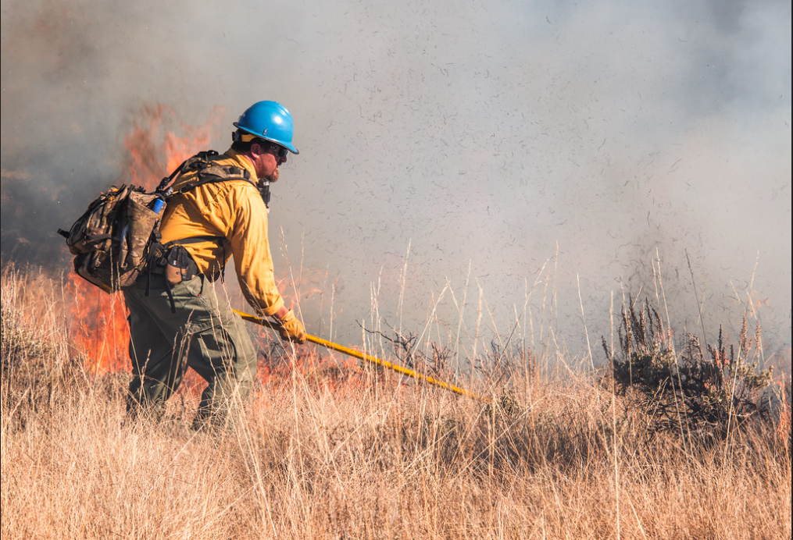
OBJECTIVES
Map forested areas with high fuel loading and potential for high fire severity using NASA Earth observations
Inform partner of current wildfire risk by delineating areas that should be prioritized for fuel reduction to address community safety
Develop a methodology for partner replication to expand project methods to other wildfire crisis strategy sites
Image Credit: Bernardo62
Image Credits: US Forest Service
Notes:
[Speaker]:
In this project we had three objectives that we completed. The first was to map high fuel loading areas and areas with potential for high burn severity by using NASA Earth observation tools.
The second was to inform our partner of current wildfire risk and delineate areas for fuel reduction efforts to address community safety.
The third was through our deliverables, inform our partner of how they could replicate our work into the USFS's future work.
------------------------------Image Information Below ------------------------------
Image Credit: US Forest Service- Wildfire Risk to Communities Burn Probability (Image Service)
Image Source: https://resilience.climate.gov/datasets/usfs::wildfire-risk-to-communities-burn-probability-image-service/about (Public Domain, licenses CC0-1)
•Image Credit: US Forest Service - Wisdom Ranger District Prescribed Fire
•Image Source: https://www.flickr.com/photos/fsnorthernregion/53298455178/in/album-72177720312343529/ (Public Domain)
Image Sources (Icons): Microsoft Office

Slide 5
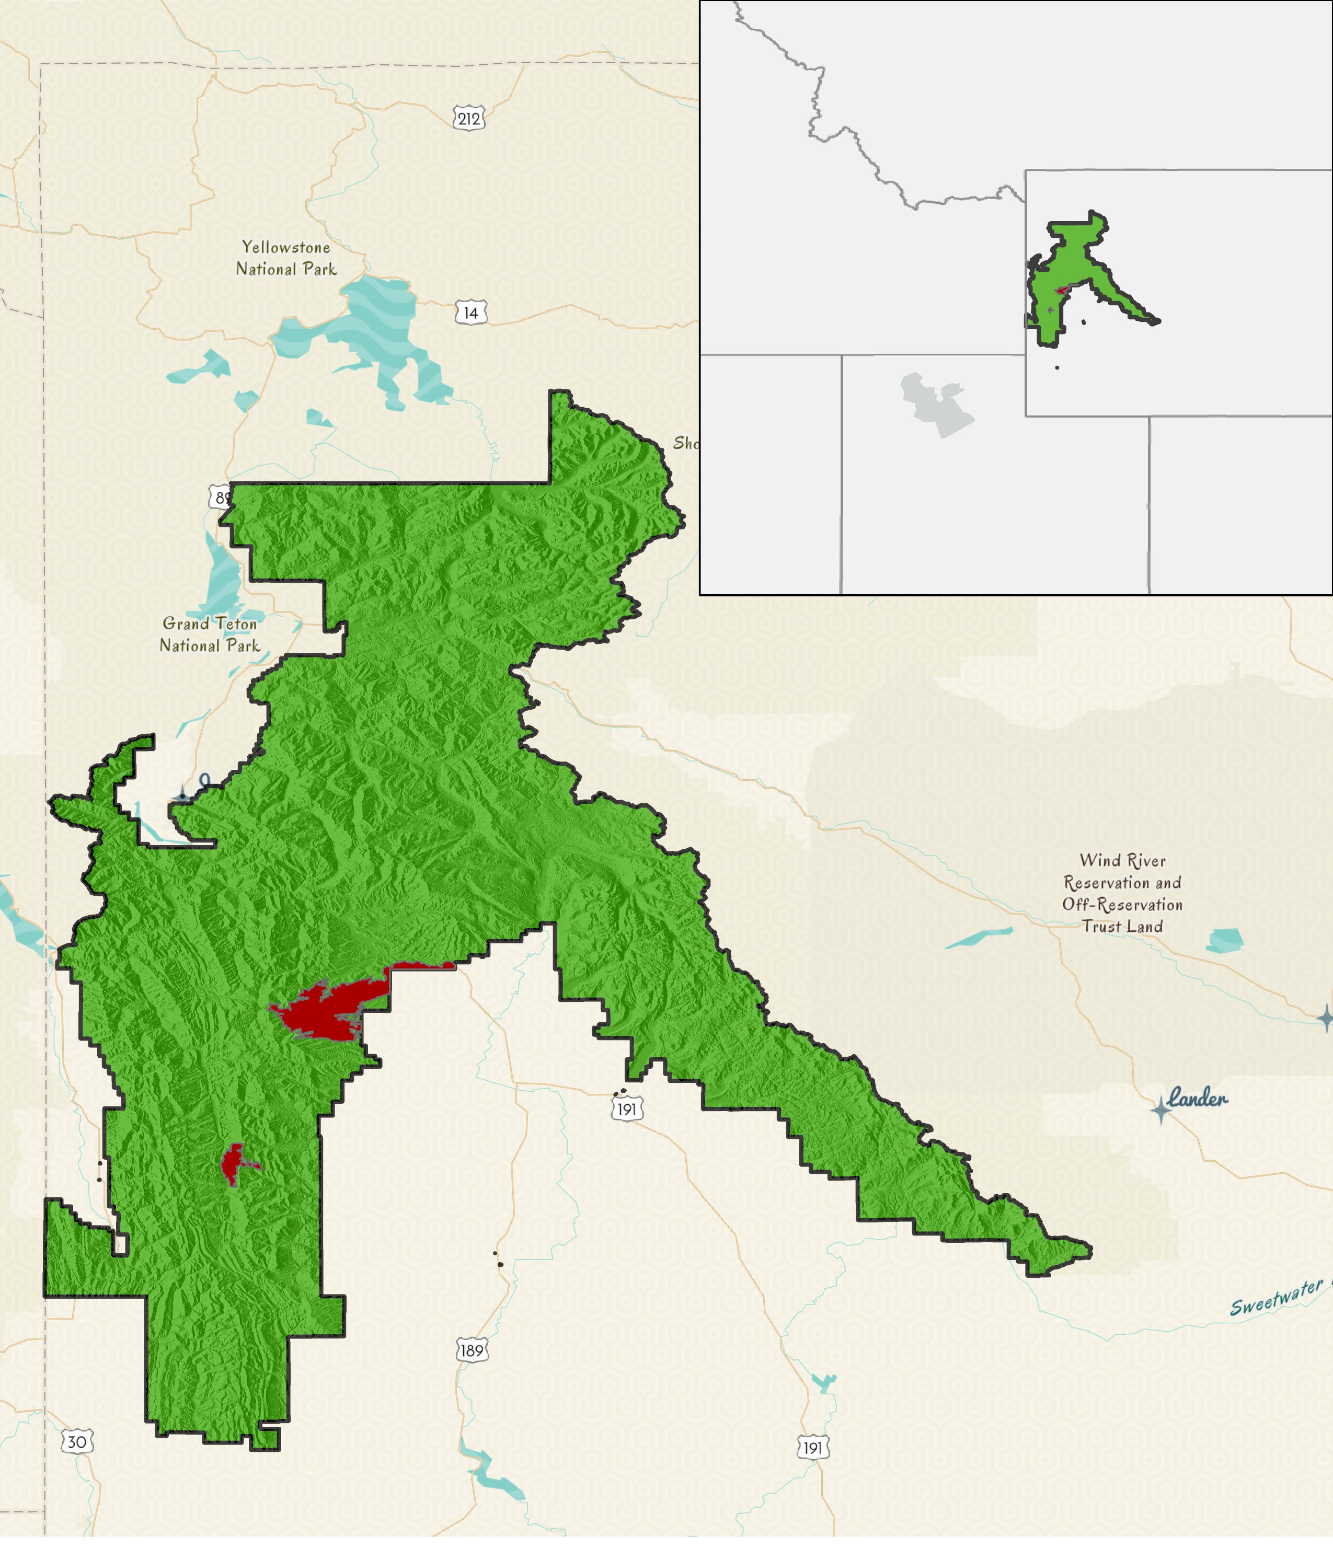
Basemap Credits: ESRI, TomTom, Garmin, FAO, NOAA, USGS, Bureau of Land Management, EPA, NPS, USFWS, USGS
STUDY AREA & PERIOD
Montana
Study Period: 2017-2023
Bridger-Teton National Forest (BTNF)
Idaho
Wyoming
LANDFIRE 2014 Fuel Bed Classification | % Cover Type
Subalpine fir- Englemann spruce-Douglas fir-Lodgepole Pine | 21%
Mesquite Savanna | 17%
Bare ground | 12%
Showy sedge-black alpine-sedge grassland | 12%
Whitebark pine-subalpine forest | 10%
Douglas fir-Ponderosa pine | 9%
Mature Lodgepole pine | 8%
Utah
Bridger-Teton National Forest
Pre-Fire: 2017(June-October) and 2018 (June-July)
Post-Fire: 2018 (August-October) and 2019 (June-October)
Current: 2023(June-October)
Wildland Fires (2018)
N
U.S. Forest Service Lands
0 25 50 miles
Image Credit: Bernardo62
Notes:
[Speaker]:
Our study area is the Bridger-Teton National Forest which is located in northwestern Wyoming. Because the largest area from wildfire burn in this forest occurred in 2018, we focused our analysis to the 2018 fires (and used data from 2017-2023 to assess pre and post fire conditions). The study area was selected through a discussion with our partner to create an obtainable project within our term. The study period was determined through the preference of our partner as well as recognizing when active fire season occurs throughout the year (June – October).
When looking at the fuel bed classification using the LANDFIRE dataset from 2014, the most common type of fuelbed classification is subalpine-fir Engelmann spruce- Douglas-fir – Lodgepole pine forest, spanning roughly 21% of the Bridger-Teton National Forest. From MTBS (1984-2022) there have been 10 prescription (Rx) fires in BTNF, totaling 19,440 acres or averaging 1,944 acres per prescribed (Rx) burn. A total of 42 Rx burns occurred across the state of Wyoming, totaling 134,606 acres with an average of 3,205 acres burned per Rx fire.
Specific to BTNF (2015-2022) non-Rx fires (e.g. wildfires), 10 fires have burned, where historically July has the highest total area burned and the largest average area burned (3 fires, 23,855 acres burned on average) followed by September (3 fires) averaging 20,929 acres burned per fire. The largest fire to burn in this time frame occurred on 09-15-2018 at 55,330 acres.
------------------------------Image Information Below ------------------------------
•Image Credit: PUP Wyoming – Mark Cervantes
•Service Layer Credits: ESRI, TomTom, Garmin, FAO, NOAA, USGS, Bureau of Land Management, EPA, NPS, USFWS, USGS

Slide 6
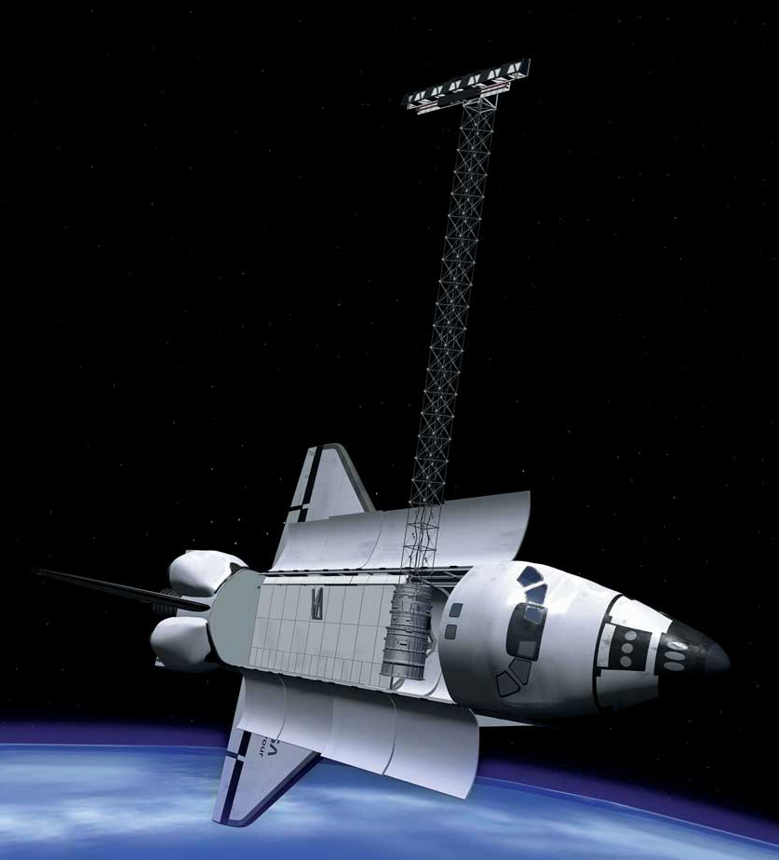
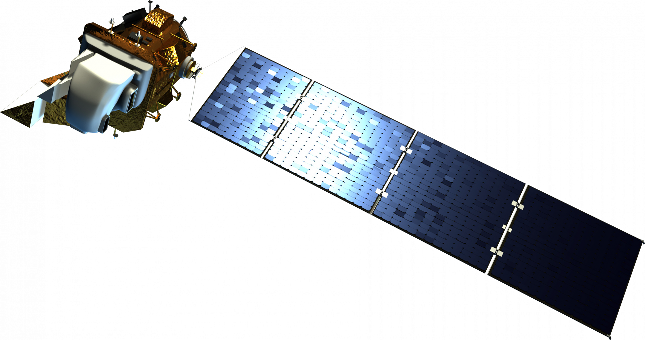
EARTH OBSERVATIONS
Landsat 8
Operational Land Imager (OLI)
Landsat 8 OLI launched in 2013
Spatial resolution
30 meters
Temporal resolution
16 days
Used for
Monitoring vegetation health and cover type changes over time
Shuttle Radar
Topography Mission (SRTM)
SRTM launched in 2000
Spatial resolution
30 meters
Temporal Resolution
16 days
Used for
Measuring elevation
Image Credit: NASA
Notes:
[Speaker]:
For this project, the satellites Landsat 8 and SRTM (Shuttle Radar Topographic Mission) were used. For Landsat 8, the spatial resolution is 30 m with the temporal resolution is 16 days with data available starting in 2013. For SRTM, the spatial resolution is 30 meters and data is available starting in 2000. Landsat 8 is used for monitoring vegetation health and cover type changes over time while the SRTM is used for measuring elevation.
------------------------------Image Information Below ------------------------------
Landsat 8:
• https://science.nasa.gov/multimedia-galleries/spacecraft-icons/
Source NASA
SRTM:
https://spaceplace.nasa.gov/topomap-clay/en/
NASA

Slide 7
WORKFLOW: OUTLINE
Data
Variables
Modeling
Output
Fuel Load Maps
(Fuel Estimation)
DEM
(30m)
Variables
Topography
Landsat 8 Indices
Landsat 8 TOA Indices
Canopy Cover
Canopy Height
Tree Size
Models for Assessing High Fire Risk
(Random Forest)
Satellite
Imagery (Landsat) (30 m)
Burn Maps (Based on Severity)
Ancillary Data
Notes:
[Speaker]:
This project uses multiple data sources to derive the variables that were used in a random forest model to assess fuel load and burn severity. We used the data sources listed in the slide to create our variables, which were then used to create two random forest models. The first random forest model was used to predict fuel load (low, medium, and high) and the second random forest model was used to predict burn severity (enhanced regrowth, unburned, low, medium, and high). Using these predicted layers, we then created maps that show areas in the BTNF and Wildland Urban Interface that should be prioritized for fuel reduction.
------------------------------Image Information Below ------------------------------
- Image Sources (Icons): Microsoft Office

Slide 8
WORKFLOW: DATA
Data Acquisition:
Google Earth Engine:
Google Earth Engine:
Ancillary:
Digital Elevation Model
(30m)
Satellite Imagery
(Landsat 8)
(30 m)
LANDFIRE & Vegetation, Classification, Mapping, Quantitative Inventory (VCMQ)
Data
Data Processing:
Google Earth Engine:
Google Earth Engine:
ArcGIS Pro:
Indices (NDVI, NDMI, dNBR)
Tasseled Cap (Brightness, Wetness, and Greenness)
Topography (Elevation, Slope, and Aspect)
Canopy Cover
Canopy Height
Tree Size Class
Variables
Notes:
[Speaker]:
This project uses multiple data sources to derive the variables that were used in a random forest model to assess fuel load and burn severity.
The first source was the Digital Elevation Model (DEM) that we acquired from NASA SRTM in Google Earth Engine (GEE). From this DEM we derived environmental variables such as slope and aspect. The second data source was satellite imagery, specifically Landsat 8 Collection 2 Tier 1 Level 2 and Landsat 8 Collection 2 Tier 1 top-of-atmosphere (TOA). The Landsat 8 Collection 2 Tier 1 Level 2 satellite images were gathered in GEE and allowed us to derive different indices that are used as variables in our final model. Some of the indices that were calculated from the satellite images were the Normalized Difference Vegetation Index (NDVI), the Normalized Difference Moisture Index (NDMI), and the differenced Normalized Burn Ratio (dNBR). The NDVI is used to measure the health of the vegetation, the NDMI measures the moisture in the vegetation, and the dNBR will be used to determine fire extents and fire severity. The Landsat 8 Collection 2 Tier 1 top-of-atmosphere images were used to derive the tasseled cap indices such as brightness, wetness, and greenness. These indices informed us about ground exposure, vegetation health, and vegetation moisture. The reason that the Landsat 8 Collection 2 Tier 1 top-of-atmosphere images were used for the tasseled cap transformation is because the coefficients are specific to these satellite images.
The last two datasets we used were LANDFIRE and Vegetation, Classification, Mapping, and Quantitative Inventory (VCMQ). The LANDFIRE dataset was acquired from US Geological Survey (USGS) and VCMQ was acquired from the US Department of Agriculture (USDA). We combined these two data sources to get a fuel load layer that included metrics on Canopy Cover, Canopy Height, and Tree Size Class. The new layer was classified and binned as Low, Moderate, and High fuel loads (next slide). These were the dependent variables for estimating fuel loads in the random forest model.
The DEM variables and the Landsat 8 images were both acquired and processed within GEE where functions integrated into the program allowed us to derive the variables that are used in the random forest model.
The final products of this project were intended to help in understanding the fuel loads and behavior of burn areas. These burn maps and fuel load maps will be used to help with pre-fire management practices as well as wildfire fighting tactics.
------------------------------Image Information Below ------------------------------
- Image Sources (Icons): Microsoft Office

Slide 9
METHODOLOGY
Fuel Load Random Forest Modeling
Independent Variables:
Elevation
Slope
Aspect
NDVI
NDMI
Brightness
Greenness
Wetness
Dependent Variable:
Fuel Load
Fuel Load Categories | Tree Canopy Cover | Shrub Canopy Cover | Canopy Height | Tree Size (Diameter at Breast Height)
Low | Non-forest 10-20% | 0-10% | Non-forest | Non-forest
Medium | 20-50% | 10-24% | 25-50m | 20-30+" DBH
High | 50-100% | 25-100% | 0-25m | 0-19.9" DBH
Fuel Load Maps
(Fuel Estimation)
Output
Notes:
[Speaker]:
A random forest model was run with the environmental and Landsat 8 OLI/TOA indices as the independent/predictor variables. The dependent variables for the fuel load random forest model are Canopy Cover, Canopy Height, and Tree Size Class. Running the random forest model can determine which independent variables are the best predictors of estimating the dependent variables. This gives insight to fuel load, as the dependent variables are classified as Low, Moderate, and High fuel loads.
------------------------------Image Information Below ------------------------------
The Random Forest Model image is from an Unknown author is licensed under CC BY.
Image Sources (Icons): Microsoft Office

Slide 10
METHODOLOGY
Burn Severity Random Forest Modeling
Severity Level | DNBR Range
Enhanced Growth | < - 0.1
Unburned | -0.1 to +0.1
Low Severity | +0.1 to +0.27
Moderate Severity | +0.27 to +0.66
High Severity | >0.66
Independent Variables:
Elevation
Slope
Aspect
NDVI
NDMI
Brightness
Greenness
Wetness
Dependent Variable:
Burn Severity
Burn Maps (Based on Severity)
Output
Notes:
[Speaker]:
A random forest model was run with the environmental and Landsat 8 OLI/TOA indices as the independent/predictor variables. The dependent variable for the burn severity random forest model is the dNBR. Running the random forest model can determine which independent variables are the best predictors of estimating the burn severity. This gives insight to the area that had low, moderate, and high burn severity.
------------------------------Image Information Below ------------------------------
Image Sources (Icons): Microsoft Office

Slide 11
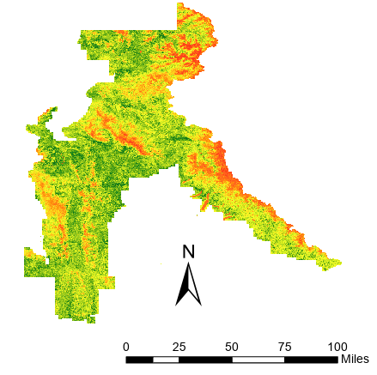
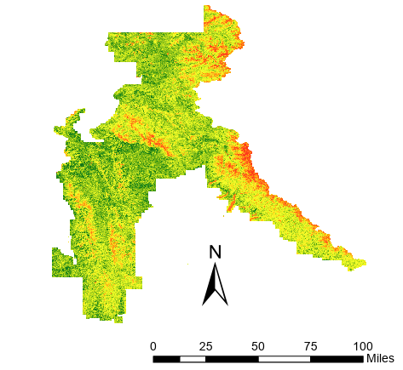
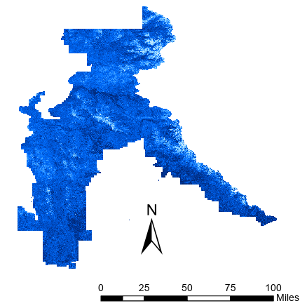
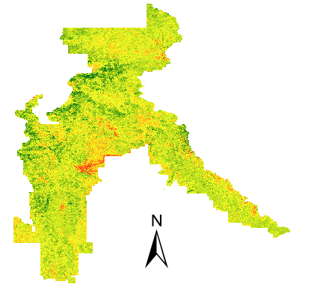
Pre-fire
Current
RESULTS
Normalized Difference Vegetation Index
Low Veg. Health (NDVI: <0)
Intermediate Veg. Health (NDVI: -1>0>1)
High Veg. Health (NDVI: >0)
Normalized Difference Moisture Index
Low Veg. Moisture (NDMI: <0)
Intermediate Veg. Moisture (NDMI: -1>0>1)
N
High Veg. Moisture (NDMI: >0)
N
0 25 50 75 100 miles
0 25 50 75 100 miles
Difference Normalized Burn Ratio
Post-fire – Pre-fire:
High Burn Severity (dNBR: >0)
Intermediate Burn Severity (dNBR: -1>0>1)
Low Burn Severity (dNBR: <0)
Notes:
Speaker : These are the results of the variables derived from Landsat 8 Images. The variables displayed are the NDVI, NDMI, and dNBR. The variables represent vegetation health, vegetation moisture content, and burn areas. The time scales are as follows: Pre-fire is 2017(June-October) and 2018 (June-July), Post-Fire is 2018 (August-October) and 2019 (June-October), and Current is 2023 (June-October).
------------------------------Image Information Below ------------------------------
•Image Credit: PUP WY- Mark Cervantes
Icons: MicroSoft Office

Slide 12
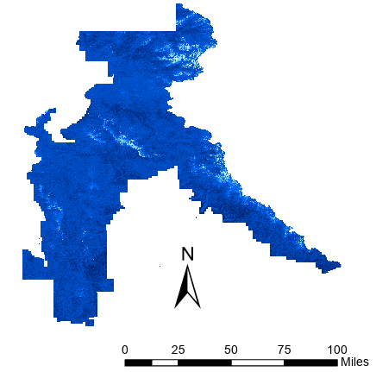
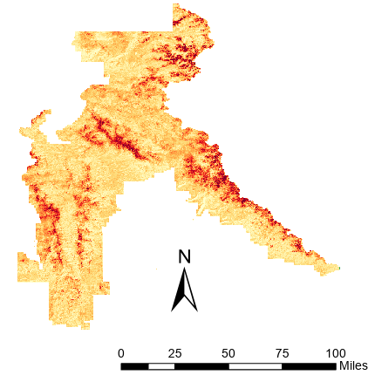
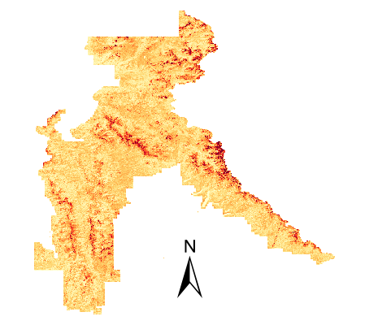
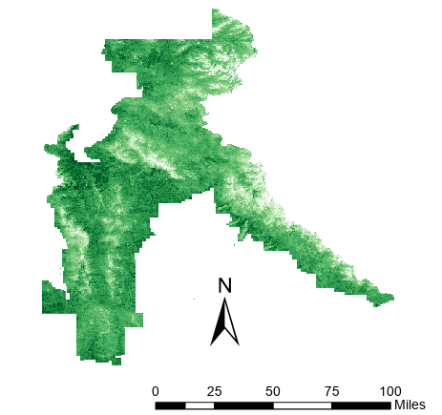
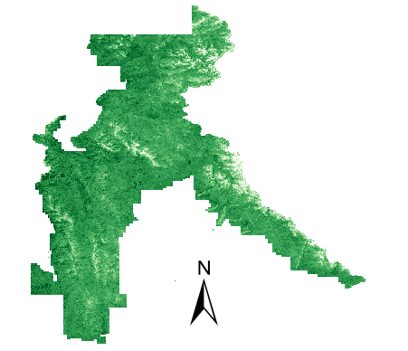
Pre-fire
Current
RESULTS
0.7
Wetness
-0.3
0
Brightness ​
1.5
-0.3
Greenness ​
0.3
0 25 50 75 100 miles
N
N
0 25 50 75 100 miles
Notes:
Speaker:
These are the results of the variables derived from Landsat 8 TOA Images. The variables displayed are the Wetness, Brightness, and Greenness. The variables represent moisture, vegetation, and reflectance. The time scales are as follows: Pre-fire is 2017(June-October) and 2018 (June-July) and Current is 2023 (June-October).
------------------------------Image Information Below ------------------------------
•Image Credit: PUP WY- Mark Cervantes

Slide 13
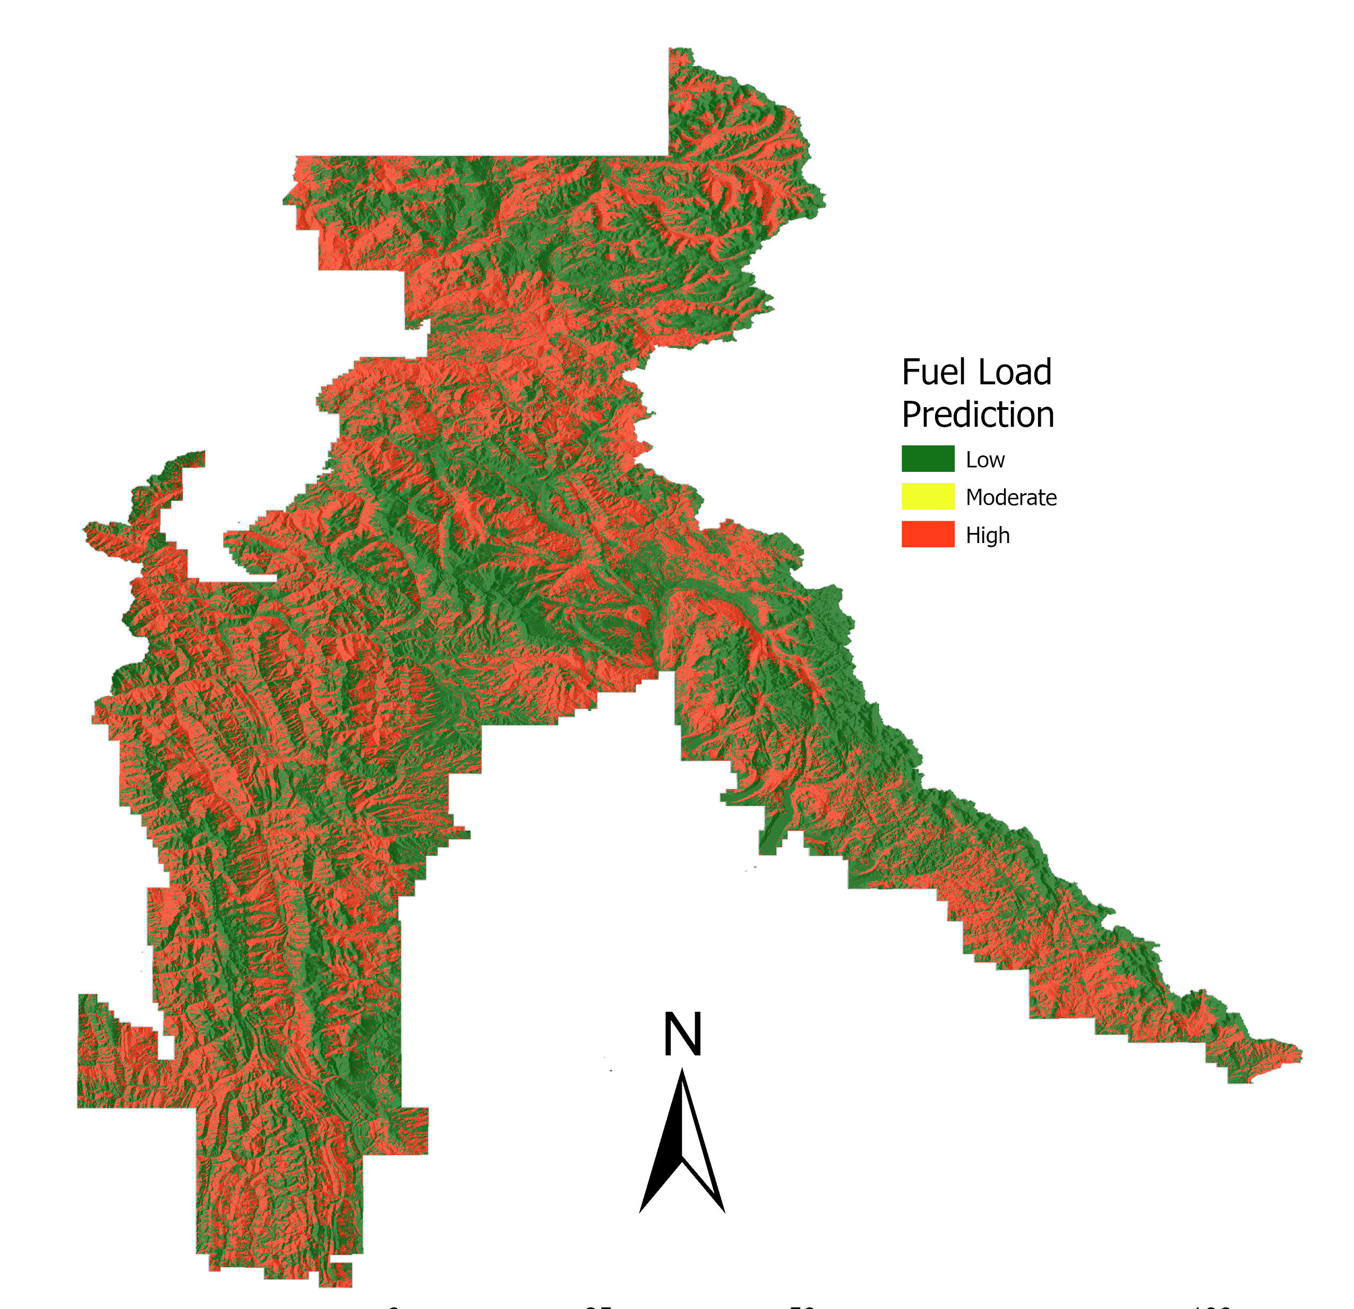
RESULTS: FUEL IN BTNF
Most important predictor variables:
Elevation
NDVI
Brightness
Wetness
Greenness
Predicted Fuel Load
Low Fuel Load
Moderate Fuel Load
High Fuel Load
Predicted Fuel | Observed Fuel Load Values
 | Low | Medium | High
Low | 96 | 0 | 13
Medium | 0 | 0 | 0
High | 5 | 0 | 63
N
0 25 50 75 100 miles
Fuel Load | Low | Medium | High
Acres & % of Area | 1,839,501 (53% ) | 13 (<1 %) | 1,626,997 (47% )
Notes:
Speaker:
These are the results from running the random forest model for fuel load. The predictor variables that were used in the random forest model for fuel loads consisted of elevation, NDVI, Brightness, Greenness, and wetness. The final fuel load map indicates that there is a rather equal amount of both high (47%) and low (53%) fuel loads, and a rather low amount of medium (1%) fuels loads. The high fuel loads are represented by red on the map, the medium is shown by yellow on the map, and the low fuel load areas are represented by green.
There is a 12% error rate of low fuel being misclassified as high fuel. Similarly, there is a 7% error rate for high fuel loads being misclassified as low fuels.
------------------------------Image Information Below ------------------------------
•Image Credit: PUP WY- Mark Cervantes

Slide 14
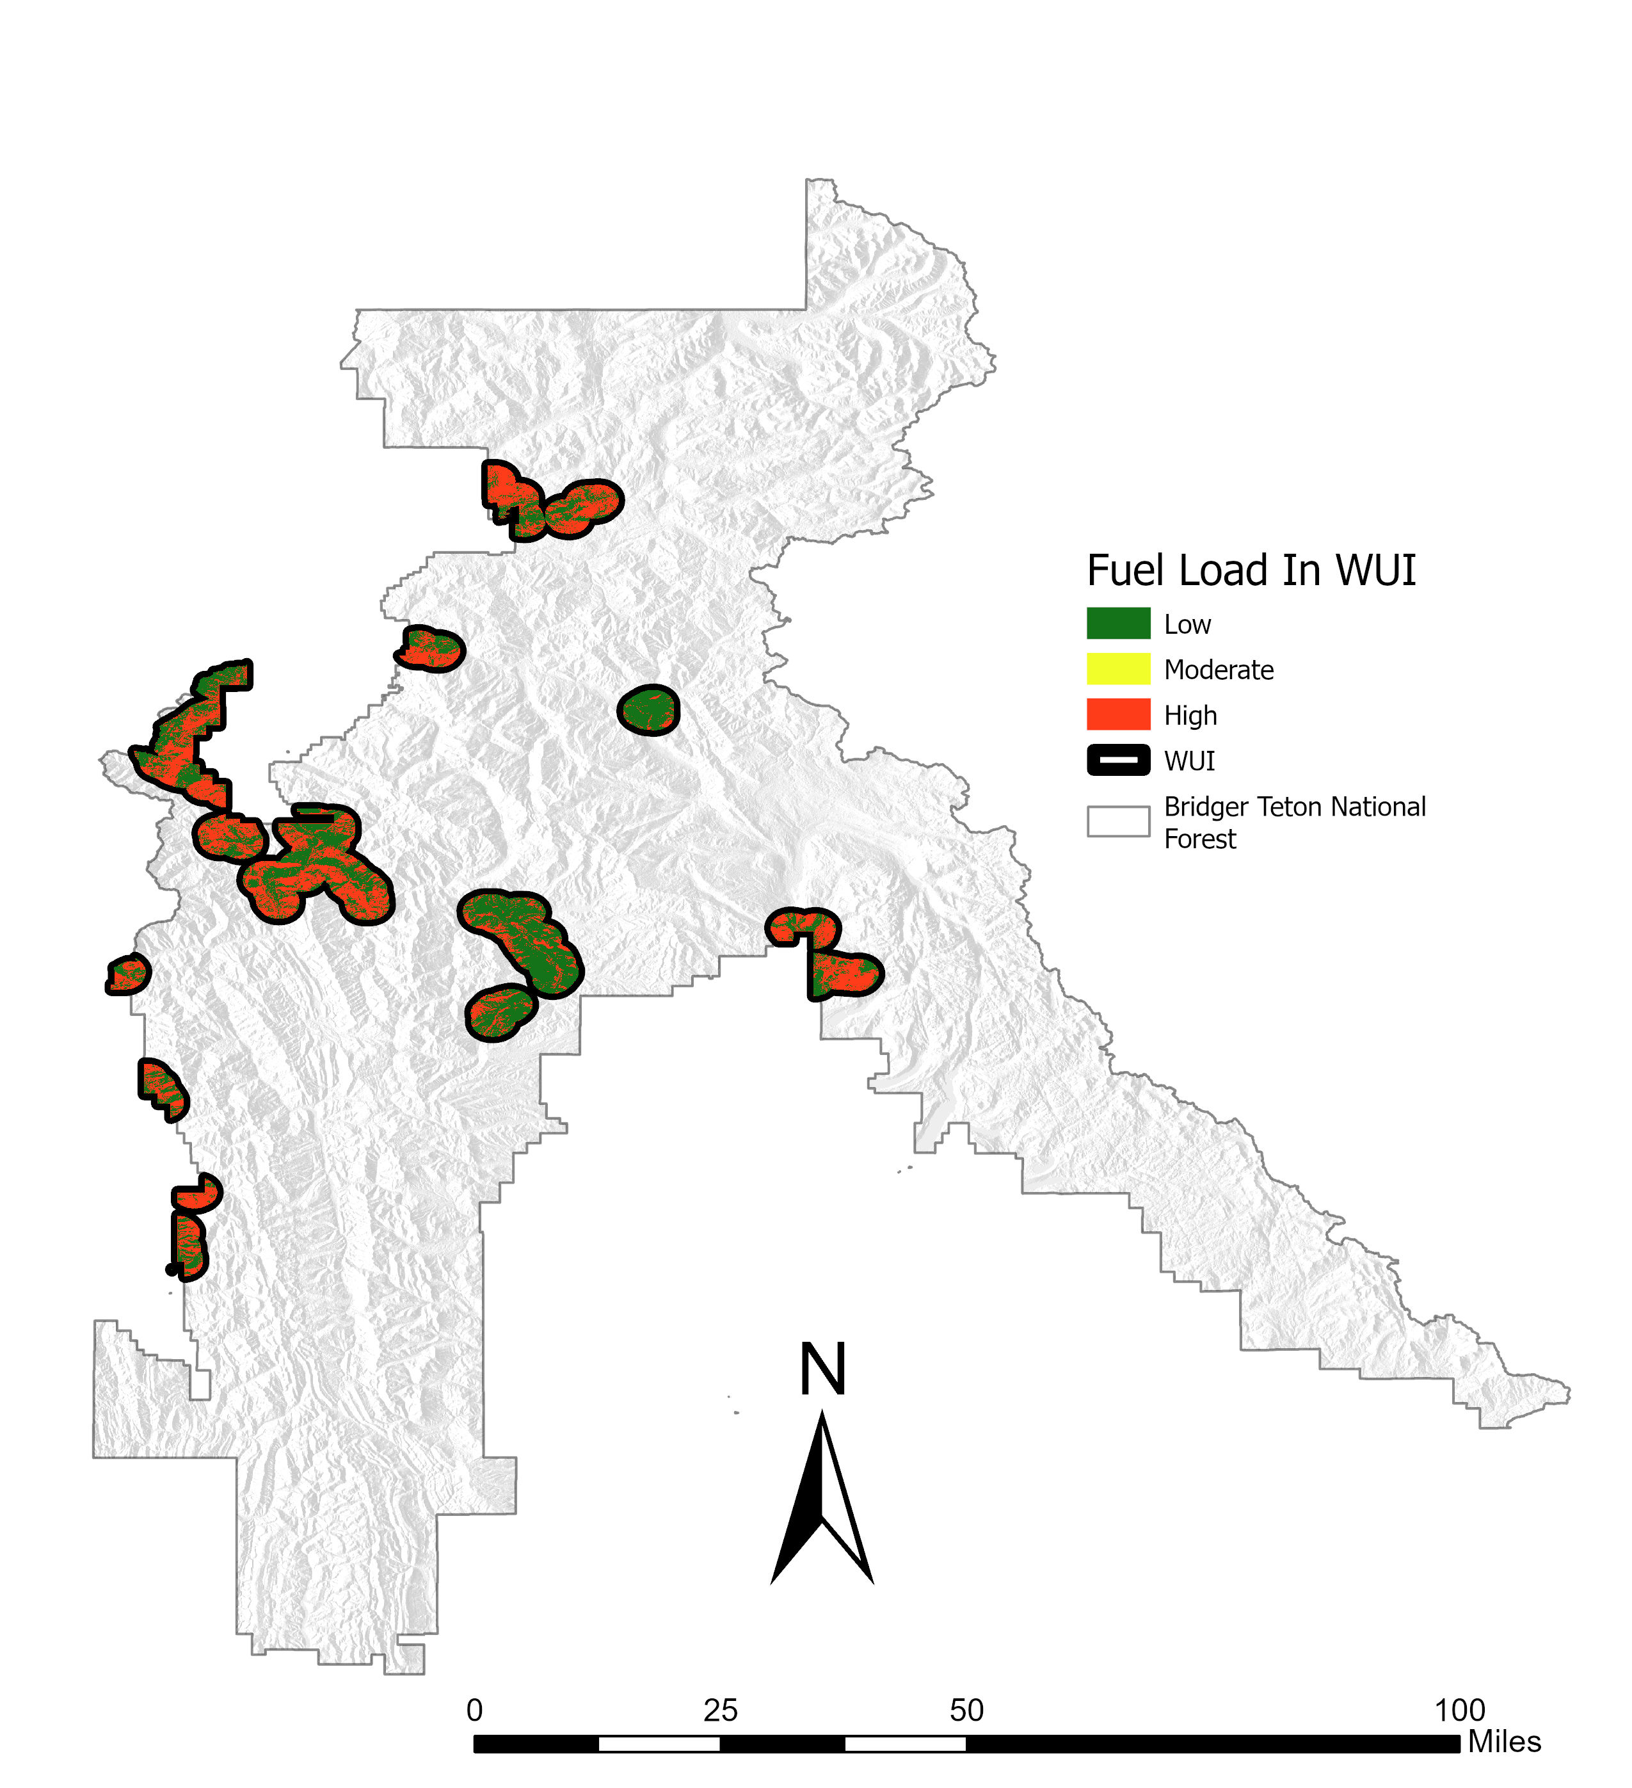
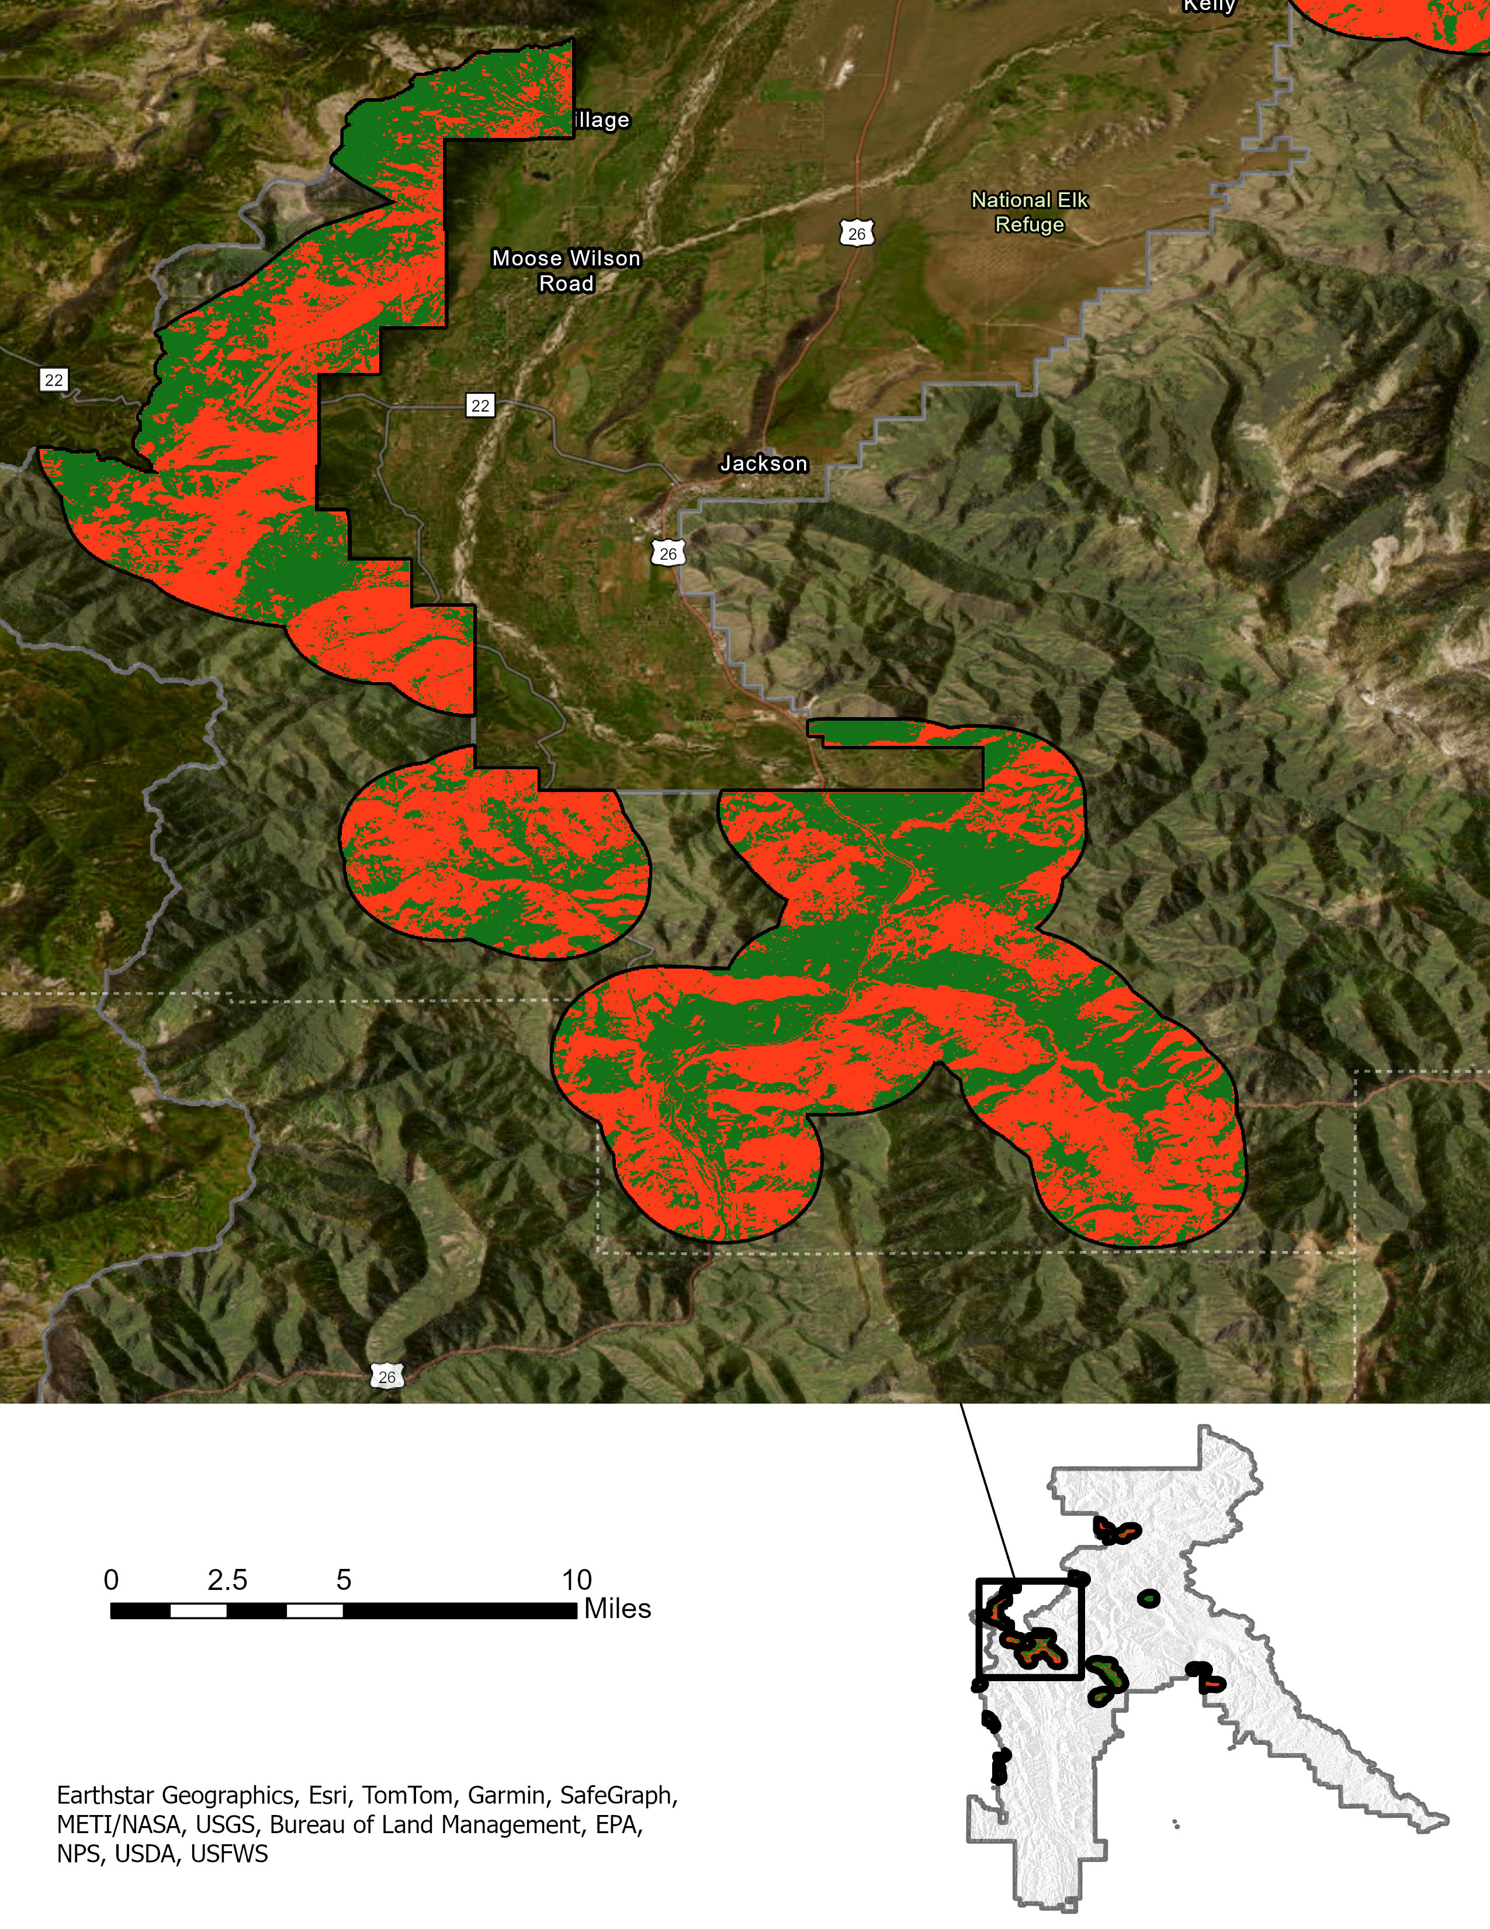
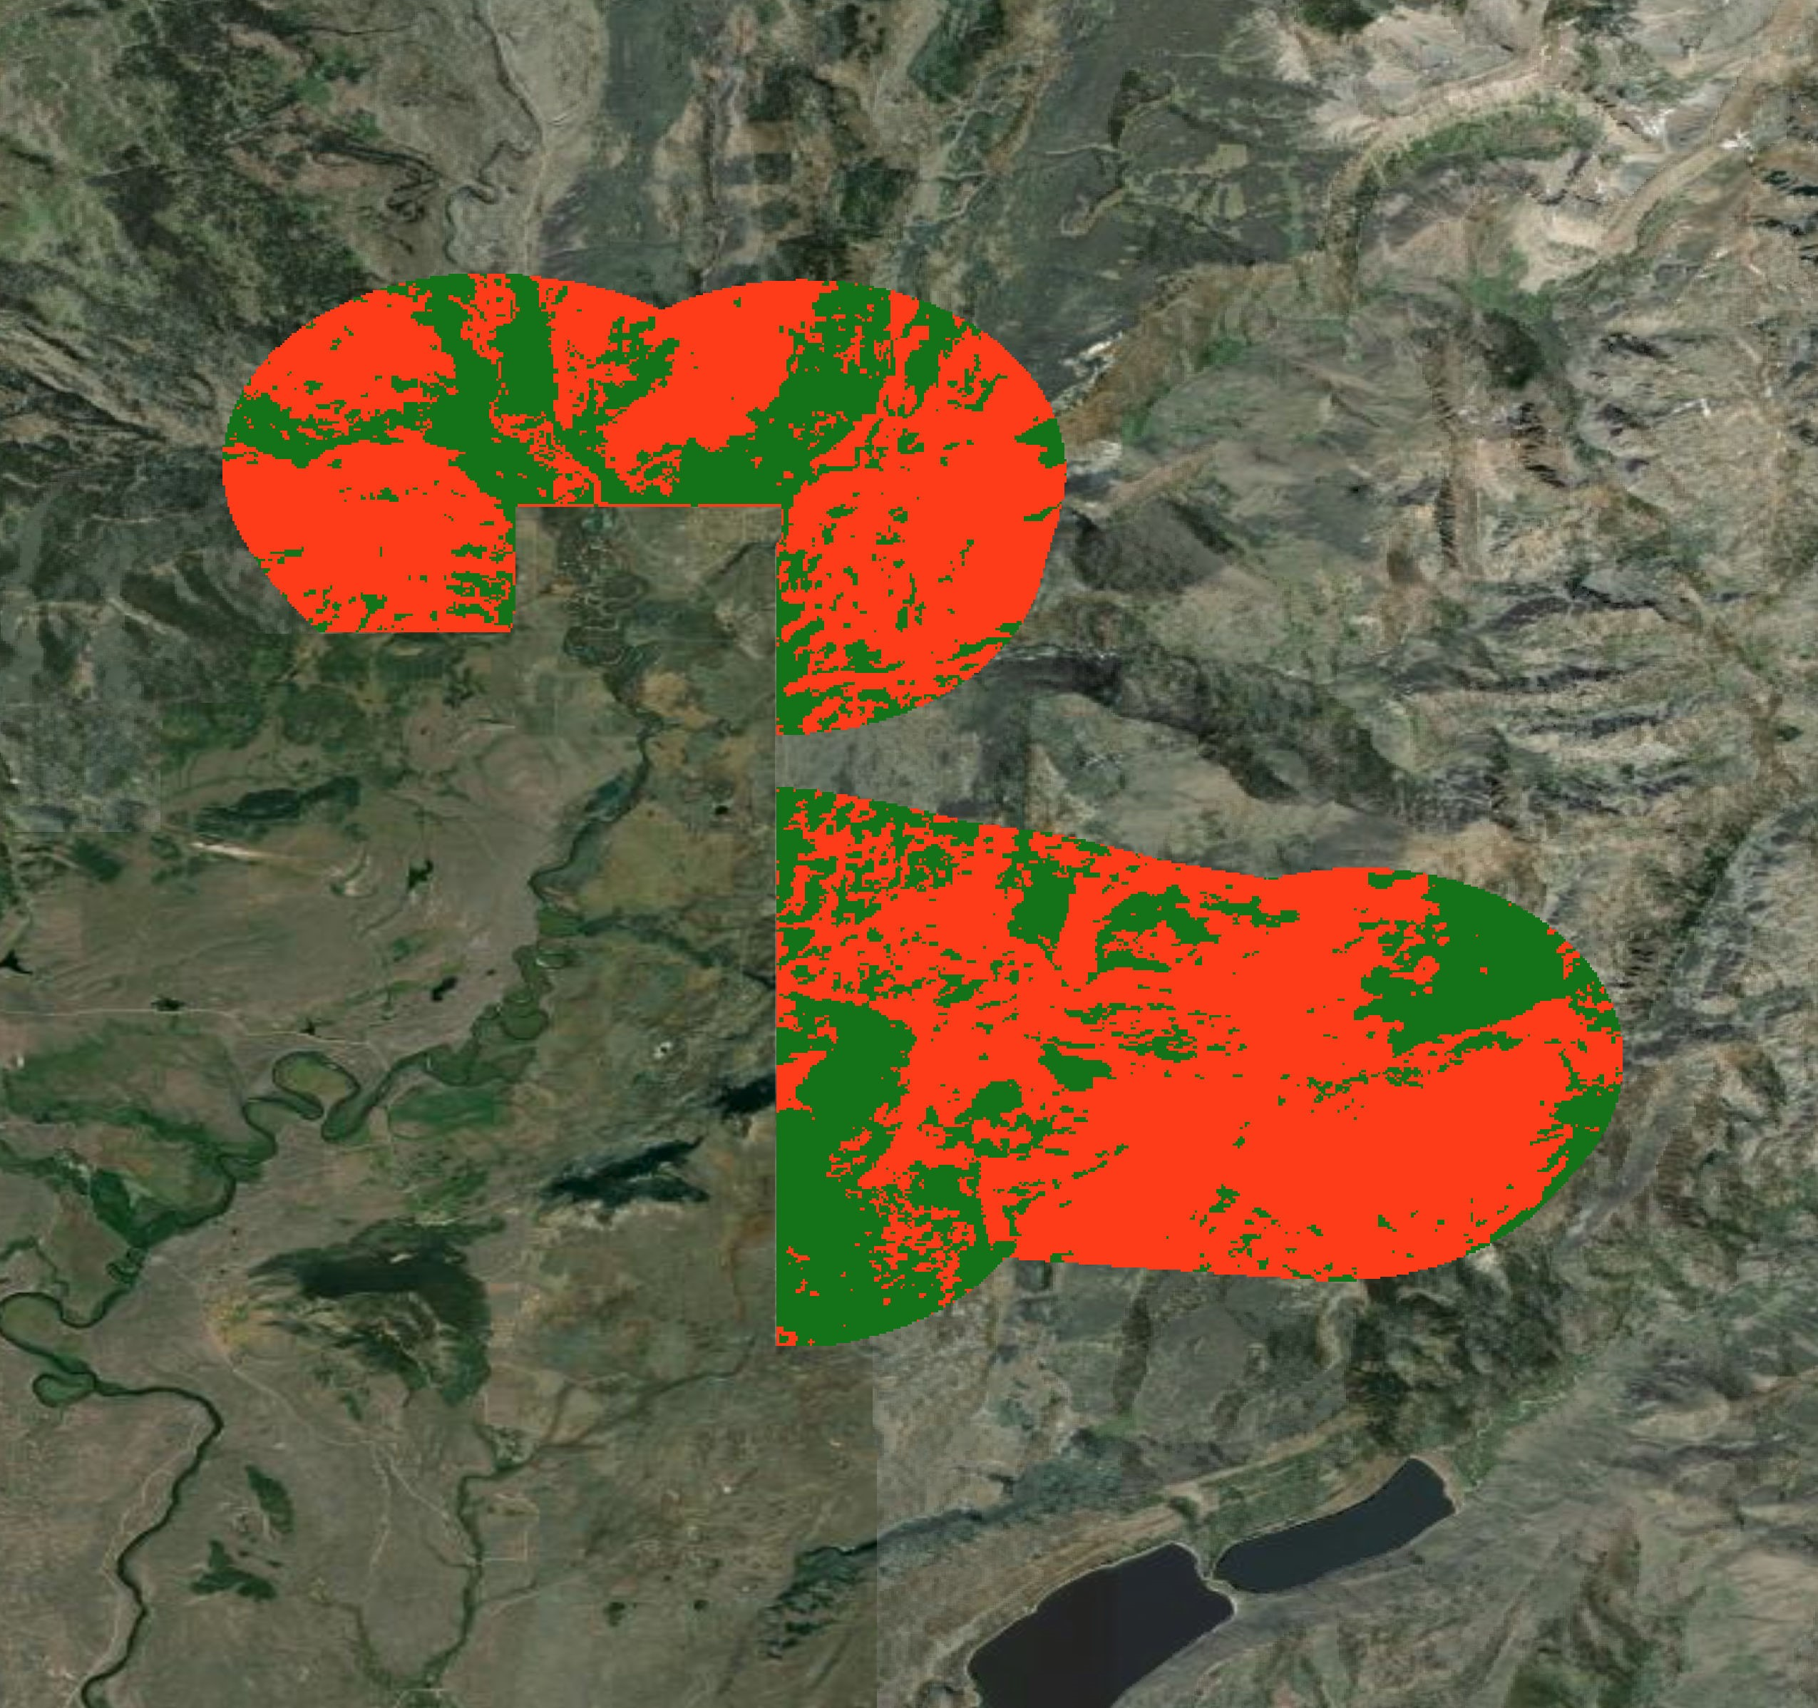
RESULTS: FUEL IN WILDLAND URBAN INTERFACE (WUI)
Moose Wilson
Rd
Predicted Fuel Load
Moran
Low Fuel Load
Moderate Fuel Load
High Fuel Load
WUI
Jackson
New Fork Lakes
0 25 50 75 100 miles
N
0 25 50 75 100 miles
Fuel Load | Low | Medium | High
Acres in WUI | 95,302 (50%) | <1 (<1%) | 95,413 (50%)
Notes:
Speaker:
These are the results from the final fuel load maps in relation to the Wildland Urban Interface (WUI). More specifically where the fuel loads maps and WUI layers overlap near the Jackson area. These areas in red are particularly important due to the close proximity to the communities that surround the Jackson area. The maps do indicate that there is a decent amount of high fuel load areas surrounding the Jackson area. These areas could potentially be of high priority for pre-fire management practices to avoid damage to the communities.
------------------------------Image Information Below ------------------------------
•Image Credit: PUP WY- Mark Cervantes

Slide 15
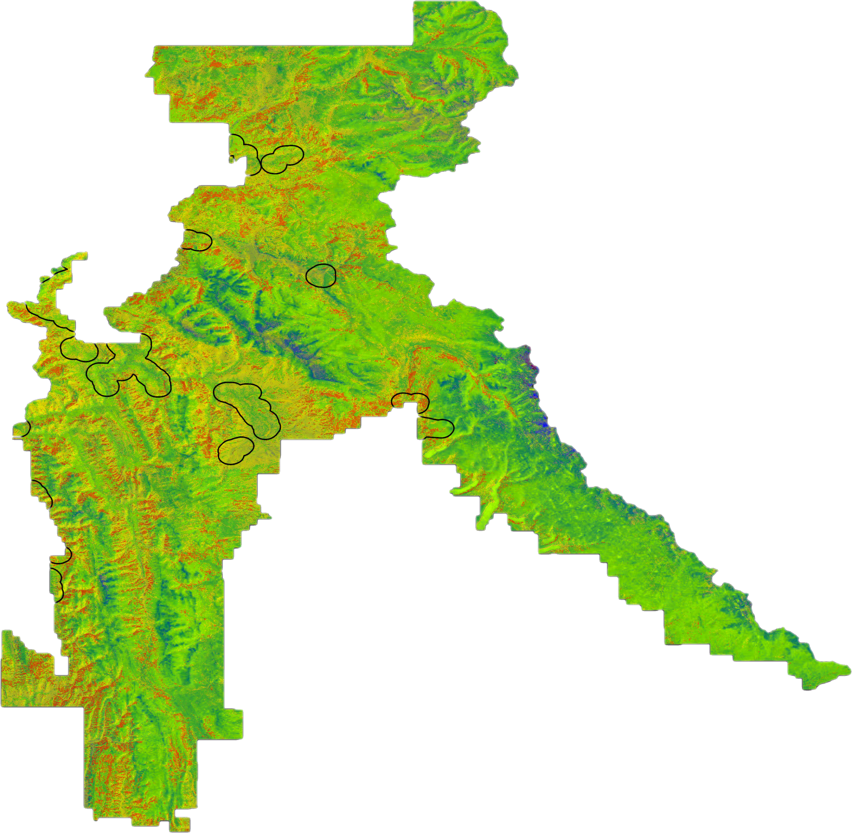
RESULTS: BURN SEVERITY IN BTNF
Burn Severity Categories | Burned Severity Values
 | Enhanced Regrowth | Unburned | Low Severity | Medium Severity | High Severity
Enhanced Regrowth | 0 | 0 | 0 | 0 | 0
Unburned | 1 | 34 | 15 | 14 | 2
Low Severity | 2 | 28 | 42 | 6 | 0
Medium Severity | 0 | 11 | 15 | 37 | 3
High Severity | 0 | 0 | 0 | 0 | 0
Predicted Burn Severity
Enhanced Regrowth
Unburned
Low Severity
Moderate Severity
High Severity
Ridgetop Feature
WUI
Burn Severity Category | Acres & % of Area
Enhanced Regrowth | 3,809 (<1%)
Unburned | 1,725,411 (50%)
Low Severity | 947,994 (27%)
Medium Severity | 767,912 (22%)
High Severity | 21,411 (1%)
Most important predictor variables:
Elevation
Aspect
Brightness
N
0 25 50 75 100 miles
Notes:
Speaker:
This slide shows a predicted final burn severity map that was produced from the random forest model. The most important predictor variables for the burn severity random forest model consisted of Elevation, aspect, and brightness. The map indicates Dark Green as Enhanced Regrowth, Light Green as Unburned, Yellow as Low Severity, Orange as Moderate Severity, Red as high severity, and lastly blue as ridgetop features on the terrain (rocks with little to no vegetation).
Across the entire Bridger-Teton National Forest, approximately 50% of the vegetation was categorized as unburned (including ridgetop features), while 27% of vegetation was classified as low severity burned, 22% of vegetation as medium severity burned, and 1 % as high severity burned. Less than 1% of vegetation in BTNF was categorized as enhanced regrowth.
------------------------------Image Information Below ------------------------------
•Image Credit: PUP WY- Britt Hays

Slide 16
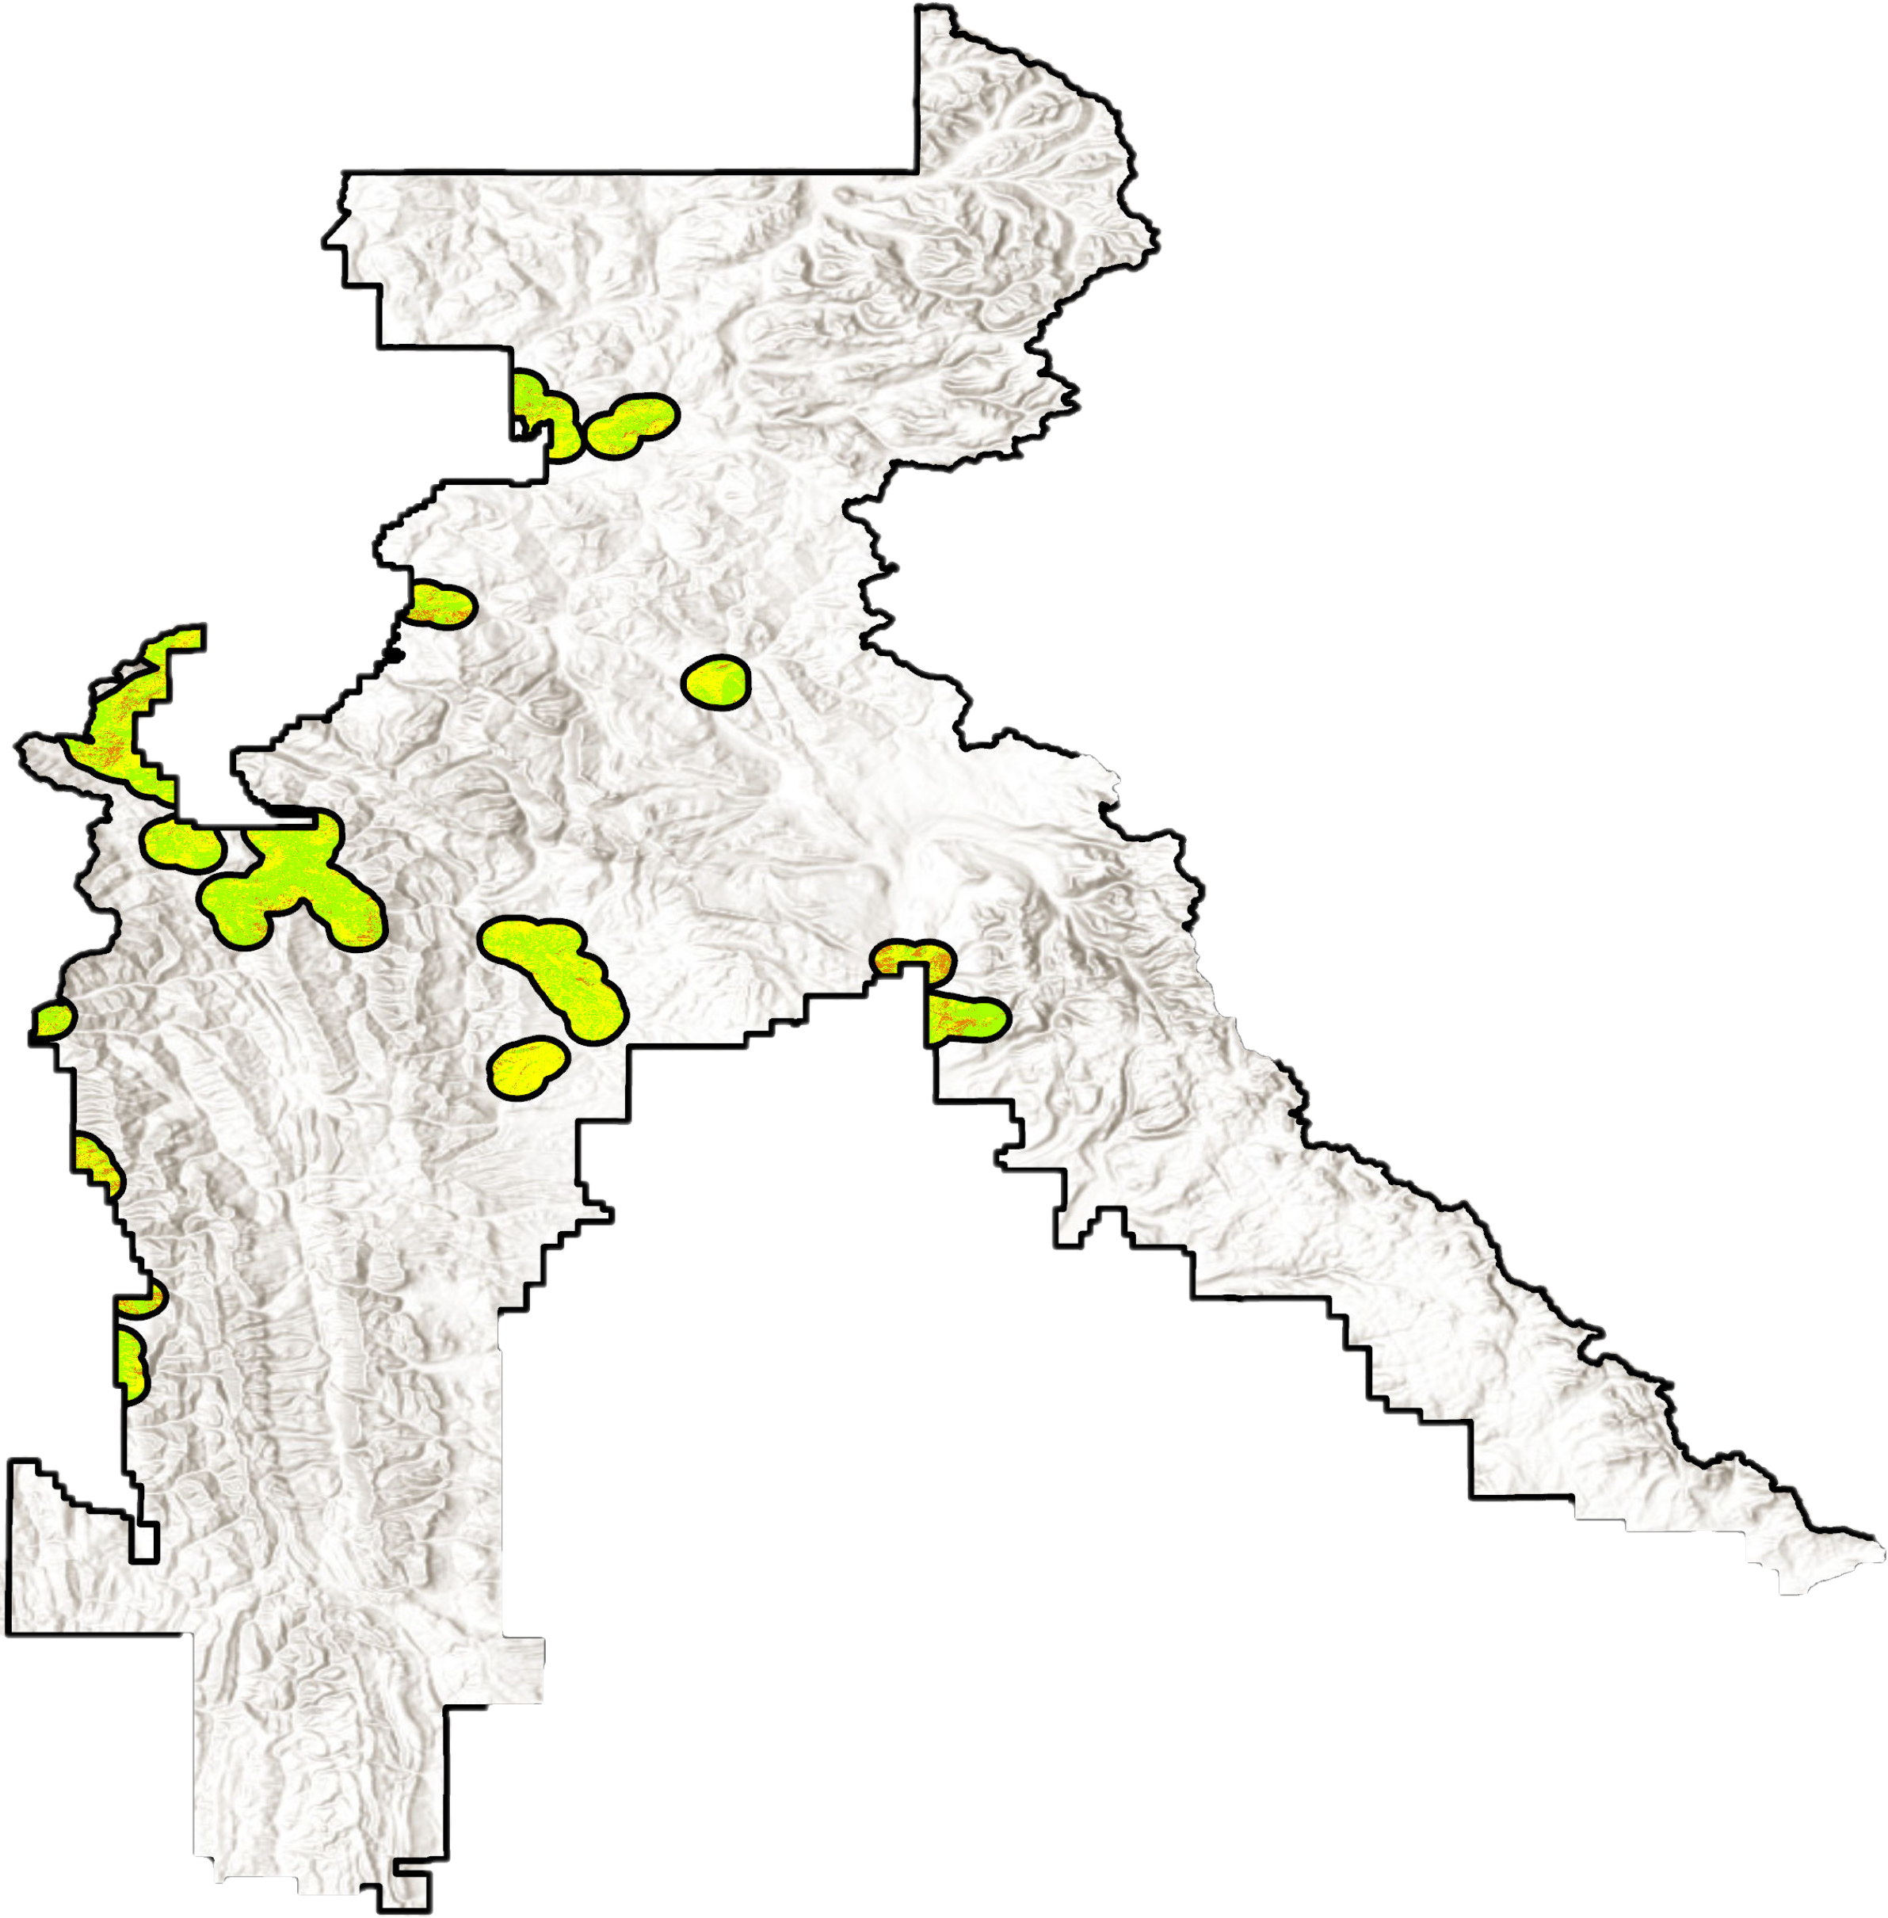
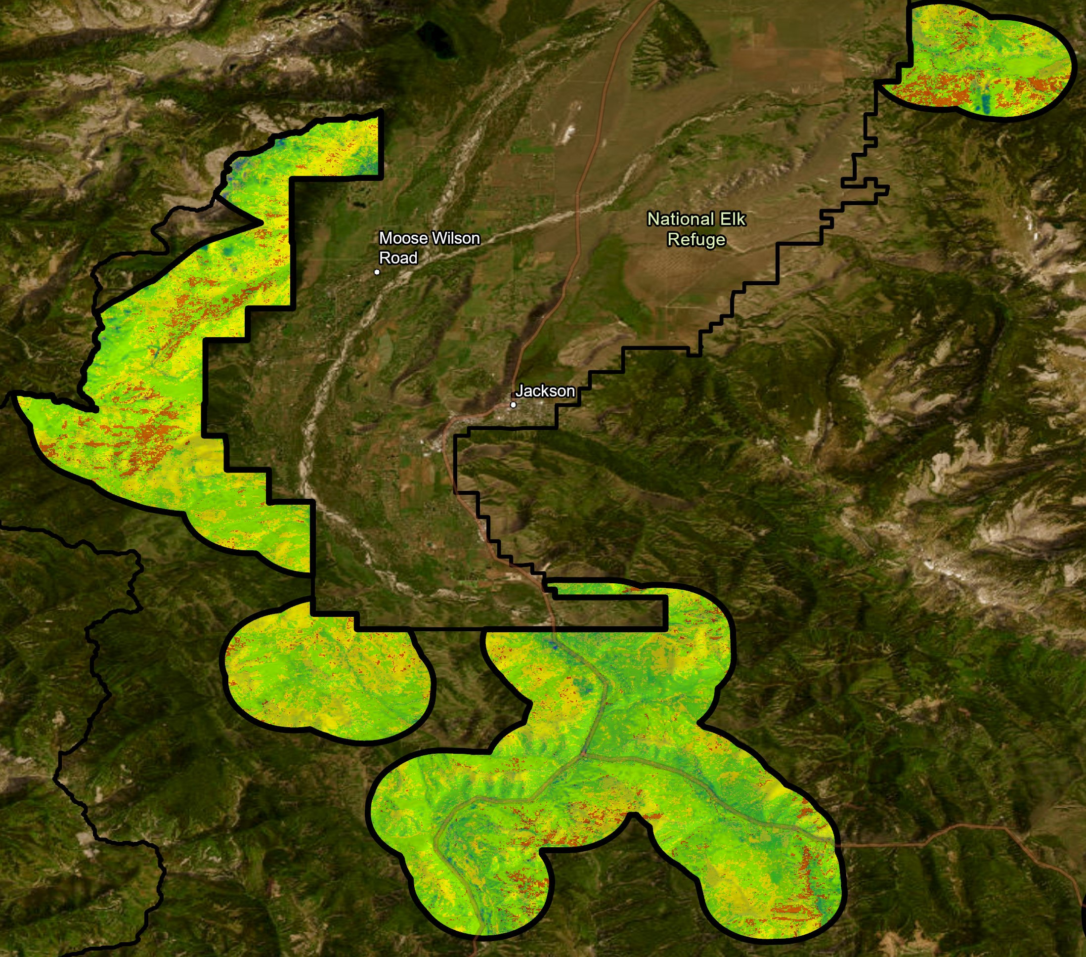
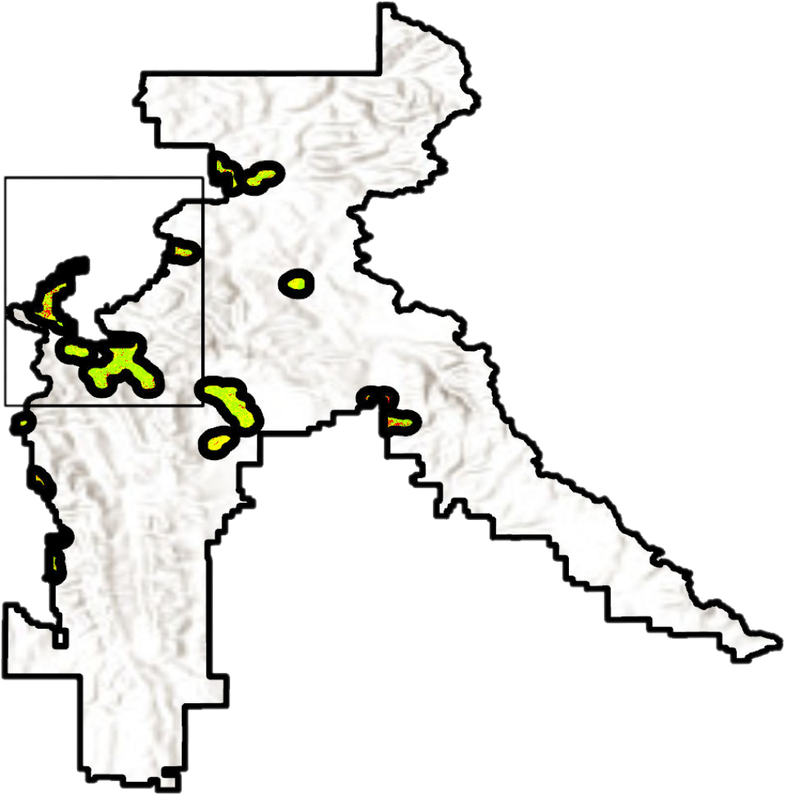
RESULTS: BURN SEVERITY IN WUI
Kelly
Moran
Moose Wilson
Rd
National Elk Refuge
Burn Severity Category | Acres in WUI & % of Area
Enhanced Regrowth | 23 (<1%)
Unburned | 26,823 (14%)
Low Severity | 103,163 (54%)
Medium Severity | 59,695 (31%)
High Severity | 1,014 (1%)
Jackson
Predicted Burn Severity
Enhanced Regrowth
Unburned
Low Severity
Moderate Severity
High Severity
Ridgetop Feature
WUI
0 2.5 5.0 7.5 10 miles
N
New Fork Lakes
0 1.25 2.5 2.75 3 miles
0 25 50 75 100 miles
N
Notes:
Speaker:
These are the results from the final burn severity maps in relation to the WUI areas. More specifically where the fuel loads maps and WUI layers overlap near the Jackson(center left), Moran (top left), and New Forks Lake (bottom right) areas. The areas in orange are of moderate severity which is important due to the close proximity to the communities that surround these urban and recreation area. The maps do indicate that there is some moderate burn severity areas surrounding the Jackson, Kelly, Moran, and New Forks Lake Trailhead areas. These areas could potentially be of high priority for pre-fire management practices to avoid damage to communities, structure, and natural resources.
------------------------------Image Information Below ------------------------------
•Image Credit: PUP WY- Britt Hays

Slide 17
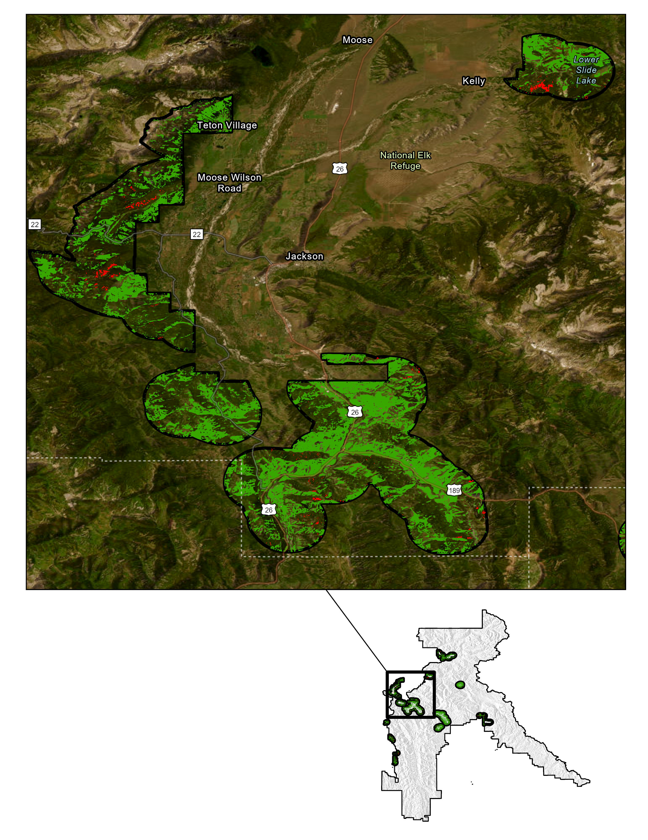
RESULTS: FUEL & BURN SEVERITY IN WUI
Kelly
Moose Wilson
Rd
National Elk Refuge
Fuel & Burn Severity Category | Acres & % of WUI
Low Fuel & Low Burn | 7,4376 (39%)
Medium Fuel & Medium Burn | <1 (<1%)
High Fuel & High Burn | 998 (1%)
Jackson
Overall, have minimal areas of both high fuel loads and potential for high severity fires
Prioritize fuel reduction in areas near Jackson, Kelly, Moran, New Forks Lake, and Star Valley
0 2.5 5.0 7.5 10 miles
N
Fuel & Burn Severity In WUI
Low
Medium
High
WUI
Notes:
Speaker:
After intersecting the predicted fuel and predicted burn severity layers, we assessed the amount of areas that had both categories of low, medium, and high for fuel load and burn severity within the Wildland Urban Interface (WUI). Overall, we found that there were very few areas (998) within the WUI across the entire Bridger-Teton National Forest had both high fuel load and potential for high severity areas. Because of our limited sampling of medium fuel loads, our predicted layer for medium fuel load and medium severity fires was virtually nonexistent. Finally, 39% of the WUI that falls within the BTNF had a combination of both low fuel and low burn severity. Note that the reason the percentages in the table don't add up to 100% is because other fuel load and burn severity combinations (such as unburned fuel load and low fire severity) were excluded. The low, medium, and high combinations were only presented since these combinations are of management concern.
When looking at WUI areas, the most commonly populated areas that have patches of high fuel load and potential for high severity fires are near the towns of Jackson, Kelly, Moran, New Forks Lake, and Star Valley. Based on management options, we recommend prioritizing these areas for fuel reduction.
------------------------------Image Information Below ------------------------------
•Image Credit: PUP WY- Teo Rautu

Slide 18
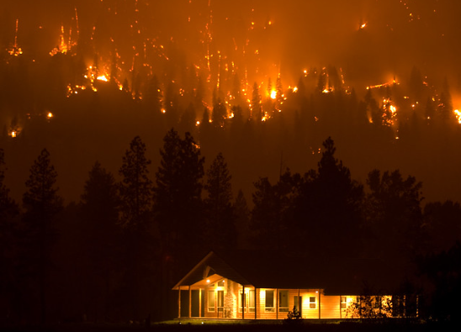
CONCLUSIONS
Fuel maps and burn maps provide valuable information in identifying areas with high fuel loading and high severity fires
Areas that overlap with the Wildland Urban Interface (WUI) are prioritized for fuel reduction
Areas outside the WUI are recommended for less pressing management activities (e.g. timber harvest)
Image Credit: Kari Greer, US Forest Service
Image Credit: Bernardo62
Notes:
[Speaker]:
Our results from the random forest model selection show that elevation, NDVI, brightness, wetness, and greenness predictor variables were the most important for predicting high fuel loading areas, and elevation, aspect, and brightness variables were the most important for predicting high fire severity areas per Random forest machine learning models. Based on our deliverables (fuel maps and burn maps), the following areas (near Jackson, Kelly, Moran, Star Valley Ranch, and New Forks Lake) within the Bridger-Teton National Forest should be prioritized for thinning as they overlap with the Wildland Urban Interfaces and are most prone to fire damage within communities. If additional resources are available, we also recommend areas outside and surrounding the WUIs (such as surrounding Jackson, Moran, East of Afton, and North of Kemmerer) for forest management (e.g. timber harvest) as they are on the trajectory of becoming a high-fuel loading area and could fall within the WUI in the future.
------------------------------Image Information Below ------------------------------
•Image Credit: US Forest Service
•Image Source: Trinity Ridge Fire, Pine and Featherville, Idaho, Boise National Forest, August, 2012. (Forest Service photo by Kari Greer) ( Public Domain)
Primary Image Source: https://www.flickr.com/photos/usforestservice/42885999045

Slide 19
ERRORS & UNCERTAINTITIES
Data sets binned vegetation cover classifications a priori, losing continuous data metrics
Space-borne observations may underestimate understory and surface level fuels
GEDI:
Predicted Above Ground Biomass Density (mg/ha)
GEDI:
Predicted Above Ground Biomass Density (mg/ha)
GEDI:
Predicted Above Ground Biomass Density (mg/ha)
Notes:
[Speaker]:
It is difficult to classify fine fuels and surface fuels using top of atmosphere sensors like Landsat 8 OLI/TOA. While there is sufficient coverage of canopy metrics, we anticipate an underprediction of surface fuels and the impacts of surface fuels in our models and thus burn severity and fuel load maps. It is important to note that via Radeloff et al., (2023) while wildland fires in forested systems are more intense and create more damage to homes in wildland-urban interfaces that on average there are more shrubland and grass fires in WUI areas.
Additionally, the VCMQ vegetation land cover data set binned variables such as tree cover (%), shrub cover (%) a prior such as we could not treat these variables as continuous metrics.
Lastly, we noticed discrepancies in classification of vegetation cover across Earth Observation products. While we planned to use National Land Cover Vegetation (NLCD) data that was collected more recently (eg., 2019, 2020, 2021).
------------------------------Image Information Below ------------------------------
Image Credits: Icons: Microsoft Office

Slide 20
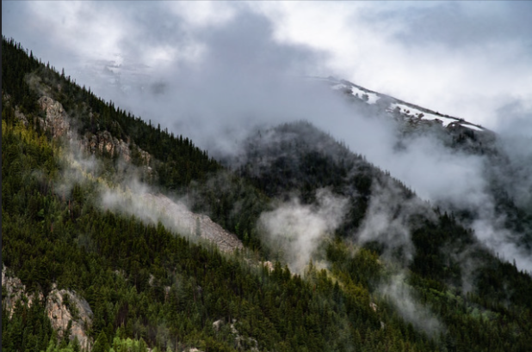
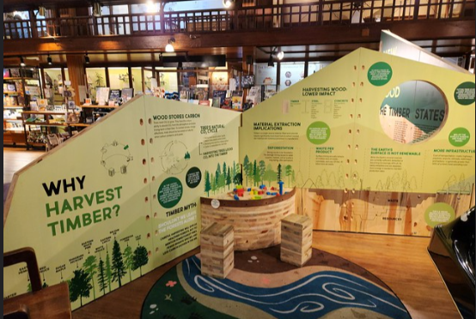
FEASIBILITY ASSESSMENT
Global Ecosystem Dynamics Investigation (GEDI) was not a feasible tool during the fire season 2017-2018, which the partner is interested in. GEDI was launched in December 2018.
Image Credit: Lance Cheung, USDA
Fuel and burn maps used decade-old data and thus hold less predictive power.
The latest inventory of vegetation data occurred in 2014 for our study area
While other products are available, they are purportedly less accurate
Image Credit: Korey Morgan, US Forest Service
GEDI:
Predicted Above Ground Biomass Density (mg/ha)
GEDI:
Predicted Above Ground Biomass Density (mg/ha)
GEDI:
Predicted Above Ground Biomass Density (mg/ha)
Notes:
[Speaker]:
Feasibility to utilize GEDI (Global Ecosystem Dynamics Investigation) at this time was limited for the scope of this study. AS GEDI launched at the end of our parameterization of pre-fire and during fire classifications, it was not appropriate to utilize GEDI. Additionally, when temporal data ranges were used to filter GEDI data coverage of the study area was decreased by over 50% and had several gaps of missing coverage making it difficult to utilize.
In relation to the fuel and burn severity maps, it is anticipated (as analyzation is currently underway) that outdated vegetation data will misclassify current condition fuel loads and fire severity.
------------------------------Image Information Below ------------------------------
Image Source Left: ….Cross-Laminated Timber is resistant to fire, earthquakes, and other disturbances, and has the potential to store vast amounts of carbon for many decades. The technology is an exciting new frontier in the forest products economy. This particular cross-laminated timber is was made from eastern hemlock, an underutilized species of softwood. (USDA Forest Service photo by Korey Morgan) (Public Domain)
Image Credit Left: https://www.flickr.com/photos/usforestservice/53215375428
Image Source Right: Pine trees and mountain clouds in the U.S. Department of Agriculture (USDA) Forest Service (FS) Arapaho and Roosevelt National Forests, in Empire, CO, on June 19, 2020. (USDA Photo by Lance Cheung) (Public Domain)
Image Credits: https://www.flickr.com/photos/usforestservice/50035128552/

Slide 21
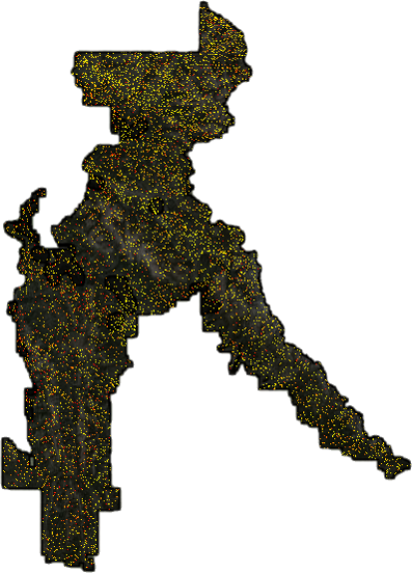
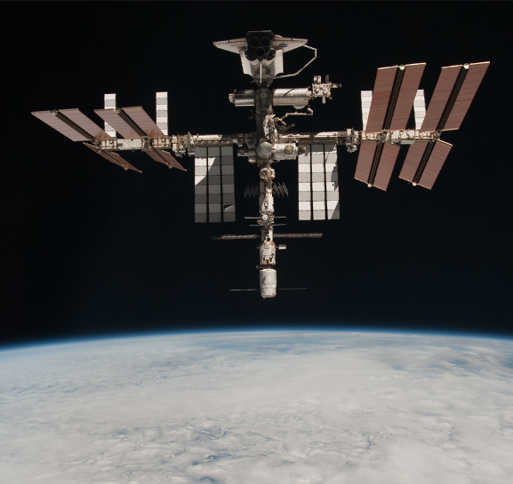
FUTURE PARTNER RECOMMENDATIONS
GEDI:
Predicted Above Ground Biomass Density (mg/ha)
GEDI provides fine resolution and would be a great tool for future fuel load management considerations
GEDI can extract canopy cover, terrain elevation, and relative tree height metrics for greater investigation from fine to large fuel loads
Future studies can use vegetation indices from GEDI and LandSat together to create high power models
0
841
Image Credit: NASA Johnson
GEDI:
Predicted Above Ground Biomass Density (mg/ha)
GEDI:
Predicted Above Ground Biomass Density (mg/ha)
GEDI:
Predicted Above Ground Biomass Density (mg/ha)
Notes:
[Speaker]:
Before creating our random forest models, we still need to acquire field data from our partner on fuel and fire severity for the Bridger-Teton National Forest. After getting this data, we can then start building our random forest models. Extracting canopy cover from GEDI and integrating it with the different vegetation indices from Landsat data are the next steps we need to complete before doing random forest model selection. After acquiring all of our data and running our analyses, we can assess which areas have the highest fuel loading and potential for high fire severity areas. Using the Wildland Urban Interface (WUI) as a buffer, we can then see where the high fire risk areas overlap with the WUI and recommend that those areas be prioritized for fuel reduction.
------------------------------Image Information Below ------------------------------
• ISS Image Credit: NASA Johnson
https://www.flickr.com/photos/nasa2explore/9471978391/in/album-72157627325426179/; CC BY-NC 2.0
Image Credit: PUP-WY
Image Sources (Icons): Microsoft Office

Slide 22
Partner
Jed Gregory (USFS Region 4 Remote Sensing Manager)
Science Advisors
Di Yang (University of Wyoming)
Austin Madson (University of Wyoming)
NASA DEVELOP
Truman Anarella (Colorado Lead)
Marisa Smedsrud (Project Coordination Fellow)
Dr. Kenton Ross (Program Manager)
Dr. Xia Cai (Program Scientist)
Notes:
[Speaker]:
We would like to take a moment to thank all who made this project proposal including our partner, researcher, science advisors, and our NASA DEVELOP Lead and Fellow.
Thank you so much for taking the time to listen to our project today. We now open up to any questions that you may have.

