Slide 1
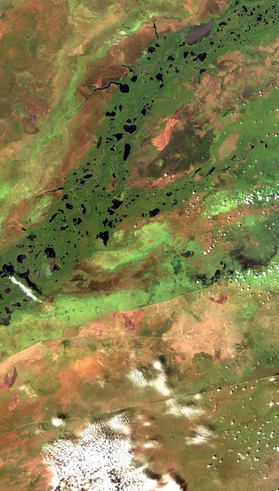
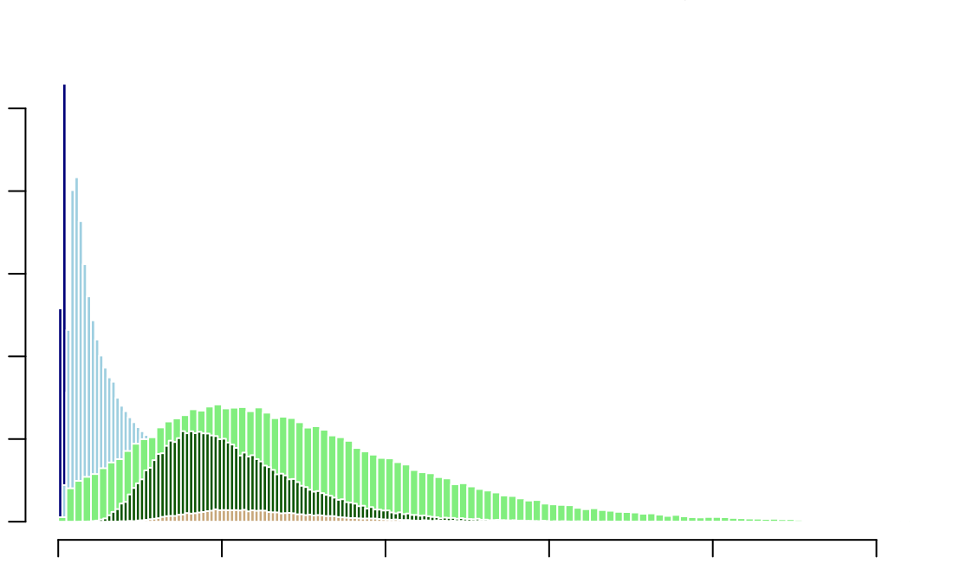
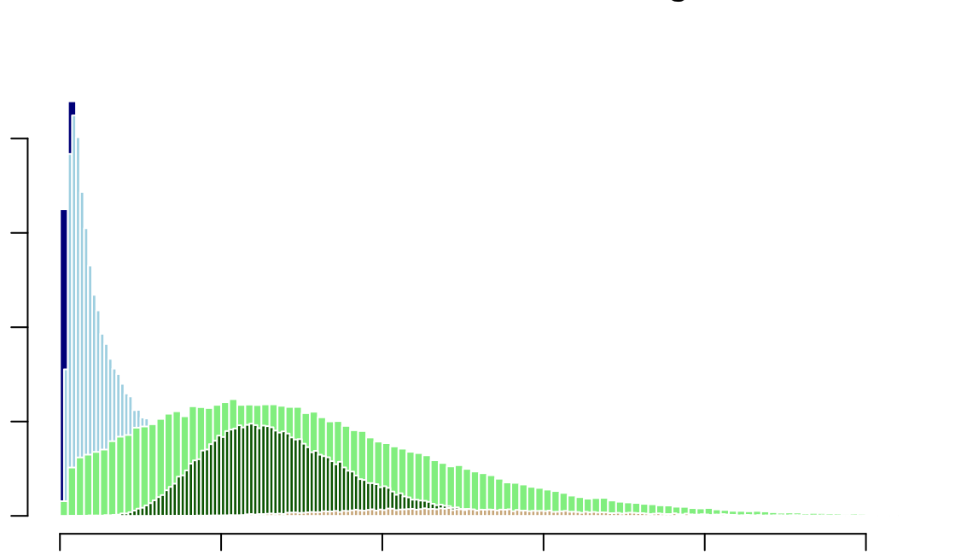
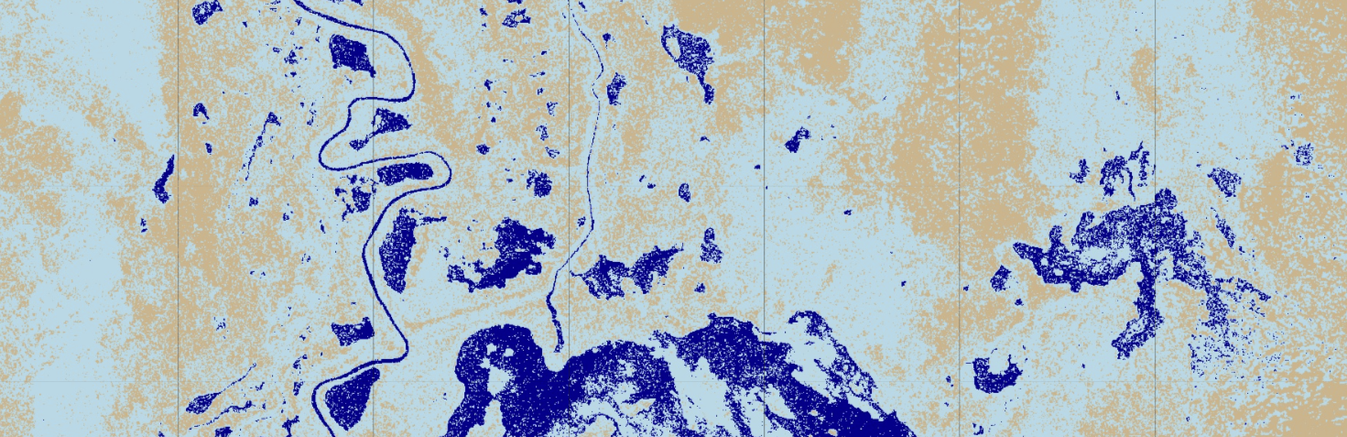
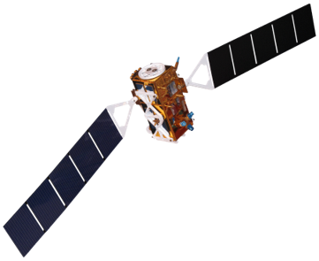
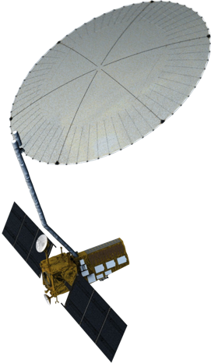
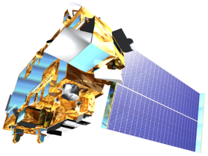
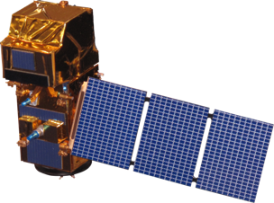
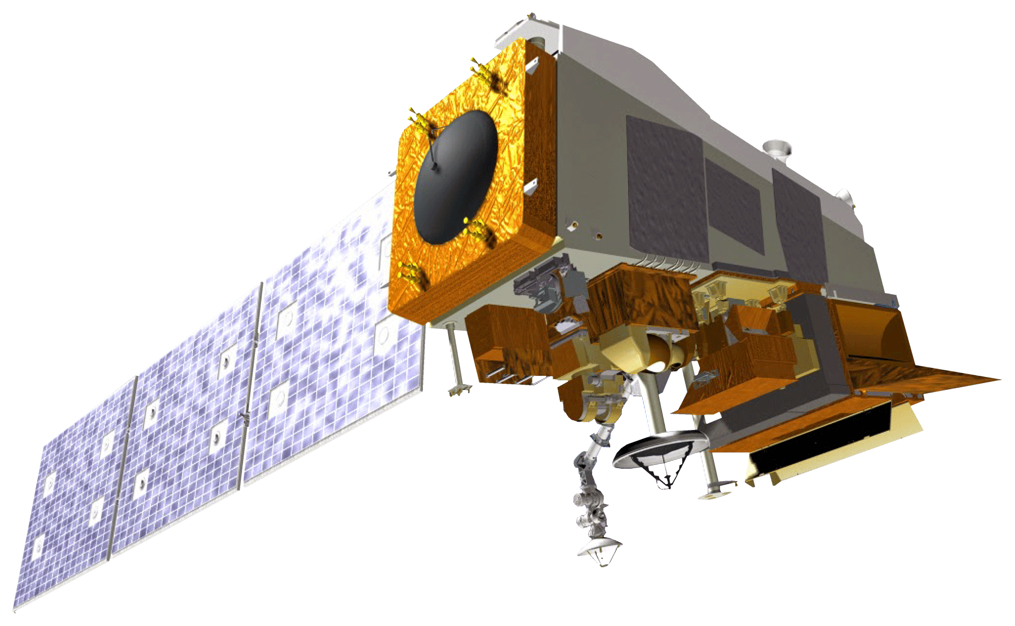
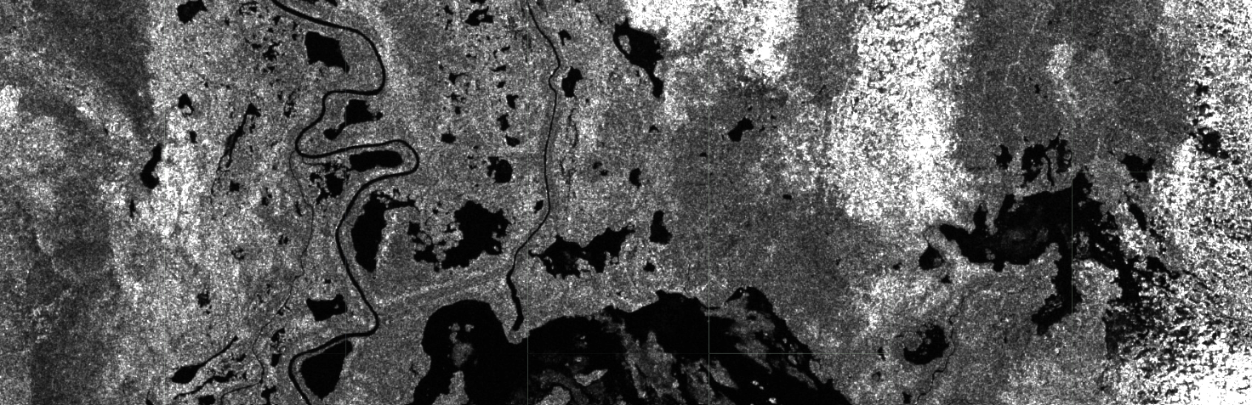





WET Water Resources
A Google Earth Engine Python API Tool to Automate Wetland Extent Mapping Using Radar Satellite Sensors for Wetland Management and Monitoring
Abstract
Study Area
Sudd Wetland, South Sudan
Wetland ecosystems are annually or seasonally wet transition zones between land and water. They provide a range of ecosystem services such as water filtration, flood mitigation, and carbon sequestration, as well as hosting biodiversity hotspots. Although they fulfill fundamental physical and natural processes, wetland extent and health are threatened by anthropogenic influences related to urbanization, population increase, pollution, and climate change. Recognizing the need to quantitatively monitor changes in these recently threatened ecosystems in a timely and cost-effective way, we developed a Google Earth Engine (GEE) Python API tool for automated wetland extent mapping using optical and radar satellite sensors that can be applied globally. The tool will significantly improve wetland change analysis and monitoring as the optical and SAR data proves high resolution (5-10 m) imagery, and SAR data is unaffected by cloud cover and light availability (day vs. night), which are common limitations for other remotely sensed sensors. The tool utilizes Copernicus Sentinel-1 C-band and NISAR L-band synthetic aperture radar (SAR) imagery. During image preprocessing, we applied a MODIS snow mask product to mask global snow coverage, which would affect land classification sensitivity. Calibration and validation were conducted through a historical change and sensitivity analysis of the Sudd watershed located in central Sudan. The tool was the first of its kind, as it enables NISAR data processing through an open-source GEE repository, further expanding and improving the utility of NASA Earth observations and contributing to NASA Open Science initiatives. We anticipate the tool will be used by researchers and practitioners interested in wetland monitoring and management..
White Nile River
South Sudan
Sudd Wetland
Satellite image of the Sudd Wetland in October 2018
0
100
200 km
Objectives
Test the precision and accuracy of our tool against Downs et al. 2023, a wetlands classification study conducted across South Sudan.
Understand a regionally important freshwater environment
Develop a tool to quantify wetland extent on a global scale using Google Earth Engine in the Python API
Create user-friendly interface for visualizing and analyzing wetland extent
Improve remote sensing applications for water resources using optical and SAR sensors
Establish a methodology that can easily integrate NISAR products upon launch
Results
We obtained thresholding values for land classification by drawing training polygons based on known land cover from the Dynamic World land cover product and plotting histograms of each land cover type. Backscatter threshold values selected by histogram analysis are approximately an order of magnitude difference for VV and VH bands.
Methodology
VV Pixel Values
VH Pixel Values
INPUT
PROCESSING
ANALYSIS
CLASSIFICATION
OUTPUT
0 2000 6000 10000
open water
0 2000 4000 6000 8000
inundated vegetation
Sentinel-1 C-SAR
filter by date and ROI
calculate mean pixel values
departure from mean
grass
trees
NISAR*
snow mask
inundation thresholds
shrub & scrub
Terra MODIS
classify study area
0 0.2 0.4 0.6 0.8 1.0
0 0.02 0.04 0.06 0.08 0.10
de-speckle
VV threshold values are dark water < 0.01 < inundated vegetation < 0.11 < no water. VH threshold values are dark water < 0.0015 < inundated vegetation < 0.011 < no water. The threshold values were applied to classify wetland inundation extent from Sentinel-1 imagery.
VIIRS data from Downs et al. 2023
calculate VV/VH ratio
accuracy assessment
final classification
October 16, 2021
Classified Image
open water
Earth Observations
inundated vegetation
no water
Sentinel-1 C-SAR​
Sentinel-1 C-SAR VV Image
Backscatter
0
Terra MODIS
Sentinel-2
NISAR (set to launch in 2024)
0.5
Team Members
Suomi-NPP VIIRS
Conclusions
Developed a user-friendly tool for regional wetland inundation assessment
Contributed to a dense time series used for detecting wetlands, a particularly important application during rainy seasons
The WET 3.0 tool will implement and utilize future NISAR data with current Sentinel-1 data
Promoting the use of the Python API will allow users to eventually move off of Google Earth Engine and use other open-source platforms through the use of Python
Lori Berberian
(Project Lead)
Kaely Harris
Mitch Porter
Emma Waugh
Acknowledgements
The team would like to show our gratitude to Bruce Chapman, Ben Holt, and Michael Pazmino at (NASA Jet Propulsion Laboratory) for their contributions to this technology and innovation project. We would also like to recognize the Wetlands Water Resources 2.0 team, and Brandi Downs et al. (2023). This material contains modified Copernicus Sentinel data processed by ESA, Dynamic World V1 data produced by Google in partnership with National Geographic Society and the World Resources Institute, and MODIS Terra data processed by NASA National Snow and Ice Data Center
California – JPL

