Slide 1
Highland Lakes
Water Resources
Using NASA Earth Observations to Improve Early Warning Systems for Harmful Algae Events in the Highland Lakes Chain in Central Texas
Kaitlynn Hietpas, Shuyu Chang, Mark Radwin, Addison Pletcher, & Emma Waugh
Arizona – Tempe
Notes:
Welcome everyone, thank you for joining us today! My name is ____ and I am joined by my teammates____. We are the Highland Lakes Water Resources Team and over the past ten weeks we have been working to utilize NASA's earth observations to improve early warning systems for harmful algae events in the Highland Lakes near Austin, Texas.
For Guest Presenter: Hello All and thanks for coming! This was a project undertaken by NASA DEVELOP's Highland Lakes Water Resources Team who worked to improve early warning systems for harmful algae events in the Highland Lakes near Austin, Texas.

Slide 2
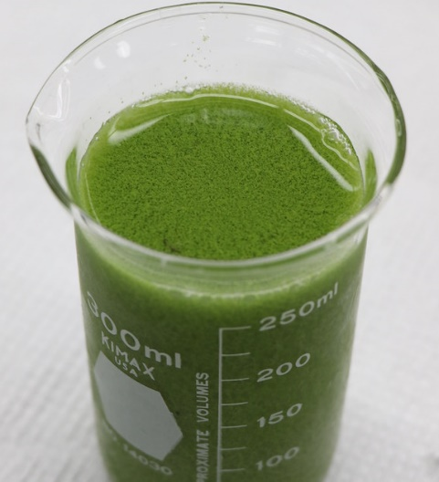
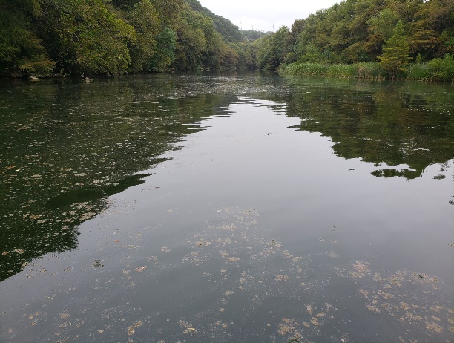
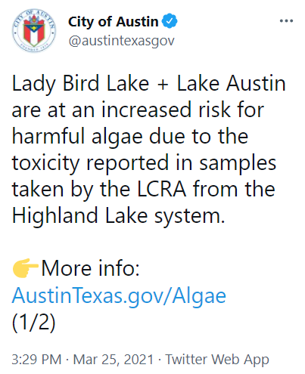
Algae in the News
Source: CoA DWP
Source: NOAA GLERL
Notes:
Algae is a natural part of ecosystems and is not always harmful! But, algae events—or, periods of prolific algae growth—can be detrimental to public health, economies, and ecosystems—and results in many headlines like these. Algae events can deplete dissolved oxygen levels, harming other aquatic life and can force beaches and nearby businesses to close, reducing tourism income, and occasionally producing toxins that are dangerous to recreational users. The Highland Lakes region began experiencing events like these only recently, with the first reports of canine deaths from toxic algae in Lady Bird Lake in 2019 and subsequently Lake Travis in 2021.
----------Image Credits---------
Lake Erie HABS Sept 2017 – NOAA GLERL https://www.flickr.com/photos/43788330@N05/37186276541 (public domain)
City of Austin, Department of Watershed Protection (CoA DWP) Partner Image
---------- News Credits -------------
1. Gates, B., & Ramkissoon, J. (2021, February 26). LCRA: More tests reveal presence of blue-green algae toxins on east side of Hudson Bend at Lake Travis. KXAN Austin. https://www.kxan.com/news/local/lcra-initial-tests-show-lake-travis-water-not-toxic-despite-dogs-death/
2. Falcon, R., & Rahman, T. (2021, February 23). CAUTION: LCRA receives reports of dogs becoming sick after swimming in area of Lake Travis. KXAN Austin. https://www.kxan.com/news/local/caution-lcra-receives-reports-of-dogs-becoming-sick-after-swimming-in-area-of-lake-travis/
3. Vuaghn, M. (2021, March 6). Lady Bird Lake and Lake Austin at Increased Risk for Toxic Algae. Spectrum Local News. https://spectrumlocalnews.com/tx/austin/news/2021/03/26/lady-bird-lake-and-lake-austin-at-increased-risk-for-toxic-algae
4. Moreno-Lozano, L. (2021, March 25). Owners warned to keep dogs away with higher risk for toxic algae in Lady Bird Lake, Lake Austin. Austin American-Statesman. https://www.statesman.com/story/news/2021/03/25/lady-bird-lake-lake-austin-increased-risk-blue-green-algae-water-samples-tested/7002799002/
5. City of Austin Twitter (@austintexasgov). Lady Bird Lake + Lake Austin are at an increased risk for harmful algae due to the toxicity reported in samples taken by the LCRA from the Highland Lake System. https://twitter.com/austintexasgov/status/1375168019840839680

Slide 3
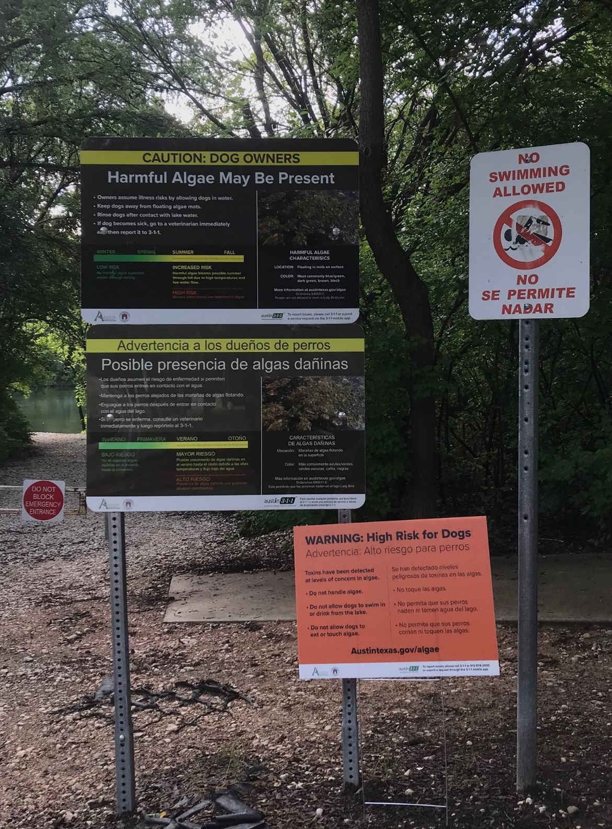
Partners
End users:
City of Austin, Department of Watershed Protection ​
Lower Colorado River Authority ​
Collaborators:
The University of Texas at Austin, Department of Molecular Sciences ​
Austin Water Utility​
Source: Addison Pletcher
Notes:
To aid in the effort of monitoring algae conditions, our Highland Lakes DEVELOP team parterned with the Lower Colorado River Authority and the City of Austin, Department of Watershed Protection as end users. These end users are responsible for managing water quality in the Highland Lakes region and worked with our team to incporporate NASA earth observations into their decision making toolkit. Historically, they have relied on in situ water quality sampling to monitor for algae events, but by utilizing more frequent satellite derived measurements they will be better prepared to recognize when to take mitigating actions against algae conditions.
The University of Texas at Austin, dep. Of Molecular Science, and the Austin Water Utility provided additional support and collaboration for the project.
---------- image credit ----------------
Photo taken by DEVELOP team member Addison Pletcher

Slide 4
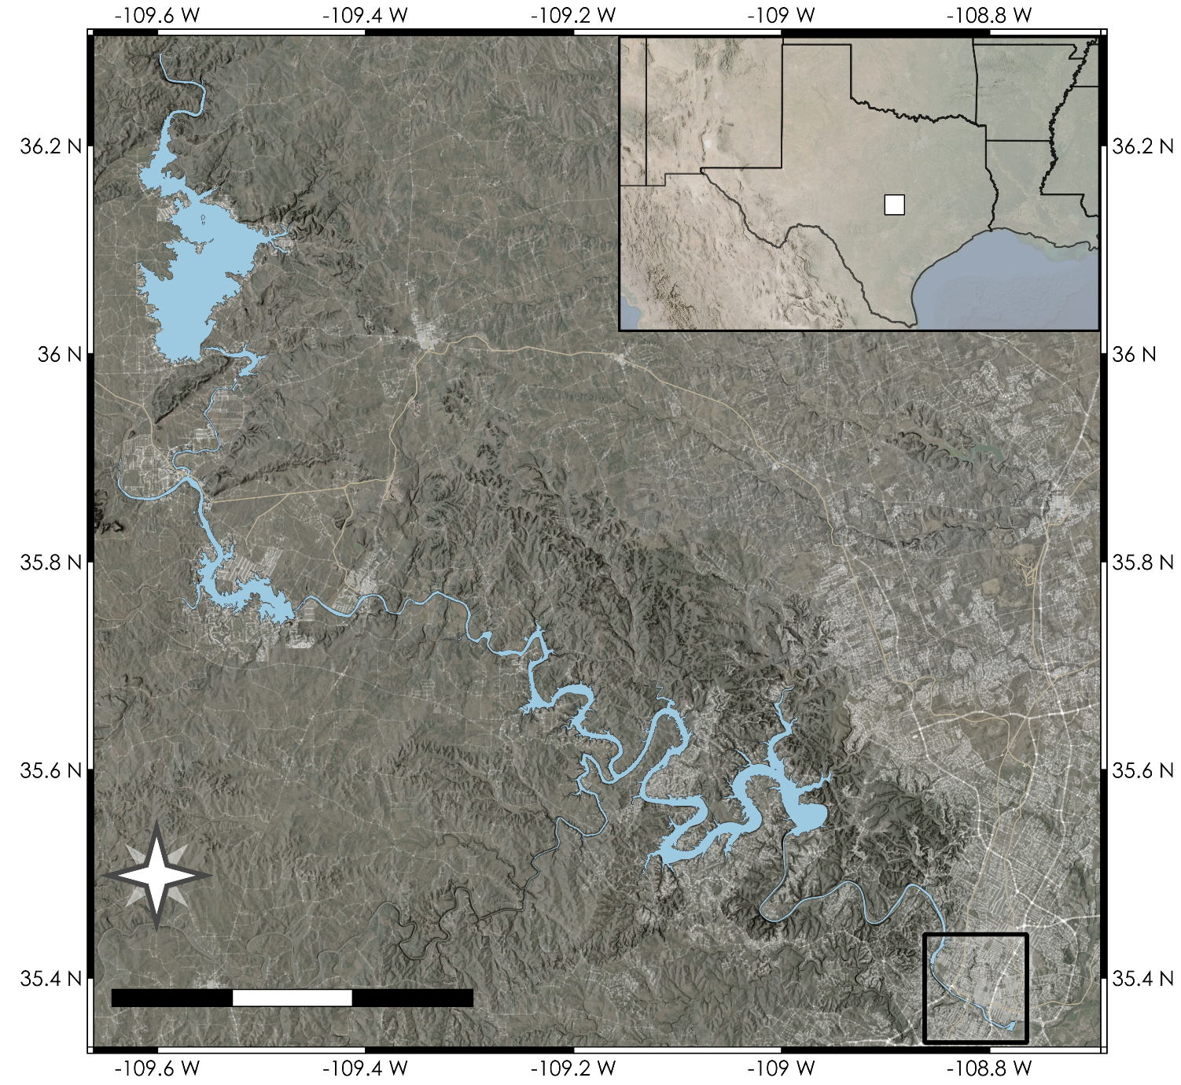
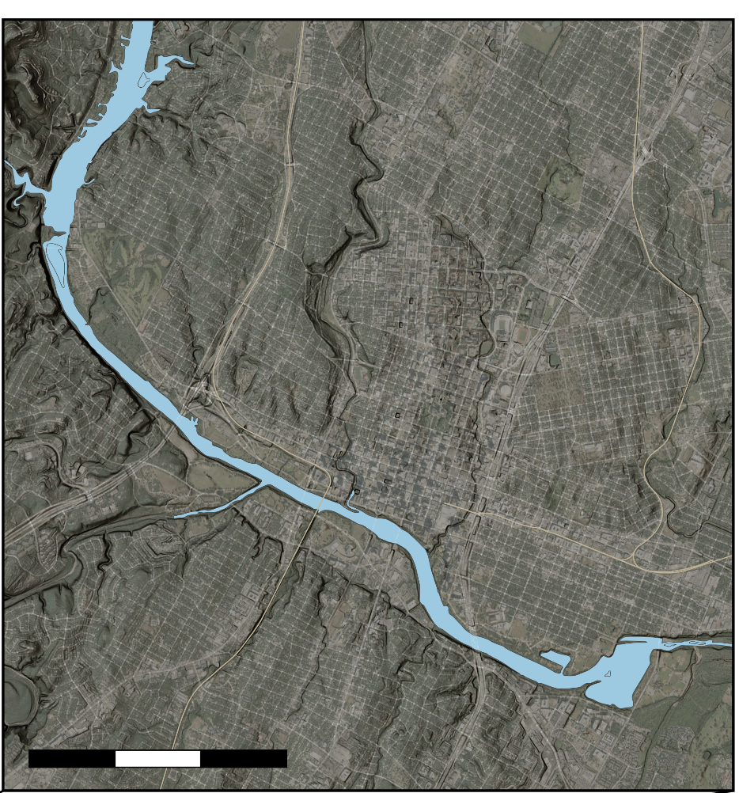
Study Area and Periods
OK
Toxins first detected, Lady Bird Lake
NM
AR
Landsat 8
Launch
Sentinel-2A
Launch
Sentinel-2B
Launch
Toxins first detected, Lake Travis
TX
LA
2013
2015
2017
2019
2021
Burnet
Austin
Lake Buchanan
Lake Austin
Austin
Lake Austin
Lady Bird
Lake
Lake Travis
Lake Lyndon B. Johnson
Austin
1
2
3 km
Lady Bird
Lake
N
Lakes of
interest
10
20
30 km
1
2
3 km
Notes:
The area of interest for this work is the highland lakes region in Texas, which runs through the city of Austin. On the left we see the spatial extent of the Highland Lakes with Austin as a reference. The lake chain is part of the Lower Colorado River and is dammed at many points, creating a chain of man made reservoirs. The placement of cities near the lake chain has led to a strong influence by human activities, which is believed to be a leading cause of the conditions favorable to algae events. Our focus observational period is between 2013 and the present, as the main satellites utilized started launching in 2013. The first harmful algal events were reported in 2019, thus more recent time periods are more important for this project. Most importantly is the focus on the present, such that more informed decisions can be made regarding current algal dangers.

Slide 5
Objectives
Chlorophyll-a
Turbidity
Temperature
Cyanobacteria
Color Imagery
NASA
User-friendly Algae Monitor GUI
Support Decision
Making
Monitor near real-time satellite derived algae event indicators
Improve early warning system of further algae events
Identify locations of high concentrations of algae
Notes:
To provide a useful monitoring tool to our end users, our objectives were to utilize environmental proxies such as chlorophyll-a concentrations, turbidity, water surface temperature, and cyanobacteria detections which help us to understand algae conditions. In order to convey the information we designed a user-friendly graphical user interface to provide an interactive near real-time algae monitoring tool. Additionally, we ran statistical analyses on all of the images from 2013 to the present to provide the end users with maps and charts to better understand historical trends and potential hotspot locations.

Slide 6
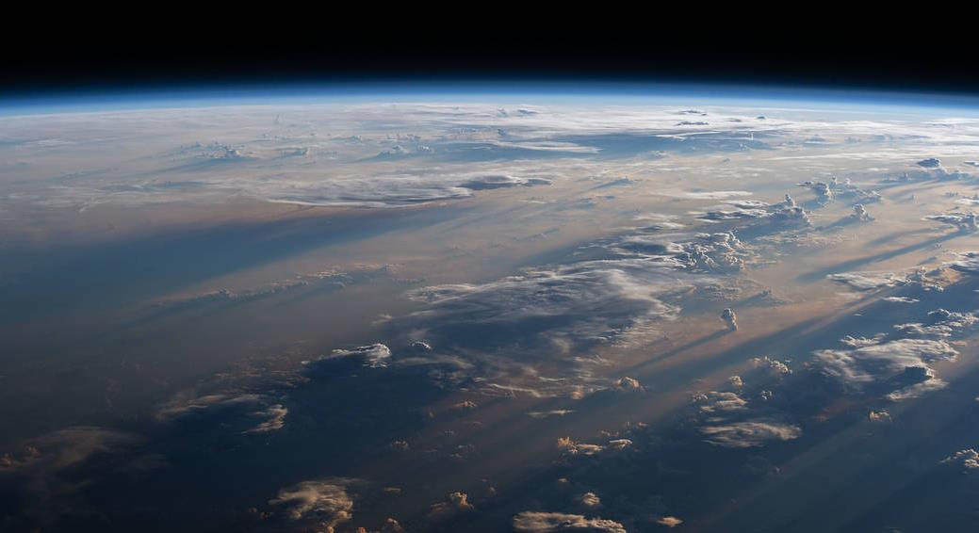
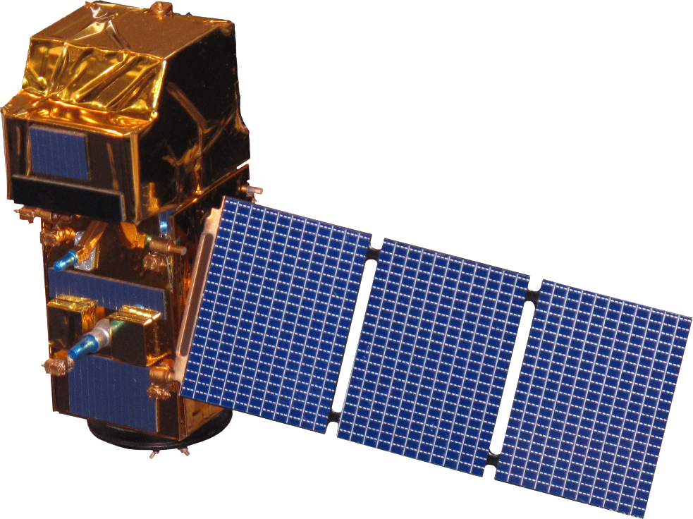
Satellites & Sensors
Sentinel-2 MSI (ESA)
Landsat 8 OLI
16-day revisit
5-day revisit (A + B)
Source: NASA, ESA
Notes:
To meet our objectives, we harnessed the jointly operated NASA & USGS Landsat 8 satellite with the Operational Land Imager (OLI) sensor, as well as the European Space Agency's (ESA) Sentinel-2 A & B satellites with the MultiSpectral Imager (MSI) sensor. Landsat 8 has a long revisit time of 16-days, has a moderately high resolution of 30 meters, and captures a large area with each pass. Meanwhile, each Sentinel-2 satellite has a revisit time of 10-days, a combined have a revisit time of 5-days. The Sentinel-2 MSI sensor provides bands with a notably high resolution of 10 meters as well as 20 and 60 meter bands. We utilized 10 and 20 meter sentinel bands for our products. Although Sentinel-2 has a great revisit time and sharp resolution, each image captured spans nearly a quarter of the area of each Landsat image. When both Landsat 8 and Sentinel-2 platforms are used in conjuction, the revisit time can be as short as 3 days.
Image from https://www.nasa.gov/sites/default/files/styles/full_width_feature/public/thumbnails/image/iss063e076166.jpg

Slide 7
Methodology Workflow
Chlorophyll-a concentrations
Earth Engine
Historical water quality statistics and maps
Widgets for alerting
Tool deployment
Landsat 8 OLI
Surface Reflectance
Cyanobacteria detection
Earth Engine
Combined visualization
Tiled maps
Sentinel-2 MSI
Surface Reflectance
Mask clouds and land
Turbidity index
Time series charts
In situ error validation
Uncertainty estimates
Water surface temperature
Notes:
This workflow chart illustrates the path taken to produce an informative and interactive tool hosting the desired end products. Surface reflectance products from Google Earth Engine were masked down to water pixels using NDWI land-water segmentation and cloud pixel detection. The masked imagery were then processed utilizing machine learning and spectral algorithms to produce chlorophyll-a concentration, cyanobacteria abundance, turbidity, and water surface temperature maps. In-situ data were then used to provide error estimates and validate the products. Utilizing the processed products, a statistical analysis was performed to retrieve historical trends as time series charts, animations, and maps. The products were also then combined into a cohesive visualization environment with interactive maps, optional time series charts, and informative widgets. Finally, the graphical environment displaying recent observations was deployed as a usable tool for the end users to access.

Slide 8
Spectral Processing
Products
Mixture Density Network Chlorophyll-a
Broad Wavelength Algae Index (BWAI)
Smith et al. (2021) and Pahlevan et al. (2020)
Zhao et al., 2020
Fluorescence Line Height Violet (FLHV) Chlorophyll-a (Landsat 8)
Normalized Difference Turbidity Index (NDTI)
Beck et al., 2016
Lacaux et al., 2007
2 Band Algorithm (2BDA) Chlorophyll-a
(Sentinel-2)
Water Surface Temperature
Dall'Olmo & Gitelson, 2006
Sekertekin & Bonafoni, 2020
Notes:
To calculate the environmental proxies we used a variety of spectrally derived products. Chlorophyll-a concentrations were calculated using a pre-trained machine learning (mixture density network) model, as well as the best reported performing indices for landsat and sentinel, the fluorescene line height violet and 2 band algorithm, respectively. For the detection of cyanobacteria we used a spectral algorithm called the Broad Wavelength Algae Index (BWAI), originally designed for Landsat but operational for Sentinel. The BWAI has two versions, one to detect cyanobacteria in the water column and one for floating cyanobacteria mats. To quantify turbdity, we use the Normalized Difference Turbidity Index (NDTI) which identifies suspended sediment in the water based on the observation that suspended sediment causes higher reflectance in the red wavelengths. Finally, the calculation of water surface temperature was achieved through inverting Planck's law and harnessing the thermal infrared bands of Landsat 8.
Processing for the Broad Wavelength Algae Index, Normalized Difference Turbidity Index, and water surface temperature were all done utilizing spectral features specific to cyanobacteria, suspended sediment, and infrared brightness temperature, respectively. The BWAI harnesses a Reflectance Peak Height index that isolates algal mats or blooms based on their different spectral features, where mats reflect more in the NIR. The BWAI uses two factors to depress noise and spectral contamination from the environment to more accurately differentiate cyanobacteria. The NDTI harnesses the increased reflectance of red wavelengths in water with increasing amounts of suspended sediment. It is normalized to prevent differences in values from environmental and lighting changes throughout the year. Water surface temperature was retrieved using a workflow which uses the infrared bands on Landsat and related the brightness temperature to surface temperature using Planck's law.
Lacaux, J. P., Tourre, Y. M., Vignolles, C., Ndione, J. A., & Lafaye, M. (2007). Classification of ponds from high-spatial resolution remote sensing: Application to Rift Valley Fever epidemics in Senegal. Remote Sensing of Environment, 9.
Nill, L., Ullmann, T., Kneisel, C., Sobiech-Wolf, J., & Baumhauer, R. (2019). Assessing Spatiotemporal Variations of Landsat Land Surface Temperature and Multispectral Indices in the Arctic Mackenzie Delta Region between 1985 and 2018. Remote Sensing, 11(19), 2329. https://doi.org/10.3390/rs11192329
Zhao, Y., Liu, D., & Wei, X. (2020). Monitoring cyanobacterial harmful algal blooms at high spatiotemporal resolution by fusing Landsat and MODIS imagery. Environmental Advances, 2, 100008. https://doi.org/10.1016/j.envadv.2020.100008

Slide 9
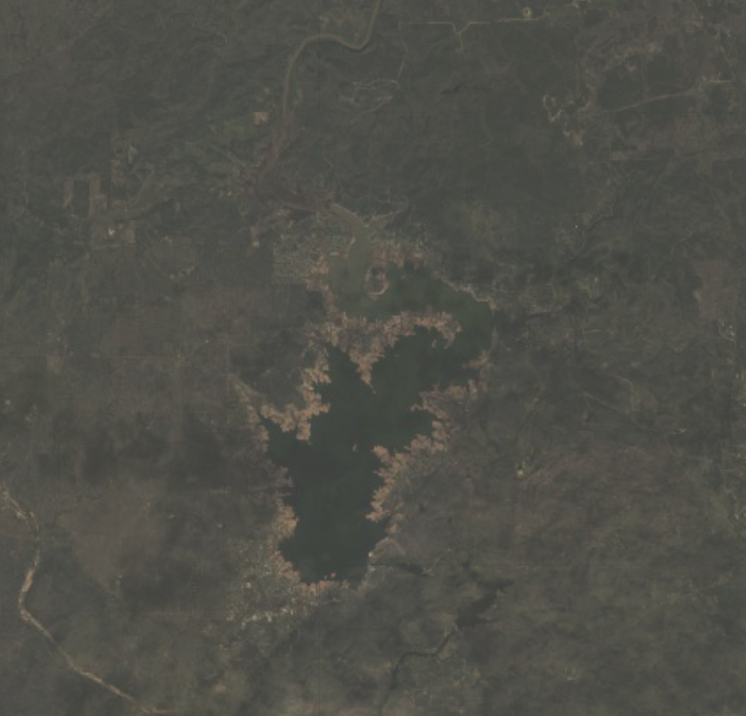
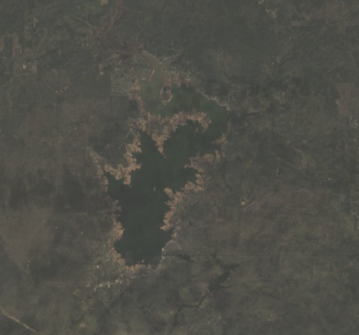
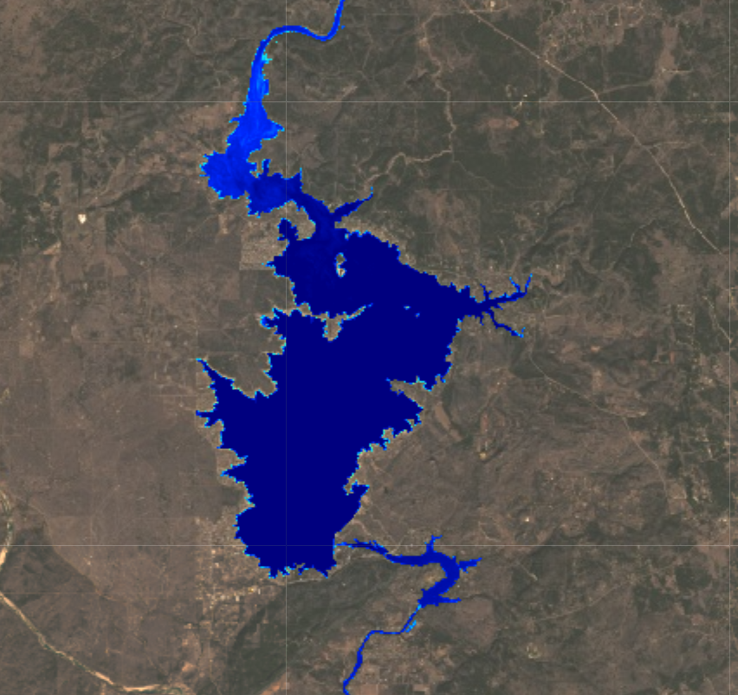
Validation Methods
Sampling Parameters
Chl-a
Water Temp
Turbidity
Raw Data
In Situ
GEE images
Filtering
Location
Date
Processing
Spectral algorithms
Analysis
Statistical Comparisons
Notes:
For the validation of the products in situ water quality sampling data was provided by our partners to assist in validating our results. First sentinel-2 and landsat 8 (surface reflectance) imagery was collected from GEE and filtered down to images that overlapped with the day and location of a sampling point. Then this imagery was processed with methods described previously. For each sampling point, the values for the pixel at that location and the 8 surrounding pixels were averaged. This average was used to compare the processed results to in situ measurements.
Statistical comparison methods used included: slope, intercept, r_value, RMSLE, rmse, Bias, MAE, MAPE, and p-value
This workflow was performed with chl-a data, water temperature data, and turbidity data
(say something about removing one pixel in from edge of water?)

Slide 10
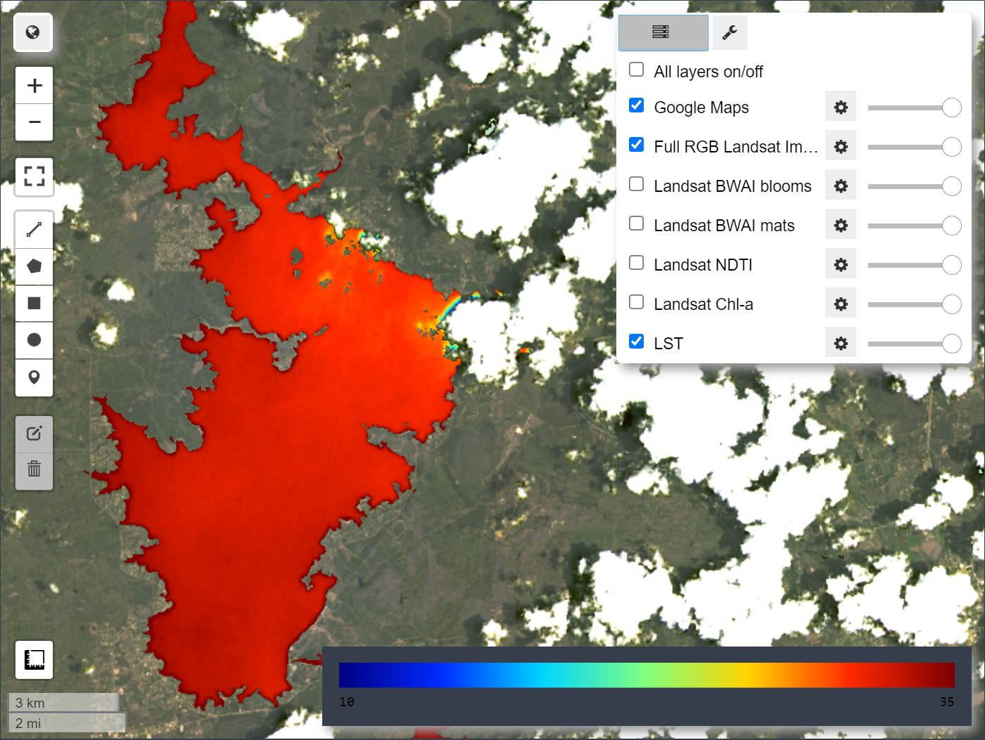
Tool/GUI Development
Workflow
LAMDA – Lake Algal Monitoring DAshboard
Process informative products
Employ interactive components
Deploy as easily usable tool
Start
Date Slider
End
Info widget
Parameter Select
Time Series Chart
Notes:
To develop a useful tool for the end users, we wanted to provide an easy to use and interactive environment derived from Python map panels and widgets, as our products were developed using Python. Once working and validated products were finished, code was organized and interactive components were employed for the generation of a graphical user interface. Shown on the left is an example wireframe illustrating how we planned our tool and the elements desired by end users. The central feature is an interactive map that allows for changing of layers and the ability to zoom to a desired view. Accompanying the map is an info widget that will display things such as the date of image and other useful stats or metadata. Additionally, a dropdown will be present to select parameters of interest for the creation of a time series chart. Once a parameter is chosen the time series chart will display and can be downloaded. Features such as these help the end user focus on monitoring and analysis.

Slide 11
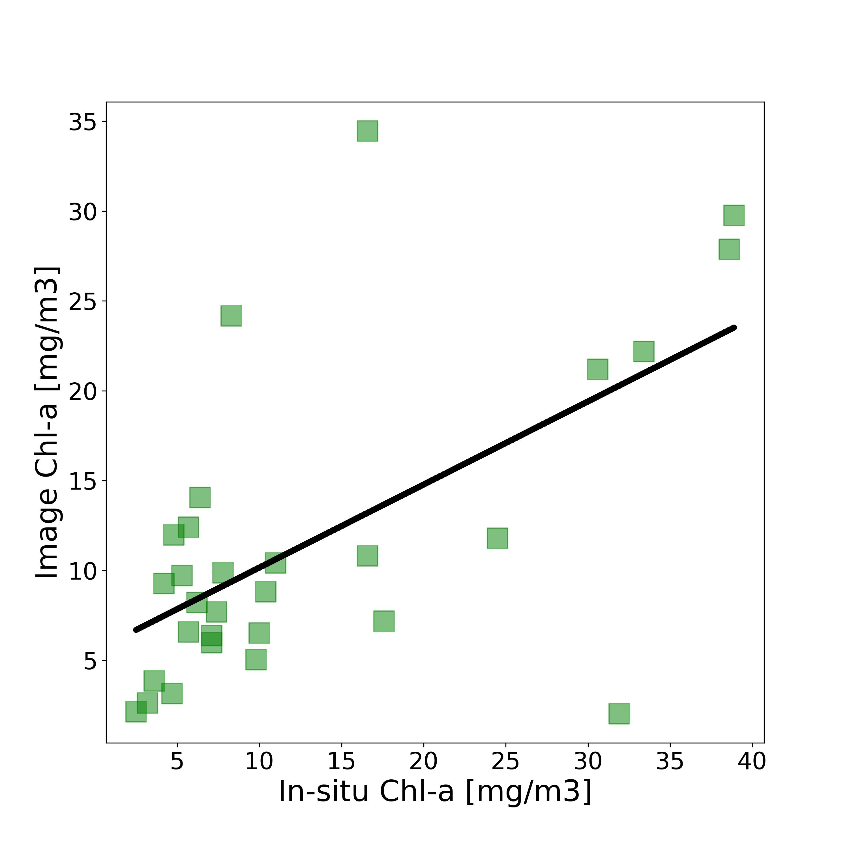
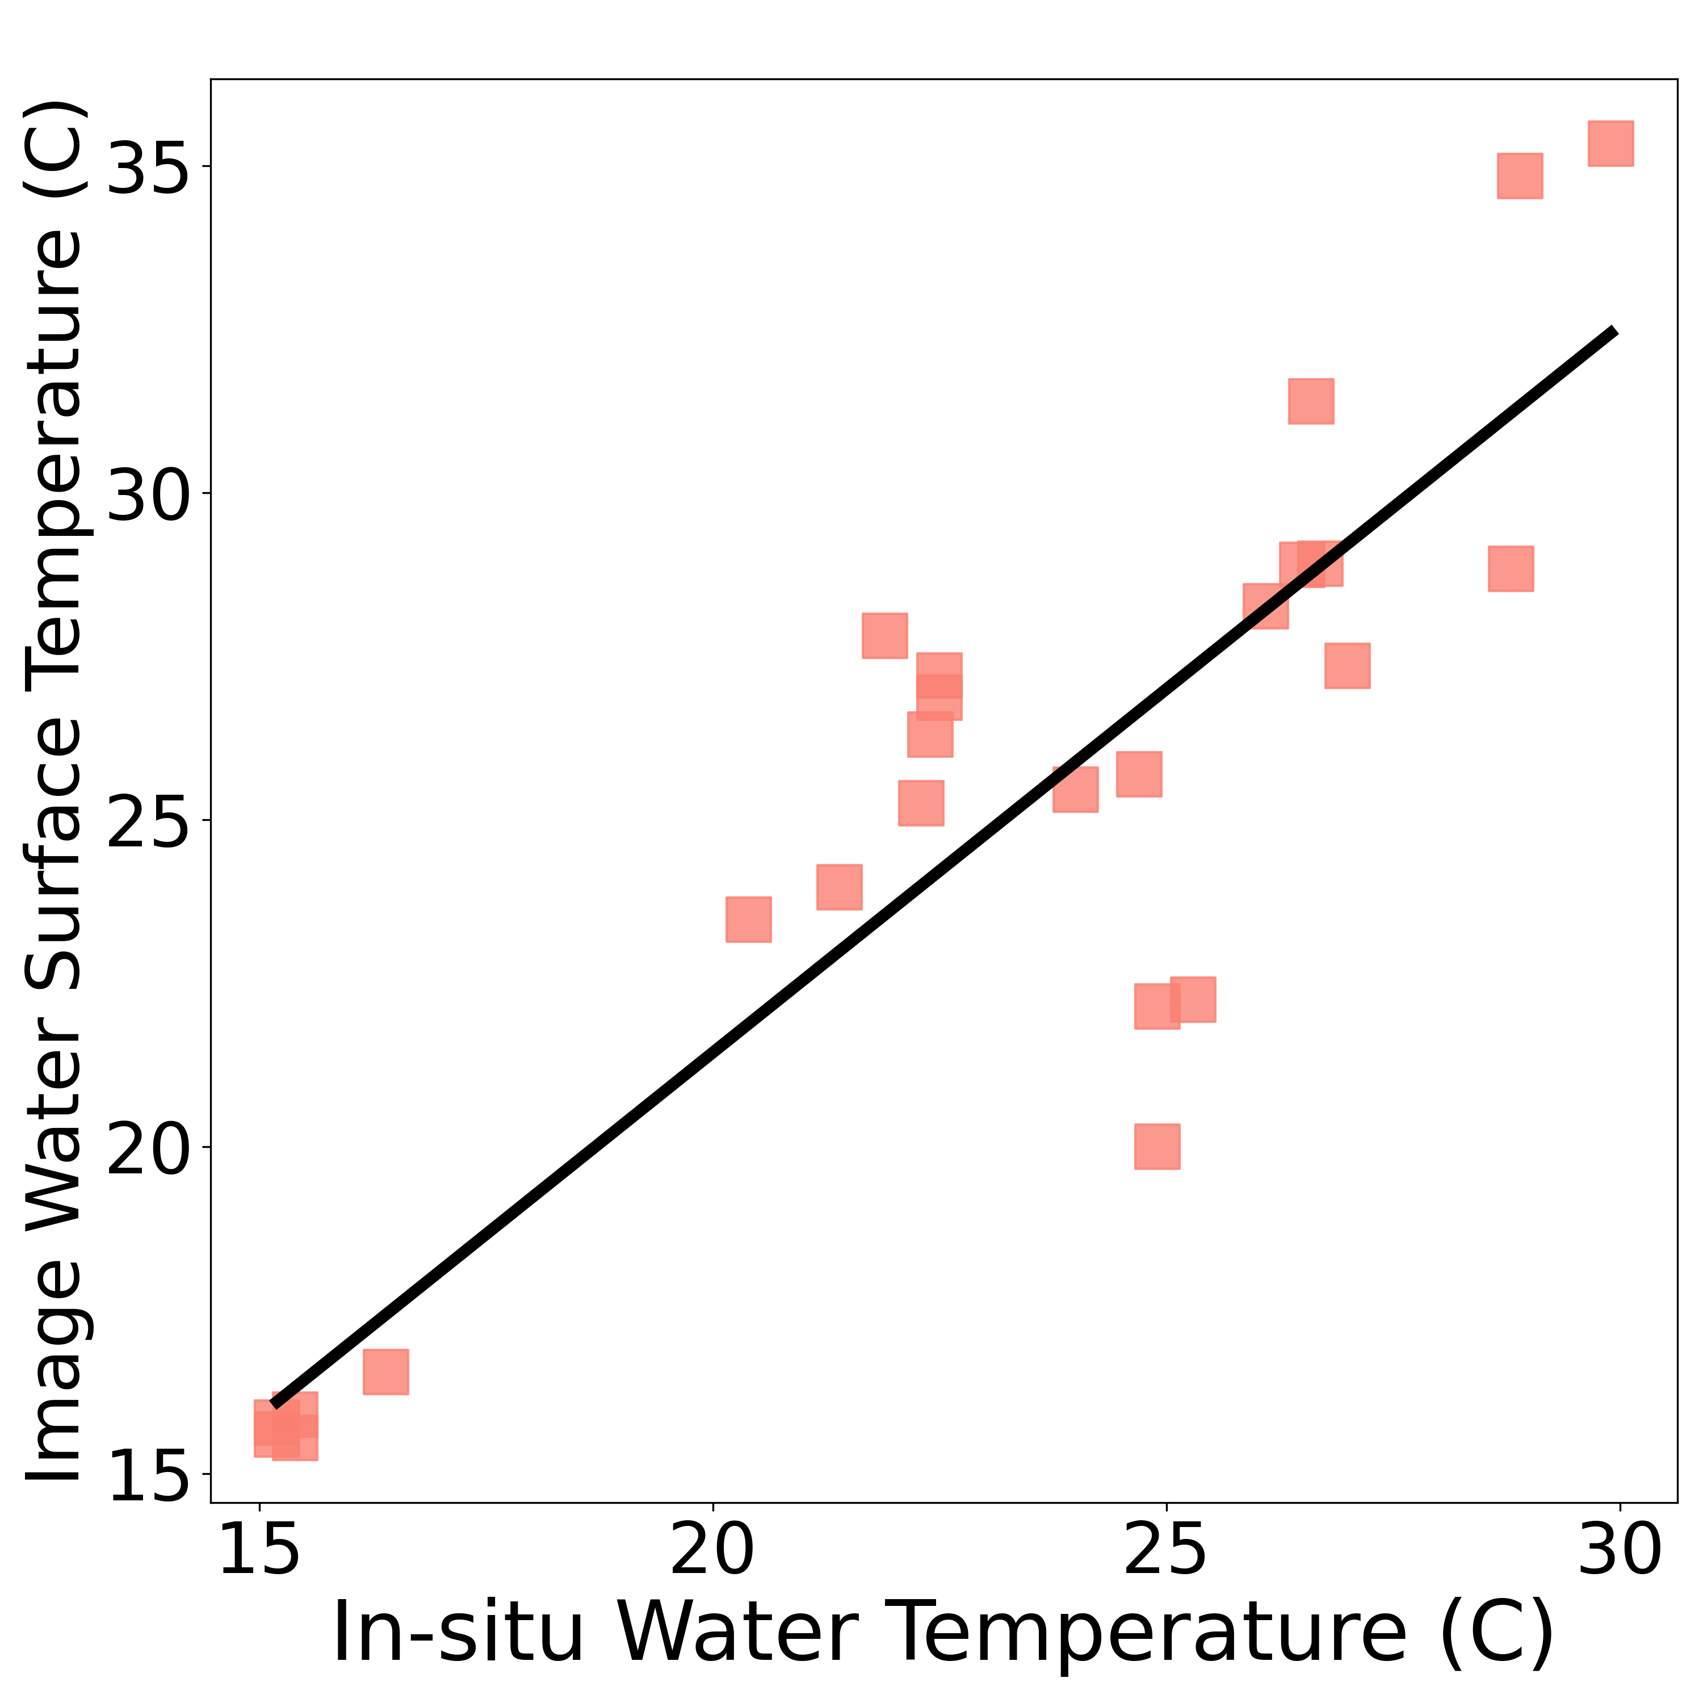
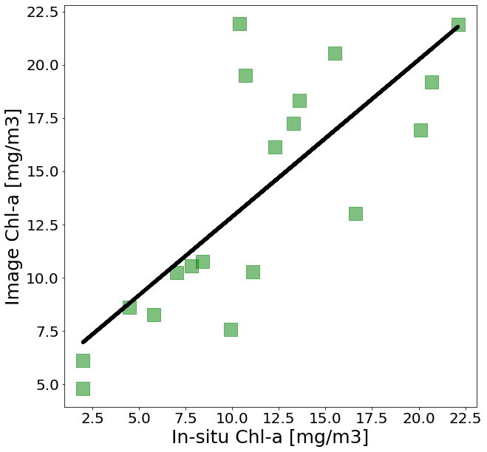
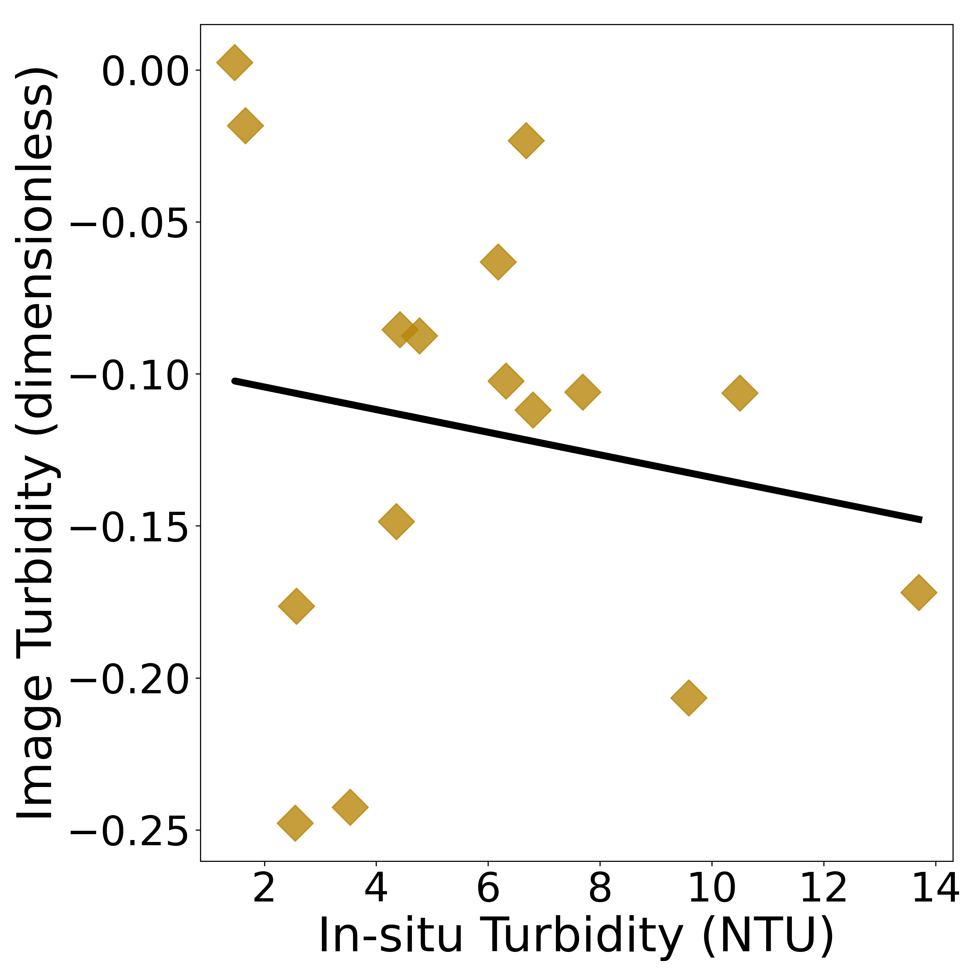
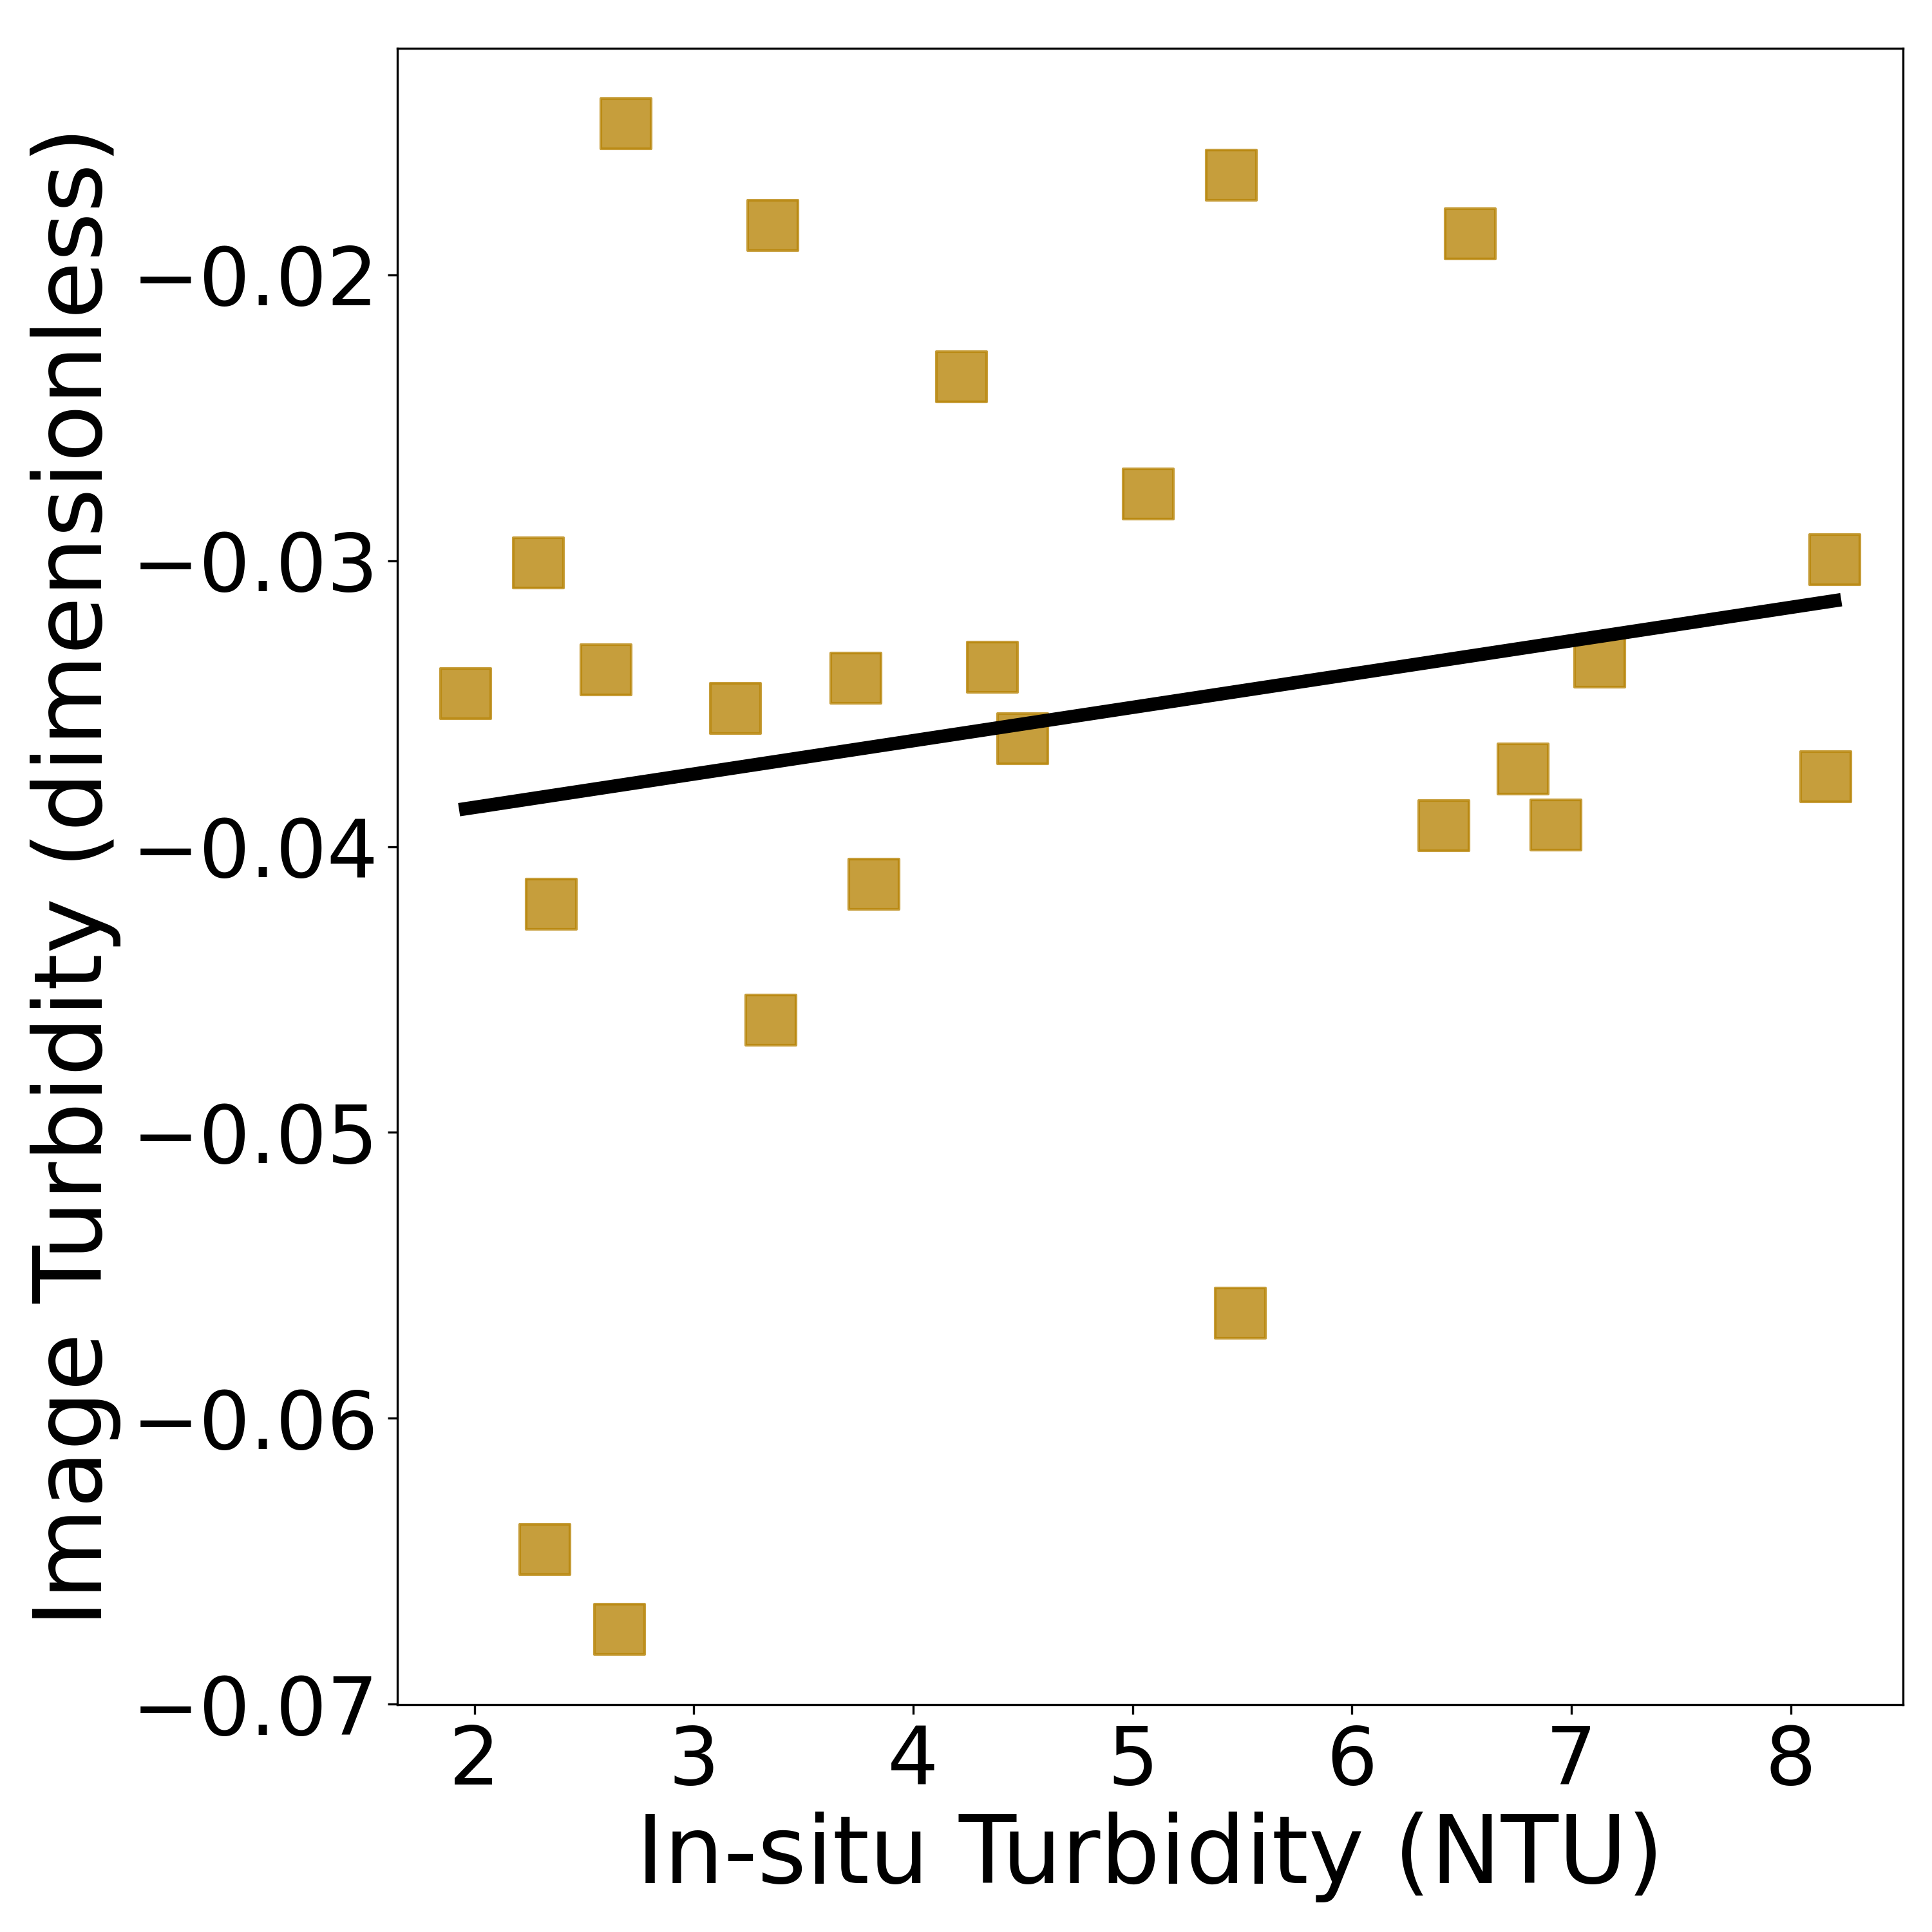
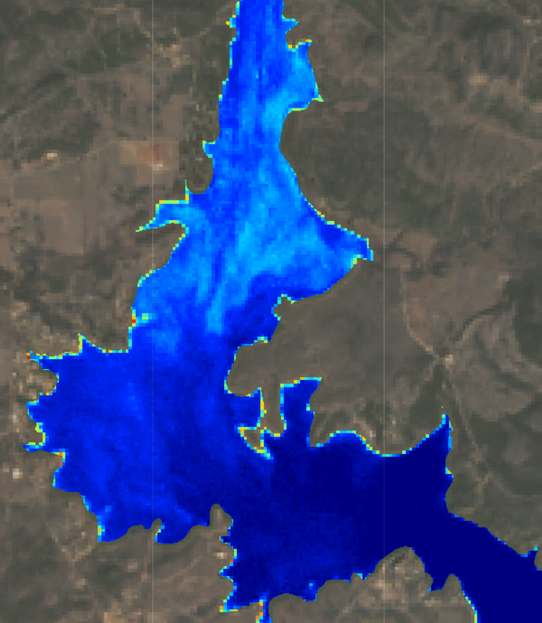
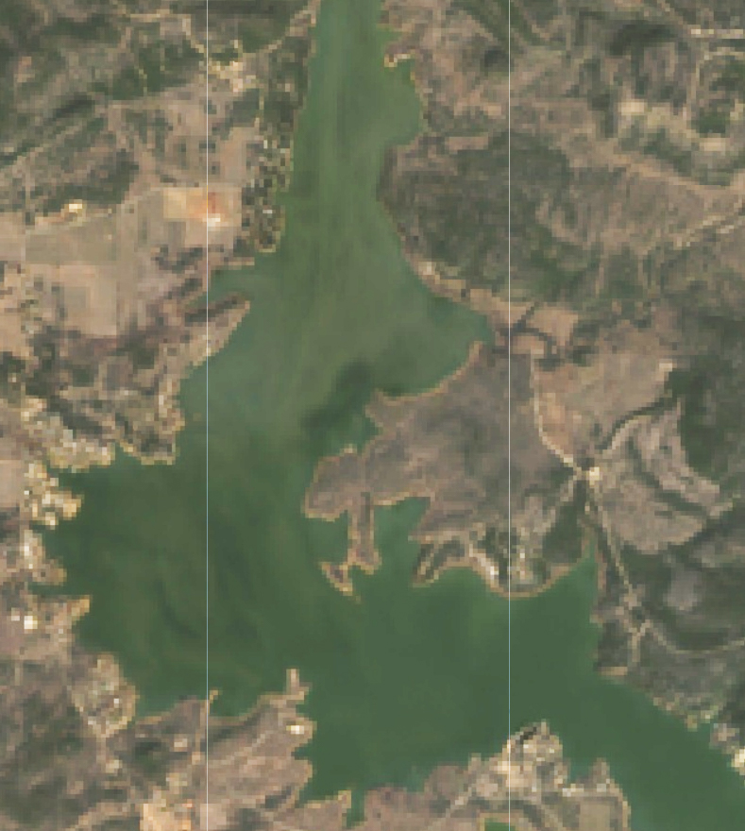
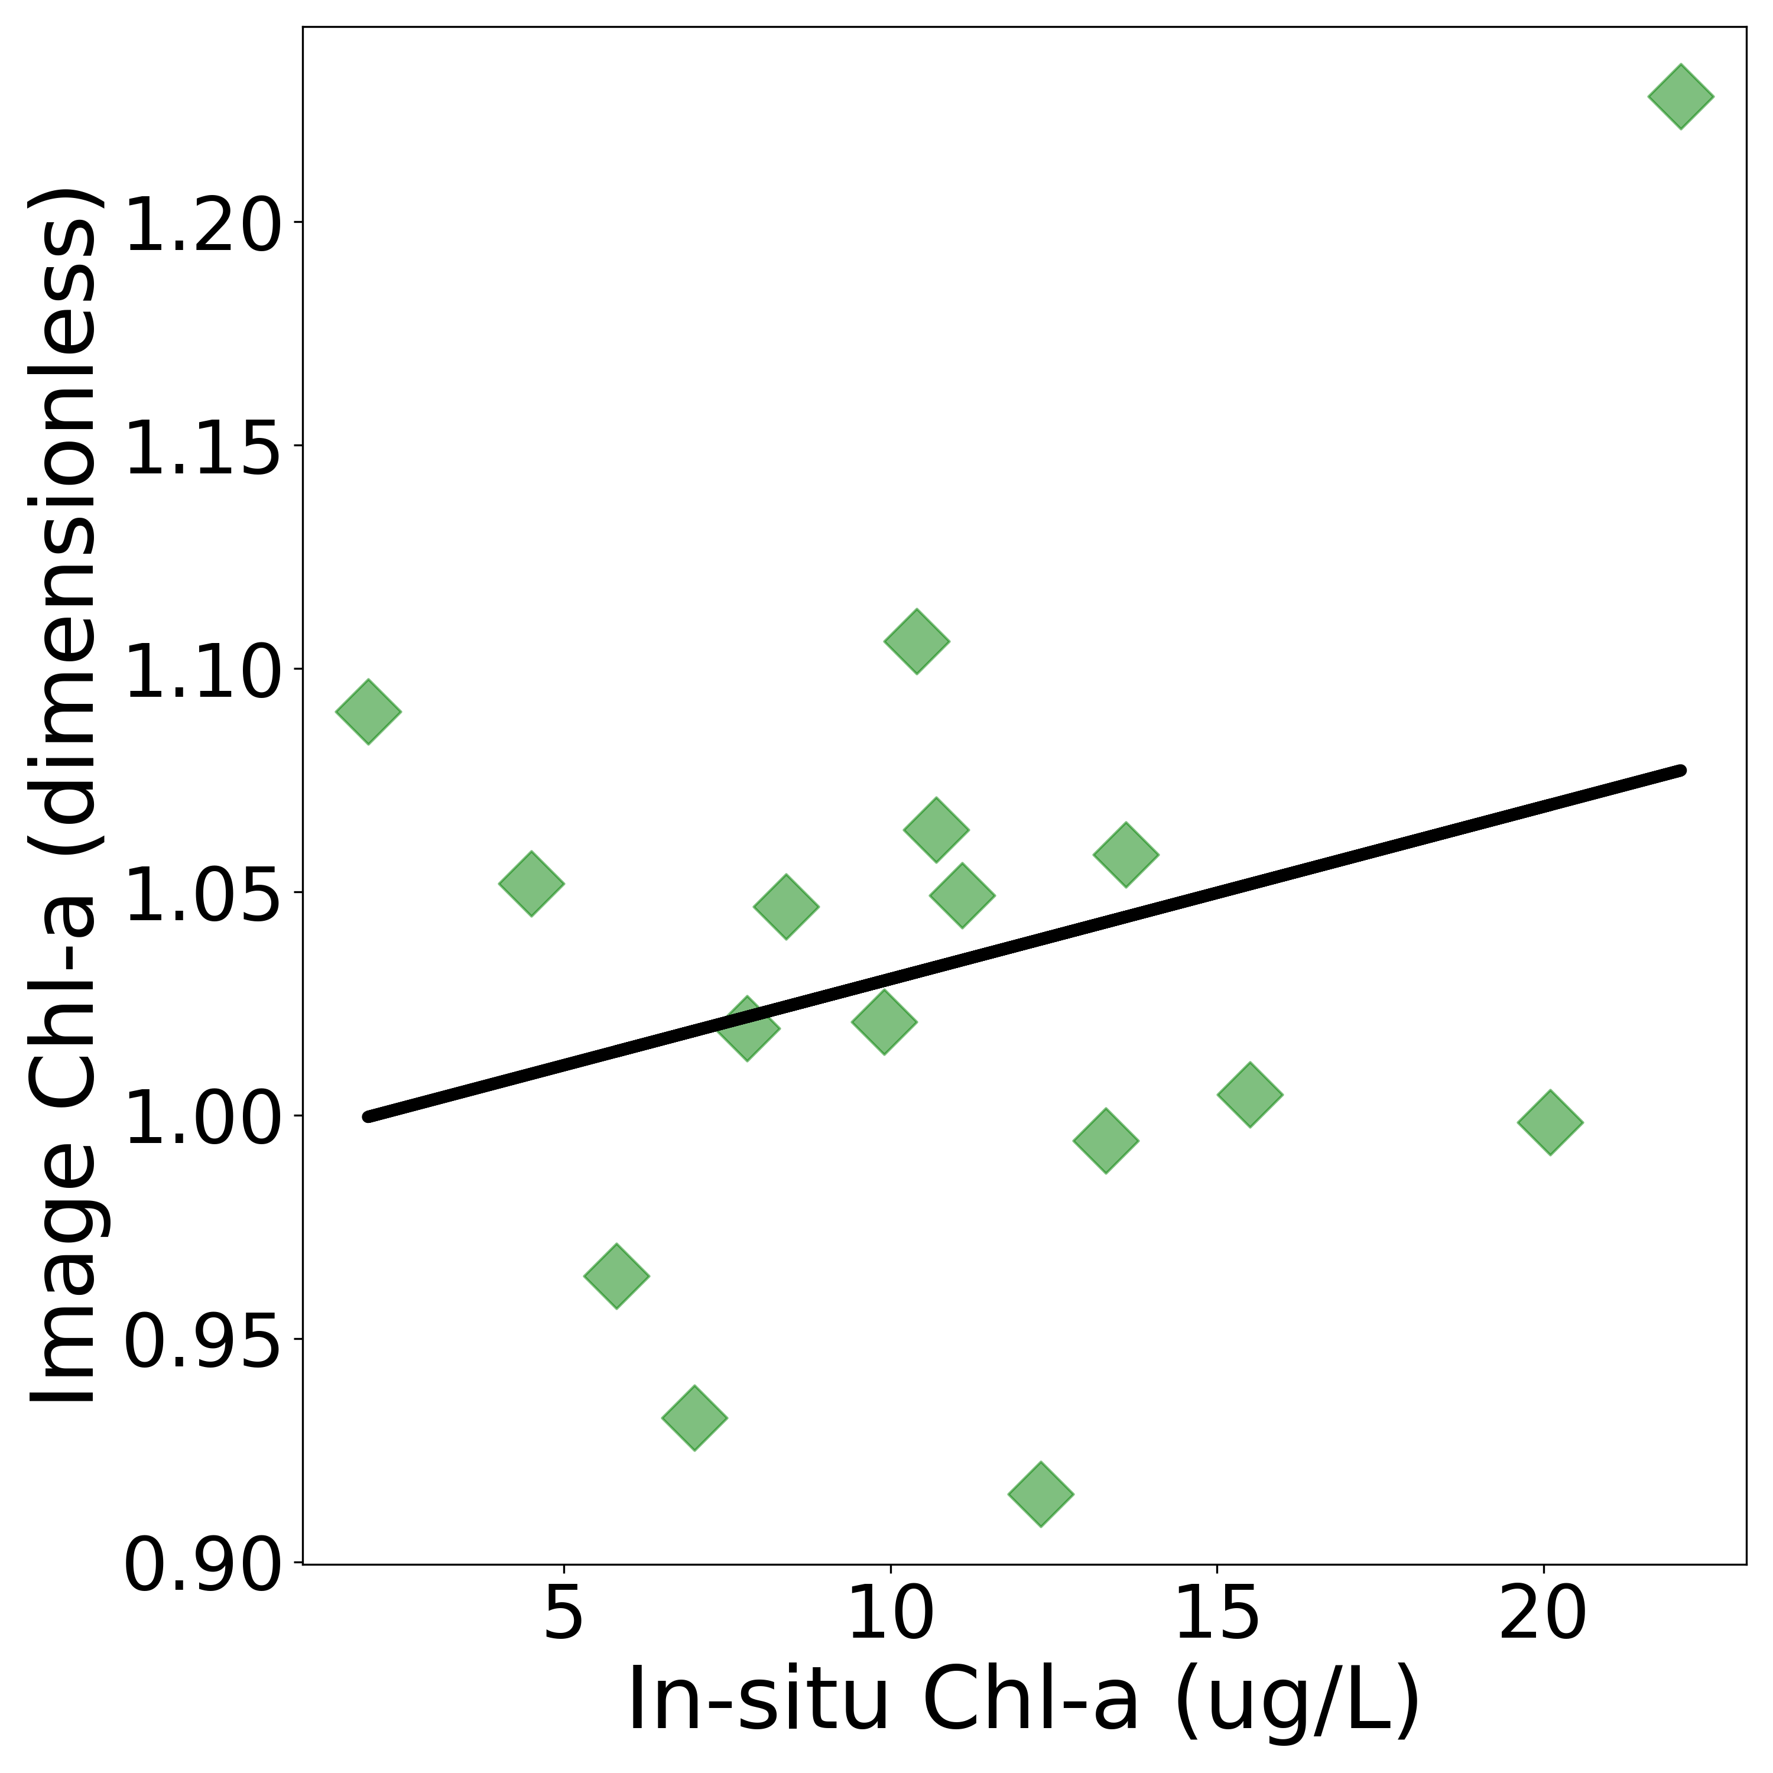
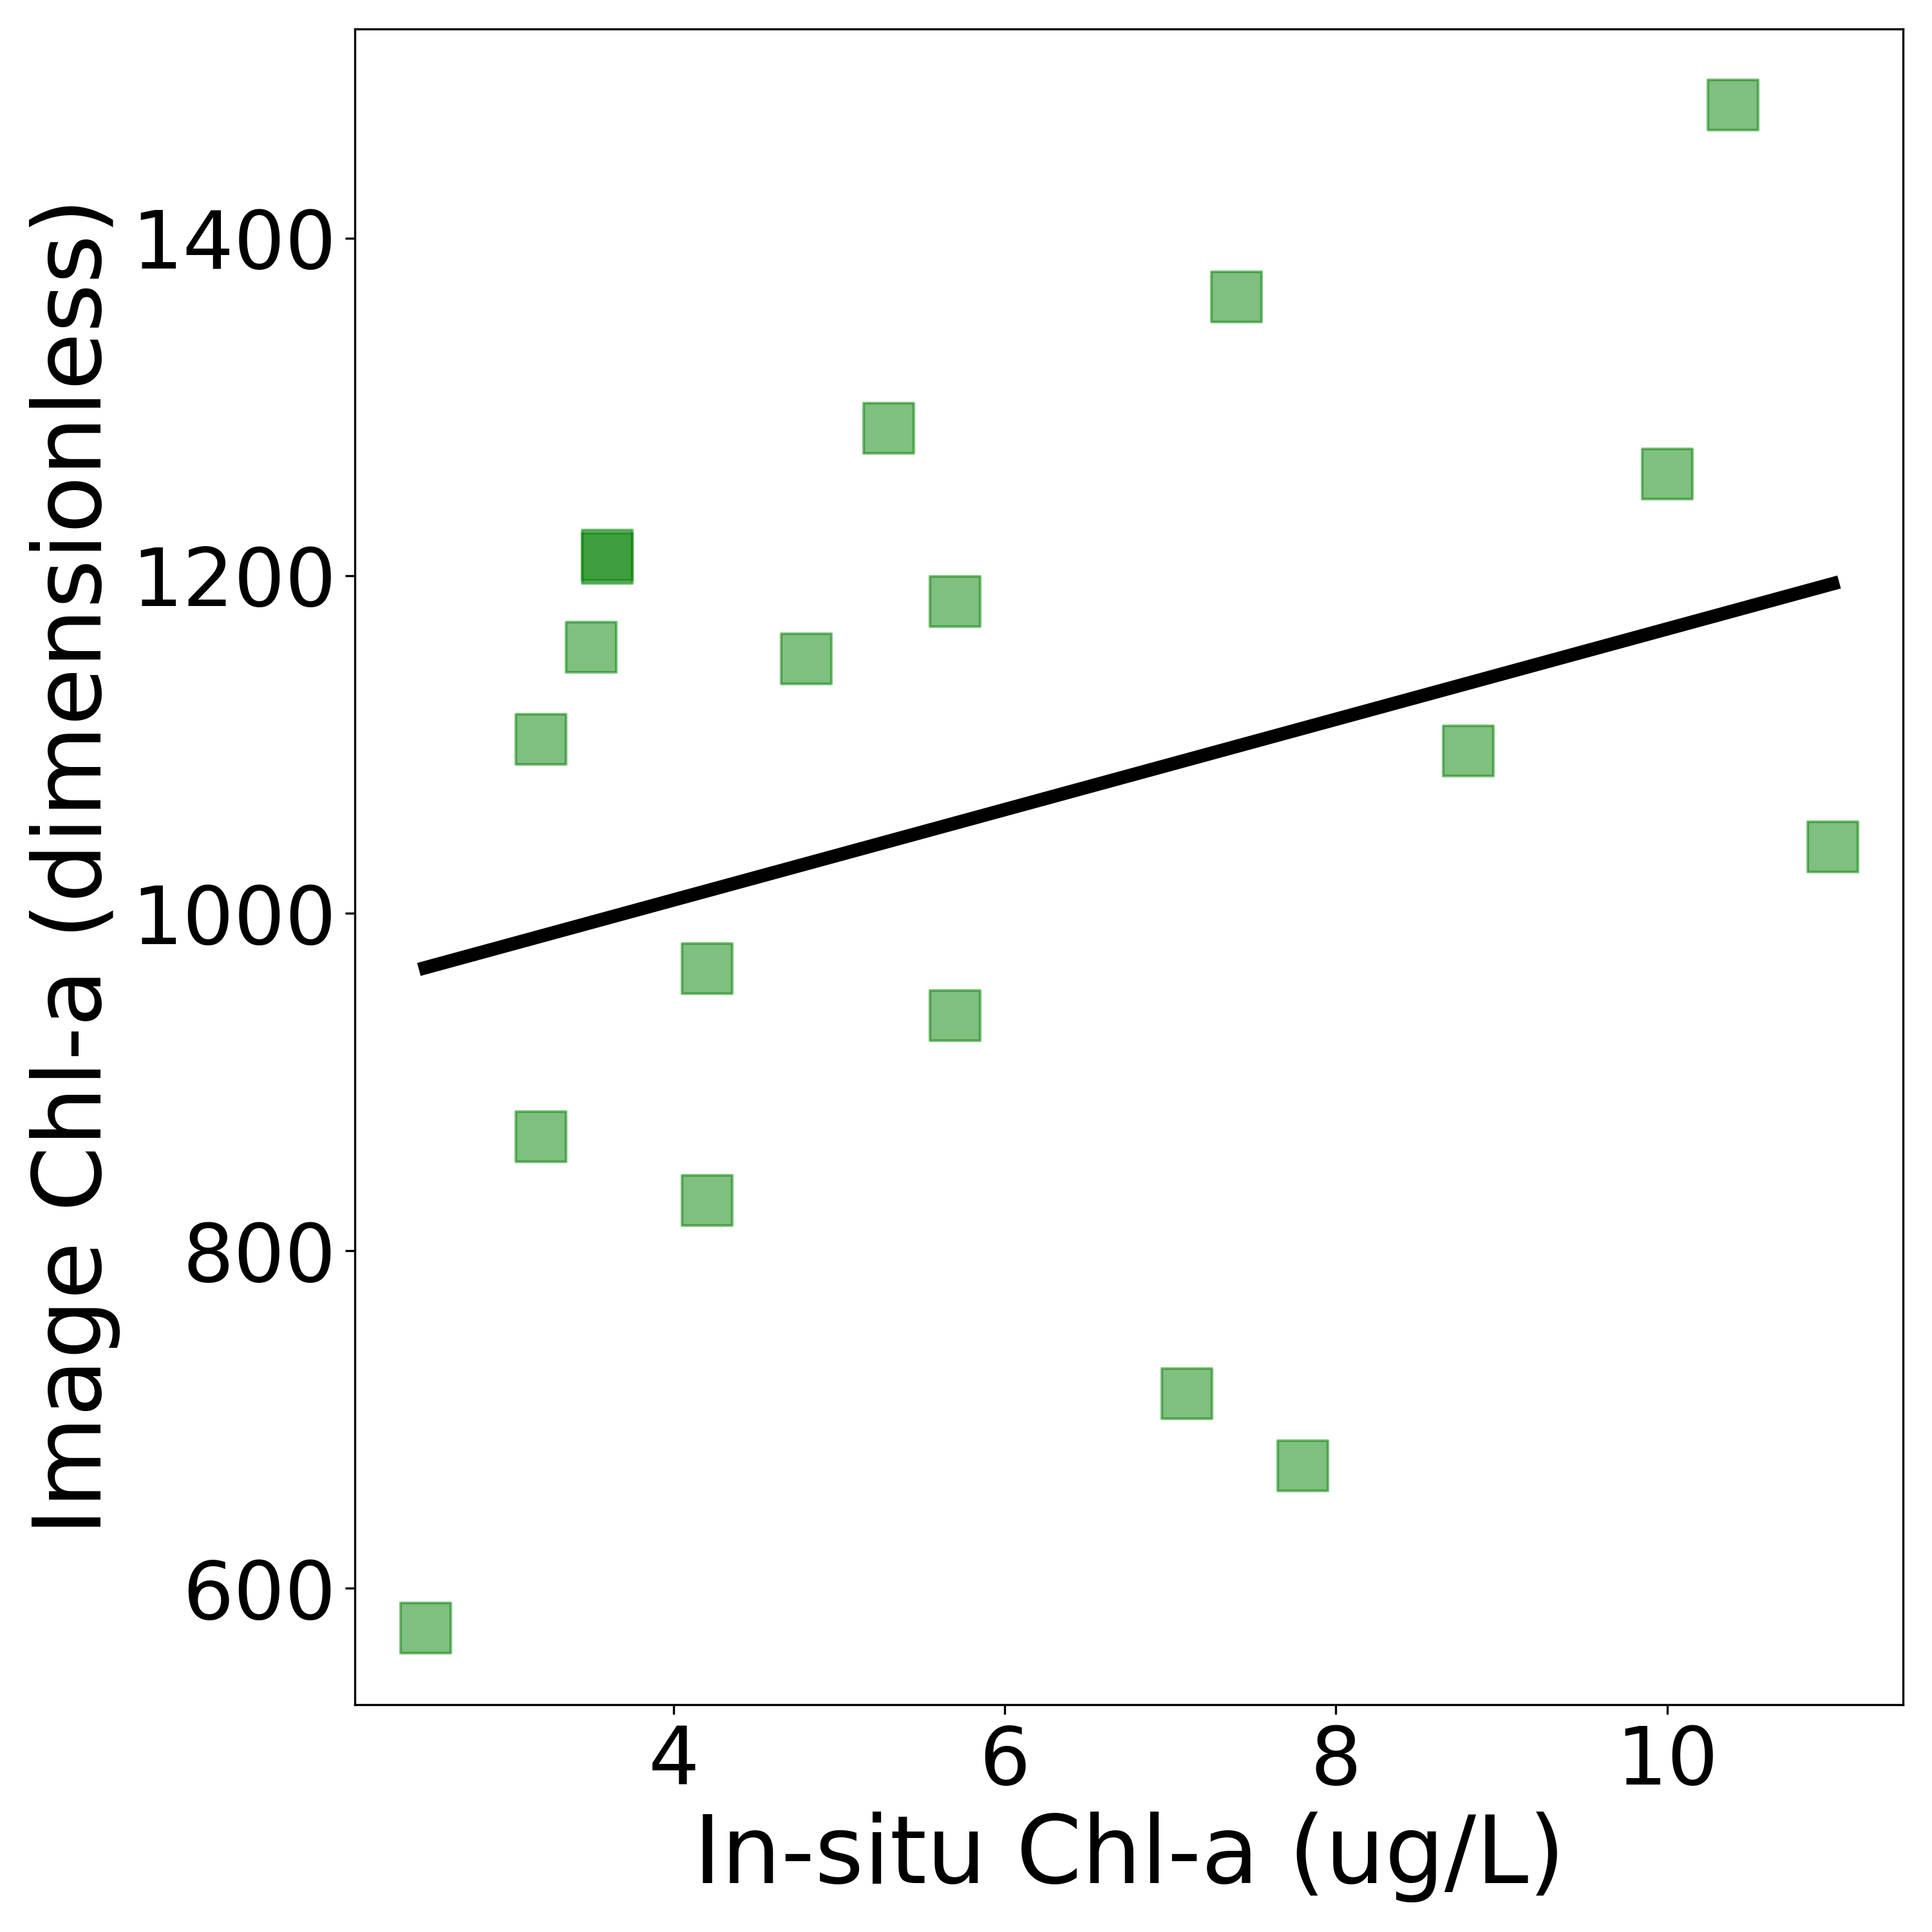
Validations
Chlorophyll-a
Turbidity
Water Surface Temp
MDN - MSI
MDN - OLI
NDTI - MSI
NDTI - OLI
LST - OLI
Slope = -0.17
R² = -0.029
P = 0.54
Slope = 0.88
R² = 0.77
P = 8.0e-9
RMSE = 3.3
Slope = 0.85
R² = 0.73
P = 8.0e-5
RMSE = 5.33
Slope =0.46
R² = 0.60
P = 5.0e-4
RMSE = 9.15
Slope = 0.17
R₂ = 0.029
P = 0.41
2BDA - MSI
FLHV - OLI
Image
Observations
MSI = Sentinel-2
Slope = 0.28
R² = 0.08
P = 0.3
OLI = Landsat 8
R2 = Coefficient of determination
P = P- value
RMSE = Root Mean Square Error
Slope = 0.3
R² = 0.09
P = 0.22
Notes:
In order for our end users to have confidence in thesse products, we needed to validate our efforts. Utilizing in-situ data collected by our end users and comparing the image measurements to the in-situ measurements we were able to do this. Here we have many of the data comparisons and linear regressions to illustrate the performace of each product. Each pointa represents a value measured on the same date, however the times of observations vary by hours and are not entirely ideal comparisons. Chlorophyll-a validations show that the machine learning product performs the best for both Sentinel and Landsat, while Landsat measurements perform slightly more poorly. Spectral chlorophyll-a indices show a reasonable trend but also shows lots of scatter. Turbidty regressions performed especially poorly, however, there are many factors involved where comparing the in-situ measurements to the satellite derived measurements may not be entirely appropriate. When identifying suspended sediment manually, the NDTI indices accurately identify turbid pixels most of the time, providing confidence where the linear regressions don't; therefore negative correlation isn't necessarily bad in this instance. Similarly, the Broad Wavelength Algae Index was validated using manual observations of anomalies, to ensure that the product identifies periods of significant algae growth. The water surface temperature product shows the best performance with a fantastic correlation and very reliable root mean square error. Overall, validation efforts have provided confidence in these products abilities to identify important environmental trends.

Slide 12
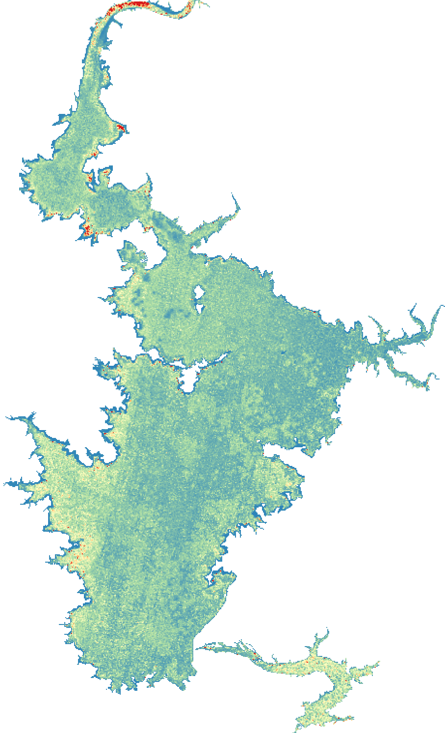
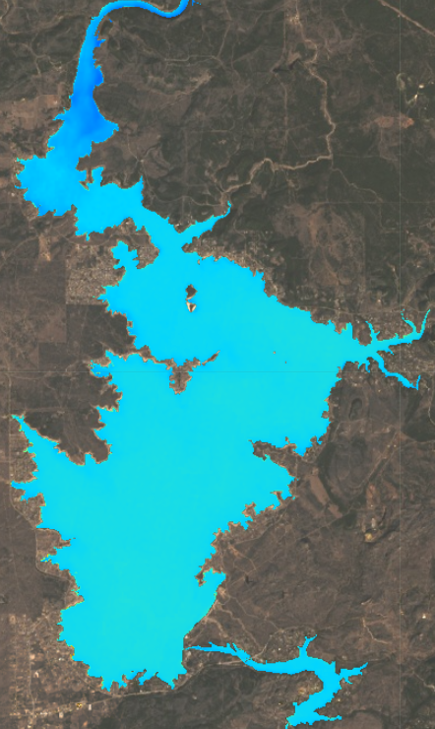
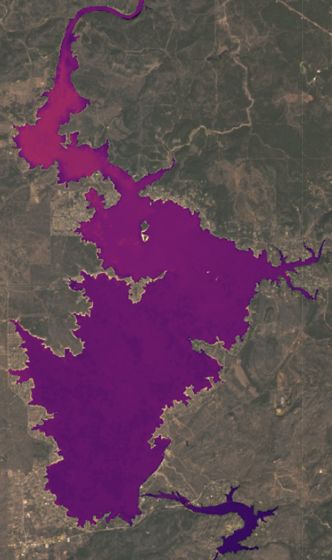
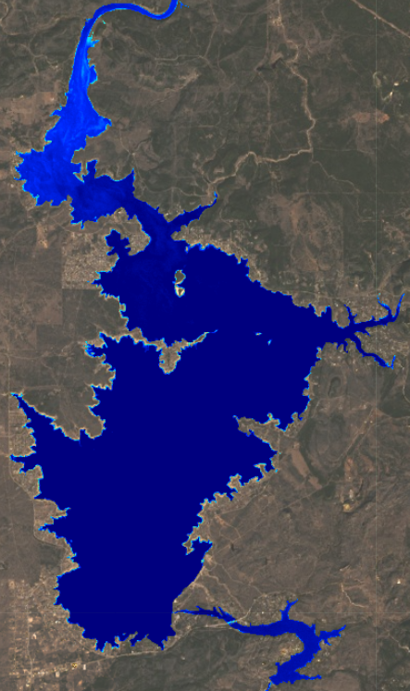
Product examples:
Chlorophyll-a
Water Surface Temperature
Bloom Detection
Turbidity
12-24-2020
12-24-2020
12-24-2020
12-24-2020
2021-03-25
2021-03-25
Placeholder
0
50 mg/m³
0
35 °C
Low
High
Low
High
Notes:
To illustrate what many of the products look like, here are four example products from December 24th of 2020 centered over Lake Buchanan. These examples were used as they are recent and cloudless, and don't illustrate any significant algal event. We can Chlorophyll-a concentrations at this time show

Slide 13
Historical Analysis: Chlorophyll-a
Lake Buchanan
Inks Lake
Lake Lyndon B Johnson
80
60
40
20
0
Chlorophyll-a Concentration [mg/m3]
Lake Marble Falls
Lake Travis
Lake Austin
80
60
40
20
0
2014 2015 2016 2017 2018 2019 2020 2021
2014 2015 2016 2017 2018 2019 2020 2021
2014 2015 2016 2017 2018 2019 2020 2021
Upstream -->> Downstream
Data only for March - October
Notes:
Beyond monitoring of near real-time conditions we also performed historical analyses with the created products. Shown here are remote sensing retrieved chlorophyll-a concentrations from late spring to early autumn of 2013 to 2020. The figure shows the time series plot for the six lakes in the highland lake chain from upstream to downstream to provide insight to hydraulic patterns of chlorophyll-a. At first, the figure suggests a clear seasonality of chl-a in all lakes. In general, it peaks around July and August. Additionally, we can see lakes upstream have relatively higher chla compared to lakes downstream. Our data analysis also shows that different lakes have different tends, which suggests different actions should be taken according to the conditions. For example, we can see the Lake Marble Falls shows continually increasing chl-a concentrations, while the Lake Austin and the Lake Travis are pretty stable, but had some extreme values in 2016 and 2017.

Slide 14
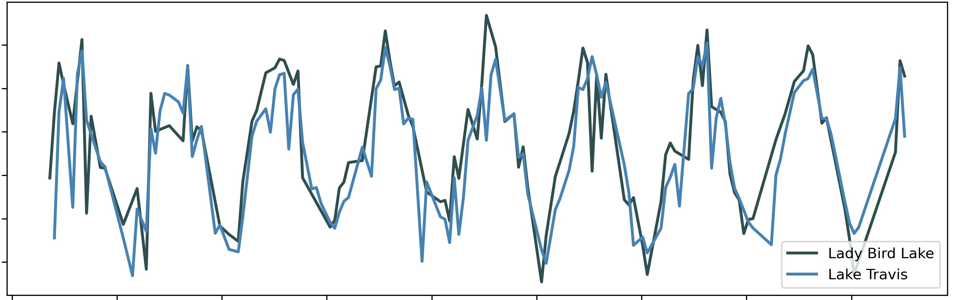
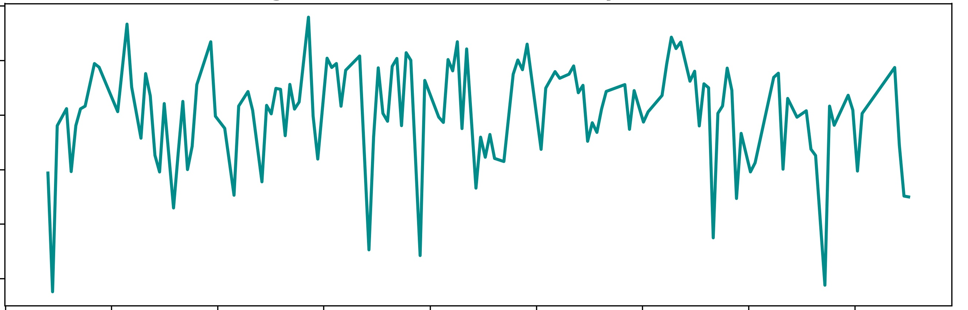
Historical Analysis:
Lake Buchanan
Lake Lyndon B. Johnson
Average Lady Bird Lake vs Lake Travis Water Surface Temperature
35
30
25
20
15
10
Water Surface Temperature (C)
2013 2014 2015 2016 2017 2018 2019 2020 2021
Date
Lake Travis
0.00
-0.02
-0.04
-0.06
-0.08
-0.10
Average Lake Travis Turbidity (Landsat)
NDTI Turbidity (Unitless)
0
Chlorophyll-a
80 mg/m³
2013 2014 2015 2016 2017 2018 2019 2020 2021
Date
Notes:
In addition to creating time series of chlorophyll concentrations for differing lakes we have produced a map illustrating the average chlorophyll-a concentrations for the summers of 2019 and 2020. Lake Buchanan and Lake Lyndon B. Johnson are two of the northwestern lakes and show much higher average concentrations than the southeastern lakes, which is interesting as the lakes with recent algal problems have been the southeastern lakes. These maps can help our end users to better plan future sampling campaigns. On the right are time series charts from 2013 to the July 2021, where the top chart shows the spatially averaged water surface temperatures for Lady Bird Lake and Lake Buchanan. A nice annual trend can be observed but it can also be observed that Lady Bird Lake typically is a little warmer than Lake Travis. This makes sense as Lady Bird Lake is smaller and shallow. The bottom chart is of turbidity as measured by the NASA Landsat 8 OLI sensor. Although the data is a bit noisy, one can see annual trends.

Slide 15
Limitations and Uncertainties
Data
Validation
Limited to products available on GEE
Atmospheric correction noise
Signal-to-noise ratio over water is low as water is dark
Wide time window: satellite images are from any time in the day of an in situ sample
Limited in situ sample data for cross reference
Notes:
Many of the challenging limitations for this project were related to data availability and the errors due to noise with these products. Being limited to the Google Earth Engine catalog prevented our project from using imagery corrected to specifically view water, as water presents many illumination and singal-to-noise complications that can be treated with rigorous pre-processing not provided by Earth Engine. Furtermore, in-situ sampling data is moderately infrequent and greatly limits the amount of usable validation data. With more validation data there could be a better concensus as to how well the products perform. Likewise, when validating against in-situ data ideally the compared measurements would be within half an hour of each other, but in our case measurements are hours apart. Measurements closer together would provide a much more robust validation scheme.

Slide 16
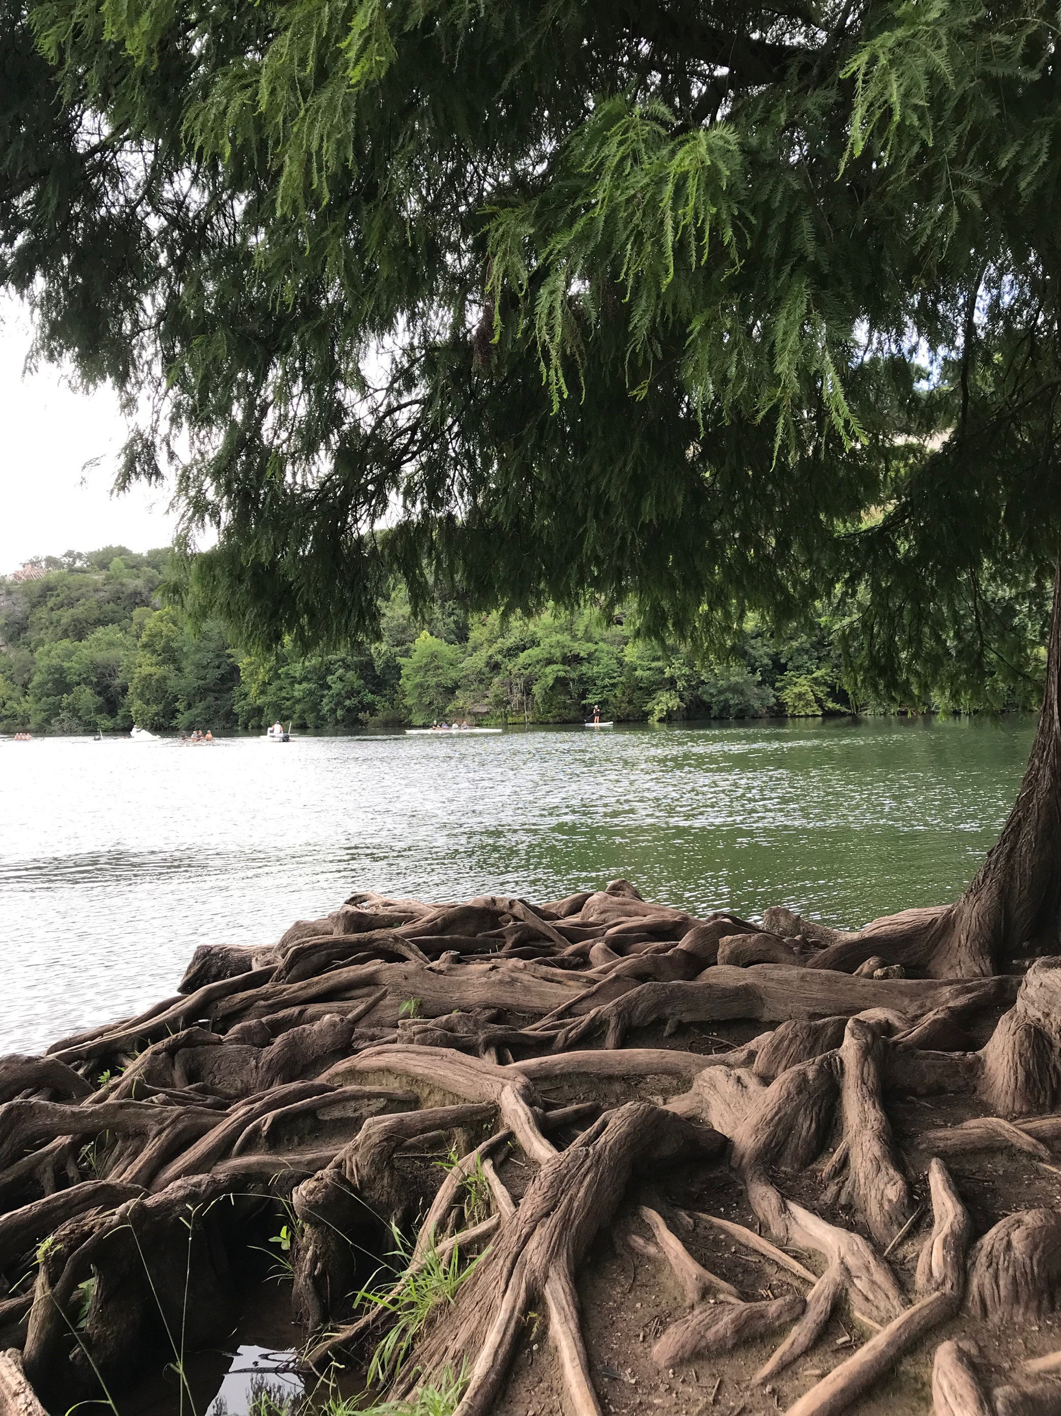
Conclusions
Methodology –
Implementation of algorithms worked well with Python and GEE
Results –
Products provide usable metrics for understanding algal event proxies and spatial patterns, to support water management, decision making, and risk communication
Environmental Trends and Patterns -
Increasing chlorophyll-a trend in Lake Marble Falls and Lake L.B.J.
Chlorophyll-a hotspots in northern lakes
Lady Bird Lake typically warmer than Lake Travis
No clear water temperature trends for Lake Travis
Stagnant waters occur most often during the summer
Source: Addison Pletcher
Notes:
In conclusion, implementing the end products in Python and GEE worked very well and saves an incredible amount of computing power as well as time. The end products provided sufficient results such that they are useable metrics to aid in predicting near future algal events and better understand the Highland Lake system as a whole. Proxies such as turbidity and surface temperature, although directly related to algal events, also provide helpful context for other environmental conditions impacted by land use. Difficulties encountered during this project were grappling machine learning processing in the cloud, as imagery was needed to be taken out of the GEE environment. Final conclusions regarding observed environmental trends are :(1). We found increasing trend of chl-a in both Lake Marble Falls and Lake L.B.J (2). Hotspot are detected in northern lakes, which suggests these sites are impacted by algae events most frequently. It should be considered when planning targeted field sampling. (3). It is also observed that the Lady Bird Lake is typically warmer than Lake Travis and stagnant waters occur most often during the summer.
-------- image credit------------
Photo was taken by DEVELOP team member Addison Pletcher

Slide 17
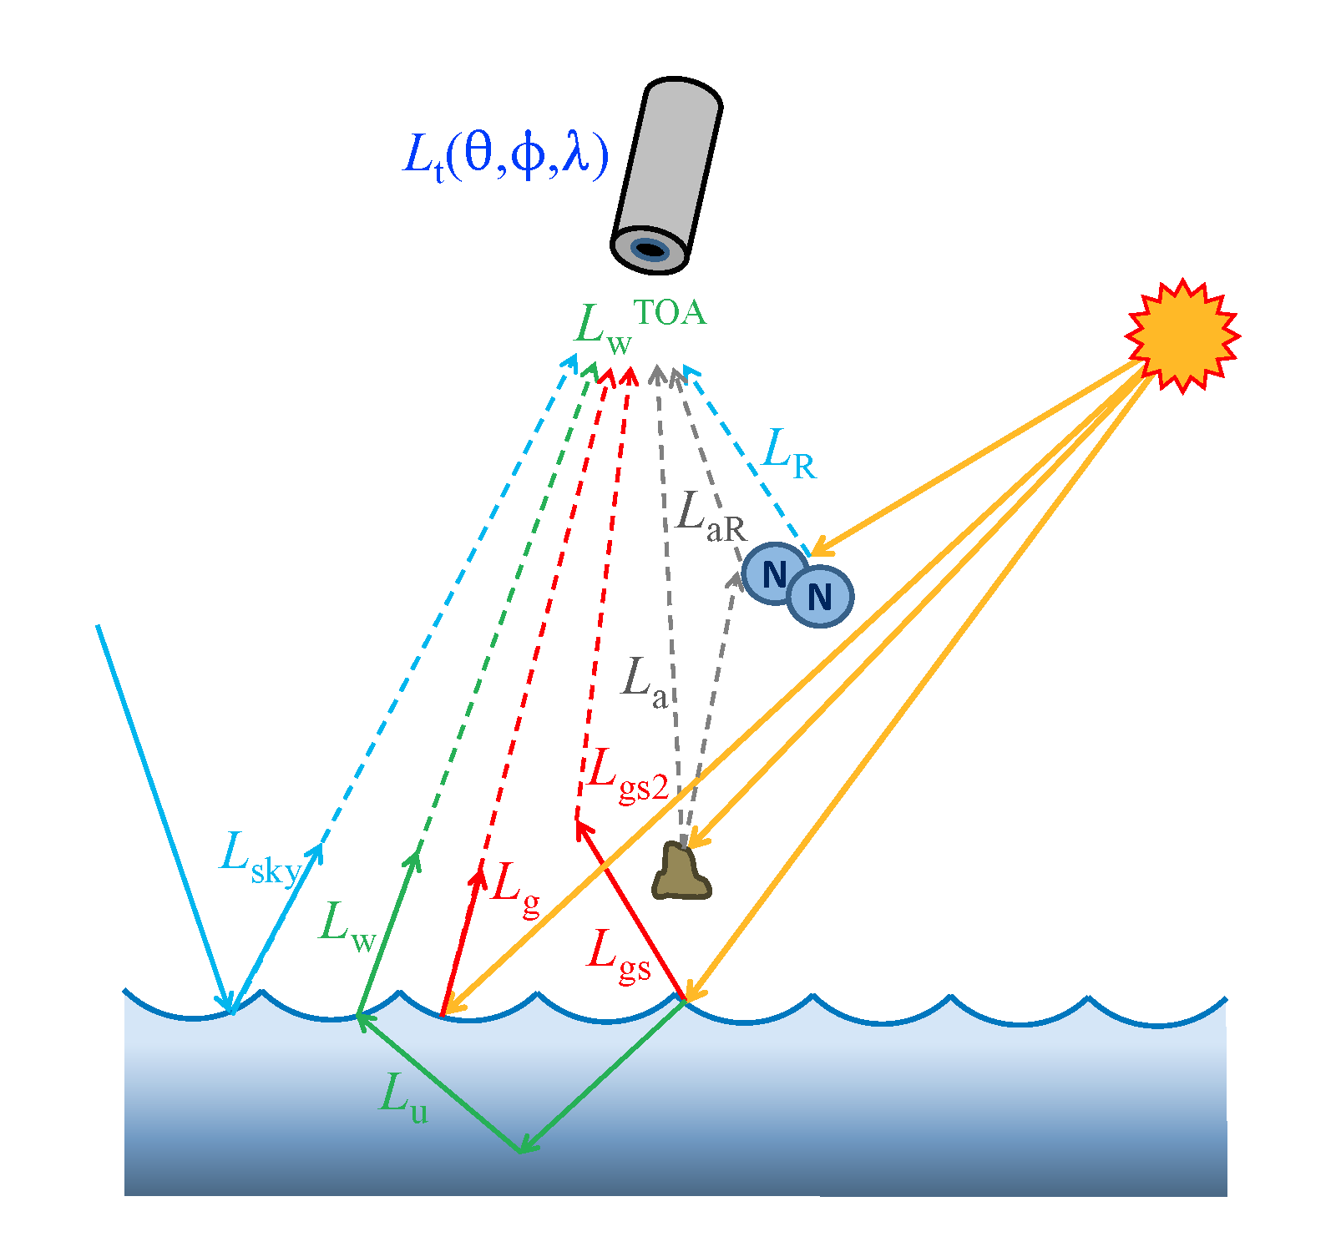
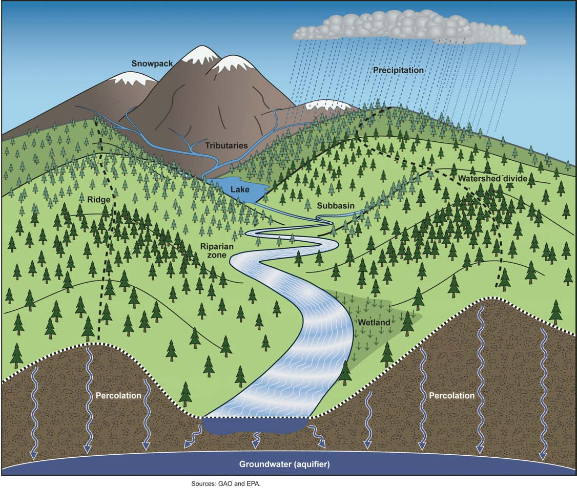
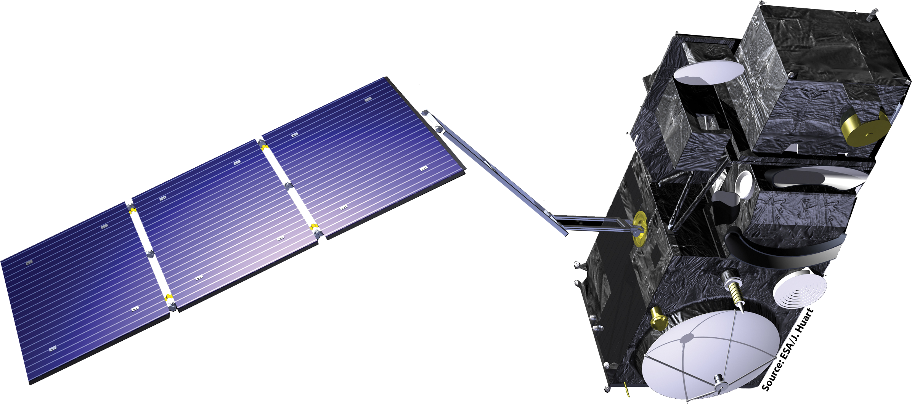
Future Work
Incorporate ocean color atmospheric processing for optimal signal-to-noise ratio
Utilize sensors with bands specific to cyanobacteria absorption features such as Sentinel-3 OLCI
Incorporate hydrological, climatic, and land use models for predictive capabilities
Source: NASA, ESA, EPA
Notes:
Ultimately, detection of algal events is a difficult task with many inherent sources of error and noise. Future work should incorporate data that have gone through atmospheric processing specifically for ocean color studies, which will have less noise and better represent the reflectance spectra directly above the water surface. Utilization of sensors such as OLCI, with bands specific to cyanobacteria absorption features, would also be very beneficial and allow for more quantitative and accurate products. Most notably, incorporation of fluid dynamic, climate, and nutrient flux models would allow for a predictive modelling component important to the end users. Future work will likely be best outside of the Earth Engine environment, as the current data acquisition limitations in Earth Engine hinder the use of upper-tier ocean color products.
------------- image credits ------------------
Left photo: https://oceancolor.gsfc.nasa.gov/docs/AtmosphericCorrectionTutorial.pdf
Middle photo: NASA DEVELOPedia – ESA source
Right photo: https://commons.wikimedia.org/wiki/File:Figure_1_A_Watershed_(7590258768).jpg

Slide 18
Science Advisors
Dr. Erin Urquhart, Science Systems & Applications, Inc., NASA Goddard Space Flight Center
Dr. Christine Lee, California Institute of Technology, NASA Jet Propulsion Laboratory
Dr. David Hondula, Arizona State University
Partners
The City of Austin Department of Watershed Protection
Brent Bellinger
The Lower Colorado River Authority
Lisa Benton
Additional NASA Advisors
Dr. Nima Pahlevan, Science Systems & Applications, Inc., NASA Goddard Space Flight Center
Brandon Smith, Science Systems & Applications, Inc., NASA Goddard Space Flight Center
NASA DEVELOP Lead & Fellow
Ryan Hammock, NASA DEVELOP Arizona
This material contains modified Copernicus Sentinel data (2021), processed by ESA.
Notes:
We would like to thank Dr. Erin Urquhart, Dr. Christine Lee, Dr. David Hondula, Dr. Nima Pahlevan, Ryan Hammock, The City of Austin Department of Watershed Protection, and the Lower Colorado River Authority (LCRA) for their support and contributions.

Slide 19
References
Beck, R., Zhan, S., Liu, H., Tong, S., Yang, B., Xu, M., Ye, Z., Huang, Y., Shu, S., Wu, Q., Wang, S., Berling, K., Murray, A., Emery, E., Reif, M., Harwood, J., Young, J., Nietch, C., Macke, D., … Su, H. (2016). Comparison of satellite reflectance algorithms for estimating chlorophyll-a in a temperate reservoir using coincident hyperspectral aircraft imagery and dense coincident surface observations. Remote Sensing of Environment, 178, 15–30. https://doi.org/10.1016/j.rse.2016.03.002
Dall’Olmo, G., & Gitelson, A. A. (2006). Effect of bio-optical parameter variability and uncertainties in reflectance measurements on the remote estimation of chlorophyll-a concentration in turbid productive waters: Modeling results. Applied Optics, 45(15), 3577. https://doi.org/10.1364/AO.45.003577
Lacaux, J. P., Tourre, Y. M., Vignolles, C., Ndione, J. A., & Lafaye, M. (2007). Classification of ponds from high-spatial resolution remote sensing: Application to Rift Valley Fever epidemics in Senegal. Remote Sensing of Environment, 9. https://doi.org/10.1016/j.rse.2006.07.012
Pahlevan, N., Smith, B., Schalles, J., Binding, C., Cao, Z., Ma, R., Alikas, K., Kangro, K., Gurlin, D., Hà, N., Matsushita, B., Moses, W., Greb, S., Lehmann, M. K., Ondrusek, M., Oppelt, N., & Stumpf, R. (2020). Seamless retrievals of chlorophyll-a from Sentinel-2 (MSI) and Sentinel-3 (OLCI) in inland and coastal waters: A machine-learning approach. Remote Sensing of Environment, 240, 111604. https://doi.org/10.1016/j.rse.2019.111604
Sekertekin, A., & Bonafoni, S. (2020). Land Surface Temperature Retrieval from Landsat 5, 7, and 8 over Rural Areas: Assessment of Different Retrieval Algorithms and Emissivity Models and Toolbox Implementation. Remote Sensing, 12(2), 294. https://doi.org/10.3390/rs12020294
Smith, B., Pahlevan, N., Schalles, J., Ruberg, S., Errera, R., Ma, R., Giardino, C., Bresciani, M., Barbosa, C., Moore, T., Fernandez, V., Alikas, K., & Kangro, K. (2021). A Chlorophyll-a Algorithm for Landsat-8 Based on Mixture Density Networks. Frontiers in Remote Sensing, 1, 623678. https://doi.org/10.3389/frsen.2020.623678
Zhao, Y., Liu, D., & Wei, X. (2020). Monitoring cyanobacterial harmful algal blooms at high spatiotemporal resolution by fusing Landsat and MODIS imagery. Environmental Advances, 2, 100008. https://doi.org/10.1016/j.envadv.2020.100008

