Slide 1
Gulf of Mexico Health &
Air Quality
Utilizing NASA Earth Observations to Manage Air Quality and Pollutants Over the Gulf of Mexico
Amanda Clayton (Project Lead)
Lori Mandable

Slide 2
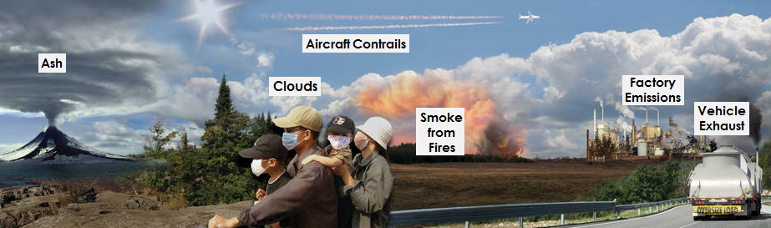
Community Concerns
Offshore oil and natural gas drilling in the GOM produces aerosol and nitrogen dioxide emissions
Affects onshore AQ, causing health and environmental impacts
Point data from individual platform and non-platform sources do not provide the regional coverage necessary to answer larger scale scientific questions
Credit: NASA
Notes:
Offshore oil and natural gas drilling in the Gulf of Mexico, on over 3,000 platforms, produces a wide variety of criteria pollutant emissions including aerosols and nitrogen dioxide. Emissions from offshore drilling can impact onshore air quality, causing health and environmental impacts. Emissions point data measured from individual platform and non-platform sources do not provide the regional coverage necessary to answer larger scale scientific questions over time.
Image Source: http://www.nasa.gov/content/goddard/cats-eyes-clouds-smoke-and-dust-from-the-space-station (Composite image created from photographs by Patrick Byrne, Carolyn Conner, Peggy Davis, Daneil Fogg, John Newman, Cyrus Reed, and Gayle Trautman)

Slide 3
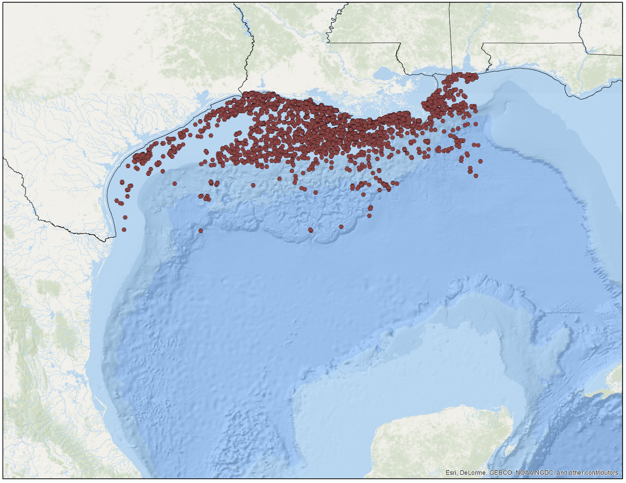
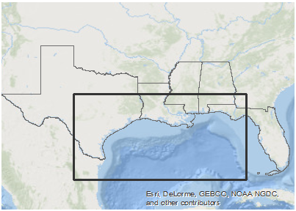
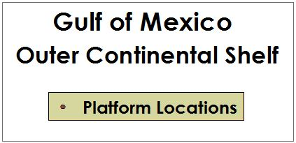

Study Area
Mississippi
Alabama
Louisiana
Florida
Texas
Notes:
Our project focused on the Outer Continental Shelf (OCS) of the Gulf of Mexico including the onshore areas of Texas, Louisiana, Mississippi, and Alabama. The points on the map show oil and natural gas production platform locations that were active from 2000 to 2015.
Base Map: Esri, DeLorme, GEBCO, NOAA NGDC, and other contributors

Slide 4


Objectives
Map and Analyze airborne pollutant concentrations of PM_{2.5} and NO₂ using NASA Earth observations
Determine correlations between pollutants and primary emission sources
Develop methodology for continuing emissions monitoring
Credit: BOEM
Notes:
Working with our partners at the Bureau of Ocean Energy Management, our project had three main objectives. First, to use NASA Earth observations to map and analyze airborne pollutant concentrations of aerosol PM2.5 and nitrogen dioxide. Second, to determine correlations between these pollutants and primary emissions sources by incorporating data from BOEM’s Gulfwide emission inventories and from EPA ground monitoring sites. Lastly, to develop a methodology that BOEM can use for continuing emissions monitoring.
Image Source: http://www.boem.gov/Sale-246/

Slide 5
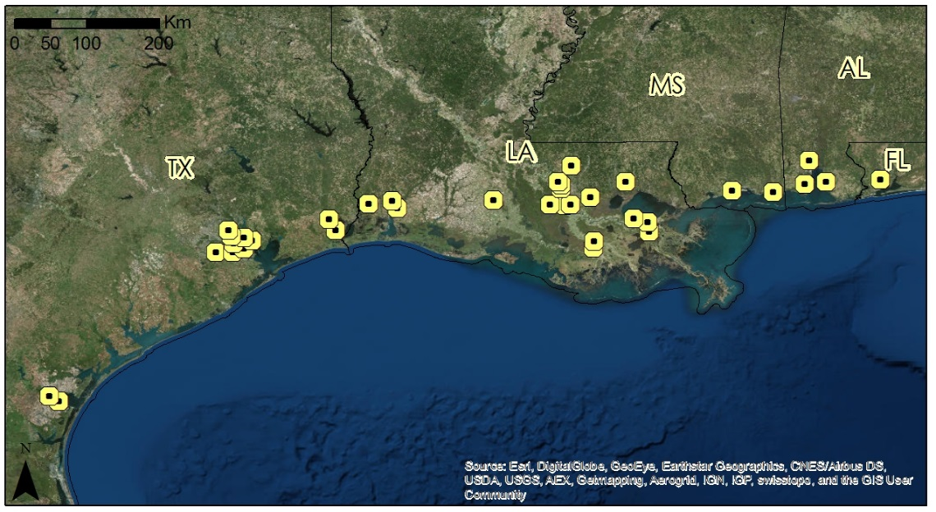

Methodology Overview
STEP 1
Examine Level 3 satellite data for preliminary analysis
STEP 2
Obtain Level 2 data and determine “hot spot” locations to analyze emission patterns
STEP 3
Compare and correlate Level 2 data with in situ point data
Notes:
The first step in the process was to obtain and examine Level 3 satellite data products from Terra’s MODIS and Aura’s OMI sensors for a preliminary, regional snapshot of emissions levels. Step 2 was to analyze higher resolution, Level 2 data to analyze monthly and annual emission patterns. And lastly, to compare and correlate the Level 2 data with in situ point data from our partners at the Bureau of Ocean Energy Management.

Slide 6
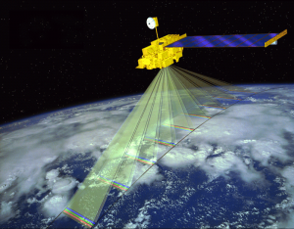
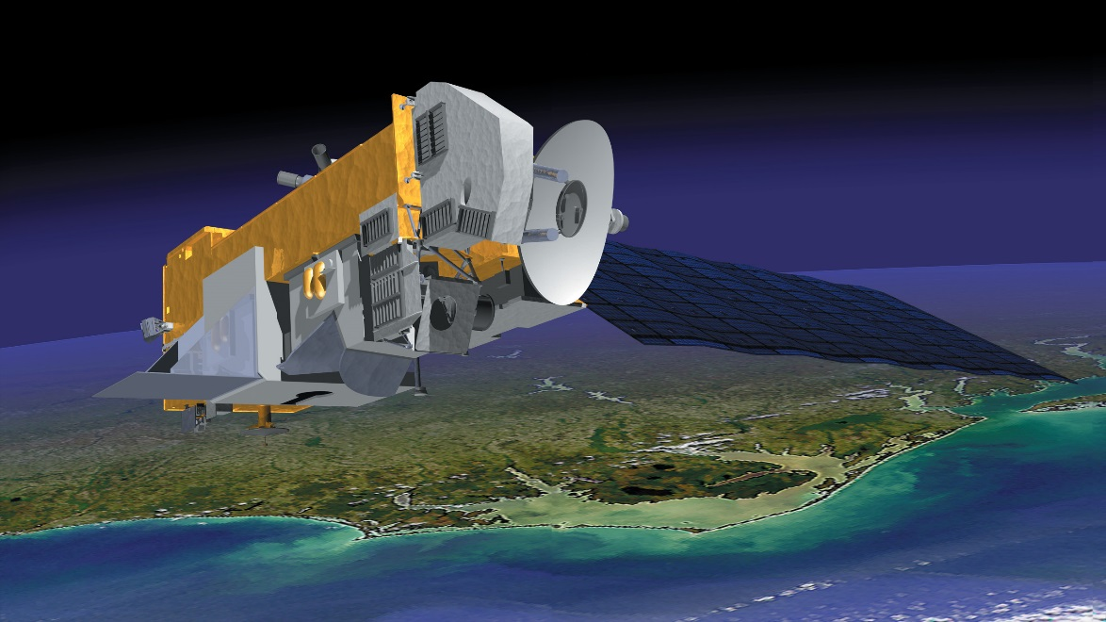
NASA Satellites & Sensors
Credit: NASA
Credit: NASA
Terra / MODIS
Aura / OMI
Aerosol Optical Depth (AOD)
Nitrogen Dioxide (NO₂)
Notes:
We utilized MODIS data from the Terra satellite for satellite retrieval of aerosol optical depth at 550 nm, which serves as a proxy for PM_{2.5} emissions, and Aura’s OMI data for total column nitrogen dioxide (NO₂)
Image Source: http://mynasadata.larc.nasa.gov/oyw/terra-celebrates-5000th-day-on-orbit/
Image Source: http://earthobservatory.nasa.gov/Features/Aura/

Slide 7
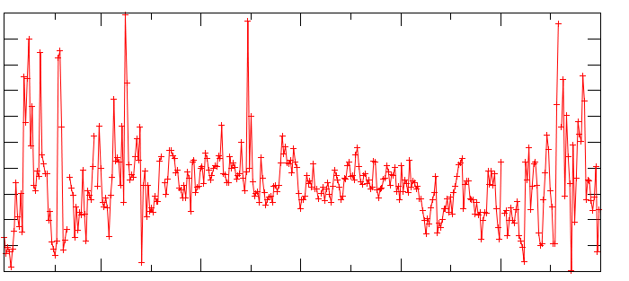
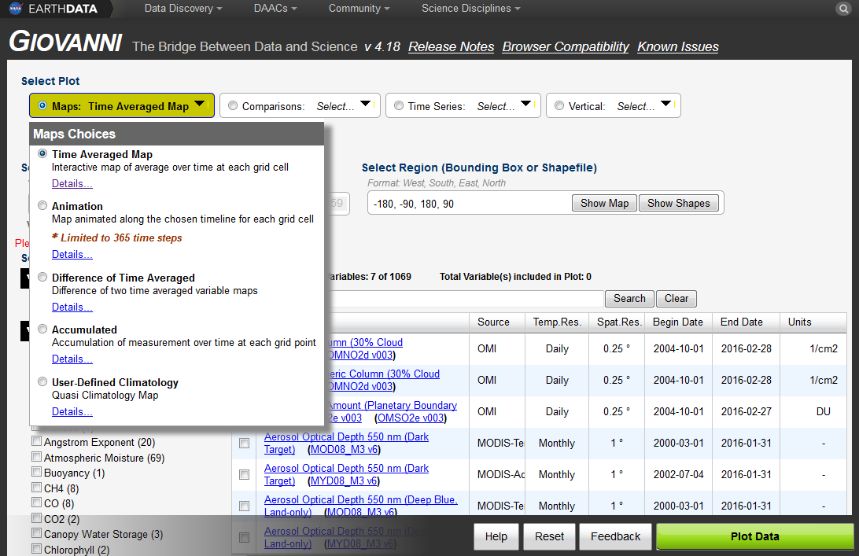
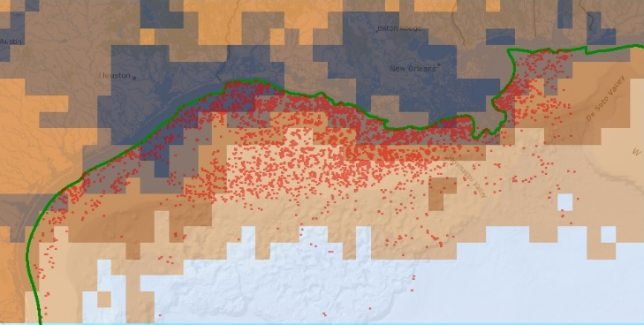
GIOVANNI
AREA - AVERAGED TIME SERIES
8e+15
7e+15
6e+15
1/cm2
5e+15
4e+15
3e+15
Jan
Mar
May
Jul
Sep
Nov
Jan
TIME – AVERAGED MAP
Notes:
We utilized NASA’s GIOVANNI online visualization and analysis tool, which allows for easy access and analysis of NASA satellite data. This allowed us to quickly visualize emissions data for the Gulf of Mexico by creating area-averaged time series and time-averaged maps over the 15 year time frame. For this preliminary analysis, daily gridded level 3 data products for Terra/MODIS (Aerosol Optical Depth) at 1 degree spatial resolution and Aura/OMI (nitrogen dioxide) at 0.25 degree spatial resolution.

Slide 8
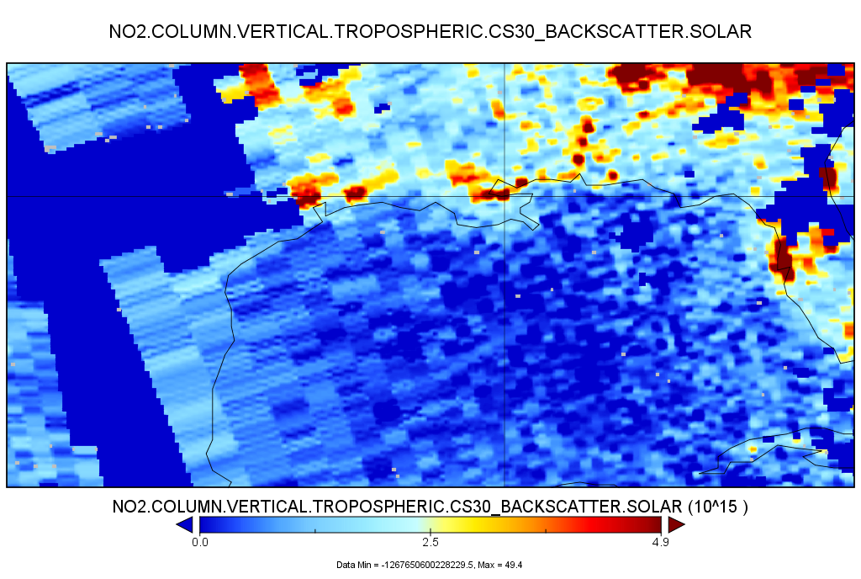
Level 2 Analysis
NO2.COLUMN.VERTICAL.TROPOSHPERIC.CS30_BACKSCATTER.SOLAR
0.1 degree gridded
Monthly MODIS AOD
Daily OMI NO₂
0.0 2.5 4.9 ^{(10^15)}
Notes:
From there, the majority of our analysis used 0.1 degree (approximately 10km) gridded level 2 data. IDL code was used to aggregate monthly MODIS AOD data to annual averages and daily OMI NO2 data to monthly and annual averages over the gulf.

Slide 9
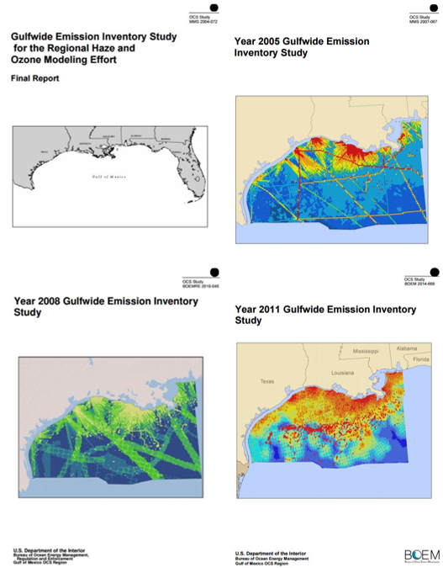
BOEM Emissions Inventories
Monthly emission data from platform and non-platform point sources
    CO
    CO₂
    VOCs
    CH₄
    SO₂
    NO_{x}
    PM_{2.5}
Sort and aggregate Access tables to identify PM_{2.5} and NO_{x} sources
Credit: BOEM
Notes:
BOEM requires that oil and gas platform and non-platform sources in the Gulf of Mexico record monthly emissions measurements for a variety of criteria pollutants and greenhouse gasses. These include carbon monoxide, carbon dioxide, volatile organic compounds, methane, sulfur dioxide, and the focus of this project - PM2.5 and nitrogen oxides. Examples of platform sources include diesel and natural gas engines, flares, and drilling equipment while non-platform sources include drilling rigs, pipe laying vessels, and helicopters. These monthly emissions data for the years 2000, 2005, 2008, and 2011 were stored in Microsoft Access database tables. These data were parsed by pollutant type and downloaded into Microsoft Excel for upload into ArcGIS, where it could be correlated with NASA satellite data.
Image Source: http://www.boem.gov/Gulfwide-Offshore-Activity-Data-System-GOADS/

Slide 10
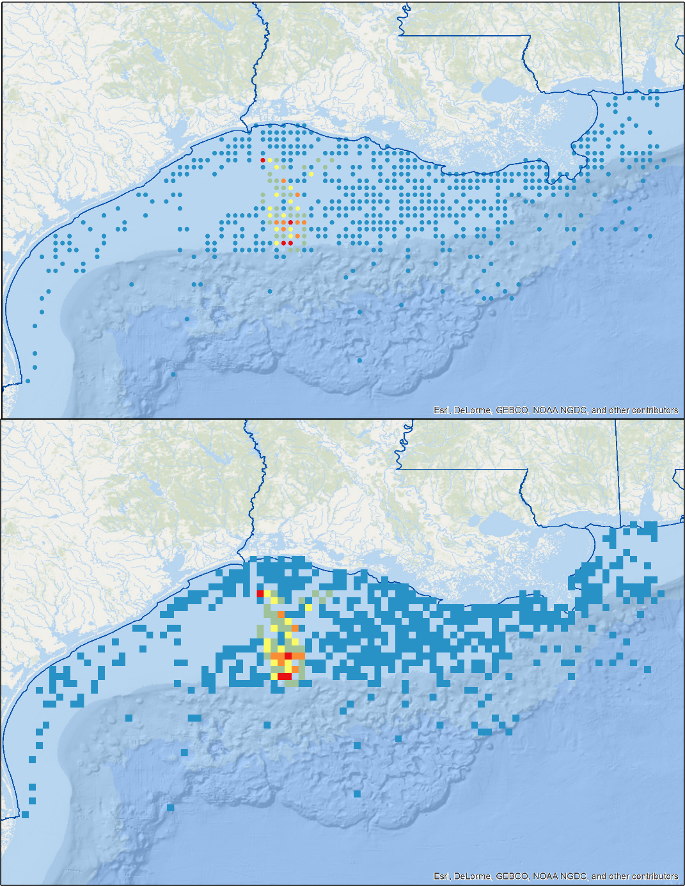
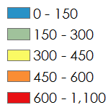

2011 PM_{2.5}
BOEM Data
Processing
3 years: 2005, 2008, 2011
Monthly Annual
Rasterization at 10km
Reclass and Identify hotspots
Tons per year
Notes:
We extracted BOEM emissions inventory data for the 3 years that corresponded with available satellite data: 2005, 2008, and 2011. We combined the platform and non-platform emissions tables and aggregated monthly emissions measurements to annual totals. We then combined the point data to create a 10km raster to match the spatial extent of the gridded level 2 data products.

Slide 11
Notes:
This graph shows the yearly averages for MODIS retrievals for Aerosol Optical Depth from 2002 to 2014. AOD emissions have decreased over the study area during this time. Yearly average values ranged between 0.16 and 0.2.

Slide 12
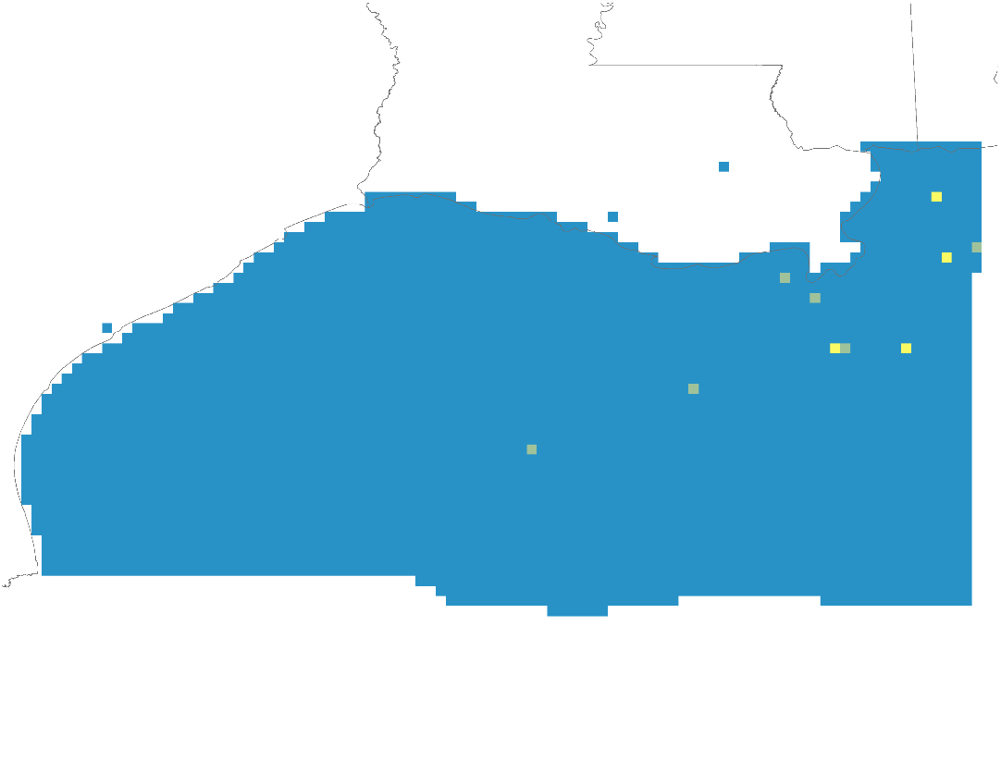
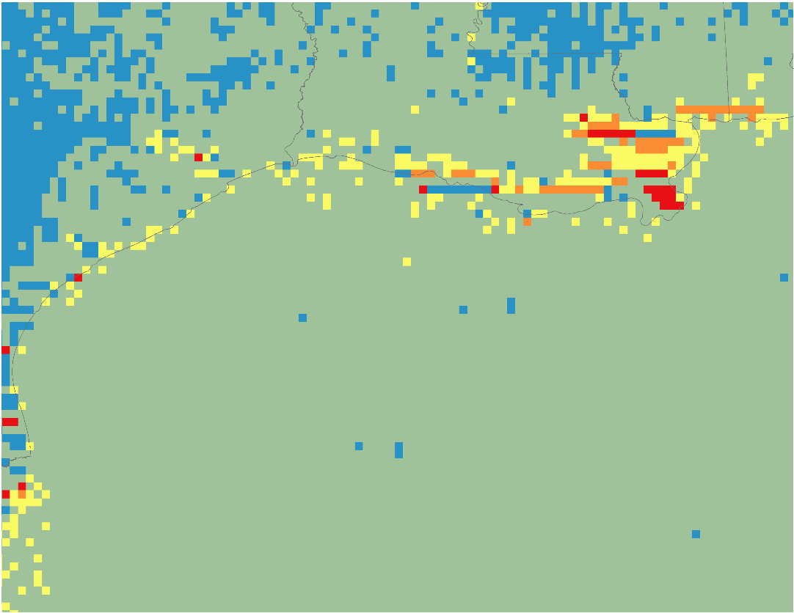

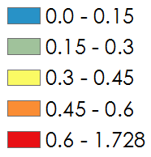
2005
BOEM MODIS
PM_{2.5} in tons per year
Aerosol Optical Depth
Notes:
The next series of figures shows the results for the comparison of BOEM measured PM2.5 emissions and MODIS satellite retrievals for AOD. On the left, is PM2.5 measured in tons per year and the right image represents AOD, a unitless quantity, for 2005. The scale for PM2.5 was standardized for all three years which is why the images depict primarily low values.

Slide 13
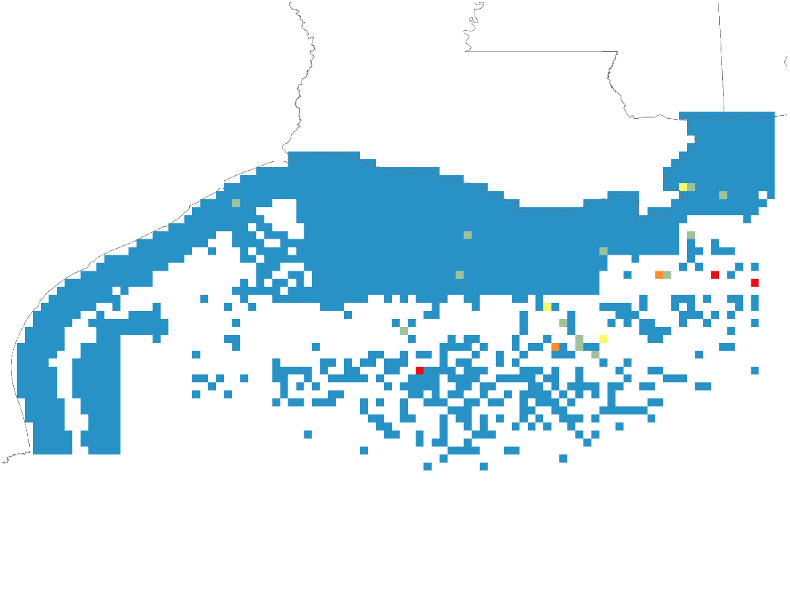
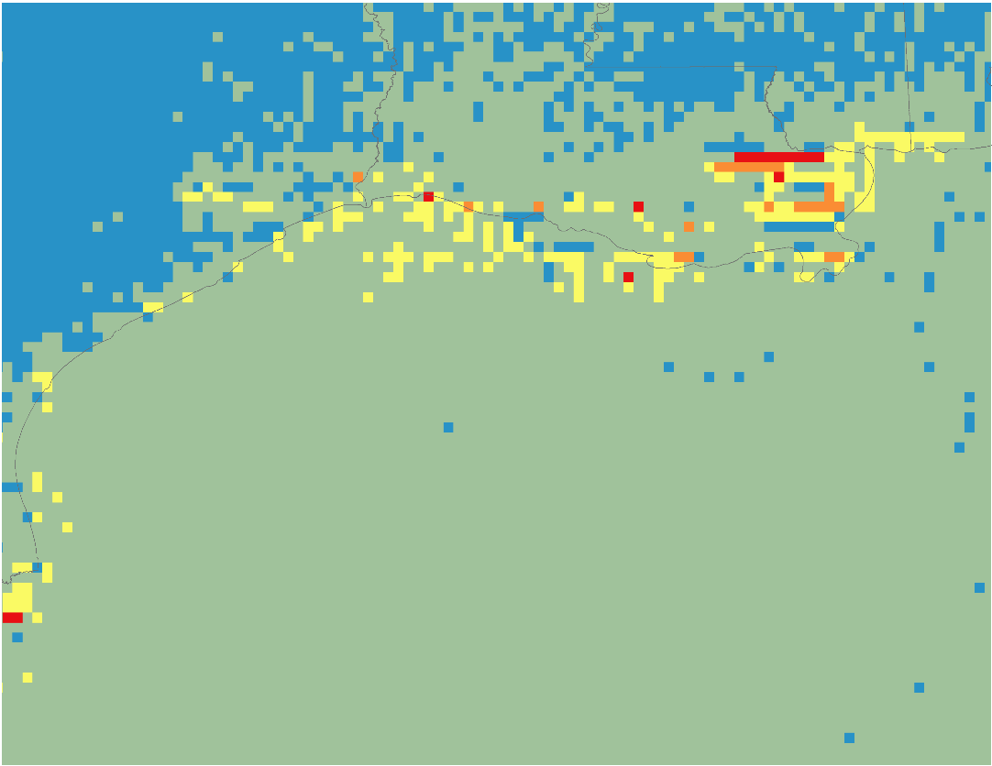
2008
BOEM MODIS
PM_{2.5} in tons per year
Aerosol Optical Depth
Notes:
This slide shows the same comparison for the year 2008.

Slide 14
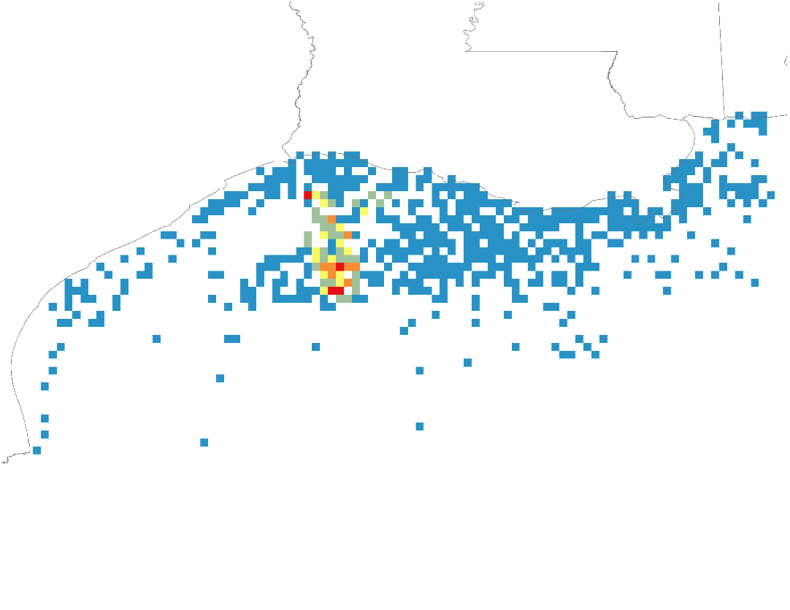
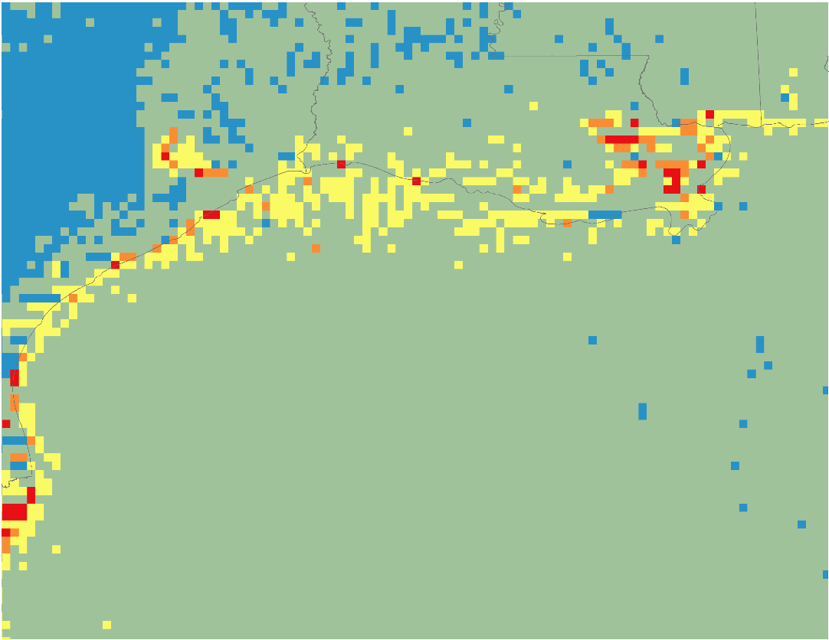
2011
BOEM MODIS
PM_{2.5} in tons per year
Aerosol Optical Depth
Notes:
As previously seen in the MODIS AOD time series, BOEM emissions measurements were high in 2011. It’s important to note that the number of platform/non-platforms measured by BOEM varied from year to year which can account for increases or decreases in total annual emissions measurements.

Slide 15
PM_{2.5}/AOD Correlation
Notes:
These scatter plots show the correlation between BOEM measured PM2.5 and MODIS AOD retrievals. No strong correlation was seen for either of the 3 years for collocated data points for the two sources.

Slide 16
Notes:
This graph shows the yearly averages of OMI retrievals for NO2 from 2005 to 2015. Nitrogen dioxide emissions have also decreased over the study area, although not as much as for AOD. Average values ranged from approximately 1.4E15 to 6.4E15.

Slide 17
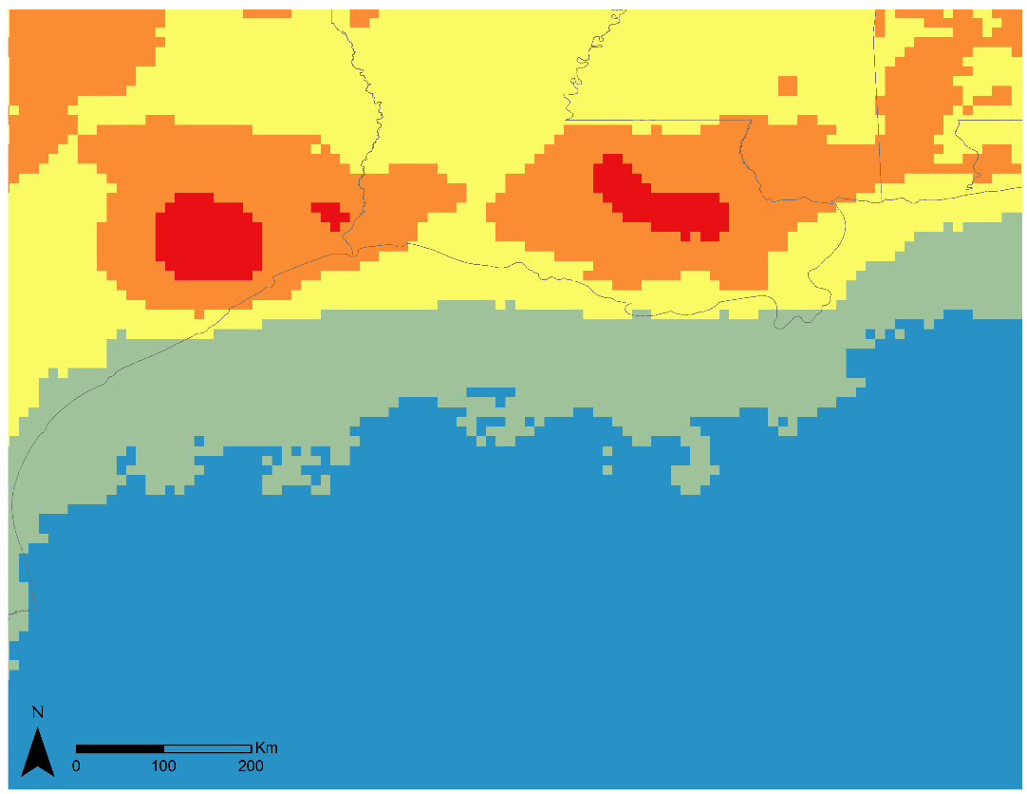

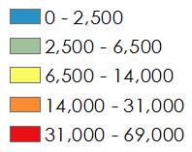
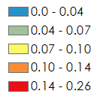
2005
BOEM OMI
NO_{x} Tons per Year
NO₂ in Dobson Units
Notes:
The next series of figures shows the results for the comparison of BOEM measured NOx emissions and OMI satellite retrievals for NO2. On the left are BOEM measured NOx from platform/non-platform sites in tons per year. OMI values were converted from molecules/cm2 to Dobson Units for easier analysis.

Slide 18
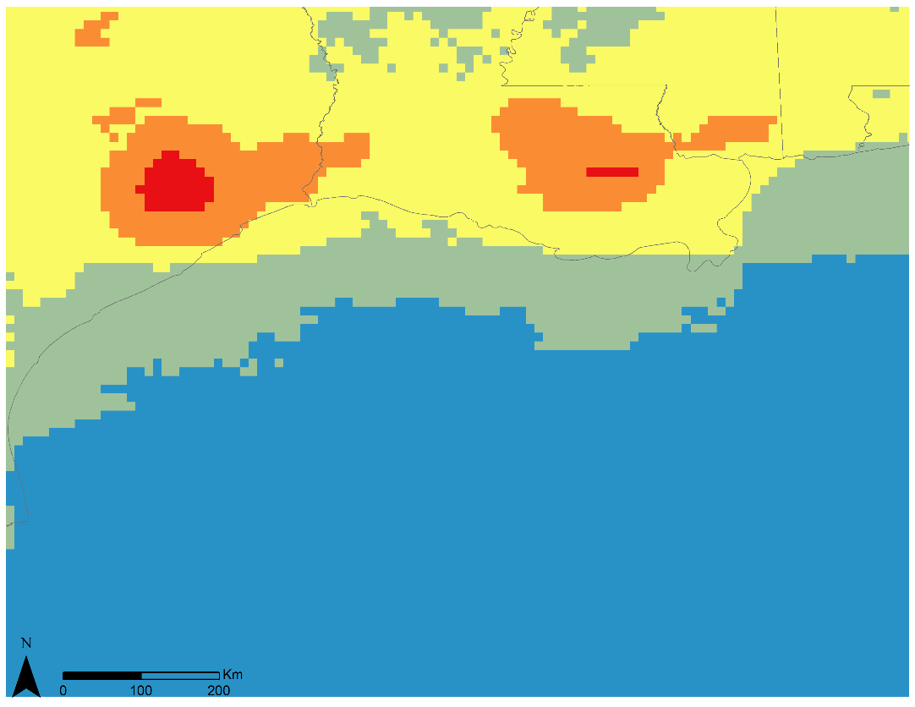
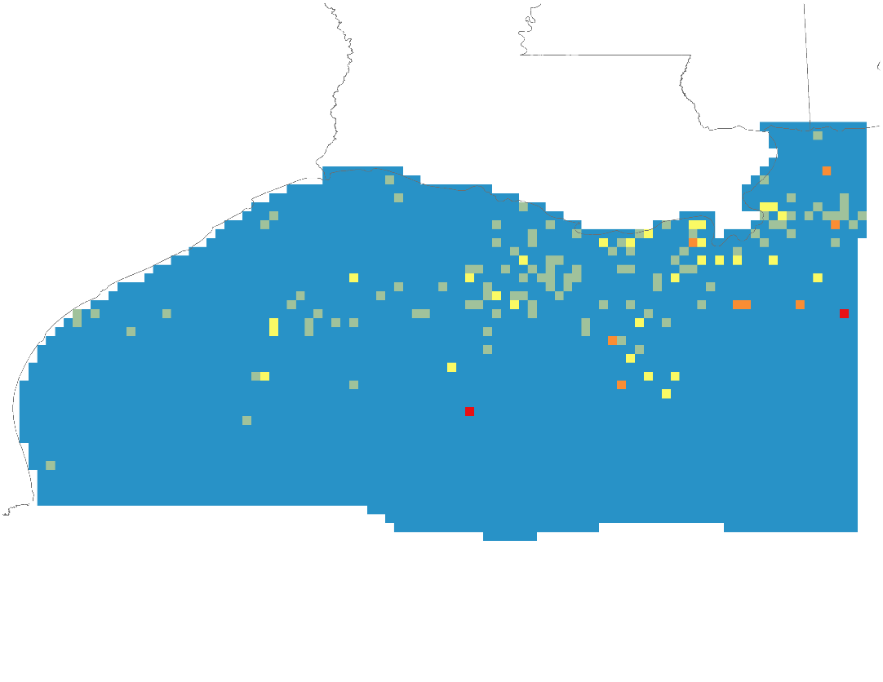
2008
BOEM OMI
NO_{x} Tons per Year
NO₂ in Dobson Units
Notes:
This slide shows the same comparison for 2008.

Slide 19

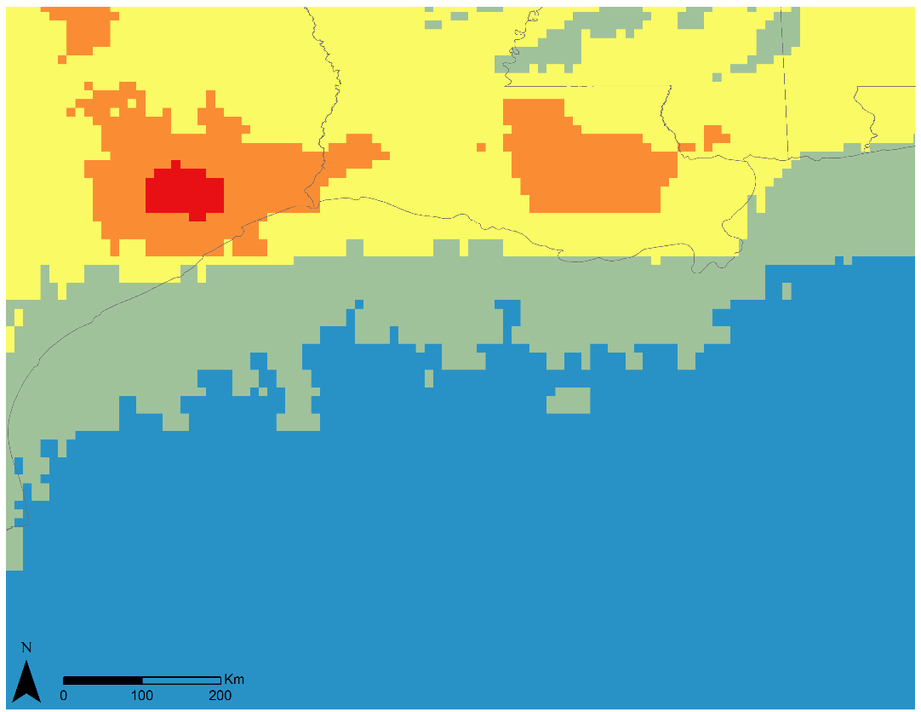
2011
BOEM OMI
NO_{x} Tons per Year
NO₂ in Dobson Units
Notes:
And lastly, BOEM and satellite measurements for NOx/NO2 in 2011. The OMI images from over the 3 years show the decrease in NO2 emissions from 2005 to 2011.

Slide 20
NO2 Correlation
Notes:
These scatter plots show the correlation between BOEM measured NOx and OMI NO2 retrievals. No strong correlation was seen for either of the 3 years for collocated data points for the two sources however, the correlations were stronger than those for PM2.5 and AOD.

Slide 21
Conclusions
Terra MODIS and Aura OMI satellite data for regional analysis
No significant correlations between BOEM and satellite emissions data
Incorporate additional data and satellites
Examine other pollutants (CO, CH₄, VOCs, etc.)
Notes:
Terra’s MODIS and Aura’s OMI instruments successfully provide AOD and NO2 emission data to analyze patterns on a regional scale over a time span of 10+ years. There were no significant correlations found between BOEM’s Emission Inventory data for the years 2005, 2008, and 2011 and corresponding satellite data for AOD and NO2. The results of this project could be improved by incorporating the 2014 BOEM emissions inventory, available later this year, and CALIPSO lidar data for additional AOD analysis. Additionally, the relationship between satellite retrievals and other pollutants measured in BOEM’s Gulfwide emissions inventories (sulfur dioxide, methane, carbon monoxide, and volatile organic compounds) could be examined following this method.

Slide 22
Advisors
Dr. Robert Levy, NASA GSFC
Dr. Pawan Gupta, NASA GSFC
Partners
Dr. Jose Hernandez, BOEM
Dr. Pawan Gupta, ARSET
Others
Dr. Bryan Duncan, NASA GSFC Dr. Can Li, NASA GSFC
Dr. Nickolay Krotkov, NASA GSFC Dr. Yan Zhang, NASA GSFC
Dr. Lok Lamsal, NASA GSFC

