Slide 1
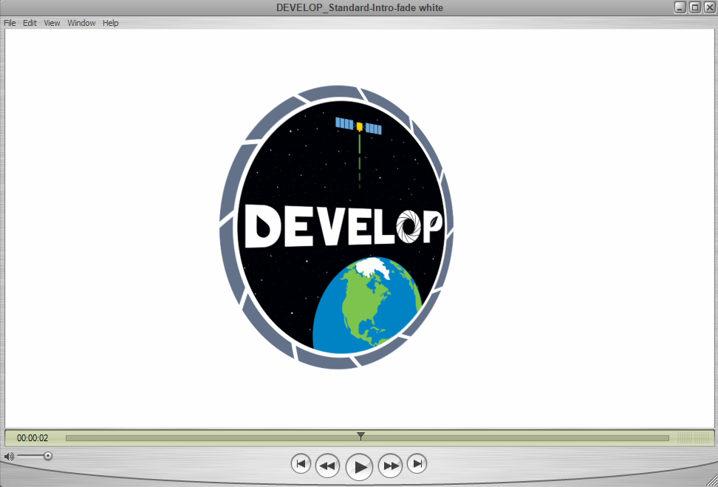
Scene 1: Opening
Scene Elements
Script: | Official DEVELOP introductory clip
Estimated Scene Duration: | 8 seconds
Narrator/ Team Member: | None
Scene Text/ Captions: | None
Royalty Free Music: | Last Stand – Purple Planet Music

Slide 2
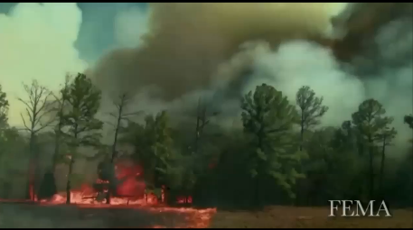
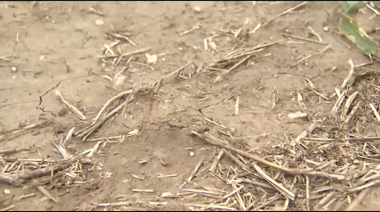
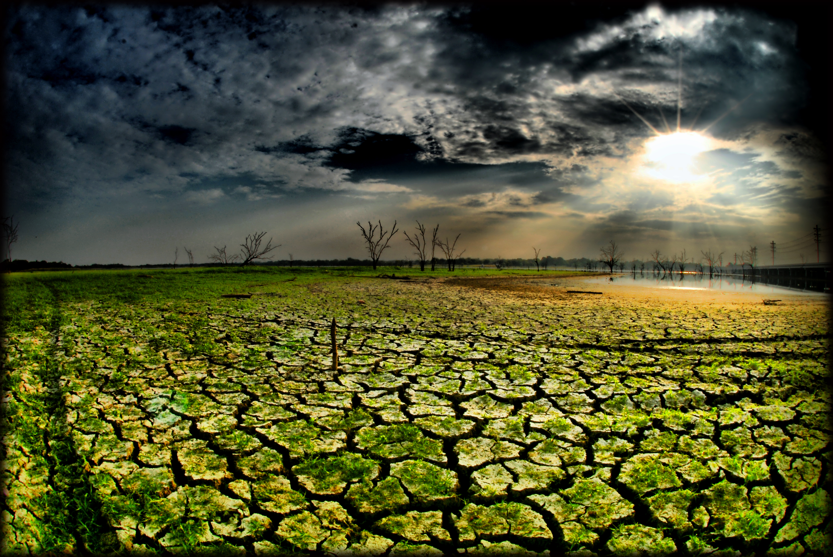
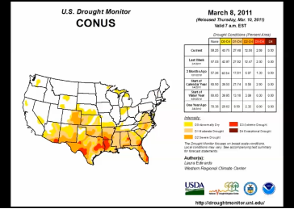
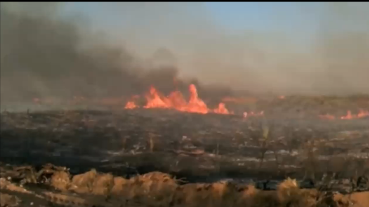
Scene 2: Background Information
10 seconds
Scene Elements
Script: | <Bastrop Video> The recent multi-year drought in Texas began in October 2010, however, March 2011 delivered the greatest blow to the state with widespread extreme drought conditions ailing the majority of its counties. Receiving 51% of the average annual precipitation, aquifers and lakes plunged to their lowest levels since the drought of the 1950s. By September, the Texas Forest Service reported 23,835 wildfires scorching 3.8 million acres. The estimated agricultural losses? 5.2 billion dollars.
Estimated Scene Duration: | 51 seconds
Narrator/ Team Member: | Zacary
Scene Text/ Captions: | None
Royalty Free Music: | Last Stand – Purple Planet Music

Slide 3
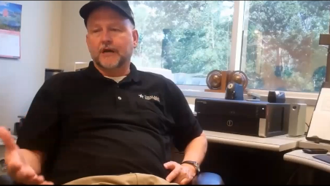
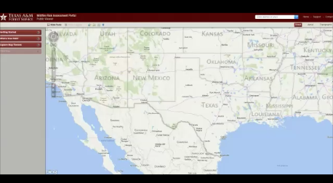
Scene 3: Partners
Tom Spencer
Curt Stripling
Scene Elements
Script: | In response to this issue, the project’s partner, the Texas A&M Forest Service, has made available an interactive Wildfire Risk Map currently accessible to the public which pinpoints areas prone to wildfires based on historical data. However, the TFS desired a product from NASA DEVELOP that could acquire data as close as possible to the present in order to verify locations reaching critical thresholds of live fuel moisture content in near real time.<Tom Spencer’s Interview>
Estimated Scene Duration: | 39 seconds
Narrator/ Team Member: | Zacary
Scene Text/ Captions: | Tom Spencer, Department Head of Predictive Service, Texas Forest Service
Royalty Free Music: | Sierra Nevada – Purple Planet Music

Slide 4
Scene 4: Intro Team
Scene Elements
Script: | The Texas Water Resource team was to assist the Texas Forest Service in preparing for future wildfires by expanding upon a drought severity index created by a previous term. This modified index will allow our partner to identify what geographical locations within the state of Texas are the most prone to wildfire disasters and where water resources may be concentrated in order to fight them efficiently before the cycle repeats itself once more. In this way, NASA DEVELOP plans on breaking the ring of fire in Texas.
Estimated Scene Duration: | 27 seconds
Narrator/ Team Member: | Zack
Scene Text/ Captions: | Texas Water Resources Team Zacary Richards, Texas Water Resources, Team Member Breaking the Ring of Fire
Royalty Free Music: | None

Slide 5
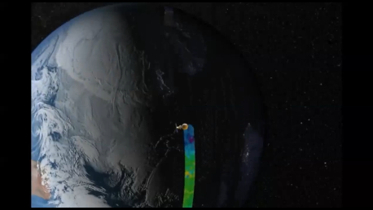
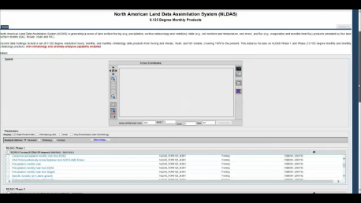
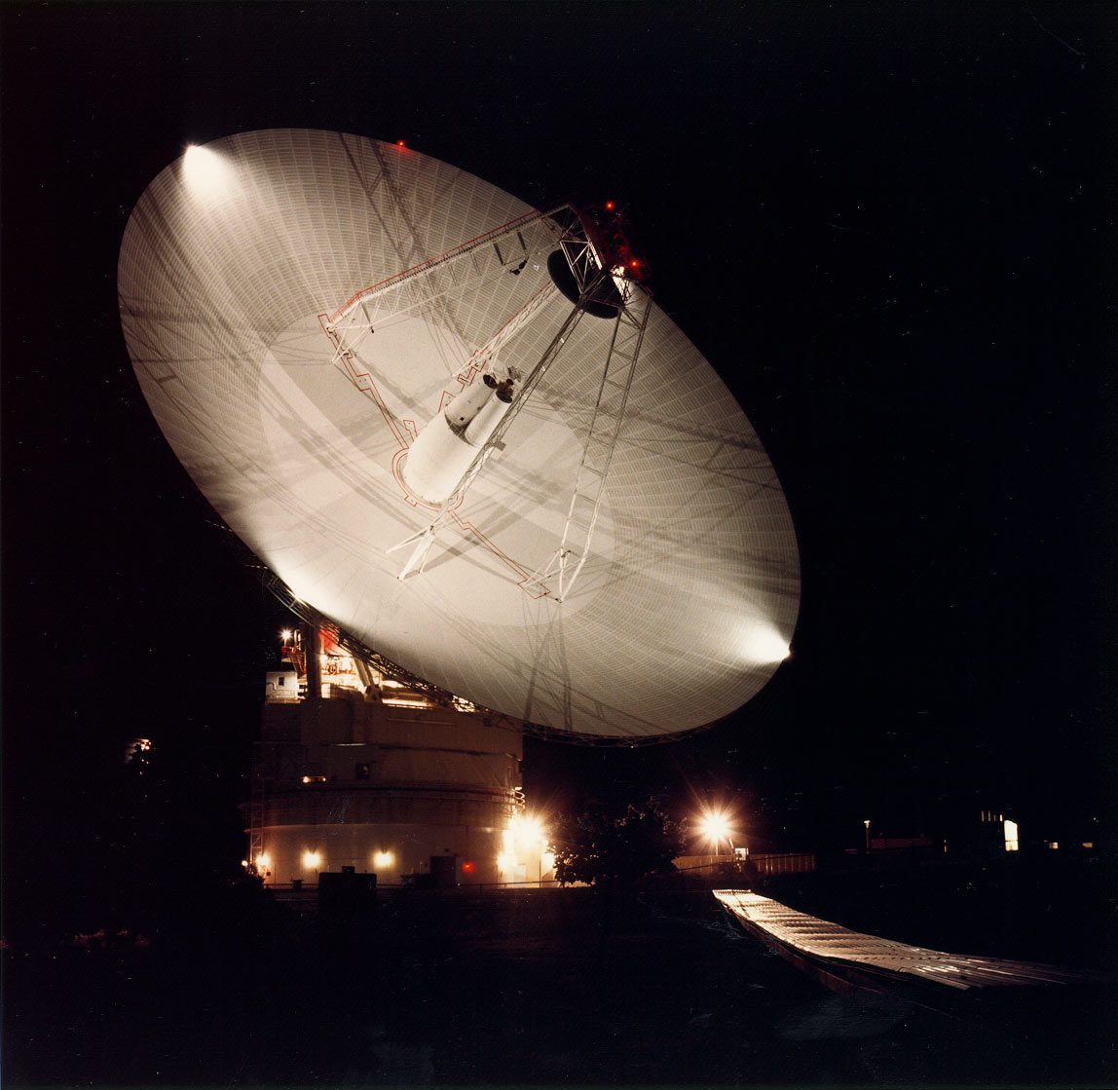
Scene 5: Data Acquisition and Processing
Scene Elements
Script: | With the help of our science advisor, the team first determined the factors that contribute to wildfires: land surface temperature, vegetation, precipitation and soil moisture . NASA Earth Observing System Data from Aqua and Terra MODIS provided the inputs for Land Surface Temperature and Vegetation. Soil moisture data were collected from the North American Land Data Assimilation System and precipitation data were provided by the Multisensor Precipitation Estimator hosted by NOAA. Data were collected for the summer months between the years 2010-2011 and 2014-2015. These periods were selected because of the extreme drought conditions that began in the state in 2010, and brought about widespread wildfires to various regions the following year. The latter years were included in this study as they offer the most current timeline available for research. In addition, the drought severity index was given three different weight values calculated in Python script.
Estimated Scene Duration: | 55 seconds
Narrator/ Team Member: | Laura
Scene Text/ Captions: | Dr. Kenton Ross, NASA DEVELOP Science Advisor Laura Lykens, Texas Water Resources, Team Member images of the satellites, or video of satellites http://svs.gsfc.nasa.gov/cgi-bin/details.cgi?aid=3939 (Source: NASA/GSFC Scientific Visualization Studio)
Royalty Free Music: | Rumble - Bensound

Slide 6
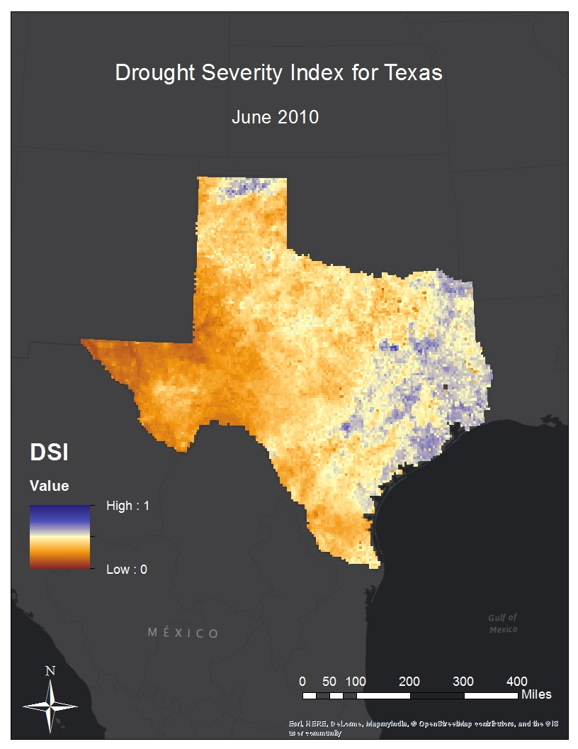
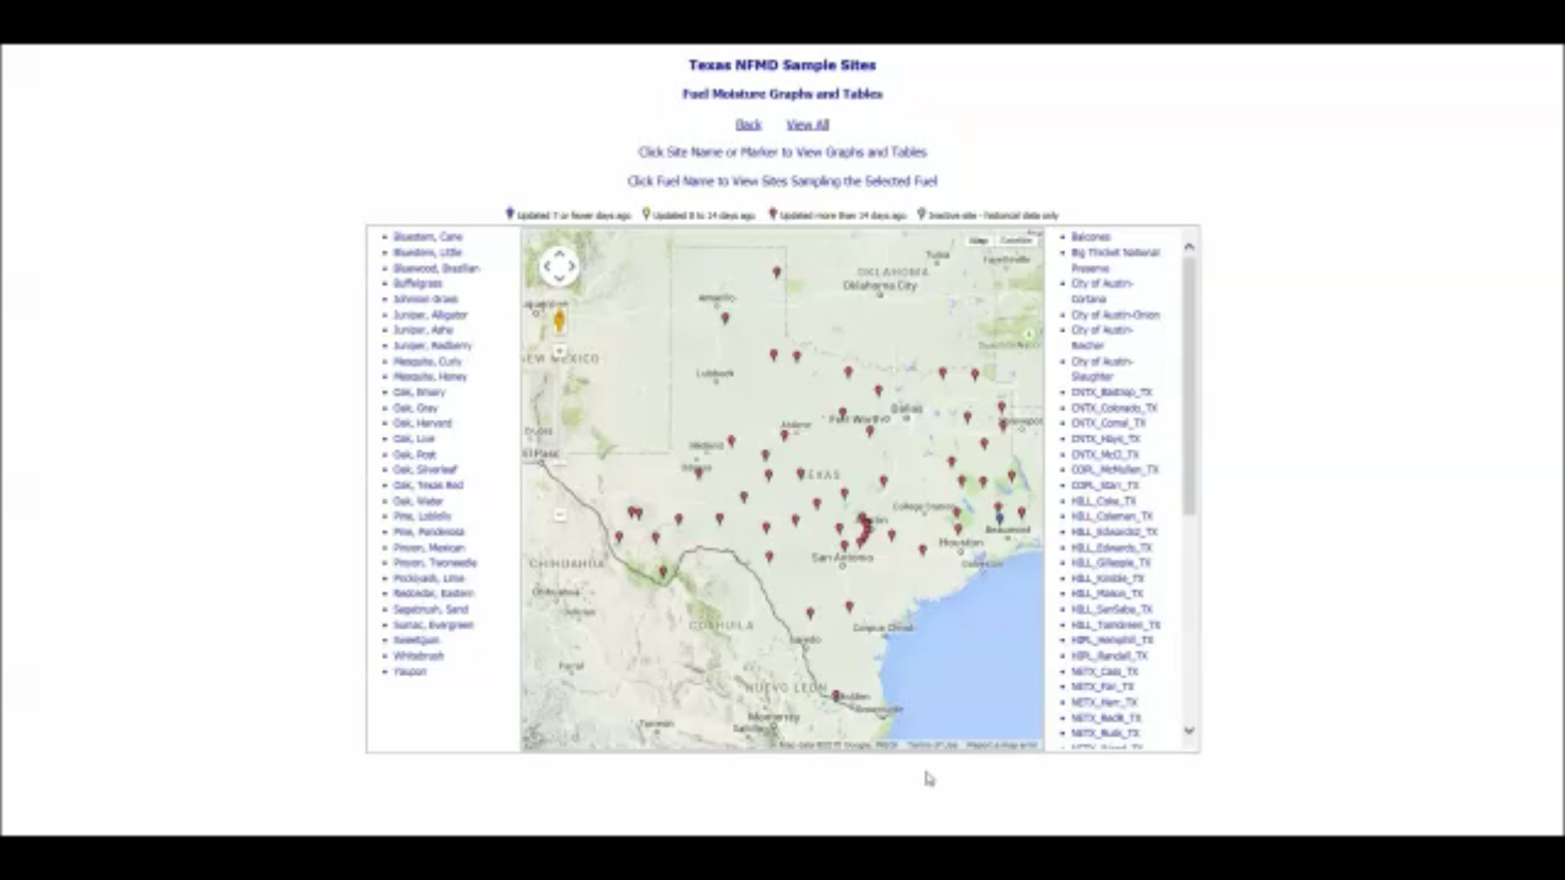
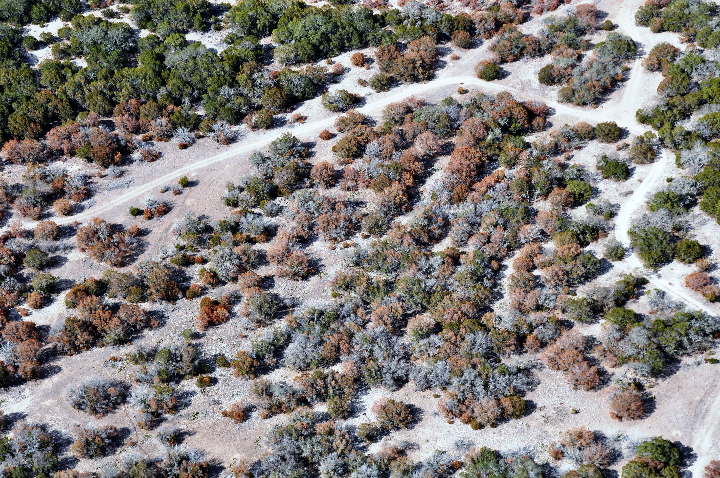
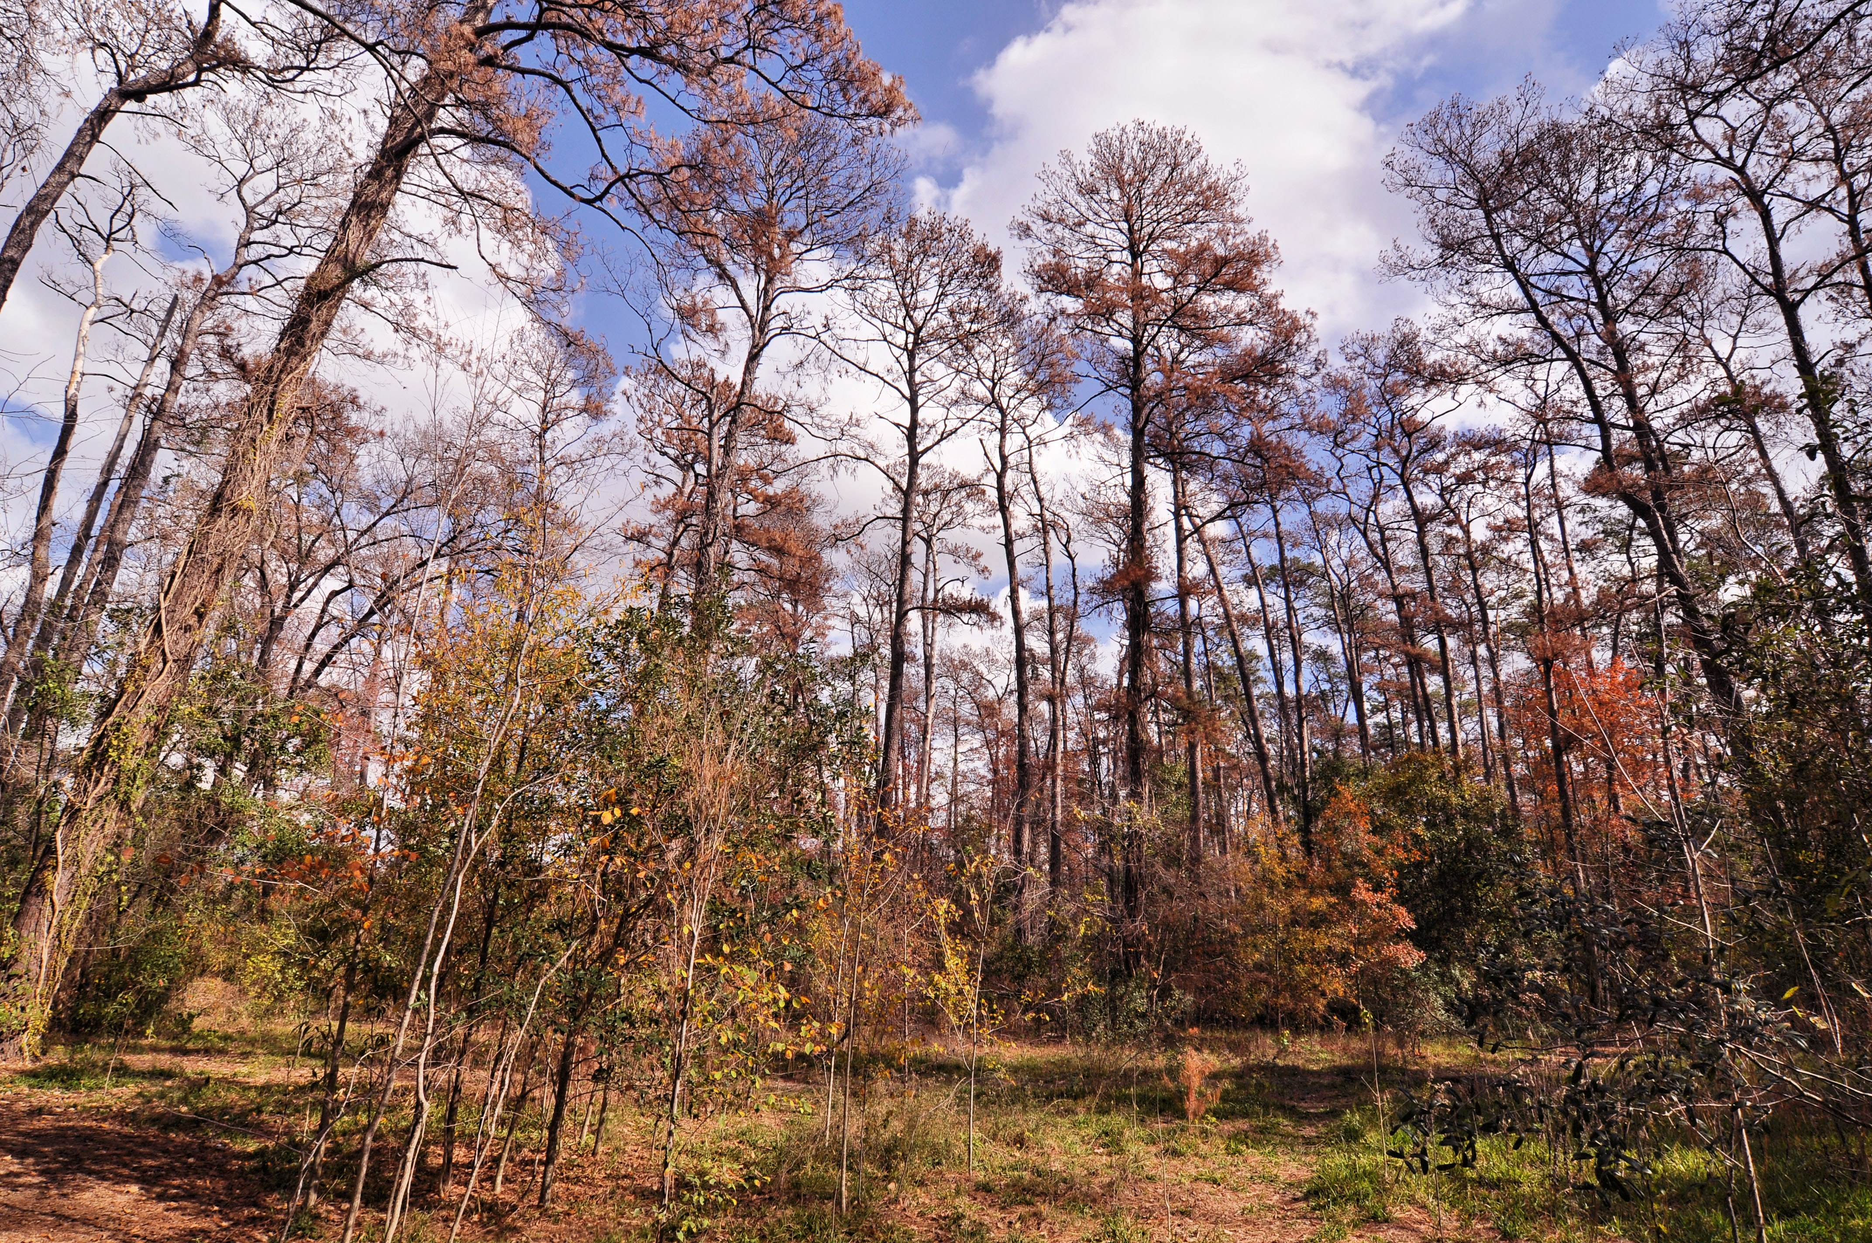
Scene 6: Results
Scene Elements
Script: | The resulting maps display six classifications of drought severity. Blue areas reflect adequate to slightly lacking moisture levels while the pale-yellow to brown colors indicate areas of concern and potential wildfire risk. The months for each year in the study period reflect the change in the impact of drought conditions on various regions throughout the state. The values for the DSI were then compared with fuel moisture content data from two different coniferous species at specific locations to verify the accuracy of the algorithms. These species included Redberry Juniper and Loblolly Pine. Scatterplots were created for each year to show the correlation between drought severity and fuel moisture values.
Estimated Scene Duration: | 35 seconds
Narrator/ Team Member: | Megan
Scene Text/ Captions: | None
Royalty Free Music: | Acoustic Sun – Purple Planet Music

Slide 7
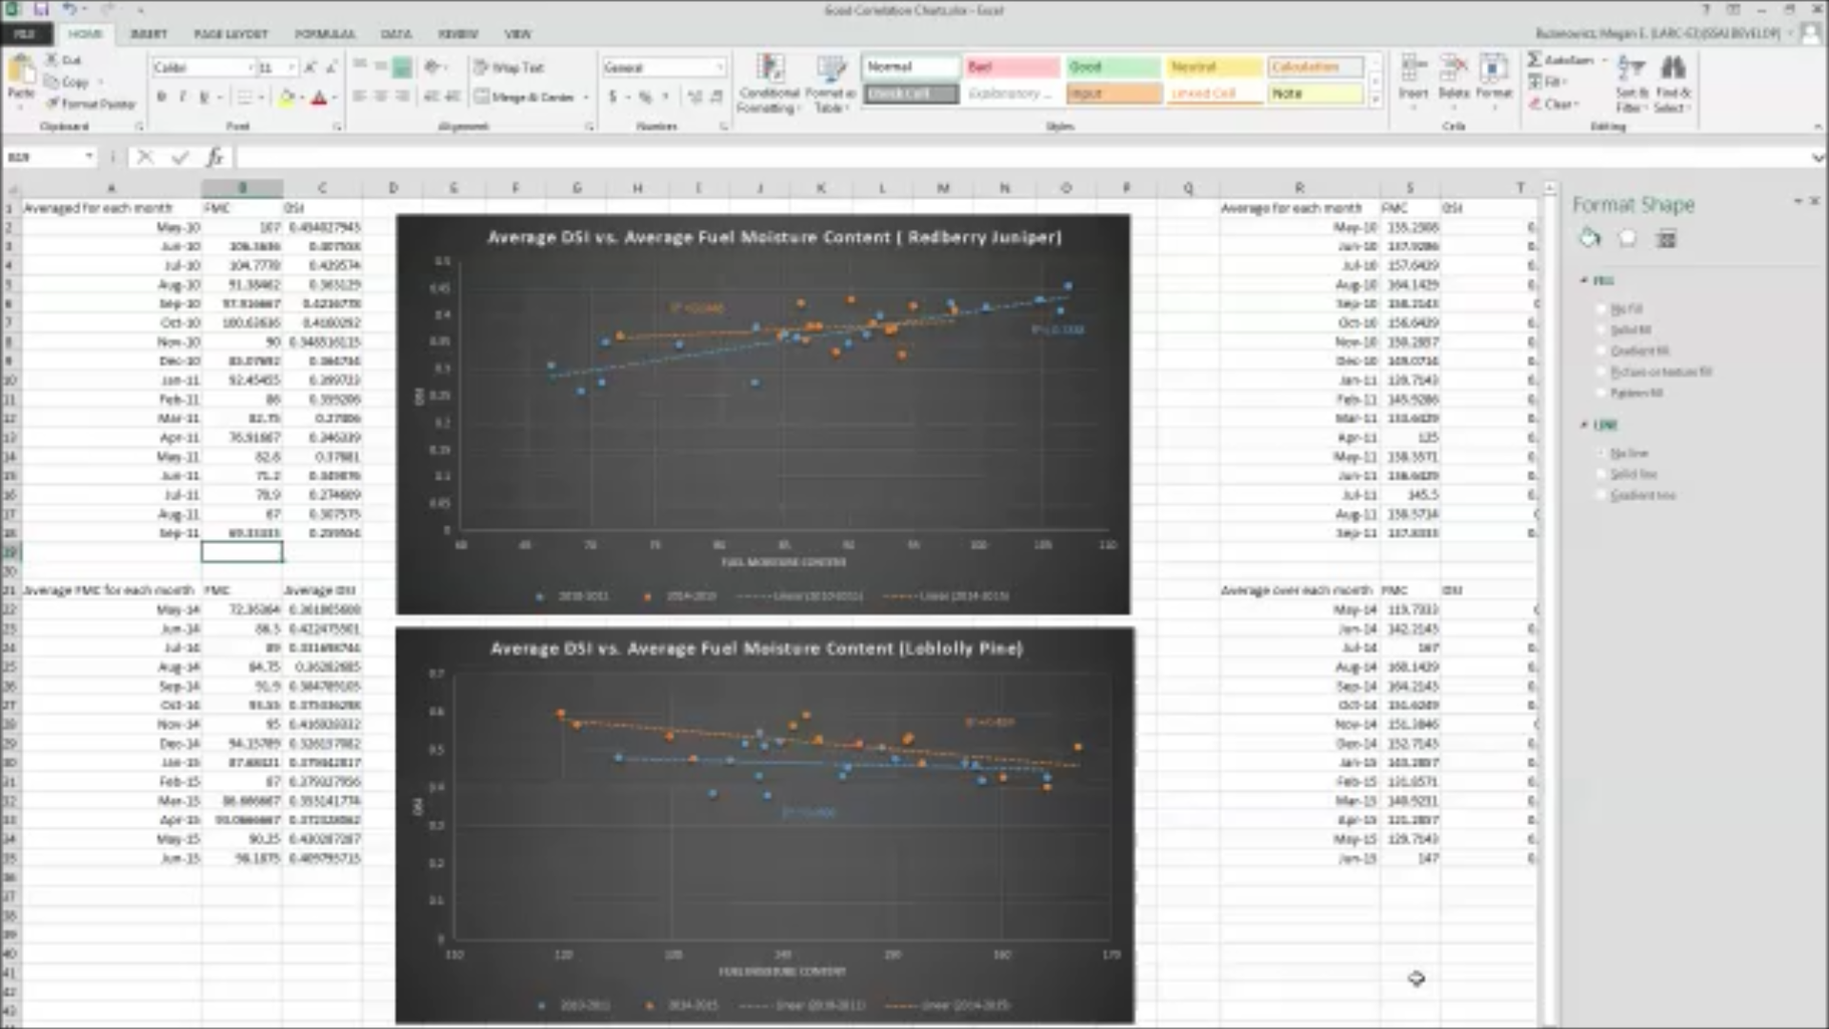
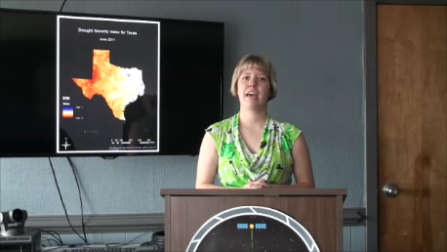
Scene 7: Conclusions
Scene Elements
Script: | Despite inconsistencies in the correlation graphs between the DSI and the FMC, this study has laid the foundation for forthcoming work that involve a focus on the importance of soil moisture in dry conditions and how soil moisture may play a role in determining prospective trends in wildfire risk. The history of drought in Texas insist that we learn from the past in order to prepare for a similar event in the years to come. The Drought Severity Index can help in that regard by identifying areas of environmental concern and allowing decision makers to allocate resources where they are needed most.
Estimated Scene Duration: | 23 seconds
Narrator/ Team Member: | Megan
Scene Text/ Captions: | Megan Buzanowicz, Texas Water Resources, Team Lead
Royalty Free Music: | Acoustic Sun – Purple Planet Music

Slide 8
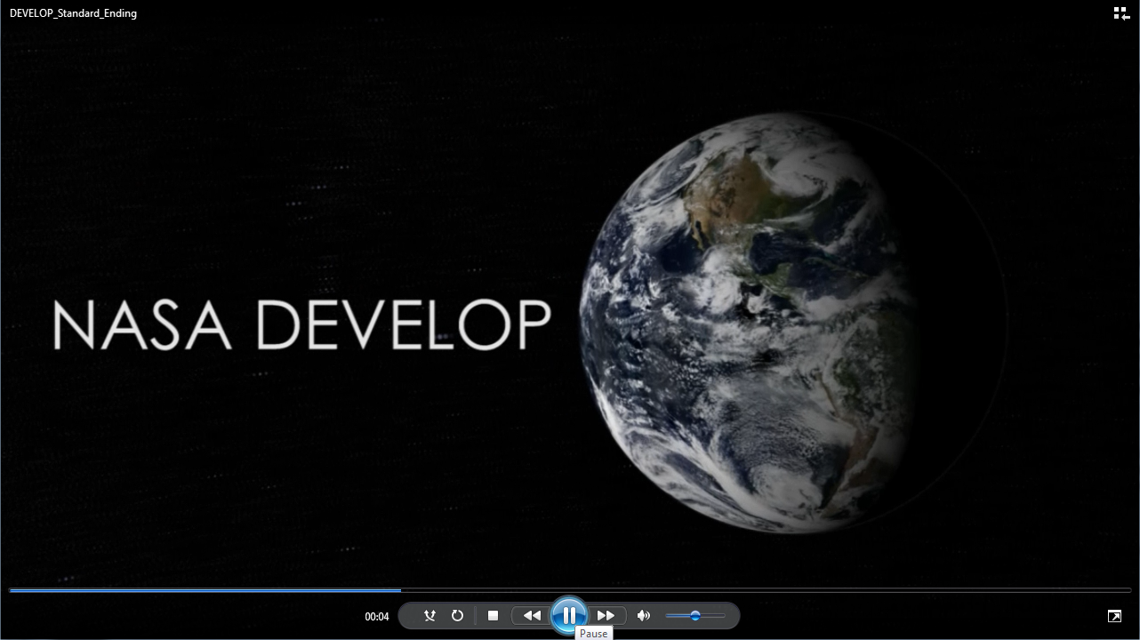
Scene 8: Ending
Scene Elements
Script: | Official DEVELOP ending
Estimated Scene Duration: | 17 seconds
Narrator/ Team Member: | None
Scene Text/ Captions: | Leave a comment or question below Trade names and trademarks are used in this report for identification only. Their usage does not constitute an official endorsement, either expressed or implied, by the National Aeronautics and Space Administration. This material is based upon work supported by NASA through contract NNL11AA00B and cooperative agreement NNX14AB60A.
Royalty Free Music: | Acoustic Sun – Purple Planet Music

