Slide 1
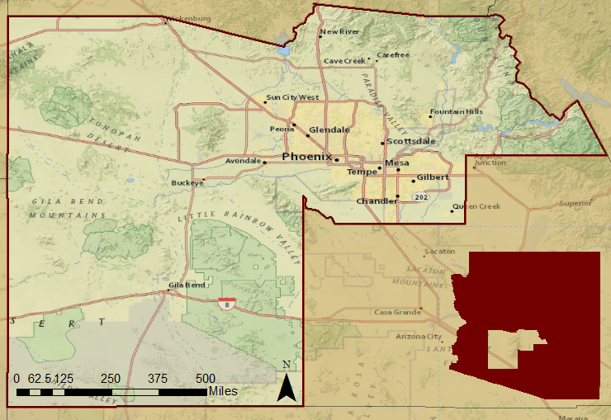
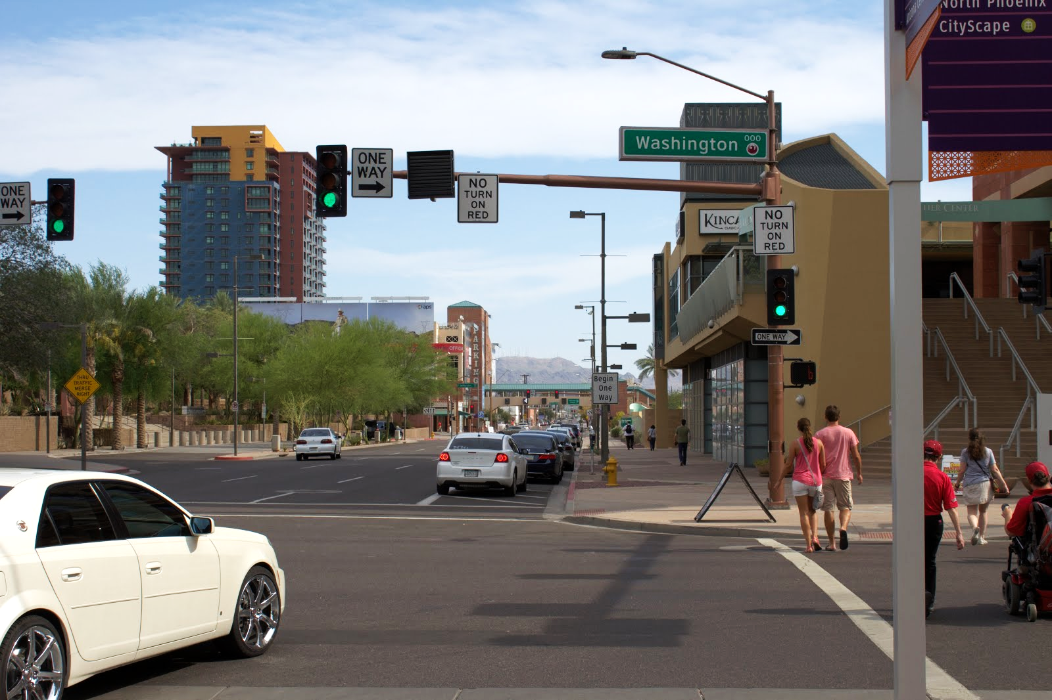
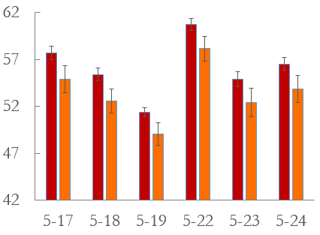
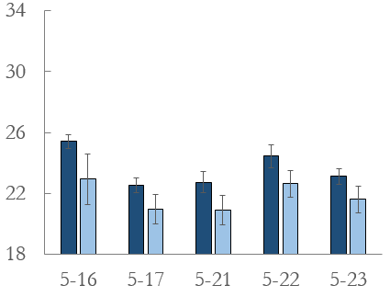
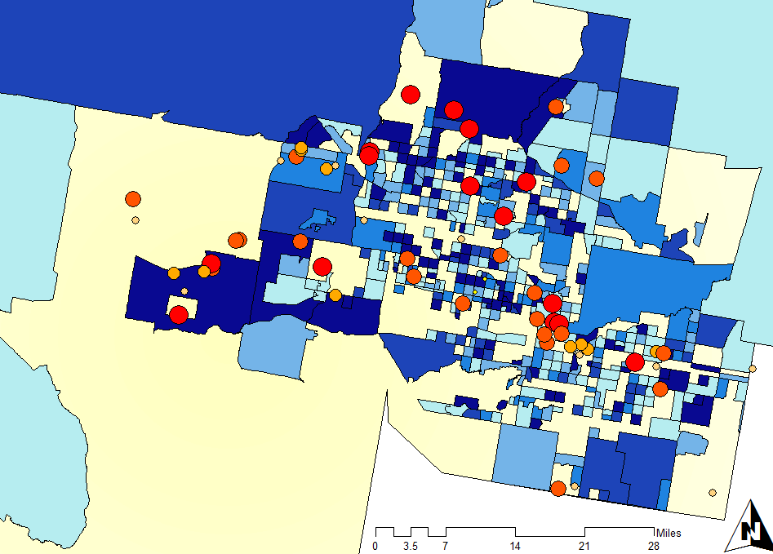
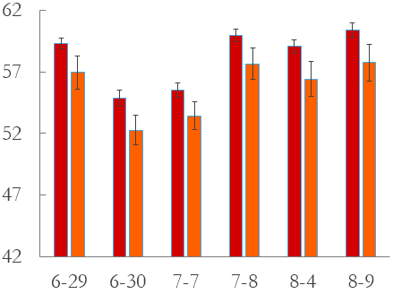
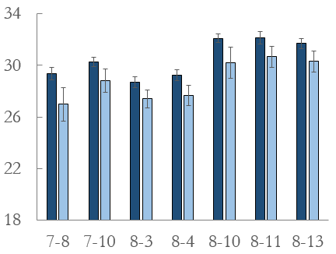
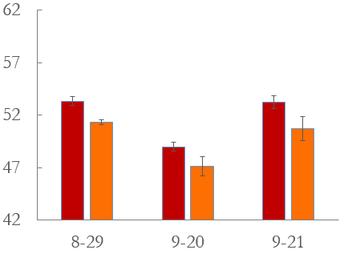
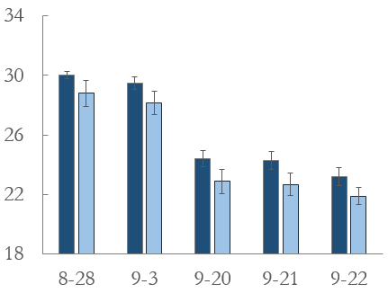
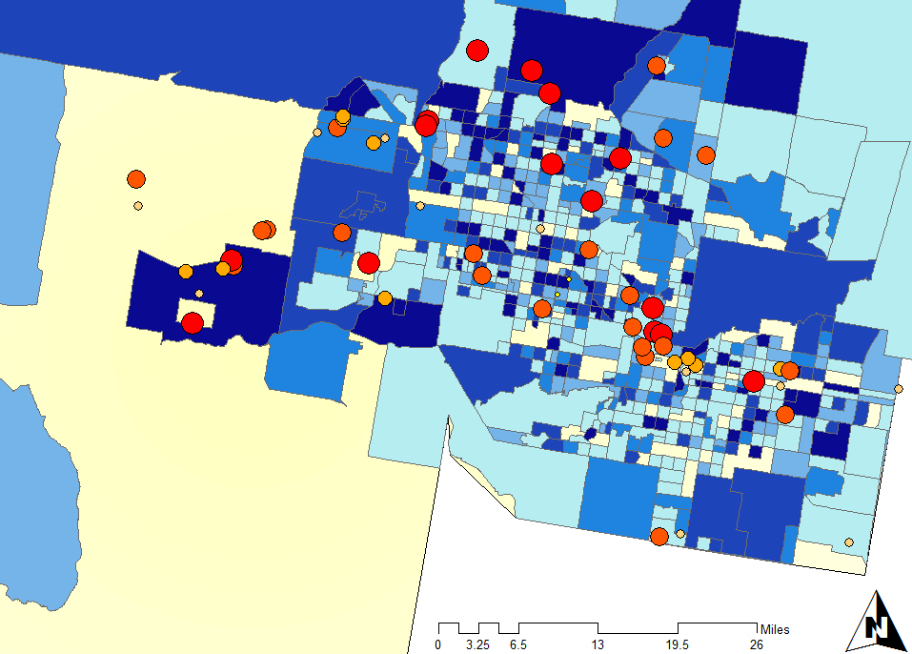
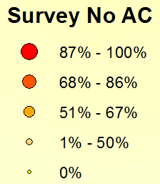
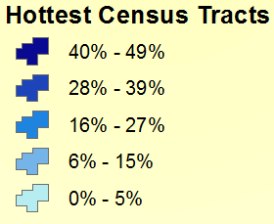
Arizona Health & Air Quality
Enhancing extreme heat intervention and preparedness activities in Maricopa County, AZ
Amy Stuyvesant (Project Lead), Geordi Alm, Rocky Garcia, Emma Baghel, April Rascon, Bernardo Gracia
NASA DEVELOP National Program at NASA Langley Research Center
Abstract
Objectives
Study Area
Study Period:
May - Sept.
2005-2014
Extreme heat causes more human fatalities in the United States than any other natural disaster, elevating the concern of heat-related mortality. Maricopa County, Arizona is specifically known for its high heat index and is the leading megapolitan area in the U.S. for population growth and urbanization. As Phoenix expands, the increase in urban strictures raises nighttime temperatures and induces a positive feedback loop, creating an urban heat island (UHI) effect. Individuals at higher risk are unequally distributed, leaving the poor, homeless, non-native English speakers, elderly, and socially isolated vulnerable to heat events. While this is a devastating incidence, it can be prevented. The Arizona Department of Health Services and the Phoenix Heat Relief Network, among others, are working to create more effectively placed cooling centers and heat warning systems to aid those with the highest exposure. Using NASA Earth observation technology from Landsat 8, Aqua (MODIS), and Terra (ASTER) satellites (sensors) the daily spatial and temperature variability within the UHI was quantified over the summer seasons of 2005 – 2014. A series of One-way Analysis of Variance revealed significant differences between daily surface temperature averages of the hottest 30% of census tracts within a single season. Visual analyses displayed shifts of where and how consistently the top 30% occur. These results provided detailed information regarding nuances within the UHI effect and will allow pertinent recommendations regarding the health department’s adaptive capacity. They also hold essential components for future policy regarding appropriate locations for cooling centers and efficient warning systems.
Create a climatology map of Maricopa County, Arizona to detect extreme heat anomalies on various scales (i.e. daily, monthly, seasonal) and the consistency among such events (where, how, and why variations between extreme heat events occur)
Determine current use and frequent users of relief resources in order to establish how this correlates with current socioeconomic vulnerability assumptions
Analyze these anomalies and survey results to determine where, when, and how relief efforts should intervene
Maricopa County, Arizona
Arizona
Earth Observations
Aqua MODIS
Landsat 8
Terra ASTER
Downtown Phoenix: Photos by Geordi Alm.
Results
Daily Average Surface Temperature
in Maricopa County, 2012
Table 1: Binary logistic regression for census bureau income and survey response of having a non-English speaker in the household on likelihood of answering that something prevents individual from using A/C.
Daily Early Season
Nightly Early Season
Term | Coefficient | St. Error | Z-Value | p-value
Intercept | 1.84 | 0.432 | 1.415 | 0.157
Income | 1.00 | 5.33E-06 | 1.236 | 0.2164
Non-English (Yes) | 0.369 | 0.3561 | -2.798 | 0.005 **
Percent Non-White | 0.997 | 0.00717 | -0.34 | 0.7339
Methodology
Hotspots for Neighborhood Vulnerability to Extreme Heat for a Single Season (2012) and for All Seasons (2005 – 2014)
1
Processing
Preparing Surface Temperature Data
2012
Surface Temperature Averages
2
Python, ENVI, Matlab
Data Analysis
Daily Mid-Season
Nightly Mid-Season
Filter Images
Dates chosen from MesoWest weather data
Air Temperature Threshold: 104°F
Spatial Consistency Analysis
Average Comparisons
Average Surface Temperature (°C)
RStudio
Compare daily hottest 30% tracts 1) spatially (where) and 2) temperature intensity (how)
Nuances within Urban Heat Island
2005 - 2014
3
Survey Analysis
Daily End Season
Nightly End Season
Where are individuals not using A/C?
Community Health & Emergency Response Survey
Map Responses
Census Bureau Income Data
Binary Logistic Regression
Likelihood of not using A/C
Figure 1: Comparison of average surface temperature of the top 30% hottest census tracts versus the rest of the tracts. Daily variation is inconsistent throughout the summer and nightly variation is low in the early season, increases in the mid season, and very slowly cools down in the late season, not following daily cooling trends.
Figure 2: Consistency of daily top 30% hottest census tracts for summer season in 2012 (top) and for entire study period (bottom) with survey response of no A/C use in Phoenix, Arizona (May - Sept.). Note: Green circles indicate regions of overall highest incidence throughout entire season.
Team Members
Conclusions
1. Average temperature values within a month and between months throughout the years does significantly vary.
Relief efforts should intensify for a daily variable early season and nightly lag into the late season.
2. There are three regions that consistently show up as the hottest tracts throughout the season where people are also not using A/C.
Relief efforts should shift correspondingly to effectively reach these regions.
Geordi Alm
Project Partners
Acknowledgements
April Rascon
Arizona Department of Health Services
(ADHS)
Environmental Remote Sensing and Informatics Lab
(ASU ERSL)
Center for Policy Informatics
(ASU CPI)
Dr. David Hondula (ASU Geographic Science - Urban Planning) for his heavy involvement and guidance on this project and to Dr. Kenton Ross (NASA LaRC), providing practical direction.
Emily Adams (LaRC Center Lead), Dan Wozniak (LaRC Assistant Center Lead) and Jeff Ely (SSAI Geoinformation Scientist).
Fellow DEVELOP participant Grant Mercer (LaRC).
Rocky Garcia, Amy Stuyvesant, Emma Baghel
Bernardo Gracia
NASA Langley Research Center

