Slide 1
Alaska Disasters
Utilizing NASA Earth Observations to Identify Oil Spills and Natural Oil Seeps off the Northern Shore of Alaska
Will Manion (Project Lead)
Amy Ferguson
Jordan Vaa
Kristen Noviello
Katelyn Quinn
Nicole MacDonald
Notes:
The Alaska Disasters Team at Langley Research Center partnered with the US Coast Guard to utilize NASA Earth Observing Systems to improve their strategic oil spill response planning.

Slide 2
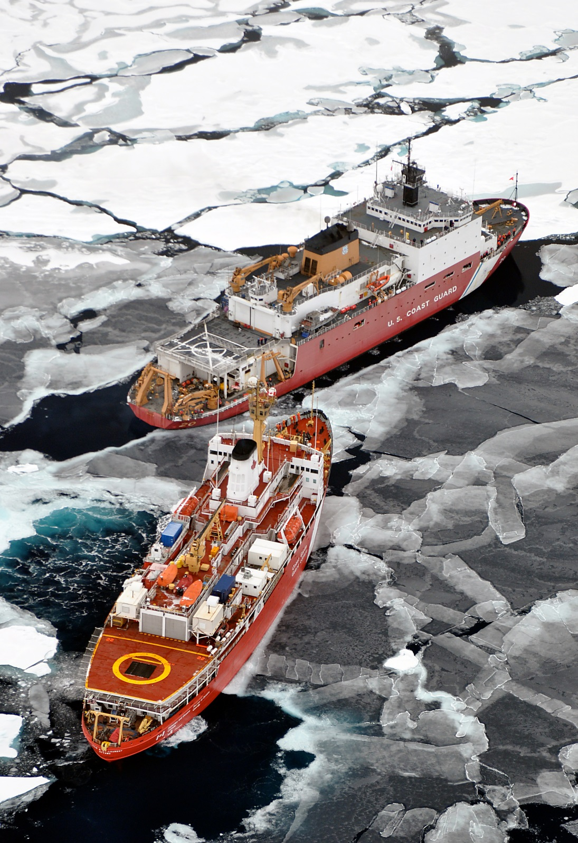
Background
Information
Arctic sea ice is decreasing
Maritime activity is increasing
Oil spill risk increasing
Credit: USCG, 2009
Notes:
With increased activity, comes an increase in maritime risk, especially the risk of oil spill as shipping traffic surges.
Creative Commons, Photo Credit: Patrick Kelley, U.S. Coast Guard, https://www.flickr.com/photos/usgeologicalsurvey/4370266187/in/album-72157623467470824/

Slide 3
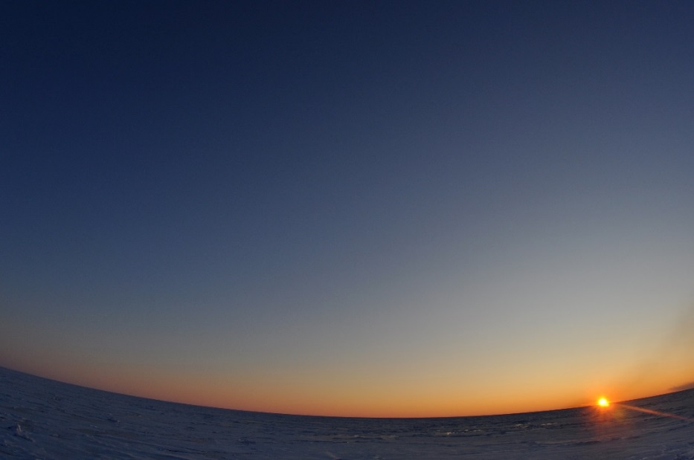
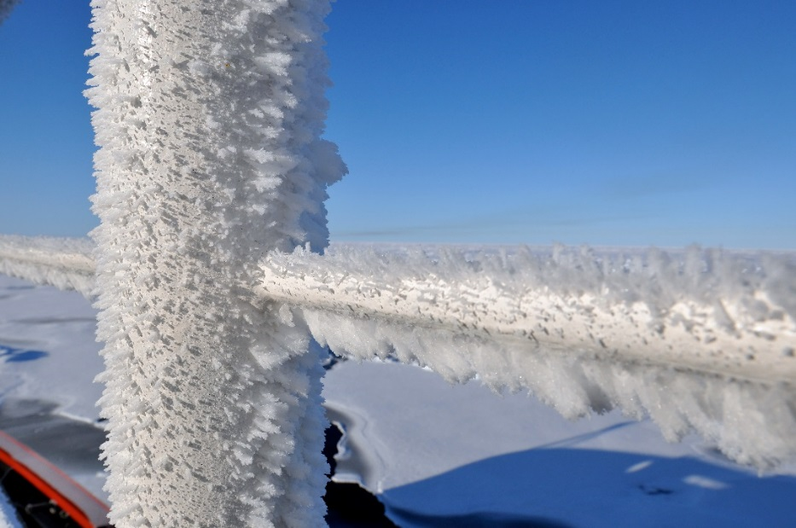
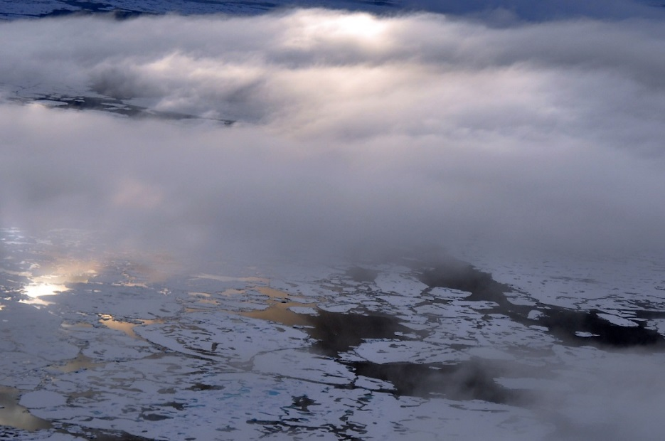
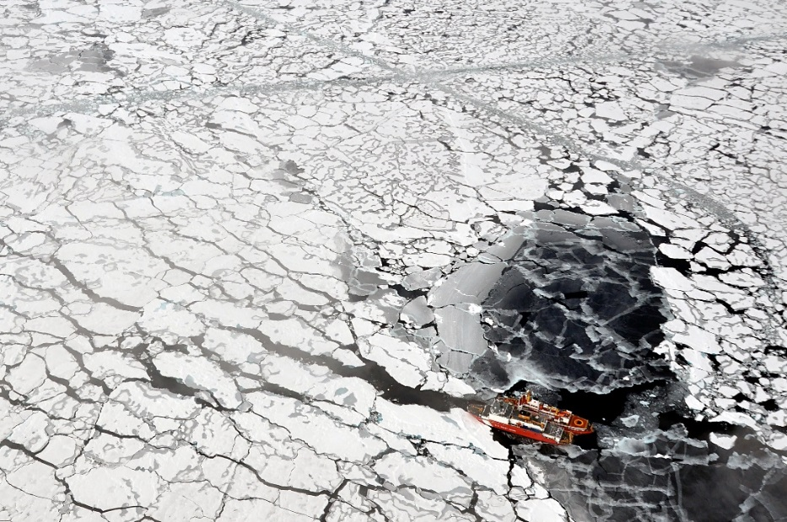
Community Concerns
Oil spill clean up is difficult in harsh Arctic environment
Oil behavior is poorly understood in freezing environments
Environmental impact is more severe in Arctic
Oil spills shut down valuable shipping channels
Credit: USCG, 2009
Notes:
Several challenges make oil spill response operations difficult and dangerous:
1. Weather: Clouds and fog reduce visibility and extreme weather hinders operations
2. Sea Ice: Blocks passages, damages vessels
3. Periods of extended darkness: Several months of darkness, Nov-Feb
4. Lack of Infrastructure: Remote location and undeveloped towns lack support infrastructure for emergency incidents
5. Freezing Temperatures: Freezing temperatures can cause wear to machinery and be dangerous to response personnel
Oil persists longer in freezing environments, making environmental impacts more severe.
Environmental impacts from an oil spill are more severe in the arctic due to its fragile ecosystem and harsh environmental conditions.
Oil behavior and fate in freezing environments is poorly understood. Oil spreads on and under ice; is absorbed in snow; is contained on and in ice; and spreads over ice-infested water.
Last, oil spills shut down valuable shipping lanes which can have an economic impact on the Arctic Nations’ industry.
Creative Commons, Public Domain, Photo Credit: Patrick Kelley, U.S. Coast Guard,
https://www.flickr.com/photos/usgeologicalsurvey/4370266339/in/album-72157623467470824/
https://www.flickr.com/photos/usgeologicalsurvey/4370264559/in/album-72157623467470824/
https://www.flickr.com/photos/usgeologicalsurvey/4371011748/in/album-72157623467470824/
https://www.flickr.com/photos/usgeologicalsurvey/4371011032/in/album-72157623467470824/
https://www.flickr.com/photos/usgeologicalsurvey/4370262379/in/album-72157623467470824/

Slide 4
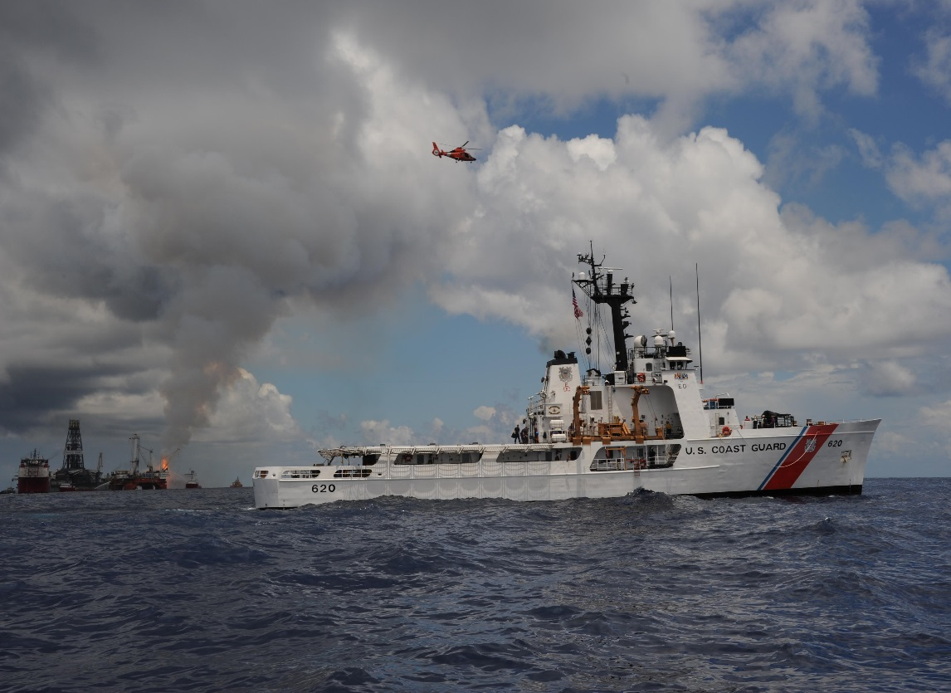
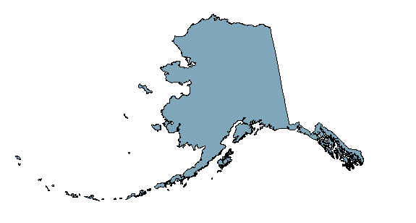
Project Partners
United States Coast Guard is the lead agency for oil spill response in US coastal waters
NOAA manages the Arctic Environmental Response Management Application - Arctic ERMA
Credit: USCG, 2010
Notes:
The USCG is the lead response agency for oil spills in US coastal waters. They currently utilize the Arctic ERMA to visualize maritime situations and improve communication and coordination among their responders.
The Alaska Disasters partnered with the USCG Office of Marine Environmental Response Policy and the National Oceanic and Atmospheric Administration, Spatial Data Branch, to investigate how NASA EOS and ESA EO can assist their strategic oil spill response planning.
Creative Commons, U.S. Coast Guard photo by Petty Officer 1st Class Matthew Belson: https://www.flickr.com/photos/deepwaterhorizonresponse/4761356357/in/photolist-8fKcmZ-4yHSa2-p9pHKY-7X8Vjm-7Xjc7n-nCt5Lv-89mZXd-mpzivv-8w7yf8-uiFpB-r4sDBV-7WKZ5c-8oYDza-8p2Prd-87qSui-8bpe5b-8b1giF-8hwyTM-oRWkyF-nqYgBo-9CMP7A-8cXCAC-837X5D-4nxvGE-q78jK7-7KWbHw-s2J49o-8GiZN8-8GiZGv-6at2Tn-8vDqxr-7ZAW7N-9CJSeT-a4fVye-8tKcMh-82jBH1-8v95Ah-83VbB2-7ZVsXY-oX9Jzp-kam7jw-83uu44-mnJmKF-43xt2N-9d7wjz-rLMVK9-bMonWB-89JJea-8dj1VA-8zo4cR

Slide 5
Objectives
Create
Create a tool to facilitate fast visualization of an oil spill incident
Identify natural oil seeps across coastal Alaska
Inject spatial dataset into Arctic ERMA
Identify
Inject
Notes:
The objective of this study was to:
Identify: Map known natural oil seeps in order to give the USCG the ability to monitor and account for background pollution and to rule out anthropogenic sources.
Create: Python-based tool to retrieve imagery data in order to quickly visualize optical and radar information to detect, map, and monitor oil spills and natural oil seeps within the coastal area of Alaska.
Inject: Upload oil seeps dataset into the Arctic Emergency Response Management Application (ERMA) to improve USCG communication and coordination efforts.

Slide 6

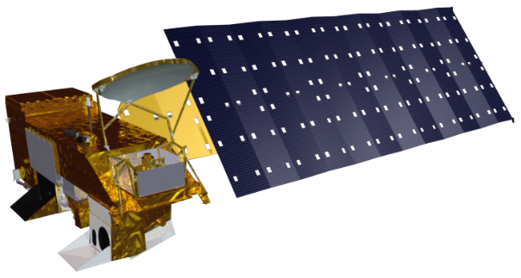

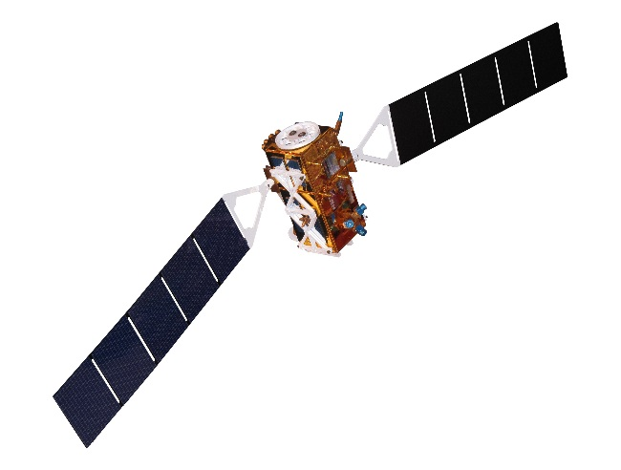
Earth Observing Systems
Remote sensing in the Arctic requires a combination of sensors to overcome individual limitations
All-weather
High Spatial Resolution
High Temporal Resolution
Aqua MODIS
Terra MODIS
Sentinel-1
Landsat 8
Notes:
Remotely sensing the presence of oil in an ice-infested region requires a mix of sensors, both passive and active, operating across the electromagnetic spectrum.
The ideal combination of sensors will overcome individual sensor limitations.
With this in mind, our team leveraged the European Space Agency’s Earth Observation system, Sentinel-1, for its all-weather capabilities using synthetic aperture radar, combined with Landsat 8 for its high spatial resolution and MODIS-Aqua and MODIS-Terra for its high temporal resolution.
Analyzed together, these sensors provide the most accurate visualization of an Arctic oil spill incident.
All-weather = Sentinel-1 (SAR)
High Spatial = Landsat-8 OLI/TIRS
High Temporal = Aqua/Terra MODIS

Slide 7
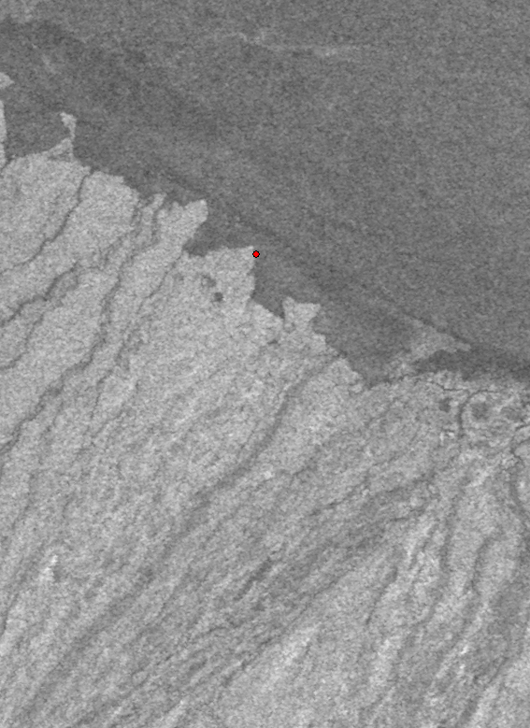
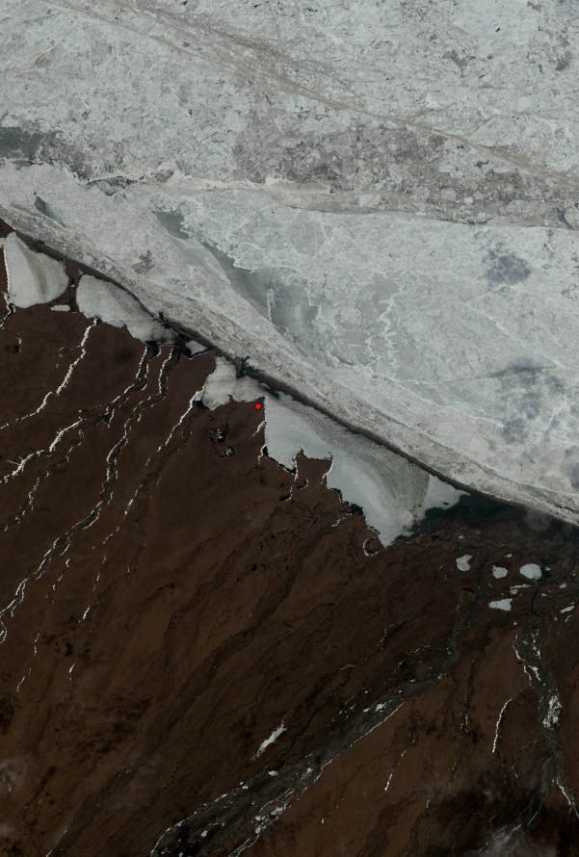
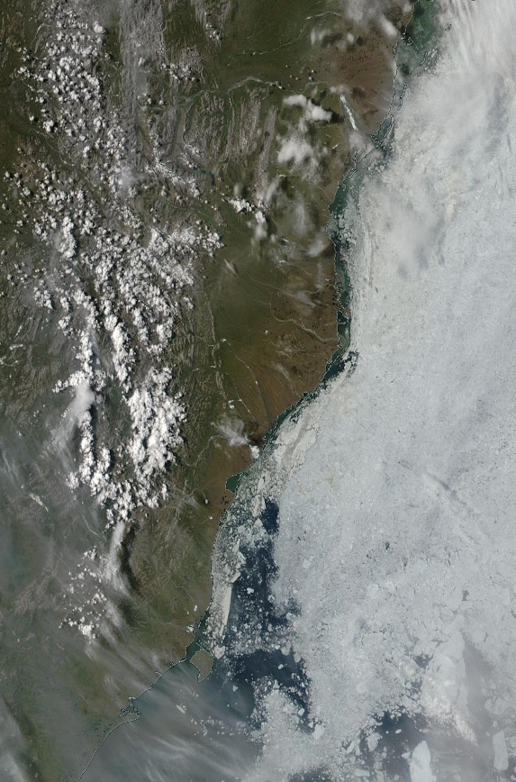
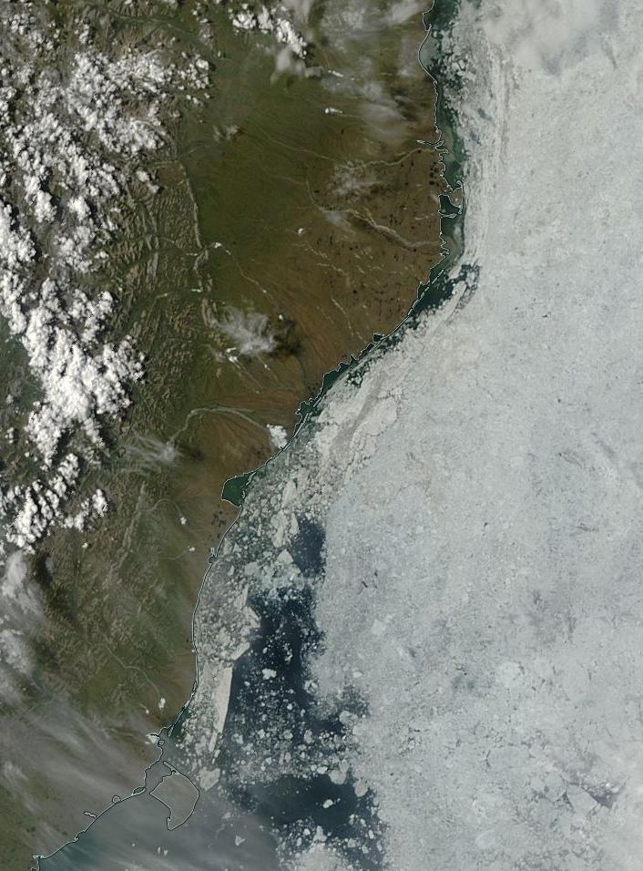
Methodology
Imagery Retrieval Tool
Sentinel-1
Landsat 8
Data Repositories
Amazon Web Server
USGS
Software
Python 2.7
Product
Graphical User Interface
Sentinel-1 Scientific Datahub
NSIDC
Aqua MODIS
Terra MODIS
Notes:
The second component of our project is a Python-based tool used to expedite the process of downloading spectral data from multiple repositories. This tool retrieves imagery on-demand for the user, all that is required is a lat/long and date range.

Slide 8
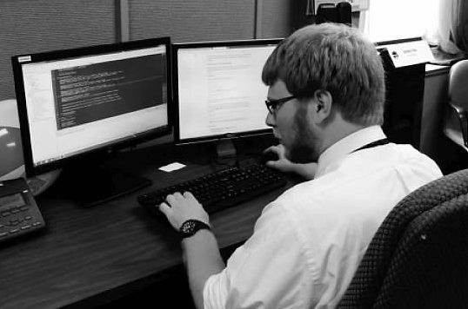
Methodology
Imagery Retrieval Tool
Data Repositories
Amazon Web Server
Software
Python 2.7
Product
Graphical User Interface
Sentinel-1 Scientific Datahub
USGS
NSIDC
Credit: Ferguson, 2015
Notes:
The second component of our project is a Python-based tool used to expedite the process of downloading spectral data from multiple repositories. This tool retrieves imagery on-demand for the user, all that is required is a lat/long and date range.

Slide 9
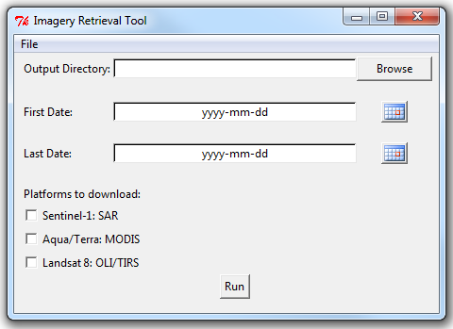
Methodology
Imagery Retrieval Tool
Data Repositories
Amazon Web Server
Software
Python 2.7
Product
Graphical User Interface
Sentinel-1 Scientific Datahub
USGS
NSIDC
Notes:
The second component of our project is a Python-based tool used to expedite the process of downloading spectral data from multiple repositories. This tool retrieves imagery on-demand for the user, all that is required is a lat/long and date range.

Slide 10
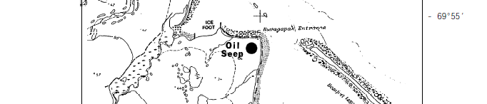
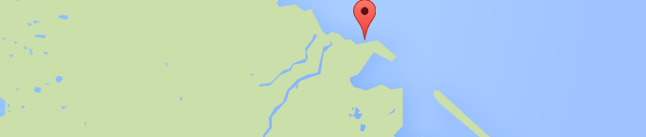
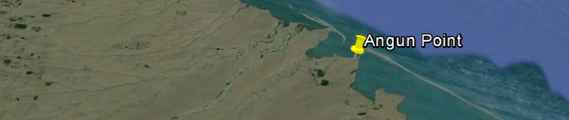
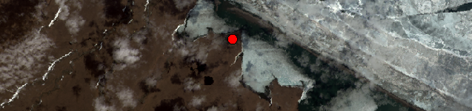
Methodology
Identify Natural Oil Seeps
Becker and Manen, 1988
1
3
4
2
5
Becker and Manen (1988)
Google Maps
Google Earth
Landsat 8
ArcGIS
Notes:
Using figures from the report, like the one shown on the slide, we first manually graphed its location.

Slide 11
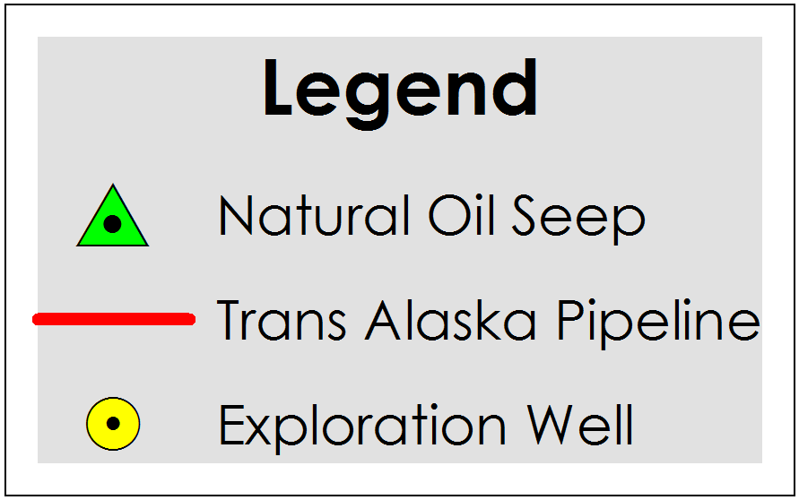
Methodology
Identify Natural Oil Seeps
Notes:
The XY dataset was imported into ArcGIS, where all the individual points were plotted and projected to compile a final map.

Slide 12
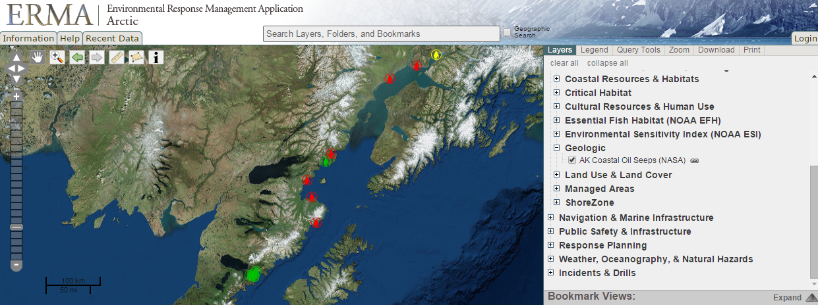
Methodology
Inject Natural Oil Seeps Dataset
Public, web-based GIS tool
Integrates and synthesizes datasets
Fast visualization and improved communication

Slide 13
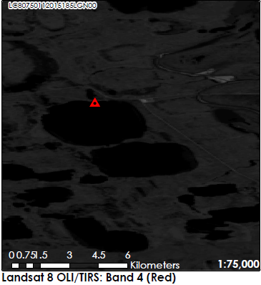
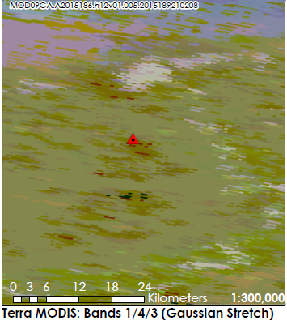
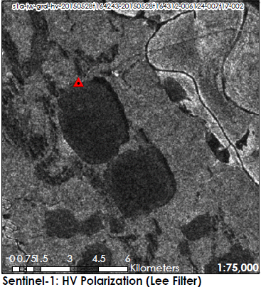

Methodology
Confirm Natural Oil Seeps
Spectral band combinations and image enhancement techniques applied

Slide 14
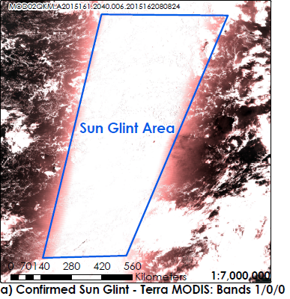
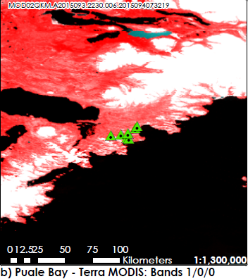

Methodology
Confirm Natural Oil Seeps
Calibrated radiance data analyzed
for sun glint phenomenon

Slide 15
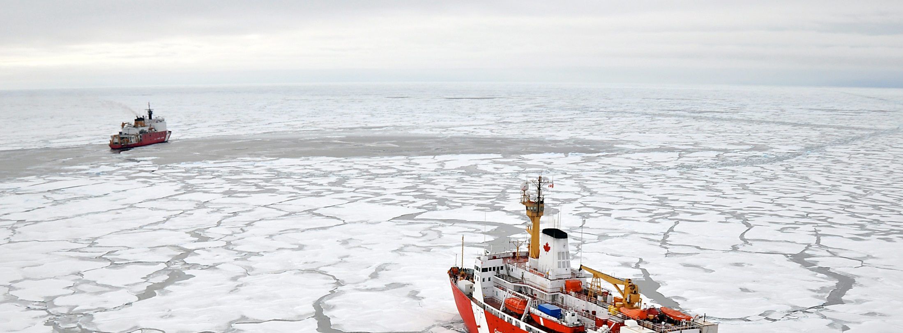
Results
Rapid acquisition capability for improved strategic and operational coordination efforts
Robust complement of geographic and spectral data for USCG strategic oil spill response planning
Negative result in attempt to confirm oil seeps
Image Credit: USCG, 2009
Notes:
The project team provided the USCG with the ability to access a robust complement of geographic and spectral data for use in strategic oil spill response planning.
Additionally, the product’s implantation in Arctic ERMA allows for emergency response teams to access a fast visualization tool in order to accelerate response time.
Creative Commons, Photo Credit: Patrick Kelley, U.S. Coast Guard: https://www.flickr.com/photos/usgeologicalsurvey/4371016246/in/album-72157623467470824/

Slide 16
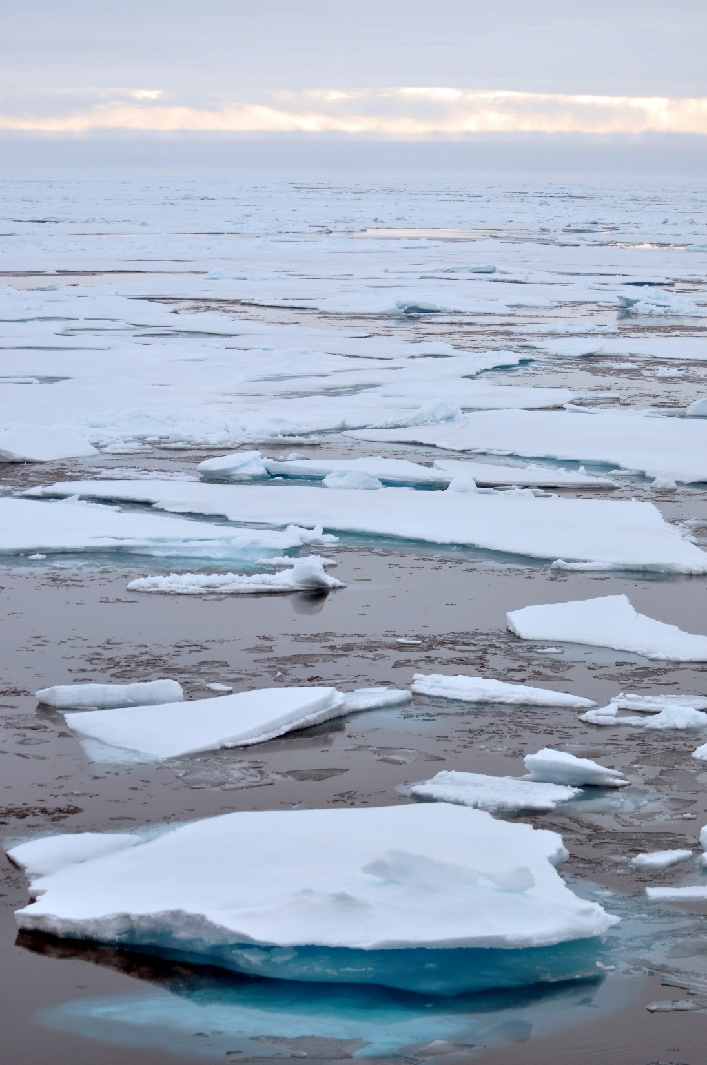
Future Work
AVIRIS and NISAR
Introduce search parameters to GUI
Incorporate image processing
Credit: USCG, 2009
Notes:
Future work for the project could incorporate optical and radar parameters into the GUI code to project and refine the data in a format that facilitates improved oil detection.
Creative Commons, Photo Credit: Patrick Kelley, U.S. Coast Guard: https://www.flickr.com/photos/usgeologicalsurvey/4370261777/in/album-72157623467470824/

Slide 17
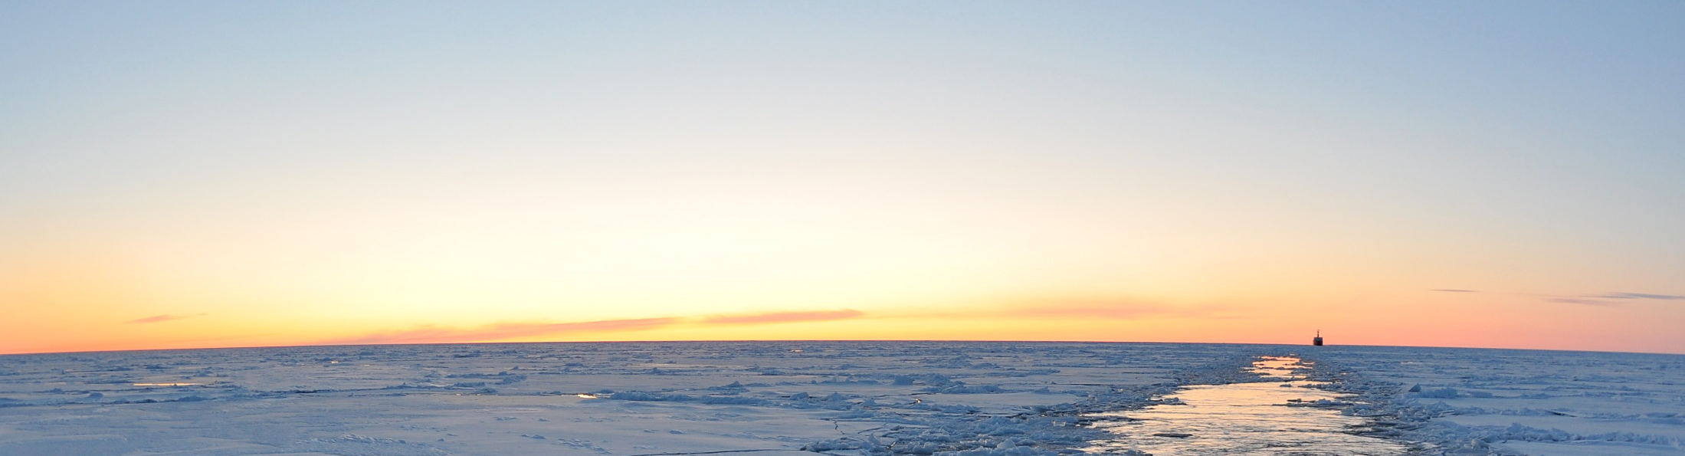
Acknowledgements
Advisors
Dr. Kenton Ross, NASA DEVELOP National Program
MST1 Justin Hoffer, United States Coast Guard Office of Marine Environmental Response Policy
Dr. Amy Merten, NOAA Office of Response and Restoration
Zachary Winters-Staszak, NOAA
Office of Response and Restoration
Jeff Ely, NASA DEVELOP National Program
Partners
Others
This material is based upon work supported by NASA through contract NNL11AA00B and cooperative agreement NNX14AB60A
Credit: USCG, 2009
Notes:
We would like to thank Dr. Kenton Ross, our advisor for all his help and expertise with the Alaska Disasters project.
Additionally we would like to thank Petty Officer Justin Hoffer, our partner with the USCG for his information and communications with the project and its implementation.
We’d also like to thank Dr. Amy Merten and Zachary Winters-Staszak of the NOAA Office of Response and Restoration for their work in integrating the data map into ERMA, and Jeff Ely of the NASA DEVELOP Program for his help with the python script.
Creative Commons, Public Domain, Photo Credit: Patrick Kelley, U.S. Coast Guard
https://www.flickr.com/photos/usgeologicalsurvey/4371016084/in/album-72157623467470824/

