Slide 1
NASA Applied Sciences’
DEVELOP National Program
Summer 2010
Marshall
UAB
7/15/2010

Slide 2
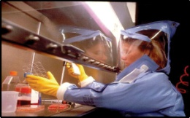
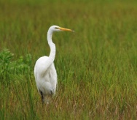
Project Methodology
Community Concerns
Currently, many state officials and physicians do not recognize the presence of Lyme disease and STARI in Alabama.
The general public is not aware of the basic measures to prevent Lyme disease and other TBIs.
Students will collaborate with community stakeholders to increase awareness of TBIs and disseminate preventative messages.
Identifying risk groups and tailoring specific prevention messages is an underutilized approach in the state.
Science Advisor
Jeffrey C. Luvall, Ph.D.
NASA Marshall Space Flight Center
NATIONAL APPLICATION AREAS
Public Health
Ecological
Forecasting

Slide 3
Project Methodology
Partners
Dr. Robert Carter (Jacksonville State University)
Birmingham Lyme
Camp Coleman
University of Alabama at Birmingham Outdoor Pursuits
Dr. Leslie McClure (University of Alabama at Birmingham School of Public Health, Biostatistics department)
Study Area & Period
Talladega National Forest, Fort McClellan, and Birmingham, Alabama
4 terms, Summer 2009-2010
Satellites Utilized
Landsat TM
ASTER (Terra)
QuickBird

Slide 4
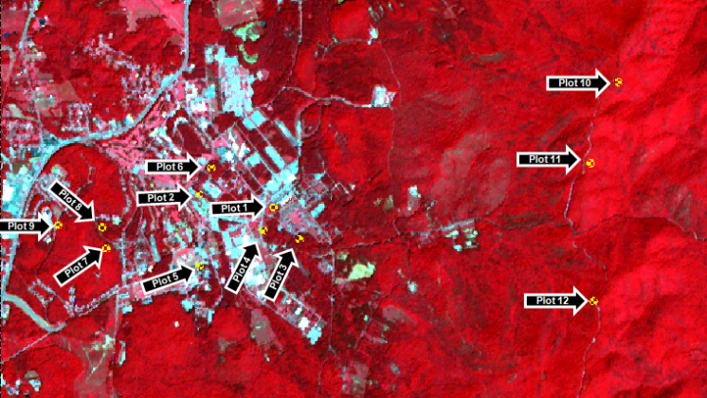

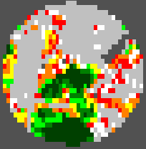
Project Methodology
Image analysis –
ASTER imagery obtained for Fort McClellan
Coordinates for 12 tick drag plots charted on image
ArcGIS shape files created for each plot
Plots approximately 500 meters in diameter
Shape files used to subset plots on ASTER imagery for analysis
Plots chosen to represent different types of vegetative biomass and varying degrees of edge effect
Unsupervised NDVI classification applied to image
Overall ASTER image
Plot 1 (ASTER)
Plot 1 (NDVI)
Steps 1-4
Steps 5-6
Step 7

Slide 5
Project Methodology
Edge effect –
Best described as the concentration of ticks along edges of forests and ecotones (convergence of two different habitats). Ecological boundaries are crossed frequently by host vertebrates to perpetuate tick life cycle. Human population risk is predicated on length and proximity of exposure to these areas.
Objective –
  Test the hypothesis that edge effect is associated with tick population dynamics using the
  following remote sensing variables:
Response variable = Tick Density

Slide 6
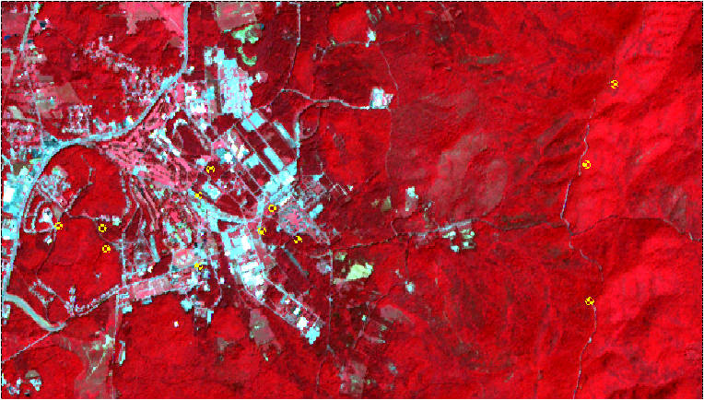
Results
Overall Study Site – 12 plots were chosen at Fort McClellan based on varying degrees of vegetation. Plots are shown in yellow above on a 321 RGB ASTER image.
Plot 10
Plot 6
Plot 11
Plot 8
Plot 2
Plot 1
Plot 9
Plot 7
Plot 4
Plot 3
Plot 5
Plot 12

Slide 7
Results – Table 1
Overall tick density by plot and species
General Conclusions
Difference by species - Abylomma Americanum made up 98.5% of all ticks counted
Difference by stage of development - Nymphal ticks represented 86.5% of the total ticks sampled
Difference by plot – Tick counts ranged by plot from 283 (25% of total) to 6 ( >%1 of total)

Slide 8
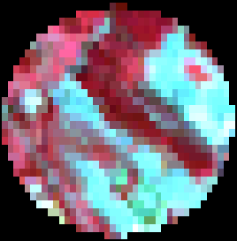
Results – Tick density by plot/week
Plot 1
Plot 2

Slide 9
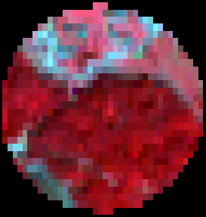
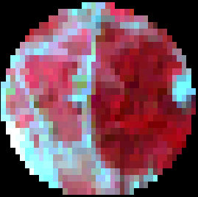
Results – Tick density by plot/week
Plot 3
Plot 4

Slide 10

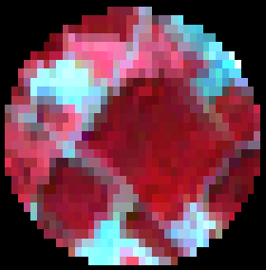
Results – Tick density by plot/week
Plot 5
Plot 6

Slide 11
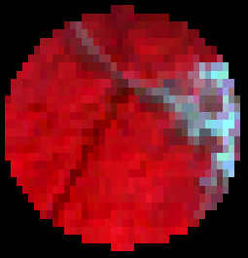
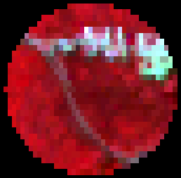
Results – Tick density by plot/week
Plot 7
Plot 8

Slide 12
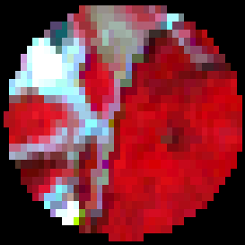
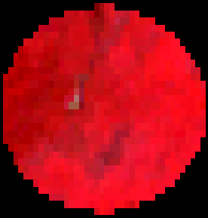
Results – Tick density by plot/week
Plot 9
Plot 10

Slide 13
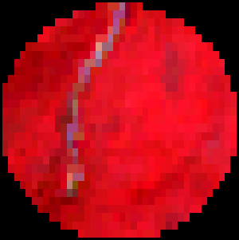
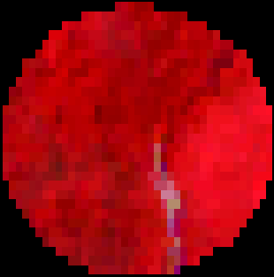
Results – Tick density by plot/week
Plot 11
Plot 12

Slide 14


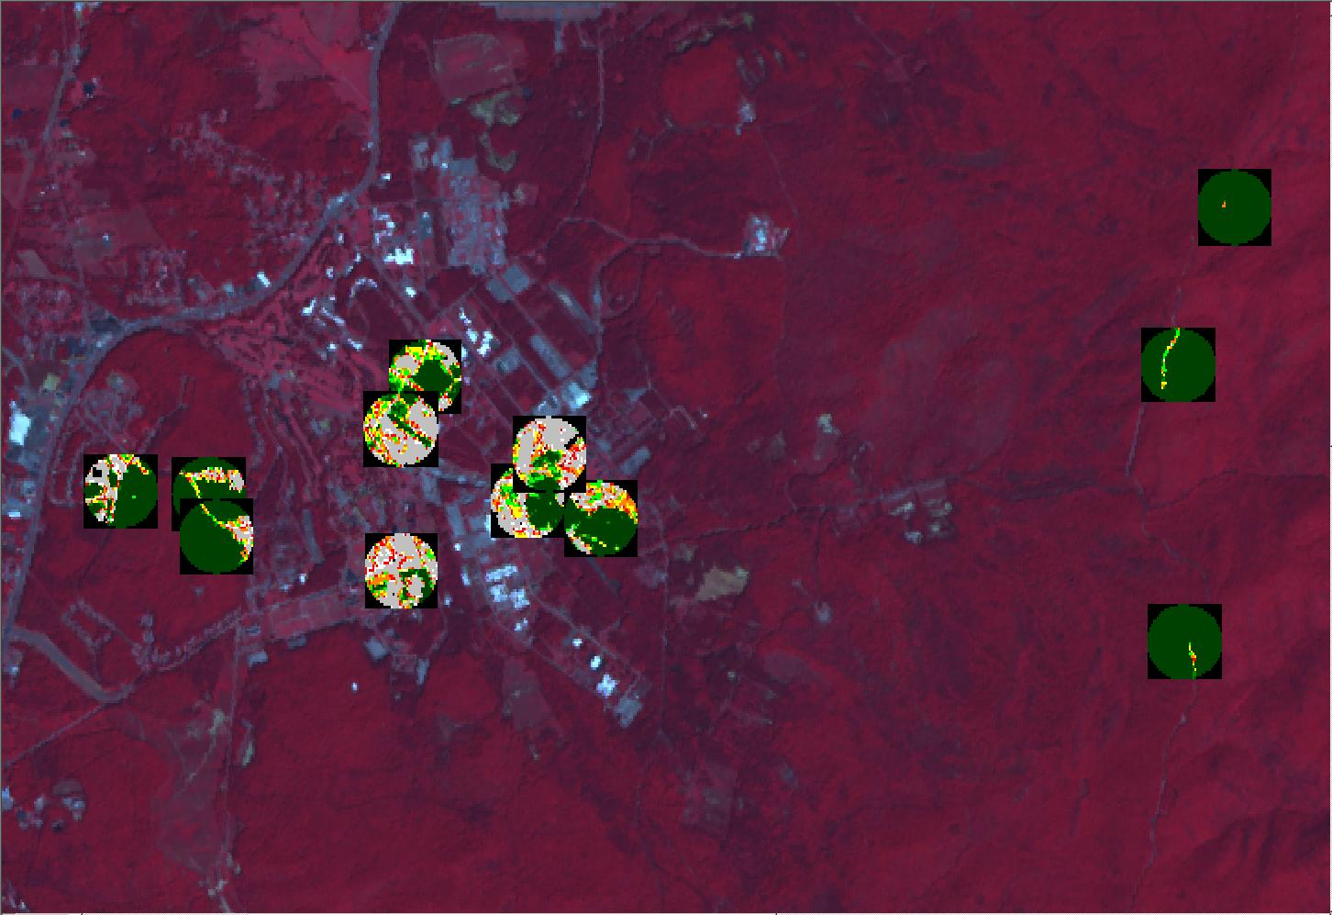
Results – % NDVI by class
Results - 500 m diameter NDVI plots
Plot 10
Plot 6
Plot 1
Plot 11
Plot 8
Plot 2
Plot 9
Plot 4
Plot 7
Plot 3
Plot 12
Plot 5

Slide 15
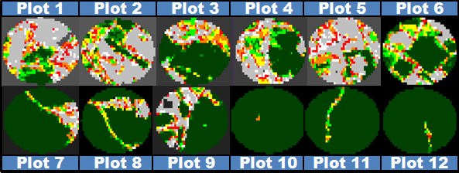
Results – % NDVI class: plot detail

Slide 16
Results – % NDVI class analysis
Figure 1b: NDVI class proportion by plot sorted by tick count

Slide 17
Results – Image variables by tick count
9
8
Plot 9
General | Mean plot digital number | 170.3
 | % NDVI by class | above
Edge | Patch area (meters²) | 91382.3
 | Distance to nearest edge from centroid (m) | 1.6
 | Edge length (m) | 854.9
 | Edge length/Patch area ratio | 0.00002
Plot 8
General | Mean plot digital number | 155.4
 | % NDVI by class | above
Edge | Patch area (meters²) | 63711.5
 | Distance to nearest edge from centroid (m) | 46.2
 | Edge length (m) | 1217.2
 | Edge length/Patch area ratio | 0.01910

Slide 18
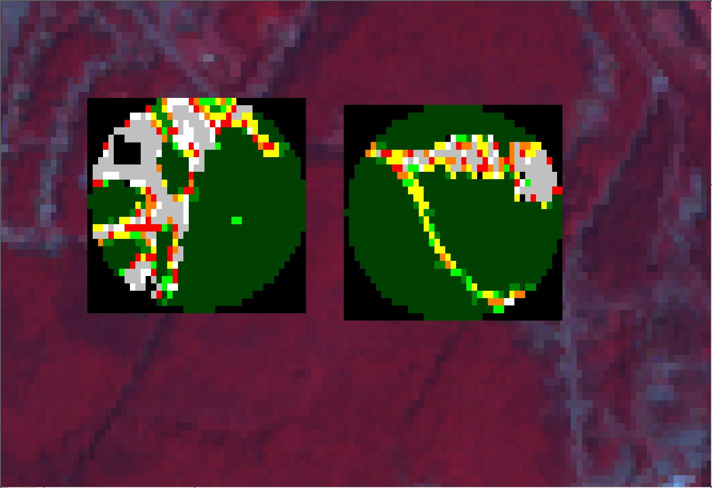
Results – Integrated image variables
9
8
Plot 9
General | Mean plot digital number | 170.3
 | % NDVI by class | above
Edge | Patch area (meters²) | 91382.3
 | Distance to nearest edge from centroid (m) | 1.6
 | Edge length (m) | 854.9
 | Edge length/Patch area ratio | 0.00002
Plot 8
General | Mean plot digital number | 155.4
 | % NDVI by class | above
Edge | Patch area (meters²) | 63711.5
 | Distance to nearest edge from centroid (m) | 46.2
 | Edge length (m) | 1217.2
 | Edge length/Patch area ratio | 0.01910

Slide 19
Conclusions
Risk Perception survey created and awaiting IRB approval
Satellite remote sensing can identify environmental factors associated with likely tick habitats
Tick density inversely associated with plots where > 90% of area contains NDVI values over 0.60
Potential trends exist between variables related to edge length, patch area, distance to edge, and ratio of area to edge length with tick density
Statistical analysis will help to identify degree of correlation between tick abundance and predictor variables
Effects of forest fragmentation and terrestrial island biogeography to be explored in relation to tick habitat suitability

Slide 20
Transition to Partner
Partner(s):
Birmingham Lyme
Camp Coleman
Benefits to Partner
Project Transition Plan
Camp Coleman
  5 presentations on prevention and treatment
  Reached approx 30-50 campers each session
  Groundwork in building future campaigns at Camp Coleman and other Girl Scout sites
Best practices document
  Document can be used as a guide for continued outreach at Camp Coleman or as a basis for new effort by Birmingham Lyme

Slide 21
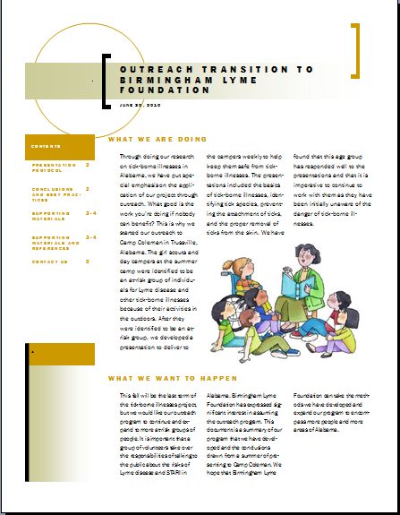
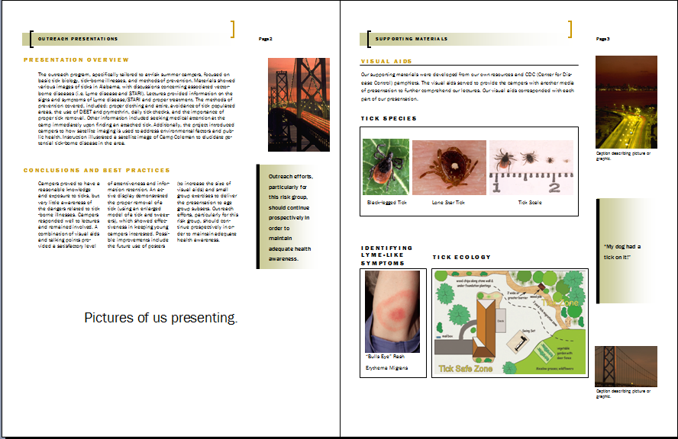
Transition to Partner – Best Practices
Example of best practices document made for Birmingham Lyme
Outreach Transition Best Practices Document - Content

