Slide 1
African Great Lakes Weather II
Utilizing NASA Earth Observations to Identify Indicators to
Help Predict Deadly Storms over African Great Lakes
Annabel White (Project Lead)
Jakub Blach
Kathy Dooley
Michael Brooke
Rajkishan Rajappan
Megan Buzanowicz
Ryan Umberger

Slide 2
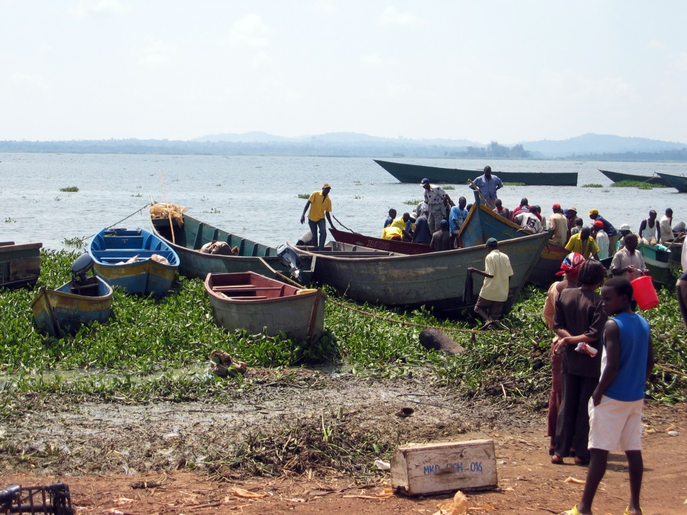
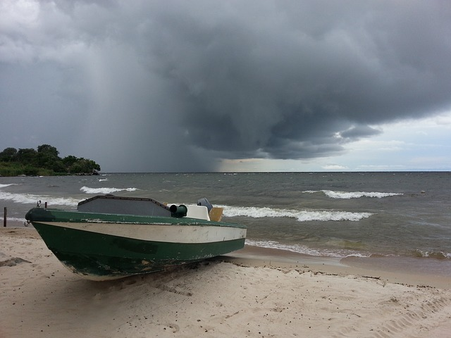
Community Concerns
Deadly storms
No early warning system
Frequent casualties
The affected areas have the highest population density in all of Africa
30 million people
200,000 fishermen
Image Credit: Wikimedia Commons
Image Credit: Pixabay
Notes:
Storms along the African Great Lakes can bring torrential rainfall, lightning, hail, and/or high winds, producing hazards that pose a major threat to the local infrastructure and population.
Most of the victims are fishermen who depend on the lakes for their livelihood.
The affected areas have the highest population density in all of Africa due to the vital economic opportunities of fishing, tourism, and agriculture that the lakes provide
No early warning system is in place to inform the public of storm events. This prevents fisherman and others from being able to adequately prepare for the dangers associated with the storms.
Construction of fishing boats poor and warning systems not comprehensive.
Weather is intense, storms arise suddenly… Are often not part of larger storm systems that can be forecasted.
Image Credit (left): Author (Role of Author). (Year image was created). Title of work [Type of work], Retrieved from URL (address of website)
Sarahemcc. (2006). [Type of work], Retrieved from URL (address of website
https://upload.wikimedia.org/wikipedia/commons/e/e8/Ugandan_fishing_boats.jpg
Image Credit (right): https://pixabay.com/static/uploads/photo/2014/05/26/13/40/lake-victoria-354533_640.jpg

Slide 3
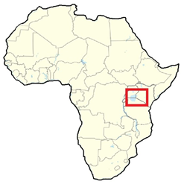
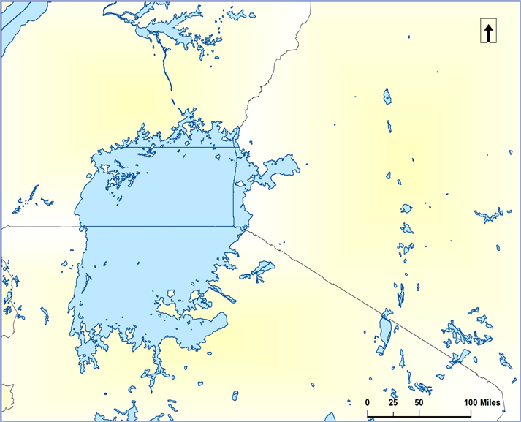
Study Area
Uganda
Uganda
Kenya
Kenya
Lake Victoria
Lake
Victoria
Tanzania
Tanzania
Date Range: March 2005 – November 2013
Notes:
Our project focused on the largest of the African Great Lakes in terms of surface area: Lake Victoria. The weather over this lake is of paramount importance to our project partner, the Kenya Meteorological Department.
Our temporal study area was based on availability of data in the Hazardous Storm Event Database, created from overshooting top detections, which we will explain in more detail shortly.

Slide 4
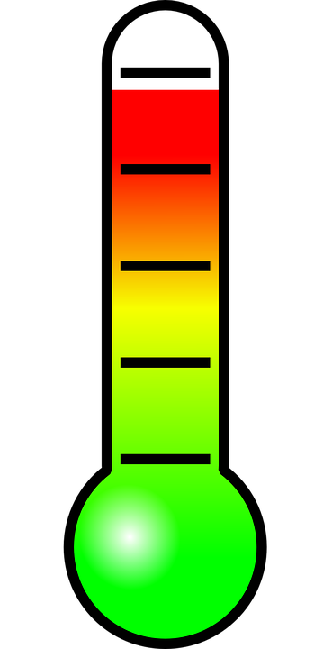
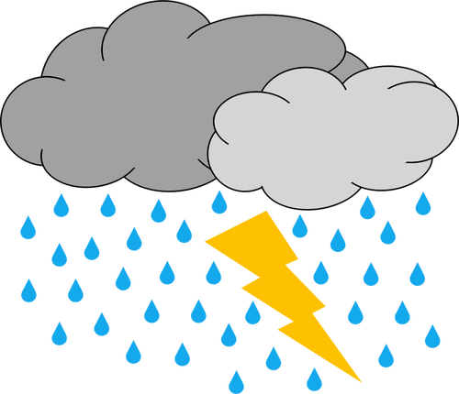
Objectives
Understanding which climatic variables
precede thunderstorms
?
Image Credits: Pixabay & Public Domain Vectors
Notes:
The objective of this project was to contribute to research at NASA Langley Research Center’s Climate Science Branch with regards to storm development over the African Great Lakes—focusing on Lake Victoria. Measurements of certain environmental aspects were compiled from MERRA products and TRMM satellite data at intensity levels chosen to highlight extreme storm activity from typical weather. These parameters were then compared to detect indicators that can be used in forecasting efforts.
thermometer https://pixabay.com/static/uploads/photo/2013/07/12/18/15/thermometer-153138_960_720.png
wind http://publicdomainvectors.org/photos/Wind.png
dropplets https://pixabay.com/static/uploads/photo/2013/07/12/14/49/drops-148870_960_720.png
thunder http://publicdomainvectors.org/photos/thunderstorm.png
turbine http://publicdomainvectors.org/photos/erlandh_Wind_Turbine.png

Slide 5
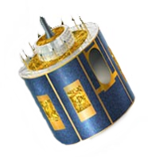
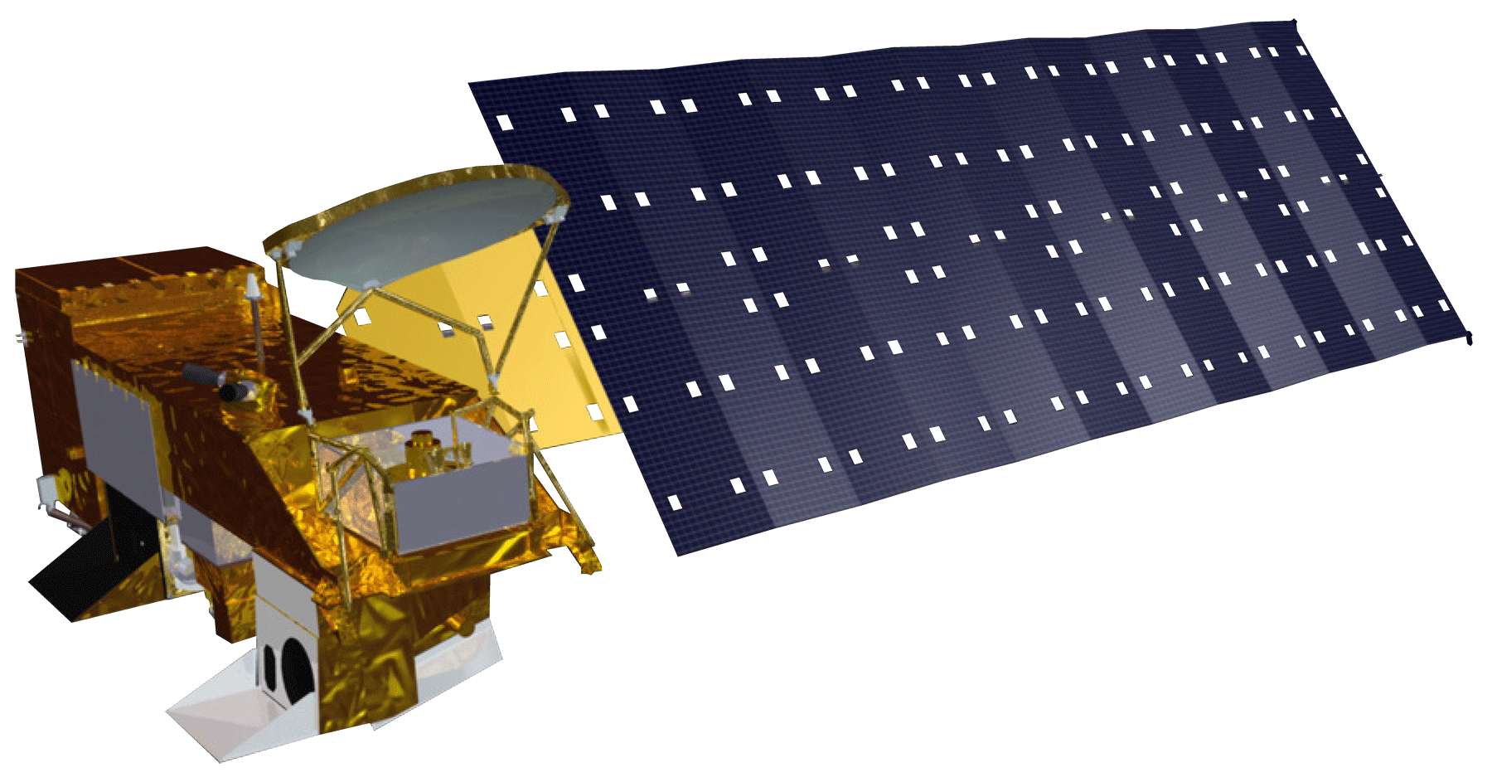
Sensors & Data Used
Meteosat
8 & 9
SEVIRI
Spinning Enhanced Visible and InfraRed Imager
AQUA
AIRS
Atmospheric Infrared Sounder
MERRA
Modern-Era Retrospective Analysis for Research and Applications
Notes:
TRMM: Tropical Rainfall Measuring Mission
SEVIRI sensor on the Meteosat satellite → provided data for HSED (which provided our OT data)
AIRS sensor on Aqua satellite → provided data for skew-T plots
LIS sensor on TRMM → provided lightning data
MERRA → data for climatic variables

Slide 6
Methodology
Selecting Study Dates
OT Detection
Algorithm
99th Percentile
50th Percentile
Image Credit: NASA GSFC
Notes:
Image Credit: https://flic.kr/p/dRgakQ
https://commons.wikimedia.org/wiki/File%3AEarth_with_server.jpg
This project used the hazardous storm event database, which is a collection of overshooting top data derived from the SEVIRI sensors on board the Meteosat 8 and 9 satellites, to choose out study dates.
Overshooting tops are known to occur in abundance during thunderstorm events, so 30 days were selected in which overshooting top activity was most intense over the study area to serve as our severe weather study dates.
30 days were also selected from days of average overshooting top activity to serve as our control group, or “normal” weather dates

Slide 7
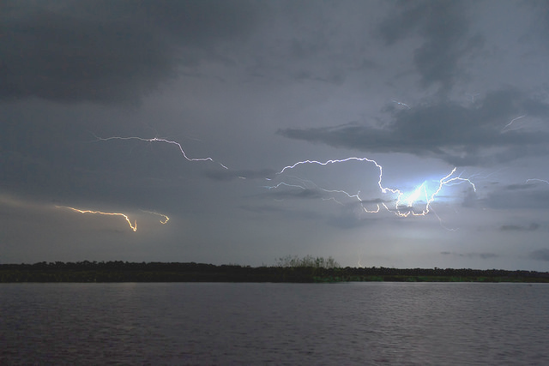
Methodology
Analyzing Storm Indicators
MERRA
AQUA - AIRS
Weather Maps
Temperature at 500 mb
Geopotential Height at 500 mb
Wind Speed at 700 mb
Temperature at 700 mb
Surface wind
Surface temperature
Vertical Pressure Velocity at ??
Skew-T Log-P Plots
Image Credit: Fernando Flores
Notes:
Image Credit: https://www.flickr.com/photos/ferjflores/24335489591
Thunderstorms typically develop over the land surrounding Lake Victoria during the day and over the Lake itself during the night. 12:00 UTC is typically when the storms are first developing over land and 00:00 UTC is the time when night storms are present. Therefore, data from MERRA and the AIRS sensor was analyzed at these hours.
Weather variables such as temperature, humidity, and wind speed were collected from MERRA and used to generate 30 day average value maps of each variable at 0:00 and 12:00 for both the 99th and 50th percentiles.
We also generated daily 0:00 and 12:00 maps for each variable, and hourly maps for select days to analyze how the climatic variables change over the course of a day.
Skew-T Log-P plots were created using AIRS sensor data, from the Aqua satellite. These plots are powerful tools for weather forecasting efforts and are traditionally created using weather balloons.

Slide 8
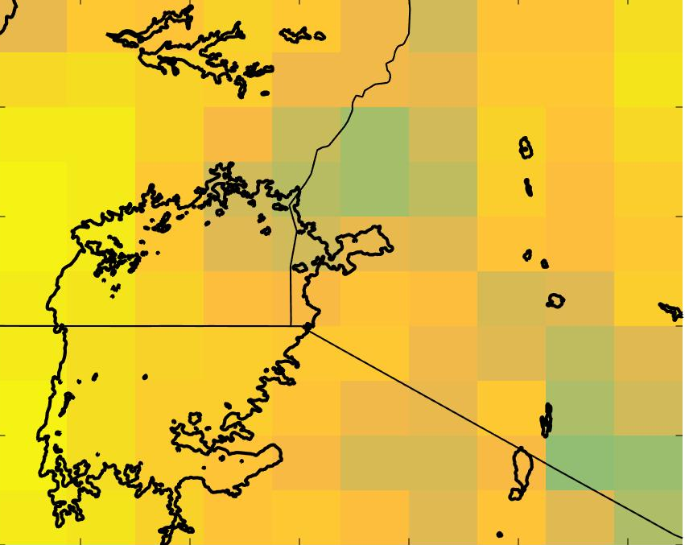
Results & Conclusions
MERRA Variables
99th Percentile Ave Vertical Pressure Velocity (Pa/s) at 500 mb at 0:00 UTC
50th Percentile Ave Vertical Pressure Velocity (Pa/s) at 500 mb at 0:00 UTC
2°N
2°N
0
1°N
1°N
-0.1
0°
0°
Latitude (degrees)
Latitude (degrees)
-0.2
1°S
1°S
-0.3
2°S
2°S
-0.4
3°S
3°S
32°E
34°E
36°E
-0.5
32°E
34°E
36°E
Longitude (degrees)
Longitude (degrees)
-0.6

Slide 9
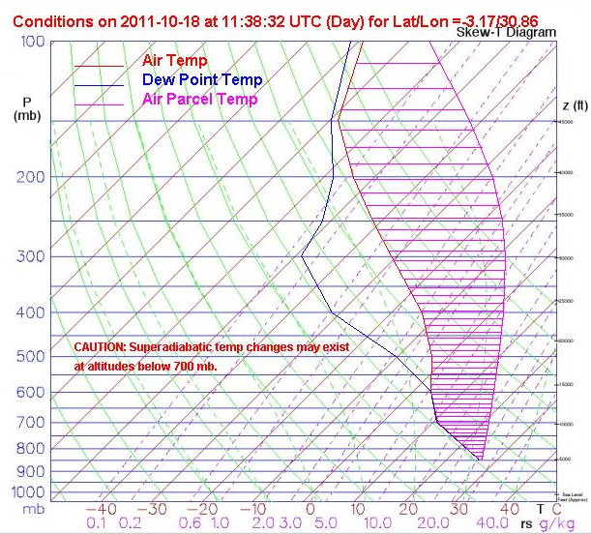
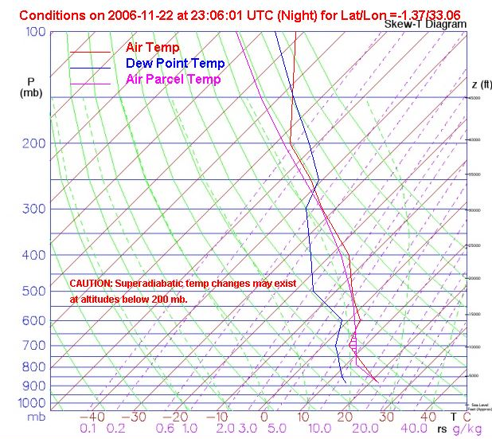
Results & Conclusions
AQUA - AIRS Skew-T Plots
Notes:
These are two Skew-T plots generated from AIRS data.
Both of these plots were generated from days within the 99th percentile: the severe storm days.
While a large amount of information in present on these plots, one major typical indicator of a severe storm is a large CAPE value, which is represented by the fuschia area between the red and fuschia lines.
The plot on the left was generated over land, about 100 km from Lake Victoria. The plot on the right was generated directly over Lake Victoria.
As you can see, the CAPE area is relatively small on the plot over the lake, while it is high, as expected, on the plot over land. Plots from other days show a similar trend. This suggests that one of the major drivers of typical storm events is not present for the storms which occur over Lake Victoria.

Slide 10
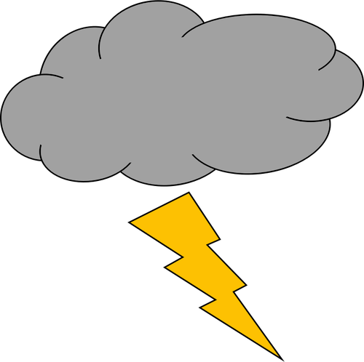
Error & Uncertainty
OTs as Storm Indicators
Image Credits: Public Domain Vectors
Sample Size
vs
Resolution
Image Credit: Wikipedia
Notes:
resolution
assuming overshooting tops direct thunderstorm indicator (grab statistic from paper)
Bedka 2011: an OT was found near 47% of the confirmed European Severe Weather Database events.
are we looking at the correct variables (put in future work)
small sample size
OT(ish) cloud → http://publicdomainvectors.org/photos/clouds_2.png
resolution https://en.wikipedia.org/wiki/Image_resolution#/media/File:Resolution_illustration.png
Lightning cloud → http://publicdomainvectors.org/photos/thunder-and-lighting.png

Slide 11
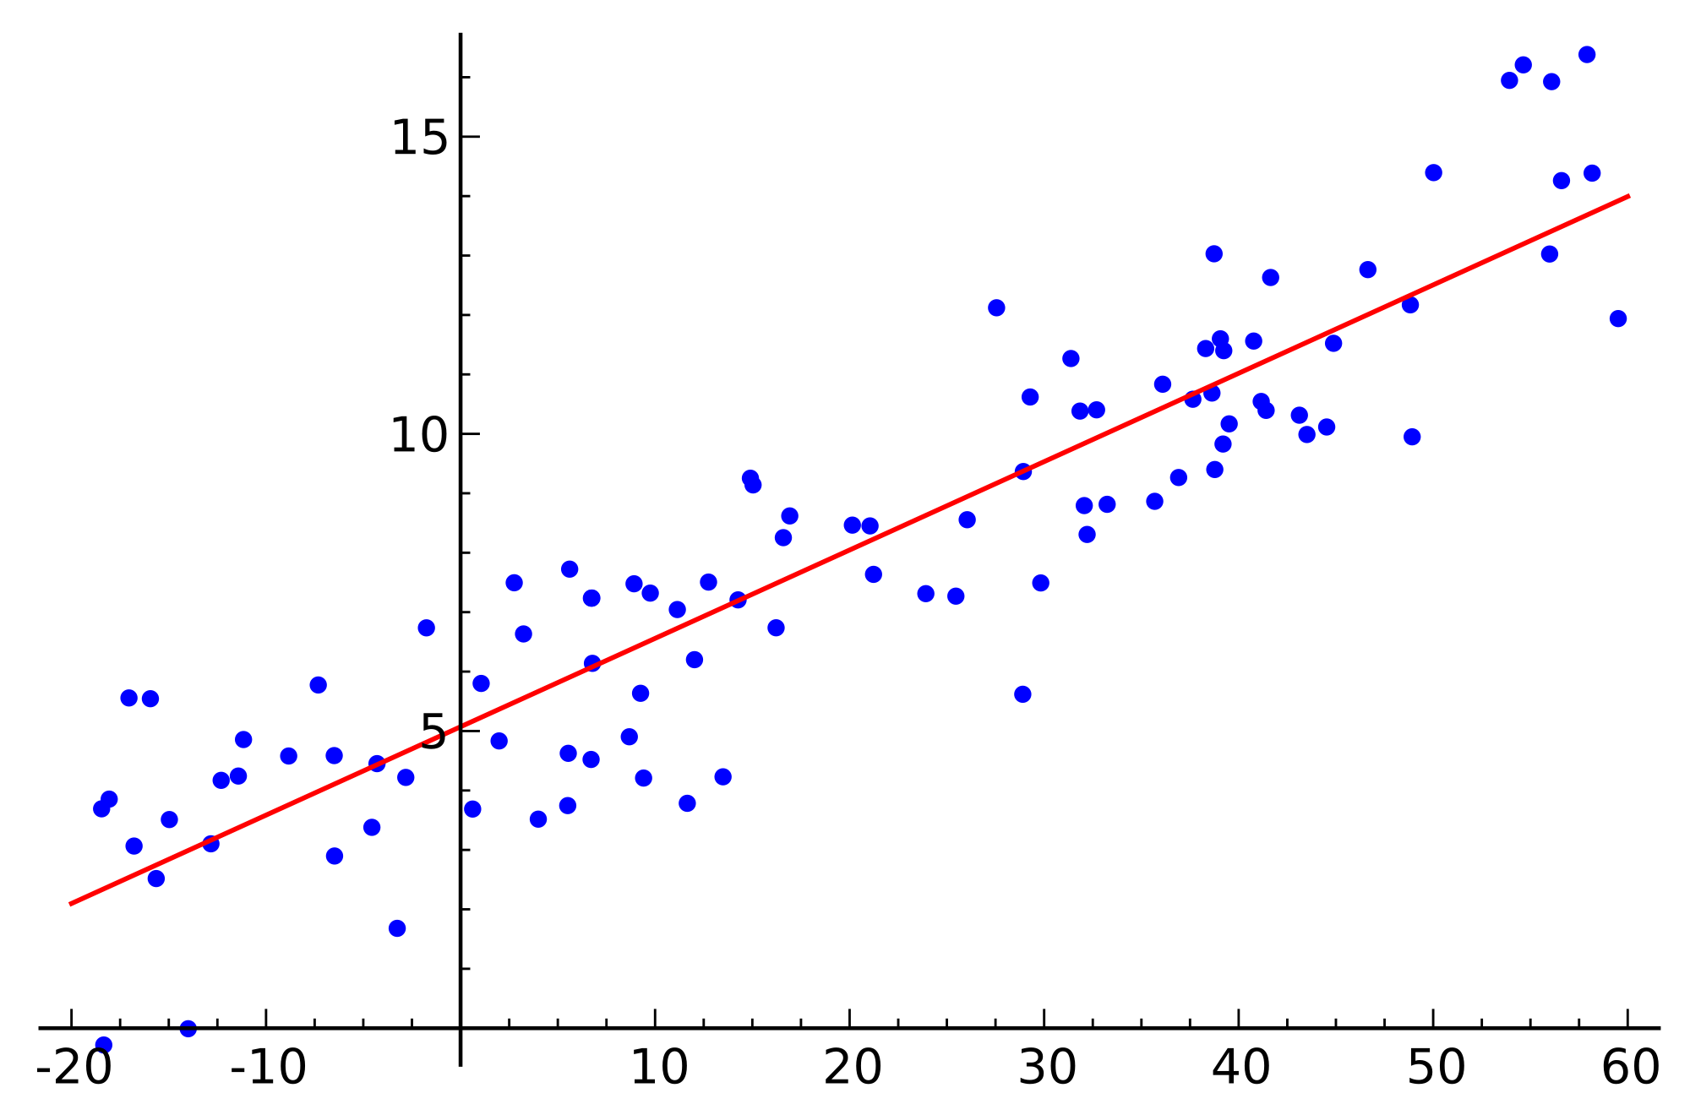
Future Work
Hourly averages across all study
dates
Image Credit: PIxabay
Study date percentiles based on morning OT occurrences
Image Credit: PIxabay
Statistical correlations between OT and variable data
Image Credit: Wikimedia
Notes:
To eliminate errors caused by averaging information
hourly averages across all study days
99 percentile days based on morning OTs
statistical analysis of OT location and climatic variables
Image Credits
clock https://pixabay.com/static/uploads/photo/2014/03/24/17/15/clock-295201_960_720.png
calendar https://pixabay.com/static/uploads/photo/2015/10/21/10/27/calendar-999172_960_720.jpg
lightning https://upload.wikimedia.org/wikipedia/commons/d/de/Harry_Potter_Lightning.gif

Slide 12
Future Work
Include additional climatic variables
Image Credit: PIxabay
Public Domain Vectors
Compare OT detections with lightning data
Image Credit: Wikimedia
Notes:
Adding more weather variables will help create a more robust weather forecasting model.
Comparing overshooting top detections to lightning data will help validate the use f OTs as storm predictors, and provide a wider temporal study range, past the availability of the hazardous storm event database.
Image Credits:
thermometer https://pixabay.com/static/uploads/photo/2013/07/12/18/15/thermometer-153138_960_720.png
dropplets https://pixabay.com/static/uploads/photo/2013/07/12/14/49/drops-148870_960_720.png
turbine http://publicdomainvectors.org/photos/erlandh_Wind_Turbine.png
lightning https://upload.wikimedia.org/wikipedia/commons/d/de/Harry_Potter_Lightning.gif

Slide 13
Advisors
Dr. Kenton Ross, NASA DEVELOP National Program
Kristopher Bedka, NASA Applied Sciences Climate Science Branch
Dr. DeWayne Cecil, Global Science & Technology, National Centers for Environmental Information (NECI)
Robert VanGundy, University of Virginia’s College at Wise
Partners
Kenya Meteorological Department
Others
William Wilson, Past contributor
Grant Bloomer, Past contributor
Juan Antonio Chacón Castro, Past contributor
Steve Licata, Jet Propulsion Laboratory, Atmospheric Infrared Sounder Project
April Huff, NASA DEVELOP/Wise County Clerk of Court’s Office
Notes:
We would like to acknowledge the help and support of all the wonderful people who have contributed to this project.

