Slide 1
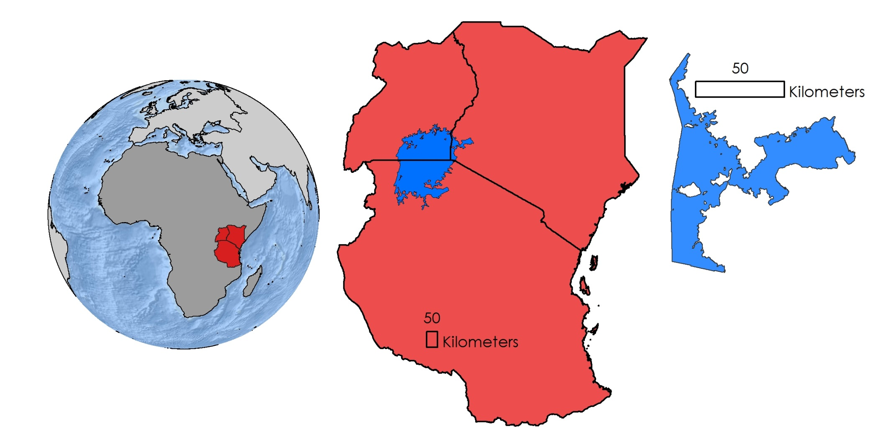


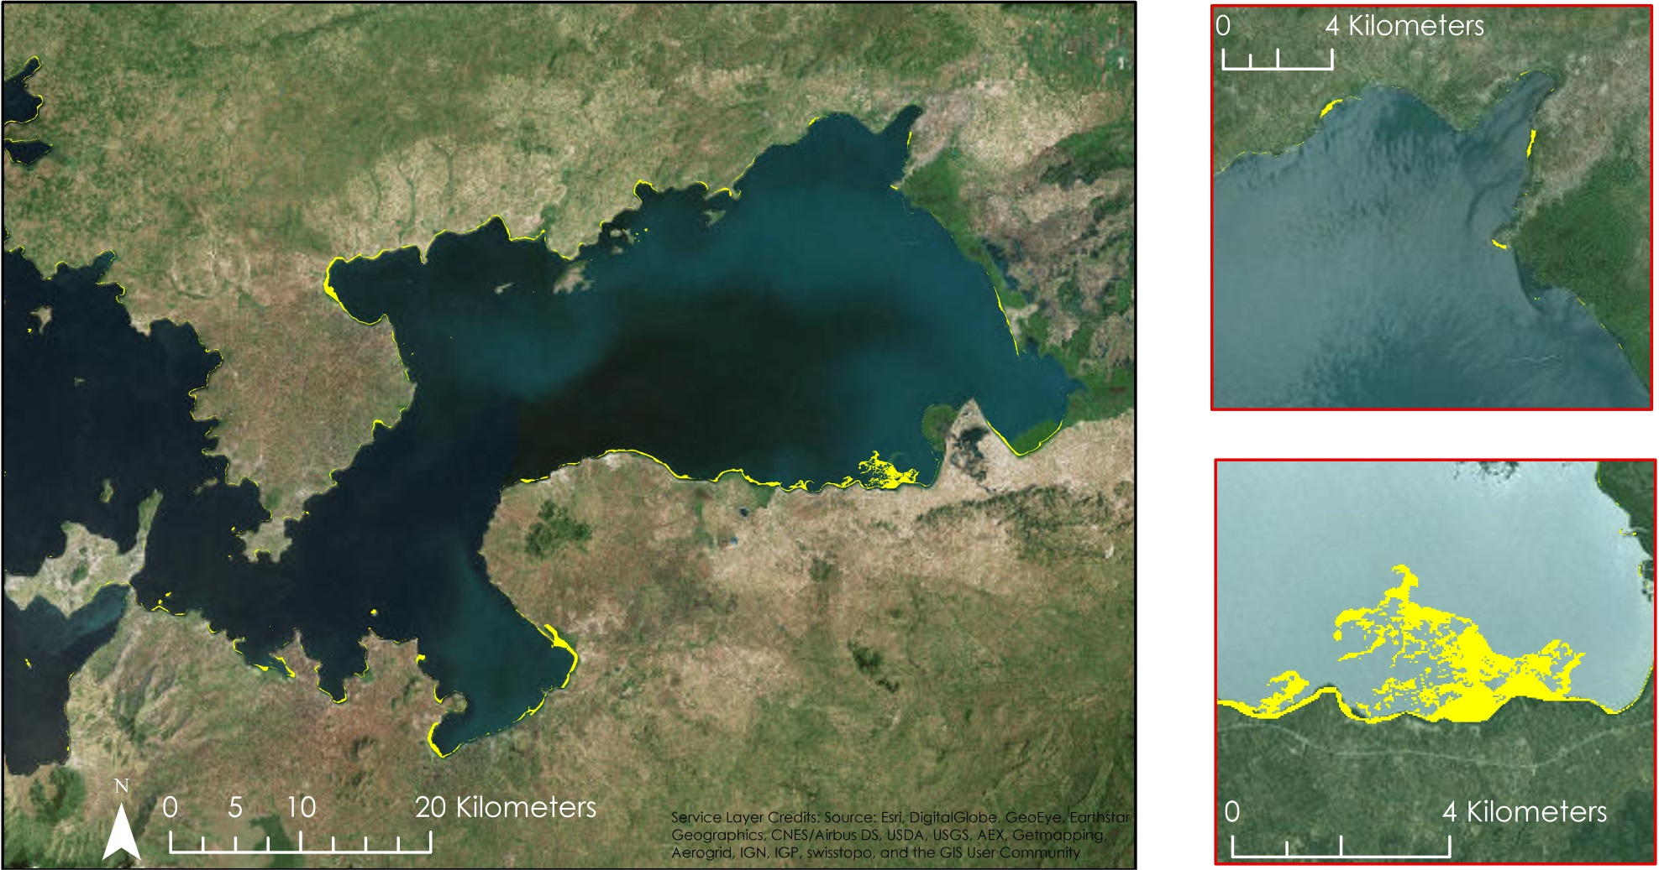
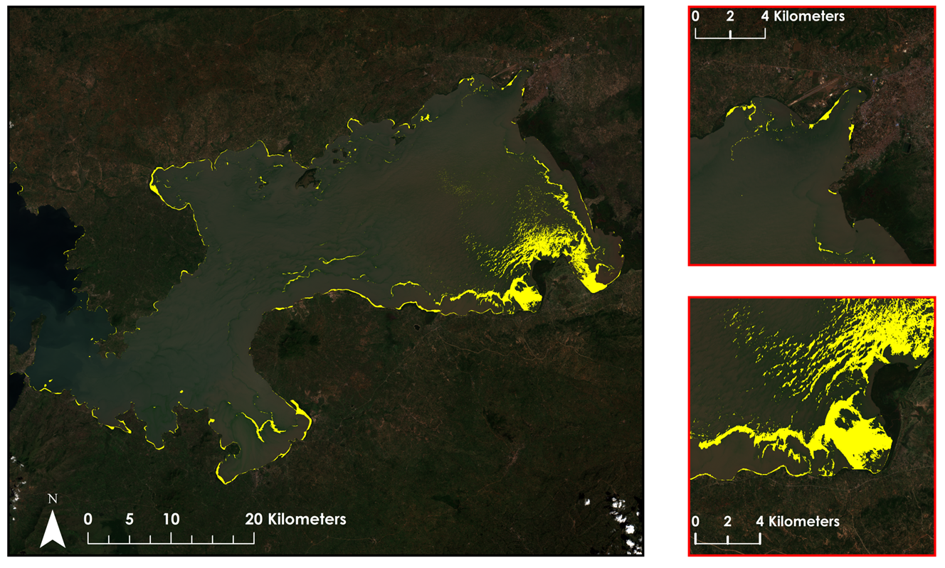


Lake Victoria Water Resources II
Developing an Automated, Near Real-Time System to Monitor Eichhornia Crassipes over the Winam Gulf in Lake Victoria
Jeanné le Roux (Project Lead), Daryl Ann Winstead, Christina Fischer, Sara Amirazodi, Dwight Tigner
DEVELOP National Program at NASA Marshall Space Flight Center
Abstract
Objectives
Methodology
Lake Victoria has a surface area of 68,800 square km, making it the largest lake in Africa. The lake is surrounded by Kenya, Tanzania, and Uganda and is home to more than 30 million people. These people rely on the lake for all aspects of their lives including fishing, agriculture, and industrial applications. However, the increasing population has negatively impacted water quality due to sewage, as well as agricultural and industrial run off. Furthermore, the introduction of Eichhornia crassipes, or water hyacinth, has been detrimental to local communities by blocking fishing access and providing breeding grounds for diseases carried by mosquitoes and snails. Ongoing efforts between the NASA SERVIR Coordination Office at Marshall Space Flight Center, the SERVIR-Eastern and Southern Africa Hub, the Regional Centre for Mapping of Resources for Development (RCMRD), and the Makerere University Department of Geomatics and Land Management have been assessing and monitoring water quality parameters, such as chlorophyll concentration, temperature, and turbidity, for Lake Victoria using the Moderate Resolution Imaging Spectrometer (MODIS) sensor on the Aqua satellite. This project sought to include the use of Sentinel-2 Multispectral Imager (MSI), as well as the Operational Land Imager (OLI) sensor on Landsat 8, to assess water hyacinth presence in addition to current monitoring activities. This study focused on the Winam Gulf region of Lake Victoria in Kenya since this area experiences abundant water hyacinth activity and has been identified by RCMRD as an area of focus. As a continuation of the Lake Victoria Water Resources project from Fall 2015, this project used data previously collected to create an automated model to detect water hyacinth. This model employed Python scripting to continuously download and process new Landsat 8 images and automate the methodology for Sentinel-2 images. These end products will be utilized by partner organizations in their water hyacinth monitoring efforts.
Develop the Surface Aquatic Vegetation Detection Tool (SAVDT) to automate data download and hyacinth detection over the Winam Gulf.
Assess the accuracy of the Surface Aquatic Vegetation Detection Tool (SAVDT).
Create Script
Automate data download and hyacinth detection for Landsat 8
Analyze Data
Assess accuracy of algorithm with Landsat 8 output
Automate hyacinth detection for Sentinel-2
Assess accuracy of algorithm with Sentinel-2 output
Automate hyacinth detection for Landsat 8 Surface Reflectance
Study Area
Uganda
Kenya
Lake
Victoria
Tanzania
Winam Gulf,
Kenya
Earth Observations
Conclusions
Automated script allows for almost real-time water hyacinth monitoring
The inclusion of Sentinel-2 increased temporal resolution of the model
The Landsat MNDWI output extracts water hyacinth and other macrophytes with 87% accuracy
Landsat 8 OLI & TIRS
Results
MNDWI < 0, Landsat 8 November 29, 2015
MNDWI < 0
MNDWI < 0, Sentinel-2 December 19, 2015
Image: Sentinel-2
December 19, 2015
Non-Water Features
Non-Water Features
Team Members
Project Partners
Acknowledgements
Africa Flores, NASA SERVIR Coordination Office at MSFC
Dr. Robinson Mugo, SERVIR - Eastern and Southern Africa Hub
James Wanjohi Nyaga, Regional Centre for Mapping of Resources for Development (RCMRD)
Dr. Anthody Gidudu, Makerere University Department of Geomatics and Land Management
We would like to thank our science advisor, Dr. Jeffrey Luvall with NSSTC, our science mentor, Dr. Robert Griffin with UAH, Dan Irwin with SERVIR, Timothy Klug with UAH, and our Center Lead, Leigh Sinclair with DEVELOP.
We would also like to thank a past contributor to the project, Austin Vacek with UAH.
Furthermore, we would like to thank Dr. Jospeh Ortiz and Dulci Avouris with Kent State University.
From left to right: Christina Fischer, Jeanné le Roux ( Project Lead), Dwight Tigner, Daryl Ann Winstead, Sara Amirazodi
NASA Marshall Space Flight Center

