Slide 1
Lake Tahoe Water Resources
Creating a Global Continuous Lake Level Monitoring Algorithm using Landsat Imagery
Nolan Cate (Project Lead)
Anton Surunis
Chelsea Ackroyd

Slide 2
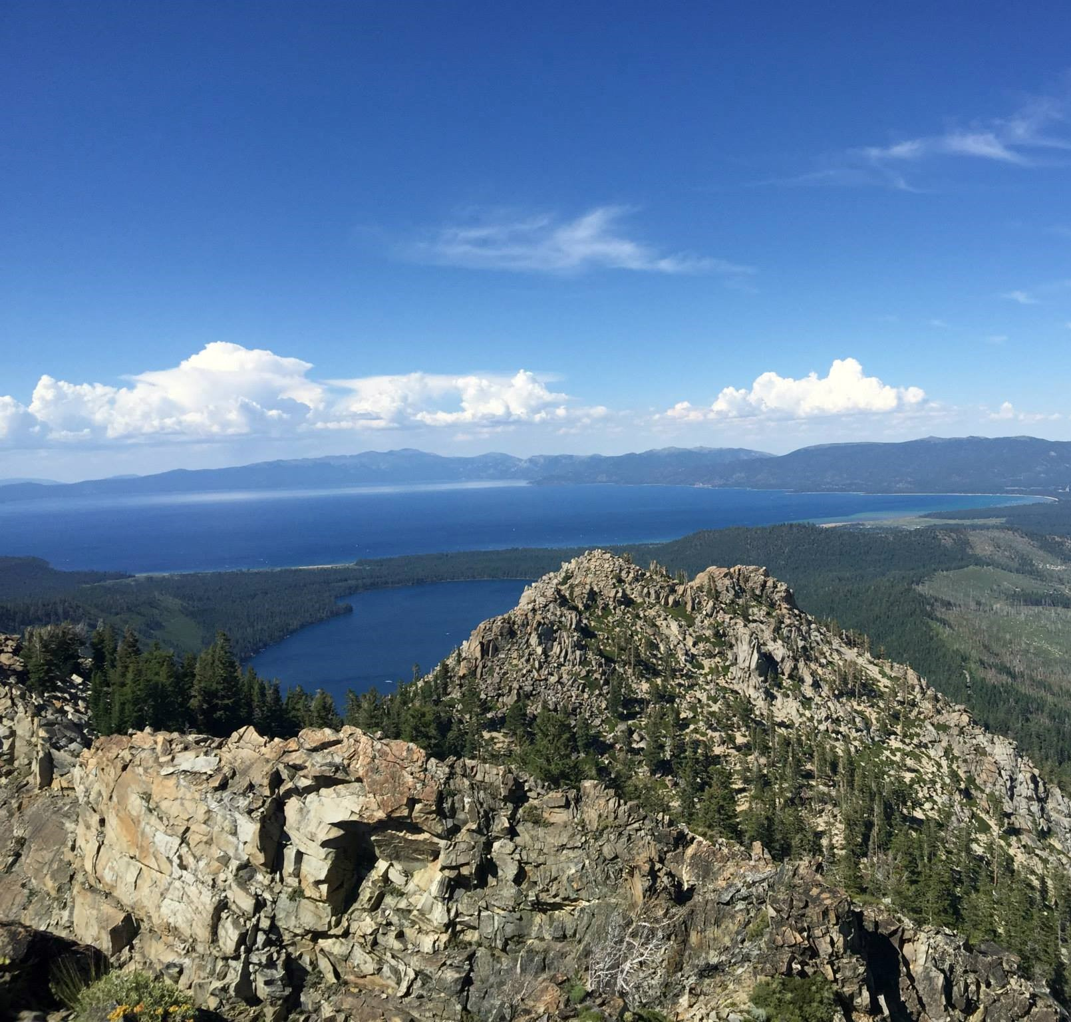
Background
The Lake Tahoe Basin Management Unit (LTBMU) rarely takes lake level measurements
Lake level is measured by time-intensive fieldwork
Notes:
The Lake Tahoe Basin Management Unit, which is part of the USDA Forest Service, was the primary end user for this project. The Lake Tahoe Basin Management Unit is not only responsible for Lake Tahoe, but it is also responsible for other relatively small water bodies in the region, including Fallen Leaf Lake. However, their current methods for monitoring lake levels are inconsistent and rather time-consuming. Both the USGS and the UC Davis Tahoe Environmental Research Center have gauge stations in place, but the data can be very limited. For instance, the gauge station near Tahoe City is the only one that monitors lake height. This pattern is common throughout the gauge stations, where data for one variable may only be available for the north end of the lake and vice versa for the south end. The Lake Tahoe Basin Management Unit, therefore, is interested in a more efficient method that will monitor the lake as a whole and that will take measurements consistently.

Slide 3
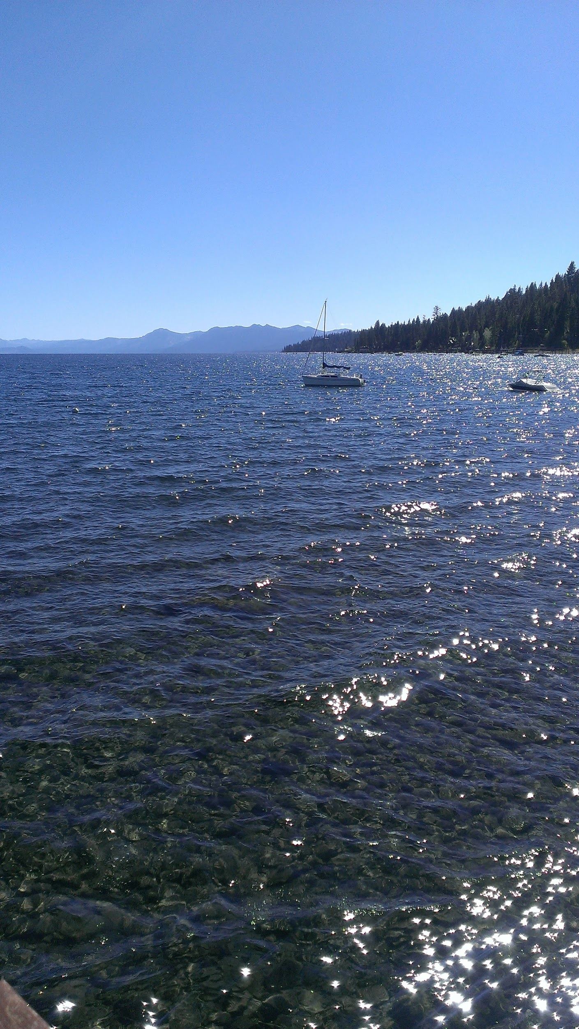
Community Concerns
Drought: 2015 CA State of Emergency
Economic importance: 3 million tourists per year
Endangered species at risk: Tahoe Yellow Cress
Notes:
There are several reasons why the Lake Tahoe Basin Management Unit wants to measure Lake Tahoe regularly. One of the most critical reasons is that the state of California is currently facing one of the most severe droughts on record. In fact, due to harsh drought conditions, Governor Jerry Brown declared earlier this year that California is in a state of emergency. Lake Tahoe’s decreasing water levels, therefore, are important to monitor as local residents, economies, and ecological factors rely on this body of water. Residents depend on this lake for drinking water, and many residents are able to find employment because of Tahoe’s large tourism industry. Nearly 3 million tourists visit Lake Tahoe each year, which is comparable to the Grand Canyon and Yellowstone National Park which attract approximately 3.2 million and 2.7 million tourists, respectively. Lastly, there are a number of endangered species along Tahoe’s shorelines, including the Tahoe Yellow Cress, that are becoming more vulnerable as water levels decrease.

Slide 4
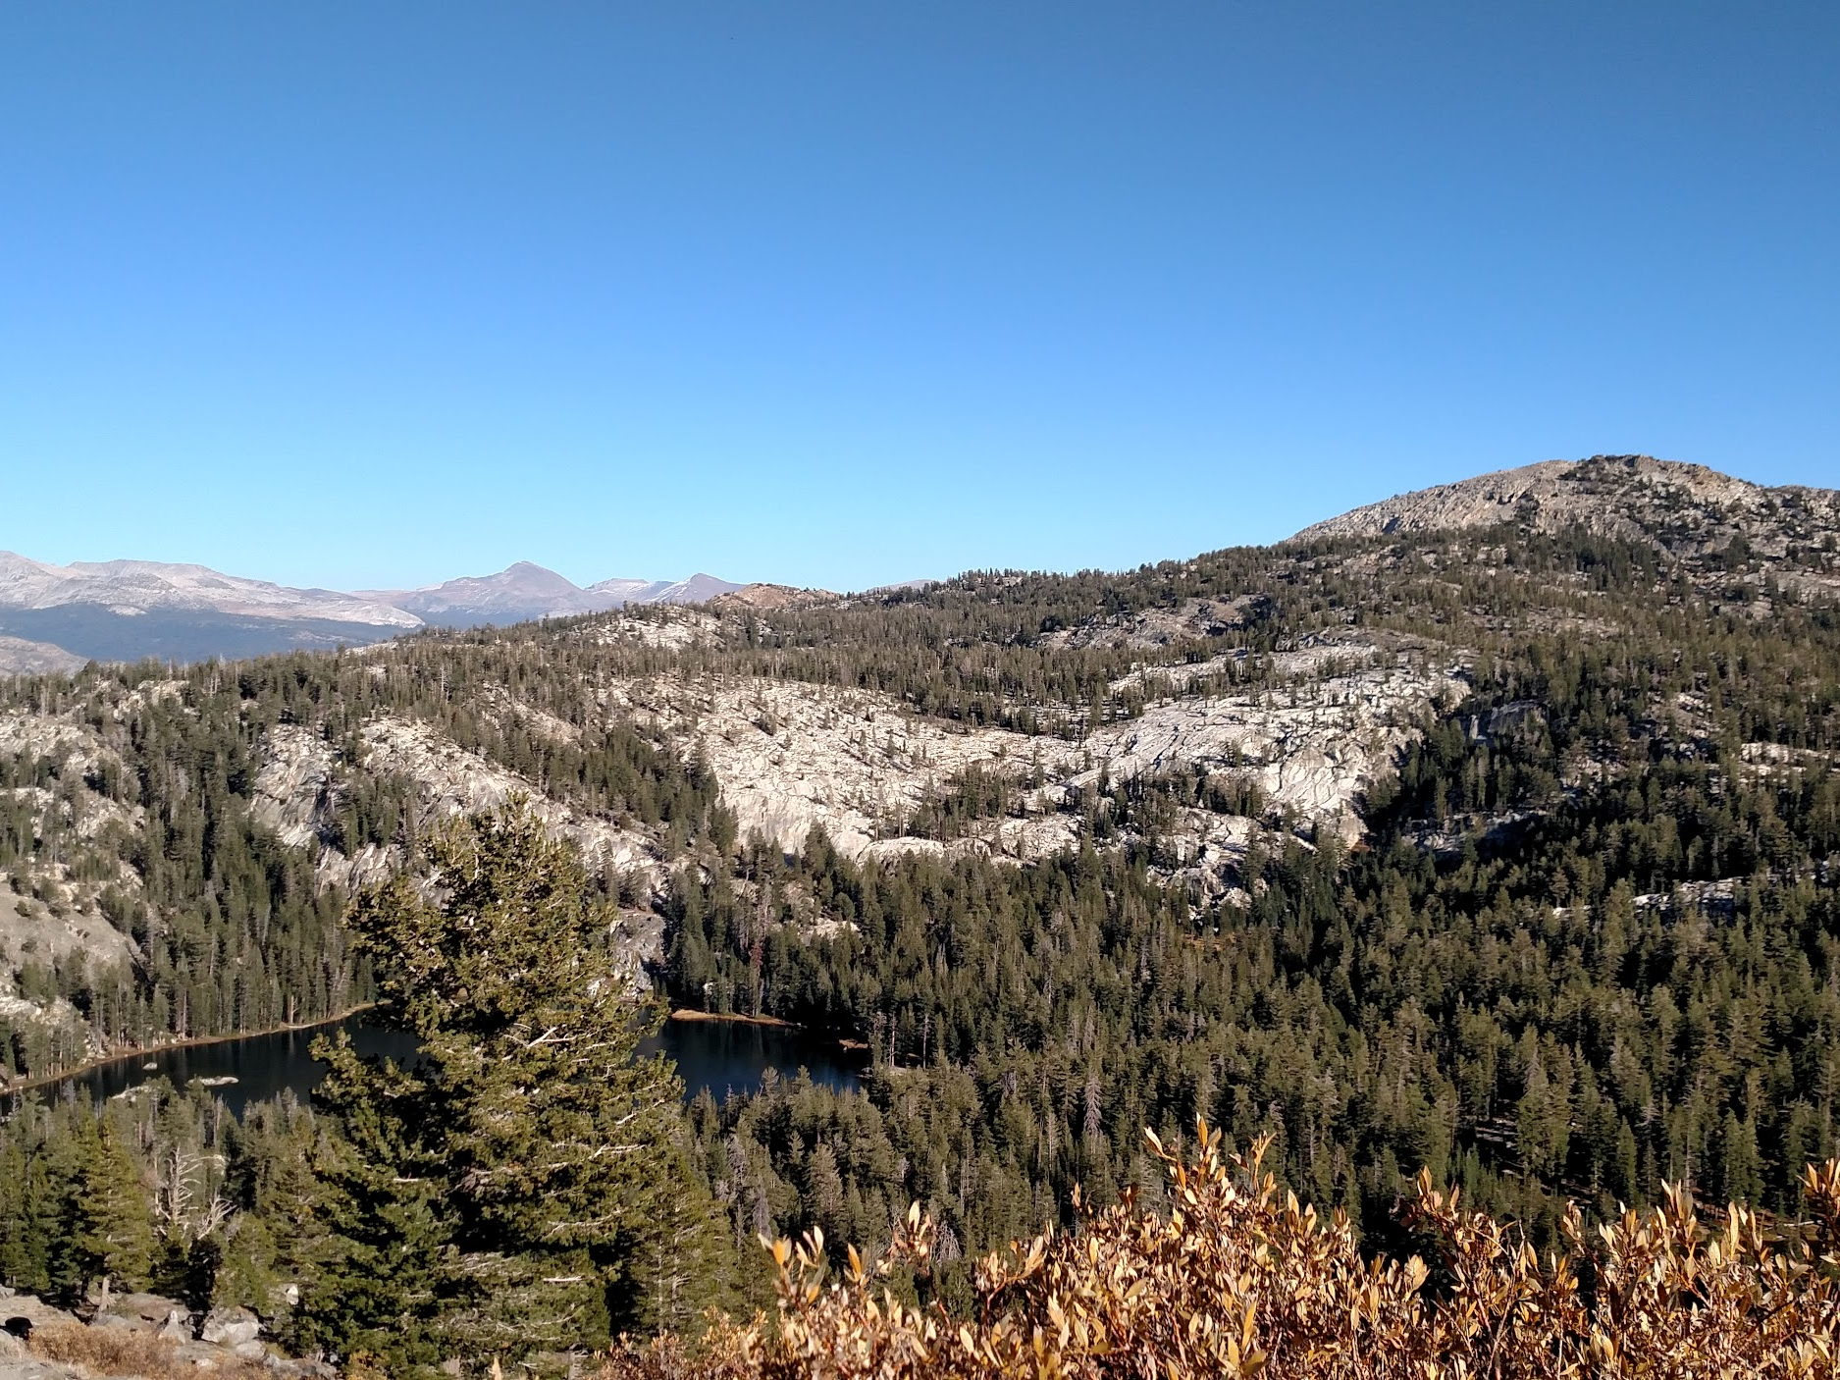
Objectives
Create a tool that continually monitors the level of Lake Tahoe and surrounding lakes
Provide a method to regularly measure lake turbidity
Generalize tool for water managers worldwide
Notes:
Our goal was to modify Dr. Brian Coltin’s code which monitored Mono Lake's water level, and apply it to Lake Tahoe. We also wanted to add the option of monitoring the lake’s turbidity and algae. Overall, our ultimate goal was to provide near real-time data regarding the turbidity, algae, and water levels for any lake or body of water.

Slide 5
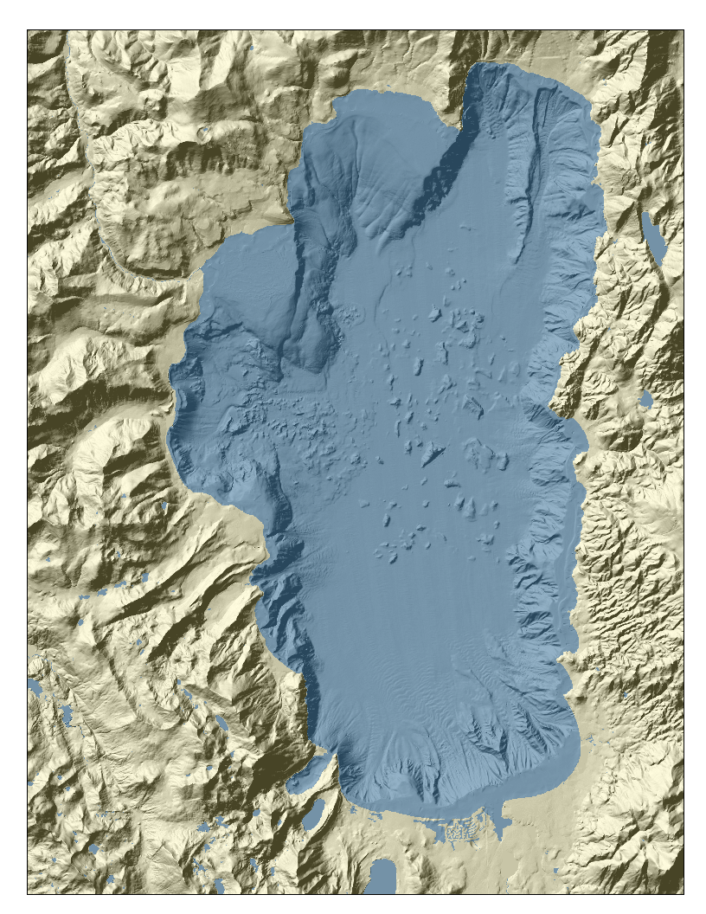
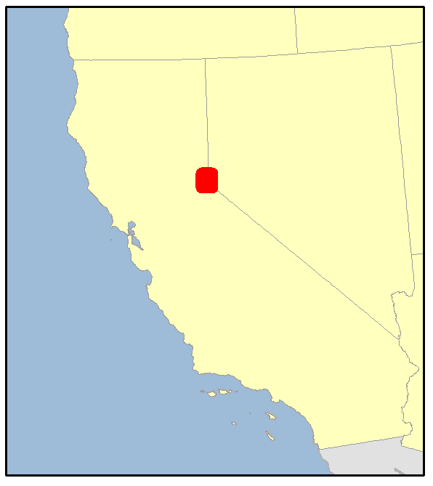
Study Area
Lake Tahoe
Notes:
As mentioned previously, we wanted to ensure that our tool works specifically for Lake Tahoe so that we could give it to the Lake Tahoe Basin Management Unit. However, our goal was to create a tool that could be applied to any body of water.

Slide 6
Earth Observations
Landsat 4-5 (TM) Landsat 8 (OLI)
Notes:
Similar to Dr. Coltin, we used Landsat imagery. However, we also added Landsat 8, which has the OLI sensor, or Operational Land Imager. Because of our choice in using Landsat, the data range from 1984 to the present, with the exception of 2012. We could have included Landsat 7 to account for 2012, but because of Landsat 7’s malfunction we decided it was best to leave it out.

Slide 7
LLAMA
Lake Level Automated Monitoring Algorithm

Slide 8
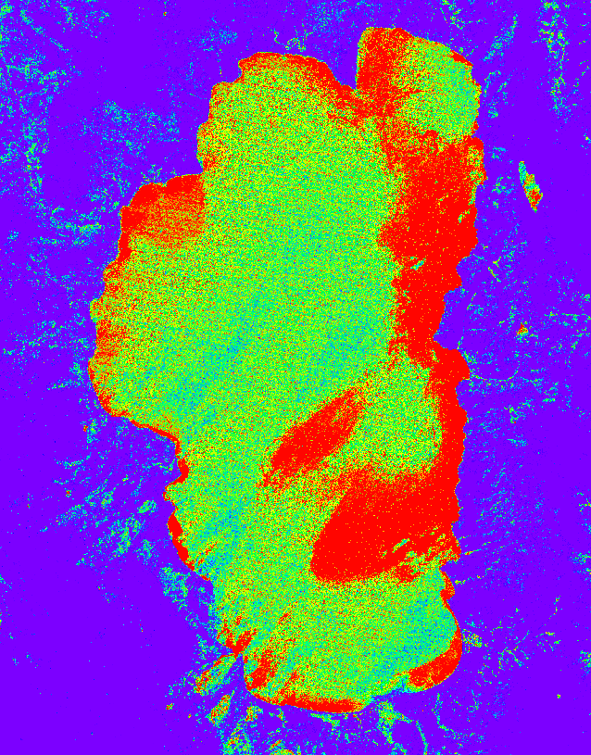
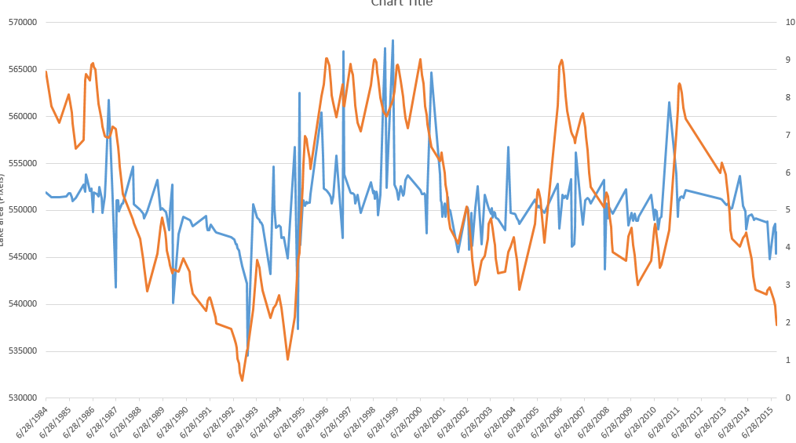
Methodology
LLAMA Overview:
Locate water body
4-step water detection process
Calculate turbidity and algal information
Output statistics
Locate Water Body
Detect Water
Step 1
Step 2
Step 3
Step 4
Water Threshold
Turbidity + Algae
Statistics
Notes:
Basic 4 step overview of how LLAMA works:
First locates the water body using a geodatabase
Detects water using a four step pixel scoring method
calculates various water quality rasters, such as algal content and turbidity
cleans-up data using statistical methodology and creates data visualizations for easy-viewing and output

Slide 9
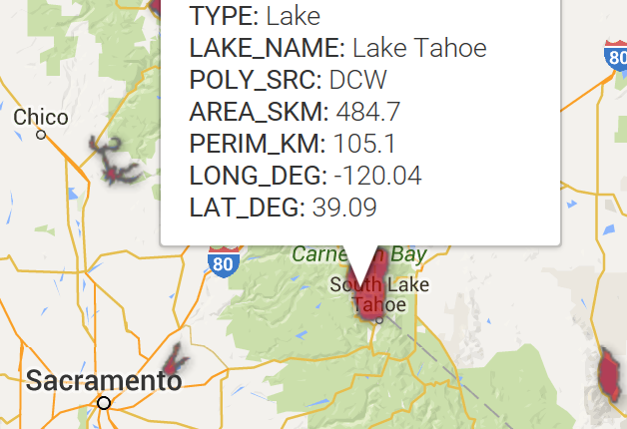
Methodology: Locate Water Body
Water body is located via KML polygons located in a Google Fusion Table
Table contains metadata for approximately 3,700 lakes
Locate Water Body
Detect Water
Step 1
Step 2
Step 3
Step 4
Water Threshold
Turbidity + Algae
Statistics
Notes:
Lake data is stored in what is called a Google Fusion Table. This is similar to a Google Sheet, except it can be directly queried and filtered from the cloud through Earth Engine code. Similar to a Sheet, new data can be added from anywhere as time goes on. This allows users and developers to add more and more Lake data as time goes on.
Our fusion table currently contains KML polygons and other metadata for over 3700 lakes around the world, and can be regularly updated. A tutorial will be released along with LLAMA, in order to make this process hassle-free.

Slide 10
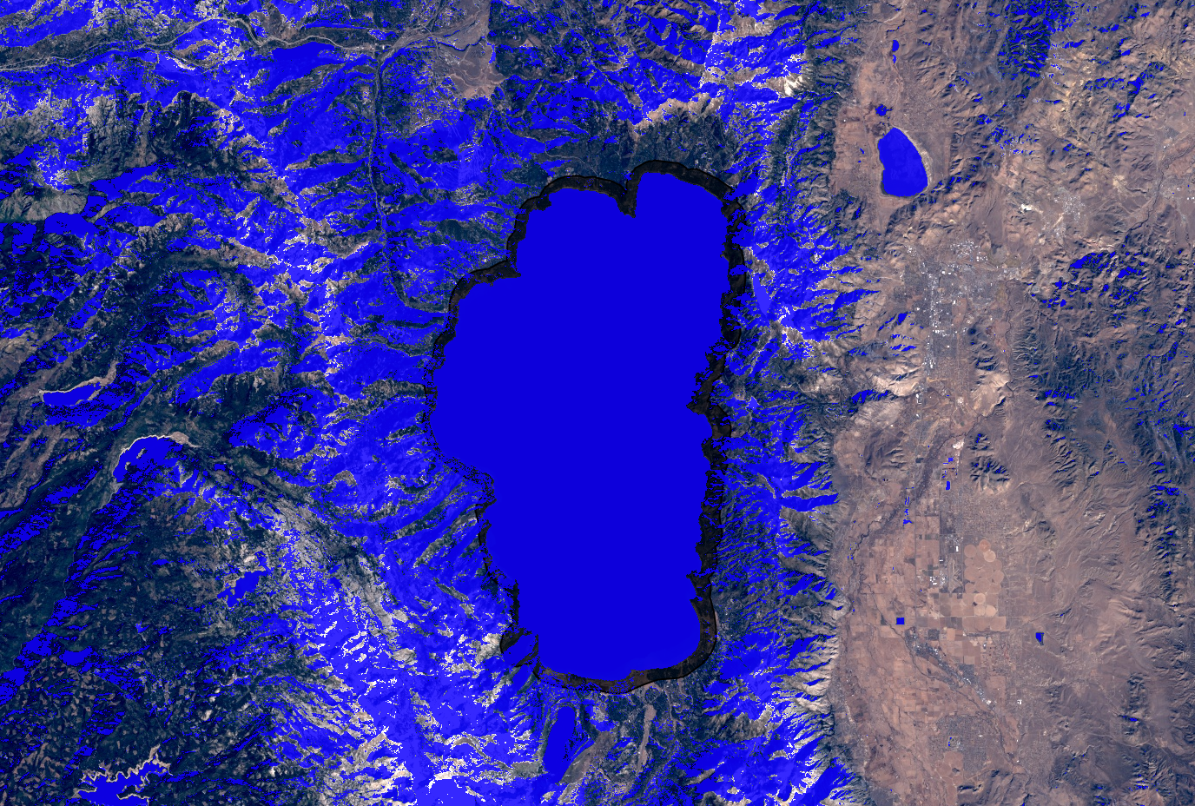
Methodology: 4-step Detection
Step 1 - Modified Normalized Difference Water Index (MNDWI)
Assigns pixel values between -1 and 1
Water is closer to 1
Snow is also assigned a high value
Green - SWIR
Green + SWIR
MNDWI=
Locate Water Body
Detect Water
Step 1
Step 2
Step 3
Step 4
Water Threshold
Turbidity + Algae
Statistics
Notes:
LLAMA uses a four-step scoring process to detect water in each image. Each method generates a rescaled score for each pixel, where the most water-like pixels are scored low. Pixels that fall below a certain threshold on each step are classified as water.
The first step using the Modified Normalized Difference Water Index, or MNDWI. This index uses the formula shown here to rescale pixels between the values of -1 and 1, where water has the highest values. We then invert these values so water has a low value.
mention that same index is used for snow mapping and thats why we need the remaining steps. MNDWI is from Xu, 2006. He says water can be anything above 0 and the MNDWI gives a lower value to vegetated and urban environments.

Slide 11
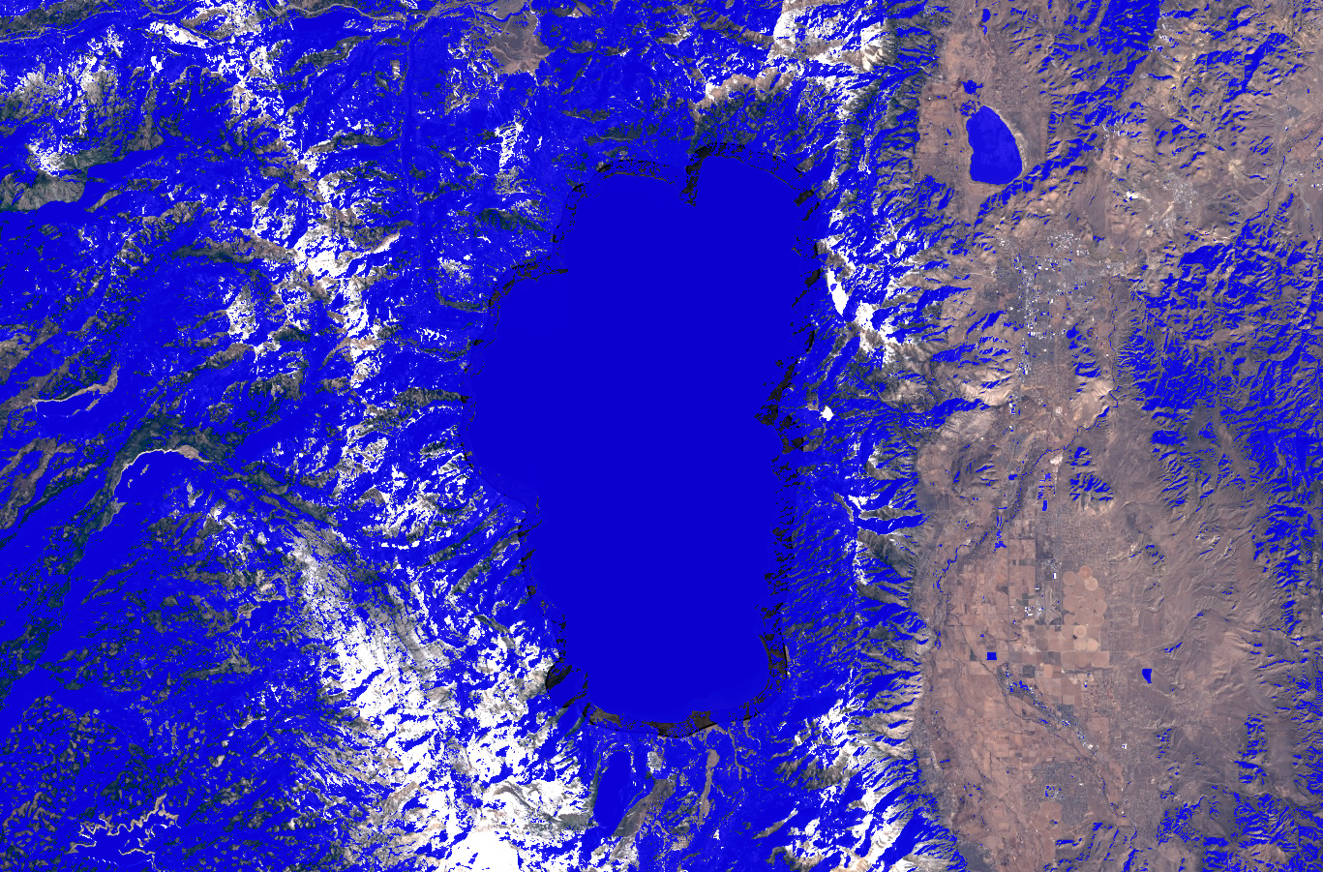
Methodology: 4-step Detection
Step 2 - Dark Objects
Water is spectrally dark
LLAMA looks for pixels that are relatively dark in Landsat infrared bands
Darker objects are more likely to be classified as water
Locate Water Body
Detect Water
Step 1
Step 2
Step 3
Step 4
Water Threshold
Turbidity + Algae
Statistics
Notes:
The next step looks at the darkness of pixels. Water is relatively dark, spectrally-speaking, so our code sums all the pixels across the near-infrared, and both short-wave infrared bands, and rescales them so the darkest pixels are more-likely to be classified as water.

Slide 12
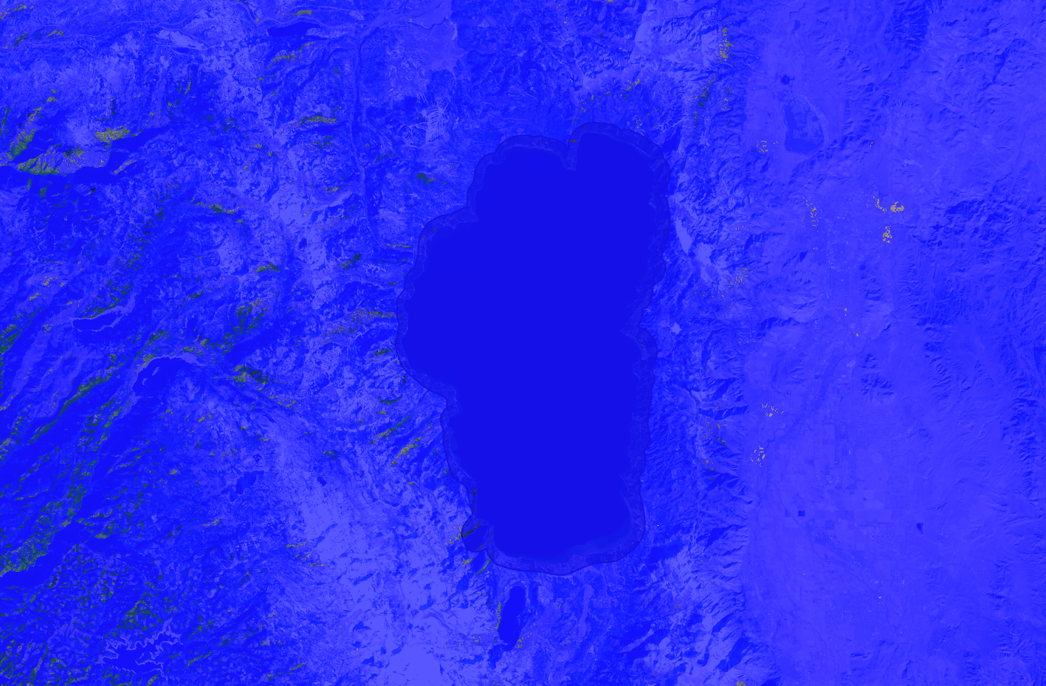
Methodology: 4-step Detection
Step 3 - Blue Band Reflectance
LLAMA is more likely to accept a pixel as water if its reflectance is higher in the blue than in other visible bands
Locate Water Body
Detect Water
Step 1
Step 2
Step 3
Step 4
Water Threshold
Turbidity + Algae
Statistics
Notes:
The third step looks at the “blueness” of pixels in the image. LLAMA uses a z-score to find pixels where the mean values of the non-blue bands are significantly lower than the value of the blue band. These z-scores are then rescaled so that the bluest pixels are more likely to be classified as water.

Slide 13
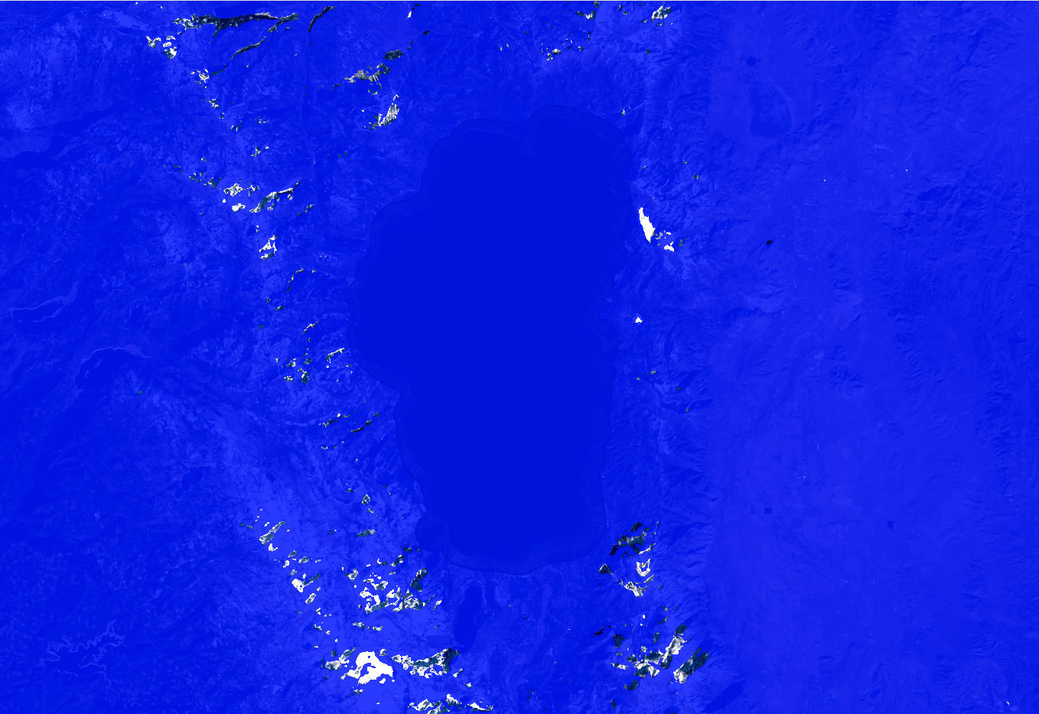
Methodology: 4-step Detection
Step 4 - Temperature Band
LLAMA examines the thermal bands of the Landsat instruments
Verifies if pixel is above freezing (273 K)
Locate Water Body
Detect Water
Step 1
Step 2
Step 3
Step 4
Water Threshold
Turbidity + Algae
Statistics
Notes:
Finally, LLAMA uses the thermal band of LANDSAT to find pixels that are above freezing. This ensures that any snow that is found in the MNDWI step will be not be mis-classified as liquid water.

Slide 14
Methodology: Water Threshold
➢Water threshold fluctuates inversely with sun angle
➢Compensates for snowy winter and hazy summer images
Water Threshold = 0.6/54*(64-sun angle) + 0.05
Locate Water Body
Detect Water
Step 1
Step 2
Step 3
Step 4
Water Threshold
Turbidity + Algae
Statistics
Notes:
LLAMA calculates a series of additional indices to provide users with more water information
The tool can calculate both a floating algal index and a turbidity index.
Through LLAMA, both indices can be displayed on rasters and downloaded for further manipulation in other geoinformatics software.

Slide 15
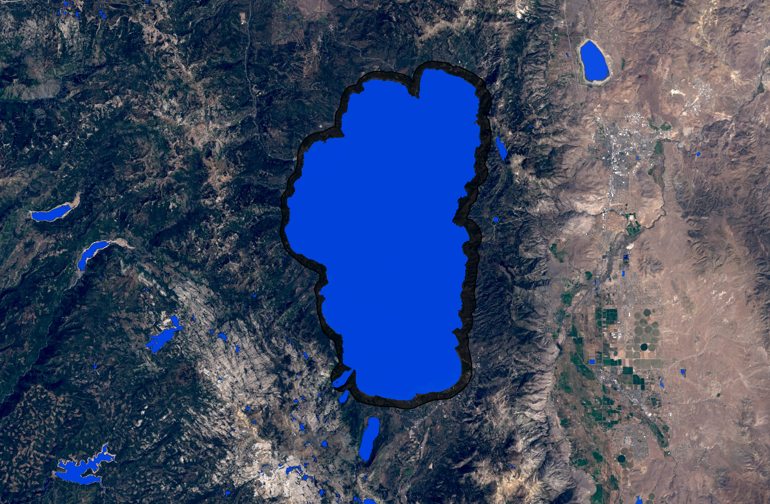
Methodology
Complete measurement
Notes:
Using this final result, we’re able to count the number of pixels classified as water, and then convert the pixel count to lake area.

Slide 16
Methodology: Turbidity & Algae
Additional Indices:
Floating Algae Index (FAI)
Normalized Difference Turbidity Index (NDTI)
NIR-(red+((SWIR-red)*(λ_{NIR}-λ_{Red} )/λ_{SWIR}-λ_{Red} )
Red-Green
Red+Green
Locate Water Body
Detect Water
Step 1
Step 2
Step 3
Step 4
Water Threshold
Turbidity + Algae
Statistics
Notes:
LLAMA calculates a series of additional indices to provide users with more water information
The tool can calculate both a floating algal index and a turbidity index.
Through LLAMA, both indices can be displayed on rasters and downloaded for further manipulation in other geoinformatics software.

Slide 17
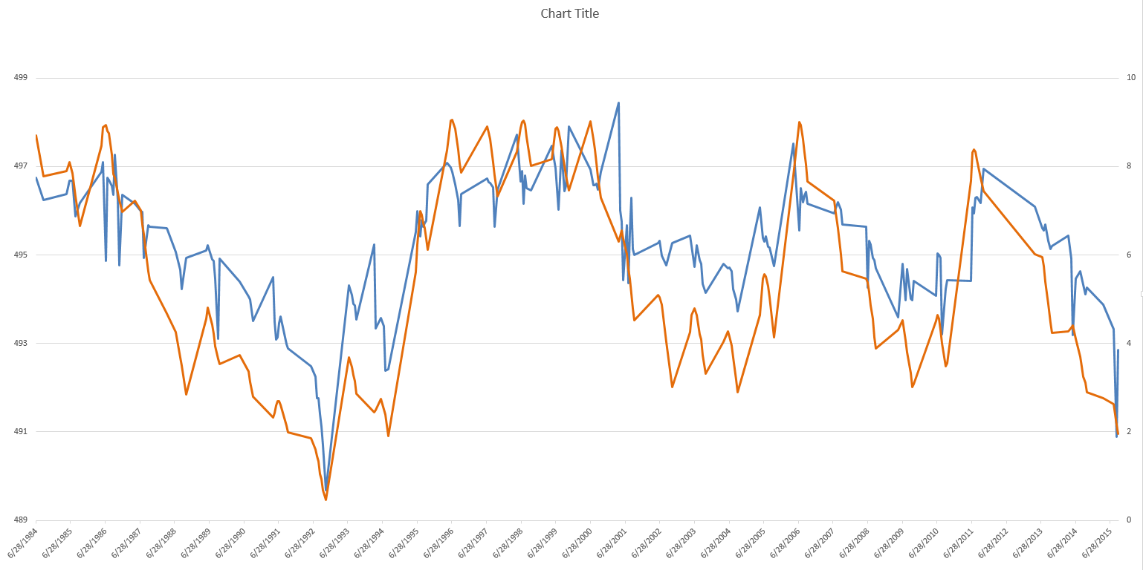
Results: Lake Tahoe
r=0.814
Lake Area (pixels)
Gauge Height (ft)
Date
Notes:
This is the initial result from lake tahoe. r value is showing the correlation between the lake area that our tool is measuring, shown in blue, and a usgs gauge station height, shown in orange.

Slide 18
Results: Lake Tahoe
r=0.814
Lake Area (pixels)
Gauge Height (ft)
Date
Notes:
While the lake measurements have a very high correlation, they don’t show a perfect match to the gauge station data. For tahoe the tool is still very effective at monitoring trends over time, making it especially useful for monitoring drought.

Slide 19
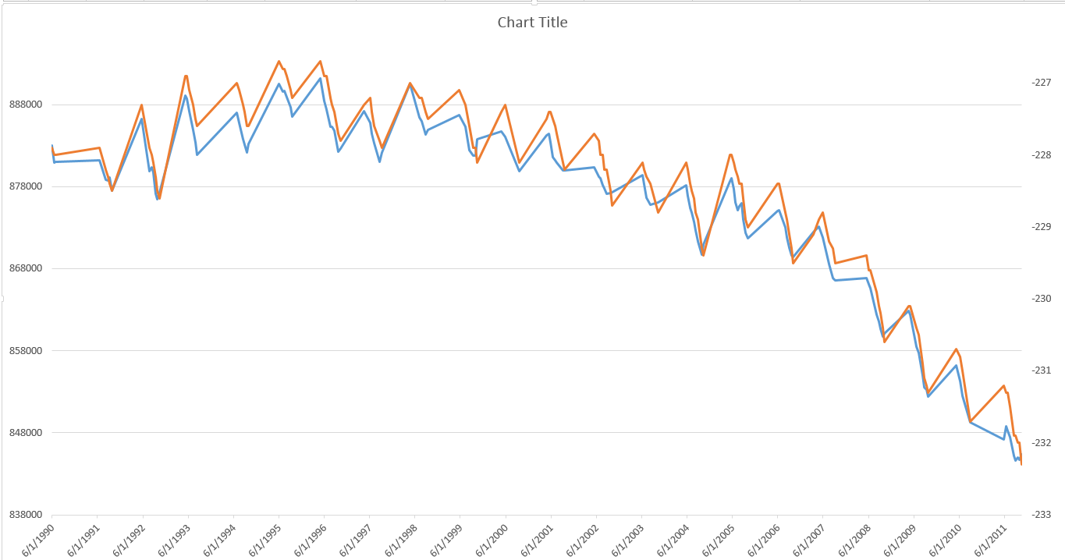
Results: Salton Sea
r=0.992
Lake Area (pixels)
Gauge Height (ft)
Date
Notes:
For the Salton Sea the measurements are almost perfectly correlated, suggesting that LLAMA is not only useful for monitoring trends over time, but taking direct measurements of the lake.

Slide 20
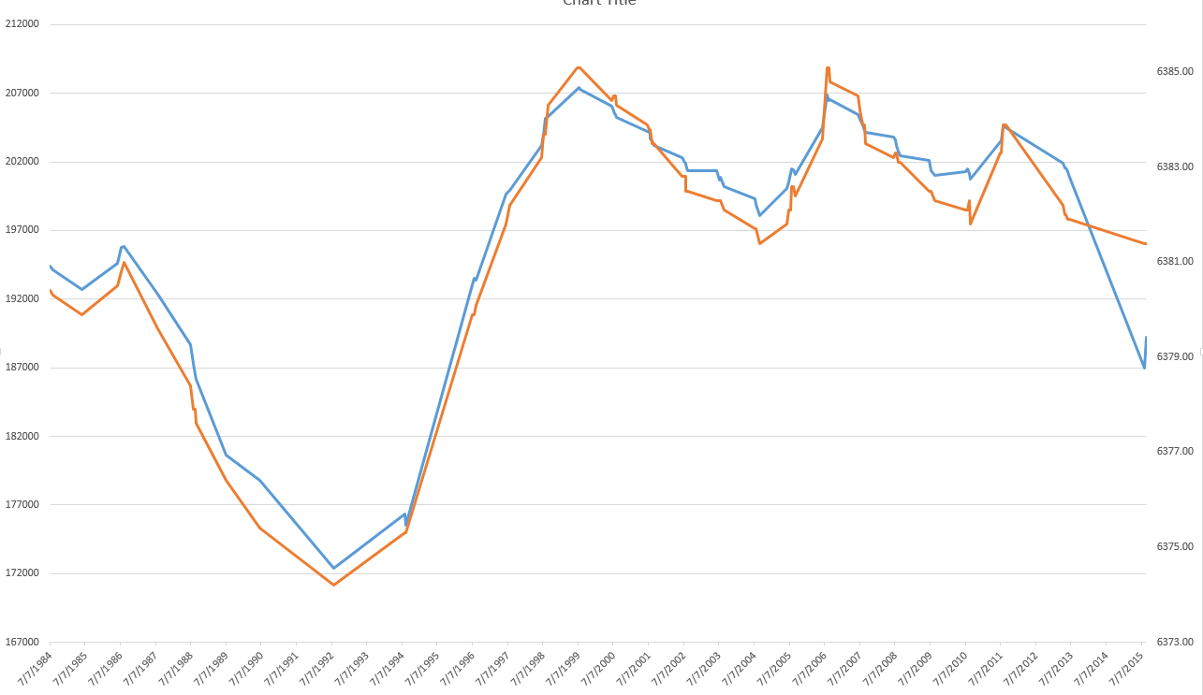
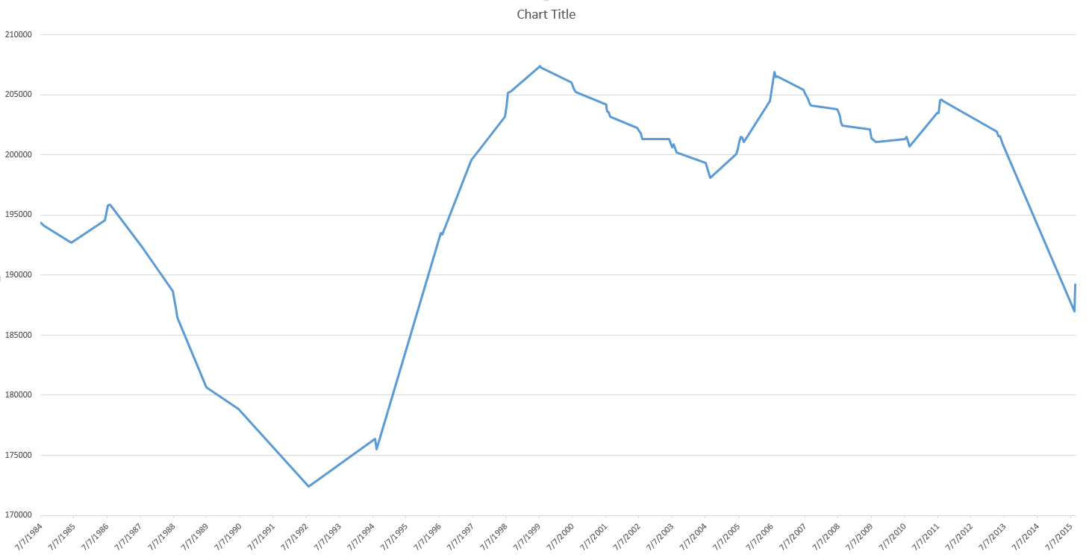
Results: Mono Lake
r=0.970
Lake Area (pixels)
Gauge Height (ft)
Date
Notes:
Mono Lake showed similar results to the Salton Sea. A near perfect correlation means that LLAMA can be used to take measurements of lake level

Slide 21
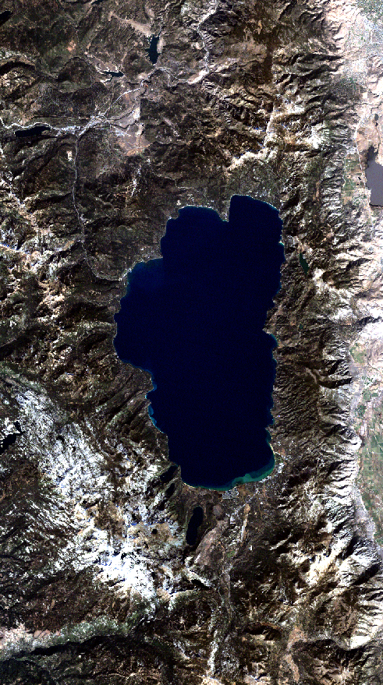
Conclusions
Ideal conditions allow for direct measurements
LLAMA may be used to monitor the trends of lake level over time.
Cloud-based computing is a promising tool for the future of remote sensing and resource management
Notes:
Ideal conditions such as in the Salton Sea and Mono Lake allow for almost direct measurements of lake level. However in lakes such as tahoe (shown here) trends can still be monitored in lake level over time. Also Google Earth Engine comes with a variety of advantages that makes cloud based computing a very useful and reliable tool for geospatial analysis.

Slide 22
Limitations
Spatial resolution of Landsat Sensors
Temporal resolution of Landsat Satellites
Lakes that are positioned on multiple Landsat tiles cannot be measured
Notes:
The limited resolution of Landsat data can make changes at the the fringes of a lake difficult to detect. The image at the bottom of the slide shows the previous image of tahoe zoomed in on the southern shelf. You can begin to see the limited resolution of the Landsat imagery. This also limits the size of the water body that the tool can measure. Smaller water bodies will not be measured with as much accuracy. Lake tahoe falls in the middle of a landsat tile but for lakes that fall on the boarder of two or more tiles LLAMA will not be able to calculate a measurement. This will be explained further on the next slide.

Slide 23
Future Work
Fix split-image problem
More in-depth UI
“Auto-detect” lake function
1
3
2
4
Notes:
Shown here is a crudely drawn diagram showing a possible position of a water body over some landsat tiles. This isn’t actually representative of the placement of lake tahoe in landsat tiles. If a lake were to fall in a similar position LLAMA wouldn’t be able to measure it. There are a number of ways to overcome this problem that should be implemented in LLAMA in the future. we should also like to see a more in depth user interface as well as an auto detect lake function. Neither of which could be completed in the amount of time this project was given.

Slide 24
Advisors
Dr. Brian Coltin (NASA Ames Research Center)
Dr. Juan Torres-Pérez (Bay Area Environmental Research Institute)
Emily “Chippie” Kislik (NASA DEVELOP)
Victoria Ly (NASA DEVELOP)
Partners
Dr. Joey Keely (Lake Tahoe Basin Management Unit, USDA Forest Service)

