Slide 1
DEVELOPedia
Improving the Functionality and Features of DEVELOPedia to Replace the DEVELOP Exchange
Logan Kendle
Rick Farmer
Carolyn Lynch
Luke Thompson
Timothy Stelter
Adam White
Notes:
LOGAN
This is where we introduce the team and their roles, and affiliations.

Slide 2
DEVELOPedia 101
What is DEVELOPedia?
DEVELOPedia is a repository which strives to organize and share the wealth of information, technical knowledge, and practices accumulated both during and as a result of NASA DEVELOP’s applied science research projects
Will replace the DEVELOP Exchange, the current web based database for DEVELOP projects and their deliverables

Slide 3
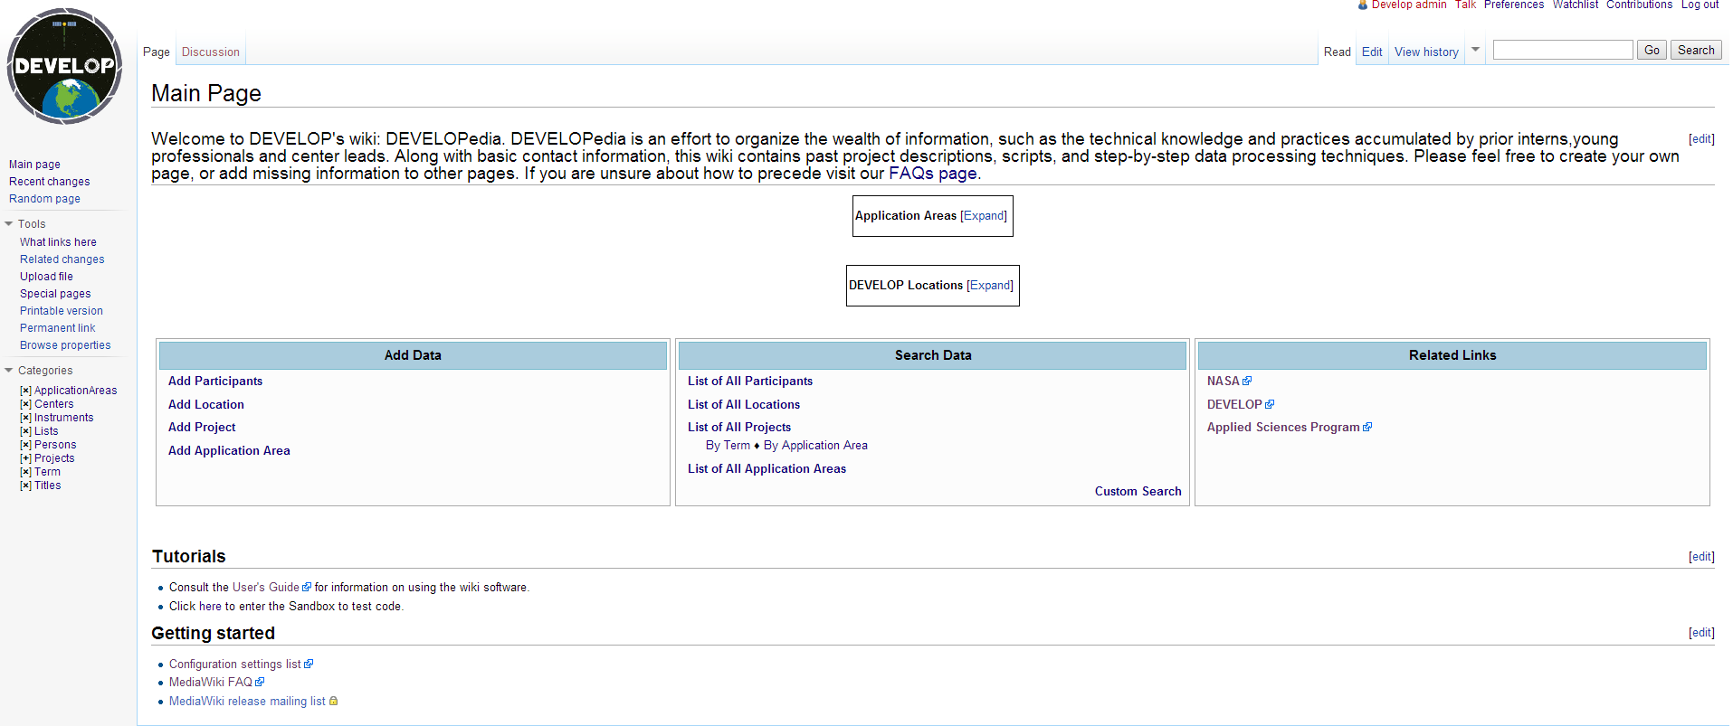
Progress of DEVELOPedia
Spring and Summer 2014
Still had organizational and presentation problems
Only included basics like adding participants, node and projects
Needed more features to replace DEVELOP Exchange
Notes:
LOGAN
Talk about what we took over from the Summer 2014 term
What the site did at the time
What the site needed to have added before going live

Slide 4
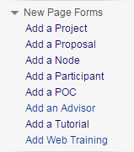
Fall Goals of DEVELOPedia
Fall 2014
All pages rewritten to include similar format
Naming systems, tables, links, files, and forms all implemented to increase functionality
User friendliness and editing abilities added
Increased file upload size
Several “Add Page” forms created
Notes:
LOGAN
We created a similar format for each page to follow so that they would be as intuitive as possible.
A naming nomenclature or system was created so that files over the years wouldn’t overlap. As long as they name the files correctly things will not overlap or over write over time.
The site is now more pleasant to the eye and more user friendly, the pages and how your navigate between them is more self explanatory

Slide 5
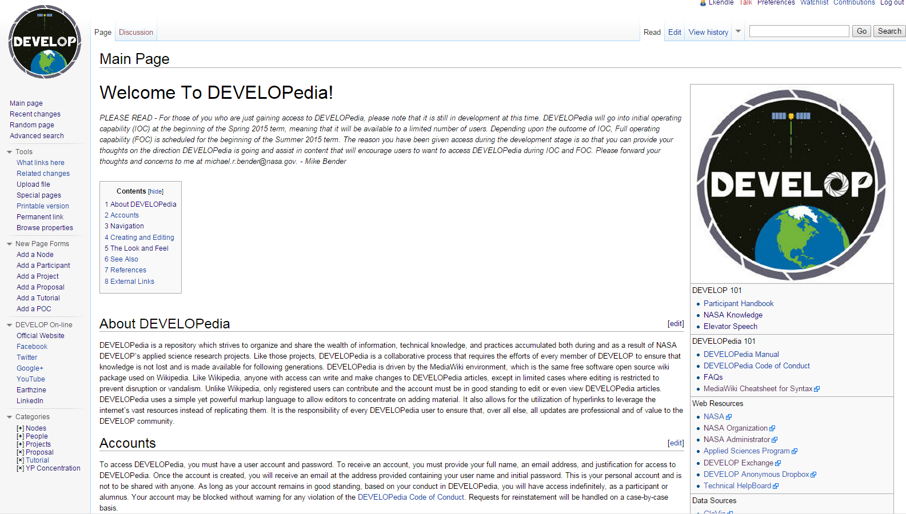
DEVELOPedia Main Page - Admin
The main page includes all of the basic user functions to navigate the website and a list of useful resources for every DEVELOPer.
Notes:
LOGAN

Slide 6
DEVELOPedia Admin View
Admins have the privileges to edit both the form, template, and page
Users only have the privileges to edit the page using the preset form
Administrator
Notes:
LOGAN

Slide 7
DEVELOPedia Admin View
Admins have the privileges to edit both the form, template, and page
Users only have the privileges to edit the page using the preset form
User
Notes:
LOGAN

Slide 8
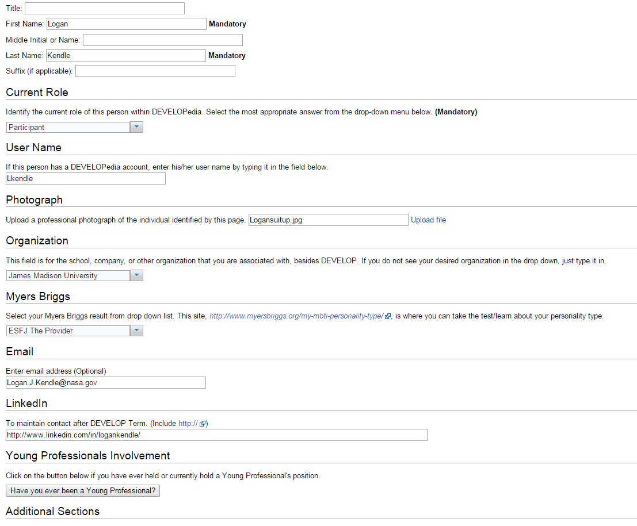
Add a Participant
The new participant page includes:
Myers Briggs personality test result
Young Professional involvement options
Additional add on sections are also available
Notes:
CAROLYN

Slide 9
Add a Participant
The new participant page includes:
Myers Briggs personality test result
Young Professional involvement options
Additional add on sections are also available
Notes:
CAROLYN

Slide 10
Add a Participant
The new participant page includes:
Myers Briggs personality test result
Young Professional involvement options
Additional add on sections are also available
Notes:
CAROLYN

Slide 11
Add a Young Professional
Young Professional status, skills, year, and specific tasks can now be added to each individual participant page. This will also help to provide information of how the YP’s can help the participants to complete their projects.
Notes:
CAROLYN

Slide 12
Add a Young Professional
Young Professional status, skills, year, and specific tasks can now be added to each individual participant page. This will also help to provide information of how the YP’s can help the participants to complete their projects.
Notes:
CAROLYN

Slide 13
Add a Young Professional
Young Professional status, skills, year, and specific tasks can now be added to each individual participant page. This will also help to provide information of how the YP’s can help the participants to complete their projects.
Notes:
CAROLYN

Slide 14
Add a Young Professional
Young Professional status, skills, year, and specific tasks can now be added to each individual participant page. This will also help to provide information of how the YP’s can help the participants to complete their projects.
Notes:
CAROLYN

Slide 15
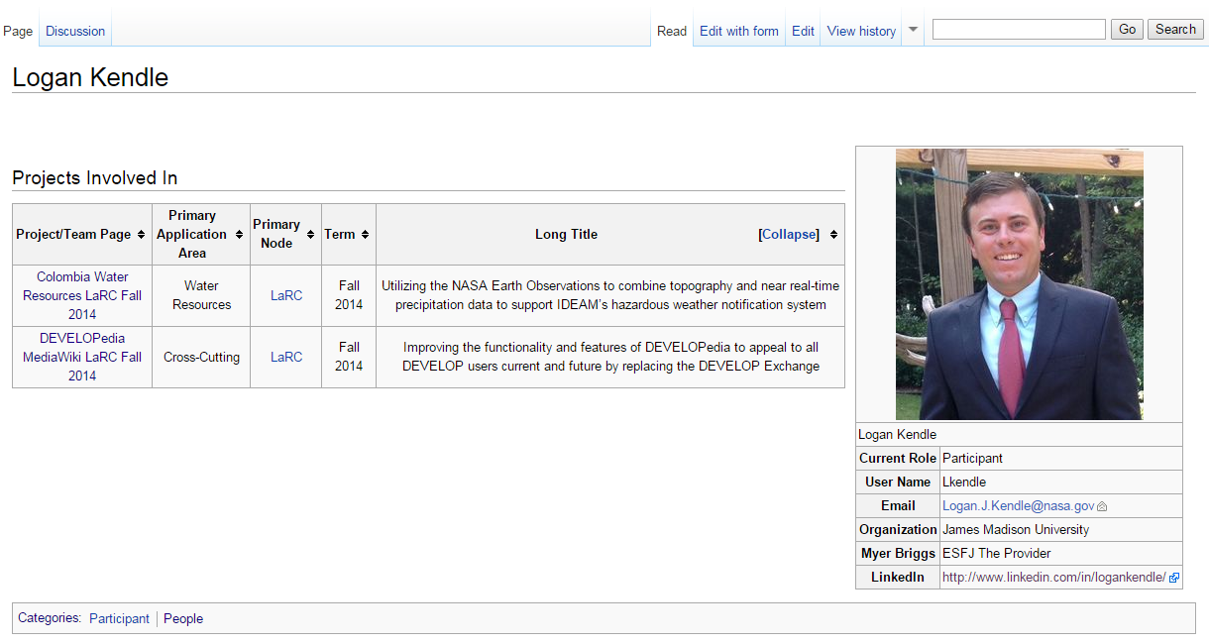
Participant Example Page
You now have the ability to add LinkedIn profiles
Notes:
CAROLYN

Slide 16
Naming Projects
Notes:
TIM
Briefly explain why we now have naming system
Benefits of new system
No overwriting
Allows for easy search
Allows CL and NPO to query by term, application area,……
Keeps file names unique

Slide 17
Naming Projects
Notes:
TIM

Slide 18
Naming Projects
Notes:
TIM

Slide 19
Naming Projects
Notes:
TIM

Slide 20
Add a Project
Sections from the tech paper can be added to the project page using tables and free text boxes
Additional sections like: See Also, References, and External Links can be added, moved, and removed easily
Notes:
CAROLYN
We have created a very intuitive, step by step process that should be pretty

Slide 21
Project Example Page – Part 1
Notes:
CAROLYN

Slide 22
Project Example Page – Part 1
Notes:
CAROLYN

Slide 23
Project Example Page – Part 1
Notes:
CAROLYN

Slide 24
Project Example Page – Part 1
Notes:
CAROLYN

Slide 25
Project Example Page – Part 1
Notes:
CAROLYN

Slide 26
Project Example Page - Part 2
Notes:
CAROLYN

Slide 27
Project Example Page - Part 2
Notes:
CAROLYN

Slide 28
Project Example Page - Part 2
Notes:
CAROLYN

Slide 29
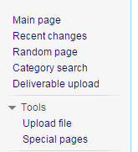
Deliverables
Deliverables can now to uploaded and stored on the DEVELOPedia site replacing the DEVELOP Exchange
Notes:
TIM
Mention how to find this (on the main page, left side bar)

Slide 30
Deliverables
Deliverables can now to uploaded and stored on the DEVELOPedia site replacing the DEVELOP Exchange
Notes:
TIM

Slide 31
Deliverables
Deliverables can now to uploaded and stored on the DEVELOPedia site replacing the DEVELOP Exchange
Notes:
TIM

Slide 32
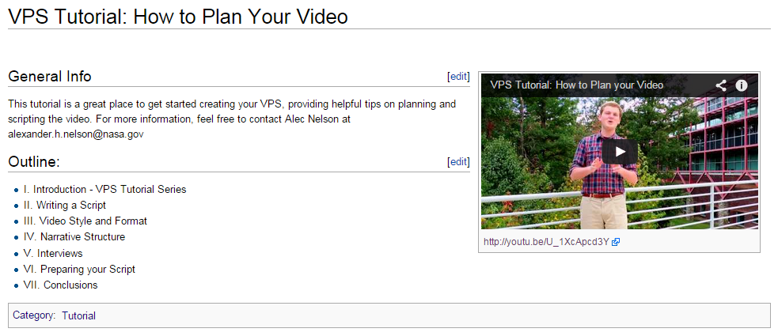
Add a Tutorial
Tutorials will continue to become a larger role in the DEVELOP as projects become more challenging and complex
Notes:
TIM

Slide 33
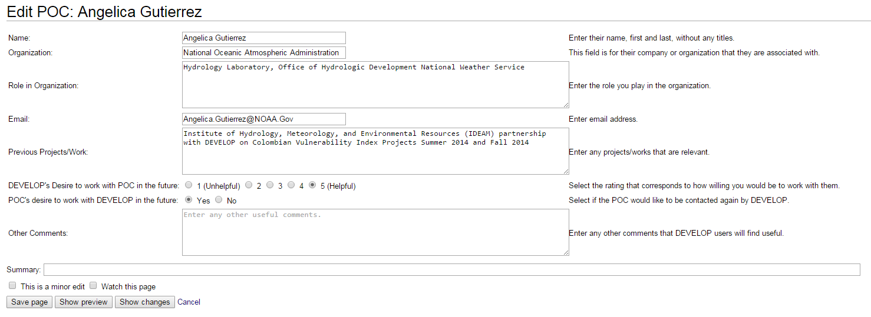
Add a Point of Contact (POC)
This will create a new internal database for end-users, collaborators, and other individuals that contributed to completing Term projects
This page may help future teams determine whether the POC could be a helpful contributor to their project
Notes:
CAROLYN
Just say we can now list their organizations and the previous projects they worked on

Slide 34
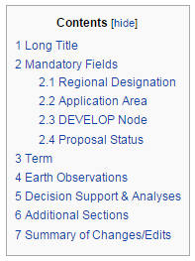
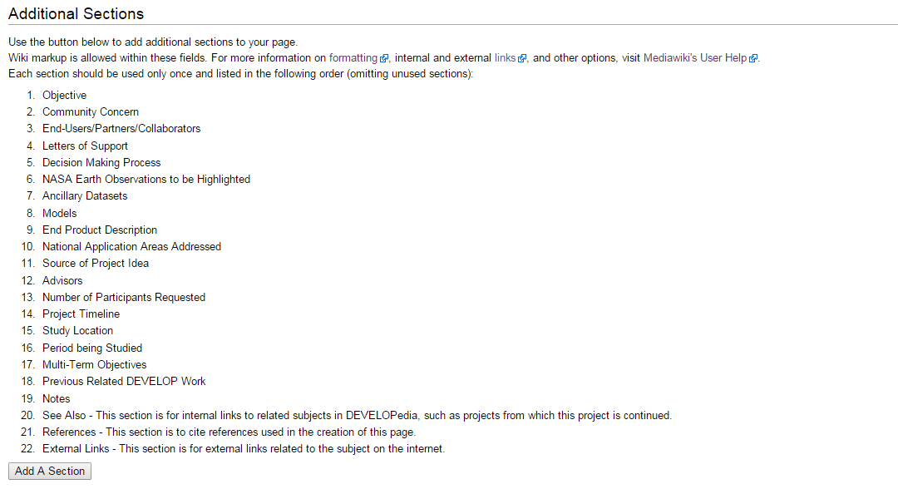
Add a Proposal
Previously, proposals were saved as word documents and pdfs.
DEVELOPedia will allow for proposals to be saved and updated online
Notes:
CAROLYN

Slide 35
Add a Proposal
Previously, proposals were saved as word documents and pdfs.
DEVELOPedia will allow for proposals to be saved and updated online
Notes:
CAROLYN

Slide 36
Uploading New Files
Naming uploaded files must be completed with diligence so that they don’t overwrite previously uploaded files.
The file max upload size was finally increased from 7MB to 60MB.
Notes:
TIM
File size was changed from 7 MBs to 60 MBs to accommodate for the deliverables. To avoid risk file from being replaced by, the filename must be detailed and precise.

Slide 37
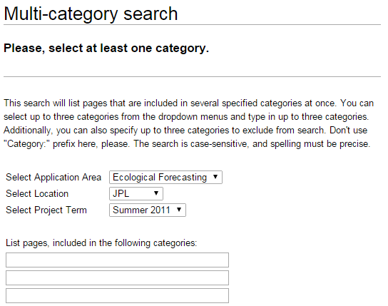
DEVELOPedia Abilities
Categories
Searching
This is the method to broadly search all projects at one time.
This is the method to specifically search inside terms, location, or application area.
Notes:
TIM
The left picture shows all the page categories that will contain their sub-categories. USE AN EXAMPLE FOR YP SEARCHING. The right picture DEVELOPedia has the function to query for projects that can be used as references for users.

Slide 38
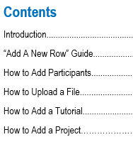
DEVELOPedia Manuals
Admin Manual
User Guide for DEVELOPers
Notes:
LOGAN
So if you didn’t catch all of that we now have an improved manual. It is the improved version from the previous DEVELOPedia Manual. It is a step-by-step guide that includes explicit instructions with visual aids. It goes over the basic functionality for users.

Slide 39
DEVELOPedia Timeline
Fall 2013 – DEVELOPedia was created by Jonathan Hicks and Ajoke Williams
Summer 2014 – DP took on a rapidly different look and had some of its current features created using the Semantic MediaWiki write-up
Fall 2014 – DEVELOPedia takes on it’s current look and has the rest of it pages and forms added by Tech Team
Spring 2015 – Langley Node semi launch to gauge and problem solve DP’s remaining bugs
Summer 2015 – National Full Live launch to all DEVEVLOP Nodes
Team photo
Notes:
LOGAN
To conclude DEVELOPedia has been a ongoing project since Fall 2013 that is finally ready for nationwide use by Summer 2015.

Slide 40
Colombian Vulnerability Index of torrential events (IVET)
Setting the stage for Next Term’s Programming Project
Logan Kendle
Gennifer Anderson
Luke Thompson

Slide 41
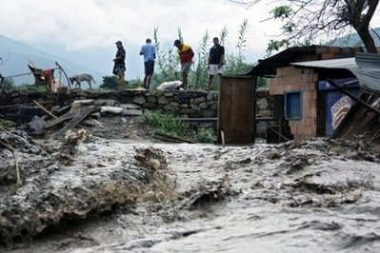
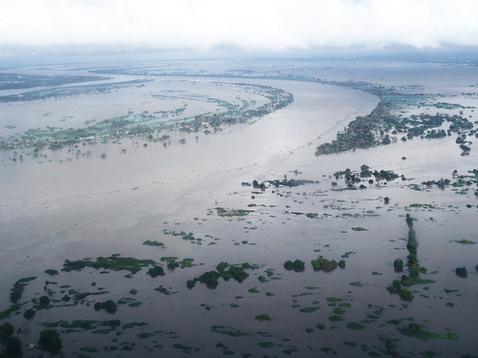
Project Scope
Purpose of project
Due to the highly variable terrain stretching from the Andes Mountains to the Coastal areas in Colombia, the country is prone to flash flooding.
The goal of the Colombian IVET project is to use the data found in ArcGIS to aid IDEAM* in preventing unnecessary deaths caused by natural disasters
*IDEAM: Institute of Hydrology, Meteorology and Environmental Studies

Slide 42
Project Scope
Objectives
Use ASTER 30m Digital Elevation Data (DEM) in ArcGIS to calculate the Vulnerability Index of torrential events (IVET)
Study Area
La Mosca River Basin, Colombia

Slide 43
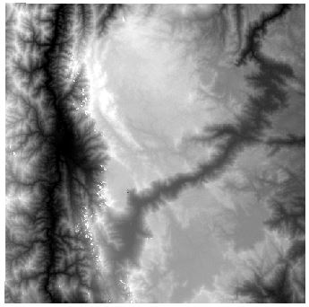
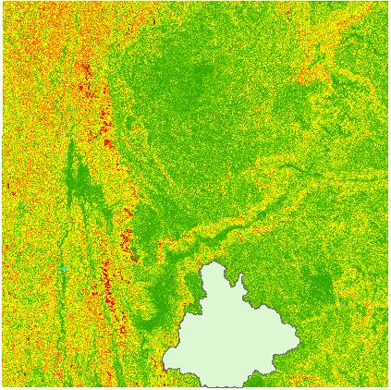
Methods
1. Get Data
First, we downloaded 30m ASTER Digital Elevation Model (DEM) data from Earth Explorer, then prepared the data for calculations in ArcGIS
2. Slope and Watershed
Then we calculated the slope of the terrain and the end points of where the majority of rainfall would collect, using the data calculated

Slide 44
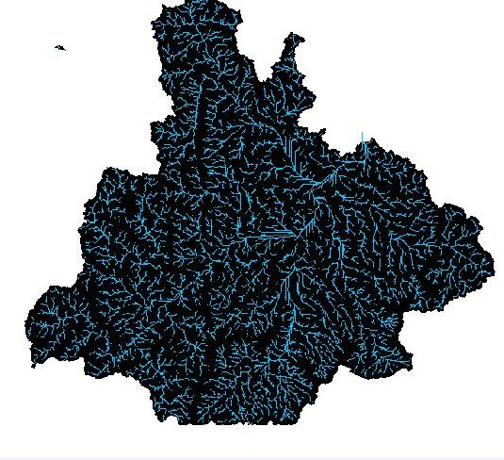
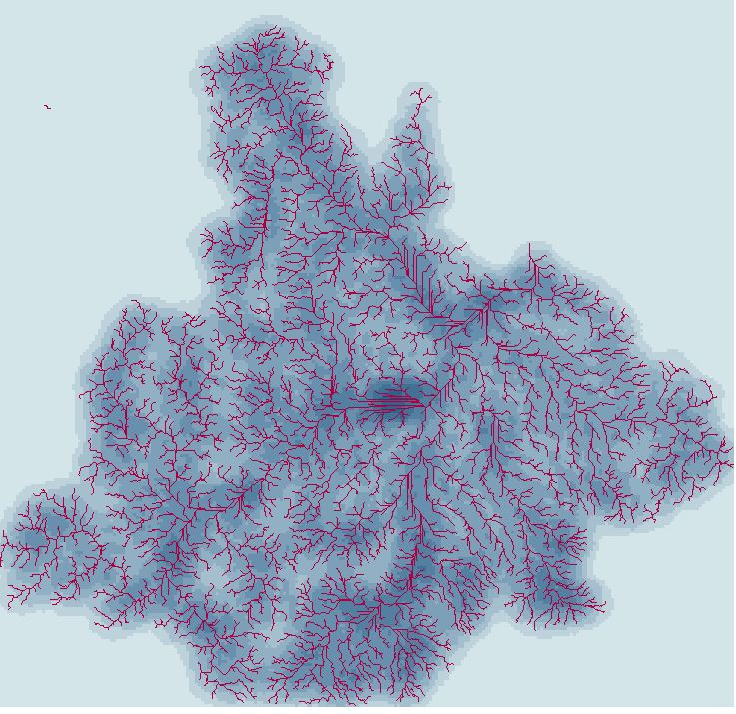
Methods
3. Streams Defined
Next we defined the streams within the watershed, segmented the streams and then used the Drainage Line Processing tool in ArcGIS to determine the line (stream) density
5. Drainage Defined
After the drainage lines were calculated we needed to determine the line density

Slide 45
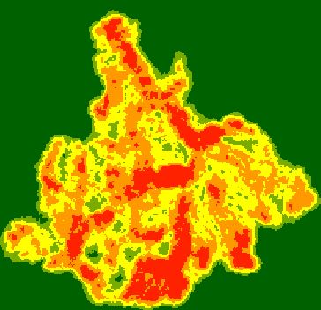
Results
5. Reclassify data
The last step was to reclassify our data to match the Index Morphometric table provided to us from IDEAM
Table Translated
6. Reclassified data
After reclassifying our density of drainage data, IDEAM can now combine the Index Morphometric table with our data sets to determine the high risk areas within La Mosca River Basin. This in turn will be put into the IDEAM water resources website (SIRH) to notify residents when flash floods are likely to occur

Slide 46
Future Work
Updated Precipitation Maps
Updated Digital Elevation Maps
We used ASTER 30 meter DEM (1 arc-second resolution data)
When Shuttle Radar Topography Mission (SRTM) 30 meter (1 arc-second) resolution data becomes available, the project will need to use this dataset per request of the end user
SRTM data becomes available November 2014
Tropical Rainfall Measuring Mission (TRMM) data was used but since the falling satellite has questionable accuracy at the moment, GPM data will need to be used
When GPM Level 3 data comes available DEVELOP will need to use this dataset per request of the end user
GPM data becomes available December 2014
Notes:
SRTM still not released as of Nov 19

Slide 47
Future Work
DEVELOP will need to use JBOSS to push data through SIAC (Sistema de Información Ambiental de Colombia) using SIRH (Sistema de Información del Rescurso Hídrico)
*JBOSS: is a Middlewear cloud friendly portfolio
What does that mean?
Develop will use a Middlewear cloud friendly portfolio to push data through the SIAC website using SIRH. SIRH is a tool that organizes/integrates all Colombian water resources
*SIRH (Translated) – Information System of Water Resources
Pronounced (Sir-A-Chay)
*SIAC (Translated) – Environmental Information System of Colombia
Notes:
(Sir-A-Chay)

Slide 48
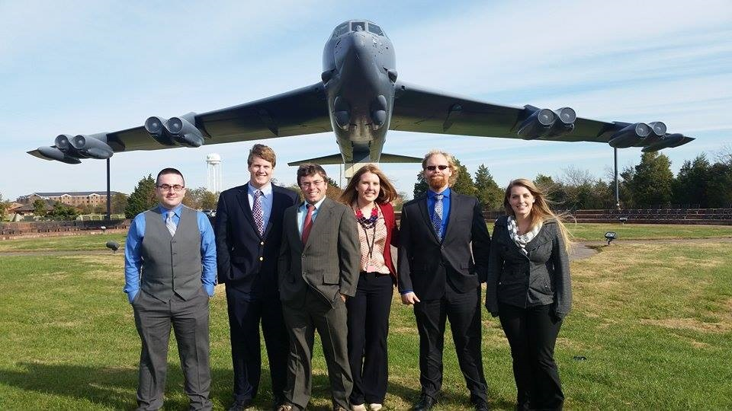
Acknowledgments
Thank you for helping us with our projects
Mike Bender
Jason Rogers

