Slide 1
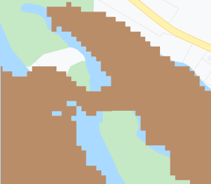
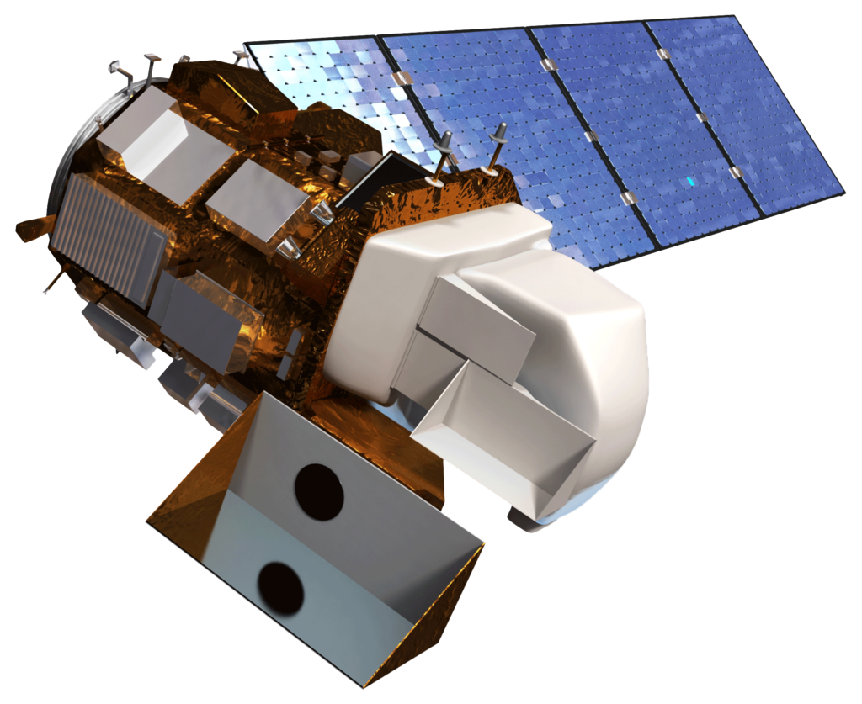
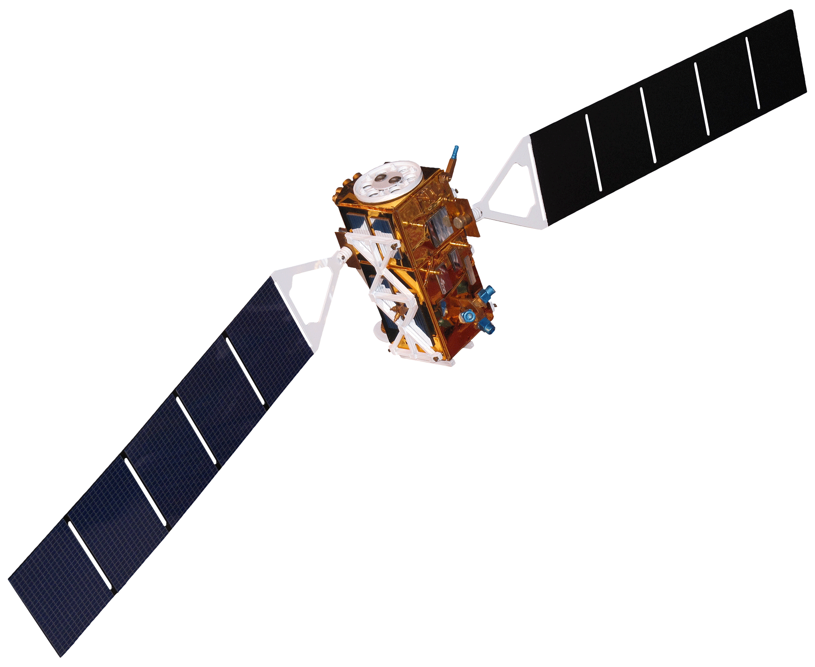
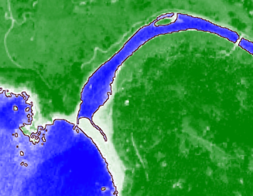
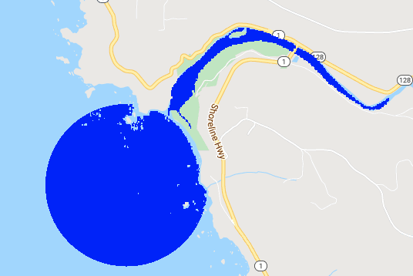
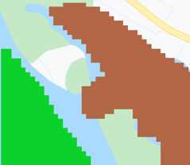
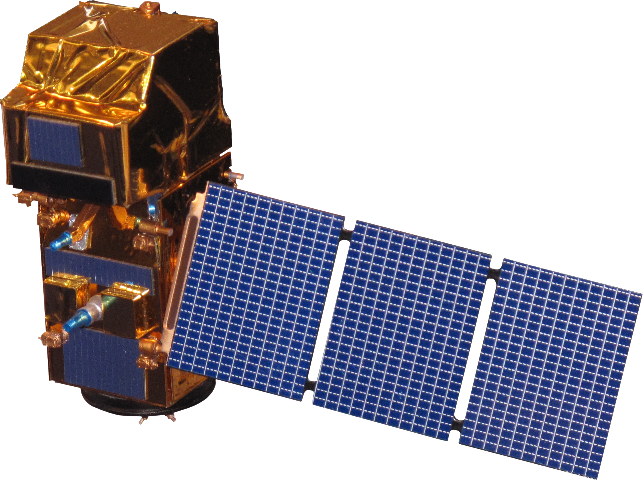
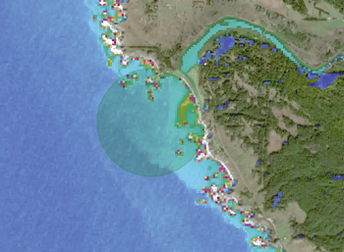
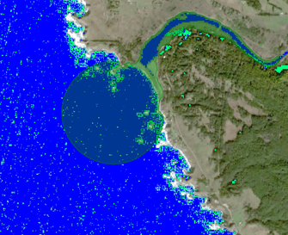
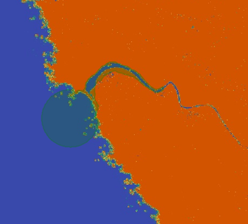
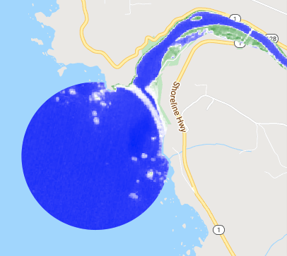
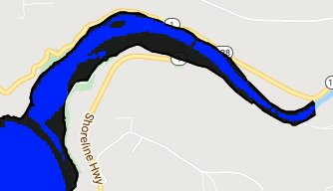
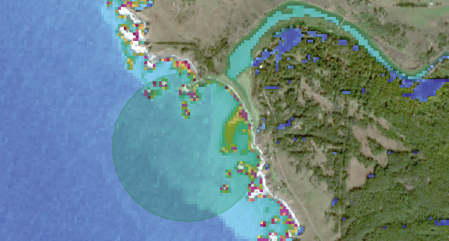
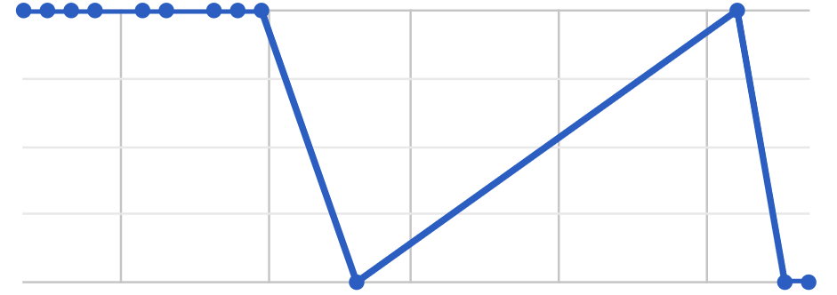
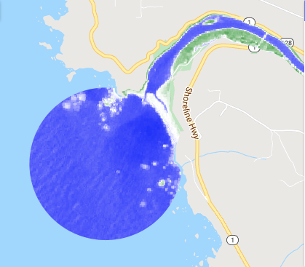
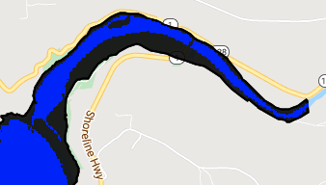
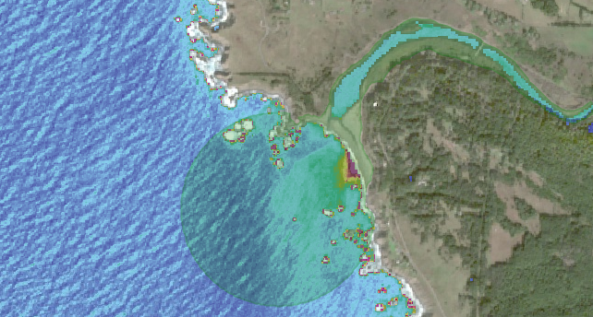



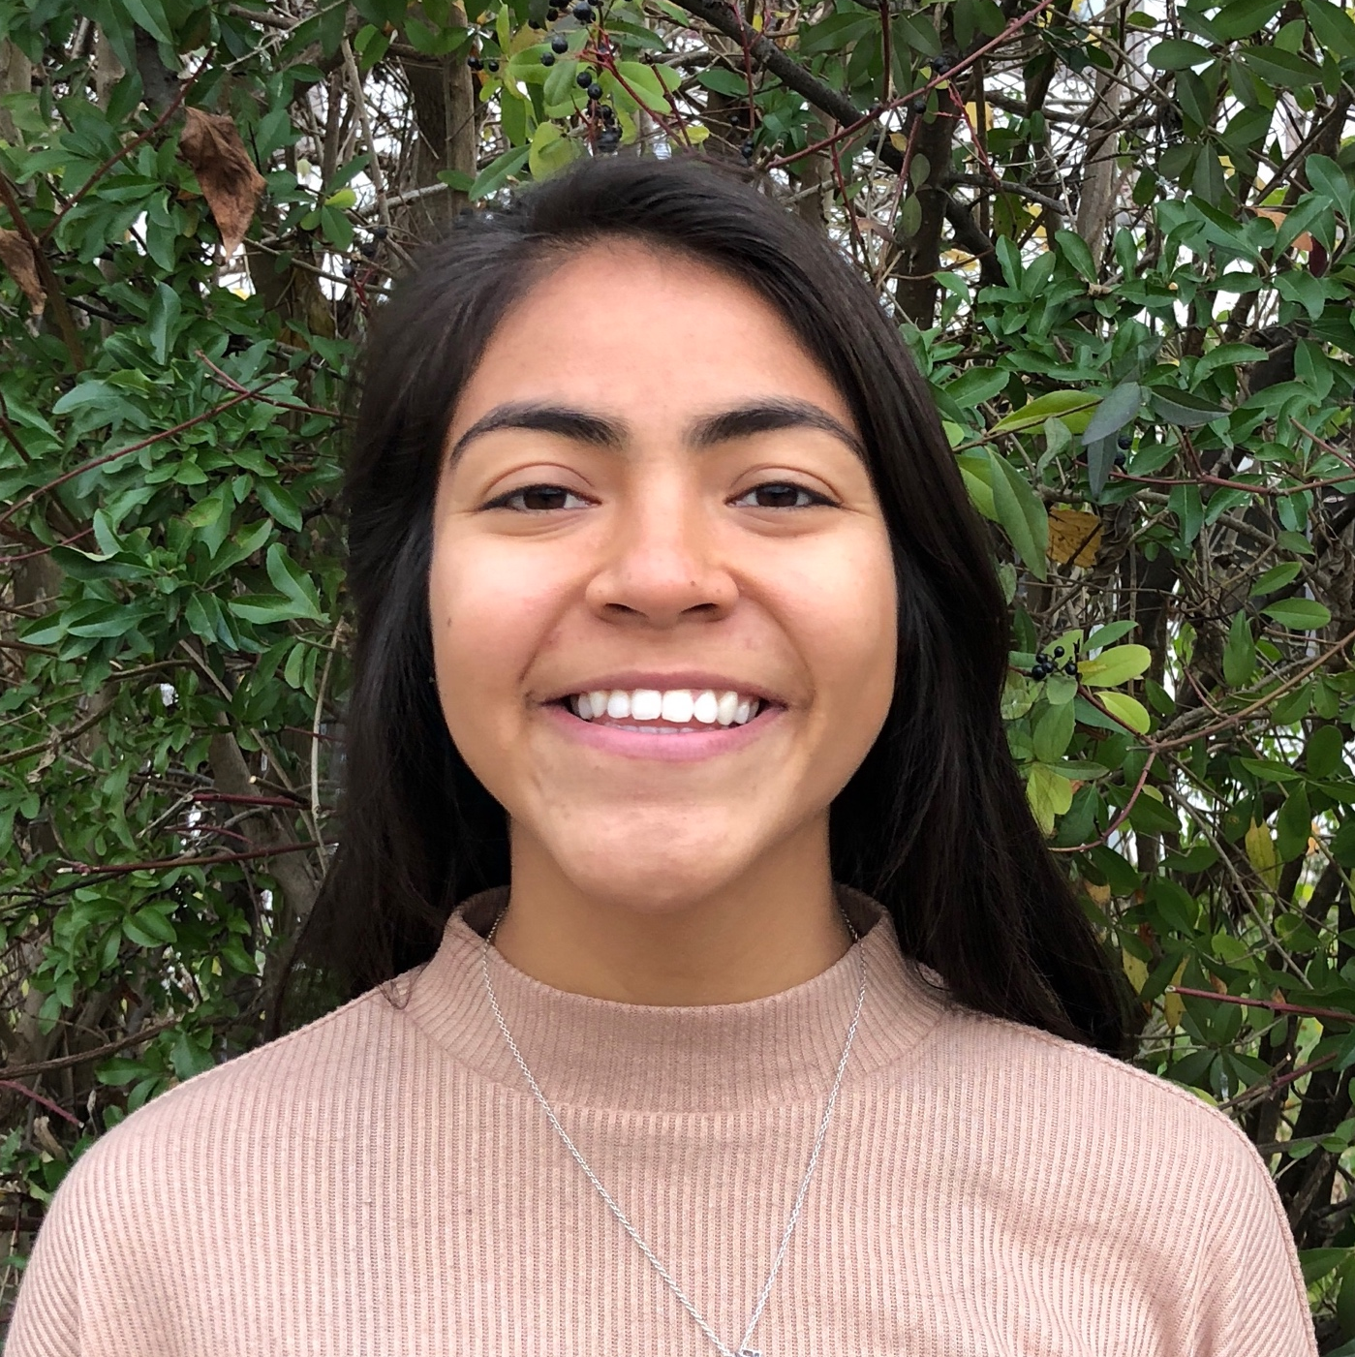



0
45 FNU
Assessing Estuarine Ecosystems for
Improved Wetland Monitoring and Management
Abstract
Study Area
Coastal California Water Resources
Estuaries are vital ecosystems that serve important ecological functions. The Marine Life Protection Act aims to protect these ecosystems by establishing a network of marine protected areas (MPAs), in part by requiring regulatory agencies to monitor estuary extent and health. However, California has 23 estuarine MPAs (EMPAs) and approximately 440,000 total acres of estuarine habitat, making ground-based data collection time and resource intensive. This project used remotely sensed data to examine the health of California EMPAs in an effort to supplement ground-based field measurements. Using Landsat 8 Operational Land Imager (OLI), Sentinel-2 MultiSpectral Instrument (MSI), and Sentinel-1 C-band Synthetic Aperture Radar (C-SAR), this project assessed mouth state, inundation extent, turbidity, Chlorophyll-a, and colored dissolved organic matter (CDOM) for estuaries observable with these sensors. Determining the Normalized Water Difference Index (NDWI) from Sentinel-2 MSI data captured estuary mouth state and inundation extent. Meanwhile, Landsat 8 OLI and Sentinel-2 MSI indicated a capacity to capture differences in water quality metrics coinciding with changes to estuary mouth state using algorithms applied in Google Earth Engine (GEE). The GEE California Estuary Assessment tools will allow project partners to better monitor and understand estuarine dynamics and health.
A. Navarro
B. Russian River
C. Drake’s Estero
A.
B.
C.
0
1
2
0
2
4
0
3
6
Km
Km
Km
D.
D. Carmel
E. Ventura
F. Malibu
E.
Objectives
F.
1
0
2
0
1
2
0
1
2
Improve data collection of EMPAs throughout California by incorporating remote sensing
Create an estuary assessment tool in GEE for California (California Estuary Assessment CEA tools)
Identify mouth state and inundation extent of estuaries
Assess water quality metrics including turbidity, Chlorophyll-a, and colored dissolved organic matter (CDOM)
Km
Km
Km
Earth Observations
Landsat 8 Operational Land Imager
Level 2 Surface Reflectance Tier 1
Sentinel-1 C-Band Synthetic Aperture Radar
Level 1 Single Look Complex
Methodology
Sentinel-2 Multispectral Instrument
Level 2A Surface Reflectance
1
16 days, 30 m, 2013 +
12 days, 10 m, 2016 +
Breach
Detection
2
1
+
+
NDWI
Inundation
Mouth State
~5 days, 10-20m, 2018 +
Turbidity
Chlorophyll-a
CDOM
Water
Quality
Results
Mouth
Closed
Image
February 7th, 2020
*
NDWI
NDWI threshold
Turbidity
-0.8
0.8
Water
Non-water
0
45 FNU
Mouth
Open
Oct-19
Nov-19
Dec-19
Jan-20
Feb-20
February 17th, 2020
*
In situ data suggests breach event on 2/11/2020
N
Project Partners
0 km
0.5
1.0
Conclusions
0 m
250
500
0
1000 m
Michael Esgro (Ocean Protection Council)
Dr. Eric Stein (Southern California Coastal Water Resource Project)
Dr. Kris Tanaguchi-Quan (Southern California Coastal Water Resource Project)
Ross Clark (Moss Landing Laboratories, Central Coast Wetlands Group)
Kevin O’Connor (Moss Landing Laboratories, Central Coast Wetlands Group)
Dr. Kyle Cavanaugh (University of California, Los Angeles)
Sentinel-2 derived NDWI can be used to adequately determine estuary mouth state as open or closed
Sentinel-1 C-SAR shows potential to supplement data gaps in Landsat 8 and Sentinel-2 imagery particularly regarding inundation extent
Satellite imagery captures health metrics influenced by estuary mouth state: inundation extent and turbidity
CEA Tool will allow partners to monitor and better understand estuarine dynamics and health
Acknowledgements
Team Members
Our sincere gratitude extends to Erica Carcelen, Benjamin Holt, Dr. Christine Lee, and Dr. Bruce Chapman. Their insight, constructive feedback, time, and support has been very much appreciated.
This material contains modified Copernicus Sentinel data (2018-2021), processed by ESA.
Karina Alvarez
Project Lead
Molly Bruce
Roger Ly
Sarah Payne
JPL

