Slide 1
DEVELOP National Program
About NASA:
History, Organization, and Personnel

Slide 2
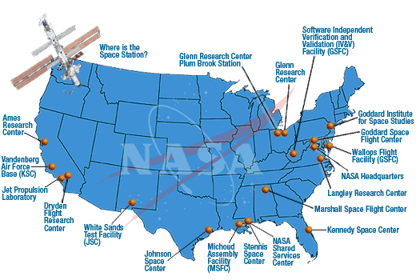
NASA History
"An Act to provide for research into the problems of flight within and outside the Earth's atmosphere, and for other purposes." With this simple preamble, the US Congress and President Dwight D. Eisenhower established the National Aeronautics and Space Administration (NASA) on July 29, 1958.
NASA began operations on October 1, 1958, absorbing into itself the earlier National Advisory Committee for Aeronautics (NACA) intact: 8,000 employees, an annual budget of $100 million, three major research laboratories - Langley Aeronautical Laboratory, Ames Aeronautical Laboratory, and Lewis Flight Propulsion Laboratory - and two smaller test facilities.
DEVELOP History
In 1998, three interns at NASA Langley Research Center co-authored the white paper “Practical Applications of Remote Sensing” (Bauer et al., 1998). At that time, the Digital Earth Initiative, a federal interagency project dedicated to creating a virtual representation of the Earth to further human understanding of the world, was piloting an effort to increase public access to federal information about the Earth and the environment. A proposal combining NASA’s Digital Earth Initiative and the students’ paper advocated the formation of a program, and in 1999 DEVELOP was officially formed. Beginning in 2001, new offices were established across the country and expansion has continued to today. DEVELOP is always looking for new opportunities to expand the DEVELOP network and those benefiting from DEVELOP activities.

Slide 3
Where DEVELOP Fits at NASA
NASA Administrator
Associate Administrator
Mission Directorates
Human Exploration and Operations
Space Technology
Science
Mission Support
Aeronautics Research
Joint Agency Satellite Div.
Heliophysics Division
Earth Science Division
Planetary Science Div.
Astrophysics Division
Applied Sciences Program
Capacity Building Program
You Are Here!
DEVELOP National Program

Slide 4
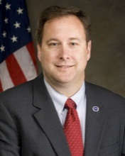
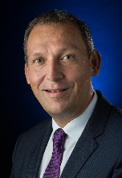
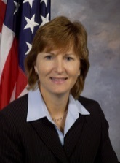
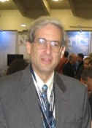
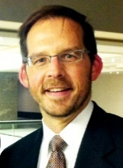
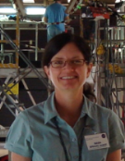
NASA Chain of Command
NASA Administrator
Robert M. Lightfoot, Jr. (Acting)
Deputy Administrator
Lesa Roe (Acting)
Associate Administrator
Robert M. Lightfoot, Jr.
Robert Lightfoot
Associate Deputy Administrator
Lesa Roe
Science Mission Directorate
Thomas Zurbuchen, Ph.D.
Earth Science Division
Mike Freilich, Ph.D.
Lesa
Roe
Dr. Thomas Zurbuchen
Dr. Mike Freilich
Applied Sciences Program
Lawrence Friedl
Capacity Building Program
Nancy Searby, Ph.D.
DEVELOP National Program
Mike Ruiz
Lawrence Friedl
Dr. Nancy Searby
Mike
Ruiz
NASA Organization Chart: http://www.nasa.gov/about/org_index.html#.VBNBWvldWbM

Slide 5
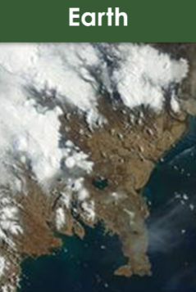
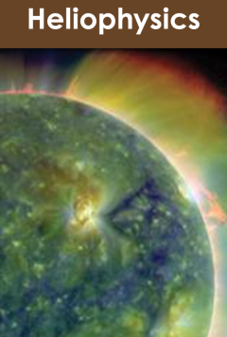
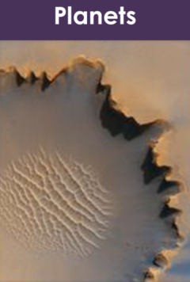
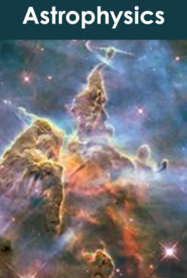
Science Mission Directorate
“Exploring near… and far… for the benefit of all.”
NASA leads the nation on a great journey of discovery, seeking new knowledge and understanding of our planet Earth, our Sun and solar system, and the universe out to its farthest reaches and back to its earliest moments of existence. NASA's Science Mission Directorate (SMD) and the nation's science community use space observatories to conduct scientific studies of the Earth from space to visit and return samples from other bodies in the solar system, and to peer out into our Galaxy and beyond.
Earth
Heliophysics
Planets
Astrophysics
NASA Science Mission Directorate Website: http://science.nasa.gov/

Slide 6
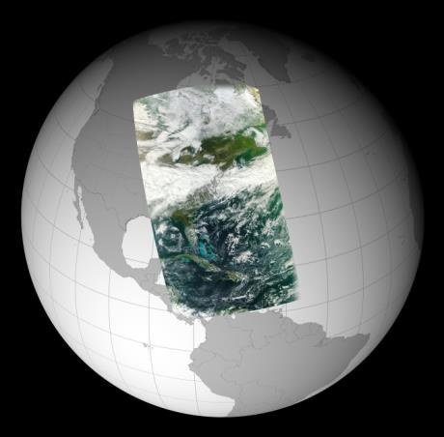
Earth Science Division
“Advancing Earth System Science to meet the challenges of climate and environmental change.”
Earth is a complex, dynamic system we do not yet fully understand, and like the human body, is comprised of diverse components that interact in complex ways. Our planet is changing on all spatial and temporal scales. The purpose of NASA's Earth science program is to develop a scientific understanding of Earth's system and its response to natural or human-induced changes, and to improve prediction of climate, weather, and natural hazards.
Research Encompasses:
The global atmosphere
The global oceans including sea ice
Land surfaces including snow and ice
Ecosystems
Interactions among the atmosphere, oceans, land and ecosystems, including humans
NASA Earth Science Division Website: http://science.nasa.gov/earth-science/

Slide 7
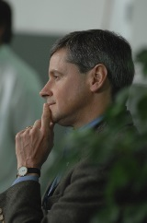
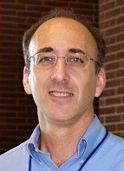
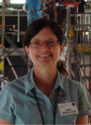
Applied Sciences Program
“Discovering Innovative & Practical Applications of NASA Earth Science”
Lawrence Friedl
Director
Partner with public and private organizations
Discover innovative NASA Earth science applications
Support environmental decision-making activities
ASP Program Managers (NASA HQ)
Brad Doorn
Water
Woody Turner
Eco
John Haynes
Health/AQ
David Green
Disasters
Lucien Cox
Operations
Manager
Nancy Searby
Capacity
Building
Demonstrate practical benefits of NASA Earth science
Help improve the quality of life and strengthen the economy
Applied Sciences Program Website: www.nasa.gov/applied-sciences

Slide 8
Applied Sciences Program Organization
National Application Areas + Capacity Building Elements
Agriculture
Climate
Disasters
ARSET
Eco Forecasting
Energy
Health & AQ
DEVELOP
Oceans
Water Resources
Weather
SERVIR
Applied Sciences Program Website: www.nasa.gov/applied-sciences

Slide 9
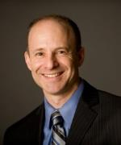
ASP’s Capacity Building Program
Nancy Searby
Program Manager
CBP Element Leads
Engages current and future decision makers in a spectrum of activities to improve skills and capabilities in the United States and developing countries to access and apply NASA Earth science.
Three elements: ARSET, DEVELOP, SERVIR
(GOMI recently graduated)
Ana Prados
ARSET
NASA Goddard
Mike Ruiz
DEVELOP
NASA Langley
Dan Irwin
SERVIR
NASA Marshall
ARSET
Online and hands-on NASA remote sensing training
DEVELOP
Dual workforce capacity building using collaborative feasibility projects
SERVIR
Building international capacity in
developing countries

Slide 10
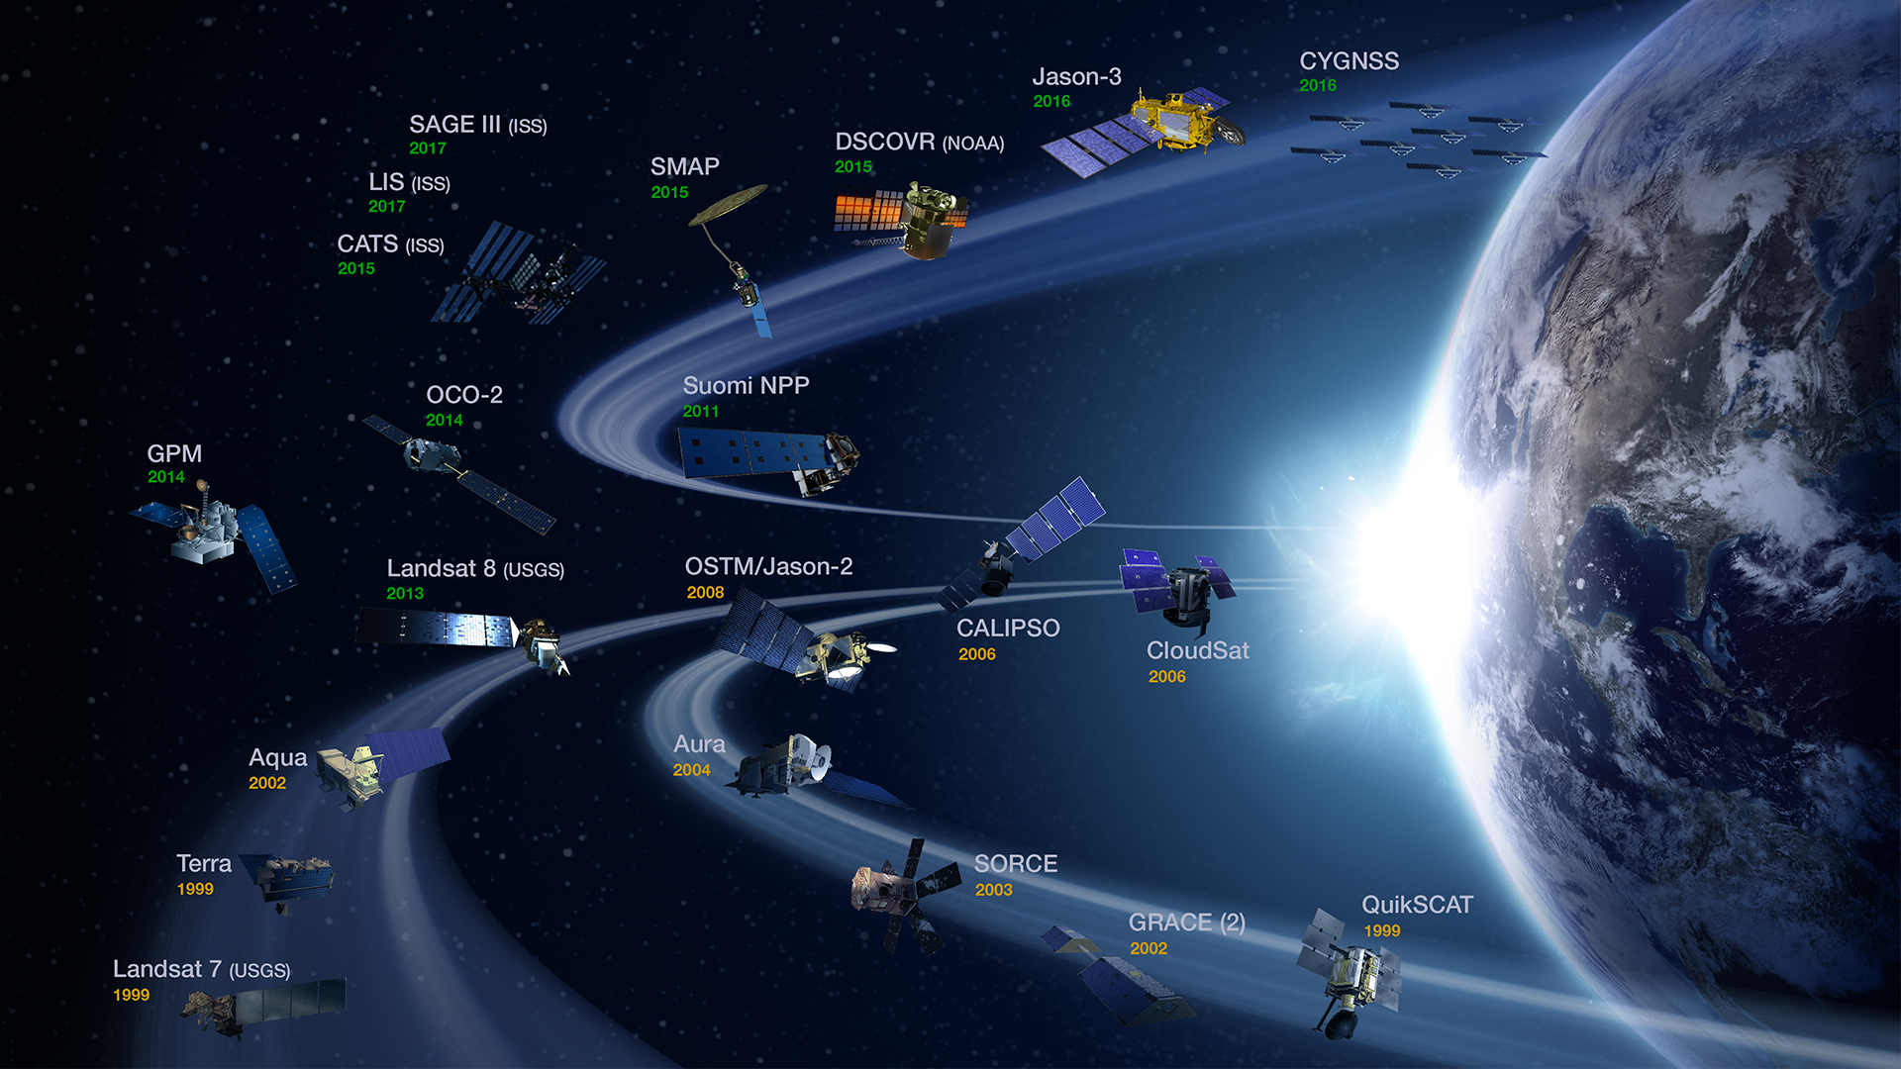
NASA Earth Observations
NASA Earth observations include a coordinated series of 18 polar-orbiting and low inclination satellites and 3 instruments on the ISS for long-term global observations.

Slide 11
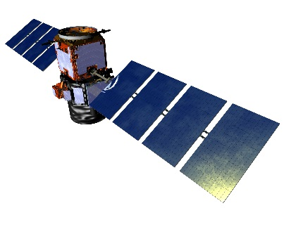
EO vs. EOS
NASA Earth observations: umbrella term used that includes all airborne and flight missions that study the Earth.
Current NASA EO Missions:
NASA’s Earth Observing System (EOS): EOS is a subset of the full suite of NASA Earth observing missions focused on long-term global observations of the land surface, biosphere, solid Earth, atmosphere, and oceans to improve understanding of the Earth as an integrated system.
Only use this term when speaking exclusively to the below missions:
Current EOS Missions:
Aqua
Aura
Landsat 7
Landsat 8
OSTM/Jason-2
QuikSCAT
SORCE
SAGE III-ISS
Terra
Aqua
Aura
CALIPSO
CloudSat
GPM
GRACE
Jason-3
Landsat 7
Landsat 8
OSTM/Jason-2
OCO-2
QuikSCAT
SORCE
SMAP
Suomi NPP
Terra
CYGNSS
DISCOVR
SAGE III (ISS)
LIS (ISS)
CATS (ISS)
Future EOS Missions:
Landsat 9
NASA Earth Science Missions: https://eospso.nasa.gov/mission-category/3

Slide 12
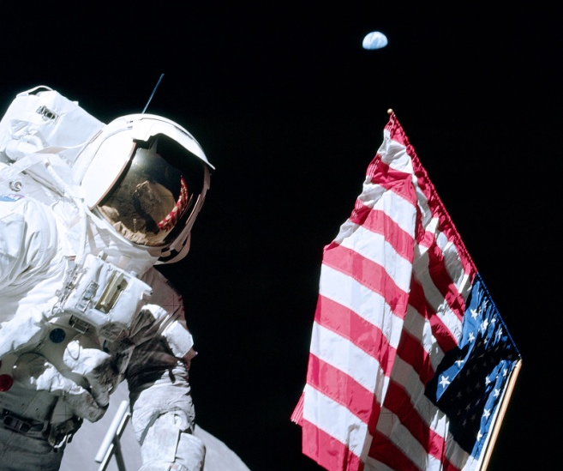
THANK YOU!
Joining the DEVELOP family means being part of NASA’s Legacy.
Learn it.
Know it.
Live it.

