Slide 1
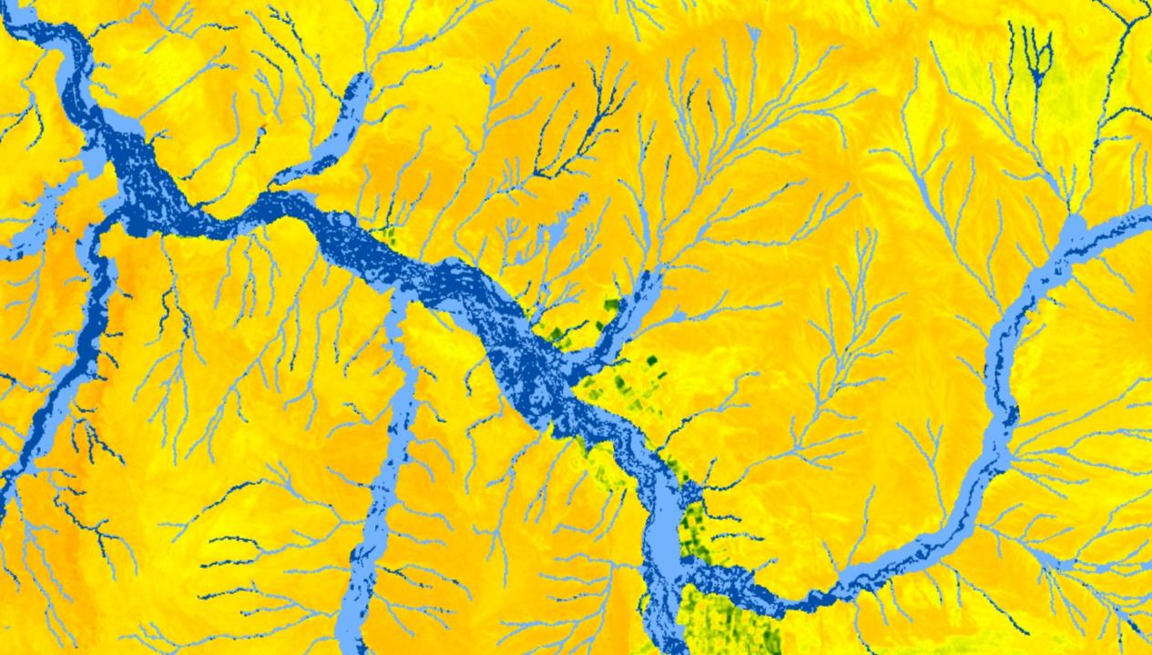


Colorado River Basin Water Resources II
Utilizing NASA Earth Observations to Evaluate the Presence of Russian Olive and its Impact on Evapotranspiration in the Upper Colorado River Basin
Katie Walker
Kevin Gallagher
Dan Carver
Caroline Martin
Kristin Davis
Colorado – Fort Collins
Fall 2017

Slide 2
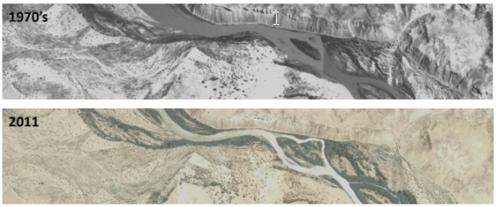
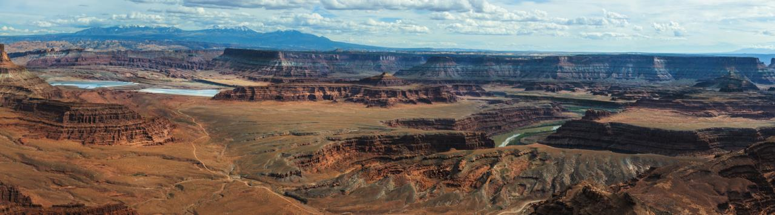
Community Concerns
Image Credit: Monet
Image Credit: Geoff Llerena
Upper Colorado River Basin (UCRB) supplies water to over 40 million people
Function and structure of riparian zones are threatened by invasive species
Russian olive presence and ET rates in the UCRB are unknown
Russian olive is expected to have high ET compared to native vegetation
Notes:
The Colorado River Basin is a major water source for seven states in the western US; its waters irrigate agriculture, support human development and sustain native riparian ecosystems.
Riparian areas represent a unique transition zone between aquatic and terrestrial environments, are highly biodiverse, and provide important ecosystem services (such as erosion control).
However, the function and structure of riparian zones are threatened by the spread of invasive species.
One such invasive species is Russian olive, native to Eurasia, which has spread quickly into riparian areas since its introduction in the early 1900s
Currently, Russian olive presence along the San Juan River is unknown.
Additionally, evidence suggests Russian olive has high evapotranspiration rates compared to native riparian species, which means that where it is present, Russian olive could decrease stream flow and reduce water supply.
Image Source: https://www.flickr.com/photos/jeffrt/10561122726/
Kevin

Slide 3
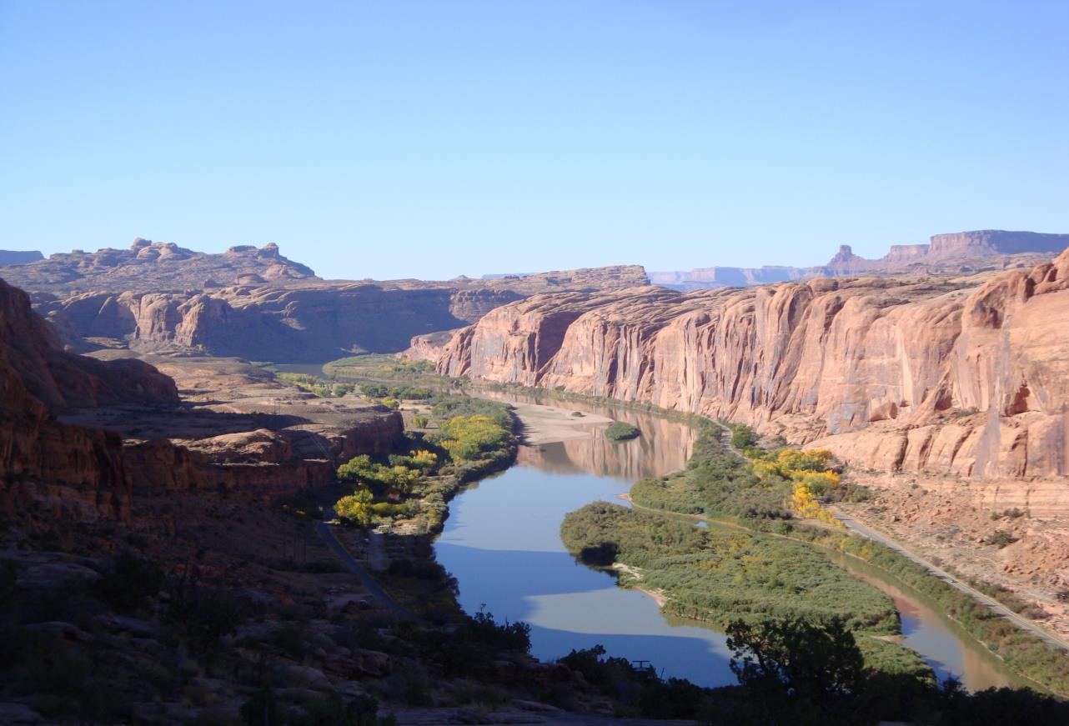


Project Partners
Walton Family Foundation
Natural Resource Ecology Laboratory
Image Credit: USGS
Notes:
We partnered with the Walton Family Foundation and USGS, in collaboration with the North Central Climate Science Center and Natural Resource Ecology Laboratory at CSU
The Walton Family Foundation helps promote a healthy environment for future generations by supporting the sustainable management of invasive species in the Colorado River Basin.
By utilizing invasive species’ expertise, modeling software and collaborators’ knowledge at the USGS to create Russian olive presence maps, the Foundation will be able to prioritize management and restoration efforts based on the presence and evapotranspiration maps we provide.
Image Source: https://www.flickr.com/photos/usgeologicalsurvey/26837176242/
Kevin

Slide 4
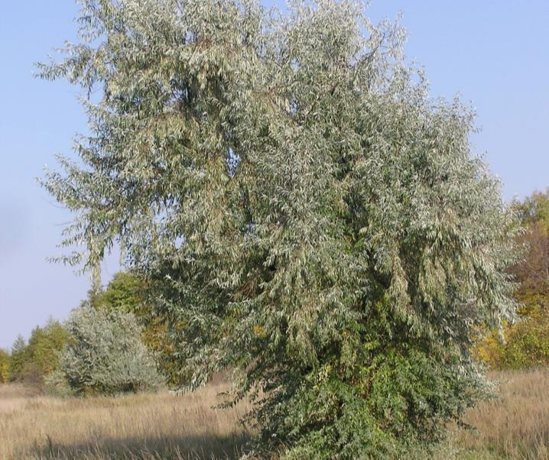
Objectives
Map Russian olive presence on the San Juan River
Detect and compare change in Russian olive presence between 2006 and 2017
Evaluate evapotranspiration (ET) rates of riparian zones on San Juan River
Provide Walton Family Foundation with products to inform management
Image Credit: Le.Loup.Gris
Notes:
We had four objectives for our project.
One main objective of this project was to map Russian olive distribution in the UCRB.
We then compared the change in Russian olive distribution between 2006 and present day. We chose 2006 as our initial year due to limited data before this time. Additionally, in this year Congress passed the Salt Cedar and Russian Olive Demonstration Act, which encouraged research into and the development of a management plan for Russian olive on public lands in the western US. This is important for analyzing the results of restoration and management efforts over the past decade.
We also evaluated evapotranspiration rates for riparian zones in the UCRB. As we mentioned previously, evidence suggests Russian olive may affect the hydrologic cycle, and determining evapotranspiration rates is the first step in exploring these effects further.
Ultimately we will provide the Walton Family Foundation with these products that they may use to inform management for Russian olive.
Image Source: By Le.Loup.Gris - Own work, CC BY-SA 3.0, https://commons.wikimedia.org/w/index.php?curid=17191769
Kevin

Slide 5
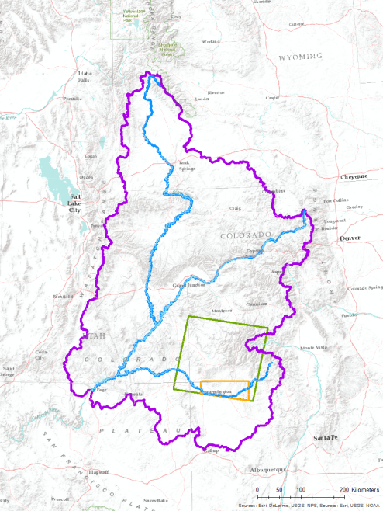
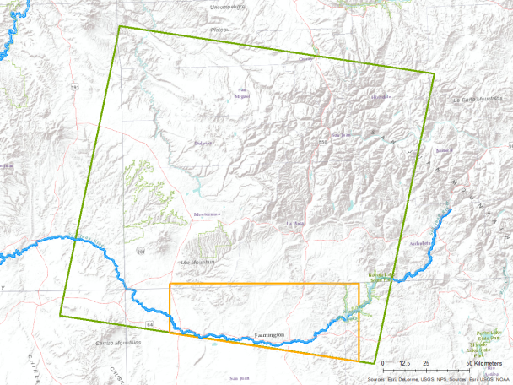
Study area
Study area
Upper CRB
Rivers
Landsat
study area
Sentinel-2
study area
Landsat P35-R34
Green
River
Colorado River
San Juan River
Portion of Sentinel-2
Tile 12SYF
San Juan River
Notes:
The UCRB covers portions of Colorado, Utah, New Mexico and Arizona, but for our project we focused on riparian areas in Landsat path 35, row 34, which contains the San Juan River and Animas River
Additionally, we wanted to compare how different satellites detected Russian olive presence, so we included the area of overlap between our Landsat scene and Sentinel-2 tile 12SYF since it covers a large portion of the San Juan River
Image Source: Esri, Delorme, USGS, NPS, NOAA; ArcMap 10.3.1
Kevin

Slide 6


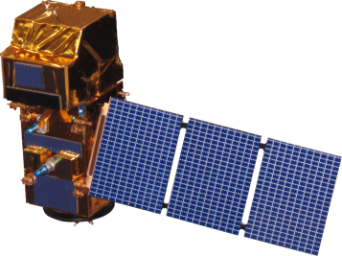

NASA Satellites/Sensors Used
Landsat 5 TM
Landsat 8 OLI & TIRS
Sentinel-2 MSI
10 m
30 m
30 m
Image Credit: NASA
Notes:
In order to compare Russian olive presence across our focal time periods, we used Landsat 5 imagery from 2006 and Landsat 8 imagery from 2017 to include in our models. We also used Sentinel-2 imagery to compare to Landsat 8 for 2017. We implemented appropriate pre-processing to account for the resolution differences between Sentinel-2 and Landsat 8.
Earth Background Image Source: https://www.nasa.gov/sites/default/files/bwhi1apicaaamlo.jpg_large.jpg
Satellite Image Source: http://www.devpedia.developexchange.com/dp/index.php?title=List_of_Satellite_Pictures, NASA DEVELOP
Kristin

Slide 7
Methodology – Mapping Russian Olive
Field & Digital
Data
2016 - 17
RF
NASA Earth Observations
Landsat 5 & 8, Sentinel-2
SAHM: Software Assisted Habitat Modelling
SAHM
MARS
Field & Digital Data
2005 - 06
GLM
Presence/ Absence
Binary
Maps
Field Collected Data: Information collected by user on the ground
BRT
Riparian Zone
RF
Image Credit: Monet
Digitally Collected Data: ocular estimation using
NAIP imagery
R
Presence/ Absence
Binary
Maps
Data
Software
Algorithm
Output
1
2
3
4
Notes:
Here we have the workflow we used to map Russian olive presence in the UCRB. We used imagery from Landsat 5, 8 and Sentinel-2 along with a delineated riparian zone and Russian olive presence and absence data during our focal time periods to map RO presence.
Focusing on the data portion of the work flow, we used ocular estimation to sample Russian olive presence and absence points from 1m NAIP imagery in 2006 and 2016. We then fit models using the NAIP data and LS5, 8 and Sentinel-2 imagery. We subsequently will refer to these visually sampled points as the NAIP points. We collected the NAIP points because we wanted to compare the quality of maps produced using different types of data. As we mentioned before, we also wanted to compare the quality of presence maps produced using two different sensors over the same time period. For this reason, we subset the data that fell within our focal Landsat and Sentinel-2 images and fit models on these subset data to be able to compare presence maps produced by LS8 and Sentinel-2.
We mapped Russian olive presence in two ways – in program R using Random Forest models, and in the USGS’s Software for Assisted Habitat Modeling, or SAHM. SAHM fits multiple types of models to create distribution maps and provides metrics indicating which model performed best. The outputs of our R and SAHM modeling were binary maps showing Russian olive presence and absence in our study area.
Image Source: Colorado River Basin Water Resources I, NASA DEVELOP
Kristin

Slide 8
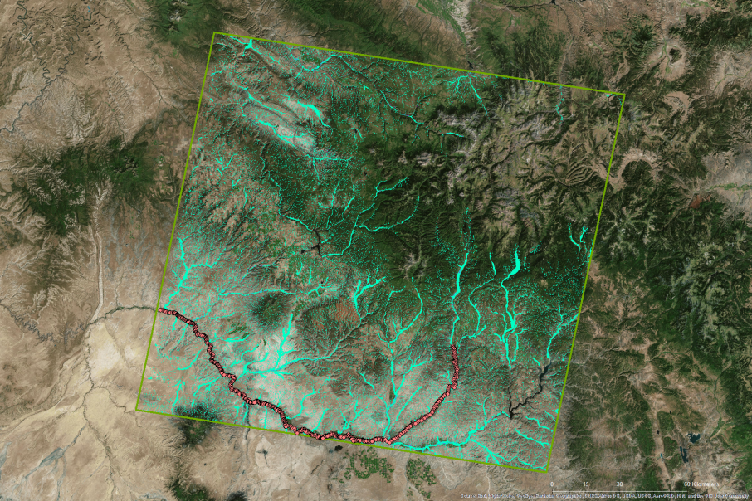
Methods– Mapping Russian Olive
Digitally sampled points
Landsat study area
Valley bottom
Notes:
This map shows the full extent of our Landsat scene study area. We modelled RO presence and absence in valley bottoms delineated by a previous term, which are shown here in teal. However, we excluded high-elevation areas where Russian olive will not grow.
Image Source: ESRI, DigitalGlobe, GeoEye, Earthstar Geographics, CNES/Airbus DS, USDA, USGS, AeroGRID, IGN, and the GIS User Community
Katie

Slide 9
Results – Mapping Russian Olive
Presence Area and Statistics
Data Set | Percentage of Valley Bottom Detected as RO |  | Out of Bag Error (%) |  |  | AUC (Area Under ROC Curve)
 | Digital | Field | Digital |  | Field | Digital | Field
LS5 | 3.30 | 63.75 | 2.44 | 15.36 |  | 0.69 | 0.60
LS8 | 1.06 | 1.46 | 2.94 | 6.01 |  | 0.68 | 0.62
LS8 subset | 1.42 | N/A | 2.11 | N/A |  | 0.68 | N/A
Sentinel-2 | 1.26 | N/A | 2.09 | N/A |  | 0.77 | N/A
Notes:
This chart shows the area of Russian olive presence detected as a percentage of the total Valley Bottom area, as well as two model evaluation statistics, Out of Bag Error and AUC, for each model run. Models trained on digitally collected data generally performed better based on evaluation statistics, and the top performing models were those trained on the Sentinel-2 Landsat 8 subset data sets. Here you can also see differences in Russian olive detected over time, or the differences between the Landsat 5 model from 2006 and the Landsat 8 model from 2016.

Slide 10
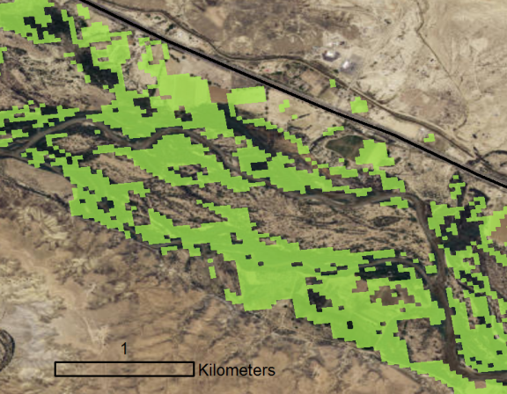
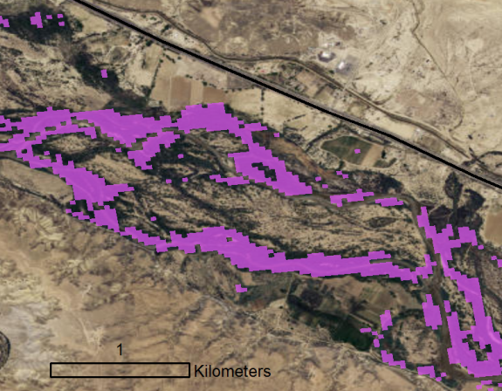
Results – 2006 to 2016
LS5 2006 Digitally Sampled
LS8 2016 Digitally Sampled
Presence: 3.30% of Valley Bottom
Presence: 1.06% of Valley Bottom
Notes:
These maps show the change in Russian olive cover detected from 2006 to 2016 using models trained on digitally sampled data. Models detected less Russian olive cover in 2016 than in 2006 overall.

Slide 11
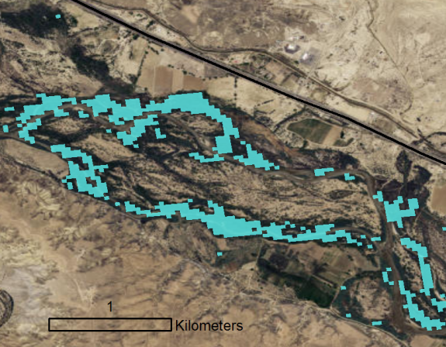
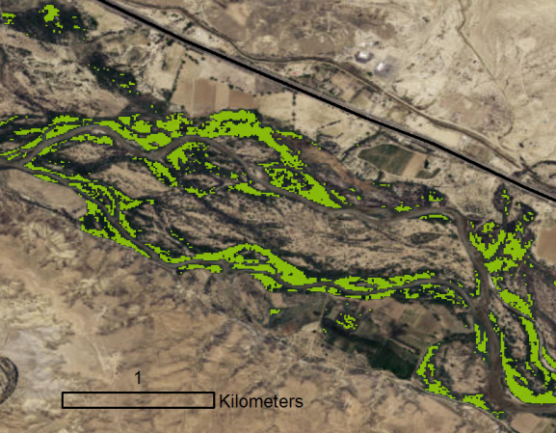
Results – Landsat 8 to Sentinel-2
LS8 2016 Digitally Sampled Subset
Sentinel 2016 Digitally Sampled
Presence: 1.42% of Valley Bottom
Presence: 1.26% of Valley Bottom
Notes:
Here, we decided to compare the accuracy and distribution of models created with Landsat-8 versus higher resolution Sentinel-2 imagery. Training points for this comparison were collected in the area of overlap between our Landsat and Sentinel scenes, hence the “Landsat-8 Subset”. The Sentinel-2 model predicted a lower percent cover than did Landsat-8, and had a lower Out of Bag Error and a higher AUC. This suggests that Sentinel-2 is well-suited for detecting the presence of Russian olive in this ecological zone.

Slide 12
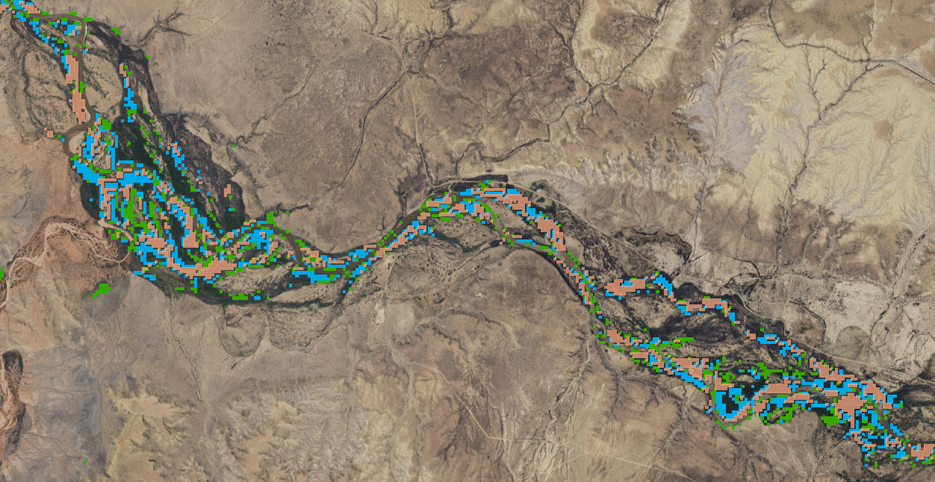

Results – Digital to Field
LS8 Field and Digital Presence Detection
Both agree presence
LS8 Field presence
LS8 Digital presence
Percentage of Valley Bottom Detected as RO
Data Set | Digital | Field
LS8 | 1.06 | 1.46
Notes:
We also investigated differences between modelled presence using Digital versus field sampled data. This map shows where models agreed and disagreed on Russian olive presence.
The green indicates areas where the digitally sampled model predicted presence but the field data model did not, whereas the blue indicates areas where the field data model predicted presence but the digitally sampled model did not. The pink represents areas where the two models both predicted absence. Here, our model trained with Field data detected more Russian olive than the model trained with Digital data.
We saw similar patterns to the one shown here in maps generated from other models, where the field data model and the digitally sampled model detected Russian olive slightly differently.
Image Source: ESRI, DigitalGlobe, GeoEye, Earthstar Geographics, CNES/Airbus DS, USDA, USGS, AeroGRID, IGN, and the GIS User Community
Katie

Slide 13
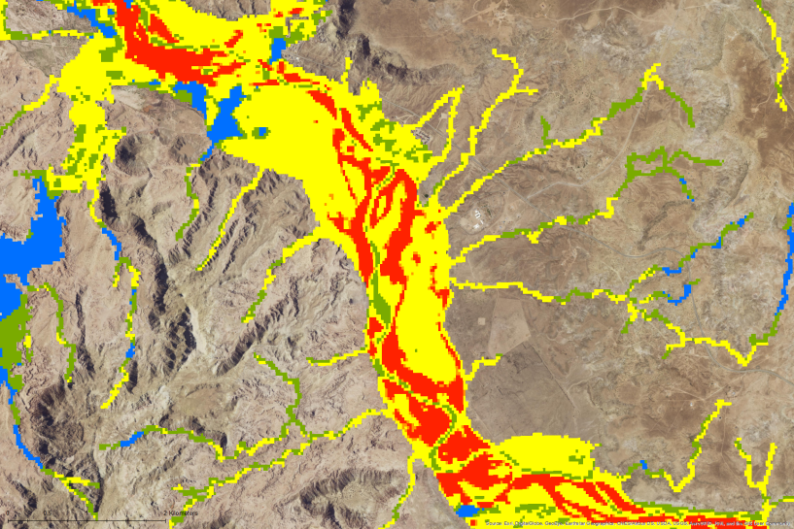
Results – Mapping Russian Olive
LS8 Digital Ensemble using SAHM
Four Models Compared:
Number of models detecting presence
0
3
GLM: Generalized Linear Model
1
4
2
RF: Random Forest
BRT: Boosted
Regression Trees
MARS: Multivariate
Adaptive Regression Splines
Notes:
We experimented with the USGS’ Software for Assisted Habitat Modelling to fit a suite of models to create maps of Russian olive presence. This image represents presence predicted by four different models, in an attempt to produce a conservative estimate of area, or a most-likely scenario of distribution. Cooler colors area areas where the least models agree on presence, and warmer colors are where the most models agree on presence.
Image Source: ESRI, DigitalGlobe, GeoEye, Earthstar Geographics, CNES/Airbus DS, USDA, USGS, AeroGRID, IGN, and the GIS User Community
Katie

Slide 14
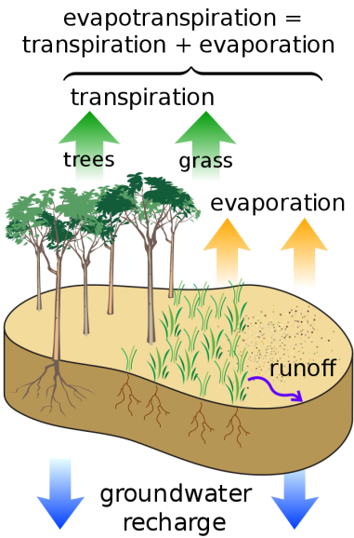
Methodology – Calculating ET
NASA Earth Observations
Landsat 8
Convert Band 10 to Surface Temp
Python
ET Map
SSEBop
Reference ET
Air Temp
Data
Software
Algorithm
Output
1
2
3
4
Image Credit: M. W. Toews, Wikimedia Commons
Notes:
Here we have our workflow for calculating evapotranspiration.
To calculate evapotranspiration, or ET, we used Landsat 8 imagery and converted band 10 to surface temperature. We used a reference ET layer and an air temperature layer as additional inputs for our ET model, which is called SSEBop and was created by one of our USGS collaborators, Dr. Gabriel Senay. We fit the SSEBop model using Python script and clipped the resulting ET map with our riparian zone layer to create a map of ET rates for the riparian zones in the UCRB.
Based on our Russian olive presence/absence models, we extracted evapotranspiration rates for areas of Russian olive presence and absence to determine whether there were differences in ET between these areas. (Want to discuss different land cover types?)
We have written a tutorial on how to calculate ET following our methodology that we will give to the Walton Family Foundation.
ET image Source: https://commons.wikimedia.org/wiki/File:Surface_water_cycle.svg#file; M. W. Toews, Wikimedia Commons
Workflow Image Source: Colorado River Basin Water Resources II, NASA DEVELOP
Caroline

Slide 15
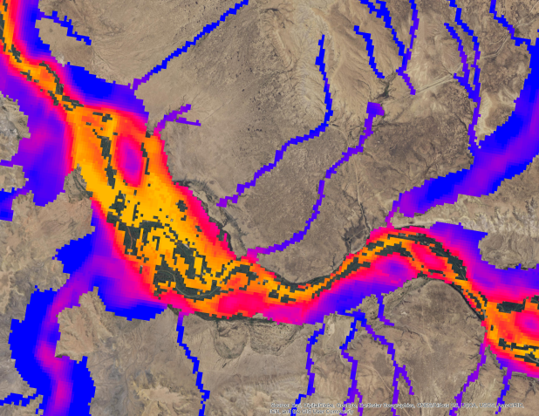
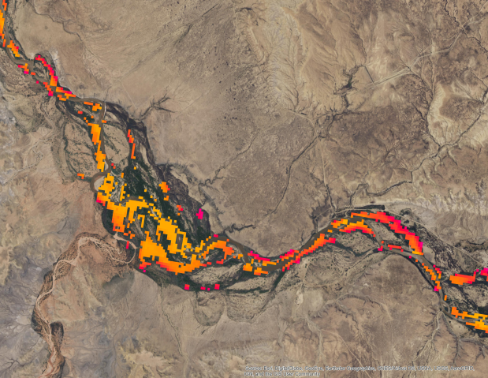

Results – Calculating ET
Absence
Presence
9.25 mm/day
0 mm/day
Notes:
These map show the ET rates in a portion of the riparian zone in our study area. The map on the left shows ET rates for the riparian zone where Russian olive is absent. The map on the right shows ET rates in the riparian zone where Russian olive is present. Note that the San Juan River has higher ET rates than the tributaries that feed into it. Based on our models, areas of Russian olive presence had higher ET rates than areas without Russian olive.
Image Source: ESRI, DigitalGlobe, GeoEye, Earthstar Geographics, CNES/Airbus DS, USDA, USGS, AeroGRID, IGN, and the GIS User Community
Caroline

Slide 16
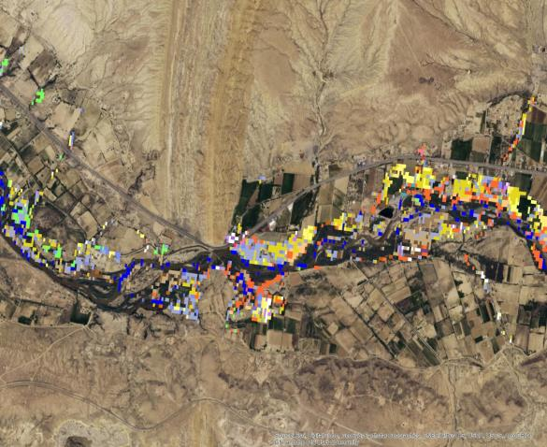
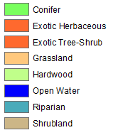

Results – Calculating ET
Chart of Evapotranspiration
LAND COVER TYPE | MIN | MAX | RANGE | MEAN | STD | AREA
Riparian without Russian olive | 0 | 9.10 | 9.10 | 4.43 | 1.94 | 767.03
Russian olive | 0 | 9.06 | 9.06 | 5.34 | 1.82 | 35.92
Exotic Herbaceous | 0 | 8.70 | 8.70 | 2.76 | 1.76 | 1.23
Shrubland | 0.40 | 6.46 | 6.06 | 2.90 | 1.29 | 3.17
Exotic Tree-Shrub | 0 | 8.81 | 8.81 | 4.20 | 2.16 | 5.27
Riparian | 0.59 | 7.63 | 7.04 | 4.49 | 1.28 | 11.34
Grassland | 0.71 | 8.09 | 7.38 | 4.59 | 1.44 | 2.19
Conifer | 1.83 | 7.69 | 5.86 | 4.88 | 1.13 | 12.51
Hardwood | 0.61 | 8.72 | 8.11 | 6.05 | 1.02 | 26.18
Open Water | 0 | 9.10 | 9.10 | 6.21 | 1.63 | 21.62
Notes:
Riparian vegetation has a mean ET of 4.43 and Russian olive had a greater relative ET rate of 5.34. The riparian vegetation was a map created by NREL and I used LANDFIRE to break down the vegetation types further and extracted the ET rates for those types. Russian olive has greater rates than the exotic tree shrub and riparian, grasses, and conifer. Hardwood such as aspen and open water had greater ET rates.

Slide 17
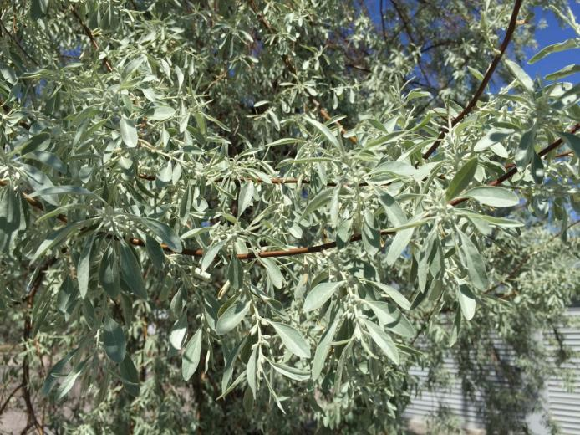
Errors, Uncertainties, and Future Work
Utility of data collected to identify individual locations of a species vs. data collected for remote sensing purposes
Difficulty in comparing models over time
  Models based on older imagery can be less reliable (e.g. our Landsat 5 models)
Could apply ET methodology to create a time series
Could improve digital sampling methodology by layering Landsat grid
Image Credit: Famartin, Wikimedia Commons
Notes:
One issue we ran into during this project was the realization that all data are not equally useful for remote sensing analyses. The 2005 data we used to fit models were publically sourced, or were essentially citizen science data. These data seemed to arise from individual people going out and collecting presence locations of individual Russian olive trees. Because our remote sensing analyses were at the scale of a Landsat or Sentinel-2 pixel, individual locations of trees were not conducive to trying to detect Russian olive across an entire pixel. The emphasized to us the importance of using data collected in such a way that is appropriate for the analysis for which they will be used.
We also ran into problems when we tried to fit models across time, i.e. when we tried to fit the Landsat 5 model to the Landsat 8 imagery. Models were fit to imagery that corresponded to a specific year, and it was difficult to fit those models to images from a different year in a way that was statistically appropriate. Additionally, the farther back in time one goes, the less reliable one’s models may be. Our Landsat 5 model severely overdetected Russian olive presence, and while we attribute that issue mostly to the quality of the data used to train the model, there may be components of the imagery itself that contributed to overdetection.
We also see ways this project could continue to improve knowledge of Russian olive presence and how the species affects riparian ecosystems. One could apply our ET methodology to create ET maps over different time periods. One could also improve our digital sampling methodology by laying a Landsat grid over imagery to more accurately ensure points sampled as presence contain the selected threshold of presence.
Image Source: https://commons.wikimedia.org/wiki/File:2015-04-29_14_31_02_Russian_Olive_foliage_along_Nevada_State_Route_723_(Soda_Lake_Road)_in_Churchill_County,_Nevada.jpg

Slide 18
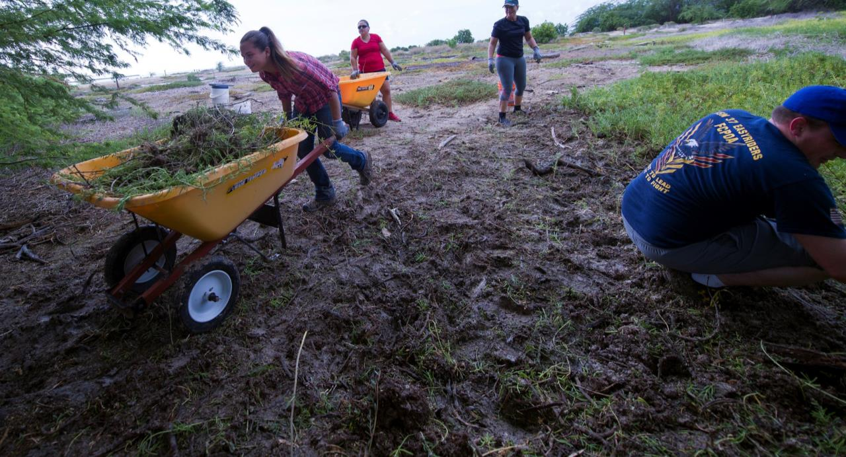
Conclusions
Digitally sampled models had higher performance metrics than field data, but field data plays a role in validation and bias offsetting
Russian olive is well-suited to map with remotely sensed images
Our ET methodology is flexible for species and time periods
Managers can direct monitoring and restoration efforts based on our presence maps
ET calculations can inform restoration decision making and prioritization
Image Credit: Petty Officer Gabrielle Joyner, Wikimedia Commons
Notes:
Across all models, we found the models fit to the digitally sampled data performed better than those fit to field data. However, obtaining field data is important to model testing and evaluation.
We believe Russian olive is well-suited to being mapped with remote sensing given its unique gray-green leaves that are easy to see on imagery.
Our ET approach is relatively novel and robust, and can be applied to other invasive species.
Using our maps, managers can visit areas of Russian olive presence to make decisions about management or eradication efforts.
Our ET calculations could also justify eradication Russian olive in an area, if it is potentially limiting water for other native species.
Image Source: Petty Officer 2nd Class Gabrielle Joyner, Wikimedia Commons, 161028-N-WC566-040, https://www.dvidshub.net/image/2953305/navfac-hawaii-continues-ahua-reef-restoration

Slide 19
Acknowledgements
Science Advisors and Mentors at Colorado State University:
Dr. Paul Evangelista (Advisor) Anthony Vorster (Mentor)
Dr. Amanda West (Advisor) Brian Woodward (Mentor)
Science Mentors at the USGS:
Dr. Gabriel Senay
Dr. Catherine Jarnevich
Previous Contributors:
Megan Vahsen
Emily Campbell
Julia Sullivan
Chanin Tilakamonkul
Brian Woodward
Leana Schwartz
Sarah Carroll
Amandeep Vashisht
Partners:
US Geological Survey
Walton Family Foundation
This material contains modified Copernicus Sentinel data (2017), processed by ESA
Notes:
We would like to acknowledge all the advisors, mentors and contributors to this project.

Slide 20
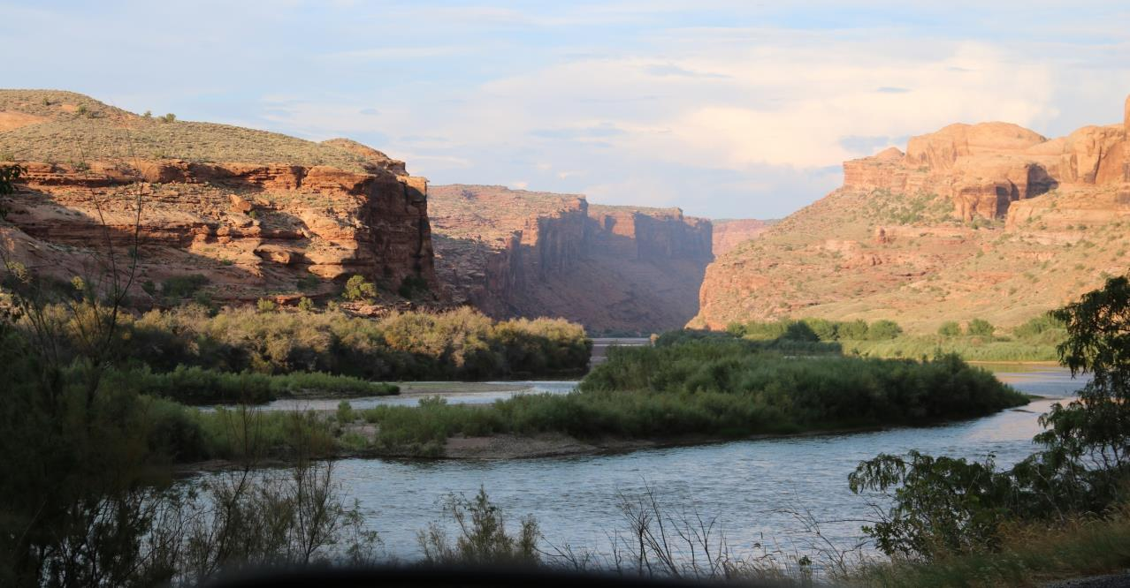
Questions?
Image Credit: diveofficer
Notes:
Thank you for your time and attention and we will take questions if there are any.
Image Source: https://www.flickr.com/photos/diveofficer/36478654913/; diveoffier, Flickr

