Slide 1
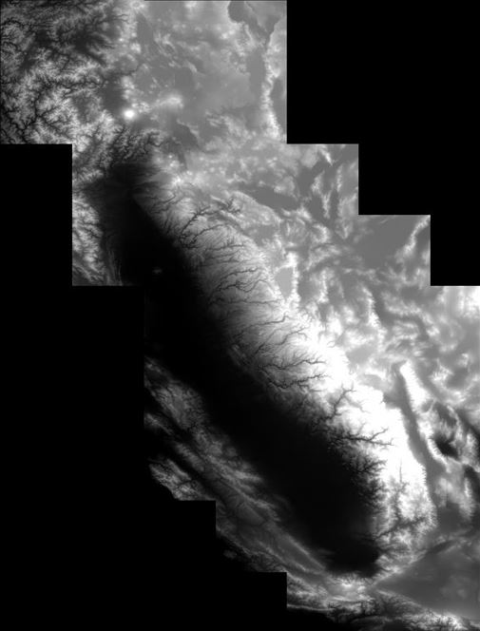
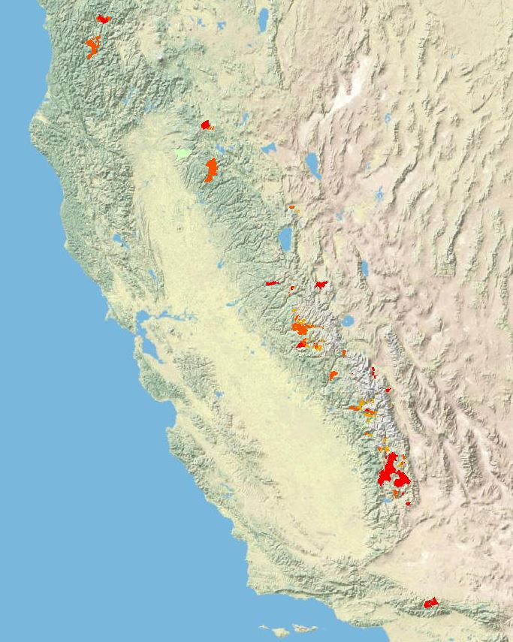
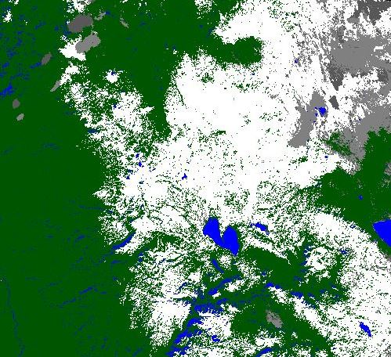
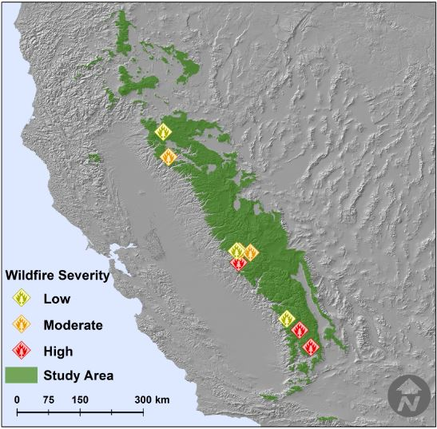
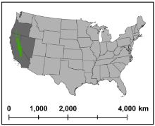
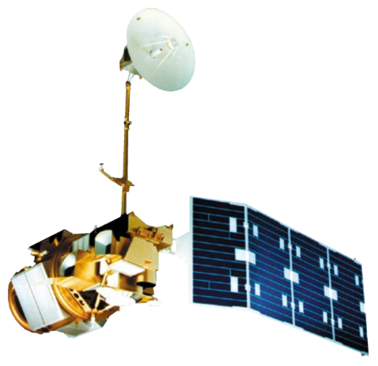
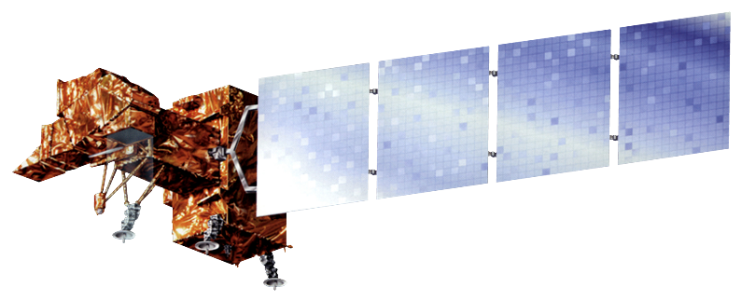
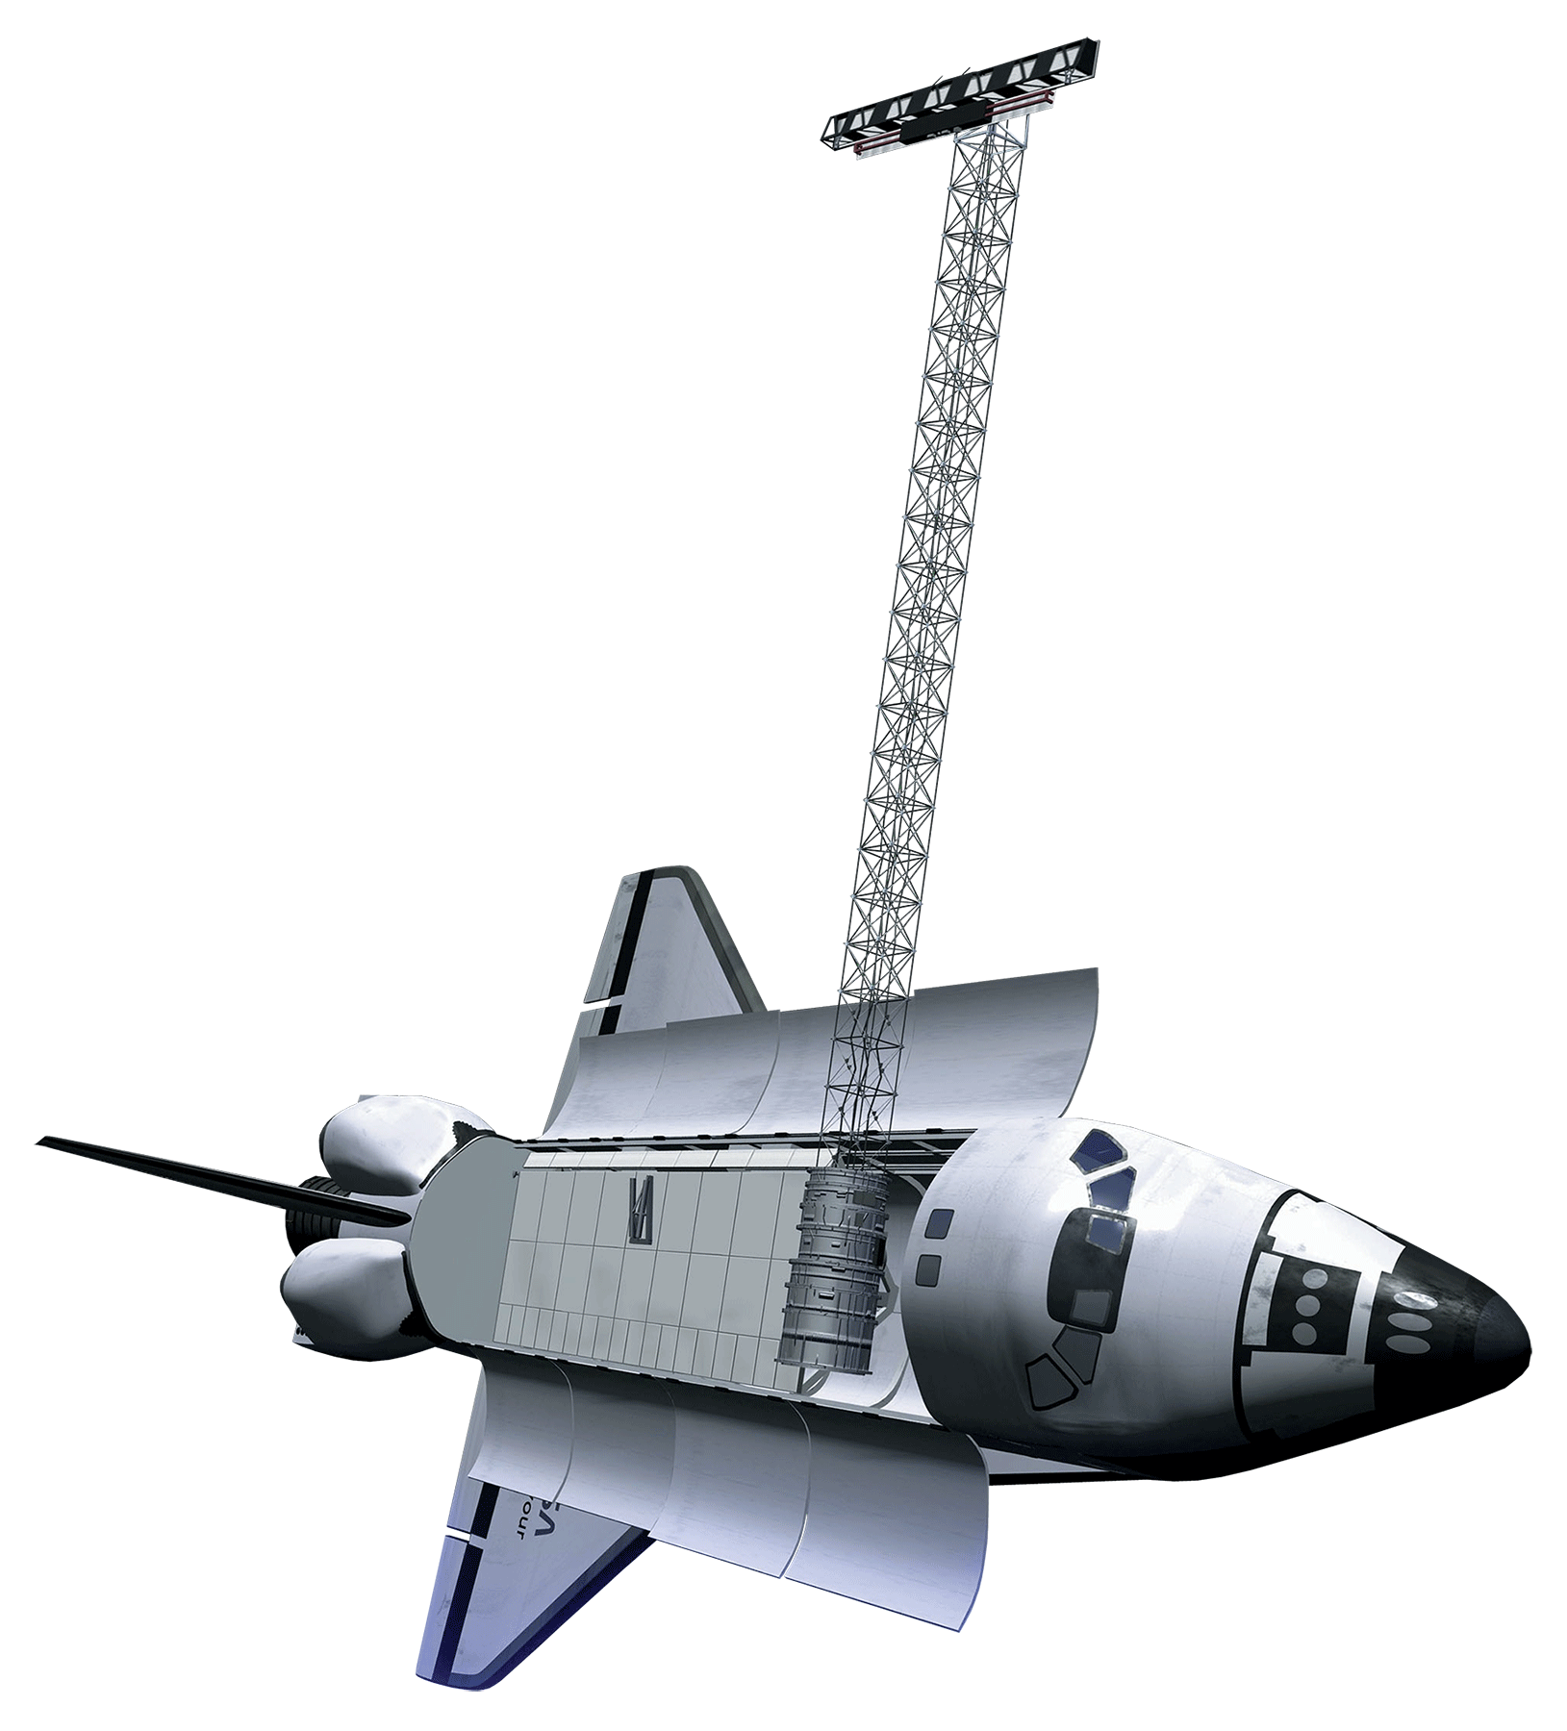
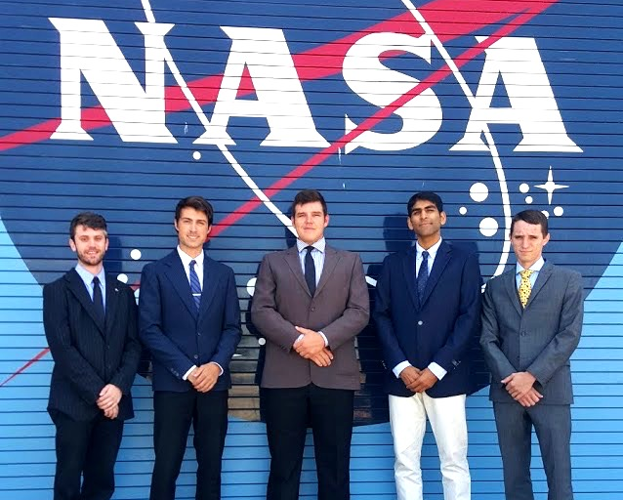
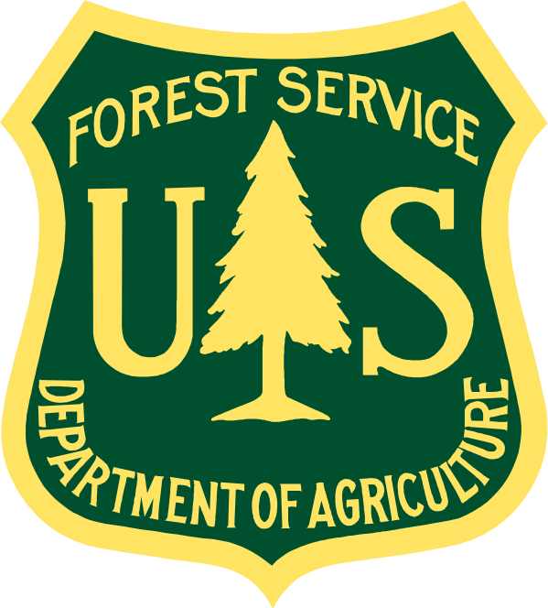
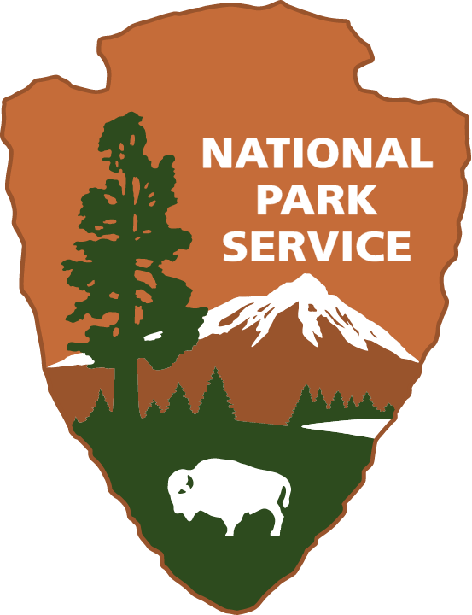
A Quantitative Assessment of Wildfire Severity and its Effects on Snow Water Equivalent Throughout the Sierra Nevada
Sean Cunningham (Team Lead)¹,², Justin Anzelc¹,³, Vishal Arya¹,⁴, Nolan Cate¹,⁵, Clayton Sodergren¹,⁴
¹NASA DEVELOP Program, NASA Ames Research Center, ²University of British Columbia, ³California State University-East Bay, ⁴University of California-Berkeley, ⁵University of Utah
Abstract
Methodology
Snowpack in the Sierra Nevada is a crucial component of the California water supply. Climate change effects on forest ecosystems in this region have reduced snowpack resulting in earlier snowmelt. Wildfire frequency and severity in the Sierra Nevada have also increased, due to climate change-induced warmer temperatures, drought, and a legacy of fire suppression policies leading to increased fuel loads beyond their range of historic variability. These combined factors have the potential to severely impact California’s water supply. The effects of wildfire severity on snowpack have not been quantified. To achieve this, the team at DEVELOP partnered with the USDA Forest Service and National Park Service and used NASA Earth Observing Systems, and automated classification of Landsat data, to quantify the effect of low, moderate, and high severity wildfire on snowpack and snow water equivalent in the Sierra Nevada.. Results show…… This information will improve management of forest ecosystems and water resources.
Initial Data
Preprocessing
Final Analysis
Image Showing Results
SRTM Data
Mosaic DEM and clip to M261 watersheds for elevation mask
Nine fires for study area (Three low, moderate, and high severity)
USFS Region 5 Burn Severity Data
Clip to wilderness areas and elevation > 1500 m, create Fire Severity Index
+
Landsat Imagery from 1984-2014
Fmask, reclassify, zeropad, resample, mask
Time series trend analysis, NDVI, NDSI
2014 CA Basin Characterization Model
Seasonal trend analysis
Study Area
Objectives
Earth Observations
Use Landsat data to map snow and vegetation cover from 1984-2015 within the area of nine wildfires and quantify the effect of wildfire burn severity on snow cover.
Quantify the effect of wildfire burn severity on land-surface temperature (LST), snow melt timing and snow water equivalent (SWE) using the California 2014 Basin Characterization Model (BCM).
Conduct seasonal trend analysis to quantify changes in the seasonality of snow cover in relation to wildfire burn severity.
Landsat 4-5 (TM)
Landsat 7 (ETM+)
Results
Landsat 8 (OLI)
SRTM
Results go here
Results go here
Results go here
Results go here
Results go here
Results go here
Results go here
Results go here
Results go here
Results go here
Results go here
Results go here
Results go here
Low, medium, and high severity wildfires, within the Sierra Nevada Range, are analyzed from 1984-2014. Three wildfires were selected for each severity class.
Team Members
Conclusions
Conclusions go here
Conclusions go here
Conclusions go here
Conclusions go here
Conclusions go here
Conclusions go here
Conclusions go here
Conclusions go here
Conclusions go here
Conclusions go here
Conclusions go here
Conclusions go here
Conclusions go here
Conclusions go here
Conclusions go here
Acknowledgements
Project Partners
From Left to Right:
Clayton Sodergren - University of California-Berkeley
Nolan Cate - University of Utah
Justin Anzelc - California State University-East Bay
Vishal Arya - University of California-Berkeley
Sean Cunningham - Clark University, University of British Columbia
Special thanks to Marc Meyer of the USDA Forest Service and Jim Roche of the National Park Service.
The authors also wish to thank the Ames DEVELOP management team, Andrew Nguyen and Chippie Kislik, for their overall support and help with this project.
This material is based upon work supported by NASA through contract NNL11AA00B and cooperative agreement NNX14AB60A.
NASA Ames Research Center

